Slide 1
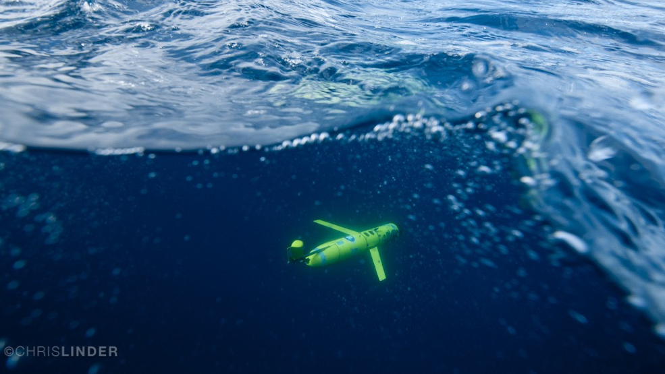
A Decade of Autonomous Underwater Glider Observations of Tropical Cyclones:
Travis Miles, PhD
Rutgers University
Center for Ocean Observing Leadership
Co-authors: Scott Glenn and many more!

Slide 2
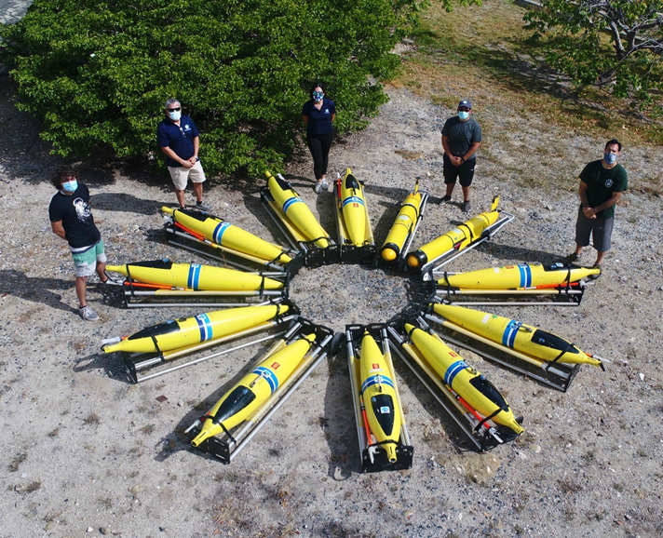
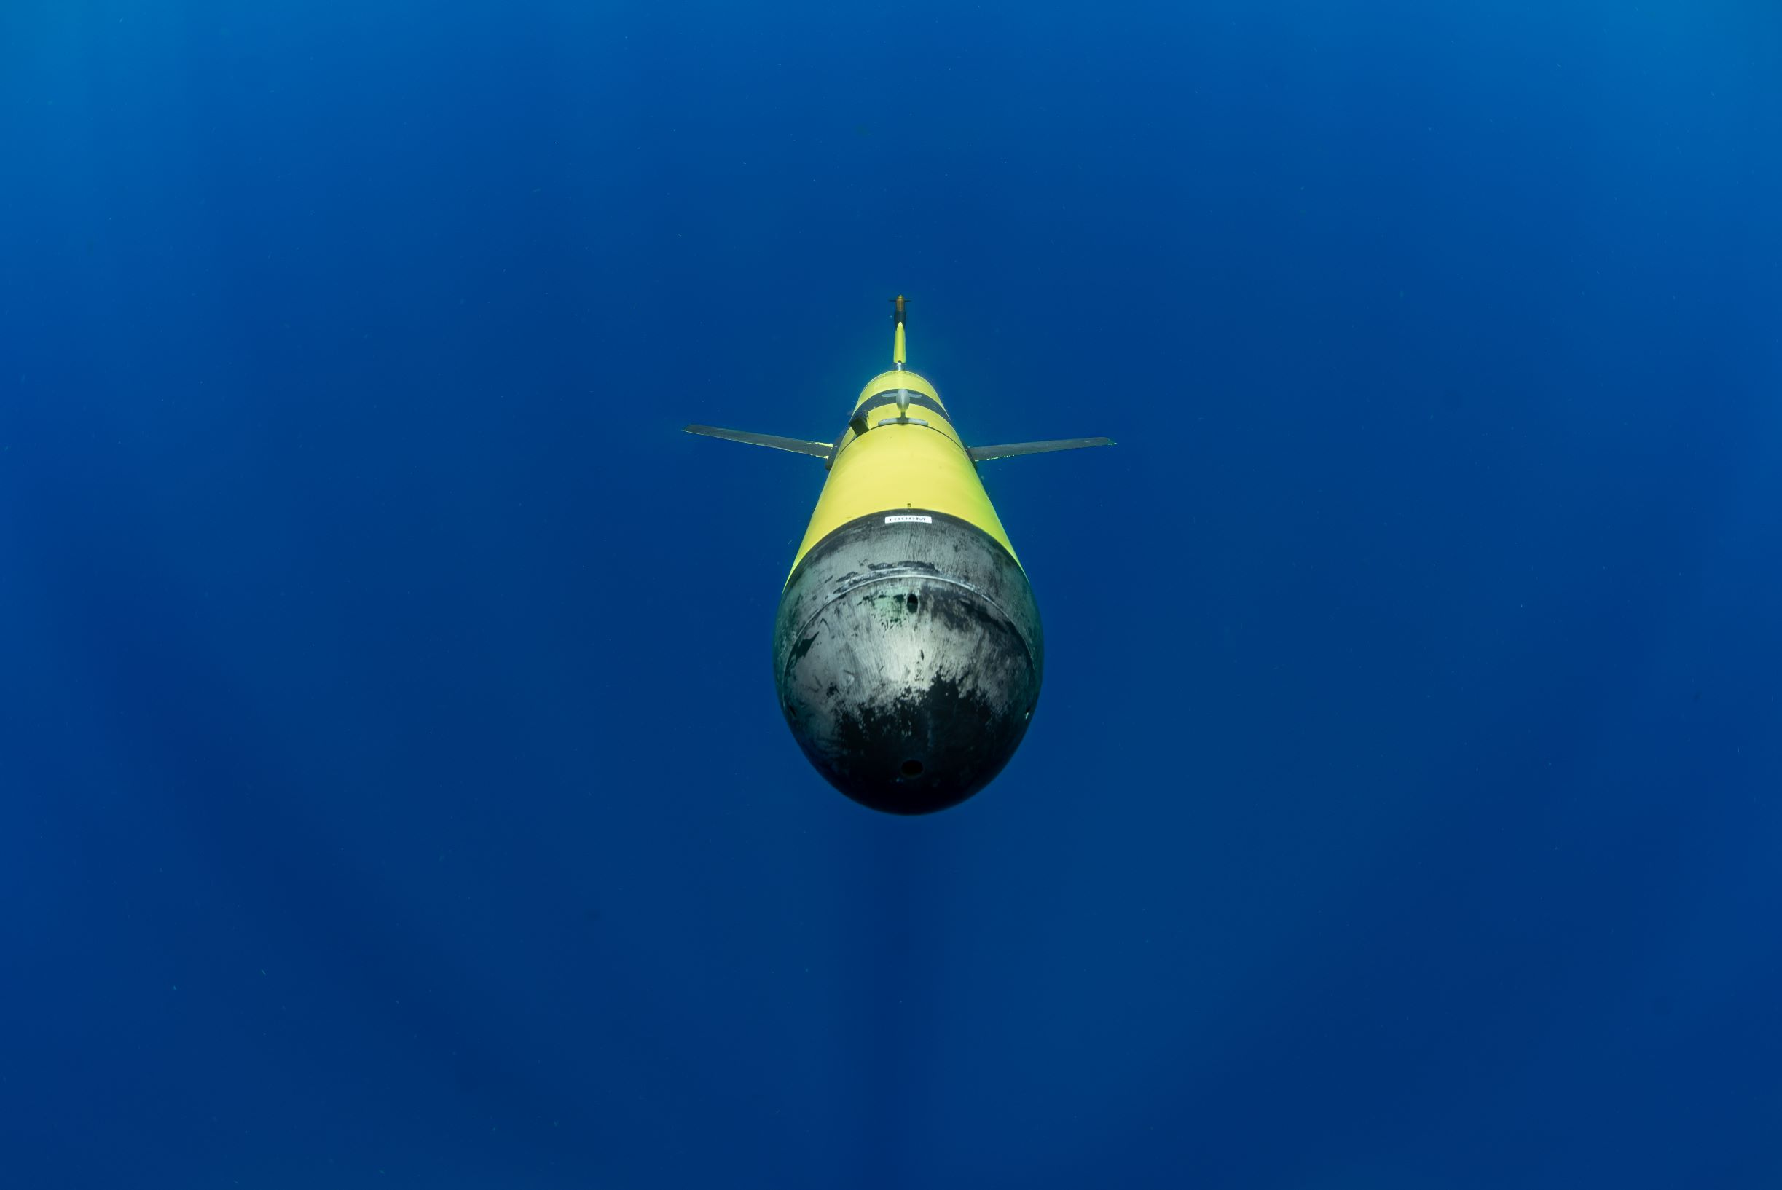
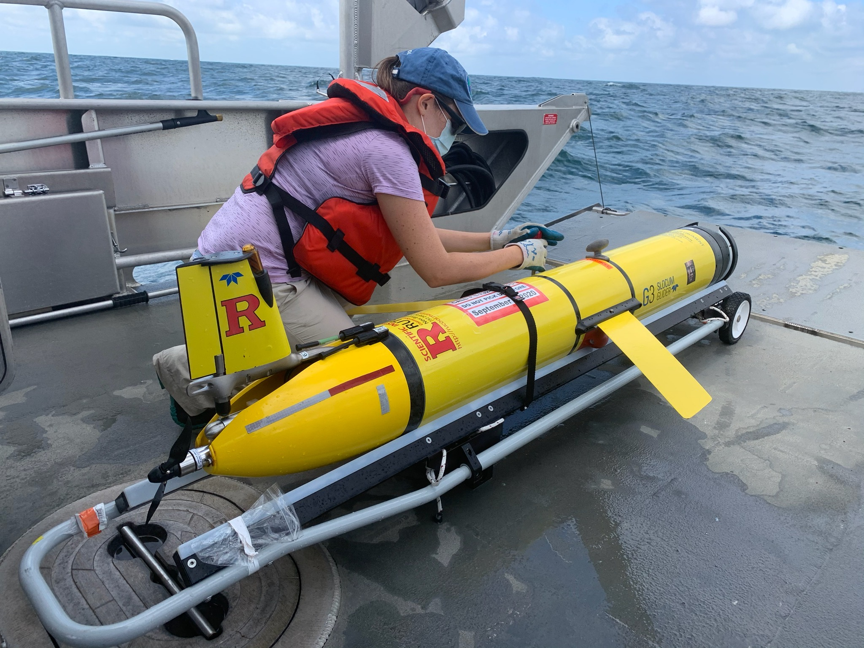
>20 years of ocean observing from autonomous underwater gliders.
>Ten years of tropical cyclone research, observations, and observing system development.
> Five years of integration with NOAA OAR EEOOTT & CHAOS

Slide 3


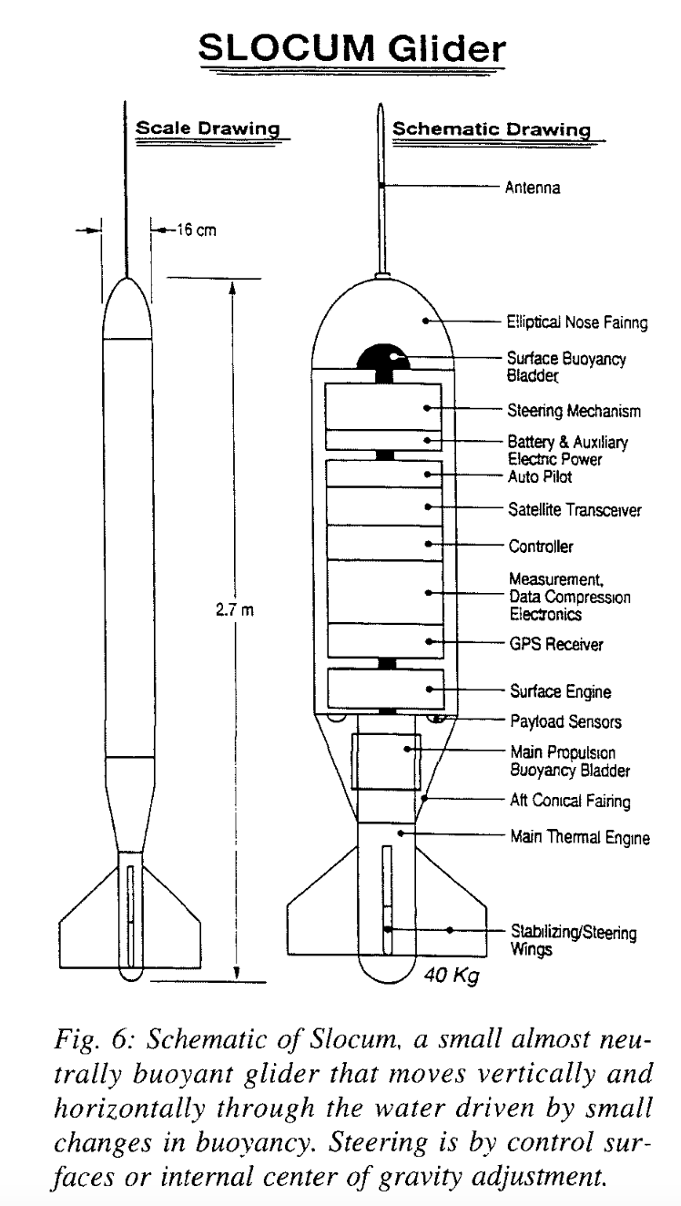
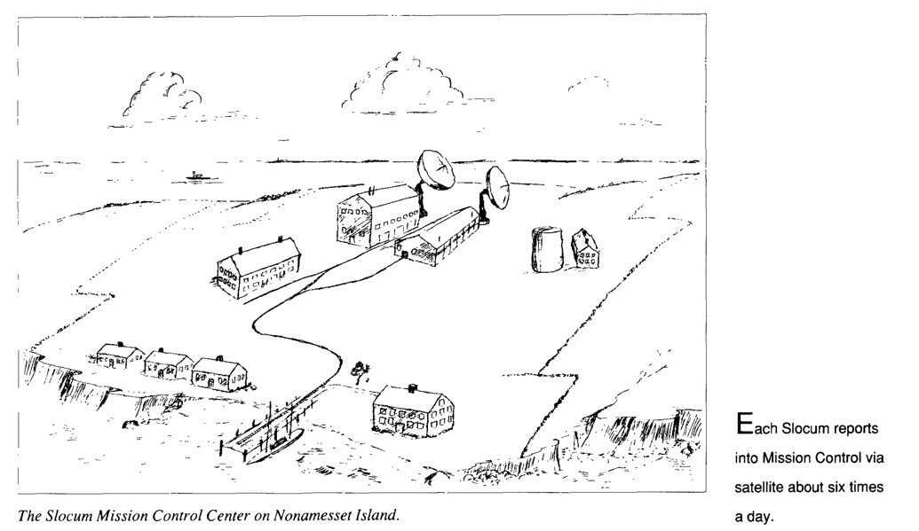
1989 Science Fiction

Slide 4
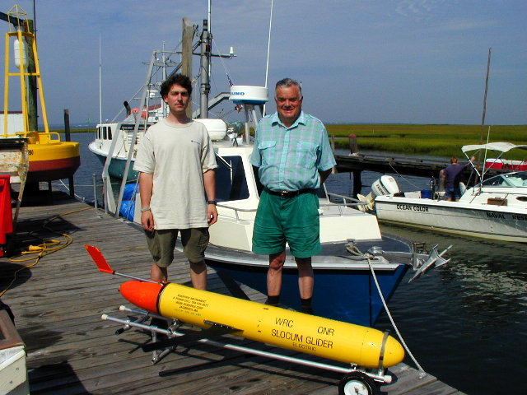

1999
First Slocum glider deployed at Sea
At the Rutgers University Tuckerton Marine Field Station
October 28 2003
First Slocum Glider Cross-shelf mission
(Last year was 20th Anniversary)!
Doug Webb

Slide 5
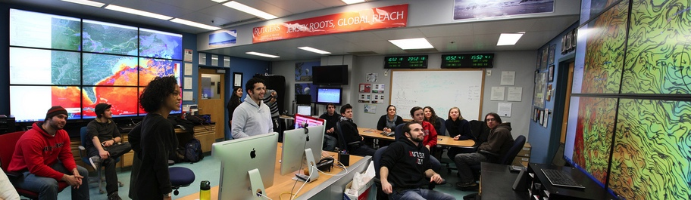
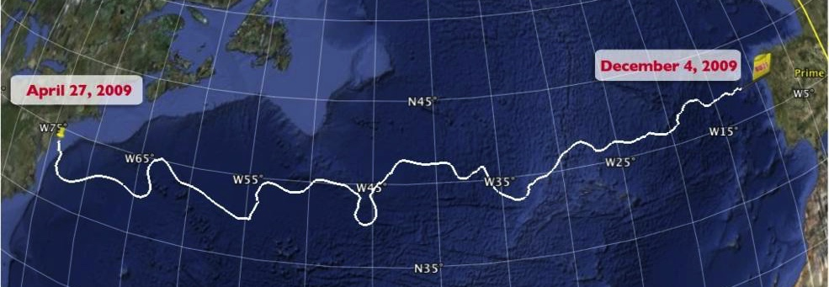
2009 First Atlantic Crossing

Slide 6
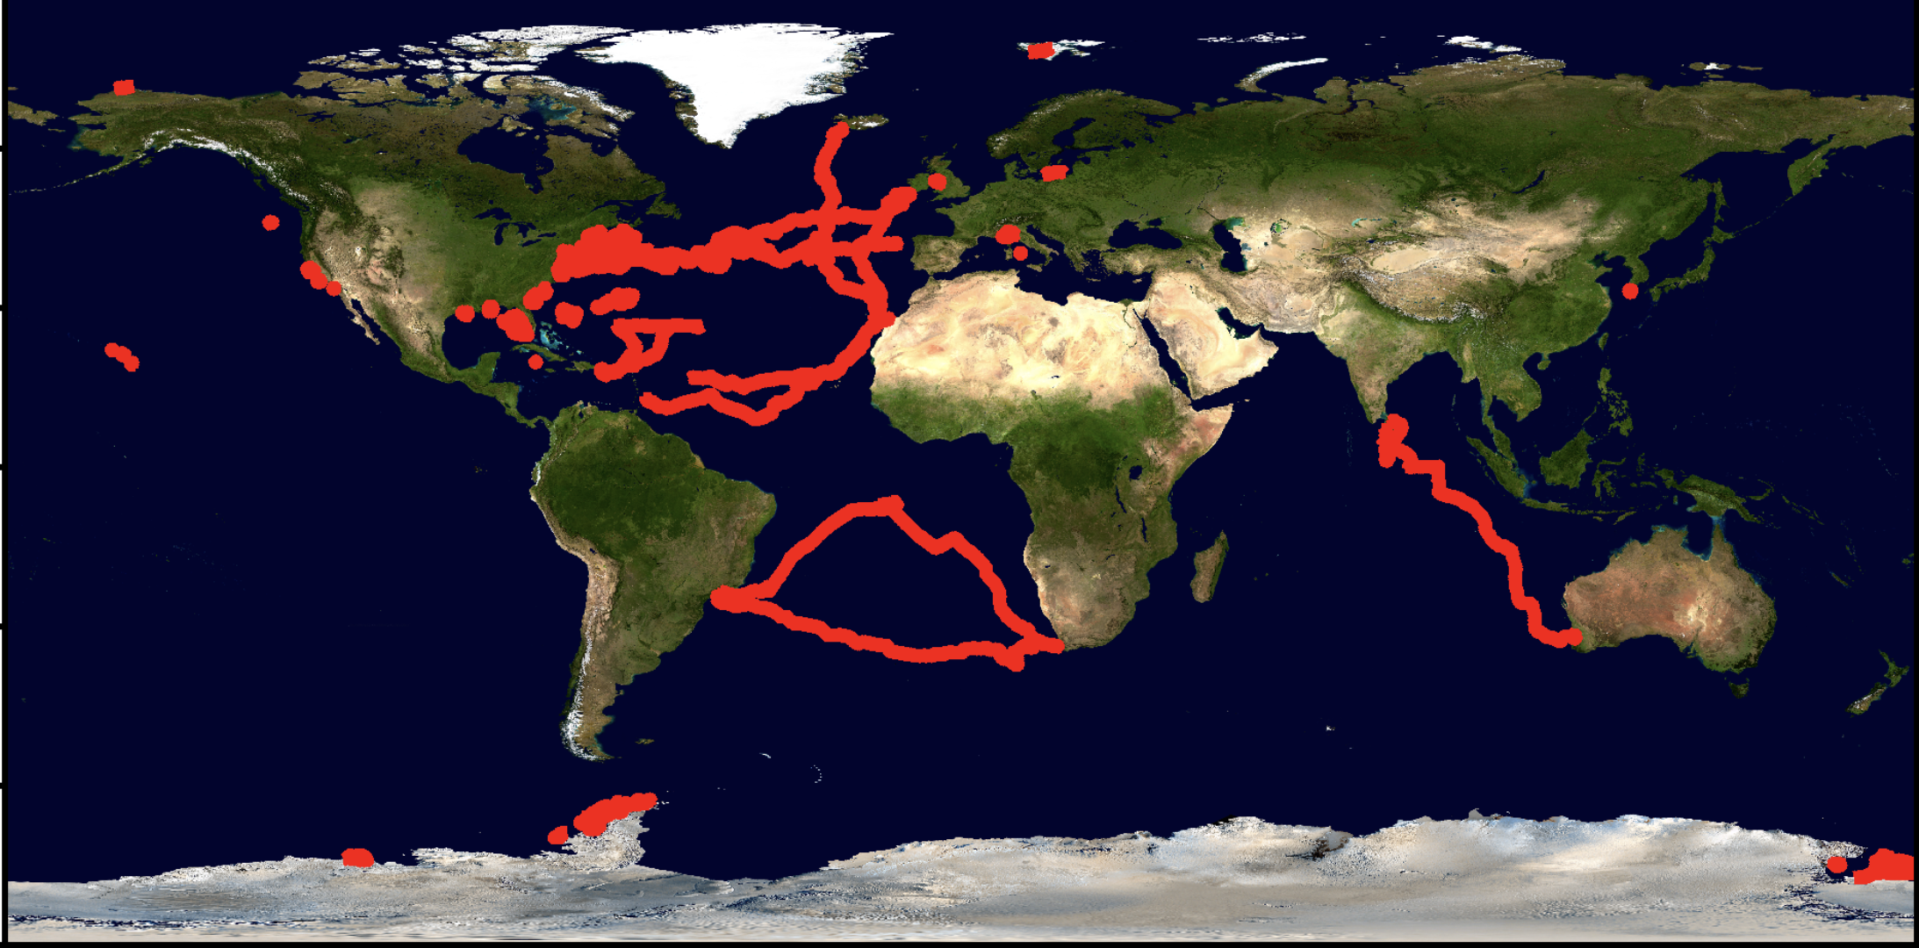
Rutgers Totals: 709 Glider Deployments, 375,128 km (9x earth), 19,388 days (~53 years) at sea

Slide 7
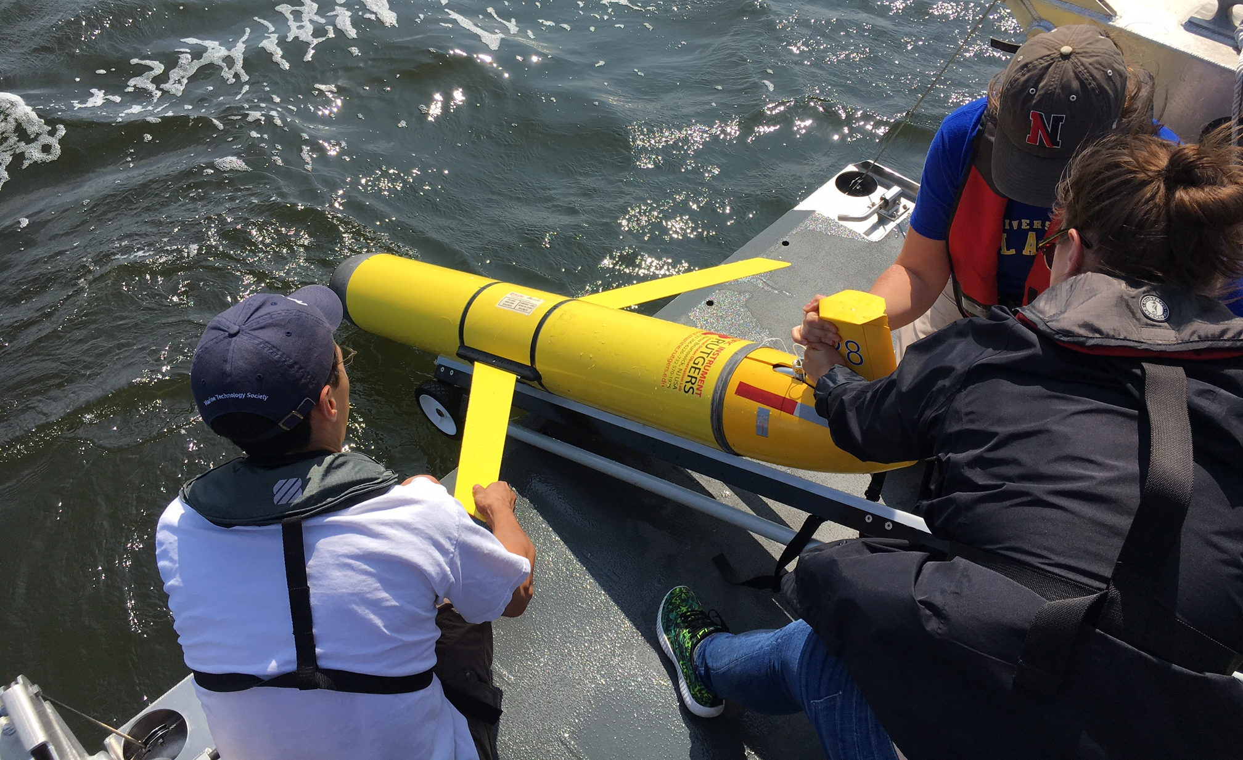
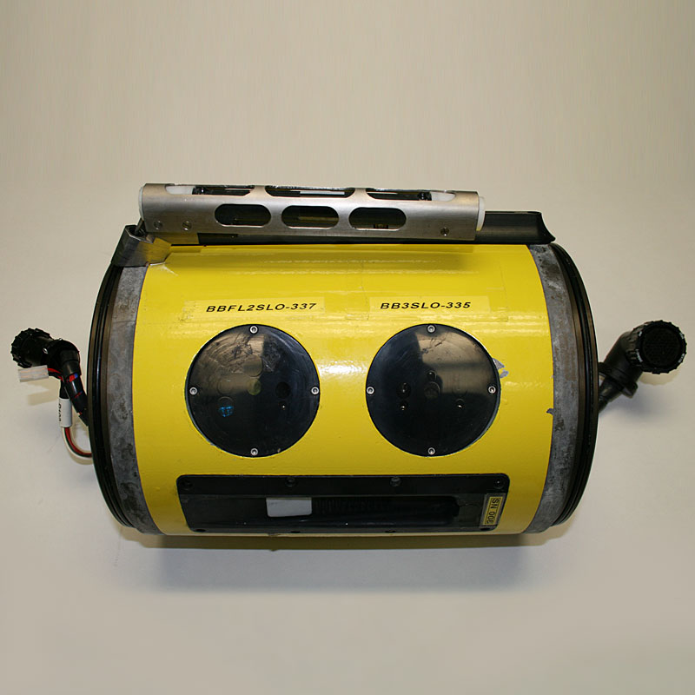

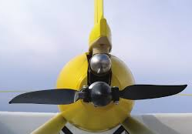
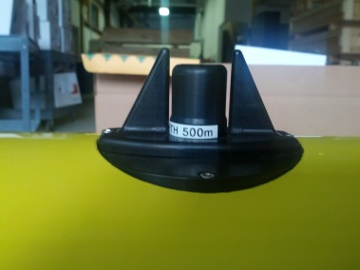
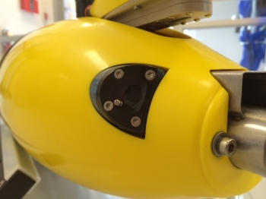
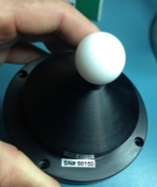
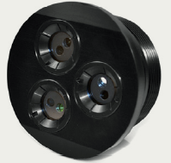
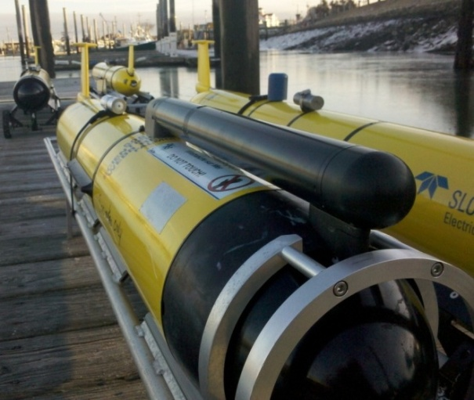
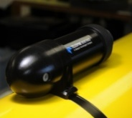
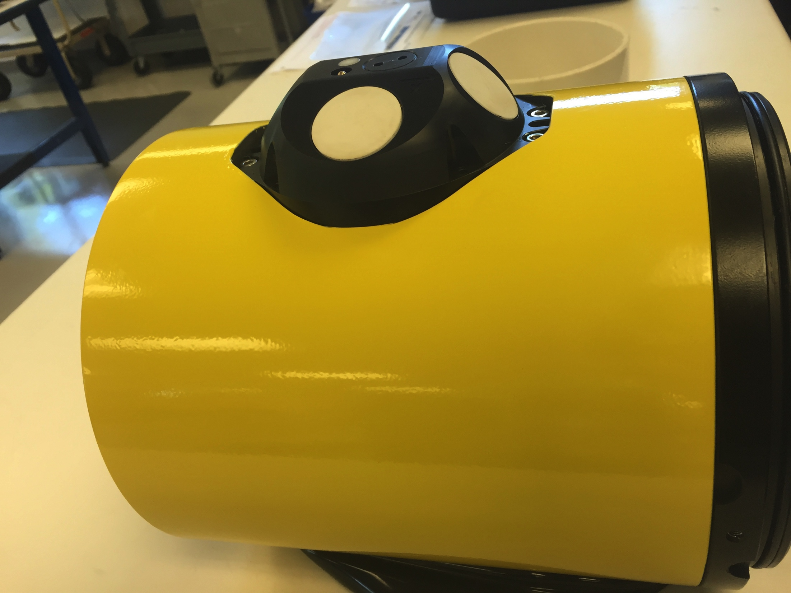
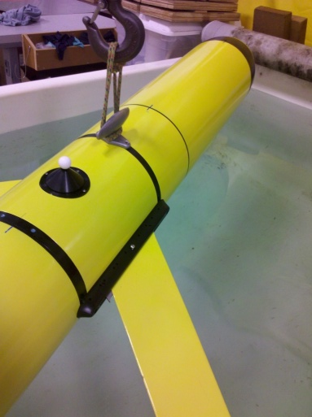
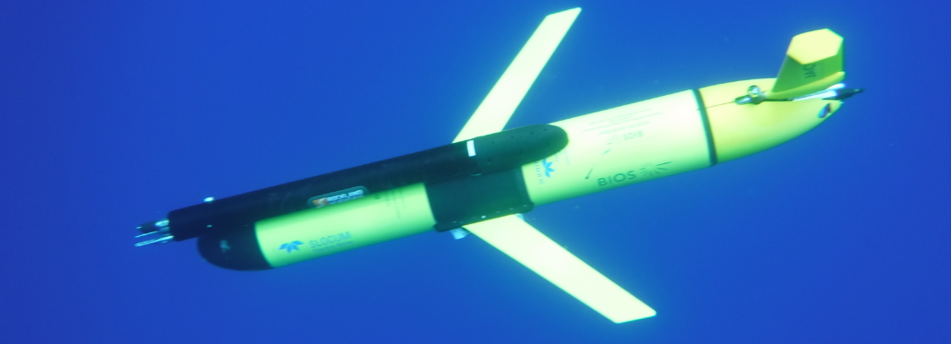
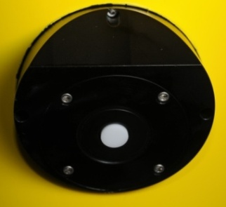
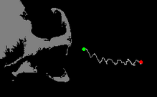
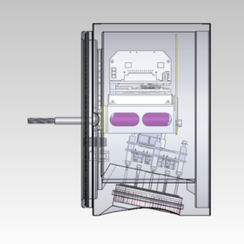
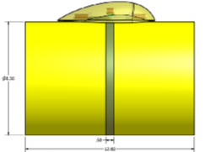
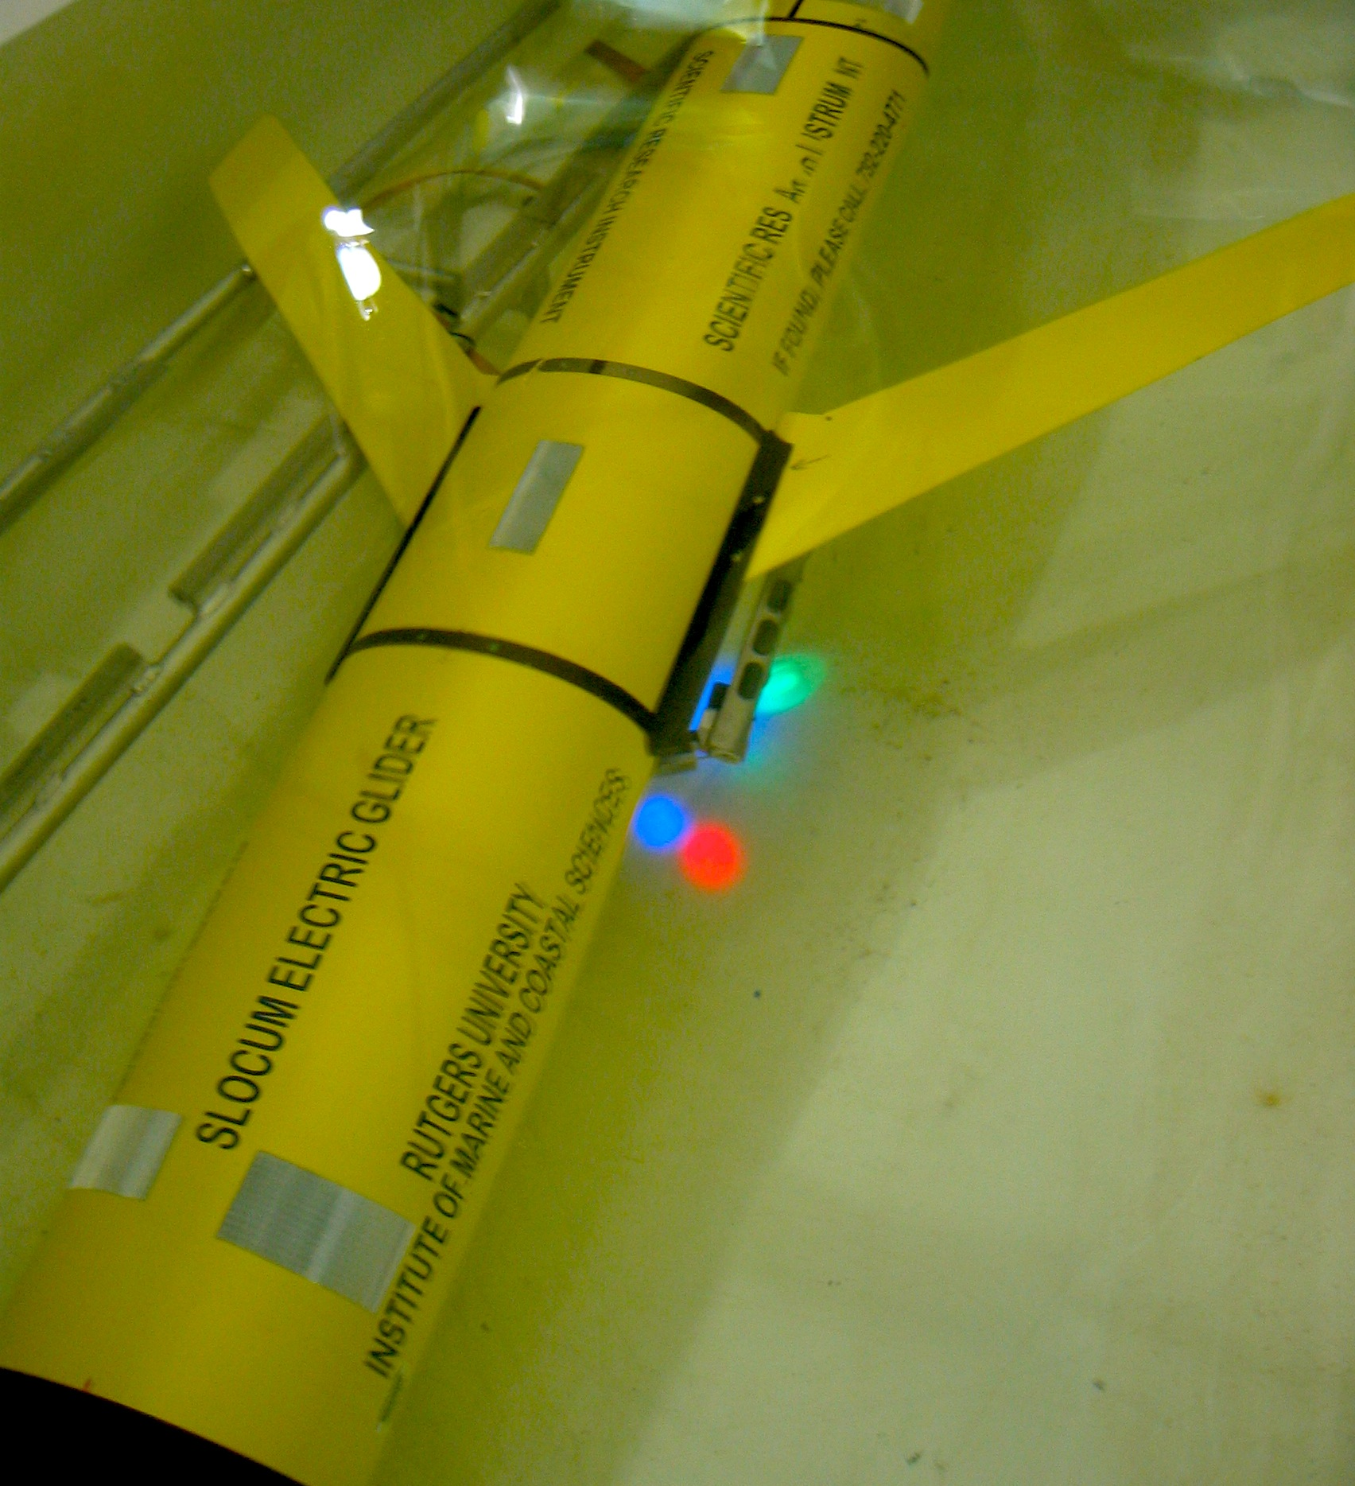
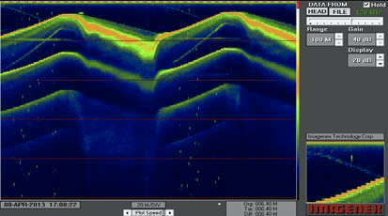
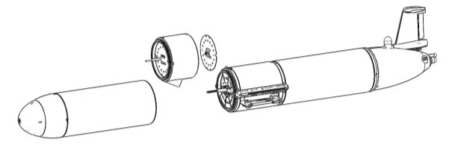
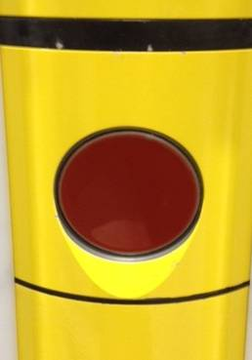
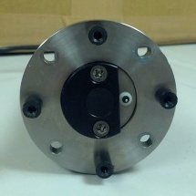
Slocum Glider Science Sensors - Stretch, Stack, and Port
Slocum

Slide 8
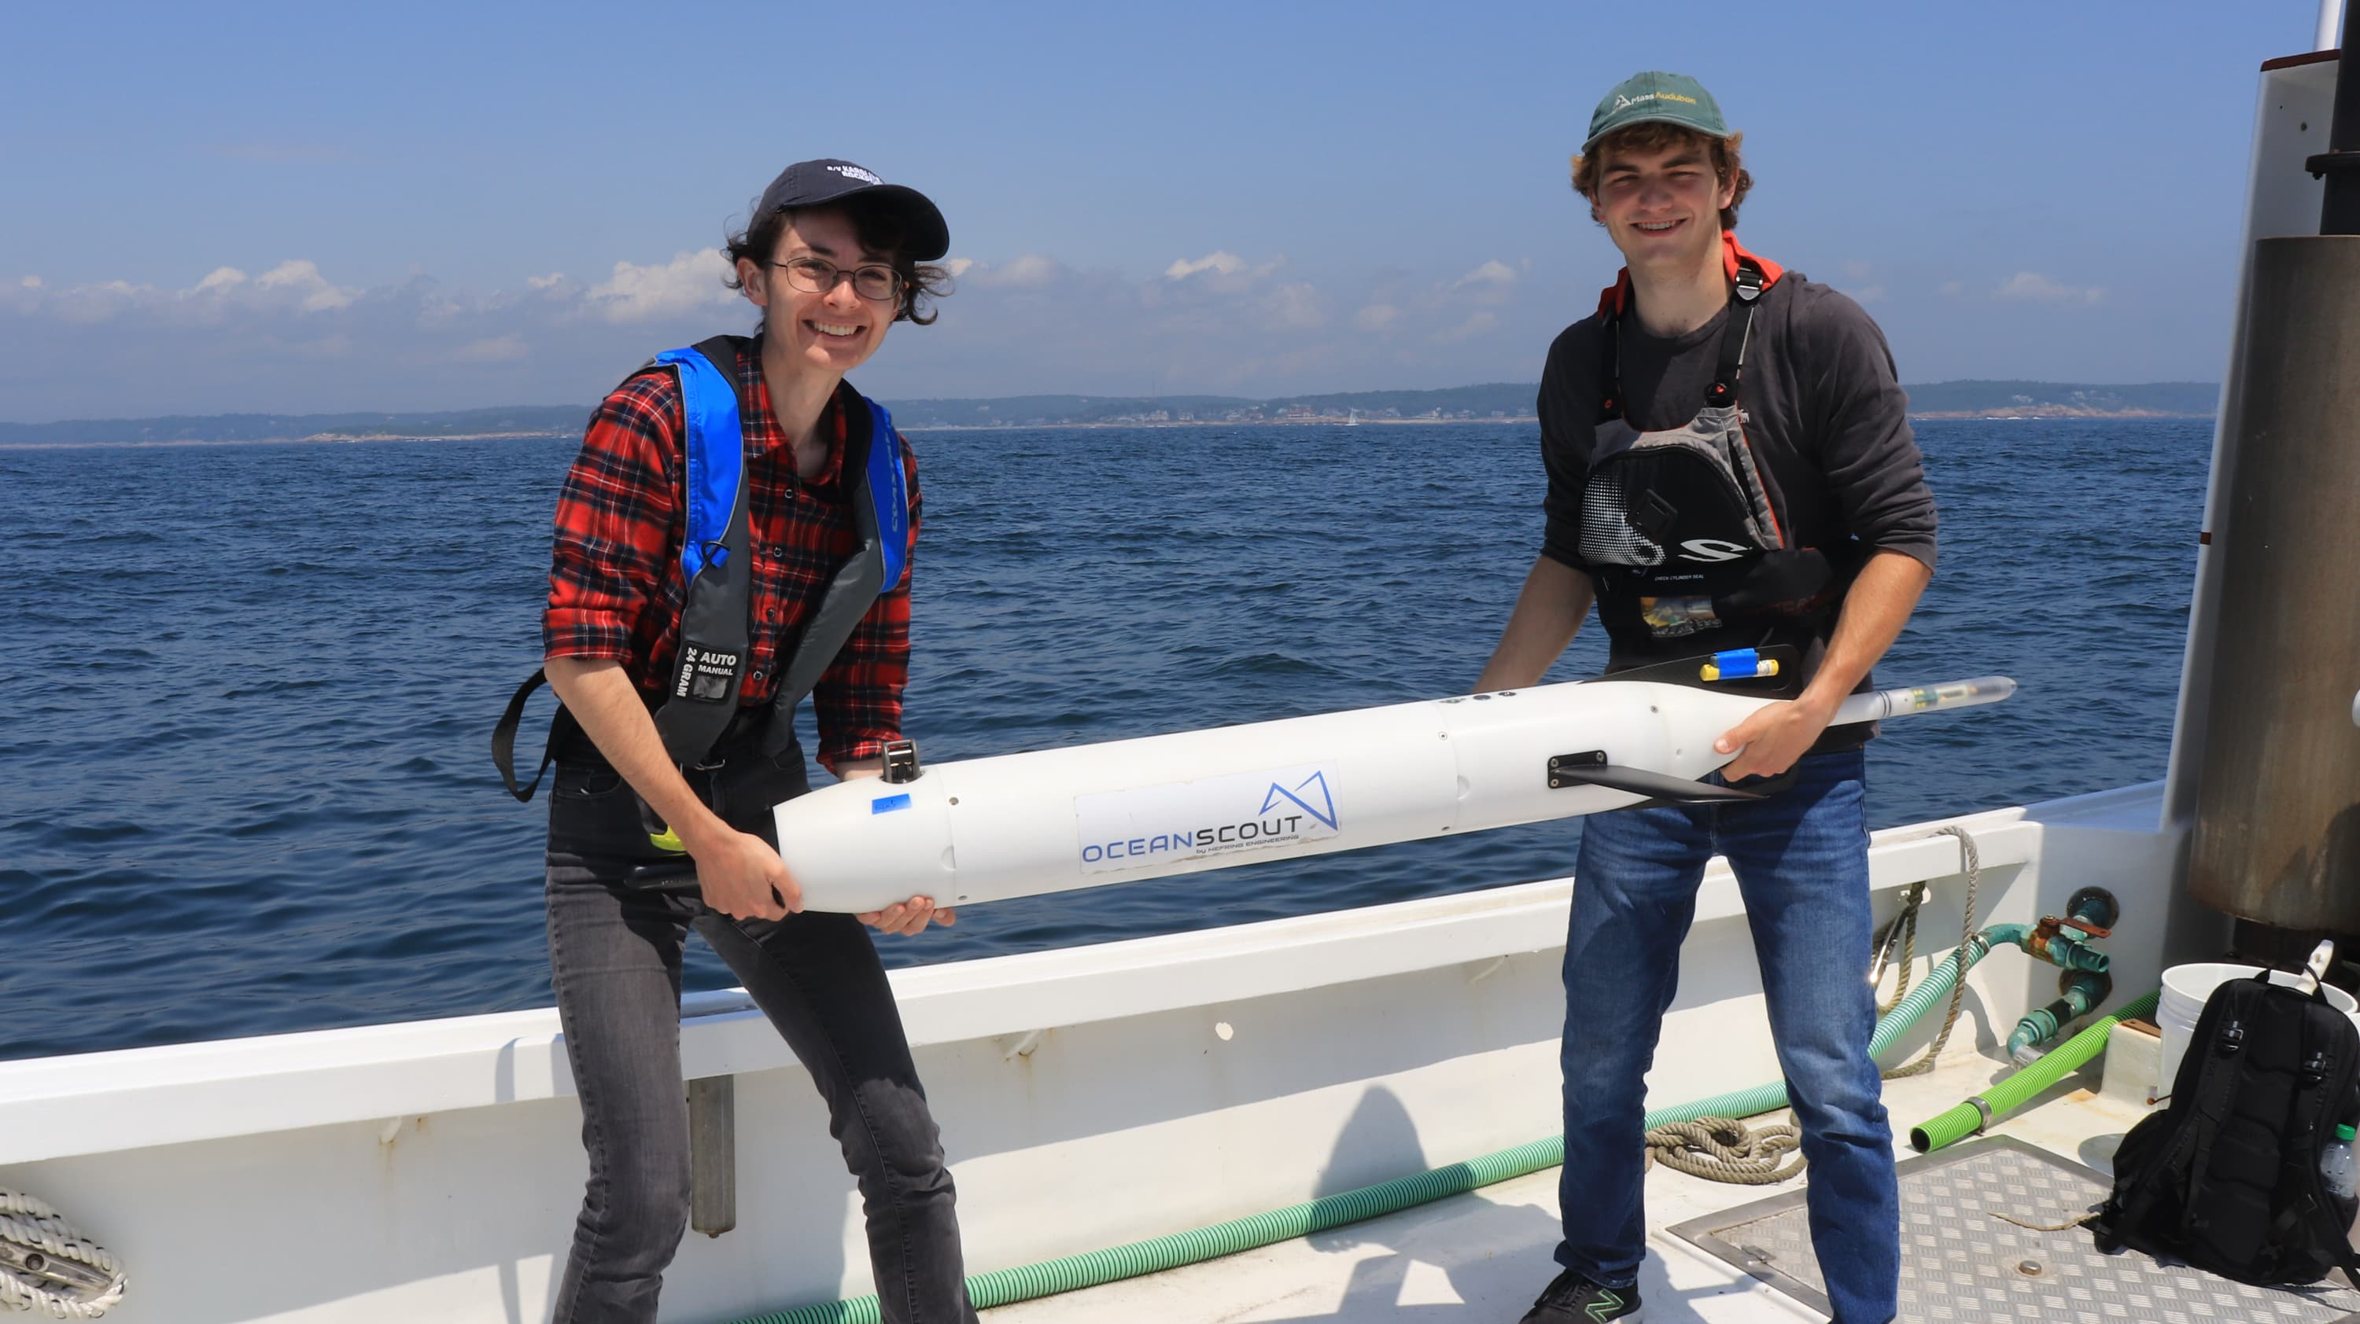
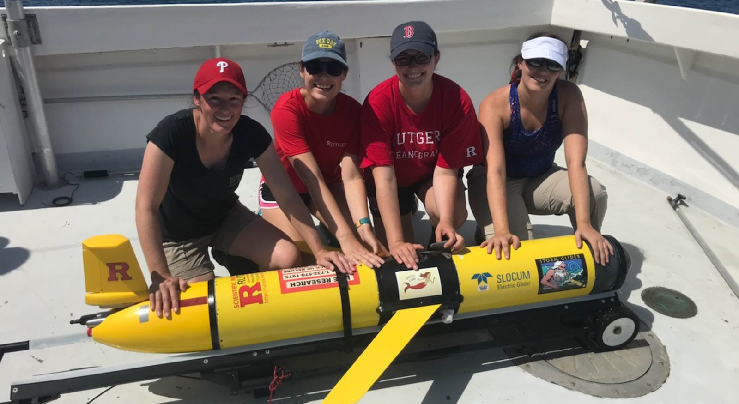
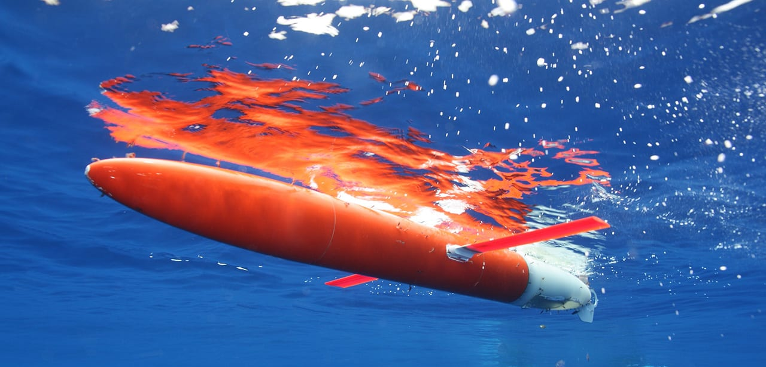
Oceanscout
Spray

Slide 9
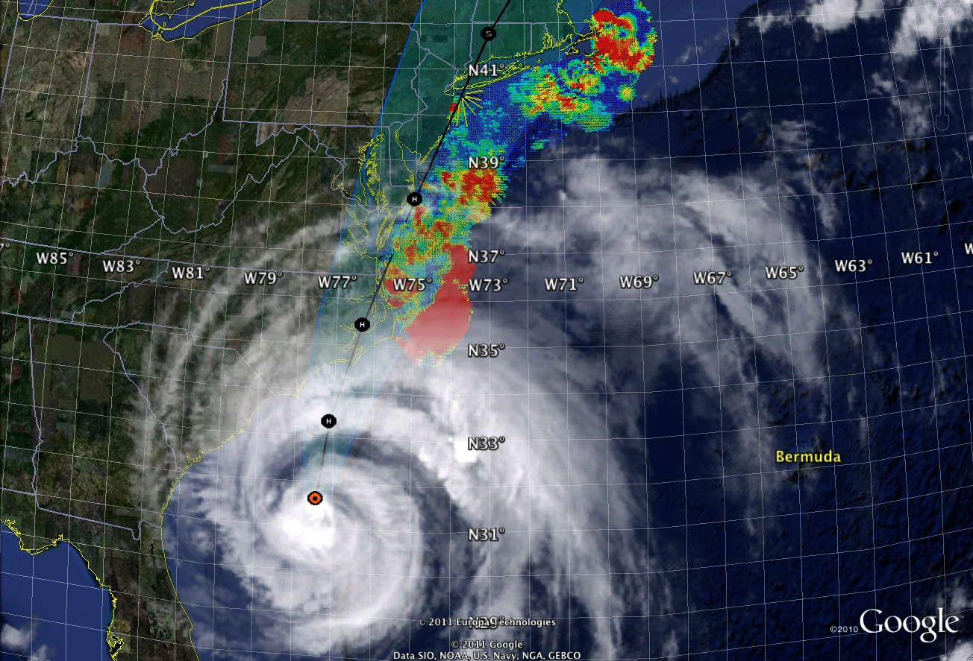
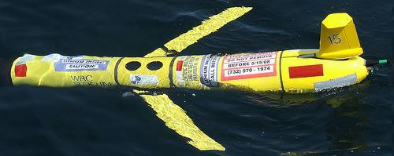
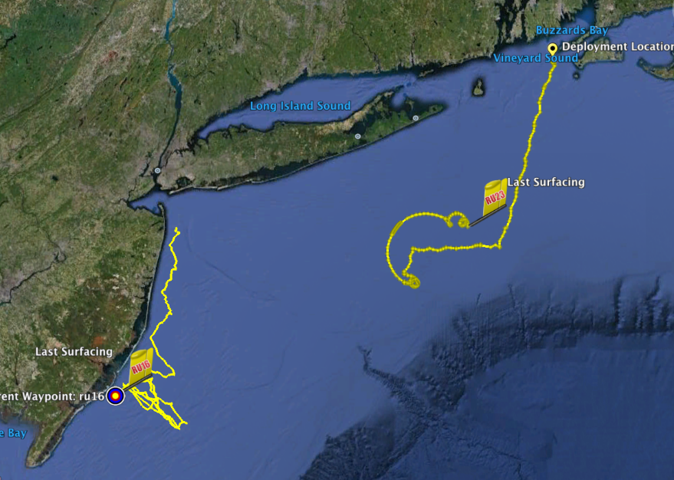
Hurricane Irene
August 28, 2011
NOAA/NHC Damage:
>$16 Billion.

Slide 10
Official NHC intensity forecasts for Irene every 6 h from 1200 UTC 23 August to 0600 UTC 28 August.

Slide 11
AP PHOTO/MEL EVANS
Notes:
Can I improve this picture?

Slide 12
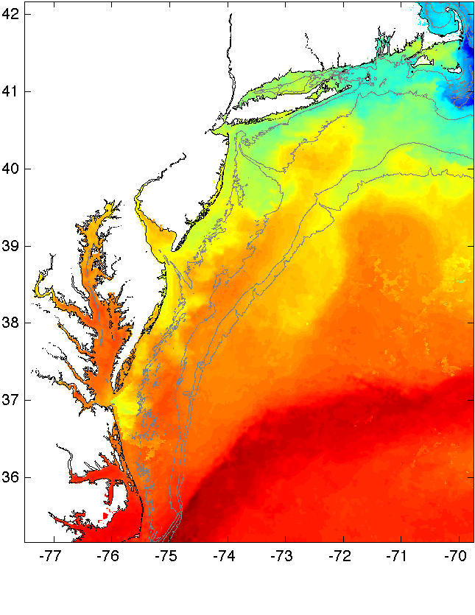
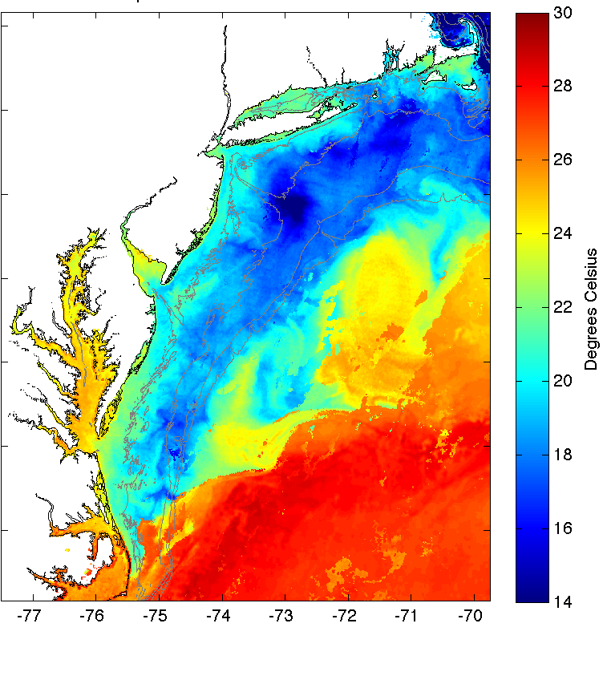
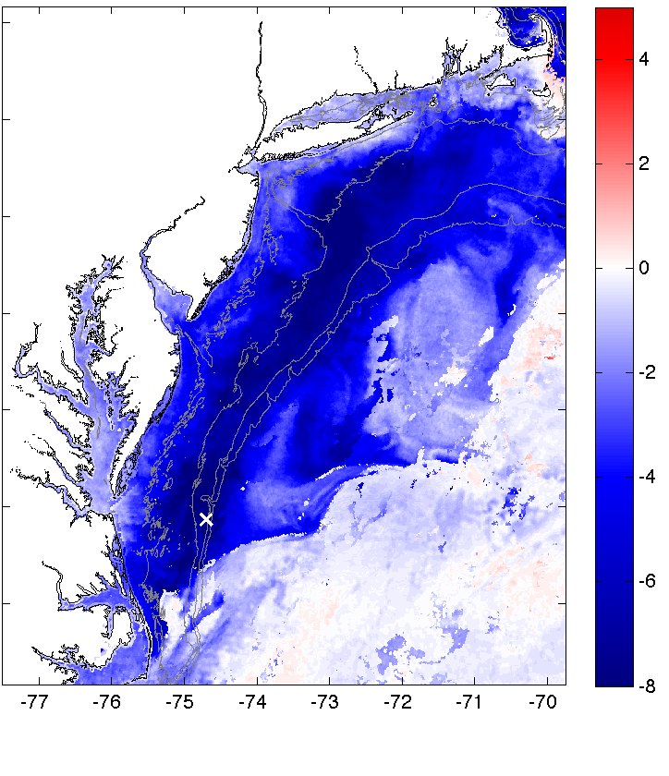
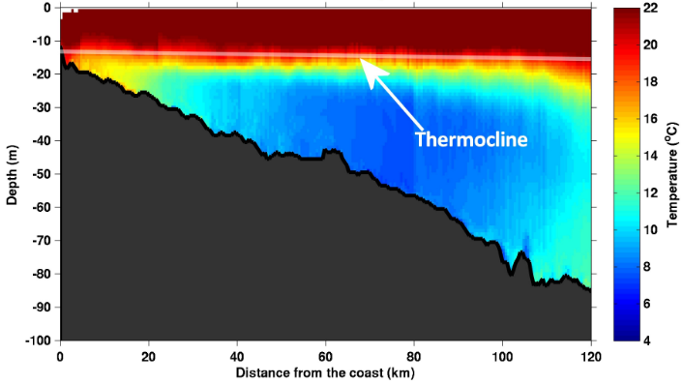
Pre-Irene
Post-Irene
Difference
11C max Cooling
WHAT?
Satellite
SST
Lentz et al., 2017
August Cold Pool Temperature Climatology
August Cold Pool Temperature Climatology
COSEEnow.net
Nature Communications (2016)

Slide 13
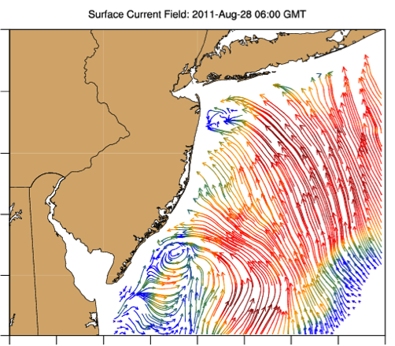
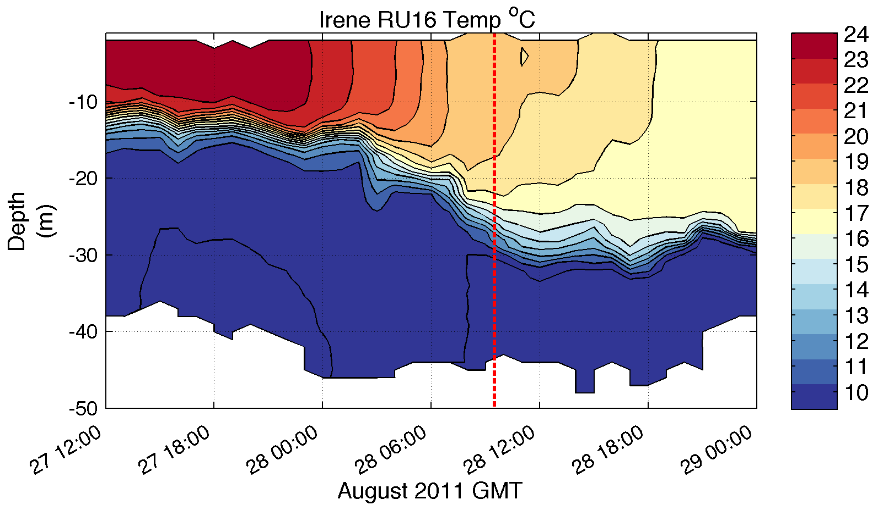
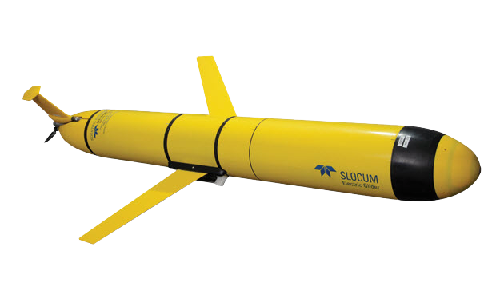
Pre-Irene
Post-Irene
Difference
11C max Cooling
WHAT?
Satellite
SST
WHEN? Glider Temperature
WHY?
HF Radar
Currents
Eye Passage
Essential Ocean Processes:
Ahead of eye center – Vertical Shear > Mixing > Cooling > Reduced Intensity > Reduced Surge

Slide 14
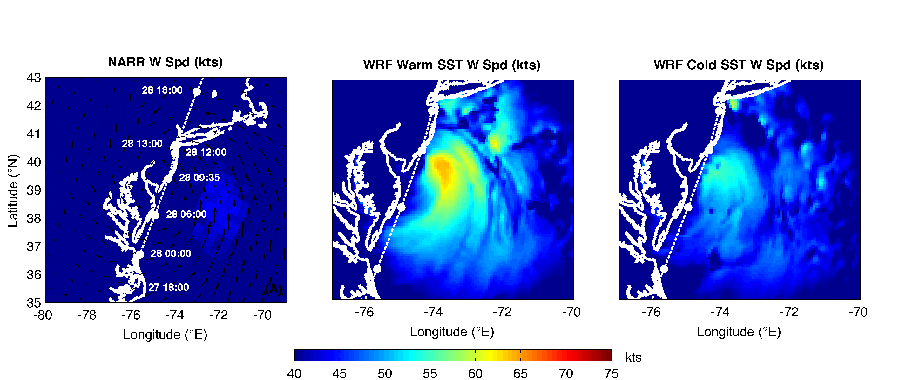
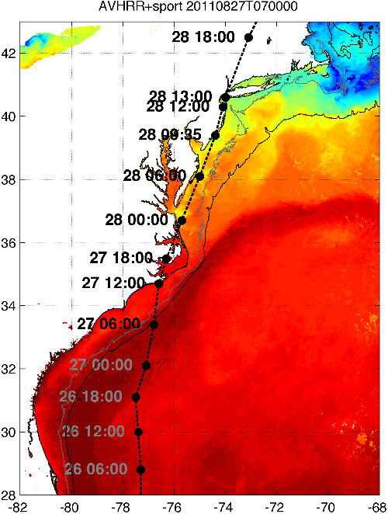
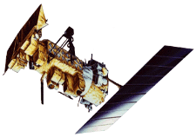

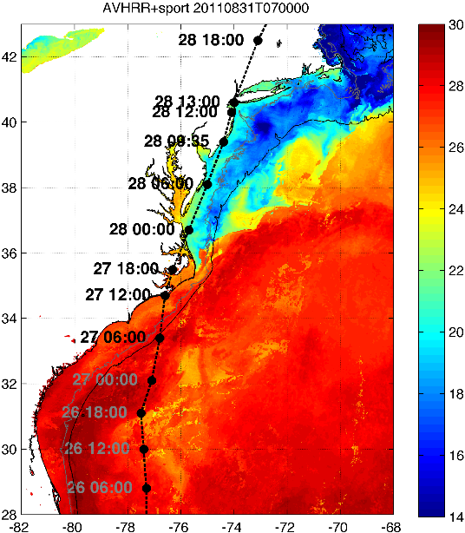

Atmospheric Forecast Sensitivity Study
Warm Ocean
Boundary Condition
Cat 1 Hurricane
Tropical Storm
Cold Ocean
Boundary Condition
IMPACT?
>10 knots reduction in peak wind speed

Slide 15
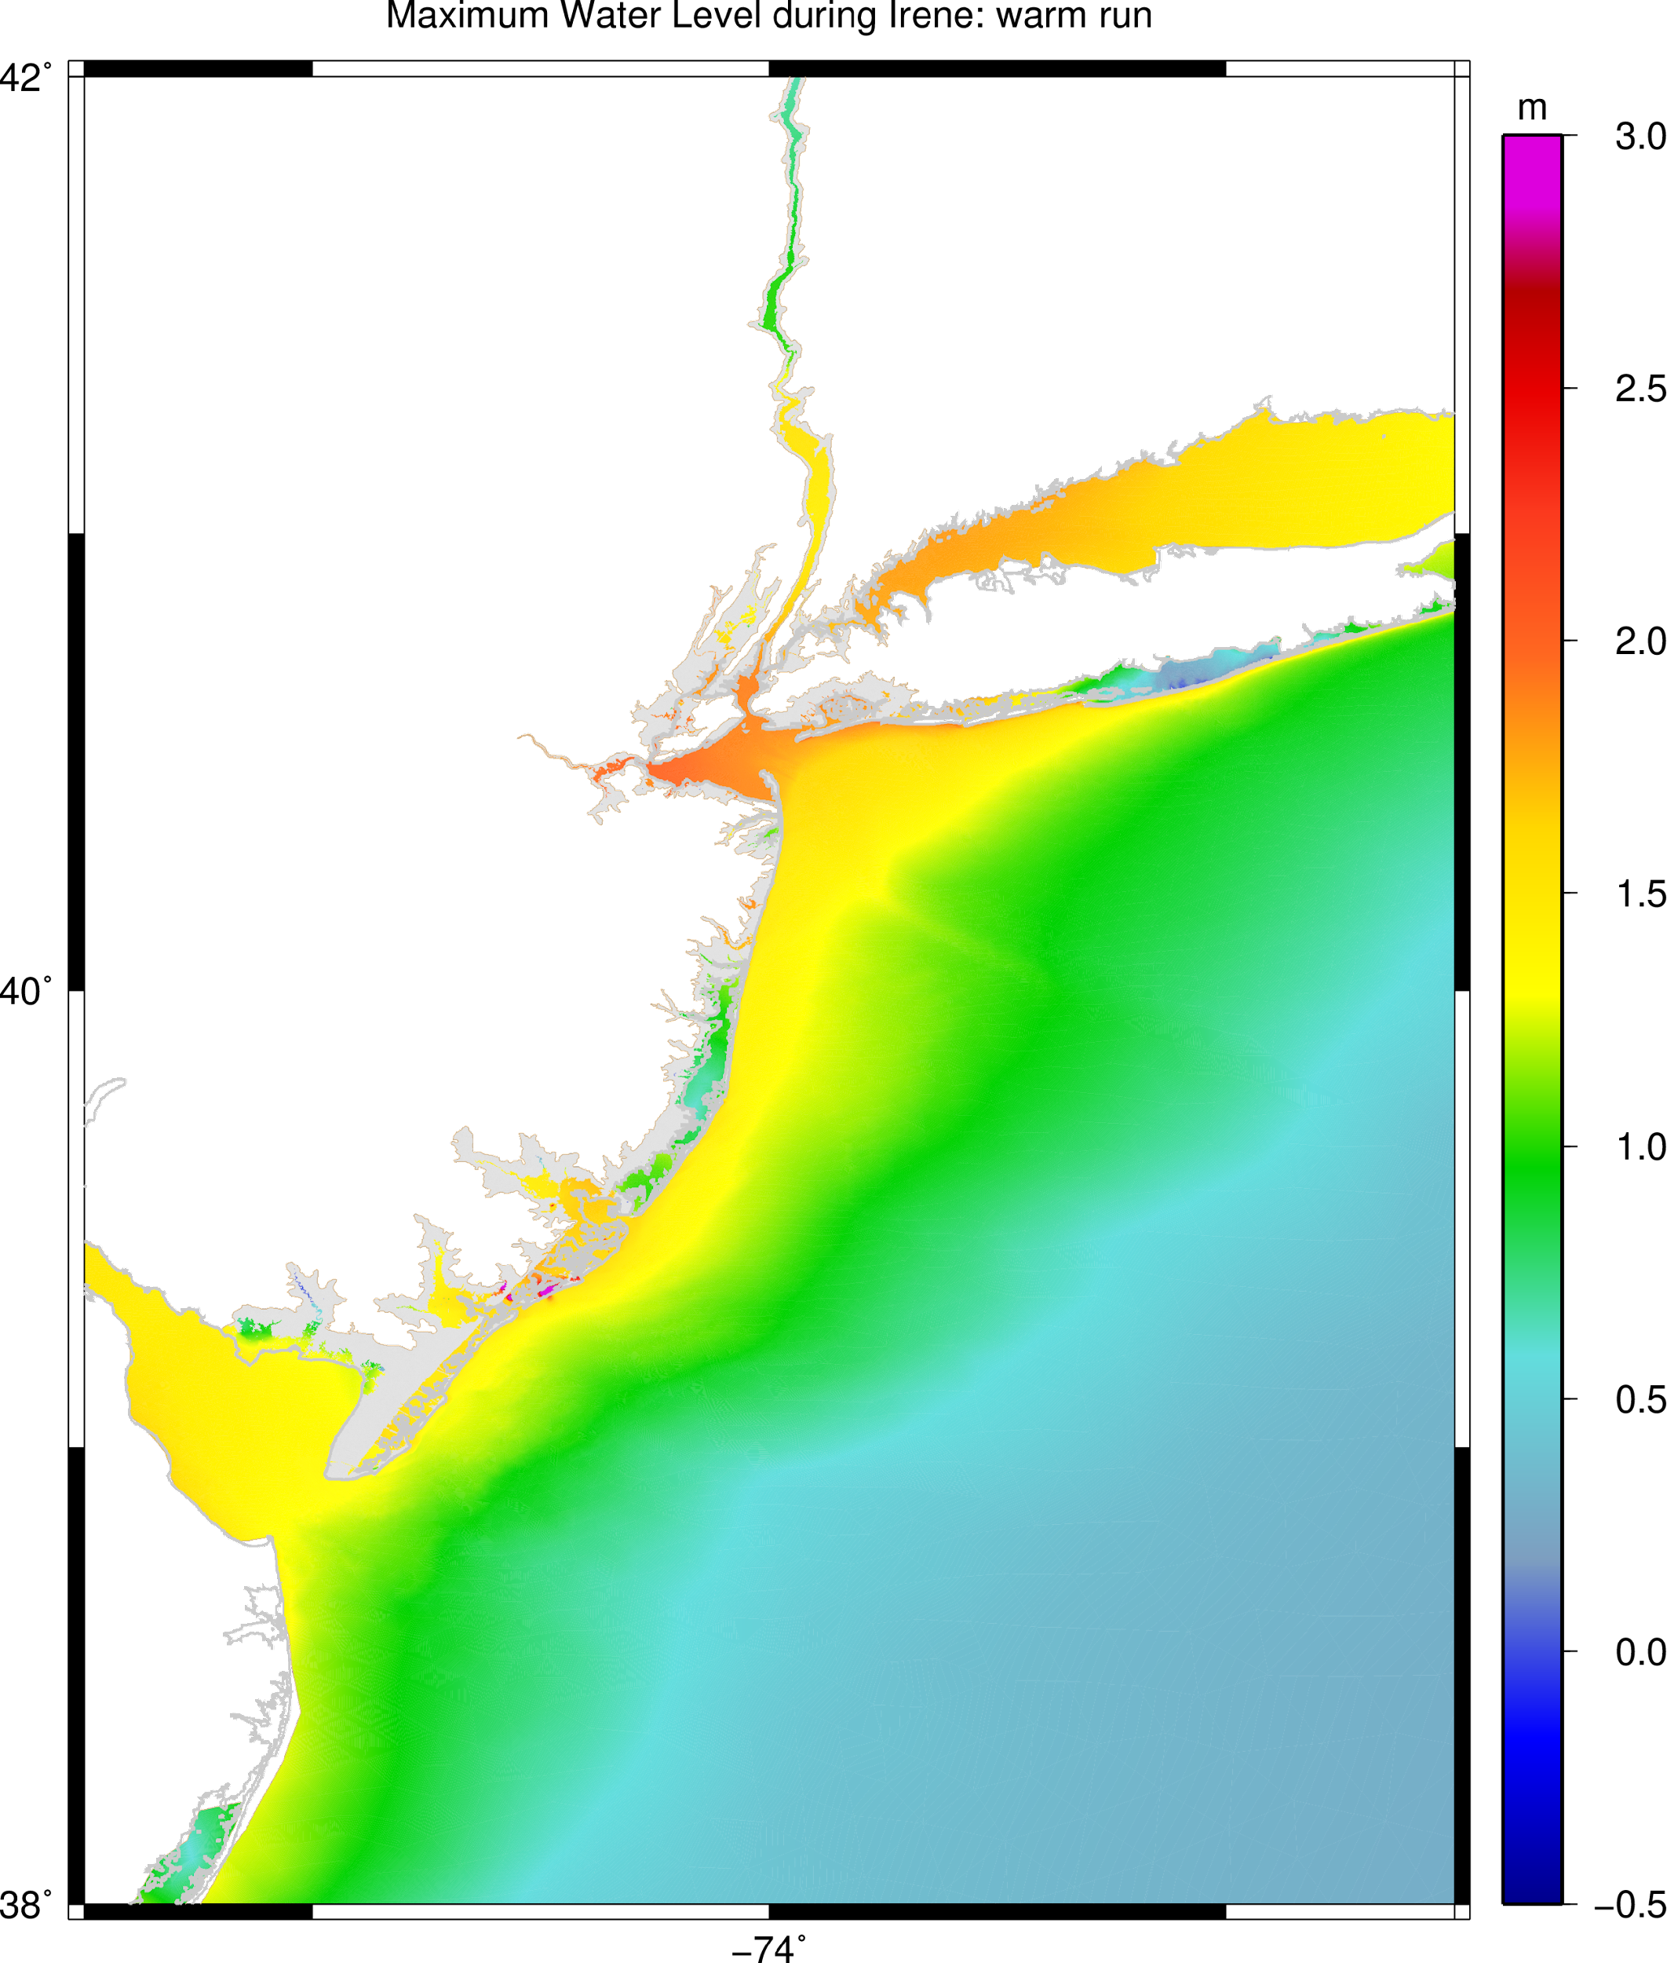
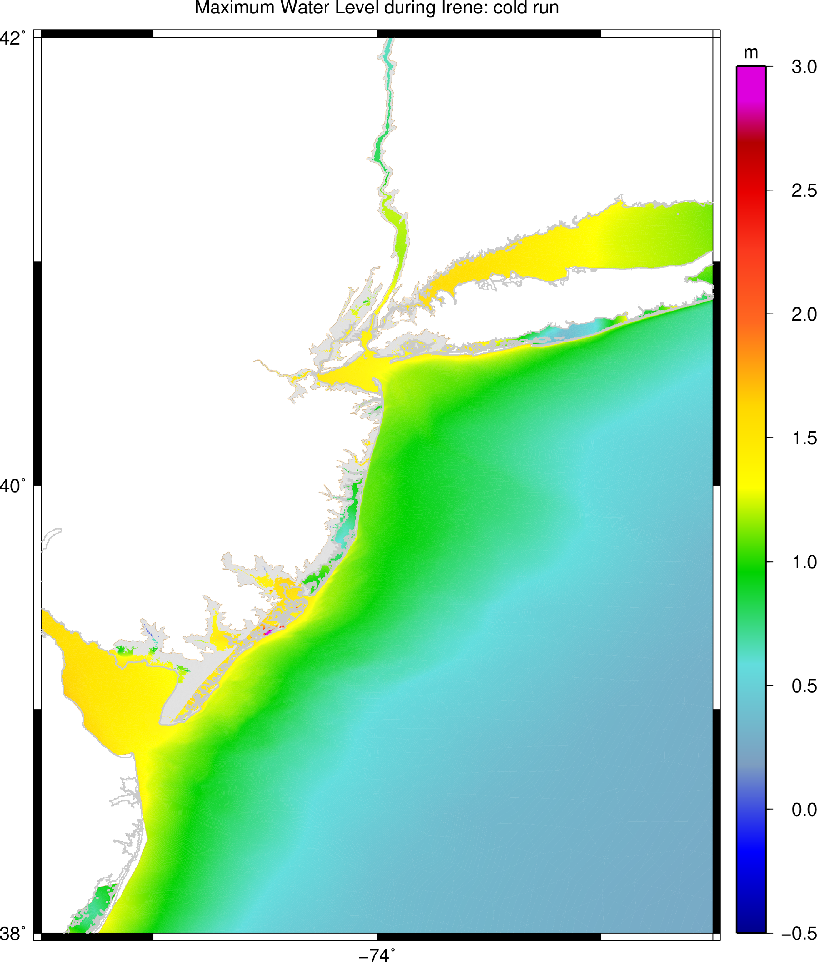


ADCIRC Storm Surge Model
Maximum water level:
Warm Run
Maximum water level:
Cold Run
Water Level Difference (m)
Warm - Cold
1.9 m
1.4 m

Slide 16





Alongshore winds (from NE) in WRF
Downwelling in ROMS x-shelf section
Miles et al.
JGR, 2015;
JGR, 2017
Downwelling Storm

Slide 17








Typhoon Soulik Sampling:
NOAA Joint Program Agreement
August 15 2018 Deployment: Jeju Island
>10º C Cooling

Slide 18







Regionally-specific Essential Ocean Features
impacting Atlantic Hurricane Intensity
Through 2015 and 2018 a growing body of literature:
Domingues et al., 2015
Glenn et al., 2016
Seroka et al., 2016
Seroka et al., 2017
Miles et al., 2017
Dong et al., 2017
Many others continuing to grow!
And a combining of forces and ideas:
Seasonal Stratification, Cold Pool
Gulf Stream,
Shelf
Loop Current,
Eddies,
Fresh Water
Warm Pool,
Upper Ocean Heat Content,
Fresh Water Barrier Layers
Heat & Fresh Water
Inflow

Slide 19

Hurricane Gliders Deployed in 3 Picket Lines
Florence
Helene
Isaac
>30 Hurricane Sentinel Gliders from Navy, NOAA, NSF, Academic & Industry Partners
reporting ocean conditions through the U.S. IOOS Glider Data Assembly Center (DAC)
ahead of Hurricanes Florence, Isaac and Helene on September 11, 2018.

Slide 20


2024 Glider Deployments
104 Deployments
4,299 Glider Days at Sea
130,839 Profiles to GTS
Essential Ocean Features impacting hurricane intensity

Slide 21


2018 - 2024 By the Numbers (preliminary)
2024 record breaking # total deployments (~100) and # days at sea (~4,300)

Slide 22








Example of Data Impacts: - Cat 5 Beryl 2024
April 19
Profile Comparison Statistics
Before Assimilation
Glider
Production
Parallel
Upper ocean cooling during eye passage (red dashed line) of Cat 5 Hurricane Beryl
Caribbean Region:
Before profile assimilation, model is biased cold & fresh
After profile assimilation, bias and rms differences are significantly reduced
ROTFS cools in response to intense hurricane forcing
July 2
Glider
After Assimilation
RTOFS
Temp.
Sal.

Slide 23






Model/Data Comparisons: Outcomes - Ernesto
August 13
Profile Comparison Statistics
Before Assimilation
Glider
Production
Parallel
August 15
Hurricane Metric Statistics -
Ocean Heat Content (OHC)
Bermuda Region:
Before profile assimilation, model is biased warm & fresh
BIOS glider launched Aug 12
Full data flow & assimilation established before landfall
Model OHC’s converge
After Assimilation
Temp.
Sal.

Slide 24



Planned 2025 Caribbean Hurricane Array: TC Exemplar Pilot Study
North Atlantic Inflow - PR-USVI-BVI-ANG-BAH-DR
(AOML-CARICOOS-
UVI) US Hurricane Gliders)
Caribbean Throughflow
DR to Curacao
(2024 Vetlesen -> 2025 US NSF, UVI / Rutgers U.)
Caribbean Throughflow - Nicaraguan Bank (2025 US NSF, Rutgers / UVI)
Yucatan Outflow -
Mexico / US
(US NAS UGOS)
South Atlantic Inflow - Barbados - (RU, UVI 2025 Vetlesen Proposal)
Argo Floats

Slide 25
Challenges Remain:
Sustained funding for future hurricane deployments
Complex and fragile data infrastructure for real-time applications
Outreach and education: Capacity building for data sharing
Challenges in using autonomous platforms across international boundaries (requires lengthy Marine Scientific Research requests)

Slide 26






2013
2019
Building off of >10 years of partnership and friendship!
2018

Slide 27





Impacts - Operations to Research - Helene in GoM
Helene tracked over Loop Current, Cyclonic Eddy, & West Florida Shelf, all with high Ocean Heat Content
Helene intensified over warm ocean features nearly all the way to landfall
Helene’s strong cyclonic winds cooled the Cyclonic Eddy and the WFS
Before
During
After

Slide 28





Impacts - Operations to Research - Milton in GoM
Milton tracked over warm Loop Current, but cooler Cyclonic Eddy & West Florida Shelf
Milton intensified over warm features & weakened over cold approaching landfall
Milton’s cyclonic winds amplified the Cyclonic Eddy, followed by Loop Current Eddy Edison formation
Before
During
After

