Slide 1
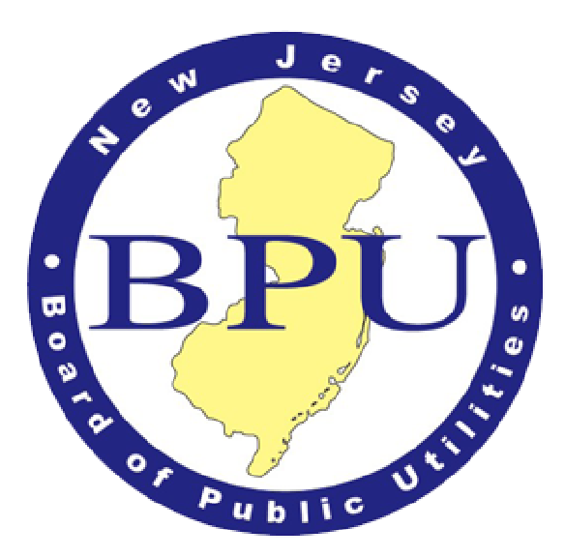
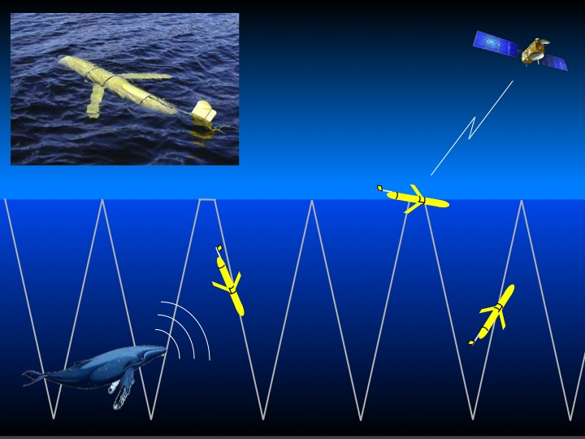
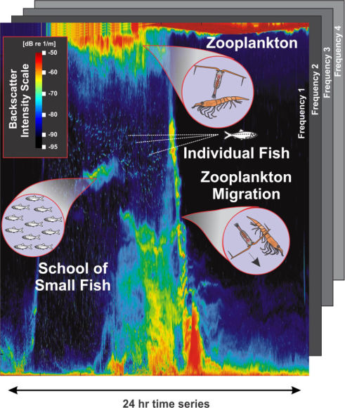
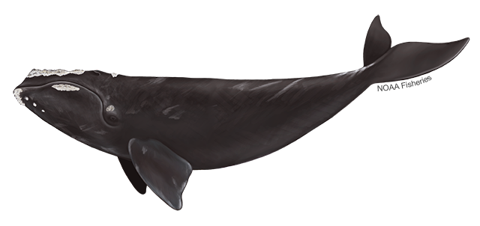
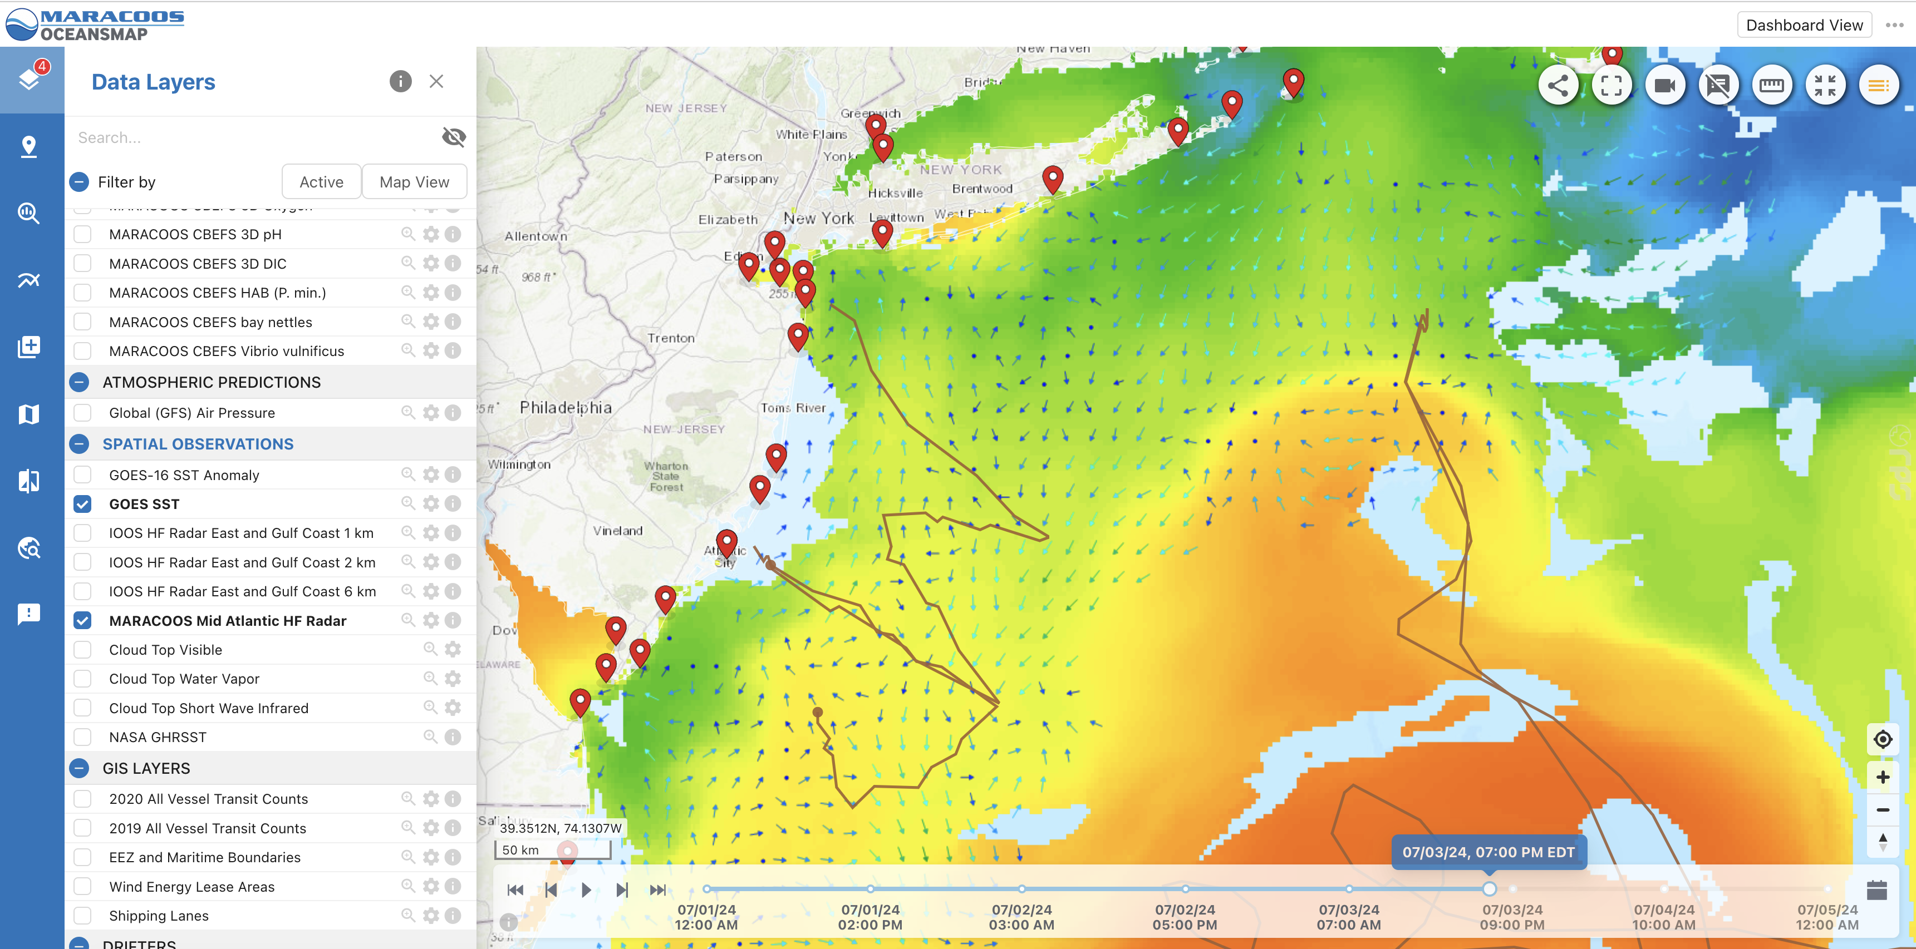
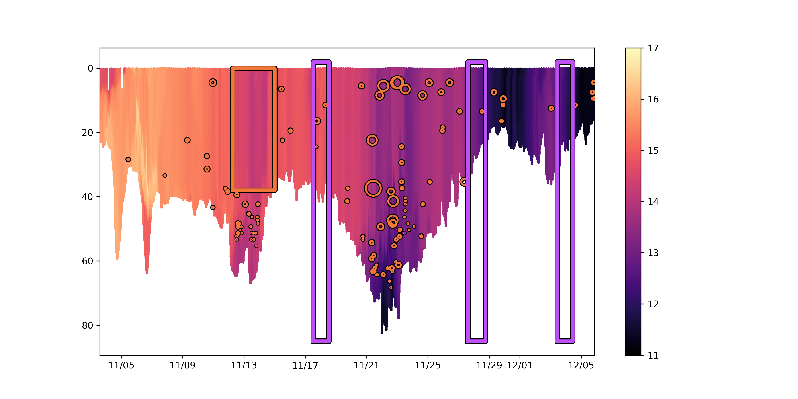
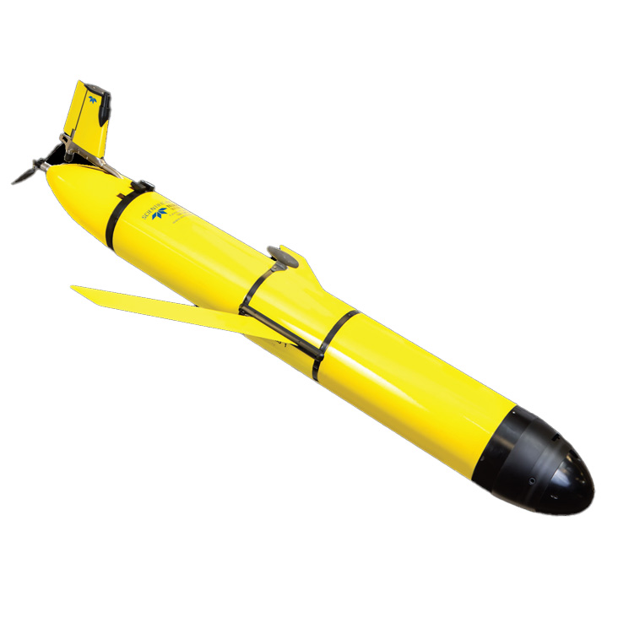
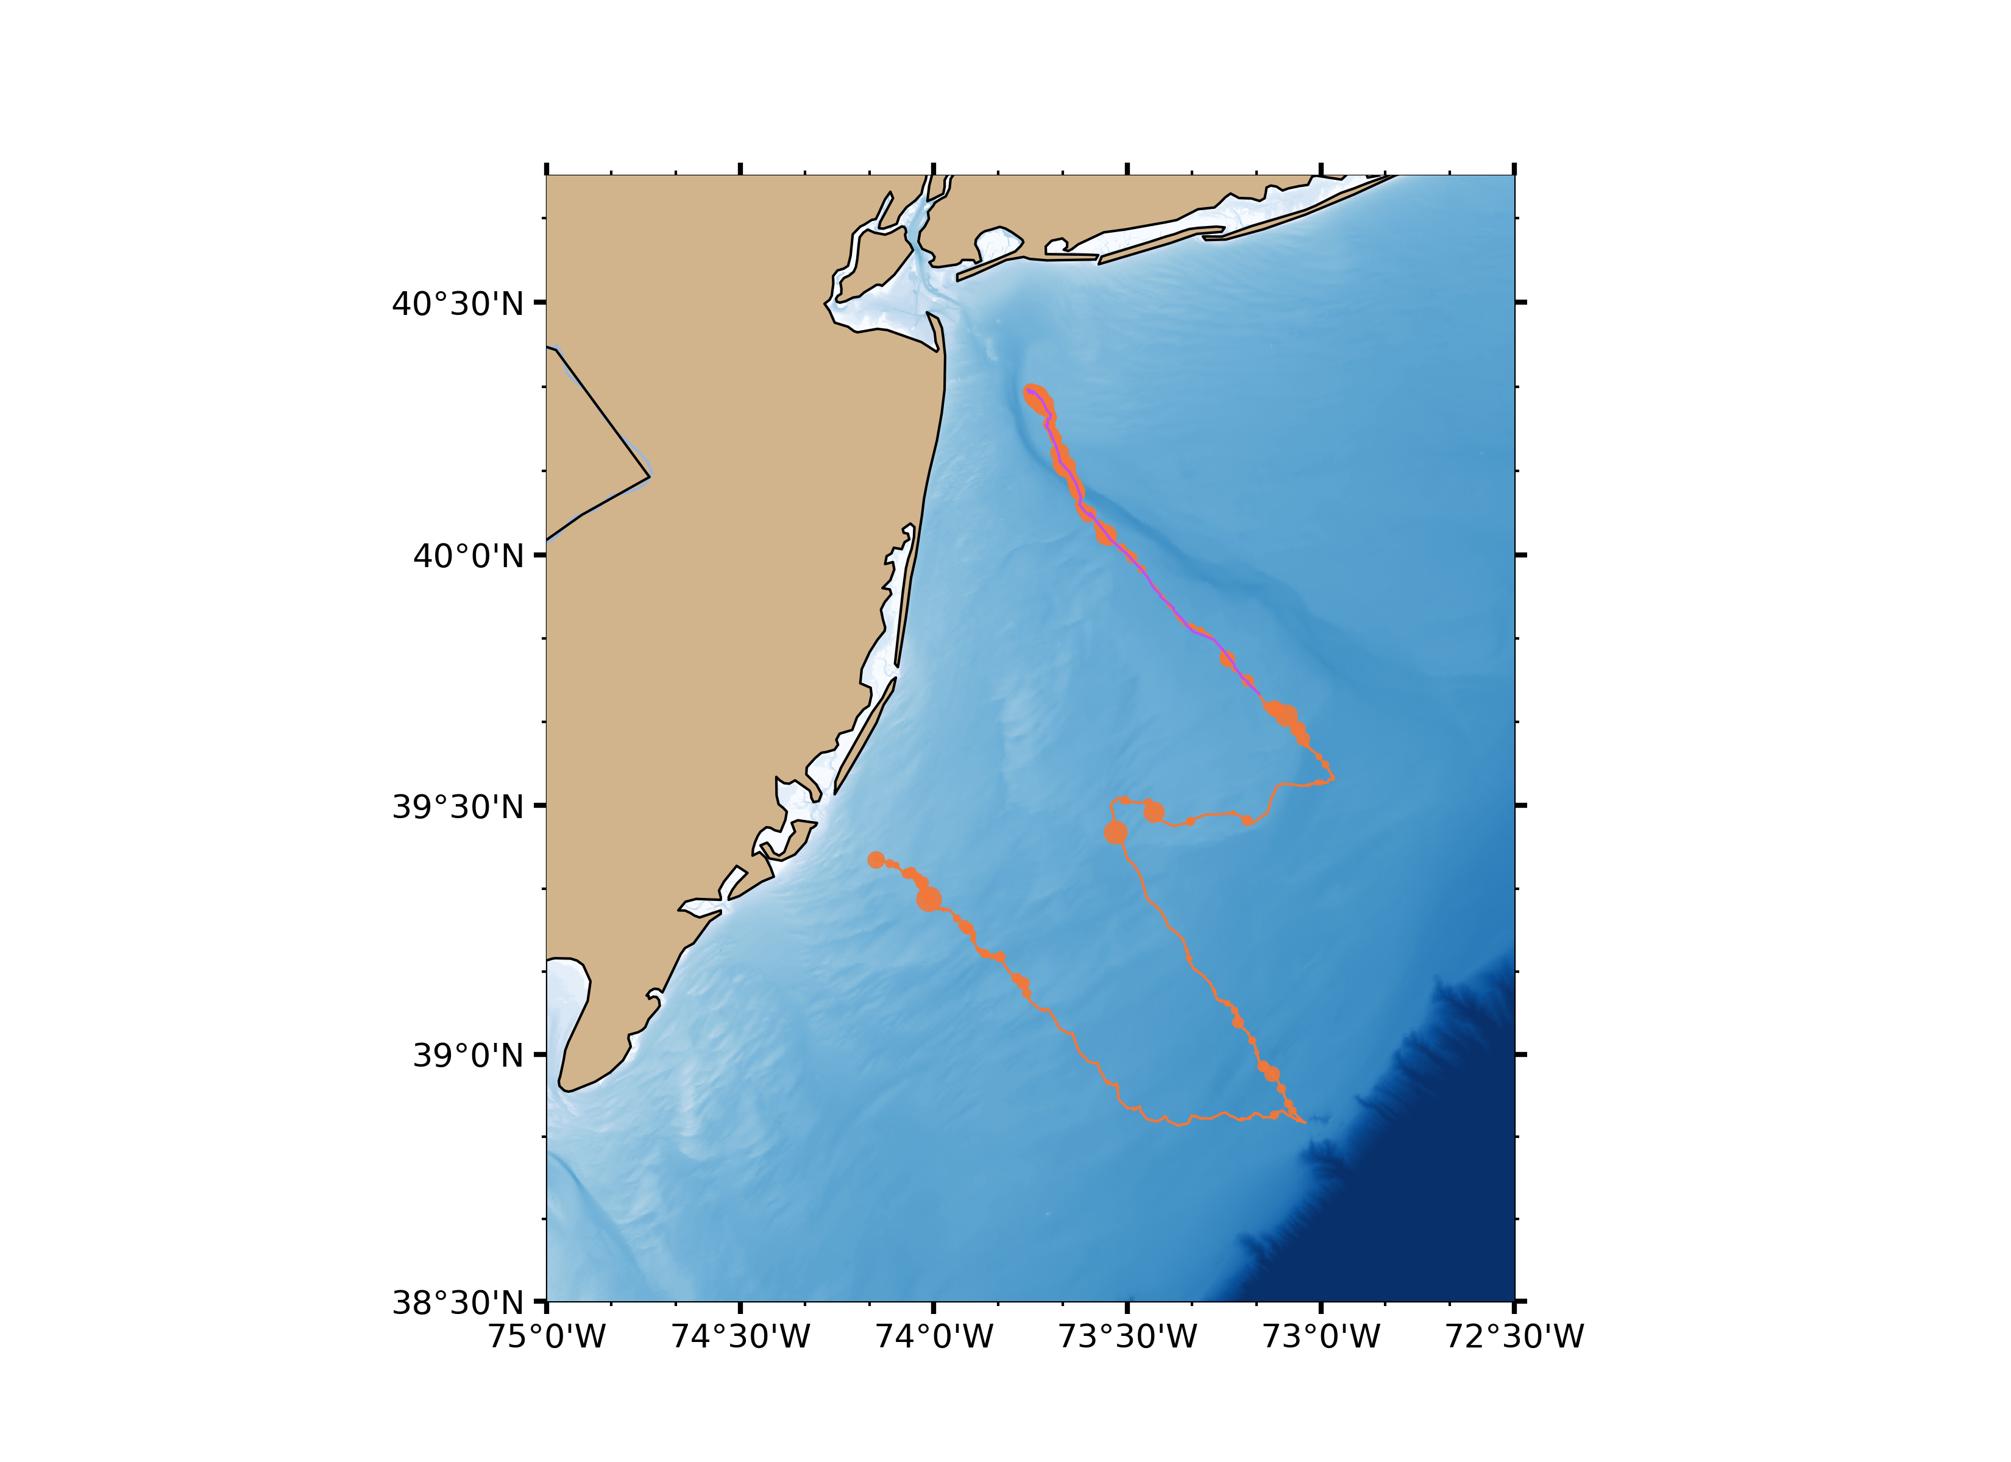
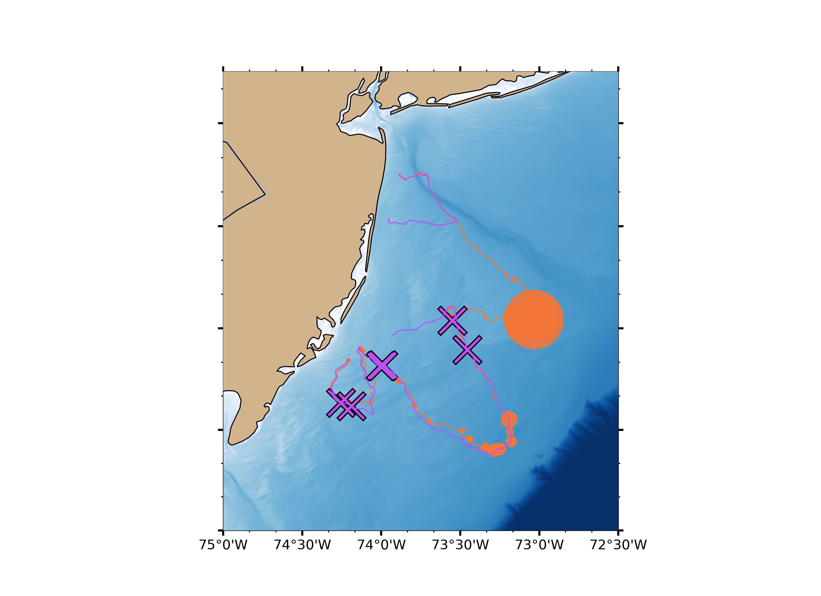
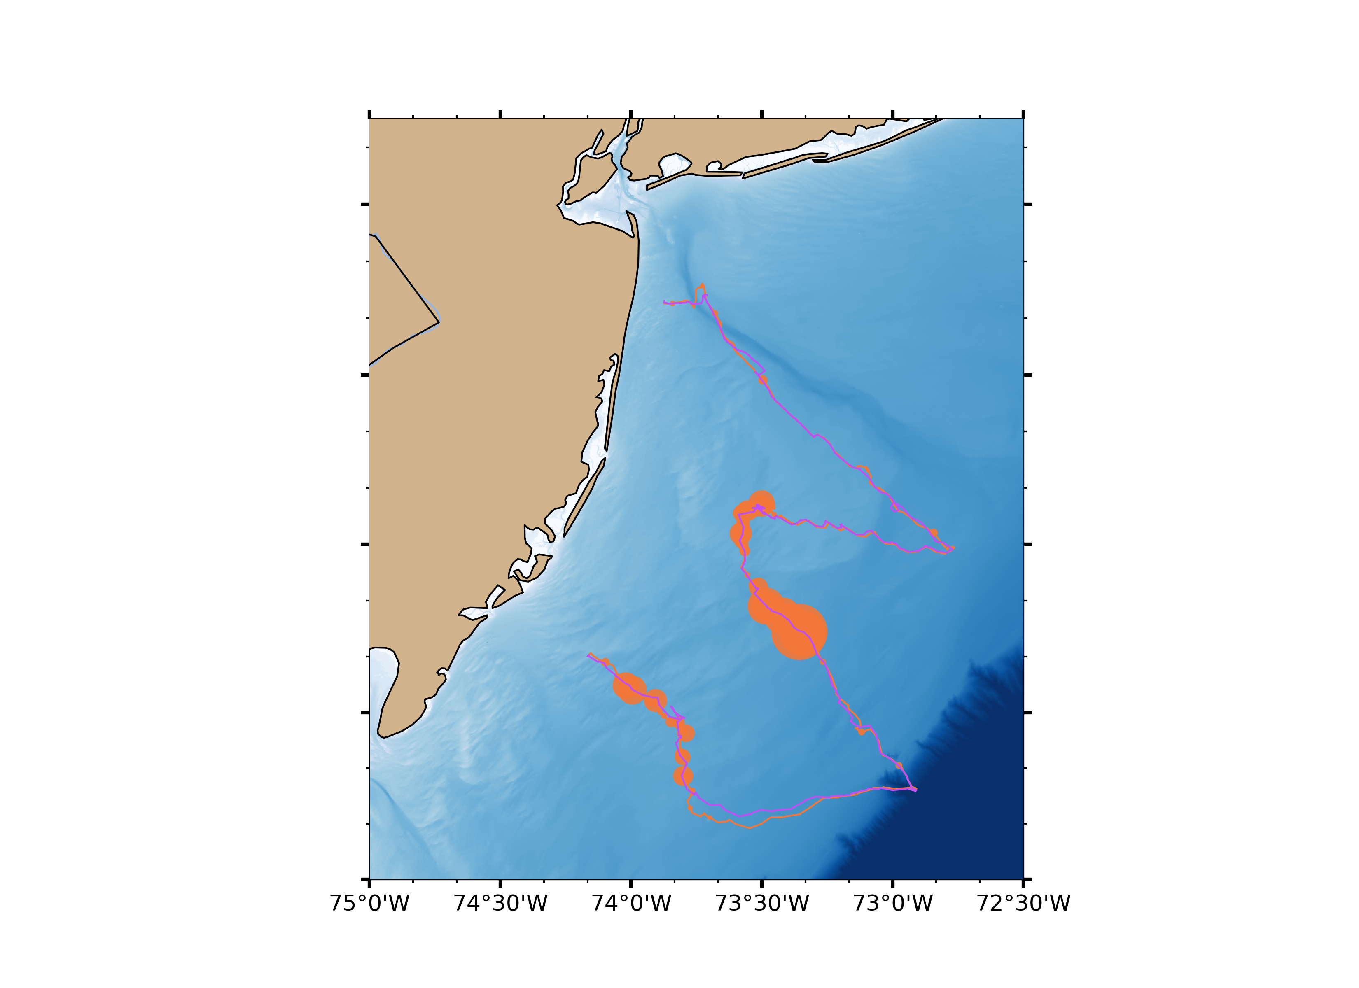
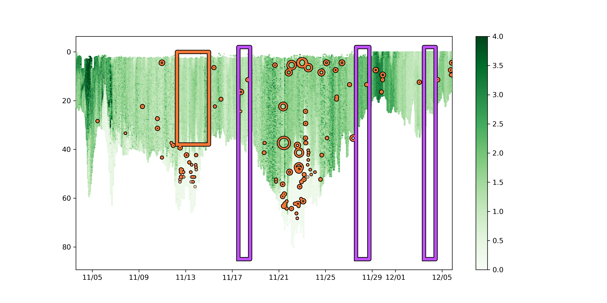
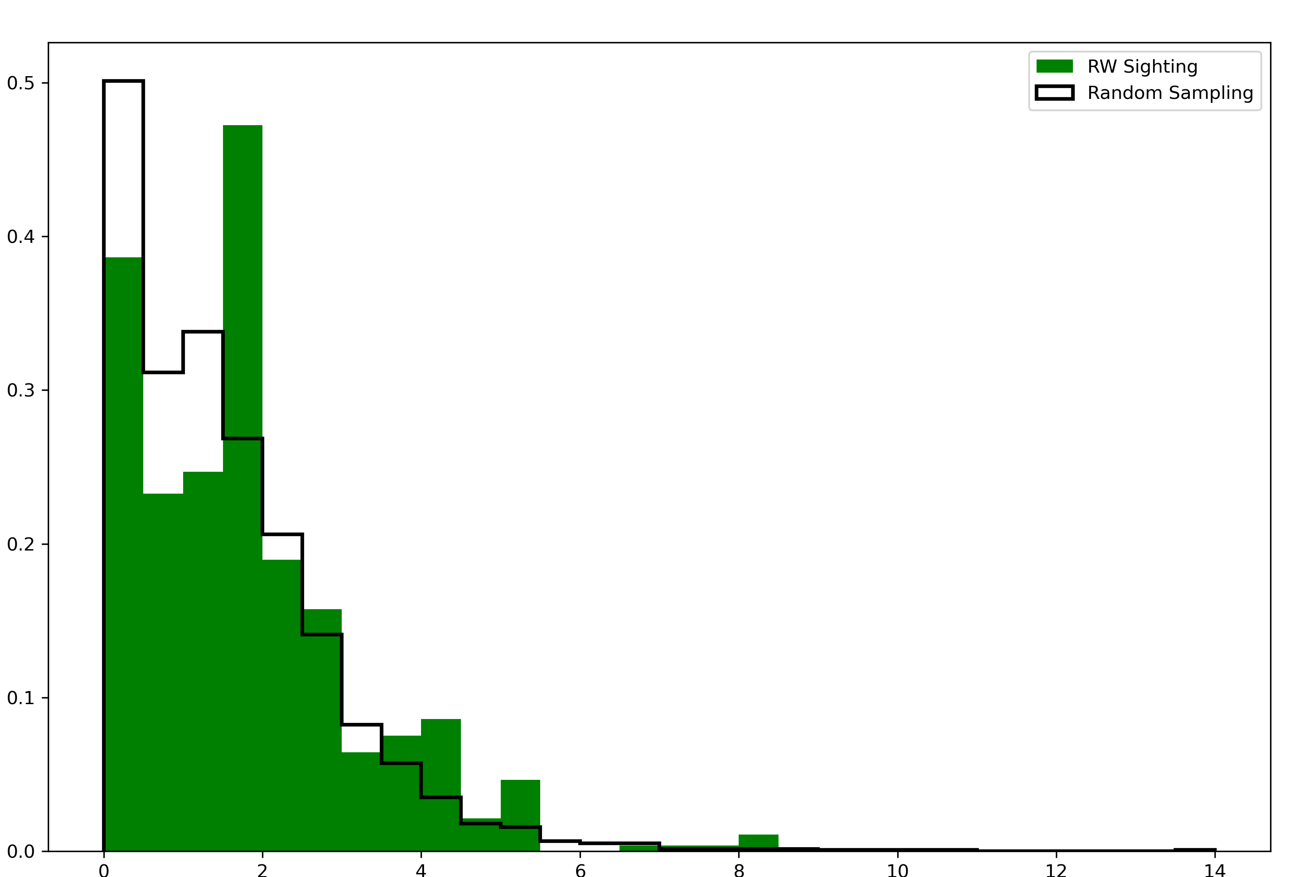
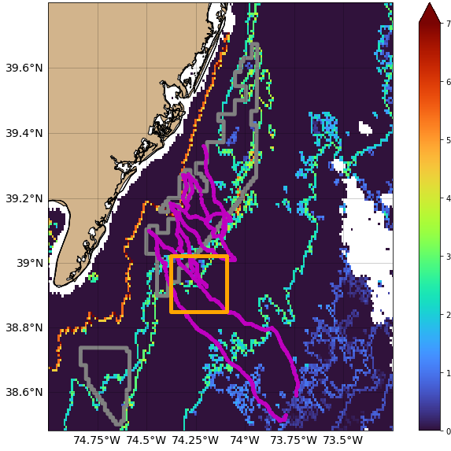
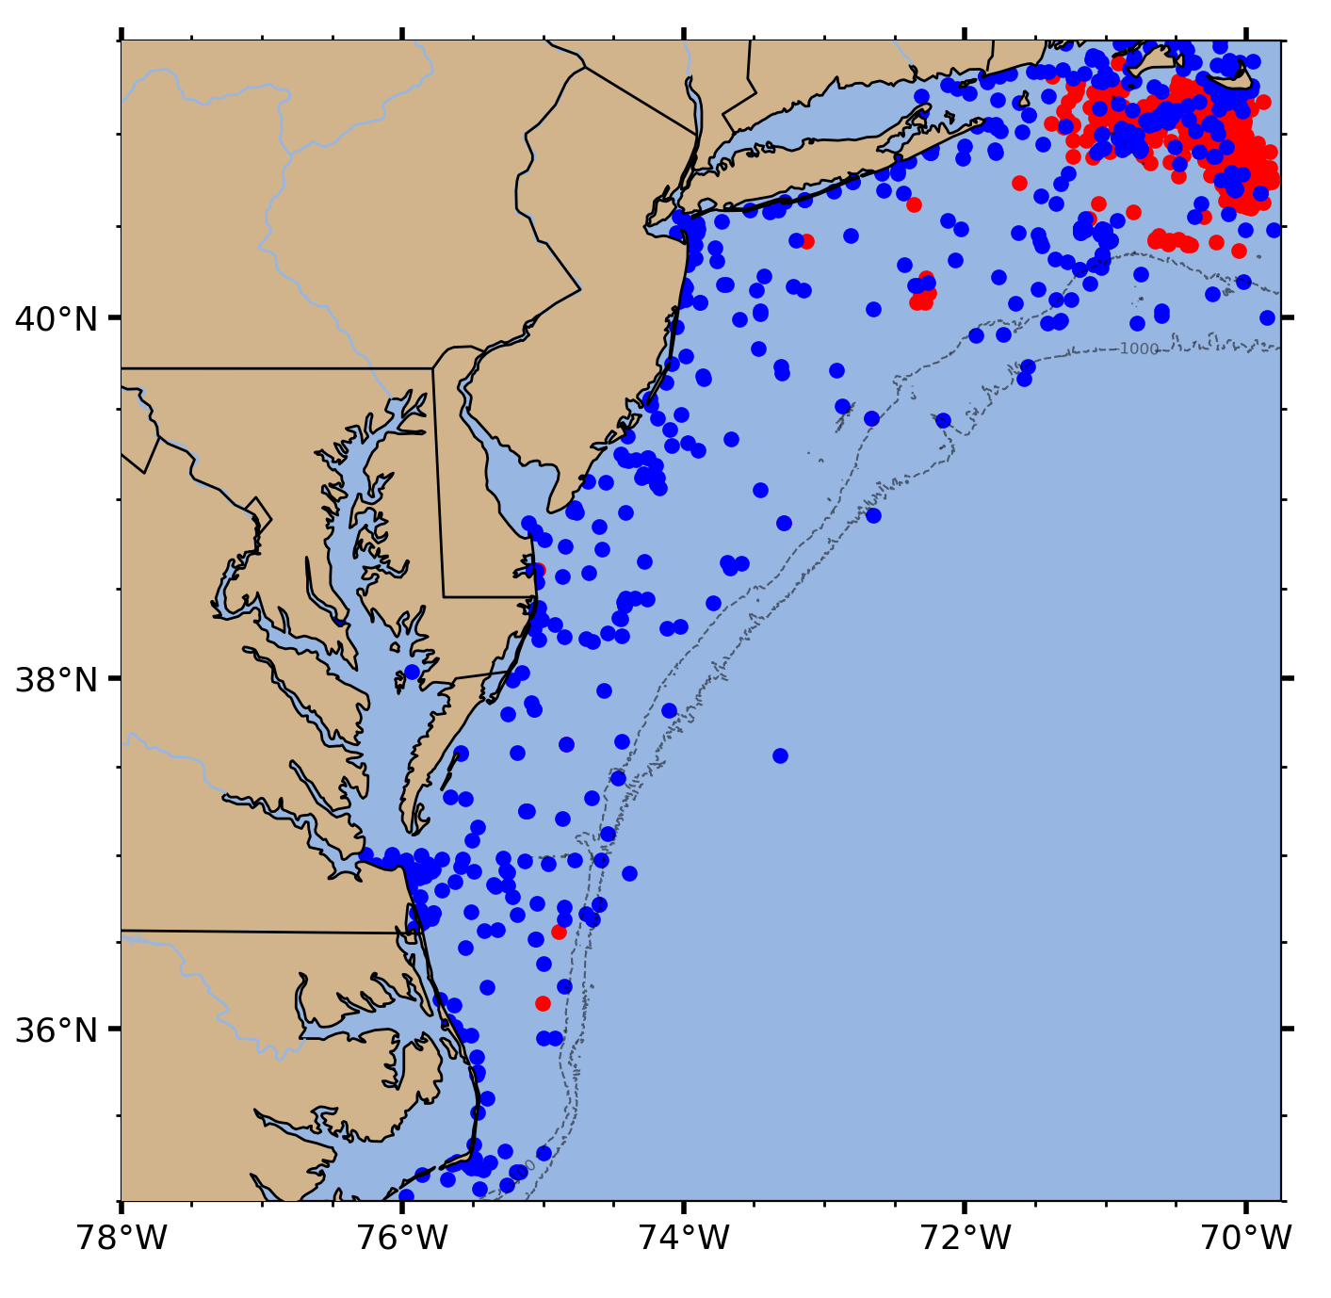
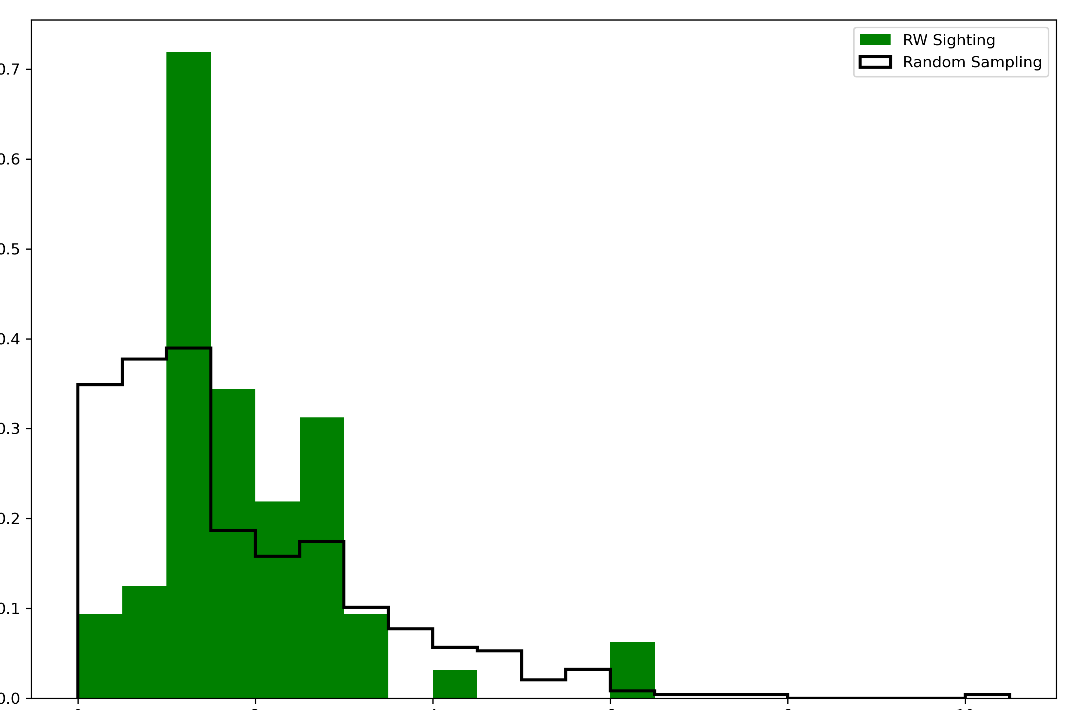
Physics, Plankton, & Whales, Oh My!
Laura Nazzaro¹, Josh Kohut¹, Grace Saba¹, Delphine Mossman¹, Mark Baumgartner², Julianne Wilder²
1
2
How can we use ocean observatories to help the critically endangered North Atlantic Right Whale (NARW)?
Offshore wind energy activity in the Mid Atlantic Bight may increase risk to NARW
NARW distribution and movements are not well documented in this region, BUT…
There is an abundance of environmental data and increased capability for remote NARW & zooplankton detection.
Better data availability can improve regional NARW models and/or prey distribution models, to help decrease risks during wind farm construction
credit: robots4whales.whoi.edu
ASL Environmental Services AZFP
Habitat features, NARW, and prey aggregations are being measured together in the New York Bight.
Using paired glider deployments, we can use passive acoustics (DMON) to detect NARW together with active acoustics (AZFP) to detect zooplankton, while also collecting
environmental data (temperature, salinity, dissolved oxygen, chlorophyll, pH, & others).
Remote data can detect aggregating features.
Satellite data can measure surface chlorophyll, temperature, and ocean color that can be used to calculate fronts between water masses, and high-frequency (HF) radar measures surface currents that can be used to calculate areas prey are likely to aggregate (example below).
Glider data can resolve vertical structure of several environmental features and assimilative hydrodynamic models provide 4-dimensional forecasts.
https://maracoos.org/ oceansmap/
Apr
2023
Nov
2023
Feb
2024
Apr
2024
temperature (ºC)
AZFP deployment track
DMON deployment track
large copepods detected by AZFP (scaled by biomass)
large copepods detected by AZFP (scaled by biomass, depth-integrated)
large copepod aggregation (boxed to not cover glider data)
NARW detected by DMON (scaled to approximate detection range)
chlorophyll-a (mg/L)
NARW may associate with mid-strength satellite-based fronts.
NARW in the NY Bight (glider-based and NARWC observations) were detected more frequently near mid-strength frontal gradients compared to frontal background conditions. Following a regime shift in Nantucket Shoals 2016, mid-strength fronts were observed more frequently (esp. in summer and fall), coinciding with increased NARW abundance as well as year-round presence.
Surface Current
Aggregating Structures
Ocean current data can be used to define Lagrangian Coherent Structures (LCS), areas where passive particles are likely to either aggregate or diverge. This image shows a version of LCS, Finite Time Lyapunov Exponent (FTLE), integrated over 24 hours for June 1, 2015. In darker areas passive particles are likely to aggregate due to surface current structure.
Satellite-Based Frontal Gradient Strength
Sightings from NARWC database 2002-2020
NARWC Sightings
We can detect fronts between cohesive water masses based on satellite data. A glider deployment in Feb 2021 (magenta line) detected multiple NARW calls near the mid-shelf front (orange box).
Stronger Fronts
Relative Distribution
near NARW detection
background
credit: Jackie Veatch
0
2
4
Frontal Gradient Strength
Acknowledgements
This work spanned multiple projects and was supported by Ørsted, New Jersey Research and Monitoring Initiative (NJ Department of Environmental Protection & NJ Board of Public Utilities), and Project WOW (Wildlife & Offshore Wind). Additional thanks to the North Atlantic Right Whale Consortium (NARWC) for providing data and to Jackie Veatch for FTLE product/imagery.
Glider Detections
Relative Distribution
near NARW detection
background
Weaker Fronts
Opportunistic
Aerial
0
2
4
Frontal Gradient Strength

