Slide 1
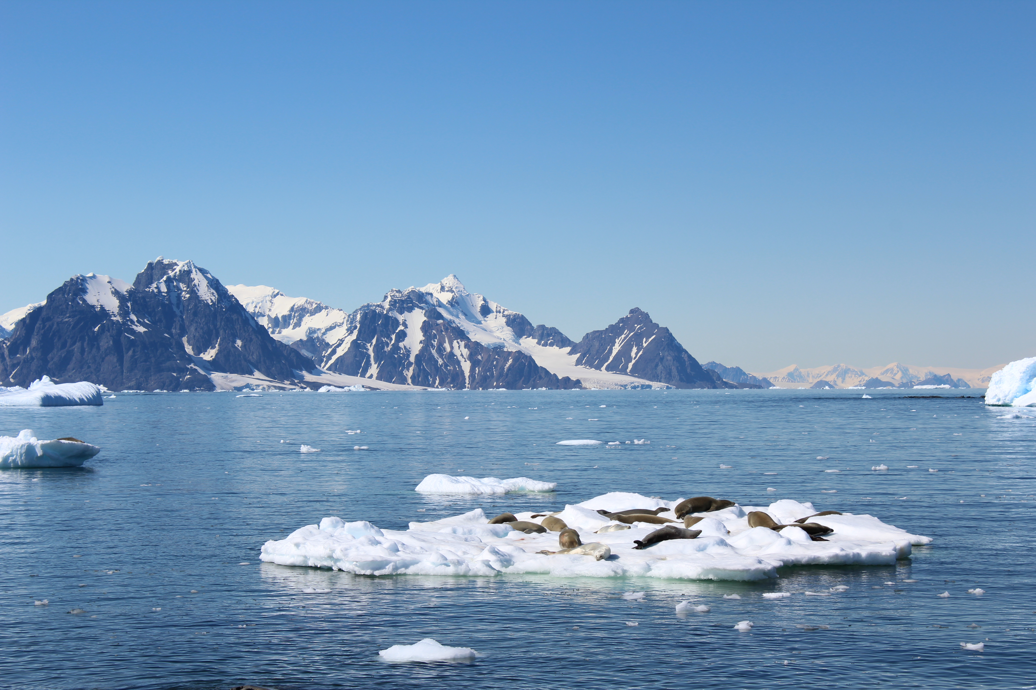
Finding Marine Grocery Stores: A Lagrangian Approach to Prey Concentrating Features in Palmer Deep, Antarctica
Jacquelyn Veatch, Josh T Kohut, Matthew J Oliver, Katherine Gallagher and Erick Fredj
Picture: Rothera, January 2020
Notes:
Today I will be presenting some of my dissertation work, done in collaboration with my advisor, Josh Kohut, as well as Matt Oliver, Katie Gallagher, and Erick Fredj

Slide 2
Motivation
Patchiness of Plankton Leading to Food Web Focusing
MODIS true color image
Adélie Penguin, Photo courtesy of Kharis Schrage
Measuring Antarctic Krill, Palmer Station February 2020
Phytoplankton patchiness is in part due to advective transport by physical ocean features
Grazer patchiness in part due to advective transport, in part due to attraction to phytoplankton
Foragers attracted to grazer patches
“Food Web Focusing” (Genin 2004)
Notes:
Plankton distribution in the ocean is notoriously patchy.
Phytoplankton patchiness is in part due to advective transport by physical ocean features.
Gazer patchiness is in part due to this same advective transport, as well as their attraction to their food source, phytoplankton.
And lastly, foragers are then attracted to grazer patches.
In this way, the concentration of these plankton patches increases prey availability for upper trophic creatures in certain regions of the ocean, as if visiting a marine grocery store
CLICK
This bottom up control on spatial ecology was coined as food web focusing by Amatzia Genin in their 2004 paper.
The goal of my research is to investigate the physical mechanisms that create these marine grocery stores, maintaining biological hotspots and allowing upper trophic creatures to feed efficiently.

Slide 3
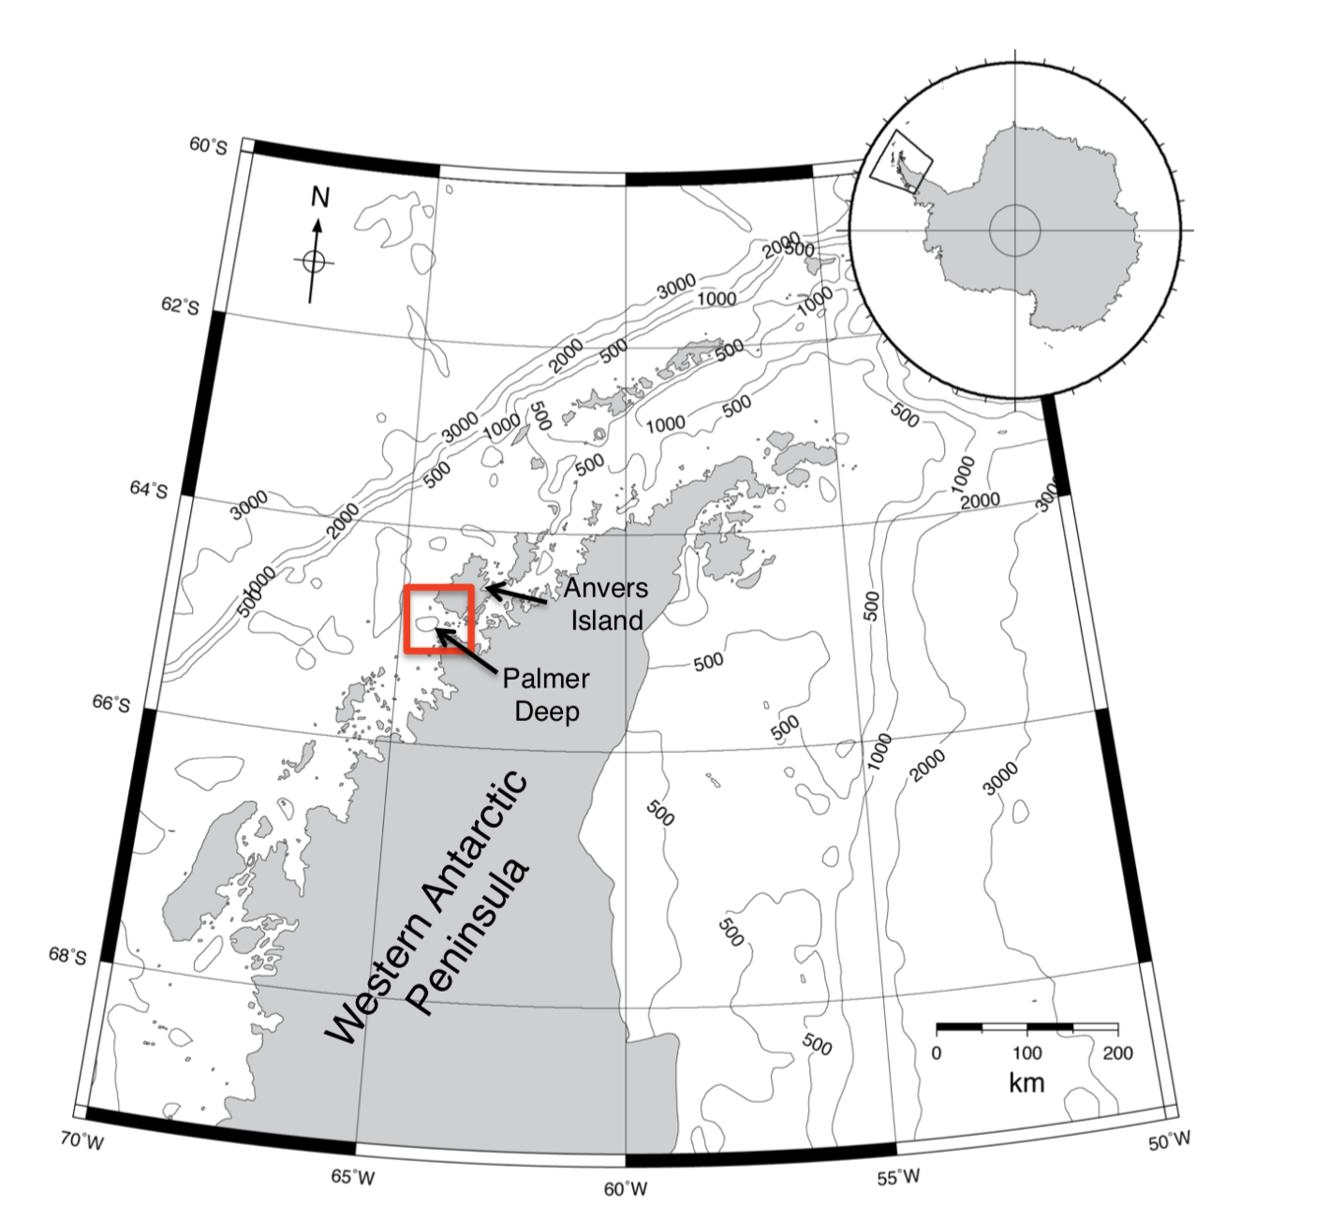
Notes:
We have used Palmer Deep Canyon, Antarctica as our ecological laboratory to investigate these physical mechanisms of food web focusing. Rapid warming in this region has added a sense of urgency to understanding how this system works.

Slide 4
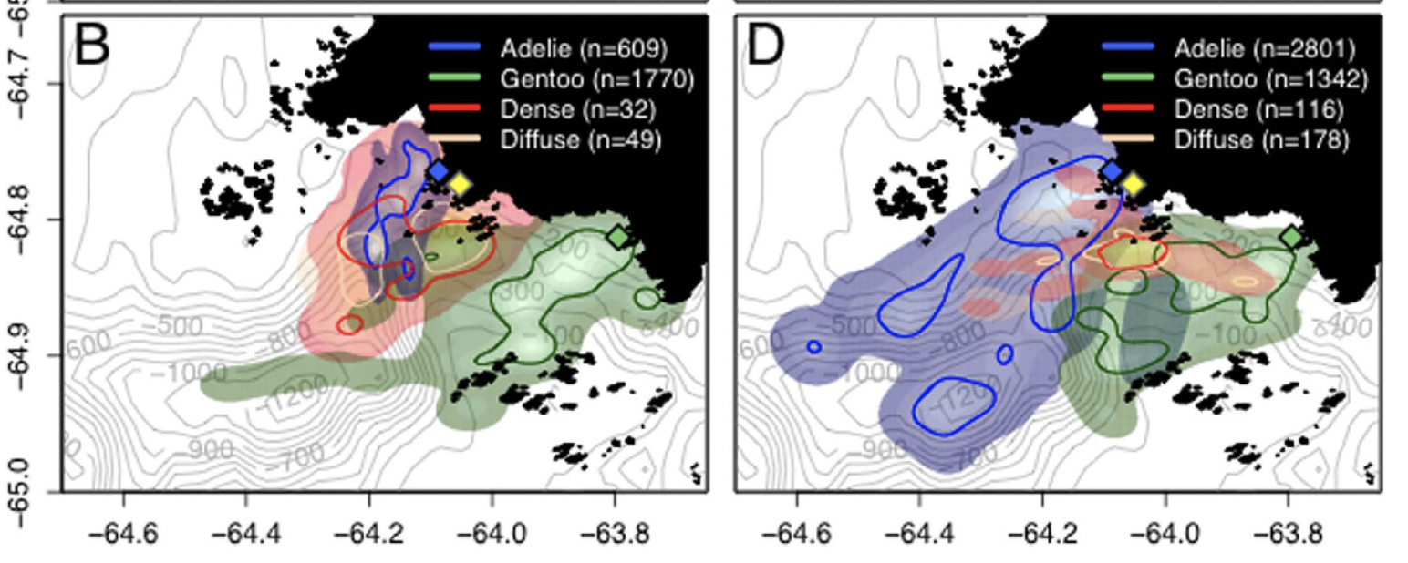
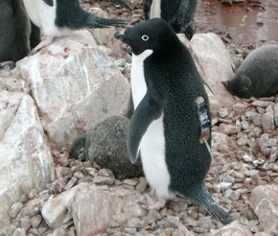
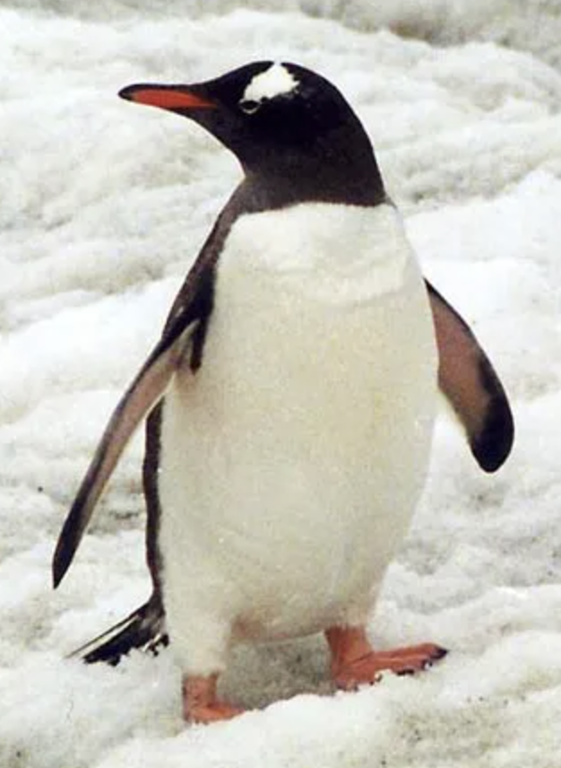
Motivation
Penguin Foraging Behavior Following Changing Tidal Regimes
Diurnal Tidal Regime
Semidiurnal Tidal Regime
Figure 1 from Cimino et al. 2016; Oliver et al 2013
Notes:
In Palmer Deep, Penguin foraging behavior has been shown to shift with changing tidal regimes, suggesting an interaction between the local food web and ocean currents. This figure shows kernel densities of penguin foraging behavior during Diurnal (on the left) and Semidiurnal (on the right) tidal regimes.
With a shift from diurnal to semidiurnal, foraging Adélie penguins on the west side of the canyon shift offshore while Gentoo Penguins on the east side of the canyon shift onshore.

Slide 5
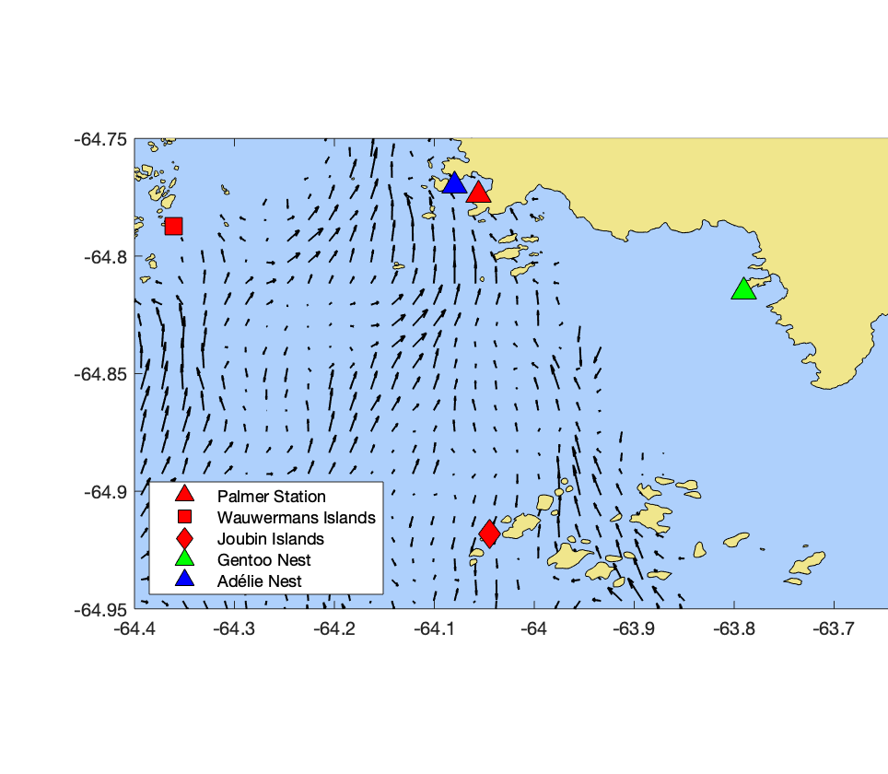
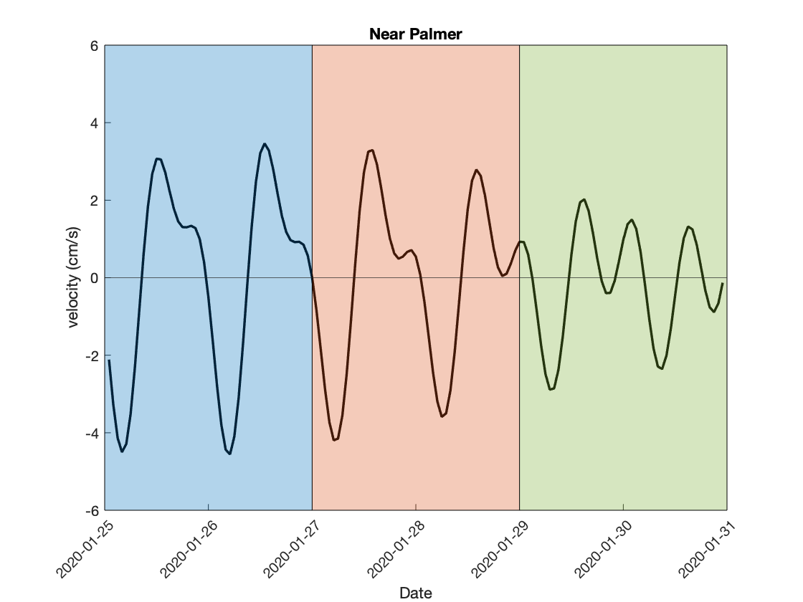
Motivation
A Spatially Varying Tidal Regime
diurnal
transition
semidiurnal
Radar Observed Surface Currents
Tidal velocity (cm/s)
v
u
Date
Notes:
These papers define tidal regime based on a gauge at Palmer Station, which is this red triangle here. Using data from a High Frequency Radar array deploy in early 2020, the north-south component of the tidal velocity near Palmer Station shows the transition from a diurnal tide, with one high tide a day, to semidiurnal with two high tides each day, which is pretty indicative of the west side of the canyon.
However,
Tidal plots made with ‘/Users/jveatch/Documents/MATLAB/SWARM/Chapter2/tidalEllipse/VU_tide_JoubWauw_Example.m’
Replace animation with stagnant map
Those papers define tidal regime based on a gauge at Palmer Station → not reflected on east side
Show only one components (or amplitude)
This is why we are looking at different sides of the canyon!!
Animation may distract from u_tide v_tide
Change colors of Joub and Wauw and coordinate with u and v plots
“when we zoom in on the tides”
Very complex, and tides are complex
Know what you mean by diurnal and semidiurnal
U and v plots made from ‘UV_tide_JoubWau_Example.m’

Slide 6
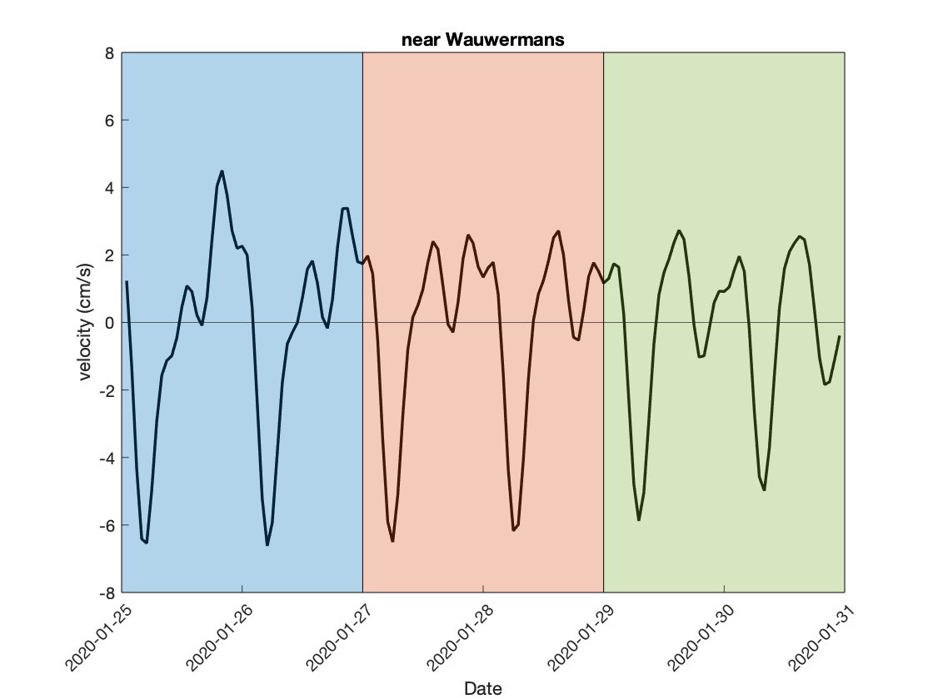
Motivation
A Spatially Varying Tidal Regime
diurnal
transition
semidiurnal
Radar Observed Surface Currents
Tidal velocity (cm/s)
v
u
Date
Tidal velocity (cm/s)
Date
Notes:
These papers define tidal regime based on a gauge at Palmer Station, which is this red triangle here. Using data from a High Frequency Radar array deploy in early 2020, the north-south component of the tidal velocity near Palmer Station shows the transition from a diurnal tide, with one high tide a day, to semidiurnal with two high tides each day, which is pretty indicative of the west side of the canyon.
However,
Tidal plots made with ‘/Users/jveatch/Documents/MATLAB/SWARM/Chapter2/tidalEllipse/VU_tide_JoubWauw_Example.m’
Replace animation with stagnant map
Those papers define tidal regime based on a gauge at Palmer Station → not reflected on east side
Show only one components (or amplitude)
This is why we are looking at different sides of the canyon!!
Animation may distract from u_tide v_tide
Change colors of Joub and Wauw and coordinate with u and v plots
“when we zoom in on the tides”
Very complex, and tides are complex
Know what you mean by diurnal and semidiurnal
U and v plots made from ‘UV_tide_JoubWau_Example.m’

Slide 7
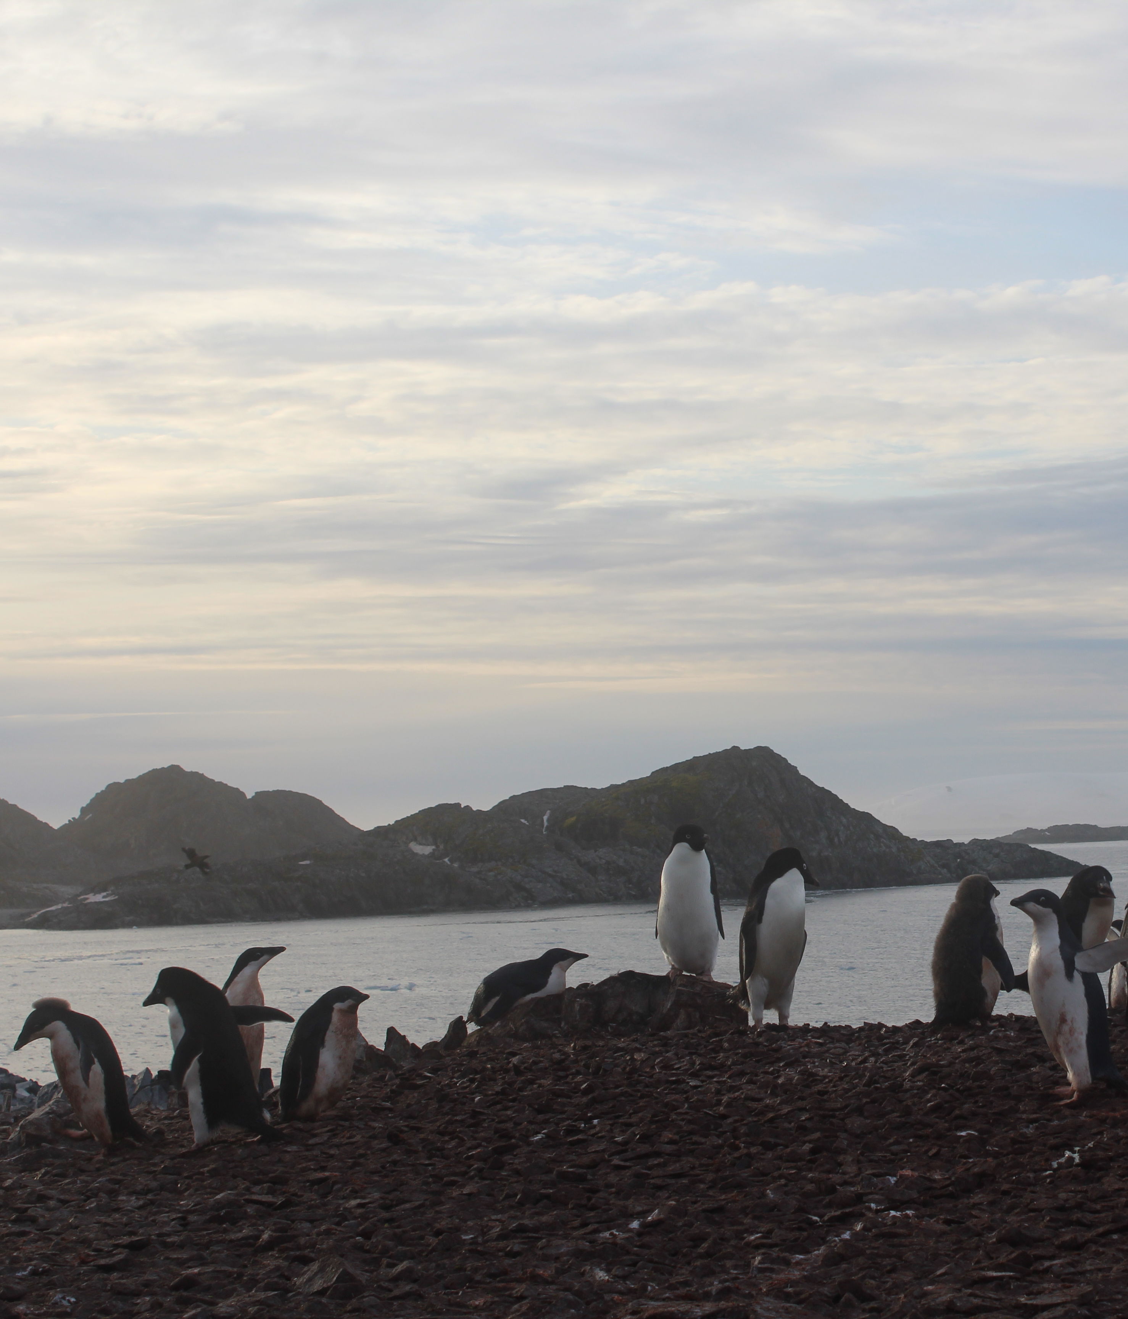
What causes this change in penguin spatial ecology with switching tidal regimes?
Hypothesis: Patterns in lagrangian transport differ in diurnal and semidiurnal regimes, concentrating the food web in different locations
Adélie Penguins on Torgersen Island
Notes:
The question that remains is:
Click
And our hypothesis is that Patterns in lagrangian transport differ in diurnal and semidiurnal regimes, concentrating the food web in different locations, moving around those marine grocery stores.

Slide 8
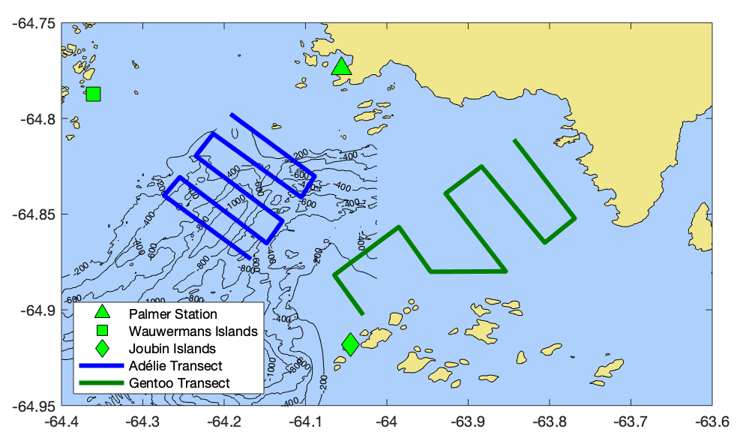
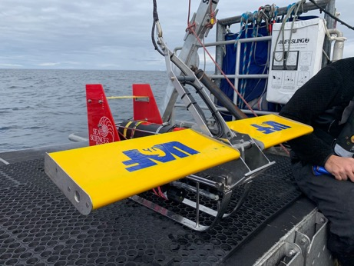
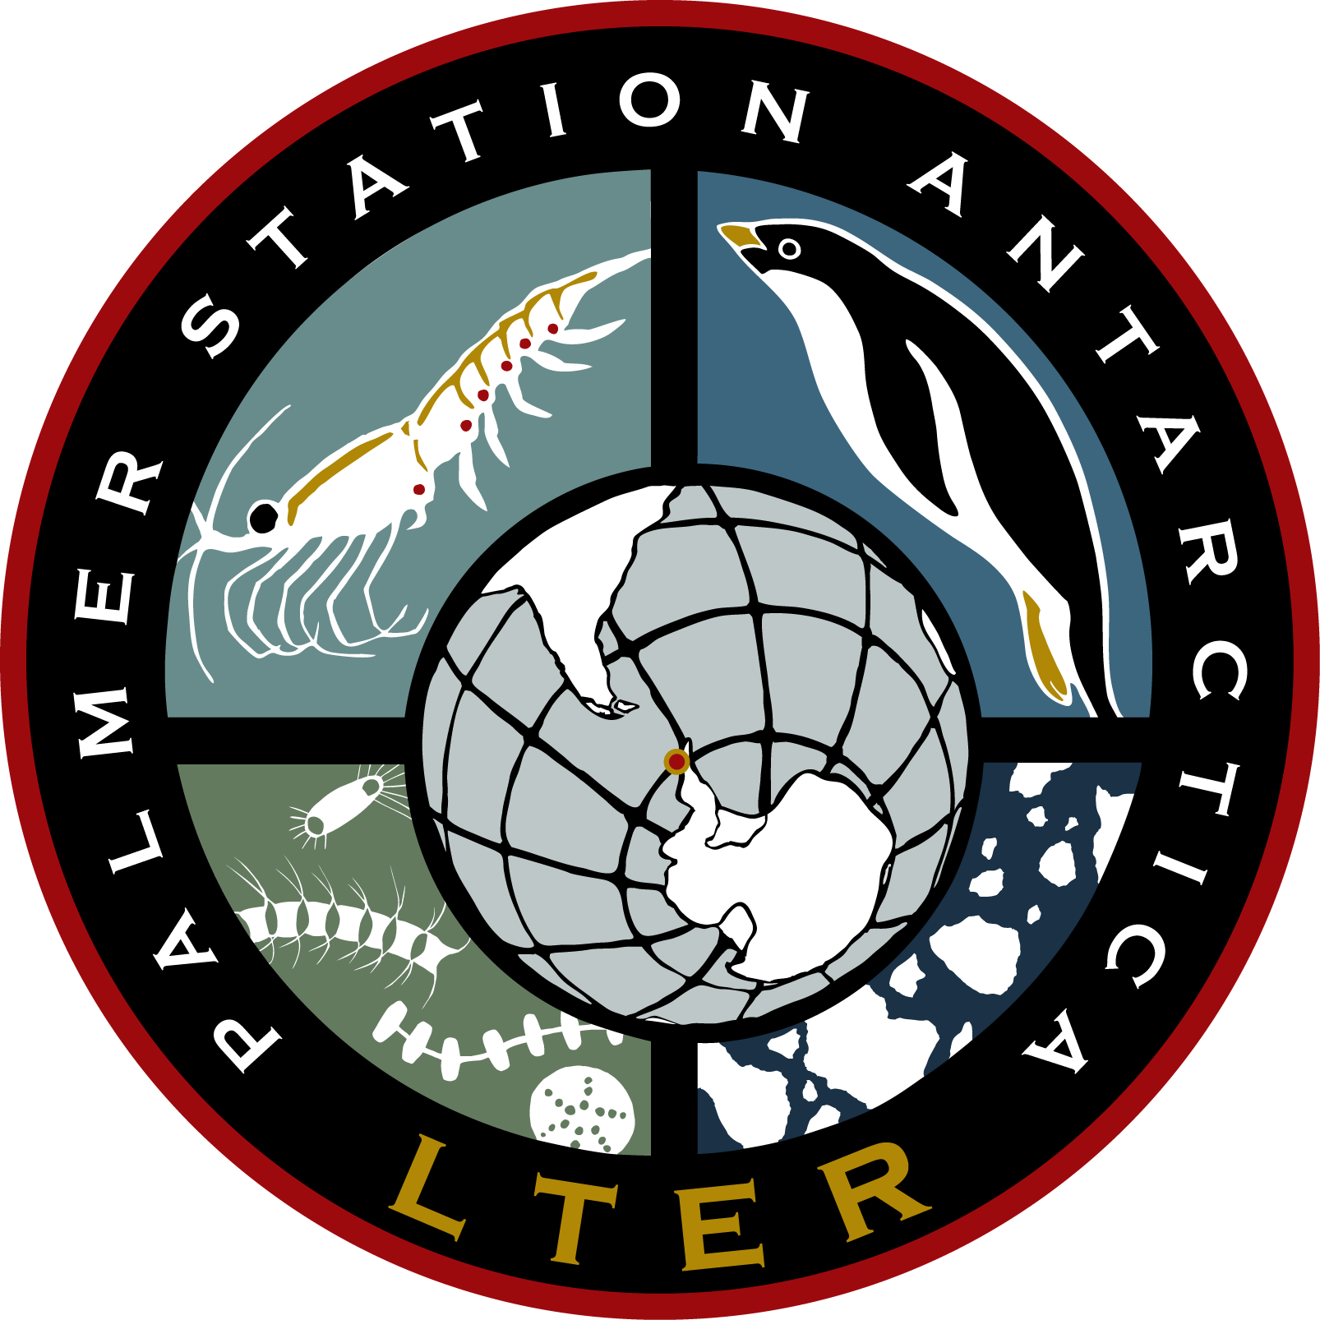
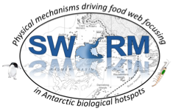
Methods
Observing Phytoplankton, Antarctic Krill, and Surface Currents
Survey Transects in Palmer Deep
Towed ACROBAT observed phytoplankton abundance
EK80 observed zooplankton swarms (Hann et al 2023)
PORG
Notes:
To test this hypothesis, project SWARM deployed an ocean observing system around Palmer Deep Canyon in the austral summer of 2019-2020 to map each level of the food web onto dynamic ocean features.
Twice weekly small boat surveys towed an ACROBAT instrument along these transects plotted here, covering both the northwest and southeast sides of the canyon, observed phytoplankton abundance. On these same surveys, an EK80 active acoustic instrument observed backsckattering zooplankton which were processed to identify krill swarms following methodologies in Ashley Hann’s 2023 paper.
RHIB is 10.2 meters
Use different bathy file?

Slide 9
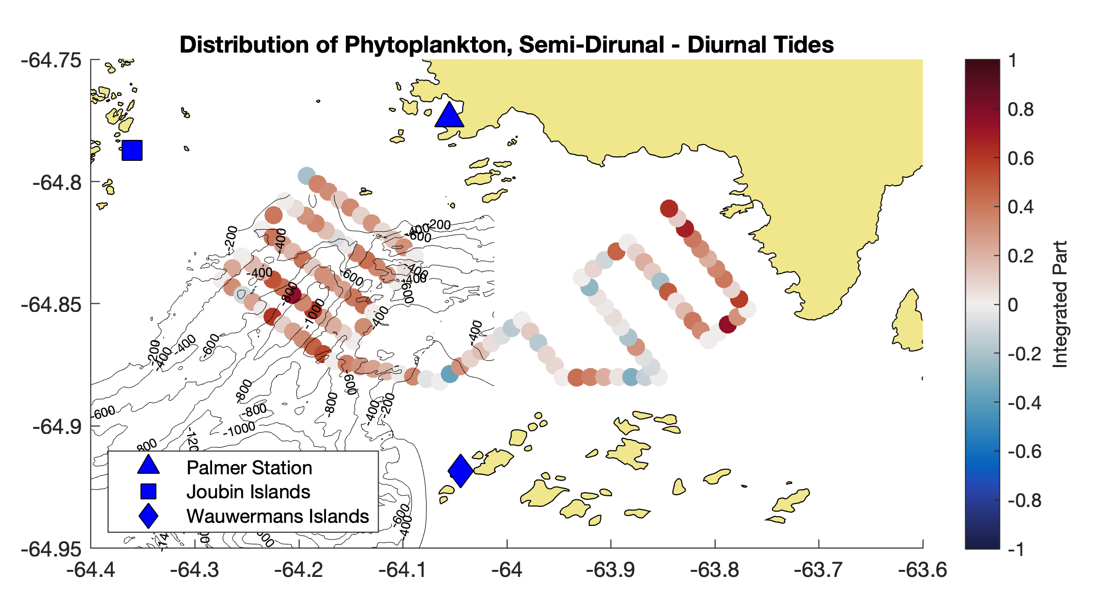
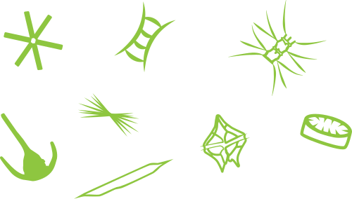
Results
Phytoplankton Shift Follows Penguins in Changing Tidal Regime
Difference in Semidiurnal and Diurnal Phytoplankton
semidiurnal
Difference in Phytoplankton Abundance
(integrated particle backscatter)
diurnal
Notes:
Using these data, I have gridded phytoplankton abundance along these transects and subtracted the phytoplankton abundance during diurnal tides from the phytoplankton abundance on semidiurnal tides. So these warmer colors indicate higher phytoplankton abundance during semidiurnal tides and cooler colors during diurnal tides.
And here we see a similar pattern to that of the foraging penguins, with a shift offshore on the west side and a shift onshore on the east side.
Fix titles of figures
Shift to Semidiurnal Tide leads to
West side phytoplankton move offshore
East side phytoplankton move onshore

Slide 10
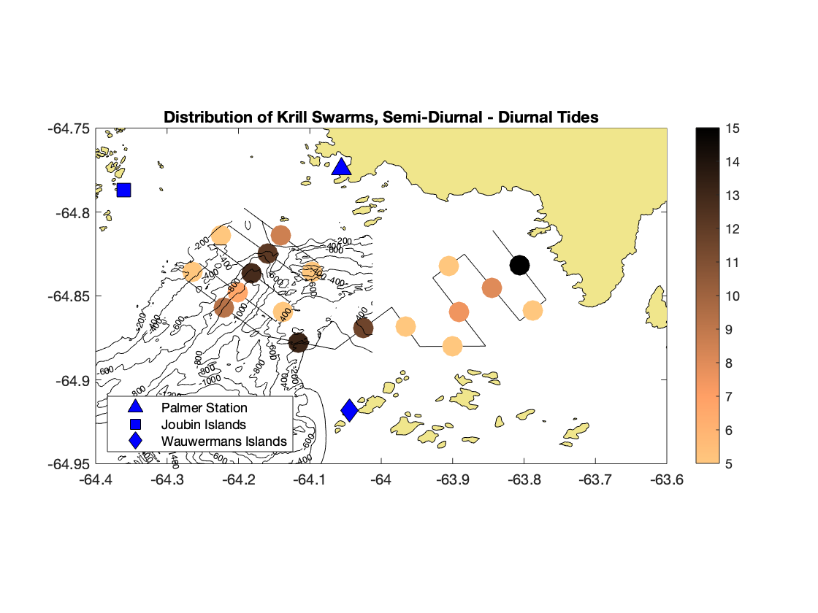
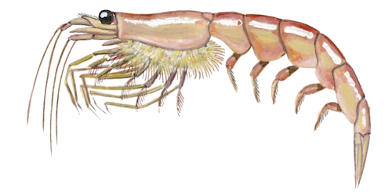
Results
Antarctic Krill Shift Follows Penguins in Changing Tidal Regime
Difference in Semidiurnal and Diurnal Antarctic Krill
Difference in Krill Abundance
(NASC)
semidiurnal
diurnal
Notes:
A similar trend was found in the krill swarm abundances. Here, I have also subtracted the semidiurnal abundances from the diurnal, but averaged by transect line. There tends to be more krill swarms observed during semidiurnal days vs. diurnal days so that is why my results are positive. The darker orange colors show more krill during semidiurnal tidal regimes than the lighter colors, and again we see this shift offshore on the west side, or at least more spread out, and inshore on the east side during semidiurnal tides.
Now that we have seen the phytoplankton, krill, and foraging penguin abundances shift with changing tidal regimes, lets take a look into the physics for potential mechanisms that are moving these marine grocery stores.

Slide 11
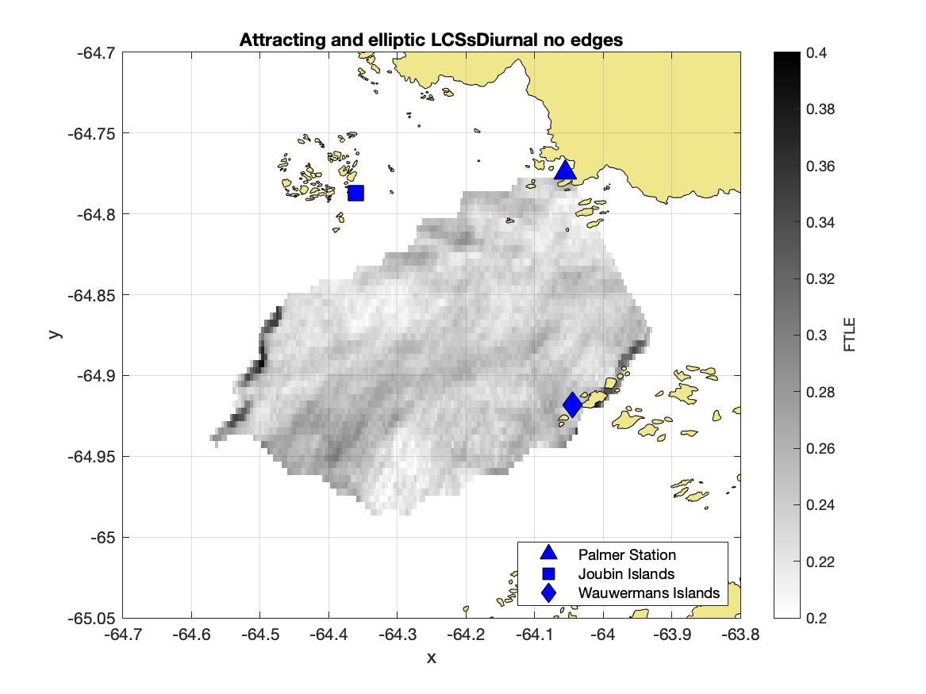
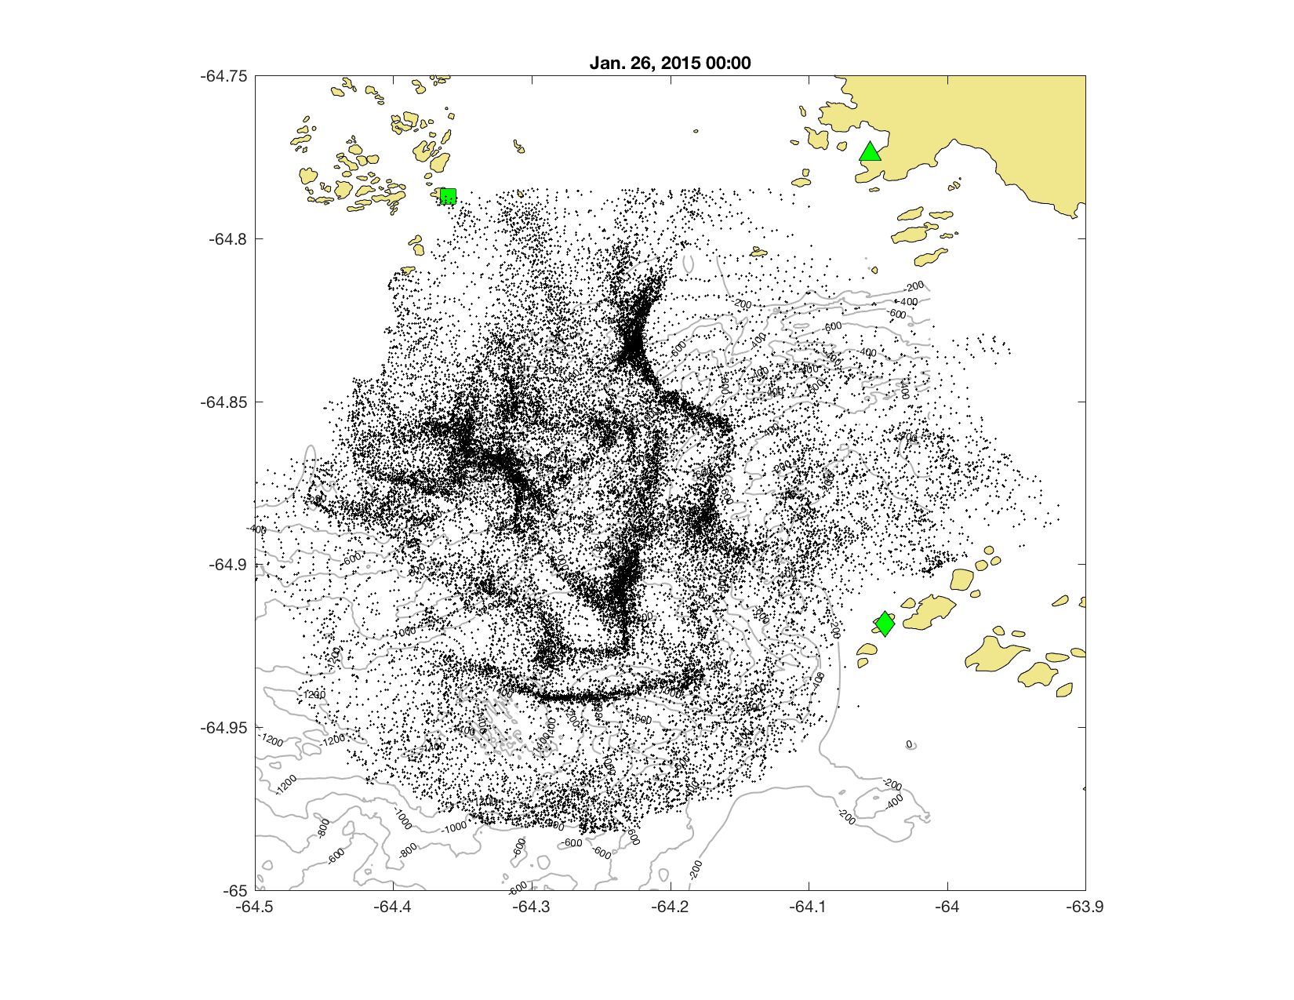
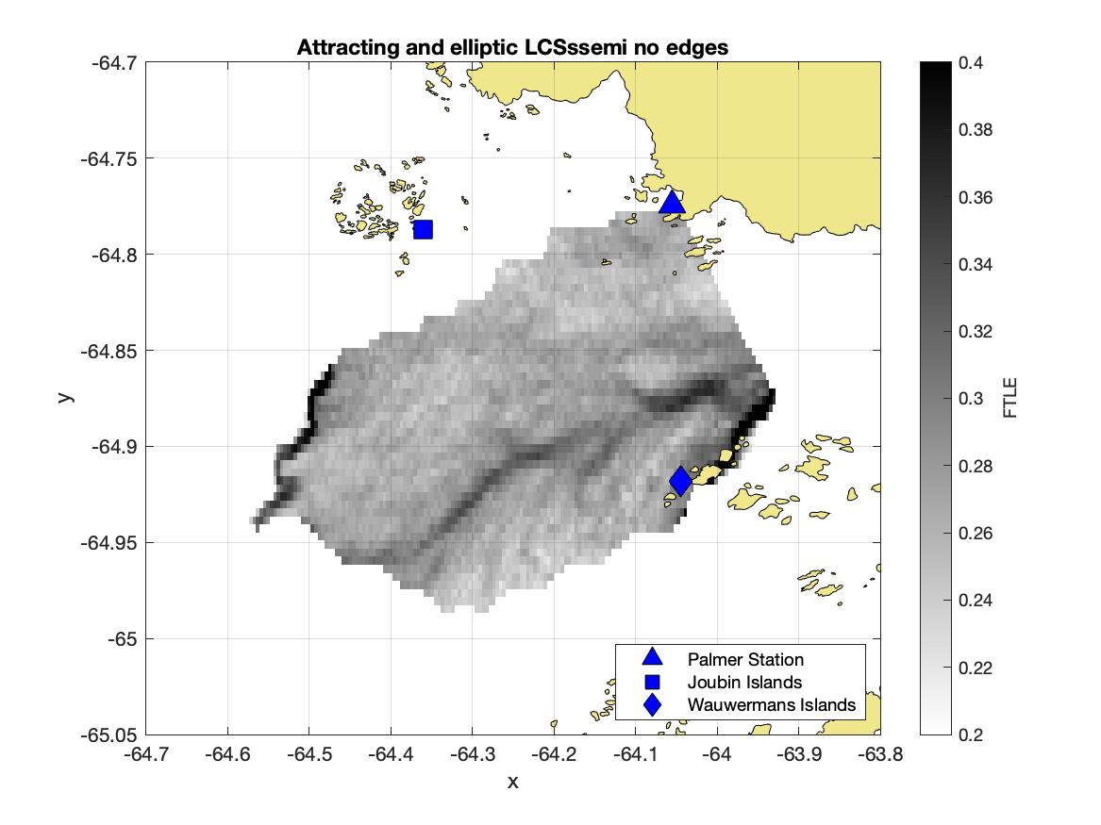
Results
Patterns of Lagrangian Transport Change with Tidal Regime
Diurnal FTLE
Virtual Particles in Observed Surface Currents
Finite Time Lyapunov Exponent
Semidiurnal FTLE
(Veatch et al 2024, ICES JMS)
Notes:
Using the High Frequency Radar observed surface currents, I have released virtual particles into the flow field to model plankton being advected. From these particle trajectories, I have calculated a Finite Time Lyapunov Exponent following methodologies that should be available soon in ICES journal of marine science. These calculations integrate over the particle trajectories to quantify attracting coherent structures that accumulate free drifting particles. Here are calcuations from just the tidal velocities, averaged over diurnal tidal regimes and semidiurnal tidal regimes.
I invite you to ask me about the intricacies of these calculations later
From these results we can see strong attracting structures appear offshore on the west side and onshore on the east side, again following that same pattern that was seen in penguin foraging behavior.

Slide 12
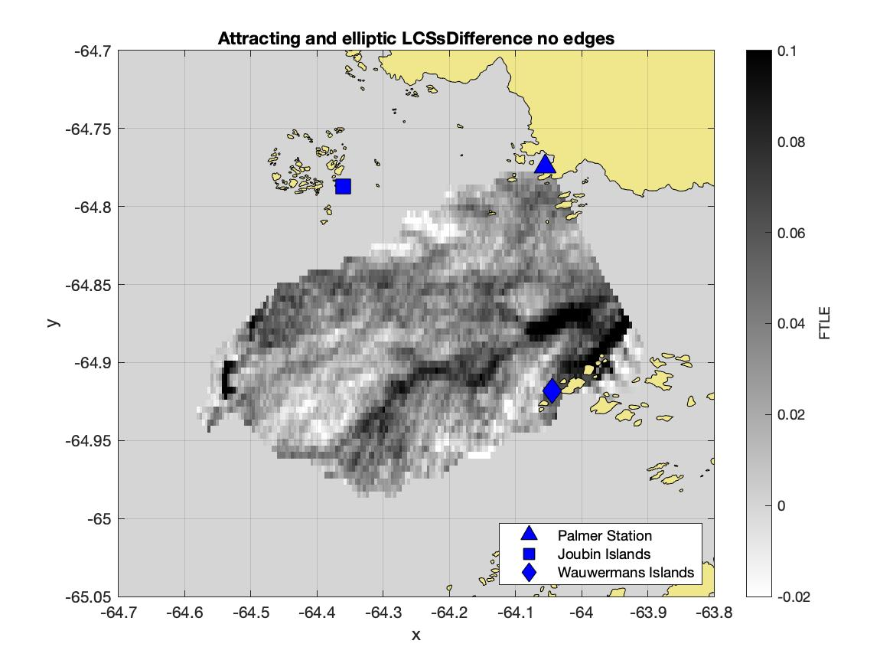
Results
Patterns of Lagrangian Transport Change with Tidal Regime
Difference in Semidiurnal and Diurnal Phytoplankton
Semidiurnal – Diurnal FTLE
Difference in Semidiurnal and Diurnal Antarctic Krill
Notes:
When we piece this all together, similar trends appear from the physics to the phytoplankton, to the krill swarms, and as previous work saw, to the penguin foraging as the system shifts from a diurnal tidal regime to a semidiurnal tidal regime based on the gauge at Palmer Station. On the left here I have subtracted the diurnal FTLE from the semidiurnal, same as was done for the phytoplankton and krill. The observations from the high frequency radar don’t quite cover the entire east side of the canyon, but show a strong attracting coherent structure offshore on the west side.

Slide 13
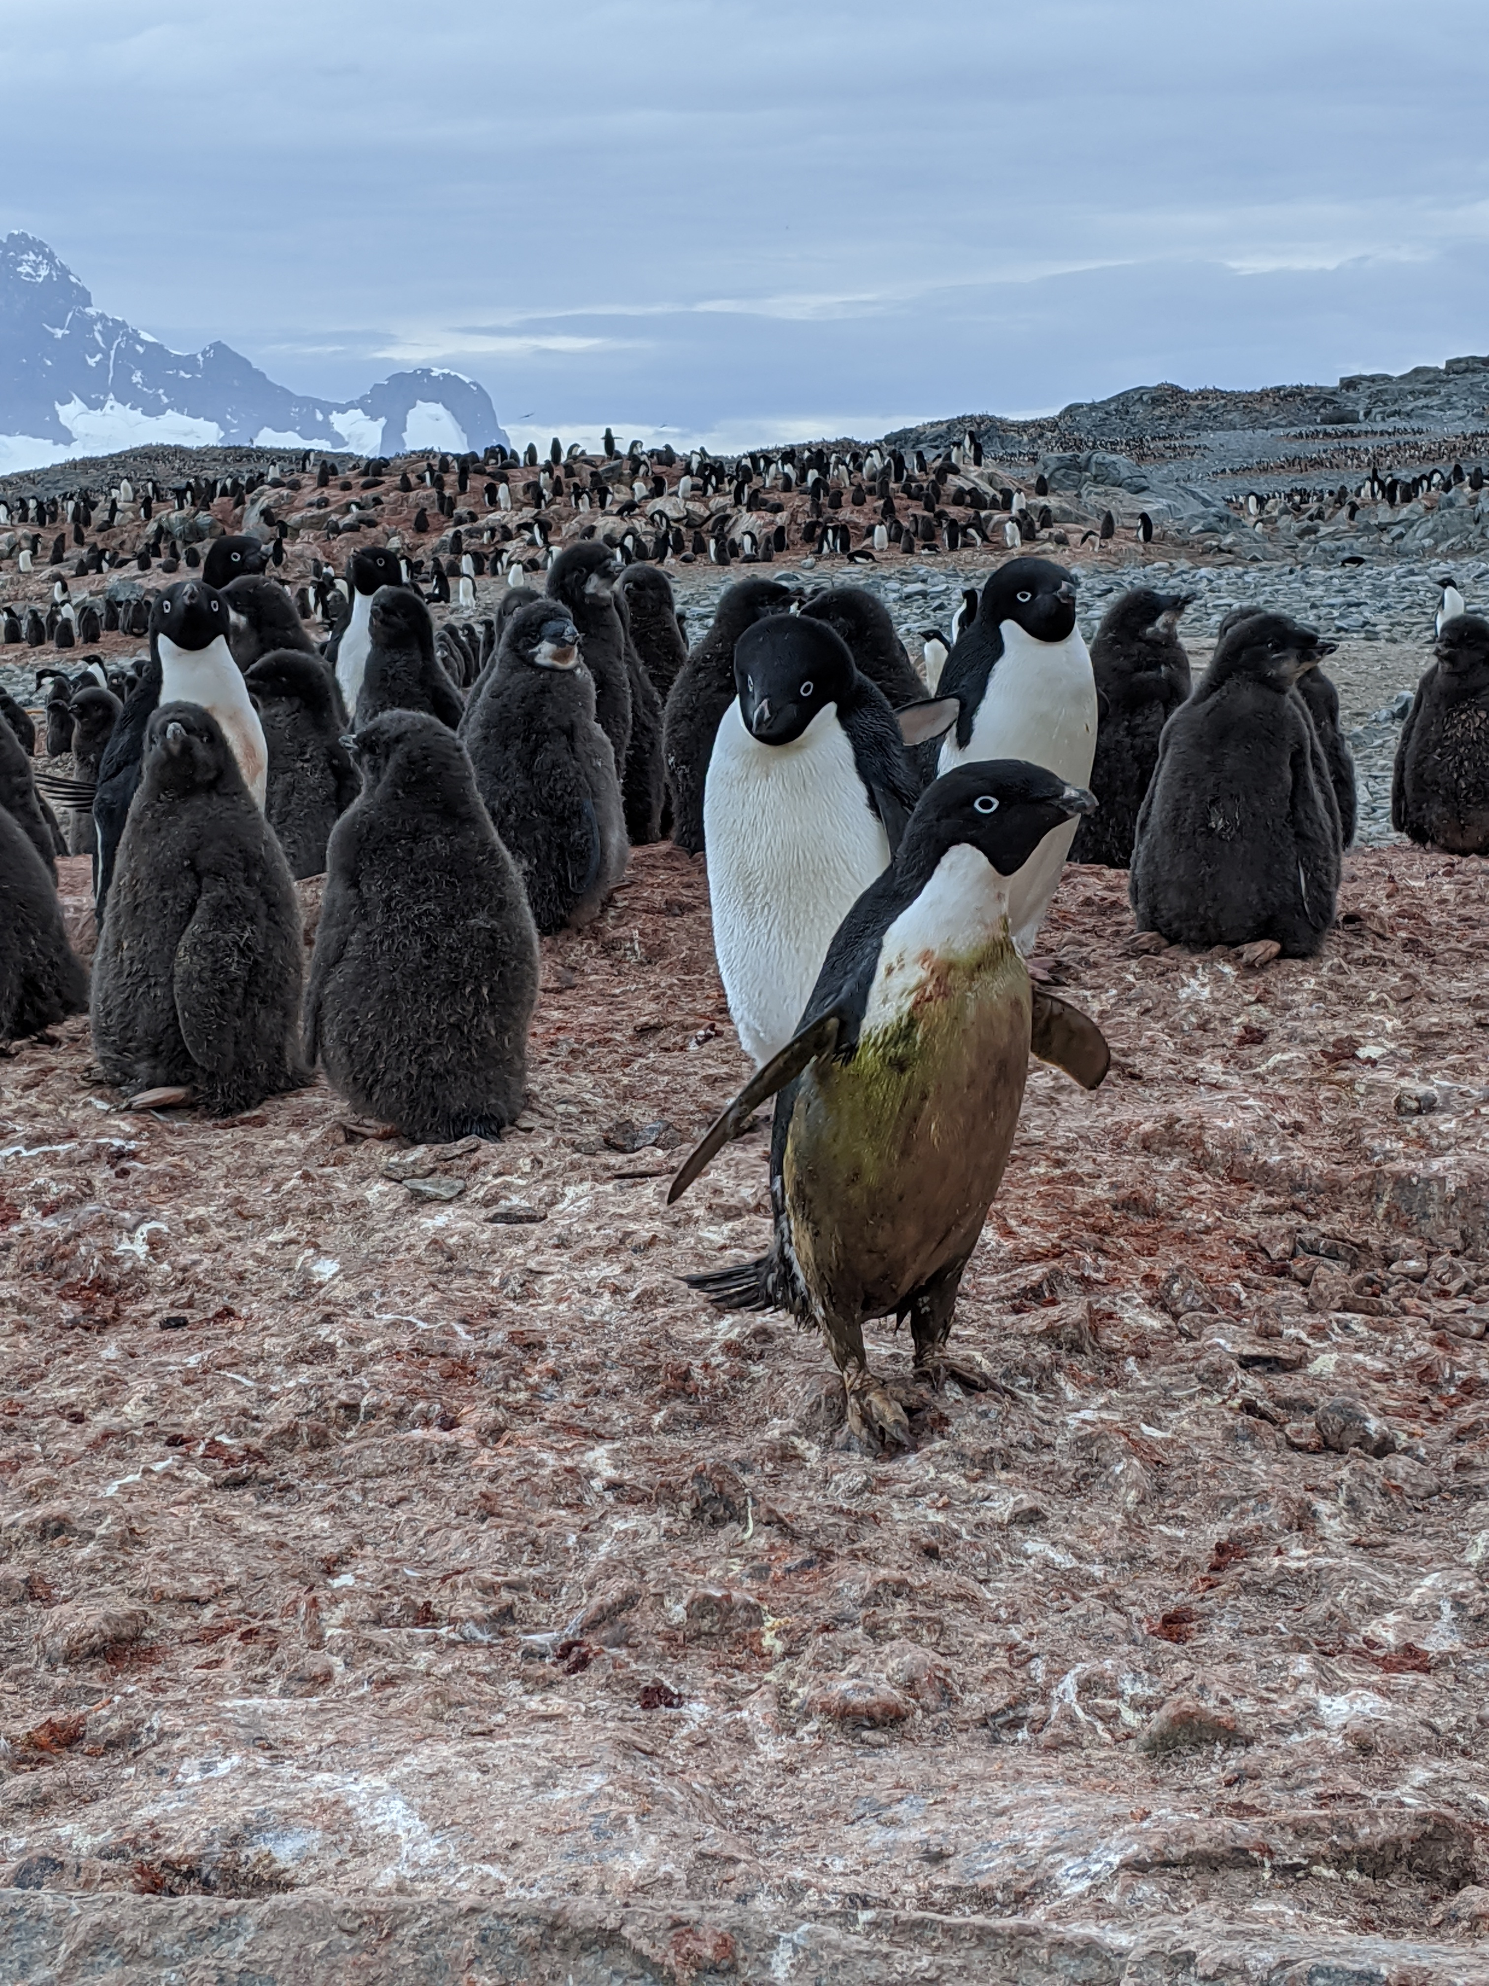
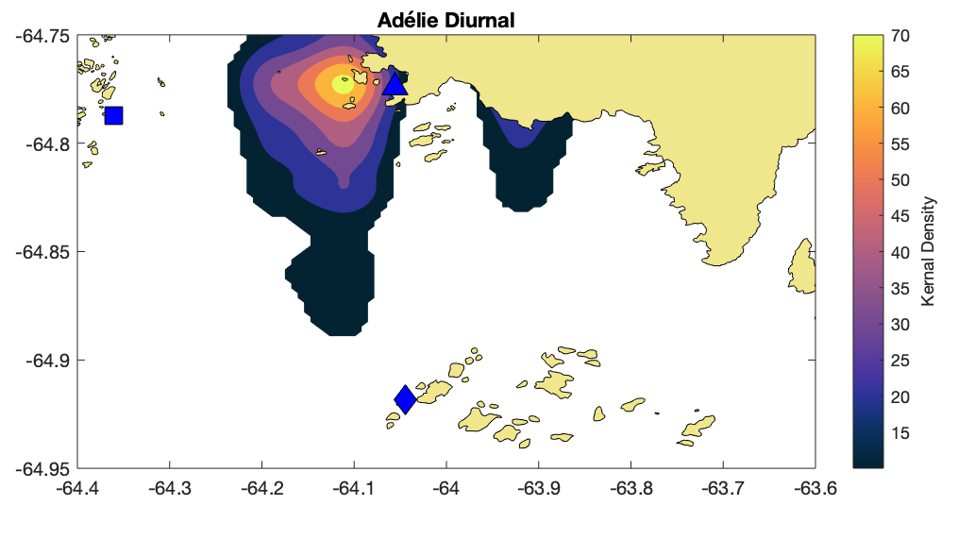
Summary of Results
Phytoplankton and zooplankton follow shifts that are consistent with previous penguin patterns (Oliver et al 2013, Cimino et al 2016) with changing tidal regimes
→ a bottom-up control on spatial ecology
Patterns in Lagrangian transport follow a similar shift with changing tidal regimes
→ physically driven food web focusing

Slide 14
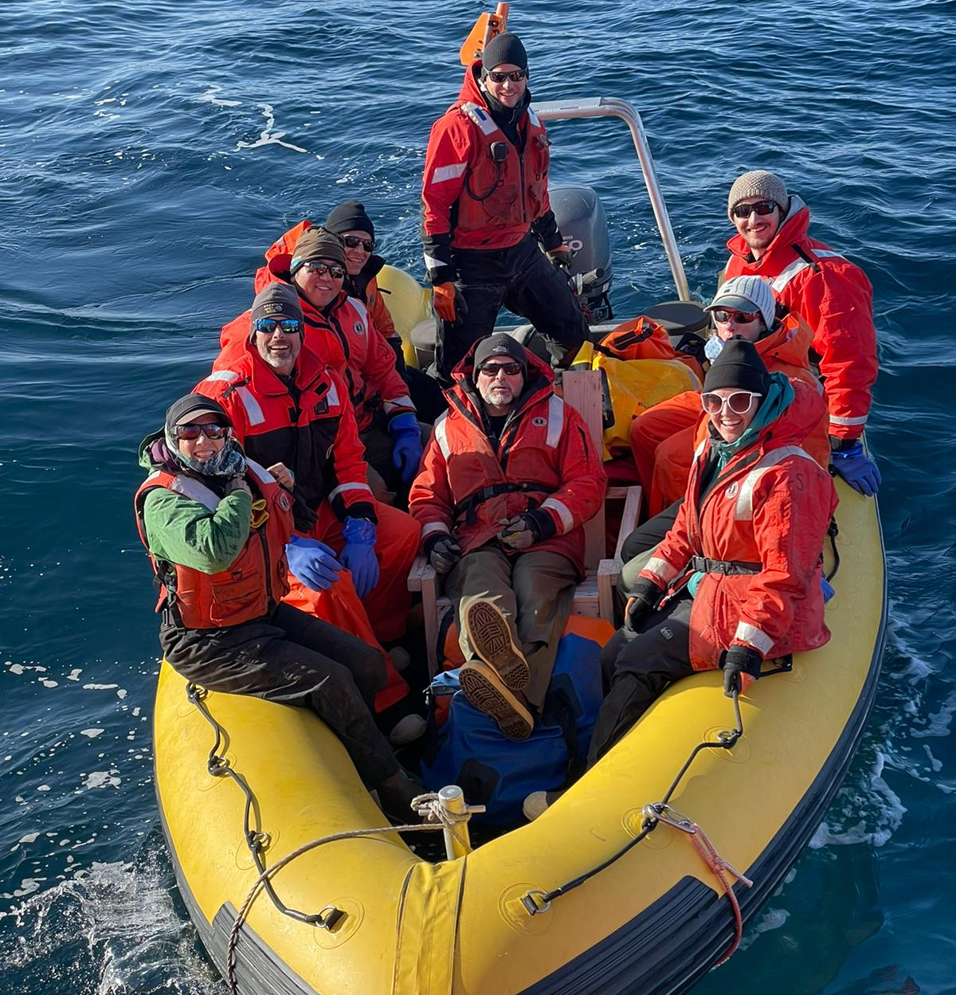
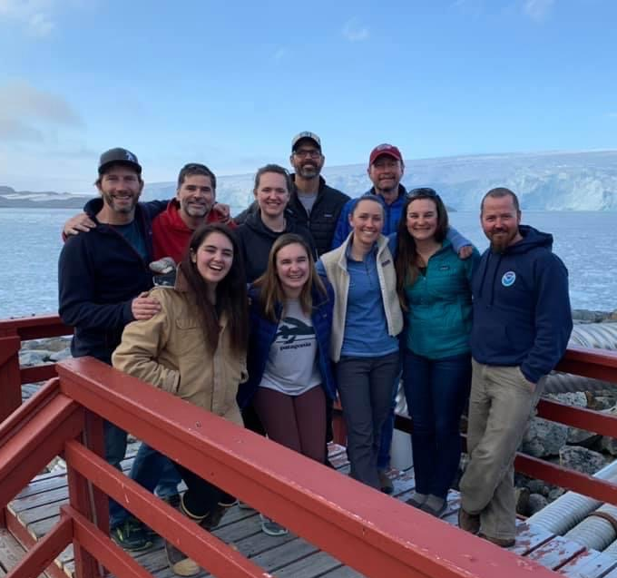
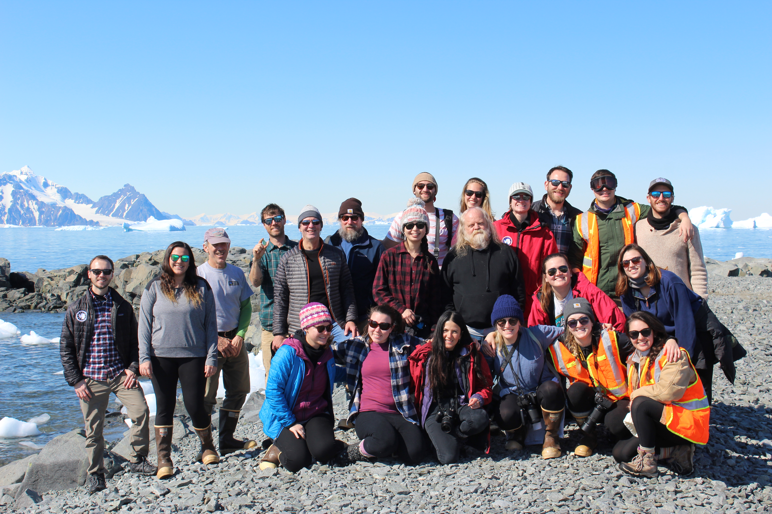
Thank you!
jveatch@marine.rutgers.edu
Looking for a postdoc
Fall 2024
PORG

Slide 15
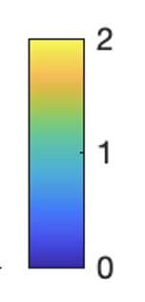
Observing Phytoplankton, Antarctic Krill, and Surface Currents
mg/m^3 chl
Filtered for krill following methods in Hann et al 2023
Notes:
RHIB is 10.2 meters

Slide 16
