Slide 1
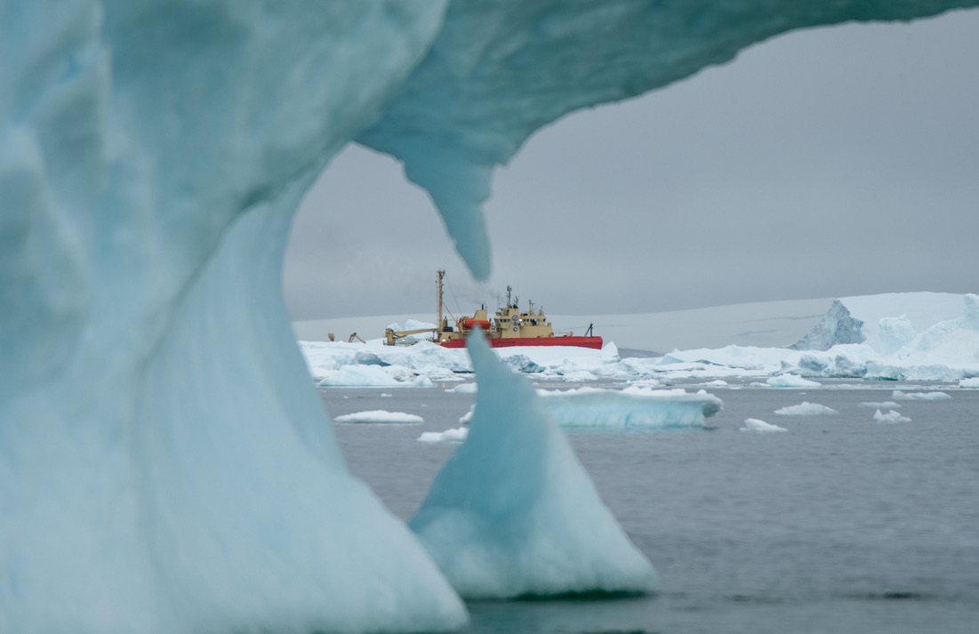



Ecological responses in Antarctic coastal food webs and the biogeochemical implications in the rapidly warming West Antarctic Peninsula
The Palmer Leadership LTER team:
Megan Cimino (NOAA-UCSC)
Scott Doney (U Virginia)
Ari Friedlaender (UCSC)
Kate Hendry (BAS)
Janice McDonnel (Rutgers)
Michael Meredith (BAS)
Carlos Moffat (U Delaware)
Oscar Schofield (Rutgers)
Sharon Stammerjohn (U Colorado)
Deborah Steinberg (William & Mary)
Benjamin Van Mooy (WHOI)
Thanks to NSF for support

Slide 2
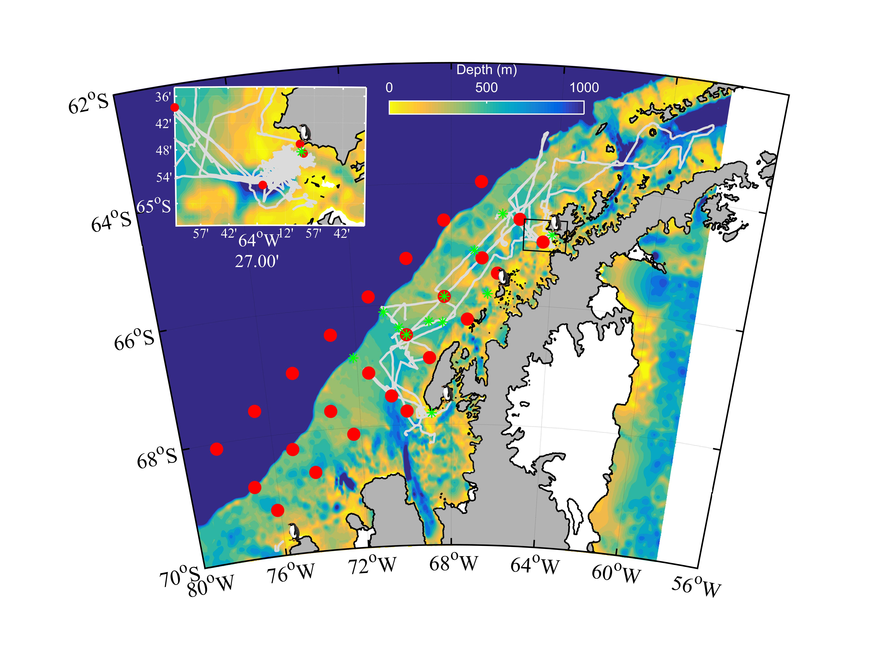



A System Undergoing Change and A Model System
For Changing Polar Food Webs
Warmer
Maritime
Climate
- Across the Climate Gradient There Are Multiple International Time Series
- Time Series Have Been Conducted Across Trophic Levels for Decades
Cold Dry
Polar
Climate
- Combined Data Provides The Unique Snapshot Of The Ecosystems At Different Stages of Change
Peninsula Spans a Climate Gradient

Slide 3
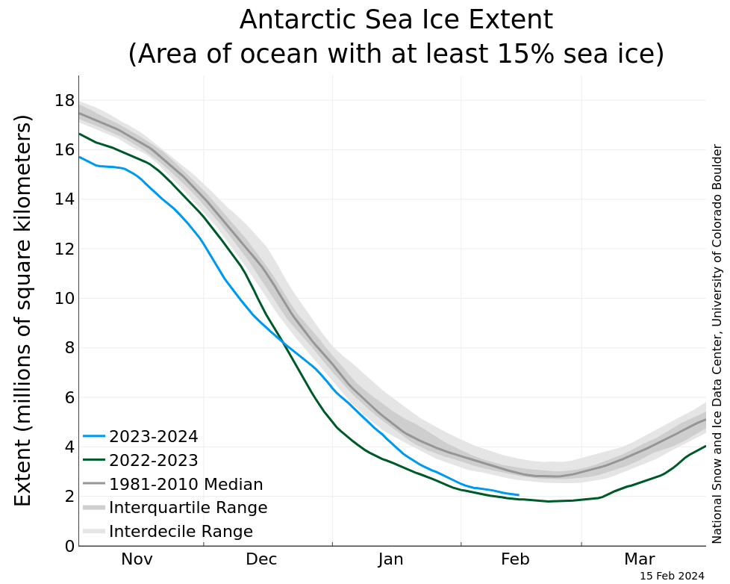
Sea Ice Structures the Coastal and Continental Shelf Ecosystems. Sea Ice is Changing!

Slide 4
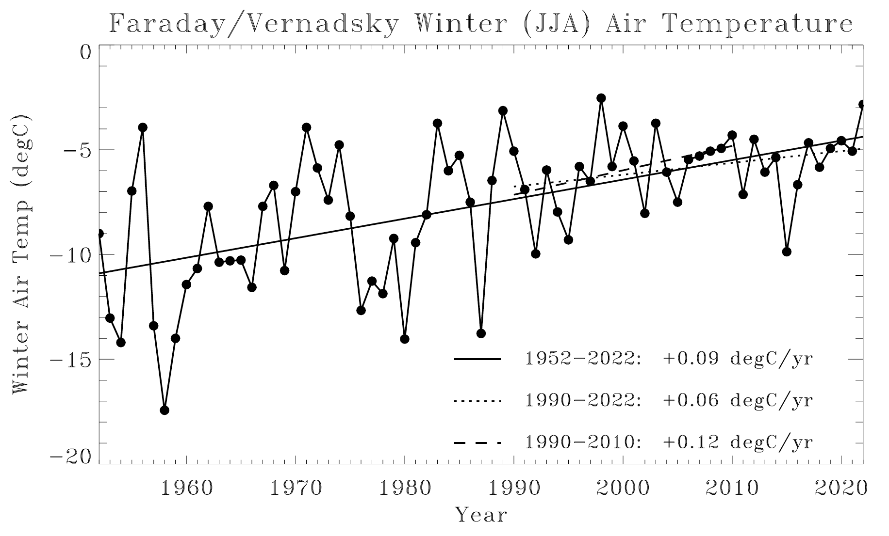
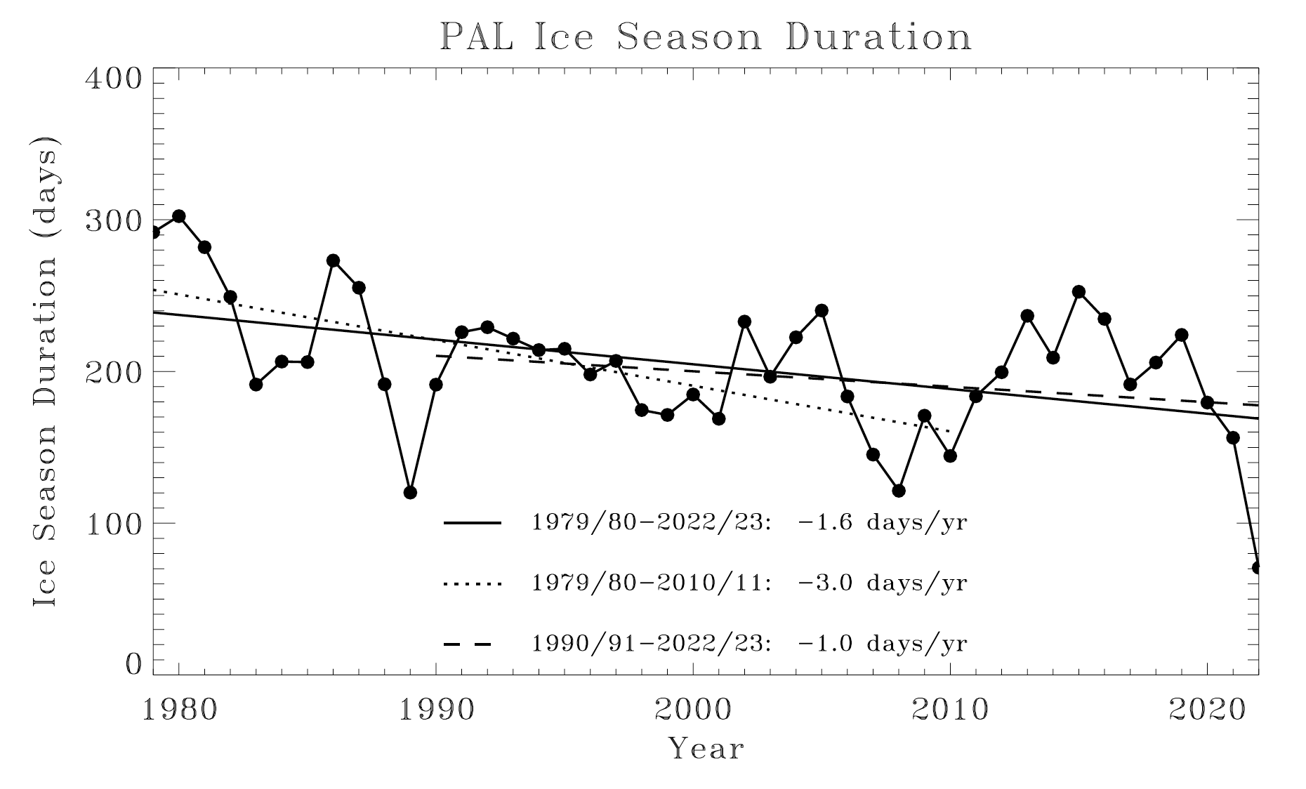
Environmental Changes in the WAP
-Increasing Winter Atmospheric Temperatures
-Overtime Decreasing Variability
The Prediction
Transitional Period
Phytoplankton Biomass
Heavy Sea Ice
Short Growing
Season
No Sea Ice
Deep Wind
Mixing
-Overtime Declining Sea Ice Duration
-Cyclical Patterns Associated With the Phasing of the Climate Cycles
Time

Slide 5
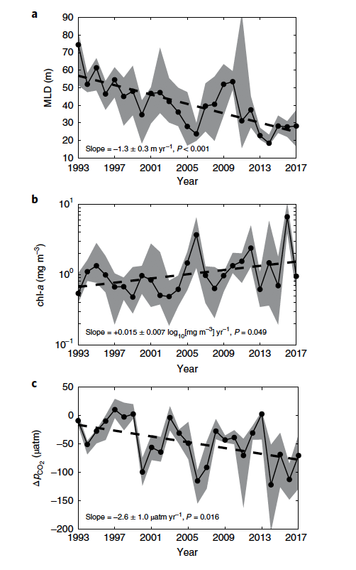
Response of the Phytoplankton in the WAP
The Prediction
Transitional Period
Upper Mixed
Layer
Phytoplankton Biomass
Heavy Sea Ice
Short Growing
Season
No Sea Ice
Deep Wind
Mixing
Time
Chl a
Delta
pCO₂
Brown et al
2019. Nature
Climate Change

Slide 6
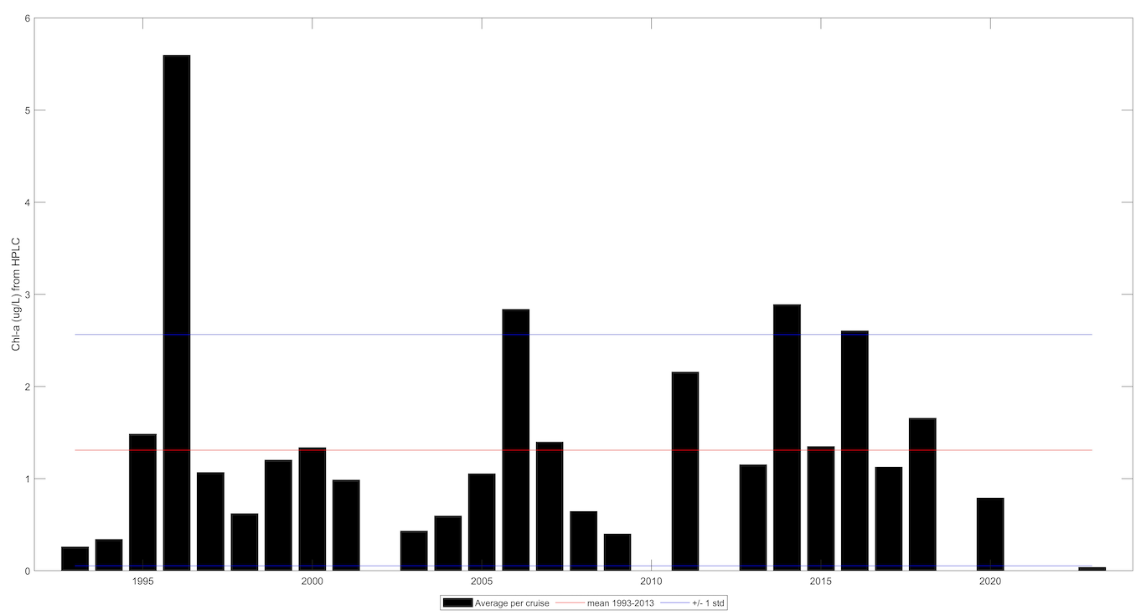
Response of the Phytoplankton in the WAP
The Prediction
Transitional Period
6
Phytoplankton Biomass
Average Chlorophyll for cruise (north & south)
Mean 1993-2013
Heavy Sea Ice
Short Growing
Season
No Sea Ice
Deep Wind
Mixing
4
Time
2
0
1995
2000
2005
2010
2015
2020

Slide 7
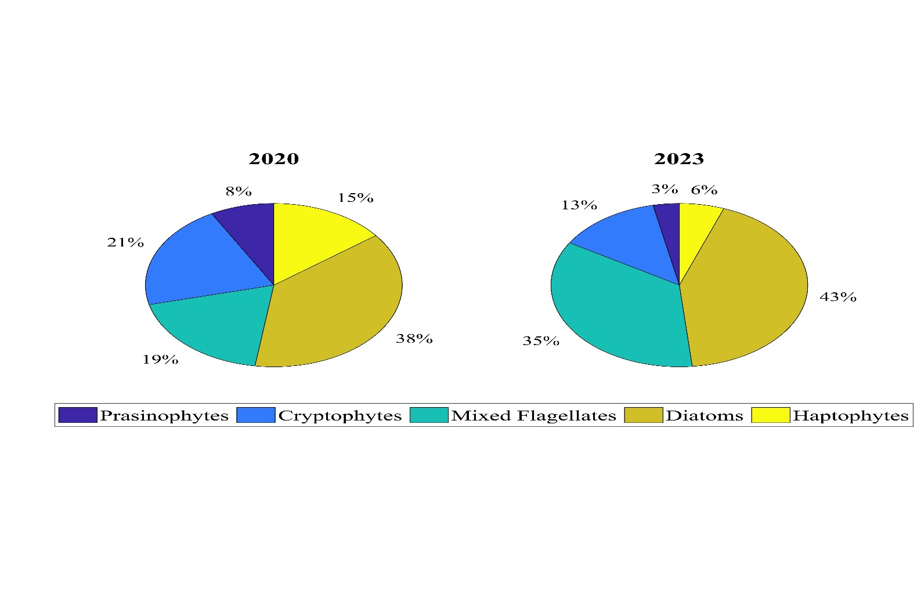
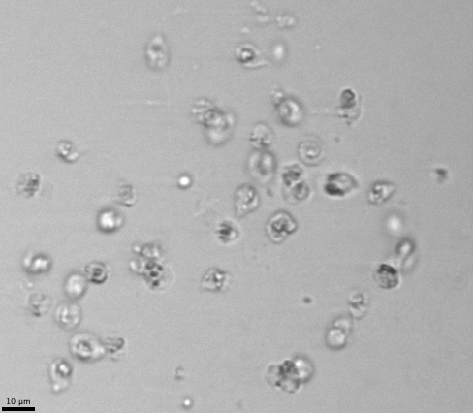

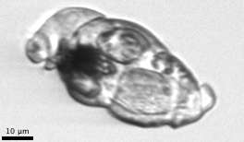
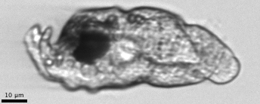
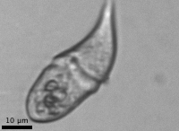
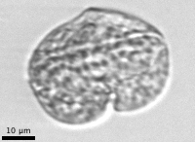
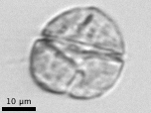

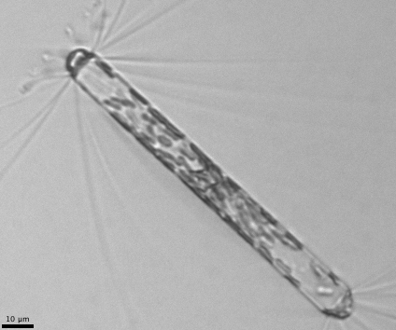
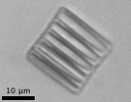

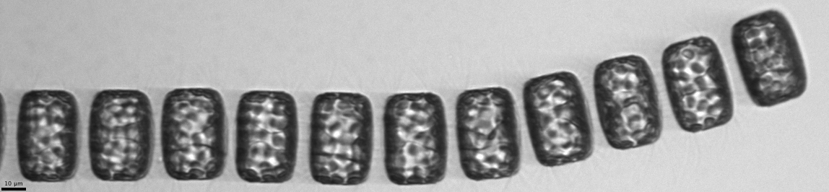
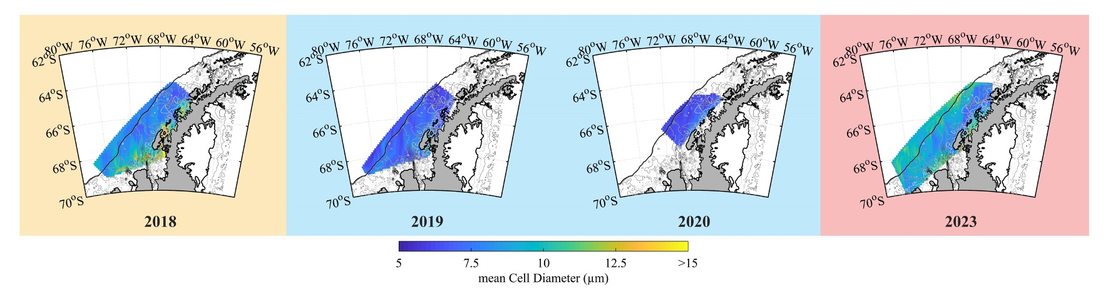
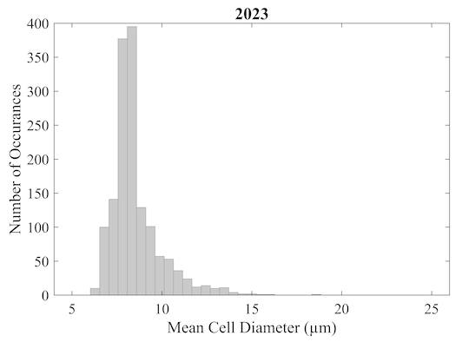
Who is “Blooming”?
2020
2023
1
2020
2023
Relative Occurrences
See Waite et al. OSM CC14A-1184
0
5
Mean Cell Diameter (μm)
25

Slide 8
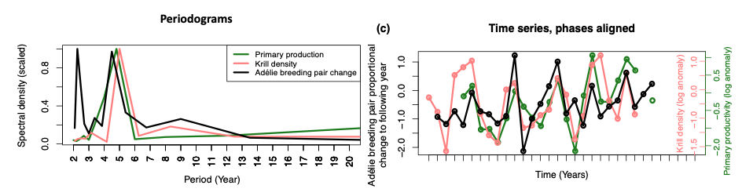
Food-Web Response
Black = Adelie Breeding Pair
Proportional Change
Green = Primary Productivity
Red = Krill Density
Lohman et al. 2023 Limnol. Oceanogr.

Slide 9
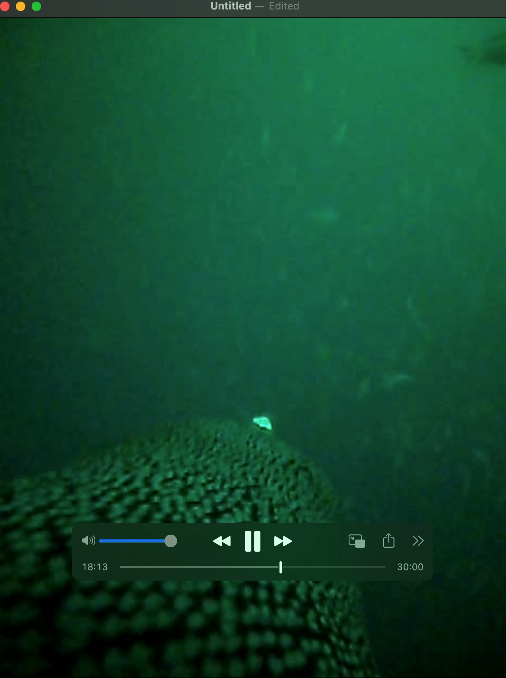
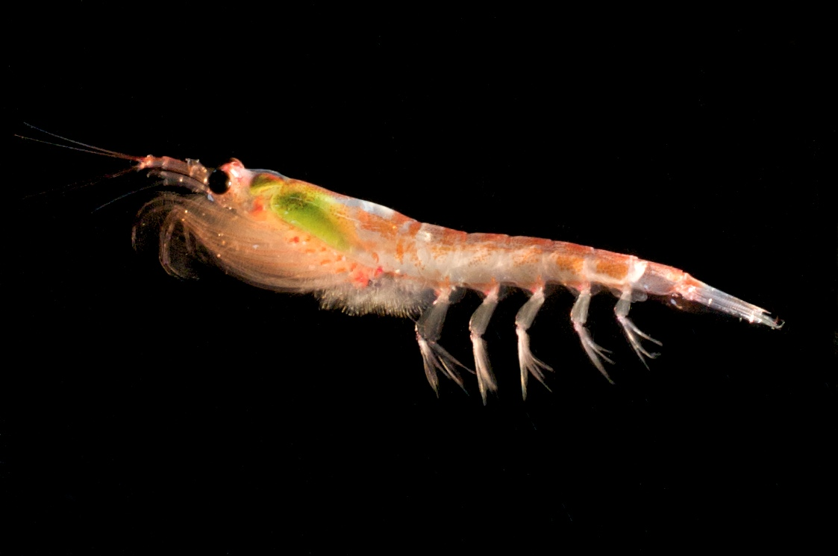
Food-Web Response
Proportion of large krill in diet vs breeding pair change
Proportion of large krill non-krill food in the diet
Thank you Megan Cimino
Lohman et al. 2023 Limnol. Oceanogr.

Slide 10
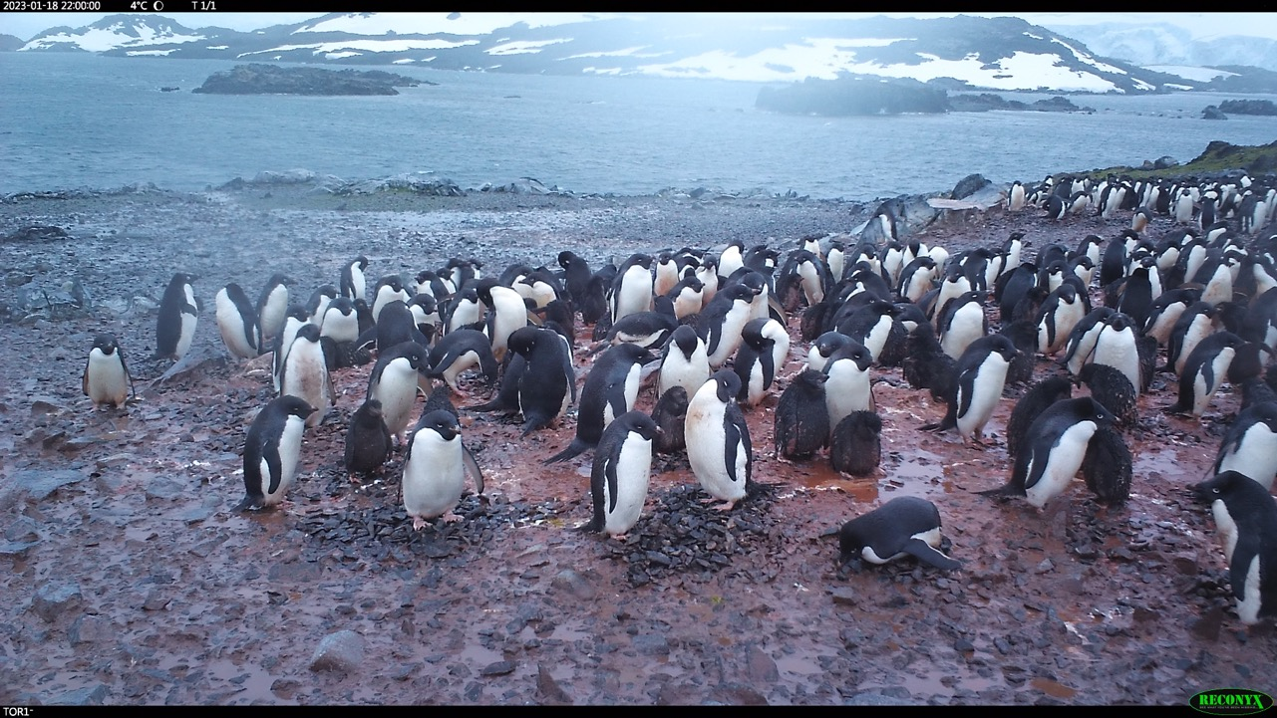
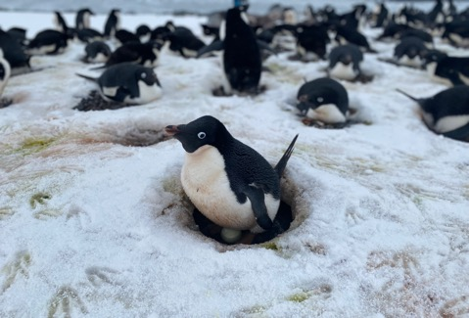
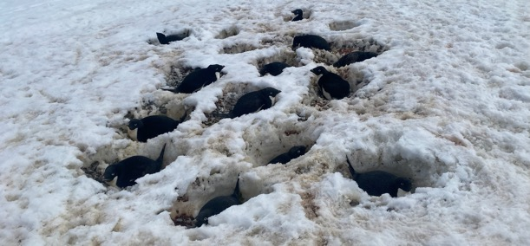
Sub-optimal nesting habitat
Thanks Megan Cimino

Slide 11
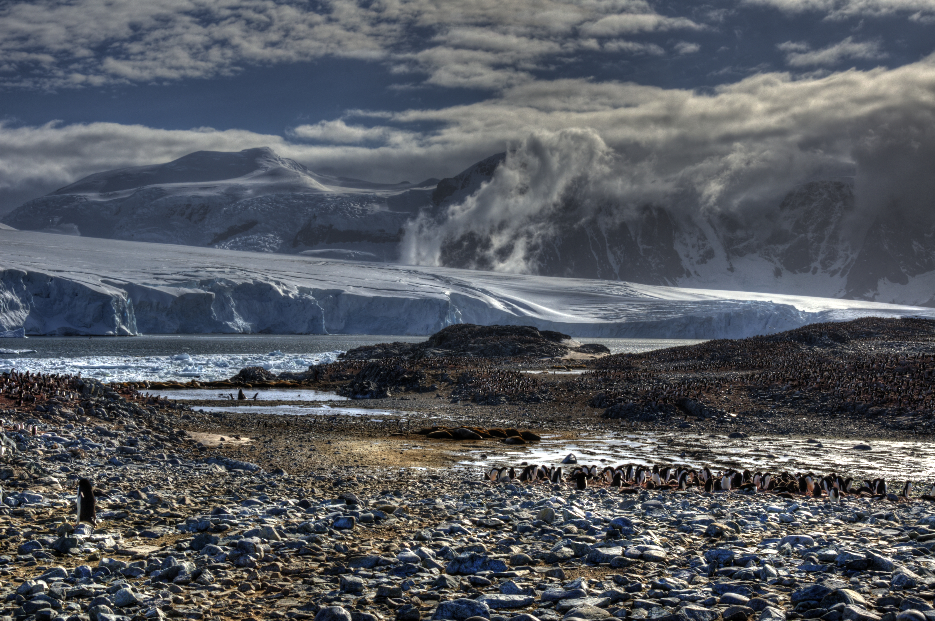
Polar system are exhibiting change. The changes in sea ice is altering the base of the food web and ripples through the food web. Higher trophic levels responses tied to both bottom up responses combined with landscape effects.

