Slide 1




Investigating species-specific trends throughout New jersey department of environmental protection’s 30+ year historical trawl dataset
Jake Kuenzli, Rutgers University
Jason Adolf, Monmouth University
Keith Dunton, Monmouth University
Grace Saba, Rutgers University
Notes:
Hello, my name is Jake Kuenzli and I am a second year PhD student at Rutgers University and today I will be giving you a quick overview of my historical analysis of the NJ DEP bottom trawl. This work was done in collaboration with Dr.s Jason Adolf and Keith Dunton from Monmouth University and Dr. Grace Saba from Rutgers University.

Slide 2
Strongest warming off the Northeast U.S.
US NES
Accelerated ocean warming → changes in abundance of fishes
Strong effects on the U.S. Northeast Shelf
NOAA & Ocean Adapt
Notes:
First, some background. Now, I don’t think I have to spend too much time for this audience going in depth on climate change, so I will briefly sum up. We know its happening, we know its being exacerbated by anthropogenic inputs, and it has a myriad of consequences for the environment. One of those impacts is the increased warming of Earth’s oceans. This is especially prudent for where we’re located as the Northwest Atlantic Ocean has warmed at much faster rate on average compared to the global ocean. With that warming comes impacts on marine species and on their behavior. The behavior change that I am primarily focused on is changes in the abundance and distribution of fishes. In this figure from NOAA, you can see that over time as the ocean has warmed species have experienced poleward shifts in latitude, as well as inhabiting deeper waters to deal with the rising temperatures. You can also see that the Northeast species have the largest increases in both northern latitudes and depth.

Slide 3
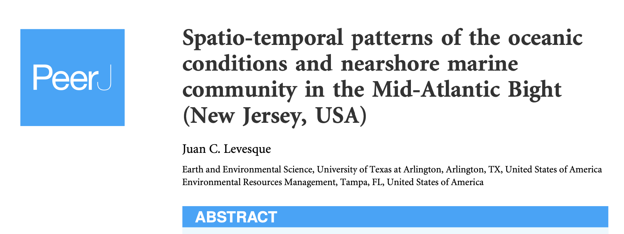
Sub-tropic species and warm water species increasing in presence in the region
Investigated trends in cold-water, warm-water, and sub-tropic adapted species (based on specifications in Howell & Auster, 2012)
Cold-water decreased, warm and sub-tropic increased
Focused on community changes instead of species-specific trends
Notes:
Another example of this shifting change can be seen in this paper by Juan Levesque from 2019 actually looked at the same dataset I used and grouped species by whether or not they were considered cold-water adapted, warm-water adapted, or sub-tropic adapted, which was based on another paper by Howell & Auster from 2012. In this paper Levesque found that the cold adapted species experienced decreases in abundance over time and the abundance for warm and sub tropic adapted largely increased over the same period. By grouping the species based on these criteria, Levesque looked at how community assemblages had changed, but outside of mentioning some of the more abundant individuals, largely ignored more of the species-specific trends that I am interested in.

Slide 4
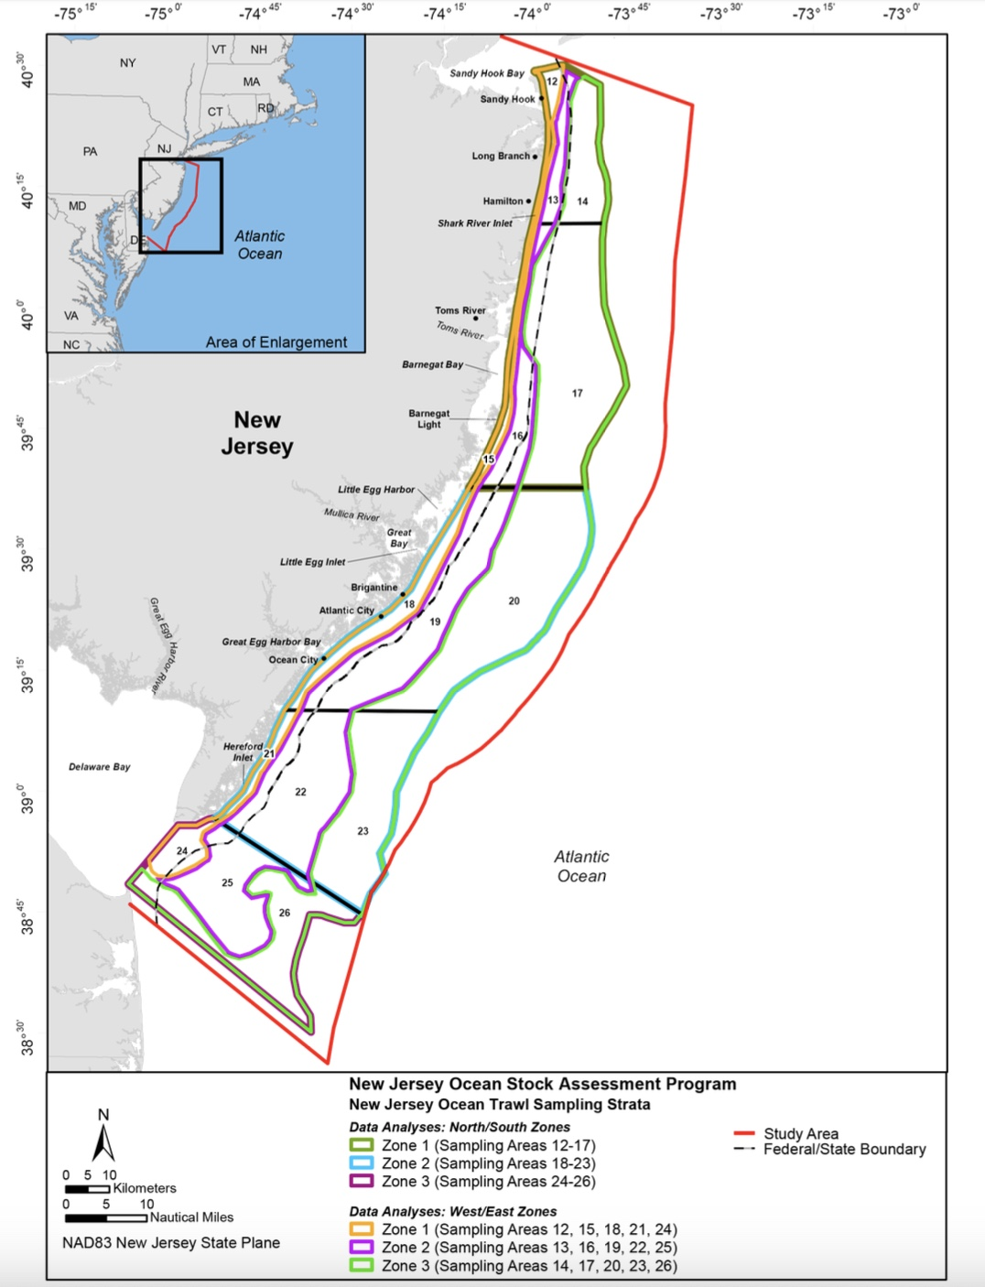
NJDEP Bottom Trawl Dataset
1988-2020
Sites sampled randomly
Nearshore to Offshore and 5.5 m to 27.4 m
Mouth of Delaware Bay to Sandy Hook Bay
Study aims were to determine:
Most abundant species
  Assign rank abundance & assess changes over time
Presence and absence of species
First occurrence of species
Levesque 2019
Notes:
To get at this question, I utlized the NJDEP Bottom Trawl Survey and historical dataset. Now if you’re unfamiliar this survey it is a bottom trawl survey that has gone out every year covering all 4 seasons and has been occurring from 1988 to the present day, but for the purposes of this talk and my data, we’re stopping at 2020 with some carryover in to 2022 based on when I received the data, broken into three decade spans, 1988-1998, 1999-2009, and 2010-2022. Over here in this figure is the survey area, sites are sampled randomly based on the transect chosen that day and cover nearshore environments with an average depth of 5.5 m to offshore with an average depth of 27.4 m, as well as north to south sampling from the mouth of Delaware Bay in the South and Sandy Hook Bay in the north. You can see these sampling strata over here in the figure as the nearshore to offshore is covered in the west/east zones (point) and the north to south in the north/south zones (point). This has proved to be an incredibly valuable dataset as provides years of historical data, but most importantly, the methodology has been standardized for most of the duration of the survey allowing us to make comparisons between years. When I first received that dataset from our collaborator at Monmouth University, it was huge. Over 900 species and more than 200 fish species so when I loaded it into R, it kinda broke it (pause for a brief but hearty chuckle). With that in mind, we needed to narrow our focus and determine what we wanted to look for. So we settled on three study aims. One, to just look at the most abundant species and see if there were any changes in their abundance over time. Two, to look at instances where a species might have fallen off in the dataset after initially being there. And 3, to specifically investigate those occurrences where a species appeared in the dataset after not previously being seen.

Slide 5
200 different fish species
Generate top 90 most abundant species based on catch for each decade
Only select species that aren’t ranked for all three decades
Notes:
Before you get too much in the weeds with looking the next plots, allow me to set the scene for them here. I started off with 200 different species of fish. I then generated the top 90 species in each of those categories for each decade span, so for example it would be the 90 most caught species from 1988-1998, 1999-2009, and 2010-2022. Those lists are then combined for each of the metrics and only the species that appeared in one or two decades were selected as ”unique”.

Slide 6
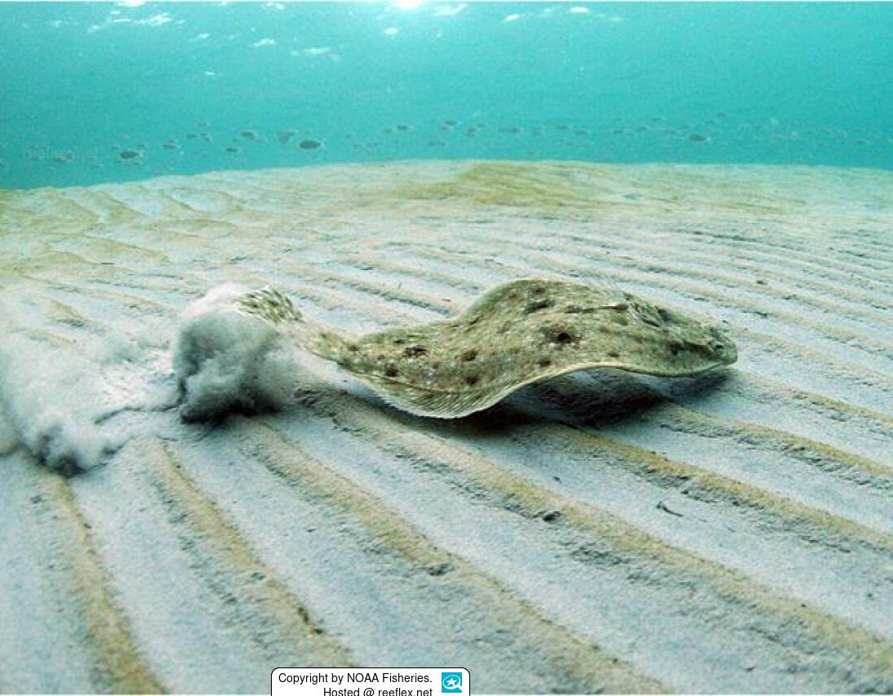
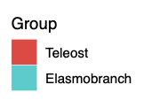
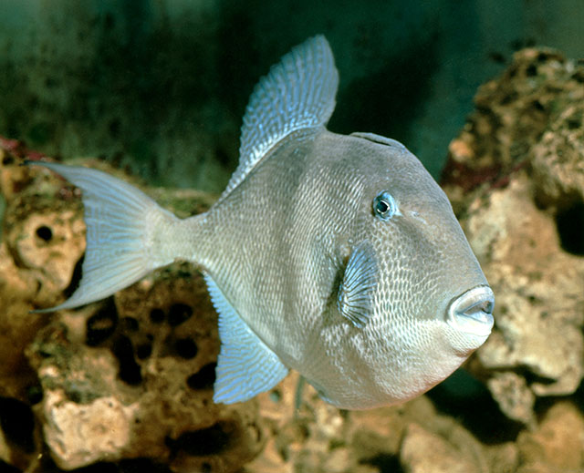
Some species have experienced increases in the last decade, others have experienced decreases throughout the data set
Myzopsetta ferruginea
Balistes capriscus
1988 - 1998
1999 - 2009
2010 - 2022
Notes:
Now that we’ve covered how this plot comes to be, hopefully it’ll be easier to understand. This first plot here looks at the presence and absence of these unique species based on catch. On the x-axis are the three-decade spans and the species are here on the y-axis. A bar denotes that a species was present during that particular decade and the lack of one shows absence. Now there are three groups that I want to draw you attention to. The first (click) are those species that were in the top 90 for the first two decades but have experienced a drop off in their abundance enough to knock them out of the ranking in the last decade. Some examples of those species are yellowtail flounder and gray triggerfish

Slide 7
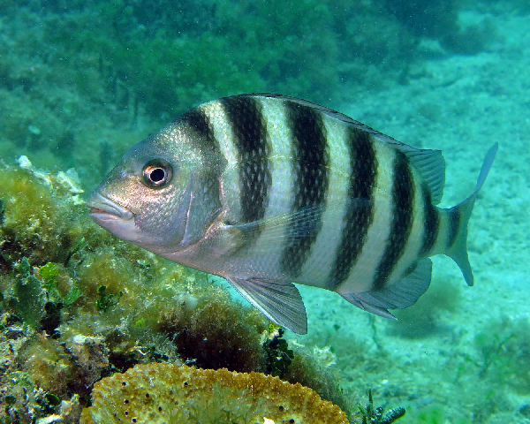
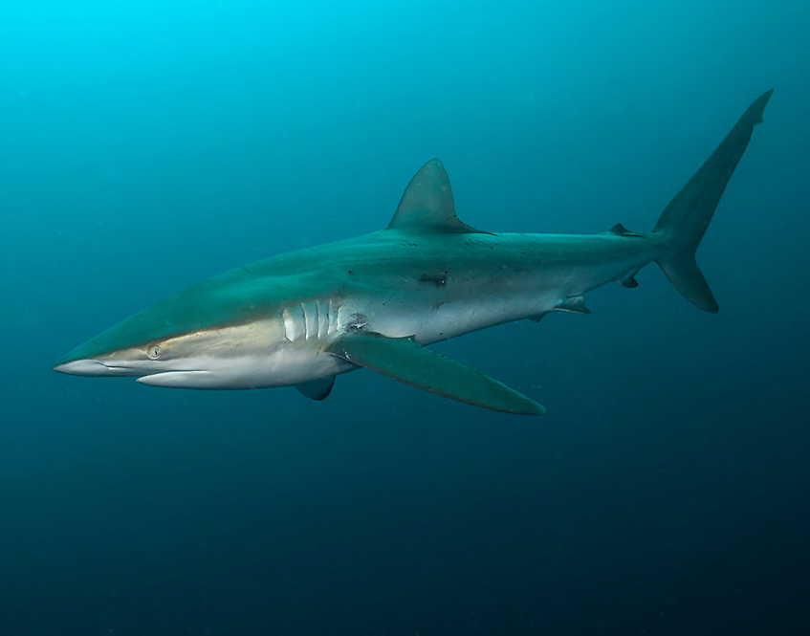
Some species have experienced increases in the last decade, others have experienced decreases throughout the data set
Archosargus Probatocephalus
Carcharhinus obscurus
1988 - 1998
1999 - 2009
2010 - 2022
Notes:
The 2nd group I want to draw your attention to are those species that have their increase in abundance only in the most recent decade, such as sheepshead and dusky sharks.

Slide 8
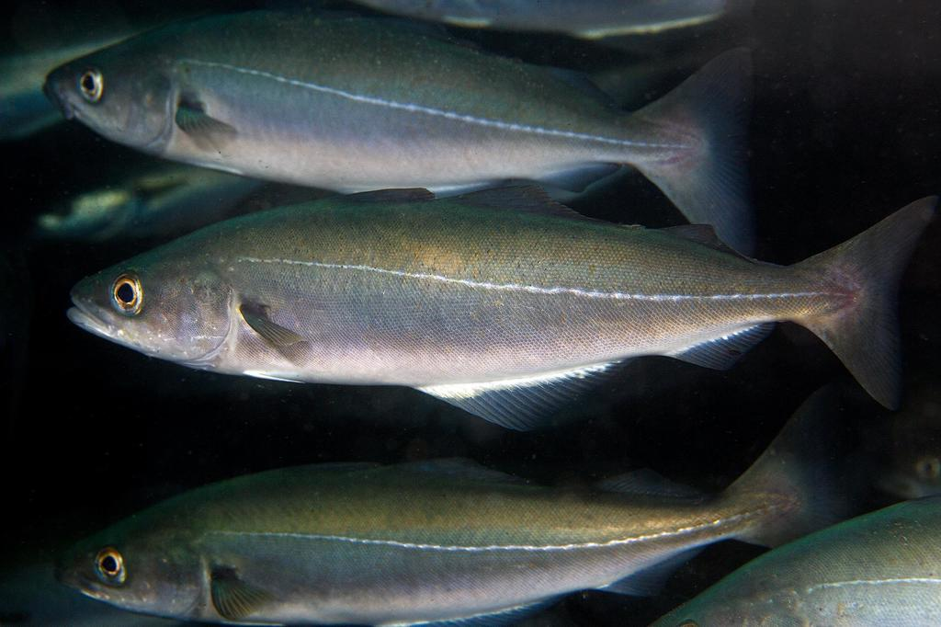
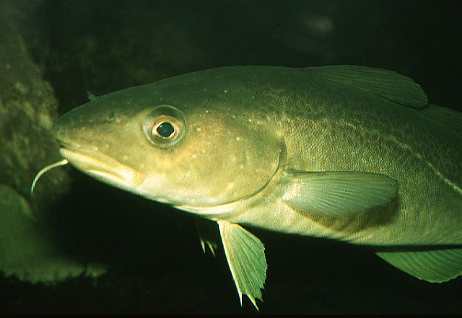
Some species have experienced increases in catch in the last decade, others have experienced decreases throughout the data set
Archosargus Probatocephalus
Gadus morhua
1988 - 1998
1999 - 2009
2010 - 2022
Notes:
The last group that have interesting trends are those species that were ranked in the top 90 abundance in the first decade and the last decade, but experienced some sort of change that led to them dropping out of the rankings in the middle. These provide an interesting research area to postulate on what drove that change. There are three species that fall under this label, Pollock, Haddock, and Atlantic Cod. Now something that I want you to keep in mind when looking at this plot, is that absence in the plot doesn’t necessarily mean that they weren’t present at all during the trawl in the other decades. They just weren’t in a high enough abundance to crack the top 90.

Slide 9
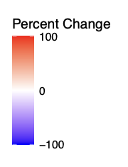
Elasmobranch catch has increased greatly over time compared to 1988-1998
1999-2009
2010-2022
Notes:
So, I've mentioned that this was a monster dataset to work with, so another way I attempted to distill this into something I could understand was to look at changes in abundance for a group of organisms. And since my personal and research interests are elasmobranchs, I decided to look at the species that are present in the bottom trawls and how their numbers have changed. Now this plot is a bit more straight forward. This is looking at percent change in catch relative to the first decade for all 22 elasmobranchs, not including the unclassified individuals, that appeared in the trawl. Decades are on the x, and species on the y, the deeper blue showing a 75% or more decrease and the deepest red showing a 100% or more increase in catch. And pretty clearly, you can see a whole lot of red on the showing that a lot of species have experienced increases in recent decades. Some species like the Thresher shark and sand tiger have experienced large increases in both of the most recent decades compared to the first, where others like the Dusky shark and Cownose ray have experienced their greatest increases in the most recent decade.

Slide 10
Largely, elasmobranch presence in our region has increased
Notes:
Finally, to hammer home this increasing elasmobranch presence this plot looks at abundance based on catch over time for the elasmobranchs in the trawl with the total number caught on the y-axes and year on the x-axes. Outside of a few species that have oscillatory patterns to their abundance, like some of the skates, you can see that a lot of them have experienced increases in recent years, specifically (press) these ones that I have highlighted for you that have some of the stronger positive trends, like the Dusky Shark, Roughtail stingray, spiny butterfly ray and Atlantic Sharpnose Shark.

Slide 11
Research Objectives
Observe presence and timing of that presence in the region
Determine relative occurrence inside and outside current and planned wind lease areas
Build a predictive model of elasmobranch distribution
Assess any distributional overlap that could result in interspecific competition
Notes:
Now all of this points to the idea that elasmobranch presence appears to be increasing in our region and this has been our jumping off point for thinking about what comes next. Based on our results, we have outlined 4 research questions. 1 (press), how are coastal elasmobranchs, including vulnerable shark species, distributed and moving throughout state coastal shelf waters on seasonal and interannual scales, looking at things like migration, residency, and presence and absence for example. 2 (press), what is the distributional overlap between tagged elasmobranchs and planned/unplanned offshore wind lease areas. 3 (press), how are oceanographic variables, such as temperature, dissolved oxygen, CDOM, and salinity, influencing the distribution and habitat use of coastal elasmobranchs on variable time scales, and more specifically, can we combine our acoustic telemetry data with oceanographic variables to build a predictive model of elasmobranch distribution This model will allow us to predict how elasmobranch movement will change with environmental conditions, as well as separate those impacts from those that arise due to the offshore development taking place so that those effects can be identified and addressed. And 4 (press), which only refers to our possible chapter 2, what is the distributional overlap between coastal elasmobranchs that have been increasing in abundance off of NJ according to the trawl data and existing resident species that may indicate interspecific competition taking place.

Slide 12
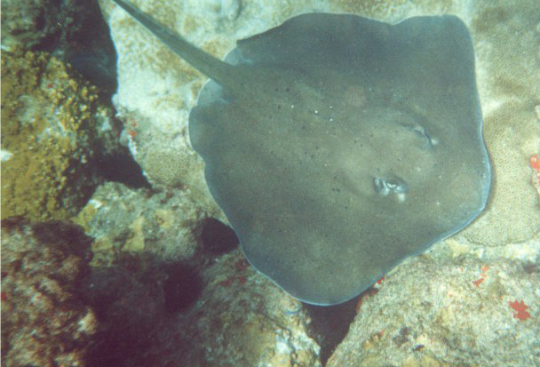
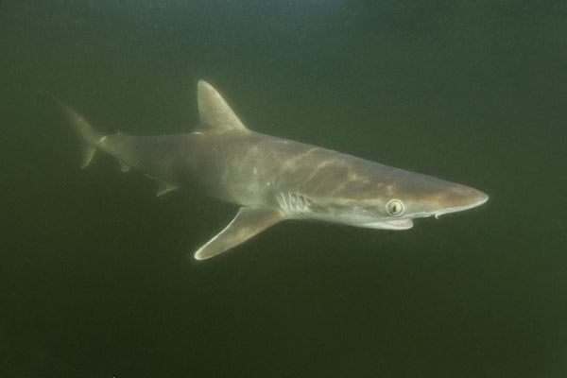
Examining the movement and distributions of two elasmobranch species that have experienced sharp increases in abundance and the possibility for interspecific competition
Catch
Catch
Bathytoshia centroura
Rhizoprionodon terranovae
Notes:
Based on those questions, we have started thinking about what that research and in particular chapters, might look like. For chapter 2, looking at species that we have data for from the trawl and taking a deeper dive into their movements as well as possible competition between species. We have highlighted some possible selections for this question, the roughtail stingray and Atlantic Sharpnose shark because while they have strong increasing trends, they occur differently in the trawl. Whereas the roughtail stingray was present since the beginning and has greatly increased in recent decades, the Atlantic Sharpnose shark was largely absent before the most recent decade. These species were also selected due to dietary overlap that will make it easier to examine the possibility for competition.

Slide 13
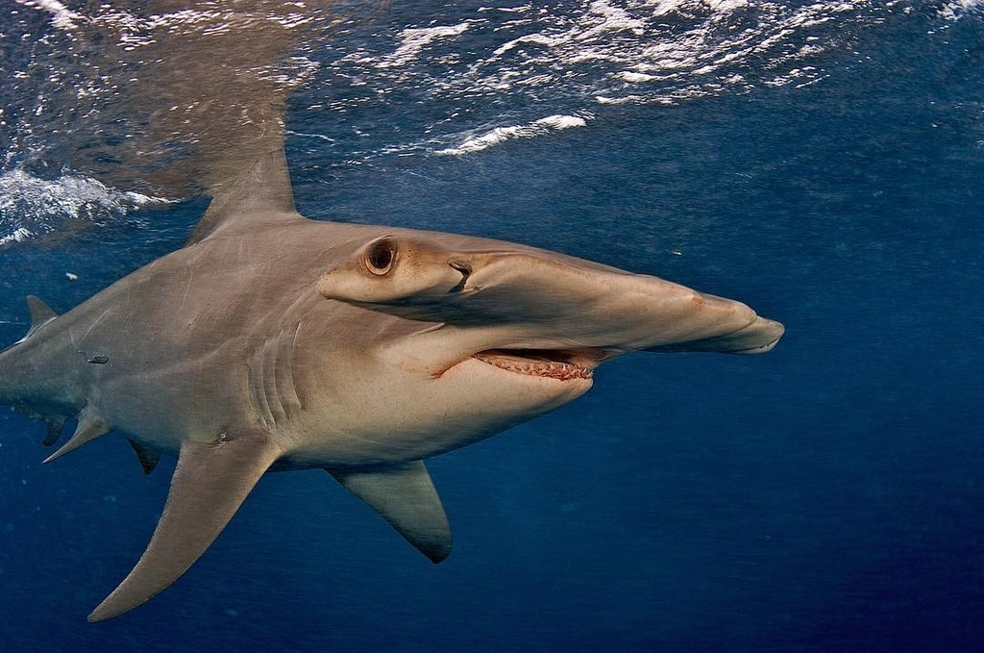
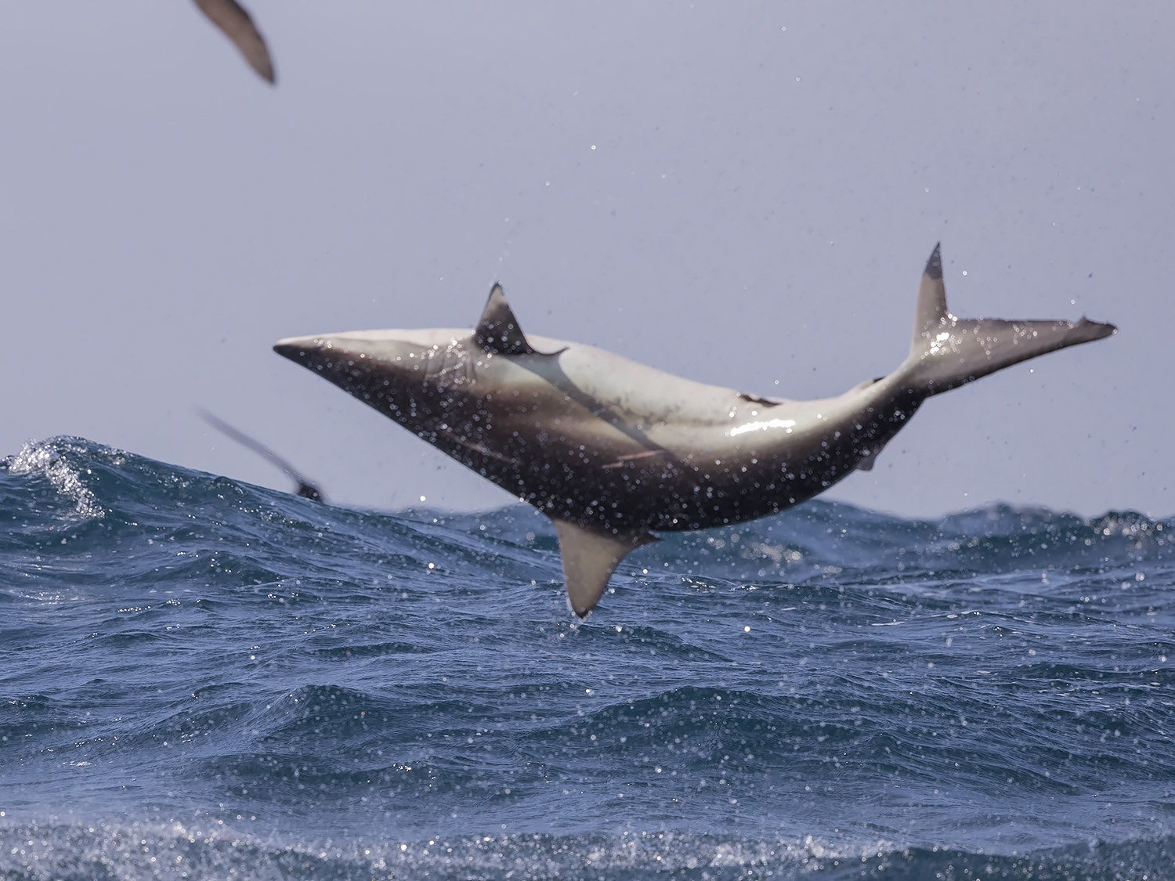
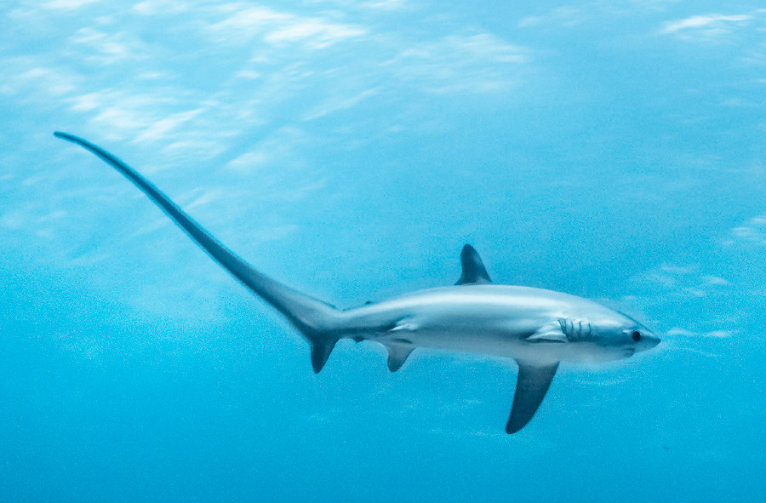
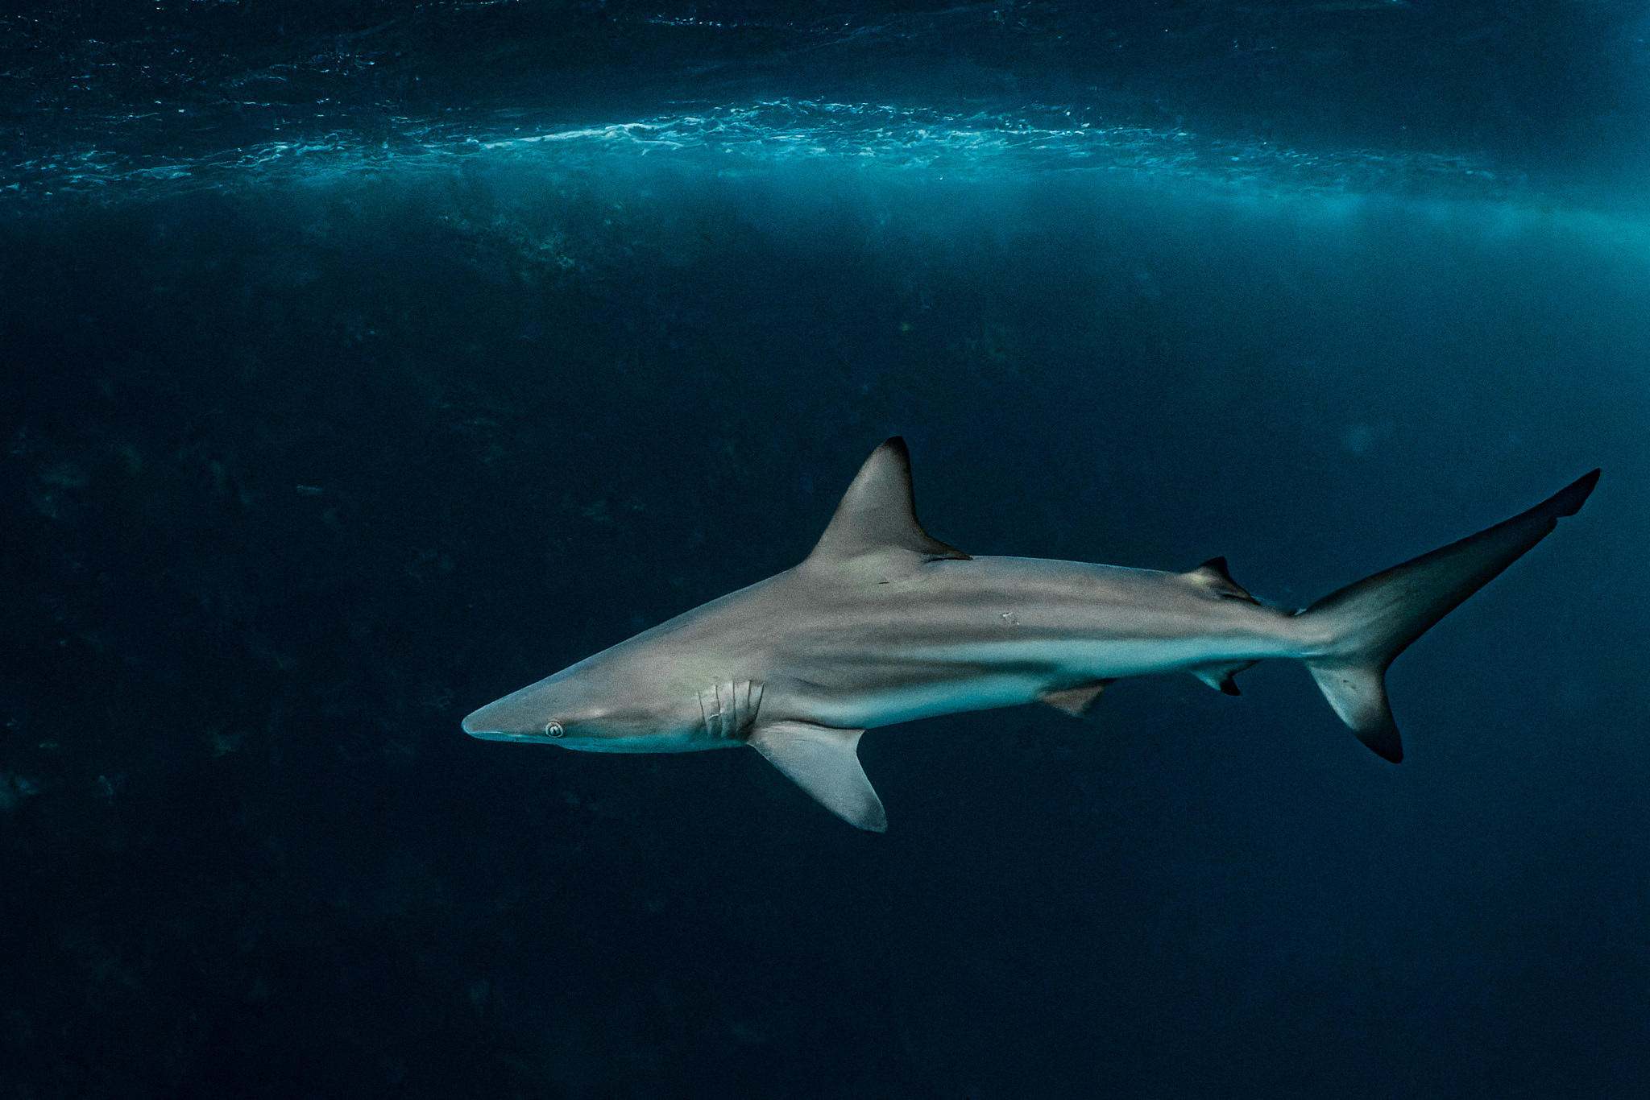
Examining the movement and distributions of vulnerable shark species
Common Name | Scientific Name | IUCN Designation
Dusky Shark | Carcharhinus obscurus | Endangered
Common Thresher Shark | Alopias vulpinus | Vulnerable
Bigeye Thresher Shark | Alopias superciliosus | Vulnerable
Smooth Hammerhead Shark | Sphyrna zygaena | Vulnerable
Great Hammerhead Shark | Sphyrna mokarran | Critically Endangered
Scalloped Hammerhead Shark | Sphyrna lewini | Critically Endangered
Blacktip Shark | Carcharhinus limbatus | Vulnerable
Tiger Shark | Galeocerdo cuvier | Near Threatened
White Shark | Carcharodon carcharias | Vulnerable
Porbeagle Shark | Lamna nasus | Vulnerable
Bull Shark | Carcharhinus leucas | Vulnerable
Blue Shark | Prionace glauca | Near Threatened
Sand Tiger Shark | Carcharias taurus | Critically Endangered
Silky Shark | Carcharhinus falciformis | Vulnerable
Oceanic Whitetip Shark | Carcharhinus longimanus | Critically Endangered
Spinner Shark | Carcharhinus brevipinna | Vulnerable
Shortfin Mako Shark | Isurus oxyrinchus | Endangered
Longfin Mako Shark | Isurus paucus | Endangered
Sandbar Shark | Carcharhinus plumbeus | Endangered
Sphyrna mokarran
Carcharhinus brevipinna
Alopias vulpinus
Carcharhinus limbatus
Notes:
For chapter 3, we are thinking about expanding on and moving past the trawl data to examine the movements of shark species that the IUCN designates as species of concern. For those of you who do not know, the IUCN is an organization that works with governments and NGOs to monitor populations of organisms and based on those designate whether or not those populations are stable or concerning. This research would fill a necessary data gap as we are largely unsure about how this group of sharks use and move throughout NJ waters, as well as having a significant conservation aspect as the management for these species could need to shift with their possible shifting distributions. This table lists all of the possible shark species that can be found off the Northeast U.S. that the IUCN designates as species of concern.

Slide 14
Questions?
jacob.kuenzli@marine.rutgers.edu
Notes:
Thank you so much and I'd be happy to answer any questions at this time, or if you would prefer, my email is here at the bottom.

