Slide 1

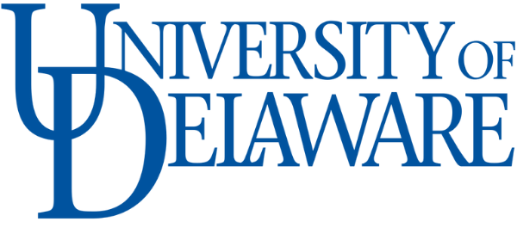

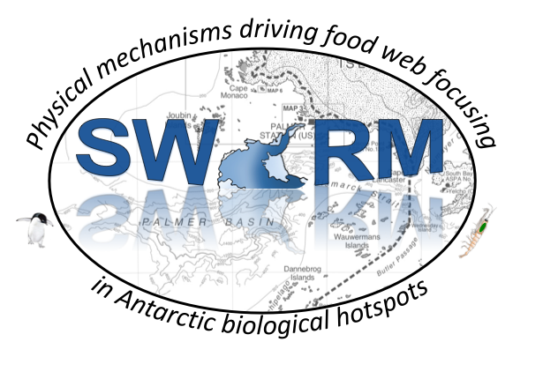




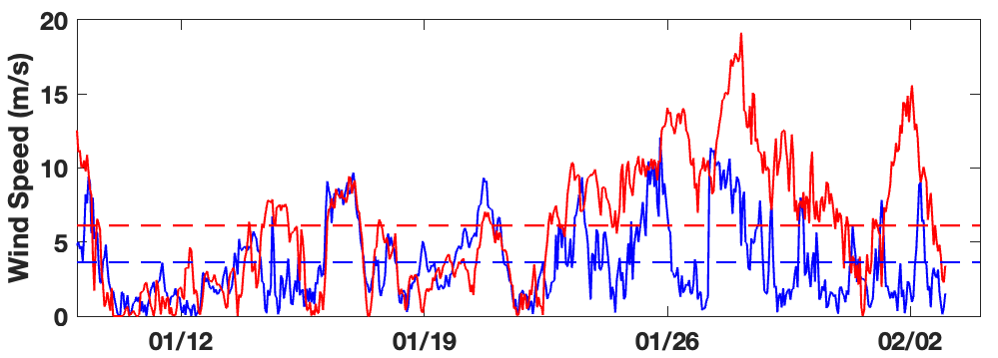
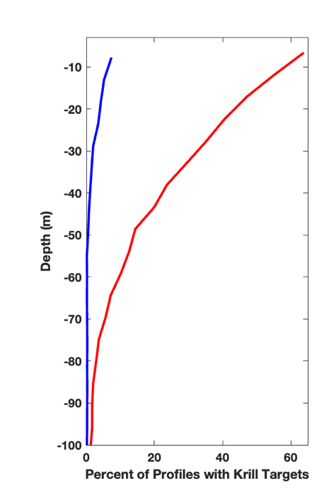
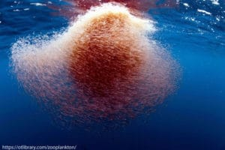
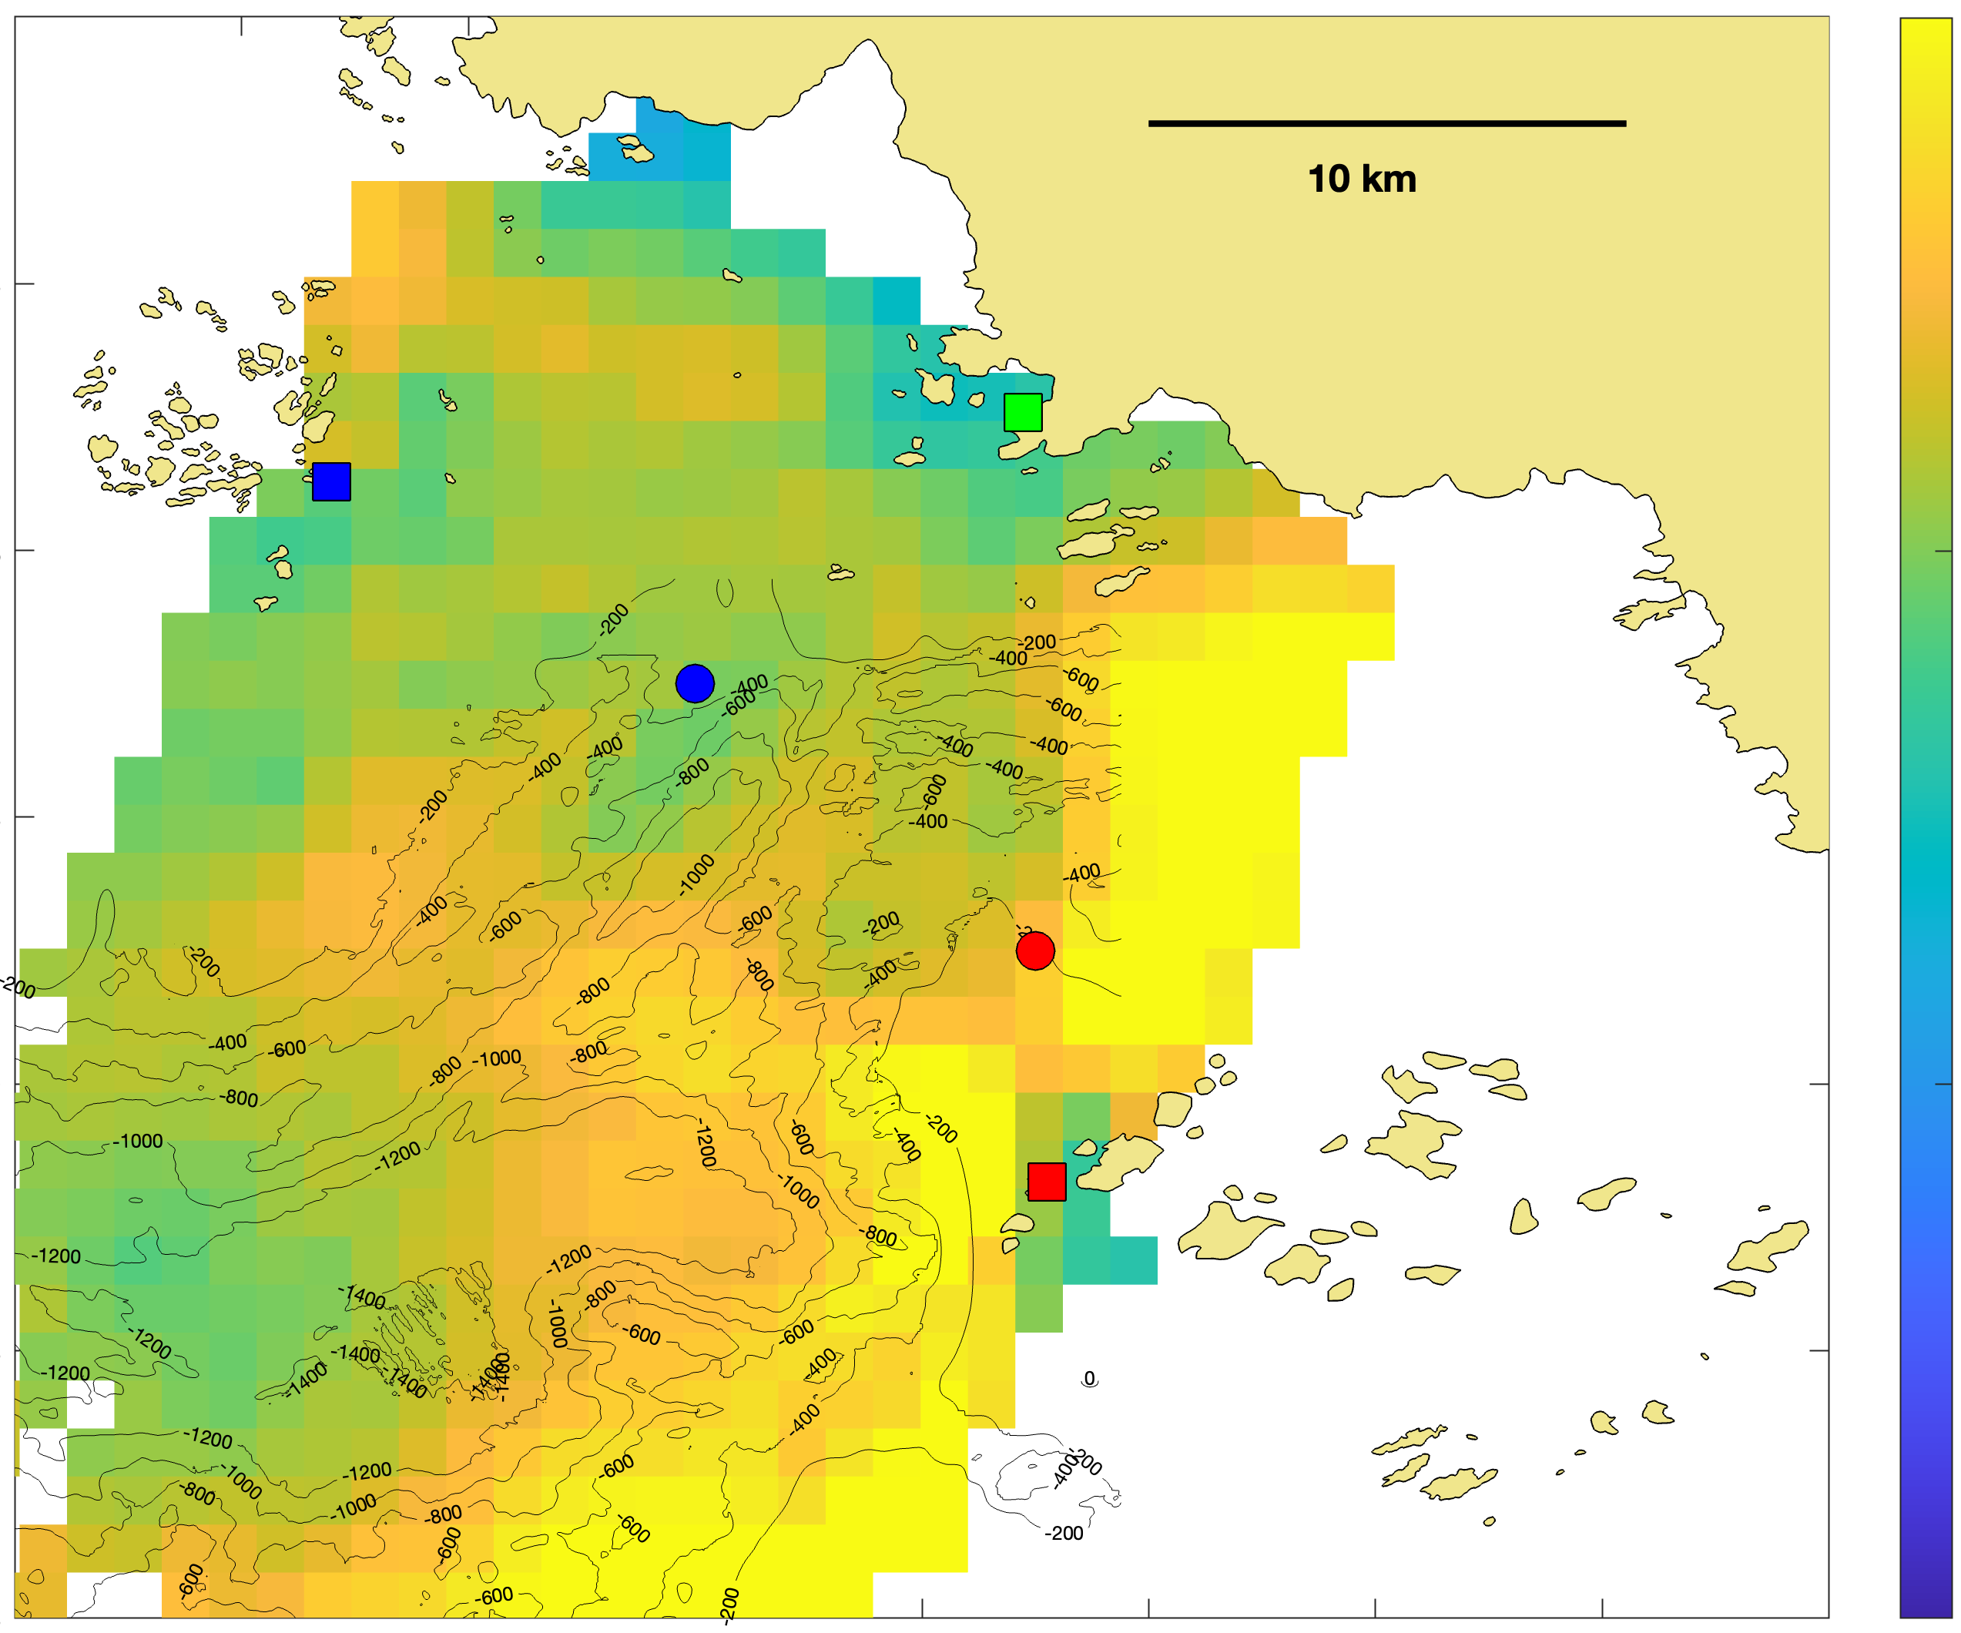
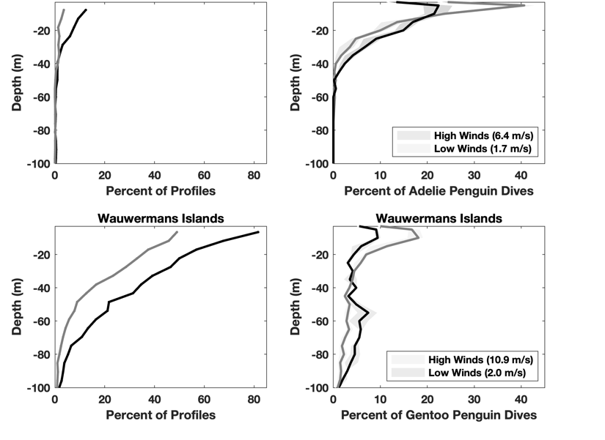
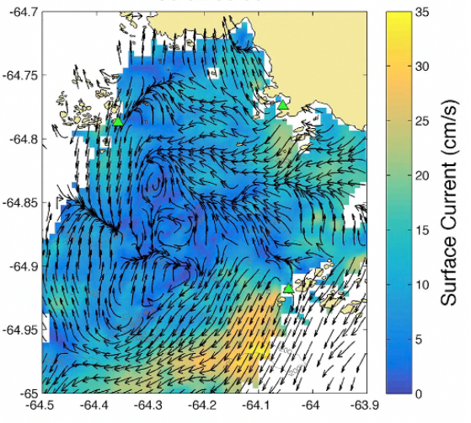
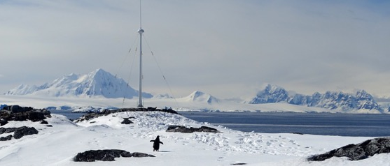
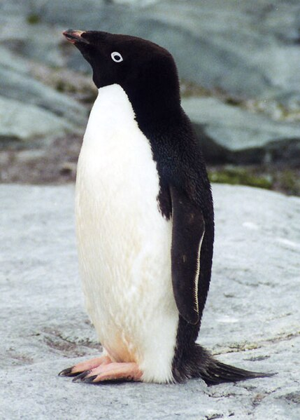

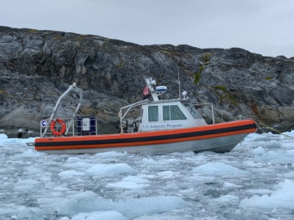
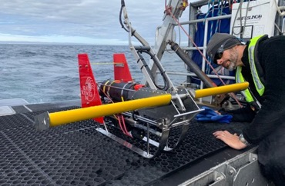
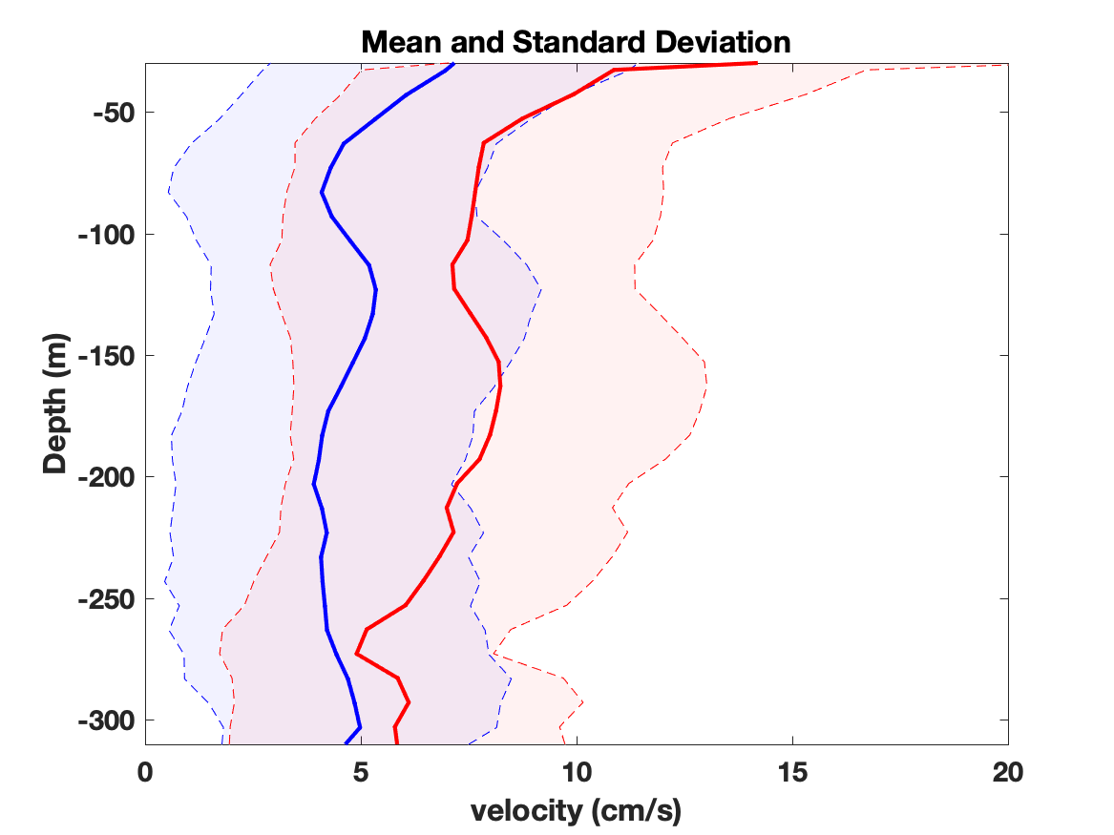
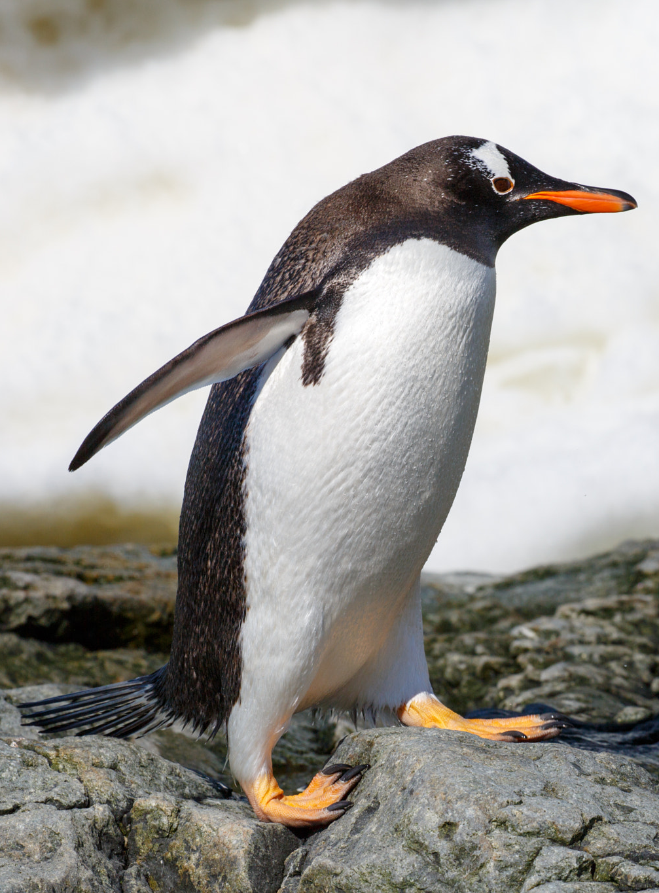
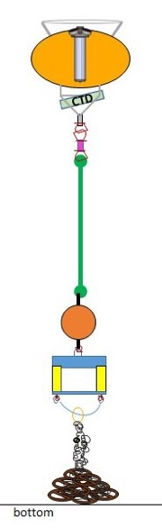
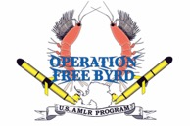

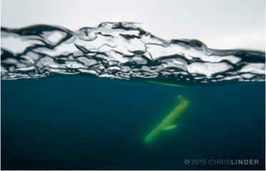
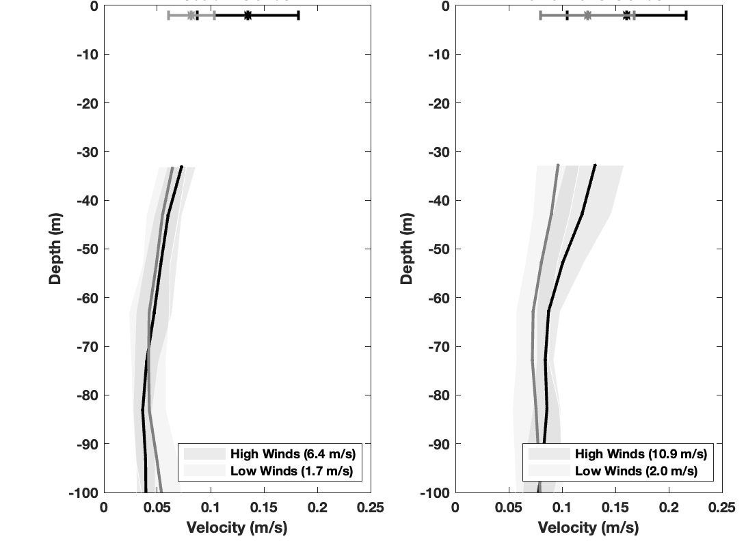

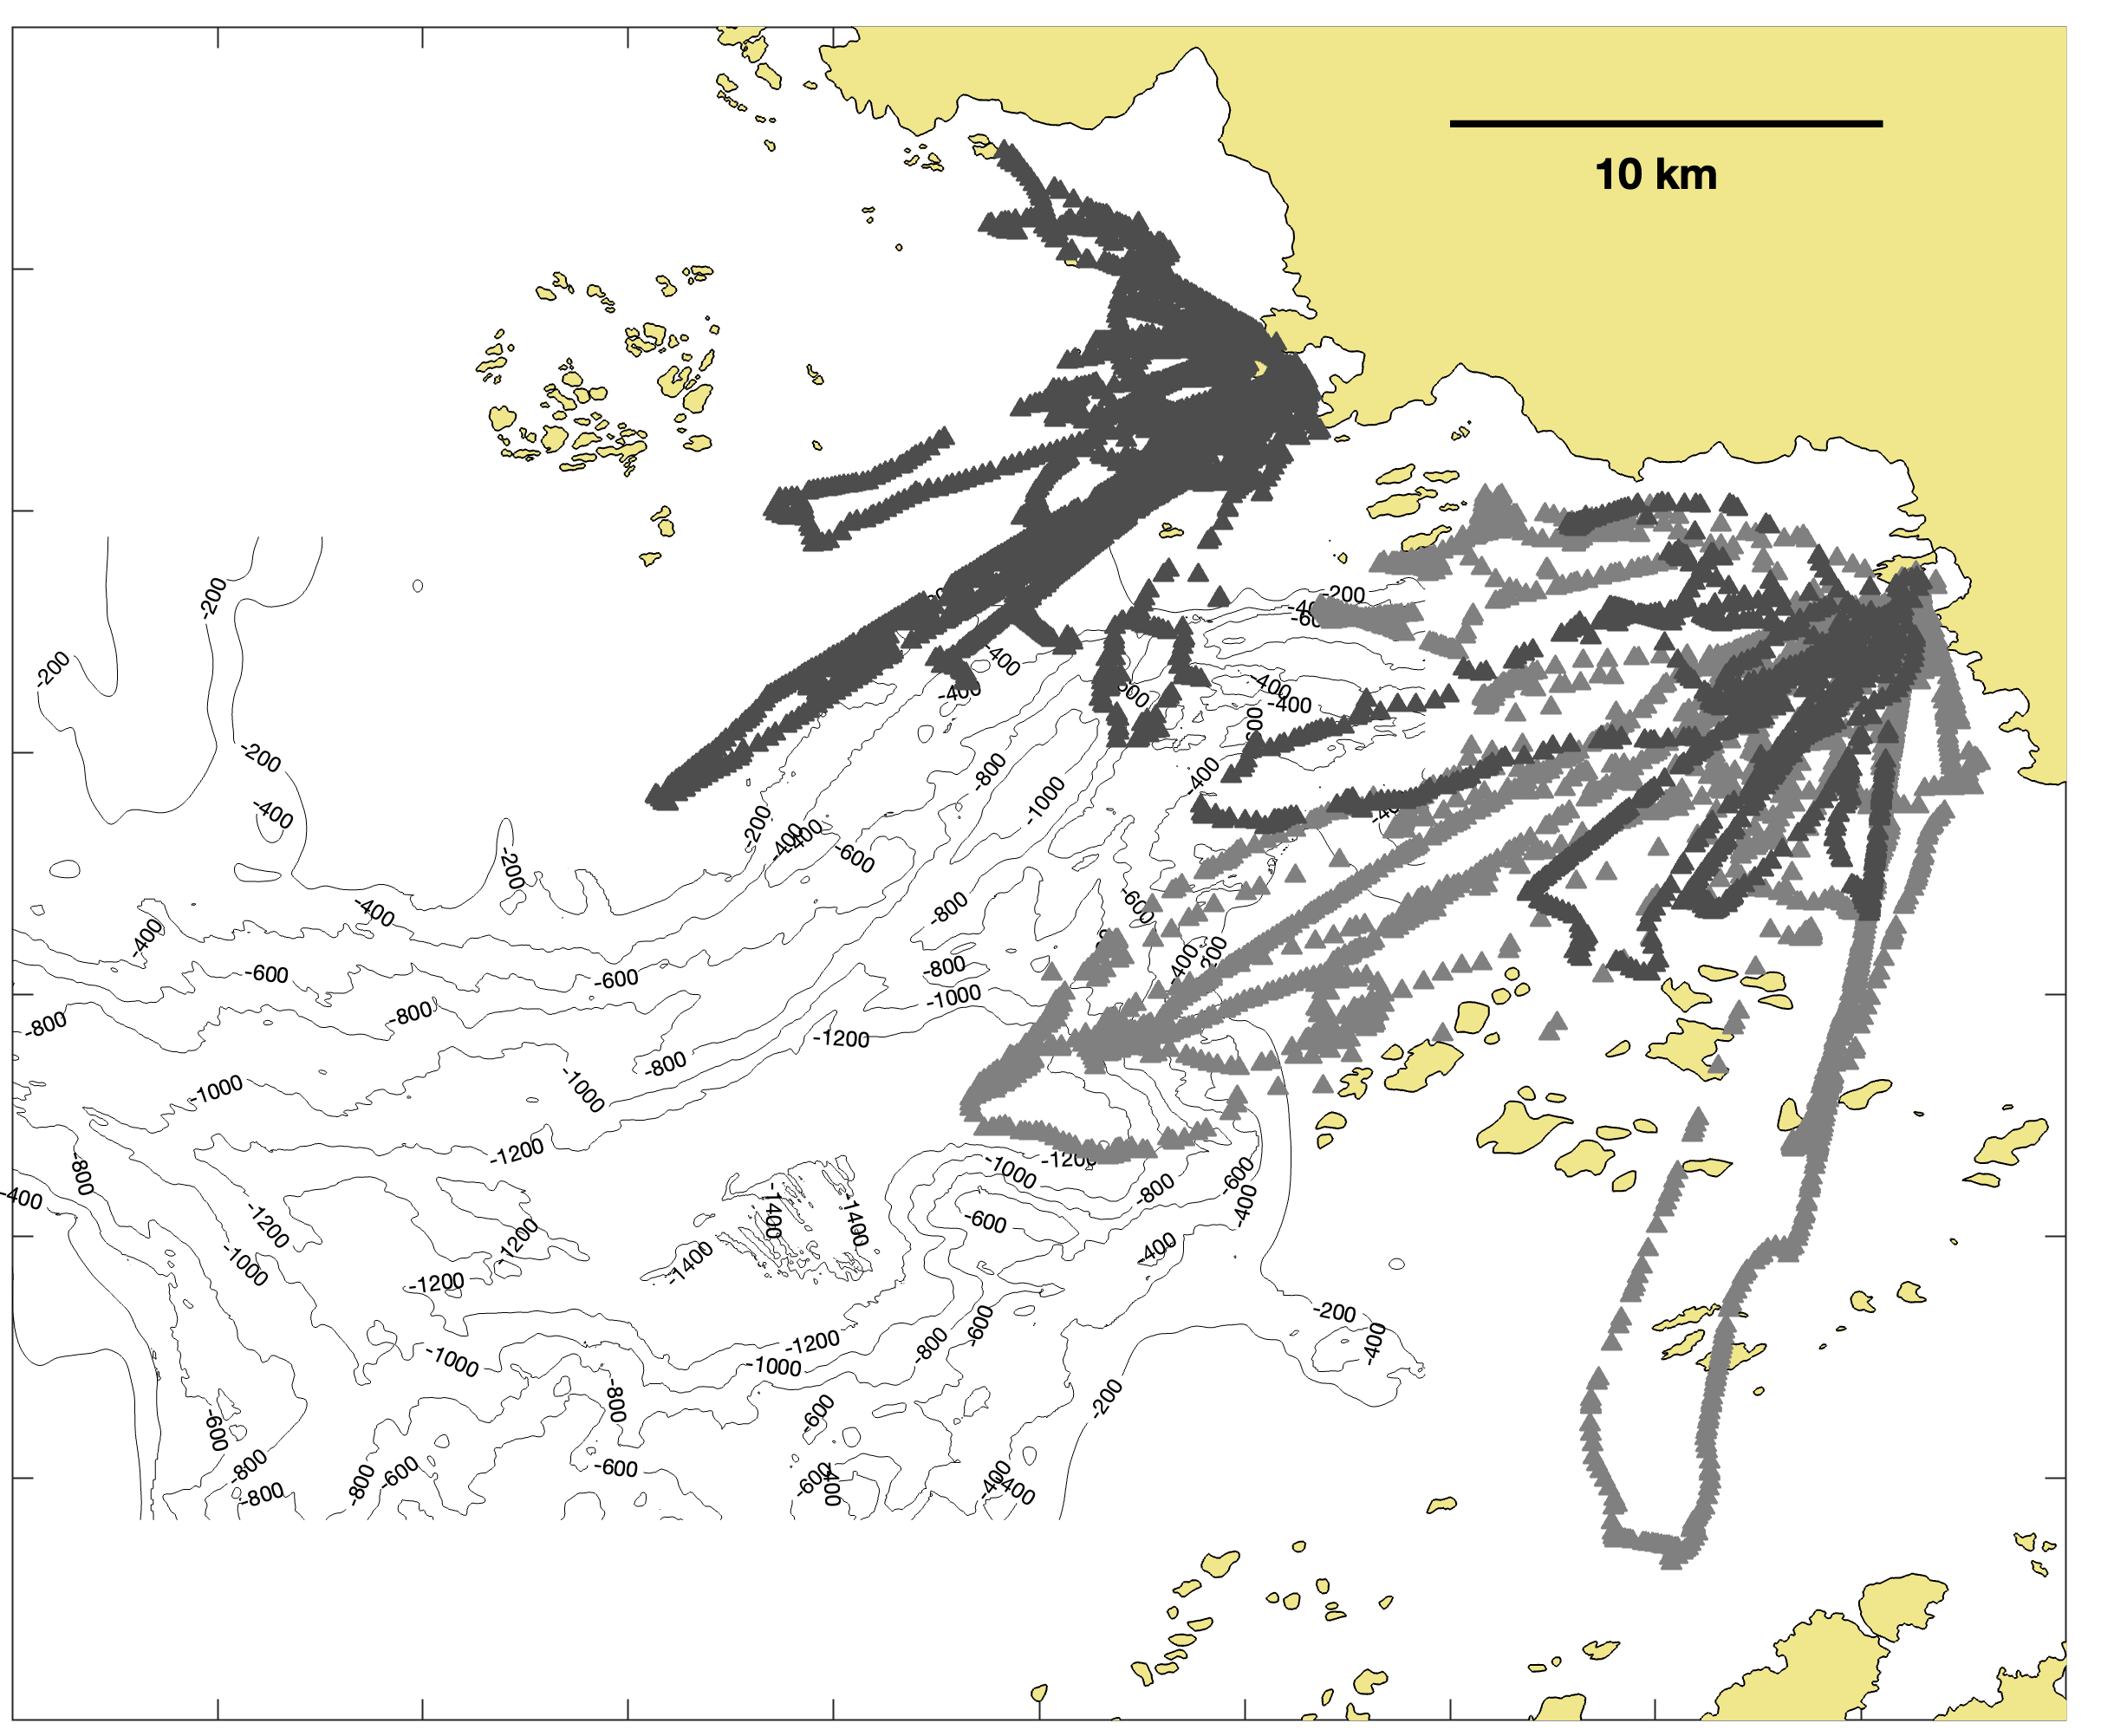
1730
Small scale physical controls of foraging behavior
in a polar biological hotspot
PORG
Josh Kohut¹, Matt Oliver², Jacquelyn Veatch¹, Kim Bernard³, William Fraser⁴, John Klinck⁵, Mike Dinniman⁵, Hank Statscewich⁶, Erick Fredj⁷
¹Rutgers University, ²University of Delaware, ³Oregon State University, ⁴Polar Oceans Research Group, ⁵Old Dominion University, ⁶University of Alaska Fairbanks, ⁷Jerusalem College of Technology
Key Finding
Sidedness across the Palmer Deep Canyon may be a fundamental bottom up mechanism that sustains this biological hotspot over ecological time.
Wind Speed (9 January – 3 February, 2020)
Macrozooplankton (9 January – 3 February, 2020)
Our Purpose Built Polar Ocean Observatory
Time (mm/dd)
SAR image, Feb 18, 2020
Time (Hour of Day)
Integrated sensors and technologies to simultaneously map physics, phytoplankton, krill, and penguin foraging
Winds are persistently higher on the Wauwermans side of the canyon compared to the Joubin side of the canyon. Particularly later in the time series
Krill targets are more frequent and deeper on the Wauwermans side of the canyon compared to the Joubin side of the canyon.
High Frequency Radar
Small Boat ACROBAT Surveys
Moorings
Gliders
Surface Currents (9 January – 3 February, 2020)
15
10
5
0
Local Food Web (High vs. Low Wind Speeds)
Mean surface currents are higher on the Wauwermans side of the canyon compared to the Joubin side of the canyon
Joubin Islands (Krill)
Joubin Islands (Penguins)
Surface Current (cm/s)
Low wind days
High wind days
HF Radar
Hourly Surface Currents
Velocity Profiles (9 January – 3 February, 2020)
Small Boat Surveys (0-50m)
Temperature
Salinity
Density
Chl-a Concentration
Particle Backscatter
Krill Acoustics (Full Depth)
Wauwermans Islands (Krill)
Wauwermans Islands (Penguins)
Mean and the standard deviation of the water column velocities are higher on the Wauwermans side of the canyon compared to the Joubin side of the canyon from the surface to the bottom.
Moorings
Ocean Current Profiles (All)
Krill Acoustic Profiles ( )
Bottom hydrography ( )
Krill are more frequent and deeper on both sides of the canyon on windier days
Penguin foraging is deeper on both sides of the canyon on windier days
Gliders (0-1000m)
Temperature
Salinity
Density
Chl-a Concentration
Particle Backscatter
Dissolved Oxygen
Krill Acoustics
Velocity Profiles (High vs. Low Wind Speeds)
Joubin Islands
Wauwermans Islands
For the first time in this region this observatory…
Integrated sensors and technologies to simultaneously map physics, phytoplankton, krill, and penguin foraging at high spatial resolution.
Revealed a persistent bottom up controlled sidedness across the canyon.
Identified a pattern that may be a fundamental mechanism that sustains these persistent hotspots over ecological time.
Stronger currents on windier days extend further down into the water column on the Wauwermans side of the canyon compared to the Joubin side of the canyon.
Tagged Penguins
Penguin Tracks
Penguin Dive Depths
Low wind days
High wind days
Acknowledgements: This project was funded by the National Science Foundation (#1745009). The moorings were generously provided by the NOAA Antarctic Ecosystem Research Division. We would also like to thank the PAL-LTER and Antarctic Support Contractors and their teams aboard the ARSV Laurence M. Gould and at Palmer Station without whom a study of this scale would not be possible.
For more information please contact:
Josh Kohut
kohut@marine.rutgers.edu

