Slide 1
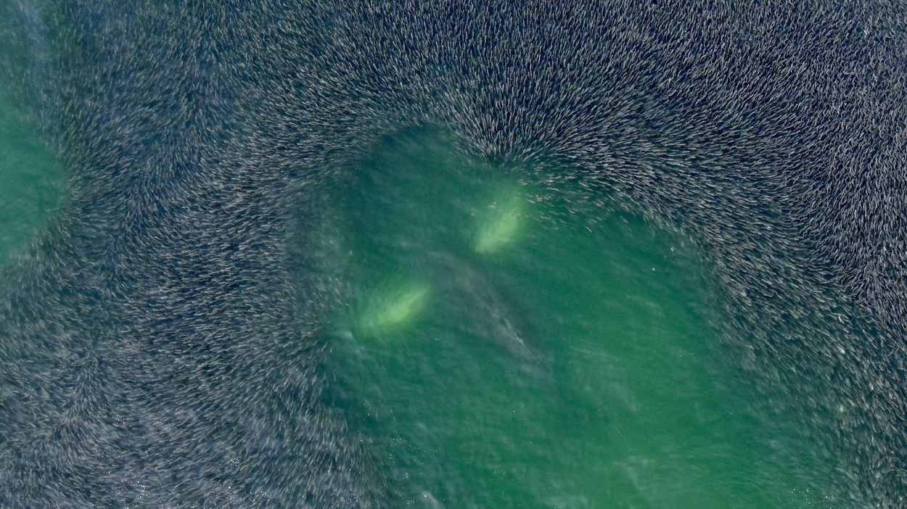
Novel quantification of carbon production for a dominant Northwest Atlantic forage fish, Atlantic menhaden (Brevoortia tyrannus; family: Clupeidae)
Lauren Cook (they/them)
Mohammed Hashim, Adam V. Subhas, Michael Schwarz,
Stephen Urick, and Grace Saba Ocean Sciences Meeting February 23, 2024

Slide 2
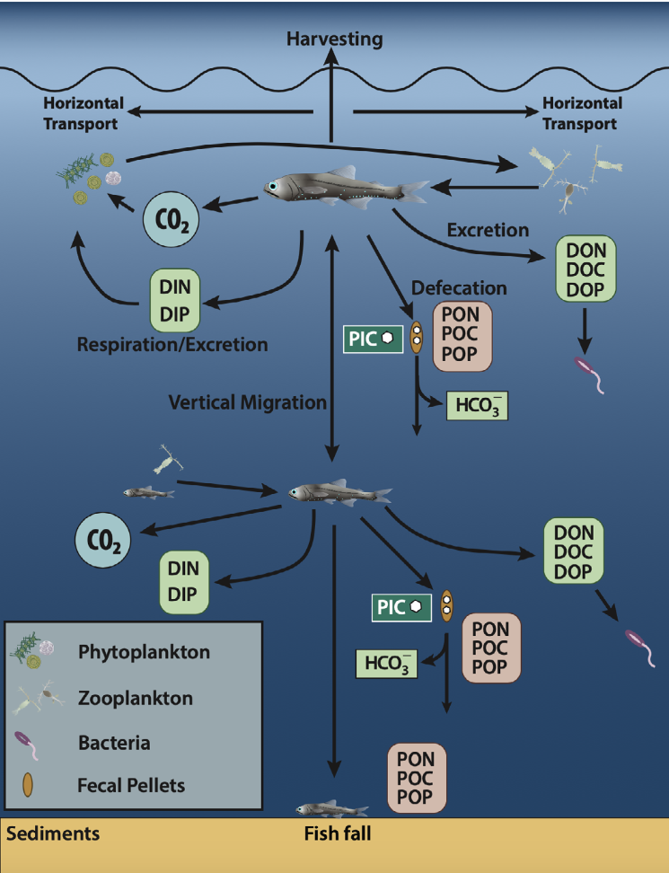
Bony fishes contribute dynamically to the marine carbon cycle…
16%
±13%
of carbon flux out of the euphotic zone globally
…but uncertainty is large!
2
Saba et al. (2021)
Notes:
Little more time on emphasizing the dynamic movement of fishes compared to plankton (explain the figure)
Contribute to dissolved (DIC/DOC) and particulate (fecal pellets and calcium carbonate) → all of this vertically and zonally AND latitudinially

Slide 3
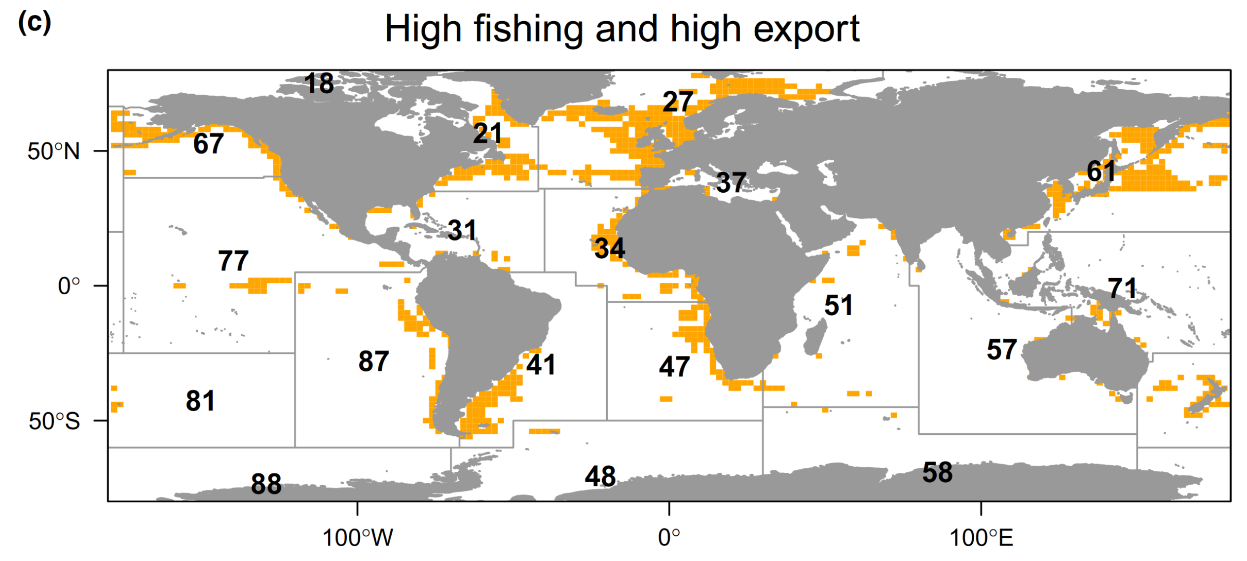
Cavan and Hill (2022)
Coastal regions are underrepresented in fish carbon export studies!
Areas of high fishing pressure overlap with areas of high carbon export
3

Slide 4
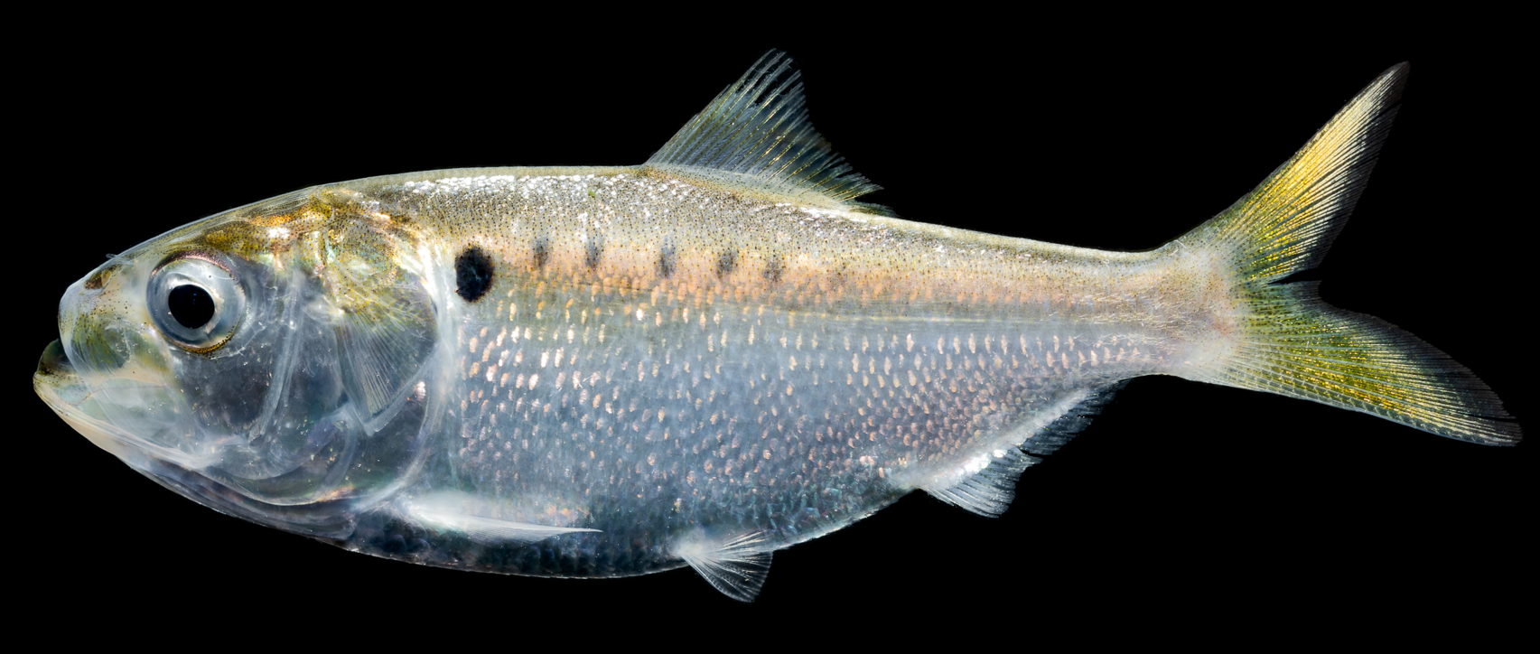
Quantification of fish carbon
DOC (gill excretion + urine)
Dissolved, labile carbon Readily available for primary producers or microbial loop
POC (fecal pellets)
Tightly packaged, large pellets
Food source for benthic ecosystems
Rapid sinking = high carbon export potential
CO2
(respiration)
Easily derived from metabolic rate
Important to consider when fish are vertically migrating
PIC (CaCO3)
Formed as osmoregulatory byproduct; unique to fish
Packaged in fecal material
Contributor to ocean buffering capacity against ocean acidification?
4
Notes:
I did this all at the same time!!!!!!

Slide 5
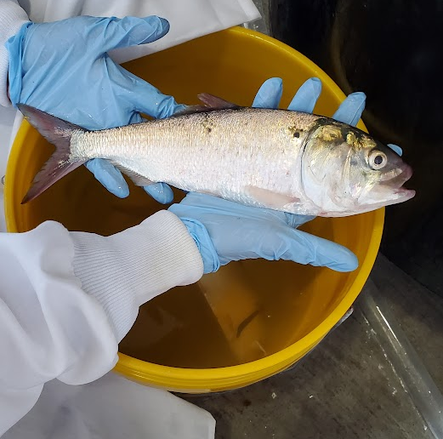
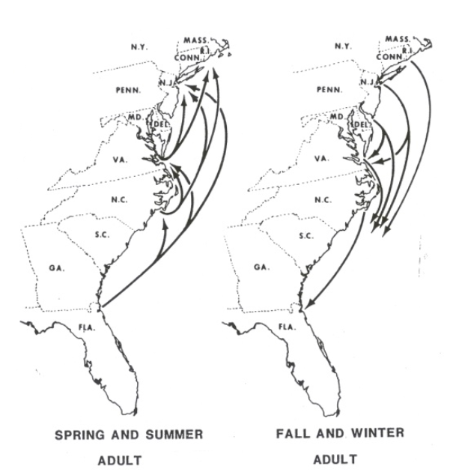
Using Atlantic menhaden (Brevoortia tyrannus) as a model species
ASMFC (1981)
High biomass (4.5 MMT) (ASMFC 2024)
Dynamic seasonal behavior
Representative coastal fish
(Relatively) easy to keep in the lab
Cross-latitudinal seasonal migrations – exposure to many oceanographic regimes!
5
Notes:
New evidence for some proportion of pop to overwinter in nearshore!

Slide 6
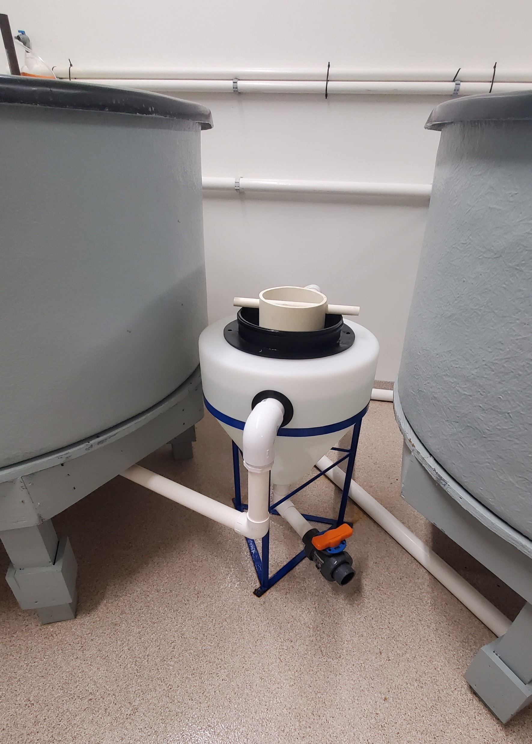
Fish POC collection methods
Experimental temperature: 25°C
Collected fecal material at 6h, 12h, and 24h post-feeding
Diet: Frozen Cyclops spp. copepods
Fish holding tank
Collected opportunistic “wild-type” fecal material
Measured sinking rates of pellets
Radial flow settler: separates and settles fecal pellets without disturbing fish
6

Slide 7
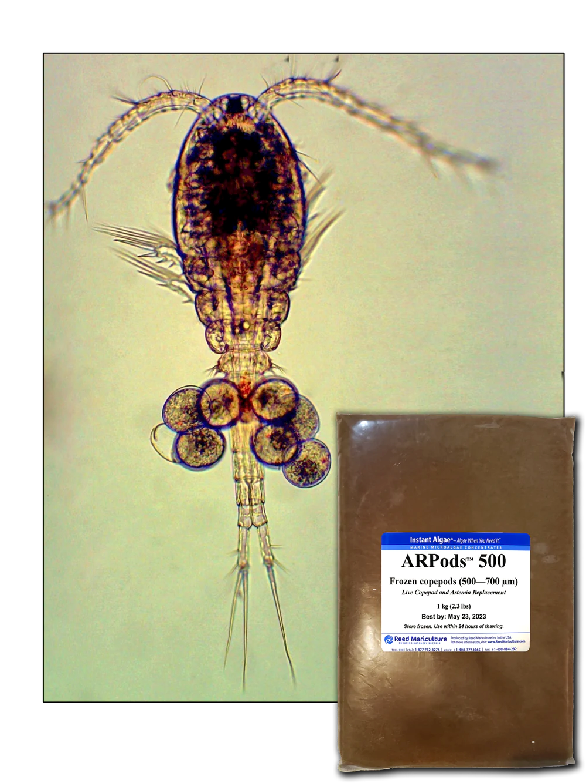
Biomass-specific POC production rate
First ever!!
1.405 μg POC g⁻¹ h⁻¹
Average tank biomass 1293.5 g
This is likely an underestimate (12h, 24h collection points not yet processed)
Estimate from a single food ration and diet (body model will tell more!)
Diet: Frozen copepods (Cyclops spp. 500-800 um)
7

Slide 8
Copepod diet fecal pellets
“Wild” diet fecal pellets
8
 | Copepod diet (avg ± st. dev) | “Wild” diet (avg ± st. dev)
Pellet volume (mm³) | 3.21 (± 1.43) 32 pellets | 22.3 (± 11.3) 11 pellets
POC content (μg C mg pellet⁻¹) | 16.8 (± 2.61) 96 pellets | 26.2 (± n/a) 154 pellets
Sinking rate | 517 (± 194 m d⁻¹) 196 (± 136 m d⁻¹ mm⁻³) 32 pellets | 7893 (± 1917 m d⁻¹) 435 (± 153 m d⁻¹ mm⁻³) 11 pellets

Slide 9
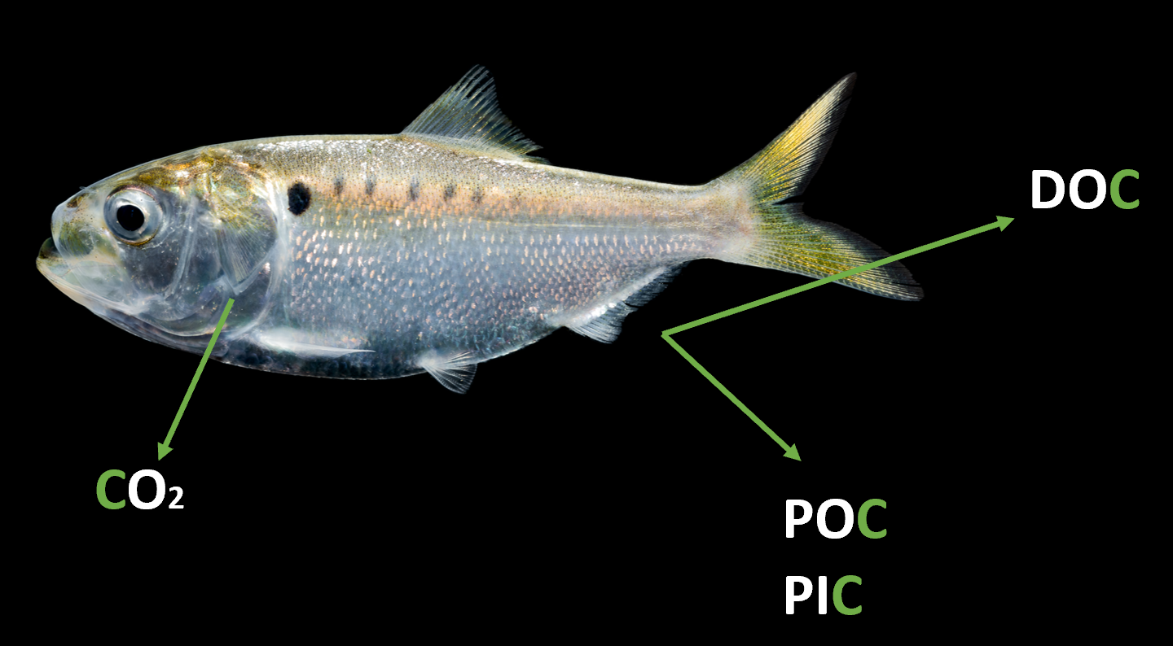
Next steps
Complete fish C budget
DIC, DOC, PIC, and remainder of POC components yet to be analyzed
Understand effect of temperature
Contextualize results for seasonality, climate change
Determine driver of sinking rate variability
Scale up to population, region
Wild fecal pellets sink faster – why? Diet? Sediment?
9
Notes:
1. First ever empirical biomass-specific POC production rates and export rates for any fish
2. Diet matters – diet and/or coastal sediment may ballast FPs?
Doing the rest of the carbon body budget
Adding temperature to capture seasonality/climate change stuff
Smaller pic of body carbon figure for visual
3. Shown only preliminary data – much more to come!

Slide 10
Special thanks to:
Mike Schwarz, Ethan McAlhaney, Steve Urick at Virginia Tech AREC
Mike Glaubke; Captain Todd - Knot Wishin’ II International Women’s Fishing Association; Manasquan River & Tuna Club Kevin Wark - F/V Dana Christine II; Vick Stott; Mike Acquafredda; Andrij Horodynsky; Ryan Bu
Thank you!
lcook@marine.rutgers.edu

Slide 11
