Slide 1





Cold Pool Stratification Influences on
Commercial Species Dynamics in the Mid-Atlantic Bight
Samantha Alaimo*¹
Bill Bright², Jeff Brust³, Colleen Brust³, Jeff Kaelin⁴,
Travis Miles¹, Daphne Munroe⁵, Grace Saba¹ & Josh Kohut¹
*alaimo@marine.rutgers.edu
1. Department of Marine and Coastal Sciences, Rutgers University
2. Captain, F/V Defiance and F/V Retriever Cape May, NJ
3. New Jersey Marine Resources Administration-Nacote Creek Research Station
4. Lund’s Fisheries, Cape May, NJ
5. Haskin Shellfish Research Laboratory, Rutgers University
Notes:
Introduce self and presentation title
Candidate

Slide 2




Cooperative Research Connections
Fish live in the Ocean
The Ocean Moves
Fish have Tails
People eat Fish
Notes:
Cooperative research connections span throughout my research, and all rely on some basic assumptions. The first being that:
Fish Live in the Ocean: Fish live in the ocean and occupy a wide range of dynamic habitats whether in the hot surface in the Bahamas or deep in the Marianas trench.
The Ocean Moves: These habitats are shaped by the ocean, through waves, tides, storms, wind.
Fish have Tails: But depending on the way the ocean moves, the habitat conditions vary in time and space leading which can significantly influence fish distribution and migration
People eat fish: Lastly, we as humans follow the fish and are dependent on the ocean as a food source.
We are left with a tightly coupled system that encompasses oceanographic, ecological and socioeconomic parts allowing for lots of room for collaboration
One place in particular, encapsulates this well.

Slide 3
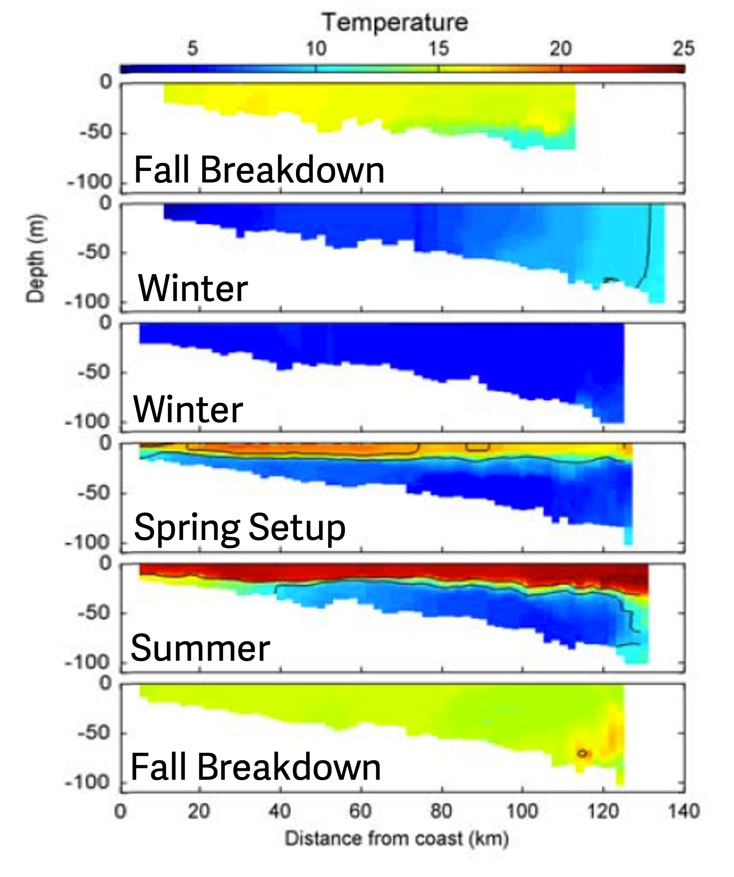
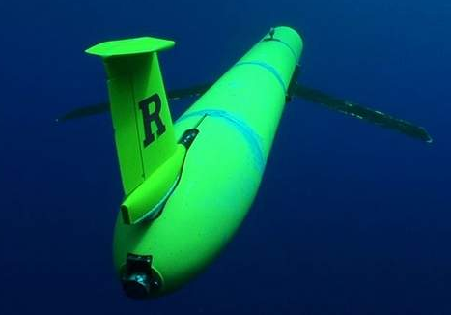
An Ecological-Economic Hub: The Mid-Atlantic
Intensification
Deeper
Offshore
(from Castelao et al. 2008)
Notes:
And that place is the Mid-Atlantic
The Mid Atlantic Bight is an ocean region that spans from Cape Cod to Cape Hatteras that has a large seasonal temperature signal known as the Cold Pool.
The cold pool is a distinctively cold, nutrient dense body of bottom water that forms every year in the spring.
Right Figure:
The figure on the right are cross-shelf transects based on glider tracks along the red line on the right
As we go further to the right on the figure, we are getting farther away from the coast and as we go down in the individual panels, we are getting deeper in the water column
Formation:
Fall into Winter: lots of storm and water column mixing so the water column is fairly uniform in temperature
Spring: the weather starts to warm up, less storms, the surface water begins to warm and become layer, or stratified
Summer: Strong layering/stratification-– surface water is really warm, deeper water is really cold from water supplied by the Scotian Shelf water in the North
Fall: Storms pick up again, the surface and deep-water mix and the water becomes more uniform
This dramatic change in temperature that happens every year in this small subset of the ocean

Slide 4
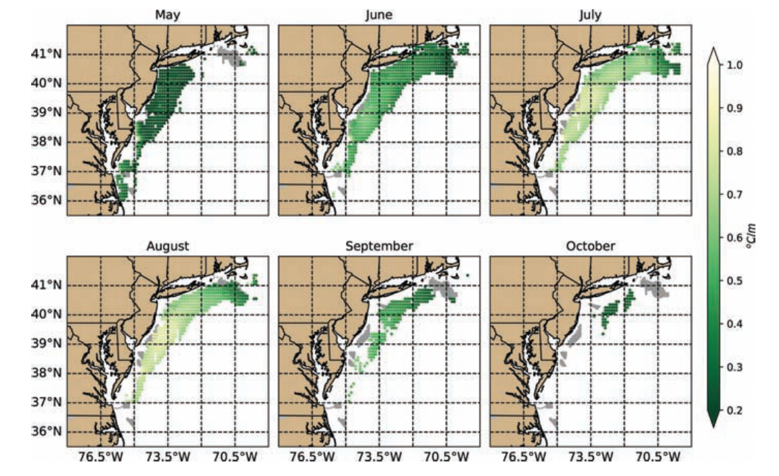
The Cold Pool Extent Depends on Season
Seasonal extent of the Cold Pool (from Miles et. al. 2021)
Notes:
Depending on the time of the year, depends on the spatial extent of the cold pool.
At it’s peak in the summer, the cold pool extends nearly the whole MAB
- Spatial extent--- lighter is more stratified, dark is less stratified

Slide 5
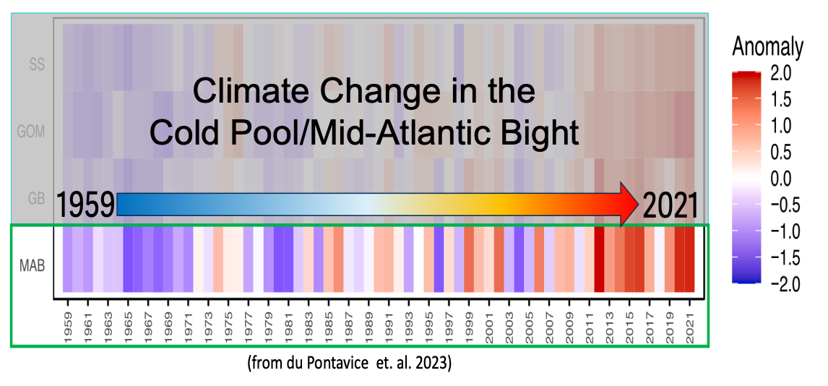
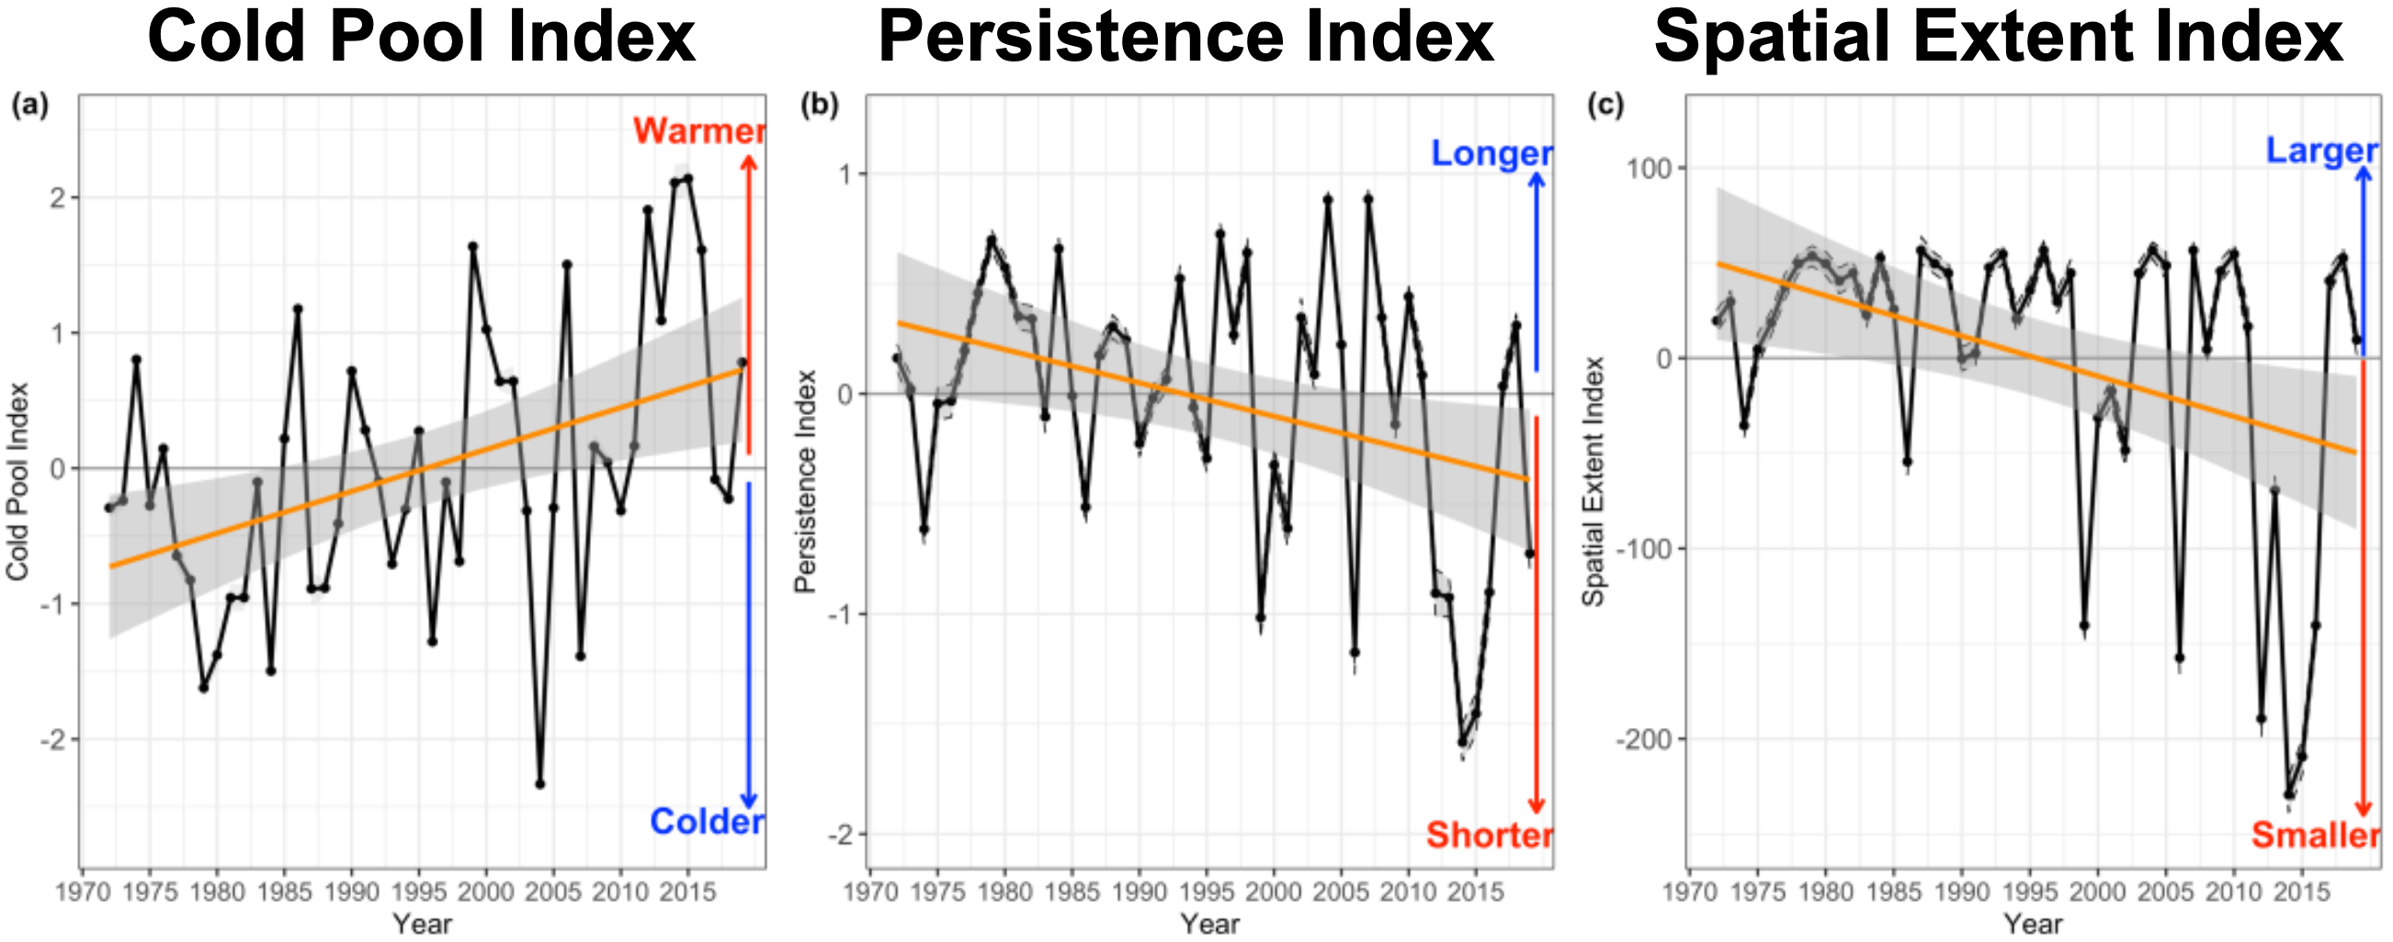
The Mid Atlantic Bight is Changing Over Time
(du Pontavice et. al. 2022)
Notes:
The MAB is changing over time in it's condition and use
*Orient to figure on Left*
Bottom temperature anomaly-- things are getting warmer
Also as we know, offshore wind development will be occurring in the coming years
The changes to the MAB are especially concerning given that....slide

Slide 6
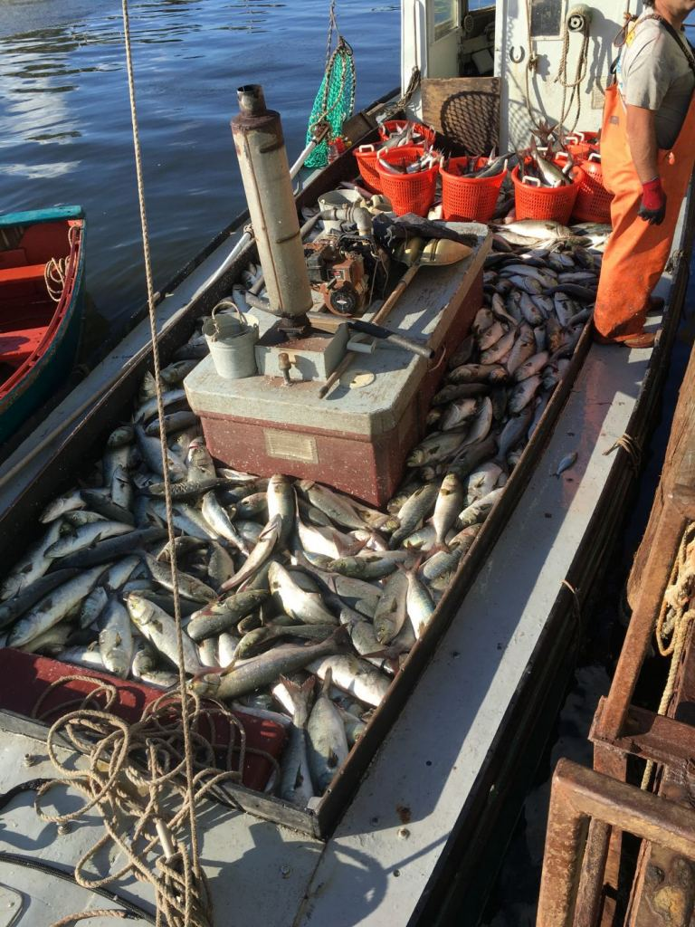
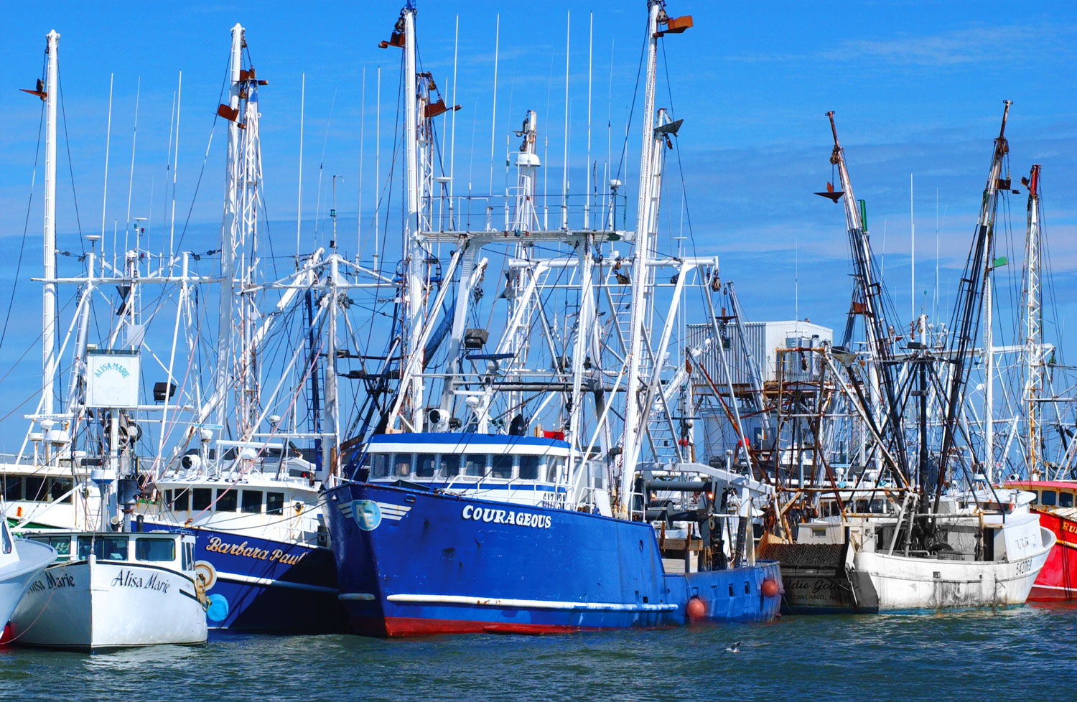
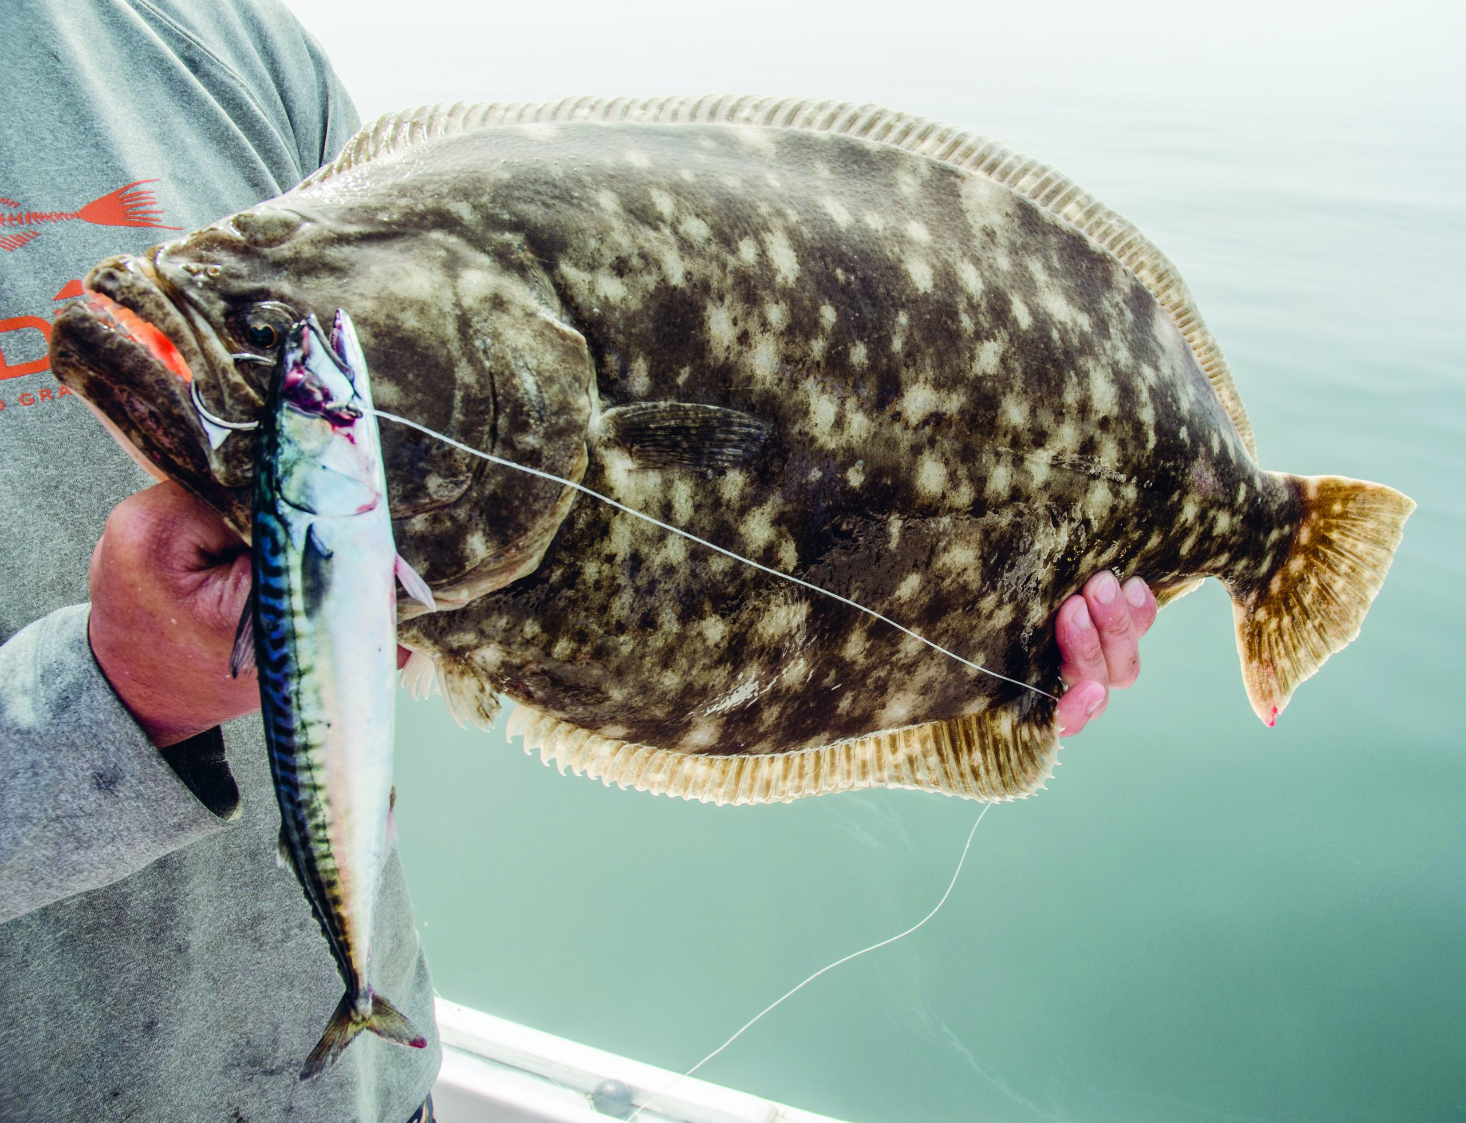
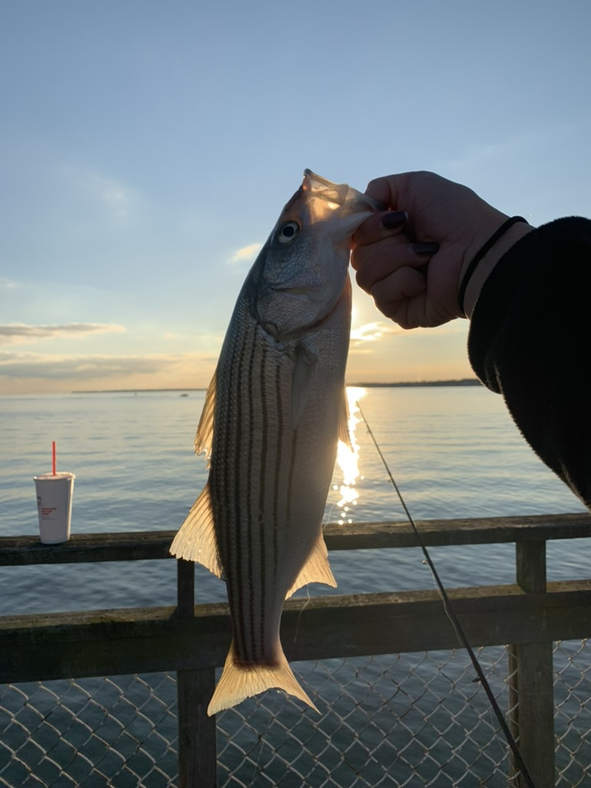
Cold Pool Supports
Commercial and Recreational Fisheries
MAB States 2019
Commercial Fisheries Revenue
$500,000,000
Notes:
The changing MAB is especially concerning for our fishing industries
The cold pool not only supports the ecology, but it also supports the economy through commercial and recreational fishing.
States bordering the MAB alone generated $500 million in commercial fishing revenue in 2019 .
Seasonal, interannual and long-term variability in cold pool processes could lead to changes to the habitat of these commercial species, impacting the coastal economies and livelihoods they support.
https://capemaycountynj.gov/940/Commercial-Fishing
https://www.jerseysbest.com/community/harvesting-the-sea/
https://www.onthewater.com/news/2021/02/19/comment-on-the-2021-new-jersey-recreational-fluke-season-options
Title : State of the Ecosystem 2022: Mid-Atlantic
Corporate Authors(s) : Northeast Fisheries Science Center (U.S.)
Published Date : 2022
DOI : https://doi.org/10.25923/5s5y-0h81

Slide 7
Research Goals:
This study will investigate the long-term and seasonal trends of commercial species’
abundances and distributions in relation to the
Mid-Atlantic Bight Cold Pool Processes
Notes:
This research in particular investigates....
to establish baseline interactions that species have with the Cold Pool in the MAB

Slide 8
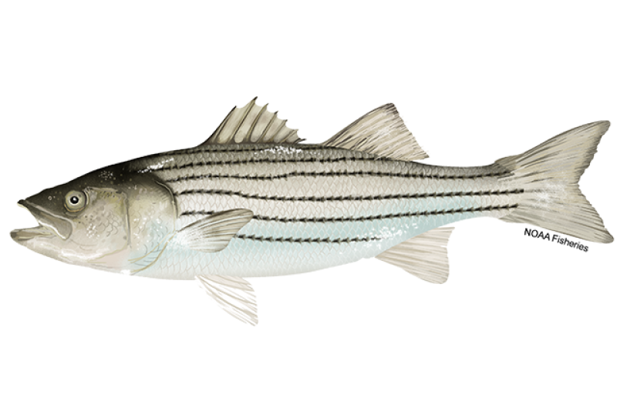
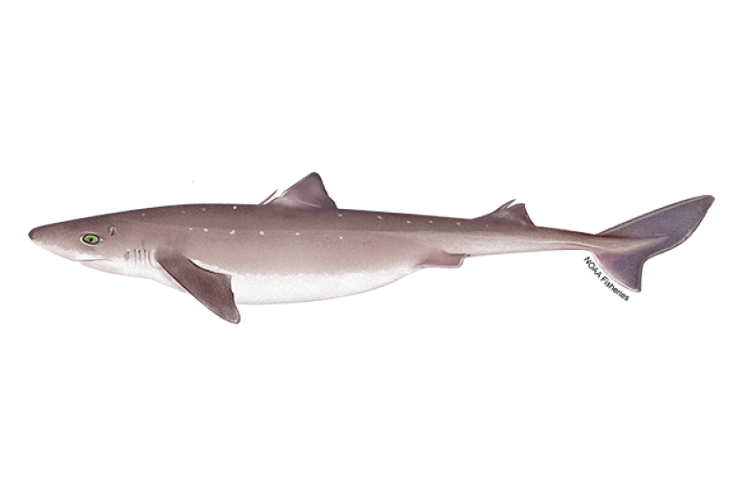
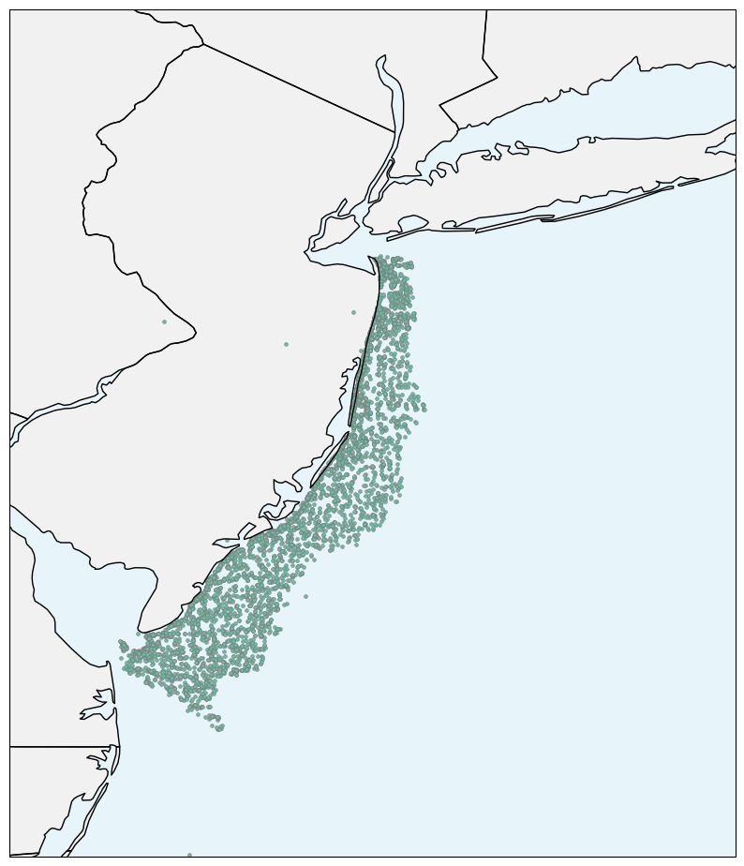
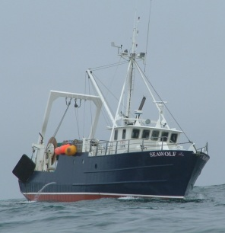
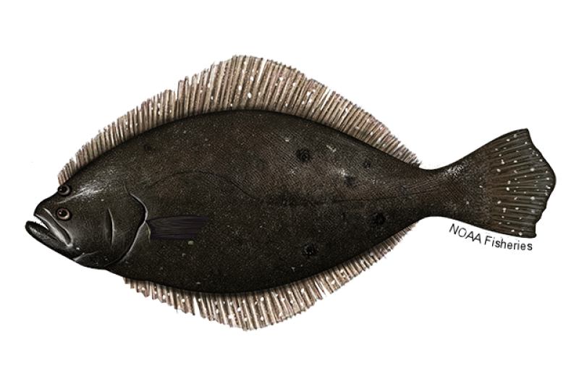
Decadal Trends of Fish and the Cold Pool
NJ DEP Trawl Survey
Start Locations
(1990-2019)
Notes:
Through collaboration with the NJ DEP and SCEMFIS, I was able to narrow down commericial species of interest and
use the NJ DEP trawl survey to analyze decadal trends of these species with the seasonal cold pool evolution.

Slide 9
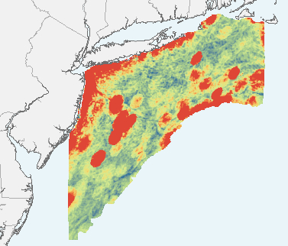

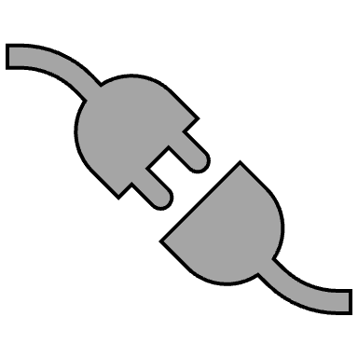
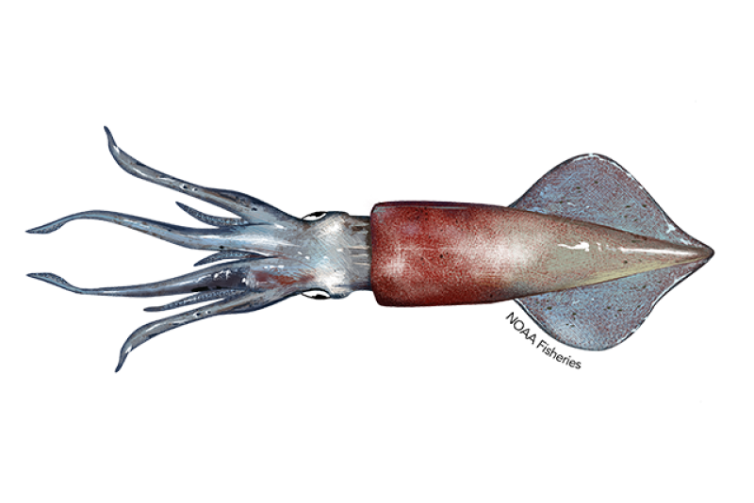
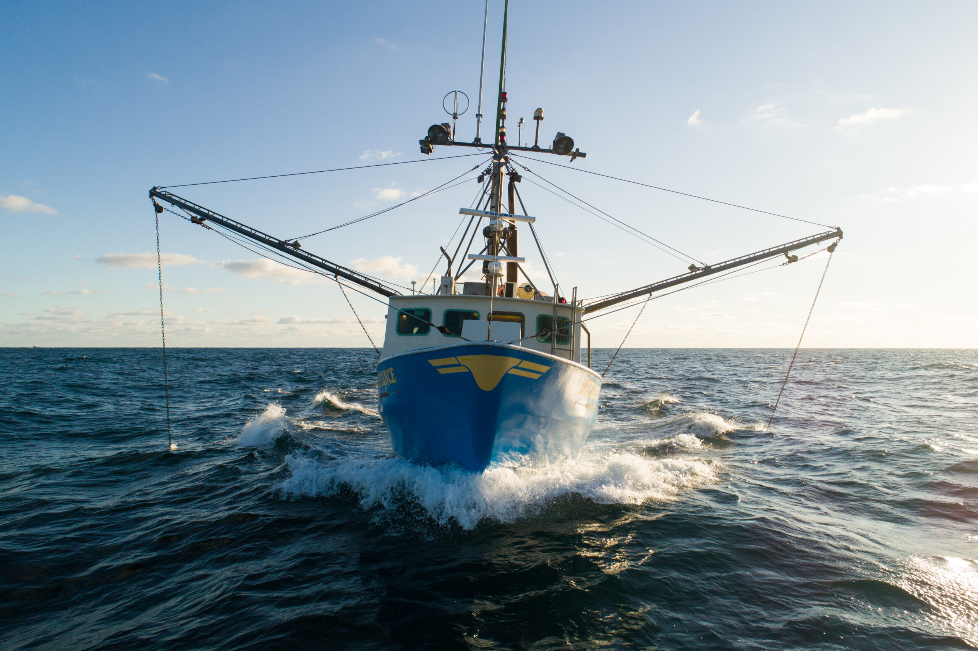

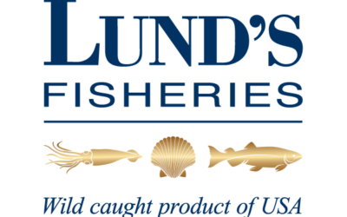
Spring Cold Pool Setup and Longfin Squid Migration
Longfin Squid
Predictive Spring Abundance
Notes:
I'll then be focusing in on the spring set up of the cold pool and the timing of the longfin squid migration
Longfin were chosen as a focal species after talking with fishermen, industry, and another collaborative group called the squid squad.. .

Slide 10
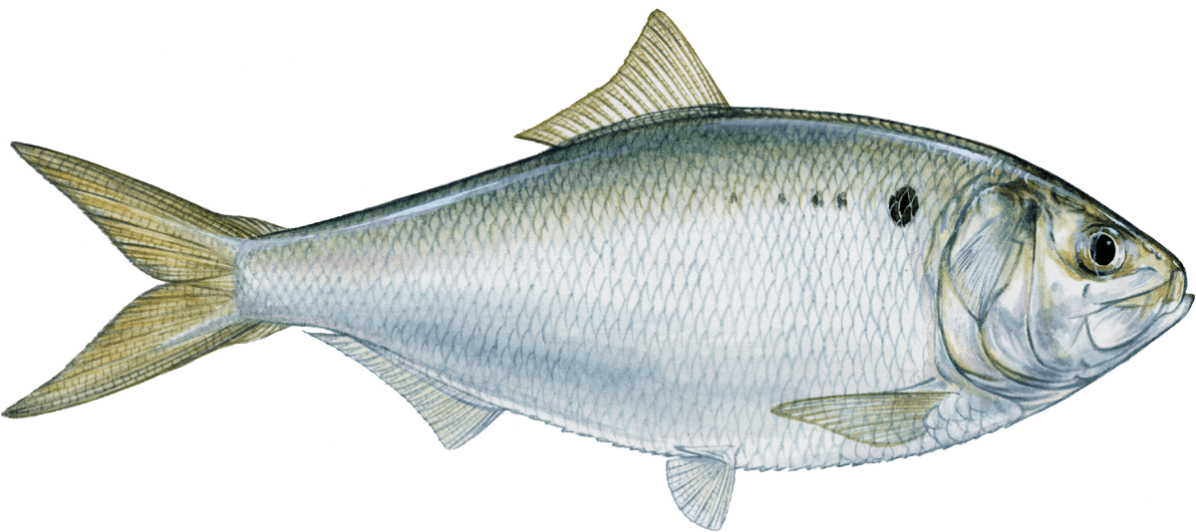
Fall Cold Pool Breakdown and Menhaden Inshore Presence
Atlantic Menhaden Habitat
9
Notes:
Then lastly I'll focus on the timing of the fall cold pool breakdown and the presence of atlantic menhaden inshore....
talking cooperative

Slide 11
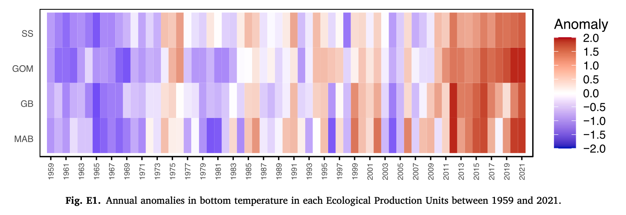
Cooperation at the Core of my Research
Current
Finalize Specific Science Questions
Identify Species and Methods
Identify and Provide Data Sources
Future
Interpretation of Results
Change over Time
1990
2019
(from du Pontavice et. al. 2023)
10
Notes:
ask not of what cooperative research can do for you but what you can do for cooperative research.
Has helped me with these things currently and will help me in the future

Slide 12
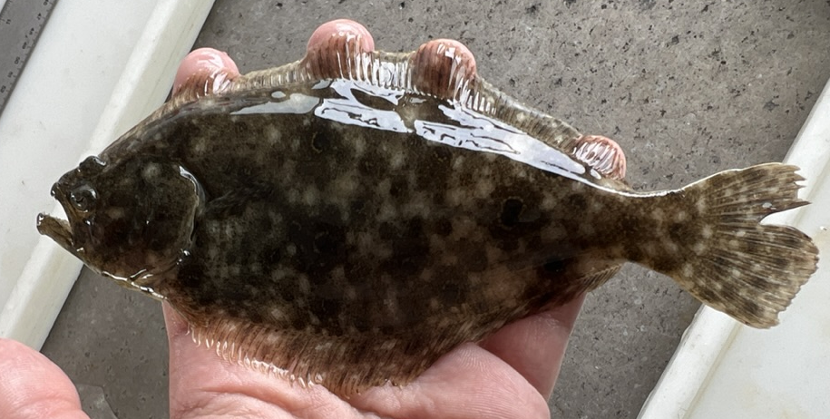
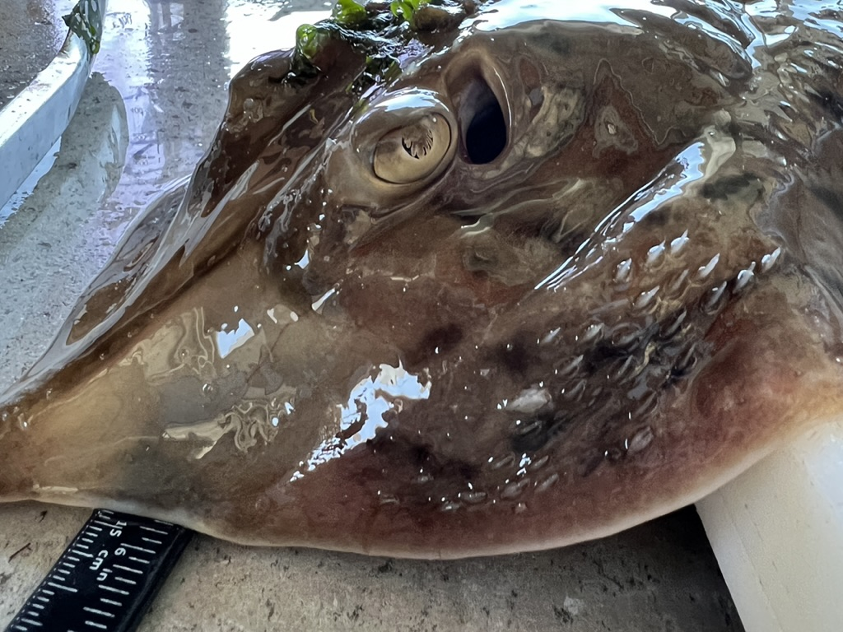
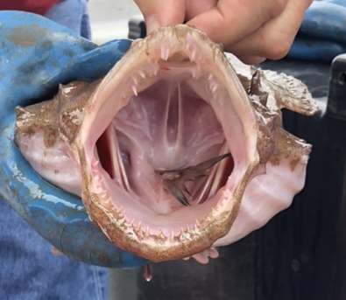
Next Steps
Continue Collaboration with Industry, Government, and Academia
Incorporate GLORYS ocean model to hindcast seasonal Cold Pool evolution
Resolve seasonal and decadal fish trends in abundance and distribution relative to Cold Pool stratification
Notes:
So whats next for this research?
Continue collaboration with industry
resolve the seasonal and decadal trends in the data
`
Hypotheses
H1: Nearshore species abundance changes over decadal time is consistent with decadal changes in seasonal stratification associated with the Cold Pool.
H2: Seasonally dependent distribution shifts can be explained by changes in the timing of cold
pool setup, intensification, and break down.

Slide 13
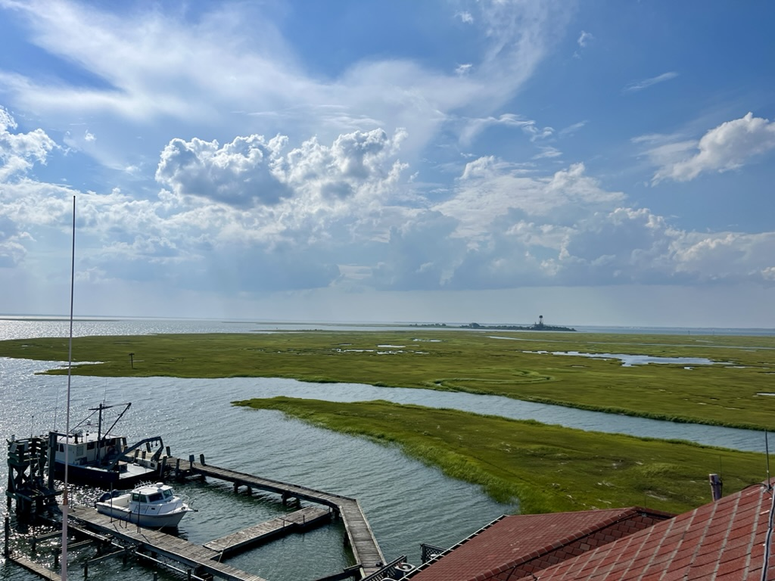
Thank you!
alaimo@marine.rutgers.edu
Check out the
Rutgers Collaborative Research Booth!

Slide 15
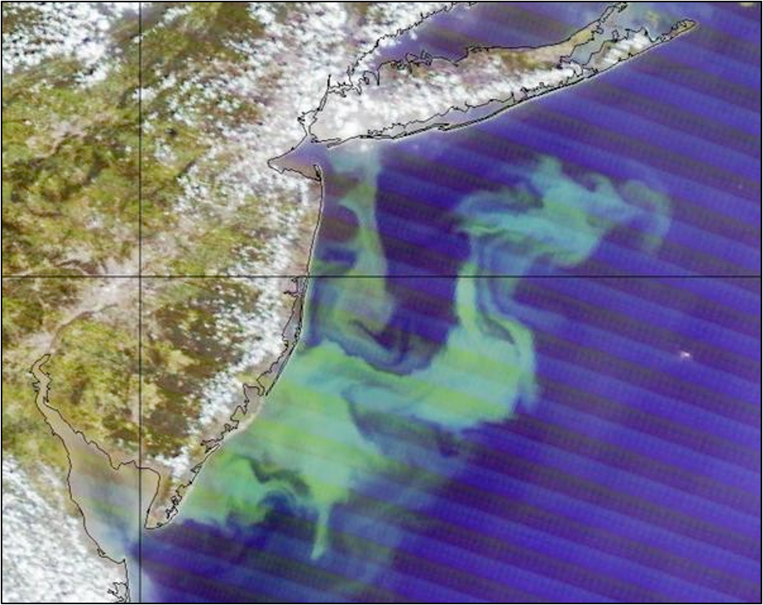
Ecological Processes and the Cold Pool
Introduction
Species Overview
SOMETHING
SOMETHING
Summary
Summer
Phytoplankton
Blooms
MODIS true-color image over Mid-Atlantic Bight
Phytoplankton Bloom, July 2011
Notes:
Starting from the base of the food chain, upwelling of cold pool what can trigger phytoplankton blooms that can be seen from Satellite imagery
Phytoplankton blooms can then translate up the food chain to upper trophic level species like *next slide

Slide 16
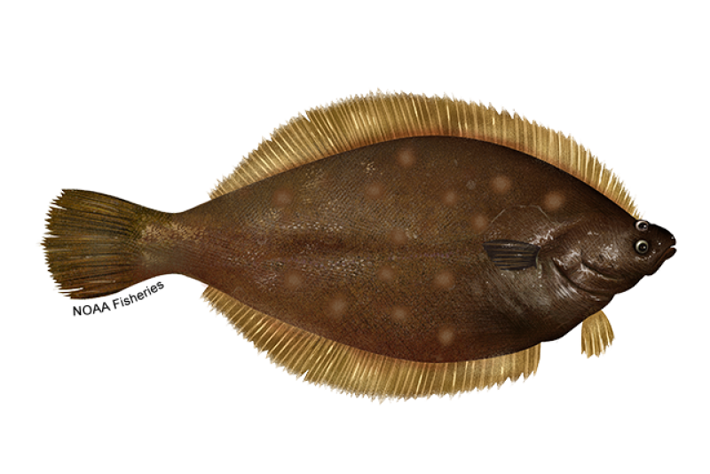
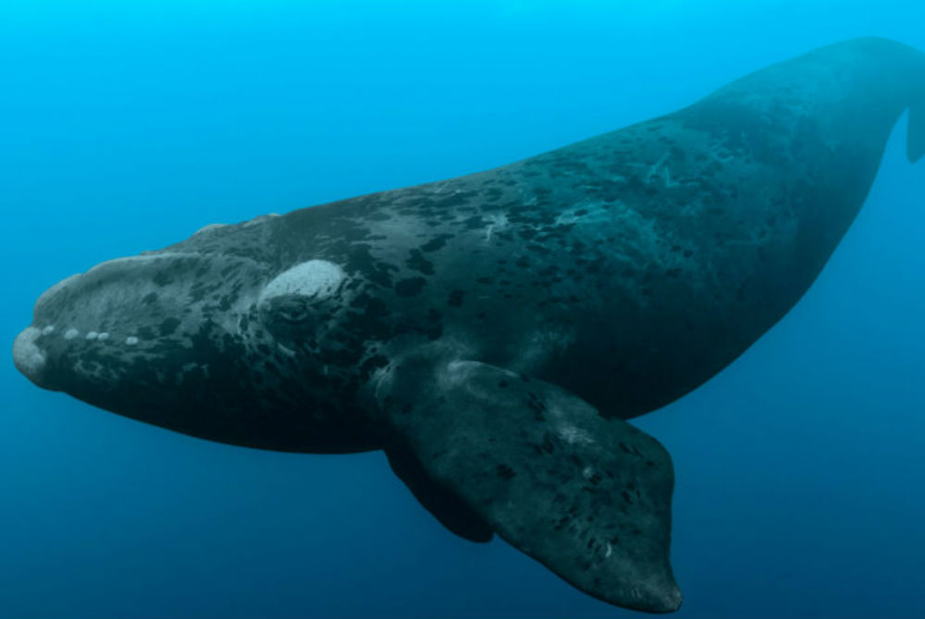
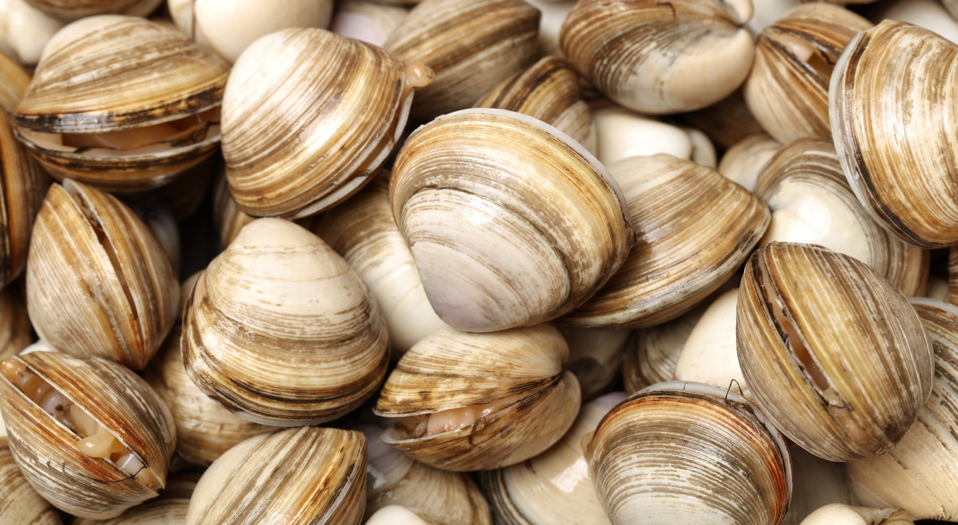
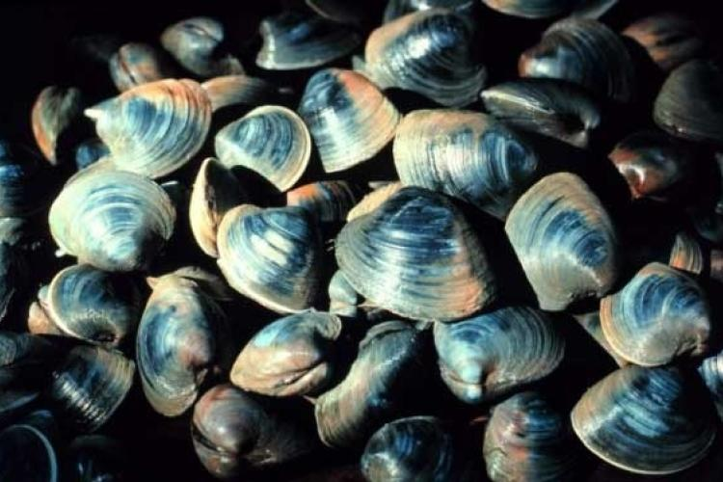
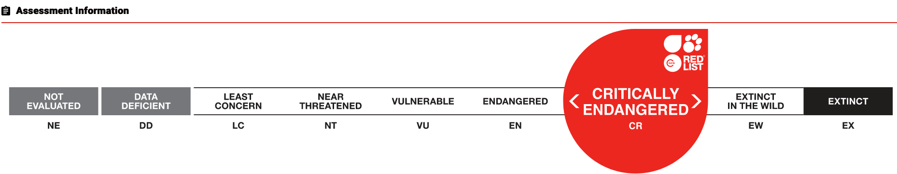
Ecological Processes and the Cold Pool
Introduction
Species Overview
SOMETHING
SOMETHING
Summary
Growth
Spawning
Migration
North Atlantic Right Whale
Surf Clam
Yellowtail Flounder
Ocean Quahog
Alter for the species that you chose
Economic and ecology of the cold pool
Striped Bass
Notes:
Like fish and invertebrates. All of these species are depending on the timing of cold pool formation and breakdown
Think of the bottom water like an air conditioner on a hot summer day→ the cold pool provides the AC for
GROWTH
Surf Clam (top left) https://www.undercurrentnews.com/2019/03/07/surf-clam-decision-helped-clearwater-end-2018-better-than-expected/
Growth and survival tied to cold pool stability throughout the year
High mortality can occur with rapid cold pool breakdown
SPAWNING
Ocean Quahogs (bottom right)
Heavy spawning associated with cold pool breakdown (Miles)
Yellowtail Flounder (top right)
Heavy spawning associated with cold pool breakdown (Miles)
MIGRATION AND FEEDING
Striped Bass (bottom left)
Critically Endangered NARW
- These two migrate though MAB region during different phases of cold pool development
These some of these species are not only ecologically important, but also commercially important

Slide 17
OSW has created Networks for Collaboration
Introduction
Species Overview
SOMETHING
SOMETHING
Summary
Mid-Atlantic Cold Pool
Where does the Cold Pool Form and why?
Habitat
Spatial Distribution and Oceanographic Features
Baseline Information
Species Distributions, Abundances, Migratory Patterns, and Ecological Drivers
Long term trends
How abundances and distributions changes over space and time
Source: Regional Synthesis Workgroup of the Offshore Wind Environmental Technical Working Group 2022
Notes:
These questions and concerns about this have led to regional coordination between industry leaders, scientists and stake holders. Here are some priorities for research that were put together as a result of coordination
Priorities including
Understanding the seasonal dynamics of the MAB cold pool
Understanding the spatial drivers of fish distribution and of oceanographic features
Establishing a baseline of knowledge for fish residing the MAB region
And how have these abundances and distributions changed over time
To isolate the effects of offshore wind development on MAB oceanography and ecology, the community must first comprehend how the system functions prior to construction.

Slide 18
Species Selection
Introduction
Species Overview
SOMETHING
SOMETHING
Summary
Notes:
Why these Fish
To address the proposed hypotheses, I will be using these three commercial species
These three were chosen with the advice of fisheries managers, industry leaders, and commercial fishers.
They also occur frequently in the dataset that I will be talking about in a minute
All bottom dwelling species that occupy the Mid Atlantic bight in the cold pool.
They all have particular temperature preferences, and they all have commercial value

Slide 19

The Mid Atlantic Bight and Cold Pool are
Changing Over Time
Notes:
The Mid-Altantic Bight and the Cold Pool, however is changing
Several studies have shown that the bottom temperature in the MAB is warming and there are indictors that the cold pool itself is warming and shrinking,
which would be impactful to the species and industry the cold pool supports
This figure is from du Pontavice et. al. 2023 and shows the yearly bottom temperature anomaly in the MAB and as you can see, it's getting warming

Slide 20

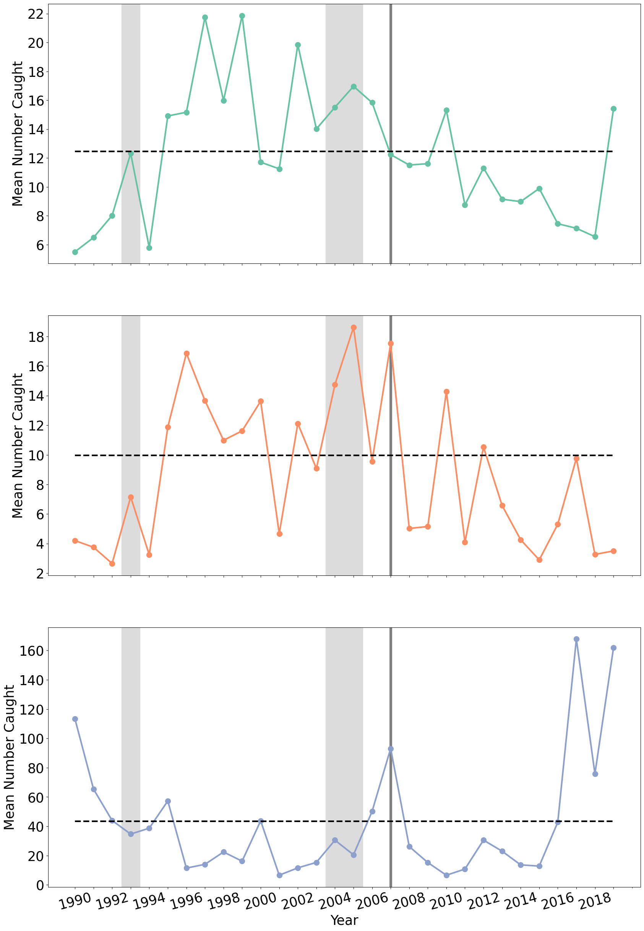
Introduction
Species Overview
SOMETHING
SOMETHING
Summary
Mean Number of Fish Caught per year across all seasons
Survey occurs
5x per year!
30-year mean
Strong Cold Pool Years
2007 Cold Pool Analysis Cut Off
Notes:
From these data, I will be looking at baseline trends in abundance over decades
*orient to the figure*
There are changes between years and between decades and
because it is sampled so frequently, we can look deeper into seasonal dynamics.

Slide 21
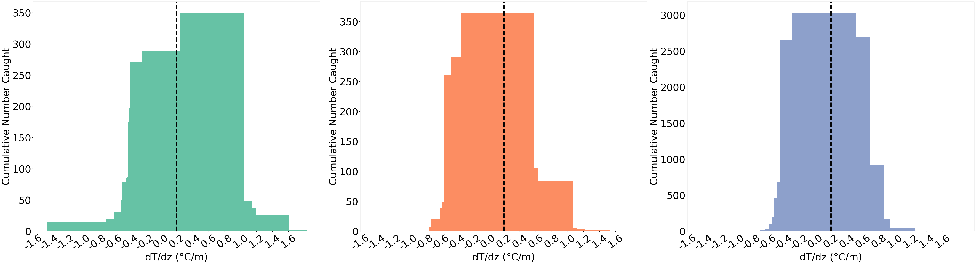
Introduction
Species Overview
SOMETHING
SOMETHING
Summary
Certain Species Favoring a Stratified Water Column?
No Cold Pool
Cold Pool
No Cold Pool
Cold Pool
No Cold Pool
Cold Pool
Notes:
This is all surveys across all years
We can also examine abundances compared to water column conditions! Do the fish care about a stratified water column?
*orient to figure*
Cumulative number caught
Top-Bottom temperature bins
values near 0 means that the surface and bottom temperatures are nearly the same

Slide 22
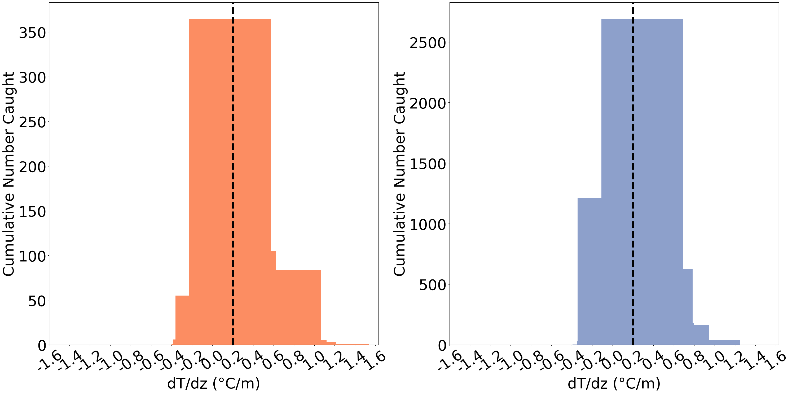
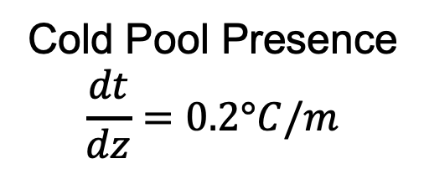
Early Cold Pool Development (June)
Cold Pool Presence
$$\frac{dt}{dz}=0.2°C/m$$
No Cold Pool
Cold Pool
No Cold Pool
Cold Pool
Notes:
with these data we can assess potential fish preferences with the stratified water column at different stages of Cold Pool Development
This is an example of Striped Bass and Spiny Dogfish,
*Orient to the figure*
Cold Pool Presence is defined using a 0.2°C/m threshold (indicated by black dotted line)

Slide 23
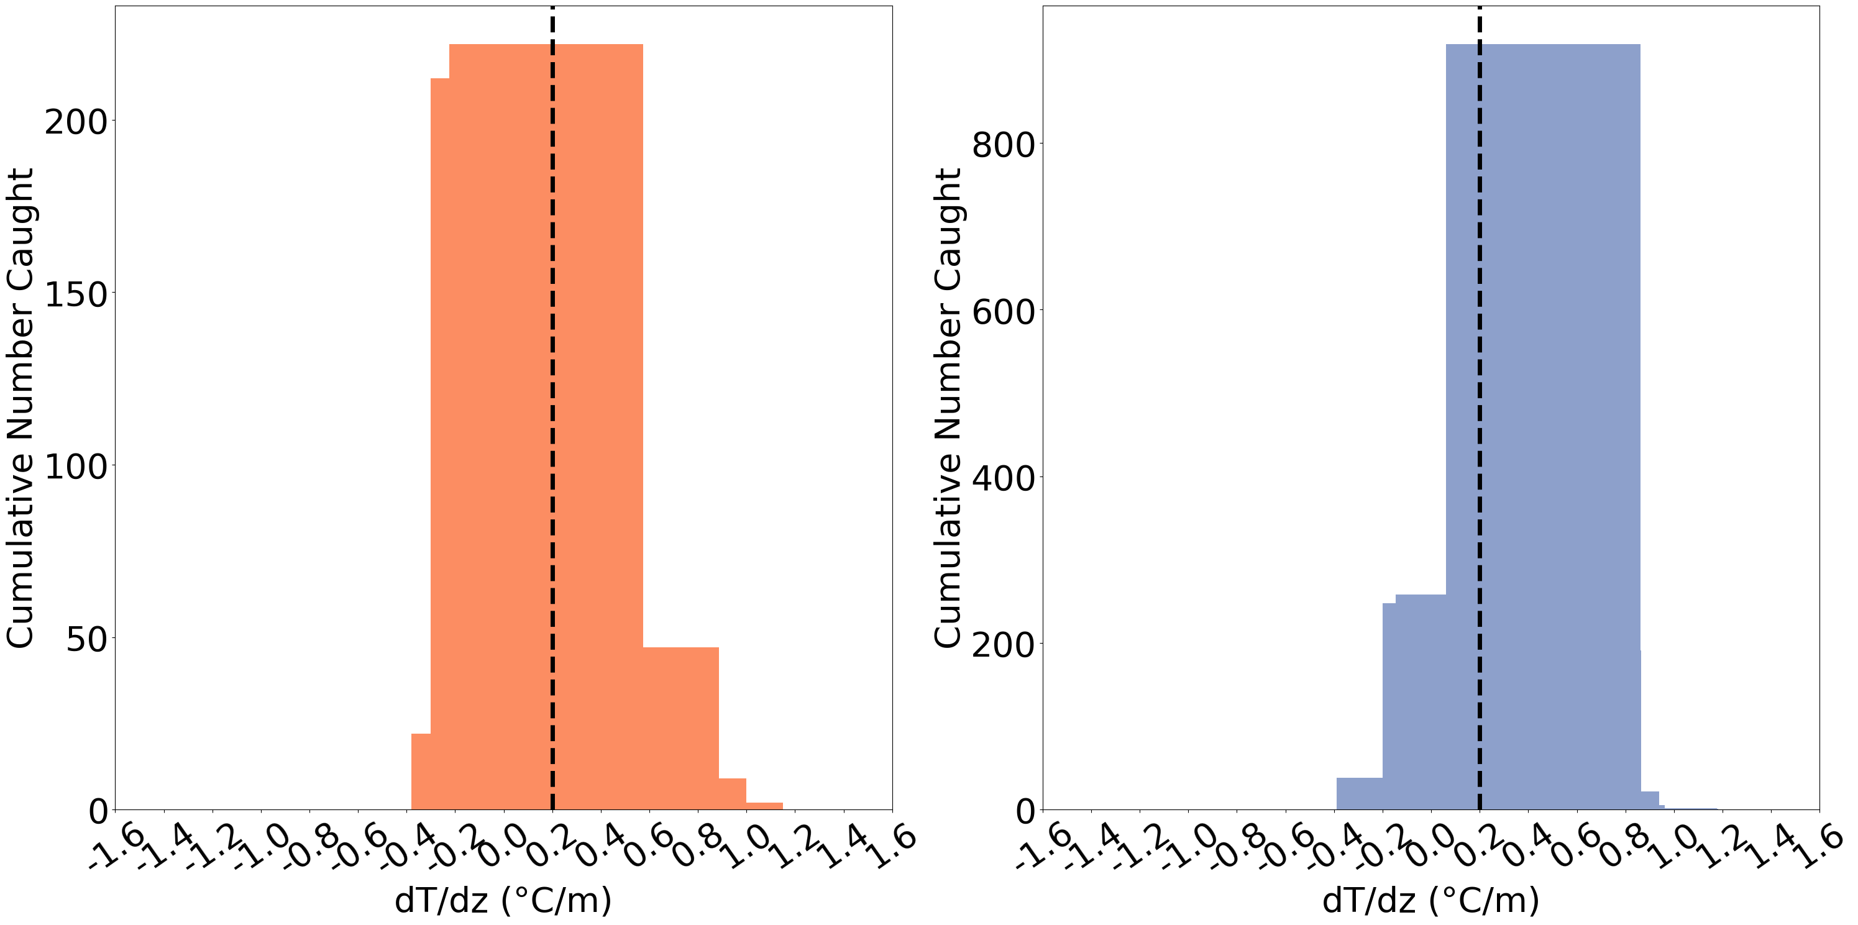
Peak Cold Pool Development (August)
Cold Pool Presence
$$\frac{dt}{dz}=0.2°C/m$$
A Shift?
No Cold Pool
Cold Pool
No Cold Pool
Cold Pool
Notes:
This is the same thing as the previous slide but now in august
What is driving the shifts seen in spiny dogfish for example?

