Slide 1





The Influence of Mid-Atlantic Bight Seasonal Oceanographic Variability on Commercial Species Dynamics
Samantha Alaimo*¹
Bill Bright², Jeff Brust³, Colleen Brust³, Jeff Kaelin⁴,
Travis Miles¹, Daphne Munroe⁵, Grace Saba¹ & Josh Kohut¹
*alaimo@marine.rutgers.edu
1. Department of Marine and Coastal Sciences, Rutgers University
2. Captain, F/V Defiance and F/V Retriever Cape May, NJ
3. New Jersey Marine Resources Administration-Nacote Creek Research Station
4. Lund’s Fisheries, Cape May, NJ
5. Haskin Shellfish Research Laboratory, Rutgers University
Notes:
Introduce self and presentation title
Candidate

Slide 2




Fish-ics: Fish and Physics
Fish live in the Ocean
The Ocean Moves
Fish have Tails
People eat Fish
Notes:
But depending on the way the ocean moves, the habitat conditions vary in time and space which can significantly influence fish distribution and migration

Slide 3
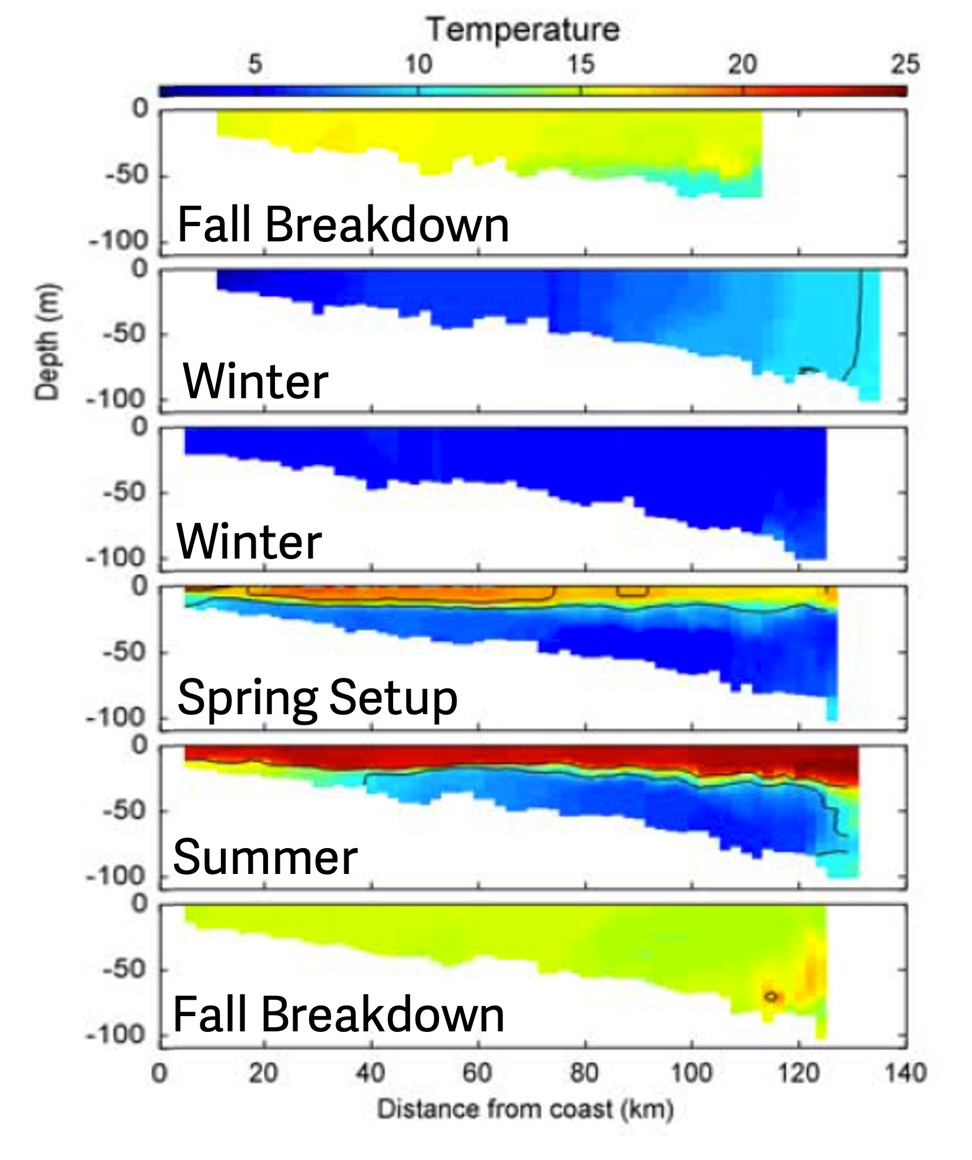
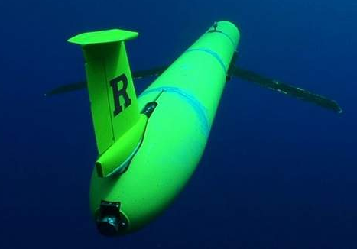
An Ecological-Economic Hub: The Dynamic Mid-Atlantic
Intensification
Deeper
Offshore
(from Castelao et al. 2008)
Notes:
And that place is the Mid-Atlantic
The Mid Atlantic Bight is an ocean region that spans from Cape Cod to Cape Hatteras that has a large seasonal temperature signal known as the Cold Pool.
The cold pool is a distinctively cold, nutrient dense body of bottom water that forms every year in the spring.
Right Figure:
The figure on the right are cross-shelf transects based on glider tracks along the red line on the right
As we go further to the right on the figure, we are getting farther away from the coast and as we go down in the individual panels, we are getting deeper in the water column
Formation:
Fall into Winter: lots of storm and water column mixing so the water column is fairly uniform in temperature
Spring: the weather starts to warm up, less storms, the surface water begins to warm and become layer, or stratified
Summer: Strong layering/stratification-– surface water is really warm, deeper water is really cold from water supplied by the Scotian Shelf water in the North
Fall: Storms pick up again, the surface and deep-water mix and the water becomes more uniform
This dramatic change in temperature that happens every year in this small subset of the ocean,

Slide 4
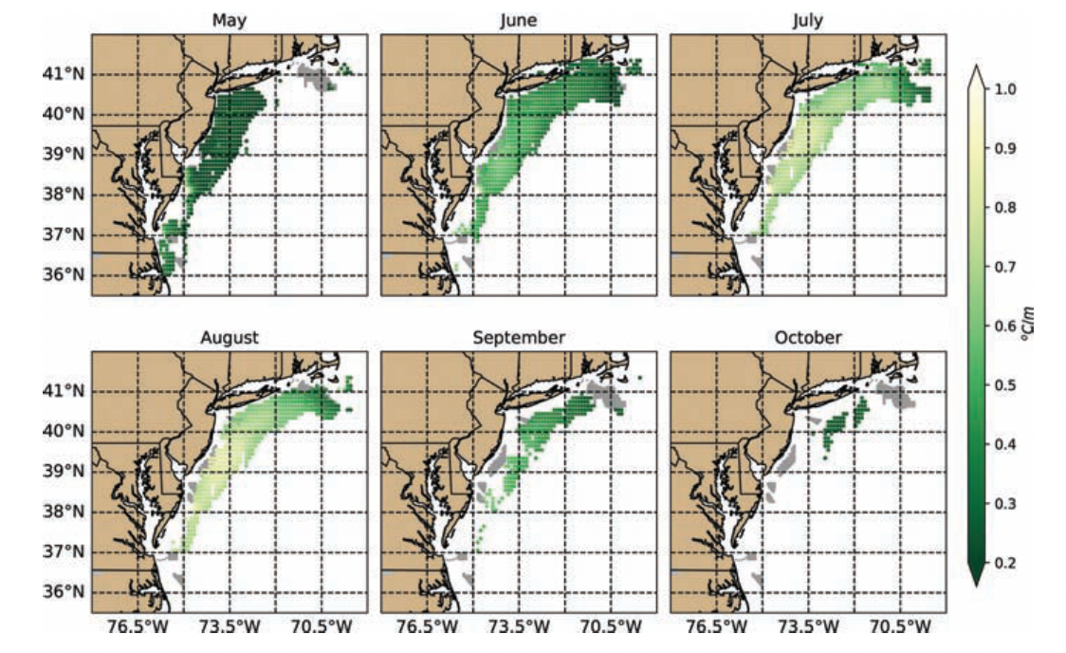
The Cold Pool Extent Depends on Season
Seasonal extent of the Cold Pool (from Miles et. al. 2021)
Notes:
The interannual formation differs every year. Not all cold pools are created equal
Depending on the time of the year, depends on the spatial extent of the cold pool.
At it’s peak in the summer, the cold pool extends nearly the whole MAB
- Spatial extent--- lighter is more stratified, dark is less stratified

Slide 5
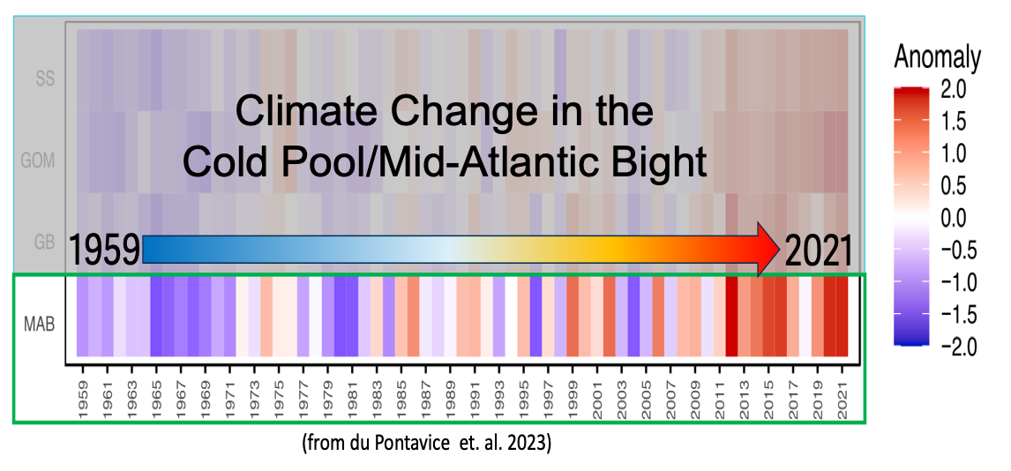
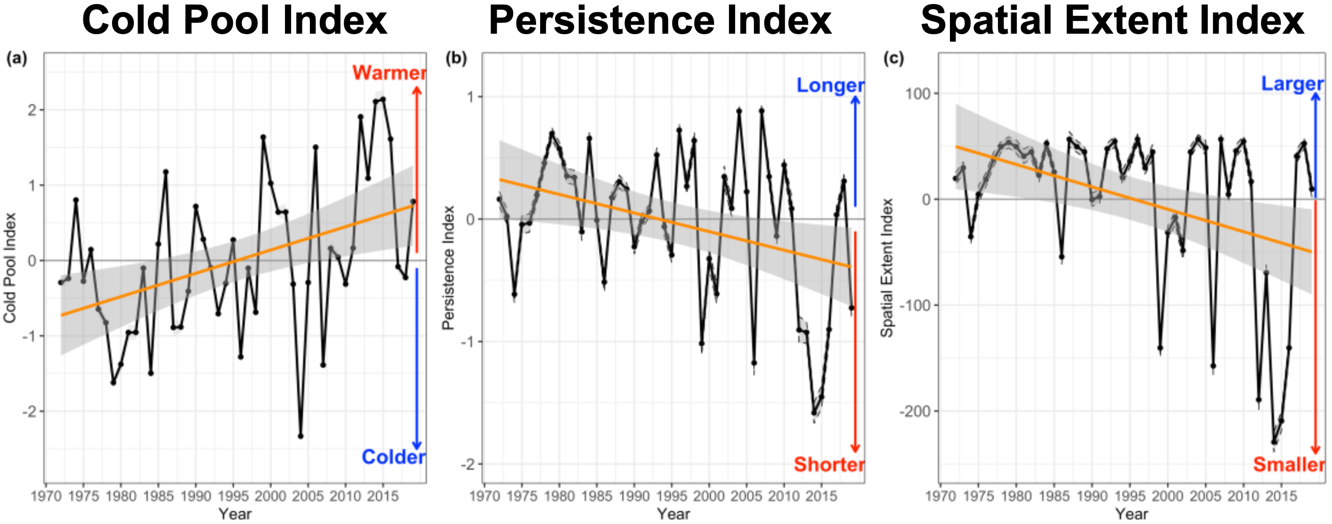
The Mid-Atlantic Bight is Changing Over Time
Bottom Temperature
Warming
Shortening
Shrinking
(du Pontavice et. al. 2022)
Notes:
The MAB is changing over time in it's condition and use
*Orient to figure on Left*
Bottom temperature anomaly-- things are getting warmer
Also as we know, offshore wind development will be occurring in the coming years
The changes to the MAB are especially concerning given that....slide

Slide 6
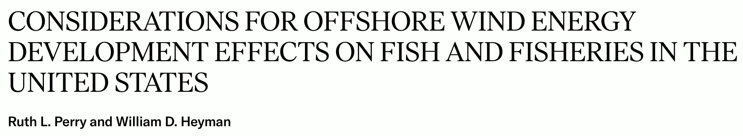
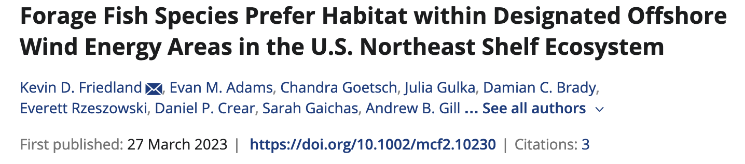
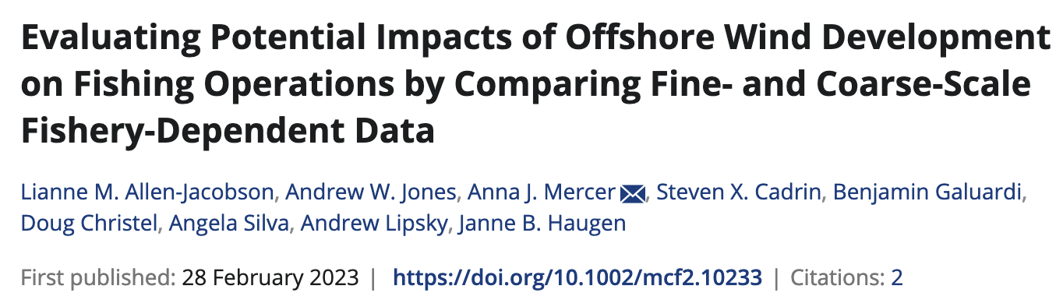
The Mid-Atlantic Bight is Changing Over Time

Slide 7
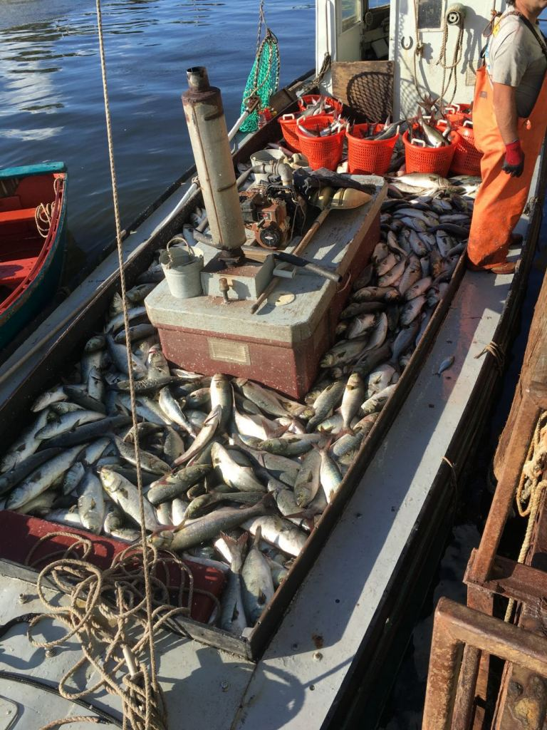
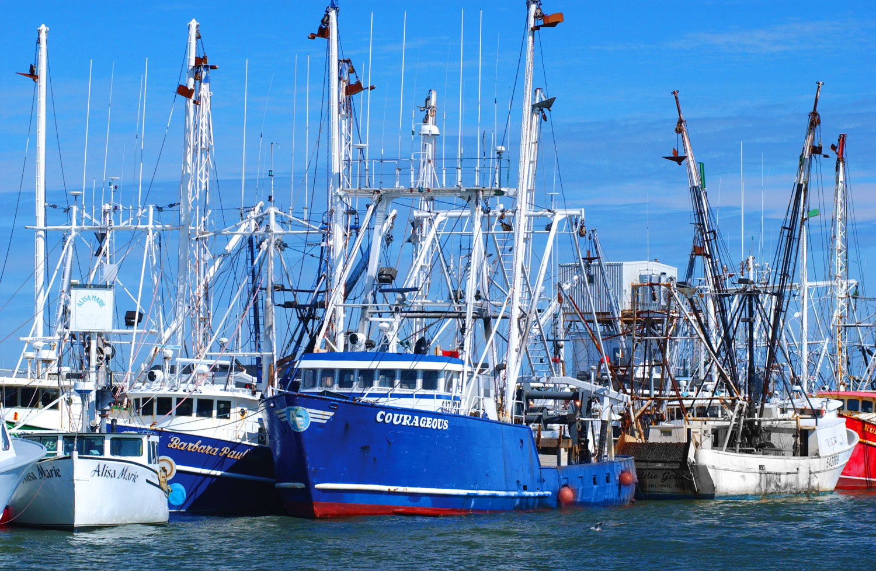
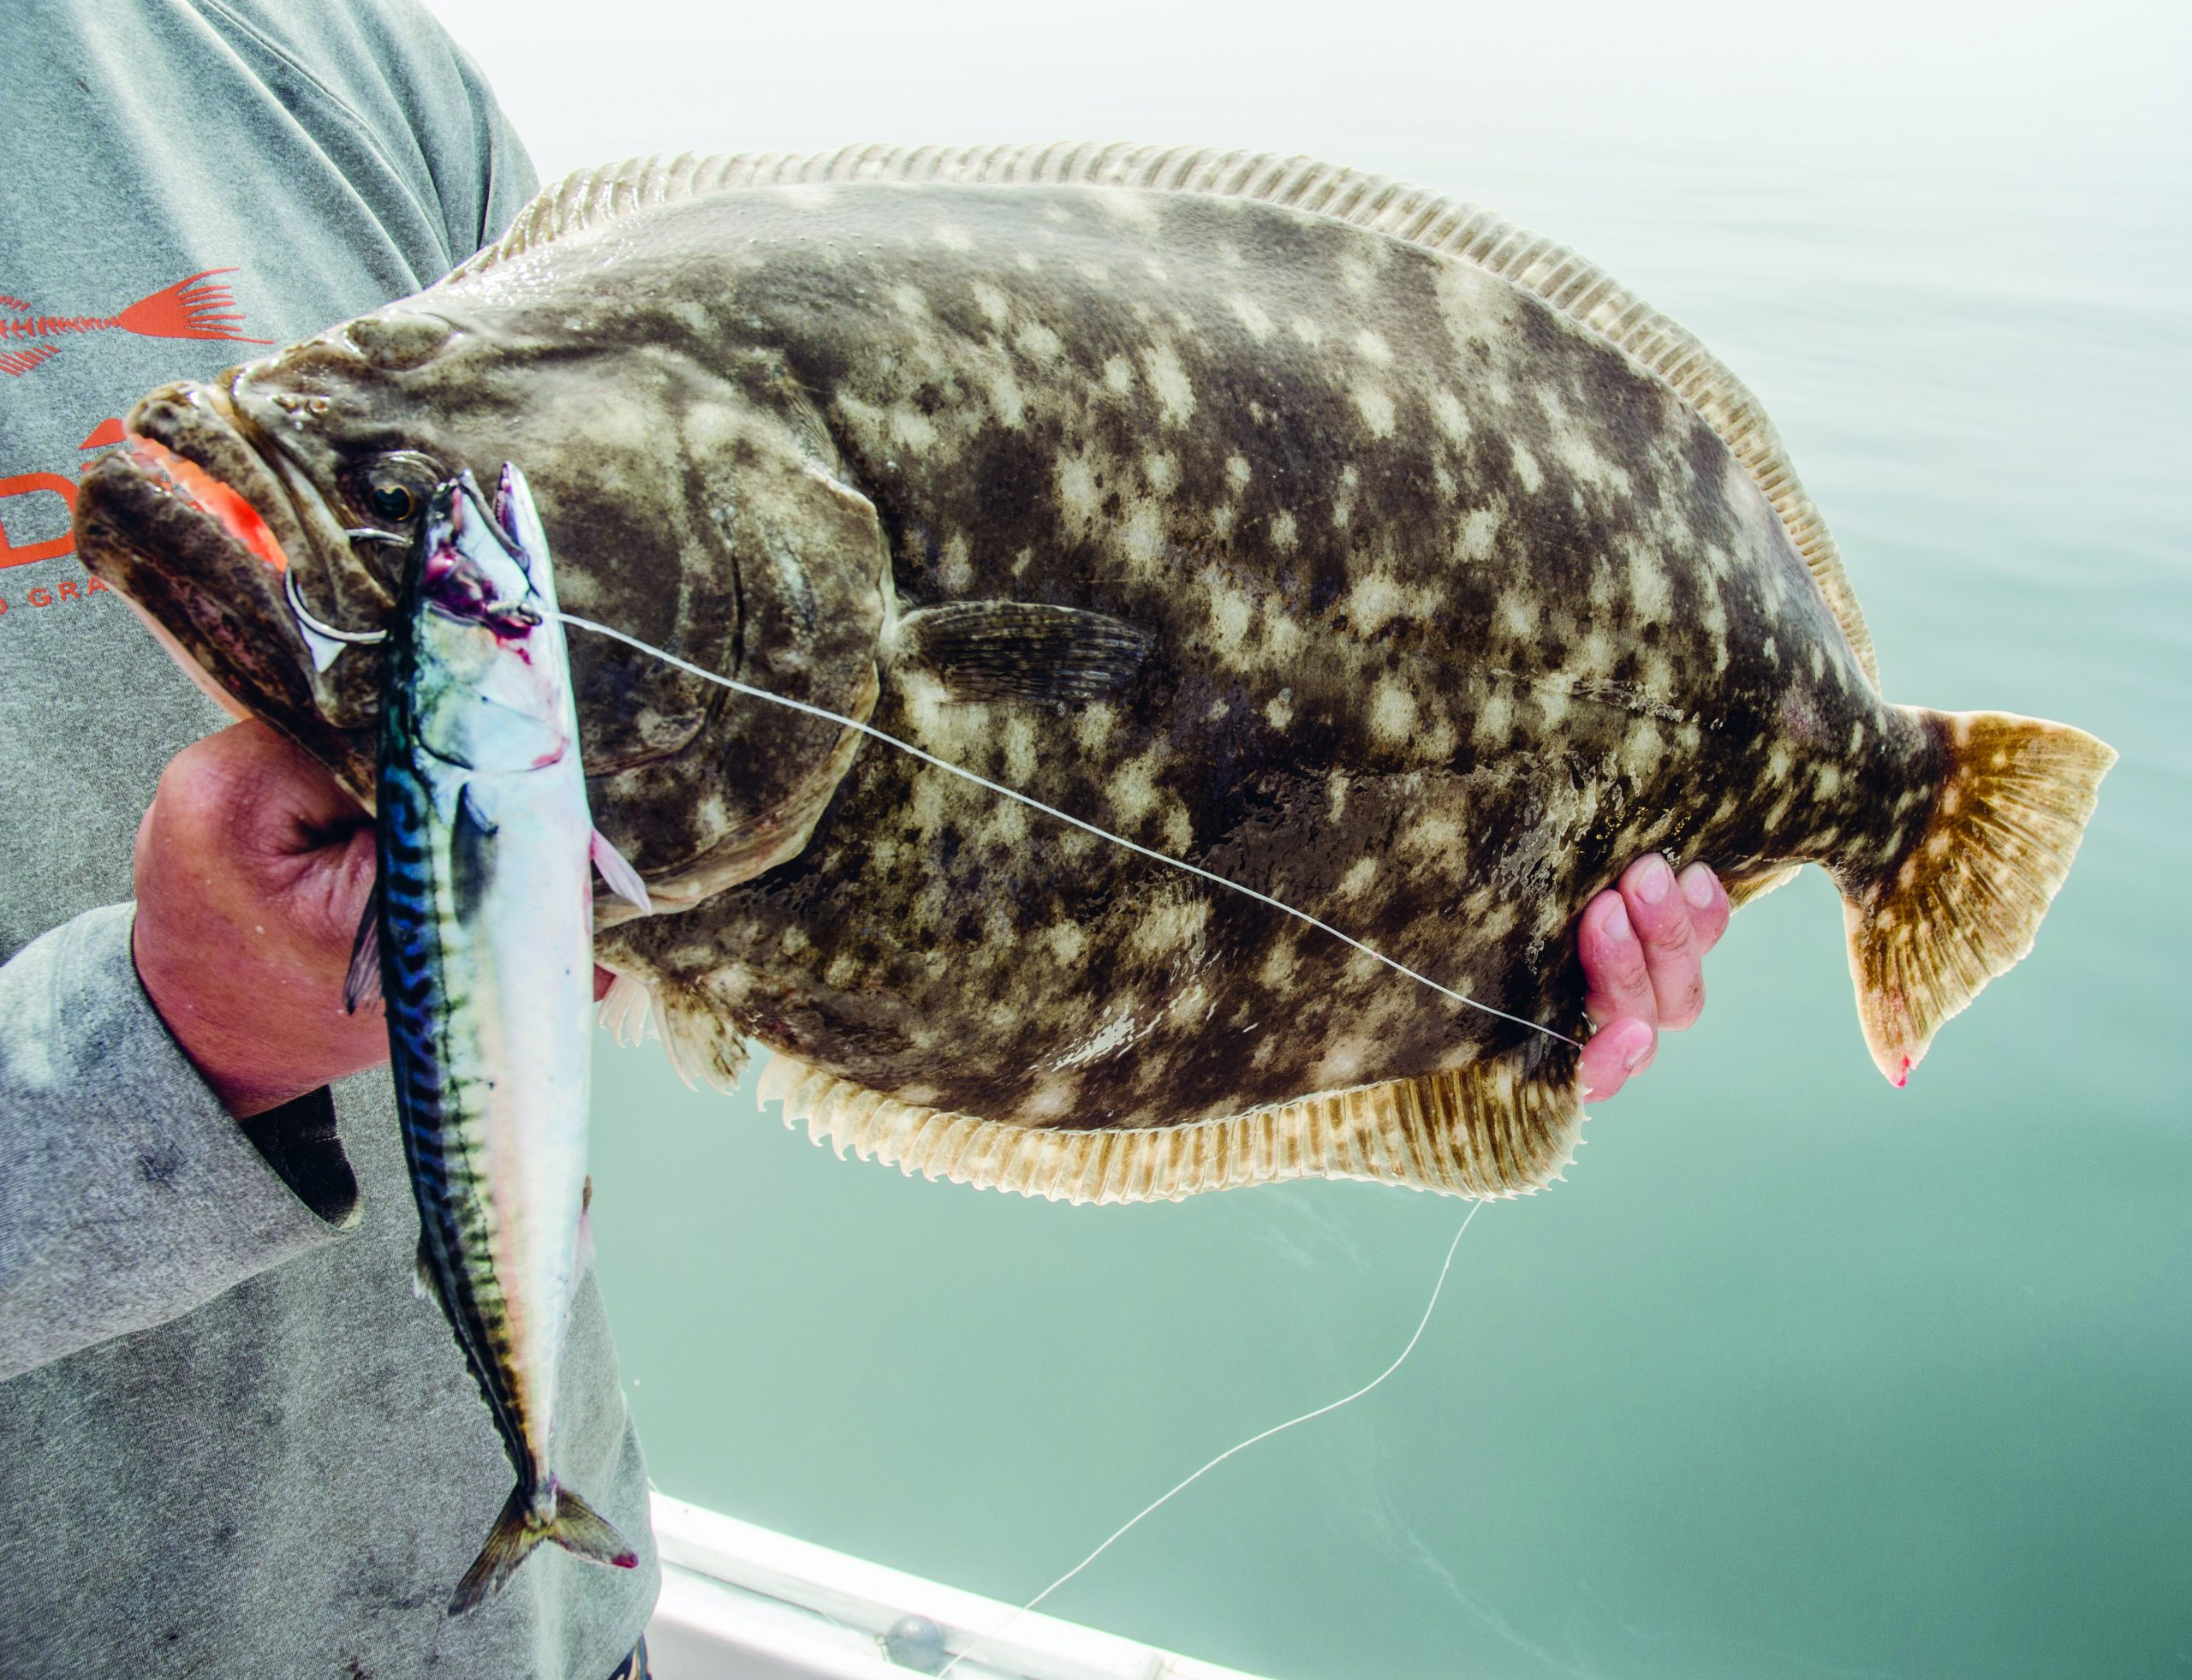
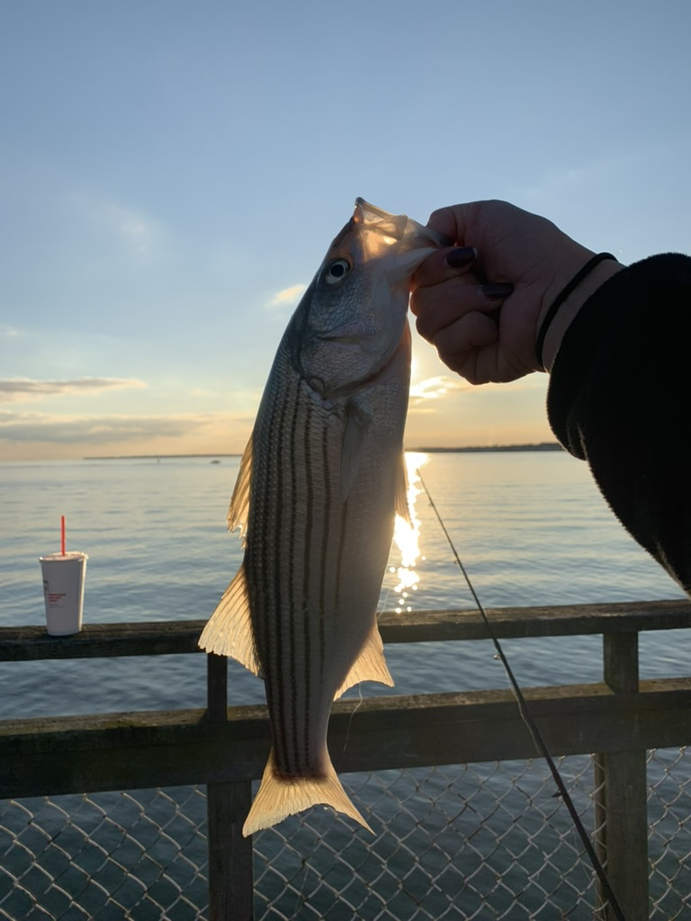
Cold Pool Supports
Commercial and Recreational Fisheries
MAB States 2019
Commercial Fisheries Revenue
$500,000,000
Notes:
The changing MAB is especially concerning for our fishing industries
The cold pool not only supports the ecology, but it also supports the economy through commercial and recreational fishing.
States bordering the MAB alone generated $500 million in commercial fishing revenue in 2019 .
Seasonal, interannual and long-term variability in cold pool processes could lead to changes to the habitat of these commercial species, impacting the coastal economies and livelihoods they support.
https://capemaycountynj.gov/940/Commercial-Fishing
https://www.jerseysbest.com/community/harvesting-the-sea/
https://www.onthewater.com/news/2021/02/19/comment-on-the-2021-new-jersey-recreational-fluke-season-options
Title : State of the Ecosystem 2022: Mid-Atlantic
Corporate Authors(s) : Northeast Fisheries Science Center (U.S.)
Published Date : 2022
DOI : https://doi.org/10.25923/5s5y-0h81

Slide 8
Research Goals:
This study will investigate the long-term and seasonal trends of commercial species’
abundances and distributions in relation to the
Mid-Atlantic Bight Cold Pool Processes
Notes:
This research in particular investigates....
to establish baseline interactions that species have with the Cold Pool in the MAB
Community-based effort to establish a baseline and better inform for EBFM

Slide 9
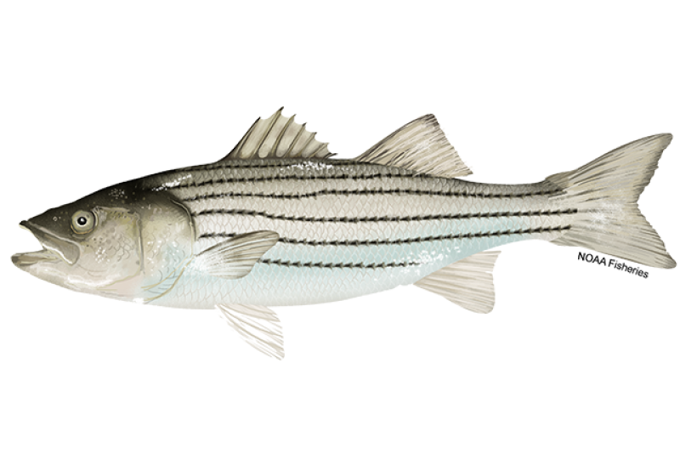
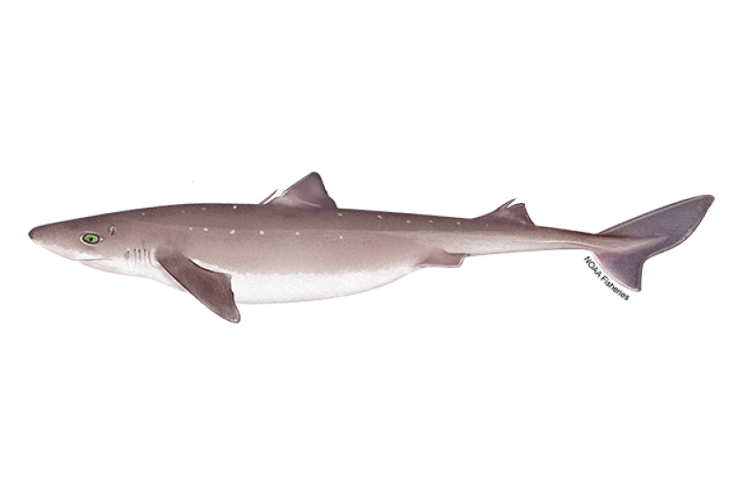
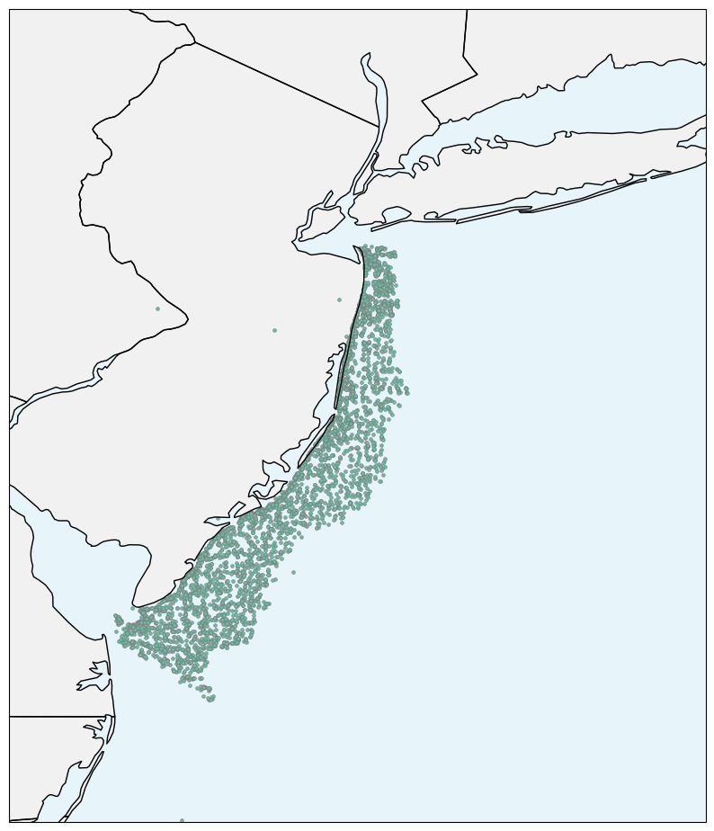
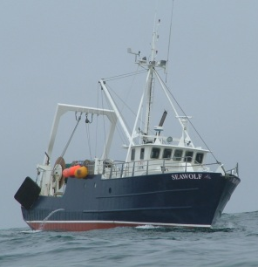
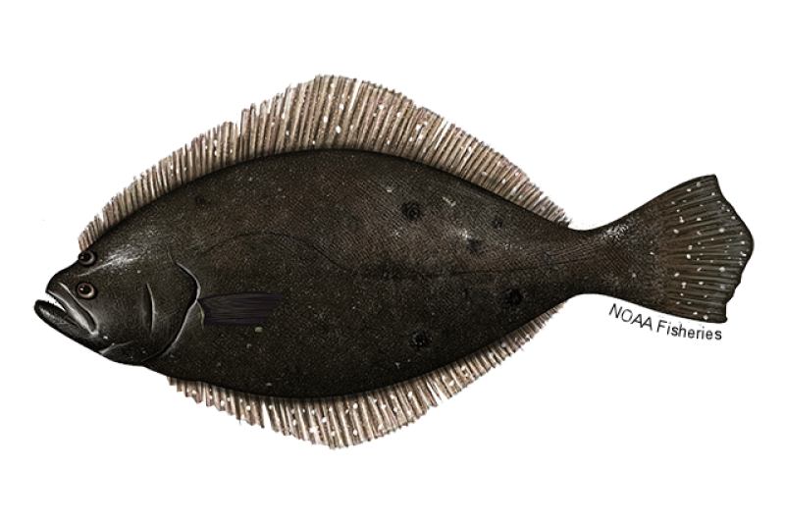

Decadal Trends of Fish and the Cold Pool
NJ DEP Trawl Survey
Start Locations
(1990-2019)
Notes:
Through collaboration with the NJ DEP and SCEMFIS, I was able to narrow down commercial species of interest and
use the NJ DEP trawl survey to analyze decadal trends of these species with the seasonal cold pool evolution.
Using GAMS—generalized additive models

Slide 10
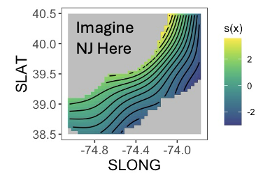
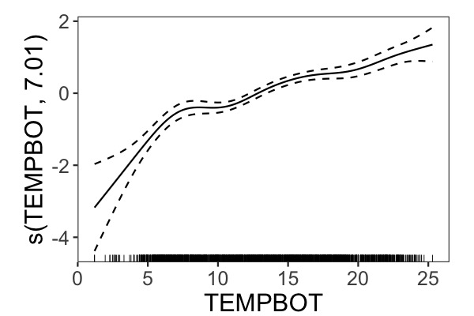
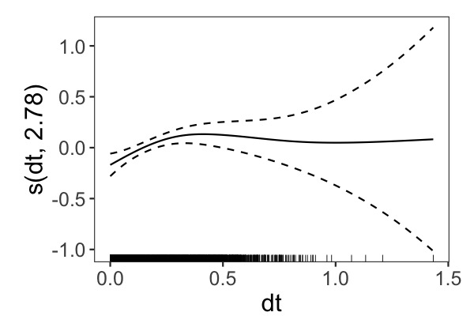
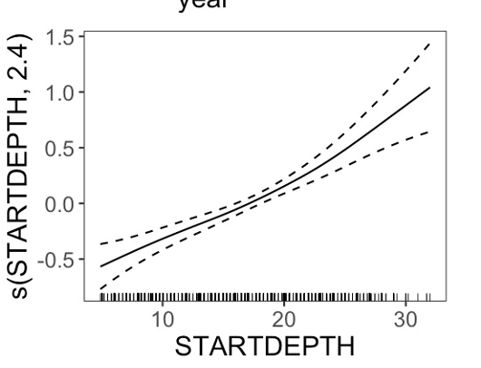
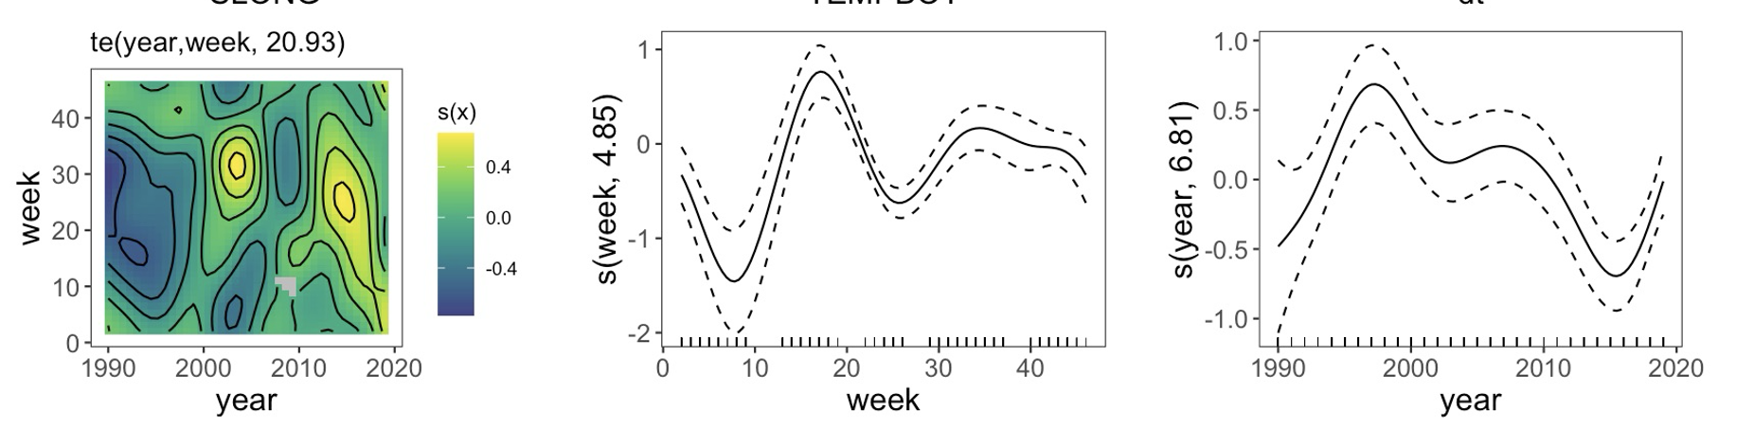
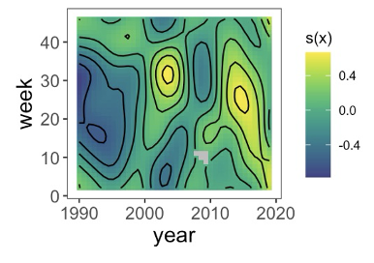
Summer Flounder CPUE
New Jersey Coast
Bottom Temperature
Depth
Water Column Stratification
Imagine NJ Here
Year vs. Week of Year
Week of Year
Year
Summer Flounder CPUE =
te(Longitude, Latitude) + s(Bottom Temp.) + s(dt/dz) + s(Depth)
+ te(year, week of year) + s(week) + s(year)
Notes:
These are the partial effects plots from the summer flounder cpue gam
Explain the plots a little
As you can see there is a lot of variability but I want to focus your attention on the temporal scale

Slide 11
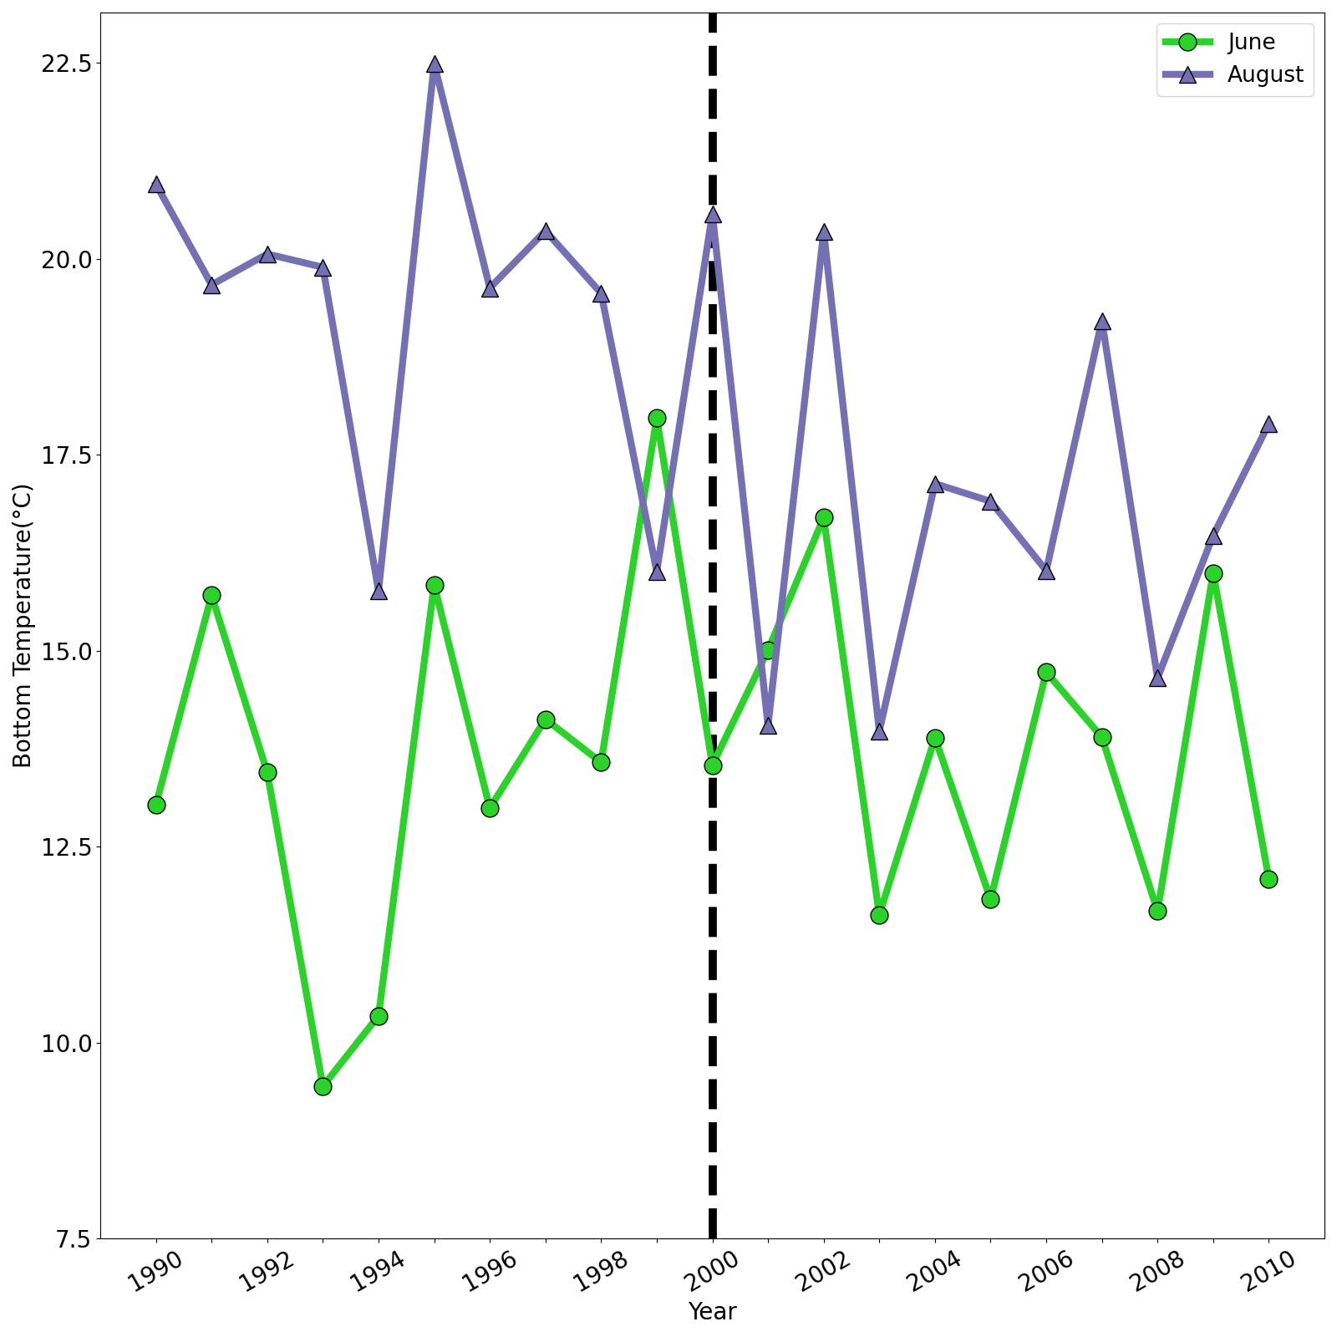
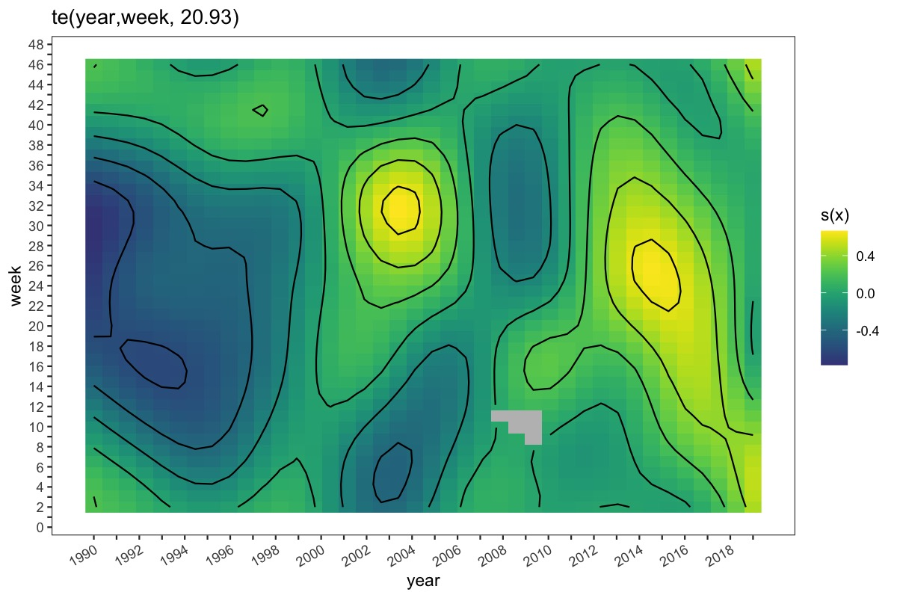
Next Steps: Diving into the Oceanography
Bottom Temperature from the NJ DEP Survey
Predicted Summer Flounder CPUE
Year
Notes:
Looking at the response of sf cpue from the model and the oceanographic params
We are looking to see if there are any changes in the oceanography that can explain the variabtion in cpue
This is bottom temp

Slide 12
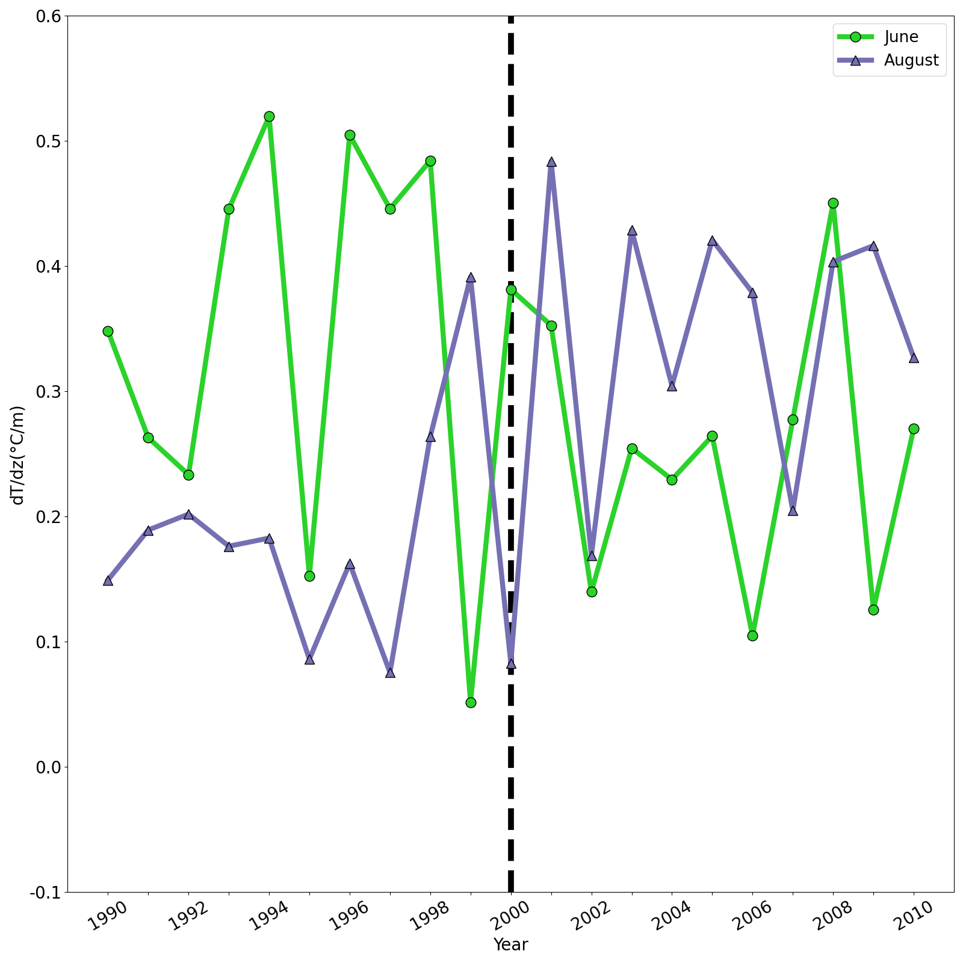
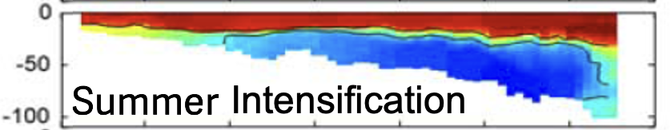
Next Steps: Diving into the Oceanography
dT/dz from the NJ DEP Survey
Predicted Summer Flounder CPUE
Year
Notes:
Looking at that again for the water column stratification theres a lot of variability in june and august

Slide 13

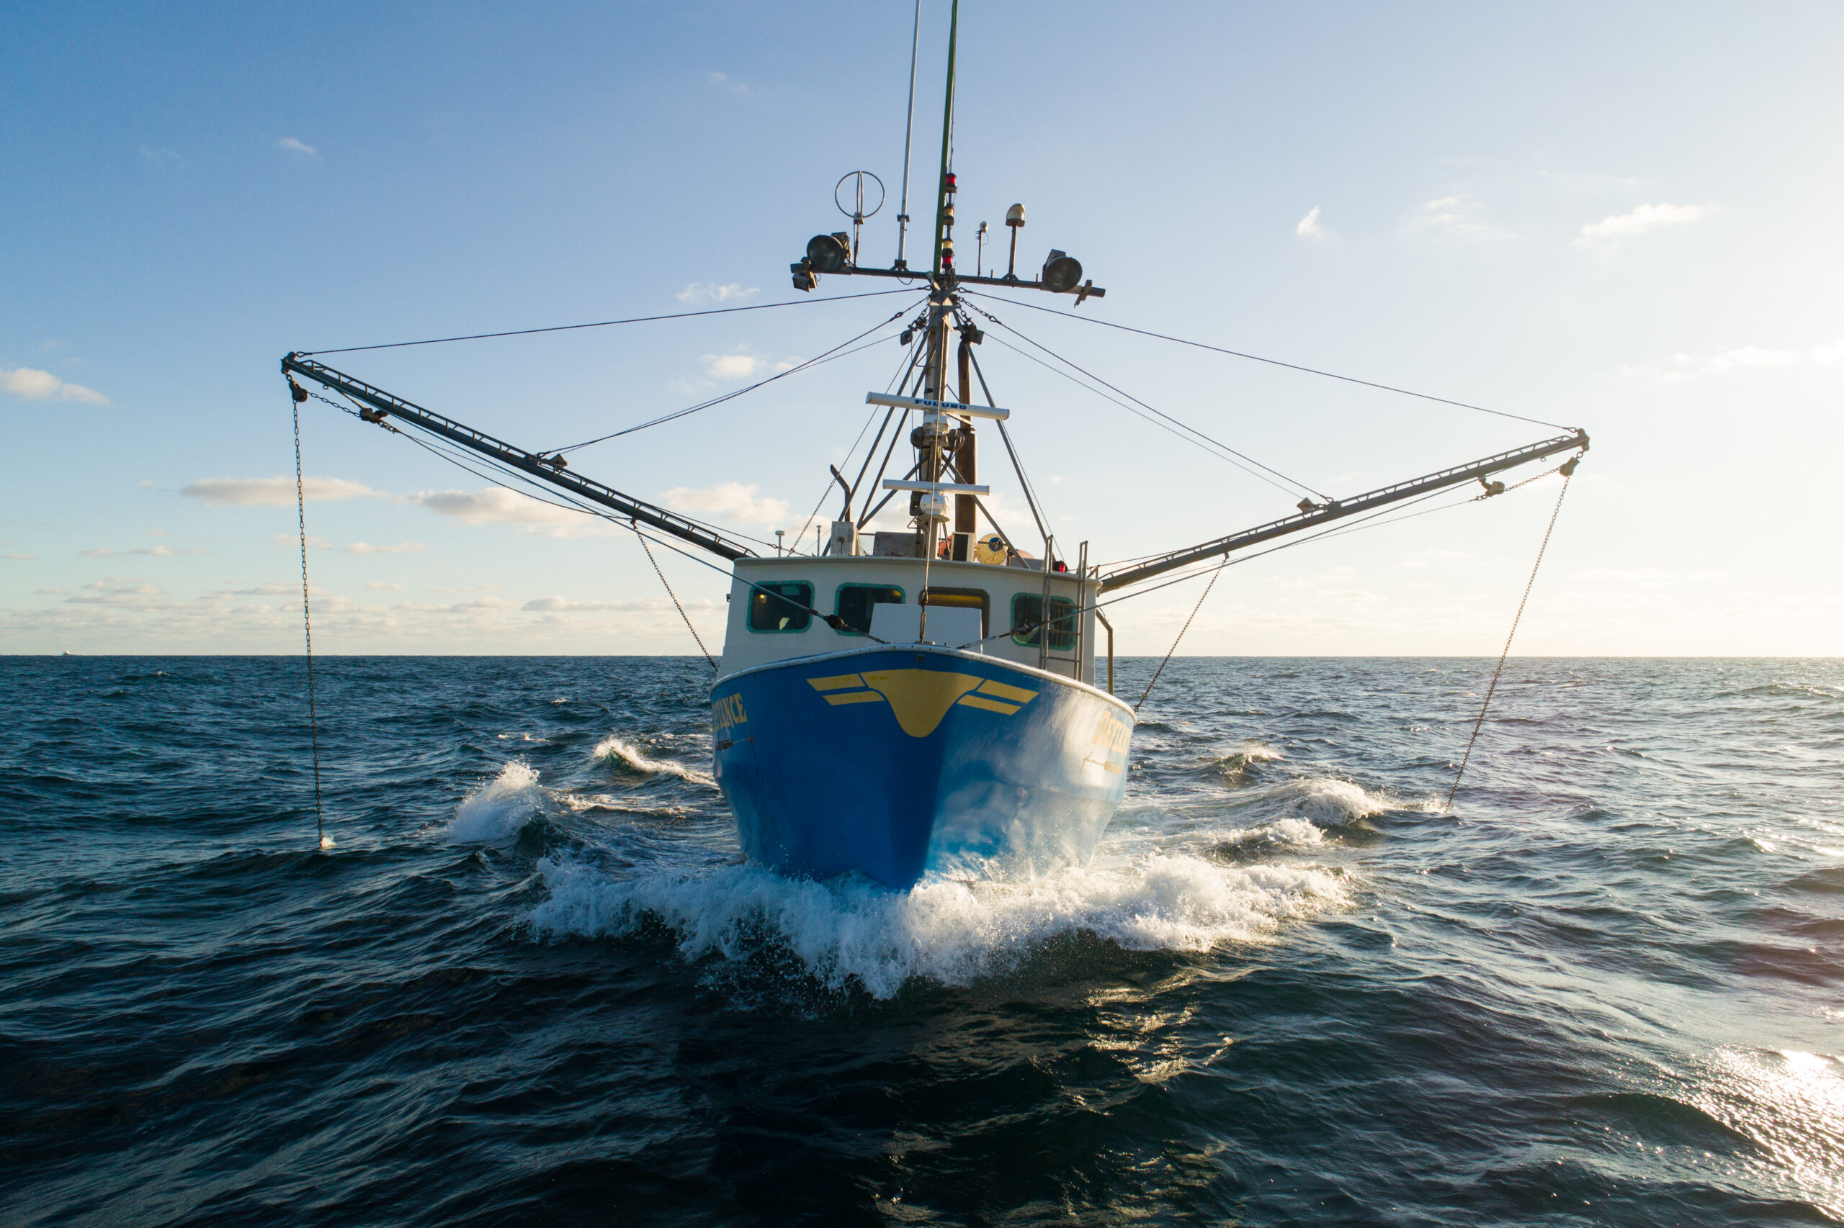
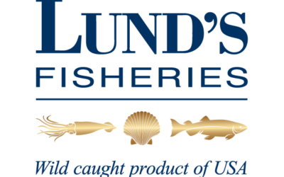
Future Work
Expand and validate the GAMS model analyses to Striped Bass and Spiny Dogfish.
Analyze potential relationships between oceanographic conditions and species abundances over seasons and decades.
Extend these analyses to other commercial species, such as Longfin Squid (Doryteuthis (Amerigo) pealeii) and Atlantic Menhaden (Brevoortia tyrannus)
Notes:
So whats next for this research?
Continue collaboration with industry
resolve the seasonal and decadal trends in the data

Slide 14
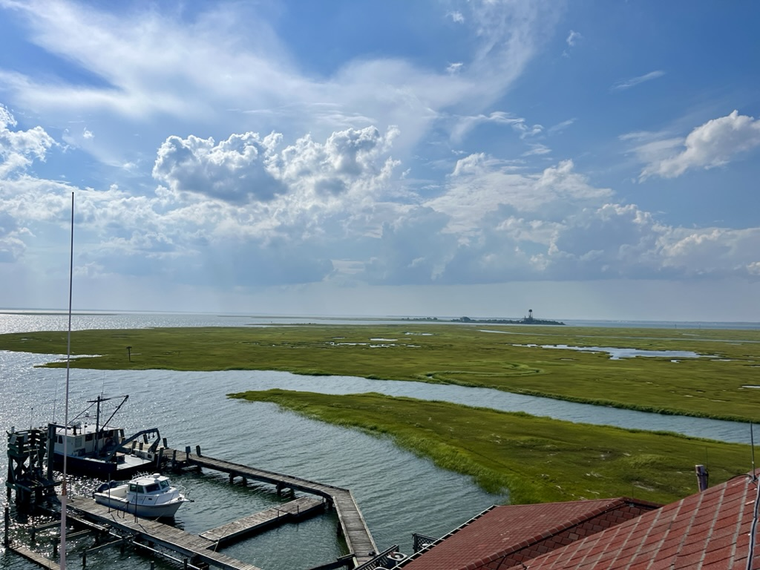
Thank you!
alaimo@marine.rutgers.edu

