Slide 1




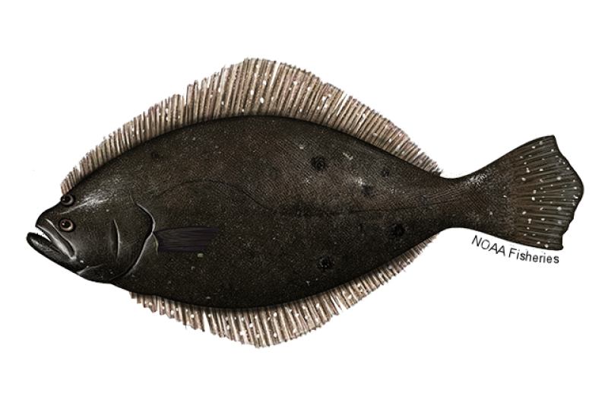
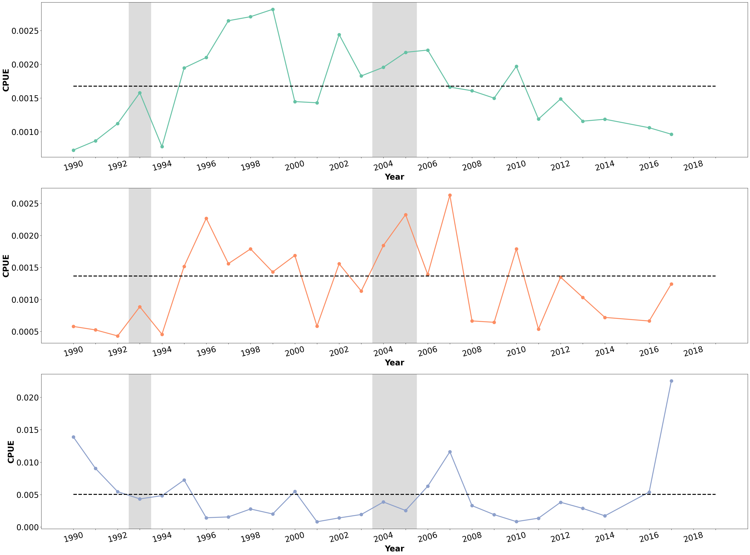
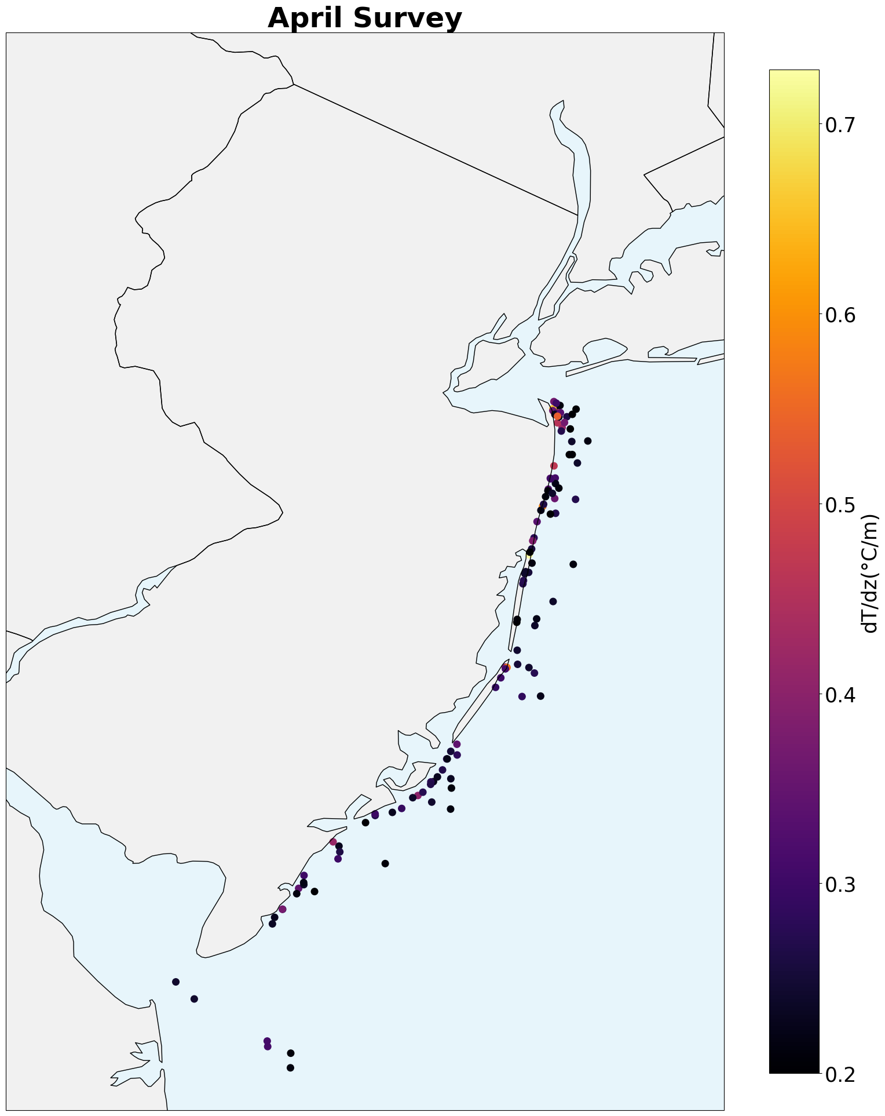
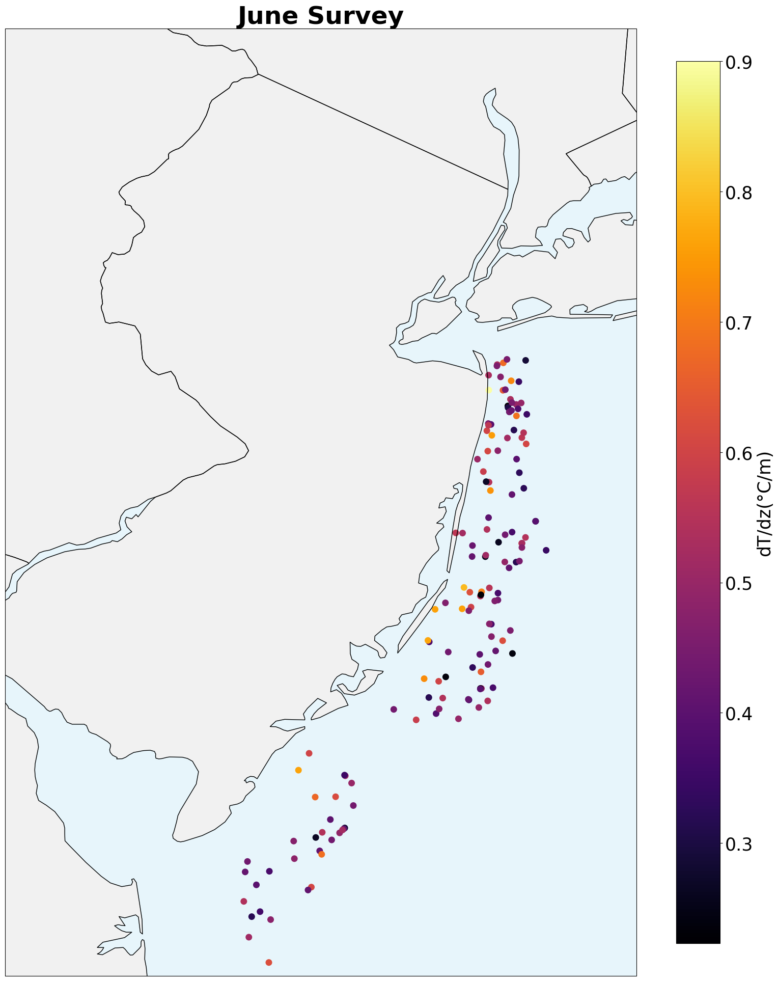
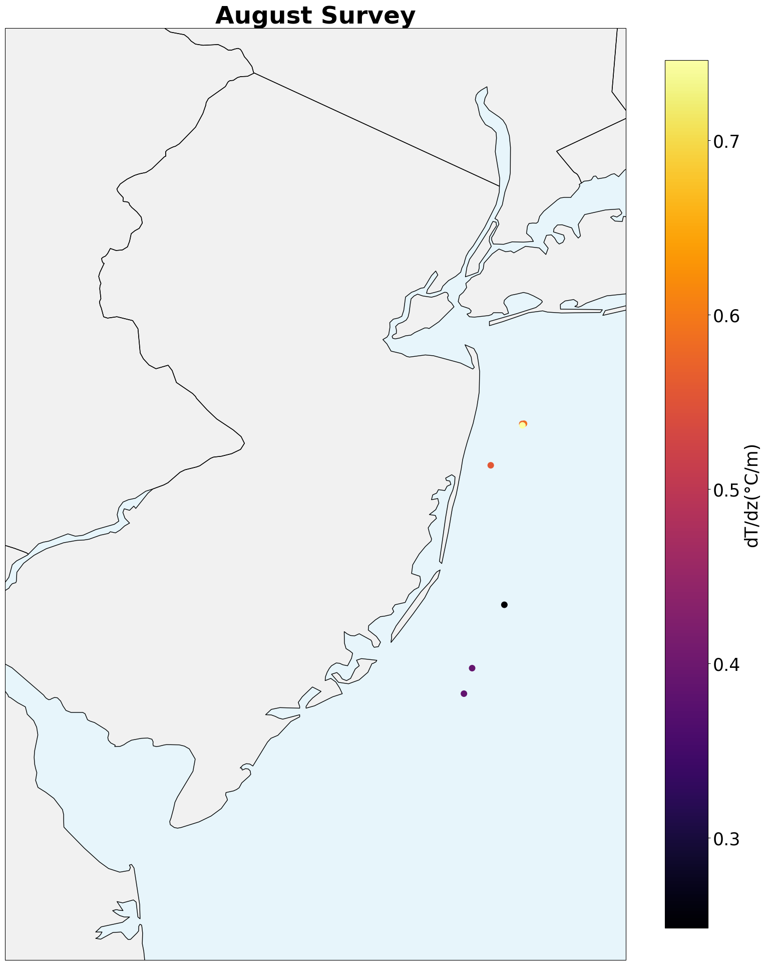
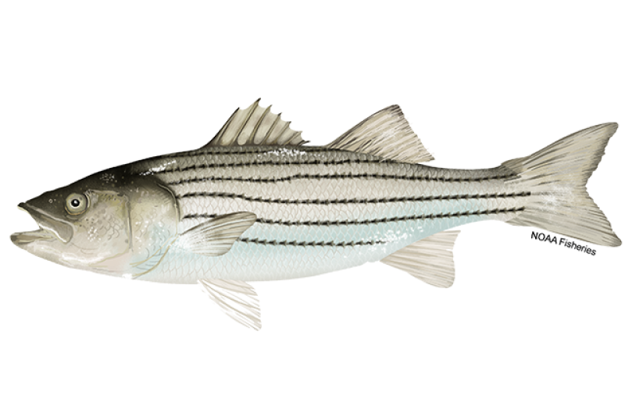
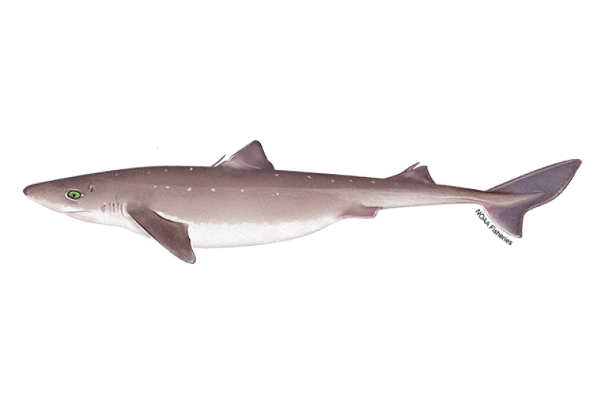

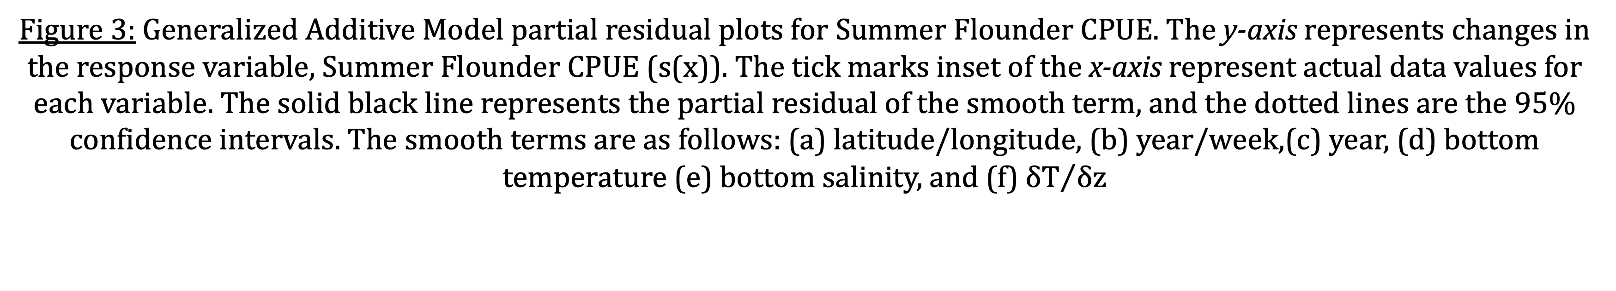
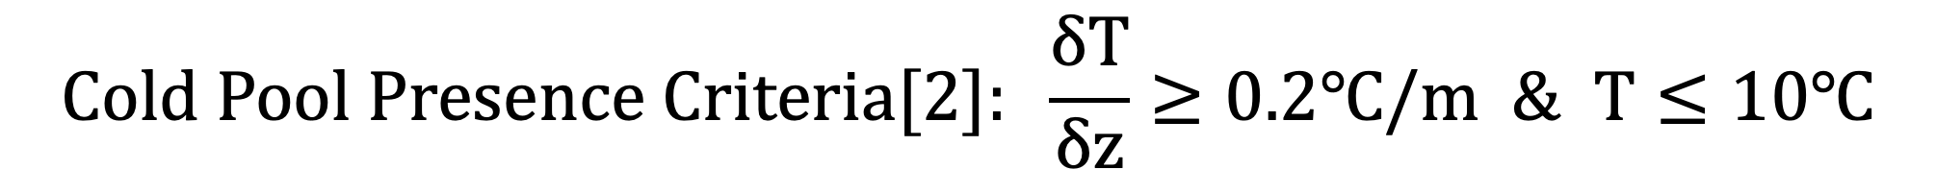
Cold Pool Stratification Influences on Commercial Species Dynamics in the Mid-Atlantic Bight
Samantha Alaimo*¹, Bill Bright²,Jeff Brust³, Colleen Brust³, Jeff Kaelin⁴, Josh Kohut¹, & Daphne Munroe⁵
¹Department of Marine and Coastal Sciences, Rutgers University ²F/V Defiance ³New Jersey Marine Resources Administration, Nacote Creek Research Station
⁴Lund’s Fisheries ⁵Haskin Shellfish Research Laboratory, Rutgers University
*alaimo@marine.rutgers.edu
Motivation
Methodology
New Jersey has an offshore wind energy goal of 11,000 MW by 2040.
The coastal ocean off New Jersey is a dynamic environment with strong seasonal cycles that serves habitat for many commercial fish species, including the Summer Flounder (Paralichthys dentatus), Striped Bass (Morone saxatilis), and Spiny Dogfish (Squalus acanthias) [1].
To better assess the impact of offshore wind facilities on commercial fish species we must first quantify long term oceanographic and fisheries trends before construction begins.
NJDEP Bottom Trawl data includes fisheries and oceanographic data sampled five times a year across all seasons between 1990 and 2019 (5548 individual tows).
Decadal trends in species abundance and biomass will be mapped relative to ocean conditions using Generalized Additive Models (GAMS).
Particular focus will be placed on the baseline trends and variability in linked cold pool and fisheries seasonal phenology.
Fish Abundances over Decades
Survey Overlap with Cold Pool Stratification
a
$$Cold Pool Presence Criteria[2]: \frac{δT}{δz}≥0.2℃/m \& T≤10℃$$
b
c
Figure 1: Average Catch per Unit Effort (CPUE) for summer flounder (a), striped bass (b), and spiny dogfish (c) per year. Blacked dashed lines indicate the 30-year mean of the respective species. Gray shaded areas indicate strong cold pool years (1993, 2004, 2005) [3]. CPUE is in units fish per minute.
116 tows
145 tows
7 tows
Figure 2: Survey start locations in April, June, and August between 1990-2019 that meet Cold Pool stratification and temperature criteria. The color of the points indicate the strength of$δT/δz$.
Integrating Fisheries and Oceanographic Data
Next Steps
a
b
c
Expand and validate the GAMS model analyses to Striped Bass and Spiny Dogfish.
Analyze potential relationships between stratification conditions and species abundances over seasons and decades.
Extend this analysis to other commercial species, such as Longfin Squid (Doryteuthis (Amerigo) pealeii) and Atlantic Menhaden (Brevoortia tyrannus).
d
e
f
By integrating fisheries and oceanographic data, the findings of this research will define mechanistic links and baseline interactions between Mid-Atlantic Bight Cold Pool dynamics and the spatial ecology of local commercial and recreational fish populations.
Figure 3: Generalized Additive Model partial residual plots for Summer Flounder CPUE. The y-axis represents changes in the response variable, Summer Flounder CPUE (s(x)). The tick marks inset of the x-axis represent actual data values for each variable. The solid black line represents the partial residual of the smooth term, and the dotted lines are the 95% confidence intervals. The smooth terms are as follows: (a) latitude/longitude, (b) year/week,(c) year, (d) bottom temperature (e) bottom salinity, and (f) ${δT}/{δz}$
References:
[1] Miles T, Murphy S, Kohut J, Borsetti S, Munroe D. 2021. Offshore wind energy and the mid-atlantic cold pool: A review of potential interactions. Mar Technol Soc J. 55(4):72–87. doi:10.4031/MTSJ.55.4.8. [2] Horwitz, R., Miles, T. N., Munroe, D., & Kohut, J. (2022). Investigating the Overlap Between the Mid-Atlantic Bight Cold Pool and Offshore Wind Lease Areas. Oceans Conference Record (IEEE). https://doi.org/10.1109/OCEANS47191.2022.9977050 [3] Chen, Z., & Curchitser, E. N. (2020). Interannual Variability of the Mid-Atlantic Bight Cold Pool. Journal of Geophysical Research: Oceans, 125, 1–20. https://doi.org/10.1029/2020JC016445
Acknowledgments: Thank you, NJ DEP for allowing access to the Ocean Trawl Survey data. Thank you, NJ EDA for supporting this research through the Wind Institute Fellowship Program. Thank you SCEMFIS for supporting this research. Thank you to Rutgers University for student support.

Slide 2
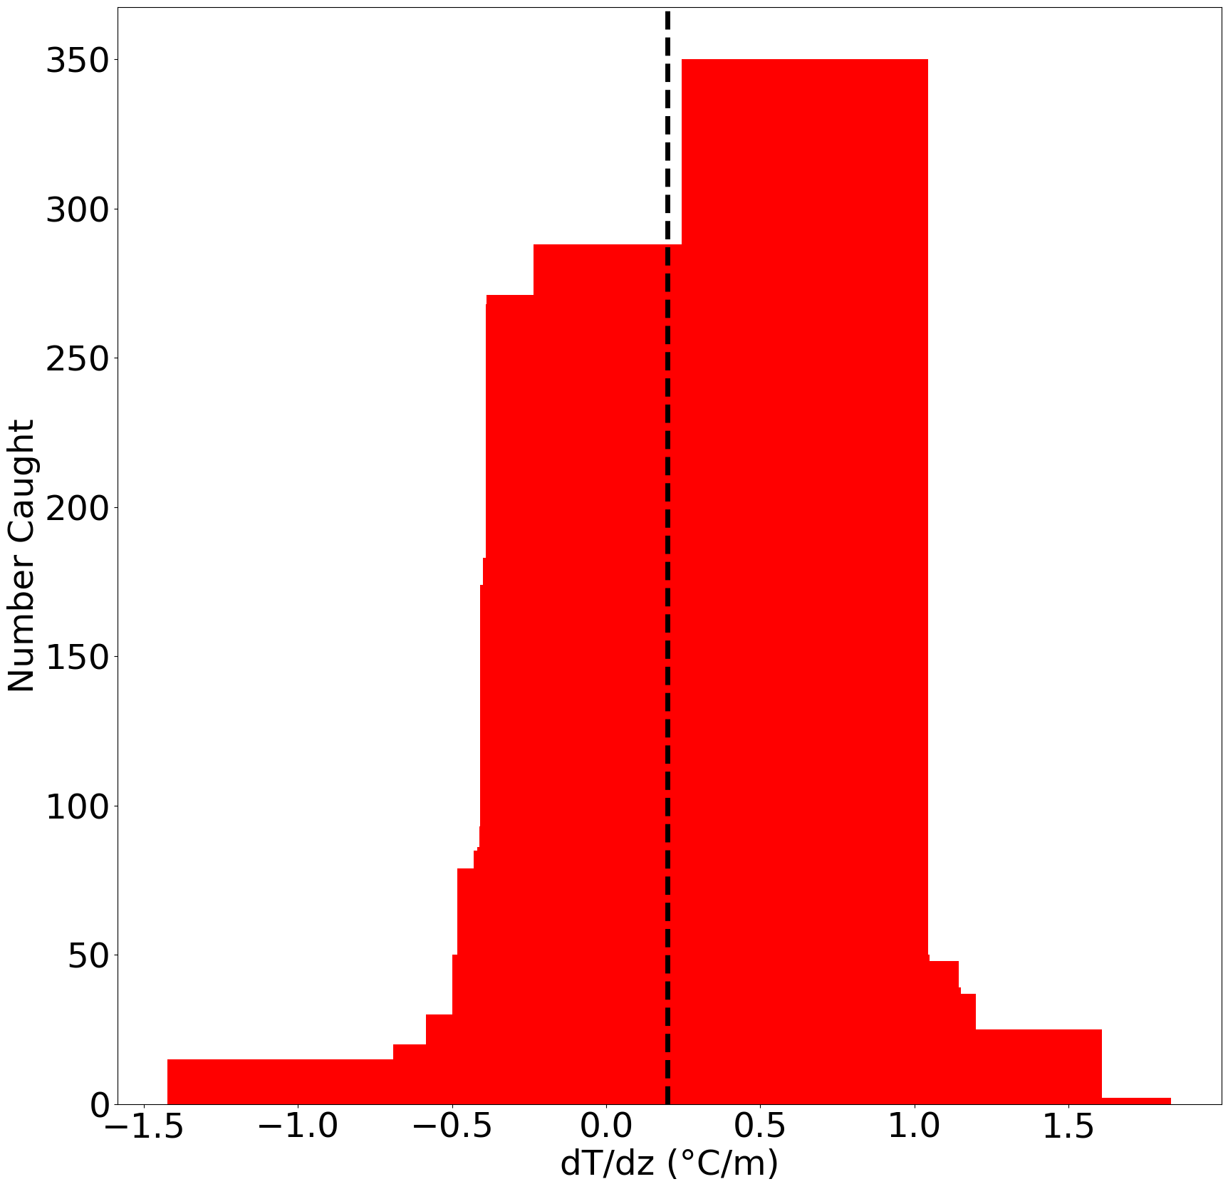
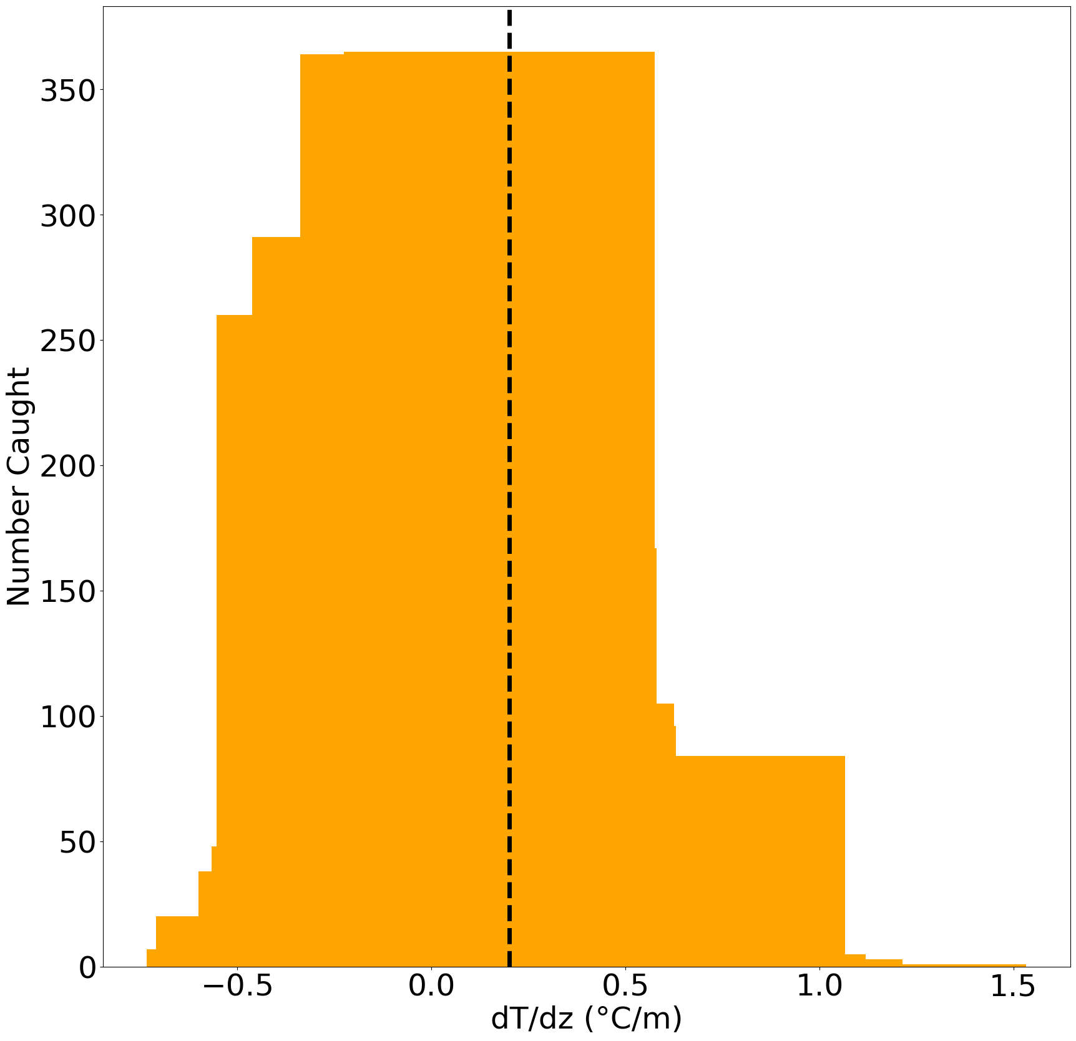
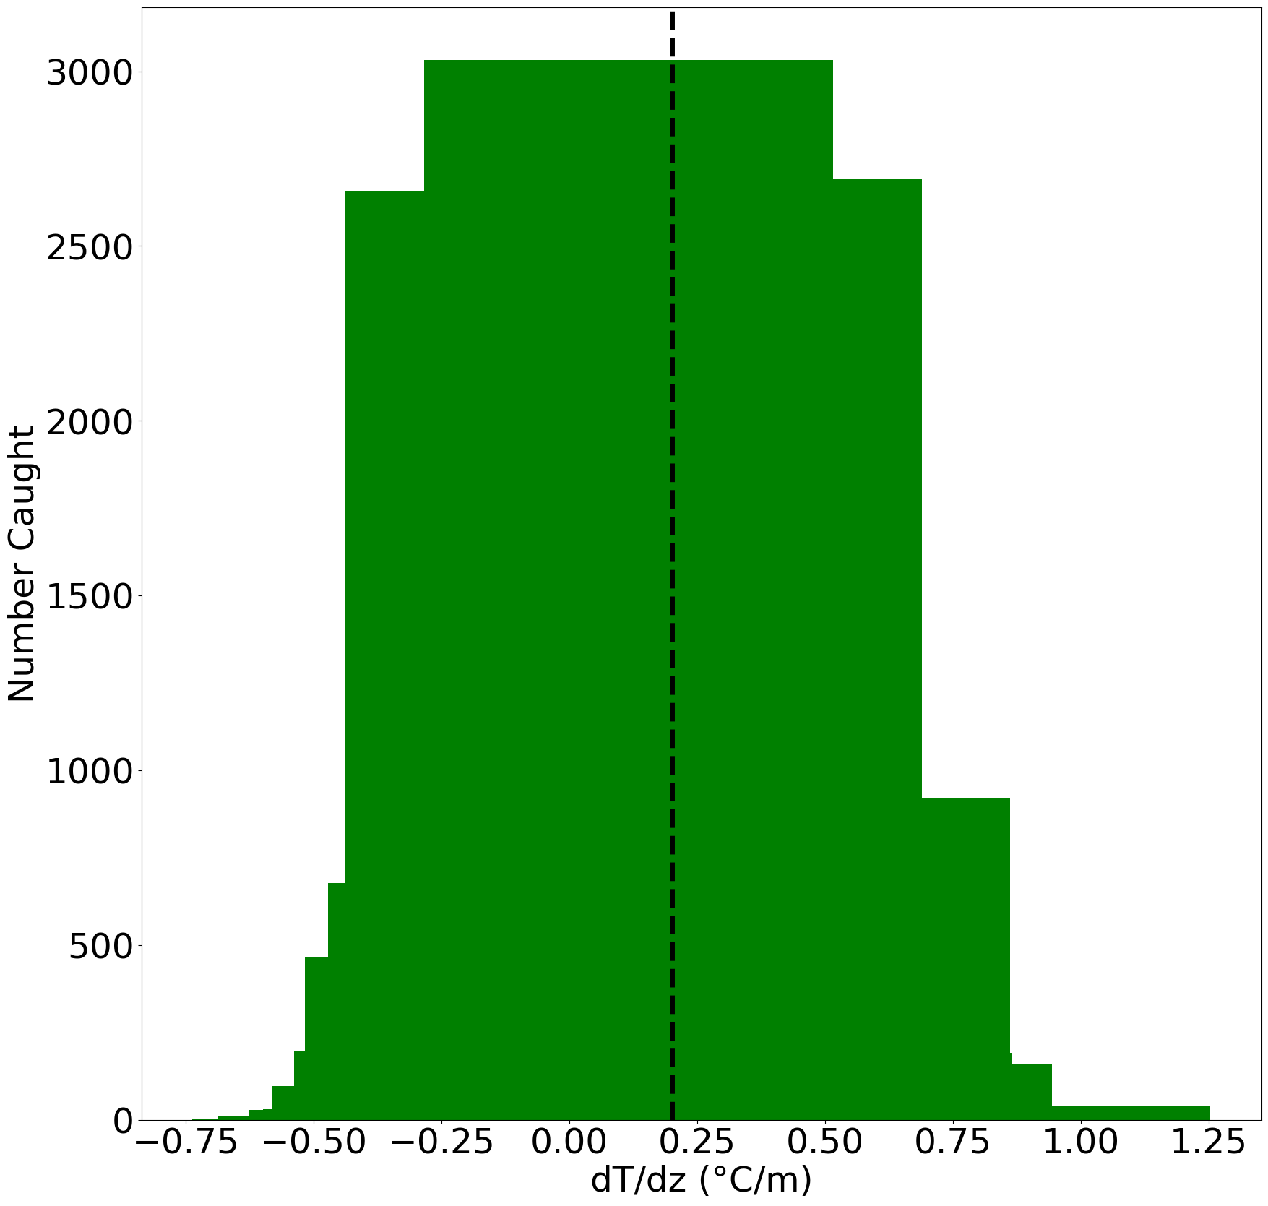
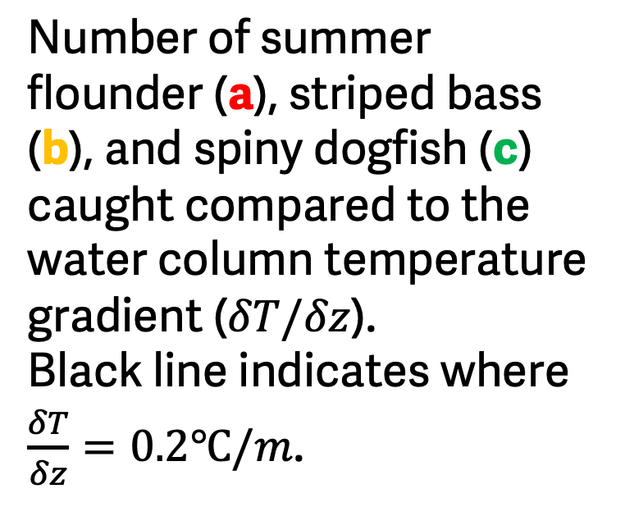
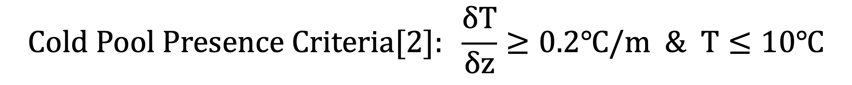
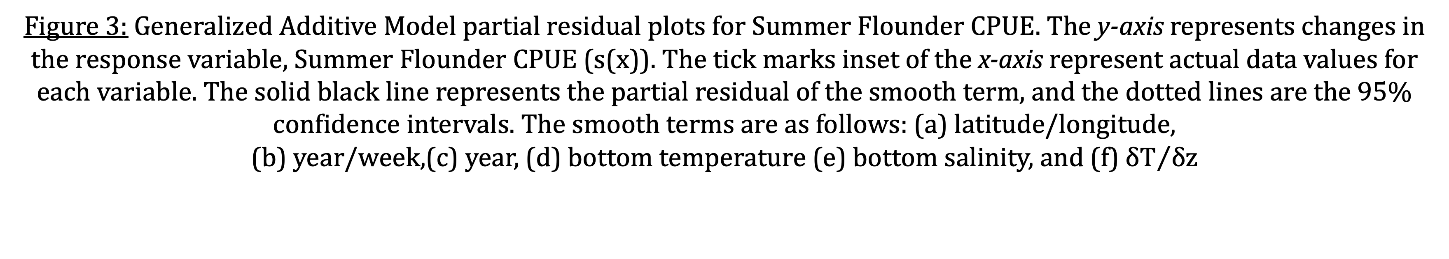
a
b
Survey Overlap with Cold Pool Stratification
$$Cold Pool Presence Criteria[2]: \frac{δT}{δz}≥0.2℃/m \& T≤10℃$$
c
Number of summer flounder (a), striped bass (b), and spiny dogfish (c) caught compared to the water column temperature gradient ($δT/δz$).
Black line indicates where $\frac{δT}{δz}=0.2℃/m$.
116 tows
145 tows
c
7 tows
a
b
Figure 2: Survey start locations in April, June, and August between 1990-2019 that meet Cold Pool stratification and temperature criteria. The color of the points indicate the strength of$δT/δz$.
d
e
f
Figure 3: Generalized Additive Model partial residual plots for Summer Flounder CPUE. The y-axis represents changes in the response variable, Summer Flounder CPUE (s(x)). The tick marks inset of the x-axis represent actual data values for each variable. The solid black line represents the partial residual of the smooth term, and the dotted lines are the 95% confidence intervals. The smooth terms are as follows: (a) latitude/longitude,
(b) year/week,(c) year, (d) bottom temperature (e) bottom salinity, and (f) ${δT}/{δz}$
Fish Abundances over Decades
a
b
c
Figure 1: Catch per Unit Effort (CPUE) for summer flounder (a), striped bass (b), and spiny dogfish (c) per year. Blacked dashed lines indicate the 30-year mean of the respective species. Gray shaded areas indicate strong cold pool years (1993, 2004, 2005) defined by Chen and Curchitser 2020 [3]. CPUE is in units fish per minute.

