Slide 1
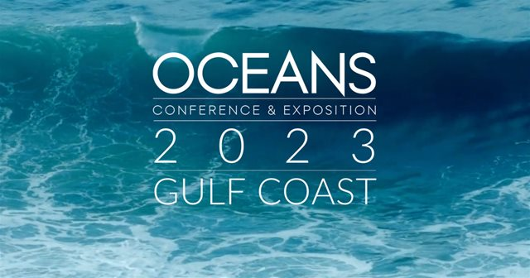
Surface current velocity observations of the Yucatan Channel using High-Frequency Radar
Steven F DiMarco¹, Professor, MTS Fellow ‘20
¹Geochemical and Environmental Research Group
Department of Oceanography, Department of Ocean Engineering
Texas A&M University
S Glenn² (MTS Fellow ’17), M Smith², R Ramos³, AH Knap¹ (MTS Fellow ’23),
R Jiménez⁴, D Salas de Léon⁴, K Teresa⁴, C Whelan⁵
²Center for Ocean Observing Leadership
Rutgers University
³Woods Hole Group, LLC
⁴Universidad Nacional Autónoma de México
⁵CODAR Ocean Sensors, LLC

Slide 2
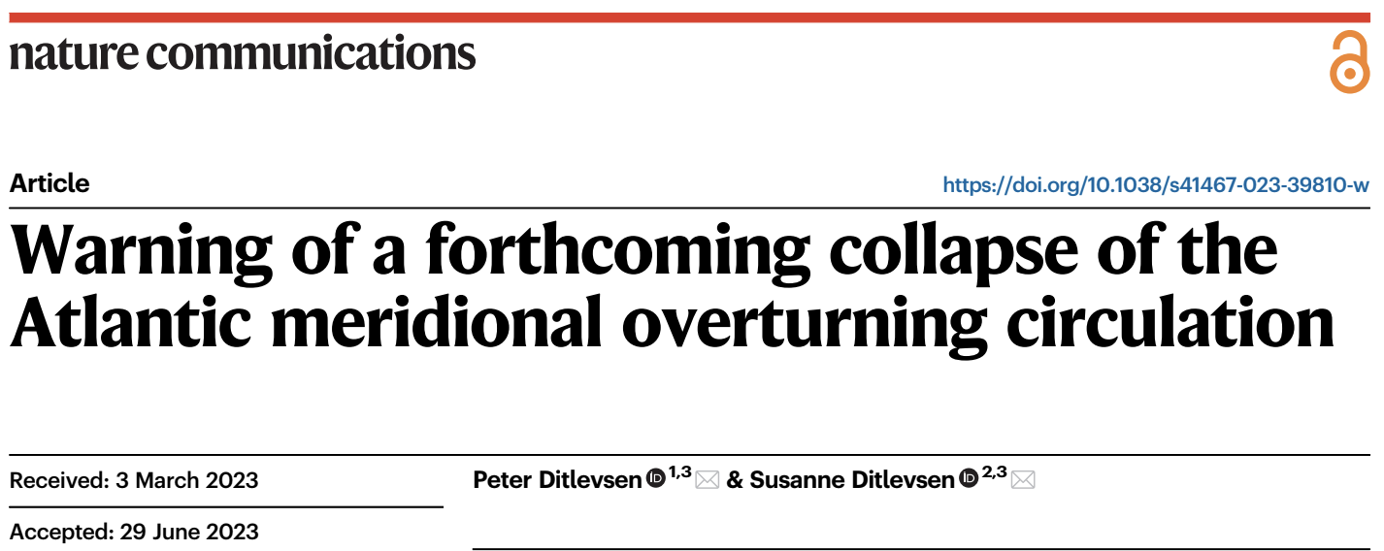
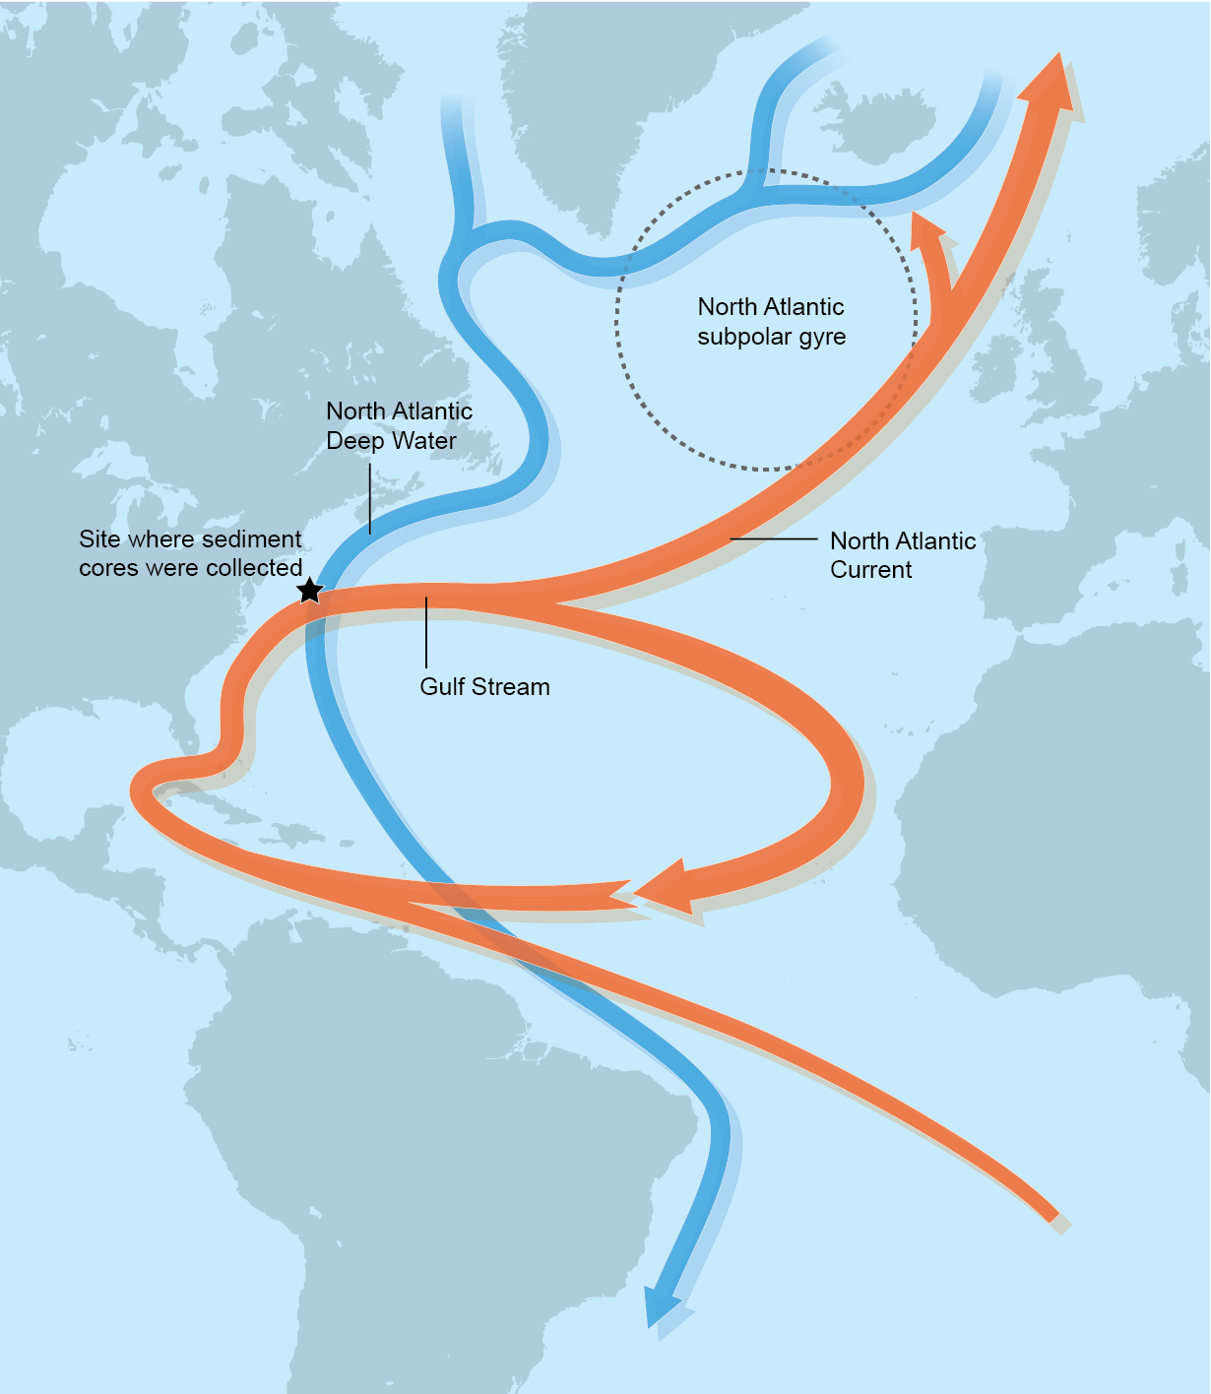
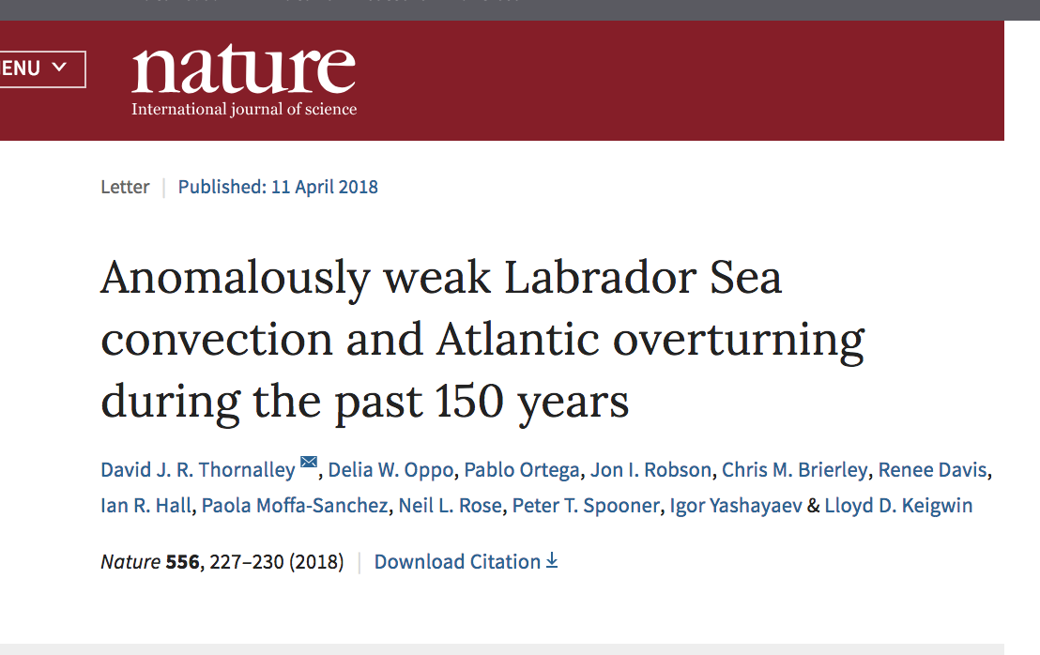
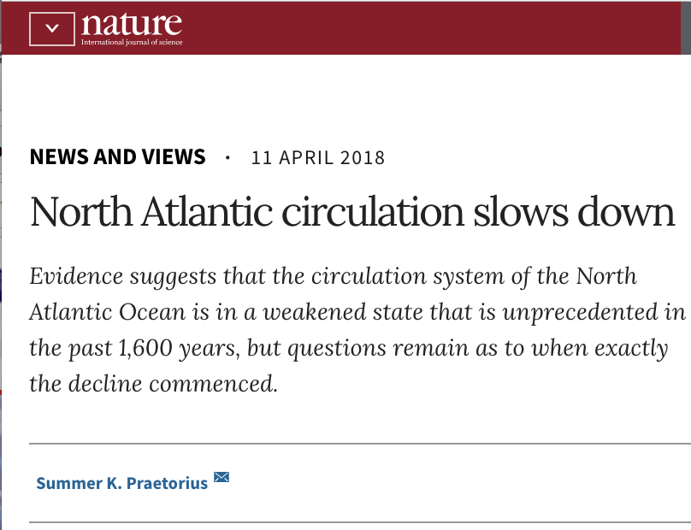
Atlantic Meridional Overturning Circulation (AMOC)
Cold Deep
Water Transported South
Published July 2023
Published April 2018
Loop
Current
Warm Surface
Water Transported North

Slide 3
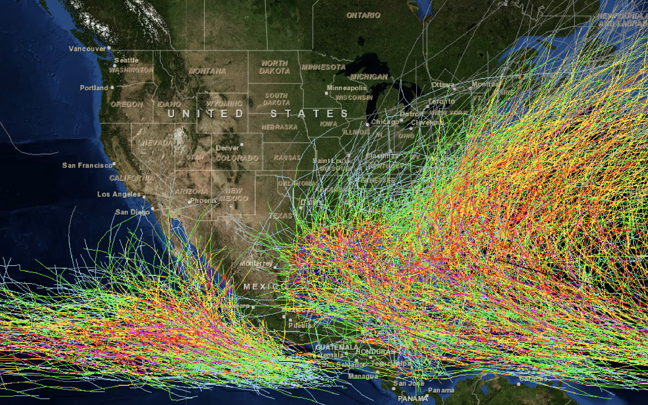
NOAA Priorities and Hurricanes
NOAA FY22-26 Strategic Goals:
Accelerate Growth in an Information Based Blue Economy
Build a Climate Ready Nation
Make Equity central to NOAA’s Mission
Hurricanes cause more economic damage than all other Weather and Climate Disasters Combined
NOAA NCEI Billion-Dollar Weather and Climate Disasters database
Climate models project future hurricanes will be more intense and slower moving, causing increased flooding due to higher storm surge and more rainfall
e.g., NASA Global Climate Change, Vital Signs of the Planet, Feature, 1 June 2022
The vast majority of excess deaths from hurricanes are concentrated in poor and socially vulnerable communities.
e.g., Parks et al., Science Reports, 16 August 2023
NOAA Historical Hurricane Tracks: 1851 - 2017

Slide 4
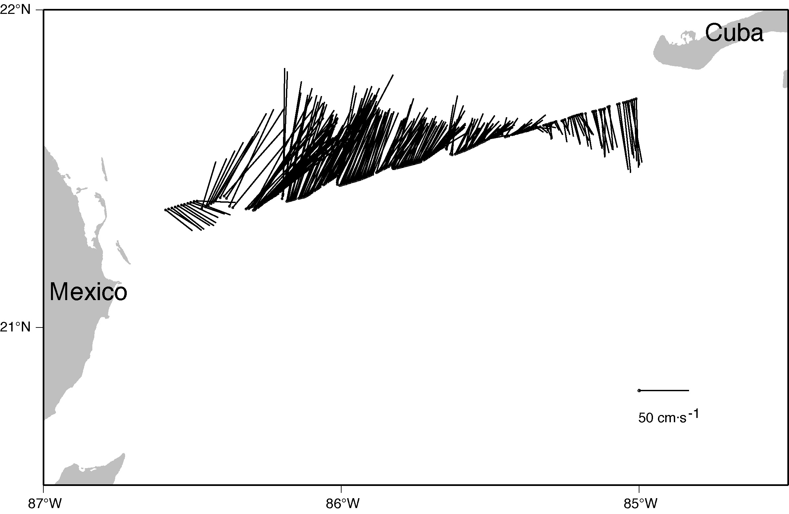
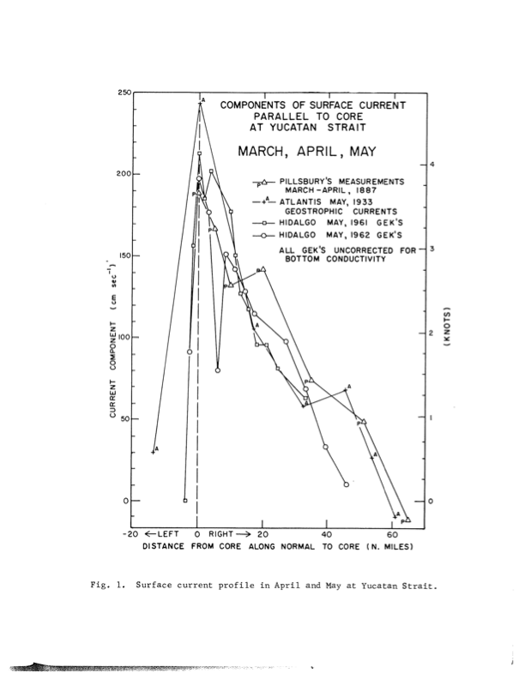
Yucatan Current Observations
1999 NOPP/TAMU:VMADCP
1887, 1933, 1961, 1962
200
4
150
3
Inflow Current Speed (cm/s)
Knots
100
2
50
1
0
0
Cochrane, 1962

Slide 5
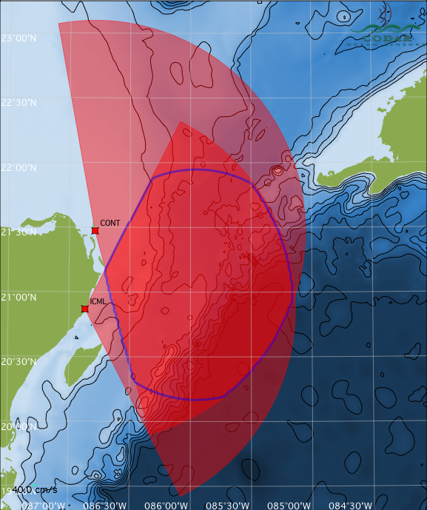
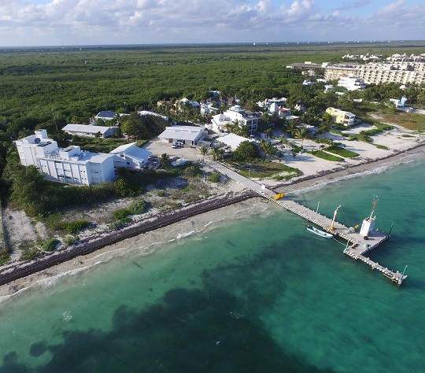
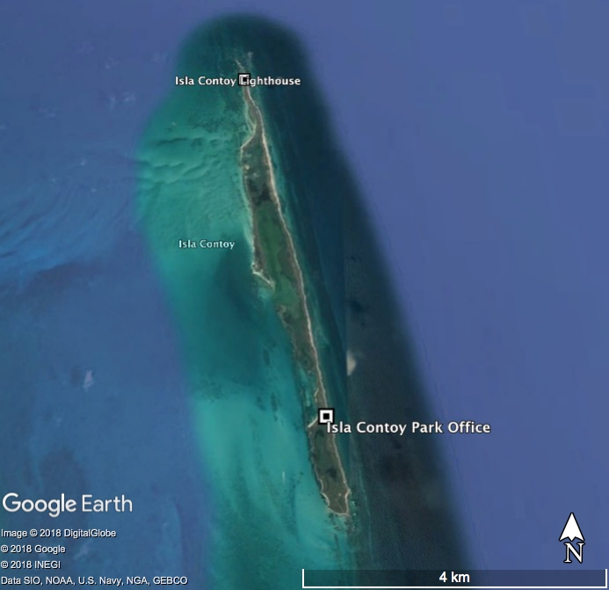
Yucatan Channel Hi-Frequency Radar
Cuba
ISCY
Two sites: Quintanna Roo, Mexico
Isla Contoy (ISCY) - north site
Puerto Morelos, La Unidad Academica de Sistemas Arrecifales (UASA) - south site
Idealized Coverage (shown)
Mexico
UASA
ISCY
UASA
Notes:
Scott: glider technology
Bruce: Informed data products
Steve: Velocity equipped APEX Floats
Tony: HF radar summary
Steve: glider mission summary
Steve: GHOST assessment
Tony: GCAB summary
Scott: processing of HFRadar
Steve: Initial time line

Slide 6
Yucatan Channel HF Radar Near-Real-Time Data Processing
Remote Site Processing
Radial Current Processing
Total Vector Processing
HFR Operators (TAMU, UNAM)
HFR Data Curator (Rutgers)
Generate total vectors from multiple radial sites
Apply Totals QARTOD QC tests
Data Density Threshold (Required)
GDOP Threshold (Required)
Max Speed (Required)
Spatial Median Comparison (Suggested)
Valid Location (Suggested)
U Component Uncertainty (Required
V Component Uncertainty (Required)
Review HFR Remote Site
Check antenna pattern – Transponder & AIS APMs
Check radial diagnostics
Check site operator logs for any hardware changes
Apply Radial QARTOD QC tests
Syntax (Required)
Max Threshold (Required)
Valid Location (Required)
Radial Count (Suggested)
Spatial Median Filter (Suggested)
Temporal Gradient (Suggested)
Apply Spectra QARTOD QC tests
Signal-to-Noise Ratio for each Antenna
Cross Spectra Covariance Matrix Eigenvalues
Direction of Arrival Metrics (magnitude)
Direction of Arrival Function Widths
Positive Definiteness of 2x2 Signal Matrix
Review radials
Review totals
Release radials
Release totals
Process Spectra into Radials
Rutgers Data Servers
ERDDAP
THREDDS
Send Radials to Data Curator
External Data Providers & Users
GCOOS, Gandalf, UGOS Scientists, EddyWatch, ...
Notes:
Feedback loops

Slide 7
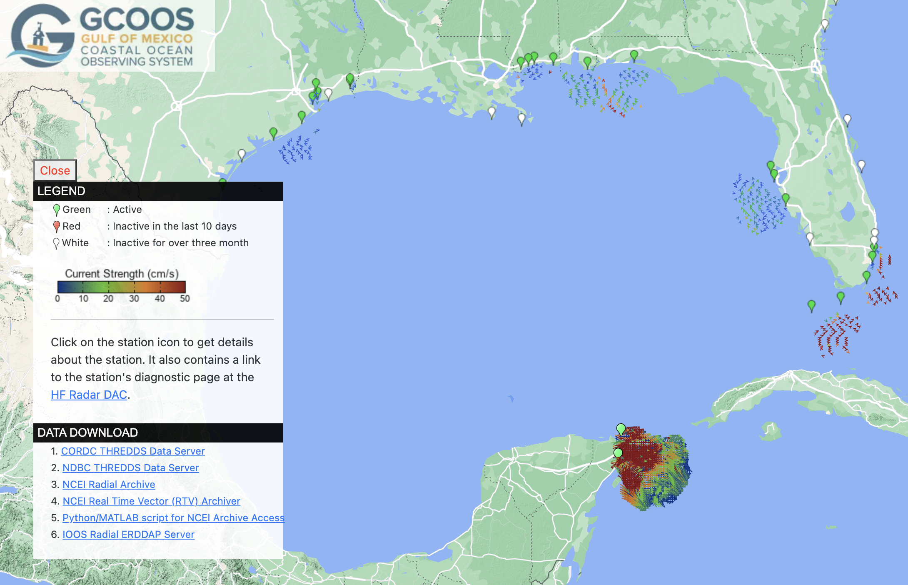
https://data.gcoos.org/hfradar/

Slide 8
Scientific Event Analyses Uncertainty Maps
50 km
Cross Channel Transect of Highest Quality
Gauss-Markov Optimal Interpolation
Notes:
There two events

Slide 9
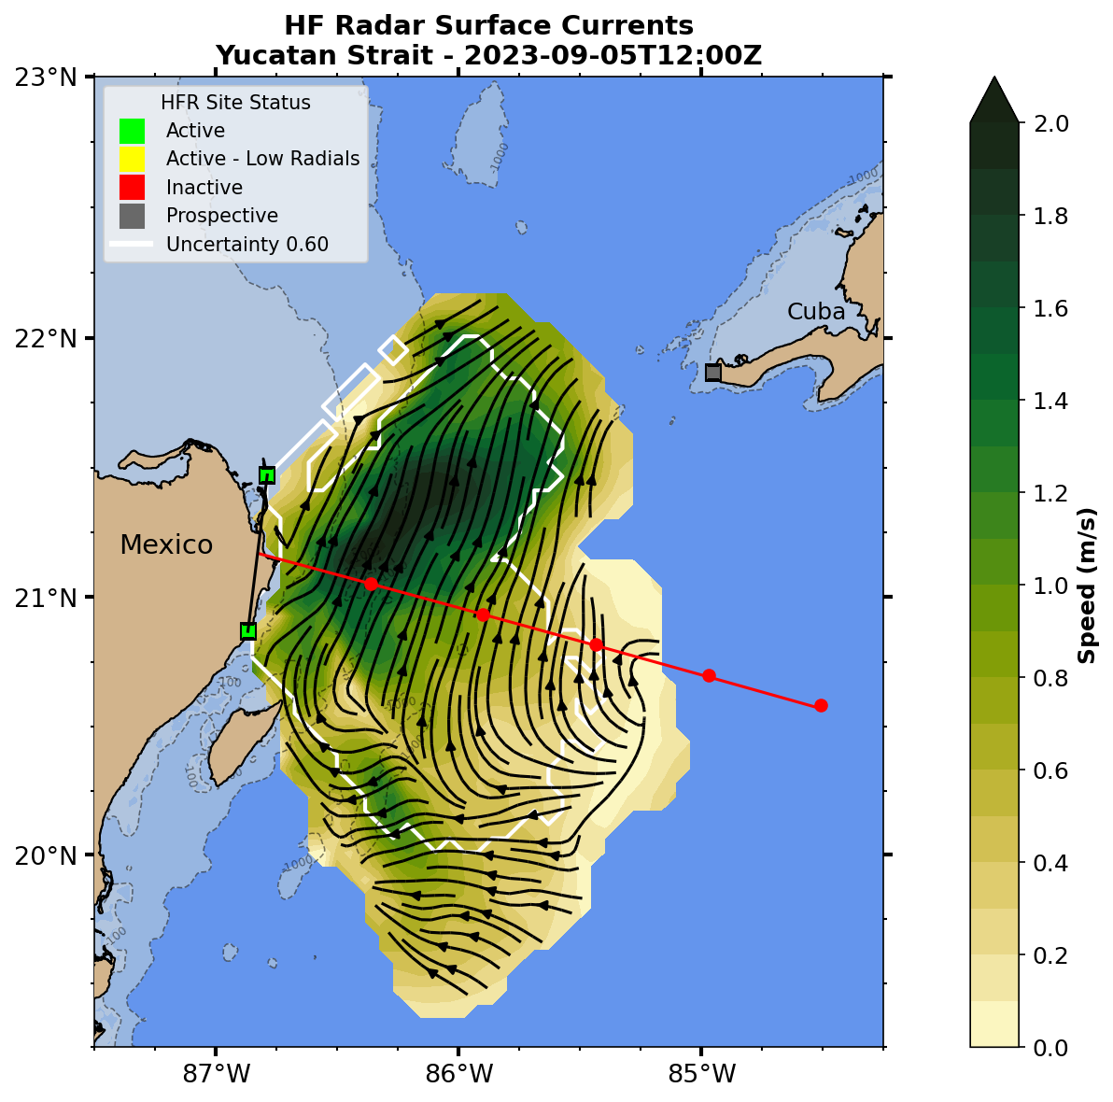
UGOS Yucatan HFR
UGOS1 and UGOS3 Project
Operational June 2022
RUCOOL Processing
Idealized: June ‘22 – Jan ‘23
Optimized: Jan ’23 – present
Real-Time Viewer
OI surface field
https://rucool.marine.rutgers.edu/ugos-hfr/
Data service will move to NOAA IOOS HFRDAC soon.
Colorbars: cmocean https://matplotlib.org/cmocean/
Thyng et al. Oceanography, 2016

Slide 10
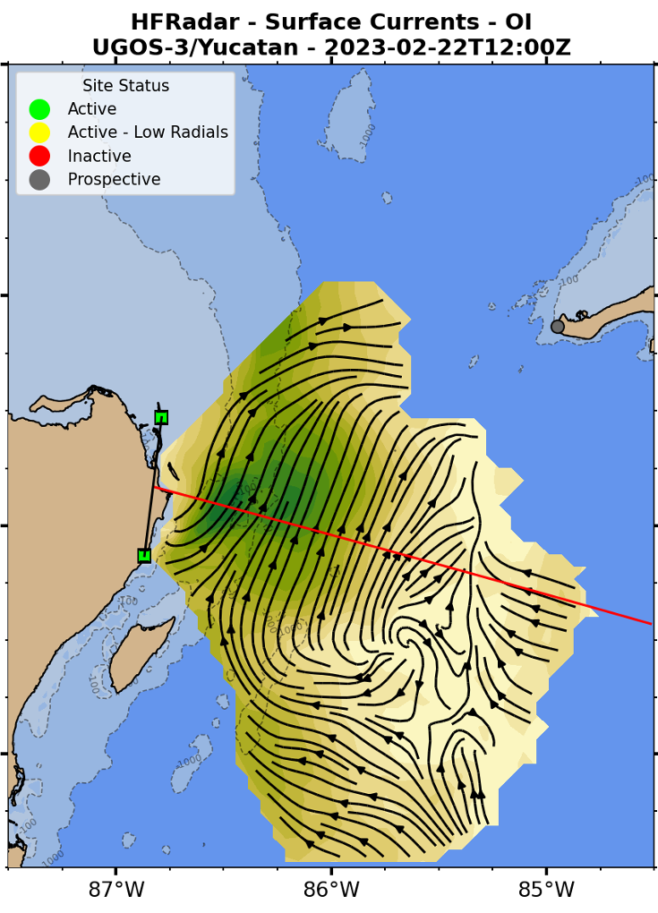
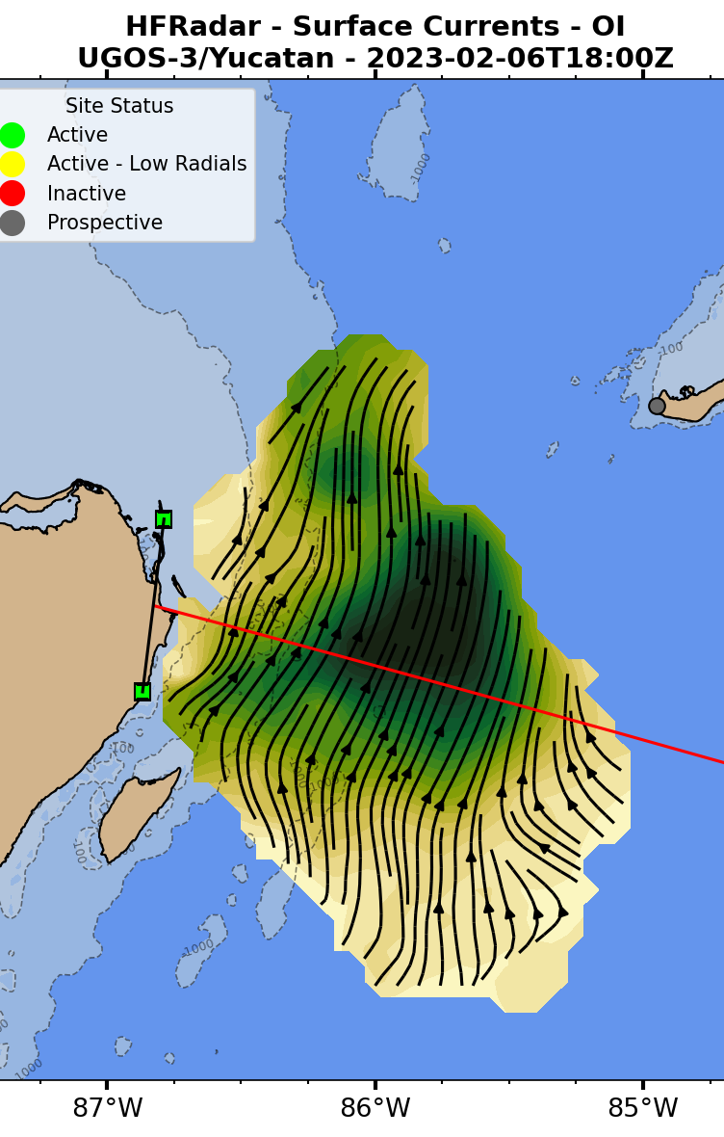
Bimodal Inflow Current Structure
Nearshore Speed Core
Offshore Speed Core

Slide 11
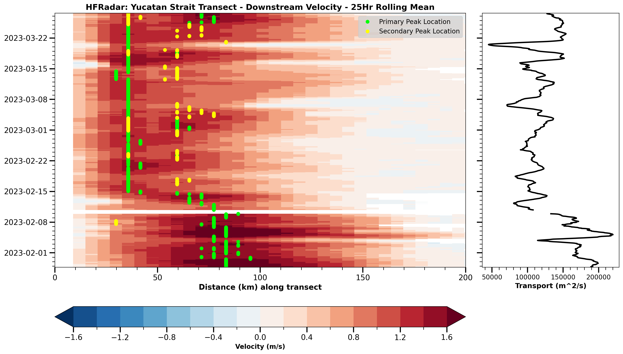
Yucatan Inflow
Hovmöller (space vs time) Diagram
Hourly HFR data
Cross-channel transect
25-hr moving average
(no tides)
Mexico
Cuba

Slide 12
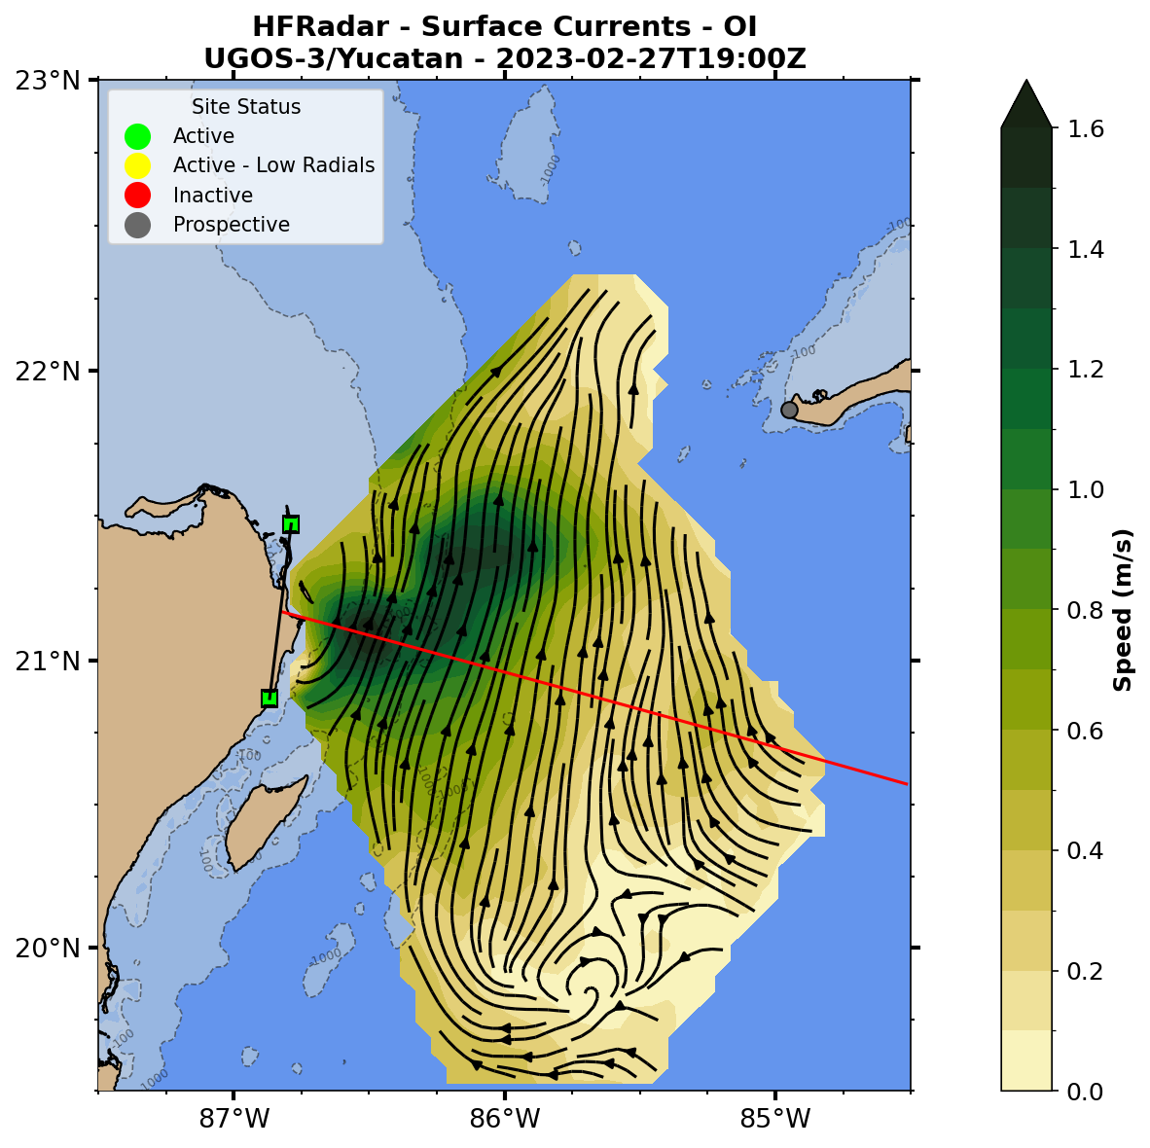
Yucatan Inflow Assessment: Five Operational Models
YUCATAN ALONG CHANNEL CURRENTS
NOAA global RTOFS (red)
Regional CNAPS (orange).
Navy global GOFS (dark green)
Regional AMSEAS (light green).
European CMEMS (violet).
HFR – black line – downstream velocity
Sampled at 6 km resolution
Animation interval is Hourly
Mexico
Cuba

Slide 13
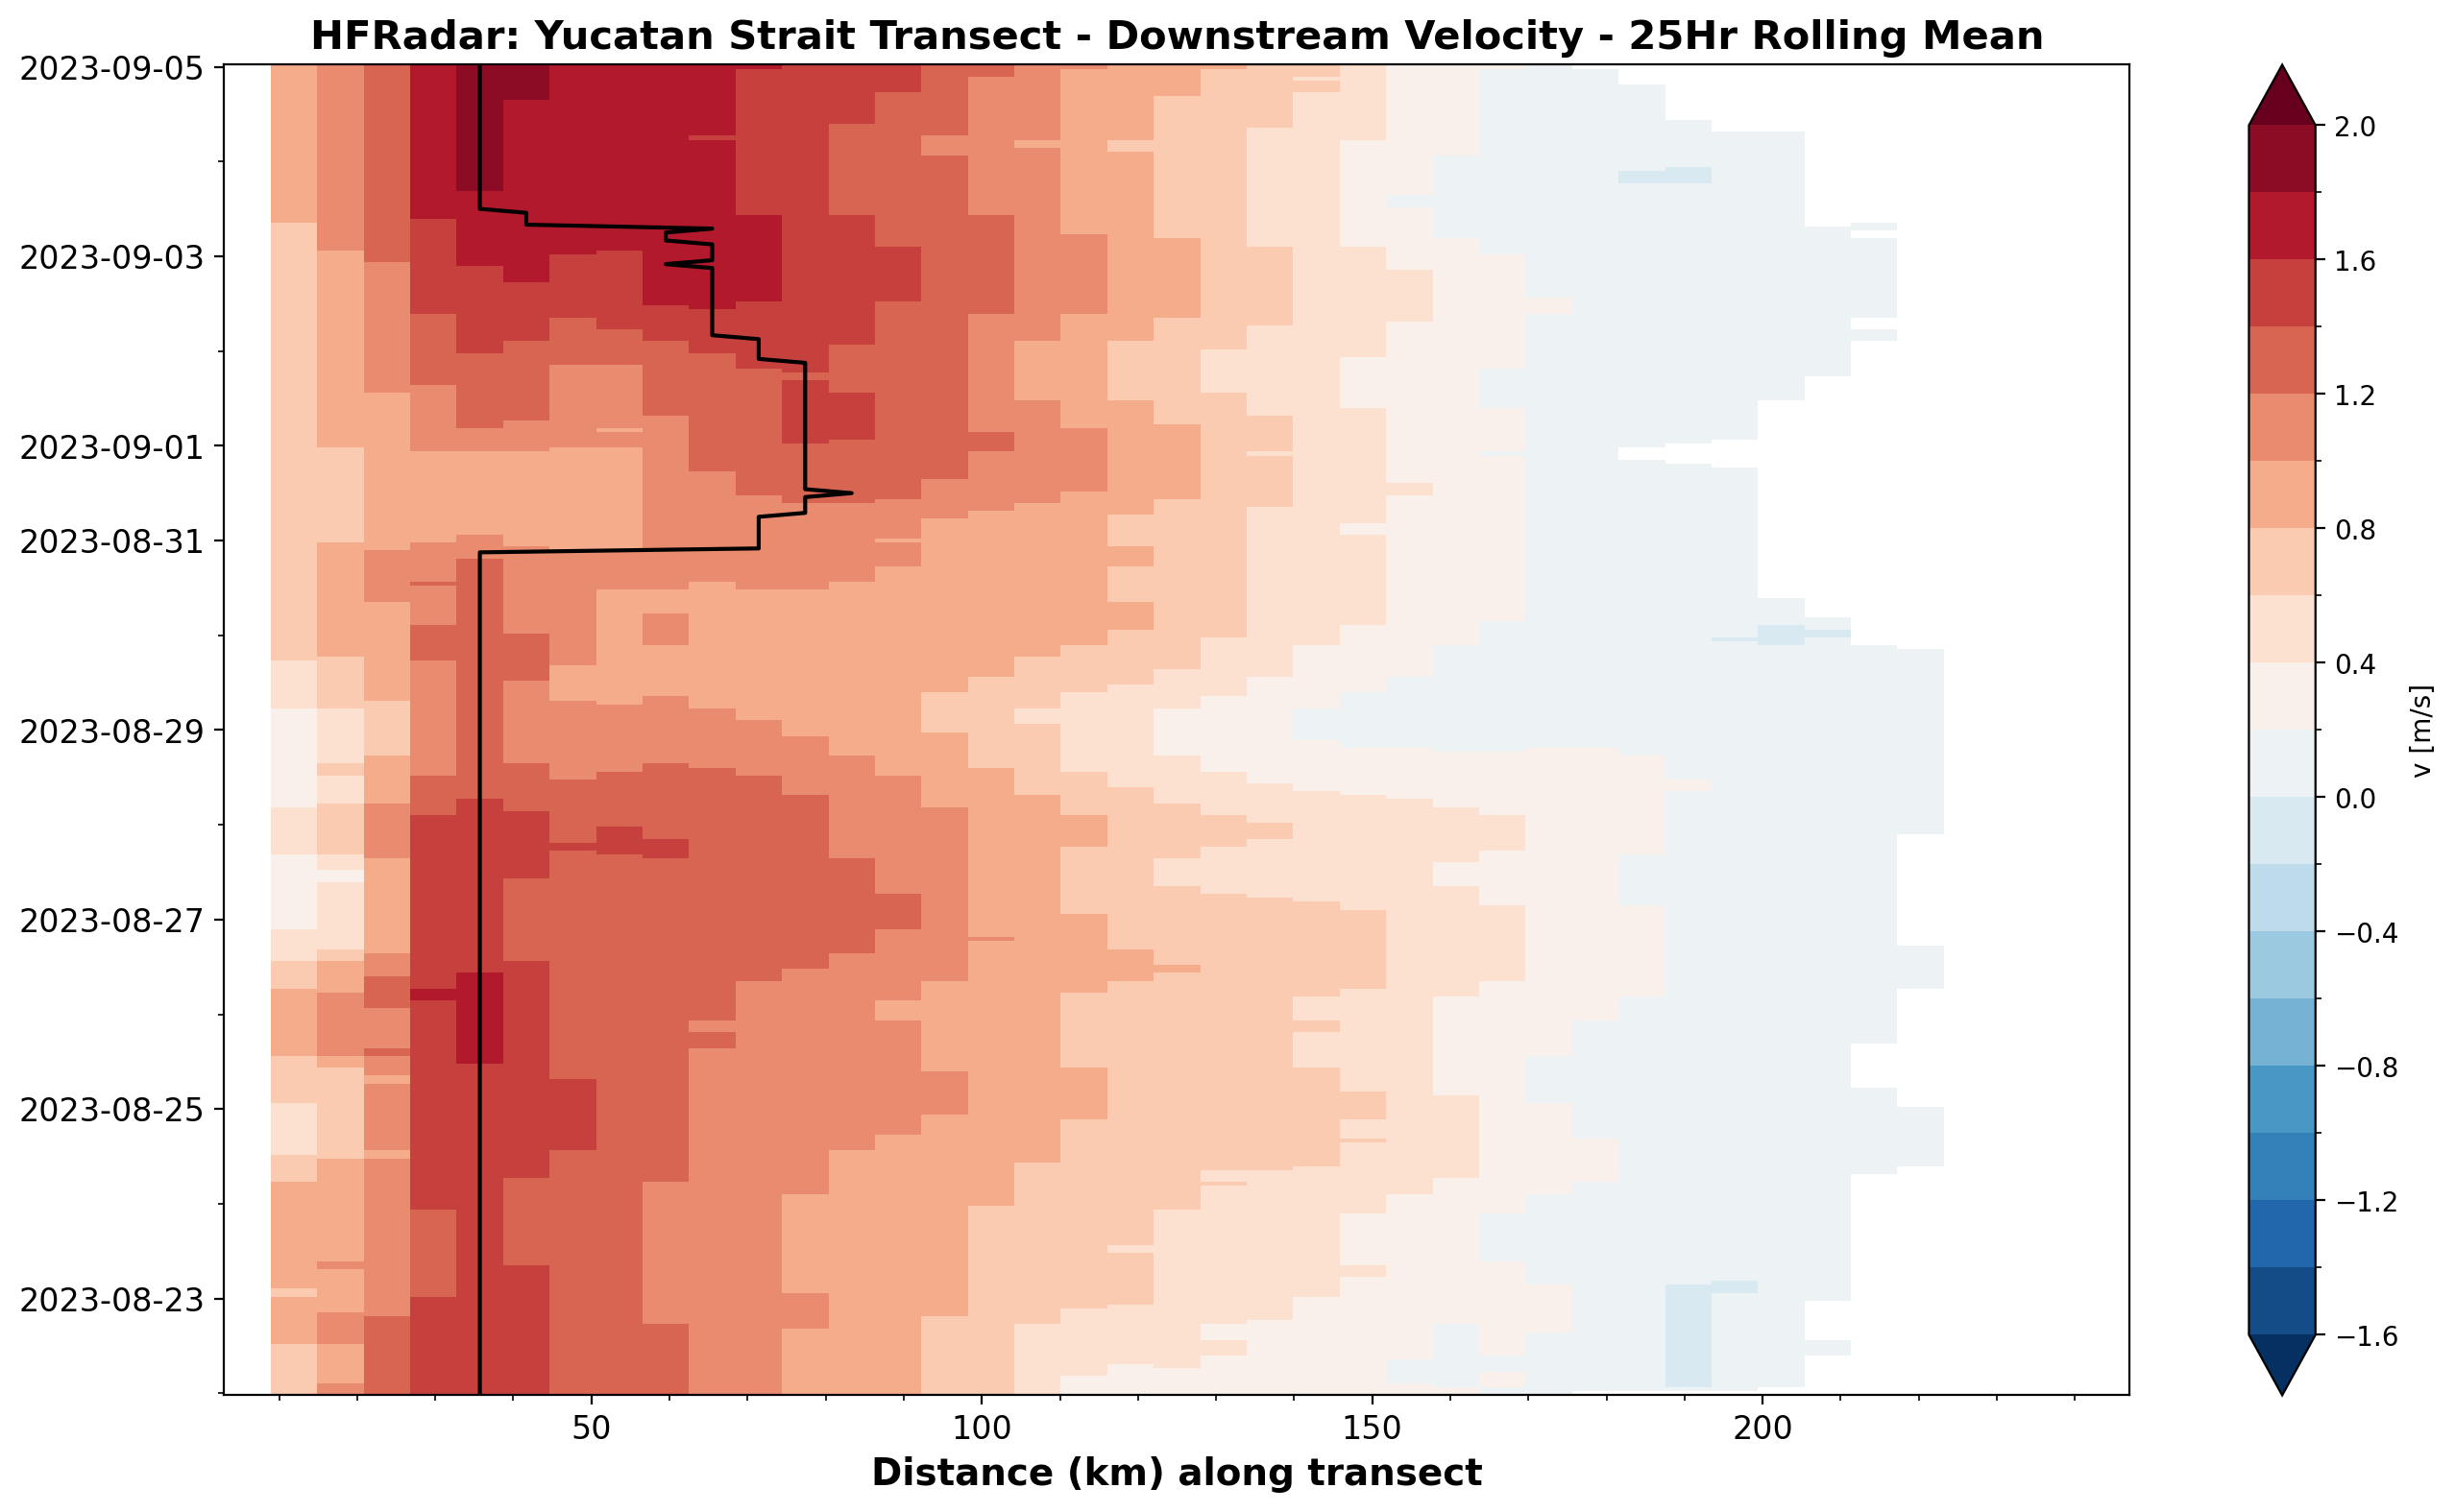
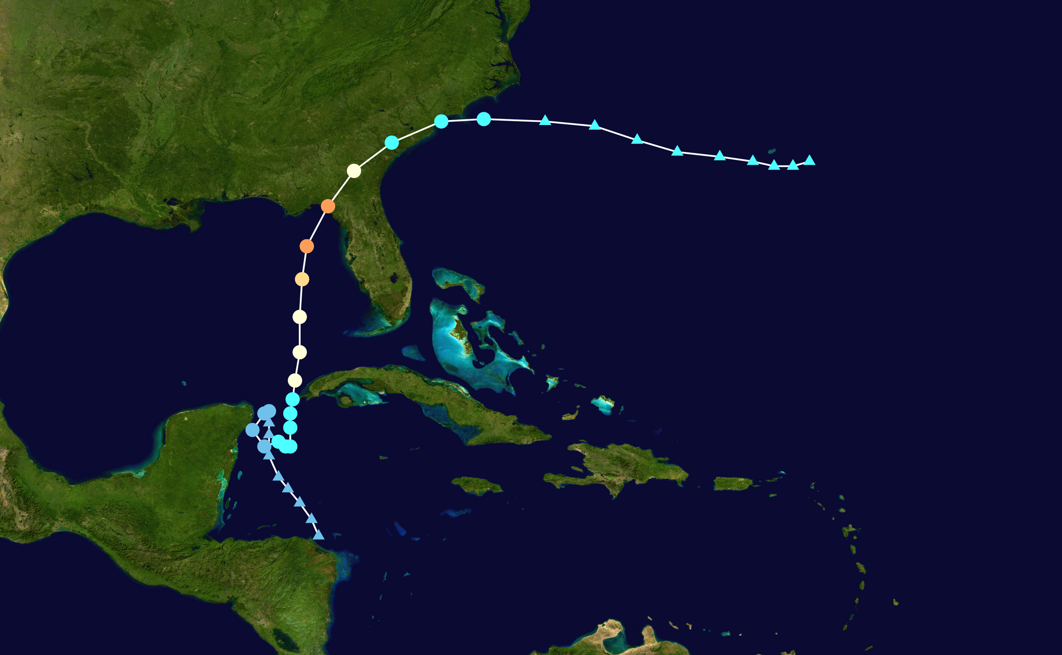
Idalia August 2023 26 Formation 27-28 Yucatan Strait 29 Cat1/Cuba 30 Cat4/Landfall-FL

Slide 14
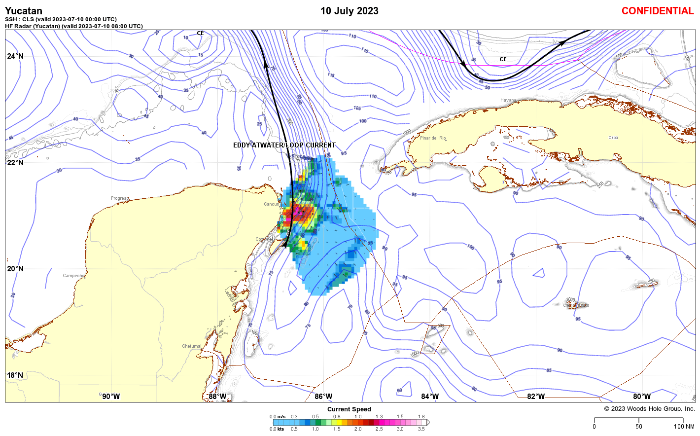
Integrated Industry Decision Support Products
WHG Daily Products
Regional maps
Numerical output
HFR

Slide 15
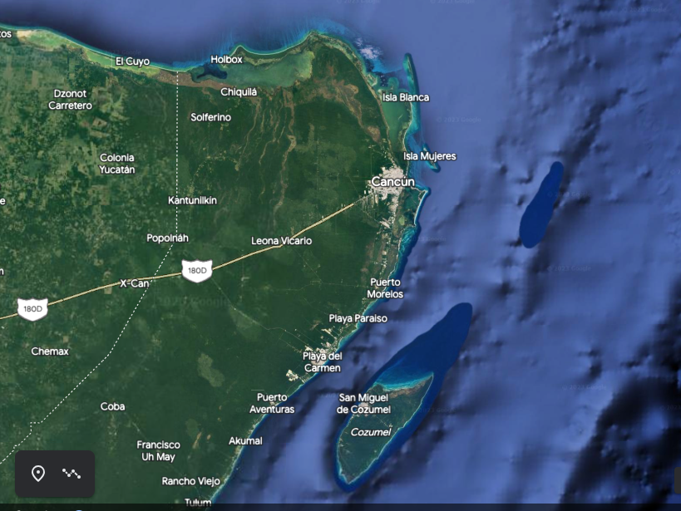
Yucatan HFR Expansion
Isla Contoy
Repurposing UGOS HFR
USM: S Howden
Isla Mujeres, Mexico
Operational redundancy
Cabo de San Antonio, Cuba
Banco Arrowsmith
More to come:…
Field Campaign November 2023
OSM24: New Orleans
Notes:
Testbed opportunity, welcome

Slide 16
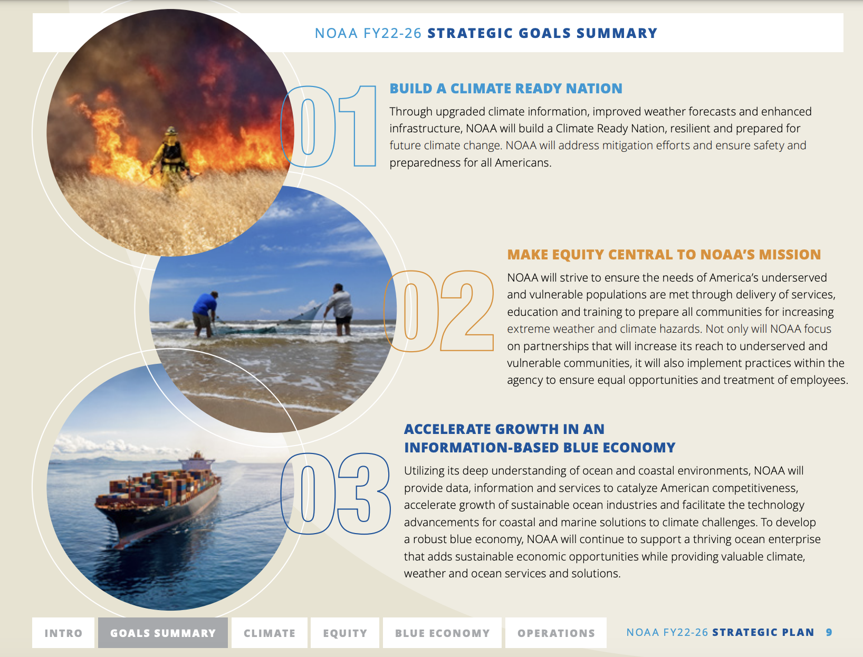
Supporting NOAA’s Mission and Strategic Goals
Build a Climate Ready Nation
Advance Integrated Breakthrough Climate Research
Improve Local/In situ Distributed Observations
Expand Commercial Partnerships and New Technologies
Make Equity Central to NOAA’s Mission
Support Underserved and Vulnerable Communities
Accelerate Growth in an Information-Based Blue Economy
Improve Ocean-related Data and Data-Access
Increase Stakeholder Engagement
Notes:
Implement noaa mission and vision by supporting strategic goals

Slide 17
Acknowledgements
This work was funded by the Gulf Research Program of the National Academy of Sciences Grant Award Number SCON-10000542.
The international Gulf of Mexico Consortium for Offshore Risk Reduction Engaging Stakeholders (GulfCORES) members are: Texas A&M University (lead), Rutgers University, HRI/Texas A&M University - Corpus Christi, University of Miami, University of South Florida, University of Southern Mississippi, Woods Hole Group, CICESE, UNAM.
GOFFISH (Eric Chassignet FSU) and GODEEP (Amy Bower WHOI) consortia
NOAA NOS (IOOS), NWS (EMC), OAR (AOML) Model Data Comparison Team
GCOOS Data Services: J Brenner, F Gayanilo, B Currier, B Kirkpatrick, U Nwankwo
Industry Partners: WHG, Codar, Teledyne, Fugro……your name here

Slide 18
Collect data,
not dust TM
GERG CETI Buoy: Caribbean Sea 2022
05 April 2023
TAMU, College Station, TX
Notes:
The GERG mantra: Collect Data, Not Dust. TM.

Slide 19
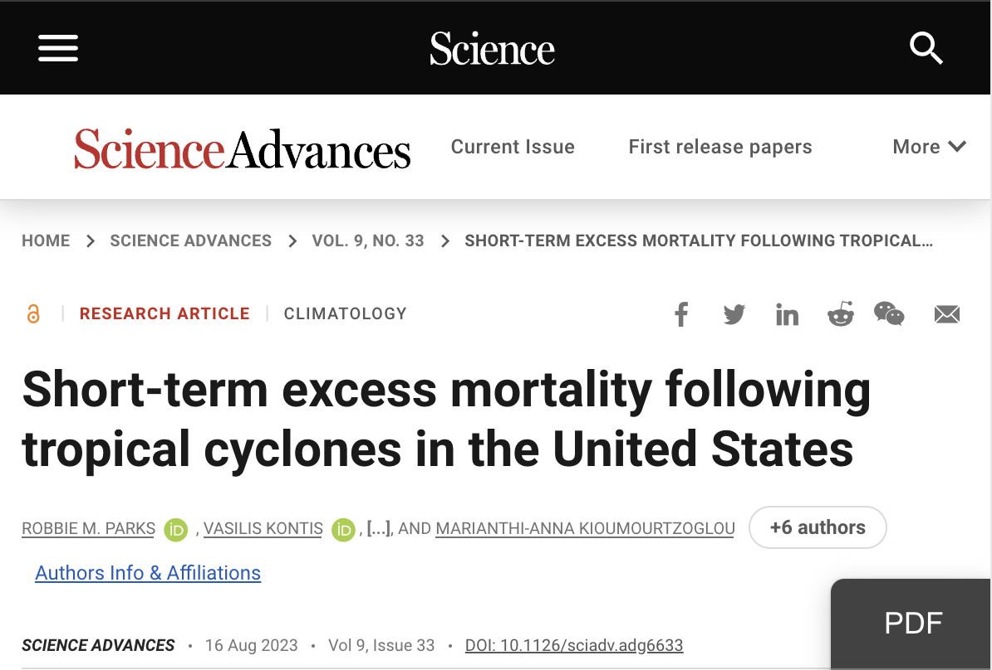
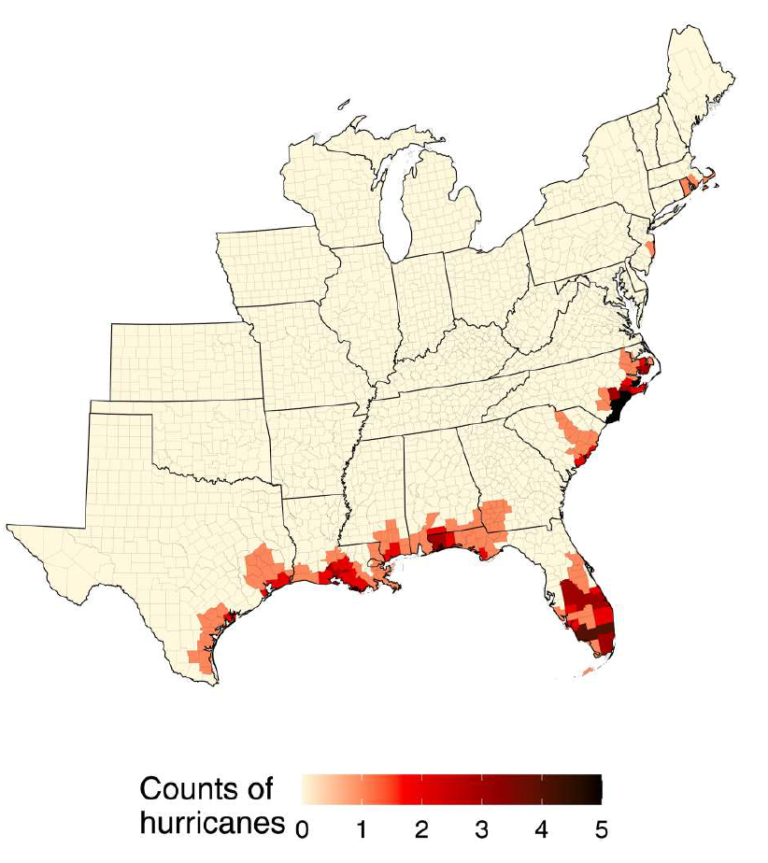
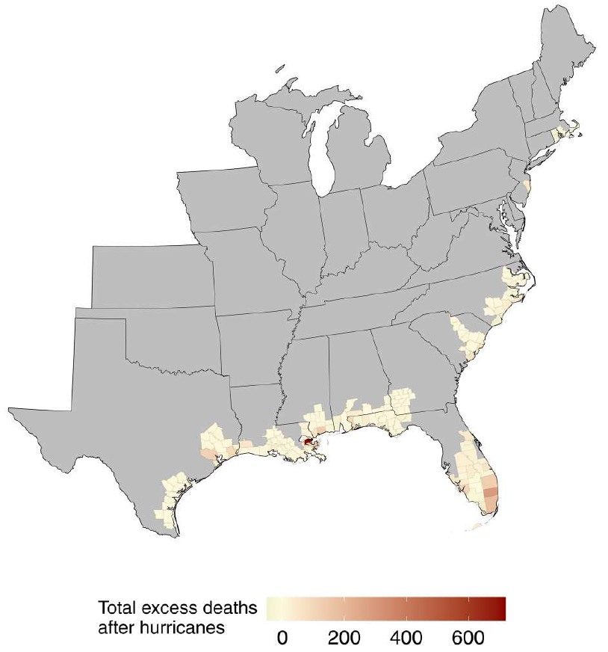
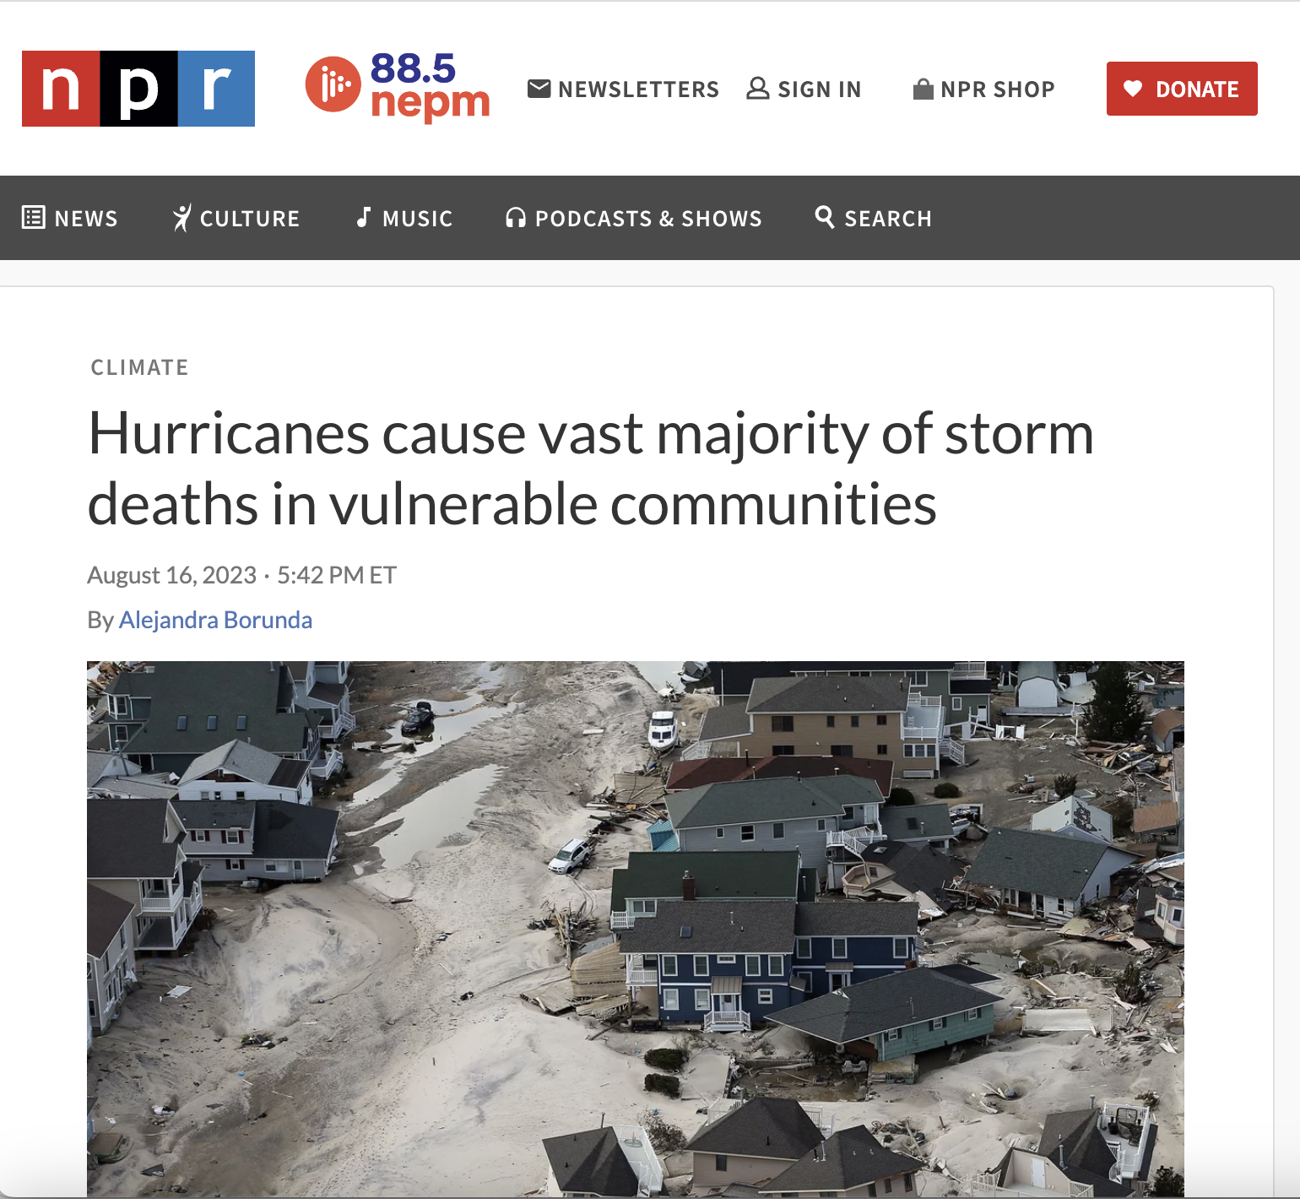
Hurricanes Disproportionately Impact Vulnerable Communities
179 storms over 32 years,
Major storms contributed to 18,000 deaths,
90% from poor or historically disadvantaged communities
Lead Author Robbie Parks:
“Cyclones are hitting randomly, but the affects are nit random.
"The excess deaths that we estimated after tropical cyclones were disproportionately in the most socially vulnerable areas of the United States."

Slide 20
Motivation
U.S. Billion-Dollar Weather & Climate Disasters: 1980-2022
https://www.ncdc.noaa.gov/billions/
Disaster Type | Events | Percent of Total Events | Costs | Percent of Total Costs | Deaths | Percent of Total Deaths
Tropical Cyclone | 60 | 17.2% | $1,365.0B | 53.4% | 6,890 | 43.4%
Severe Storm | 167 | 48.0% | $398.5B | 15.6% | 1,994 | 12.6%
Drought | 30 | 8.6% | $336.6B | 13.2% | 4,275 | 27.0%
Flooding | 40 | 11.5% | $186.6B | 7.3% | 701 | 4.4%
Wildfire | 21 | 6.0% | $135.9B | 5.3% | 435 | 2.7%
Winter Storm | 21 | 6.0% | $95.4B | 3.7% | 1,401 | 8.8%
Freeze | 9 | 2.6% | $36.1B | 1.4% | 162 | 1.0%
All Disasters | 348 | 100.0% | $2,554.1B | 100.0% | 15,858 | 100.0%
Hurricanes cause more damage than all other
Billion-Dollar Weather & Climate Disasters combined!

Slide 21
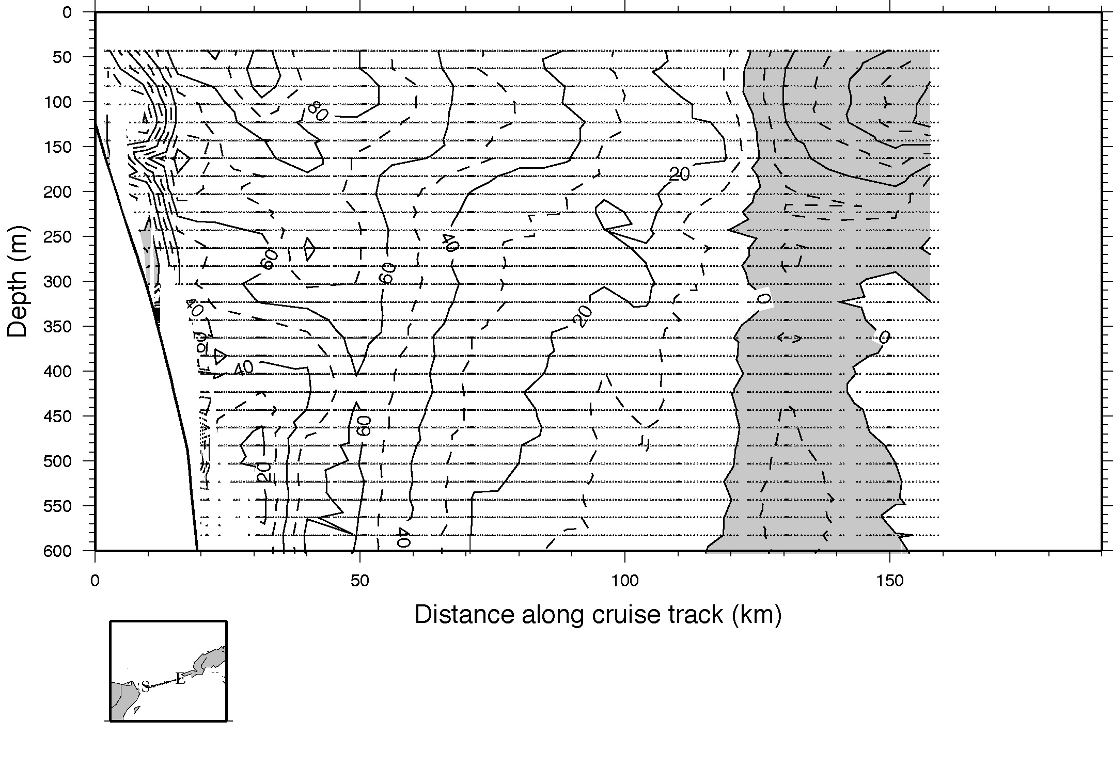
Loop Current Inflow: Vertical Profile
Nowlin et al. 2001

