Slide 1
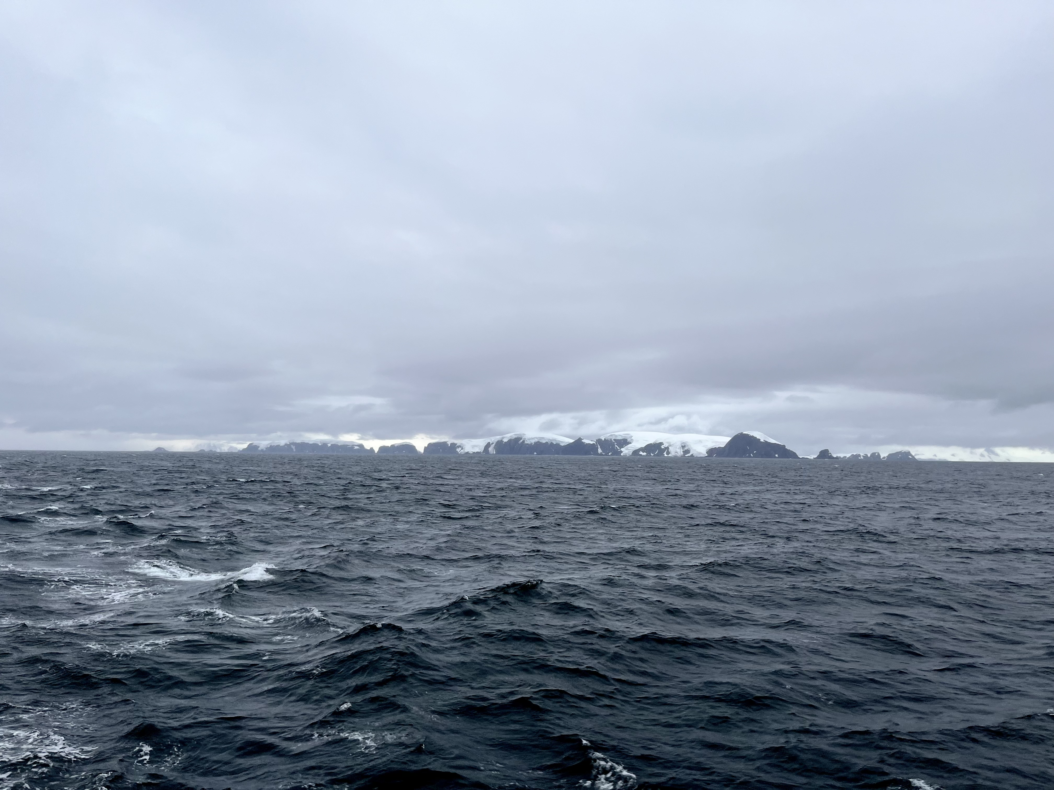
Seasonality of Particles Exported
by the Southern Ocean
Eddy Subduction Pump
Observations From Autonomous Floats
Michael Chen, Oscar Schofield
Rutgers University, USA
Aquatic Sciences Meeting 2023
mlc383@marine.rutgers.edu

Slide 2
The Southern Ocean plays an outsized role in global carbon cycling,
possibly contributing up to 50% of ocean’s annual uptake of anthropogenic CO_{2 (Gruber et al, 2009)}

Slide 3
Carbon Export: Biological Gravitational Pump
Boyd et al (2019)
Notes:
Sinking particulate carbon

Slide 4
Carbon Export: Particle Injection Pumps
Boyd et al (2019)
Notes:
Sinking and suspended POC as well as DOC

Slide 5
Motivation: Constraining the Eddy Subduction Pump’s role in export requires characterizing its seasonality and the injected particle assemblage

Slide 6
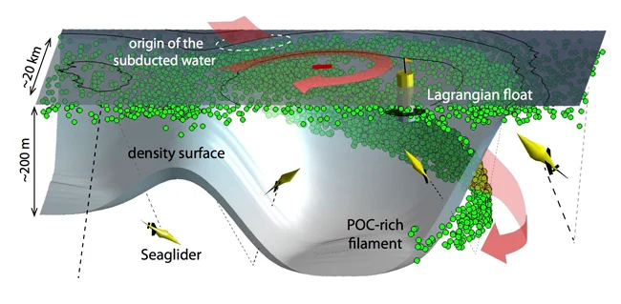
The Eddy Subduction Pump (ESP)
Driven by submesoscale circulation associated with eddies and jets
Schematic by Melissa Omand
Notes:
Front intensification along eddy boundaries in the eddying flow field generates vertical velocities (positive and negative).
Downward velocities inject surface water below the mixed layer
Can inject surface

Slide 7
The Eddy Subduction Pump (ESP)
Vertical velocities inject surface water along tilted isopycnals
Schematic by Melissa Omand
Notes:
Front intensification along eddy boundaries in the eddying flow field generates vertical velocities
Downward velocities inject surface water below the mixed layer
Can inject surface

Slide 8
The Eddy Subduction Pump (ESP)
3D pathway of water transport
Schematic by Melissa Omand
Notes:
Front intensification along eddy boundaries in the eddying flow field generates vertical velocities (positive and negative).
Downward velocities inject surface water below the mixed layer
Can inject surface

Slide 9
The Eddy Subduction Pump (ESP)
Float profiles can detect patches of subducted water
Schematic by Melissa Omand
Notes:
Front intensification along eddy boundaries in the eddying flow field generates vertical velocities (positive and negative).
Downward velocities inject surface water below the mixed layer
Can inject surface

Slide 10
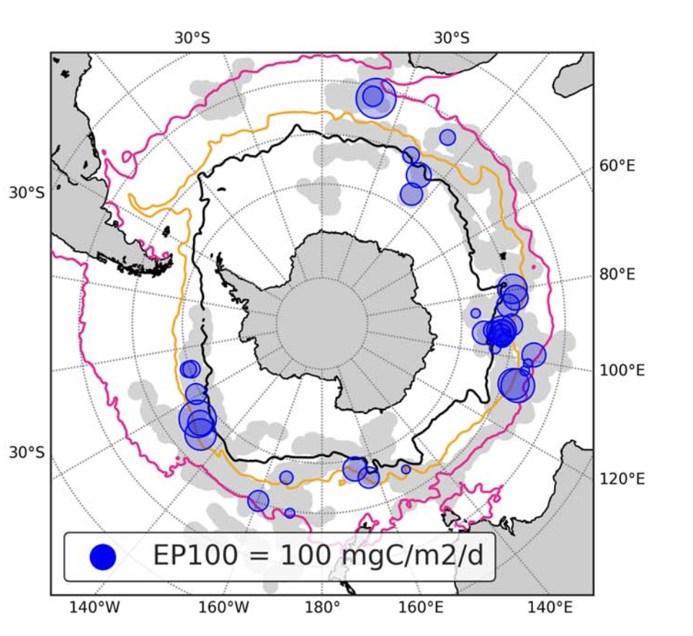
The ESP has been estimated to contribute <19% of export flux across the Southern Ocean, but can be much more locally important
Llort et al (2018)
Notes:
Front intensification along eddy boundaries in the eddying flow field generates vertical velocities (positive and negative).
Downward velocities inject surface water below the mixed layer
Can inject surface

Slide 11
Methods: detecting ESP ”anomalies” from BGC-Argo float profiles
Subducted water is associated with mesopelagic anomalies in:
spice
Apparent Oxygen Utilization (AOU)
Schematic by Melissa Omand
Notes:
Front intensification along eddy boundaries in the eddying flow field generates vertical velocities (positive and negative).
Downward velocities inject surface water below the mixed layer
Can inject surface

Slide 12
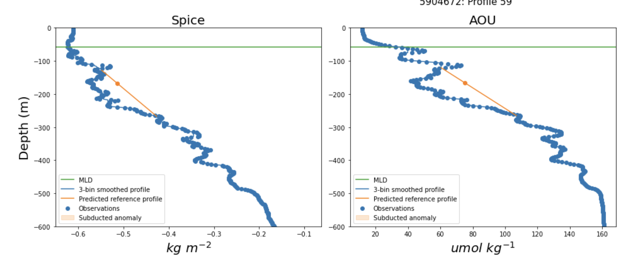
Methods: detecting ESP ”anomalies” from BGC-Argo float profiles
Methods based on Chen et al (2021) and Llort et al (2018)
Schematic by Melissa Omand
Notes:
Front intensification along eddy boundaries in the eddying flow field generates vertical velocities (positive and negative).
Downward velocities inject surface water below the mixed layer
Can inject surface

Slide 13
Methods: detecting ESP ”anomalies” from BGC-Argo float profiles
Find concurrent peaks in spice and AOU
Schematic by Melissa Omand
Notes:
Front intensification along eddy boundaries in the eddying flow field generates vertical velocities (positive and negative).
Downward velocities inject surface water below the mixed layer
Can inject surface

Slide 14
Methods: detecting ESP ”anomalies” from BGC-Argo float profiles
Define “reference” profiles
Schematic by Melissa Omand
Notes:
Front intensification along eddy boundaries in the eddying flow field generates vertical velocities (positive and negative).
Downward velocities inject surface water below the mixed layer
Can inject surface

Slide 15
Methods: detecting ESP ”anomalies” from BGC-Argo float profiles
Define “reference” profiles
Schematic by Melissa Omand
Notes:
Front intensification along eddy boundaries in the eddying flow field generates vertical velocities (positive and negative).
Downward velocities inject surface water below the mixed layer
Can inject surface

Slide 16
Methods: detecting ESP ”anomalies” from BGC-Argo float profiles
Calculate magnitude of anomalies
Schematic by Melissa Omand
Notes:
Front intensification along eddy boundaries in the eddying flow field generates vertical velocities (positive and negative).
Downward velocities inject surface water below the mixed layer
Can inject surface

Slide 17
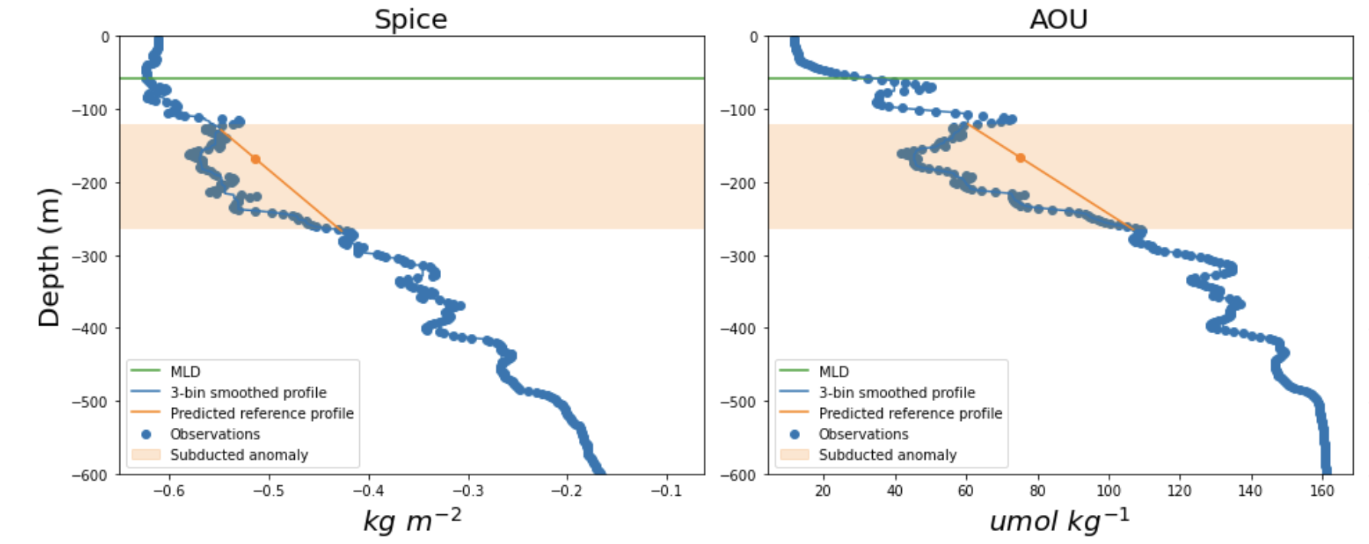
Methods: detecting ESP ”anomalies” from BGC-Argo float profiles
Schematic by Melissa Omand
Notes:
Front intensification along eddy boundaries in the eddying flow field generates vertical velocities (positive and negative).
Downward velocities inject surface water below the mixed layer
Can inject surface

Slide 18
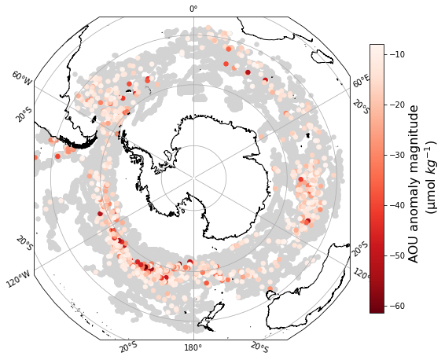
ESP events were found in about 5% of profiles, concentrated in areas with strong submesoscale circulation

Slide 19
Constraining the Eddy Subduction Pump’s role in export requires characterizing its seasonality and the injected particle assemblage

Slide 20
Constraining the Eddy Subduction Pump’s role in export requires characterizing its seasonality and the injected particle assemblage
Basin-wide seasonal patterns

Slide 21
Most events were detected in late spring and summer

Slide 22
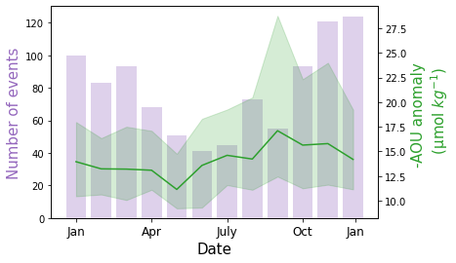
However, the strongest events occurred in early spring

Slide 23
What about the injected carbon?

Slide 24
Subducted POC also peaks in the summer, mirroring biomass in the surface mixed layer

Slide 25
Can we say anything about the subducted particle assemblage? Chl:bbp ratios: Variations can indicate differences in surface particle assemblages, or in particle “freshness” at depth

Slide 26
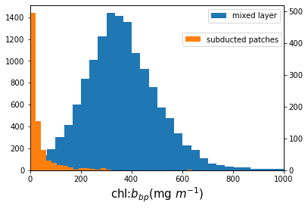
chl:bbp ratios are generally low in subduction patches

Slide 27
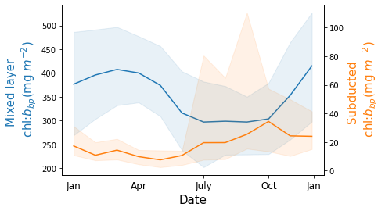
Subduction patches: chl:bbp ratios are highest in early spring Mixed layer: chl:bbp ratios are highest in late spring/summer

Slide 28
Material subducted in early spring may be “fresher”, or less grazed, before grazers catch up to surface bloom initiation

Slide 29
This is consistent with larger AOU anomalies (weaker signature of respiration) in the spring

Slide 30
Alternatively, these may indicate that we are detecting more recent subduction in the spring

Slide 31
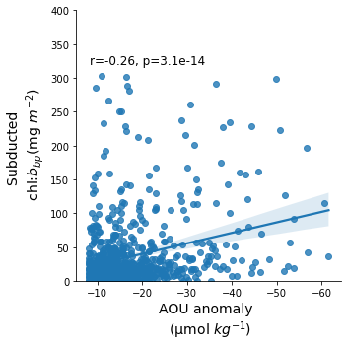
Chl:bbp ratios are loosely associated with stronger AOU anomalies

Slide 32
On a basin-wide scale, the eddy subduction pump shows seasonal patterns:
Spring
Strongest events detected
“Freshest” material subducted
Summer
Most events detected
Most POC subducted

Slide 33
The Eddy Subduction Pump may have different consequences in different seasons, affecting:
Delivery of carbon to mesopelagic ecosystems
The fate of subducted carbon / longer-term sequestration

Slide 34
Acknowledgements
Data were collected and made freely available by the Southern Ocean Carbon and Climate Observations and Modeling (SOCCOM) Project funded by the National Science Foundation, Division of Polar Programs (NSF PLR -1425989 and OPP-1936222), supplemented by NASA, and by the International Argo Program and the NOAA programs that contribute to it. The Argo Program is part of the Global Ocean Observing System.
FINESST Grant
#80NSSC22K1451
Notes:
Mostly gonna focus on fixation

Slide 35
Questions?
mlc383@marine.rutgers.edu
Notes:
Mostly gonna focus on fixation

