Slide 1
UGOS UASA HFR Data Troubleshooting
8/8/23
Timothy Stolarz

Slide 2
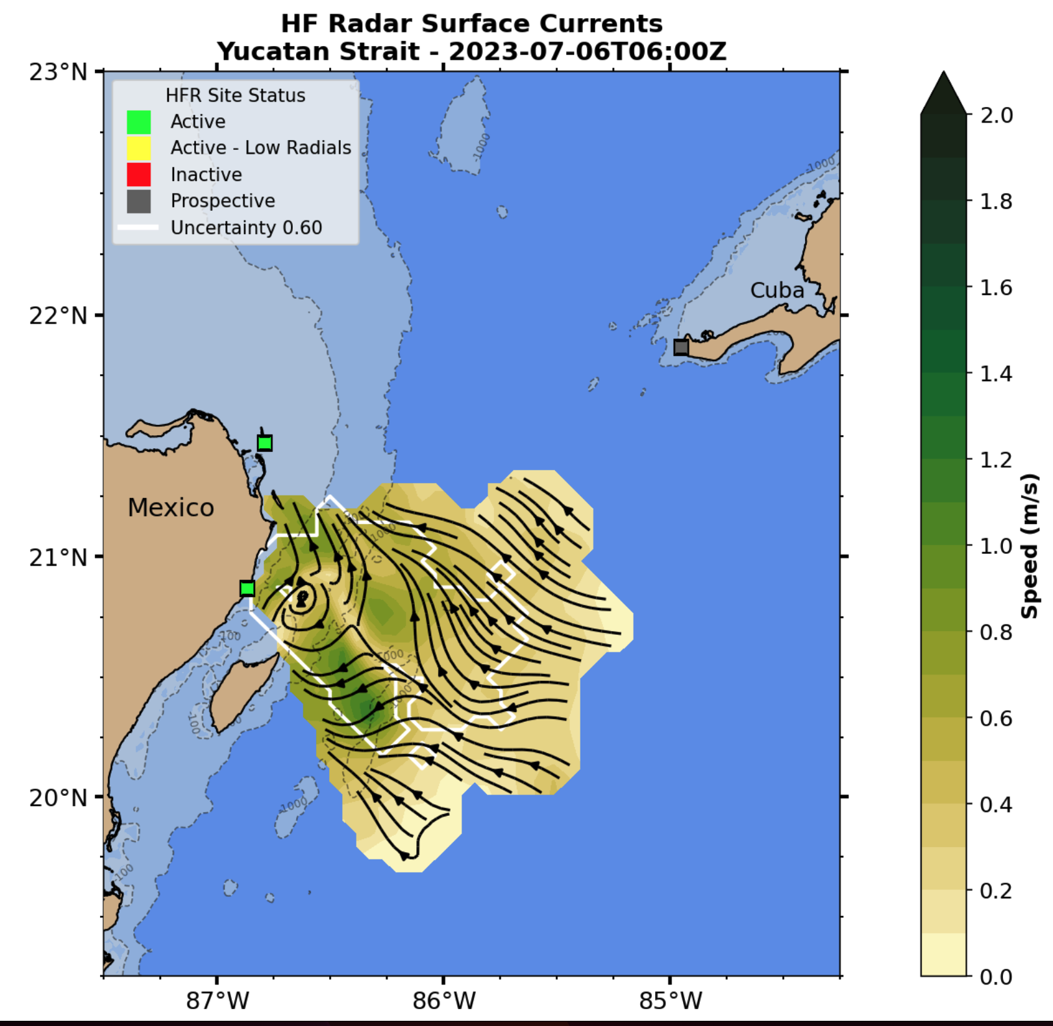
What We Noticed
Suspicious about low coverage currently as well as in also July
https://rucool.marine.rutgers.edu/ugos-hfr/

Slide 3
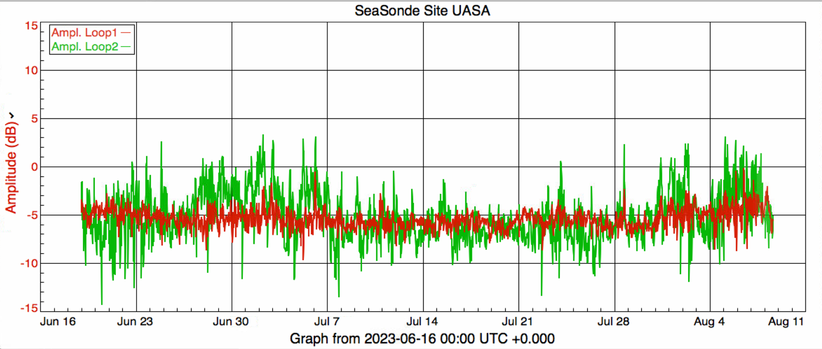
Let’s Check Some Diagnostics
One of the first things we check are Amplitudes and Phases. Disruption in one or the other usually affects each other.
Changes in these are indicative of either a hardware state change or signal to noise changes.
Phases and amplitudes seem stable enough to not cause worry.
Amplitudes
Phases

Slide 4
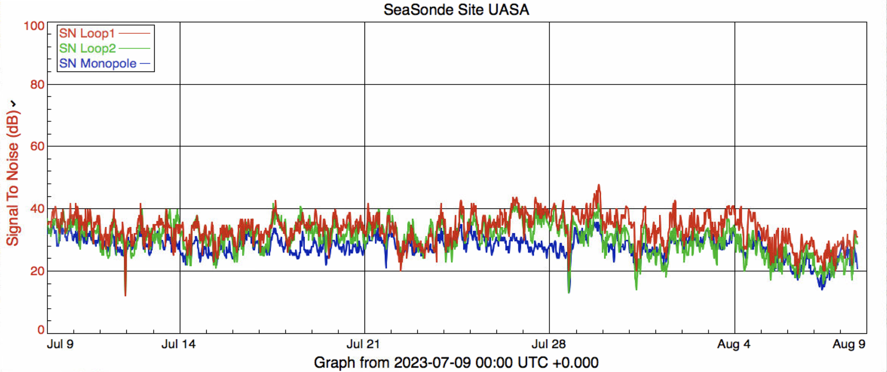
Let’s check SNR and Noise Floors
Noise Floors
Signal to Noise
?
?
It is difficult to say there is a hardware issue involved with these plots.
For sure we can say that the SNR is lower in most recent days than usual.
Also that the noise floor suddenly changed in Loop 1 and then returned to normal.
Since it did change back, not very concerning

Slide 5
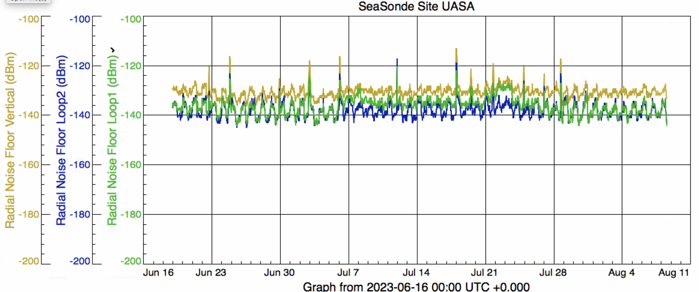
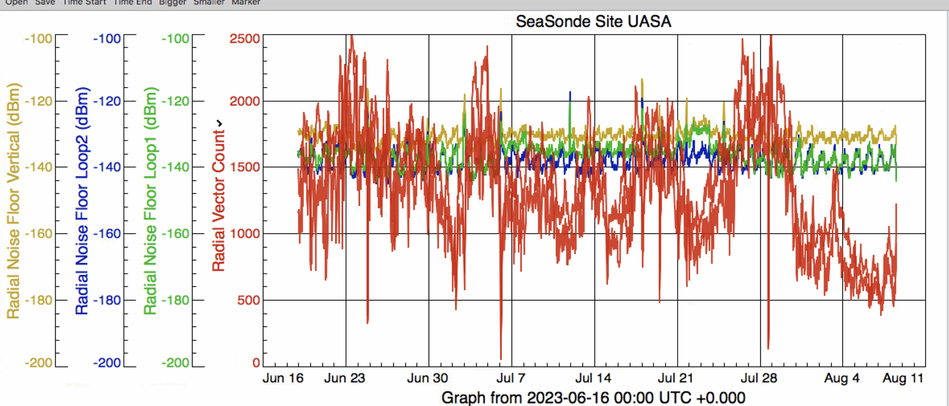
Let’s Compare SNR + Noise Floors to Radial Vector Count

Slide 6
What do we see?
Dips in SNR are generally seen with reductions in radial vector count
However this was not the case in June
Gains in Monopole noise floor is more close associated with drops in radial coverage
This occurred somewhat frequently
Since the start of August, SNR has decreased closer to the 20 dB threshold
This is on the way back up
Noise floor in Loop 1 rises from ~ July 6 – July 26 before restabilizing
No discernable pattern of impact on total radial vector count

Slide 7
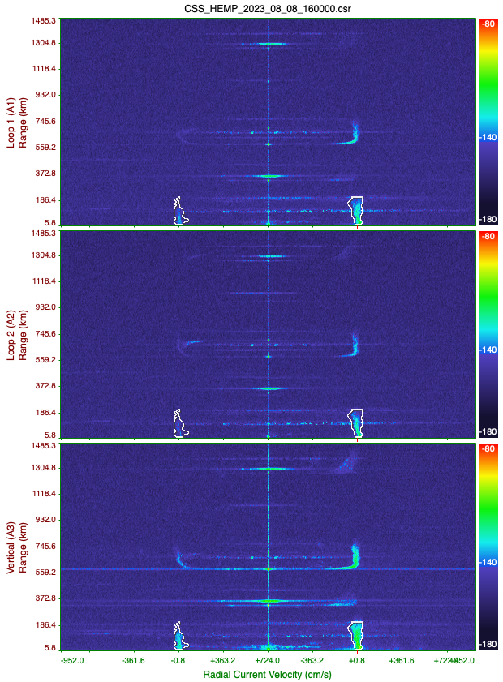
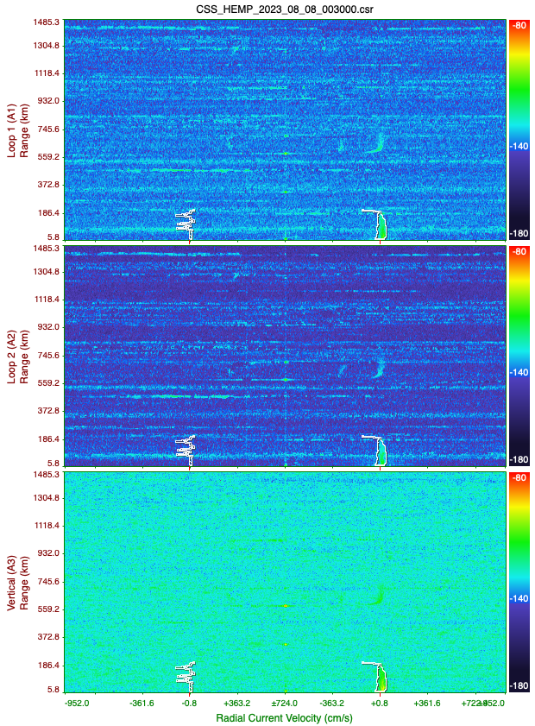
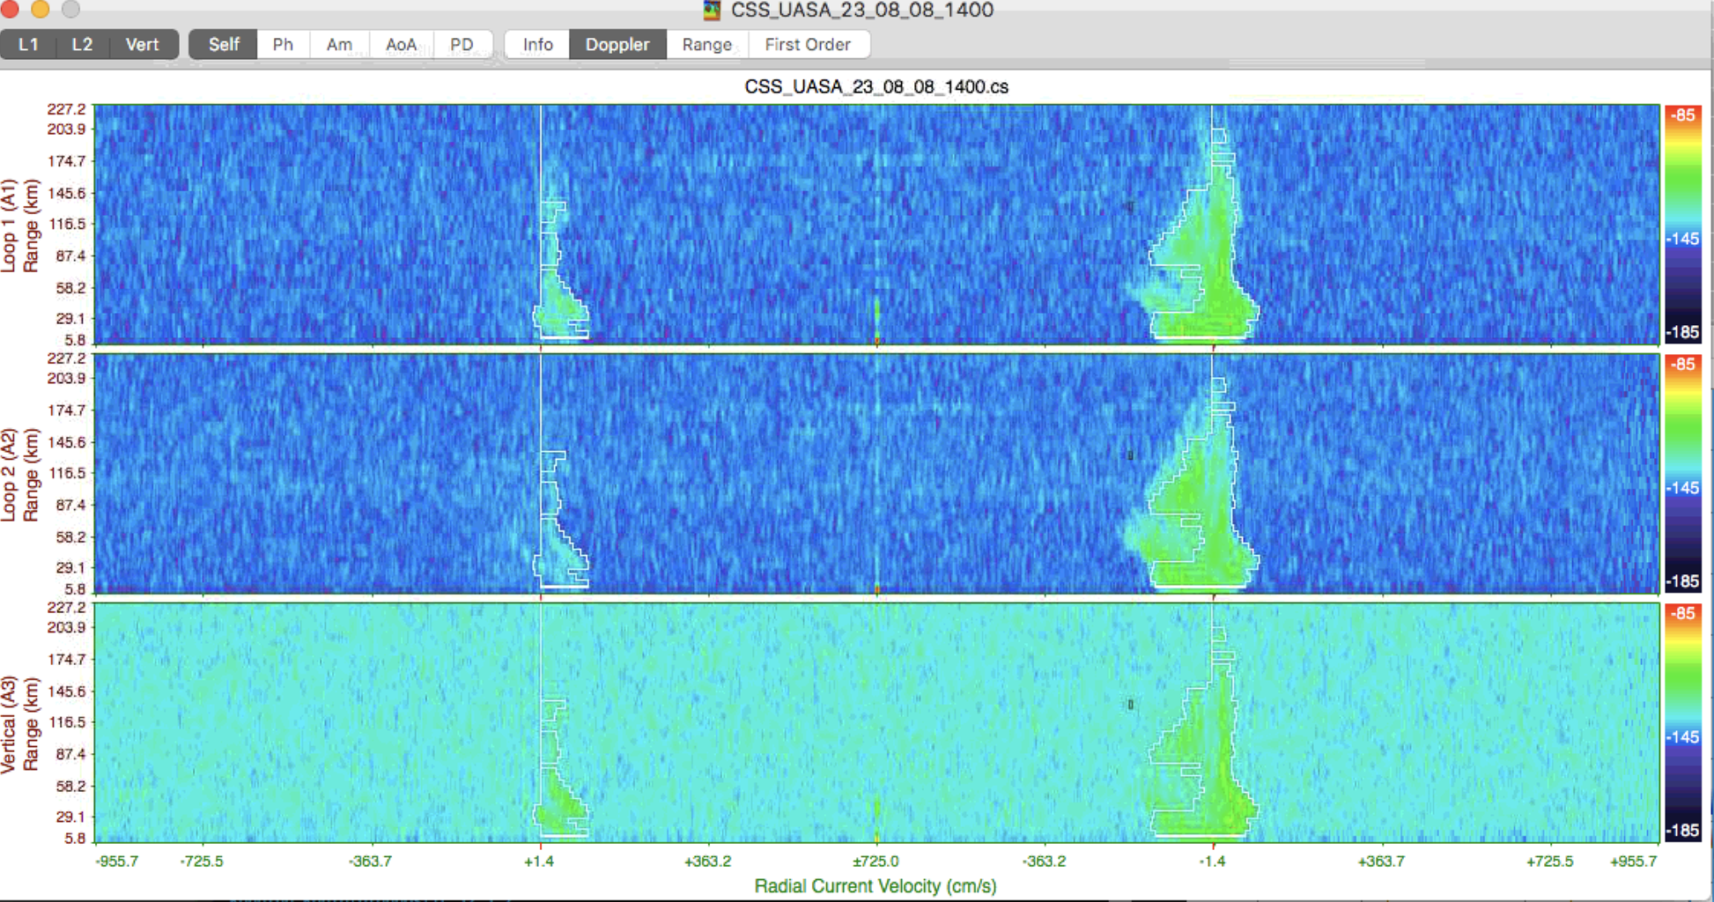
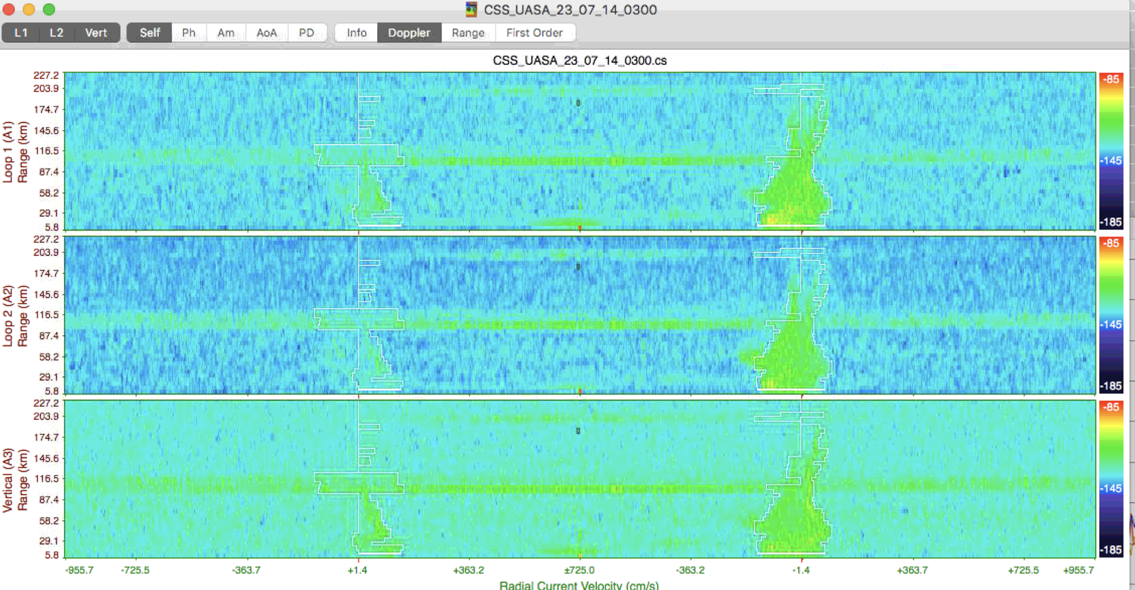
What is the Variation of Noise We See?
Noise throughout the summer varies pretty strongly
… But this isn’t that abnormal
Loop 1
Loop 2
Loop 3
Less Than 24 Hours Apart

Slide 8
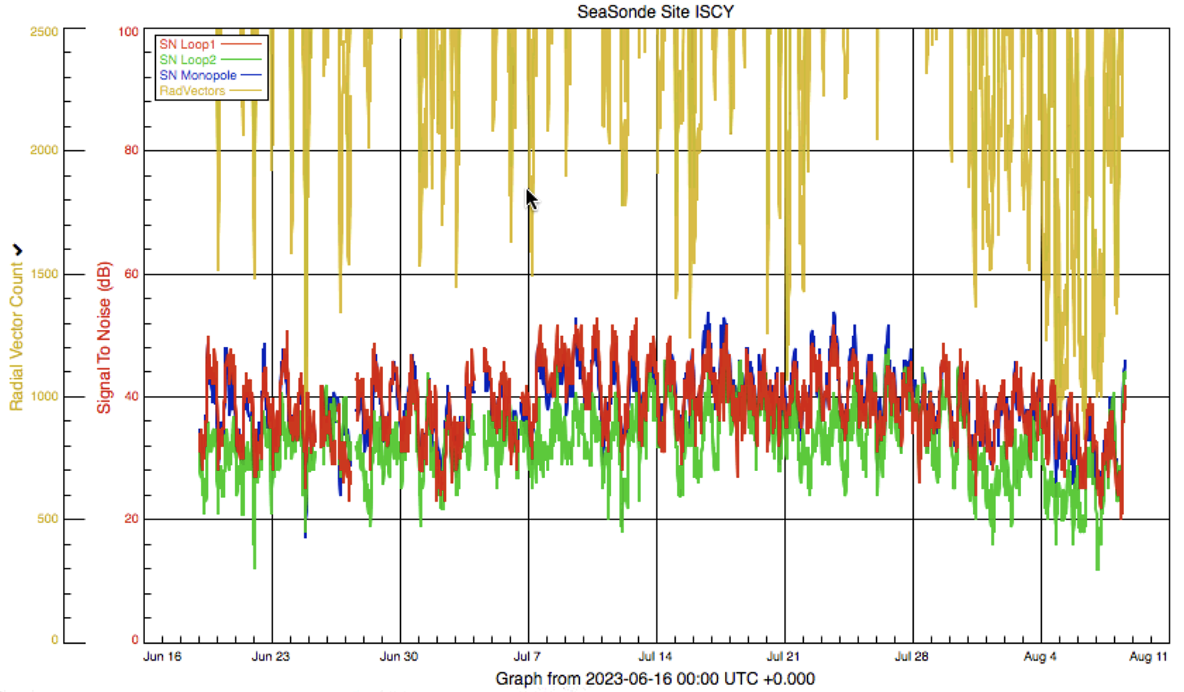
How about Noise at ISCY?
The noise floors aren’t as stable as UASA, however they remain coupled well throughout the summer
Not nearly as many spikes in Monopole noise floor (indicating likely local phenomenon at UASA)
For SNR, radial vector count seems associated well with lows in SNR (seen well in August)

Slide 9
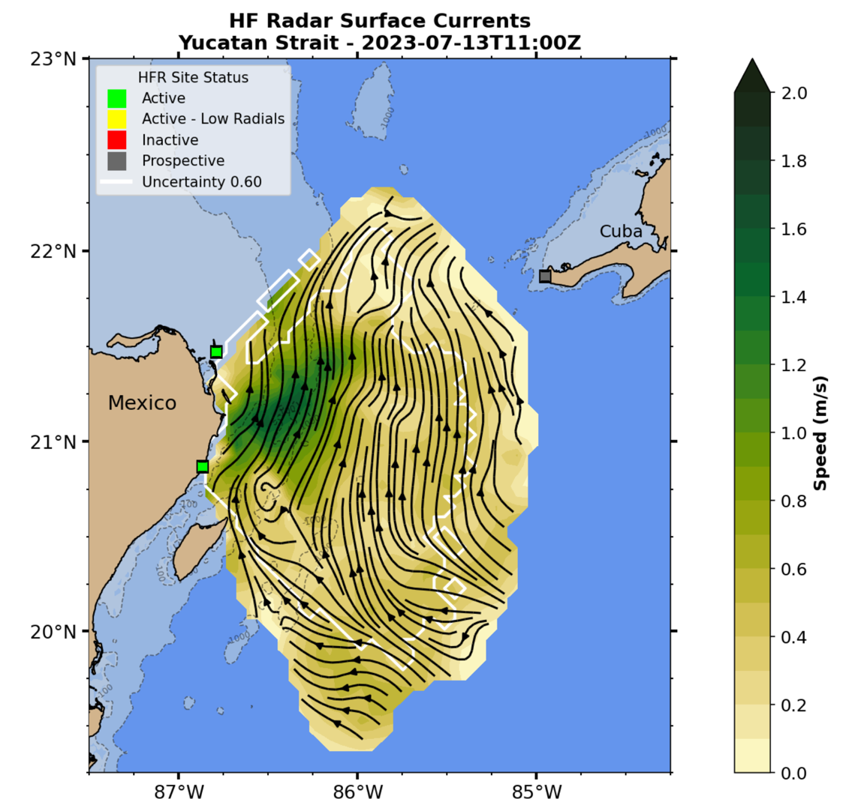
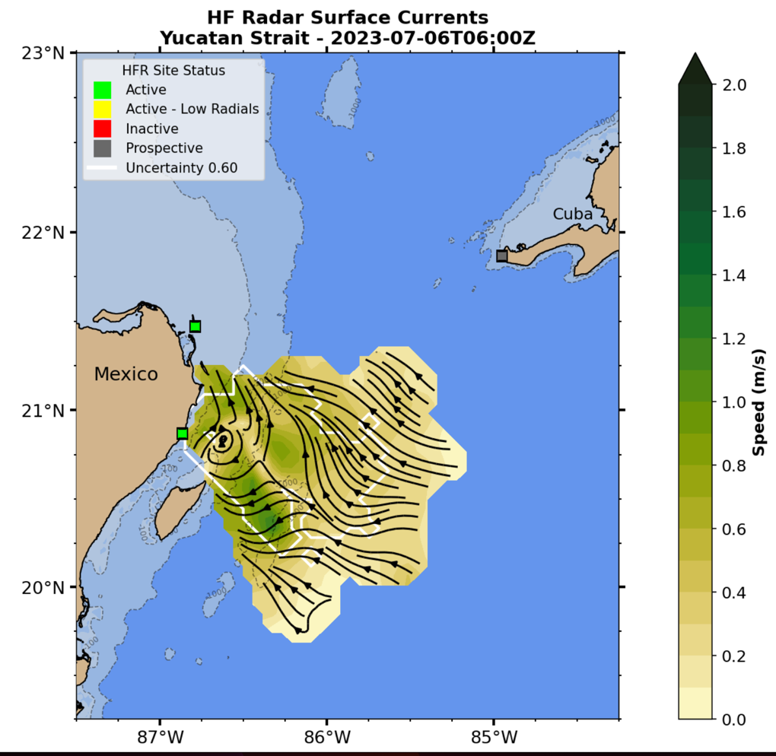
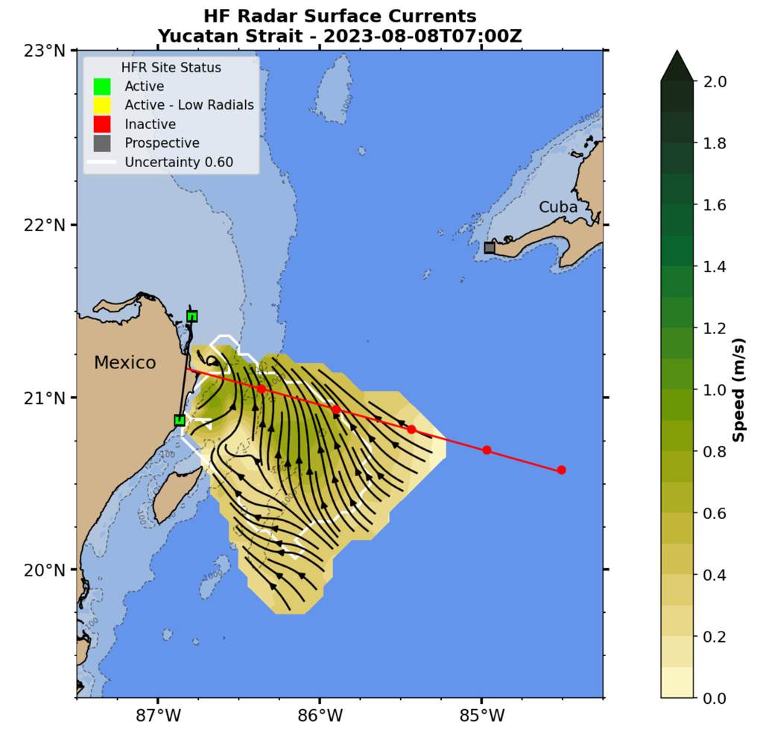
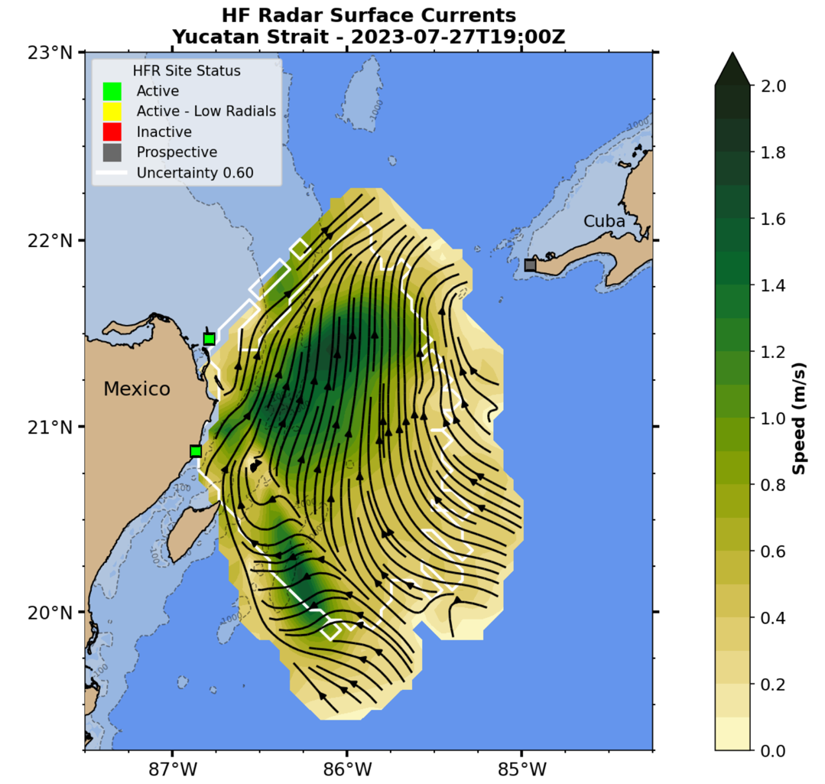
A Look at Totals Maps
We see low coverage periods…
Early July
Late July
July
August
But we also see high coverage periods…

Slide 10
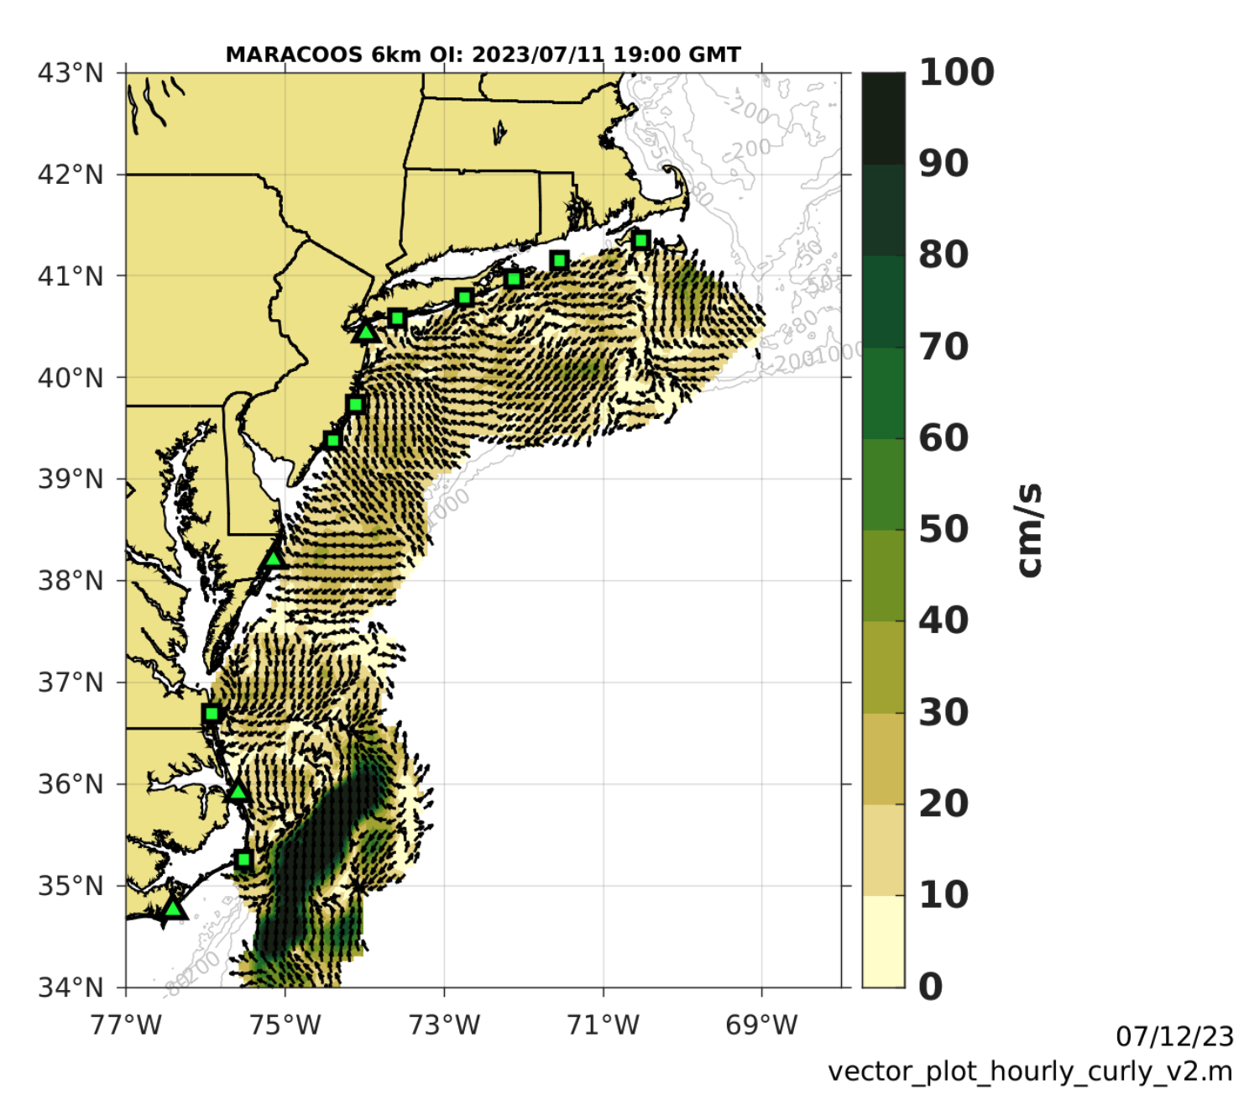
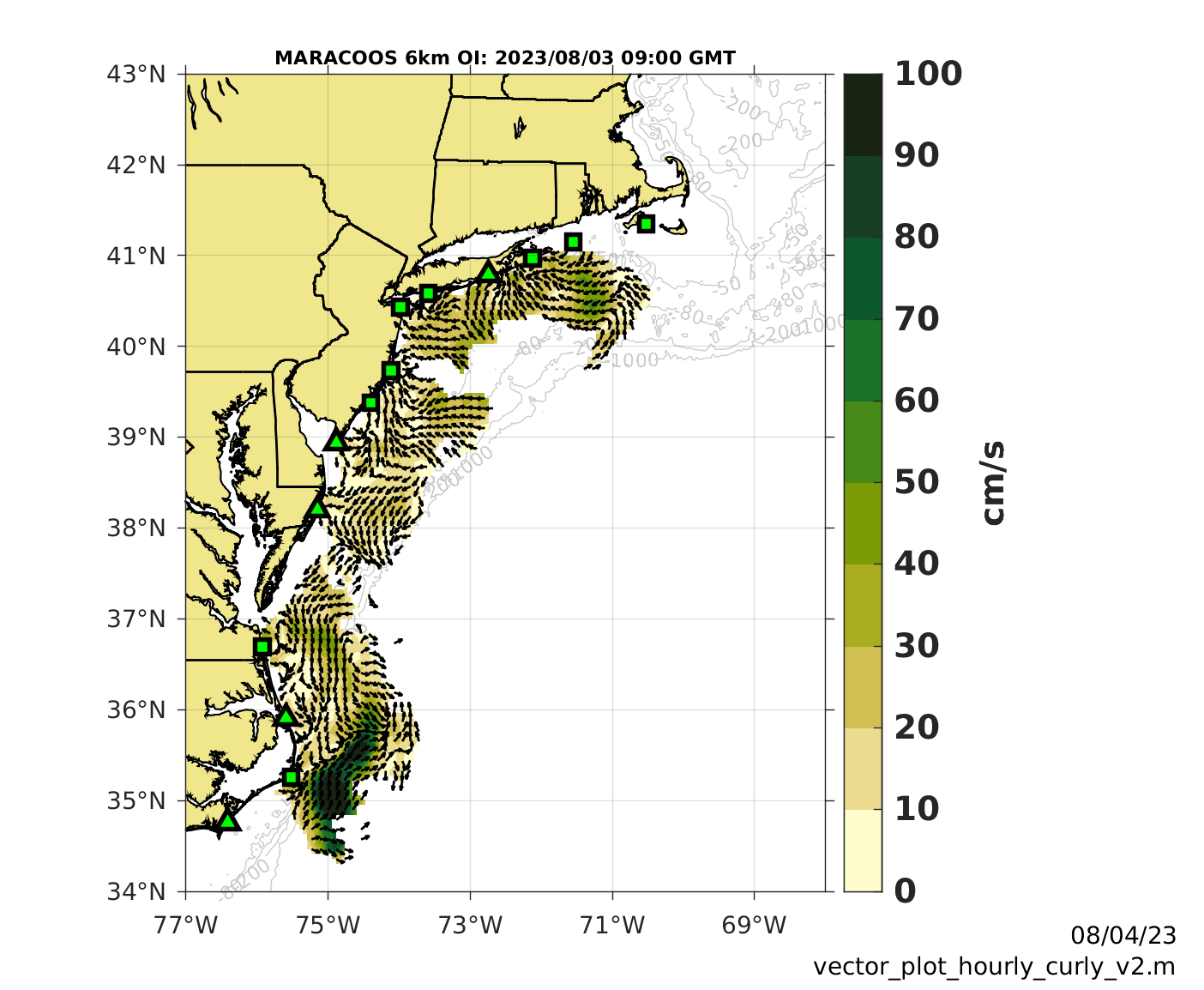
We See Similar Phenomenon in the MAB
July
August

Slide 11
Wave Heights in the Yucatan Basin

Slide 12
Taking a Deep Dive into the Spectra

Slide 13
What we saw:
Often throughout July only one of the two Bragg peaks was being tracked
Large bursts of interference every ~ 3 days for a few hours at about 100 km out (these range cells were filtered out of the radials)
In August, the software was processing ‘ghost’ Bragg peaks and not the actual Bragg peaks

Slide 14
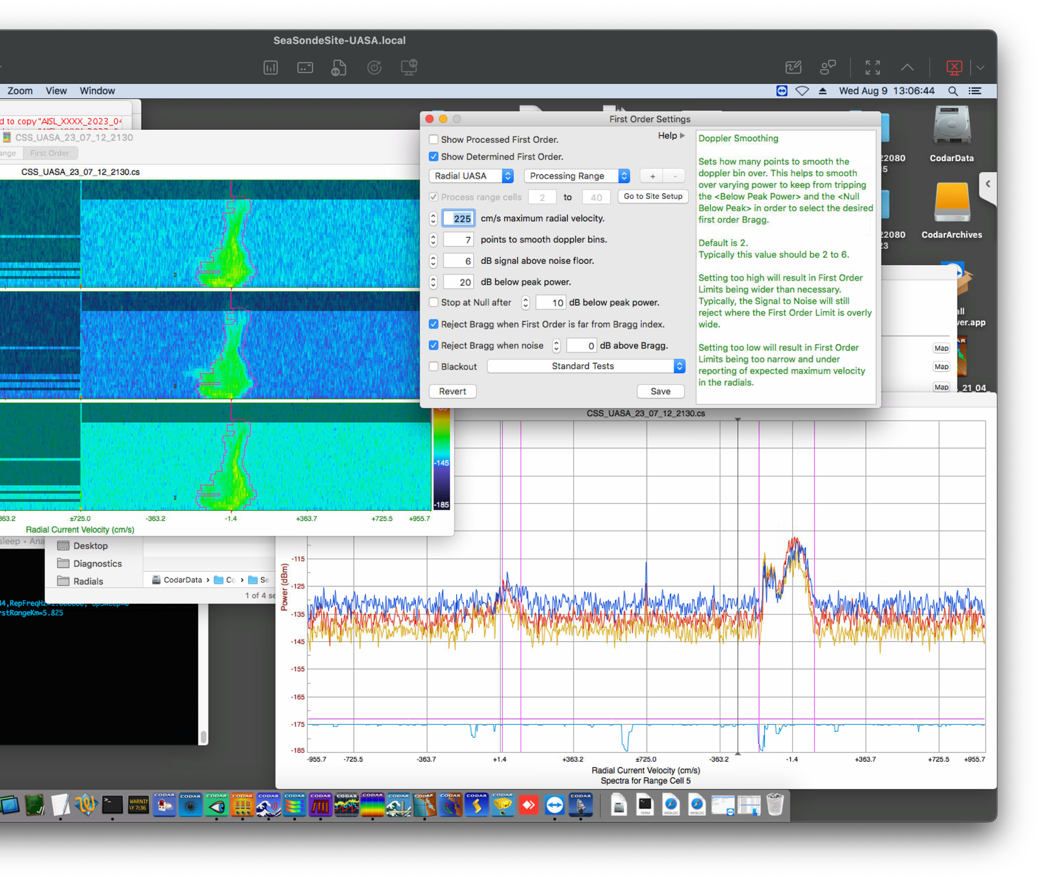
Single Peak Tracking

Slide 15
Interference
Times of Strong Interferences
23_06_27_04
23_07_04_0630 - 23_07_04_1200
23_07_07_1300 - 23_07_07_1700
23_07_09_0100 - 23_07_09_0500
23_07_11_2230 - 23_07_12_0230
23_07_15_0200 - 23_07_15_0500
23_07_16_2300 - 23_07_17_0230
23_07_18_0100 - 23_07_18_0500
23_07_21_0300 - 23_07_21_0800
23_07_21_1930 - 23_07_22_0430
23_07_24_2300
23_07_27_0100 - 23_07_27_0430
23_07_27_1300 - 23_07_27_1530

Slide 16
The very strong interference is filtered out

Slide 17
Ghost Bragg
No occurrences in July, only August

Slide 18
Thoughts On Coverage Drops
Toward end of June we see a similar situation with losing coverage in the northern end for a few days. (https://rucool.marine.rutgers.edu/ugos-hfr/)
We also see times of strong coverage persist for a few days as well
For now, it is difficult to pinpoint a hardware fault to the reduction of coverage in the sampling region
Potential causes are local interference from tech at UASA, tropical lightning storms during summer, less frequency regulation and sea state.
For now, it seems just like a natural occurrence to me. Coverage has dropped this low before, maybe not for as long but it does seem possible.

Slide 19
Steps to Inspect Spectra
Gather spectra from UASA site
Reprocess spectra using new first order settings
Compare totals maps
Hopefully we see more realistic totals with the fixed data
Assuming the increased search with doesn’t integrate more noise

Slide 20
Questions for Operators
Do you know anything about the interference that could be occurring?
What is the age of the transmit and receive antenna?
Could be a minor issue with the receive antenna monopole
Could be an issue with tuning coil of transmit antenna
Notes:
Answer to age question was a couple of years old. So not old old.
There is no answer for interference question for now

