Slide 1
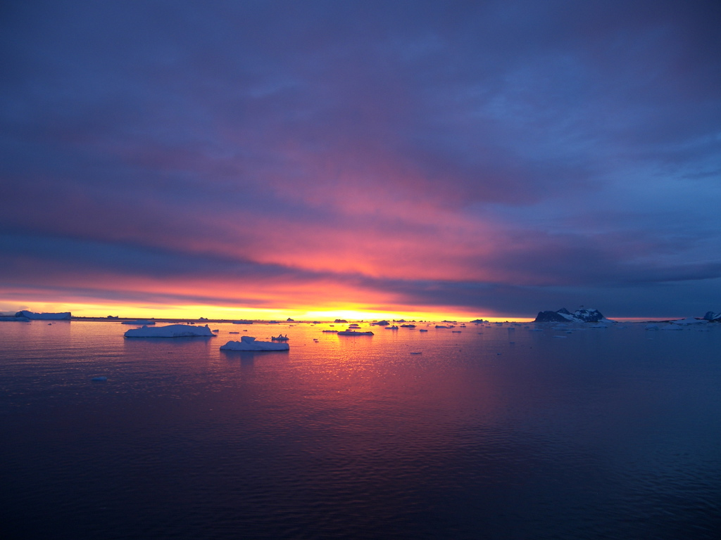



Phytoplankton dynamics in a warming Southern Ocean
Oscar Schofield – Rutgers University

Slide 2
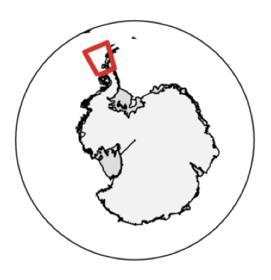
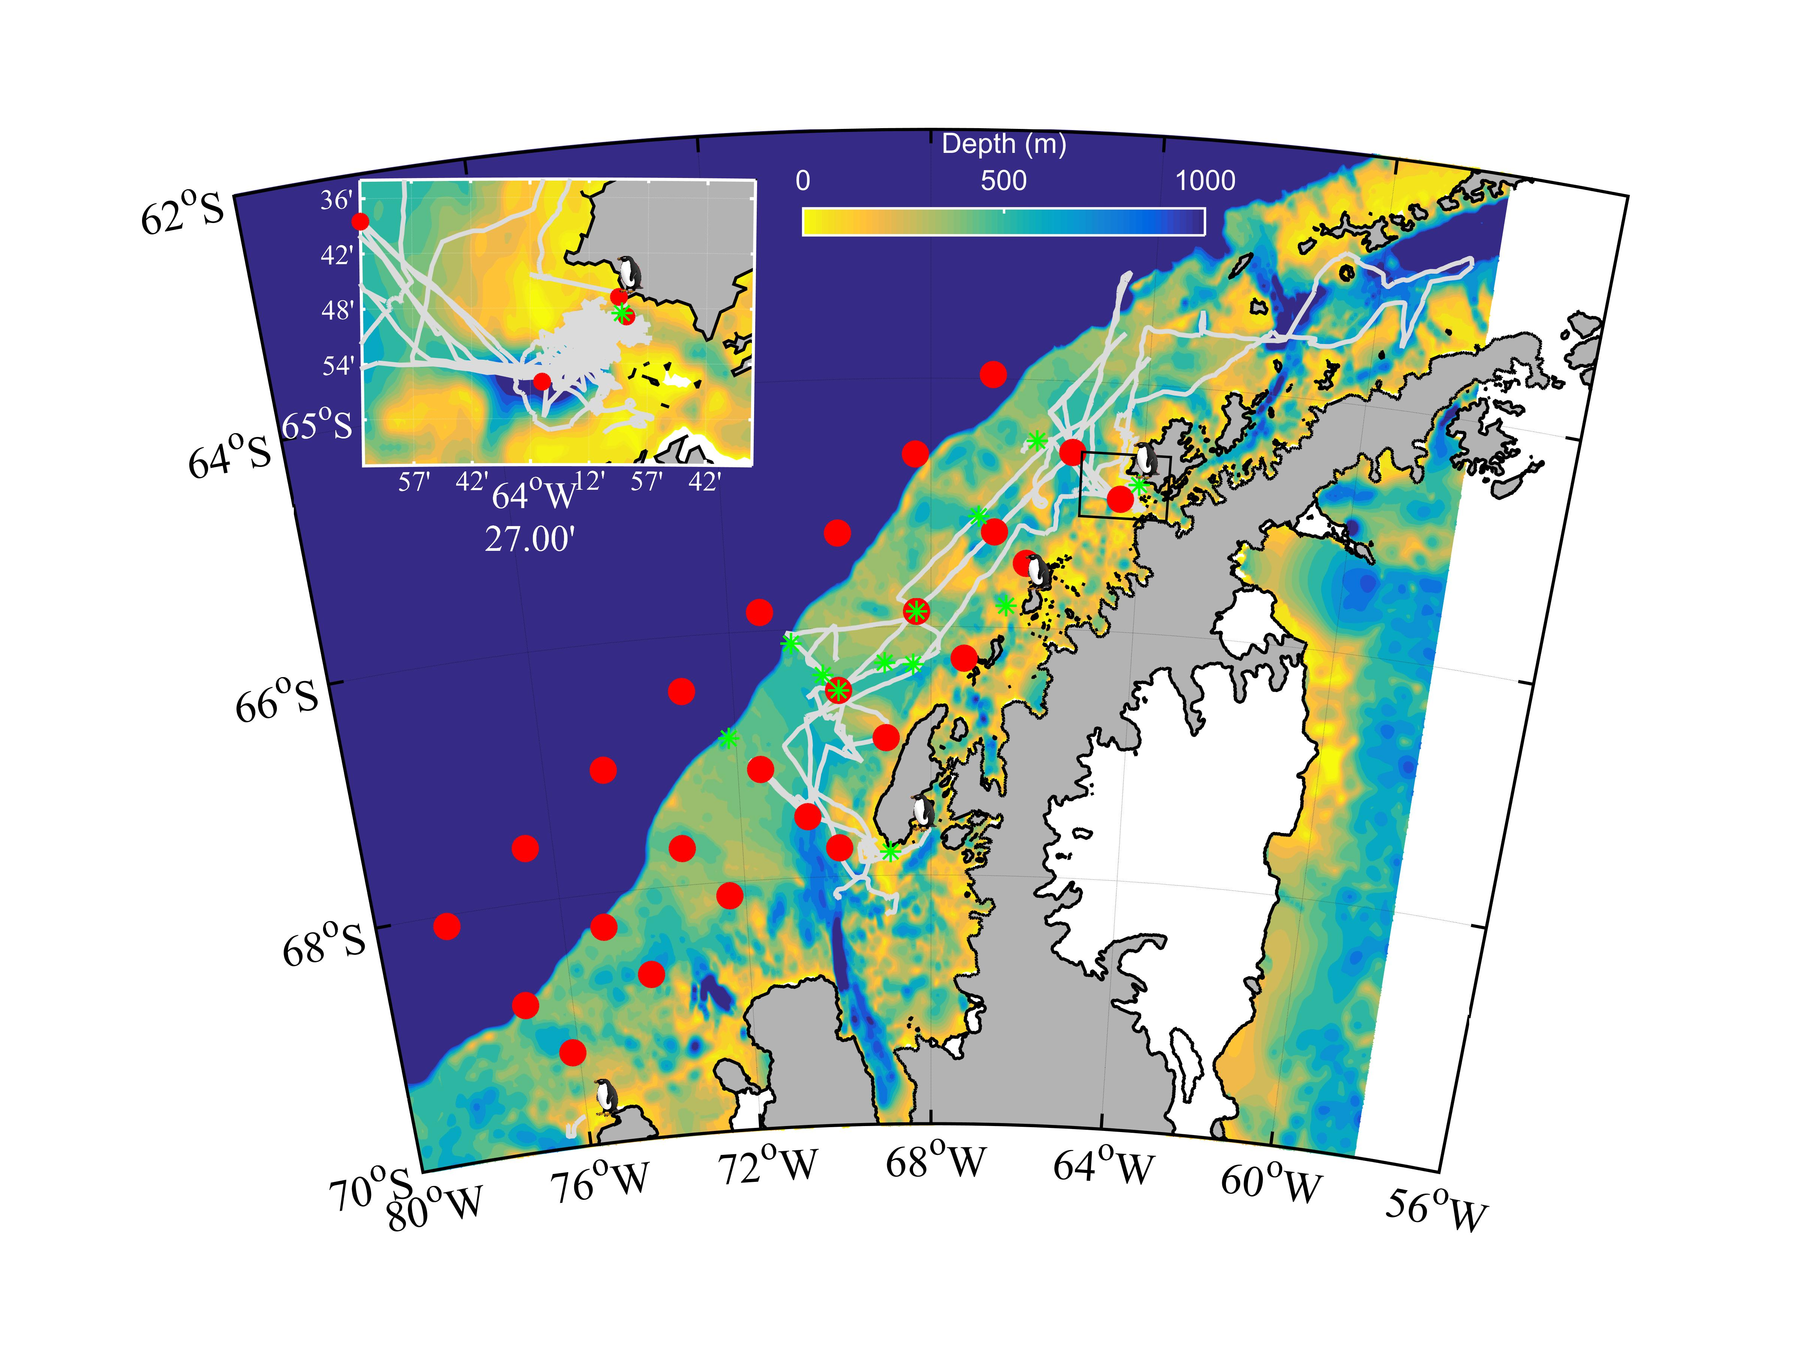
West Antarctic Peninsula as a Model System for Polar Response to Climate Change
Warmer
Maritime
Climate
Cold Dry
Polar
Climate
Peninsula Spans a Climate Gradient

Slide 3
What are our predictions?
Transitional Period
Phytoplankton Biomass
Heavy Sea Ice
Short Growing
Season
No Sea Ice
Deep Wind
Mixing
Time

Slide 4
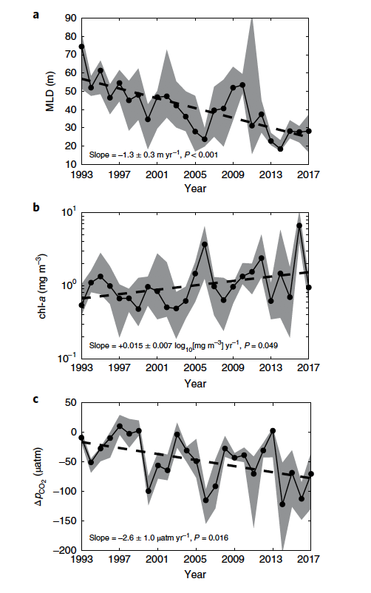
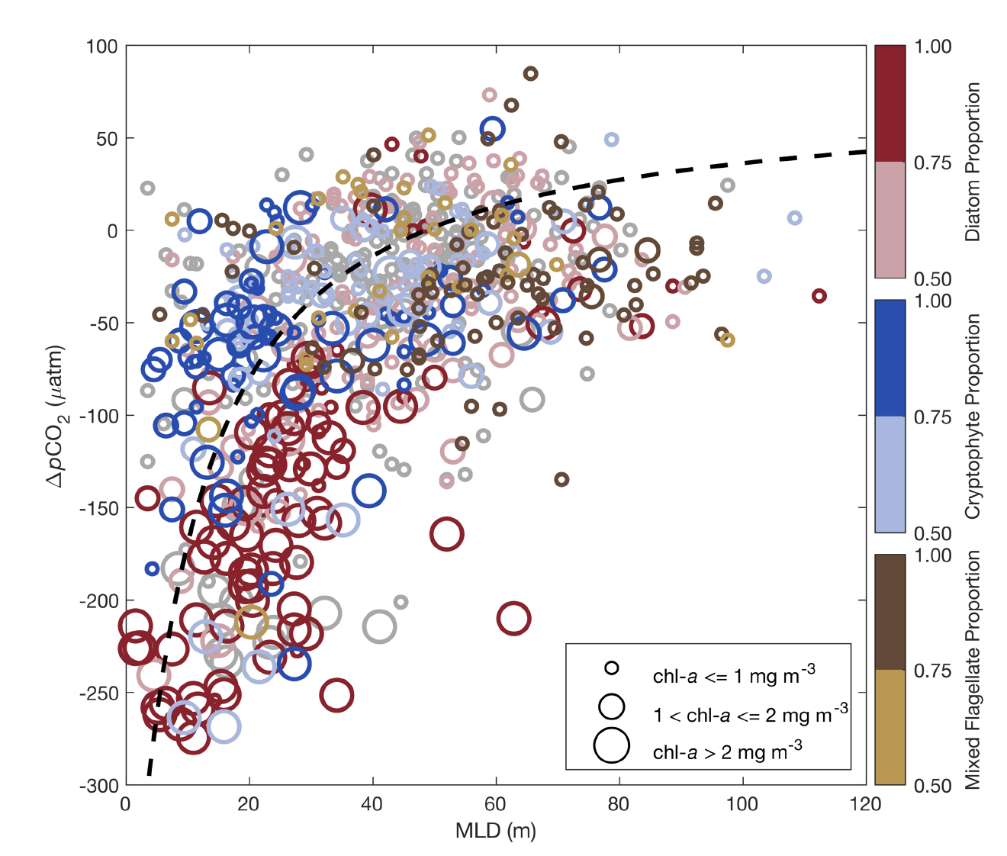
Responses of Phytoplankton

Slide 5
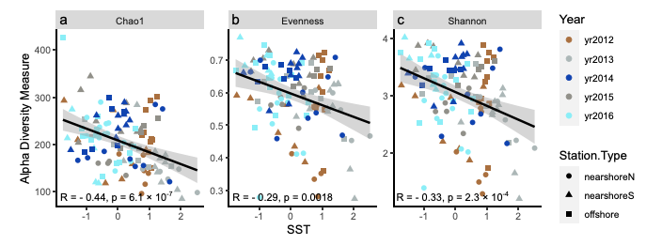
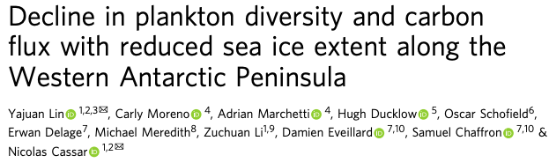
Phytoplankton Diversity Trends in a Warming System

Slide 6
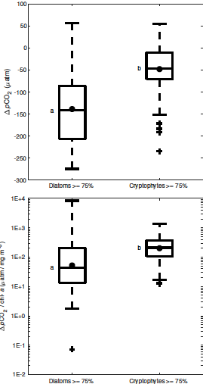
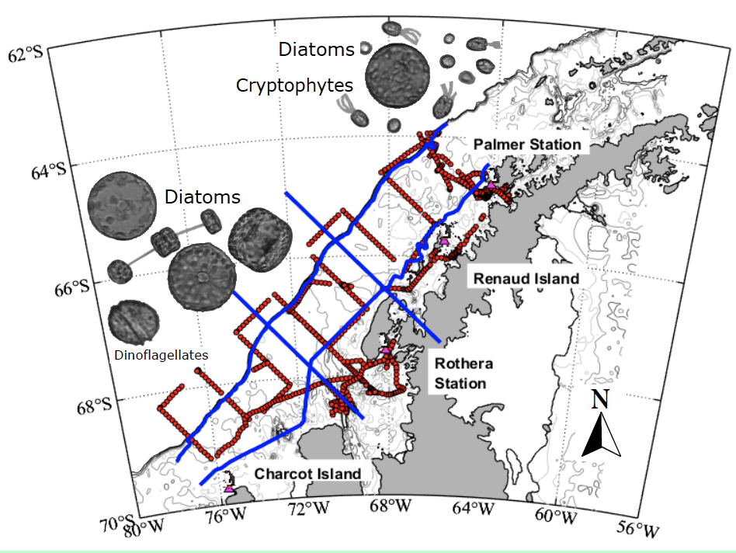
Shifts in community composition
CO₂ drawdown
Biomass normalized
CO₂ drawdown

Slide 7
From penguin diets
good recruitment years
5%
9%
5%
16%
65%
160
% Diatoms
Big Chlorophyll Year
80
% Prasinophytes
Anomaly of
chlorophyll a (mg m⁻²)
% Haptophytes
0
% Flagellates
9%
4%
% Cryptophytes
-80
Low Chlorophyll Year
8%
1992
2018
27%
52%
From penguin diets
poor recruitment years

Slide 8
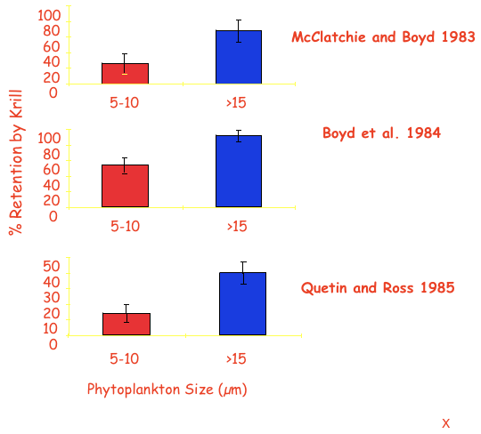
Not only the amount of food but the type of food is important

Slide 9
Rest of Food Web? Tightly Coupled Food Web & Penguin Diet Changes
High chl anomaly years result in high krill recruitment
immediately affecting penguin diet
Krill Size Distributions in Penguin Diet Samples
Saba et al Nature Comms (2014)

Slide 10
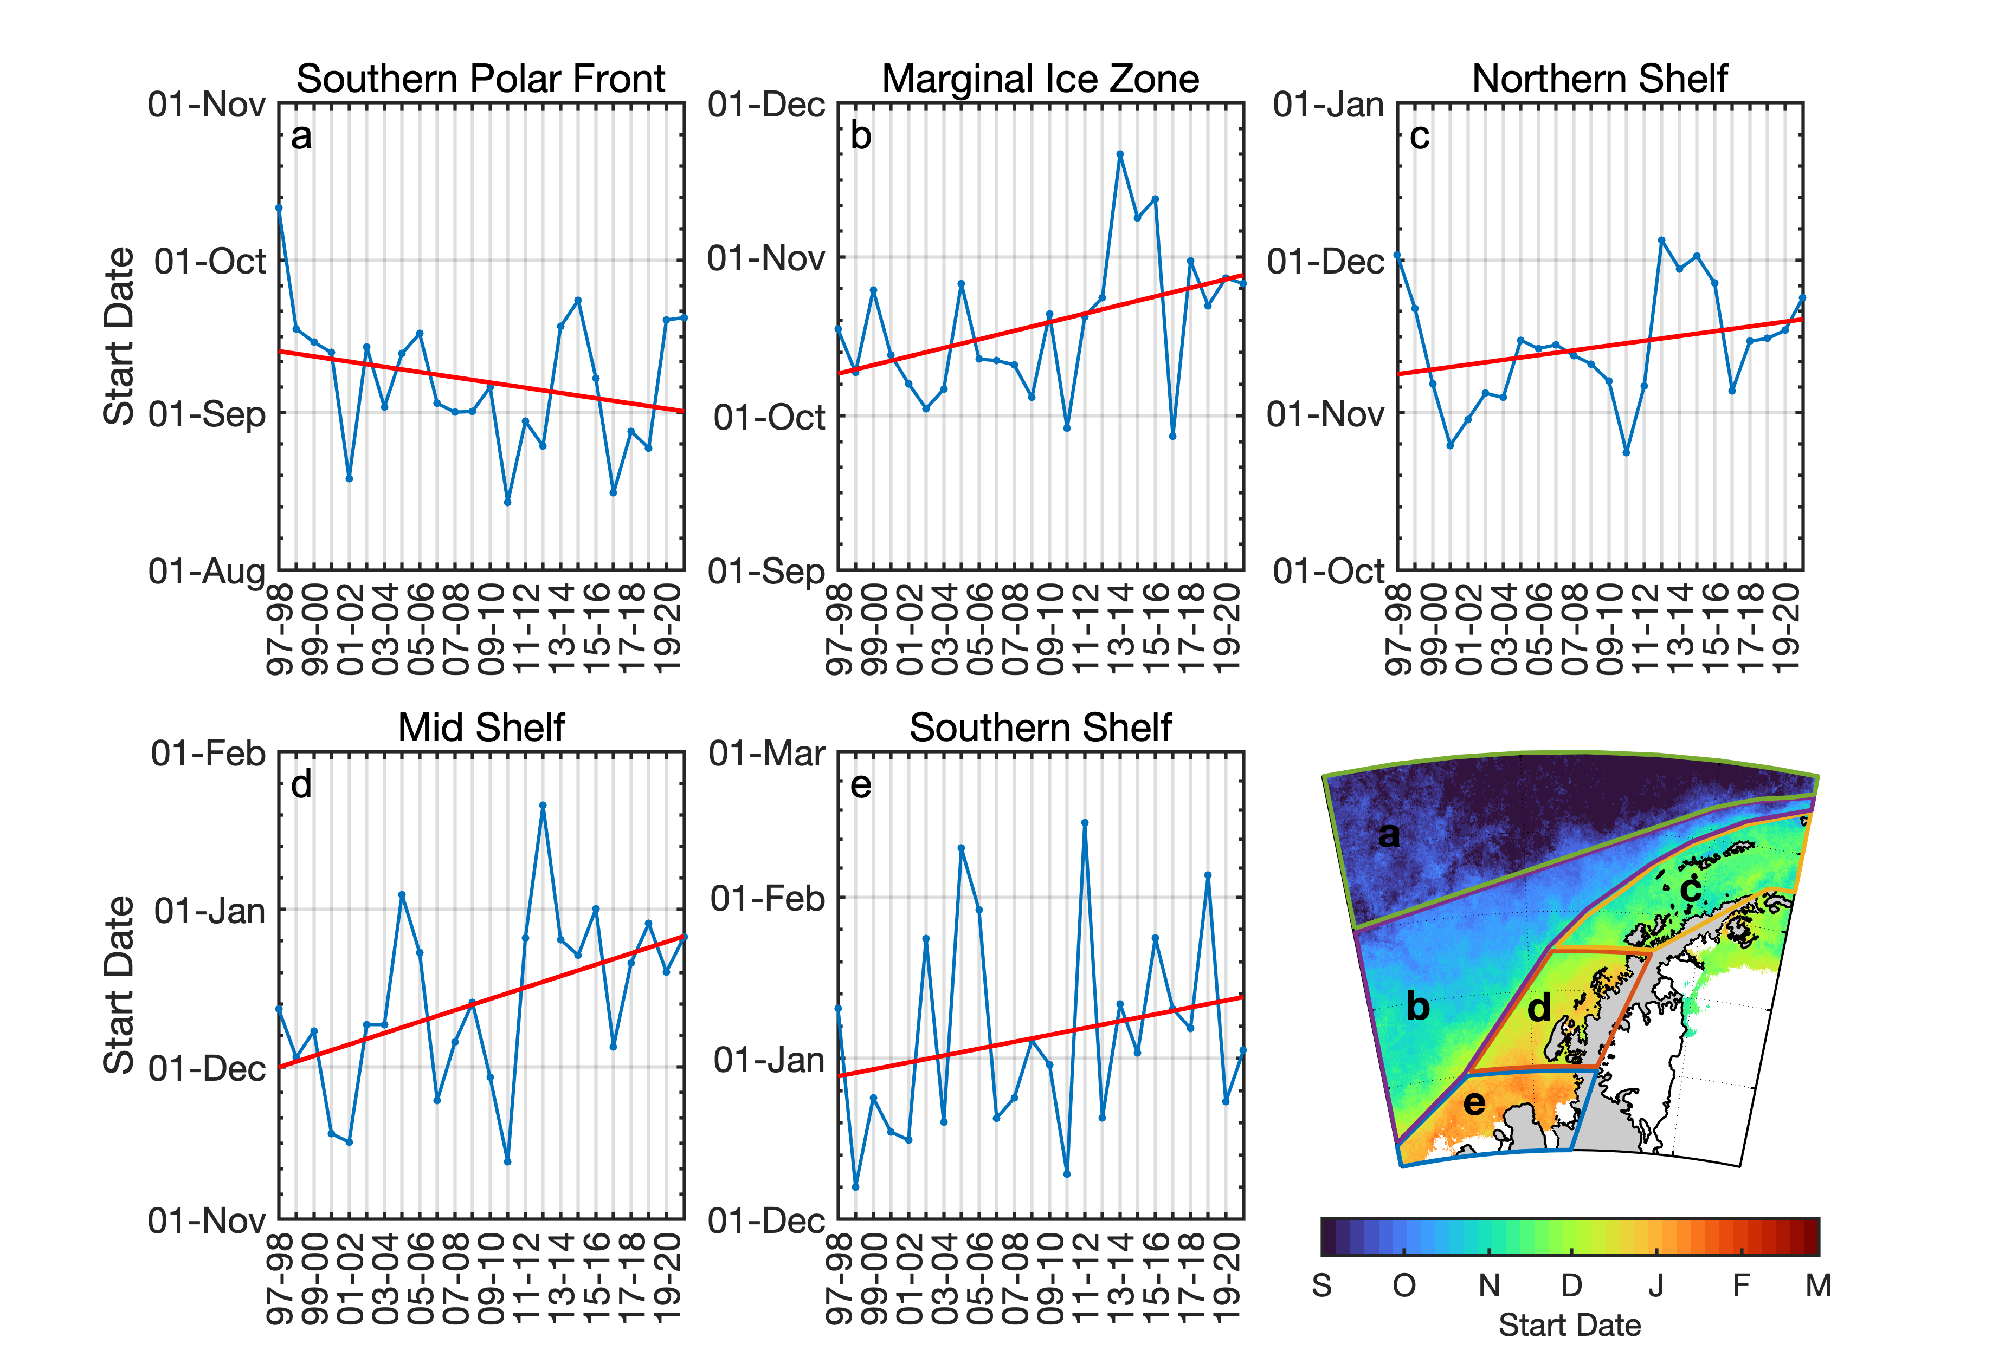
Seasonal Phenology
Turner et al. revision submitted
Global Change Biology

Slide 11
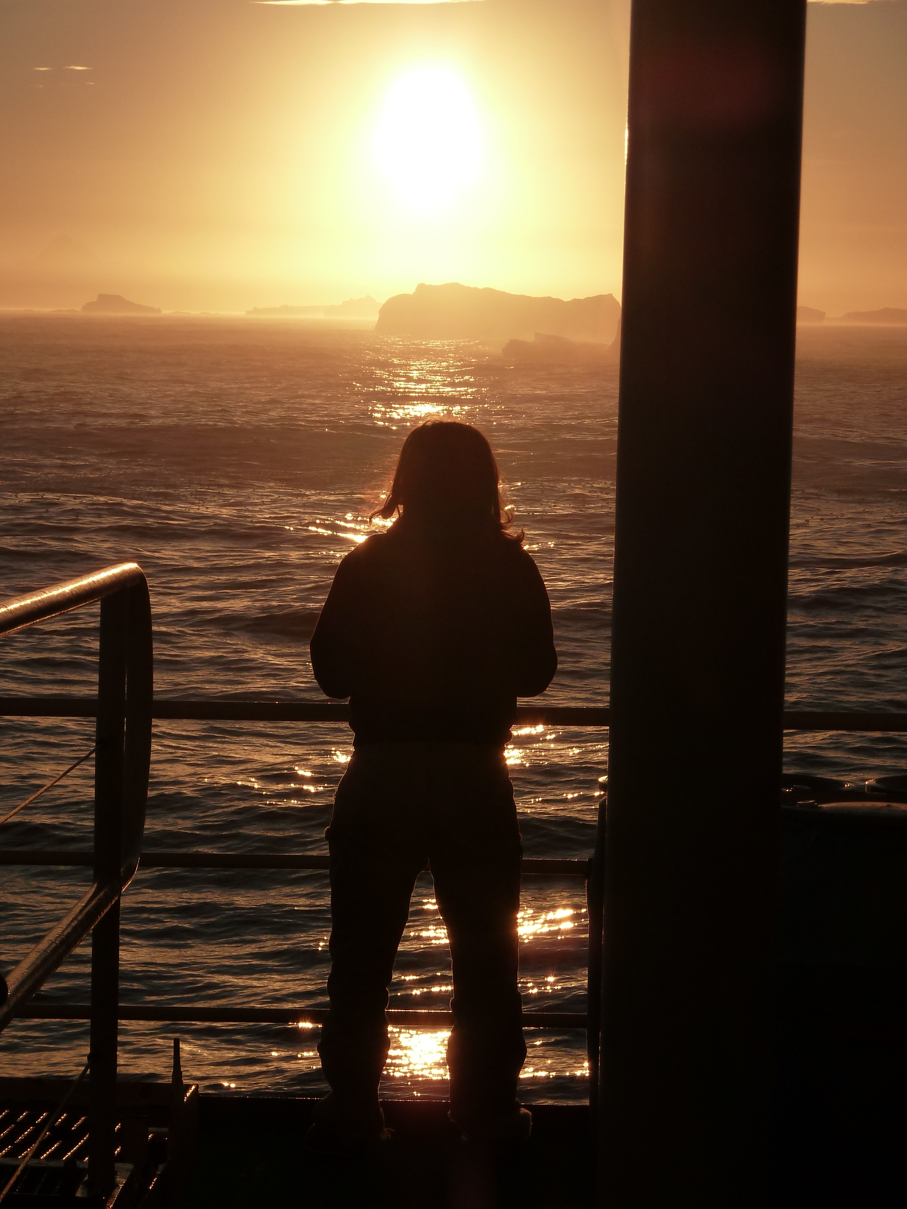
Changes in the WAP includes temperatures rising, sea ice declining, and glaciers retreating
A prediction is that initially declines in sea ice will result in a phytoplankton productivity increase. This is supported by data.
Overtime the prediction is that productivity of the system will decline, community structure will change, diversity will decline.
These changes will have the ecological and biogeochemical consequences.

