Slide 1
Developing smart adaptive sensor webs expanding ship-based science opportunities
Oscar Schofield
-Assuming the presence of a new state of the art ice breaker, what will ship-based research potentially look like in the 30-50 year time frame.
-Sampling will consist of multiplatform strategies
-Regional programs will leverage the ship and land-based US assets for coordinate sampling efforts

Slide 2
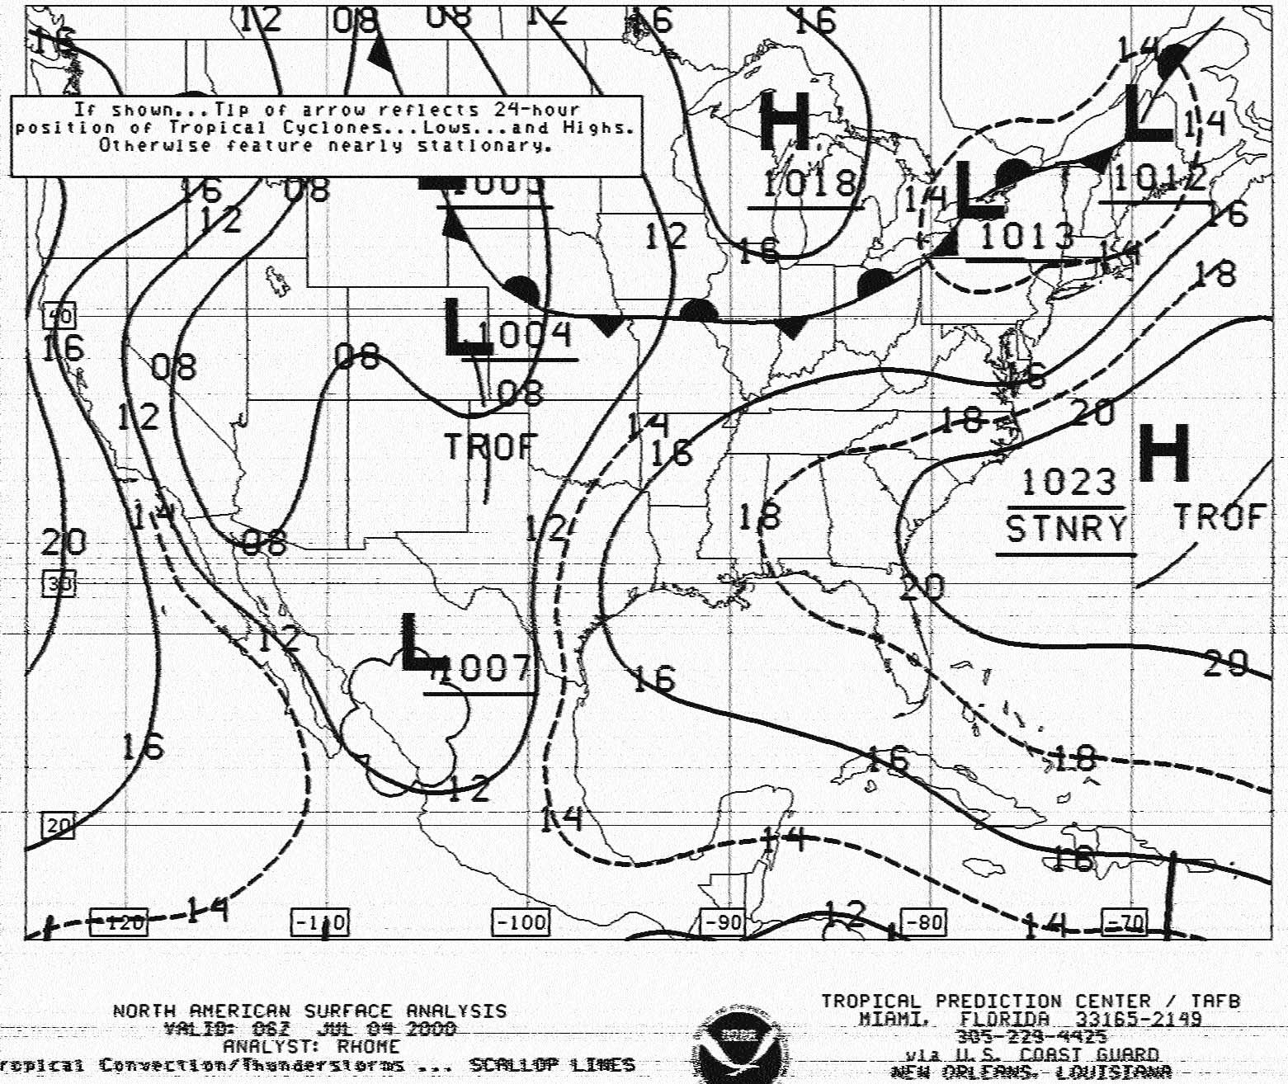
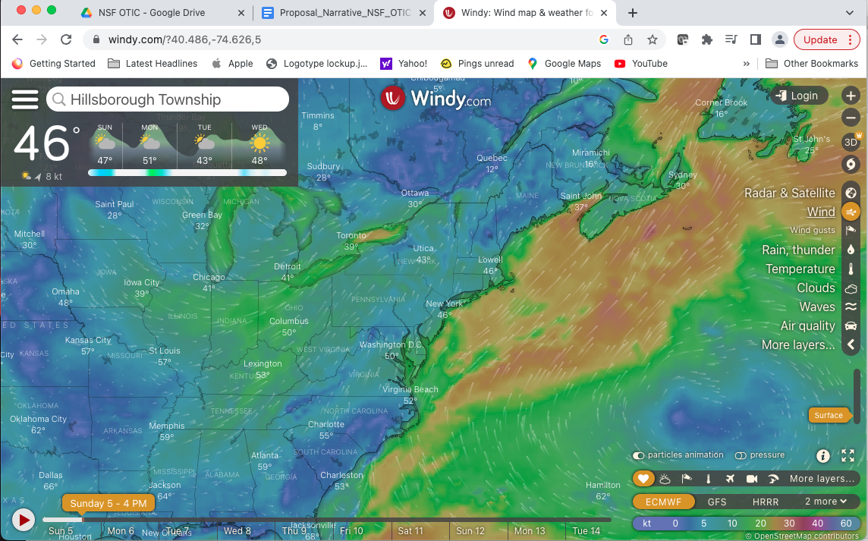
Prior to the ship expedition, scouting systems will provide information of ocean/atmosphere/state to scientists before embarking
Science problems to be addressed: Understanding the dynamics in a range of features requires context prior to the ship being on site.
Late 1980’s (during grad school)-Faxed to ship
Now

Slide 3
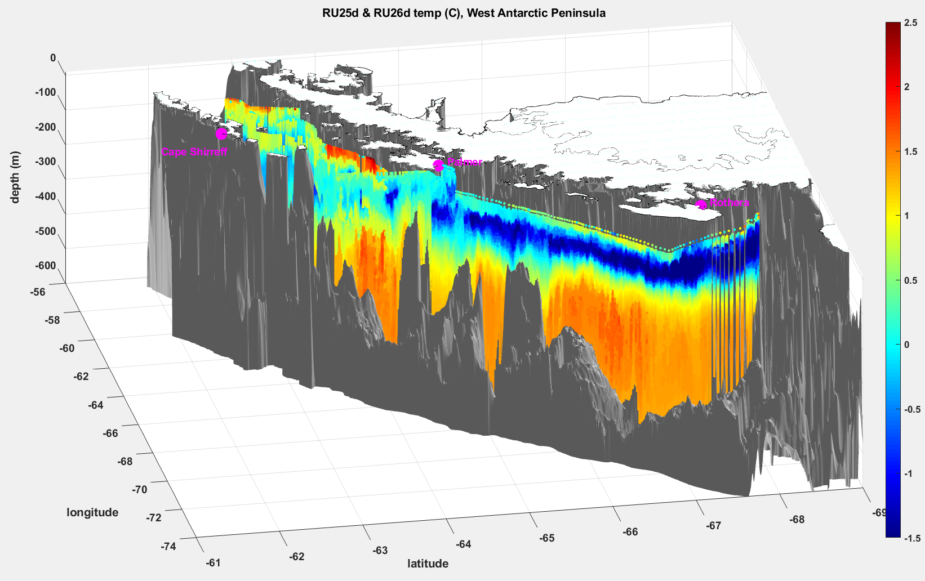
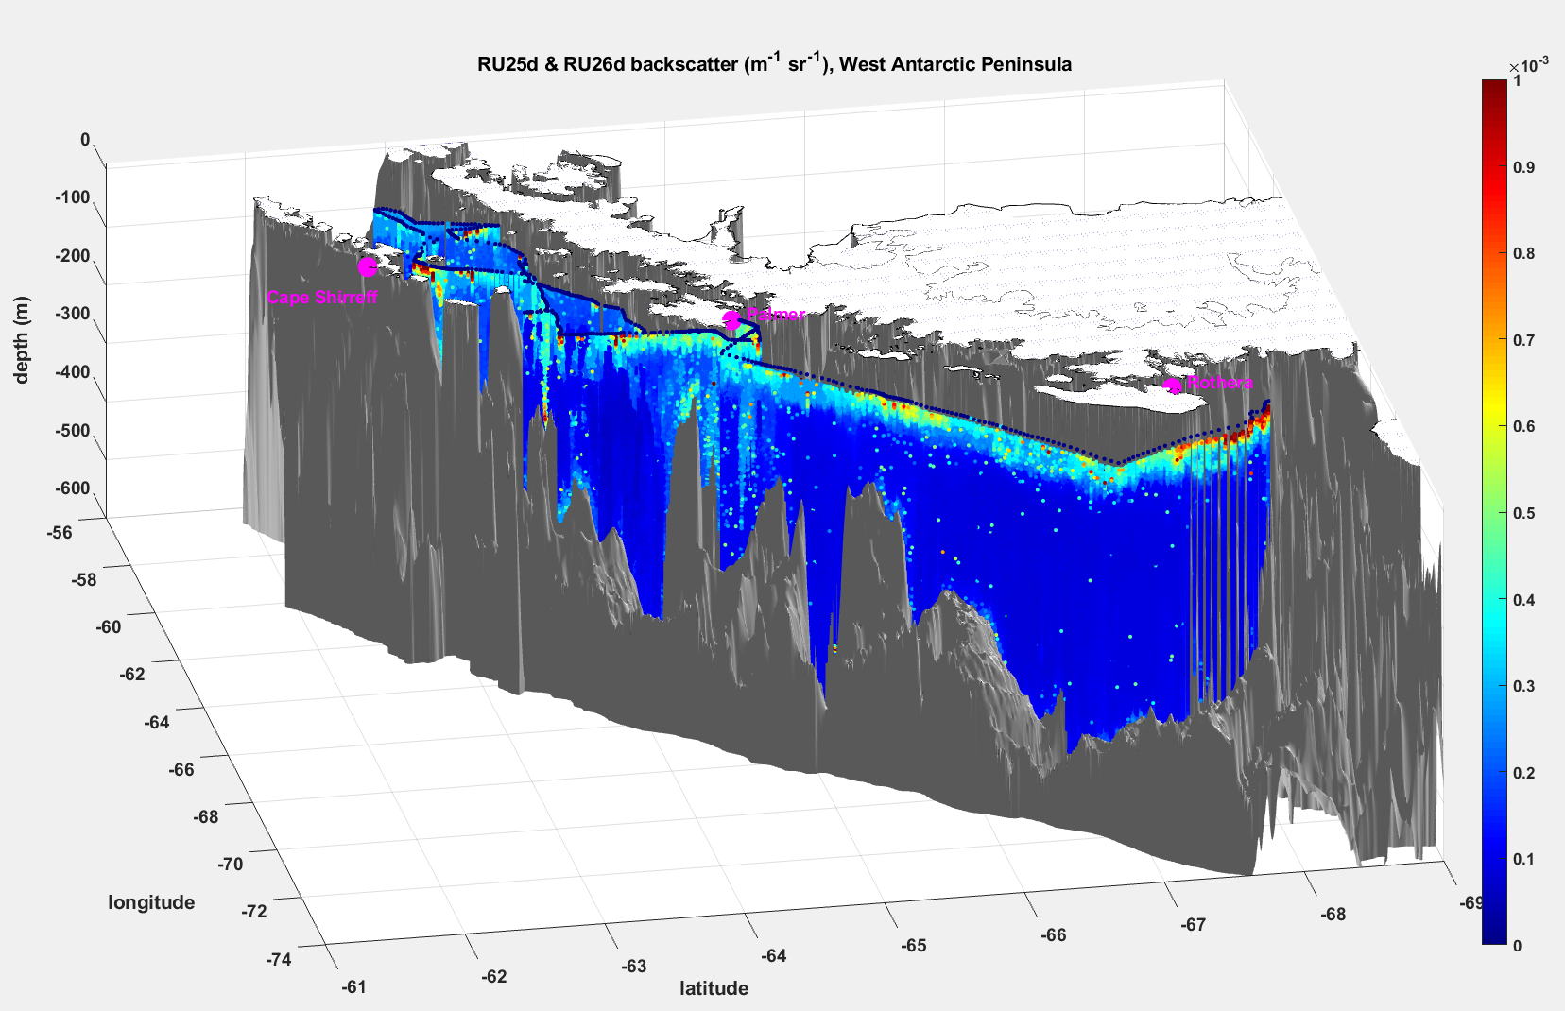
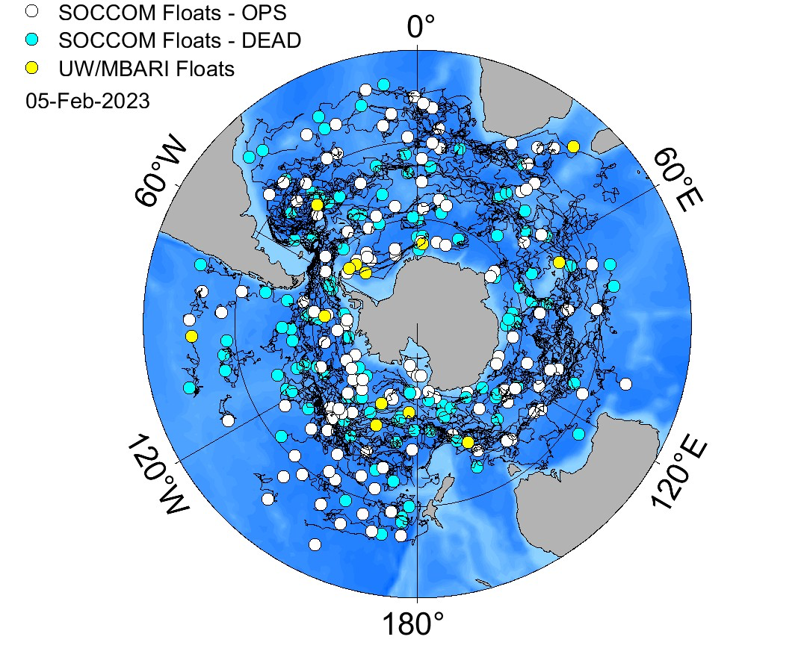
Prior to the ship expedition, scouting systems will be in the ocean also, not just atmospherically driven
Science problems to be addressed: Understanding the dynamics in a range of features requires context prior to the ship being on site. Preliminary data will be provided.
Cape Sheriff
King George
Palmer
Station
Rothera
Station
TEMPERATURE
PARTICLES
Autonomous deployments linked through the international community collaborator networks
with spatial autonomous systems

Slide 4
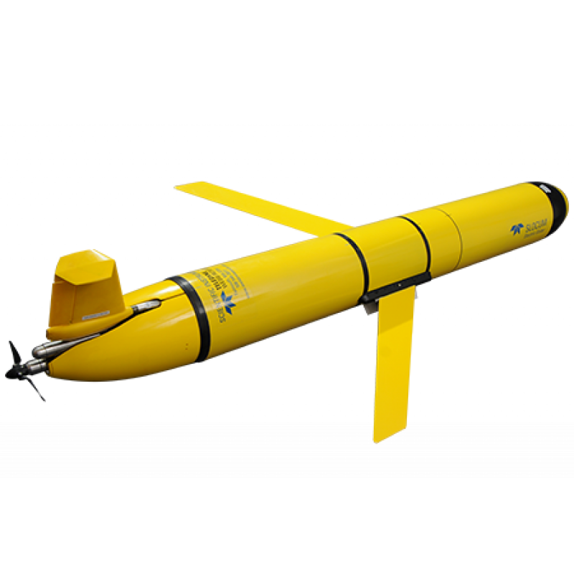
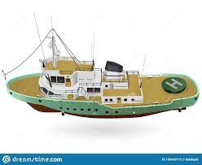
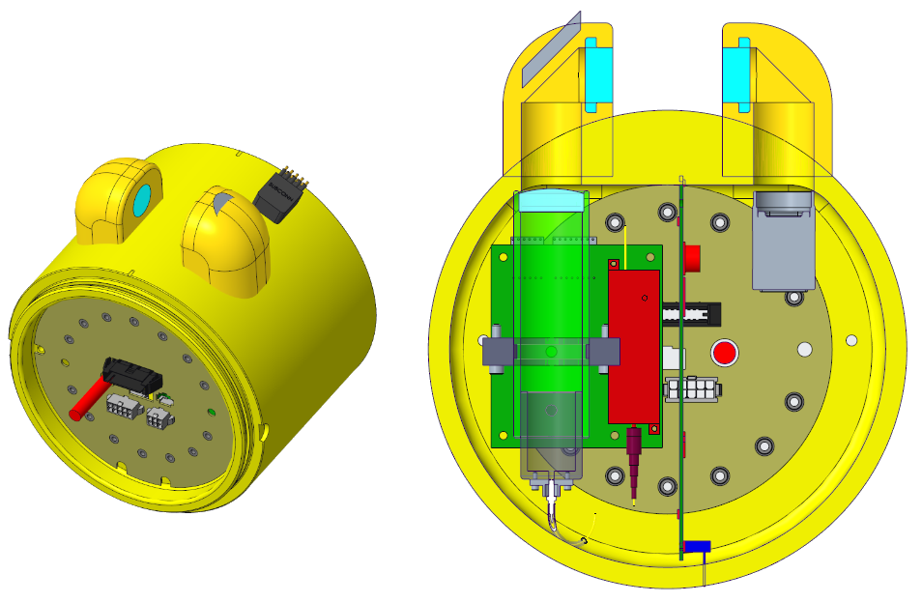
Advances in autonomous technologies will allow the ship to provide regional context
Science problems to be addressed: Given that ecosystems-biogeochemistry-ecology are characterized not only the movement of ocean, it is also characterized by the physical-chemical-biological interactions driving transformations within the ecosystem. Unraveling the transport from the transformation is a fundamental problem for making significant progress in the understanding ecosystem trajectories.
- Sustained autonomous platforms will provide regional mobile CTD maps (complementing ship based CTD/sampling). These mobile systems will be standard ship equipment. Multiple systems will be available, sciences bays will be customizable for specific problem being addressed. (Zappa airborne)
500 kilometers
Advanced biological measurements: Diversity, Physiology

Slide 5
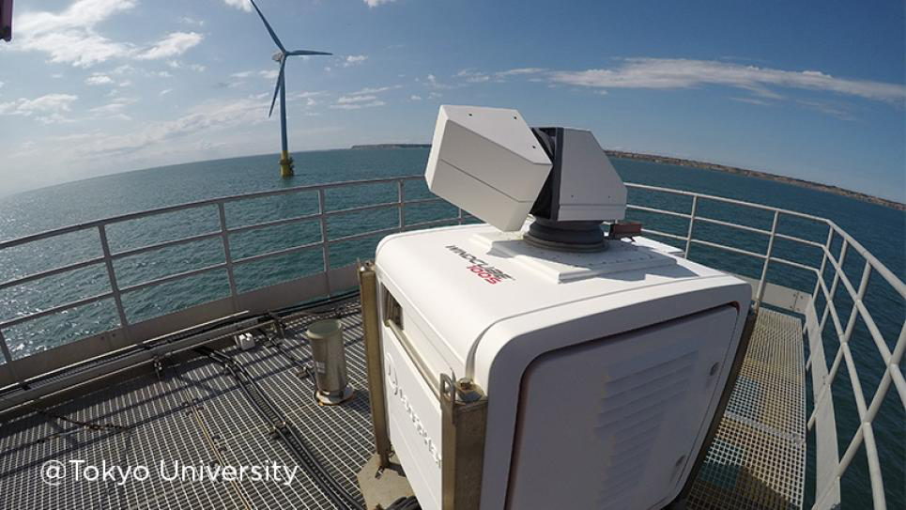
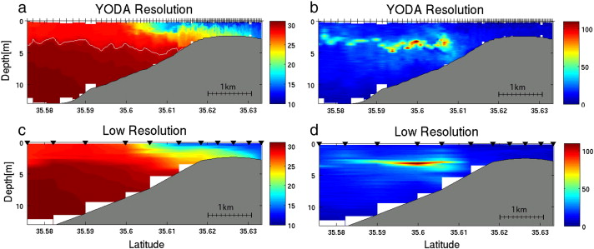
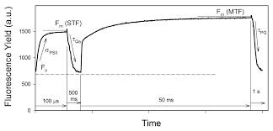
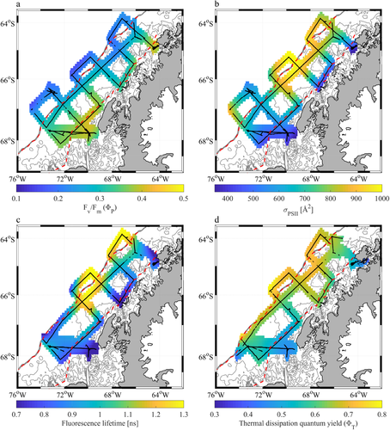
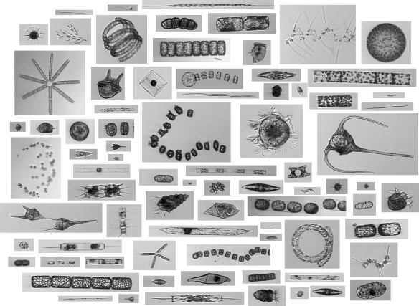
Automated ship data will increase exponentially, data will not have a
proprietary embargo period
Science problems to be addressed: Access to the continent is limited, automated flow ~surface and potentially towed systems-acoustic-LIDAR-imaging will be standard. The open access data will will flow to the community to fuel data assimilative models, and other studies by shore-side science communities.
LIDAR
Tow-Yo systems
Advanced physiology

Slide 6
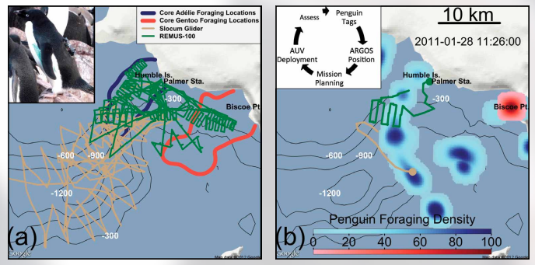
Evolutionary directed adaptive sampling
Oliver et al. 2012

Slide 7
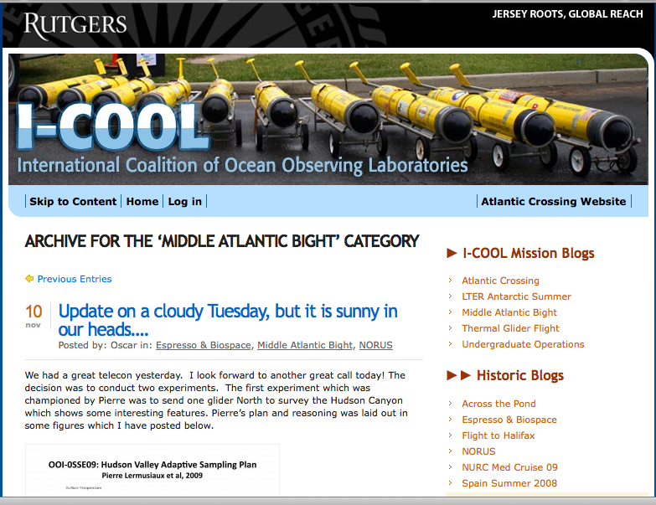
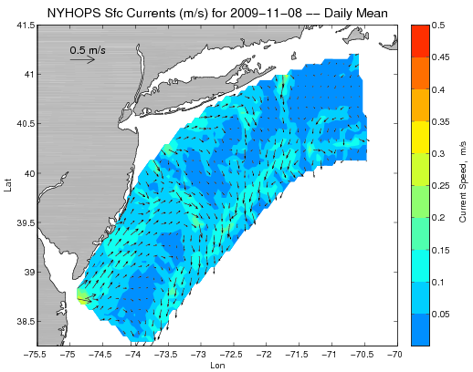
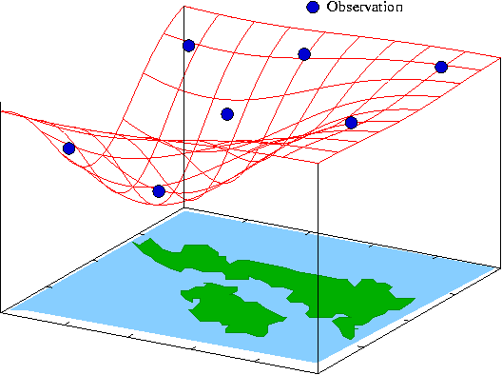
Ocean forecast directed adaptive sampling
Design, Testing and Deploy
Observatory (simulated) data
Models
Sensor &
Platform
~3 km
~100 m
Virtual Ocean
Data Assimilation
Data
Analysis
Science Questions & Drivers
Data Synthesis: Nowcast & Data Impact

