Slide 1
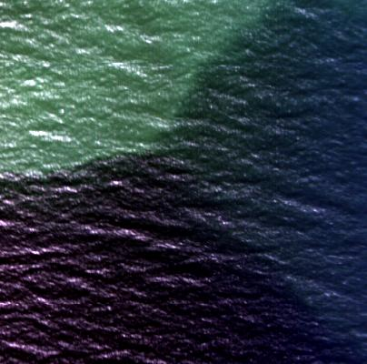
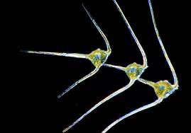
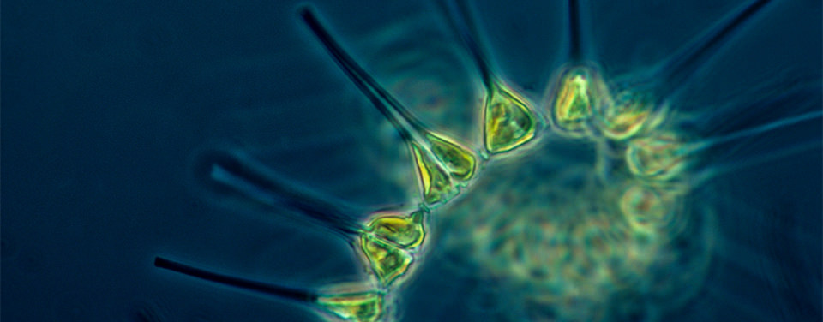
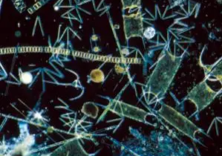
Sensor webs for marine systems undergoing accelerating change
Oscar Schofield (borrowing from many…)

Slide 2
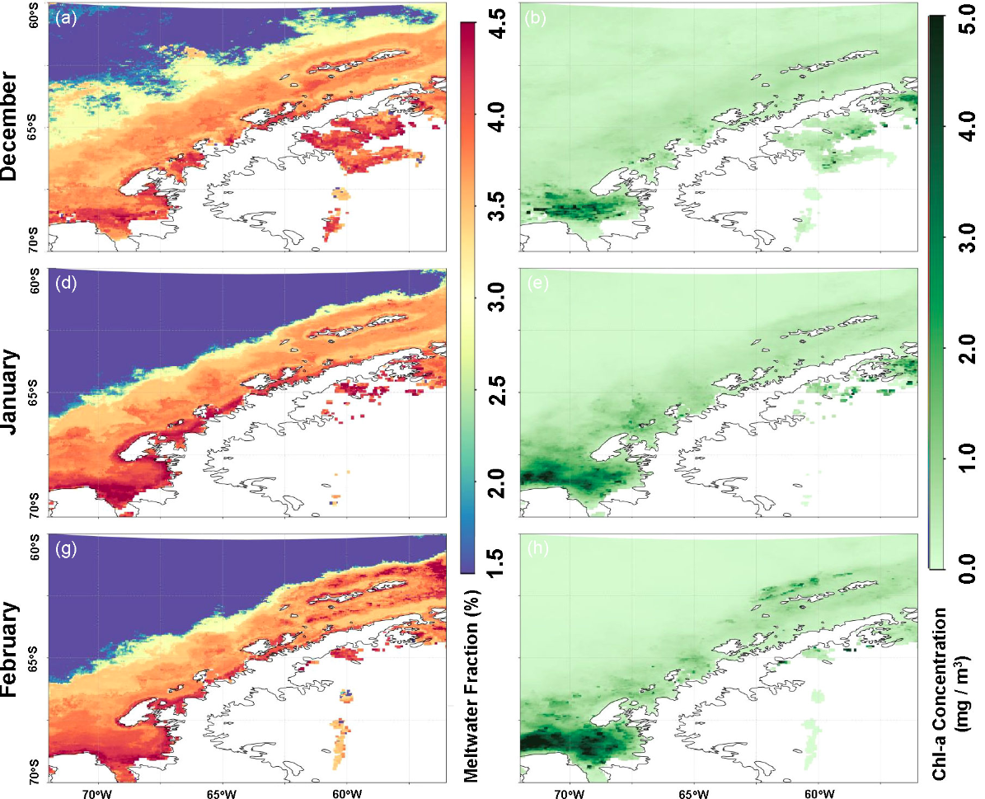
Integrated Sampling Networks Will Need to Fill Critical Gaps
Sample Space Effectively
-Cost Effective
Meltwater Fraction
Chlorophyll a
Schofield et al. 2007
Schofield et al. 2007
Pan et al. 2023
How to sample with a ship……..
Scalable technology……..

Slide 3
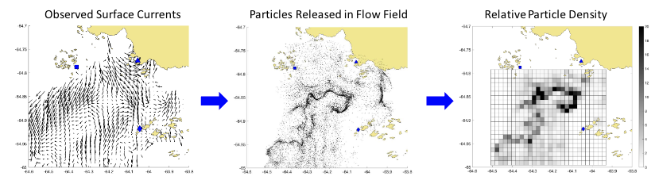
The Transport and Transformation Problem
The Transports (HF Frequency Radar – Surface currents-convergence and divergence zones
Thank you to Jacqueline Veatch

Slide 4
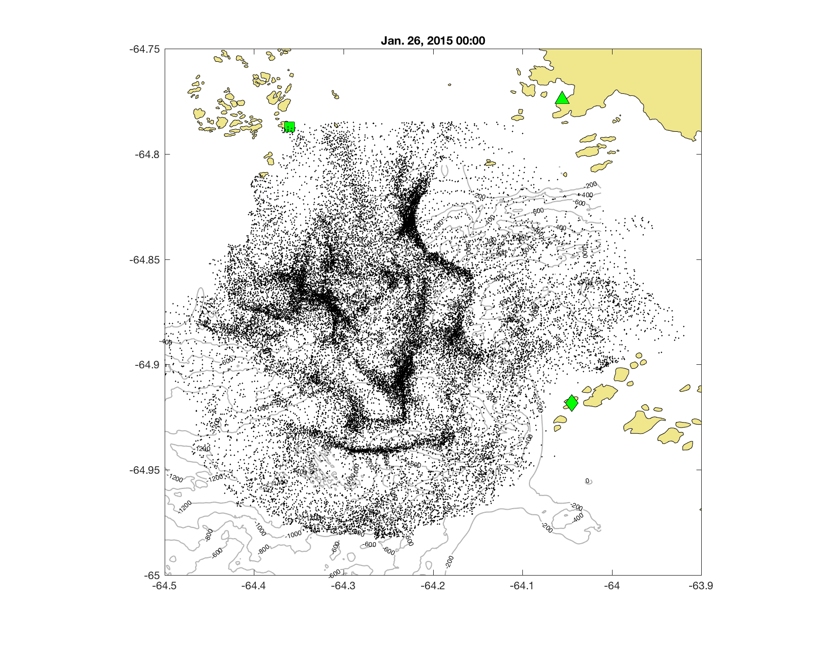







What Causes Biological Hotspots?
PORG

Slide 5
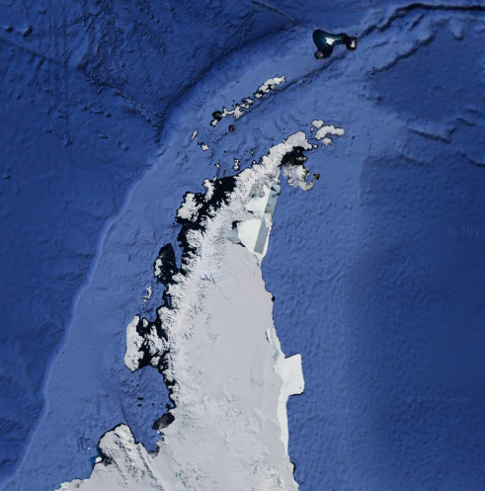
Potential for the Future?
Potential data-streams
Hourly surface currents
Convergence/divergences
Particle Transports
-Infrastructure: $250,000/unit, spares, hardening (on the order of $5,000,000)
-Operations: Ship-time, personnel, telemetry (on the order of $2,000,000/year)

Slide 6
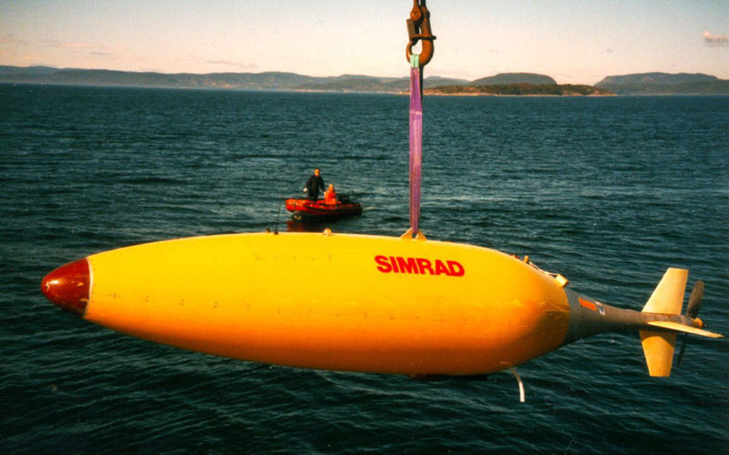
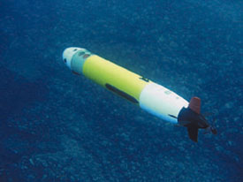
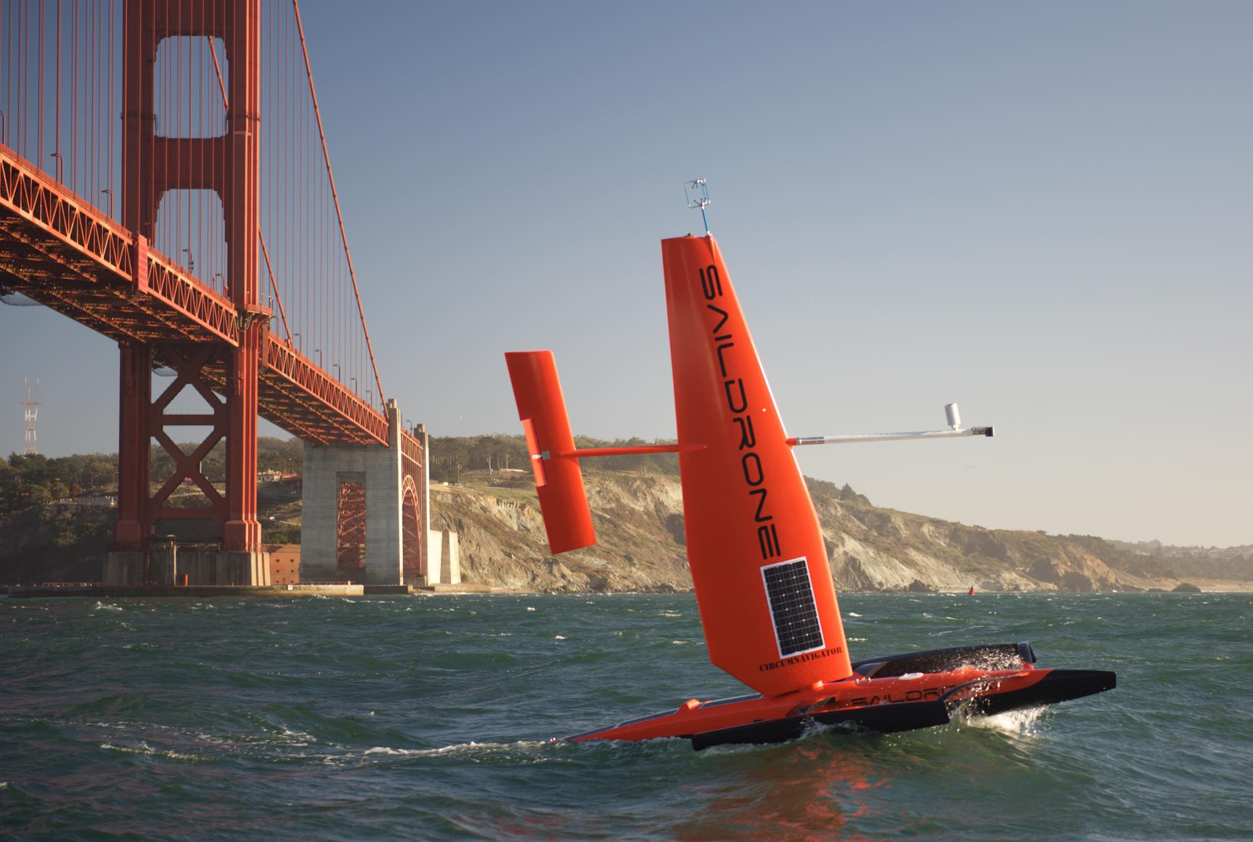
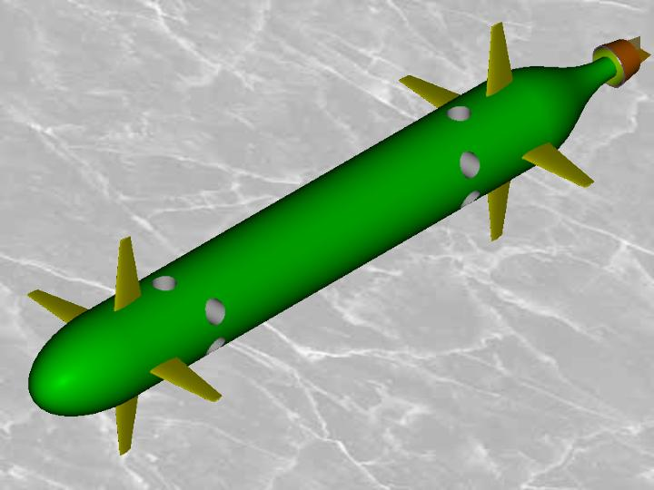
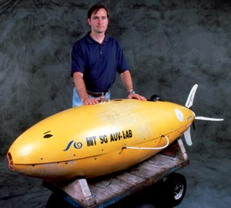
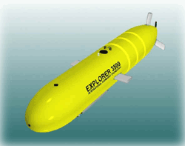
Autonomous Systems are diverse and robust and we can sample the ocean interior
Thanks Gwynn Griffiths

Slide 7
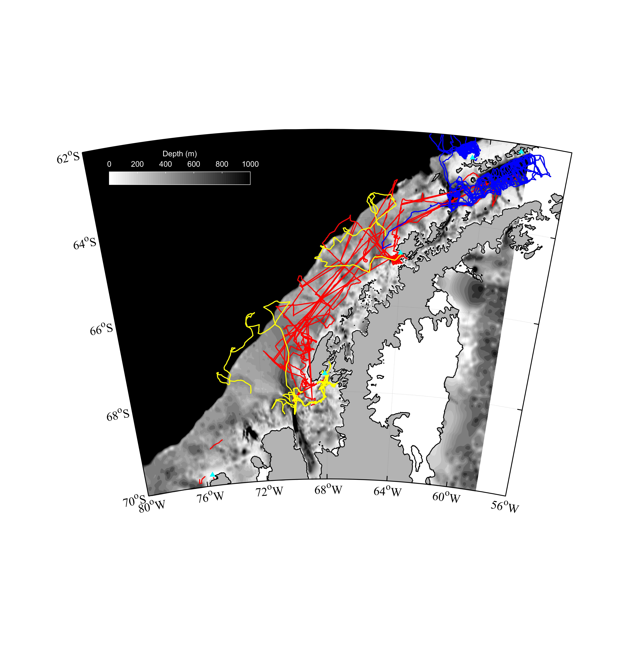
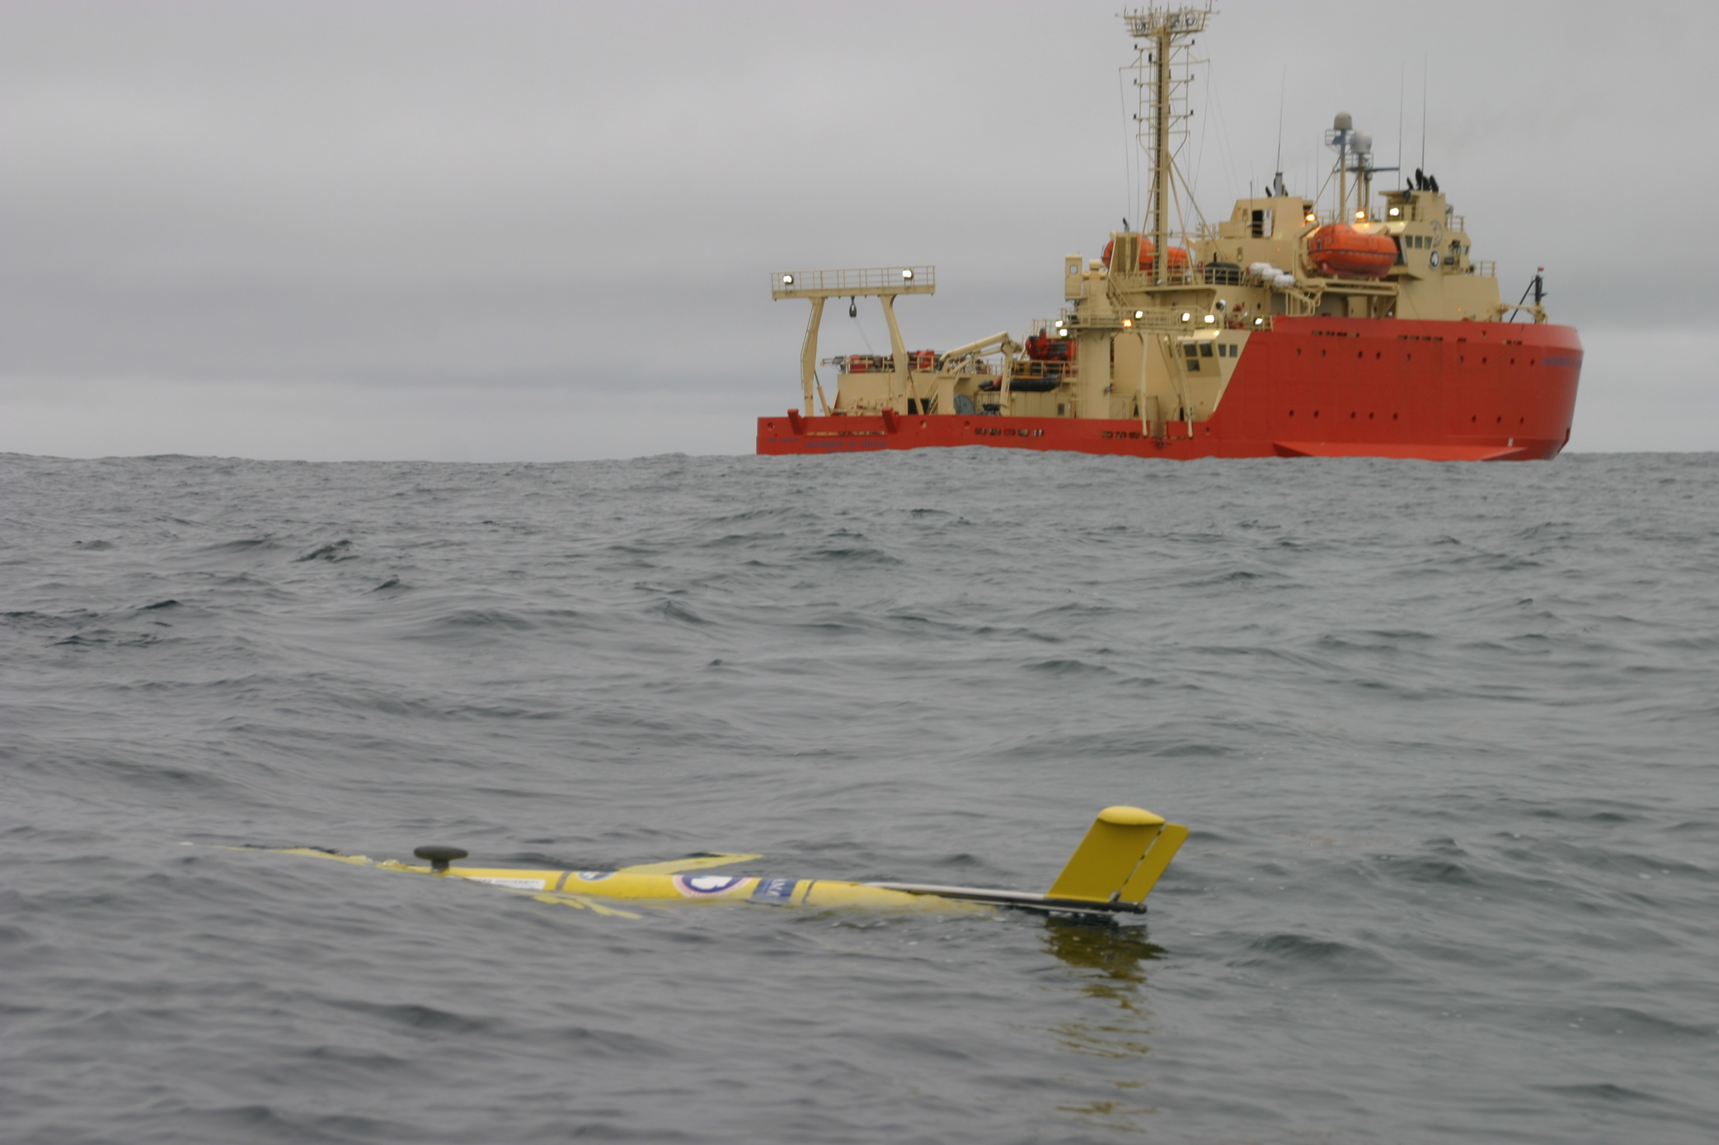
International glider surveys in the Antarctic
Yellow = BAS
Red = Palmer LTER
Blue = NOAA
Schofield et al. In Press

Slide 8
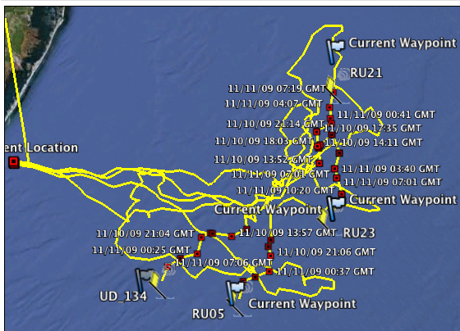
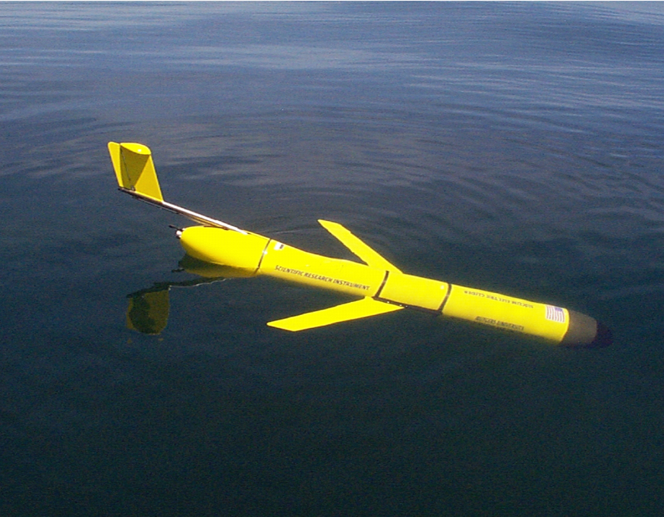
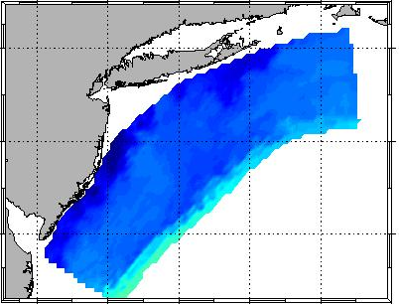
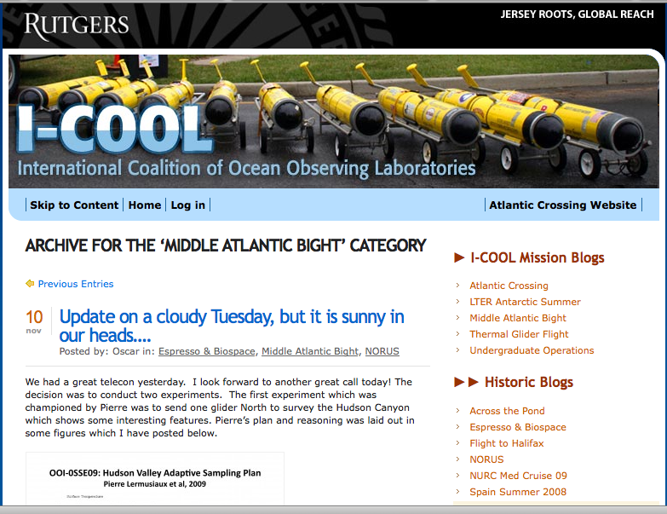
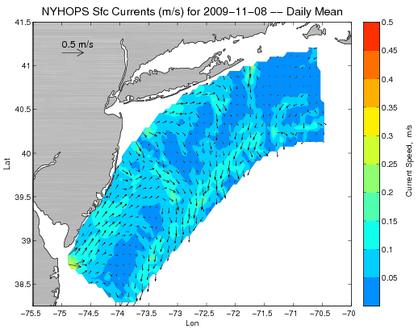
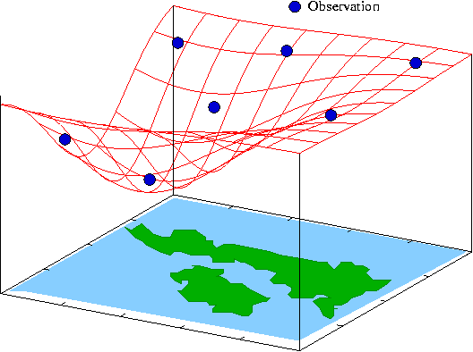
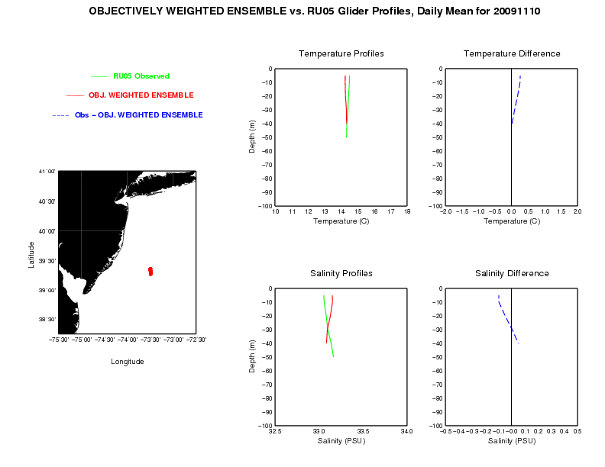
FUTURE IS NOW: MACHINE TO MACHINE NETWORKS
Design, Testing and Deploy
Observatory (simulated) data
Models
Sensor &
Platform
~3 km
~100 m
Virtual Ocean
Data Assimilation
Data
Analysis
Science Questions & Drivers
Data Synthesis: Nowcast & Data Impact
Schofield et al. 2009

Slide 10
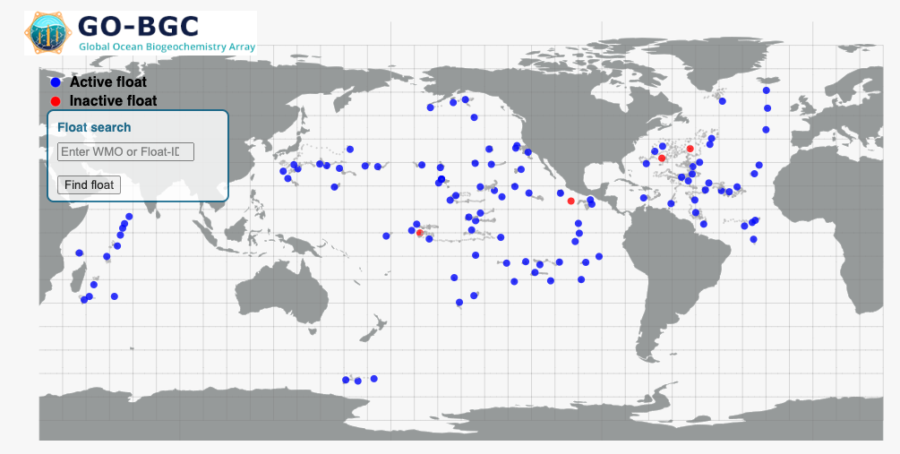
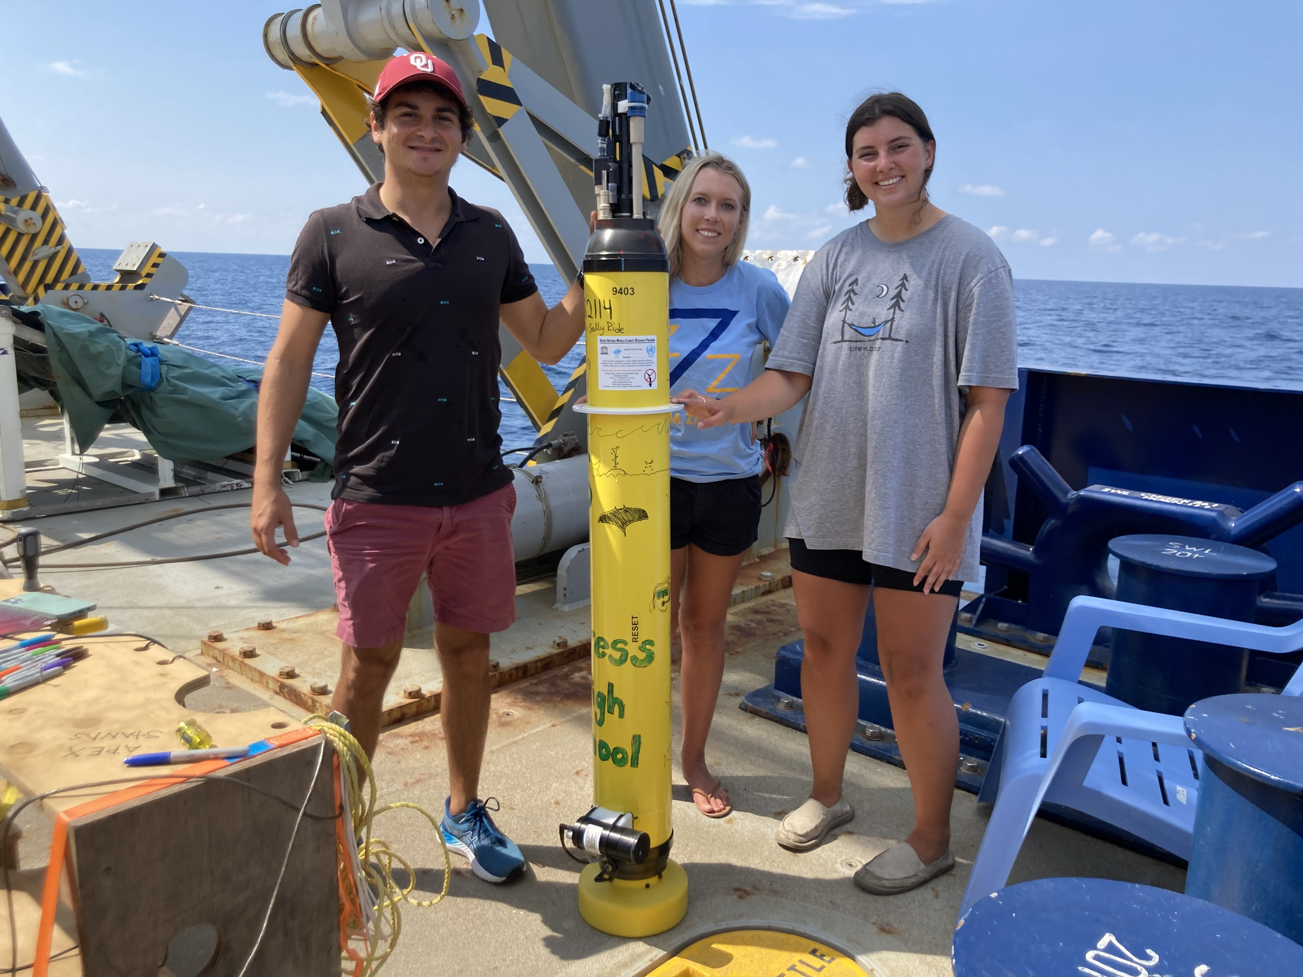
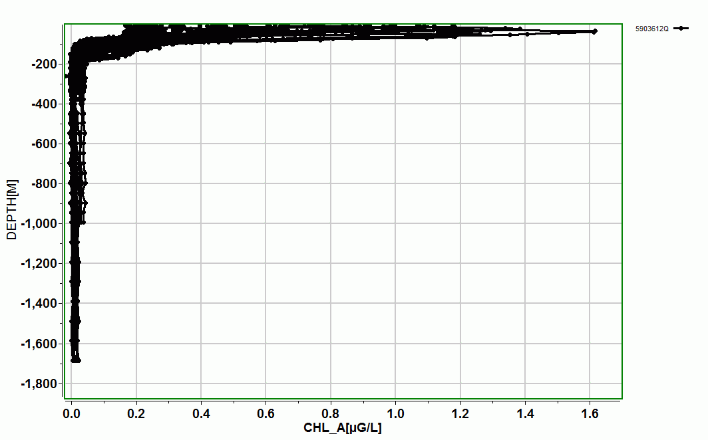
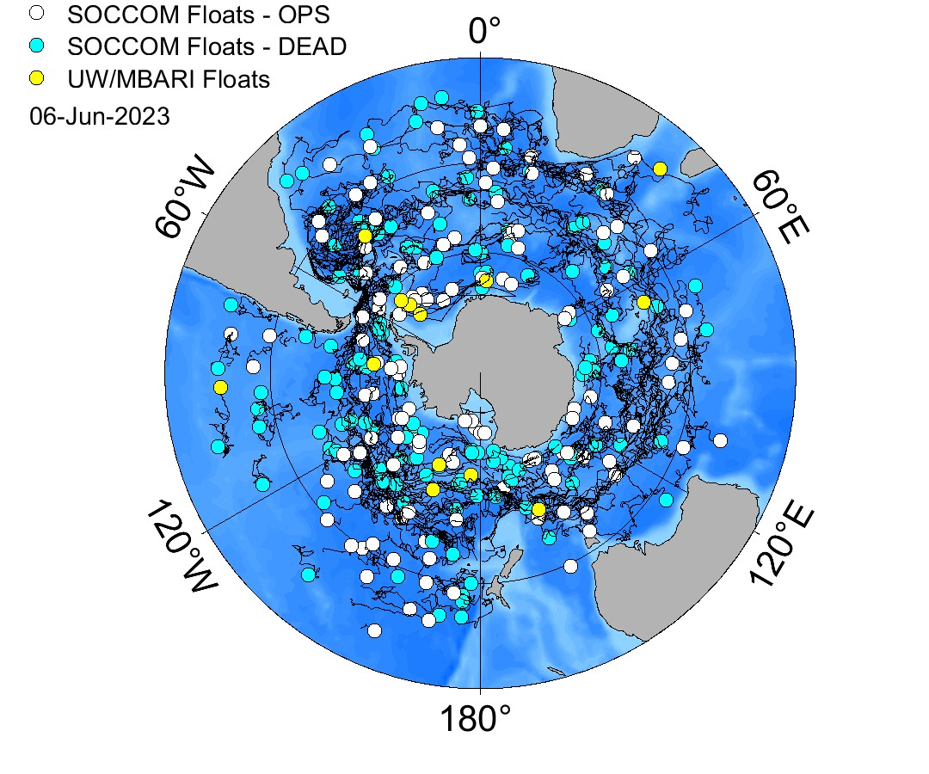
Global Arrays
Chlorophyll arrays
SOCCOM renewal
under review,
Fingers crossed
Open access (free data)

Slide 11
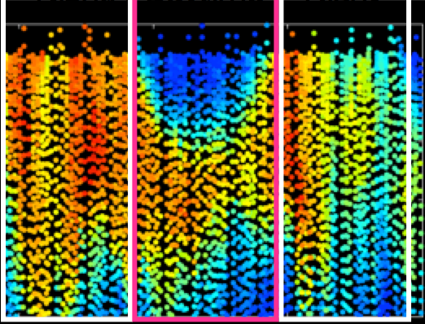
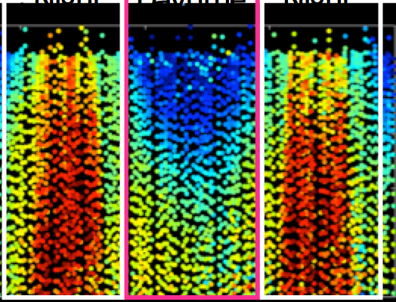
Rate Processes
Rate Processes (Photosynthetic Activity & Physiological State)
PROXY FOR BIOMASS
HEALTH
Night
Daytime
Night
Night
Daytime
Night
0
0
25
25
50
50
02/20
02/21
02/20
02/21
Time (month/day)
Time (month/day)
0
4000
8000
0
0.3
0.6
Biomass Proxy (Fm)
Quantum Yield of Photosynthesis (Fv/Fm)
Carvalho et al. 2020

Slide 12
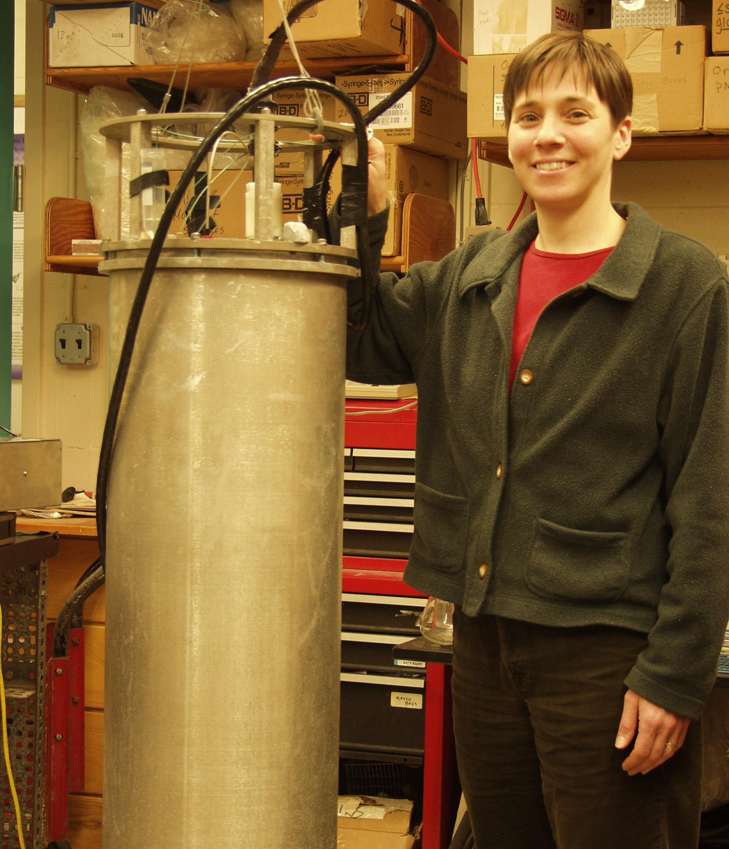
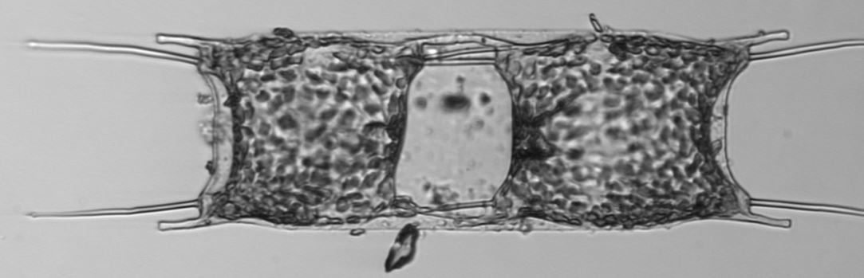
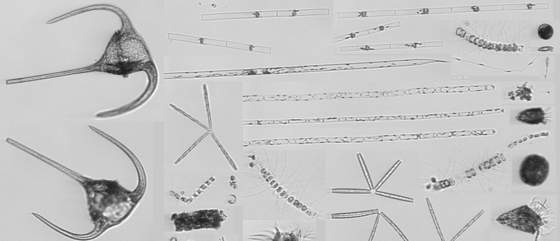
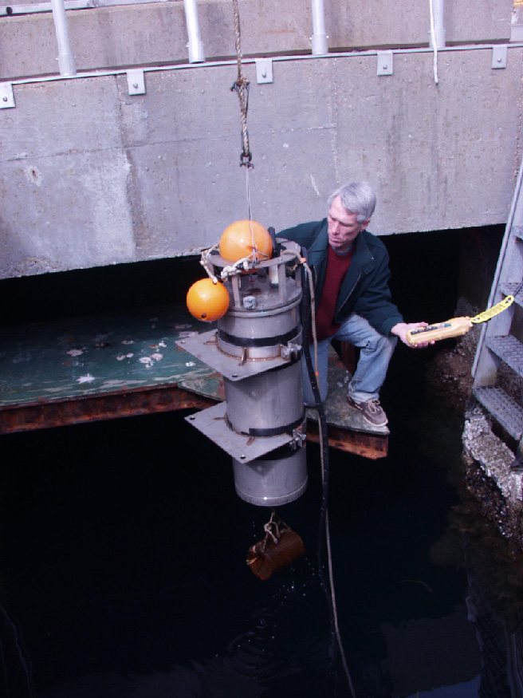
Dr. Heidi Sosik
Dr. Rob Olson
https://ifcb-data.whoi.edu/timeline?dataset=mvco

Slide 13
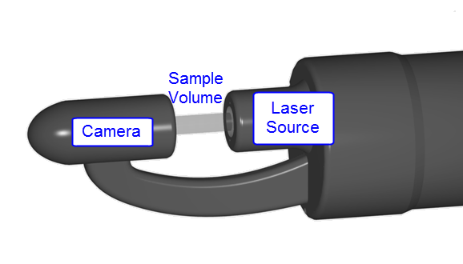
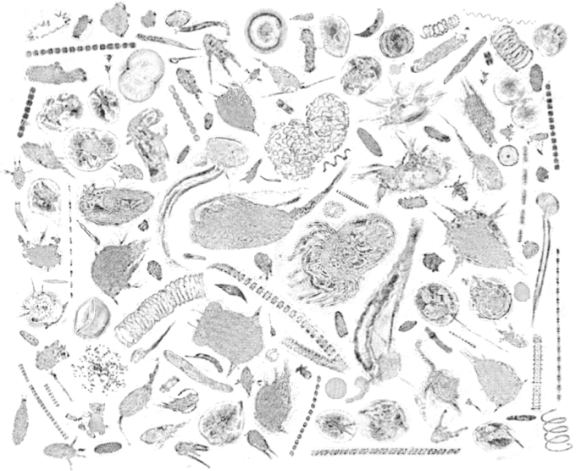
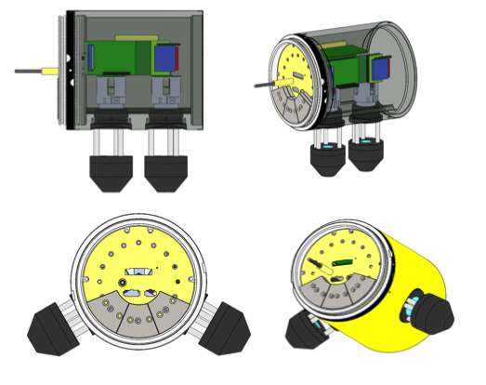
Holographic images from Monterey by an AUV
Design strategies are underway
Thanks to James Bellingham (WHOI)

Slide 14
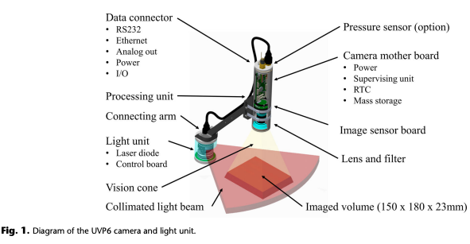
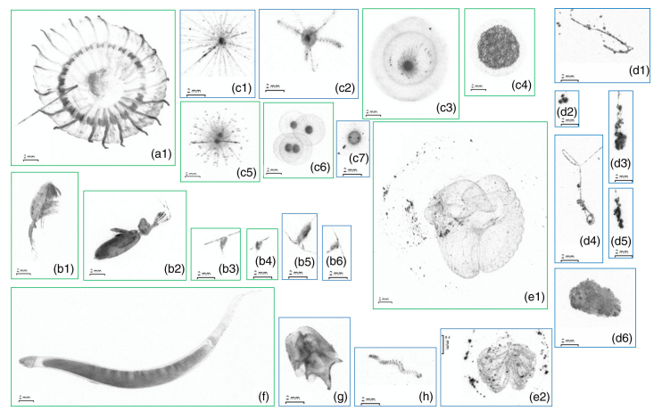
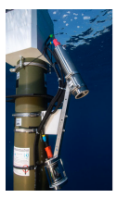
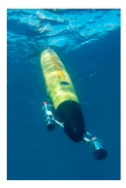
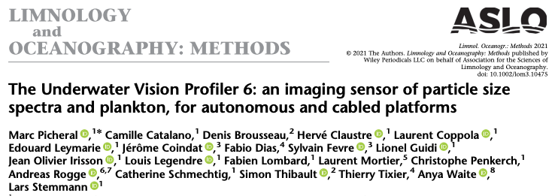
Underwater Vision Profiler

Slide 15
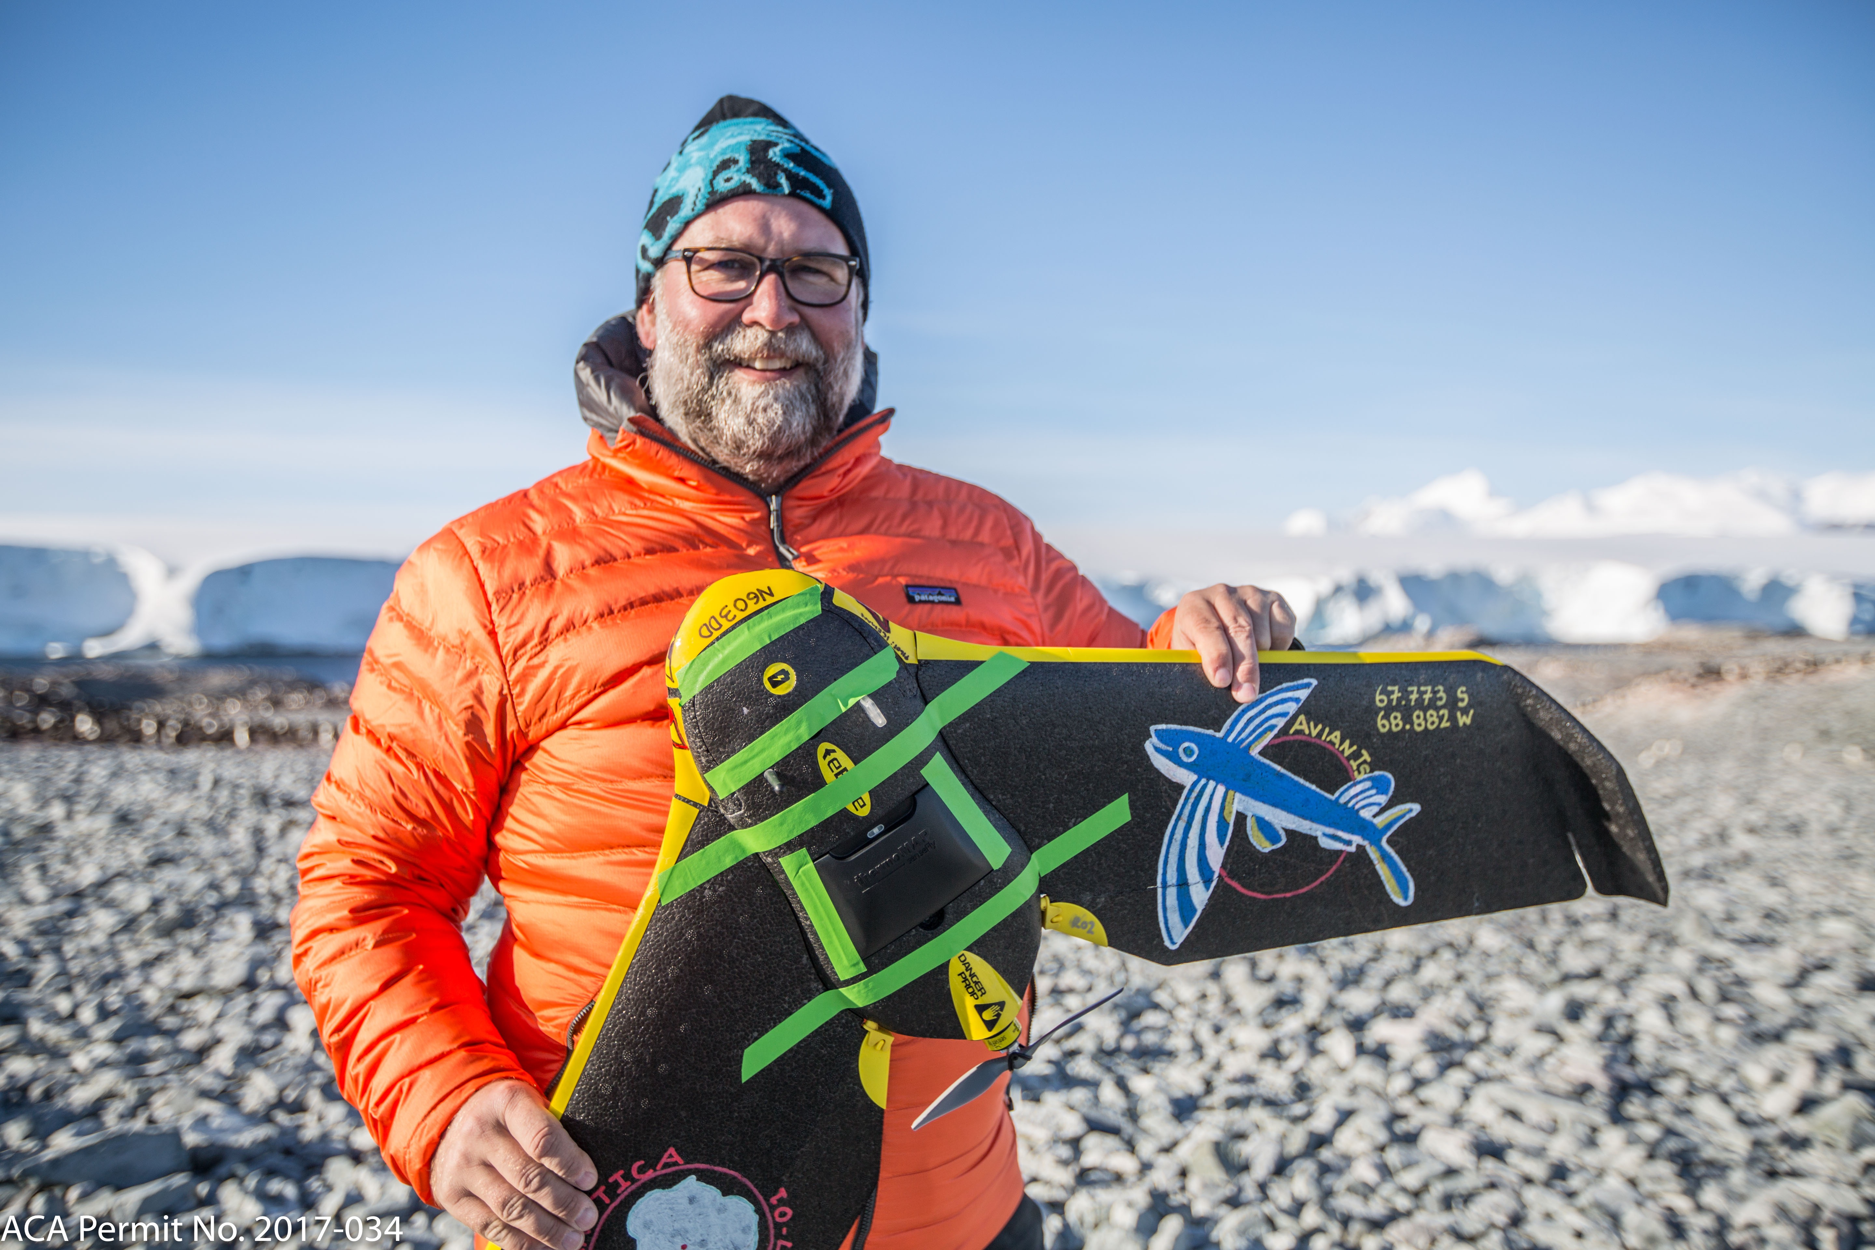
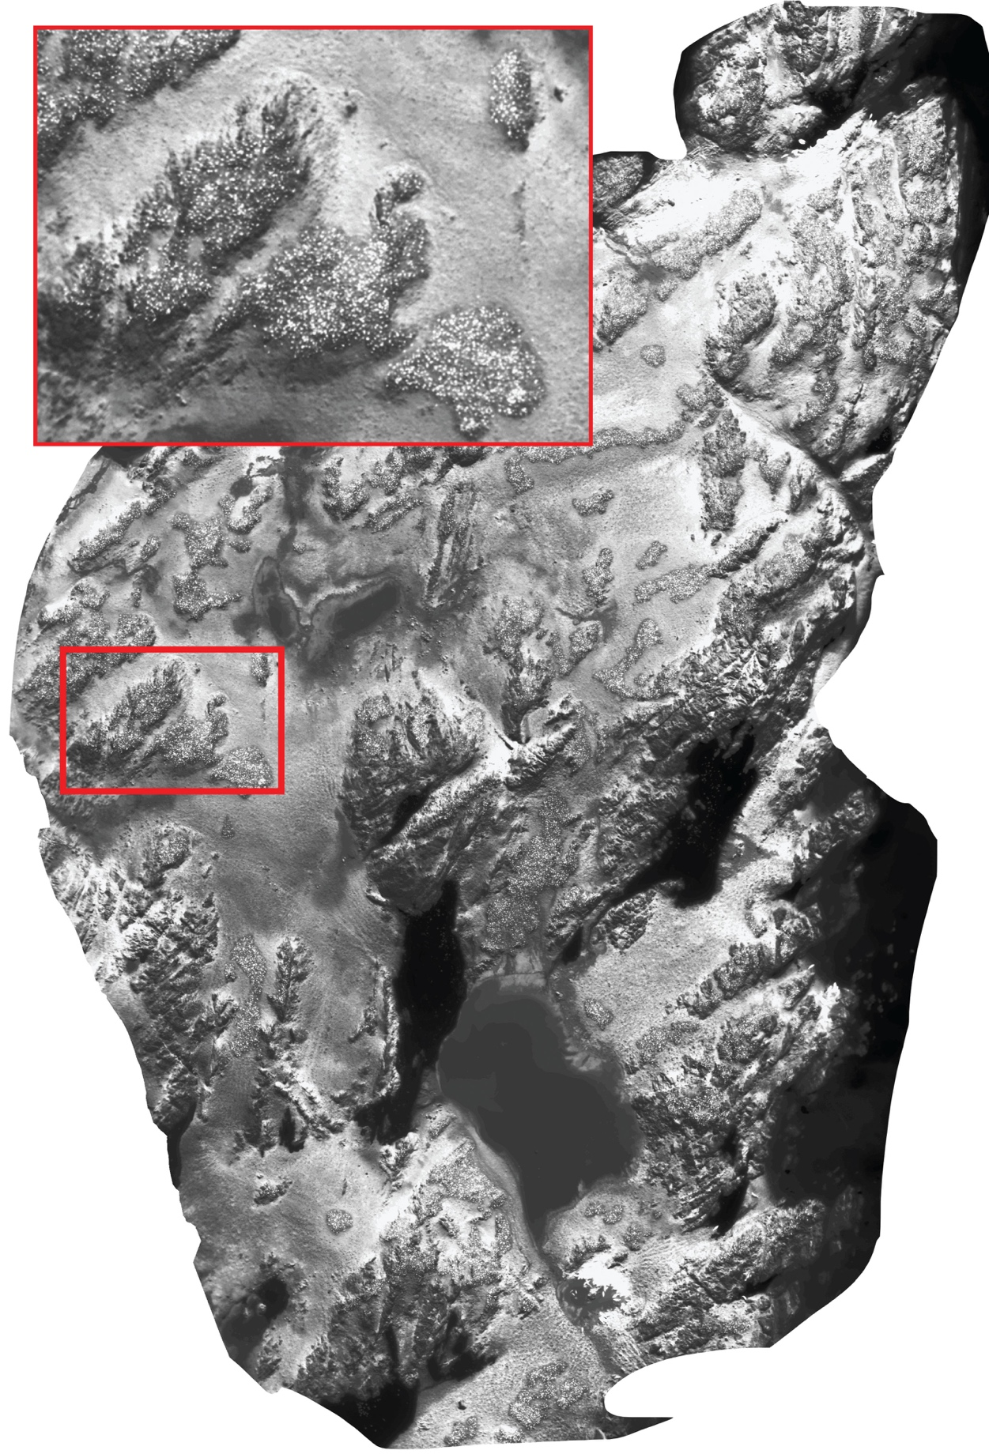
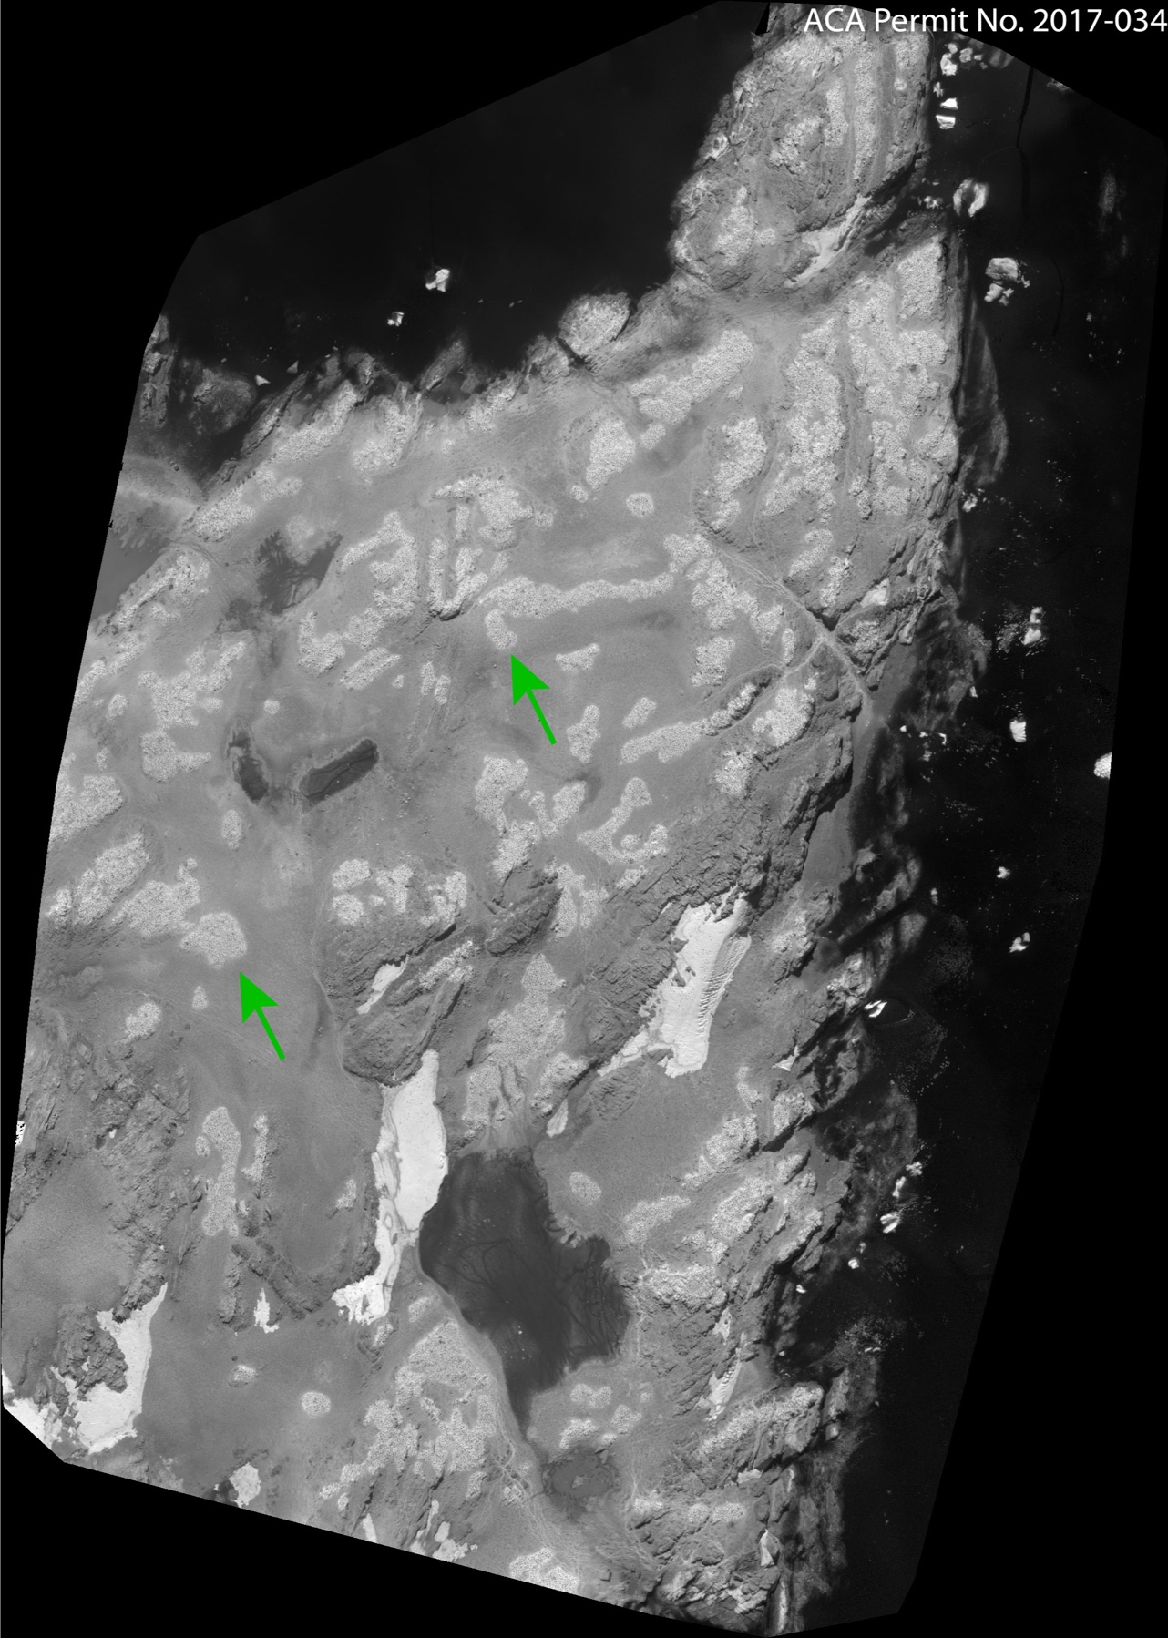
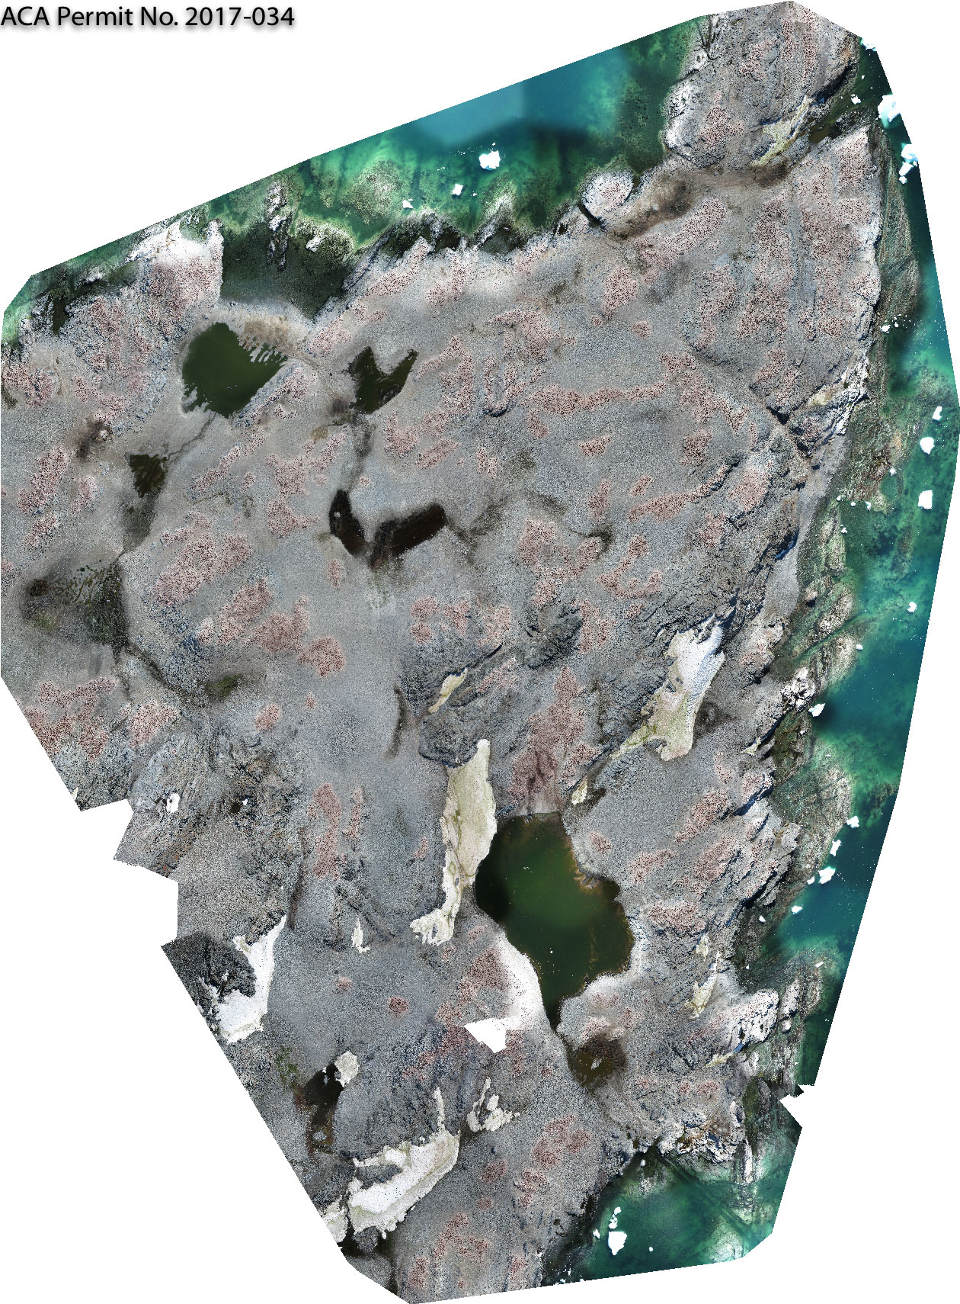
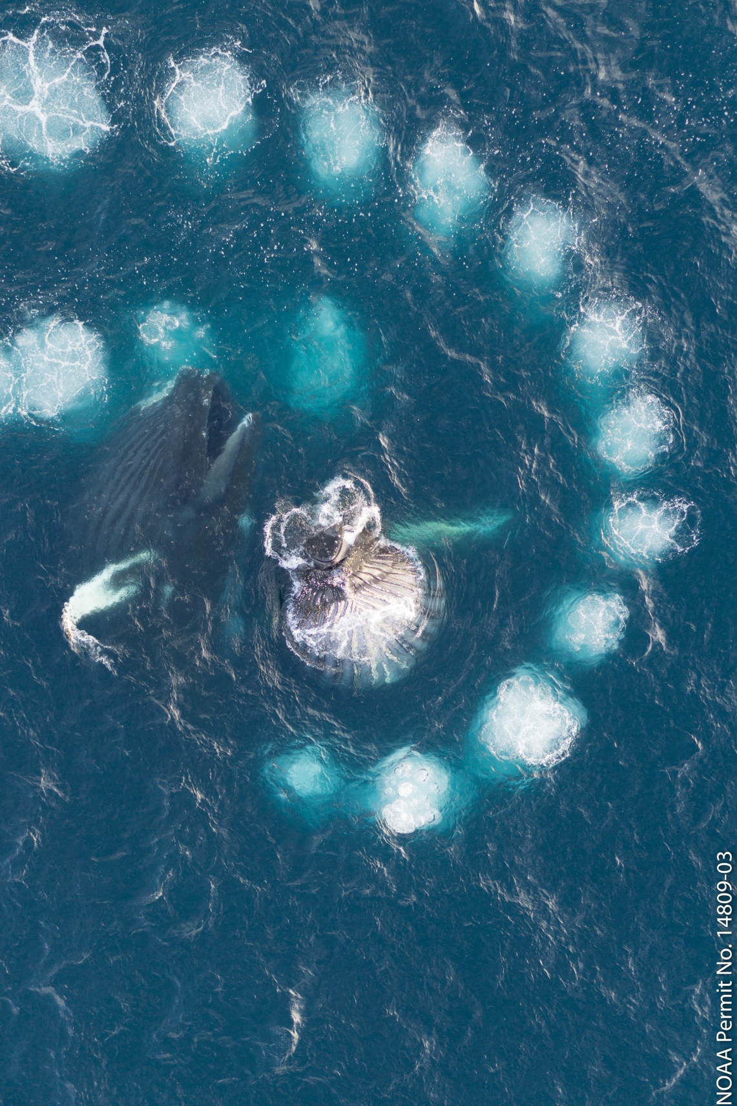
Sampling Higher Trophic Levels
UAV technology rapidly maturing! We can sample lower atmosphere and ocean surface
Multispectral sensors-cheap (relatively speaking)
Ability to repeat surveys frequently
Range of duration and stabilities
Penguin colony censuses
Adults vs chicks
Breeding areas
Dave Johnson, Duke University
RGB image
Thermal image
False color

Slide 16
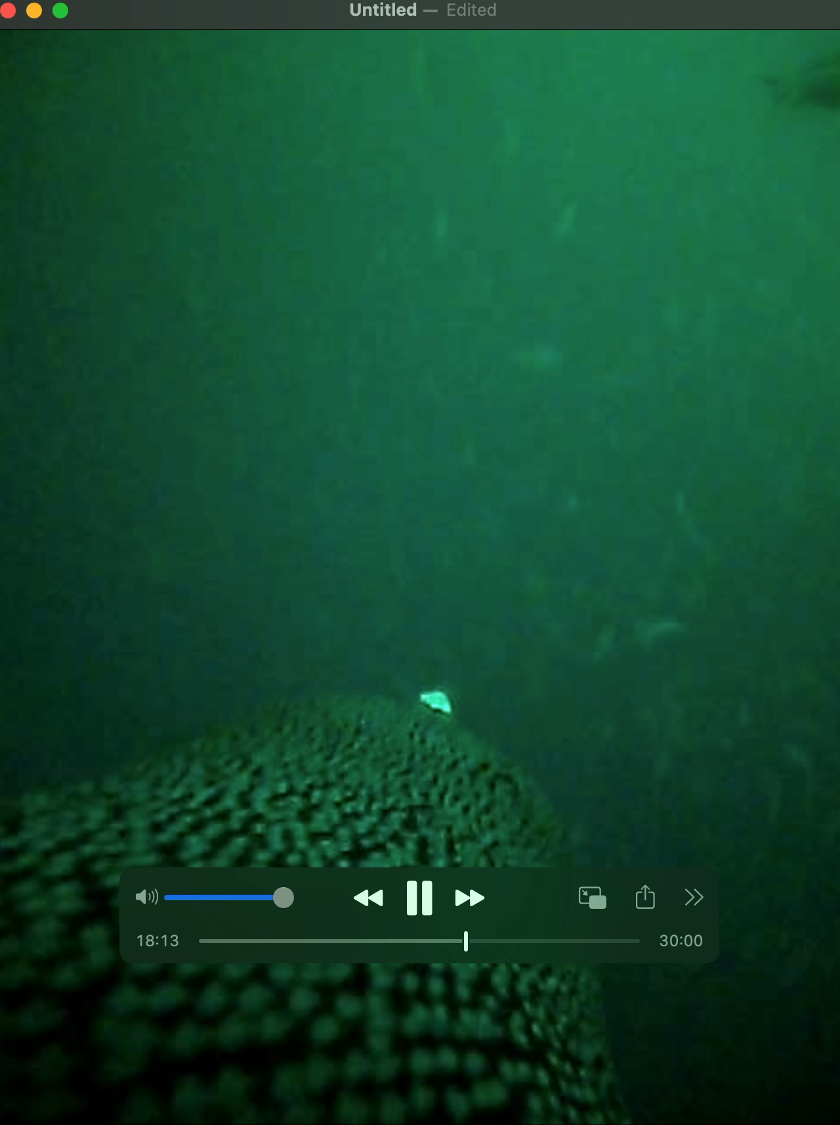
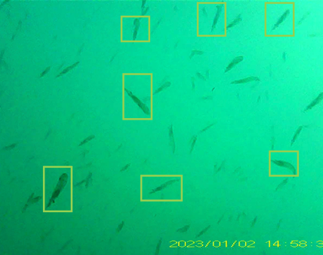
Using the Animals To Fill the Data Gaps (Tagging)
Looking for citizen science opportunities?
Thanks to Megan Cimino

