Slide 1
The Photophysiological Fingerprints of Long-Term Change
Phytoplankton Acclimation Along a Warming West Antarctic Peninsula
Quintin Diou-Cass¹, Nicole Waite¹, Oscar Schofield¹
¹Department of Marine and Coastal Sciences, Rutgers University, New Brunswick NJ
Presented by Quintin Diou-Cass, June 5th, 2023

Slide 2
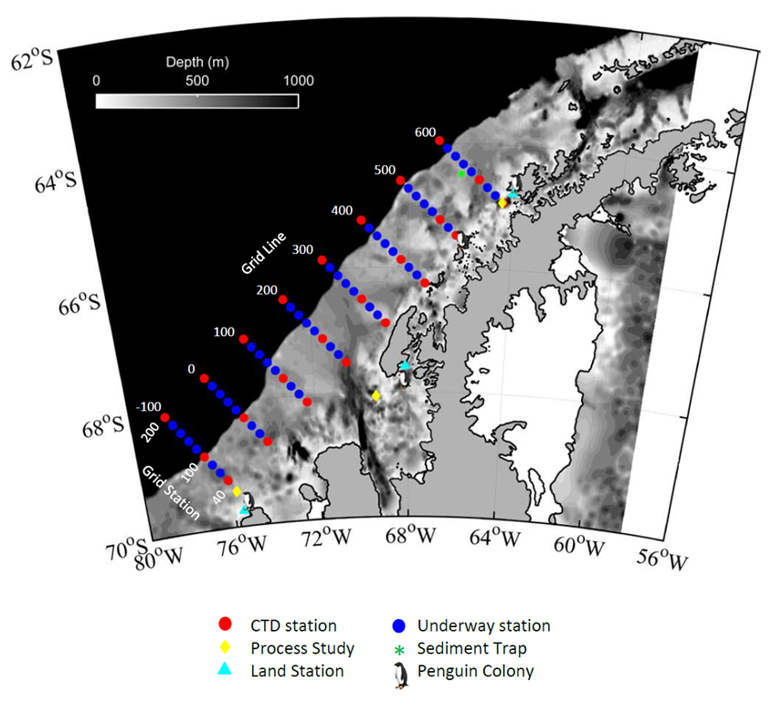
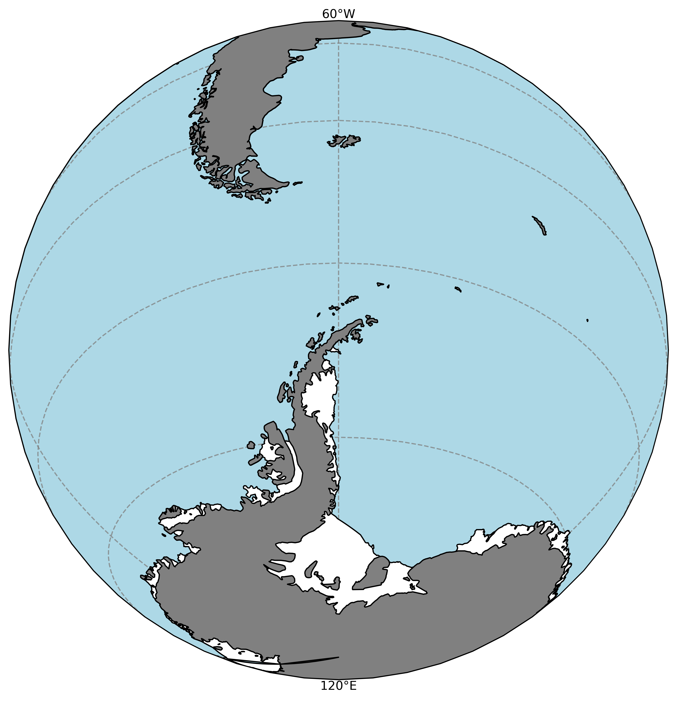
Introduction
Background
Results
Implications
Conclusions
The Palmer LTER:
Long Term Ecological Research Project
Palmer Station
LTER Survey Grid
The Palmer LTER provides a robust time series to study photobiological trends at an ecosystem level
Larsen C Ice Shelf
Objective:
Building a systematic understanding of ecological feedbacks to assess and predict the effects of climate warming on productive Antarctic ecosystems
Sampling Schemes:
Palmer Station & Annual Summer (January) Cruise
Data: Sea ice, hydrography, pigments, community composition, primary production (and more!)
West Antarctic Peninsula
1991-Present

Slide 3
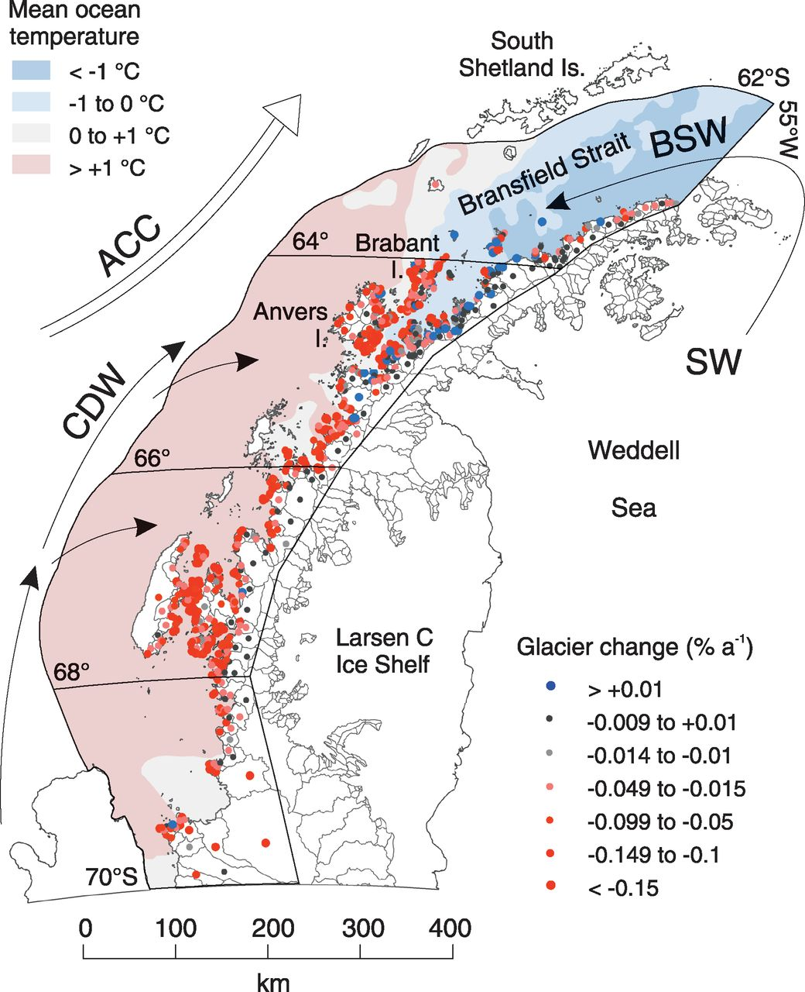
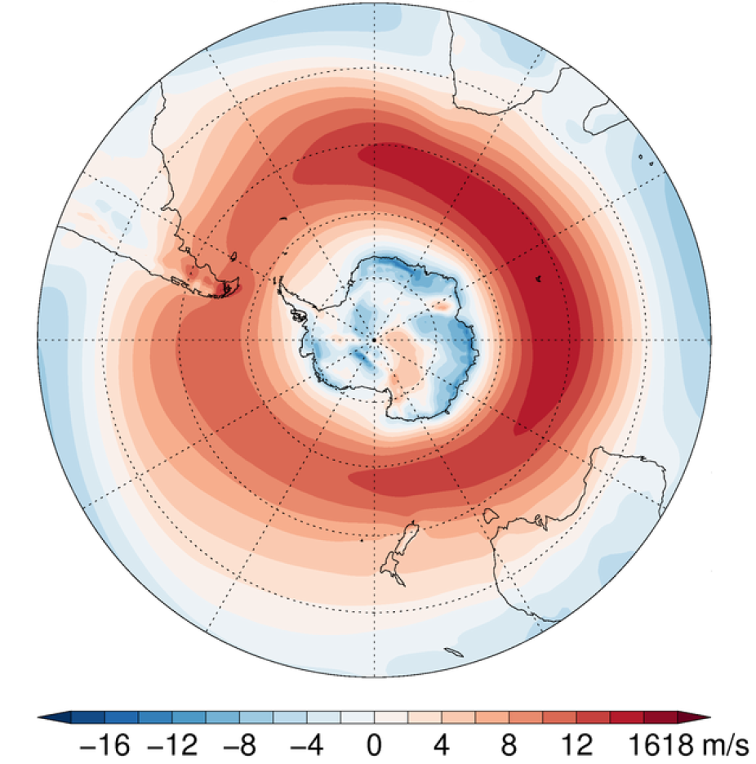
Introduction
Background
Results
Implications
Conclusions
The West Antarctic Peninsula (WAP)
Warm Westerlies
With direct atmospheric and oceanographic connectivity, the peninsula is highly vulnerable to changing climates...and a prime case study for the Antarctic
Warm Upper Circumpolar Deep Water
Annual Mean Westerly Wind Speed
(at 850hPa; NCAR, Climate Data Guide)
Cook et al. (2016)
Notes:
belt = highly vulnerable to changing atmospheric and oceanographic forces

Slide 4
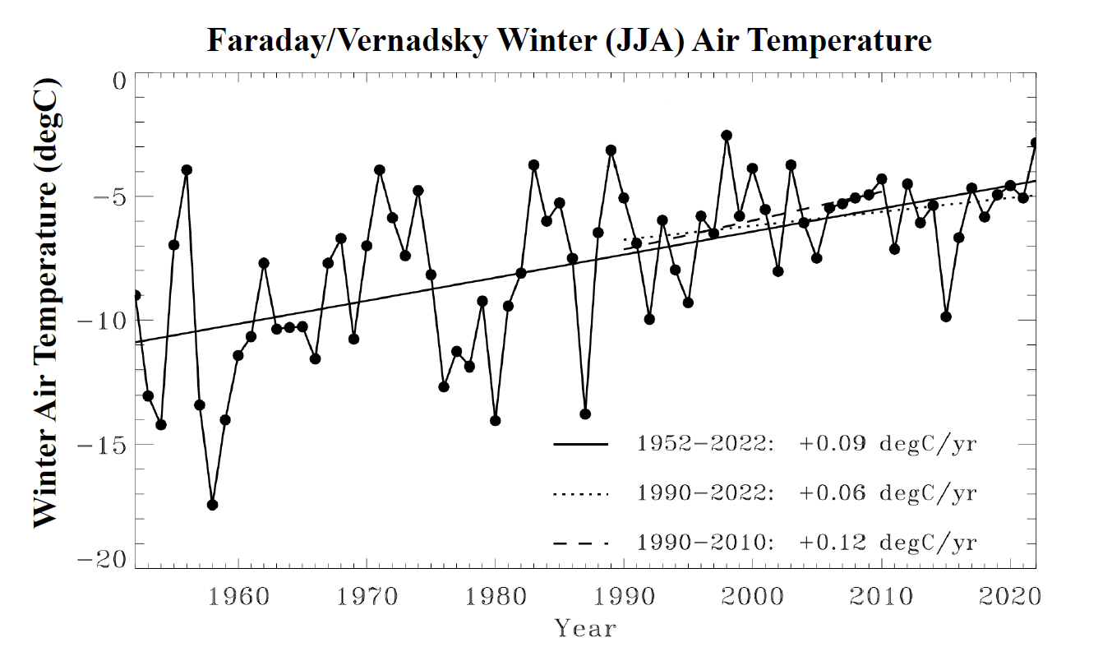
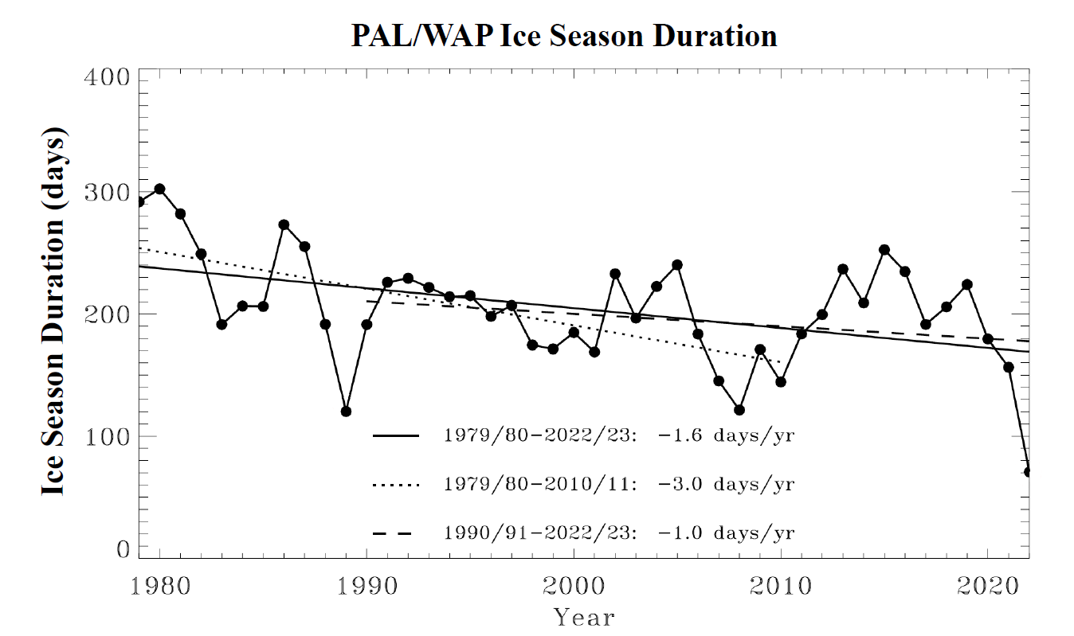
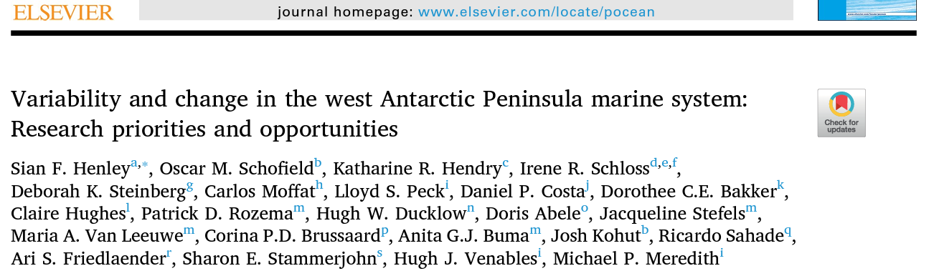
Introduction
Background
Results
Implications
Conclusions
Rapidly Shifting Climate
A rapidly warming climate sets the stage for troubles to come in polar ecosystem...
~1°C Decade⁻¹ Warmer
~15 days Decade⁻¹ Shorter
*Updated to 2022 courtesy of Sharon Stammerjohn

Slide 5
Introduction
Background
Results
Implications
Conclusions
Ice-Dependent Ecosystem
High-ice vs low-ice states set the stage for physical conditions that regulate growth
Low Wind
High Wind
High Sea Ice
Low Sea Ice
Shallow Mixed Layer
Deep Mixed Layer

Slide 6
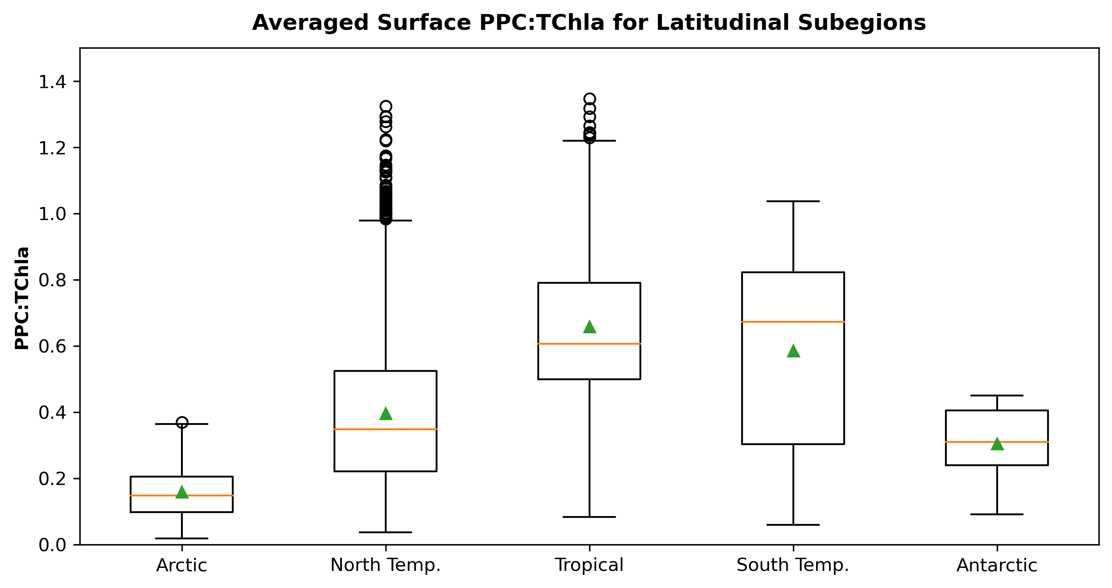
Introduction
Background
Results
Implications
Conclusions
Light Regulation
The Questions:
As environmental settings on the peninsula shift, do we see a photophysiological response in the algal community?
What are the ecological or biogeochemical associations with these responses?
Light regulates the algae in this low-light acclimated region, and expresses this as a signal in accessory pigments
Global
HPLC Data
SeaBASS
e.g., Alvarez et al. (2019)

Slide 7
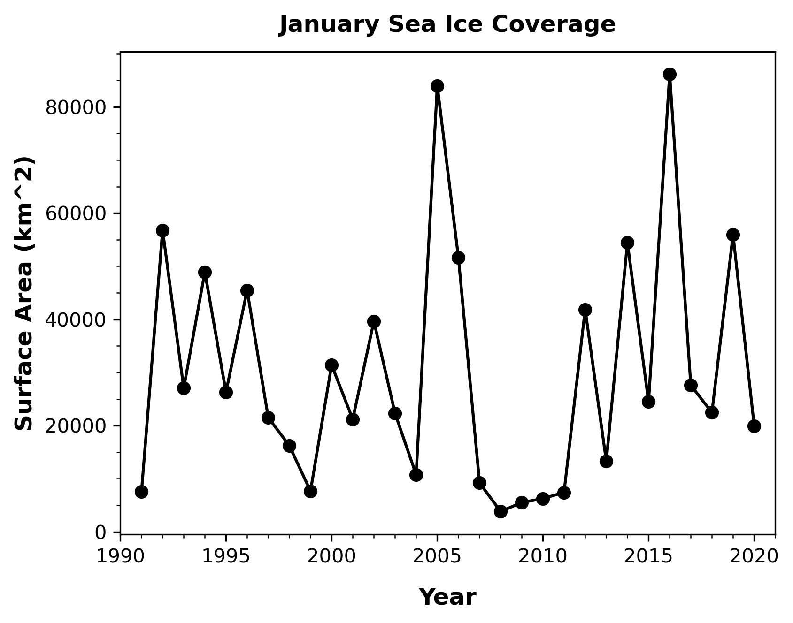
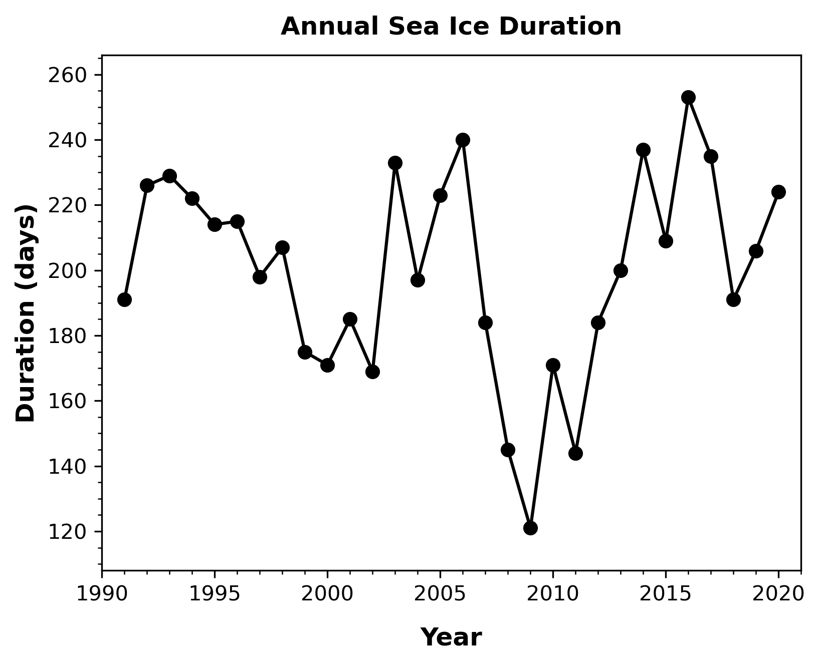
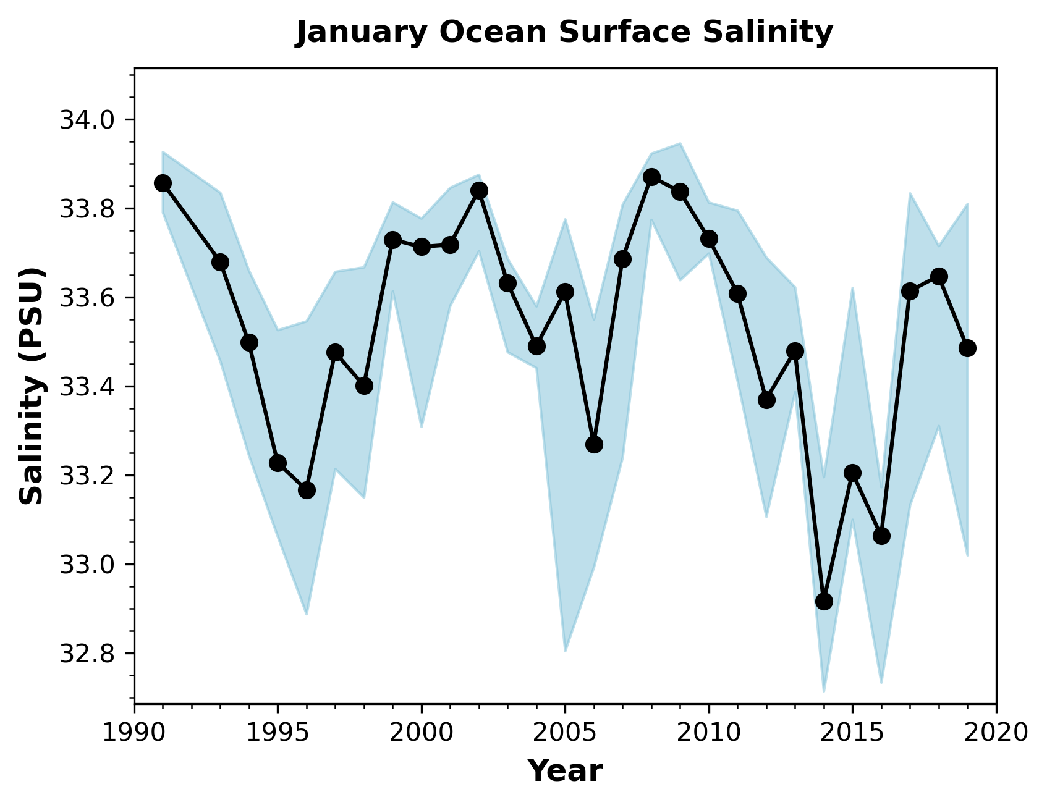
Introduction
Background
Results
Implications
Conclusions
*
*
*
*
*
*
Meltwater Input
Stratification
Wind Mixing
*
*
*
*
Sea Ice & Hydrography
*
*
Sea ice data shows high interannual variability, with direct effects on surface ocean hydrography
*
*
Low Sea Ice => Salty Surface Waters
*
Diou-Cass et al., In Prep

Slide 8
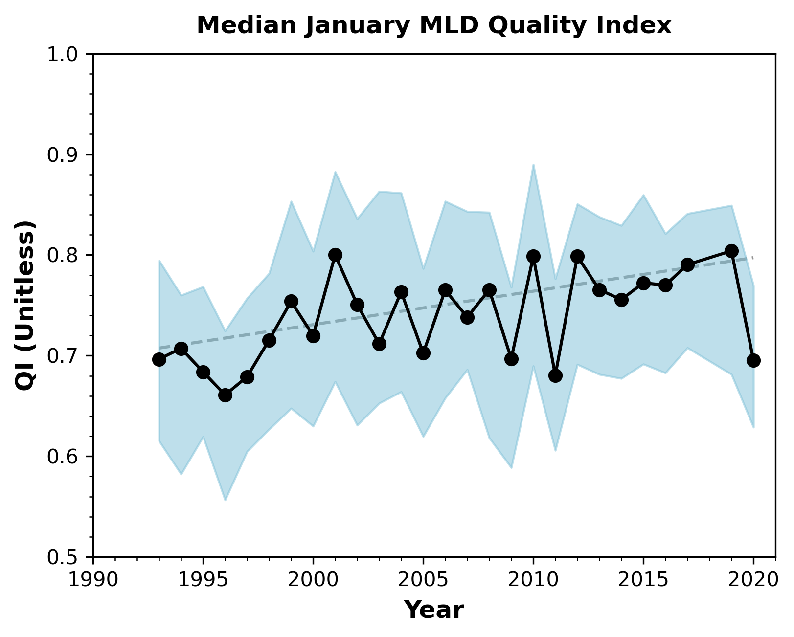
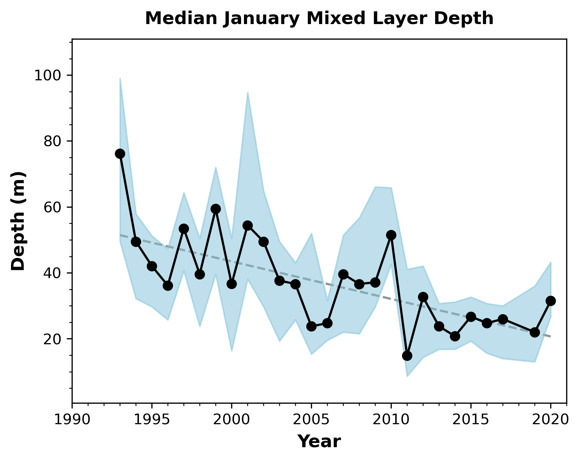
Introduction
Background
Results
Implications
Conclusions
Surface Ocean Mixing
Mixed layer changes suggest stabilization in the surface ocean
Slope: +0.003 yr⁻¹
Quality Index (QI):
An index signifying how well-defined the mixed layer is in calculation, and is dependent on the degree of stratification; the QI can serve as a proxy for surface ocean stratification in this manner
Slope: -1.176 yr⁻¹
*
*
*
*
*
As mixed layers shallow, how do the phytoplankton respond?
Diou-Cass et al., In Prep

Slide 9
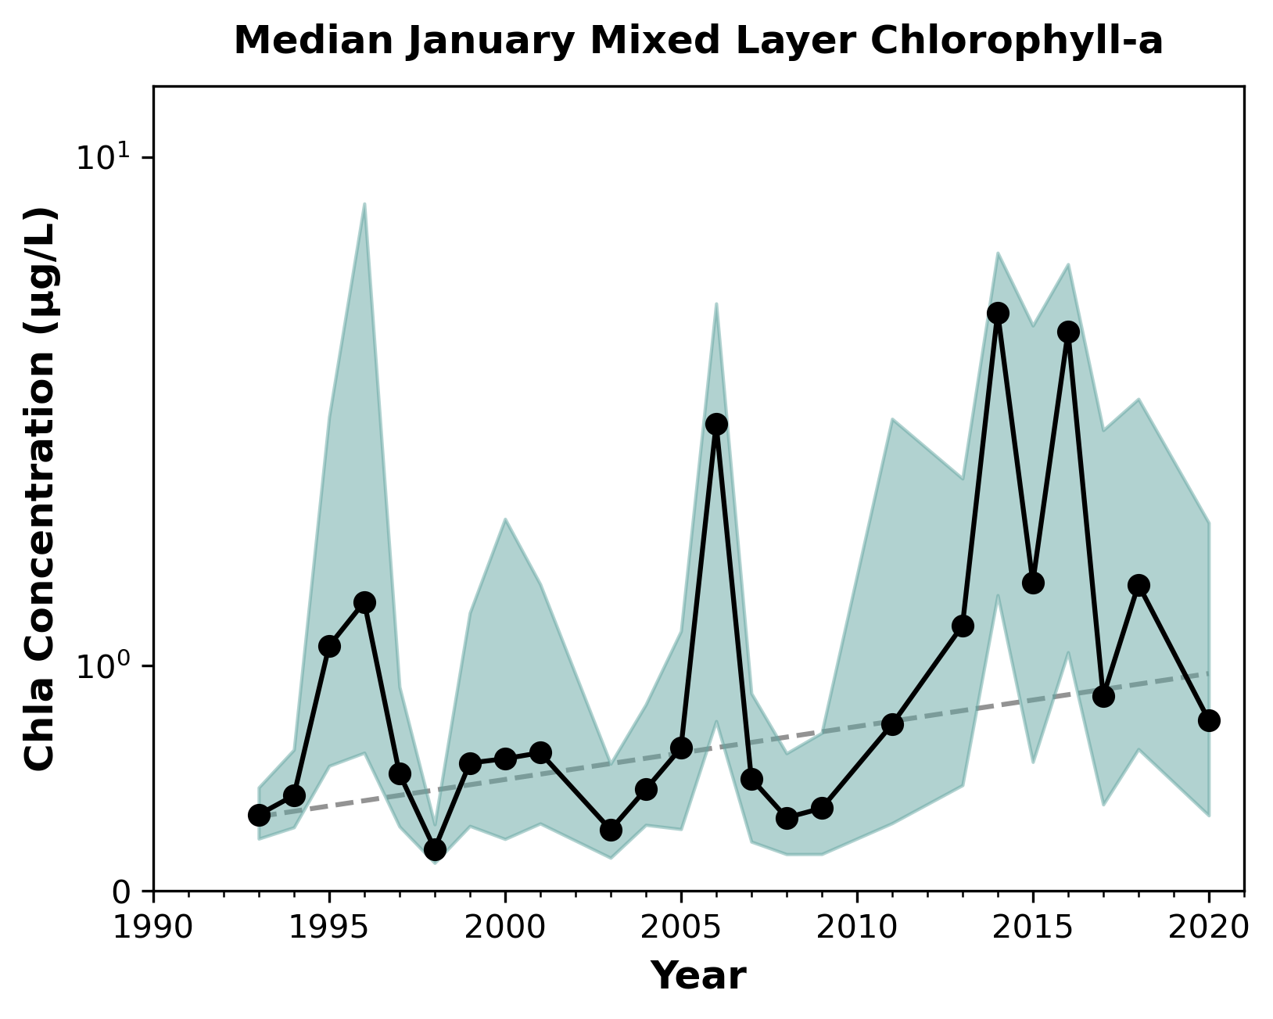
Introduction
Background
Results
Implications
Conclusions
Productivity Responses
Slope: +0.026 yr⁻¹
*
Long-term increase in algal biomass
*
Low sea ice years see peaks in alga abundance
*
Diou-Cass et al., In Prep

Slide 10
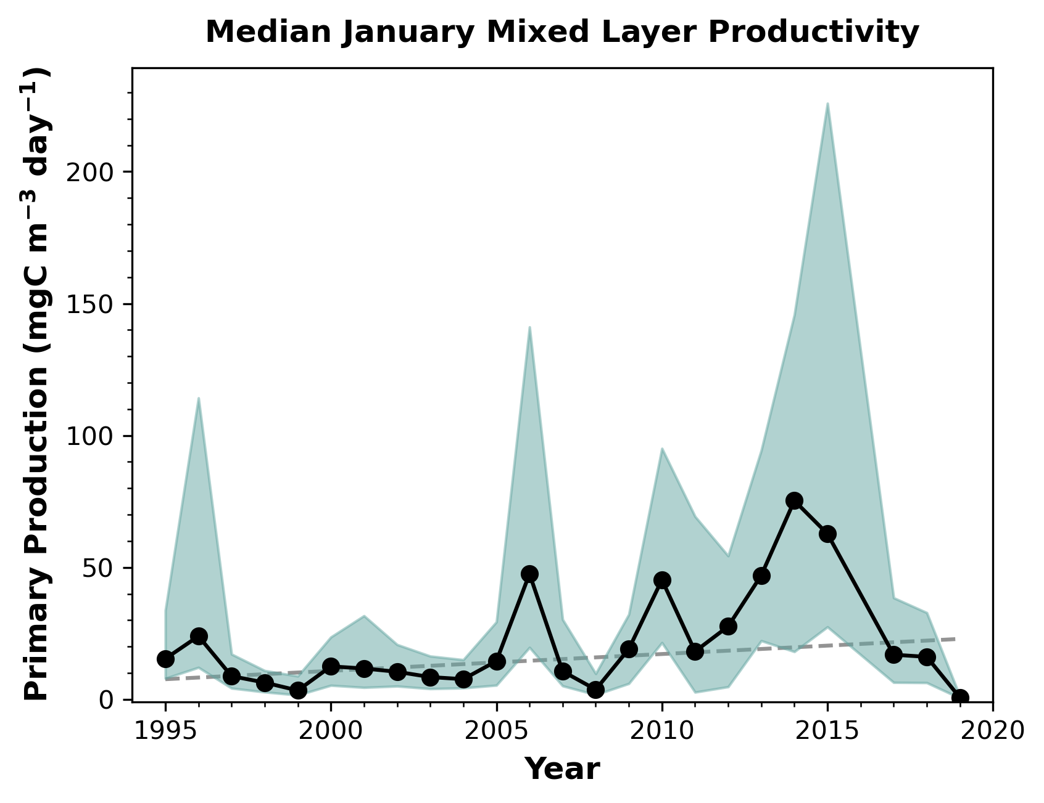
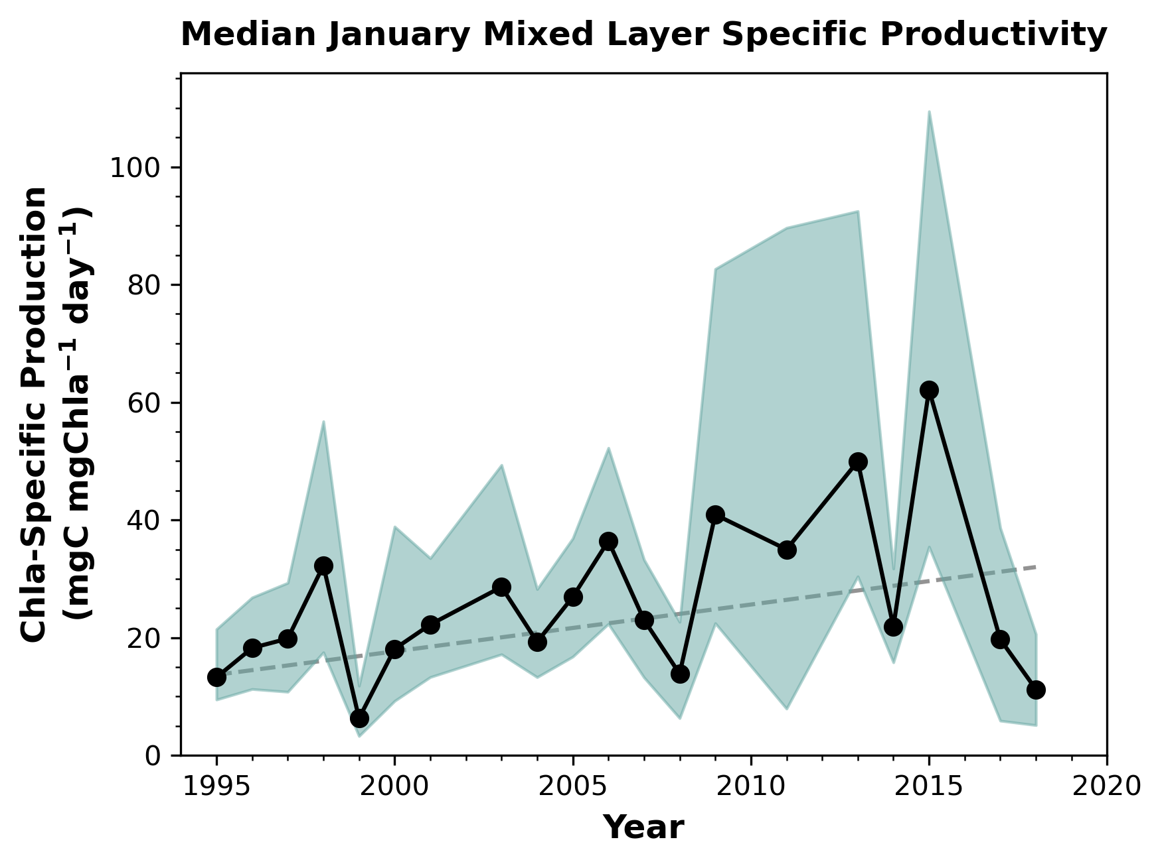
Introduction
Background
Results
Implications
Conclusions
Physiological Associations
Extremes expressed in primary production as well
MKT: 0.111
M-MKT: 0.03
Slope: +0.928 yr⁻¹
*
*
*
Apparent increase in chlorophyll-specific productivity as a coarse proxy for efficiency
Diou-Cass et al., In Prep

Slide 11
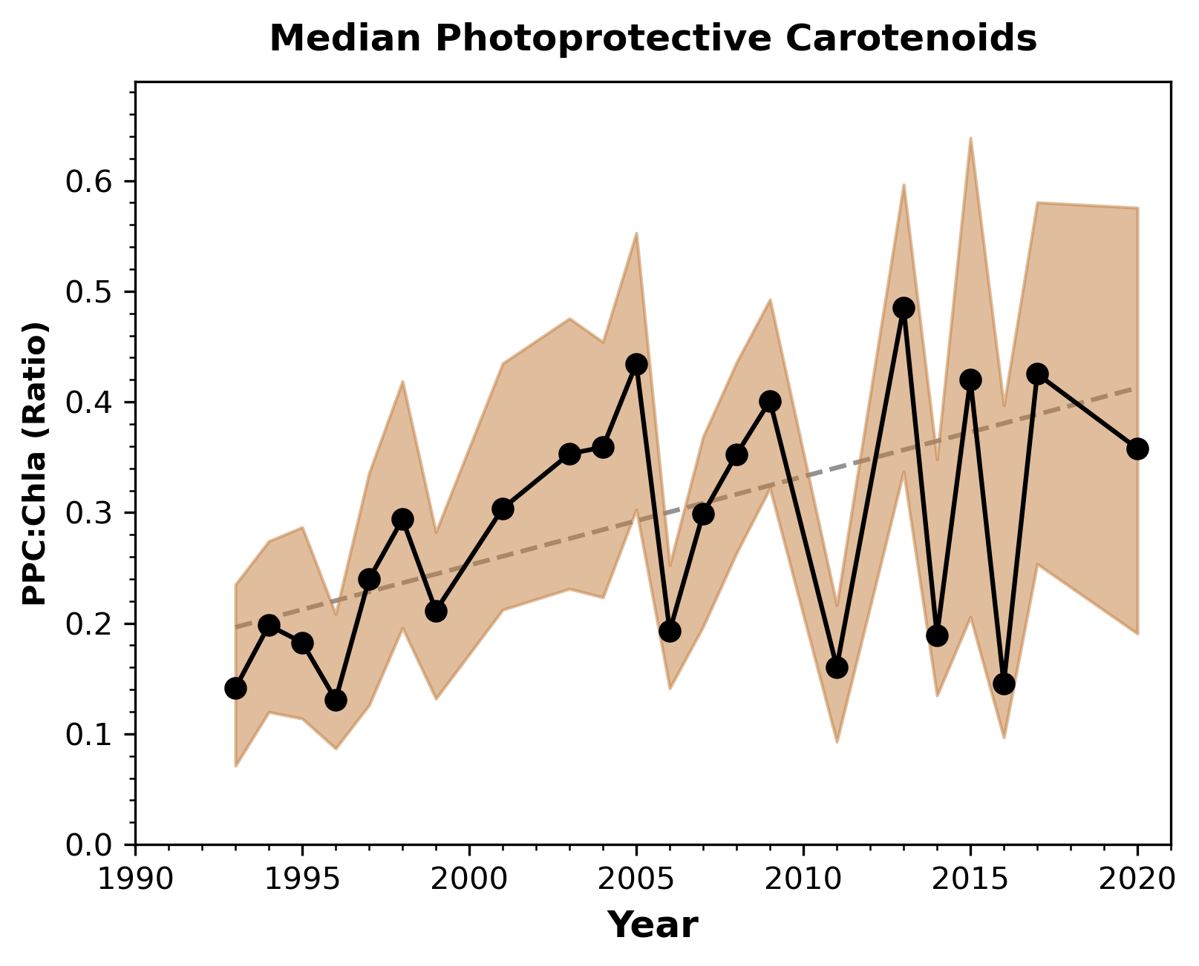
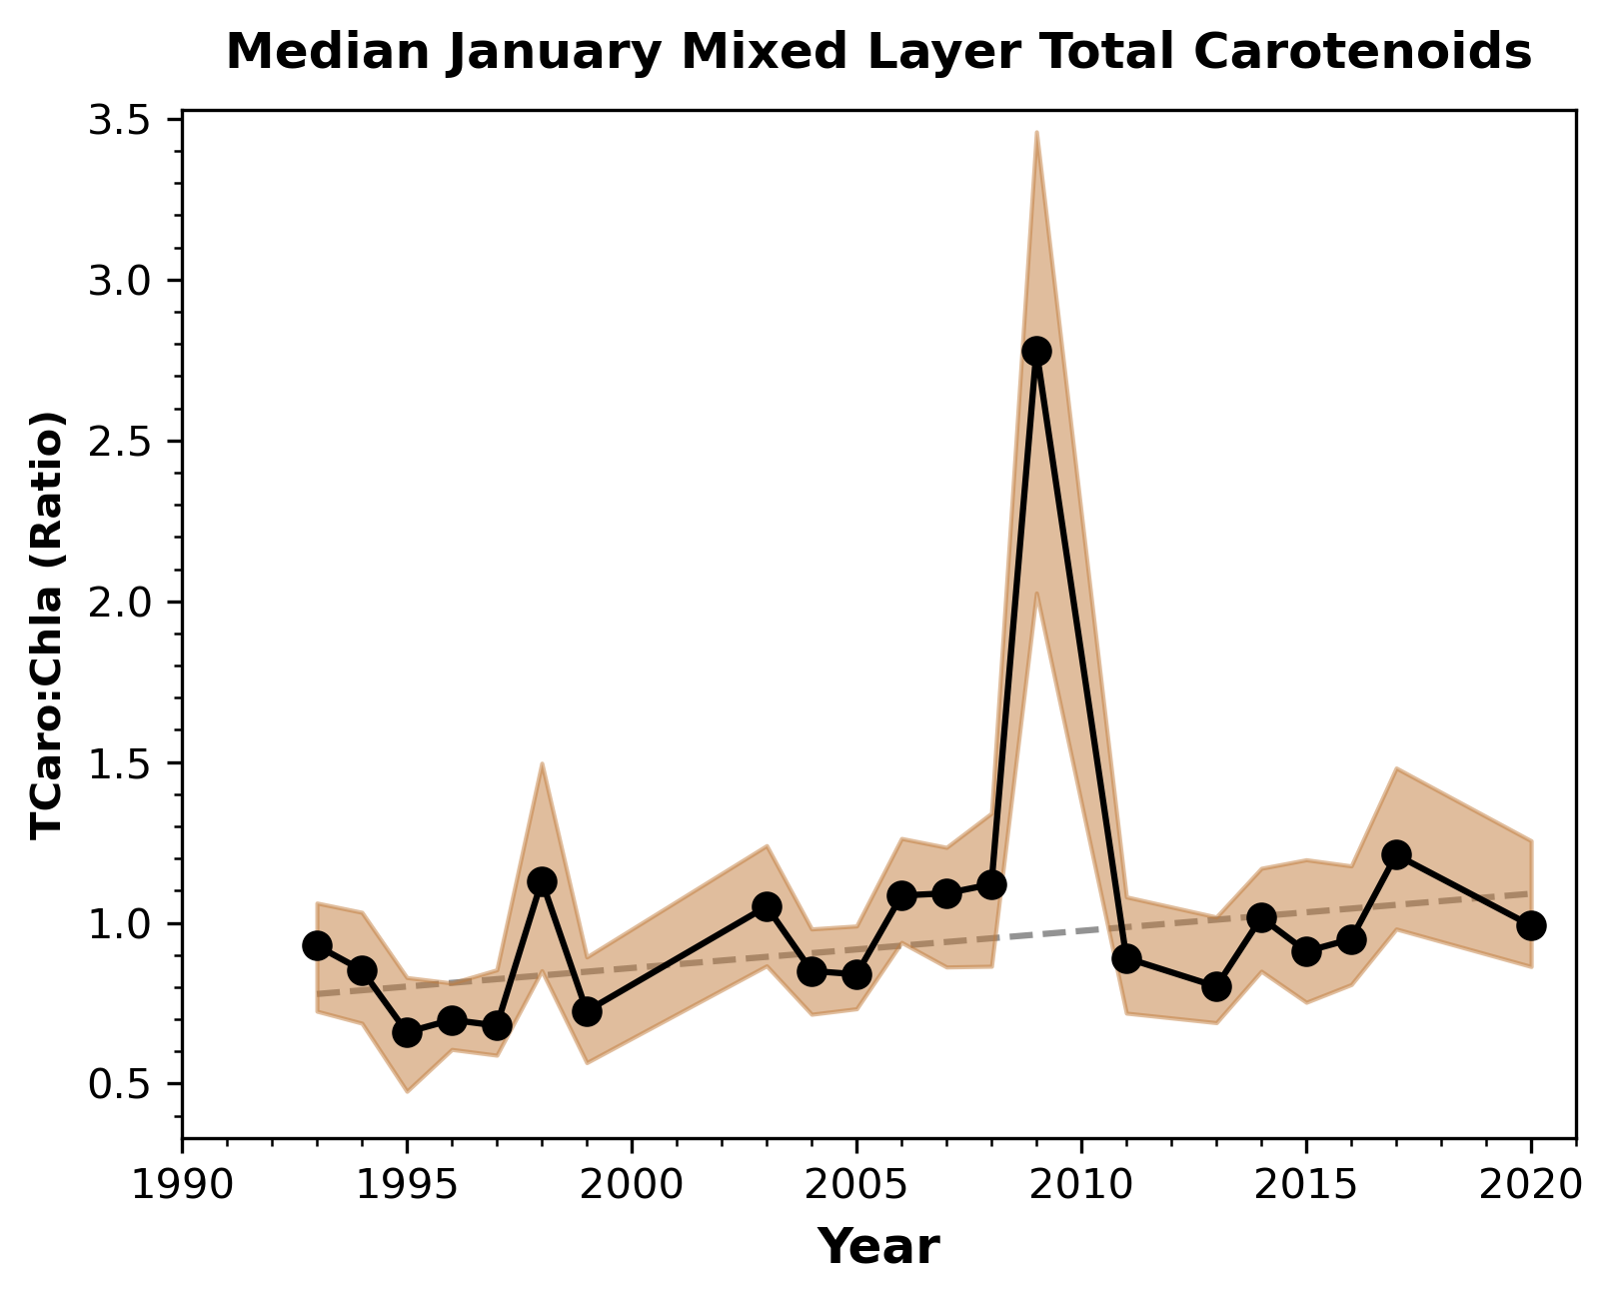
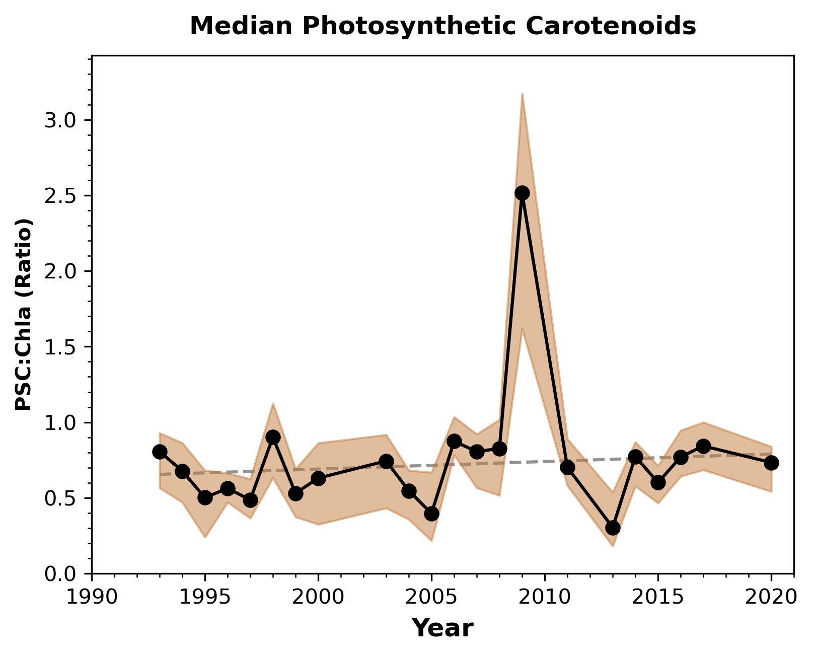
Introduction
Background
Results
Implications
Conclusions
Photophysiological Responses
Slope: +0.010 yr⁻¹
Mixed layer photoprotective fraction nearly doubles
Slope: +0.015 yr⁻¹
*
...driven by increased photoprotective pigments
*
Photosynthetic fraction contains outliers, but no trended change...
Interdecadal increase in total carotenoids in the mixed layer...
Diou-Cass et al., In Prep

Slide 12
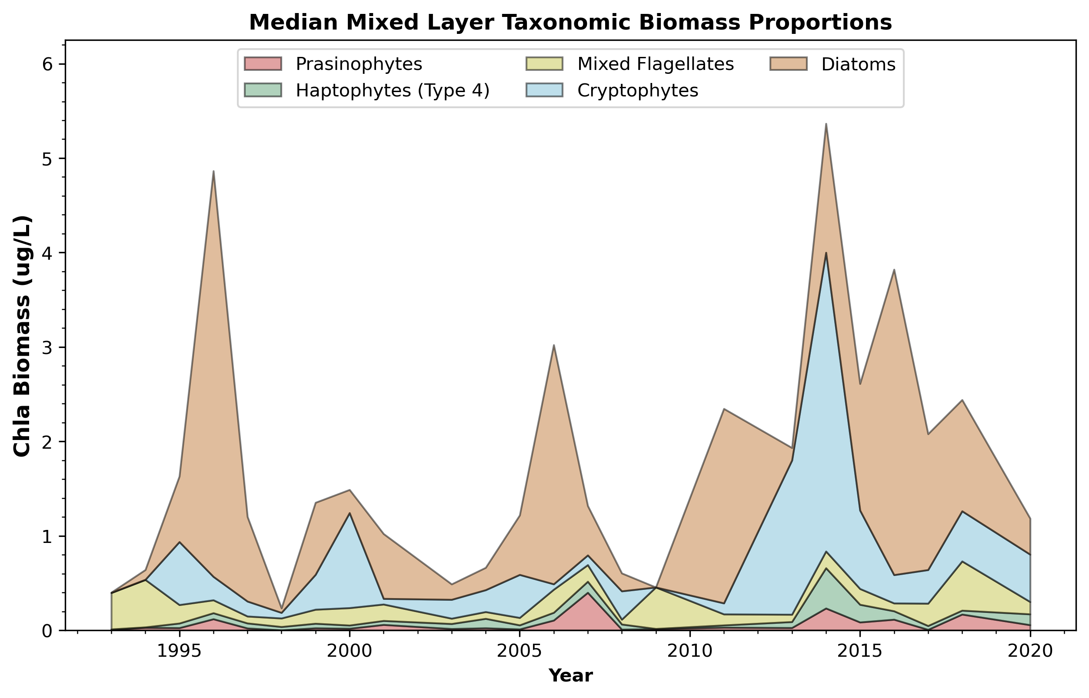
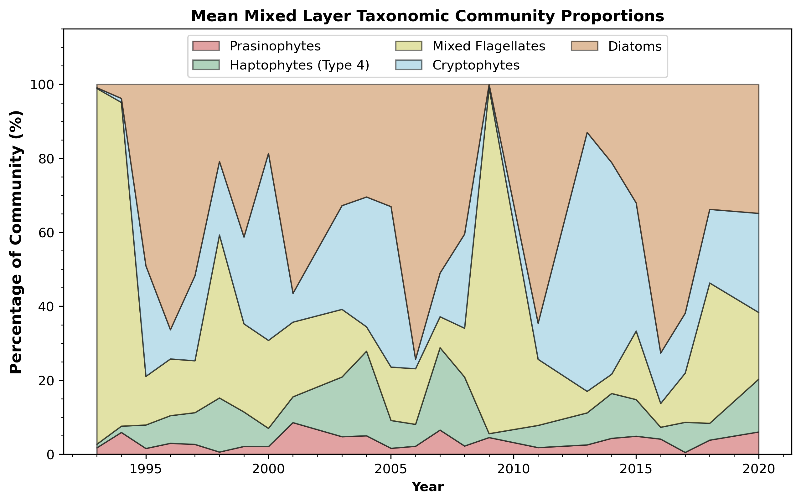
Introduction
Background
Results
Implications
Conclusions
Taxonomic Associations
*
No apparent trends in taxon groups, but interesting patterns with cyclical extremes exist...
*
*
*
*
Shallow, high biomass years are dominated by Diatoms; low biomass years see a proportional shift toward mixed flagellates
*
*
*
*
*
Cyclical Extremes – diatoms vs mixed flagellates
Diou-Cass et al., In Prep

Slide 13
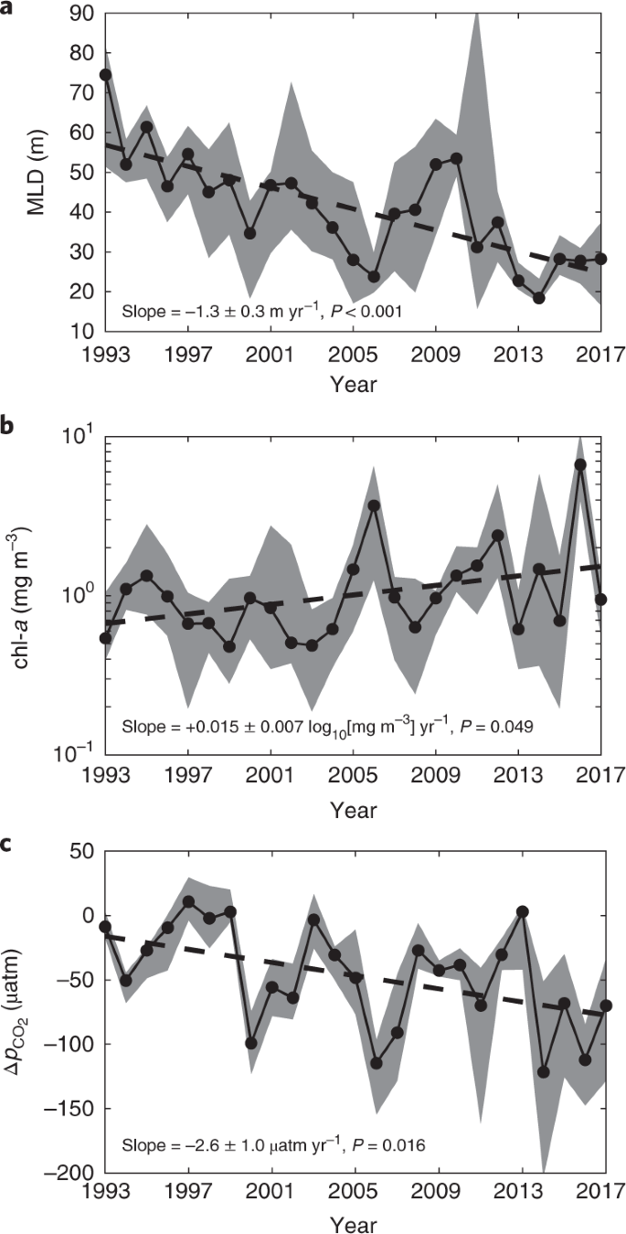
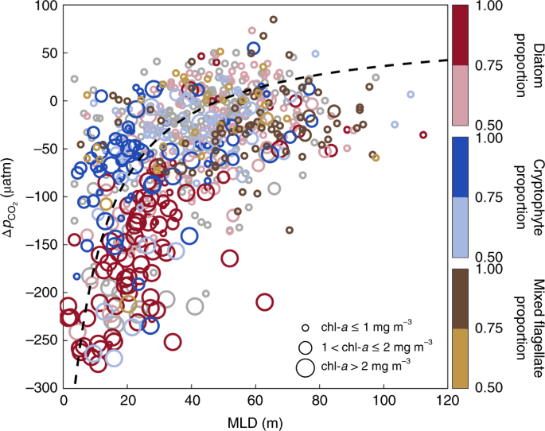
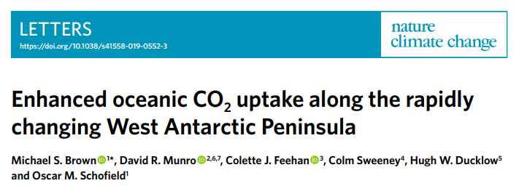
Introduction
Background
Results
Implications
Conclusions
MLD
Implications:
Carbon Drawdown
High CO² drawdown associated with Diatoms; less so with Cryptophytes and Mixed Flagellates
Shallowed ML & increased biomass = enhanced CO² drawdown
Chla
Brown et al. (2019)
∆P_{CO2}

Slide 14
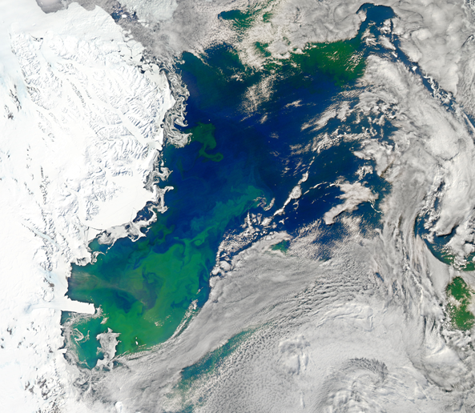
Introduction
Background
Results
Implications
Conclusions
Core Takeaways
1) The surface mixed layer along the peninsula has shallowed over several decades
2) In response, an increased proportion of photoprotective pigments is seen in the algae
3) Enhanced biomass and productivity seem to follow these shifts in photophysiology
This work deepens our understanding of photophysiology as a regulator in the climate-ecology cascade, and opens the door for further questions on what mechanisms lie under the hood

Slide 15
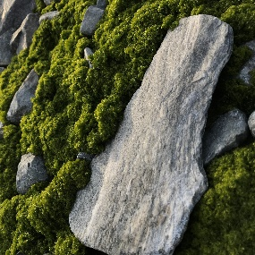
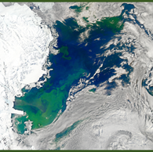
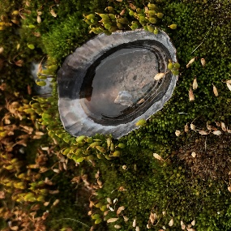
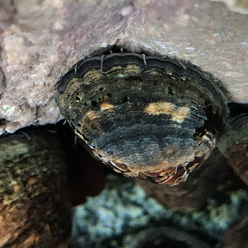
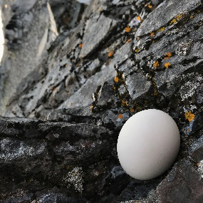
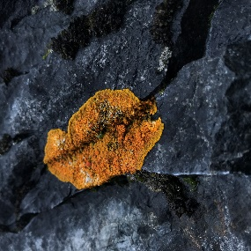
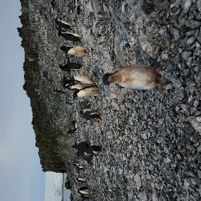
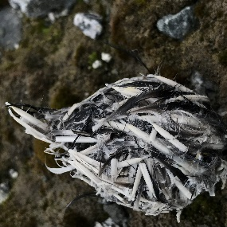
Introduction
Background
Results
Implications
Conclusions
Acknowledgments
Conclusions:
An interdecadal increase in photoprotection was seen in response to climate-driven shallowing of the surface mixed layer
Despite enhanced photoprotection, the overall effect of environmental change on the algal community seems beneficial
The apparent trends observed in composition suggest a possible role of light in shaping the algal community
This work was funded by the National Science Foundation through the Palmer Long Term Ecological Research project. Special thanks to co-authors Nicole and Oscar for their help in components of data analysis, conceptualization, and project feedback.
Contact Info:
qpd1@marine.rutgers.edu

