Slide 1
A Decade of Offshore Wind Energy Science Supporting the New Jersey Board of Public Utilities
Center for Ocean Observing Leadership
Department of Marine and Coastal Sciences
Rutgers, The State University of New Jersey

Slide 2
Rutgers offshore wind work goes far beyond our presentation today
https://osw.rutgers.edu/
Multi-disciplinary
Numerous departments
Far beyond physical oceanography and atmospheric science
Notes:
We are one small piece of offshore wind research at Rutgers

Slide 3
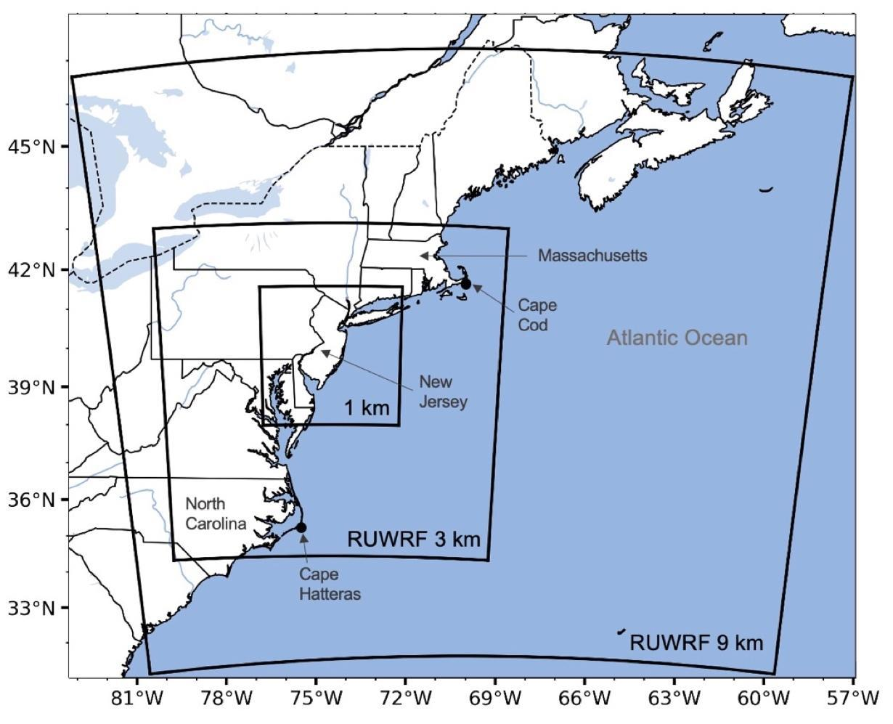
A Decade of Offshore Wind Energy Science
Supporting the New Jersey Board of Public Utilities
Overarching theme – The Coastal Ocean impacts New Jersey’s Weather
RUCOOL – NJBPU Project Fast Facts:
RUCOOL supported by NJBPU since April 2011
Leverages 30+ years of experience
Brings world leading ocean/atmospheric sciences to focus on NJ challenges and opportunities
Focuses activities on providing value to the NJ rate payer
Model simulations generated using Rutgers Univ. Weather Research and Forecasting Model
Evaluated by and optimized with NREL in 2019 (NREL Report)
Validation documents performance equivalent to or better than evolving national products (NREL WindToolkit is from before 2014 and only at 100m)
4 years of data available and in-use for a broad array of applications

Slide 4
Our Goal: Support the BPU, rate payers, and wind energy stakeholders in NJ and the region
RUCOOL has created a 4 year hourly dataset and curated wind products from RUWRF
Accessibility – All model data and wind products are available to you
Capabilities for Case studies – Are there case studies you would like to see? We are looking for feedback.

Slide 5
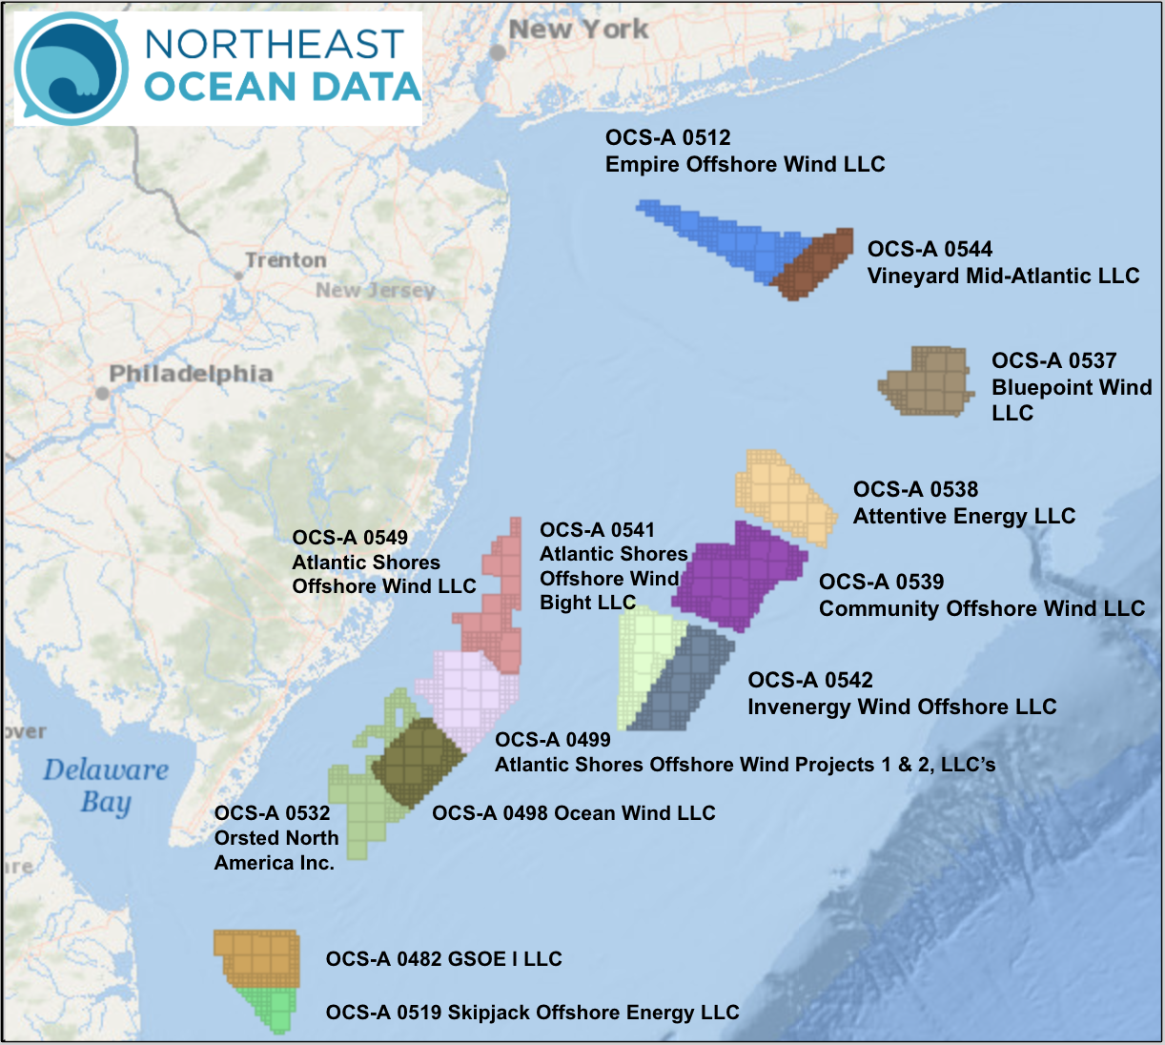
The Mid Atlantic Ocean experiences the largest seasonal temperature changes in the world
October
January
March
30 years of data
June
Cold Pool
August
October

Slide 6
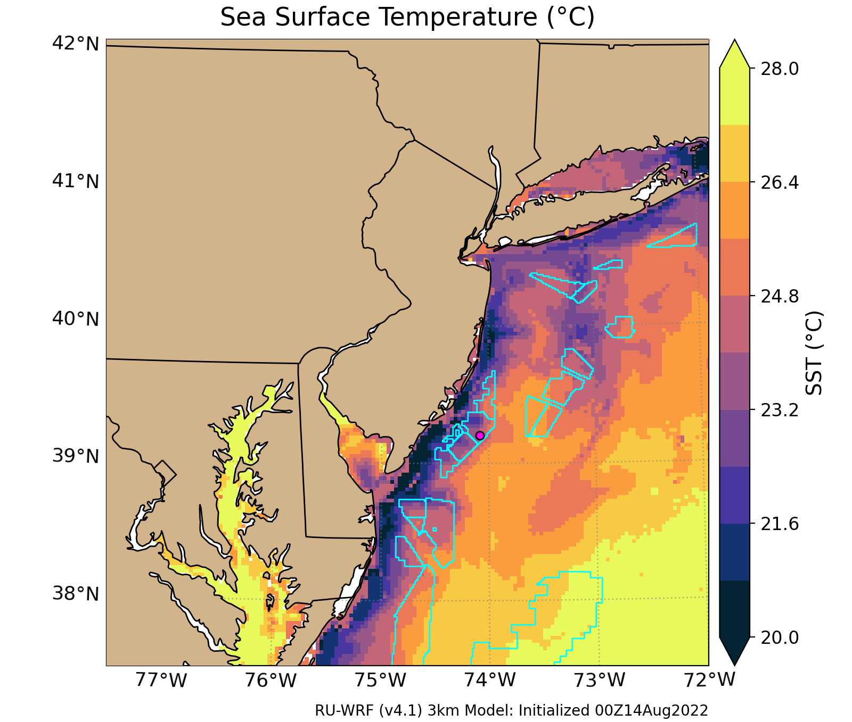
The Cold Pool is not a static feature: Coastal Upwelling/Downwelling
wind
SW upwelling
favorable wind
Notes:
Upwelling and accurate temperature is important as the upper ocean temps affect the marine boundary layer, stability/turbulence, wind speed and direction.

Slide 7
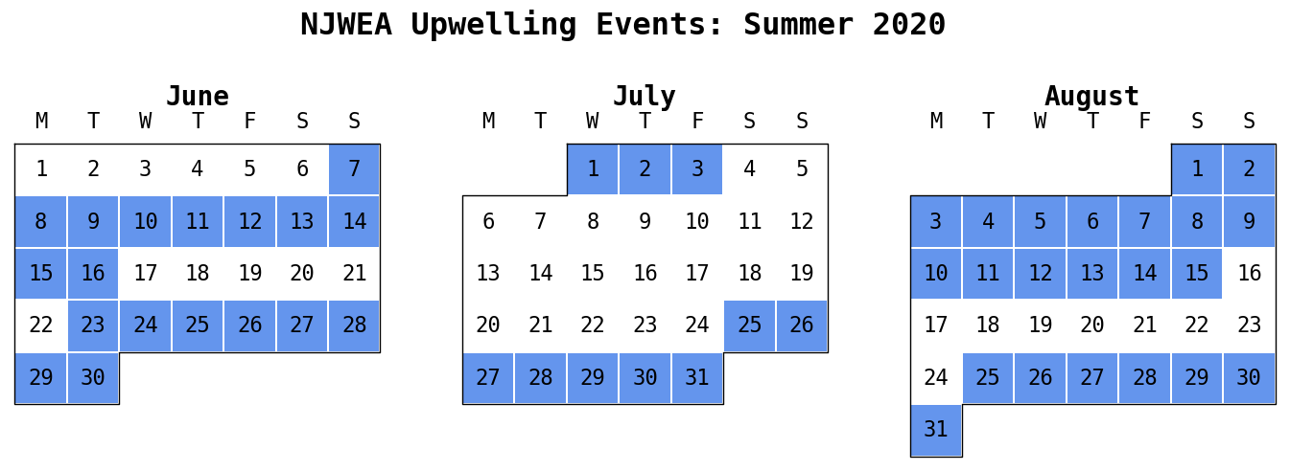
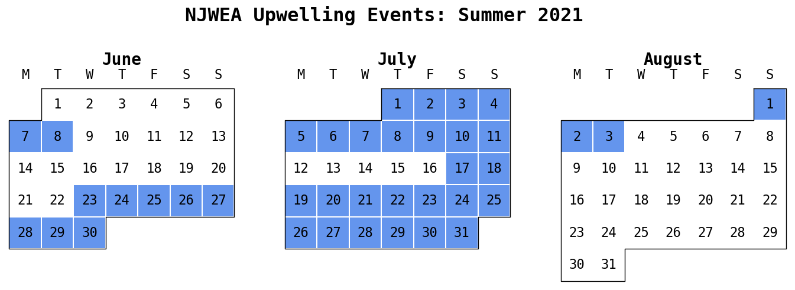
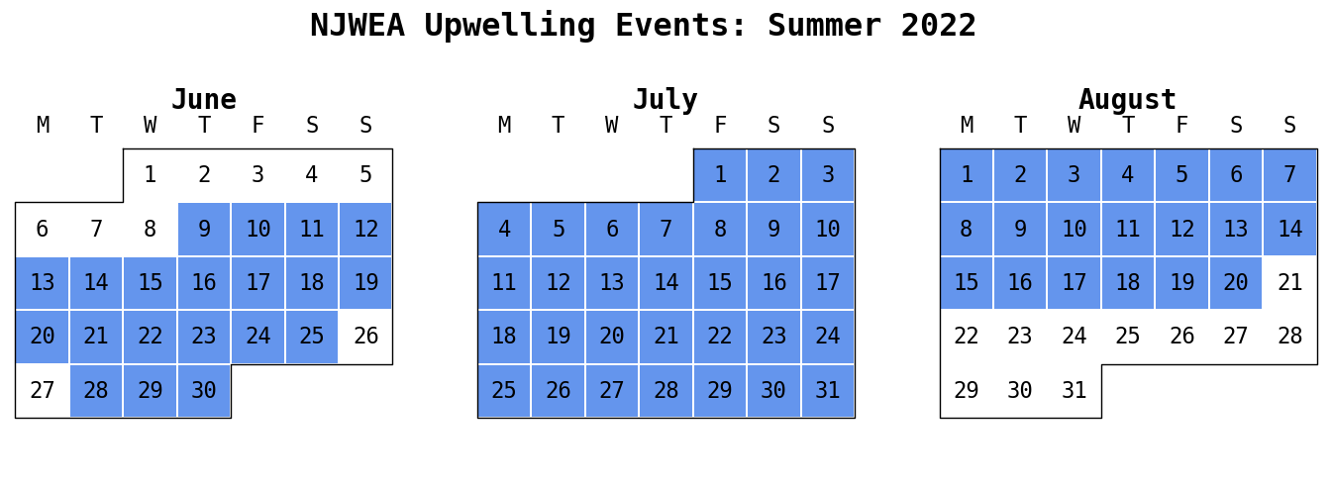
The Cold Pool is not a static feature: Coastal Upwelling/Downwelling
50/92 = 54%
39/92 = 42%
71/92 = 77%
Notes:
happens all the time

Slide 8
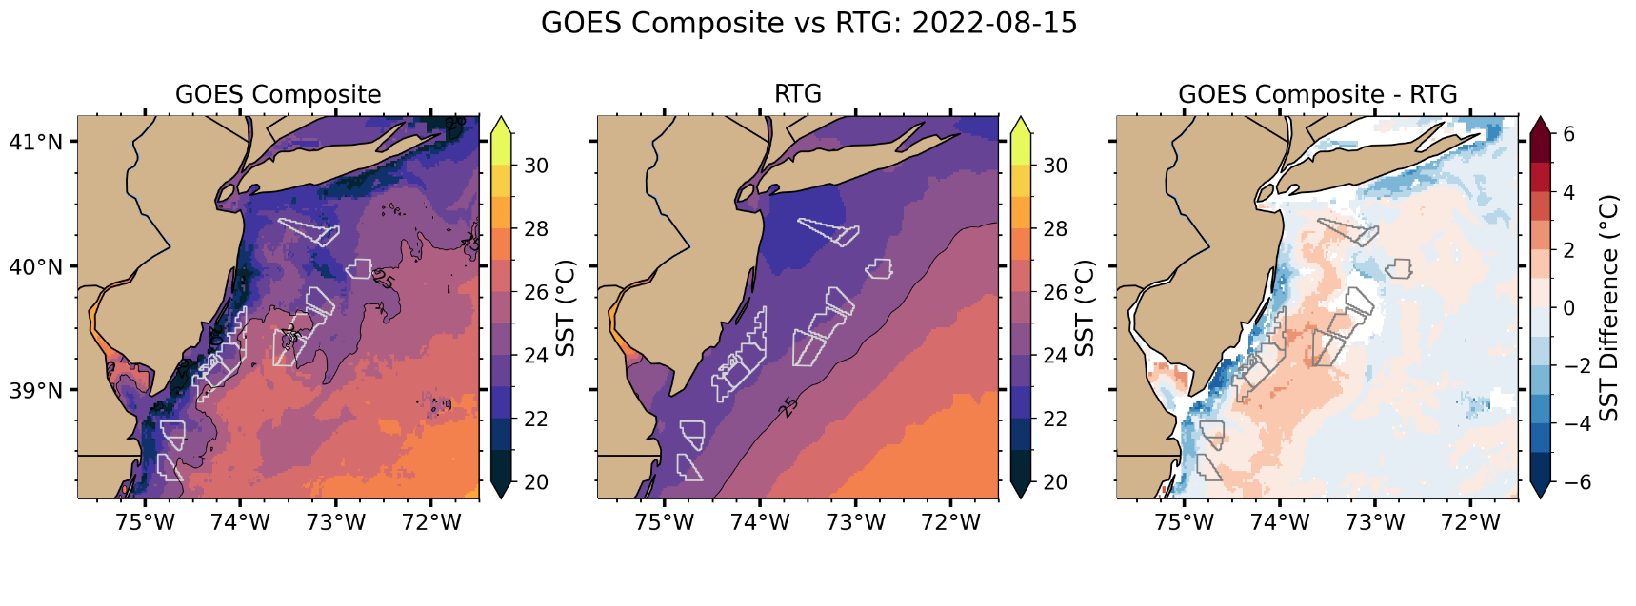
Sea Surface Temperature Satellite Products: They are not the same!
SST Image we use in RUWRF
Typical SST Image in
National Models
Difference
Example from August 15, 2022
Notes:
national satellite products to not get the upwelling

Slide 9
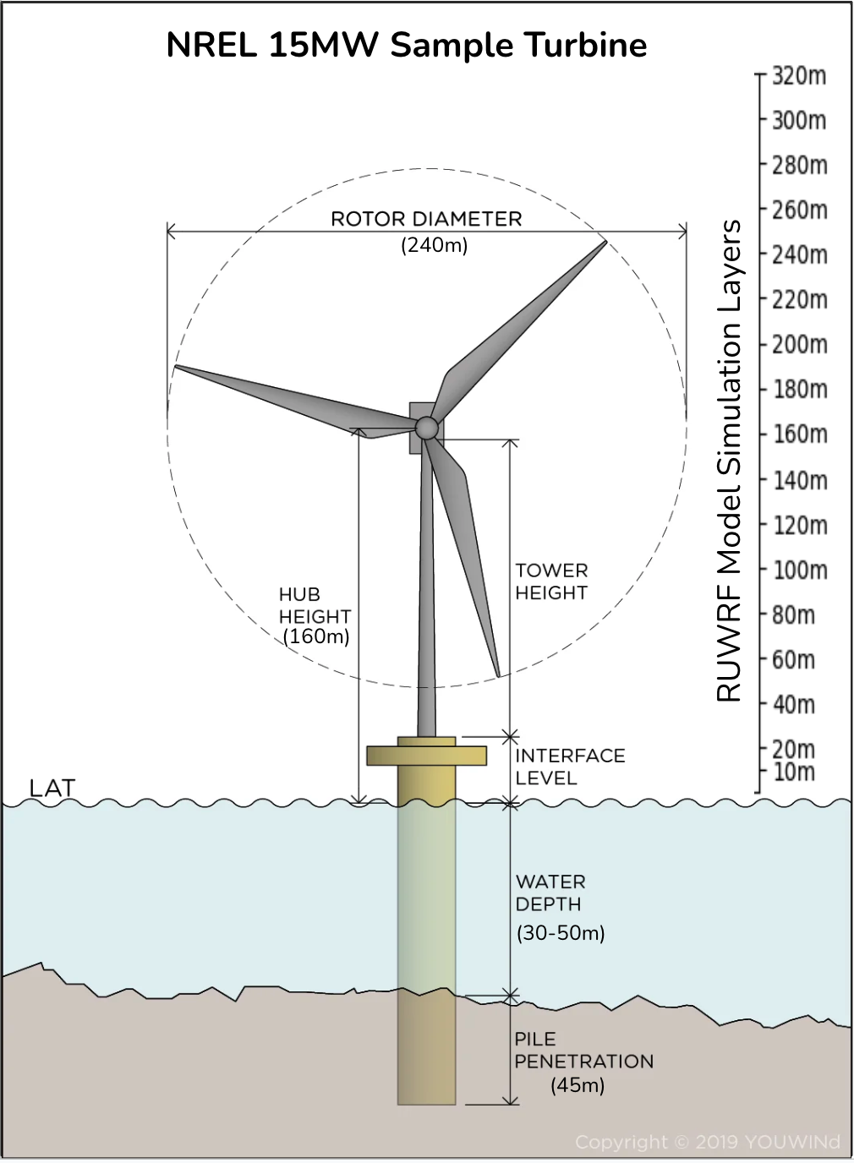
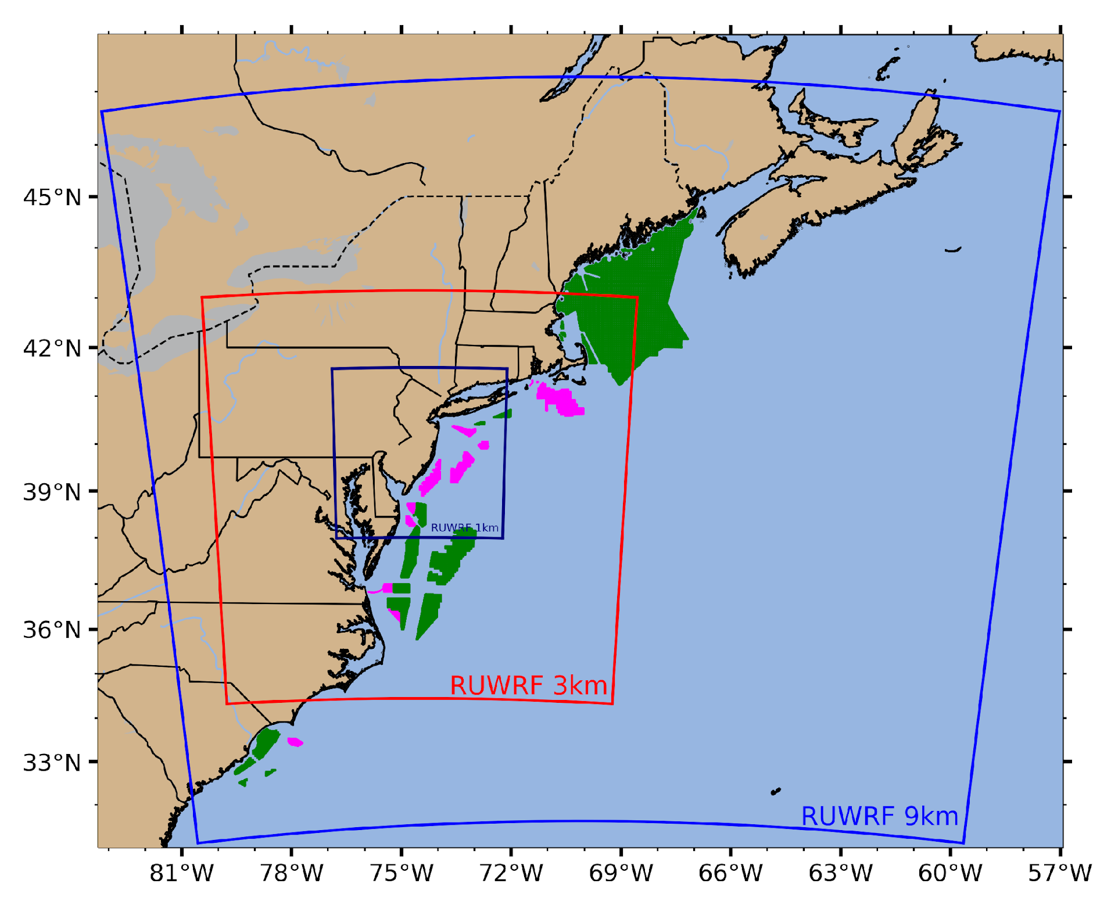
Simulating the Mid Atlantic Wind Resource
RUWRF V2: 4 years of model simulations

Slide 10
Simulating the Mid Atlantic Wind Resource RUWRF V2: 4 years of model simulations
Pre-made data product examples:
Seasonal, monthly, and annual wind roses and power (15MW curve) roses.
Seasonal wind and power production heatmaps
Seasonal 160m wind and power boxplots (following slides)
All products can generally be re-produced for a range of heights or power curves.
OCS-A 0000
39.4N, 73.8W
Centroids of NY/NJ wind lease areas.

Slide 11
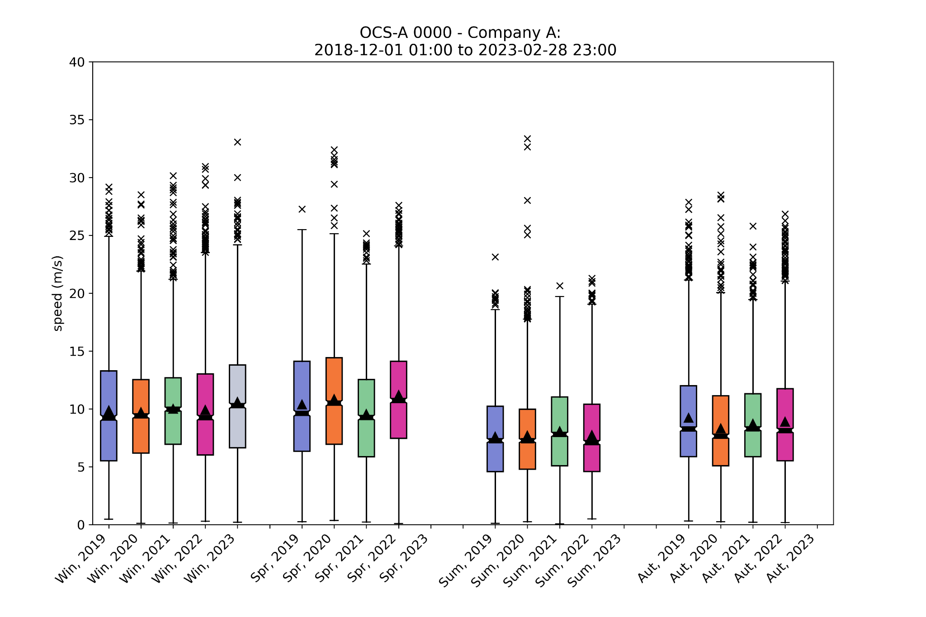
Example Product: 4 Year 160m wind speed
by season at OCS-A 0000
OCS-A 0000
Notes:
Wind speed, power, and capacity factor distributions over time for 160m winds at centroid of inshore Ocean Wind LLC lease area.
Boxplots:
Box includes interquartile range (IQR, lower limit 25th percentile, upper limit 75th percentile, horizontal bar at median)
Triangle at mean
Bars extending from box = 1.5*IQR or to min/max)
X’s indicate outliers outside 25th percentile – 1.5*IQR or 75th percentile + 1.5*IQR
Heatmaps:
Binned to approximately weekly, with darker shades of red indicating increased data density
Cells where data density exceeds the maximum in the reds colormap are marked with a shaded blue circle underneath a pale blue dot. The diameter of the shaded circle compared to the pale blue dot indicates how far the maximum has been exceeded (ie blue circle 2x larger than pale dot indicates a cell containing twice as much data as the darkest red).

Slide 12
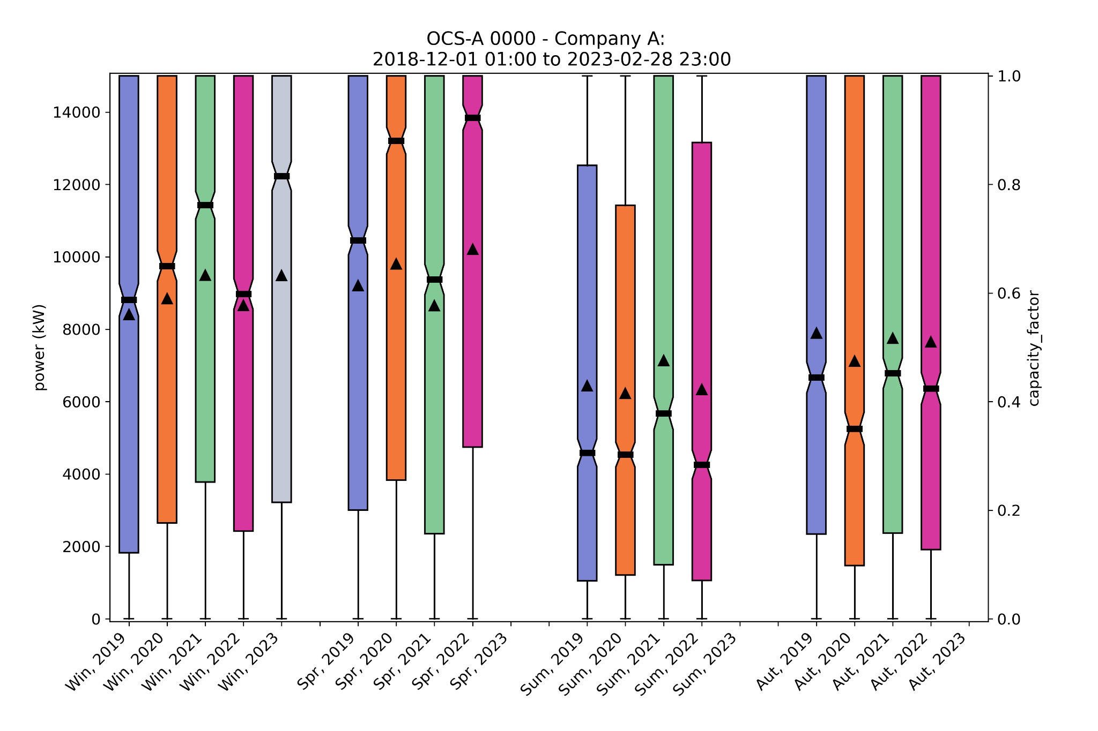
Example Product: 4 Year Power Production (15MW, curve only)
by season at OCS-A 0000
OCS-A 0000
Notes:
Summer has the least power availability, making the upwelling and sea breeze studies critical to estimations.

Slide 13
Available to you:
Four years of hourly 3D atmospheric data is available at 3km & 9km resolution and across (and beyond) wind turbine swept heights.
Download the products
https://drive.google.com/drive/folders/18eIBWkqciH_JVhZjjmZR9rpEKPsf8UIZ
Download the data
https://tds.marine.rutgers.edu/thredds/cool/ruwrf/catalog.html
Github Guidance
https://github.com/rucool/wind-energy-tutorials
Reach out to our team for additional questions
RUCOOL Software team
Notes:
Wind turbine hub height

Slide 14
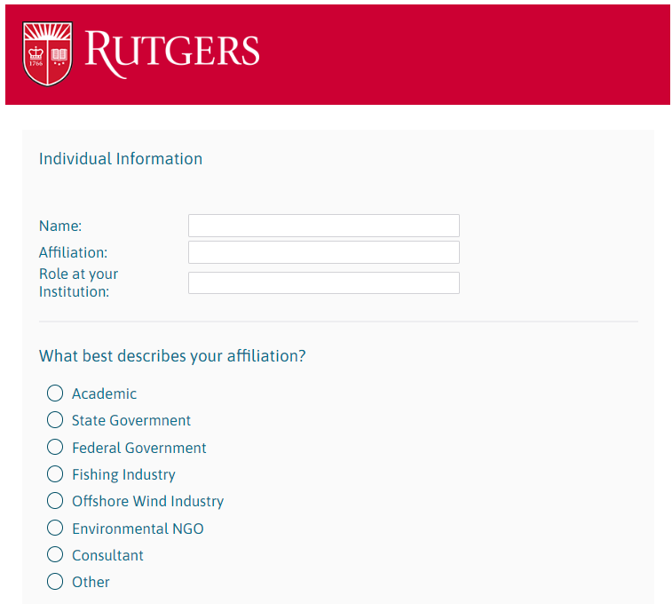
Survey this week: Looking for YOUR input
Importance of specific model outputs
Spatial scales of interest
Applicability of numerous wind resource products
Data formats
Case Studies:
Wind turbine wakes and power
With and without upwelling (shear and turbulence)
Additional wind farm configurations (spatial and/or turbine parameterization)
Short experimental runs focused on specific processes
Sea breeze studies and impacts

Slide 15
RUWRF Modeling Experiment:
The impact of sea surface temperature on wind power production
Standard SST
Rutgers SST
Cold SST
(RUCOOL product)
Warm SST
(similar to national products)

Slide 16
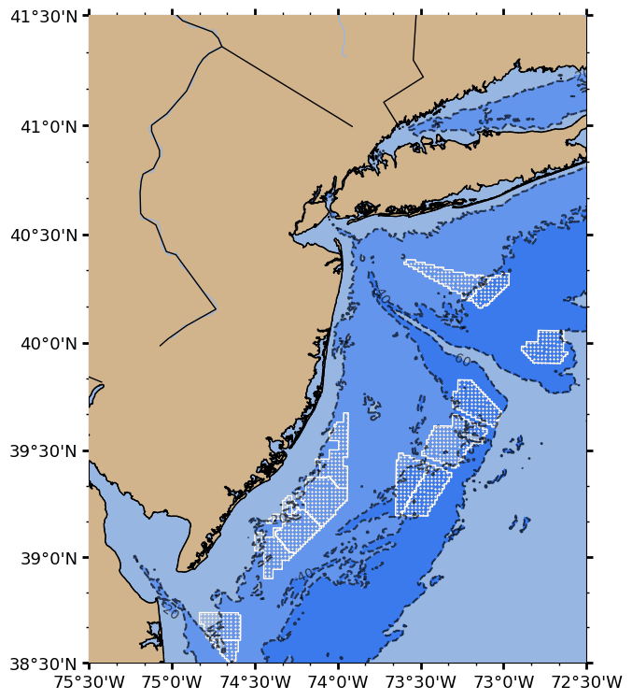
Potential Product:
Idealized Wind Turbine Simulations
15 MW, Fitch
2km turbine spacing
1126 turbines

Slide 17
POC Mike Crowley: crowley@marine.rutgers.edu, 848-932-3287
offshorewind@marine.rutgers.edu
Come by for a visit to RUCOOL: 71 Dudley Road, New Brunswick, NJ 08648 - 848-932-6555
https://rucool.marine.rutgers.edu/research/offshore-wind/

Slide 18
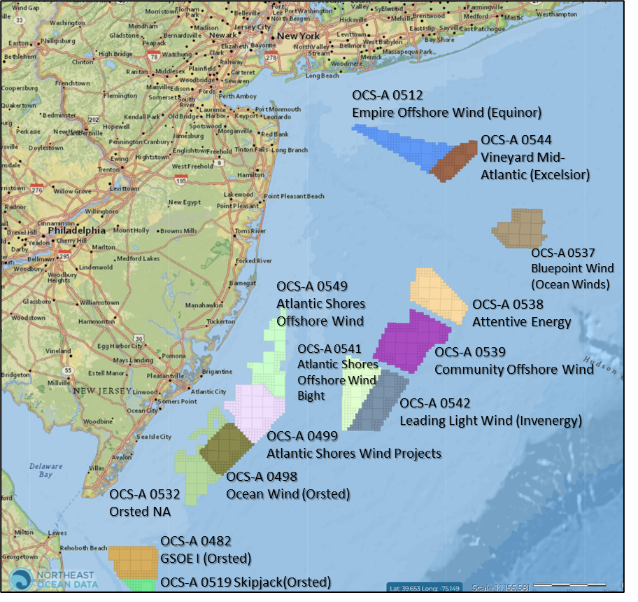
Notes:
we know the ocean between you and PJM

