Slide 1
Implementation of Near Real-Time Onboard Processing Software for a Slocum Glider Acoustic Doppler Current Profiler
Julia Engdahl¹, Joseph Gradone¹, Zachary Silva², David Aragon¹, Nikitha Shivakumar³, Travis Miles¹
¹Center for Ocean Observing Leadership (COOL), Rutgers University
²Teledyne Webb Research
³Georgia Institute of Technology
Notes:
Good afternoon, everyone. My name is Julia Engdahl, and I am a programmer/data analyst at Rutgers University Center for Ocean Observing Leadership. In this talk, I am going to share the continued development of THE near real-time onboard processing scheme for an acoustic doppler current profiler integrated into a Slocum glider.

Slide 2
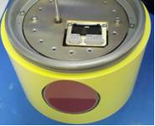
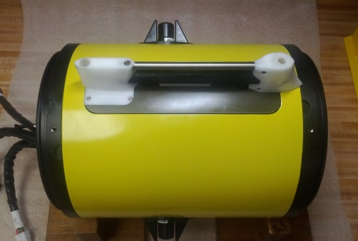
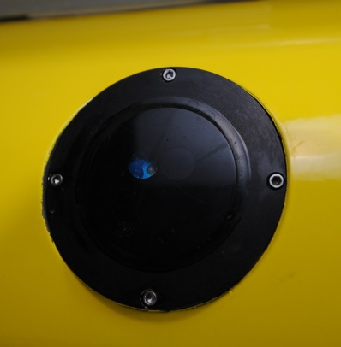
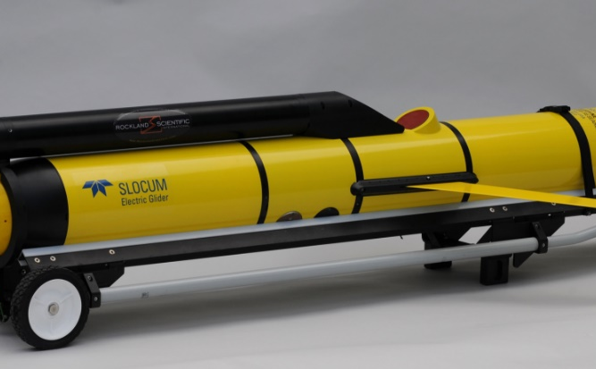
Motivation: Data Collection
Advancements of complex sensors and software being integrated into autonomous underwater vehicles (AUVs)
Notes:
-Tech advancements & complex sensors
-BSD = moreee
-what
Data collection has substantially increased due to sensor and battery technology enhancements over the last two decades which have allowed for the integration of complex sensors such as adcps, multi-frequency echo sounders, passive acoustics , turbulence among many more
In addition to sensor & battery development, software capabilities such as backseat driver have been added to the recipe of efficient data collection.
Now that we have all of this data, what do we do?

Slide 3
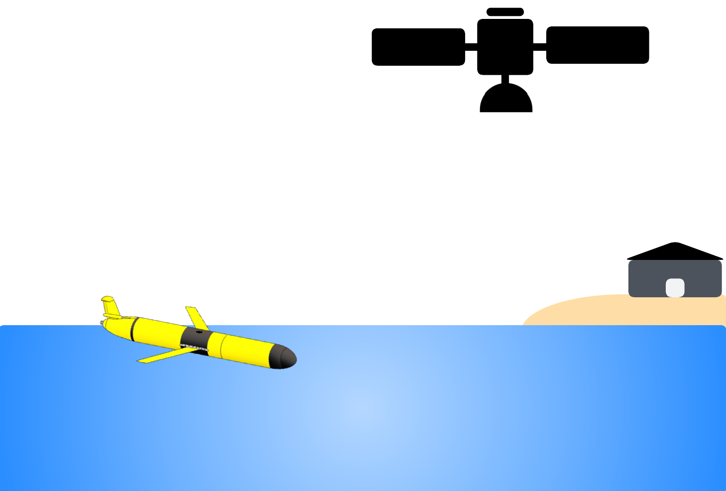
Motivation: Transmission
Large data files cannot be efficiently telemetered to shore in real-time, leaving it untouched until post recovery
Notes:
-Get off
-Unfortunately
-Costly
-Retrieval Post recovery adds to costliness
We want to get it off the vehicle, of course!
Unfortunately, because more data means larger file sizes, file transmission onshore becomes less efficient.
If we were to transfer large data file in real-time, it would be costly in the regards to money for iridium and time at the surface where the vehicle runs the risk of being hit
Ultimately, this pushes data retrieval to post recovery, which adds to the costliness as it can lead to loss of data in the event of vehicle loss or missions where retrieval is not permissible

Slide 4
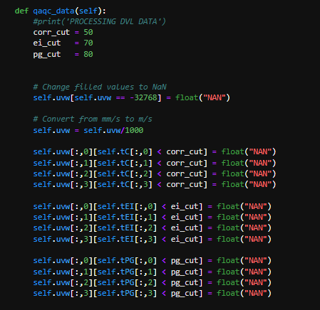
Motivation: Processing
Processing is confined to post recovery
Existing schemes are proprietary
Limitations to real-time applications
Notes:
-Complex infrastructure
-Raw data AFTER
-RTP important
-proprietary
We have built such a complex infrastructure for collecting data,
only to receive RAW data AFTER the vehicle has been recovered and THEN it can be processed, which is not conducive for real-time applications like
operational hurricane forecasting, marine mammal detection, & water quality monitoring
Real-time data processing software is increasingly becoming more important because it can aid in management and scientific applications by increasing data accuracy, preventing data loss, and allowing for adaptive surveys
A few sensors have developed processing schemes, but they are proprietary to their systems, limited to their internal
processing capabilities, and are not easily modifiable..

Slide 5
Key Points
Large datasets and files
Inefficient data transmission
Data access and processing is limited to post recovery
Notes:
-Perfectly imperfect
-Need more
-Framework conducive
All in all, we have this perfectly imperfect infrastructure for collecting more data
but we need something more to handle large file sizes, inefficient data transmission, & data access and processing being limited to post recovery .
We need a framework that is conducive to real-time processing and transmission of large datasets.

Slide 6
Solution
Software:
Backseat Driver
External Controller Script (Python)
Hardware:
Teledyne Webb Research Slocum Glider
Teledyne RD Instruments Pathfinder Acoustic Doppler Current Profiler (ADCP)
External Processor (Raspberry Pi 4 Model B)
Notes:
-how to exceed
-dev sensor agnostic RTP software and hardware architecture
-using BSD and extctl
-BSD currently used for adaptive mission control.. Does use processing but still raw
-Instead we are using it for RTP
-hardware glider,adcp,pi
So, how can we exceed those limitations?
By developing a sensor agnostic real-time processing software and hardware architecture. To do this
The software we utilizing is a backseat driver and an external controller script written in python.
backseat driver is currently used to autonomously modify AUV behavior while in mission
While data processing algorithms are utilized to accomplish this,
The resulting data that is transferred to shore still has to undergo shoreside processing post recovery.
Instead, we are utilizing this software to expand real-time data processing capabilities so that the resulting data is already processed.
The hardware of this architecture is a TWR Slocum glider, TRDI Pathfinder ADCP, and a raspberry pi 4 model B

Slide 7
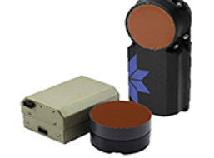
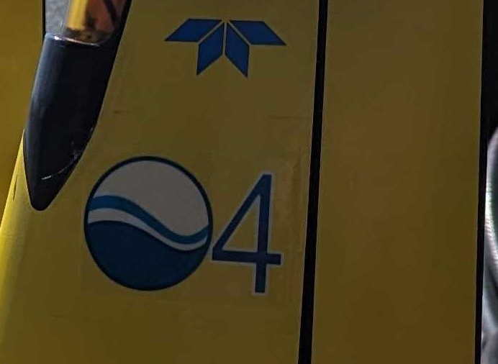
Glider
Notes:
-TWR G3S glider mara04
-sensors
-file format pd0
-3hr segment 1000skb too big
The glider we used is a Teledyne Webb Research Generation 3 Slocum glider named Maracoos04, equipped with the standard sensor loadout:
Seabird CTD, 100m depth rated buoyancy pump, wetlabs 3 channel optical sensor, and a 600kHz TRDI Pathfinder ADCP
I’d like to note here that the output file of the ADCP. The format of the raw data is configured to be PD0, which is Teledyne RDI’s standard binary format.
A PD0 from an approximately 3hour long glider segment, which is time spent underwater between surfacings, result in a file size that is on the order of thousands of kilobytes
Which is far too large to transfer over an iridium connection in a timely and cost-effective manner and can only be retrieved post recovery

Slide 8
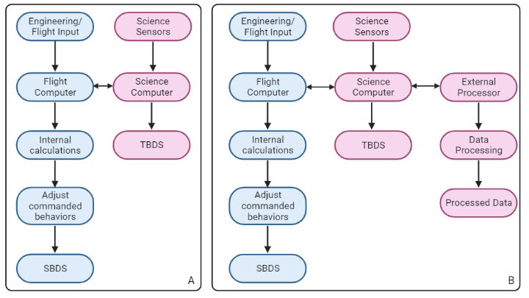
Backseat Driver for Real-Time Processing
Conventional
Backseat Driver for RTP
Notes:
-prior to dev of BSD, no adaptive mission control
-w/o BSD follow panel A
-although flight and sci talk, nothing gets updated
-with BSD, ext processor in sci
-takes flight and sci inputs that get passed to extctl
-extctl processes and spits out nc to be trans
Prior to the development and implementation of the backseat driver, gliders did not have the capability of adaptive mission control.
A glider without backseat driver follows the pathway on the left in panel A.
engineering and flight specifications manually defined by the pilot are read into the flight computer -> it does its internal calculations -> adjusts commanded behaviors -> creates decimated file
Simultaneously, the science sensors sample based on the pilot’s inputs -> send data to science -> creates decimated file
Although the flight and science computers are communicating throughout the duration of the mission, the engineering and flight inputs cannot be dynamically updated.
These inputs have to be manually updated by pilots when the glider reaches the surface and establishes communications over iridium/freewave
Gliders equipped with backseat driver follow the same flight and science pathways as panel A with an additional external processor integrated into the science computer shown in panel B
This external processor can receive engineering and science sensor that enables the system to adaptively update mission parameters.
This data is then passed to the external controller, which runs an open-source python processing algorithm
and saves the output to a netCDF file that is able to be efficiently telemetered to shore

Slide 9
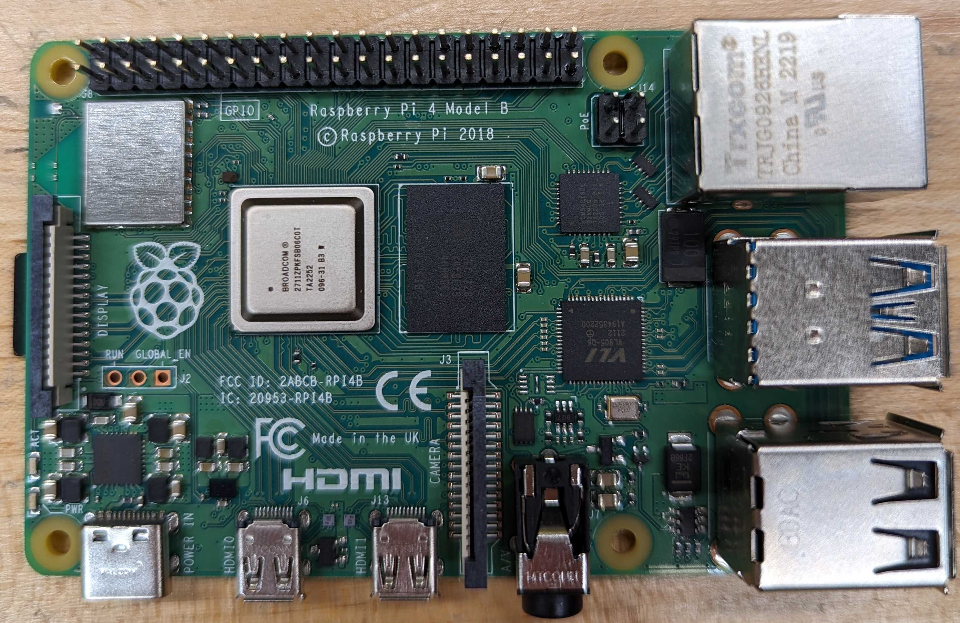
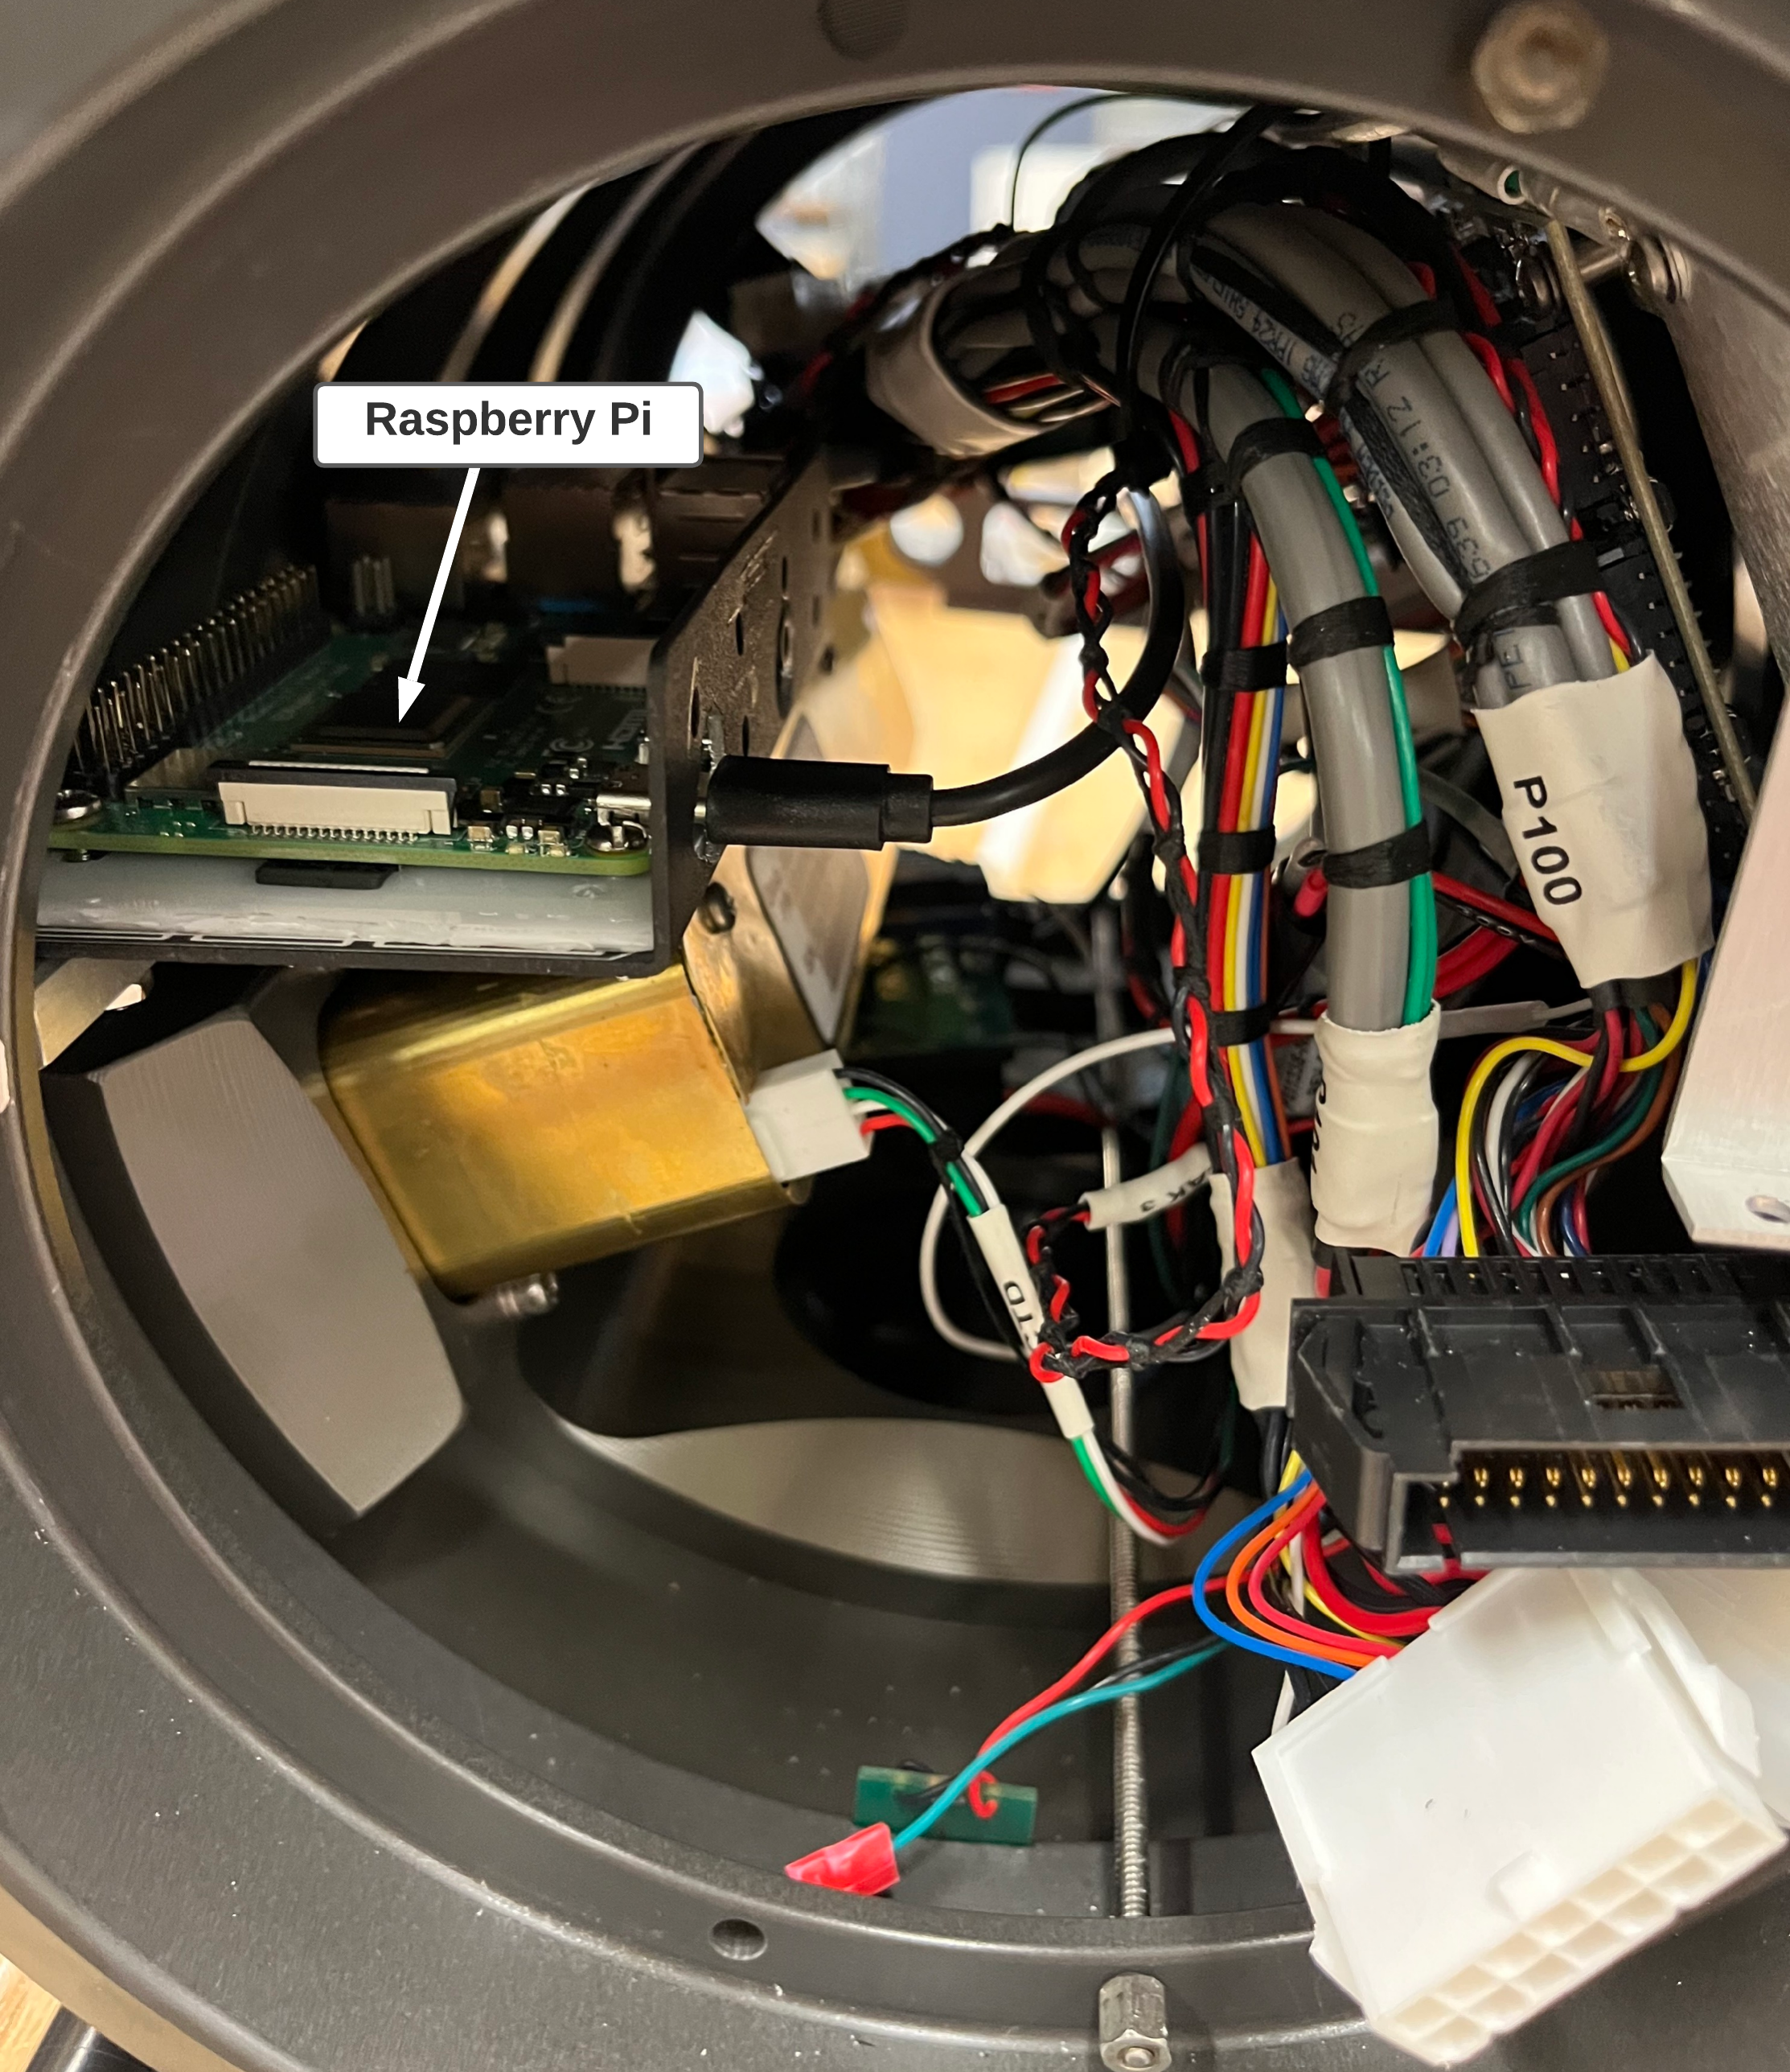
Backseat Driver: External Processor Hardware
Notes:
-pi 4 model b
-sufficient computation for RTP
-takes up limited space in payload
-integrated into sci usb2ser
-BSD recognizes thru proglet like another sensor
We are utilizing a Raspberry Pi 4 Model B because it has both sufficient computational power to execute real-time data processing and takes up minimal space within the payload as you can see in the bottom right image.
The Raspberry Pi is integrated into the science computer using the USB to Serial connector.
The backseat driver recognizes the external processor through the proglet as if it were another sensor,

Slide 10
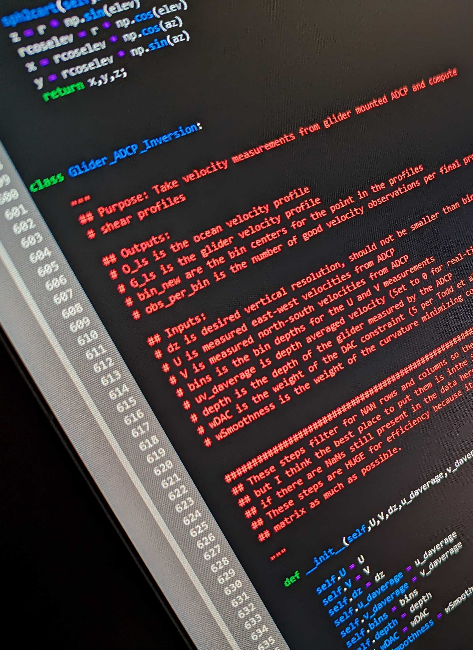
Backseat Driver: External Controller Software
Notes:
-extctl comm with sci thru BSD
-subscribe state params enable extctl to process them
-modify & update params back to glider
-to facilitate near RTP (next)
The external controller software is able to communicate with the glider’s science computer through the backseat driver
This software is able to subscribe state parameters to the backseat driver which enables the subscribed parameter to be processed by an external controller.
which can both modify and update the result back to the glider to update desired parameters.
In order to facilitate near real-time data transfer (NEXT SLIDE)

Slide 11
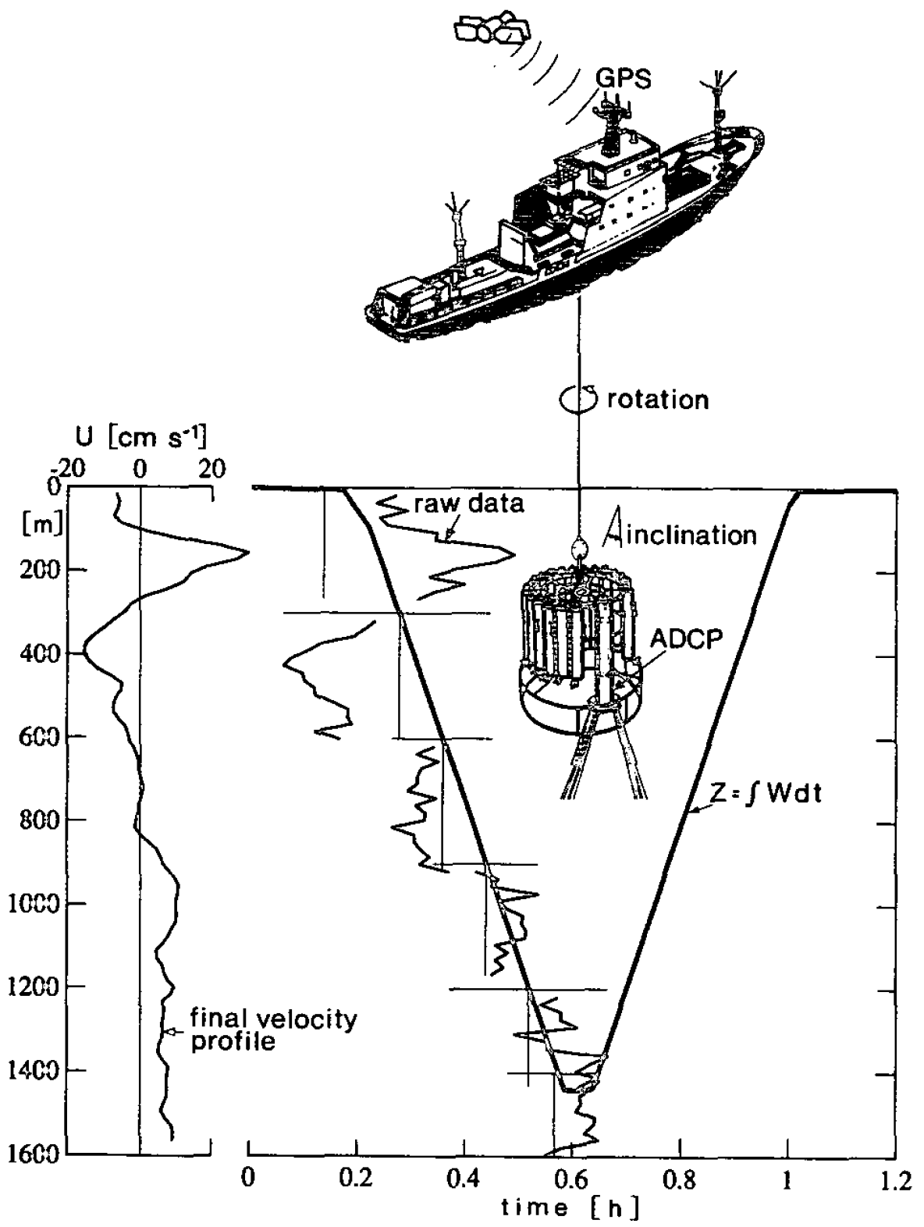
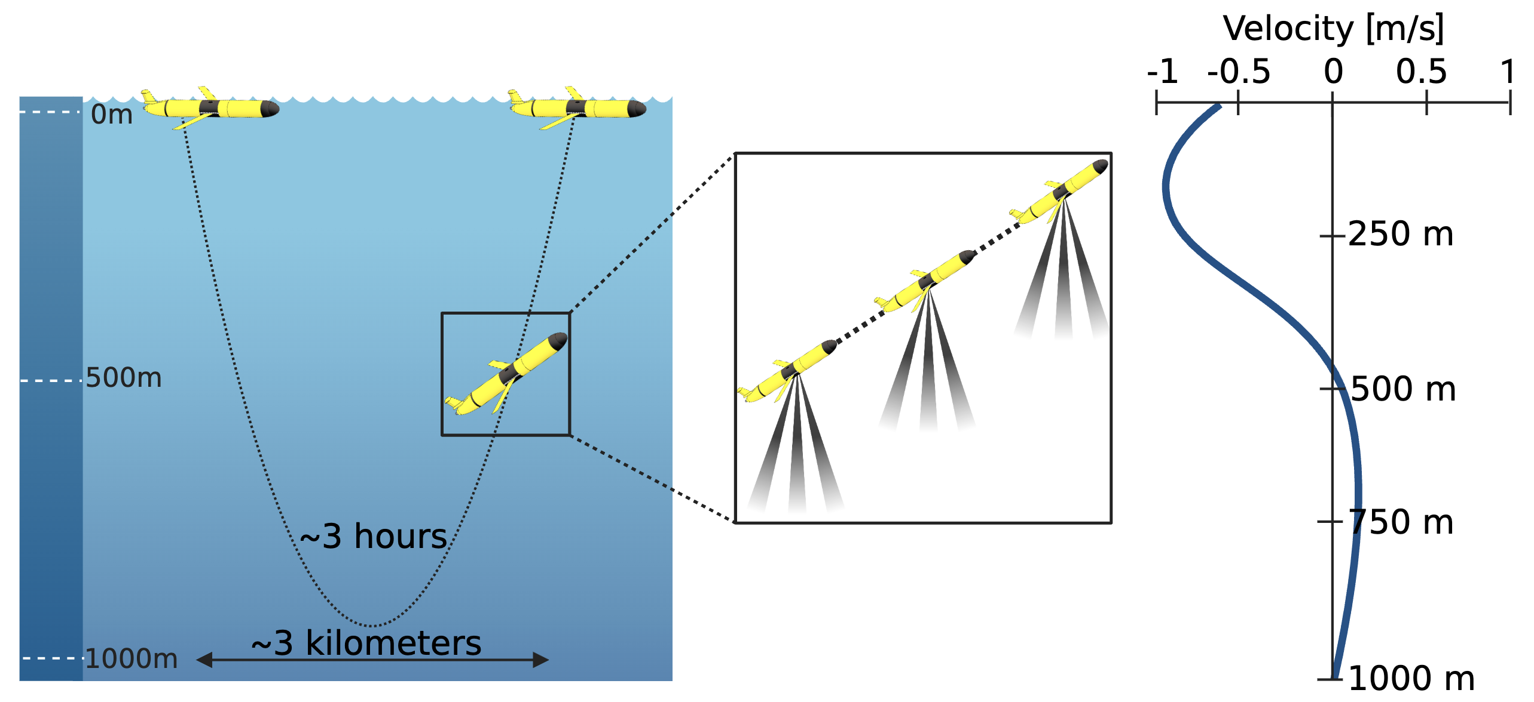
Least Squares Linear Inversion
$$U_{adcp}= U_{ocean}+ U_{CTD} + U_{noise}$$
$$U_{adcp}= U_{ocean}+ U_{Glider} + U_{noise}$$
Glider based linear inversion code can be found here: https://github.com/JGradone/Glider_ADCP_Real_Time_Processing
Visbeck et al. 2002
Notes:
-dev modified extctl using QC and LSLI
-first used for ships then gliders
-diff is uctd now uglider
-update dz in mission
-github
we have developed a modified version that uses standard quality control methods
that is input into the least squares linear inversion commonly used for ship-based lowered ADCPs applied to glider-based observations.
The only difference here is that the velocity of CTD (Uctd) from the ship-based application is the velocity of the glider (Uglider) in our glider based application.
Our linear inversion code can be found on github

Slide 12
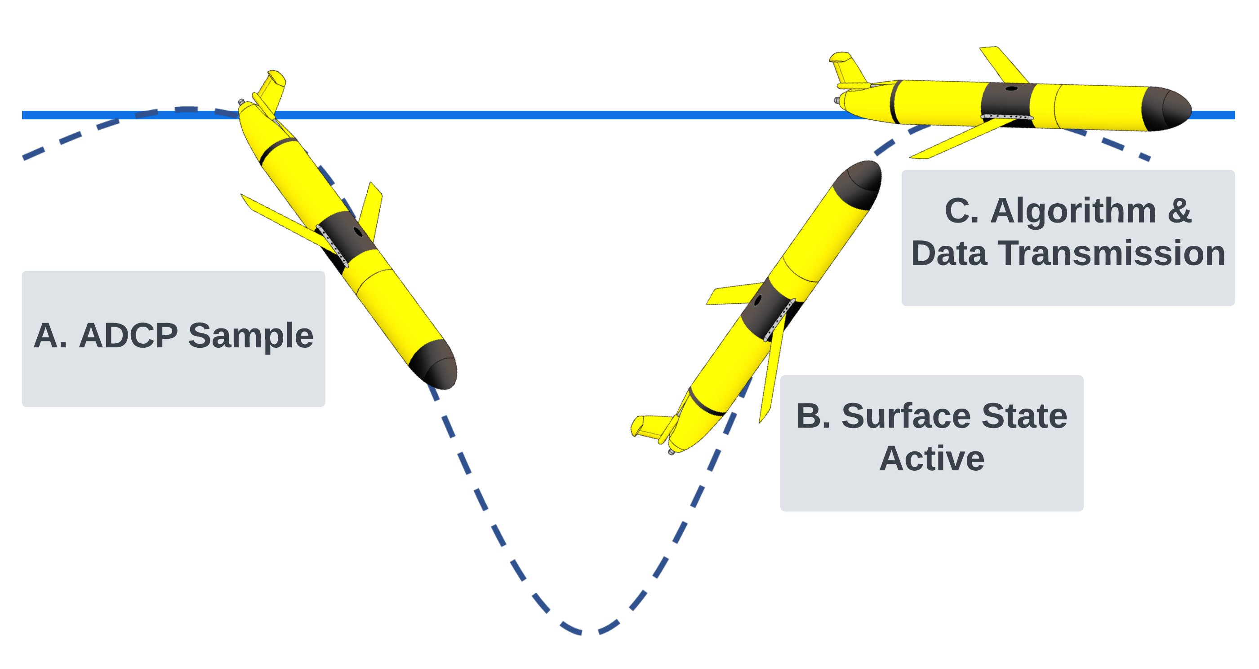
Workflow
1) ADCP is told to stop sampling: c_dvl_on = -1
2) Glider is physically at the surface: m_depth < u_reqd_depth_at_surface
3) Glider’s state changes to be at the surface:
cc_final_behavior_state = 5
Notes:
How will this all work?
Limit time at surface, dev precise triggers to init rtp as quickly as possible within lims of glider surface time
A dive and climbs
B redundant triggers due to idiosyncrasies
C once all 3 are satisfied – inversion – nc – transfer
Because it is important to limit the time the glider spends at the surface processing and transmitting data, we are developing precise software triggers to enable the glider to initiate the real-time processing workflow as quickly as possible
Within the limits of the glider’s surface behavior time
The ADCP will be sampling on dives and climbs
The active surface state will close the .PD0 file
Due to idiosyncrasies of the glider software, we have designed the external controller to start based on the following triggers:
ADCP is told to stop sampling (c_dvl_on = -1).
2) Glider is physically at the surface (m_depth < u_reqd_depth_at_surface) , which we have set u_reqd_depth_at_surface to 4 so that the triggers are satisfied as the glider physically approaches the surface
3) Glider’s state changes to be at the surface, and the ADCP is no longer sampling (cc_final_behavior_state = 5)
C) once all 3 are satisfied,
The external controller script sends the .PD0 from the science computer to the Raspberry Pi and executes the onboard processing linear inversion algorithm and the resulting velocity profile is exported into a netCDF
that is then sent from the raspberry pi to the glider science computer to be efficiently transferred to shore in near real-time

Slide 13
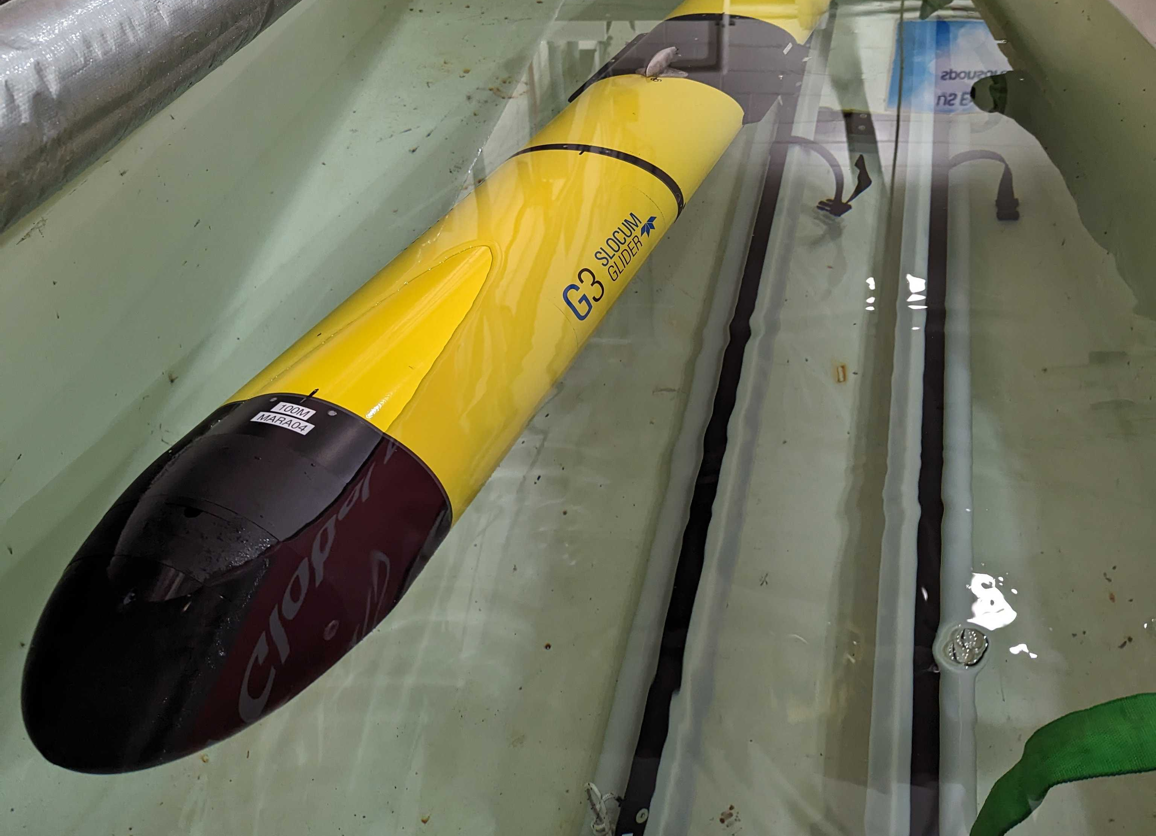
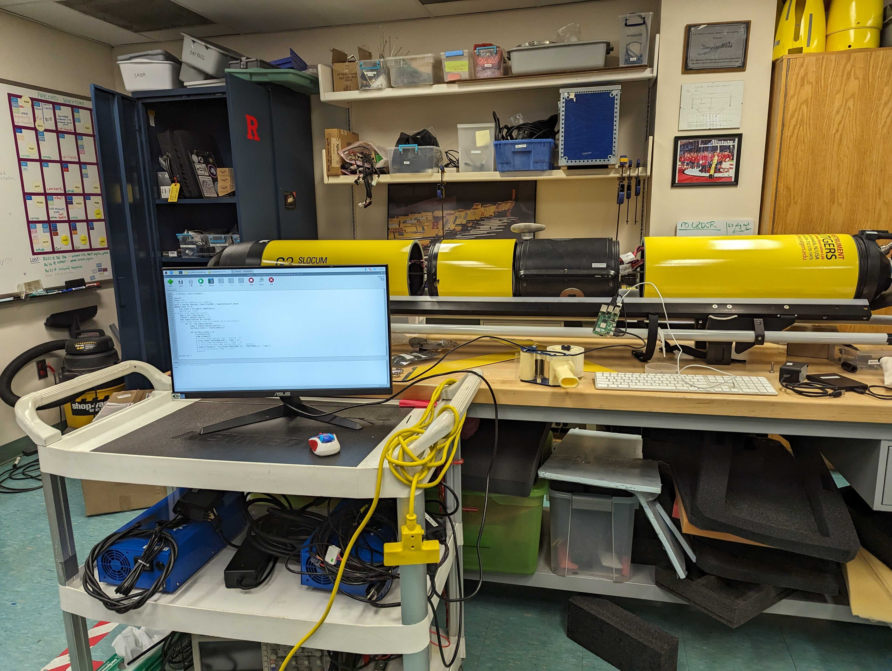
Simulation
Simulation Processing and Transfer Time of a PD0
 | Linear Inversion | File Transfer
Minimum | 0.642 sec | <1 min
Average | 17.116 sec | 1.5 min
Maximum | 28.17 sec | 2 min
The average netCDF file size is on the order of 10 KB
Notes:
-to test workflow sim on bench & tank
-on bench 125 files, 30m/1000m, 4MB avg 17s, nc 10skb
-subset for file transfer 115200 2.5hrs 230400 1.5min
-sim in tank to get PD0 size 2hr 100m seg = 1.18MB <2min trans
To test our workflow, we simulated on bench and in the ballast tank.
When on bench, we tested how long the data processing algorithm (inversion) would take. On 125 ADCP data files that were a mixture of 30m and 1000m max depth, it took an average of 17 seconds
The files tested were approximately 4 megabytes each that were reduced to netcdfs that were around 10 kilobytes
Then we tested a smaller subset of these files to see how long the file transfer from the glider to the pi took by manually putting .PD0 files on the glider, and depending on file size it ranged from less than 1 minute to 2 minutes once we set the baudrate to be 230400
Before this, a 2MB file took around 2.5 hours to transfer from the glider to the pi using a baudrate of 115200
Additionally, we tested the entire workflow by simulating in the tank with the ADCP sampling to obtain how large a .PD0 file would be for a 2 hour long segment going down to roughly 100m, which resulted in 1.18 MB file and was a sub 2 minute file transfer
The netCDF that gets transferred back to the glider is on the order of 10s of kilobytes and is transferred in a matter of seconds.

Slide 14
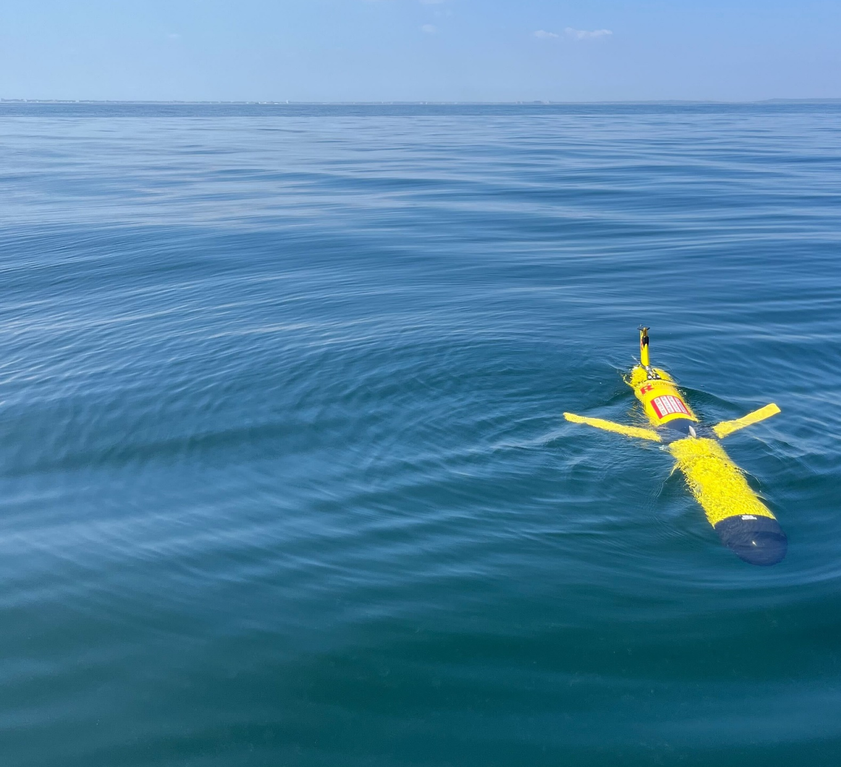
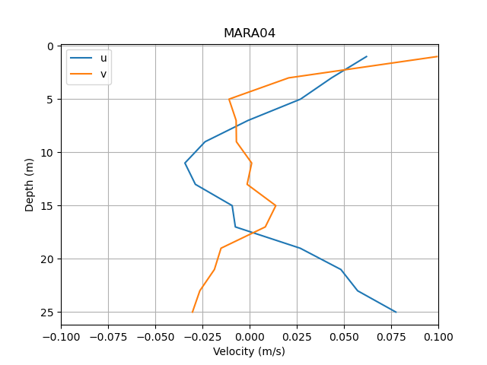
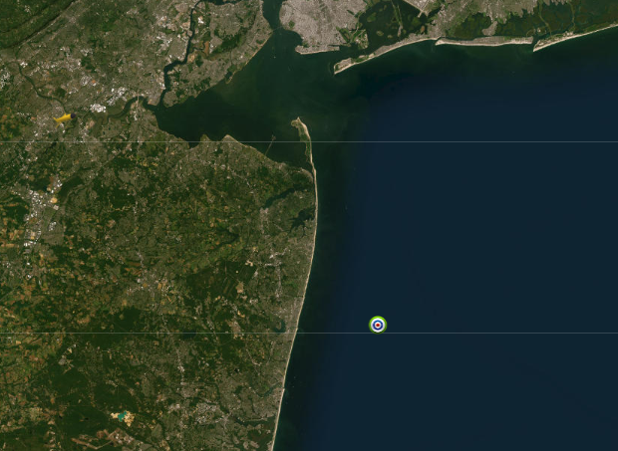
Field Test
Notes:
-first field test dive 10mile off NJ coast, 25m water
-SUCCESS first vel profile in near real-time <3min well within surf behavior
-data consistent with region
-after 1st dive couldn’t test due to (next)
To perform a test dive in the field, we went about 10 miles offshore in roughly 25 meters of water
Our first dive was a success! We were able to successfully receive an absolute velocity profile (pictured in the upper right corner) in near real-time in under 3 minutes! Which is well within a typical glider surface time so it won’t disrupt the normal data flow
Given our knowledge of the area, the data collected is consistent with the region
After this first successful dive, we were unable to conduct more testing because… (NEXT SLIDE)

Slide 15
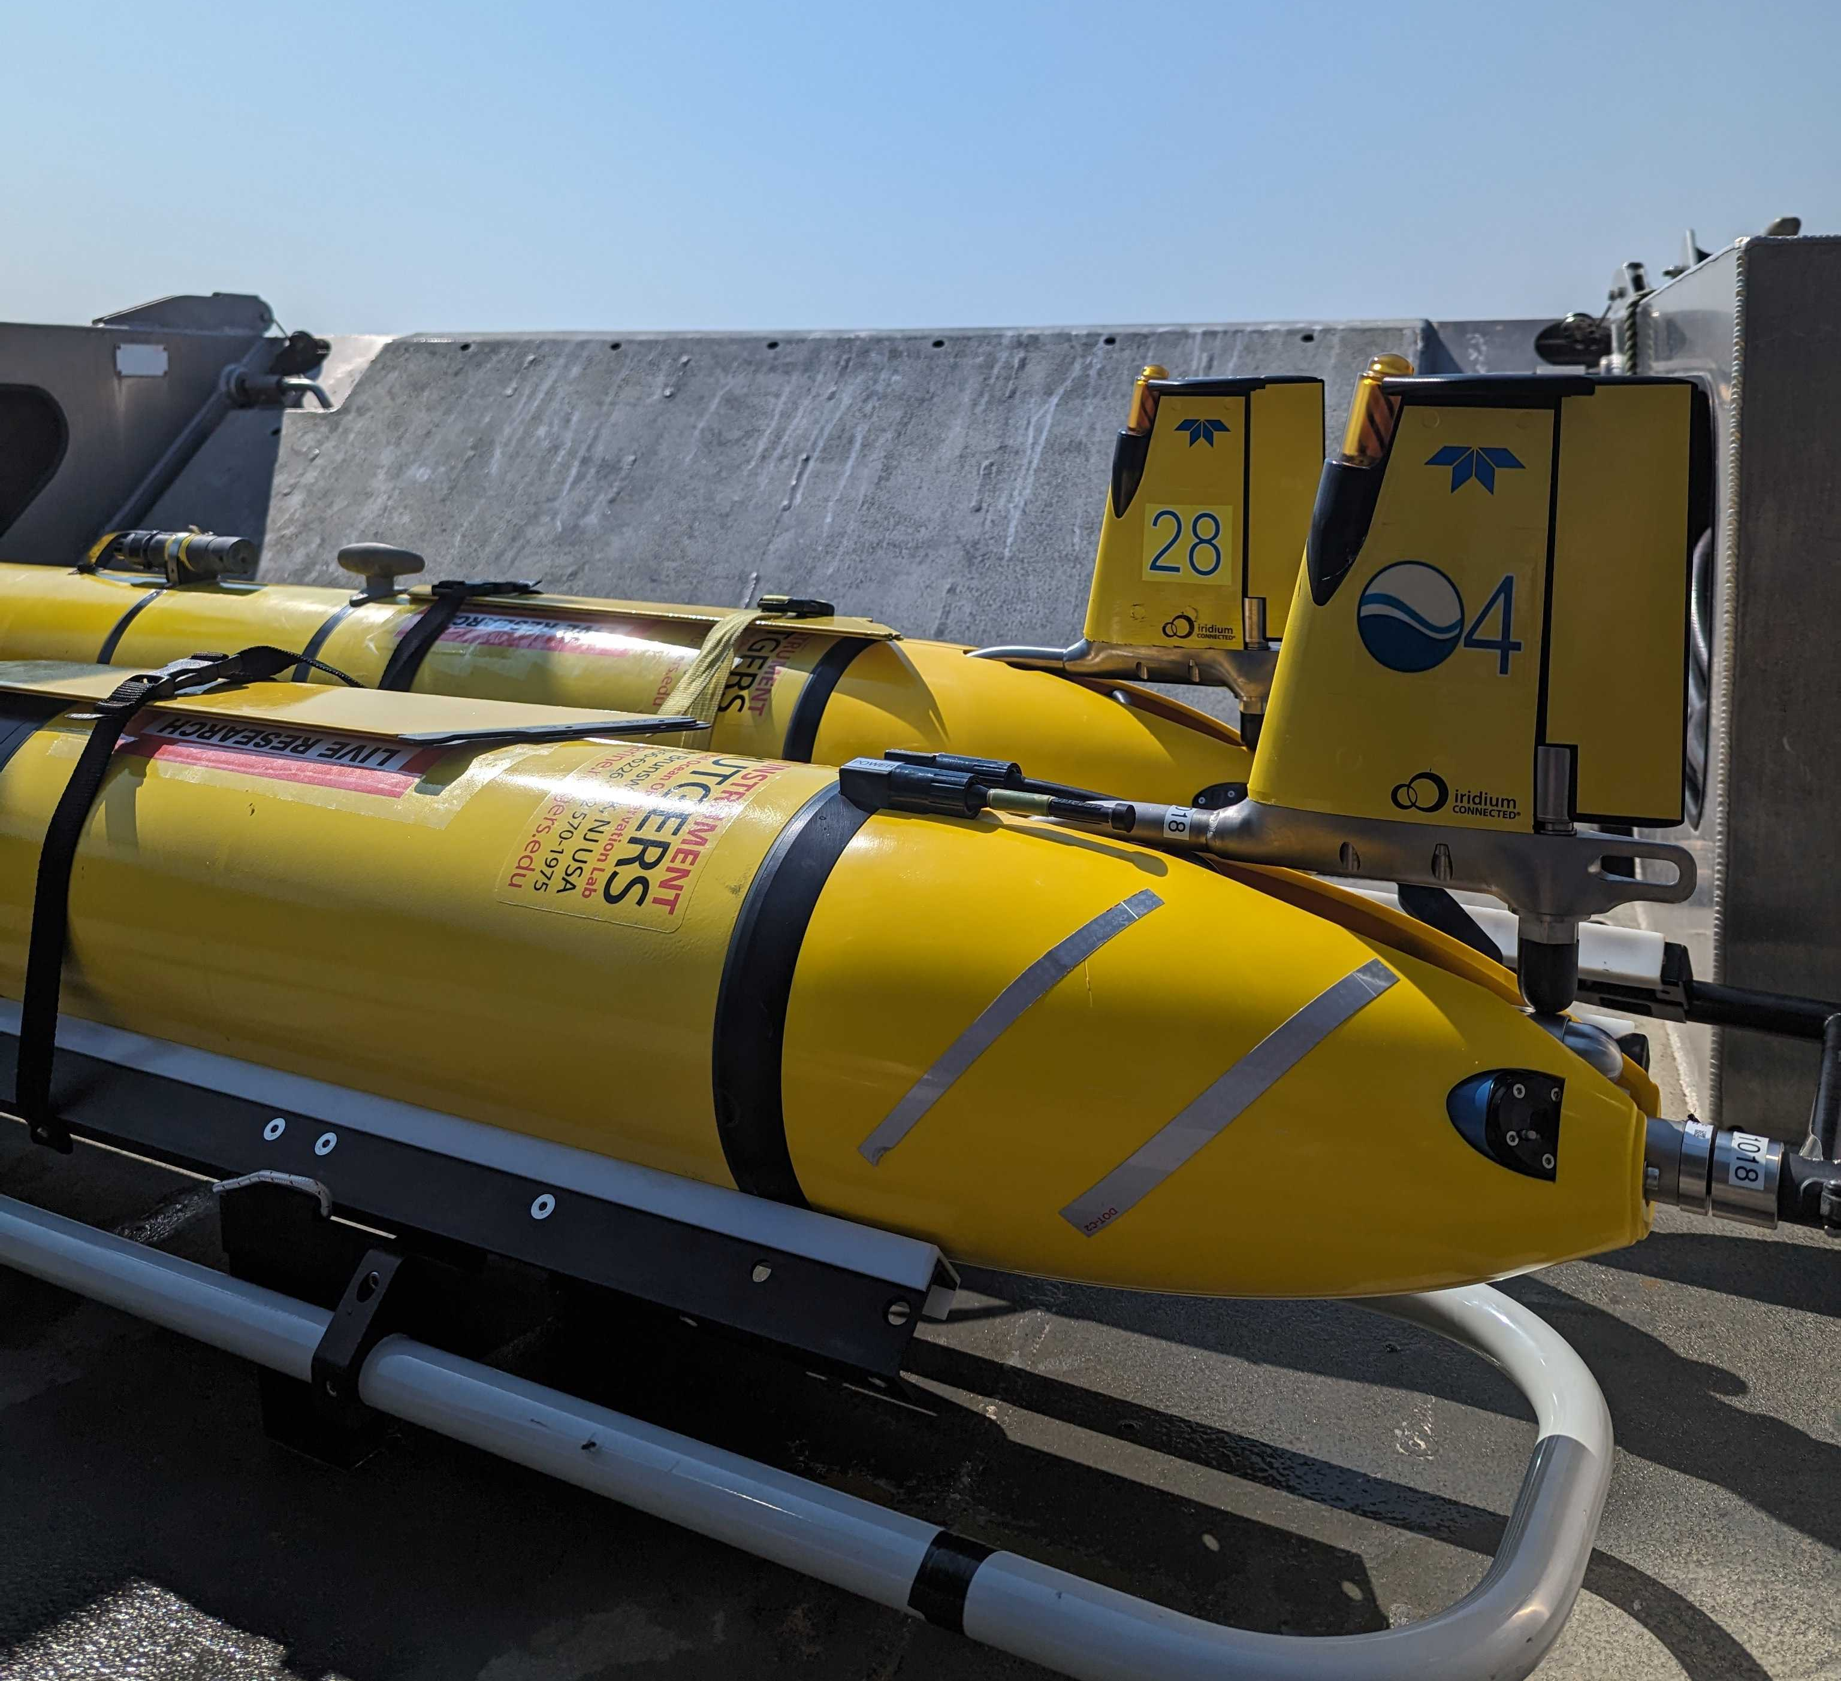
Next Steps
Work with Teledyne to troubleshoot:
Internal DVL filename issue
Comm port getting clogged
Additional tests:
Power Draw
Optimal file size for Iridium satellite transfer
Overall computation time
Long-term deployment
Notes:
We ran into a couple of issues that we are working with Teledyne to troubleshoot.
After our first dive, we noticed that the DVL was not producing a new file and was either appending to the first or overwriting it, but when we checked the data inside of that file, it was still the same data as the profile I had showed on the previous slide.
Another issue, that might be the result of our baud rate being very high for file transfer, was that we were unable to consci while in mission over freewave and iridium.
Once those issues are resolved, we want to conduct additional tests in simulation and in the field for power draw, optimal file size for iridium satellite transmission, and overall computational time.
After that is all said and done, we would like to put this framework to the test and conduct a long-term deployment.

Slide 16
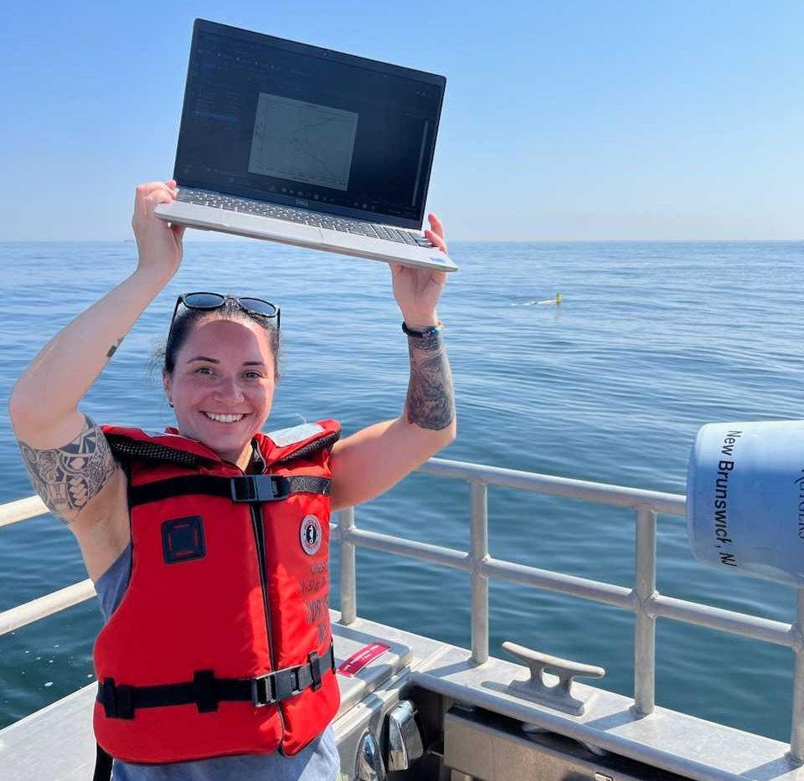
Thank you!
Questions?
Please contact me at engdahl@marine.rutgers.edu
Our linear inversion code can be found here: https://github.com/JGradone/Glider_ADCP_Real_Time_Processing

