Slide 1
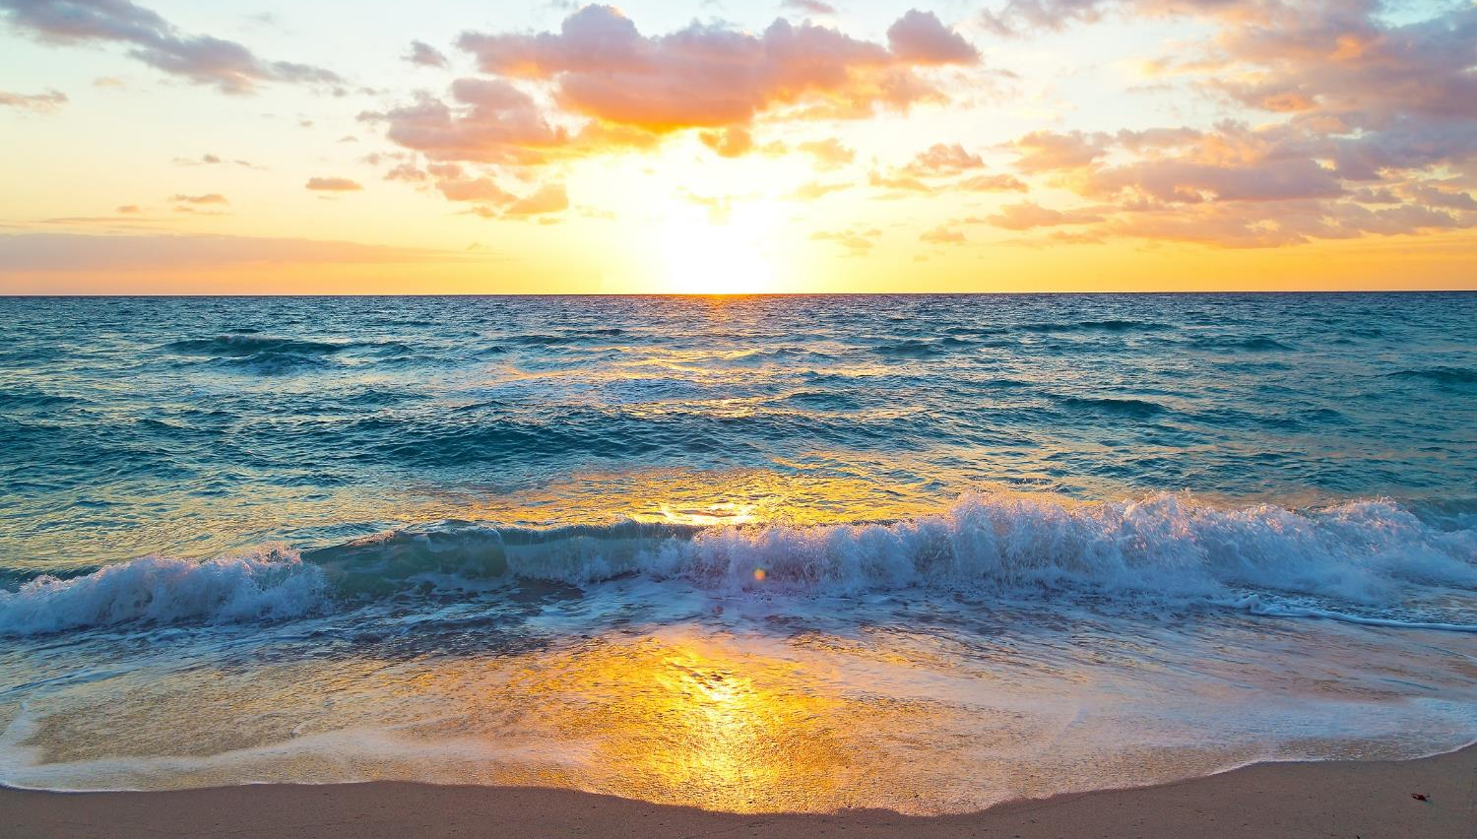
Offshore Wind Experiences On the East Coast
Mike Crowley
RUCOOL & MARACOOS Technical Director
Gerhard Kuska, Motz Grotheus, Doug Zemeckis, Jason Adolf, Keith Dunton, Grace Saba, Josh Kohut, Daphne Munroe, Jason Morson, Kaycee Coleman, Travis Miles, Jake Kritzer
And the dozens of partners on the Ops Teams

Slide 2
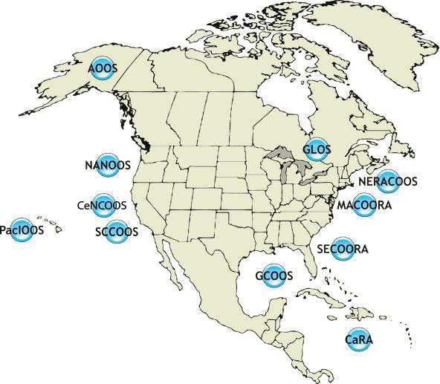
US Integrated Ocean Observing System
AOOS
U.S. Regional Component
GLOS
NANOOS
NERACOOS
CENCOOS
MARACOOS
PACIOOS
SCCOOS
SECOORA
GCOOS
11 Regional Associations
CARICOOS

Slide 3
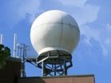
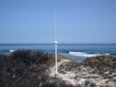
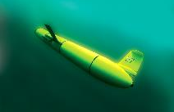
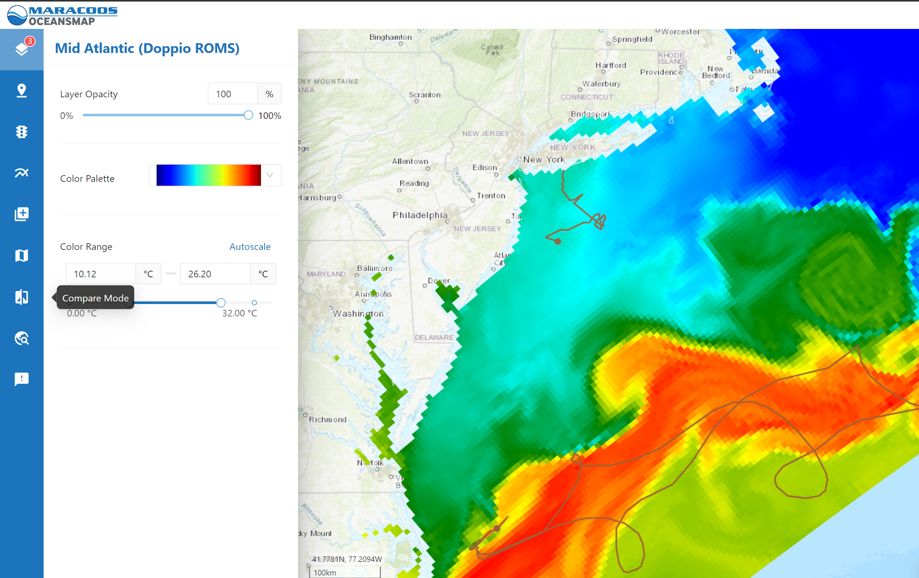
MARACOOS, NERACOOS & RUCOOL Data Acquisition and Management: Lots of toys
NERACOOS Buoys
Satellite Receivers
44+ Site HFR Network
>600 Glider Deployments
Ocean & Atmospheric Modeling
Notes:
3
All of this gets combined into our overall operations, research, and educational initiatives in the “COOL Room,” shown here (with a class in the background)
Thanks to many partners

Slide 4
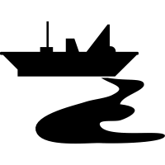
IOOS RA Focus Areas
Navigation Safety
Operations; search-and-rescue;
weather forecasting
Fisheries Management
Stock assessment inputs; survey mitigation
Wildlife Conservation
Detection & avoidance; prediction
NERACOOS
Marine Pollution
Tracking plumes; impact assessment
Climate Tracking
Long-term signals; disentangling climate & OSW impacts
MARACOOS

Slide 5
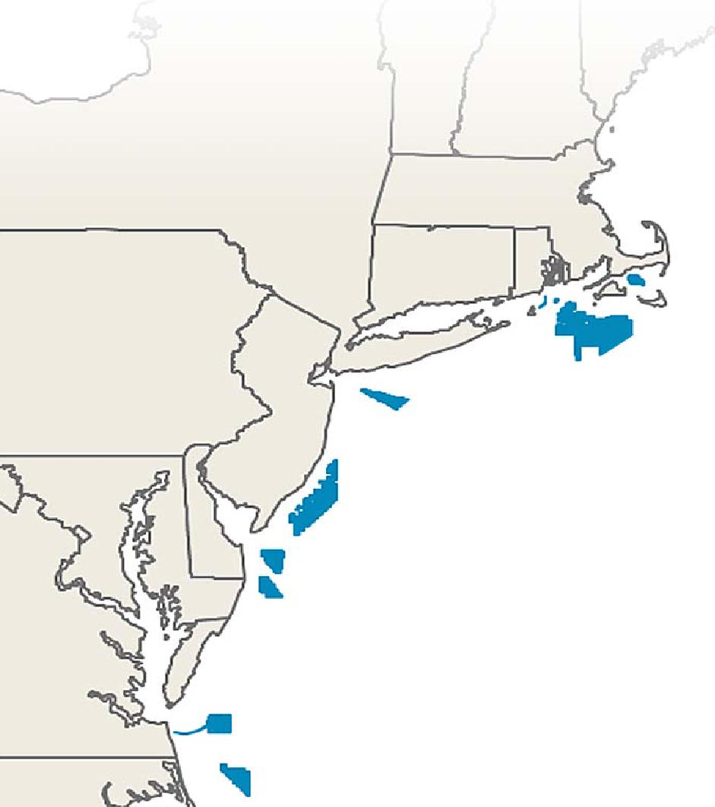
State Commitments to Offshore Wind
State | OSW Goal (MW) | Target Date
Massachusetts | 5,600 | 2035
Rhode Island | 430 | 2025
Connecticut | 2,000 | 2030
New York | 9,000 | 2035
New Jersey | 7,500 | 2035
Maryland | 1,568 | 2030
Virginia | 5,200 | 2034
North Carolina | 8,000 | 2040
Total | 39,298
24 Lease Areas, ~3500 turbines
Federal Goal: 30 GW by 2030
Sources: DOE 2021 Offshore Wind Market Report and NCSL
As of August 2021
Notes:
For comparison, Oyster Creek was 636 MW
NJ commitment is about 50% of NJ total electricity use
Maine coming soon

Slide 6
Offshore Wind Areas of Focus for Us
How will offshore wind impact wildlife?
Fish, whales, mammals, birds, bats, etc
How will it impact atmospheric and oceanic circulation?
How are they leveraging our regional scientific expertise for this work?
“they” = State agencies, lease holders, feds, NGOs

Slide 7
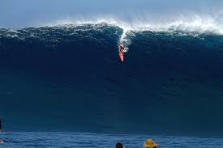
The Wave is Coming…
Rutgers had 2 offshore wind projects in May 2020. Now Rutgers has…

Slide 8
There’s a lot going on in the MAB
NJBPU Ocean/wind modeling (impacts of seabreeze and wakes on power generation)
Orsted ECOPAM
Orsted – Fisheries (before, during, after installations) (trawl, eDNA, cameras, sampling, line, gliders,
Orsted – hard clam survey
Jasco (Orsted) Cod Detection
NJ RMI Cable runs
NJ RMI Gliders (Vemco, DMON, CTD, Optode, AZFP, Ecopuck, pH) – Parallel gliders
NJ RMI – observing guidance Assistance with State RFP requirements
Atlantic Shores – surfclam planting, seed source
Atlantic shores – shellfish fisheries modeling
Atlantic Shores – cup anemometer
Dominion surf clam survey
NYSERDA – gliders
9 proposals in – Averaging a new research project every 3 months.
On east coast, state focus, not a regional focus

Slide 9
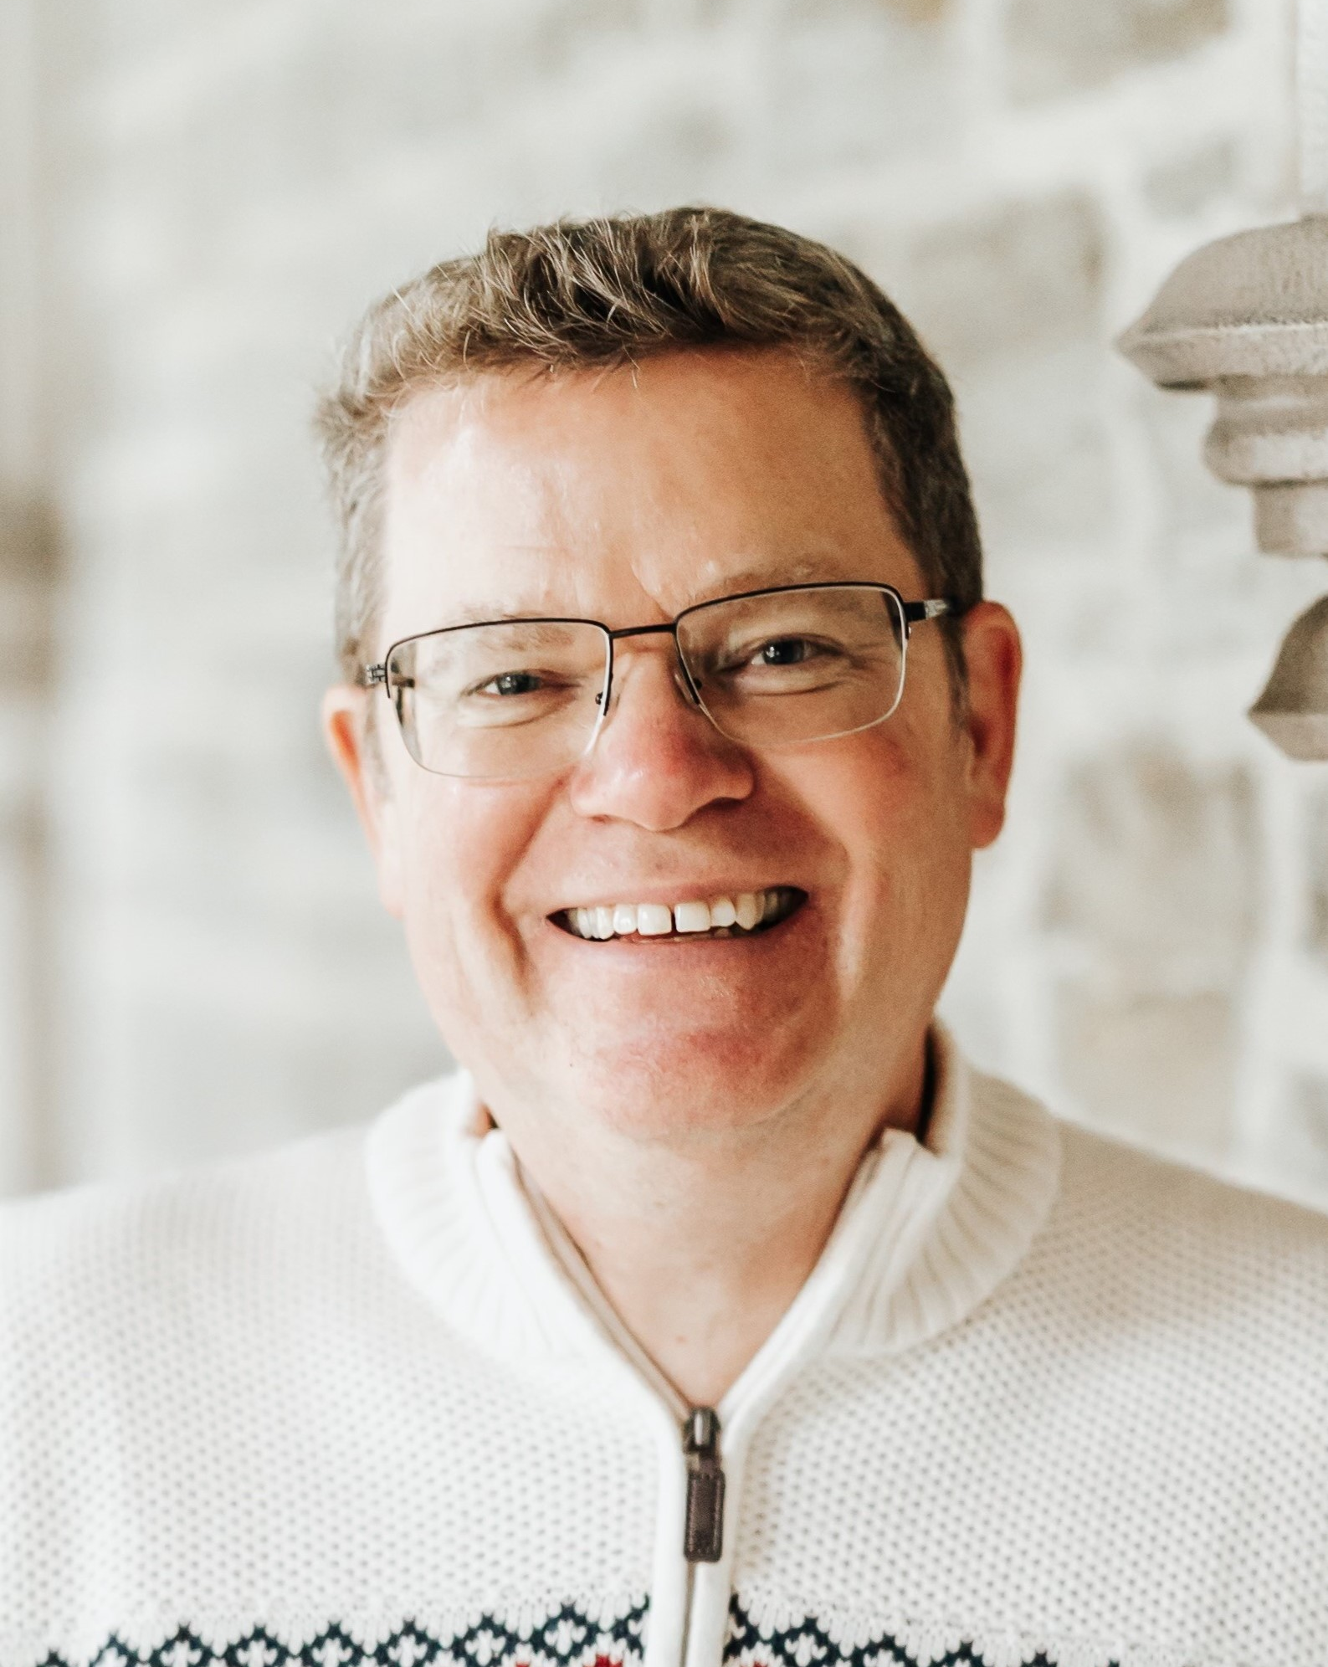
WARNING!!!
This Guy
Biologist

Slide 10
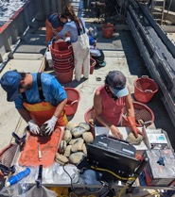
Quick overview of 1 project: Orsted Fisheries Assessing Environmental Impacts of OW – Before, during, after
Gathering ocean data via ship and robots to perform environmental, ecological and ocean community impact modeling
Our ecological scout
Methods
Benthic Trawl Survey
Structured Bottom Survey
Clam Survey
Pelagic Fish Survey
Telemetry Measures
eDNA
Oceanography
Notes:
Ocean impacts on Wind resource, Mammals, Fish

Slide 11
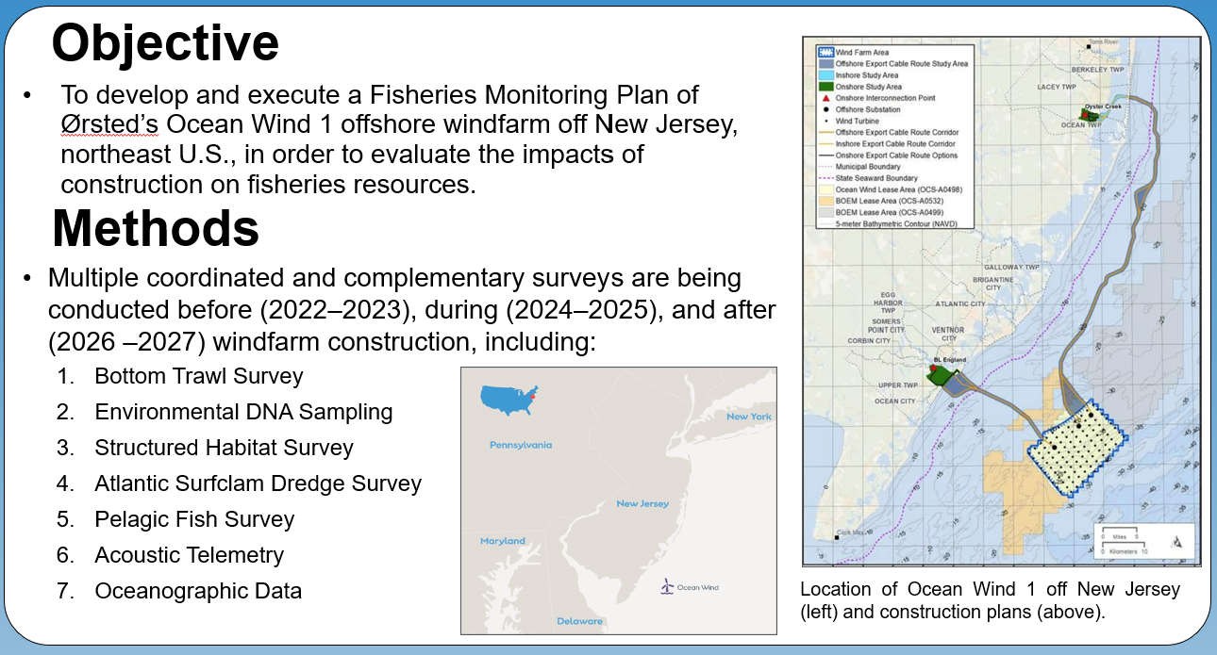
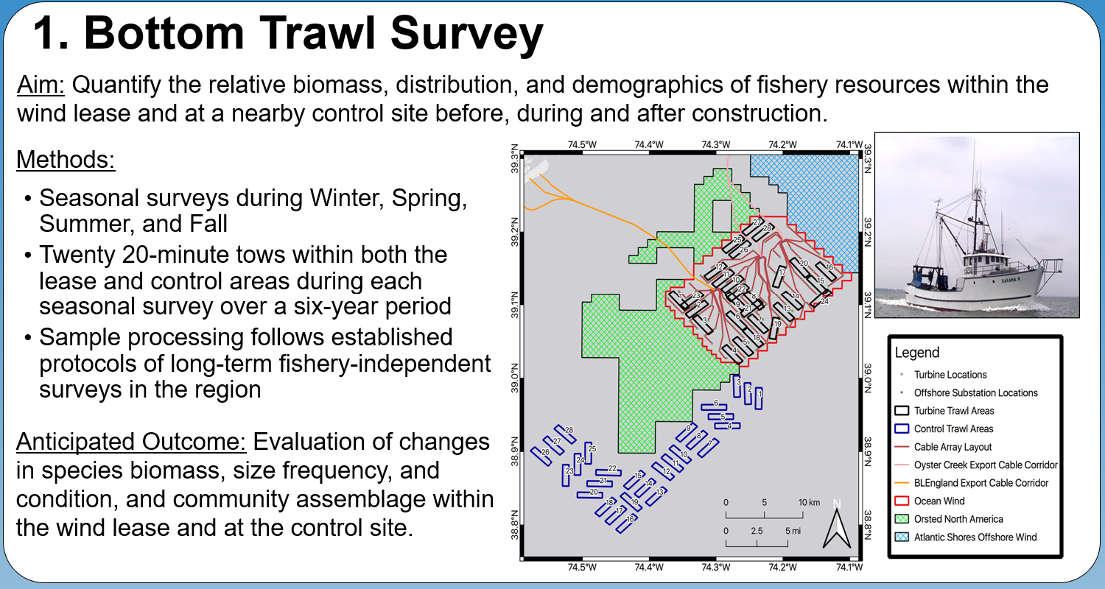
Orsted Fisheries

Slide 12
Orsted Fisheries

Slide 13
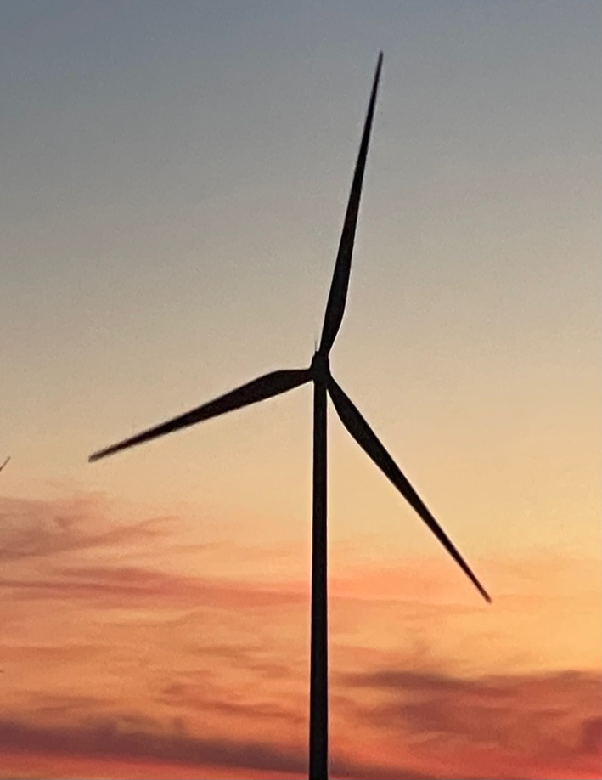
Things to plan for
Leveraging partnerships across institutions, NGOs, State/Fed, IOOS RAs
E.g. We don’t need to do a glider deployment at each lease area, 2-3 covering 12 areas
Get ahead of the game:
Start permitting process ASAP!
Get requirements and links into state RFPs regarding data management, requirements per turbine for environmental instrumentation
Offshore wind companies like requirements they can plan for
Communication from State to Feds is lacking at the top – States mandate state spending (eg Orsted)
The wave is coming. Be prepared

Slide 14
Mike Crowley
RUCOOL & MARACOOS Tech Director
crowley@rutgers.edu
Gerhard Kuska, Motz Grotheus, Jason Adolf, Keith Dunton, Doug Zemeckis, Grace Saba, Josh Kohut, Daphne Munroe, Jason Morson, Kaycee Coleman, Travis Miles, Jake Kritzer
And the dozens of partners on the Ops Teams

Slide 15
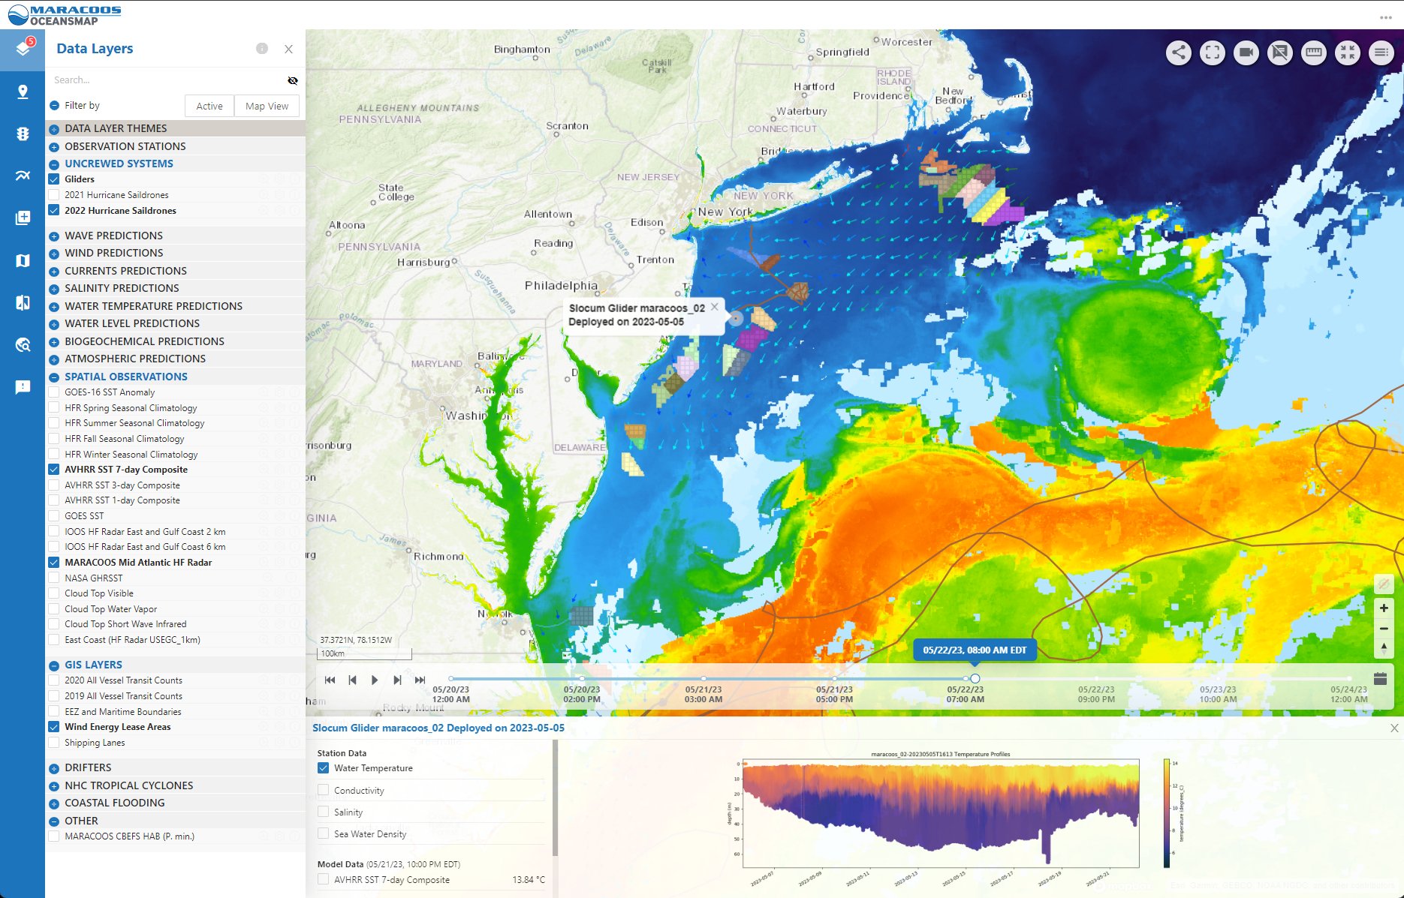
Offshore Wind Development along the US East Coast: Where does IOOS fit in?
Data collection and leveraging
QA/QC per federal standards
Data sharing
Data management
Decision tools
Platforms of opportunity
Community dialogue

Slide 16
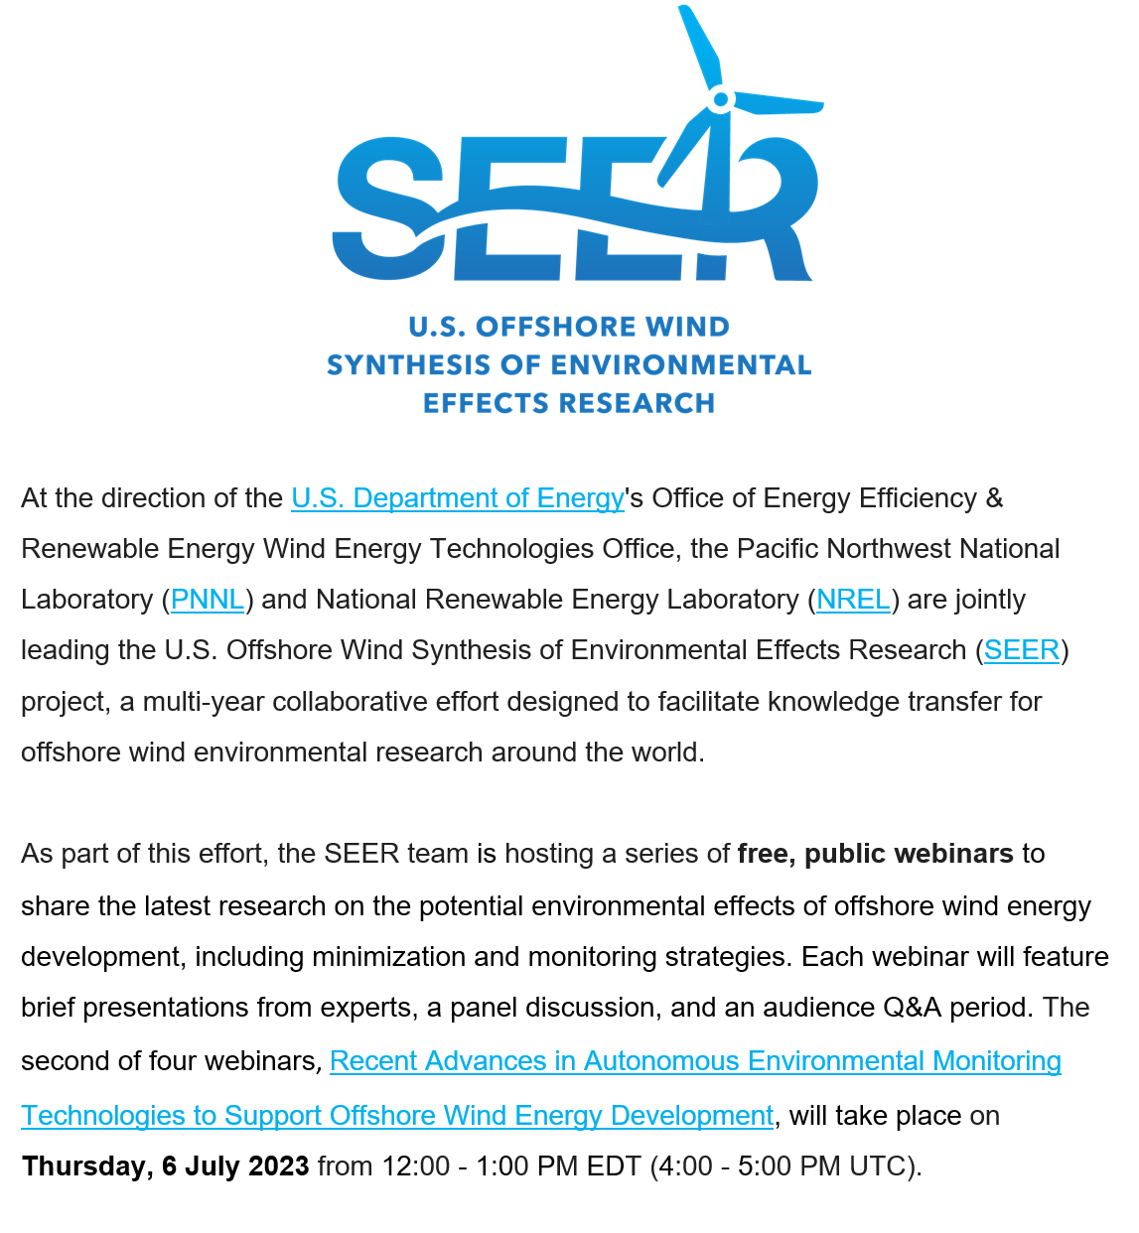
Acronym soup

Slide 17
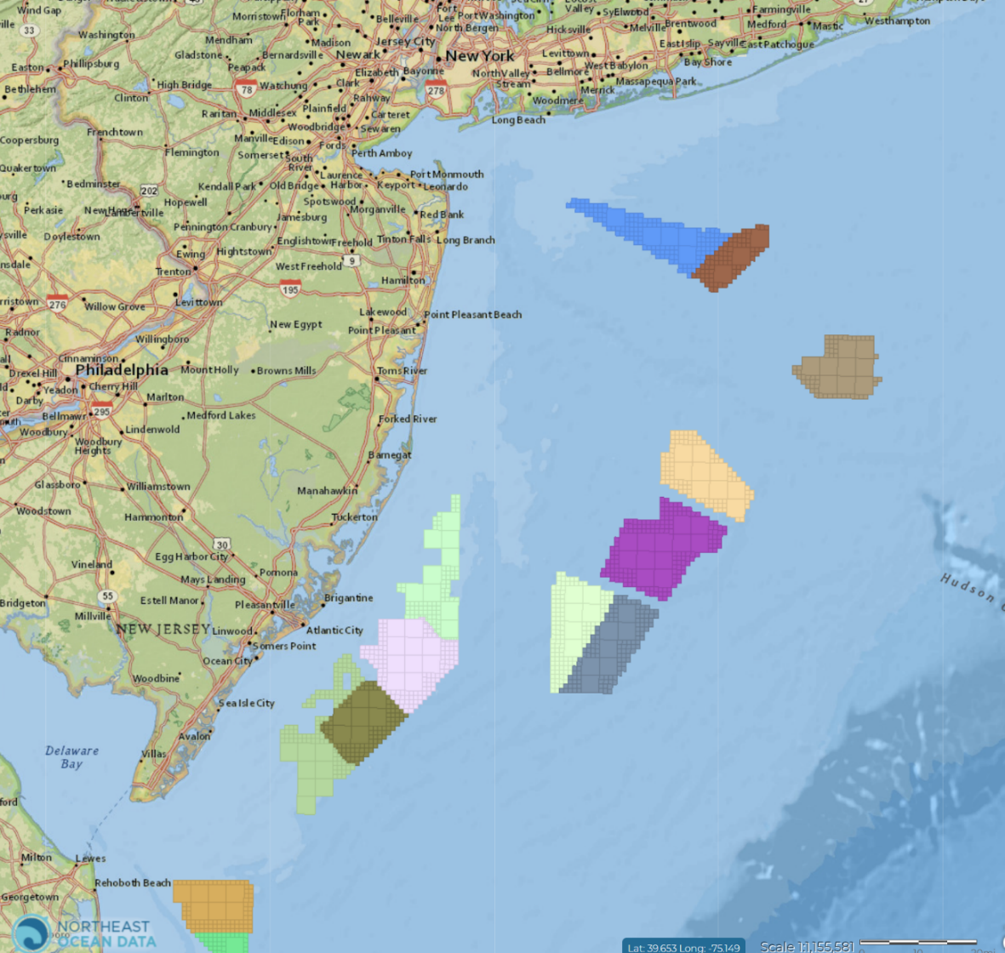
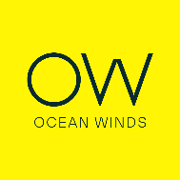
Regional Databases and Viz can bring it all together
OCS-A 0512
Empire Offshore Wind (Equinor)
OCS-A 0544
Mid-Atlantic Offshore Wind
OCS-A 0537 Bluepoint Wind
(Ocean Winds)
OCS-A 0537
Atlantic Shores Offshore Wind
OCS-A 0538
Attentive Energy
OCS-A 0541
Atlantic Shores
Offshore Wind Bight
OCS-A 0539
Community Offshore Wind
OCS-A 0542
Leading Light Wind (Invenergy)
OCS-A 0499
Atlantic Shores Wind Projects
OCS-A 0498
Ocean Wind (Orsted)
OCS-A 0532
Orsted NA
OCS-A 0482
GSOE I (Orsted)
OCS-A 0519 Skipjack(Orsted)

