Slide 1
Best Practices for SeaSonde Antenna Pattern Measurements
Timothy Stolarz, Hugh Roarty, Scott Glenn, Ethan Handel, Michael Smith
Notes:
Brief introduction of the paper and authors.
30 seconds

Slide 2
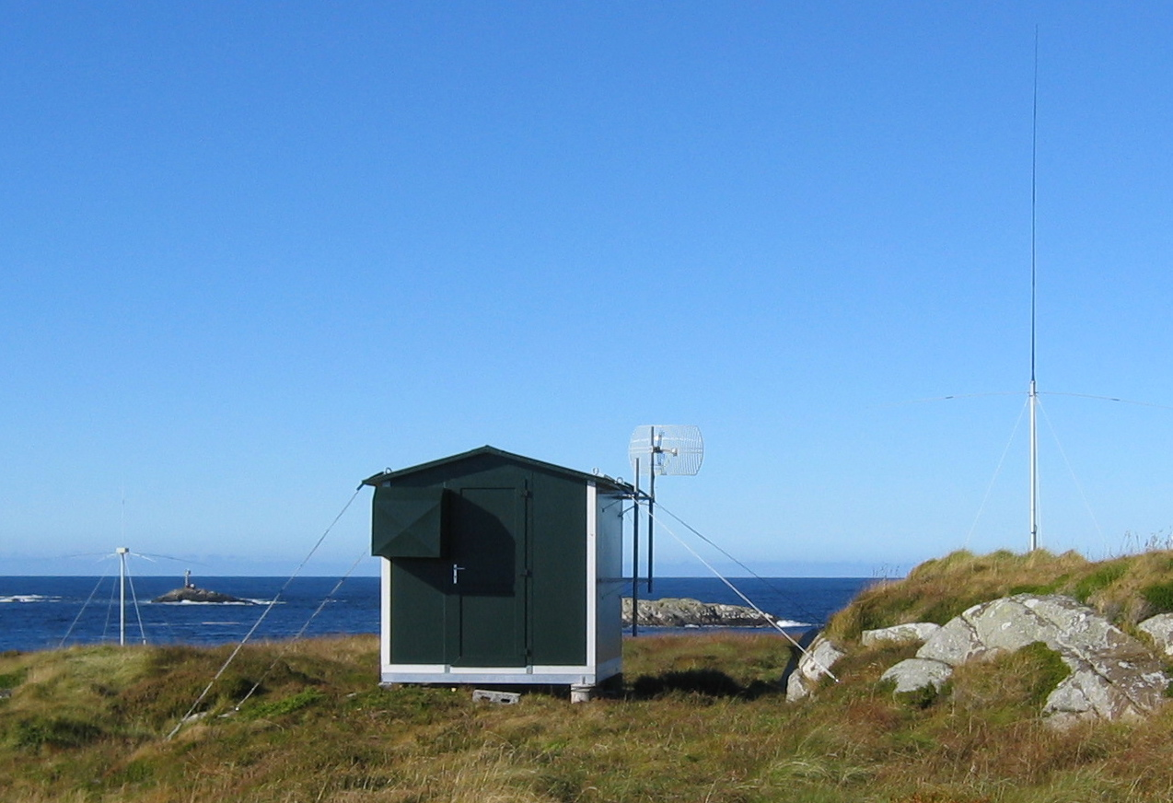
Introduction to High Frequency Radar
The SeaSonde is a stationary oceanographic sensor that allows for the measurement of surface currents
Uses doppler shift of backscattered signal to measure ocean currents
Operationally used for algal bloom tracking, oil spill tracking, microplastic tracking, model integration + more
Utilized by U.S. Coast Guard for search and rescue efforts
Transmit Antenna
Receive Antenna
Electronics
Notes:
The SeaSonde, a commercial High Frequency radar manufactured by CODAR Ocean Sensors, is low power and low impact oceanographic sensor which allows for continuous measurements of surface currents in near-real time. These sensors are located along coastlines, both beaches and cliff-faces, enabling the generation of surface current velocity maps. SeaSondes operate in the High Frequency (HF) band between 3 MHz and 30 MHz, (wavelengths ~100 m – 10 m)
1 minute

Slide 3
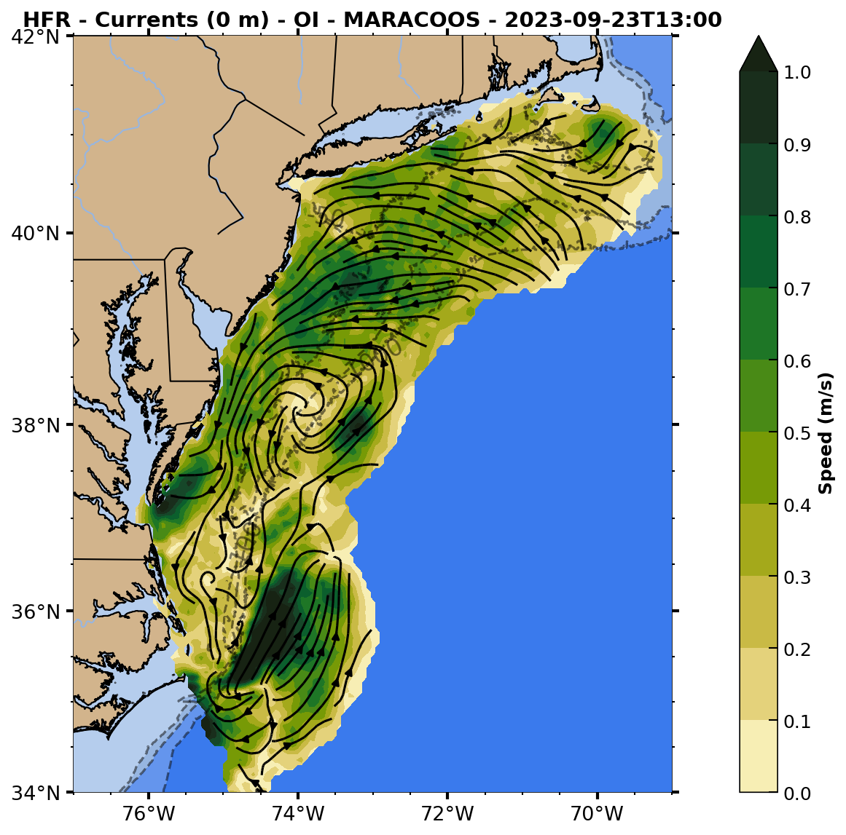
Notes:
Left radial map: Generated Hourly. Measures speed going toward and away from antenna (here data is normalized). Made at each site hourly
Right: Surface current total map. Called total cause uses all radials
Now let’s dive a little deeper into how these radial maps are created…

Slide 4
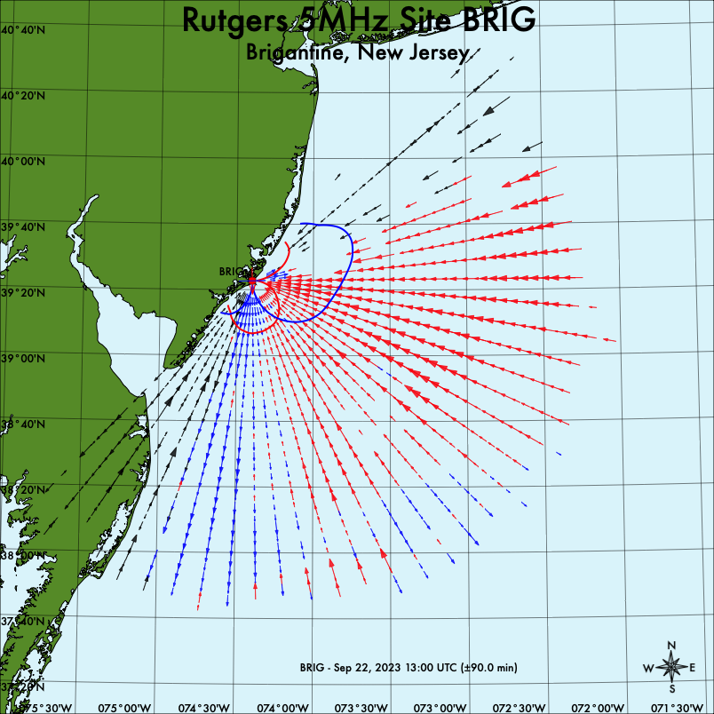
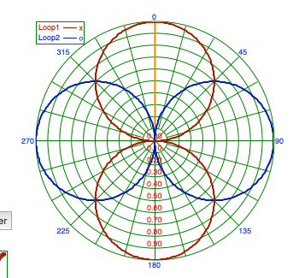
Loop 1
Loop 2
Ideal
Measured
Notes:
To get the data from the ocean currents, its receive antenna is comprised of three interior antennas. The omnidirectional monopole, and two dipoles known as loop 1 and loop 2.
So what is a measured antenna pattern? It’s a measurement of the local distortion around the antenna. A measured pattern aims to measure the local distortion to account for it during bearing assignment using the SeaSonde’s bearing assignment algorithm known as music. Without a measured pattern, an IDEAL pattern is used which essentially assumes very little distortion, with some coming back input from the currents. The antenna pattern is comprised of two signal ratios for each directional point. They are the complex ratios of each loop signal divided by the monopole signal, expressed in terms of amplitudes and phases. The ratio between the Loop 1 & Loop 2 values is what MUSIC uses to assign bearings to the reflected signal.
This signal is processed with MUSIC create a vector with range, velocity and bearing assigned to it. The bearing assignment of MUSIC is directly influenced by the current installed pattern.

Slide 5
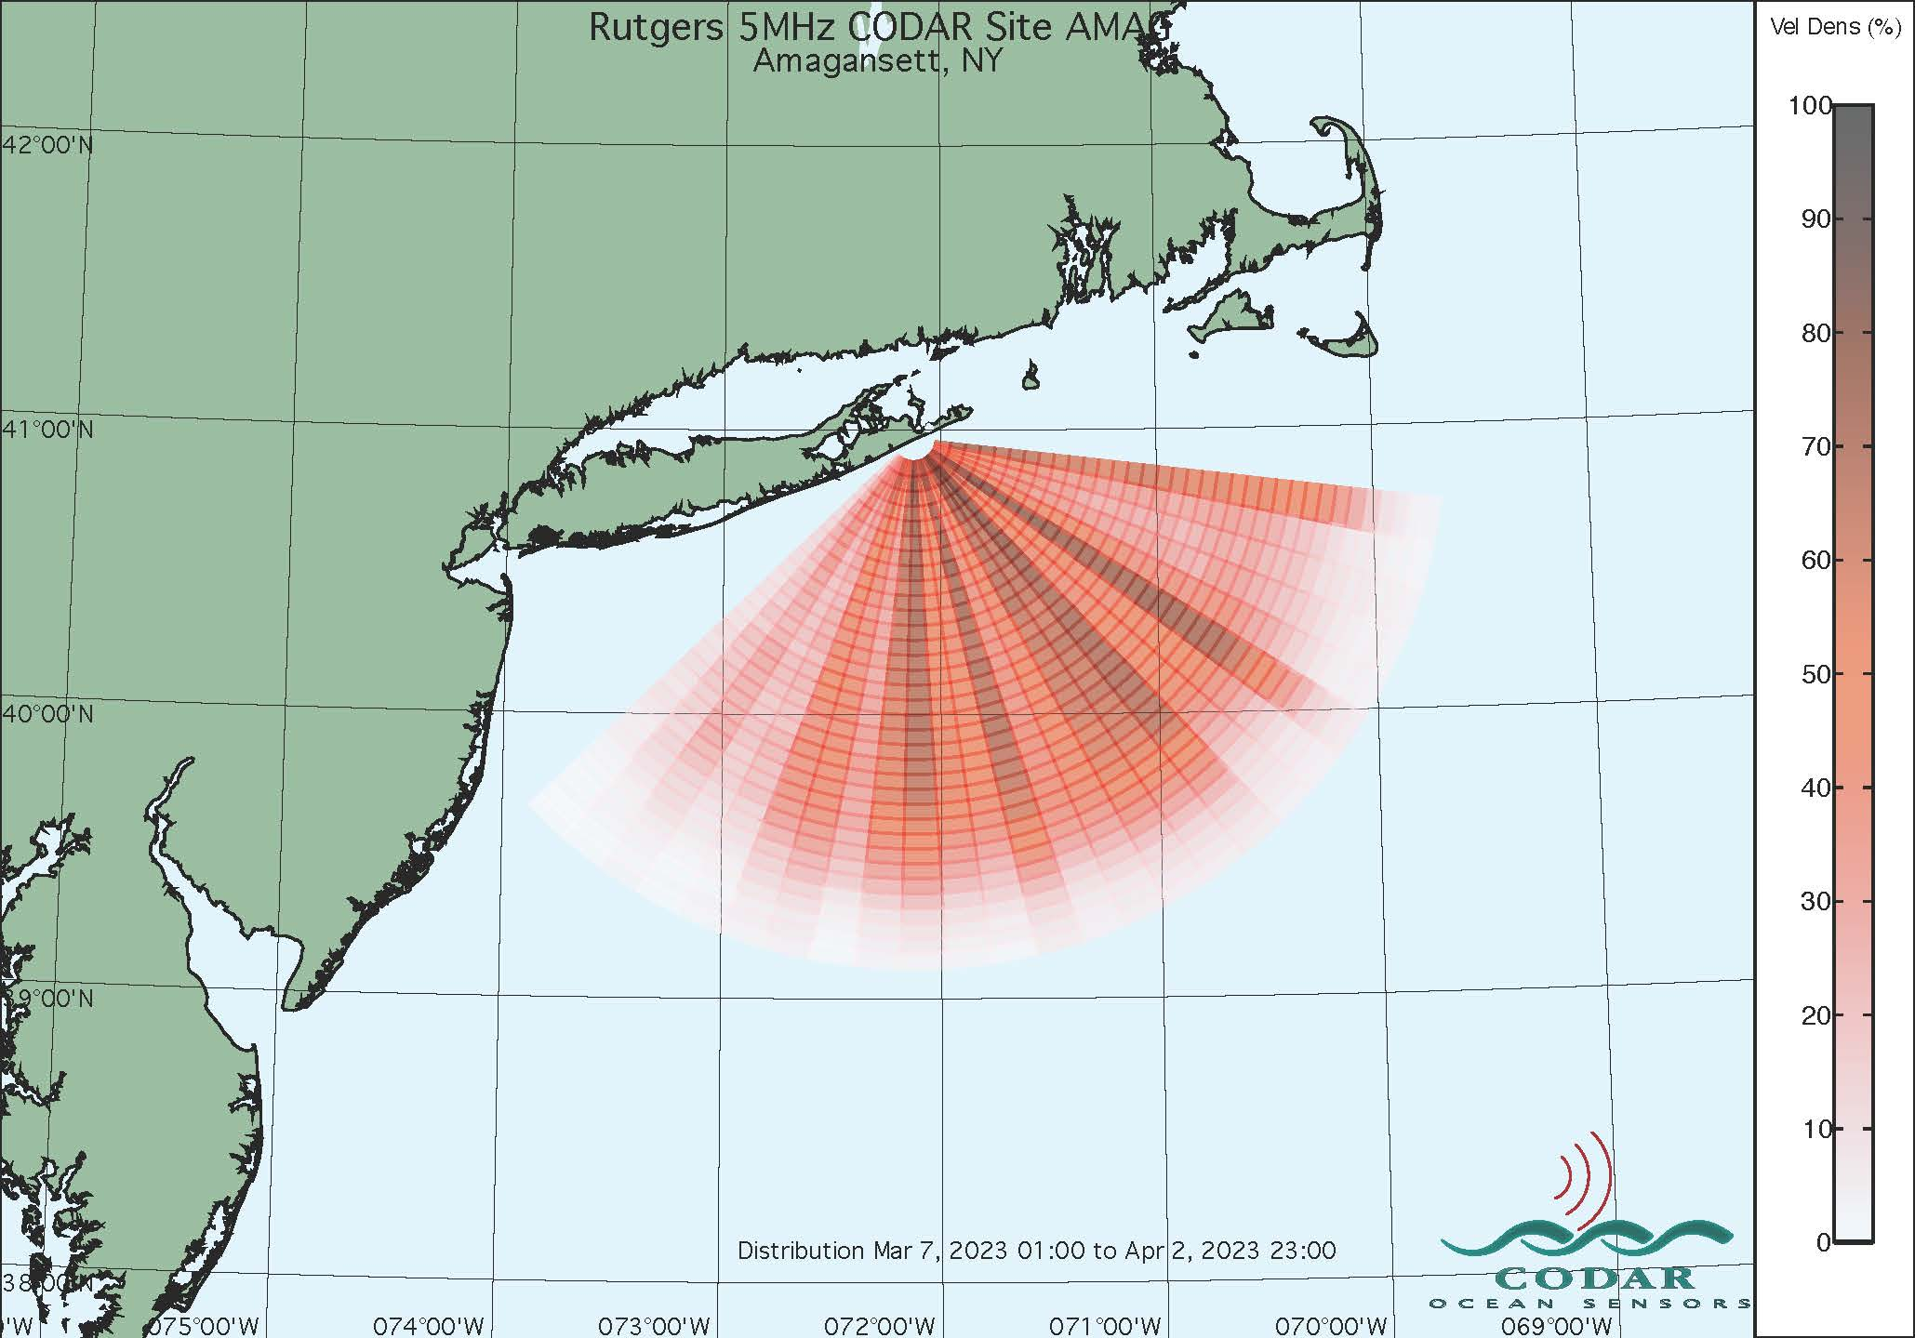
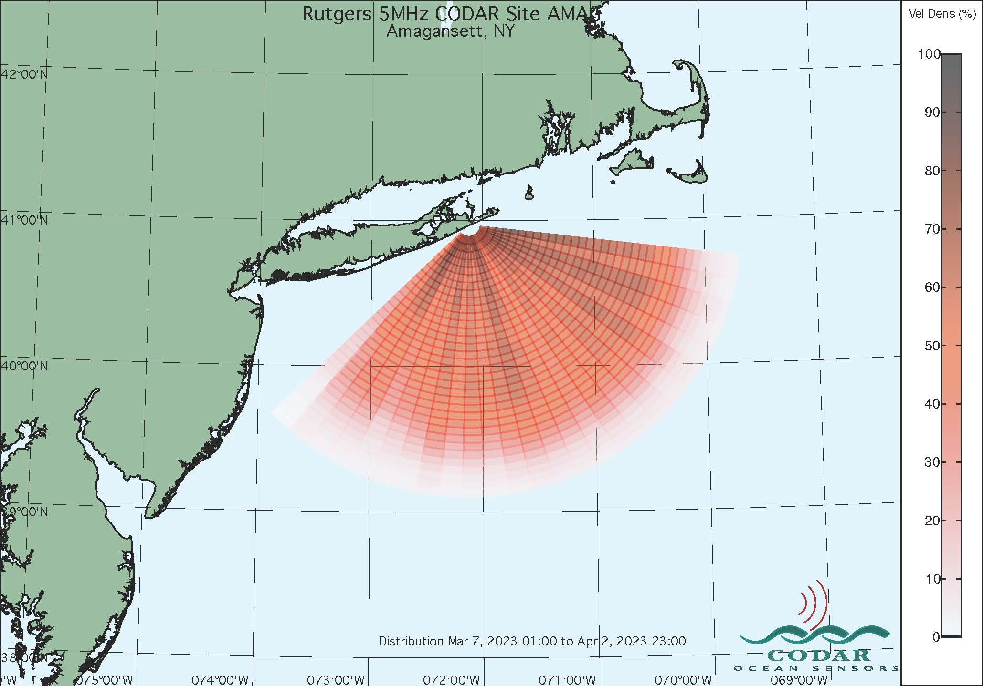
Importance of Antenna Pattern Measurements
Old Pattern distribution of data
New Pattern distribution of data
100%
100%
Low coverage
Low coverage
✅
0%
0%
Mar 7th 2023 – Apr 2 2023
Mar 7th 2023 – Apr 2 2023
Notes:
Data quality can diminish overtime due to changes in environmental distortion, internal distortion or hardware changes
So it is important to conduct APMs because…
Sources of distortions include metal objects, buildings, ionospheric disturbances, electromagnetic interference, and space weather events
1 minute

Slide 6
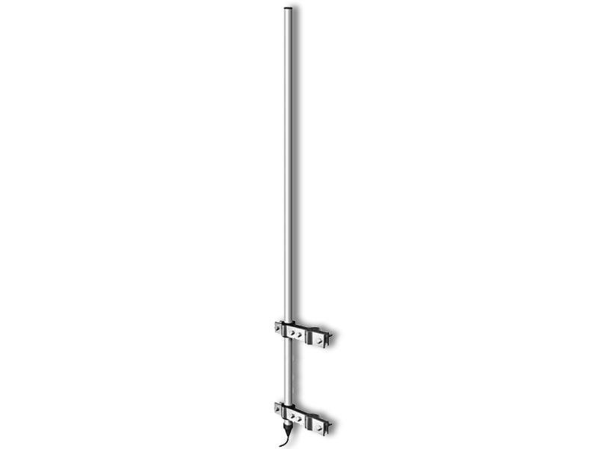
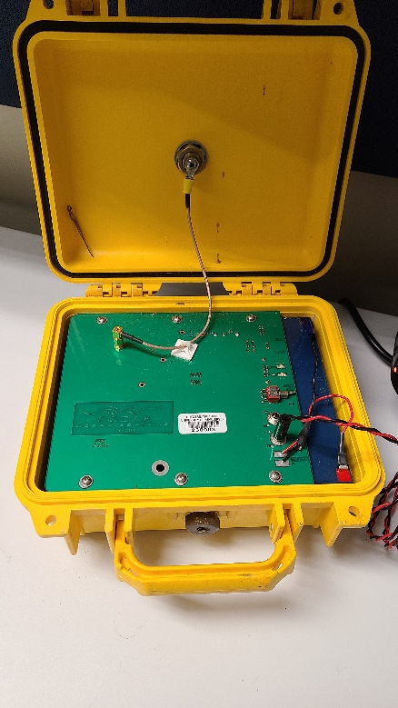
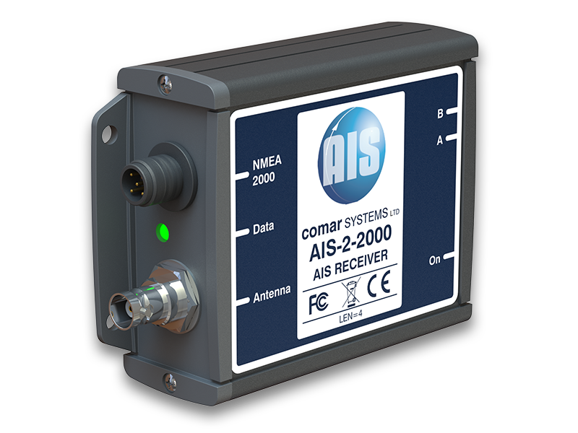
Different Methods of APM’s
There are four different methods for conducting APM’s
All require comparing the radar’s assessment of a signals location with a known location
1. Boat
2. Walking
3. Drone
4. AIS / Auto AIS
Use a transponder
Notes:
Before we discuss the methods of the APMs lets clarify the seasonde’s capability of signal tracking. When a signal is reflected off an ocean current or a boat the Seasonde is capable of discerning the location of the sea echo. There are algorithms within the software, especially new releases of the software, that are able to determine if a signal is reflected from a boat or if a signal received is actually ionospheric interference. This signal locating process is integral to performing antenna pattern measurements. All of the following APMs require comparing where the hf radar thinks a signal is coming from to a known location of a signal as a form of calibration.
So what are the different types of antenna pattern measurements?

Slide 7
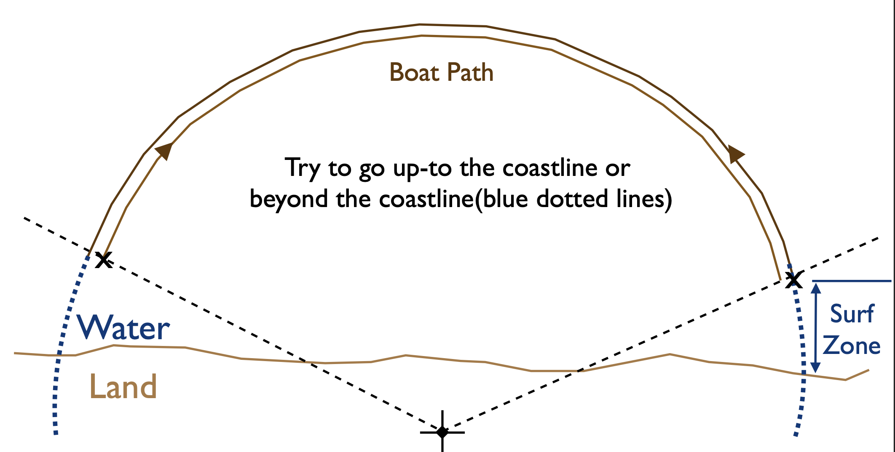
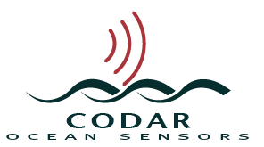
Boat and Walking APM’s
Boat APM’s allow signal propagation of water + better angle of incidence
Best used in conjunction with each other
Notes:
Boat and walking APMs are very similar to one another. Both APMs require making at least two arcs moving around 10 degs per minute around the receive antenna where you expect data. One method obviously being in a boat and the other walking on land. Both methods require using a transponder tuned to the radar’s frequency which amplifies a received signal to mimic the reflection off the ocean current. During these methods, the attenuation of the radar’s signal is increased drastically to limit signal received by the ocean and to ensure the only signal measured is the signal from the transponder.
You conduct an boat/walking apm by creating a timeseries of data moving around the receive antenna with a gps active. The goal is to match perceived transponder signal locations with actual transponder signal locations.
Codar recommends the boat apm over the walking for 2 reasons.
The boat apm allows the signal to propagate over water as is intended by the radar’s signal
The walking apm’s angle of signal to the receive antenna is steeper than the expected angle over water where you can expect data
Codar also considers the “gold standard” of antenna pattern measurements to be combining a boat pattern with walking patterns on the edges of the water that is too shallow for the boat.

Slide 8
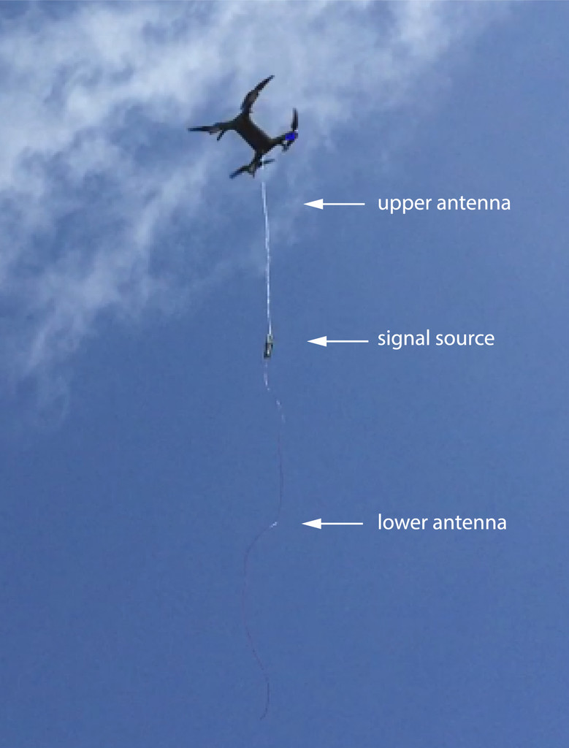
Drone APM’s
Notes:
Like the boat APM, the drone APM also allows the signal to propagate over water. Drawbacks to drone APMs include requiring an FAA drone piloting license, requiring permission to fly the drone over parks or public/protected areas, technical skill in programming and operating the drone, and vulnerability to harsh weather conditions.
2 minutes

Slide 9
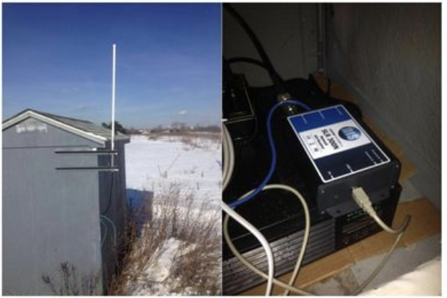
Automatic Identification System (AIS) APM’s
Compare’s antennas perceived location of vessel from sea echo to AIS signal’s known location
Only useful if there’s ship traffic
Notes:
Most of you are probably familiar with AIS systems on marine vessels. AIS transmits the vessel’s name and location to those listening. This precise gps location can be compared with where the SeaSonde is approximating where the reflected signal from the vessel is coming from to calibrate it.
The AIS equipment (antenna and AIS receiver) and software suite are a separate package
2 minutes

Slide 10
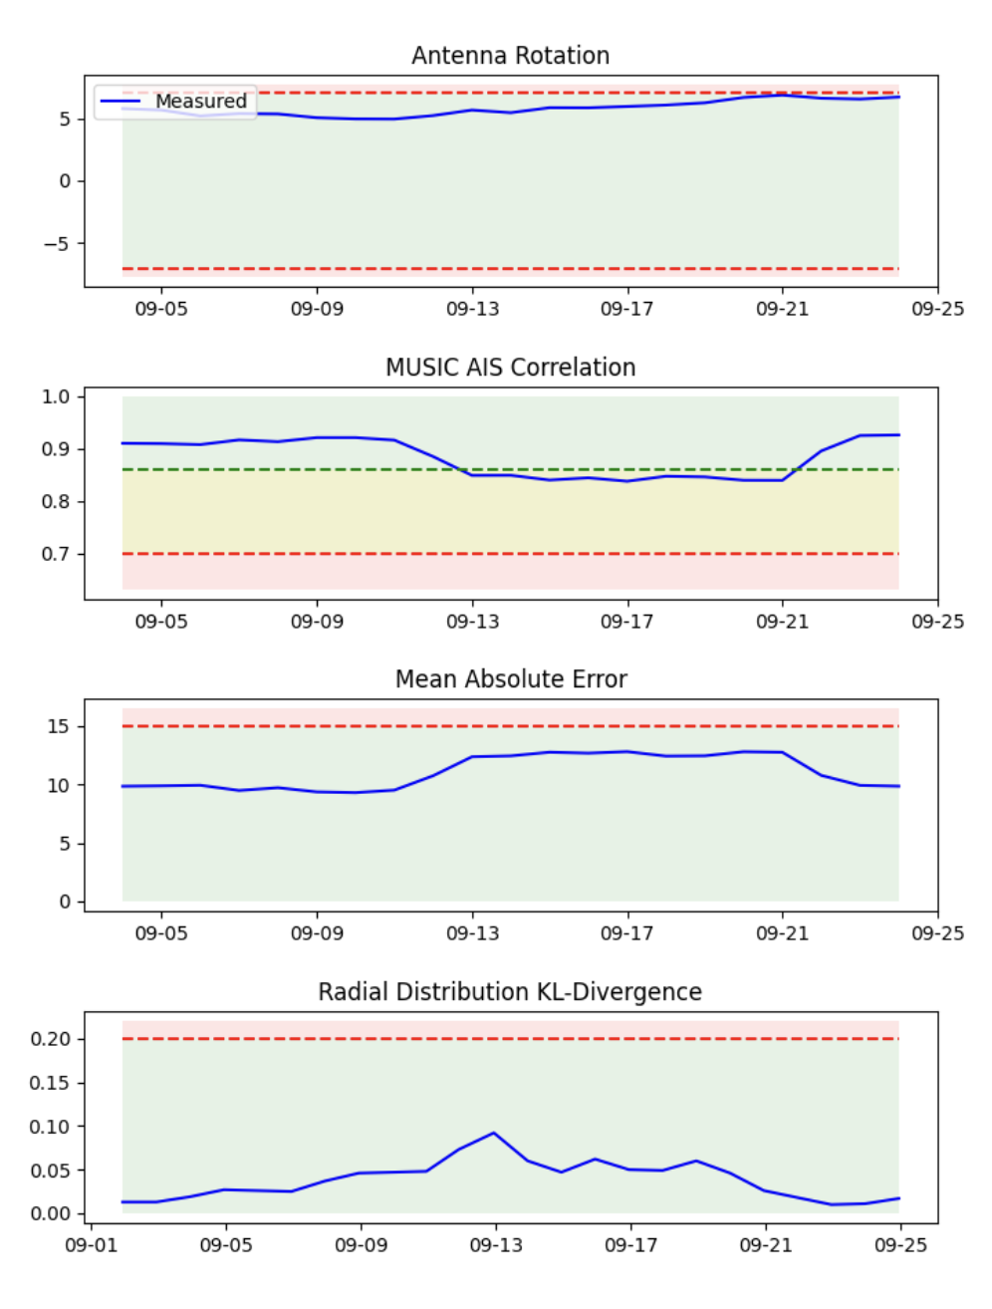
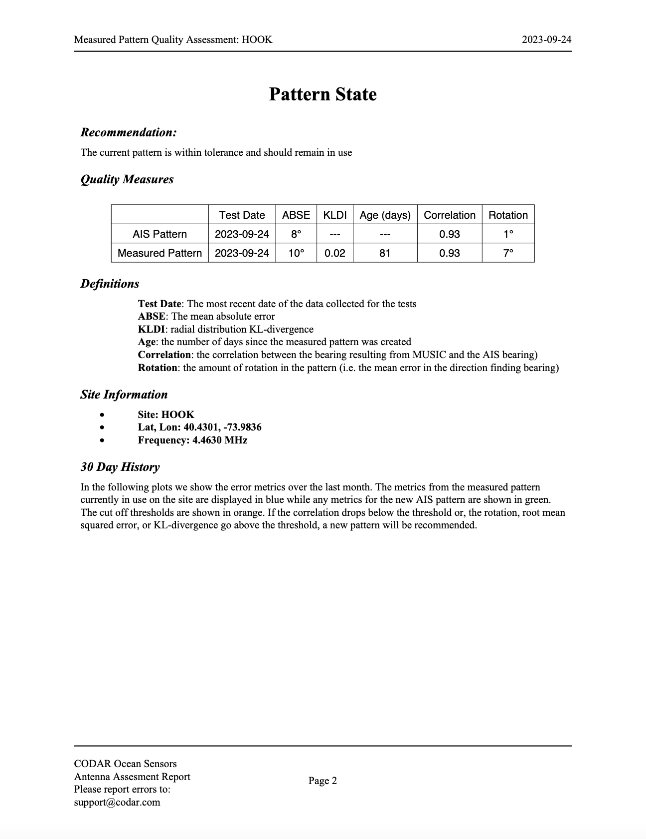
Auto AIS APM
Automatic pattern generation as a feature of newest CODAR Software
Useful with or without ship traffic
Notes:
The AUTO ais apm is not an apm conducted by the operator. As it’s name implies it is created automatically by the newest SeaSonde software release. This new software generates a daily report which indicates whether the currently installed measured pattern is within tolerance or should be changed. It judges this by conducting statistical analysis on a few parameters.
Antenna rotation, if the antenna rotates enough, the pattern can no longer assign bearings correctly.
MUSIC AIS Correlation checks to see if the bearings assigned by music using the current measured pattern are closely associated with the AIS signals known location
Mean Absolute error analysis
KL Divergence analysis which compares the quality of the currently installed pattern to the pattern when it was initially installed
The most important part of this APM isn’t necessarily the pattern generation as much as the quality tests for determining if the current pattern requires changing
1 minute

Slide 11
APM’s Conducted in the Mid-Atlantic
30 APMs over 38 Sites

Slide 12
Conclusions
There are a few distinct ways to conduct antenna pattern measurements with varying positives and negatives
The type of APM conducted is determined by many factors
Time
Funding
Site location
Weather
There is room for improvement in the sharing of APM conducting techniques among SeaSonde using organizations

Slide 13
Thank you for listening
Questions?

Slide 14
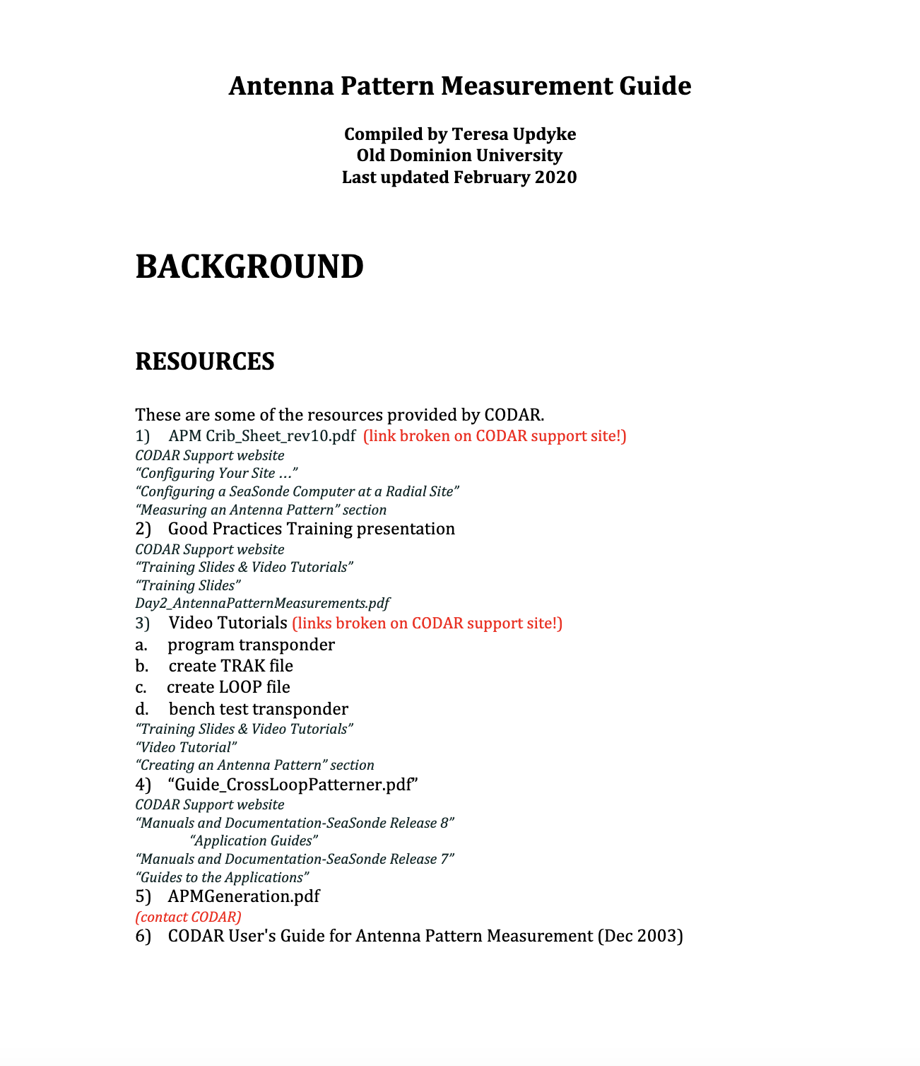
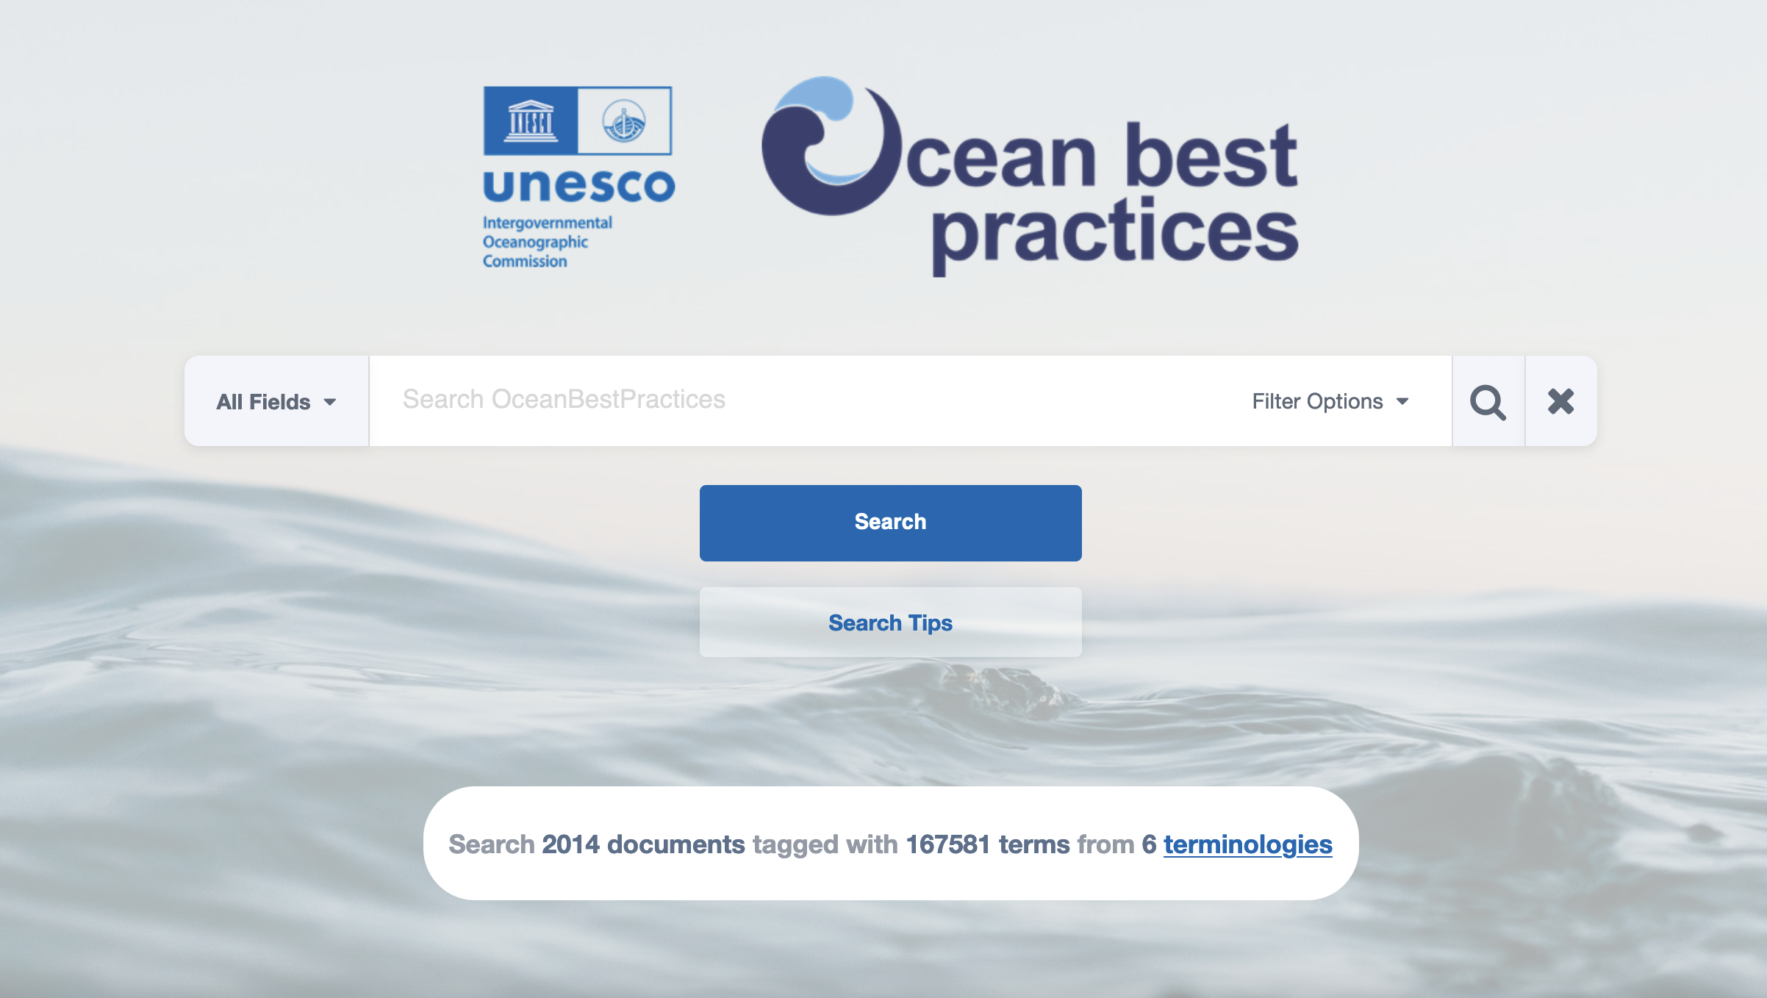
Resources / Oceans Best Practices
Notes:
Overall I would like to provide some resources on conducting some APMs. I would like to highlight Teresa Updyke’s document from Old Dominion University which documents extremely clearly how to conduct walking APMs. UC Santa Barbara provides excellent documentation on conducting drone APMs so if you are interested in those, get a hold of Eduardo Romero from UCSB. Lastly I would like to emphasize the website Oceans Best Practices which houses an open access and sustained digital repository of community best practices in all ocean-related sciences and applications, not just HF Radar.
Rutgers is looking to upload standard operating procedure documents which are in house documents at this time, to OBP with the hope to provide more resources to more HF radar operators.

