Slide 1




Fish-ics:
Cold Pool Influences on Commercial Species Dynamics in the Mid-Atlantic Bight
Introduction
Chapter 1
Chapter 2
Chapter 3
Summary
Samantha Alaimo
2 August 2023
Ph.D. Dissertation Proposal
Rutgers University
Department of Marine and Coastal Science
Dissertation Committee:
Dr. Josh Kohut (advisor)
Dr. Daphne Munroe
Dr. Travis Miles
Dr. Grace Saba
Dr. David Secor (University of Maryland)
Notes:
Introduce Self and title

Slide 2




Fish-ics: Fish & Physics
Introduction
Chapter 1
Chapter 2
Chapter 3
Summary
Fish live in the Ocean
The Ocean Moves
Fish have Tails
People eat Fish
Notes:
What is Fish-ics?
Fish-ics is the combination of fish and physics. Like many aspects of physics, we start with basic assumptions:
Fish Live in the Ocean: Fish live in the ocean and occupy a wide range of dynamic habitats whether in the hot surface in the Bahamas or deep in the Marianas trench.
The Ocean Moves: These habitats are shaped by the ocean, through waves, tides, storms, wind.
Fish have Tails: But depending on the way the ocean moves, the habitat conditions vary in time and space leading which can significantly influence fish distribution and migration
People eat fish: Lastly, we as humans follow the fish and are dependent on the ocean as a food source.
We are left with a tightly coupled system that encompasses oceanographic, ecological and socioeconomic parts.
One place in particular, encapsulates this well.

Slide 3
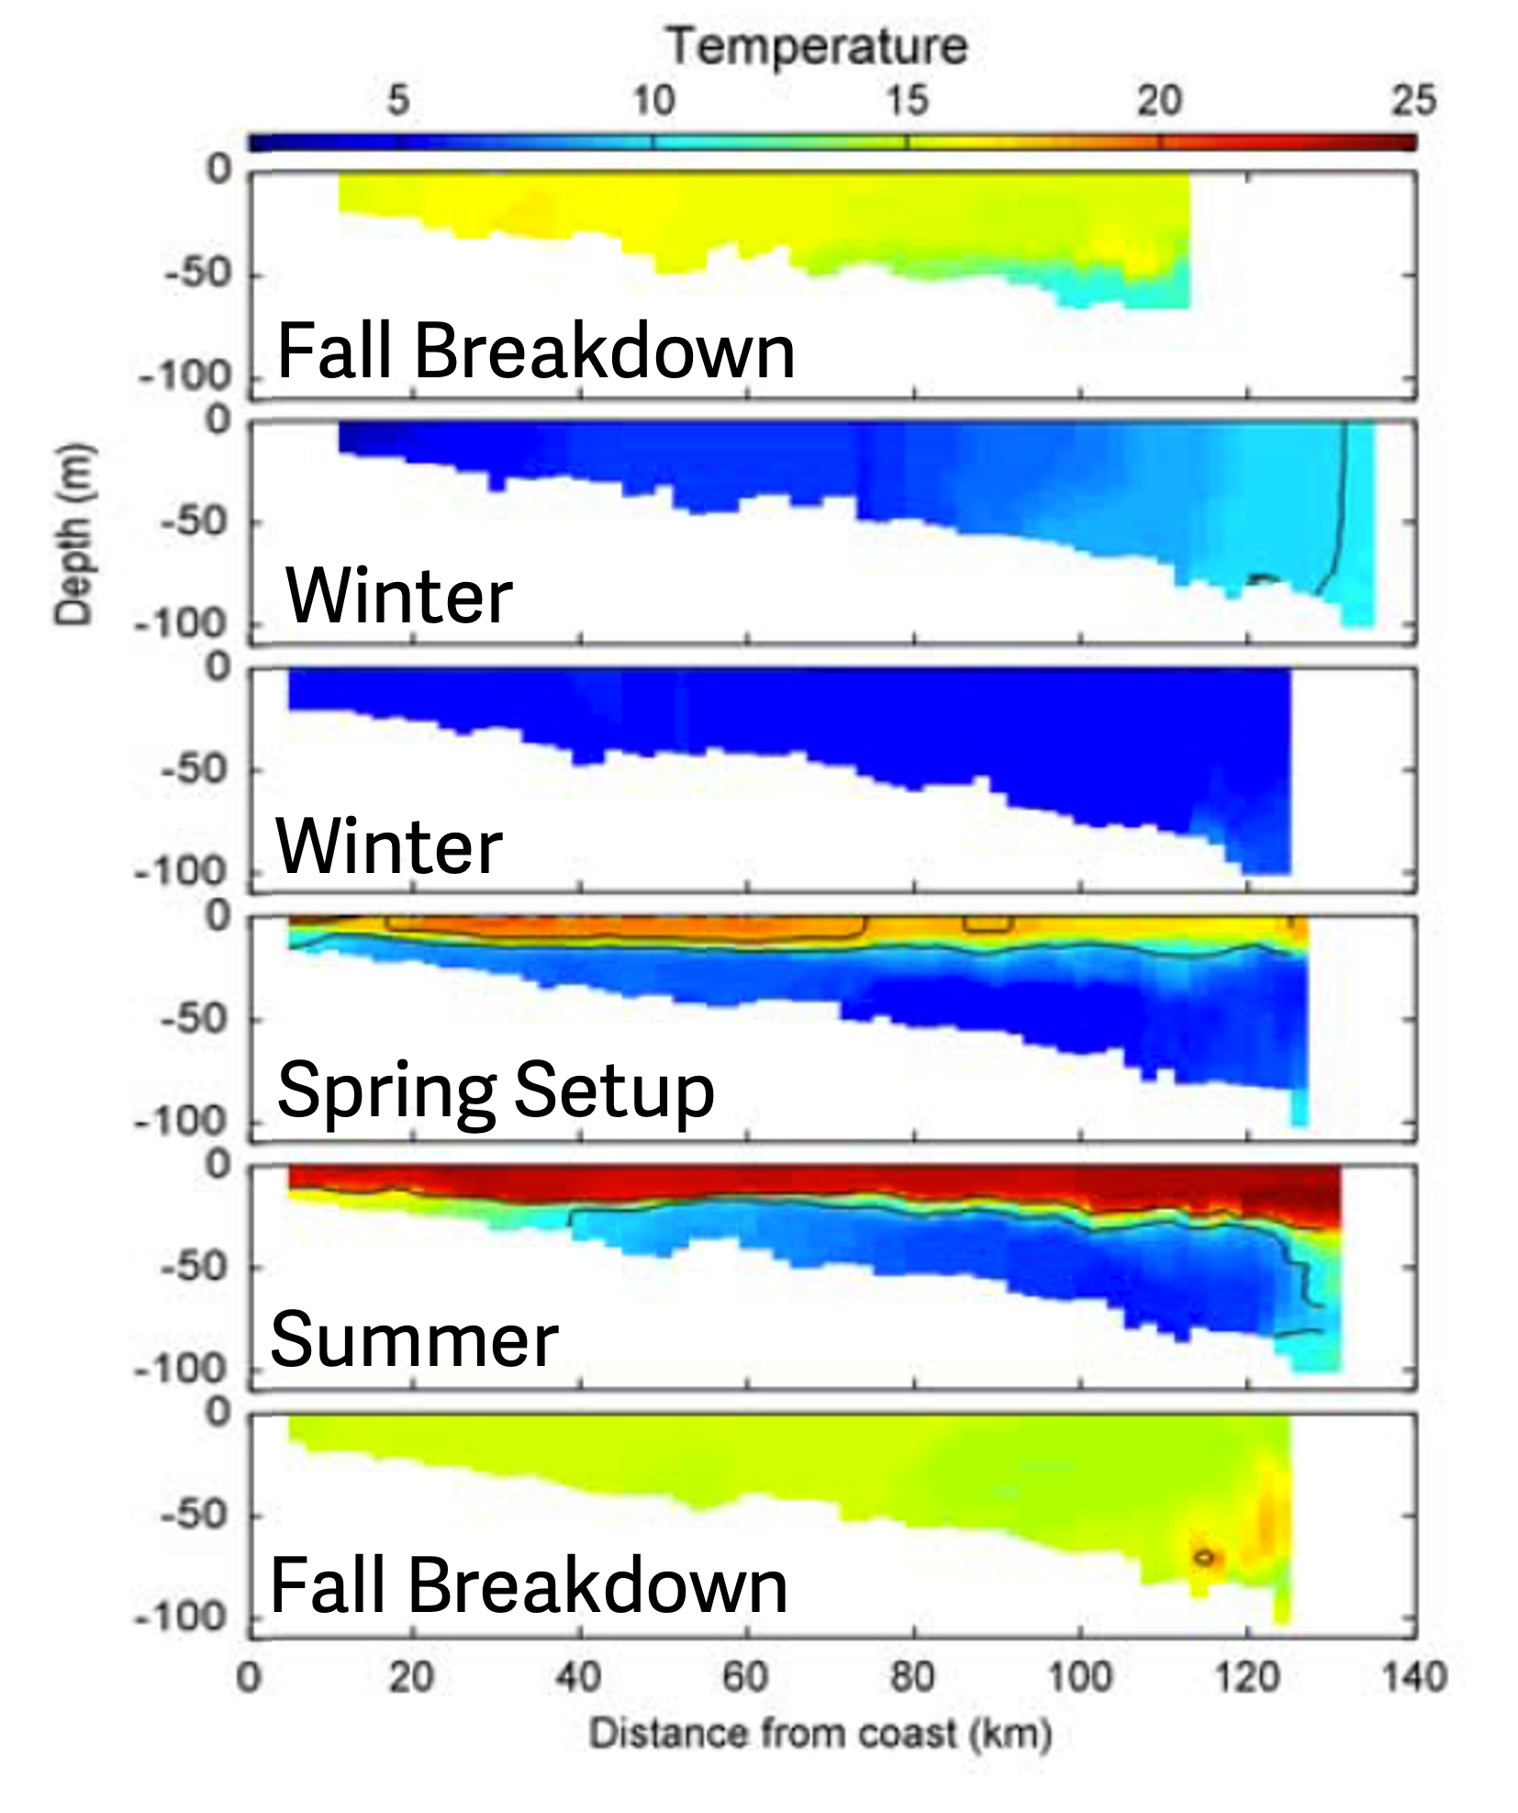
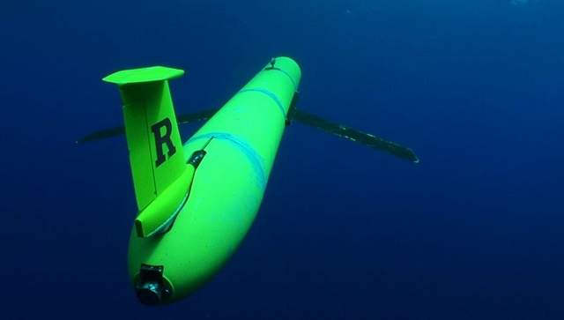
Mid-Atlantic Bight Cold Pool = Major Fish-ics
Introduction
Chapter 1
Chapter 2
Chapter 3
Summary
Intensification
(from Castelao et al. 2008)
Notes:
And that place is the Mid-Atlantic Bight.
MAB: The Mid Atlantic Bight is the ocean region off the coast of New Jersey that spans from Cape Cod to Cape Hatteras that has a large seasonal temperature signal known as the Cold Pool.
The cold pool is a distinctively cold, nutrient dense body of bottom water that forms every year in the spring.
Right Figure:
The figure on the right are cross-shelf transects based on glider tracks along the red line on the right
As we go further to the right on the figure, we are getting farther away from the coast and as we go down in the individual panels, we are getting deeper in the water column
Formation:
Fall into Winter: lots of storm and water column mixing so the water column is fairly uniform in temperature
Spring: the weather starts to warm up, less storms, the surface water begins to warm and become layer, or stratified
Summer: Strong layering/stratification-– surface water is really warm, deeper water is really cold from water supplied by the Scotian Shelf water in the North
Fall: Storms pick up again, the surface and deep-water mix and the water becomes more uniform
This dramatic change in temperature that happens every year in this small subset of the ocean

Slide 4
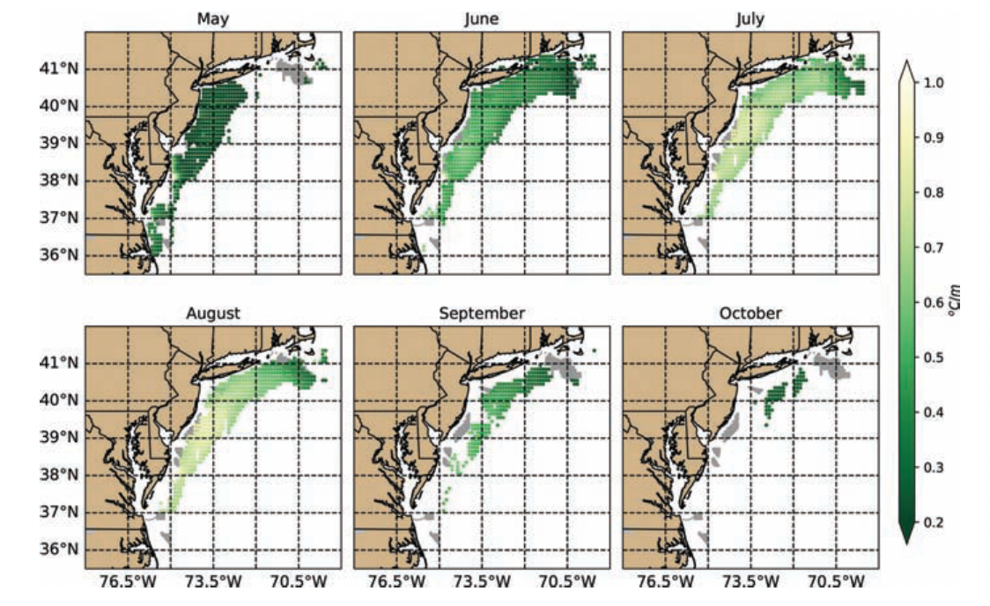
The Cold Pool Extent Depends on Season
Introduction
Chapter 1
Chapter 2
Chapter 3
Summary
Seasonal extent of the Cold Pool (from Miles et. al. 2021)
Notes:
Depending on the time of the year, depends on the spatial extent of the cold pool.
At it’s peak in the summer, the cold pool extends nearly the whole MAB
- Spatial extent--- lighter is more stratified, dark is less stratified

Slide 5
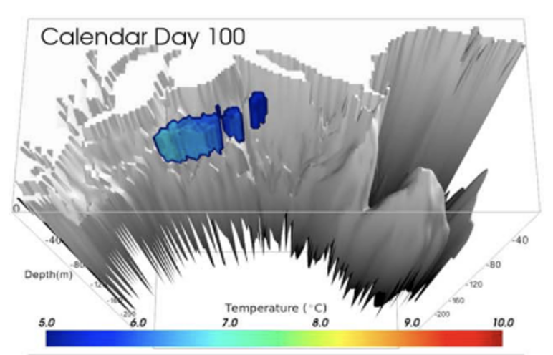
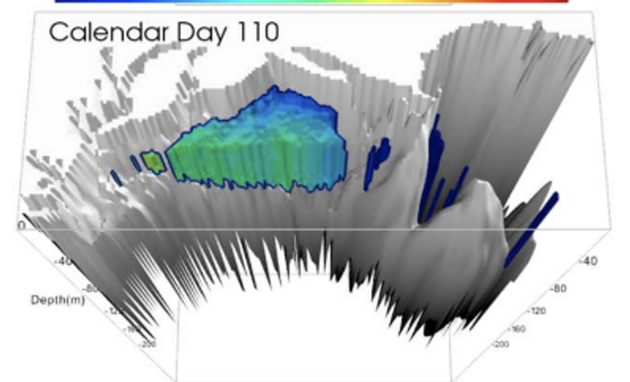
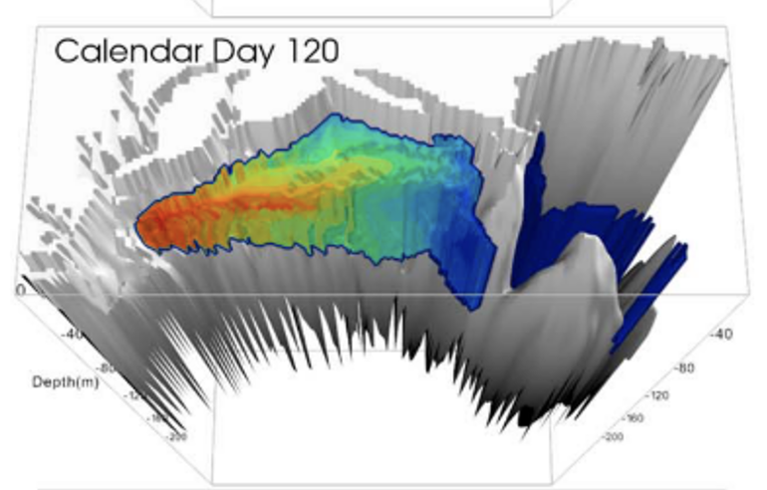
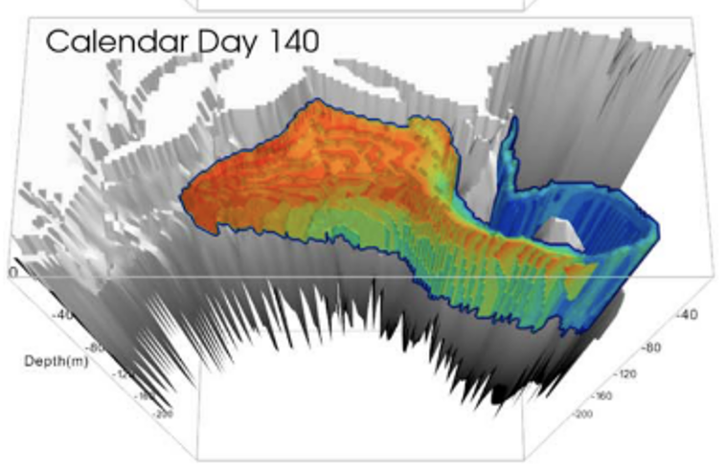
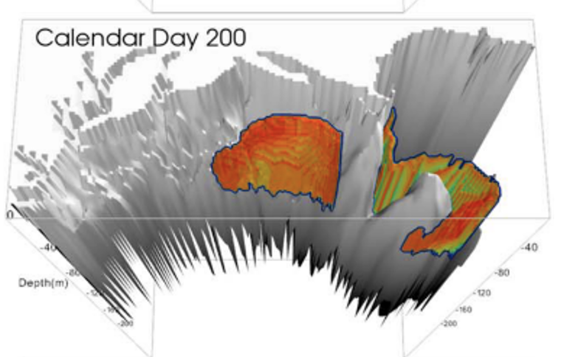
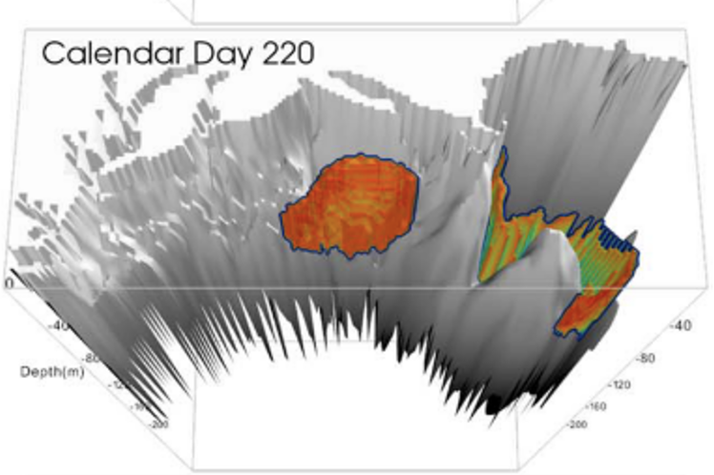
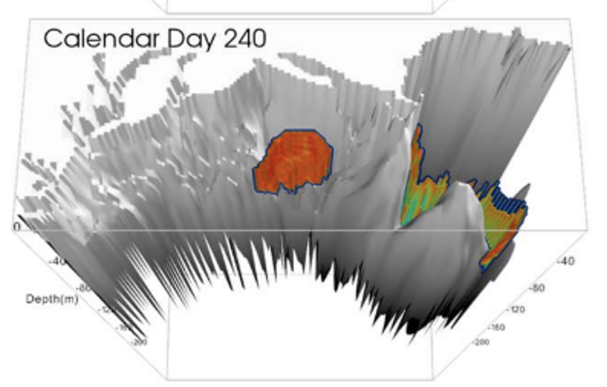
Timing of Cold Pool Formation/Breakdown Varies
Introduction
Chapter 1
Chapter 2
Chapter 3
Summary
Formation
40-day span
(from Chen et. al. 2018)
Breakdown
Notes:
The cold pool typically forms in early April and breaks down starting in September, but the exact timing of formation and breakdown can vary year to year
The timing of the cold setup and breakdown can influence the biology and ecology in the region

Slide 6
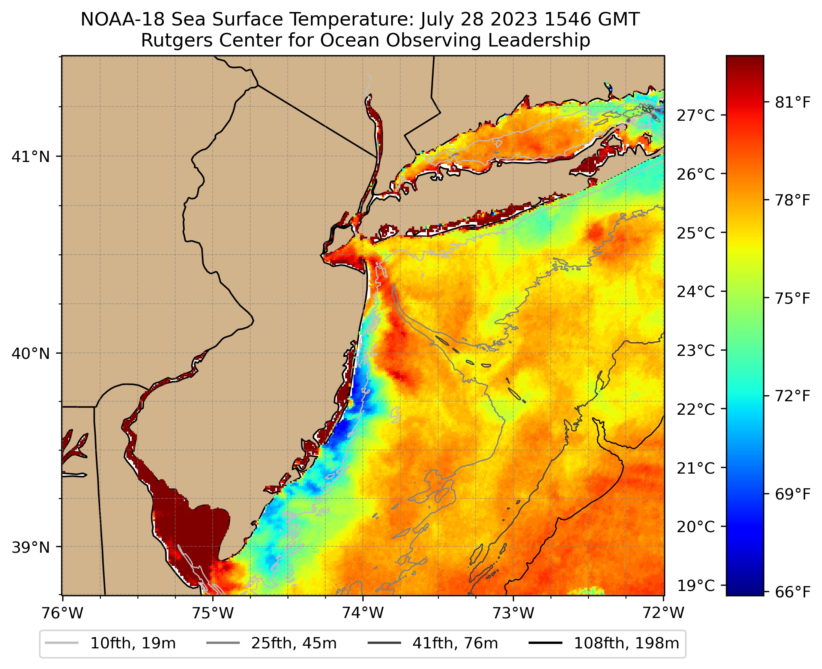
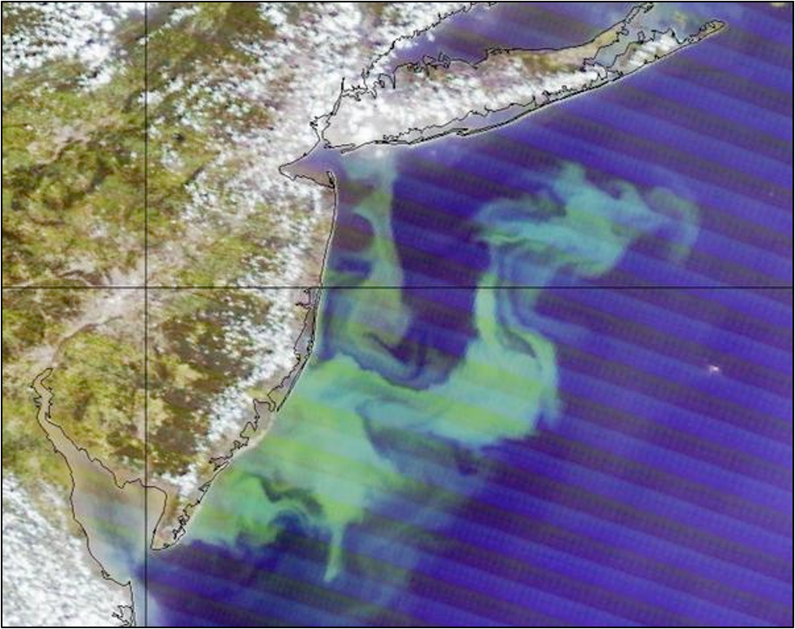
Ecological Processes and the Cold Pool
Introduction
Chapter 1
Chapter 2
Chapter 3
Summary
Summer
Phytoplankton
Blooms
MODIS true-color image over Mid-Atlantic Bight
Phytoplankton Bloom, July 2011
Notes:
Starting from the base of the food chain, upwelling of cold pool what can trigger phytoplankton blooms that can be seen from Satellite imagery
Phytoplankton blooms can then translate up the food chain to upper trophic level species like *next slide

Slide 7
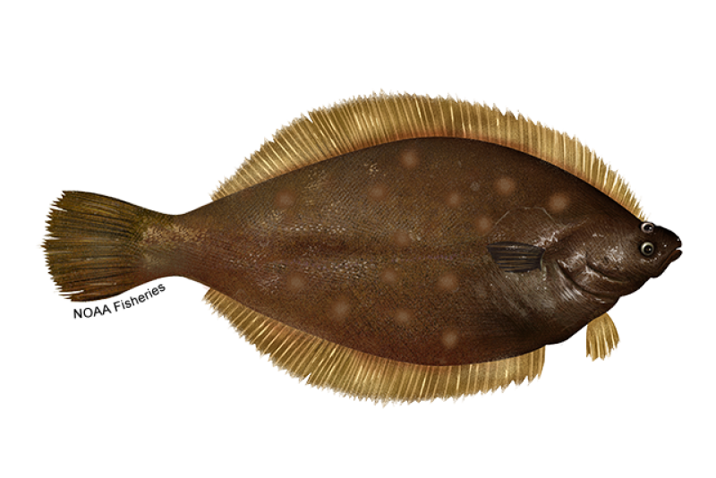
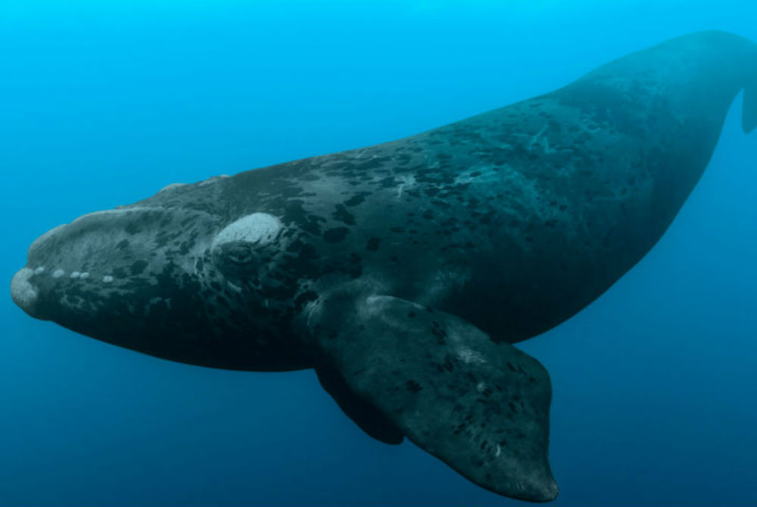
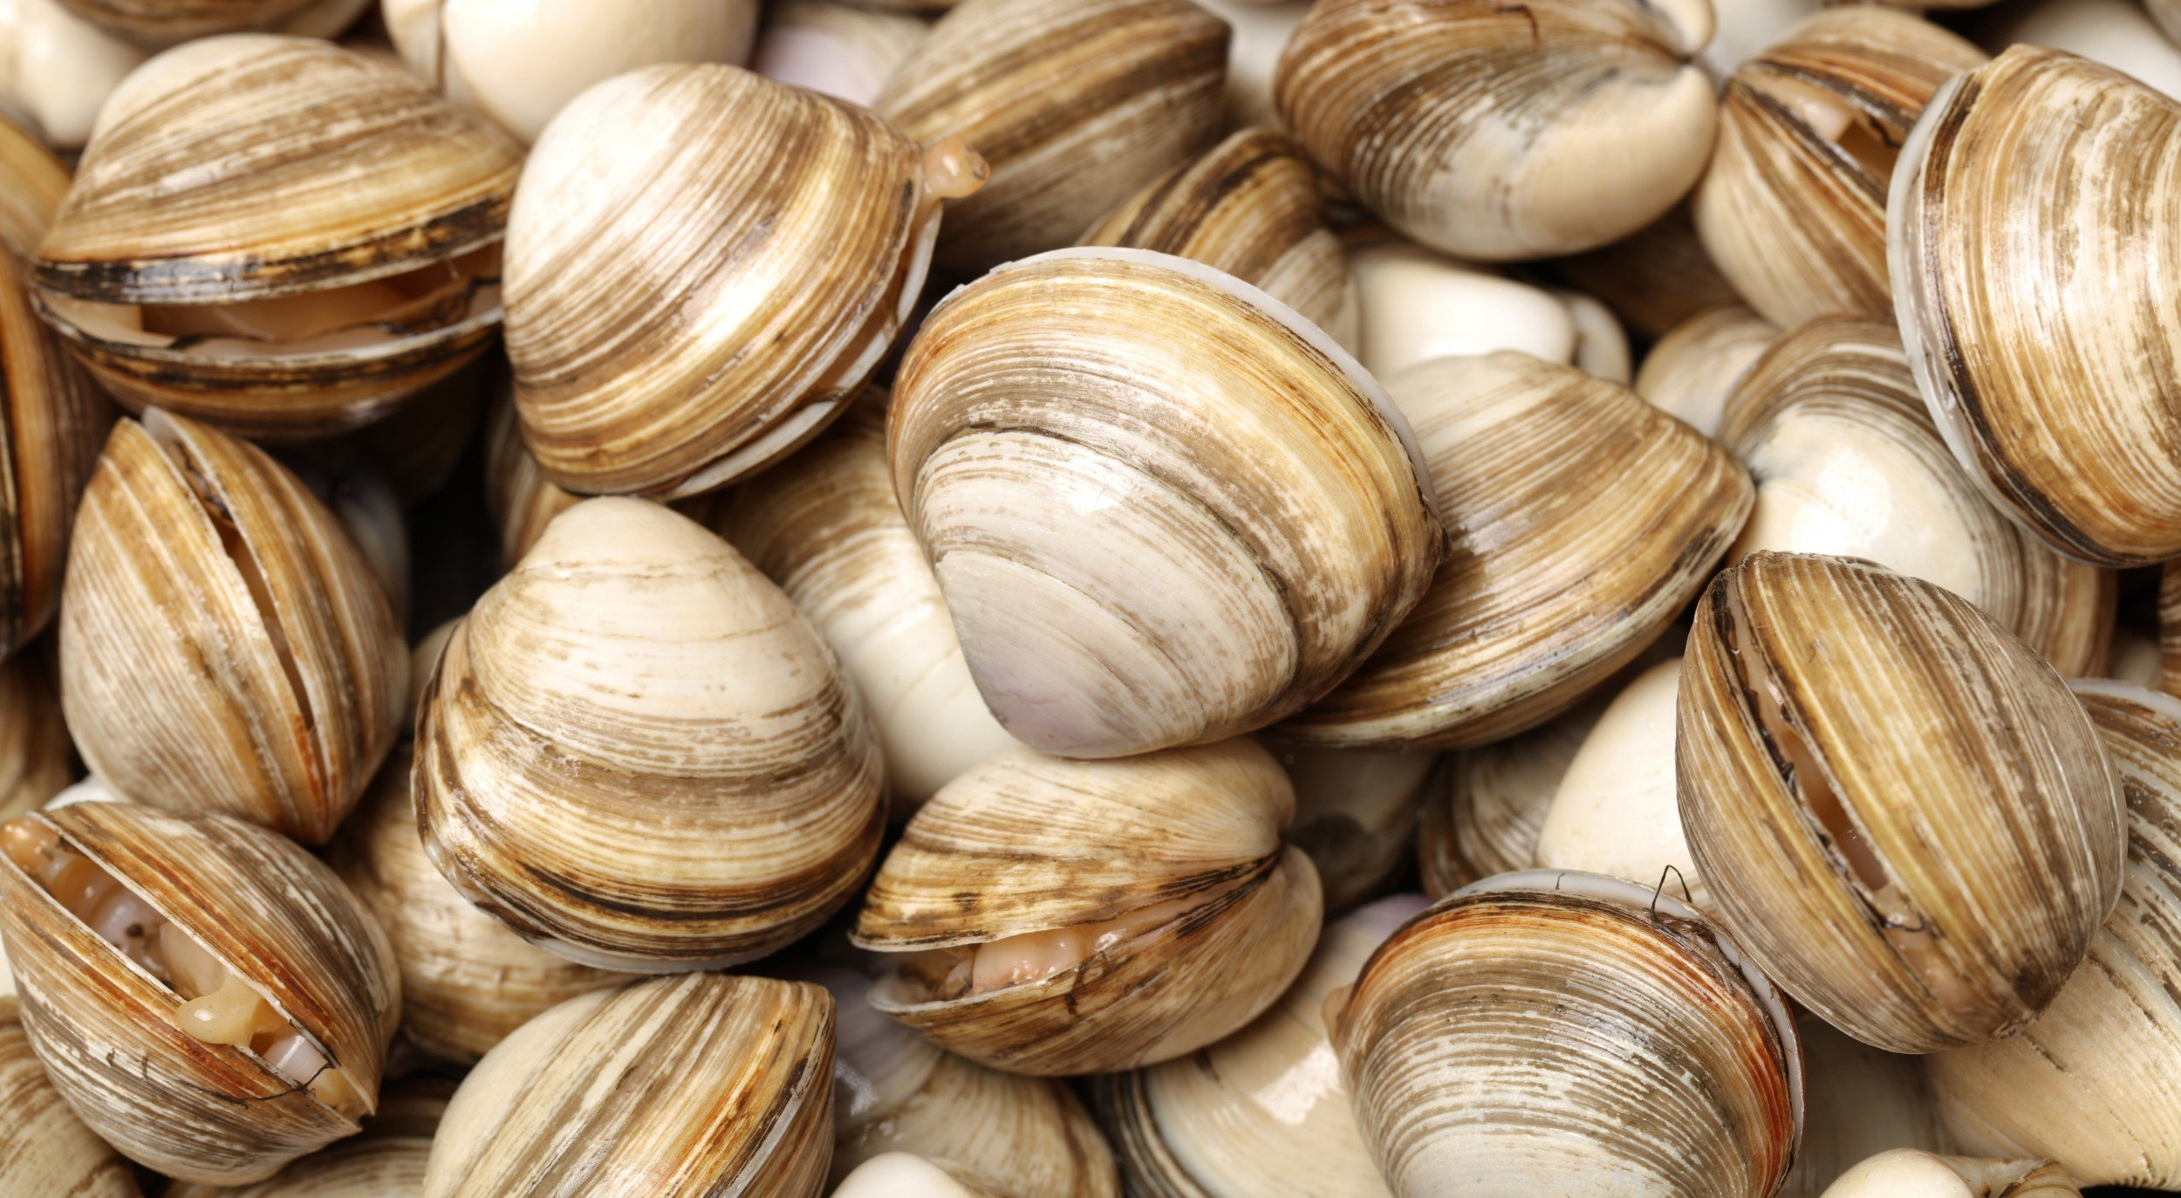
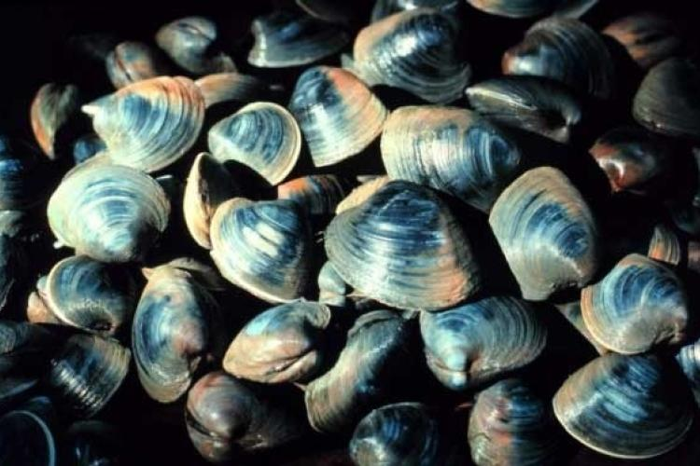
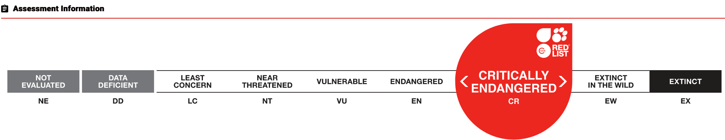
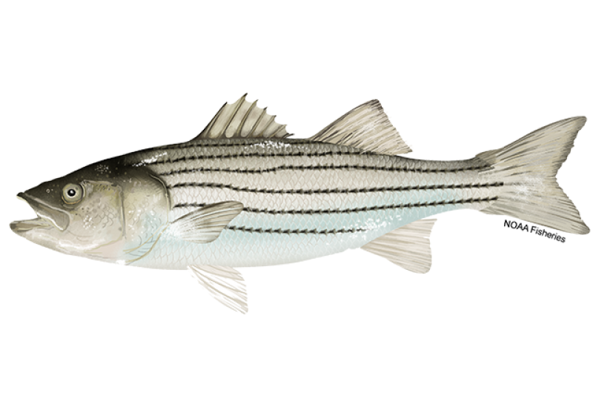
Ecological Processes and the Cold Pool
Introduction
Chapter 1
Chapter 2
Chapter 3
Summary
Growth
Spawning
Migration
North Atlantic Right Whale
Surf Clam
Yellowtail Flounder
Ocean Quahog
Striped Bass
Notes:
Like fish and invertebrates. All of these species are depending on the timing of cold pool formation and breakdown
Think of the bottom water like an air conditioner on a hot summer day→ the cold pool provides the AC for
GROWTH
Surf Clam (top left) https://www.undercurrentnews.com/2019/03/07/surf-clam-decision-helped-clearwater-end-2018-better-than-expected/
Growth and survival tied to cold pool stability throughout the year
High mortality can occur with rapid cold pool breakdown
SPAWNING
Ocean Quahogs (bottom right)
Heavy spawning associated with cold pool breakdown (Miles)
Yellowtail Flounder (top right)
Heavy spawning associated with cold pool breakdown (Miles)
MIGRATION AND FEEDING
Striped Bass (bottom left)
Critically Endangered NARW
- These two migrate though MAB region during different phases of cold pool development
These some of these species are not only ecologically important, but also commercially important

Slide 8
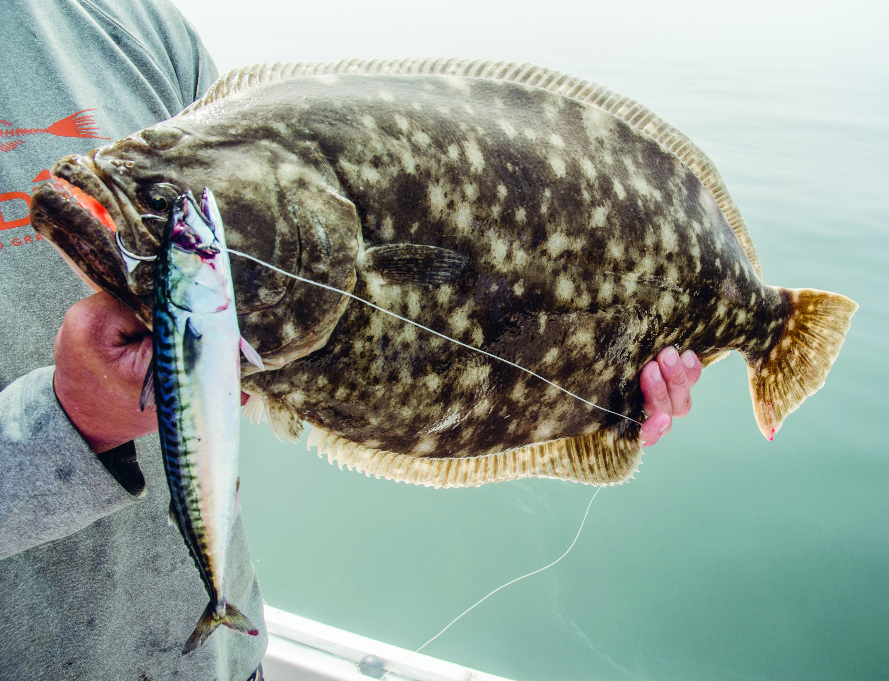
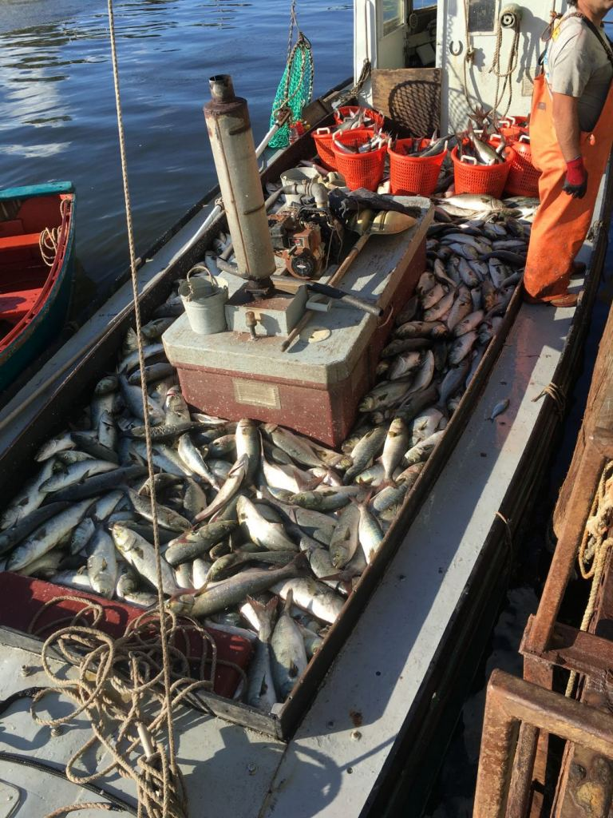
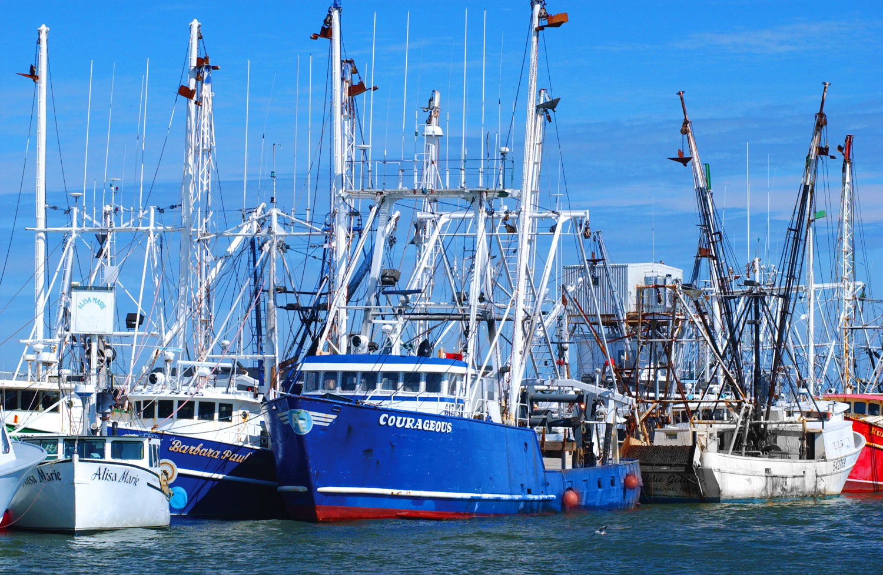
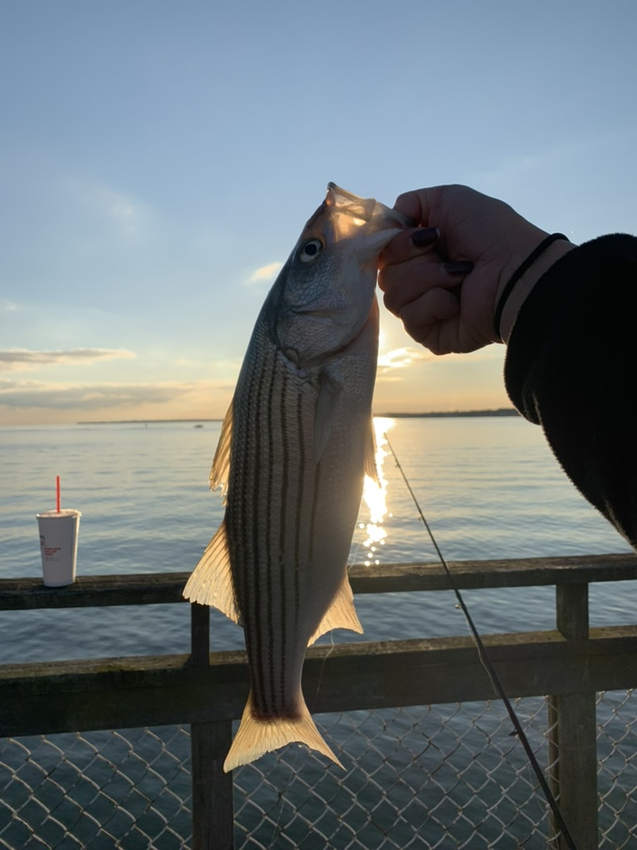
Cold Pool Supports Commercial and Recreational Fisheries
Introduction
Chapter 1
Chapter 2
Chapter 3
Summary
MAB States 2019
Commercial Fisheries Revenue
$500,000,000
Notes:
The cold pool not only supports the ecology, but it also supports the economy through commercial and recreational fishing.
States bordering the MAB alone generated $500 million in commercial fishing revenue in 2019 .
Seasonal, interannual and long-term variability in cold pool processes could lead to changes to the habitat of these commercial species, impacting the coastal economies and livelihoods they support.
https://capemaycountynj.gov/940/Commercial-Fishing
https://www.jerseysbest.com/community/harvesting-the-sea/
https://www.onthewater.com/news/2021/02/19/comment-on-the-2021-new-jersey-recreational-fluke-season-options
Title : State of the Ecosystem 2022: Mid-Atlantic
Corporate Authors(s) : Northeast Fisheries Science Center (U.S.)
Published Date : 2022
DOI : https://doi.org/10.25923/5s5y-0h81

Slide 9
The Mid Atlantic Bight and Cold Pool are Changing
Introduction
Chapter 1
Chapter 2
Chapter 3
Summary
Notes:
Several studies have shown that the bottom temperature in the MAB is warming and there are indictors that the cold pool itself is warming and shrinking,
which would be impactful to the species and industry the cold pool supports

Slide 10
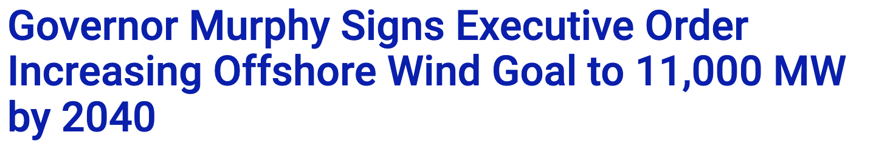
Introduction
Chapter 1
Chapter 2
Chapter 3
Summary
Climate Change in the
Cold Pool/Mid-Atlantic Bight
Notes:
To mitigate the effects of climate change, offshore wind has been proposed as a renewable energy source,
NJ specifically has an offshore wind power goal of 11,000 MW by 2040 in wind lease areas seen on the right
but with the development of offshore wind, there have been concerns raised by the community regarding the development

Slide 11
Community Research Priorities
Introduction
Chapter 1
Chapter 2
Chapter 3
Summary
Mid-Atlantic Cold Pool
Where does the Cold Pool Form and why?
Habitat
Spatial Distribution and Oceanographic Features
Baseline Information
Species Distributions, Abundances, Migratory Patterns, and Ecological Drivers
Long term trends
How abundances and distributions changes over space and time
Source: Regional Synthesis Workgroup of the Offshore Wind Environmental Technical Working Group 2022
Notes:
These questions and concerns about this have led to regional coordination between industry leaders, scientists and stake holders. Here are some priorities for research that were put together as a result of coordination
Priorities including
Understanding the seasonal dynamics of the MAB cold pool
Understanding the spatial drivers of fish distribution and of oceanographic features
Establishing a baseline of knowledge for fish residing the MAB region
And how have these abundances and distributions changed over time
To isolate the effects of offshore wind development on MAB oceanography and ecology, the community must first comprehend how the system functions prior to construction.

Slide 12
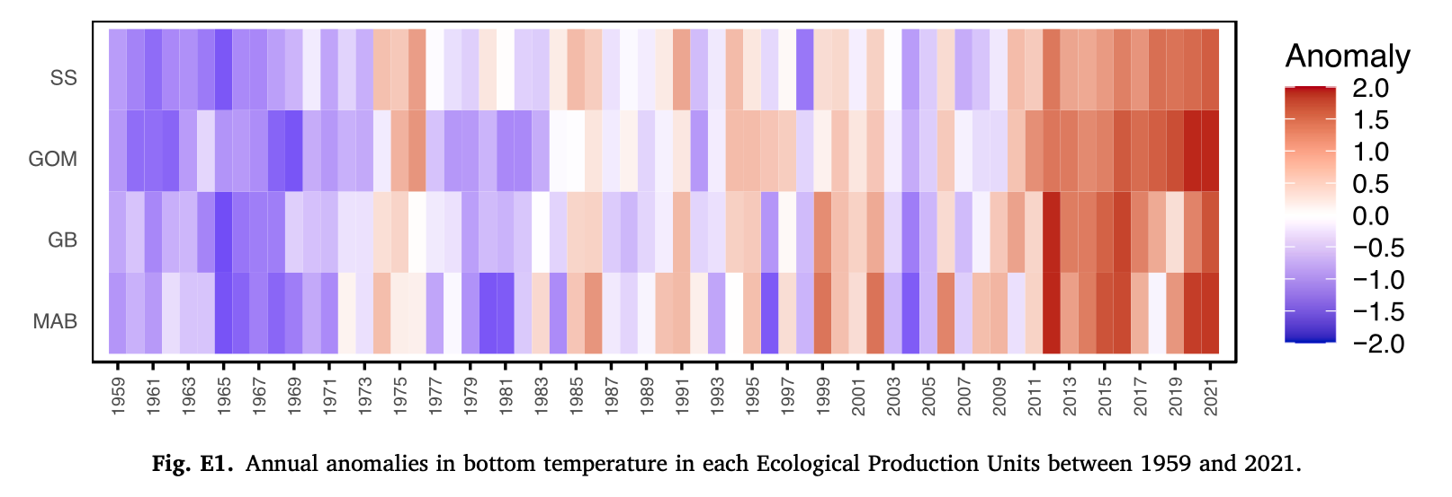
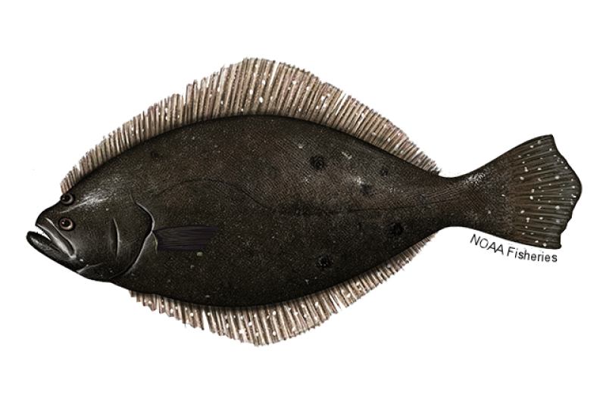
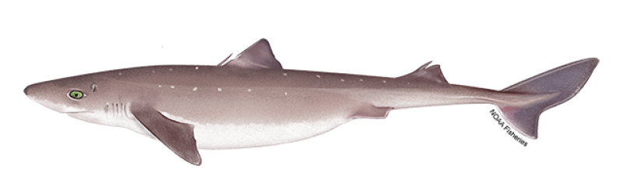
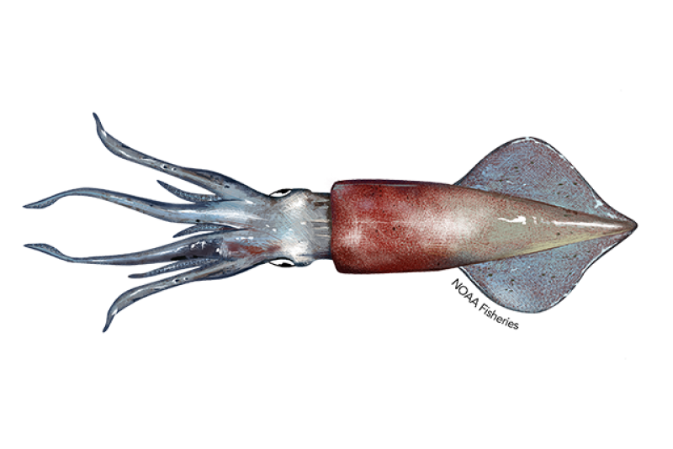
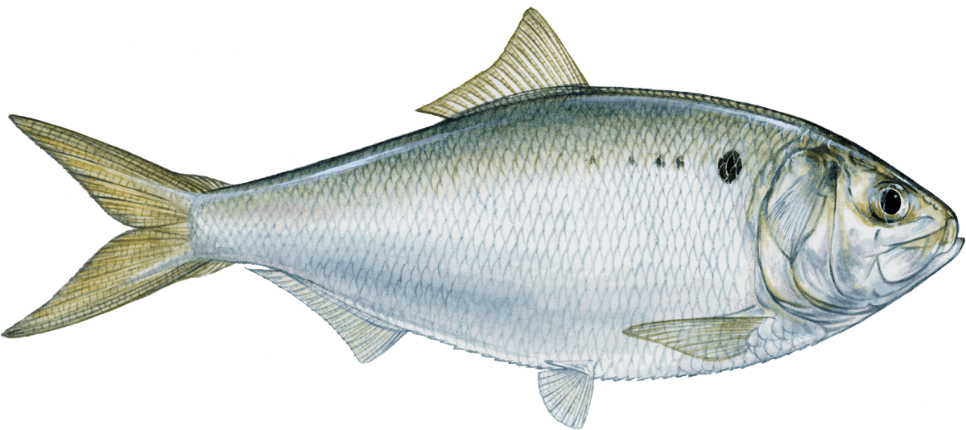
Introduction
Chapter 1
Chapter 2
Chapter 3
Summary
Chapter 1
1990
2019
(from du Pontavice et. al. 2023)
Chapter 2
Chapter 3
Migration
Presence
Notes:
To bring it all back, we have this tightly coupled system that is represented in the MAB Cold Pool
To address some of these research priorities on the previous slide, this dissertation work intends to look at commercial species over space and time in connection to seasonal cold pool dynamics in the Mid Atlantic Bight changes in commercial fish in this tightly coupled system in the Mid-Atlantic.
The First Chapter will focus on the long-term and seasonal trends of commercial species abundance and distribution in relation to the Mid-Atlantic Bight Cold Pool. This is a large view of the system
My second chapter zoom into the spring setup of the cold pool and will focus on the timing of Longfin Squid spring migration in relation to the Mid-Atlantic Bight Cold Pool spring setup.
My third chapter will then home in on the fall breakdown of the cold pool and examine the presence of Atlantic Menhaden inshore in the fall.

Slide 13
Chapter 1 Overview
Introduction
Chapter 1
Chapter 2
Chapter 3
Summary
This chapter will focus on the long-term and seasonal trends of commercial species
abundance and distribution in relation to the
Mid-Atlantic Bight Cold Pool
1990
2019
(from du Pontavice et. al. 2023)

Slide 14
Hypotheses:
Introduction
Chapter 1
Chapter 2
Chapter 3
Summary
H1: Nearshore species abundance changes over decadal time is consistent with decadal changes in seasonal stratification associated with the Cold Pool.
H2: Seasonally dependent distribution shifts can be explained by changes in the timing of cold
pool setup, intensification, and break down.
Notes:
H1: Fish abundances over time are associated with cold pool seasonal dynamics
H2: Fish distributions over time are associated with cold pool seasonal dynamics

Slide 15
Species
Introduction
Chapter 1
Chapter 2
Chapter 3
Summary
Notes:
Why these Fish
To address the proposed hypotheses, I will be using these three commercial species
These three were chosen with the advice of fisheries managers, industry leaders, and commercial fishers.
They also occur frequently in the dataset that I will be talking about in a minute
All bottom dwelling species that occupy the Mid Atlantic bight in the cold pool.
They all have particular temperature preferences, and they all have commercial value

Slide 16
Hypotheses:
Introduction
Chapter 1
Chapter 2
Chapter 3
Summary
H1: Decadal and Seasonal Trends in Fish Abundance are connected to the cold pool
H2: Decadal and Seasonal Trends in Fish Distribution are connected to the cold pool

Slide 17
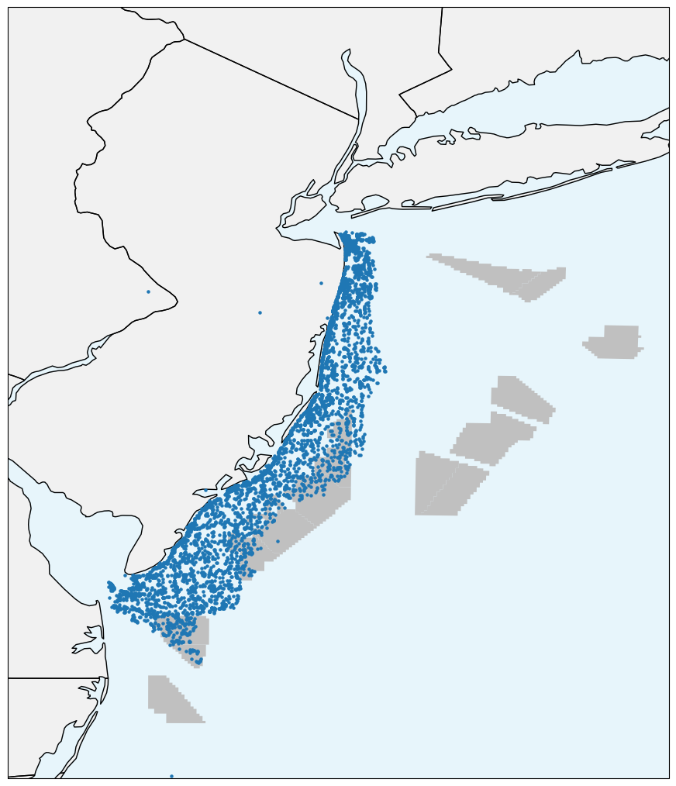
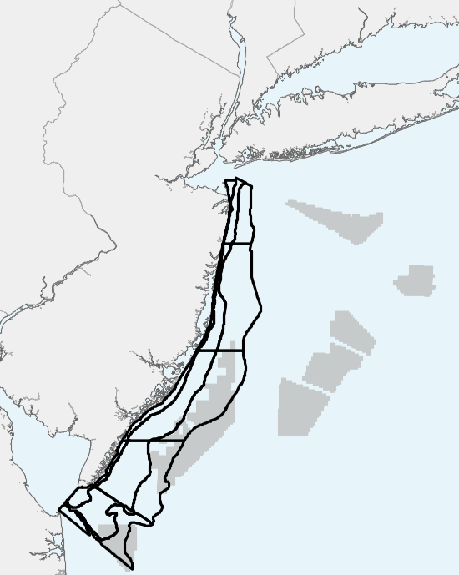
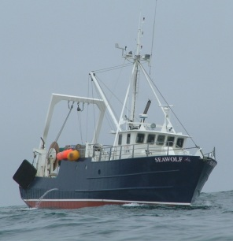
New Jersey Department of Environmental Protection
Ocean Trawl Survey
Introduction
Chapter 1
Chapter 2
Chapter 3
Summary
NJDEP Trawl
Start Locations (1990-2019)
NJDEP Trawl
Sampling Strata
Notes:
I’ll be using the New Jersey Department of environmental protections ocean trawl survey.
It’s a bottom trawl survey that is sampled 5 times a year since 1989—this captures all four seasons, which is great!
There are 15 randomly sampled strata ranging from 5-27 meters deep
Each individual tow follows the same protocols and are 20 minutes long
For this chapter, I will be focusing on years between 1990-2019 to have 3 distinct decades
The species chosen are all sampled frequently in the survey as well
The survey itself collects fisheries and oceanographic data, like number of fish caught and surface/bottom temperature

Slide 18
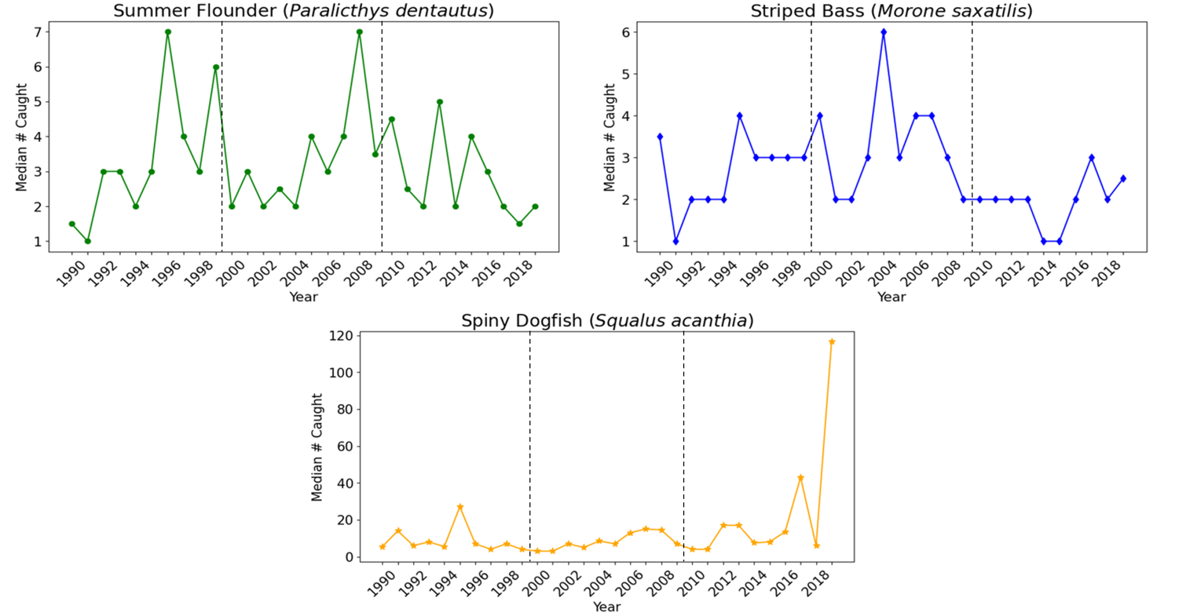
Introduction
Chapter 1
Chapter 2
Chapter 3
Summary
Median Number of Fish Caught per year (H1)
Survey occurs
5x per year!
Notes:
From these data, I will be looking at baseline trends in abundance over decades
*orient to the figure*
There are changes between years and between decades and
because it is sampled so frequently, we can look deeper into seasonal dynamics.

Slide 19
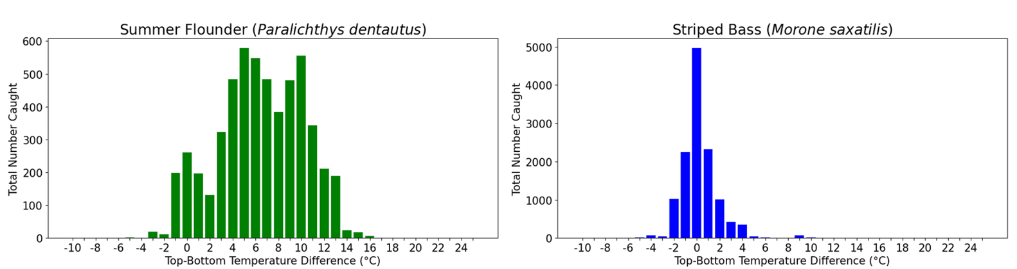
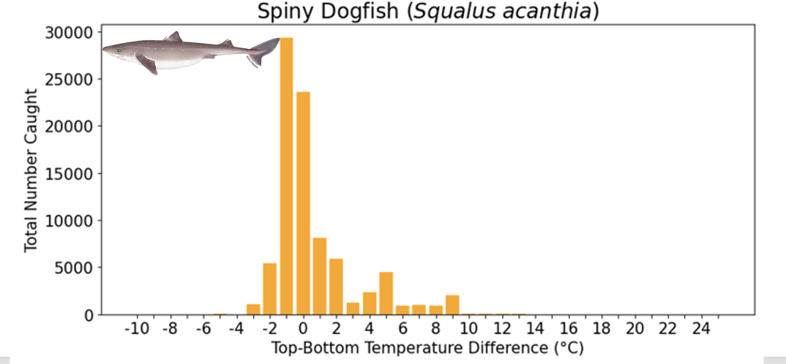
Introduction
Chapter 1
Chapter 2
Chapter 3
Summary
Certain Species Favoring a Stratified Water Column?
Notes:
We can also examine abundances compared to water column conditions! Do the fish care about a stratified water column?
*orient to figure*
Cumulative number caught
Top-Bottom temperature bins
values near 0 means that the surface and bottom temperatures are nearly the same

Slide 20
Introduction
Chapter 1
Chapter 2
Chapter 3
Summary
H1: Decadal and Seasonal Trends in Abundance
1990
2019
(from du Pontavice et. al. 2023)
(from Castelao et al. 2008)
Notes:
So the first hypothesis for this chapter is focused on the decade and seasonal trends of fish abundances
throughout the 30-year time series in relation to the cold pool set up and breakdown

Slide 21
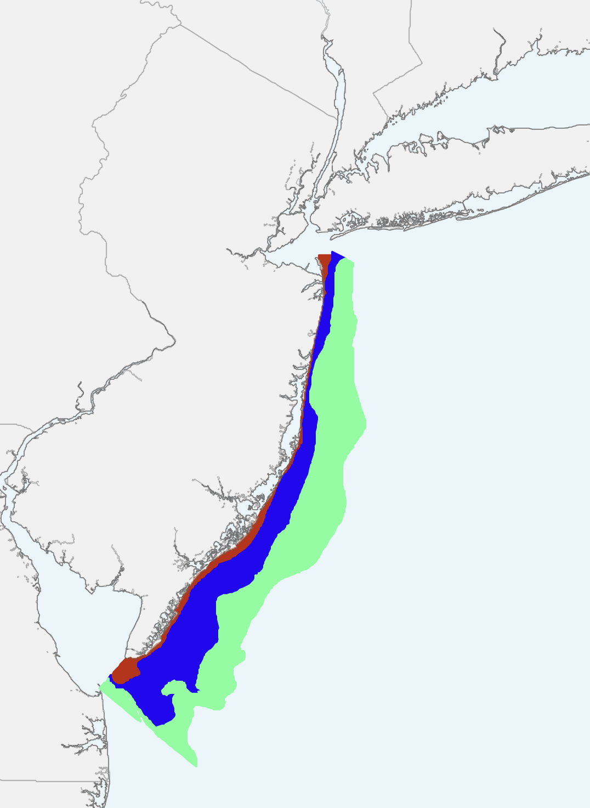
H2: Decadal and Seasonal Trends in Distribution
Introduction
Chapter 1
Chapter 2
Chapter 3
Summary
1990
2019
Inshore
Mid-Shore
Offshore
(from du Pontavice et. al. 2023)
Notes:
While my second hypothesis will focus on the decadal and seasonal trends of distribution,
focusing on inshore, mid-shore and offshore regions of the trawl survey that are predefined by DEP

Slide 22
Chapter 1 Recap
Introduction
Chapter 1
Chapter 2
Chapter 3
Summary
Hypotheses:
Fish:
-ics :
Data:
H1: Decadal and Seasonal Trends in Abundance
H2: Decadal and Seasonal Trends in Distribution
Summer Flounder
Striped Bass
Spiny Dogfish
Cold Pool
Phenology
NJ DEP Trawl Survey
Notes:
To sum up my first chapter.
I’ll be examining the decadal and seasonal trends in both abundance and distribution using summer flounder, striped bass, and spiny dogfish as representative fish for the region.
These trends will be examined in connection with the seasonal changes of the MAB cold pool using the NJDEP trawl survey dataset

Slide 23
Chapter 2 Overview
Introduction
Chapter 1
Chapter 2
Chapter 3
Summary
This chapter will focus on the timing of
Longfin Squid spring migration in relation to the
Mid-Atlantic Bight Cold Pool spring setup.
Chapter 2
Migration
Notes:
Now onto chapter 2 This chapter will focus on the timing of longfin squid spring migration in connection with the springtime cold pool setup

Slide 24
Hypothesis:
Introduction
Chapter 1
Chapter 2
Chapter 3
Summary
H1: The timing of spring migration of longfin squid is set by temperature and
stratification thresholds associated with the timing of the cold pool setup across the mid-shelf.
Notes:
For this chapter my hypothesis is that the timing of the squid inshore migration and the timing of the cold pool spring set up are around the same time across the mid-shelf

Slide 25
Introduction
Chapter 1
Chapter 2
Chapter 3
Summary
Notes:
Atlantic Longfin are a short-lived squid species that reside in the MAB,
Longfin were chosen at the recommendation of fishers and scientists
They seasonally migrate inshore in the spring and back offshore in the fall
Like the species in Chapter 1, longfin have temperature preferences
Longfin have a high commercial value as they are calamari and are exported around the world

Slide 26
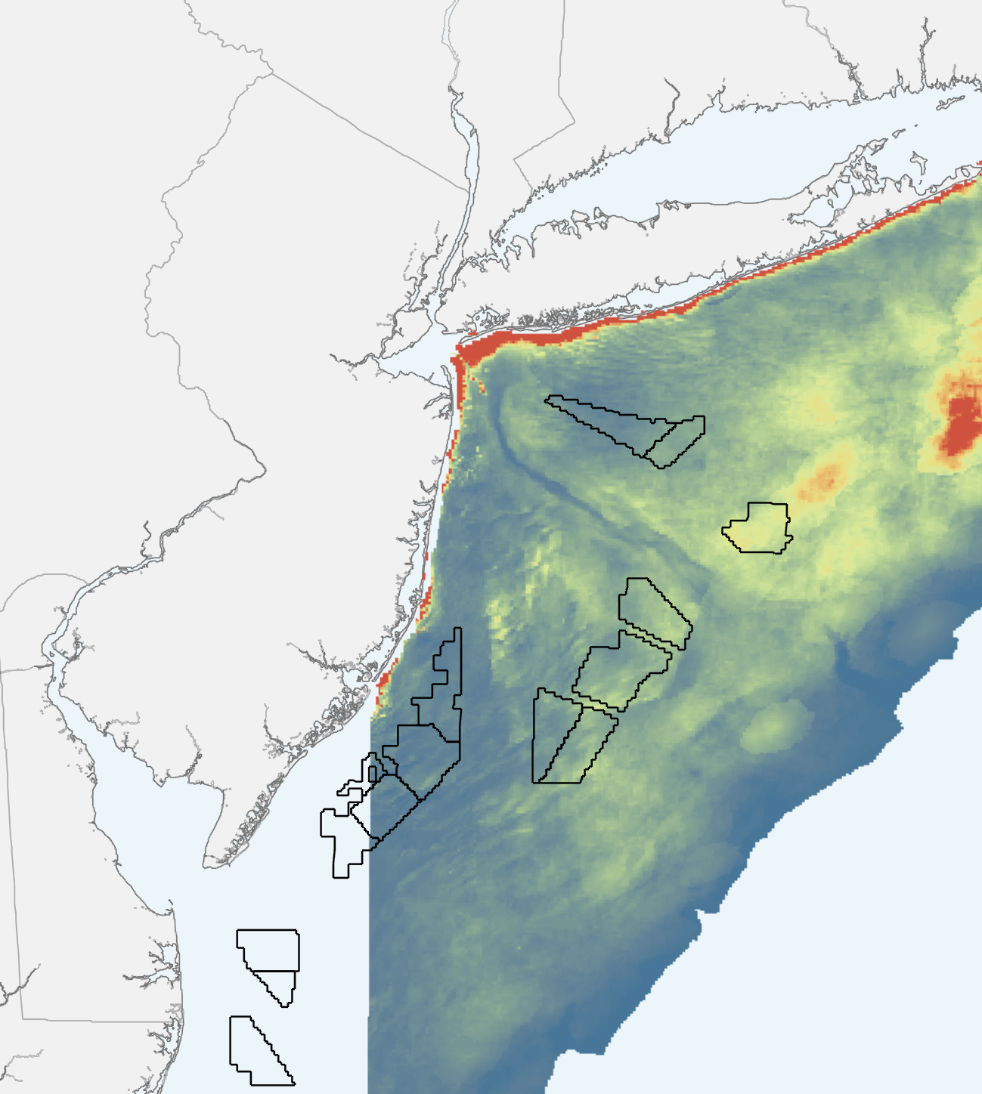
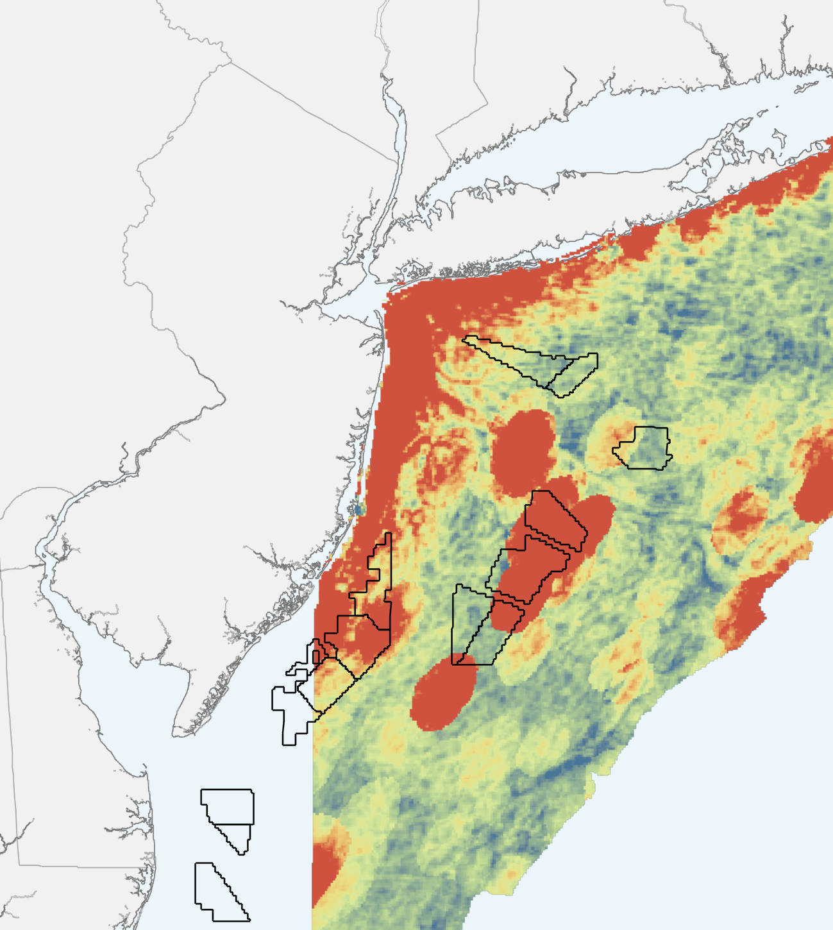
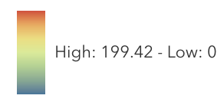
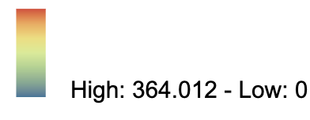
Lease Area Overlap?
Introduction
Chapter 1
Chapter 2
Chapter 3
Summary
Longfin Squid
Predictive Relative Fall Abundance
Longfin Squid
Predictive Relative Spring Abundance
Does this happen when the cold pool sets up?
(from NYDOS Model)
(from NYDOS Model)
Notes:
The fishing industry fears that longfin will be displaced by offshore wind as the longfin occupy regions where planned development is set to occur.
These maps are of the Predictive Fall and Spring Abundances on the left and right
Reds indicate higher abundance
This research is looking to better understand the dynamics of the squid prior to the construction of offshore wind
when the squid migrate inshore in the spring, when those blues become red
In the spring when the cold pool shows up these squid show up—> is the timing of this movement the same
Right Map from https://arcg.is/HWSP4

Slide 27


Hypothesis:
Introduction
Chapter 1
Chapter 2
Chapter 3
Summary
H1: Timing of Cold Pool Setup and Squid Spring Migration are connected
Notes:
In the spring when the cold pool shows up these squid show up—> is the timing of this movement the same

Slide 28
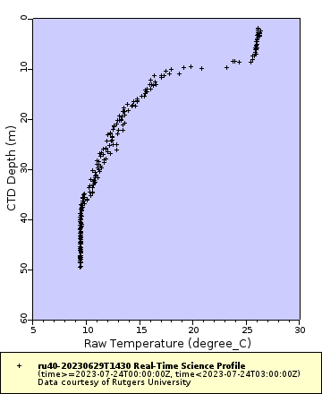
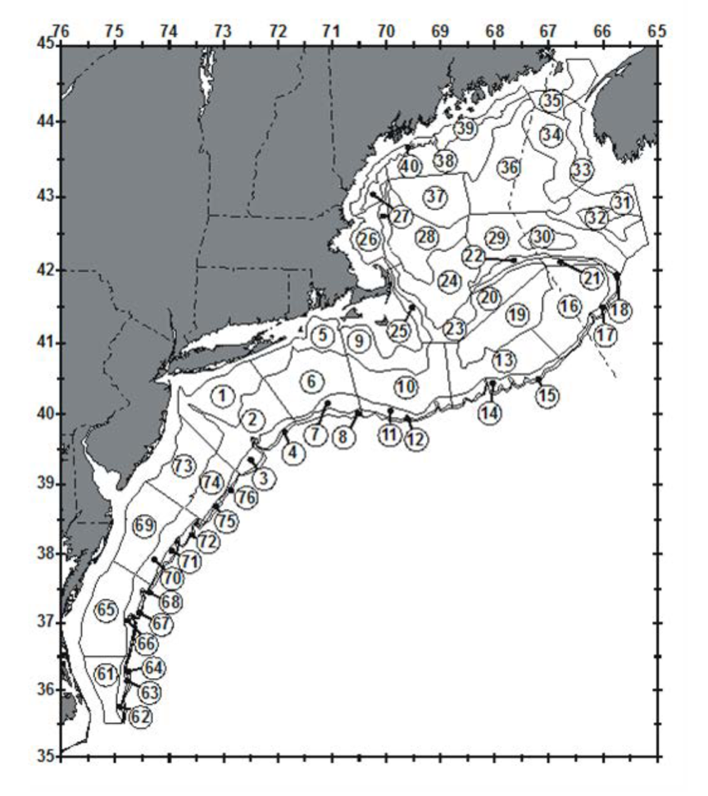
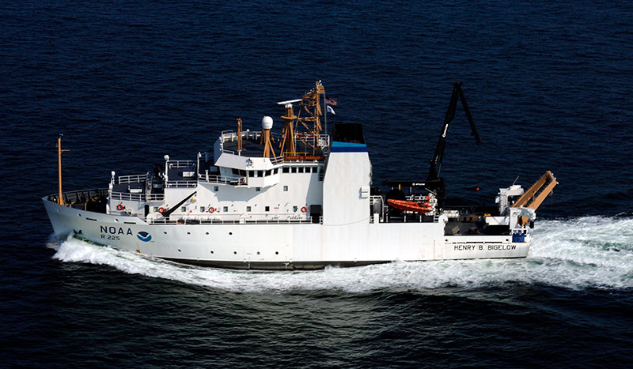
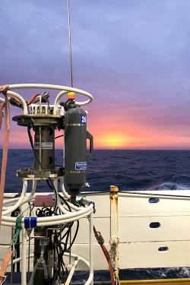

Methods
Introduction
Chapter 1
Chapter 2
Chapter 3
Summary
Focusing on these Strata
Credit: NOAA Fisheries/Christine Kircun
Extent of NEFSC Bottom Trawl Survey (from NEFSC 2019)
Example CTD profile from ru40 glider
Notes:
To address my hypothesis and maybe some concerns, I’ll be using the Northeast fisheries science center spring ocean trawl survey.
The survey has occurred since 1968 and in the regions seen on the map to the left.
In the spring the survey begins in late March/early April, which is aligned with the typically cold pool setup in the spring
Similar to the DEP survey,
This survey uses sampling strata that are randomly selected and individual tows follow the same methods
this NEFSC survey collects fisheries data through a bottom trawl and oceanographic data through conductivity, temperature and depth casts to produce temperature profiles as seen on the right.
For this research, I will be looking at the timing of when squid arrive inshore and comparing that to the cold pool conditions at that time

Slide 29
Methods
Introduction
Chapter 1
Chapter 2
Chapter 3
Summary
Focusing on these Strata
Credit: NOAA Fisheries/Christine Kircun
Extent of NEFSC Bottom Trawl Survey (from NEFSC 2019)
Example CTD profile from ru40 glider
Notes:
To address my hypothesis and maybe some concerns, I’ll be using the Northeast fisheries science center spring ocean trawl survey.
The survey has occurred since 1968 and in the regions seen on the map to the left.
In the spring the survey begins in late March/early April, which is aligned with the typically cold pool setup in the spring
Similar to the DEP survey,
This survey uses sampling strata that are randomly selected and individual tows follow the same methods
this NEFSC survey collects fisheries data through a bottom trawl and oceanographic data through conductivity, temperature and depth casts to produce temperature profiles as seen on the right.
For this research, I will be looking at the timing of when squid arrive inshore and comparing that to the cold pool conditions at that time

Slide 30
Chapter 2 Recap
Introduction
Chapter 1
Chapter 2
Chapter 3
Summary
Hypothesis:
Invert:
-ics :
Data:
H1: Timing of Cold Pool Setup and Squid Spring Migration are connected
Atlantic Longfin Inshore Squid
Cold Pool Spring Setup
NEFSC Spring Trawl Survey
29
Notes:
To recap chapter 2, I’m assessing whether the timing of the spring cold pool set up and the timing of squid inshore migration is connected
I’m using the Longfin squid as a representative species
The –ics is the cold pool spring set up and I will be using the NEFSC trawl survey

Slide 31
Chapter 3 Overview
Introduction
Chapter 1
Chapter 2
Chapter 3
Summary
This chapter will assess the potential relationship between the timing of Cold pool fall breakdown
and the presence of Atlantic menhaden in the winter
Chapter 3
Presence

Slide 32
Hypothesis
Introduction
Chapter 1
Chapter 2
Chapter 3
Summary
H1: Increased Menhaden presence in the late fall and winter is due to warmer temperatures associated with the changes in the timing of fall cold pool breakdown.

Slide 33
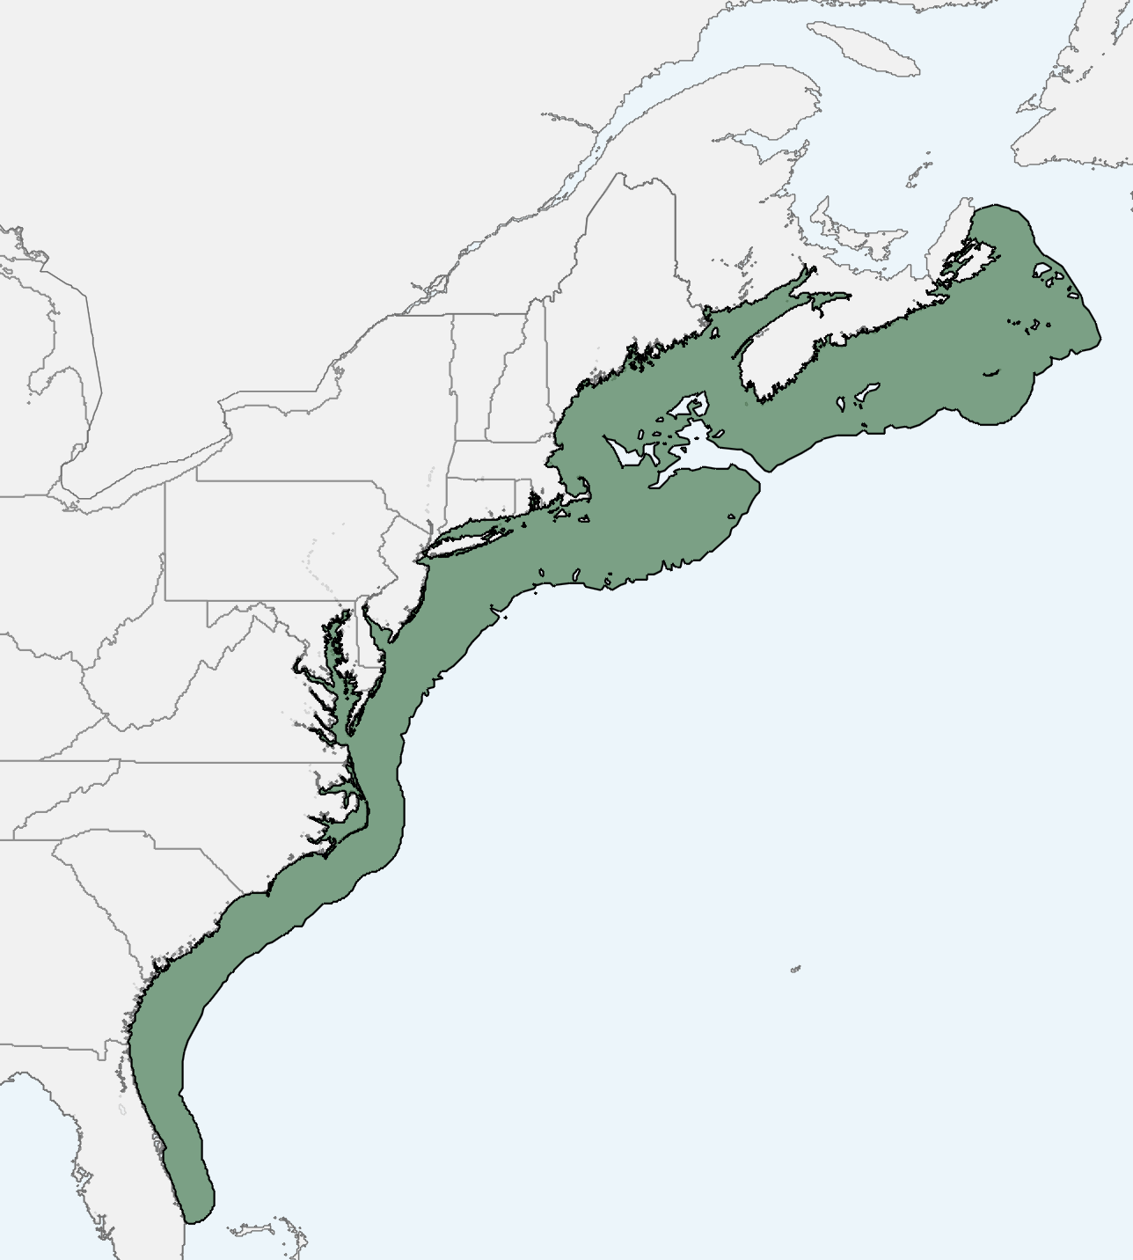
Introduction
Chapter 1
Chapter 2
Chapter 3
Summary
Atlantic Menhaden Habitat Range along the
East Coast, USA
Notes:
The Atlantic Menhaden are a pelagic forage fish
Omega Protien and bait
Map from. https://services9.arcgis.com/Y4YP7jRuZ0IpxFZH/arcgis/rest/services/Menhaden_Habitat/FeatureServer/2

Slide 34
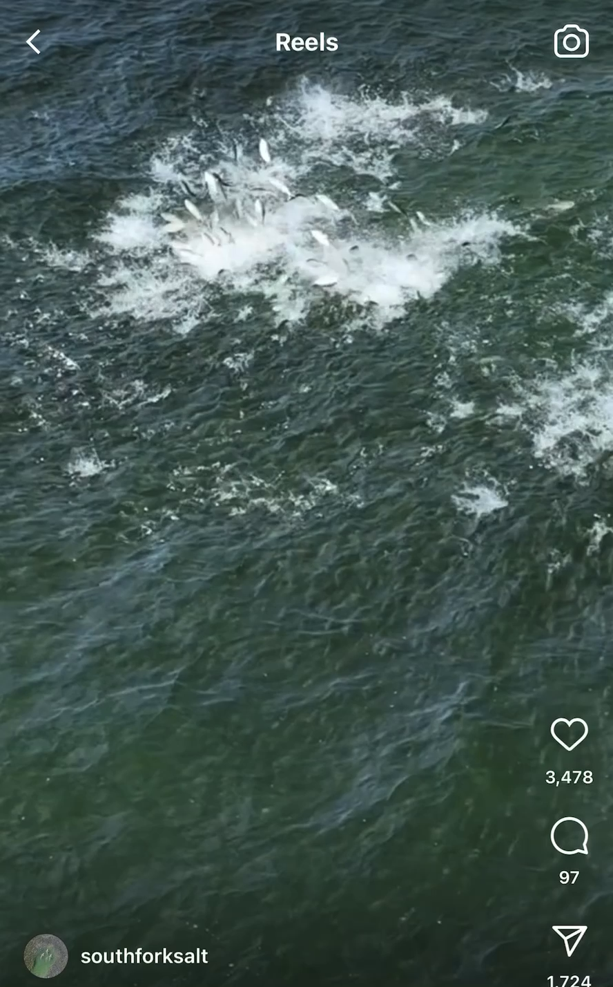
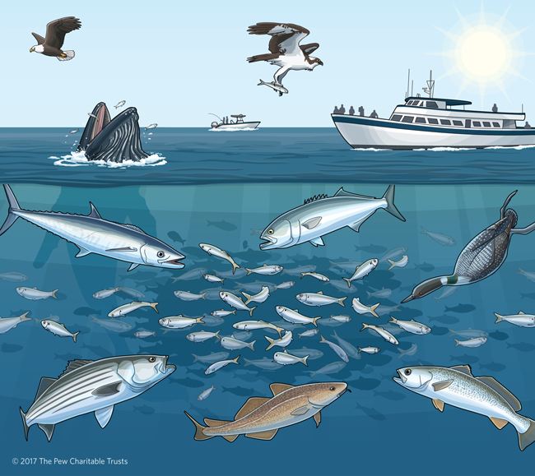
Menhaden are Important Prey
Introduction
Chapter 1
Chapter 2
Chapter 3
Summary
Video Credit to Tim Regan
@southforksalt on Instagram
Notes:
Lots of humpback strandings recently, Humpbacks follow where the prey are going so
understanding the dynamics of the prey is important to understand the dynamics of the predator
https://www.cbf.org/blogs/save-the-bay/2020/03/its-time-to-account-for-menhadens-role-in-the-ecosystem.html
https://www.nature.org/en-us/about-us/where-we-work/united-states/new-york/stories-in-new-york/menhaden-whales-return-new-york/

Slide 35
Hypothesis
Introduction
Chapter 1
Chapter 2
Chapter 3
Summary
Timing of Cold Pool Breakdown and Menhaden Winter Inshore Presence are connected
Notes:
To do this I’m going to compare menhaden precense and the cold pool

Slide 36
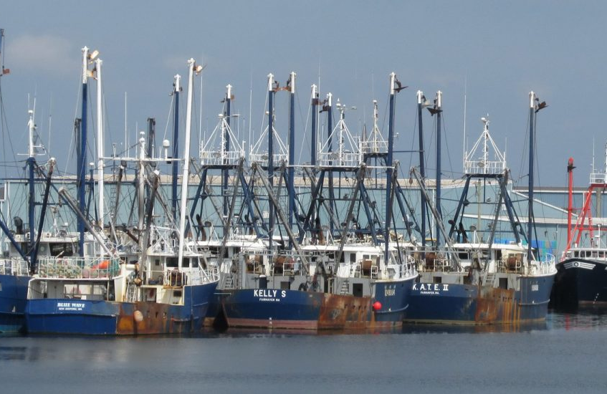
Fisheries-Dependent Catch Data
Introduction
Chapter 1
Chapter 2
Chapter 3
Summary
Data Includes:
  Location
  Date of Sampling
  # hours fished
  Distance from shore
  Area fished
Data will be binned into 1 km spatial bins
Focus on 2010-2019
  *depending on data availability*
Fish Presence/Absence
Notes:
Fisheries-Dependent Catch Data, or commercial fishing reports from boats
Focus on presence/absence bc targeted effort
This data will provide me with
Talk about the catch data-–confidentiality

Slide 37

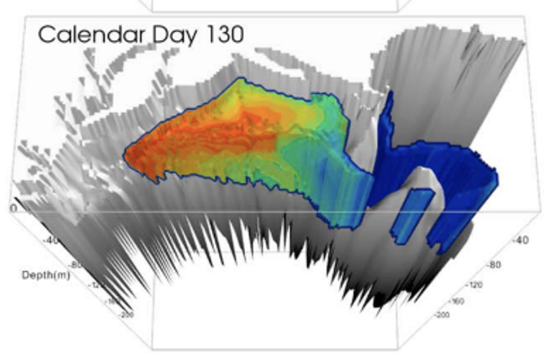
Temperature Model and Observations
Introduction
Chapter 1
Chapter 2
Chapter 3
Summary

Slide 38
Does the timing of breakdown affect fish presence?
Introduction
Chapter 1
Chapter 2
Chapter 3
Summary
(from Chen et. al. 2018)
Presence/Absence in the Fall
When did the cold pool breakdown?
Notes:
Does the presecne of the cold pool matter to the fish
Does cold pool breakdown in a given year explain the distribution of bunker later that year

Slide 39
Chapter 3 Recap
Introduction
Chapter 1
Chapter 2
Chapter 3
Summary
Hypothesis:
Fish:
-ics :
Data:
H1: Timing of Cold Pool Breakdown and Menhaden Winter Presence are connected
Atlantic Menhaden
Cold Pool Fall Breakdown
Fisher Catch Data
ROMS-NWA Temperature Model
NEFSC Fall Survey CTD
Glider Observations

Slide 40
Introduction
Chapter 1
Chapter 2
Chapter 3
Summary
Chapter 1
1990
2019
(from du Pontavice et. al. 2023)
Chapter 2
Chapter 3
Migration
Presence
Notes:
To bring it all back, we have this tightly coupled system that is represented in the MAB Cold Pool
this dissertation work intends to look at commercial species over space and time in connection to seasonal cold pool dynamics in the Mid Atlantic Bight changes in commercial fish in this tightly coupled system in the Mid-Atlantic.
The First Chapter will focus on the long-term and seasonal trends of commercial species abundance and distribution in relation to the Mid-Atlantic Bight Cold Pool. This is a large view of the system
My second chapter zoom into the spring setup of the cold pool and will focus on the timing of Longfin Squid spring migration in relation to the Mid-Atlantic Bight Cold Pool spring setup.
My third chapter will then home in on the fall breakdown of the cold pool and examine the presence of Atlantic Menhaden inshore in the fall.

Slide 41
Thank you!
Introduction
Chapter 1
Chapter 2
Chapter 3
Summary
Samantha Alaimo
2 August 2023
Ph.D. Dissertation Proposal
Rutgers University
Department of Marine and Coastal Science
Dissertation Committee:
Dr. Josh Kohut (advisor)
Dr. Daphne Munroe
Dr. Travis Miles
Dr. Grace Saba
Dr. David Secor (University of Maryland)
Notes:
Introduce, Name Rutgers, PhD

Slide 42
Outline
Introduction
Chapter 1
Chapter 2
Chapter 3
Summary
Introduction
Chapter 1
  Establishing a Baseline: exploring trends in commercial fish distribution and the Mid-Atlantic Bight cold pool over the last for 30 years.
Chapter 2
  Longfin Squid (Doryteuthis (Amerigo) pealeii ) seasonal spring migration and cold pool setup
Chapter 3
  Bunker (Brevoortia tyrannus) presence in the fall in connection with Mid-Atlantic cold pool breakdown

Slide 43
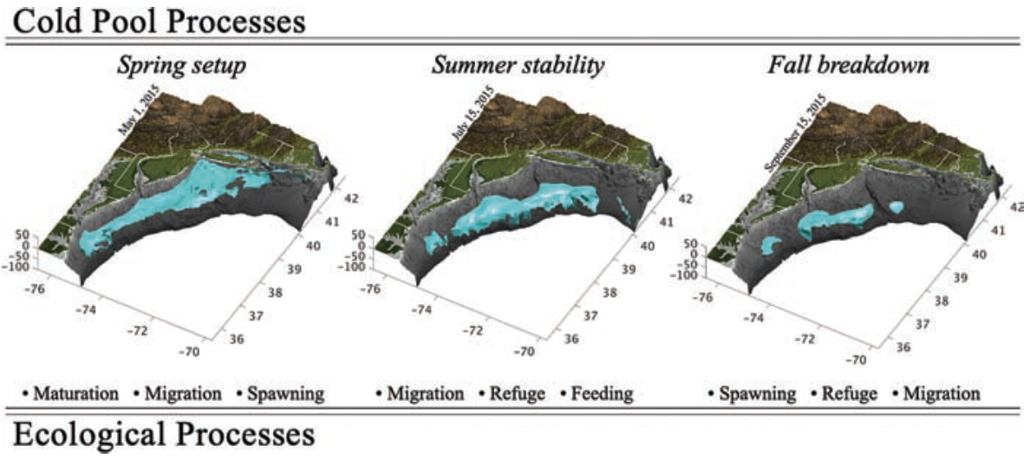
Cold Pool is a Key Driver of Biology
Introduction
Chapter 1
Chapter 2
Chapter 3
Summary
(from Miles et. al. 2021)
Notes:
Depending on the season, the cold pool provides different ecological services for different species.

Slide 44
Chapter 1:
Establishing a Baseline: exploring trends in commercial fish distribution and the Mid-Atlantic Bight cold pool over the last for 30 years.
Introduction
Chapter 1
Chapter 2
Chapter 3
Summary

Slide 45
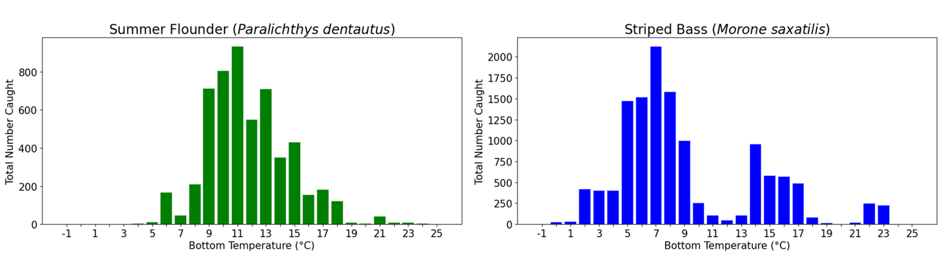

Total Number of Fish Caught at Different Bottom Temperatures
Introduction
Chapter 1
Chapter 2
Chapter 3
Summary
Notes:
We can also look at abundances in relation to different oceanographic conditions
*orient to figure*
Cumulative number caught
Bottom temperature bins

Slide 46
Chapter 2:
Longfin Squid
(Doryteuthis (Amerigo) pealeii) seasonal spring migration and cold pool setup
Introduction
Chapter 1
Chapter 2
Chapter 3
Summary

Slide 47

Climate Concerns
Introduction
Chapter 1
Chapter 2
Chapter 3
Summary
Ocean Acidification =
Smaller Squid/Abnormal Growth
(from Kaplan et. al. 2013)
Notes:
There are concerns for longfin surrounding climate change and offshore
While longfin are expected to do well in a warming ocean, ocean acidification due to climate change can lead to abnormal squid growth according to a study by Kaplan et. al. 2013.
Right Map from https://arcg.is/HWSP4

Slide 48
Chapter 3:
Bunker presence in the fall in connection with Mid-Atlantic cold pool breakdown
Introduction
Chapter 1
Chapter 2
Chapter 3
Summary

Slide 49

Nickname: Bunker
Temperature Range: Wide
Fisheries Landings (lbs): 430 million
*Largest Fishery Landings, by volume on Atlantic Coast*
Fishery Status: Not Overfished
Predators: Striped Bass, Humpback Whales
Atlantic Menhaden
(Brevoortia tyrannus)
Nickname: Loligo, calamari
Temperature Range: 8 to 16°C
Fisheries Landings (lbs): 23 million
Fisheries Value: $33 million
Fishery Status: Not Overfished
Life-Span: 1 to 2 years
Atlantic Longfin Inshore Squid
(Doryteuthis (Amerigo) pealeii)
Longfin Squid
Predictive Relative Spring Abundance
Nickname: Fluke
Temperature Range: 2 to 28°C
Fisheries Landings (lbs): 15 million
Fisheries Value: $25 million
Fishery Status: Not Overfished
Prey: Opportunistic Feeders
Nicknames: Striper, Rockfish
Temperature Range: 16 to 20°C
Fisheries Landings (lbs): 19 million
Fisheries Value: $13 million
Fishery Status: Overfished
Prey: Opportunistic Feeders
Summer Flounder
(Paralichthys dentatus)
Striped Bass
(Morone saxatilis)

Slide 50
Nickname: Cape Dogfish
Temperature Range: 7 to 15°C
Fisheries Landings (lbs): 11 million
Fisheries Value: $2 million
Fishery Status: Not Overfished
Prey: Opportunistic Feeders
Spiny Dogfish
(Squalus acanthias)
1959
2021
Atlantic Menhaden Habitat Range along the
East Coast, USA
(from du Pontavice et. al. 2023)

Slide 51
Introduction
Chapter 1
Chapter 2
Chapter 3
Summary
Chapter 1
Chapter 2
Chapter 3
Biology:
Summer Flounder,
Striped Bass, Spiny Dogfish
Biology:
Longfin Inshore Squid
Biology:
Atlantic Menhaden
Physics:
Cold Pool Phenology
Physics:
Cold Pool Spring Setup
Physics:
Cold Pool Fall Breakdown
Focus:
Changes in abundance and distribution over 30 years
Focus:
Timing of longfin Spring Migration and Cold Pool Setup
Focus:
Fall Presence of Bunker and timing of Cold Pool Breakdown
Data:
NJ DEP Trawl Survey
Data:
NEFSC Spring Trawl Survey
Data:
ASCCP Fisher Catch Data and ROMS-NWA model output

