Slide 1
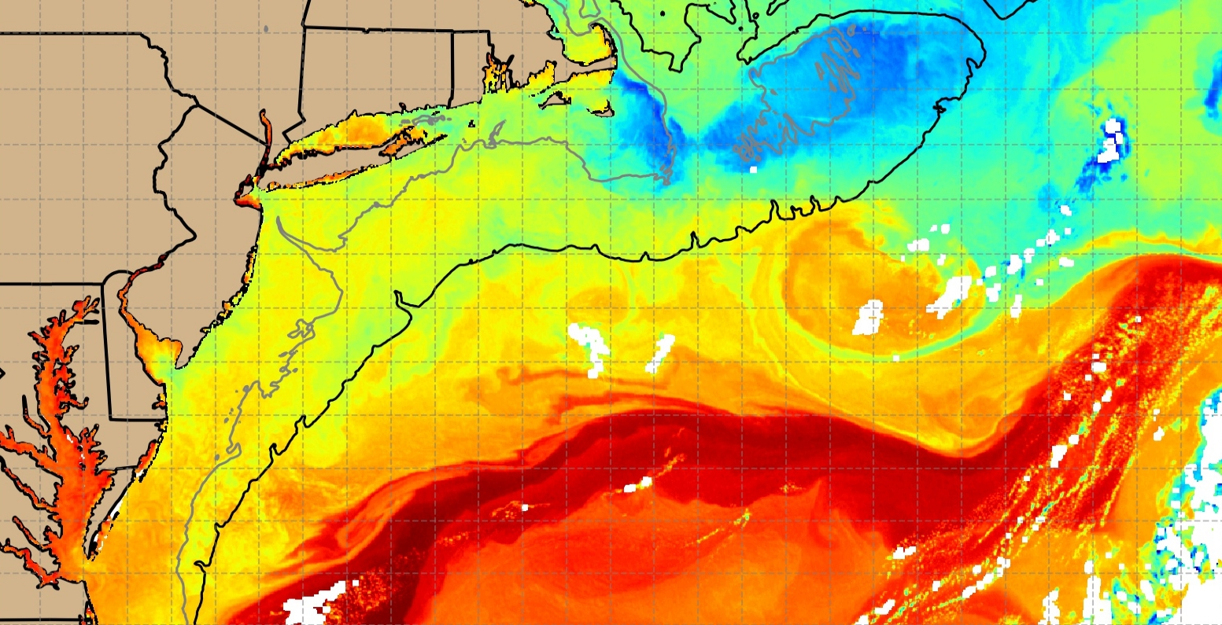
RUCOOL
Offshore Wind
Habitat & Ecosystem Efforts
September 21, 2023
RWSC Habitat & Ecosystem Subcommittee
Josh Kohut, Mike Crowley, Kaycee Coleman
Rutgers University Center for Ocean Observing Leadership

Slide 2
Main Message Today
Observatories and partnerships within those observatories exist
We can leverage them to better understand dynamic ocean habitats

Slide 3
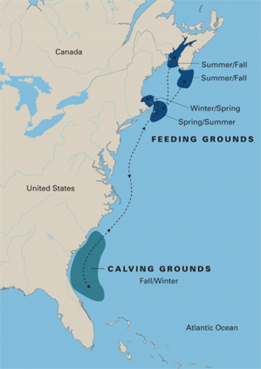
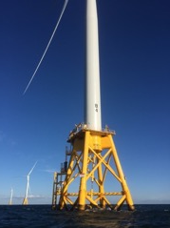
Tracking dynamic seascapes to inform offshore wind development
The Evolving Plan
The Dynamic Environment
The Dynamic Ecology
Right Whale Migration
State Commitments: ~39 GW by 2040
Federal Goal: 30 GW by 2030
Sources: DOE 2021 Offshore Wind Market Report and NCSL
As of August 2021

Slide 4
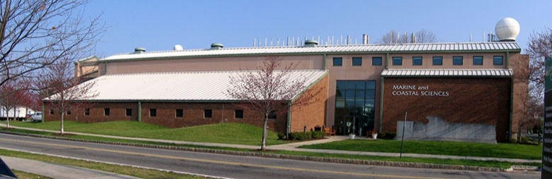
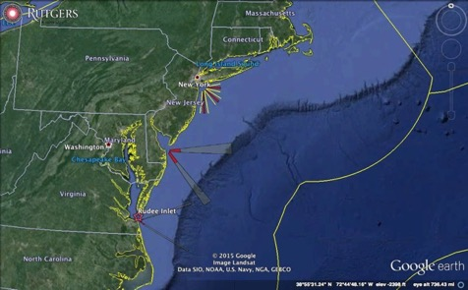

31 Years of Ocean Observing at:
Rutgers University (RU)
Center for Ocean Observing Leadership (COOL)
Department of Marine and Coastal Sciences (DMCS)
71 Dudley Road, New Brunswick, New Jersey, USA
http://rucool.marine.rutgers.edu

Slide 5
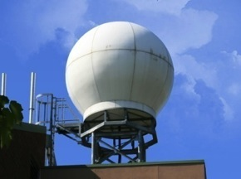
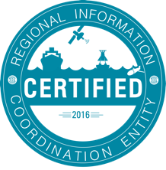
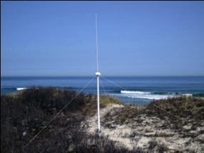
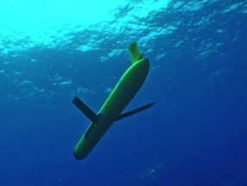

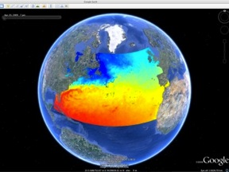

Ocean Observing in the Mid-Atlantic
Satellite Ground Stations
Satellite Ground Stations
CODAR Network
Glider Fleet
3-D Forecasts

Slide 6
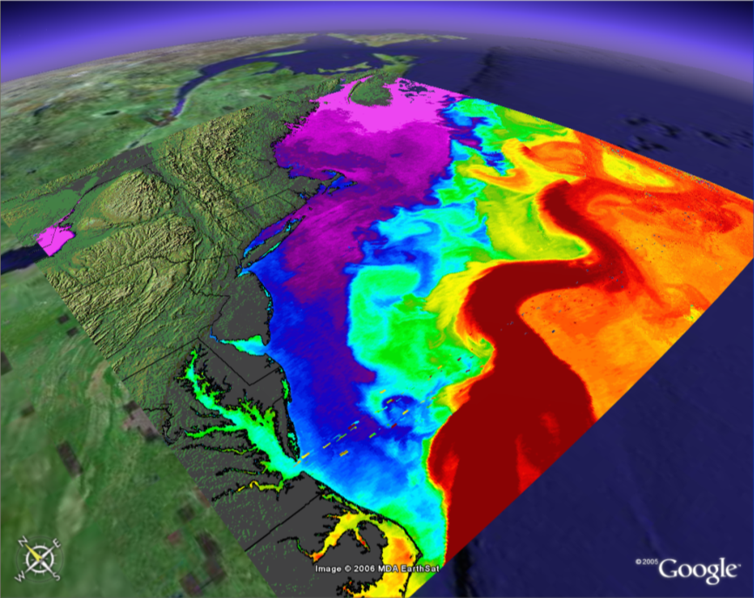
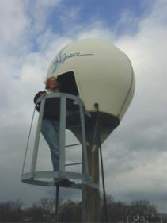
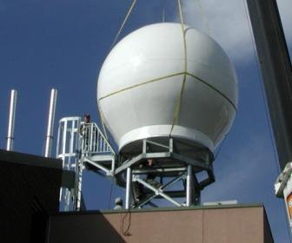

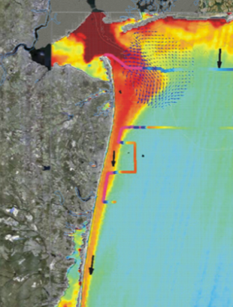
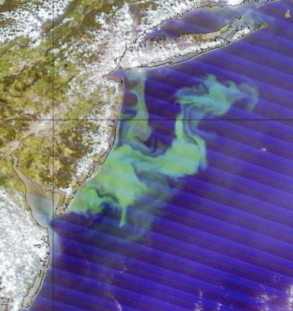
International Constellation of Satellites – Since 1992
Sea Surface Temperature - SST
L-Band
(installed 1992)
X-Band
(installed 2003)
Combined SST & Color
Water Mass Boundaries
Ocean Color
<River Plumes
Ocean Blooms>

Slide 7
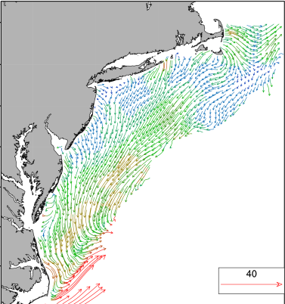
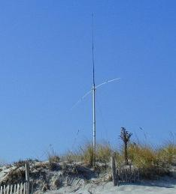
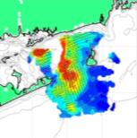
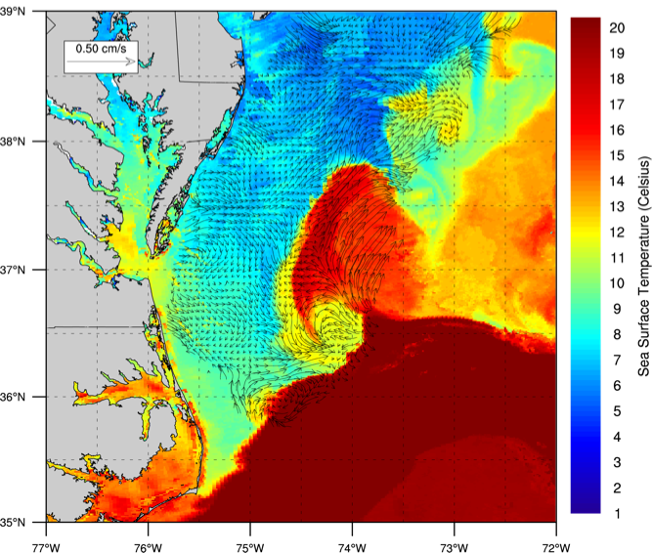
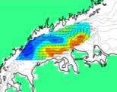
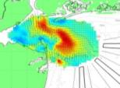
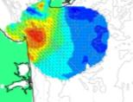
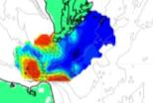
High Frequency Radar – Since 1996
Corporate Partner:
CODAR Ocean Sensors
< Nested Grids of Hourly
Surface Current Maps
WHOI, UMass, URI, UConn, RU, UDel, ODU, UNC
Combined CODAR
& Satellite Products >

Slide 8
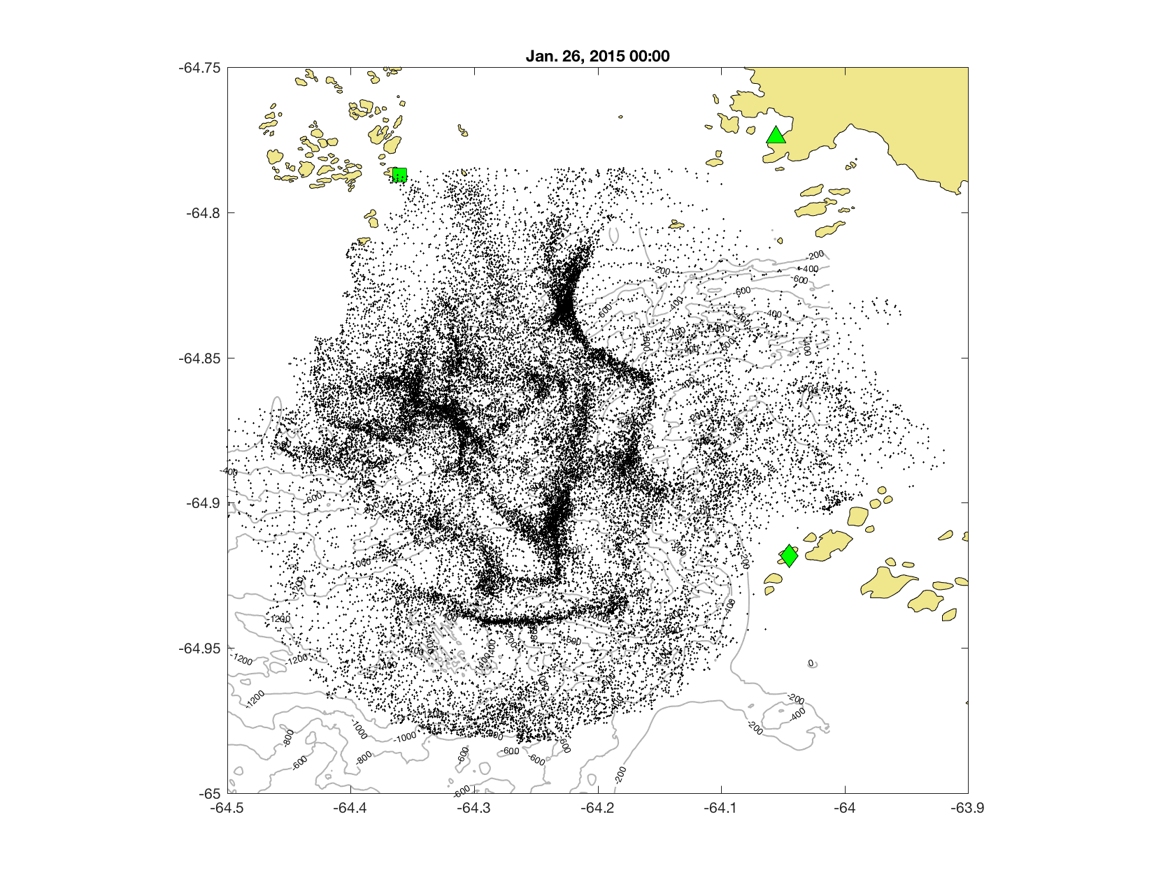
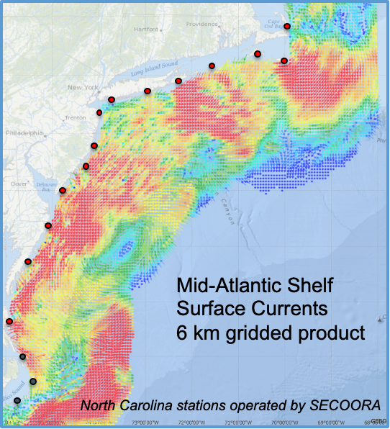
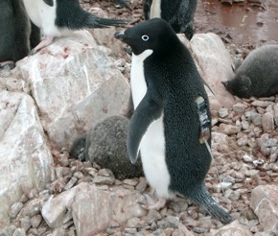
Animal distribution relative to ocean features
Oliver et al. (2019)

Slide 9
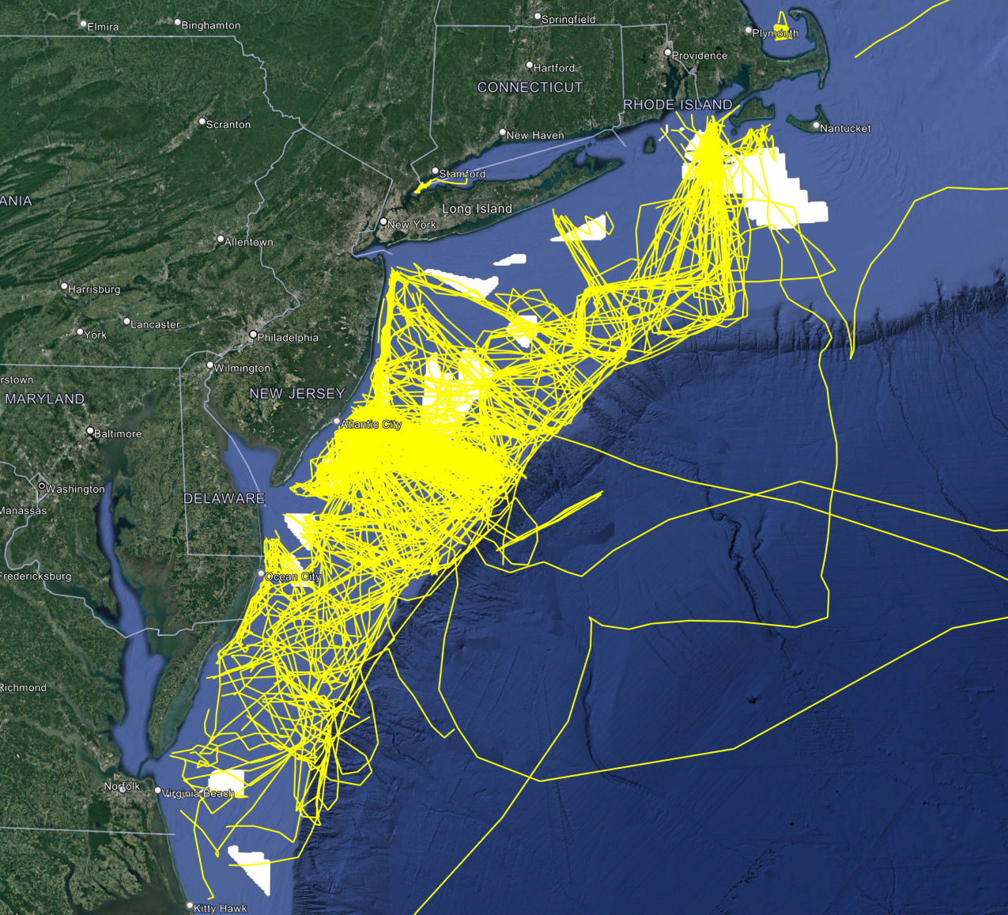
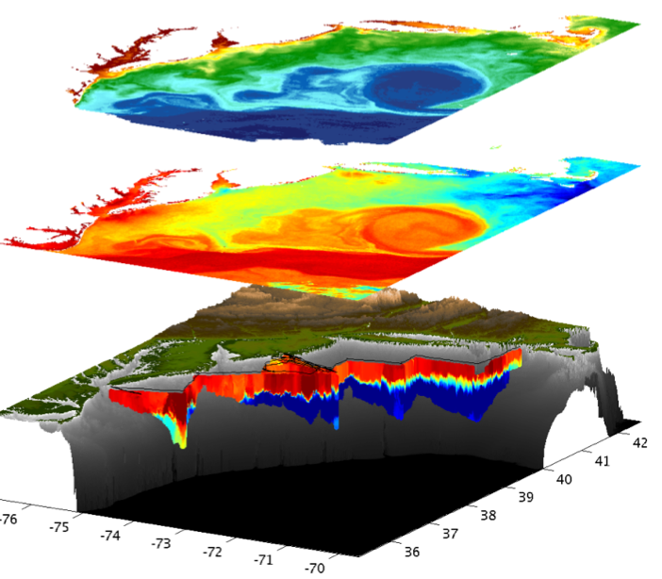
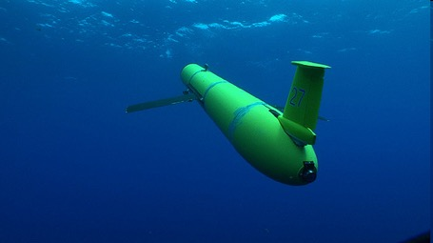
Autonomous Underwater Gliders – Since 1998
Corporate Partner: Teledyne Webb Research
~643 Global Deployments
> 336,525 km flown
RUCOOL & Partner Glider Deployments in the MAB
1999-Present
Satellite Ocean Color
Satellite SST
Subsurface
Glider
Data
UMass, URI, UConn, SUNY SB, RU, UDel, VIMS, UMary, BIOS

Slide 10
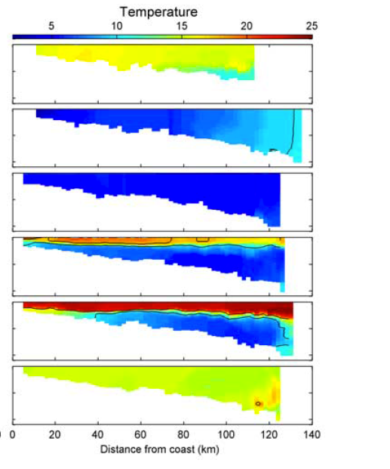
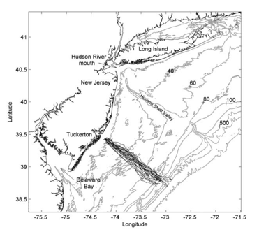
Seasonality on
the shelf
October
January
March
June
August
Castelao et al. 2008
October

Slide 11
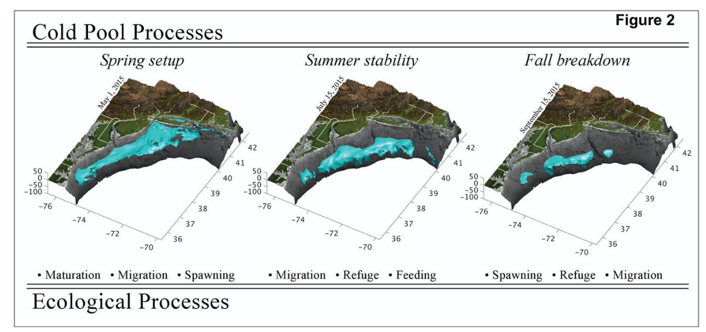

Slide 12
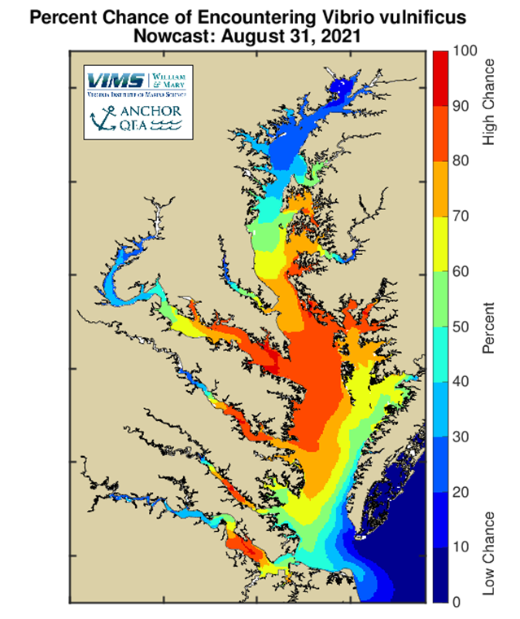

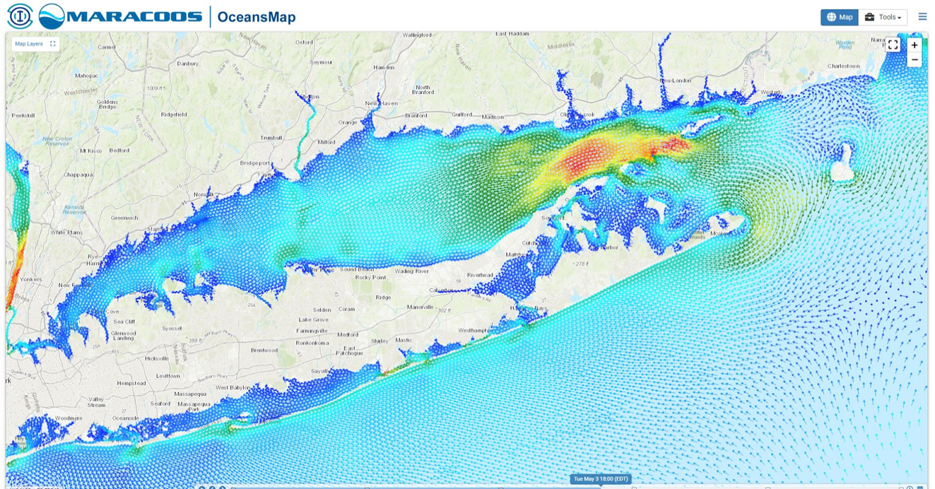

Send All Quality Controlled Data to Ocean Forecasts
QA/QC'd Data
4 Day Ocean
Forecast
Doppio Run Daily
4DVAR Data Assimilation

Slide 13
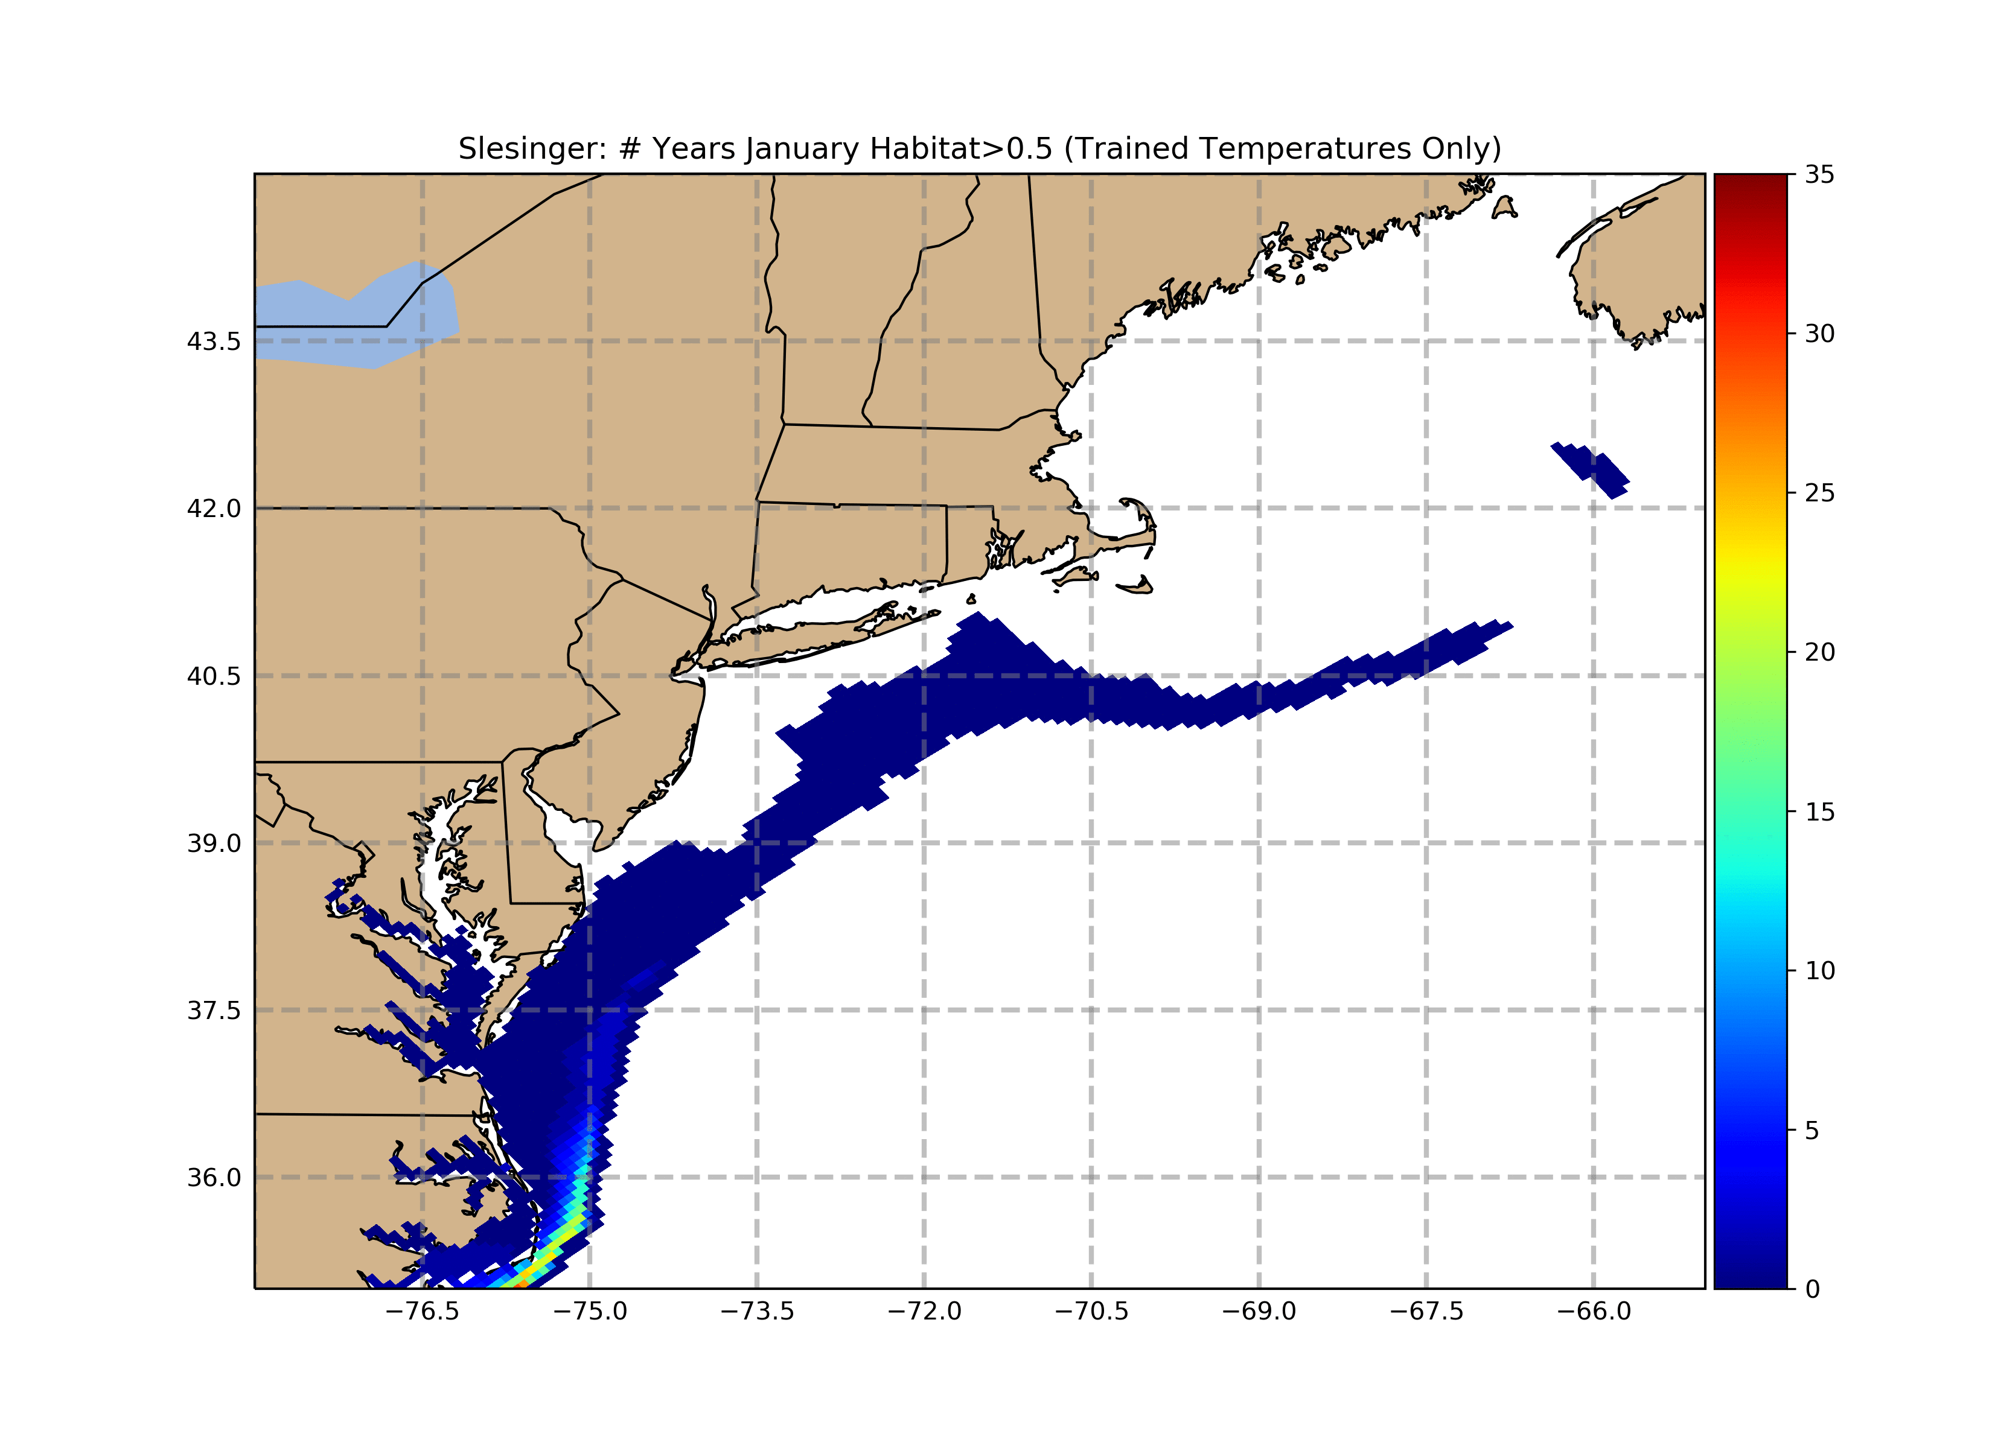
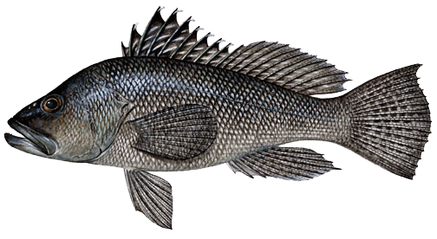
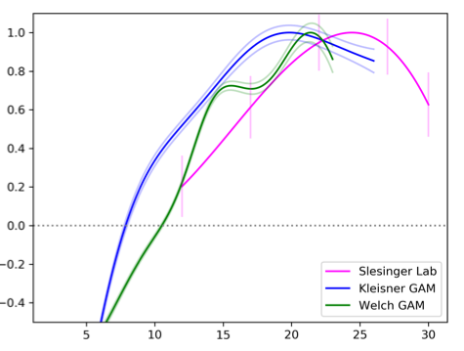
Black Sea Bass Habitat
(Lab based physiology)
Data provided by
E. Slesinger and G. Saba

Slide 14
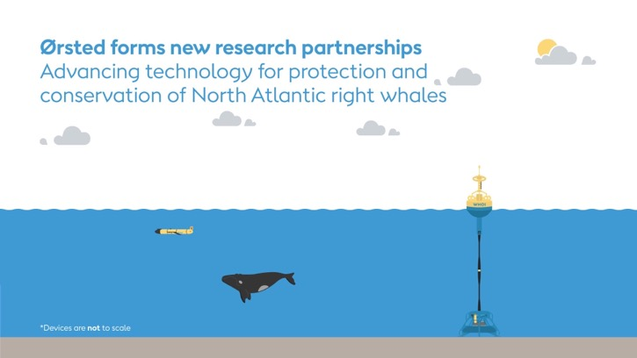
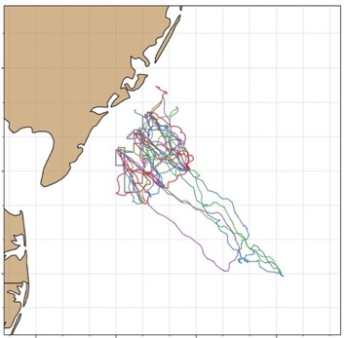


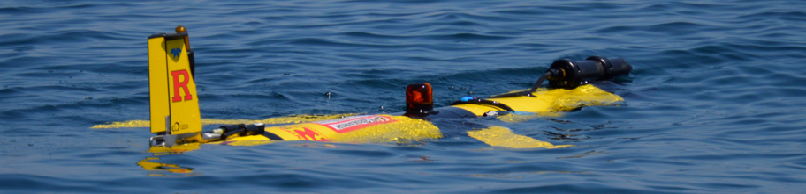
Ocean robots: Tracking dynamic seascapes to inform offshore wind development
ECO-PAM Project
Our ecological scout
https://go.rutgers.edu/ECO-PAM

Slide 15
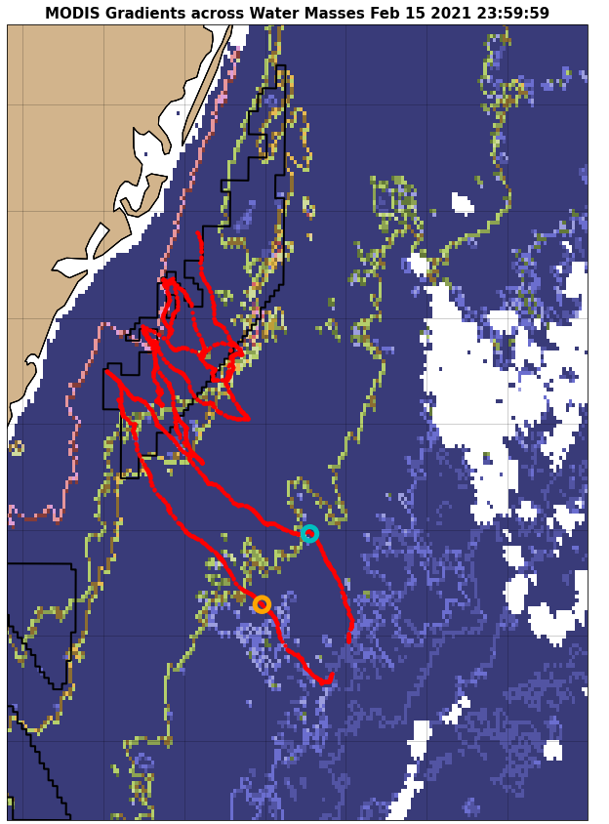
Ocean robots: Tracking dynamic seascapes to inform offshore wind development
The Dynamic Ecology
The Dynamic Environment
Informing the Plan
Ocean
Fronts
Temperature
Surface
Currents
Dynamic mapping of ecological features

Slide 16


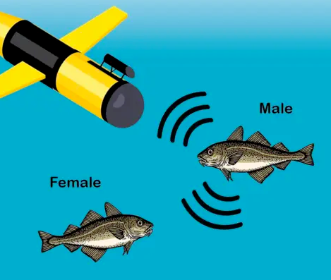
High Resolution Mapping focused on the Ocean Wind Site:
Fish Telemetry and PAM

Slide 17
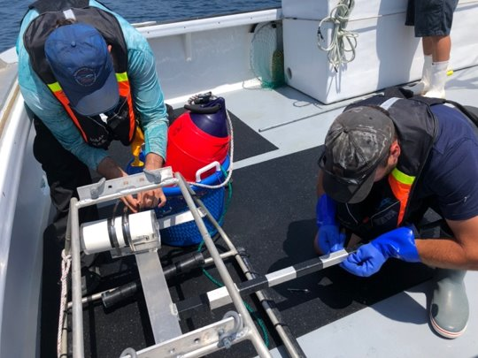
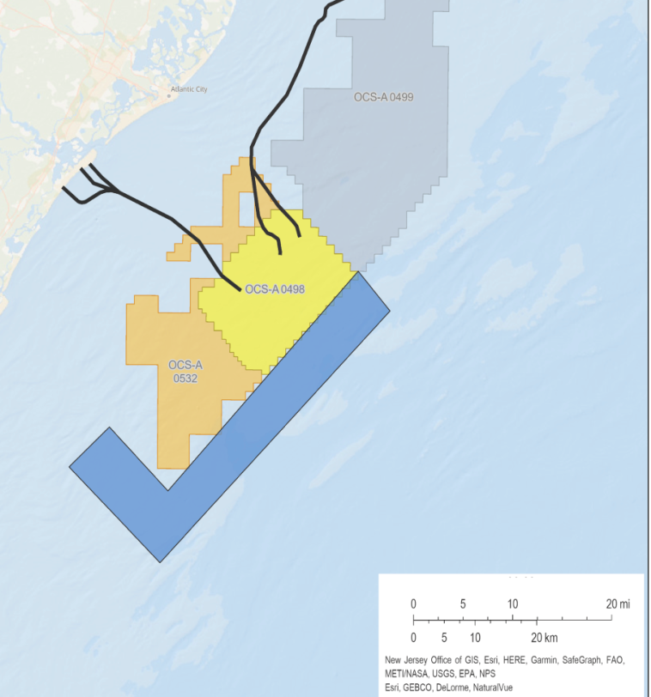
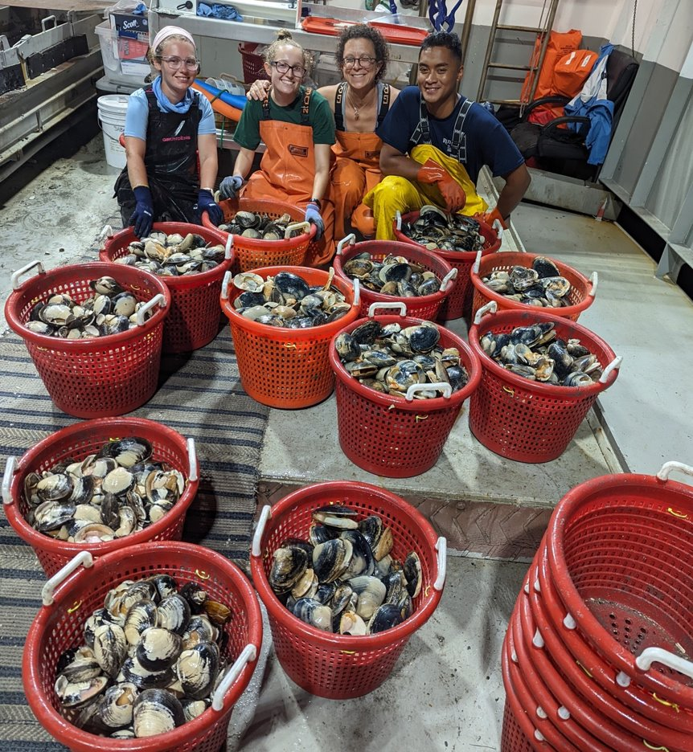
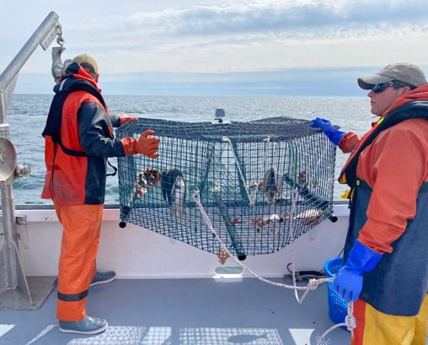
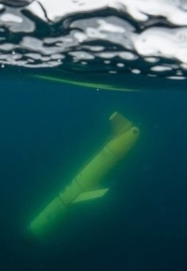
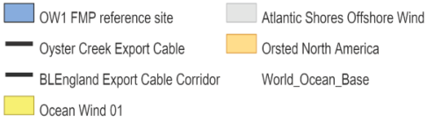
Ocean Wind 01 Fisheries Monitoring Plan
Bottom Trawl
Diet Sampling
Structured Habitat Survey
Telemetry Measures
Inshore Hard Clam survey
Atlantic surfclam survey
eDNA
Pelagic Fish Survey
Oceanography
Atlantic Shores
Ørsted
Ocean Wind 01
Ørsted North America

Slide 18
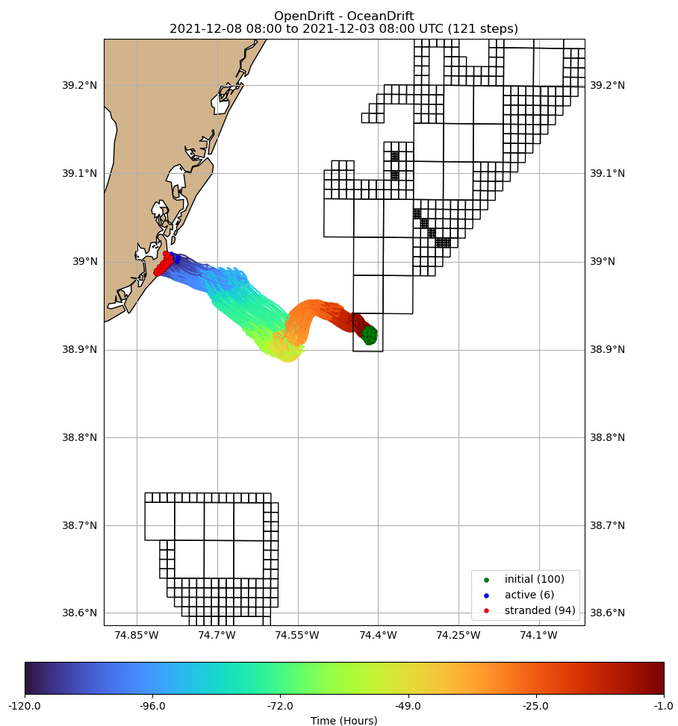
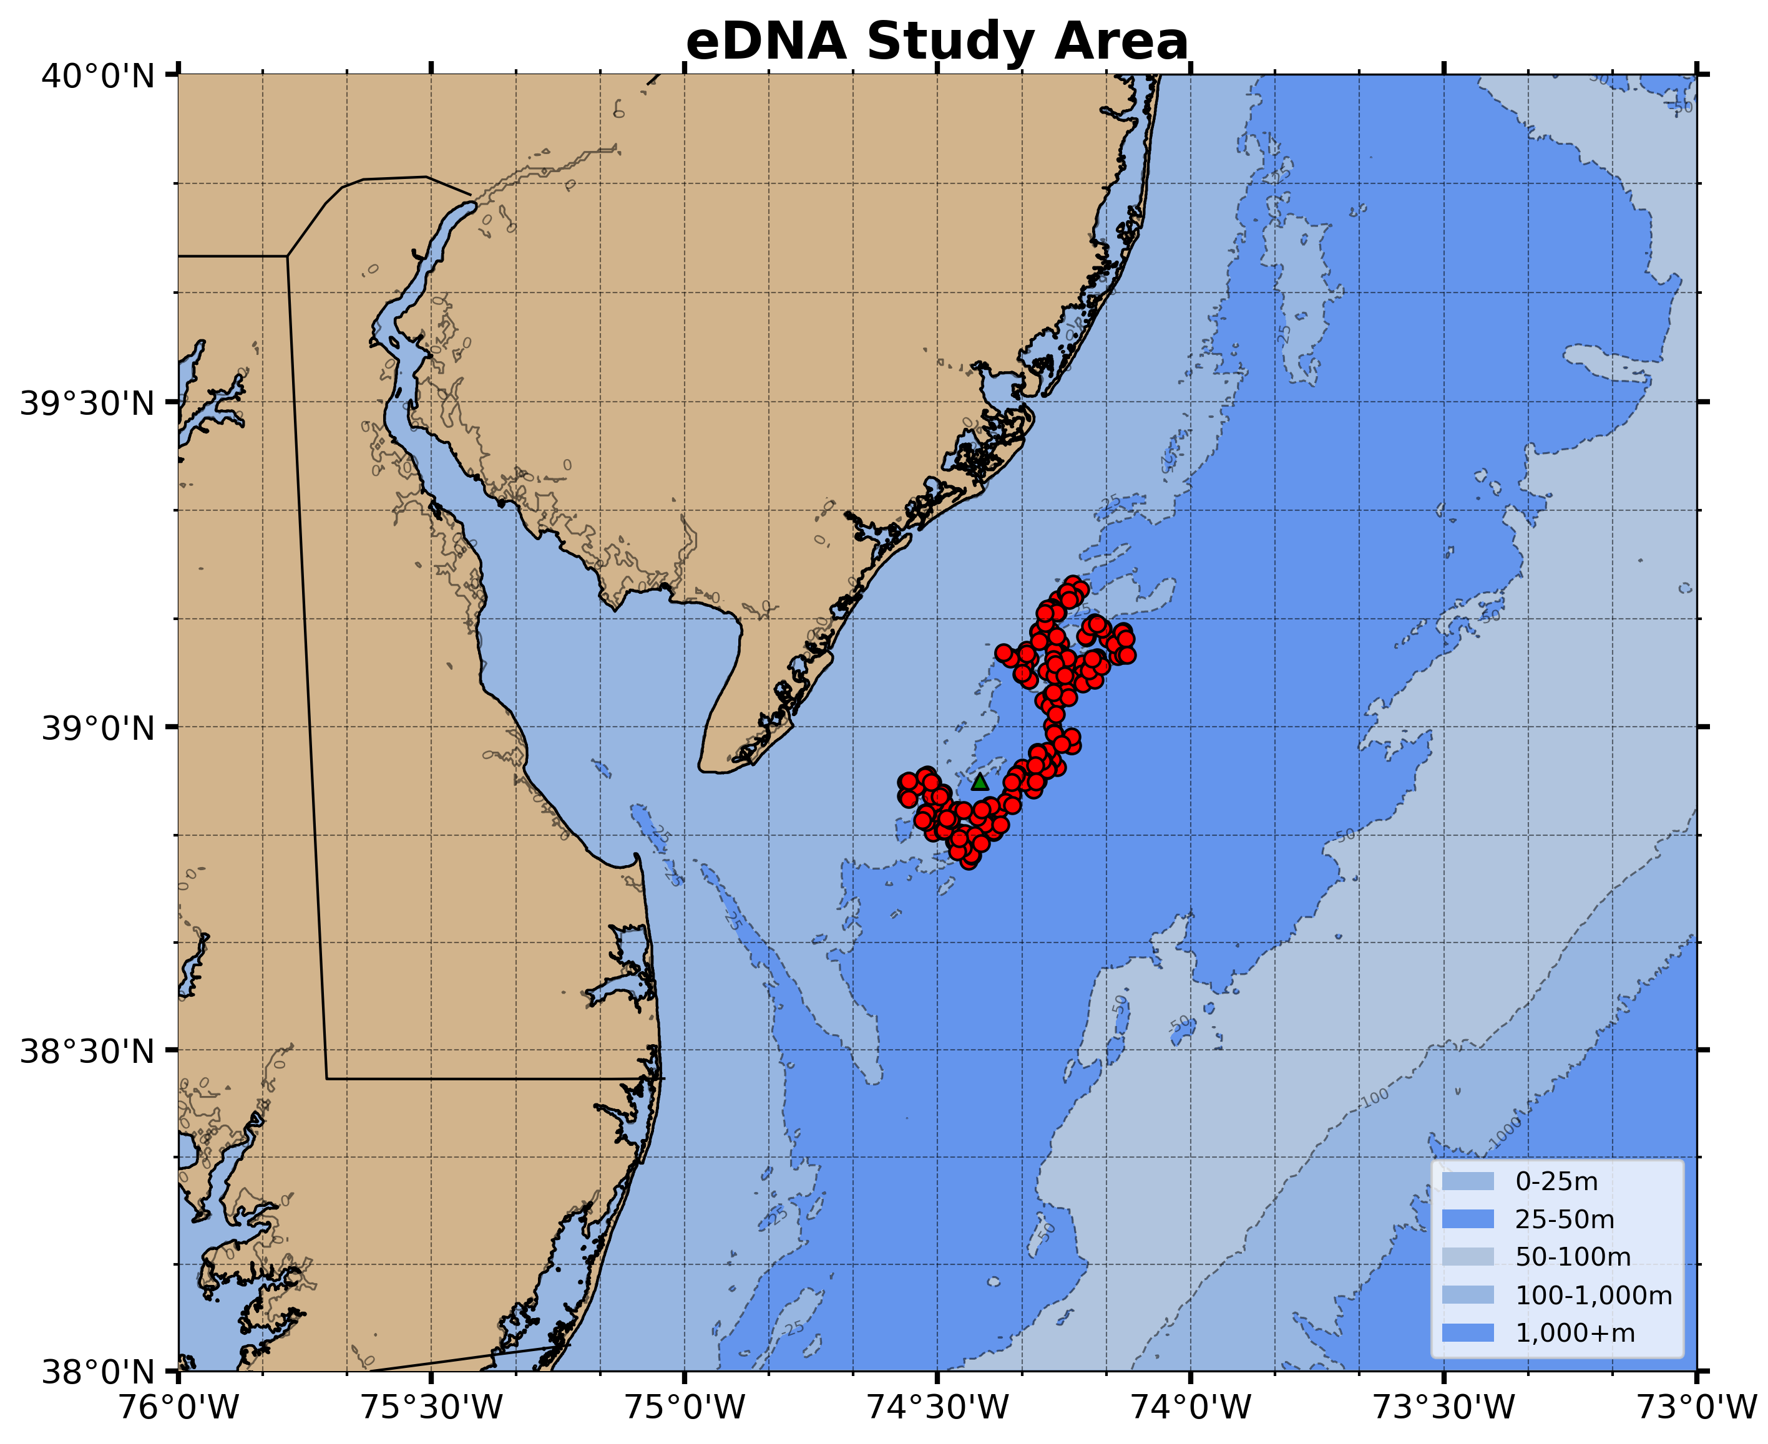



Reverse Particle Tracking eDNA
Reverse Drift
Dec 8 to Dec 4 2021
HFR
120
96
72
49
25
0
hours
eDNA Sampling Locations
Dec. 2021 to Mar. 2023
DOPPIO
120
96
72
49
25
0
hours

Slide 19




Eco-Glider: Oceanographic and Ecologic Sampling
PRELIMINARY DATA
Coastal Waters off New Jersey
Ocean Physics and Chemistry

Slide 20






Eco Glider Captures Impact of Hurricane Lee
August 17- September 17, 2023
PRELIMINARY DATA
26ºC
120%
35%
9ºC
Ocean Temperature
Oxygen Saturation

Slide 21



Sampling across the ecosystem
Center for Ocean Observing Leadership
Temperature
Salinity
Density
pH
Dissolved oxygen
Chl Fluorescence
CDOM
Optical backscatter
Active acoustics - fish
(38, 120, 200 kHz)
Active Acoustics - zooplankton
(120, 200, 455, 769 kHz)
Passive acoustics – mammals
Fish Telemetry
Sei
Whale
Fin
Whale
Right
Whale
Humpback
Whale
Conduct research and develop data products:
e.g., overlap between oceanographic features & distribution of fishes and marine mammals, between marine mammal predators & their prey

Slide 22



Tracking dynamic seascapes to inform offshore wind development
The Evolving Plan
The Dynamic Environment
The Dynamic Ecology
Right Whale Migration
State Commitments: ~39 GW by 2040
Federal Goal: 30 GW by 2030
Sources: DOE 2021 Offshore Wind Market Report and NCSL
As of August 2021

Slide 23


Data storage and access
HR Radar http://hfr.marine.rutgers.edu/erddap/info/index.html
Glider Website https://marine.rutgers.edu/cool/data/gliders/
Glider ERDDAP http://slocum-data.marine.rutgers.edu/erddap/index.html
  Real-Time: subset data delivered in real-time from sbds & tbds
    raw trajectory: raw data from glider, no QC
    raw profile: raw data from glider, split into profiles
    science profile: focus on science data, variables renamed to be “readable”, QC included
  Delayed: full resolution data from dbds & ebds, downloaded from glider after recovery
    raw trajectory
    science profile
Rutgers Offshore Wind Living Resource Studies (ROWLRS) Website & ERDDAP (still in development) https://rowlrs.marine.rutgers.edu/
  Survey descriptions, modeling efforts, and/or data (Ocean Wind 01 FMP, RMI, NYSERDA, Atlantic Shores, CVOW)
  Voluntary Data Use Agreement on ROWLRS ERDDAP

Slide 24



National & East Coast Data Storage & Access
IOOS HF-Radar DAC: HR Radar: https://hfradar.ioos.us/
IOOS Glider DAC: https://gliders.ioos.us/
MARACOOS Satellite Data at U. Delaware: http://basin.ceoe.udel.edu/erddap/griddap/index.html?page=1&itemsPerPage=1000

Slide 25



Model Forecast Access
RUWRF Meteorological Forecast archive : https://tds.marine.rutgers.edu/thredds/cool/ruwrf/catalog.html
ROMS Doppio
  https://tds.maracoos.org/thredds/remoteCatalogService?catalog=https://tds.marine.rutgers.edu/thredds/roms/doppio/catalog.xml
VIMS CBEFS: https://www.vims.edu/research/products/cbefs/cbay/index.php

Slide 26
In Summary
The ocean is a complex place, and all stakeholders can contribute their expertise to the responsible deployment of OSW.
The ocean observing community has contextual oceanographic data and model output that can contribute to species distribution research and monitoring in the areas overlapping with OSW development.
These data are publicly available across a wide range of spatial and temporal scales and, in some cases, provide decades of baseline information.
There is an opportunity for rapid advances in our understanding of dynamic marine habitats with more interactions across our research communities
If you have questions, reach out to ecosystemdata@marine.rutgers.edu

