Slide 1
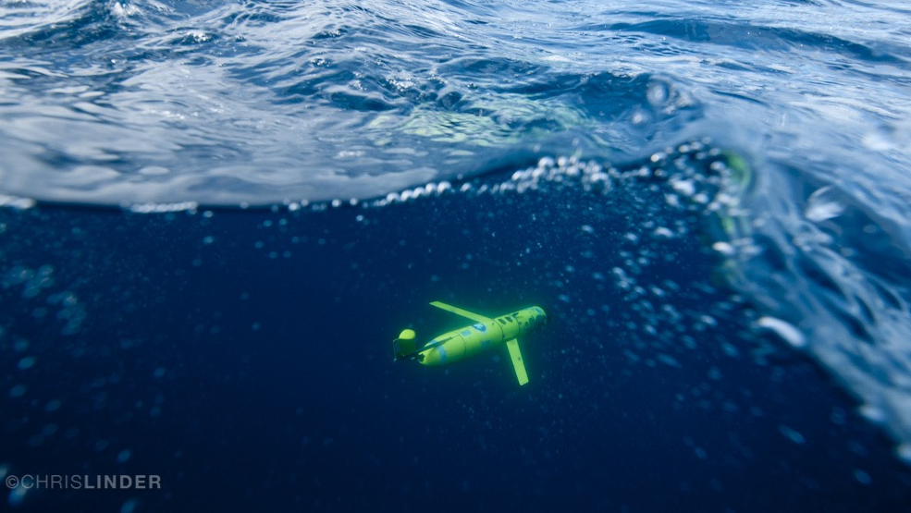


PARTICLE SIZE AND CONCENTRATION OBSERVATIONS FROM A GLIDER INTEGRATED IN-SITU SCATTERING AND TRANSMISSOMETRY (LISST) SENSOR

Slide 2
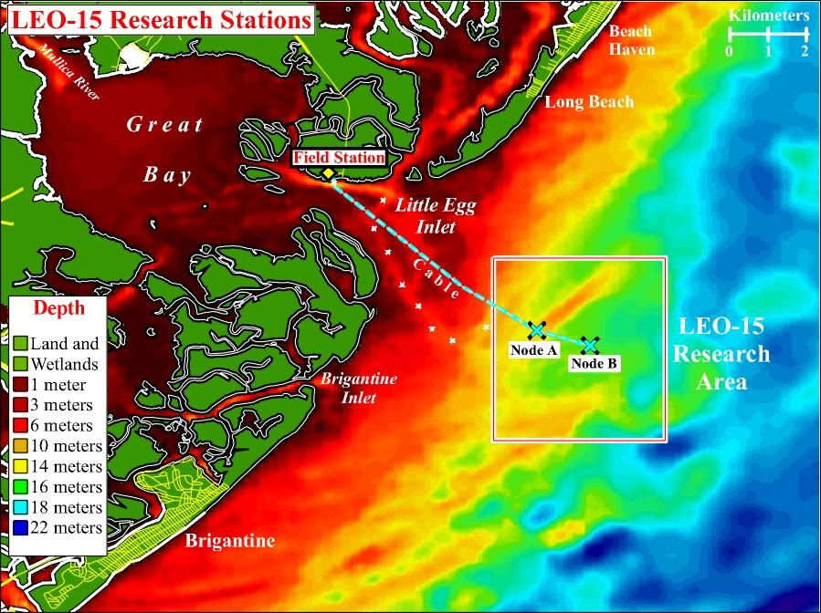
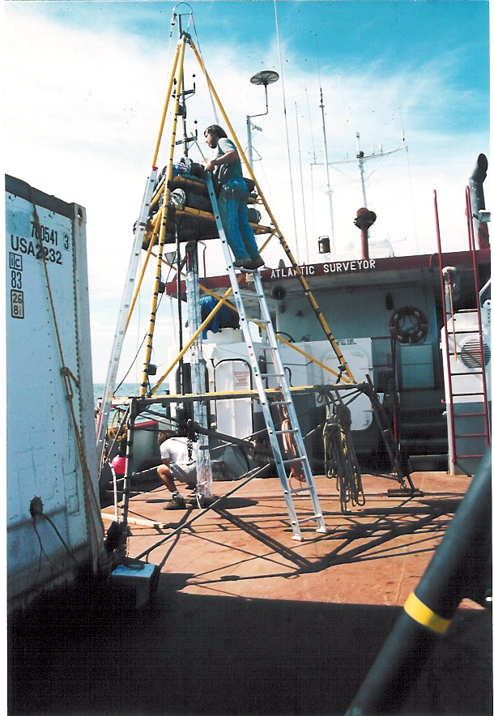
Sediment Transport Studies at LEO Site –1990’s
Coastal ocean optical properties
Water quality
Bottom boundary layer physics
Ecosystem dynamics
Pollutant fate and effects
High resolution temporal data
Limited spatial or vertical resolution
Difficult sensor calibration
Limited to no real-time data
Notes:
BASS sensor, ADCPS, Optical instruments, LISSTs
Very good at resolving wave bottom boundary layer
Provides high temporal resolution at a single location
Instrumental in developing one-dimenisional bottom boundary layer models coupled to Regional Ocean Modeling System
New technologies needed for regional model validation

Slide 3
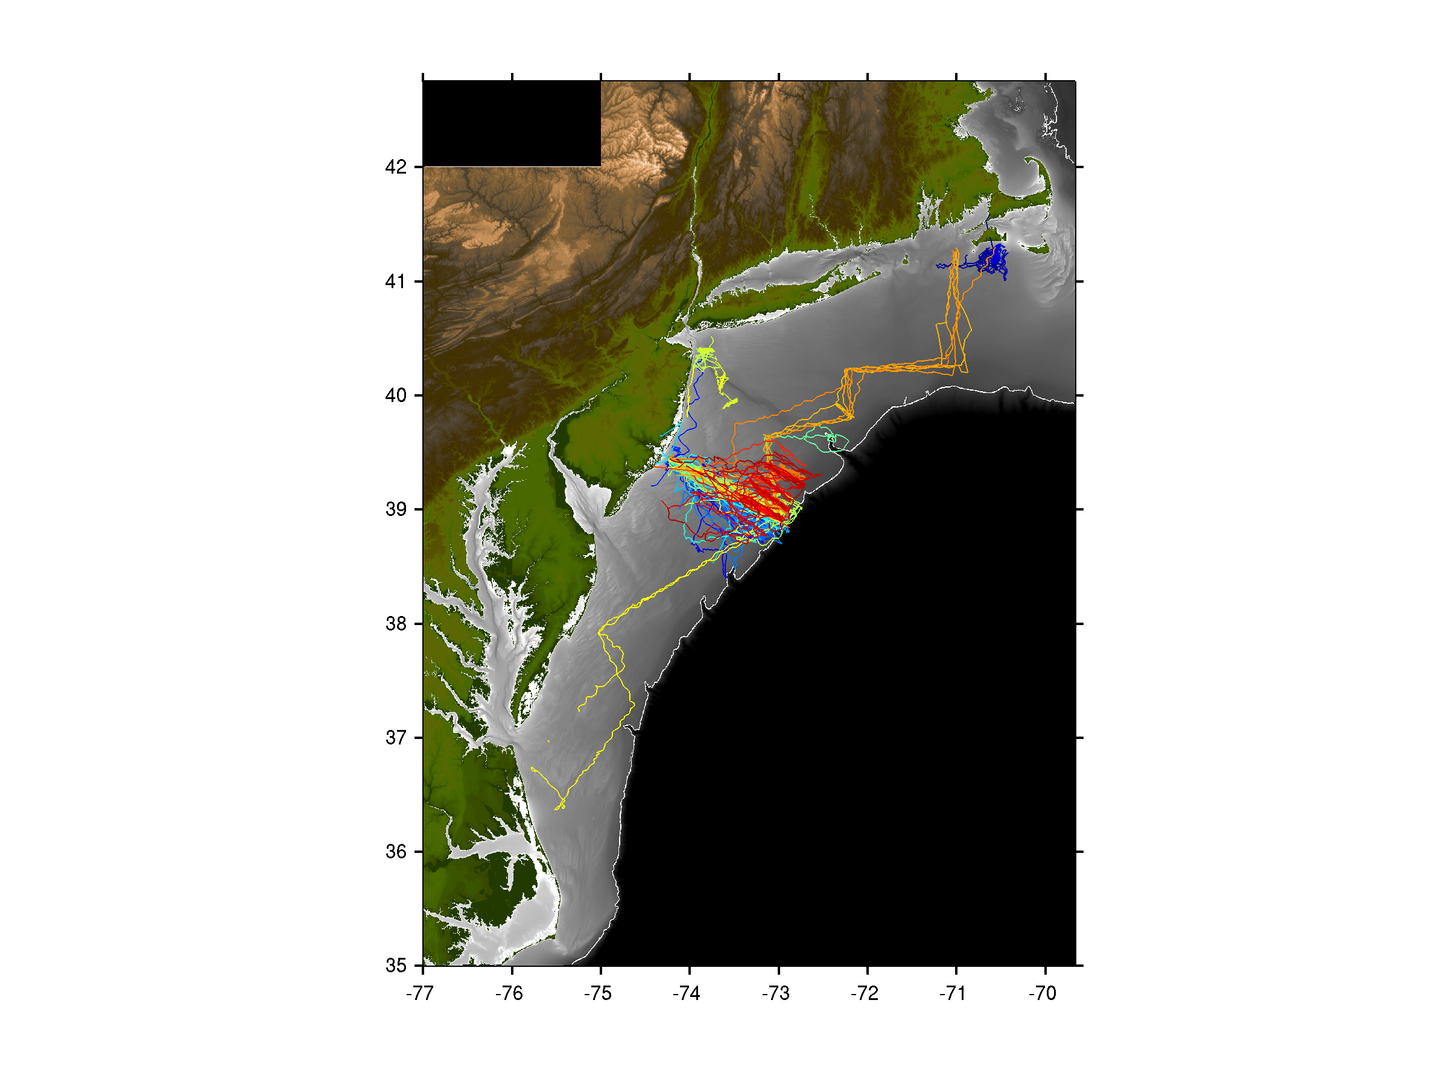

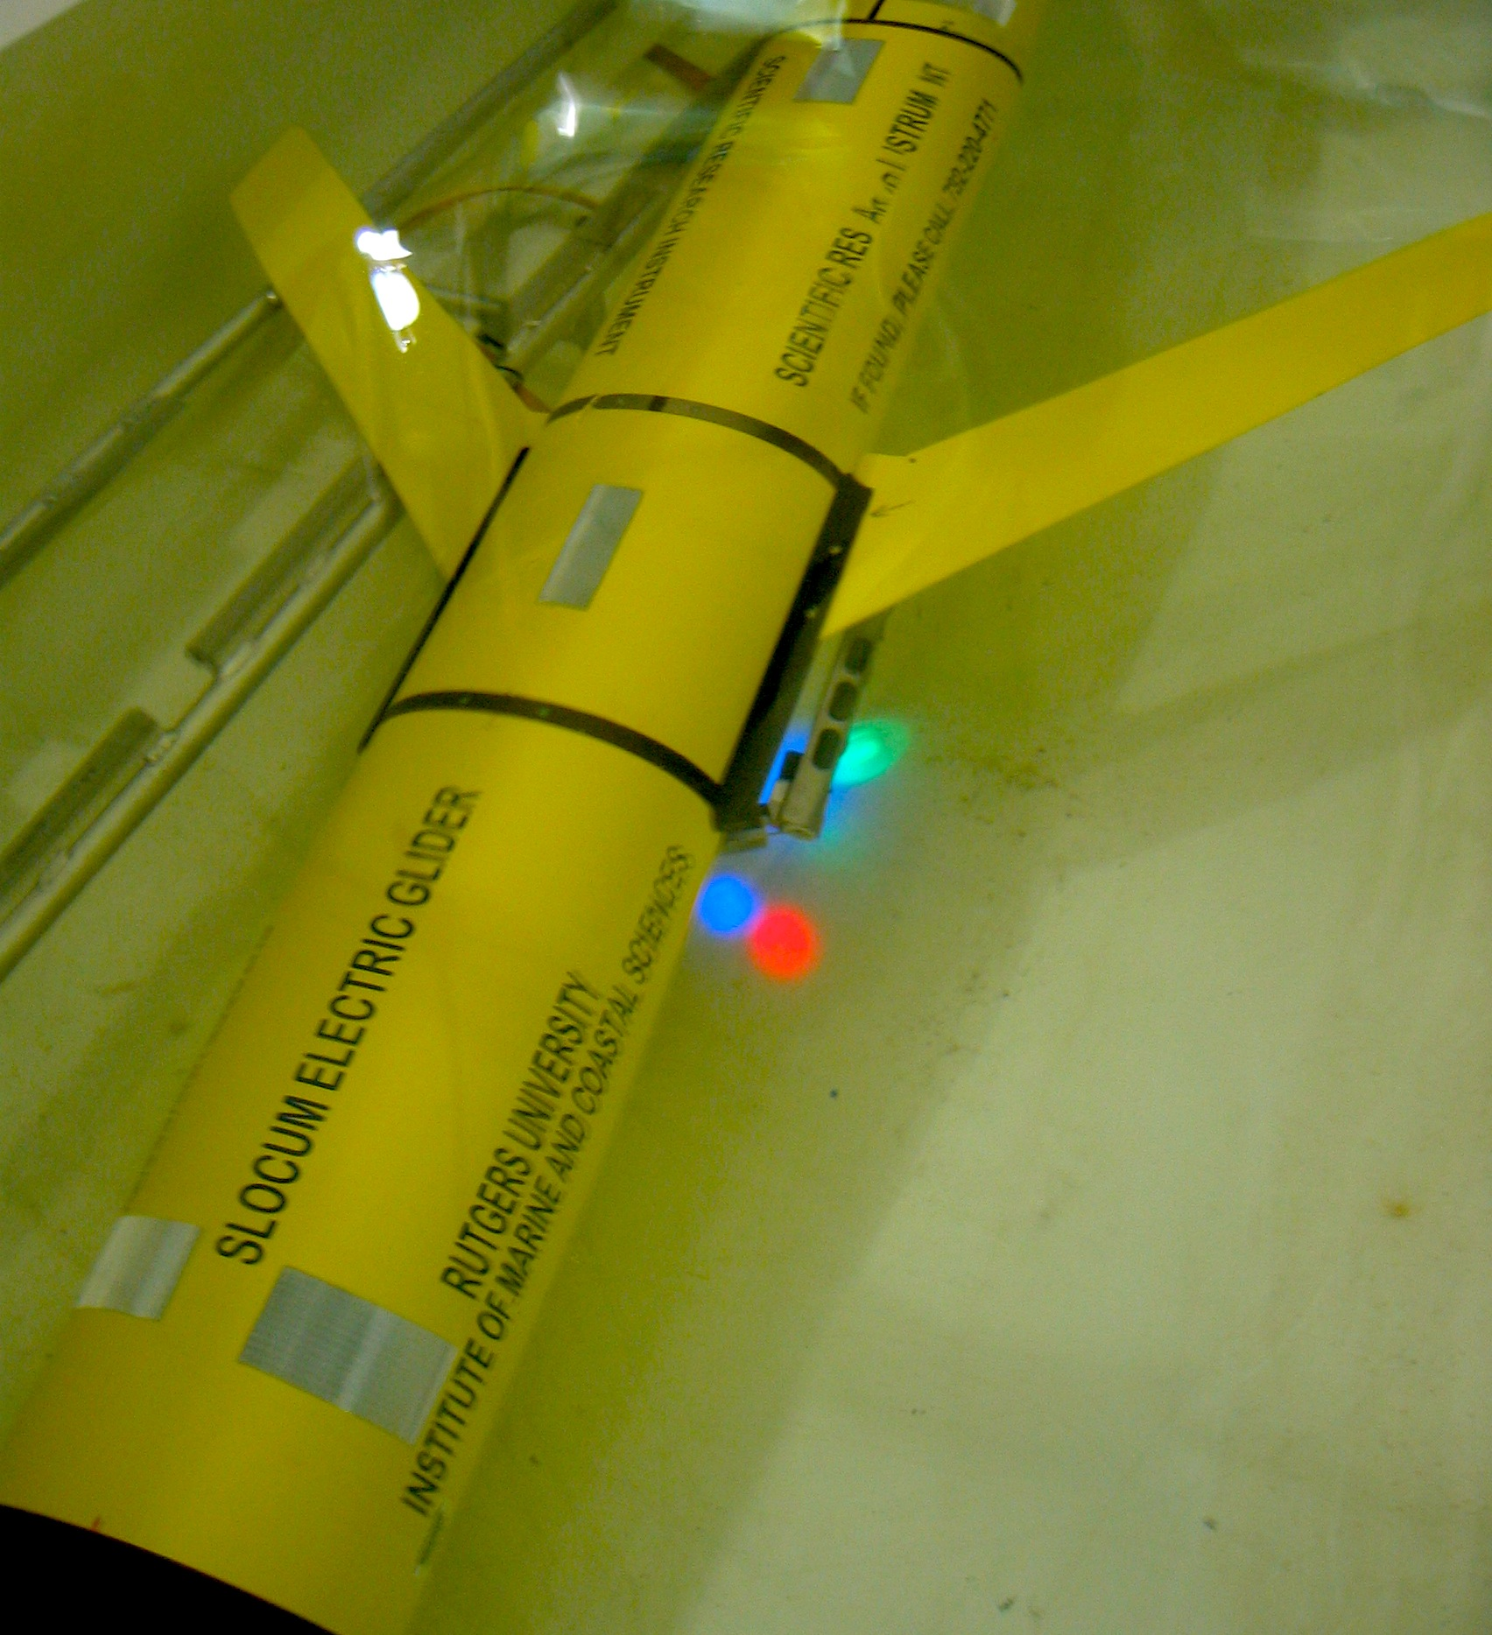
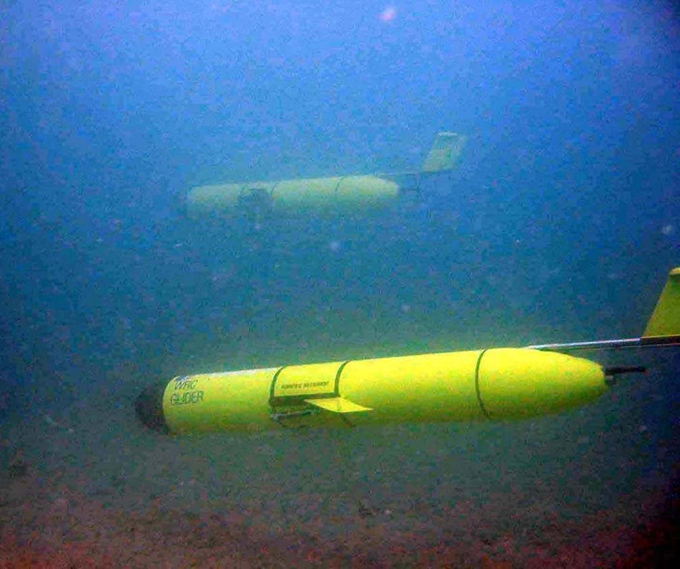
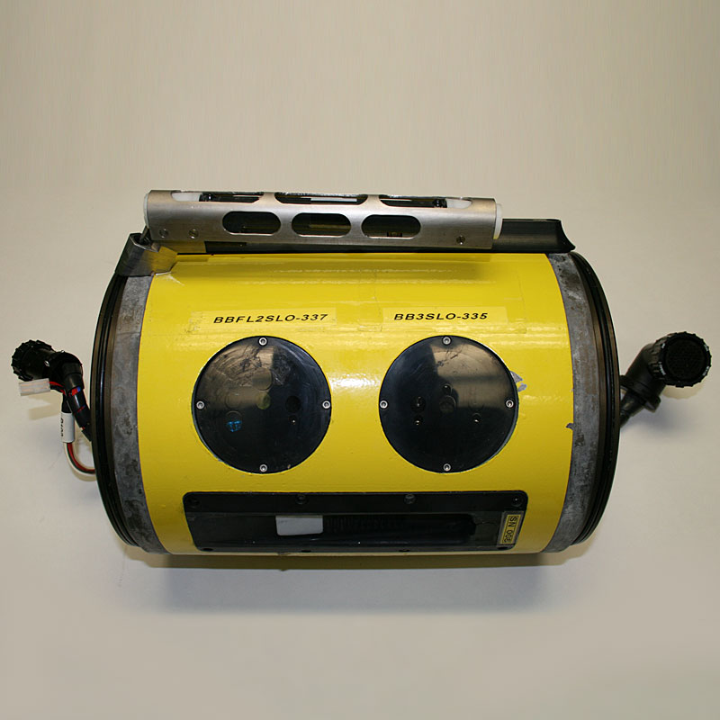
Glider Observations of Sediment Resuspension in a Middle Atlantic Bight Fall Transition Storm (Glenn et al., 2008)
Temperature
Optical
Sensors
Notes:
Regional Perspectives

Slide 4
Notes:
Two storms were sampled and presented in this study during unstratified and stratified conditions
Here you see Temperature and optical backscatter during a fall transition storm on the left
The water column is vertically well mixed and you can see full water column sediment resuspension from the bed to the surface at nearly 40 meters depth
A deployment on a similar line in Summer of 2004 shows the highly stratified continental shelf, and sediment resuspended, but limited by the stable thermocline (likely not visible from satellite etc.)

Slide 5
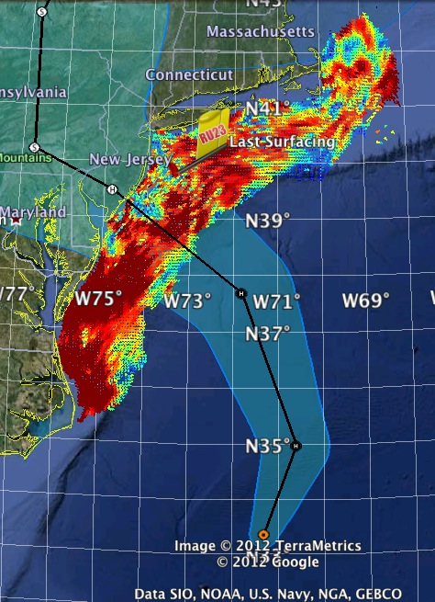
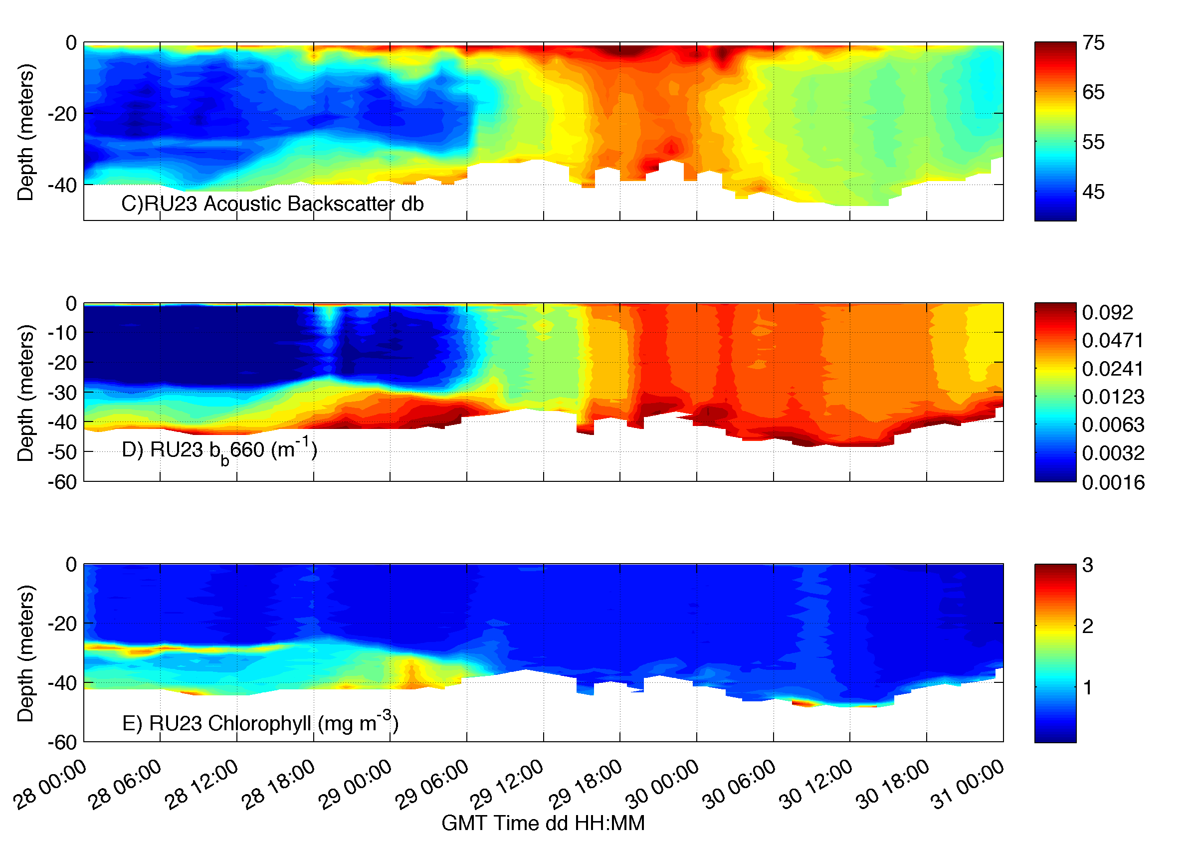
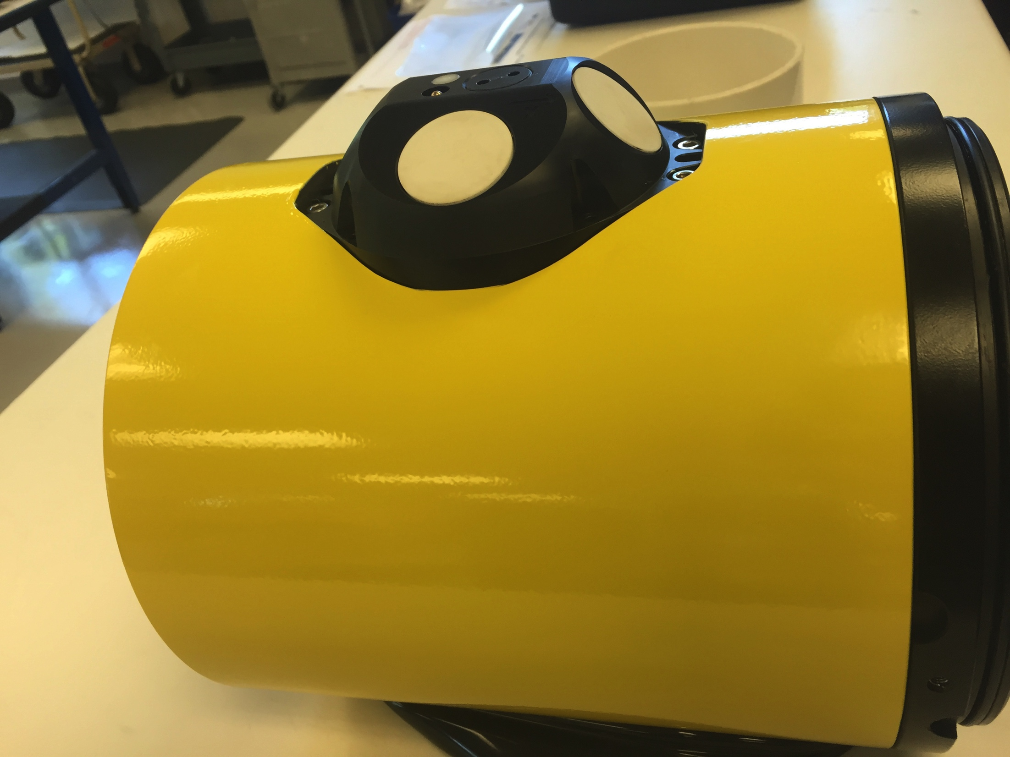
Larger Particles
Smaller Particles

Slide 6
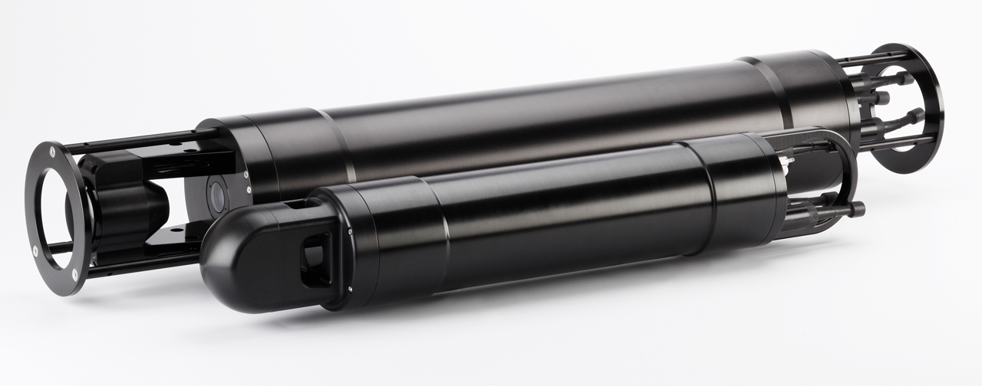
Laser In-Situ Scattering and Transmissometry (LISST) sensor
Agrawal, Y. C., and H. C. Pottsmith (2000), Instruments for particle size and settling velocity observations in sediment transport, Mar. Geol., 168(1–4), 89–114, doi:10.1016/s0025-3227(00)00044-x.

Slide 7
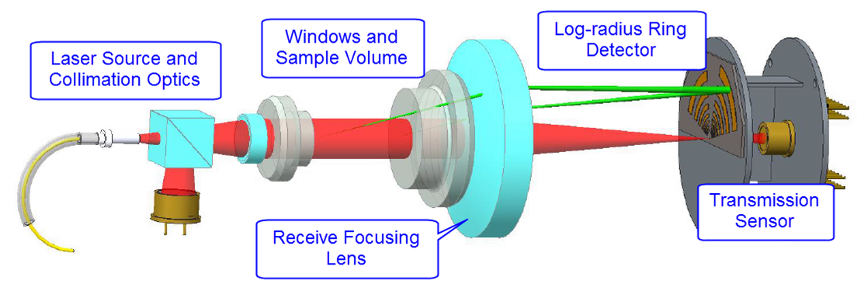
How laser diffraction works
Volume illuminated by laser light, which is scattered by particles in sample volume
Large particles scatter most of their light at small angles and small particles scatter at larger angles
Sum of scattering by all particles is measured as function of angle using specialized detector array
Scattering by particles of different sizes can be modeled using Mie Theory --> Inversion technique can be used to determine amount of each size needed to produce the measured scattering vs. angle
Inversion result is the equivalent spherical size distribution by volume
Key Points: Can obtain In-situ measurements of particle size, total concentration, as well as 36 different size bins f rom 1.25 to 500 um

Slide 8
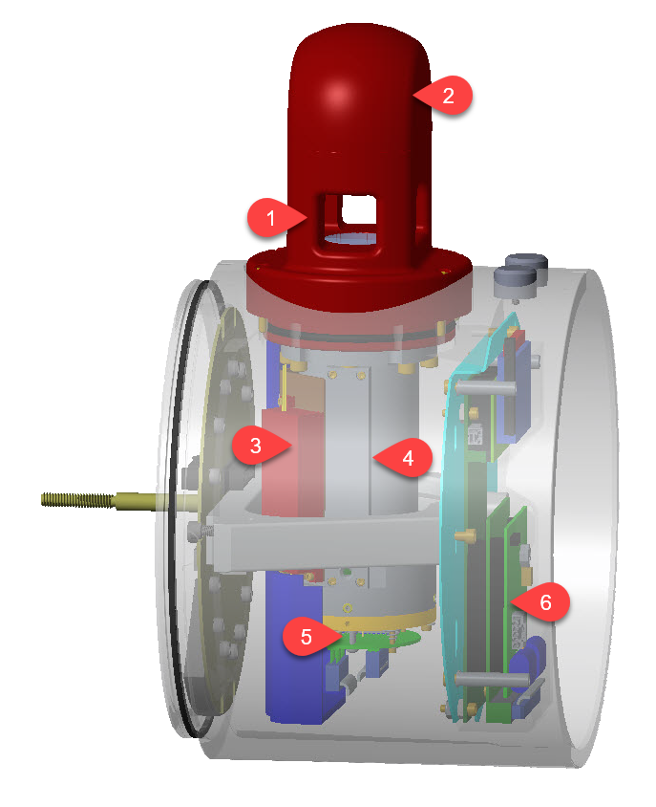
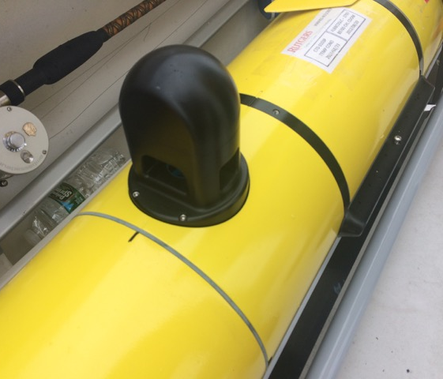


LISST particle sizer glider integration and test deployment
Scattering volume
Beam collimation optics and reference detector
Fiber coupled diode laser module
Scattered light received through lens tube
Ring detectors and transmission sensor
Electronics section
Notes:
The sample volume (1) is a 2.5 cm pathlength scattering volume flanked with fused quartz windows for durability. The beam collimation optics and reference detector are also contained in the optical head (2), connected to a fiber coupled diode laser module (3). Scattered light is received through the lens tube (4) that also contains an extended detector array. The primary ring detectors and transmission sensor (5) are mounted on a XY stage that is used to adjust the instrument alignment, which can then be locked into place. An electronics section (6) digitizes the analog signals from the scattering detectors, controls the sampling process, logs the full scattering dataset, and calculates beam attenuation particle size metrics (i.e., mean size and total concentration)

Slide 9
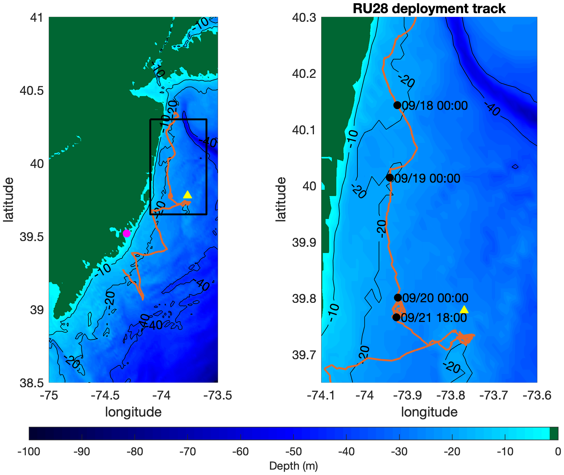
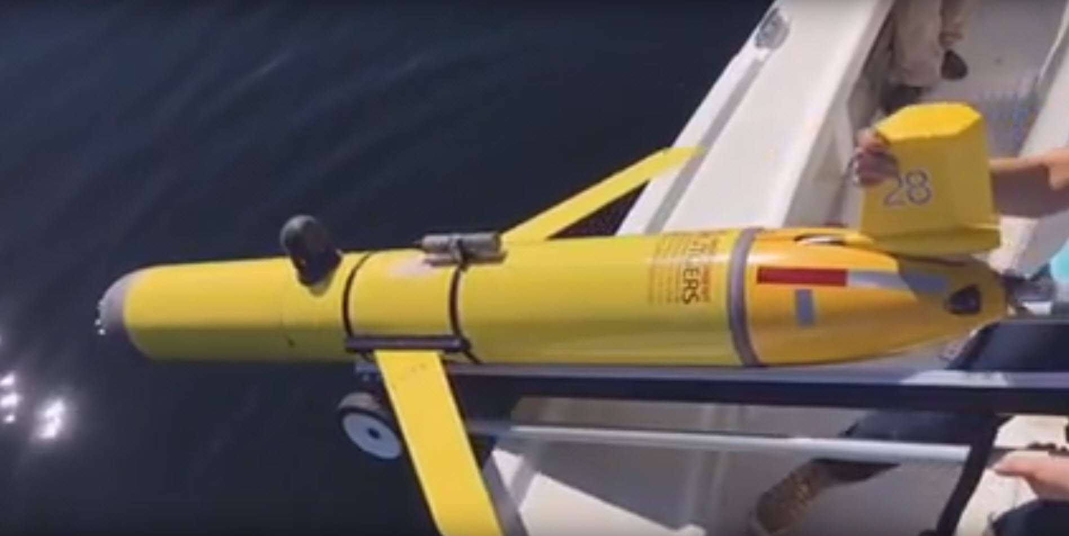

LISST – Glider test deployment September 2019
Deployed for a 1-month mission along the New Jersey Coast in September of 2019.
NJ Department of Environmental Protection mission mapping low oxygen
Large supporter of new sensor testing and storm research.

Slide 10
LISST – Glider test deployment September 2019
Extensively studied region, including some of the earliest studies with the LISST (Agrawal and Pottsmith 2000 and Agrawal 2005), in the vicinity of the historic LEO-15 Array
Sandy bottom (median particle diameters of ~400 um, though significant patchiness exists), non-cohesive and uni-modal distributions.
Sediment resuspension and transport is typically storm/wave driven, with transport modified by tidal currents.

Slide 11
LISST – Glider test deployment September 2019

Slide 12
LISST – Glider test deployment September 2019

Slide 13
LISST – Glider test deployment September 2019

Slide 14
LISST – Glider test deployment September 2019
After removing Schlieren effects through large density

Slide 16
What can we do with this?
Density, Total Volume Concentration, Optical Backscatter
Evaluate sediment resuspension/particle concentrations in situ during storm events at high vertical and temporal resolution

Slide 17
What can we do with this?
Density, Total Volume Concentration, Optical Backscatter
Evaluate sediment resuspension/particle concentrations in situ during storm events at high vertical and temporal resolution
09/20 00:00
09/21 18:00
Estimate water column sediment transport using glider derived depth averaged velocity

Slide 18
What can we do with this?
Density, Total Volume Concentration, Optical Backscatter
Evaluate sediment resuspension/particle concentrations in situ during storm events at high vertical and temporal resolution
09/20 00:00
09/21 18:00
Estimate water column sediment transport using glider derived depth averaged velocity
Combine with additional glider data to estimate additional physical properties
bottom friction velocities (U*)
Evaluate ocean and sediment transport modeling systems?
Potentially assimilate data into other

Slide 19
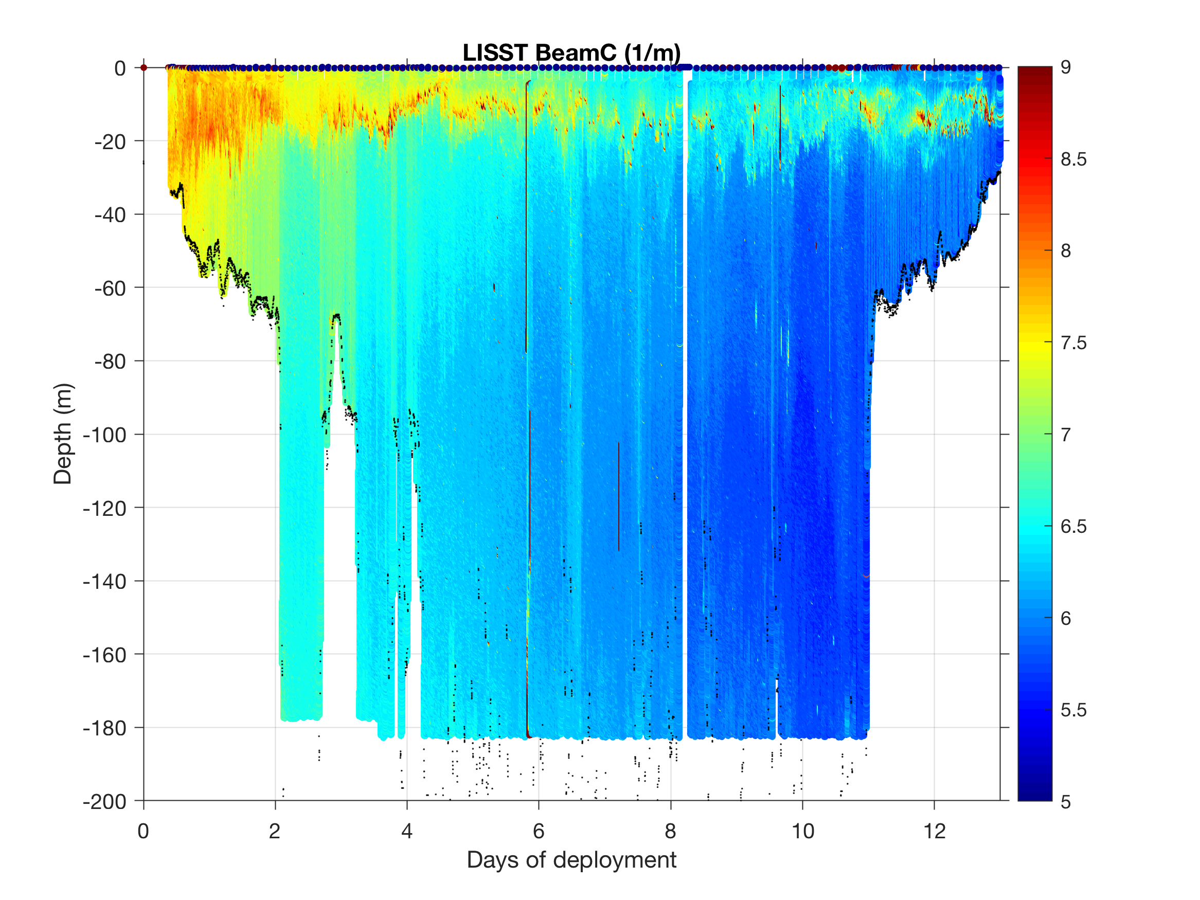
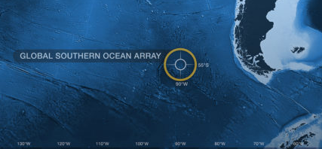


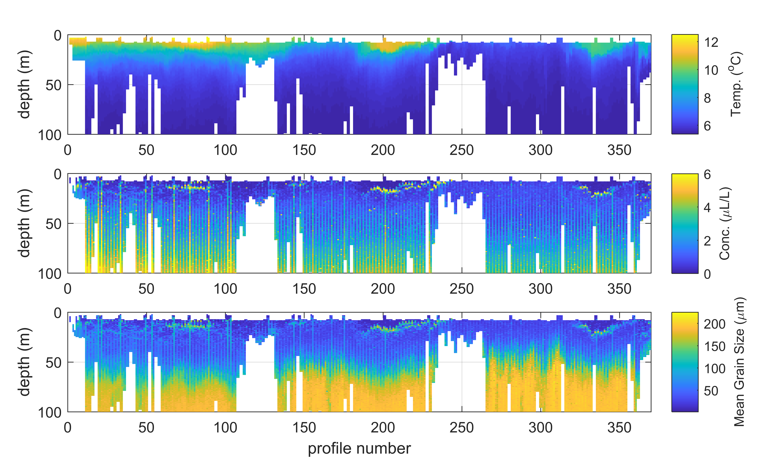

Wilmington Canyon
Lake Tahoe

Slide 20
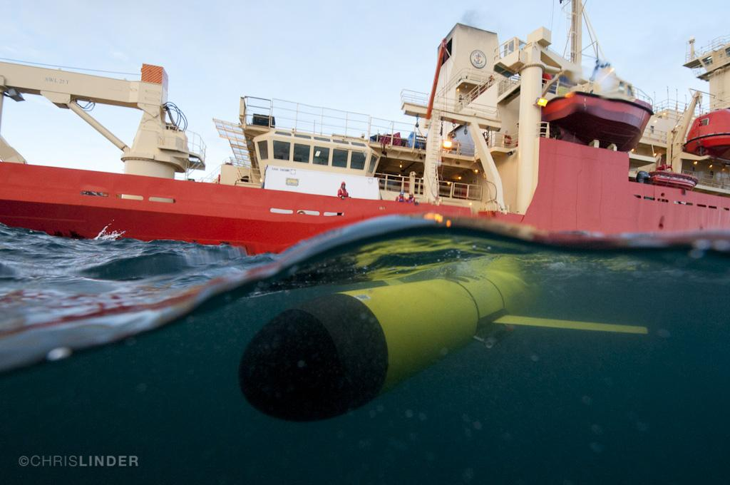
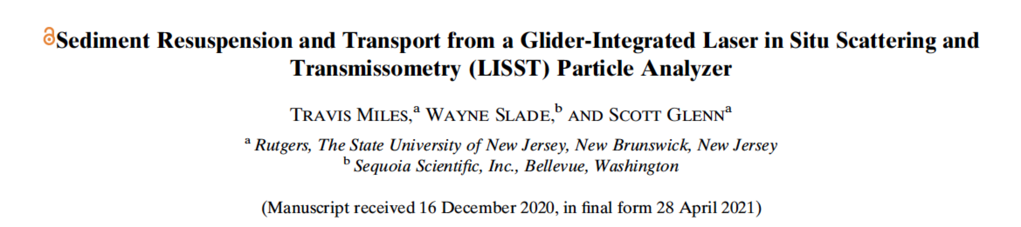
Thank You!

Slide 21

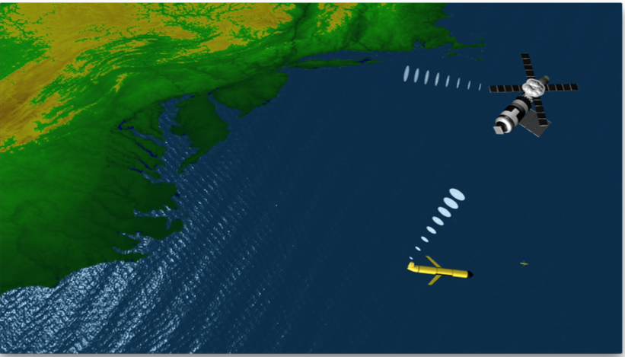
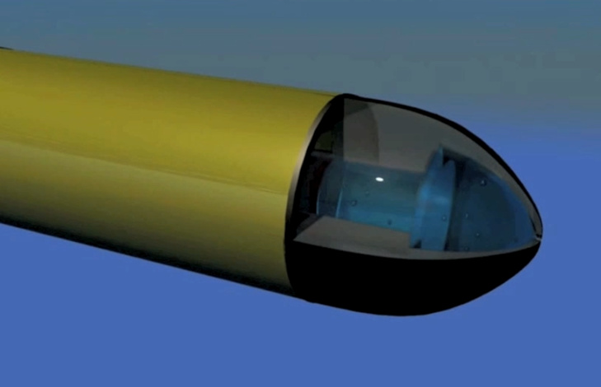
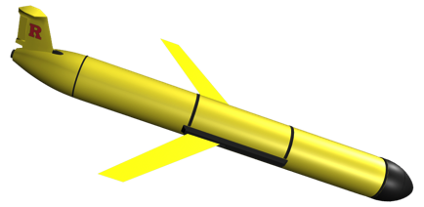
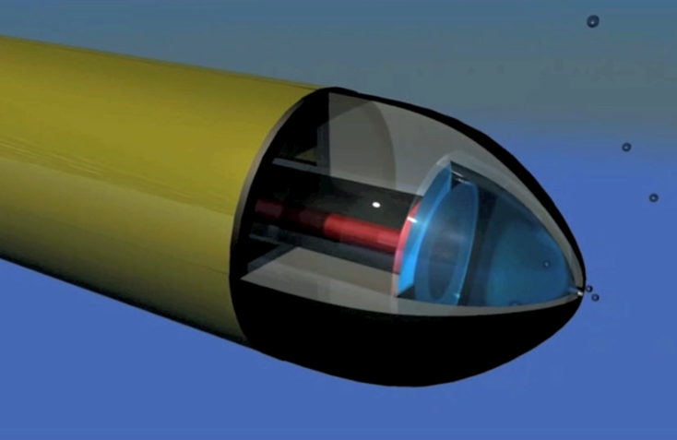
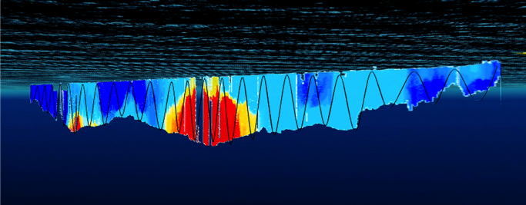
How an underwater Glider works…
4. Glider surfaces,
acquires GPS,
communicates to
shore via satellite
At surface,
pump/diaphragm
decreases volume,
Glider descends
3. Glider flies a saw tooth pattern,
collecting environmental data
along it’s path
2. At depth
pump/diaphragm
increases volume,
Glider ascends

Slide 22
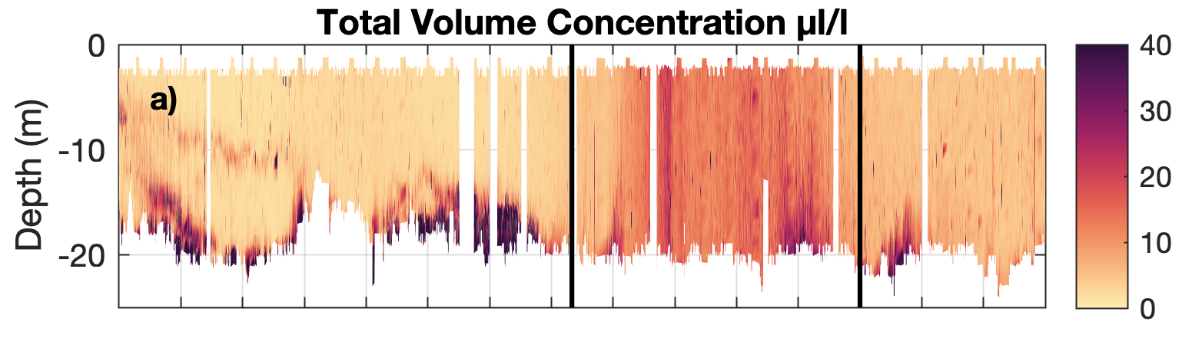
LISST – Glider test deployment September 2019

Slide 23
LISST – Glider test deployment September 2019
Implemented an in-situ background correction method (Barone et al., 2015) using the measurement with the maximum transmission during each glider segment (~3 hours)

Slide 24
LISST – Glider test deployment September 2019
Implemented an in-situ background correction method (Barone et al., 2015) using the measurement with the maximum transmission during each glider segment (~3 hours)

Slide 25
LISST – Glider test deployment September 2019

Slide 26
LISST – Glider test deployment September 2019
Tao et al., 2017
Schlieren is visible in images when the buoyancy frequency exceeds ~0.12 s⁻¹.
Sensitivity to forward scattering of light by larger particles.
Can contaminate larger size bins Mikkelson et al., 2008

Slide 27

Rutgers,
The State University of New Jersey
Mid-Atlantic Drivers
1/4 of U.S. Population
1/4 of U.S. GDP
World’s Largest Navy Port
Commercial Ports
Fishing Fleets
Energy - Offshore Wind …
Mid-Atlantic Stressors
Water quality
Hurricanes & Winter Storms
Flooding – Extreme and Nuisance
Hypoxia
Intense multi-use waterways
Urbanized coasts …

Slide 28

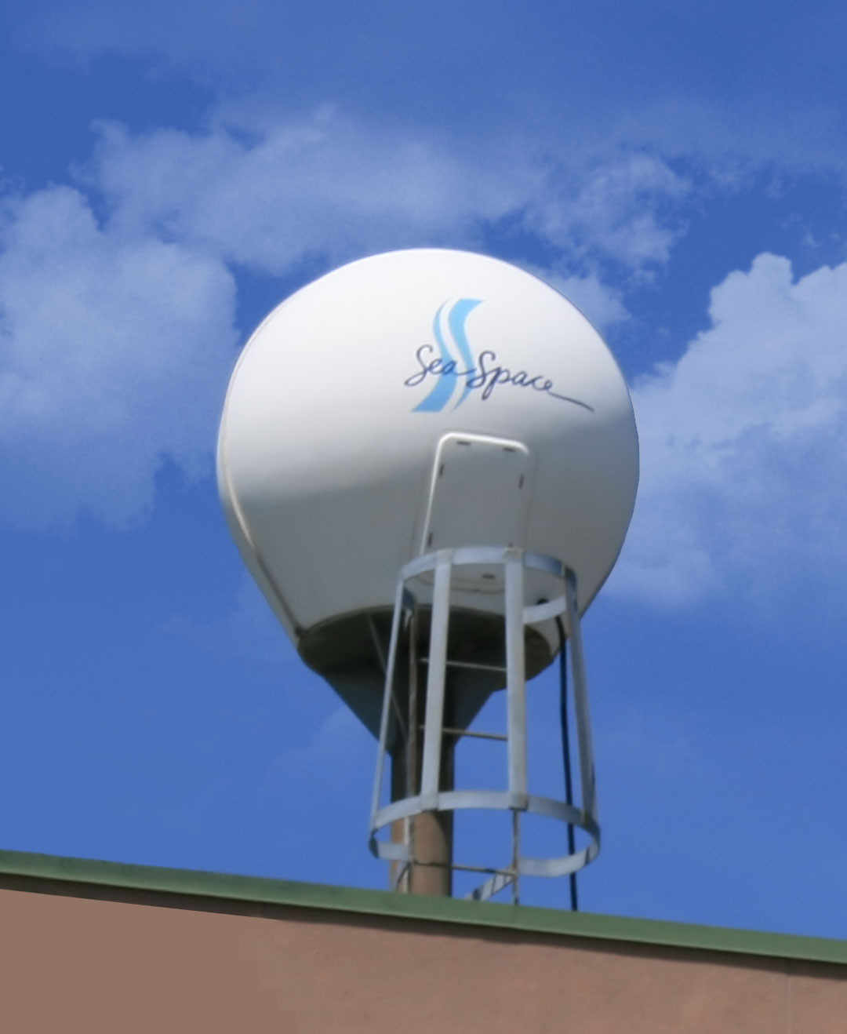
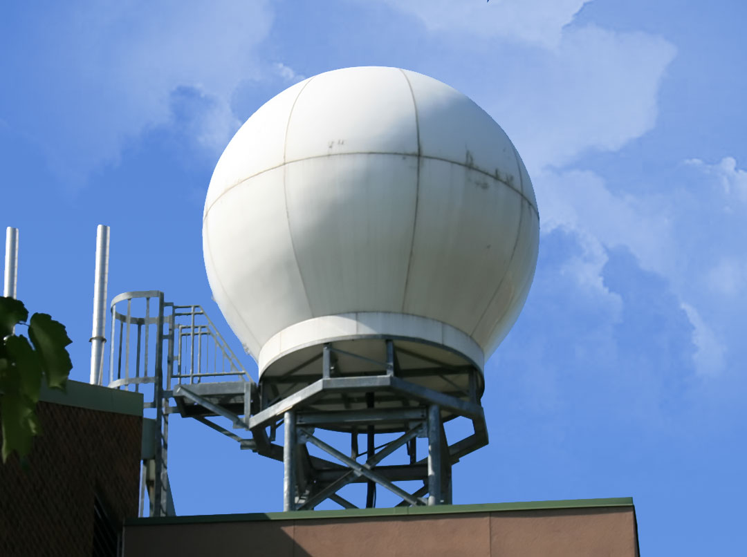
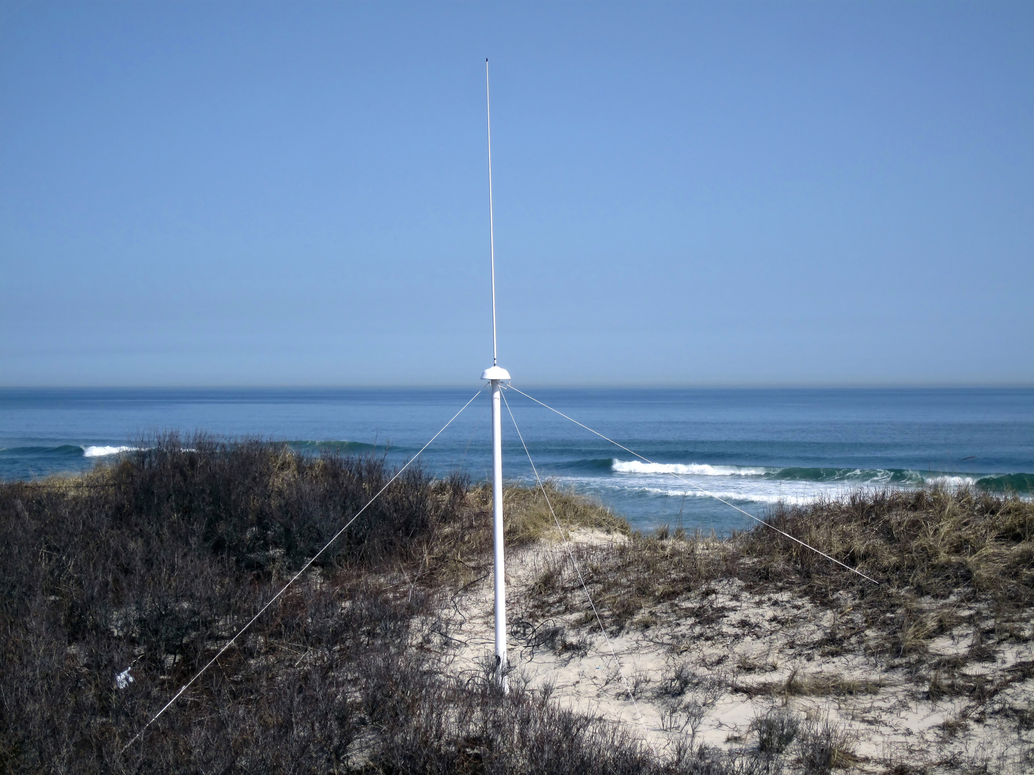
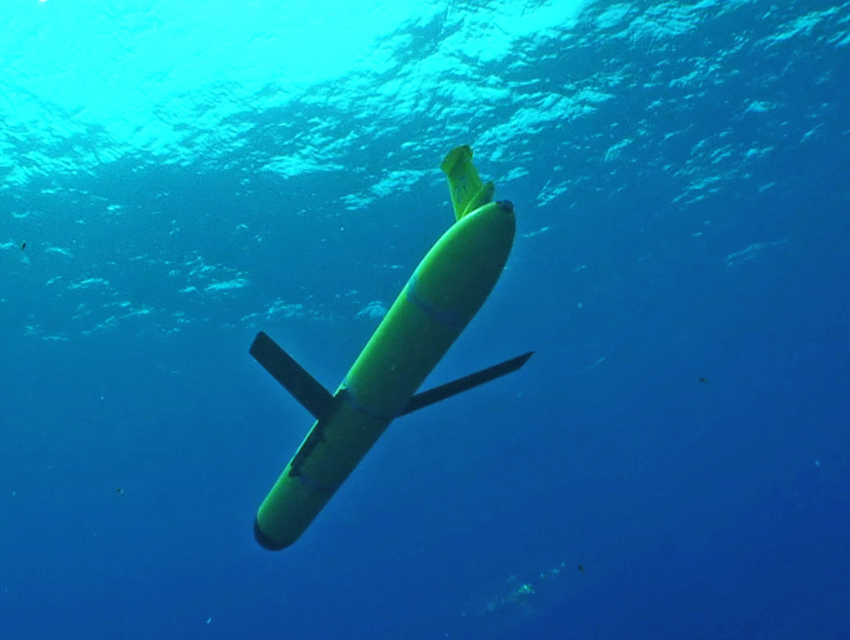
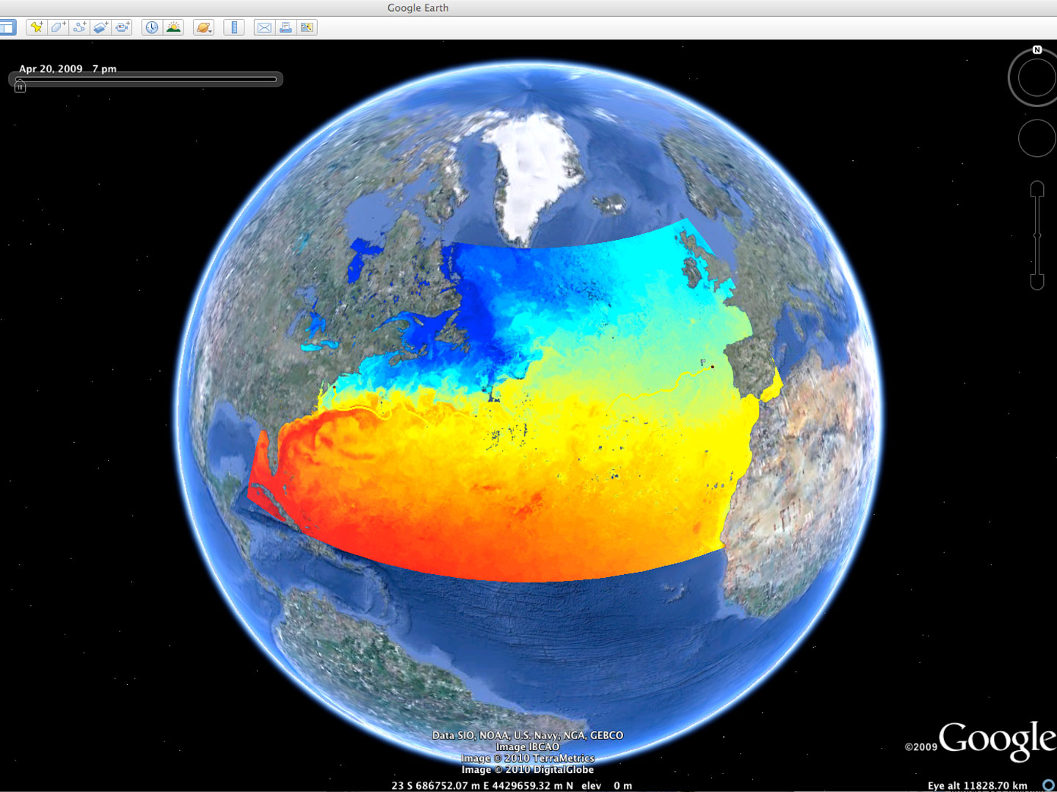












Rutgers University - Center for Ocean Observing Leadership
L-Band & X-Band Satellite Receivers
46 Site CODAR Network
~ 500 Glider Deployments
3-D Nowcasts
& Forecasts
+ Many More!
Notes:
28
Companies – TWR, Seaspace, CODAR, Aquawind, Weatherflow, Sequoia Scientific, Seabird Electronics, Wetlabs, Satlantic, Nortek

Slide 31
Schlieren is visible in images when the buoyancy frequency exceeds ~0.12 s-1.
Sensitivity to forward scattering of light by larger particles.
Buoyancy frequencies above 0.025 s⁻¹ may increase beam attenuation due to scattering from density gradients.
Measured as particles in larger size bins, >100 um
Mikkelson et al., 2008
Need to double-check these

