Slide 1



Mapping North Atlantic right whale distribution relative to coastal ocean features in the Mid Atlantic Bight
Laura Nazzaro, Josh Kohut, Joseph Brodie, Laura Morse, Mark Baumgartner, Courtney Dreyfus, Ahmed Aziz Ezzat

Slide 2
Wind Energy in the New York Bight
New York and New Jersey have both committed to 100% clean energy by or before 2050
Commitment to 9 GW (NY) and 7.5 GW (NJ) offshore wind energy by 2035
Multiple lease areas (dark green) already preparing for construction, with more planning areas (pale green) for auction
Notes:
WEA development in MAB

Slide 3
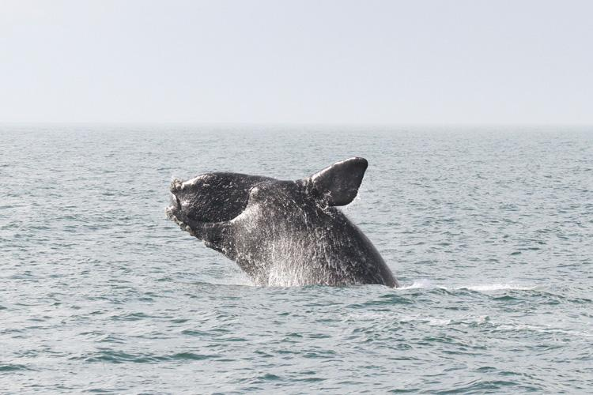
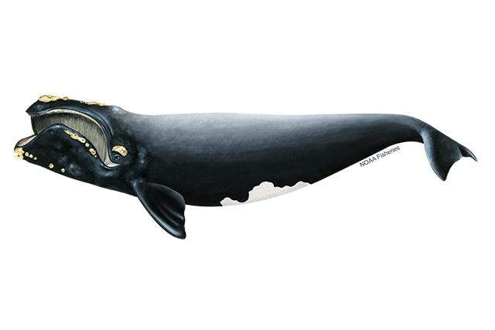
North Atlantic Right Whales in the Bight
Critically endangered, <400 estimated remaining
Migrate through MAB
Potential to be negatively impacted by wind farms planned for region, especially during construction
Difficult to predict right whale presence in MAB
Images: NOAA Fisheries
Notes:
Right whales

Slide 4
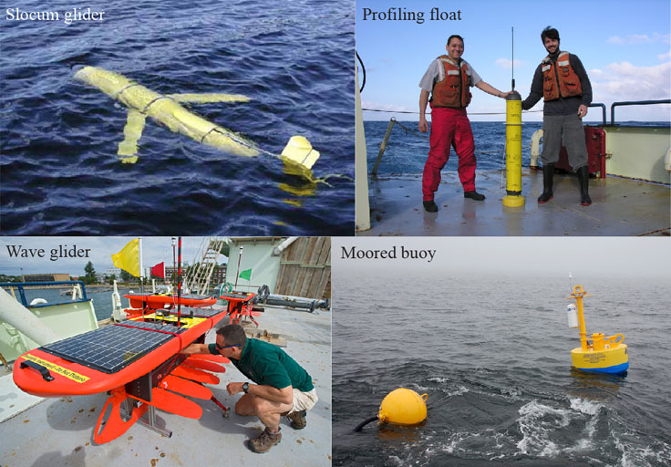
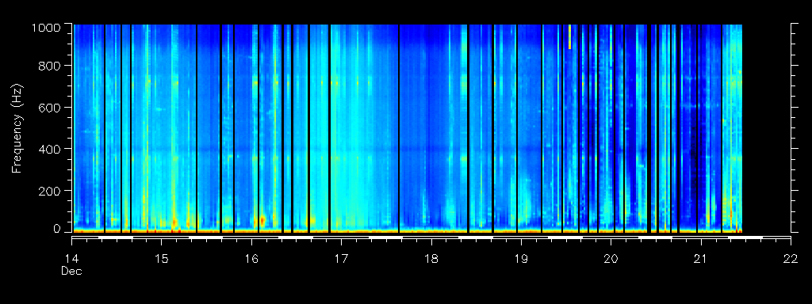
Right Whale Data Sources: Passive Acoustics
Right, fin, humpback, and sei whale calls detected via Woods Hole passive acoustic instrument (DMON); 5 nmi listening range
On multiple buoys (cyan markers) and glider deployments (black lines) in NY Bight, with good coverage of lease areas
credit: Robots4Whales (WHOI)
Notes:
Right whale data sources

Slide 5
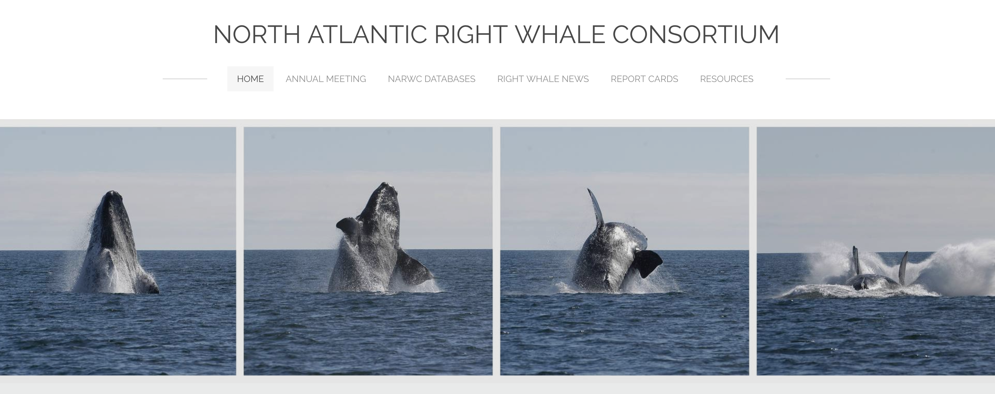
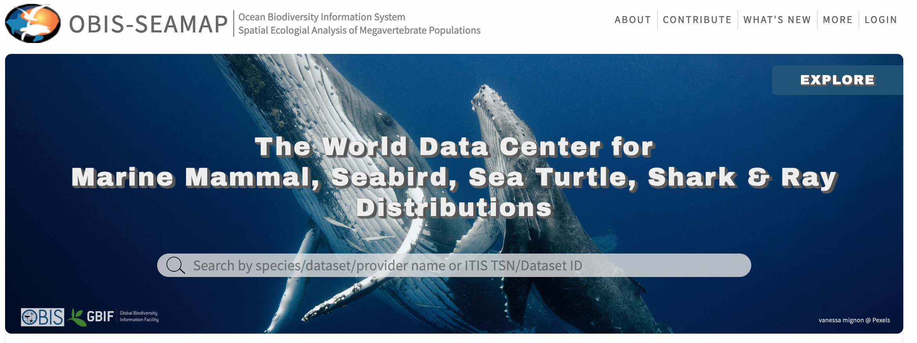
Right Whale Data Sources: Sightings
North Atlantic Right Whale Consortium (by request) and OBIS-SEAMAP (multiple species)
Surveys
  Aerial and Shipboard
  Most effort is focused outside our immediate area of interest
Opportunistic sightings
  Best coverage in our area of interest, but no associated effort data
Notes:
Right whale data sources

Slide 6
Environmental Data Sources
What we have
  Gliders
  High Frequency radar
  Satellites
  Models
What do they MEAN for whales? Focus on:
  Features that may detect, concentrate, or promote growth of prey
  Features that might ease energy demand associated with migration
  ???
Notes:
Environmental data and models

Slide 7
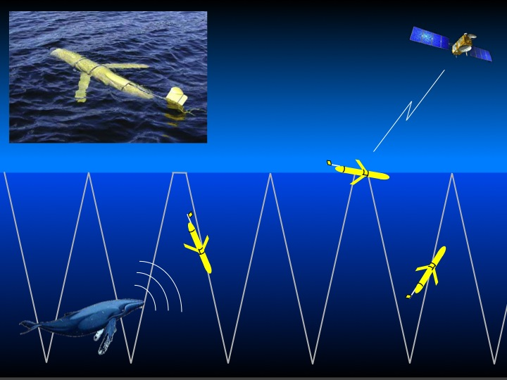
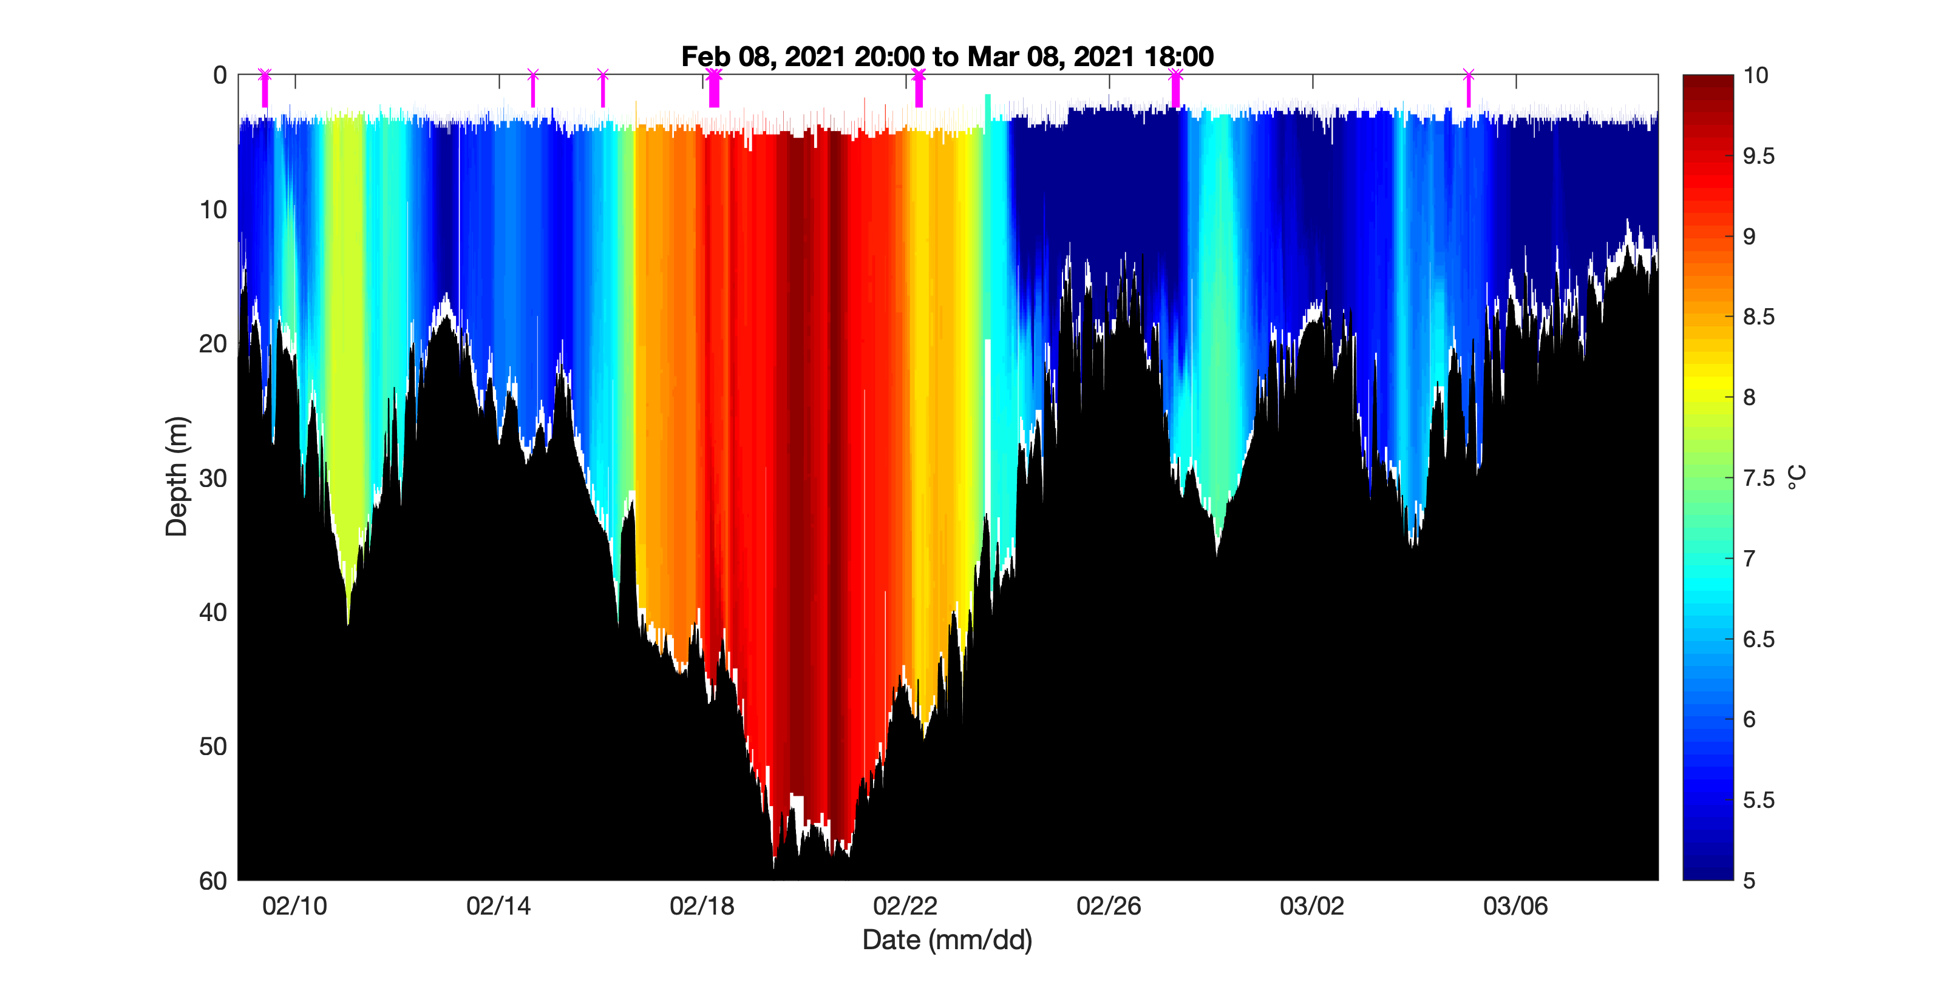
Gliders
Move up and down through water column using buoyancy pump, expending minimal energy
Collects data vertically and horizontally
Can be equipped with several sensors
  CTD
  Dissolved oxygen
  Chlorophyll
  Active or passive acoustics
  …
Notes:
gliders

Slide 8
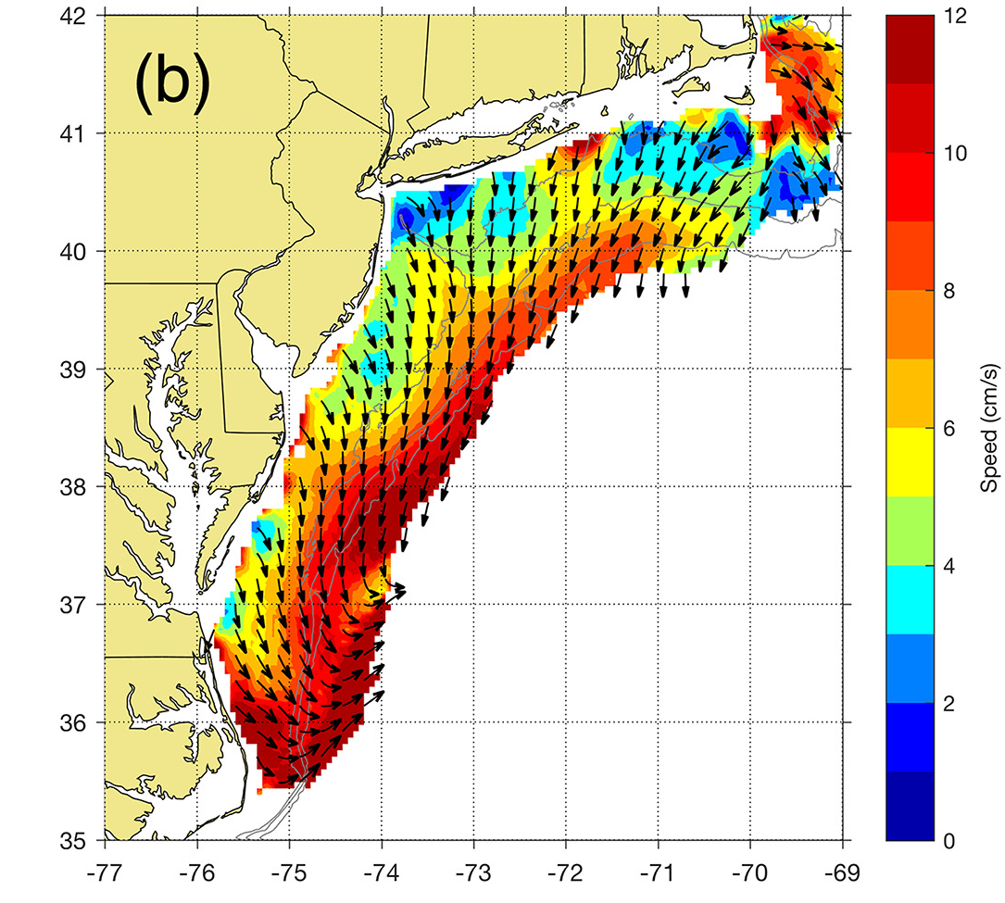
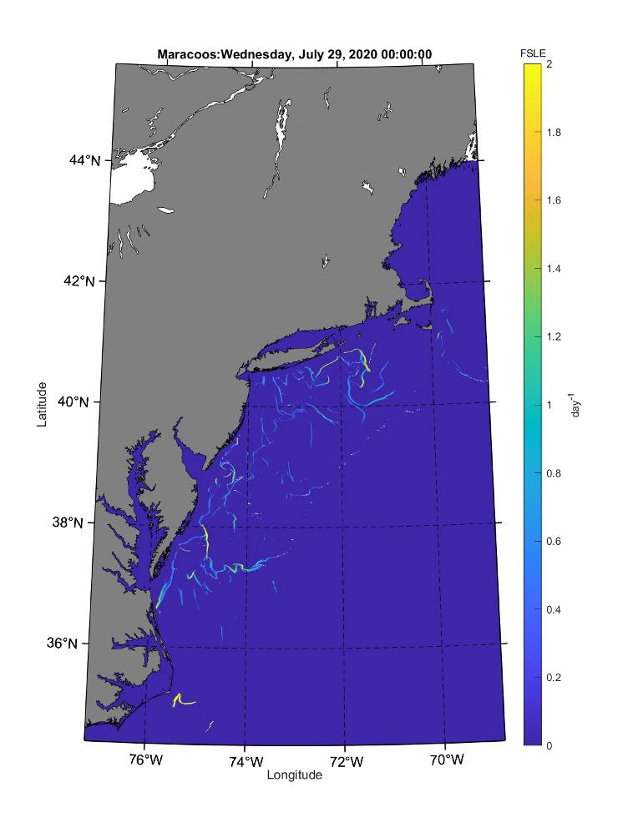
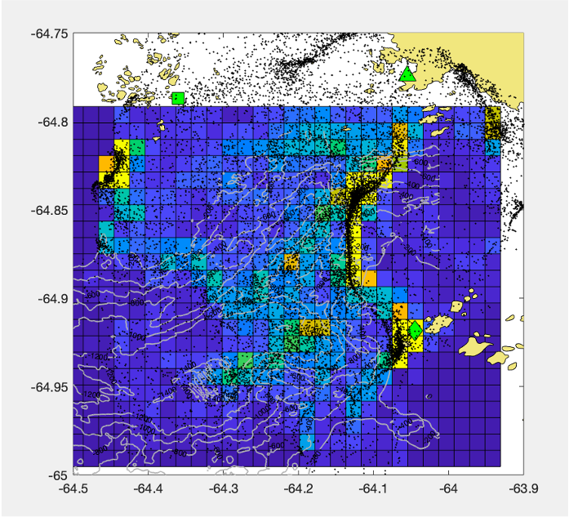
High Frequency Radar
Series of antennae along coast measure surface current via doppler; can be combined to generate a map of surface currents covering MAB shelf
Lagrangian Coherent Structures (LCS) use the surface current field to detect where particles (like zooplankton!) are likely to collect or diverge
LCS by Jackie Veatch and Erick Fredj
Notes:
HFR & LCS

Slide 9
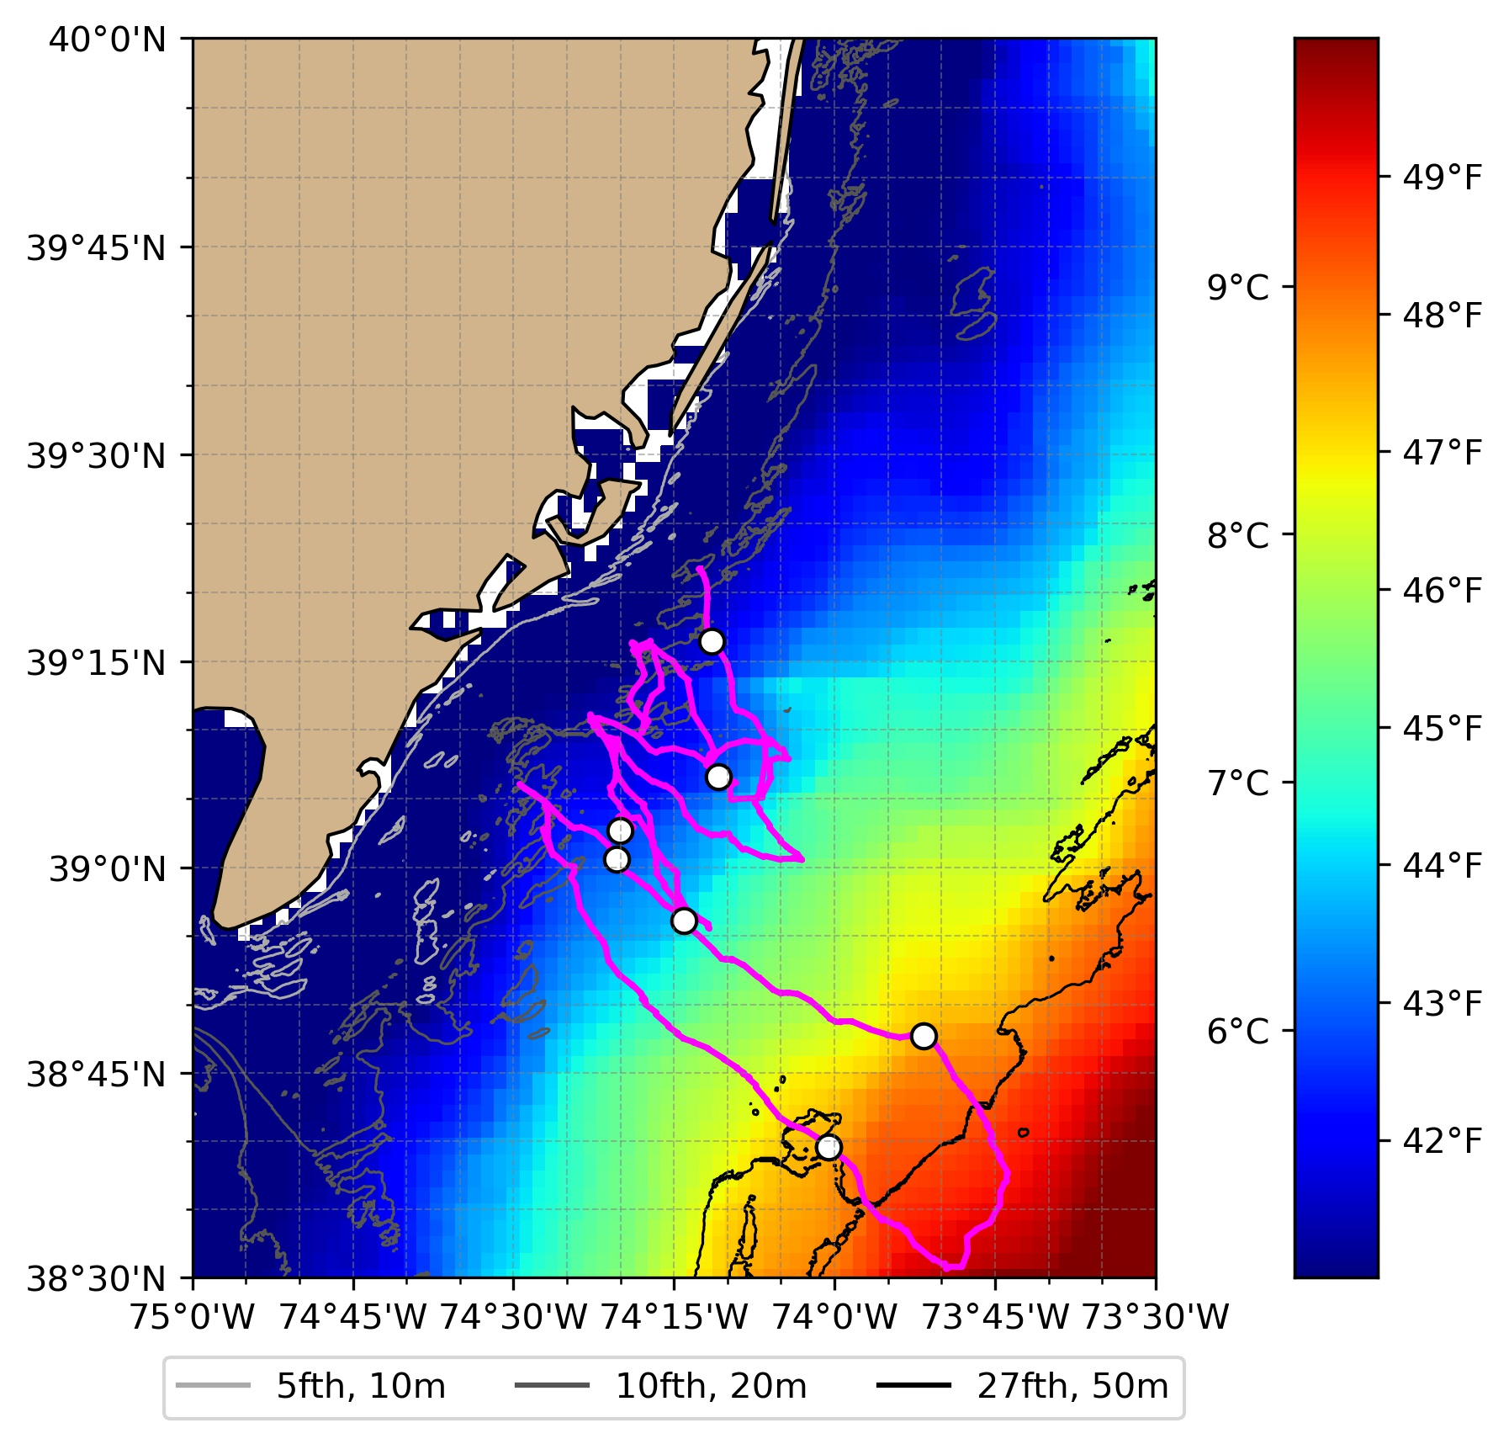
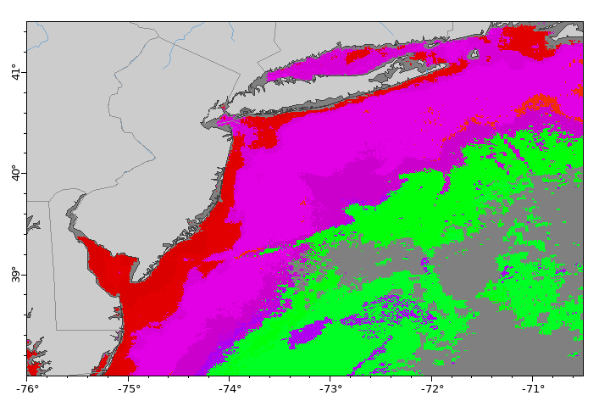
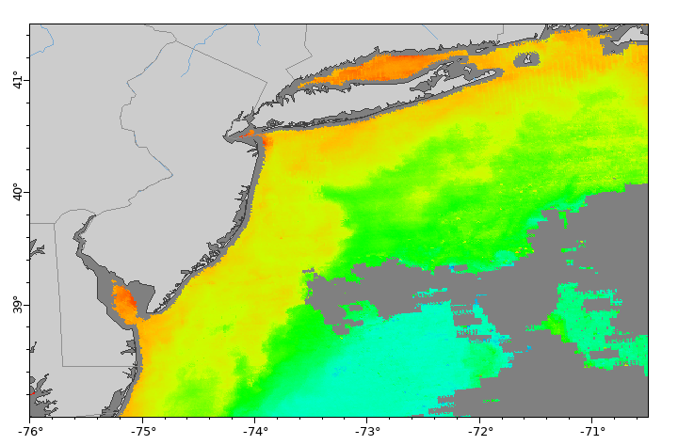
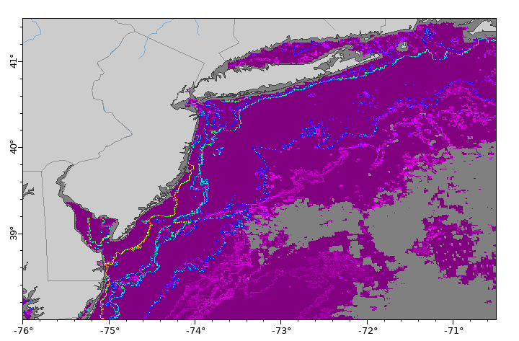
Satellites
surface temperature
credit: UDel ORB Lab
Full high-res coverage (minus clouds) of several surface features
  Temperature
  Chlorophyll
  Ocean color
  Water masses classified based on temperature and color
  Gradient strength between water masses
water mass
surface chlorophyll
fronts and gradient strength between water masses
Notes:
satellites

Slide 10
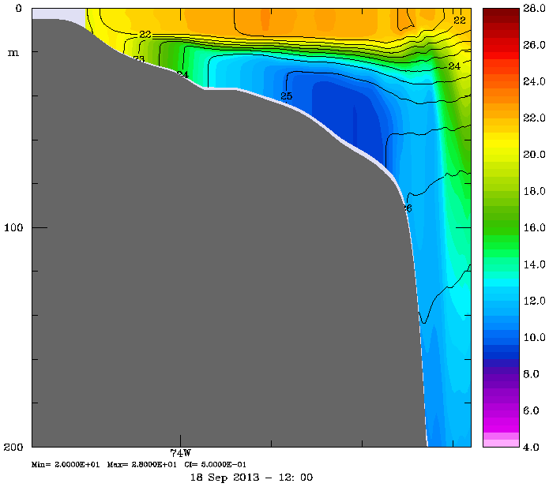
Models
Full 4-D coverage of most features we measure
Allows us to get regional and/or site-specific stratification indices
Potential for use of biogeochemical models that include estimates of zooplankton
credit: RU Ocean Modeling Group
Notes:
DOPPIO and models

Slide 11
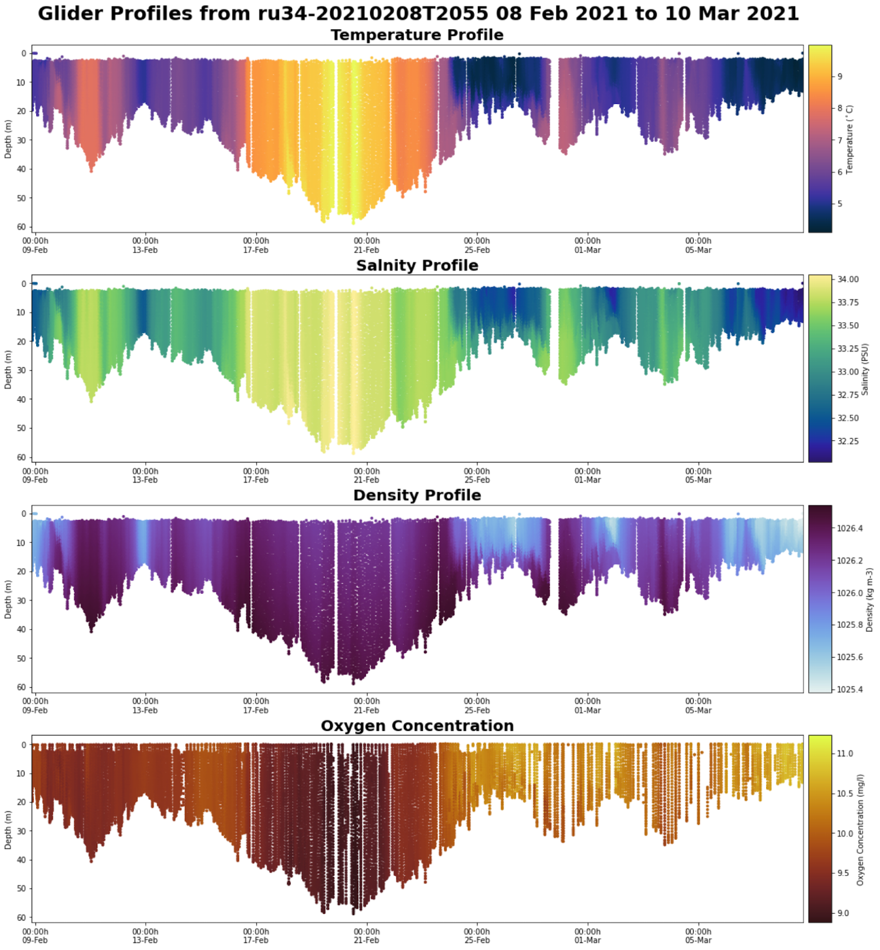
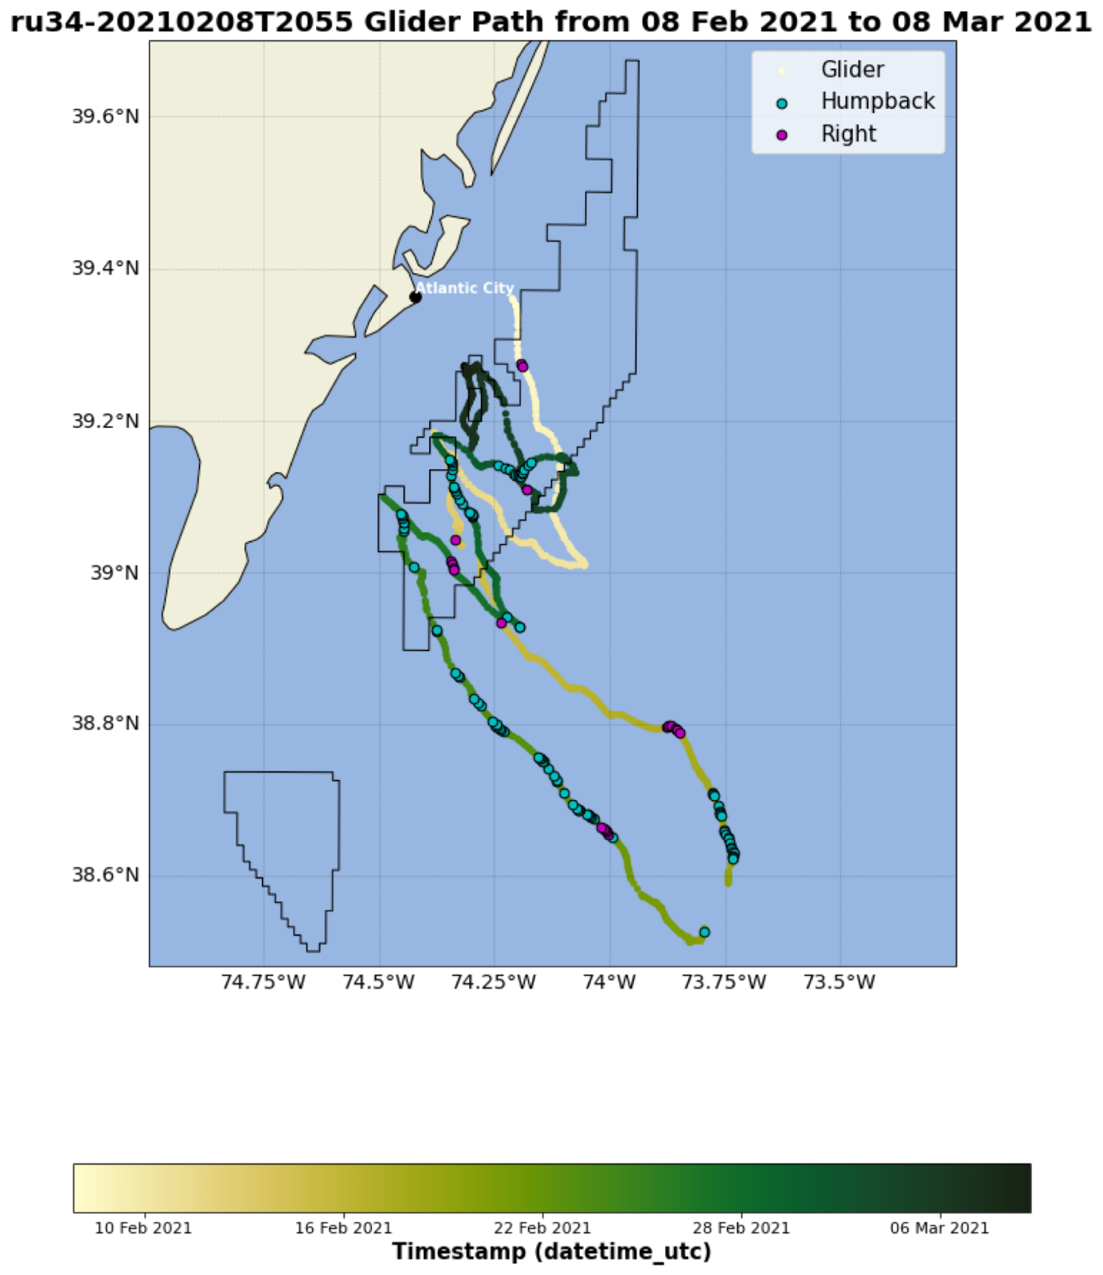
Mapping Glider Detections to Environmental Data
Masters in Operational Oceanography student is working on tools to identify and plot features commonly associated with whale detections
Notes:
Courtney’s work, fronts

Slide 12
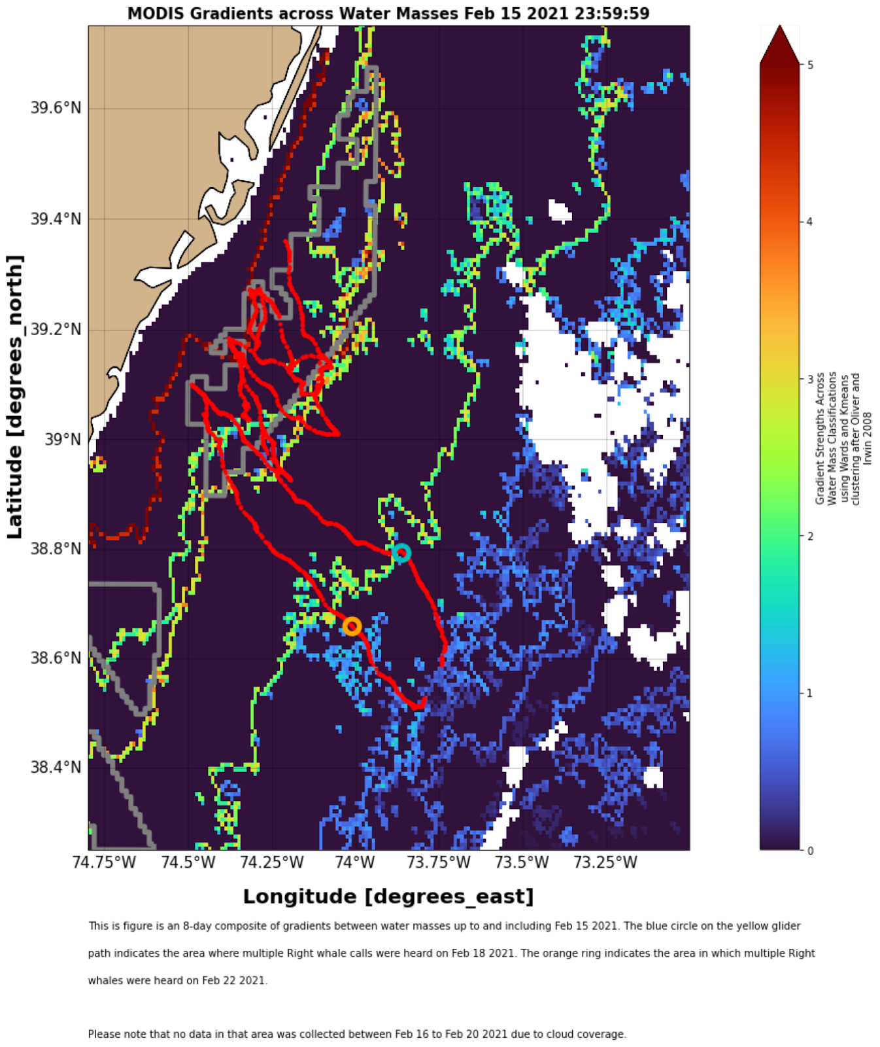
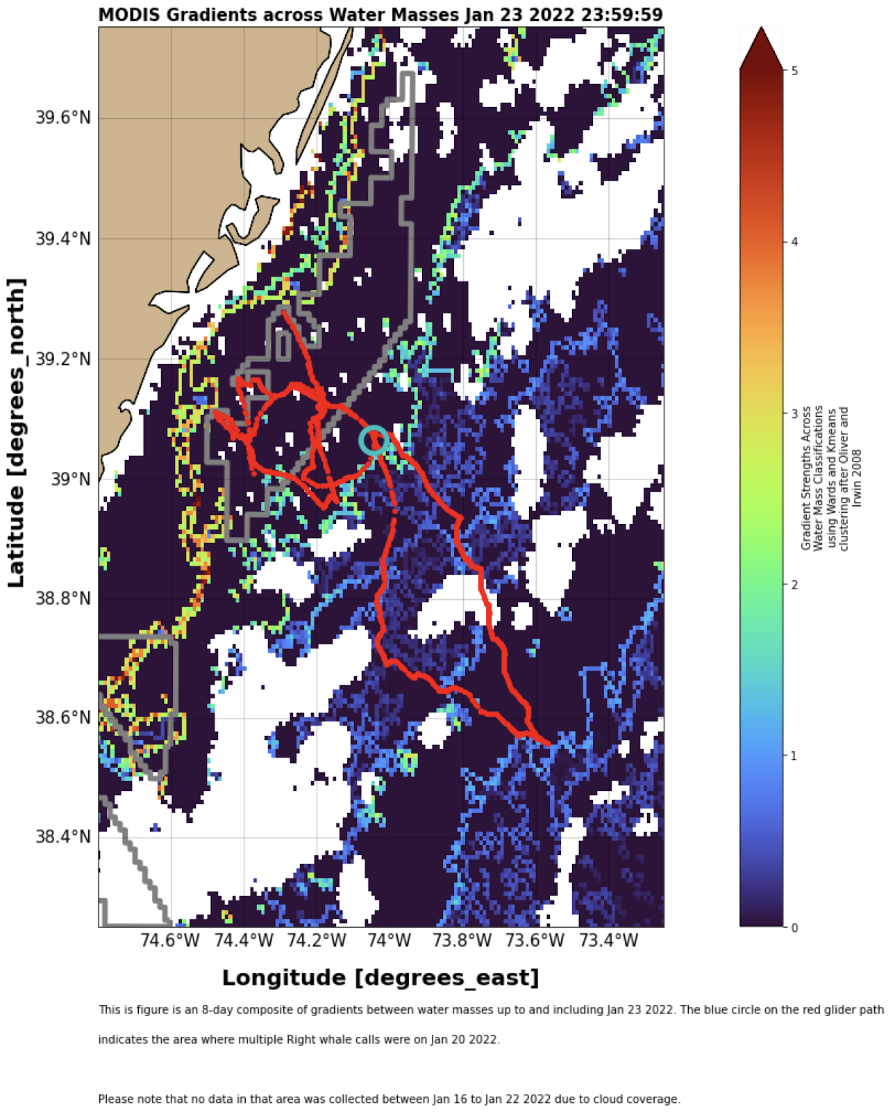
Fronts!
Gradient Strength Between Water Masses
Winter 2021
Winter 2022
Sightings mapped to other environmental features
Winter deployments 2021 and 2022 both detected right whales crossing fronts during cross-shelf transect

Slide 13
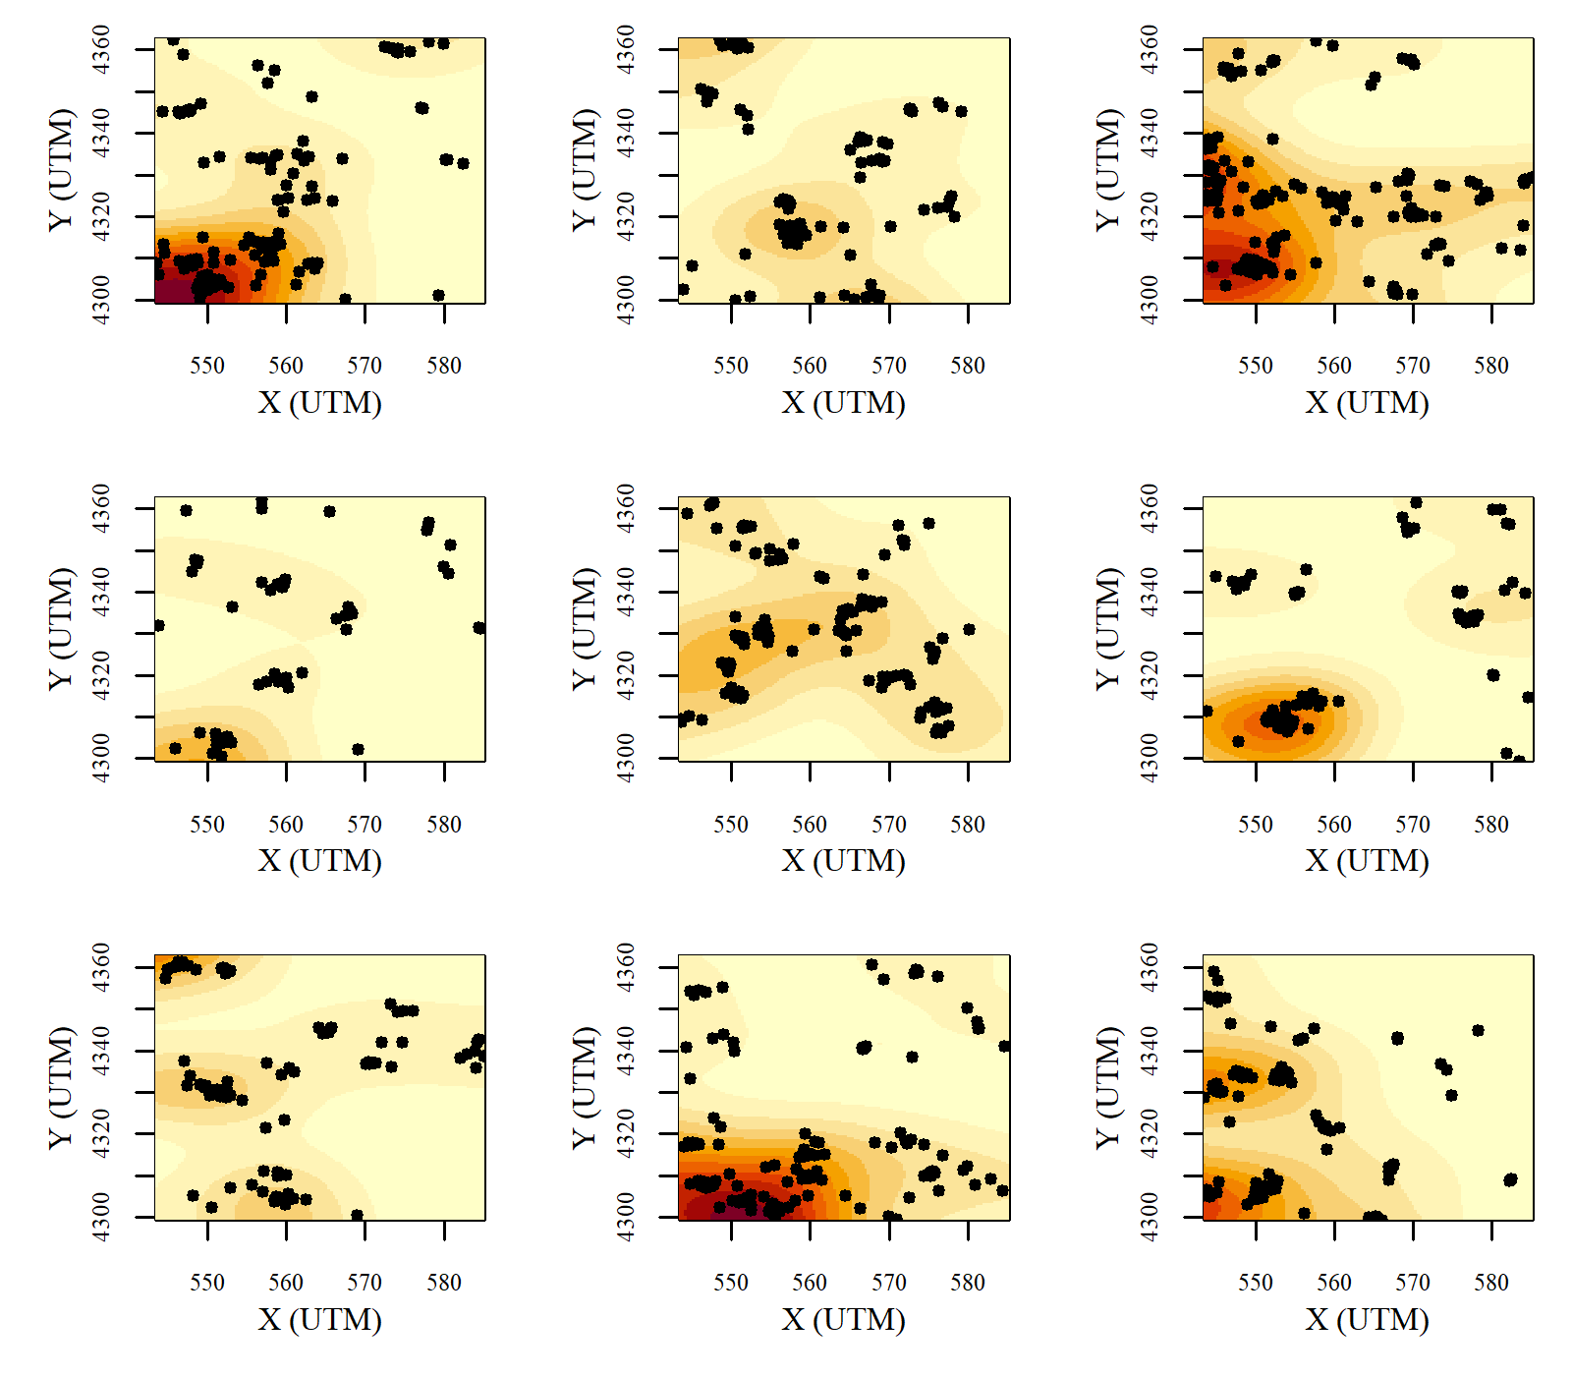
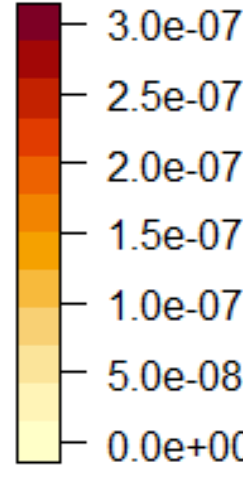
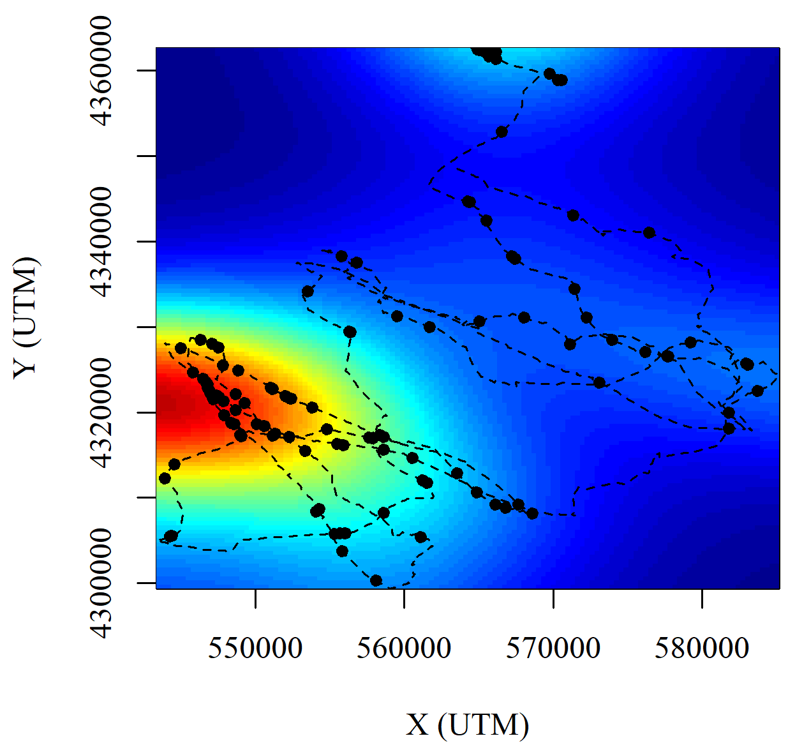
Upcoming Modeling Efforts
9 simulations
Point-process machine learning models
Can be used to model density of sightings in physical space or in environment-space, as well as
dependence on
other nearby whale
detections
*sample not based on actual data*
Notes:
Aziz model

Slide 14
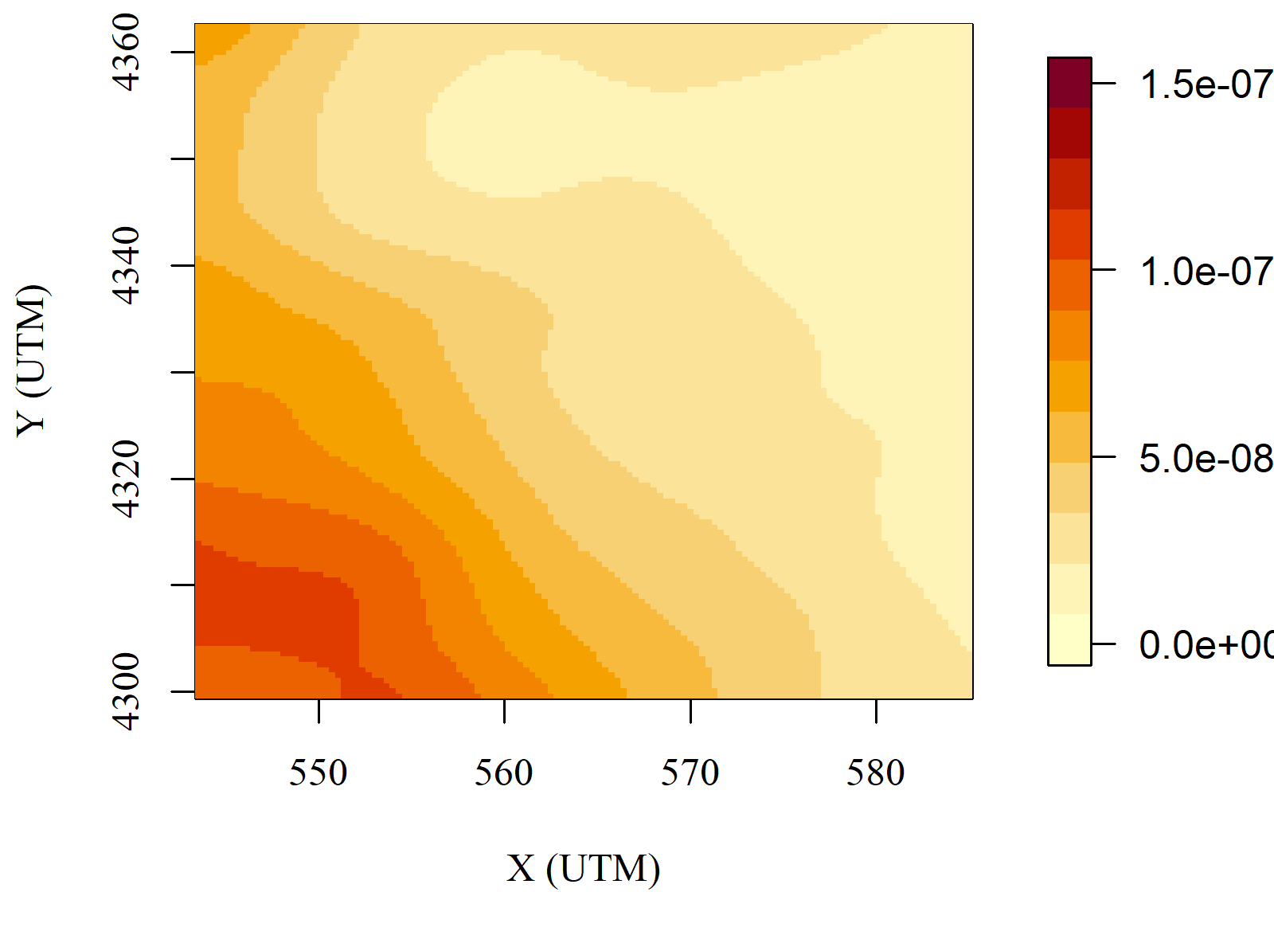
Upcoming Modeling Efforts
A “Risk Map” in physical or environmental space can be generated by averaging a large number of simulations

Slide 15
Conclusions, Questions, and Challenges
Whales are warm-blooded, response to environment less clear than tightly coupled fish
Lots of data in New England, very limited in MAB
  Difficult to determine whether multiple detections together are multiple whales or multiple calls from same whale
  Lack of effort data for many datasets in area of interest can complicate model development
Right whales don’t seem to spend much time in MAB, assumed to be mostly for migration; do we need to consider migration triggers in other regions? How?
Choosing an appropriate spatial scale can be difficult given variability in detection range
How do we choose temporal averaging scale and account for time lag? Prey (zooplankton) is related to features we can measure (after a lag), but not reliably measured itself.
Possible association with mid-shelf front, especially in winter
Machine learning can help define relationships
Notes:
Questions, challenges, conclusions

