Slide 1

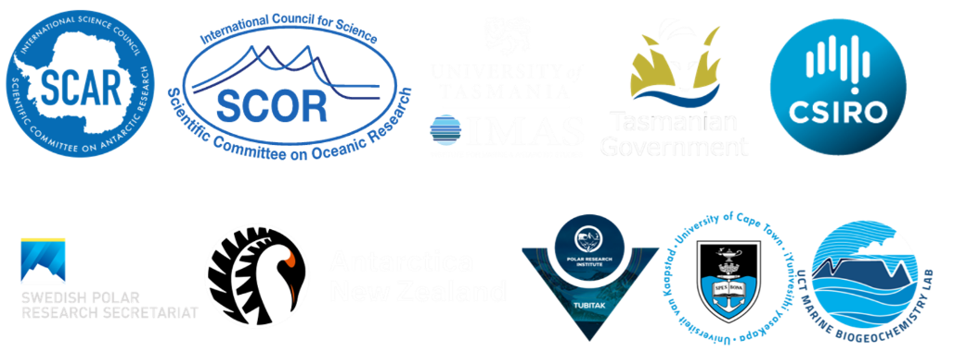
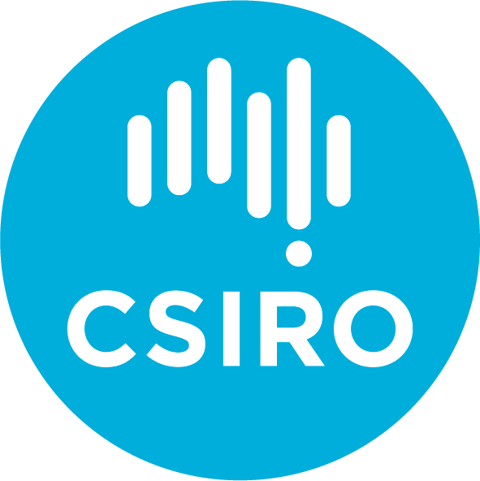

WASPA Updates & Plans
Oscar Schofield & Juan Hofer
13, September 2022

Slide 2
WASPA Working Group
Activity has been less active than it should been
Should use the activity to galvanize new activity with planned leadership rotations
Rotation processes should be started ASAP
Co-Chair Oscar Schofield (USA)
Co-Chair Juan Hofer (Chile)
Elisa Seyboth (Brazil)
Philip Trathan (UK)
Katharine Hendry (UK)
Irene Schloss (Argentina)
In-Young Ahn (South Korea)
Javier Arata (Canada)
Carlos Rafael Mendes (Brazil)
Andrew Barbosa (Spain)

Slide 3
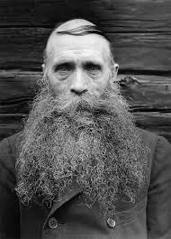
Leadership Changes
Oscar Schofield is due to rotate off
WASPA leadership group. Having SSC help with the transition to re-energize activities is a great opportunity.

Slide 4
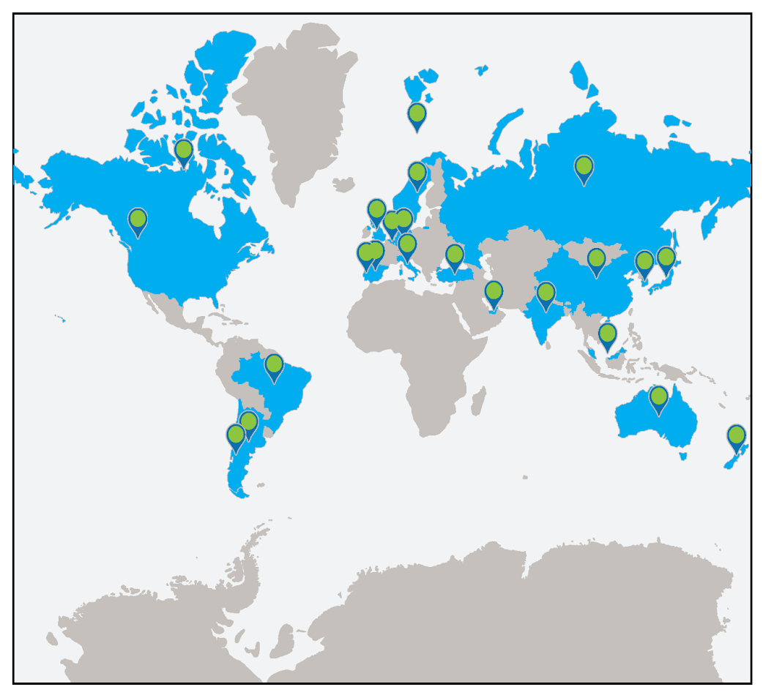
WASPA interest
General Membership:
106 members from 66 institutions and 28 countries.
Region has broad international potential participation. Great opportunity for the galvanizing broad activity.

Slide 5
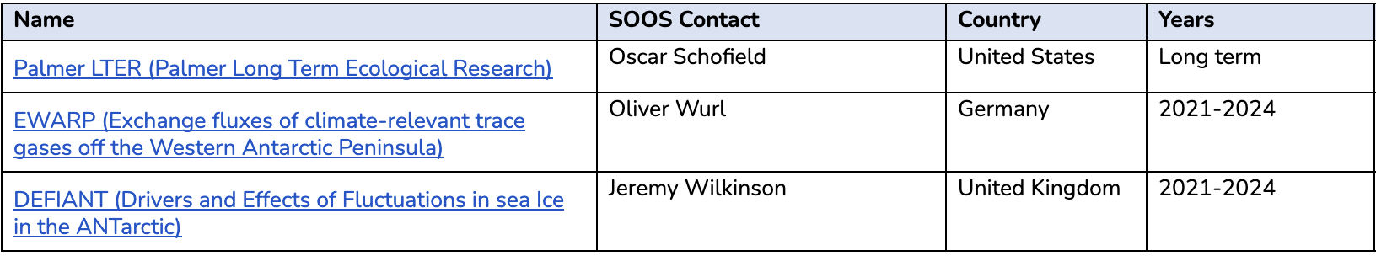
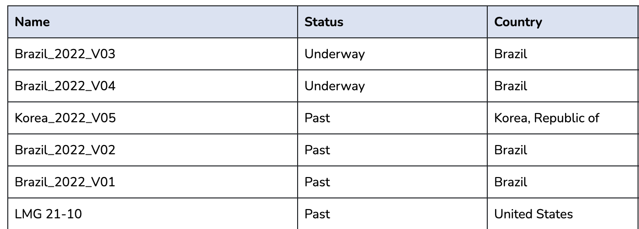
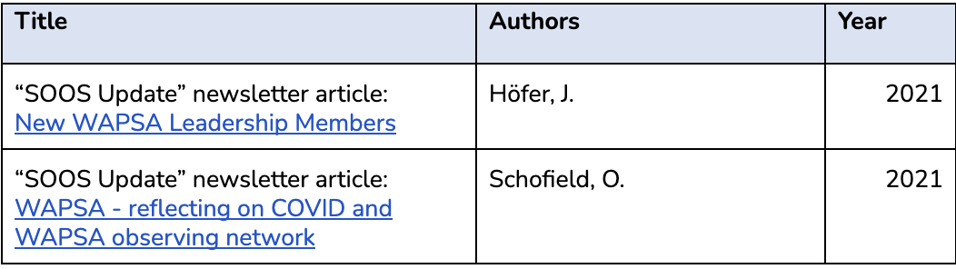
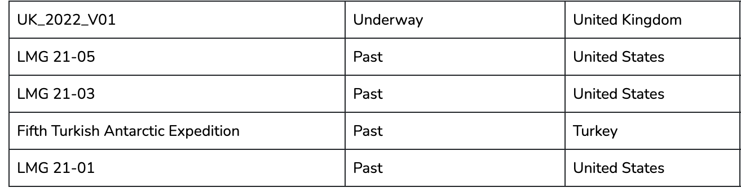
Project Endorsements
-could be improved
Due South
-significant possibility of improvement
SOOS Contributions

Slide 6
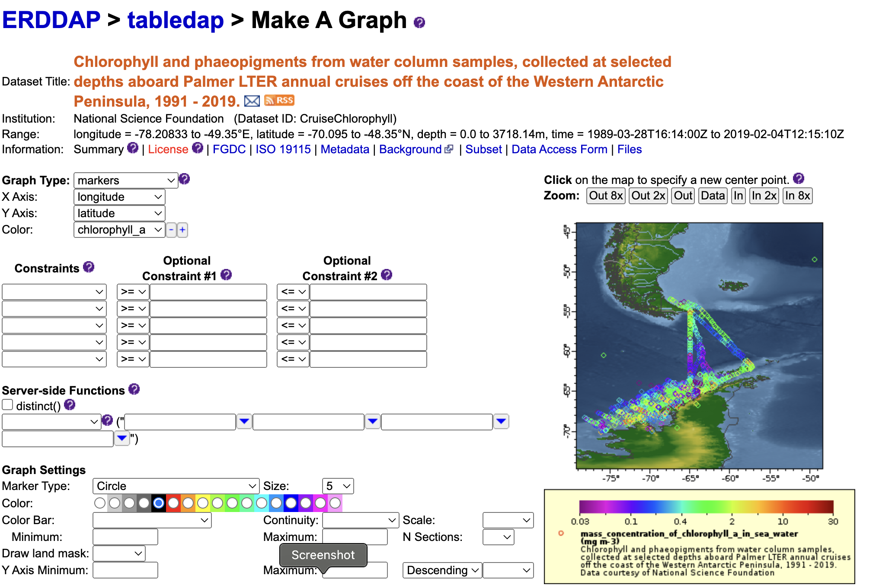
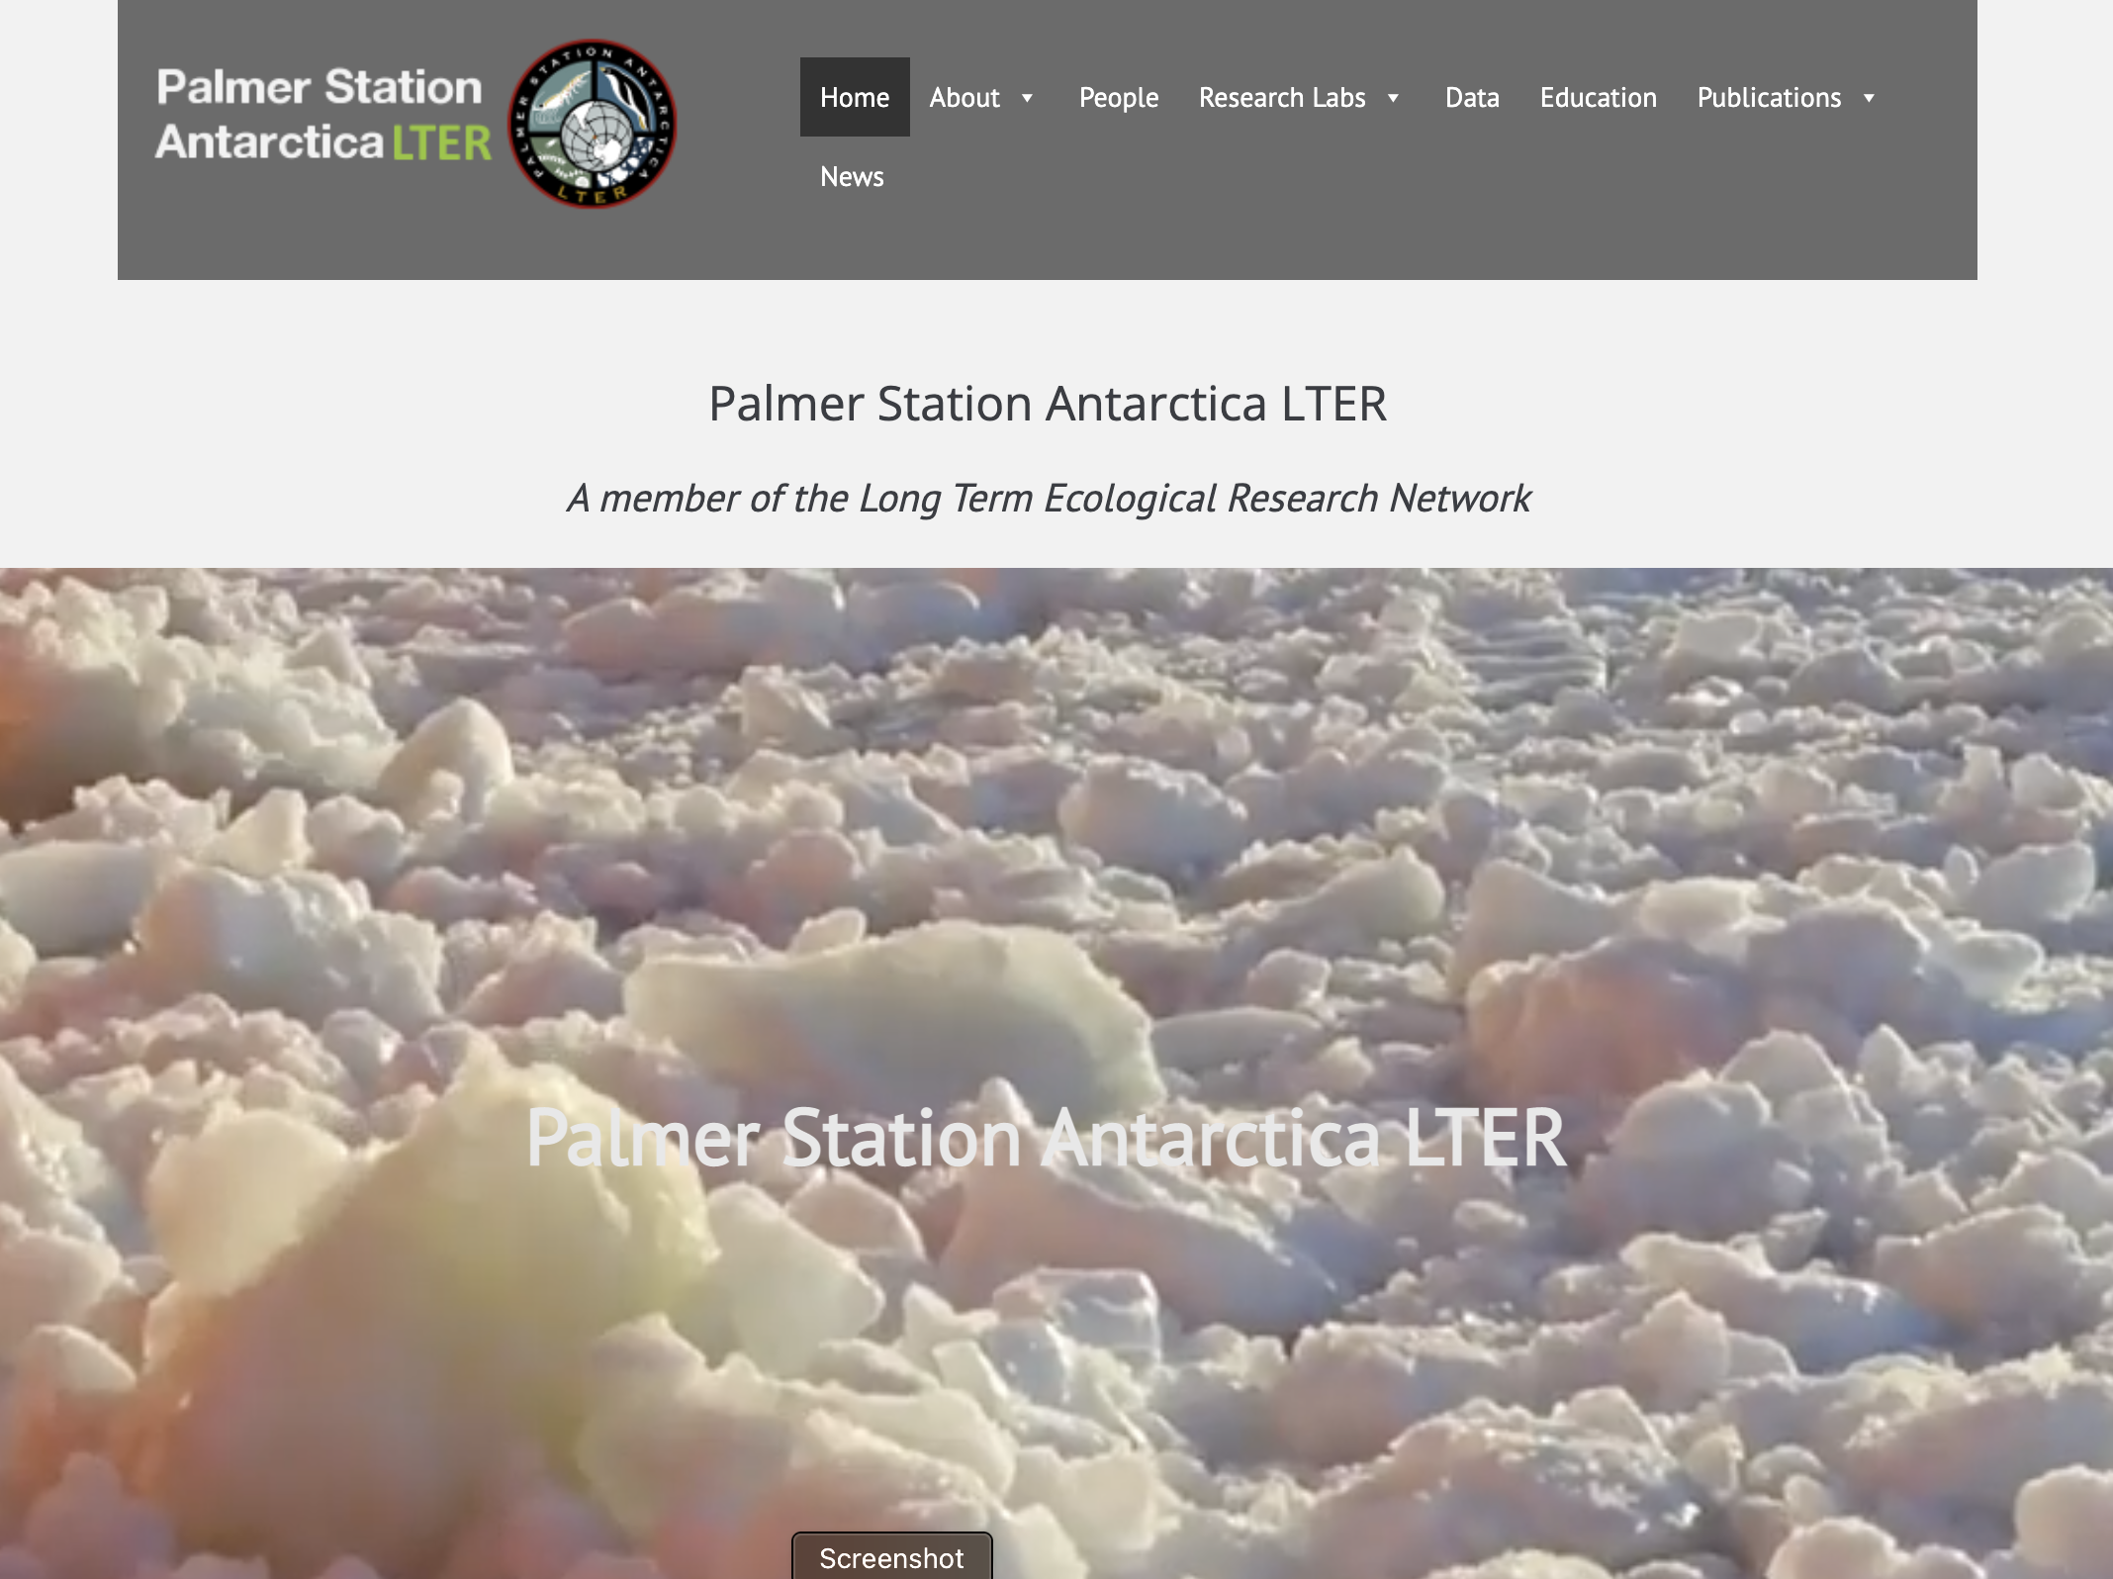
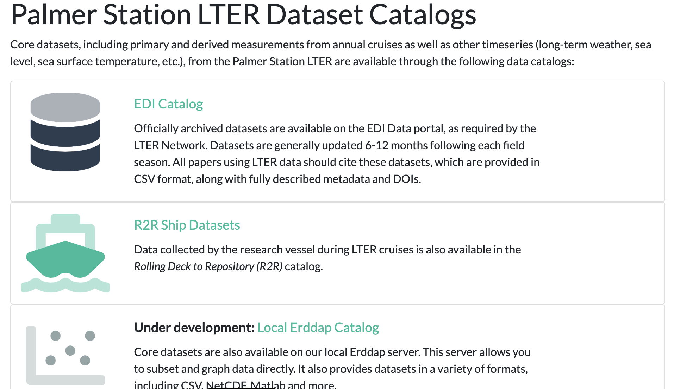
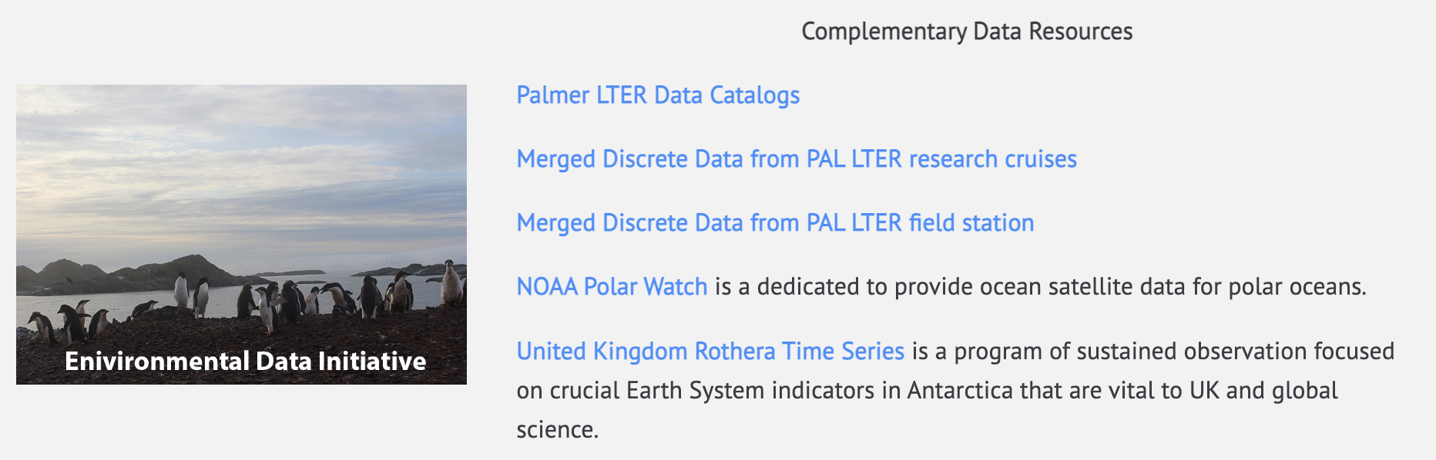
Some Announcements (Recommended for Funding through 2026!)

Slide 7

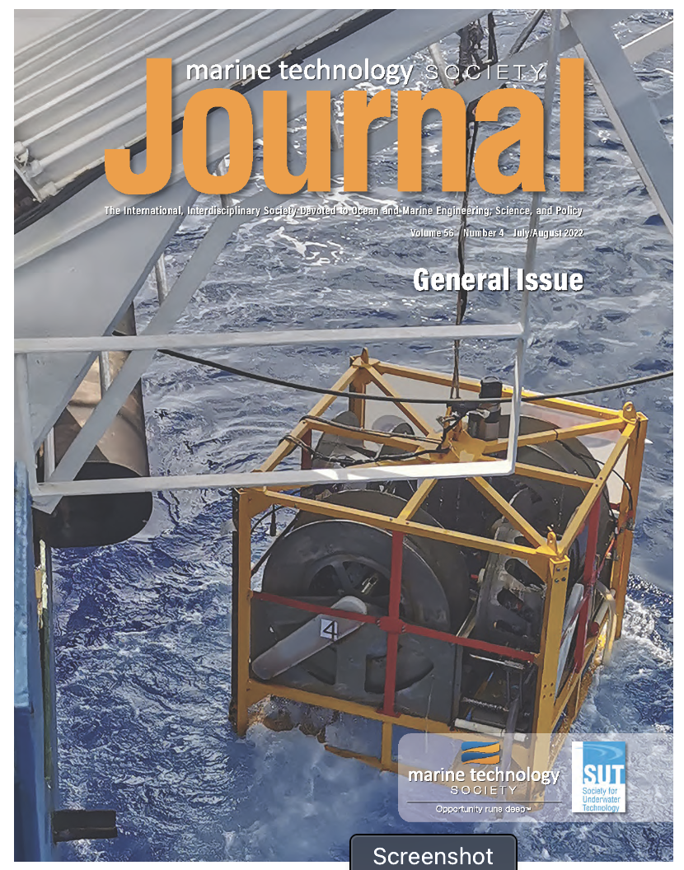
WASPA Activities
Special issue for polar issue on polar technologies
Peer-reviewed journal
Stakeholders include government agencies, companies, and academics

Slide 8
WASPA Activities
Current special delayed (COVID and conflicting field issues)
Entries are due at end of the year.
Current Submissions in progress
-Airborne Drone Applications
-Bio-Argo Goes Cold
-Autonomous Gliders
-Sensors for Low Power Autonomous Systems for Biology and Biogeochemistry
-Integrated Sensor Web Networks
-AUVs and High-Resolution Networks
-Shore-Based Radars
We can accept more applications and welcome them!

Slide 9
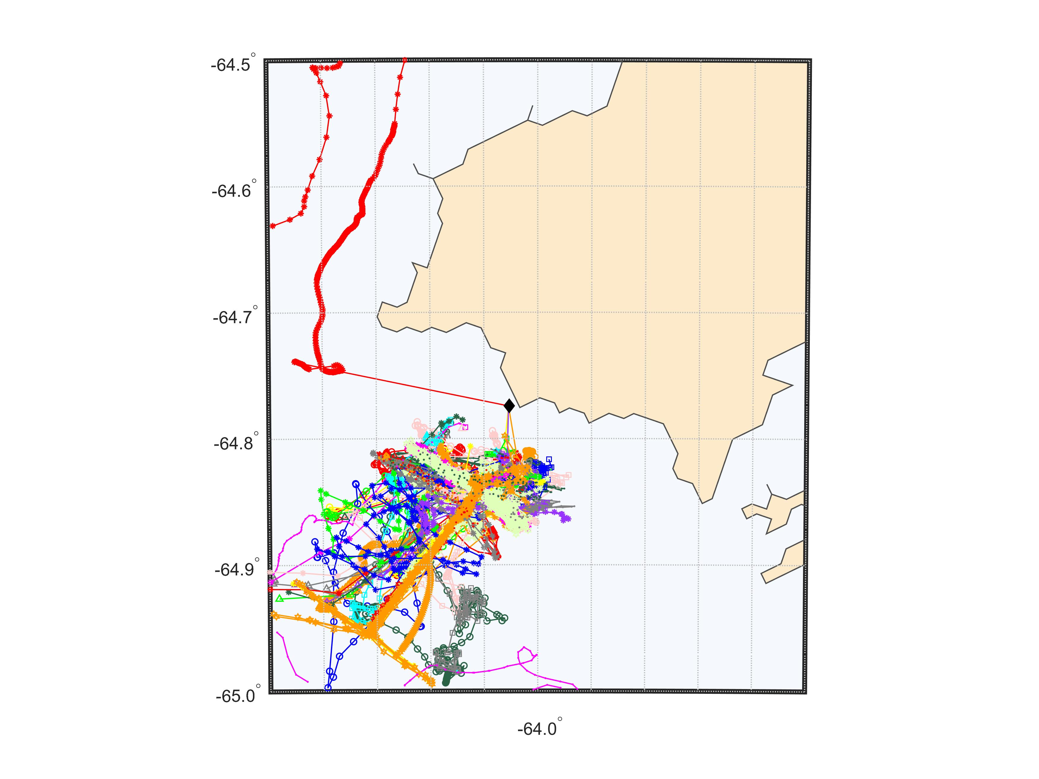
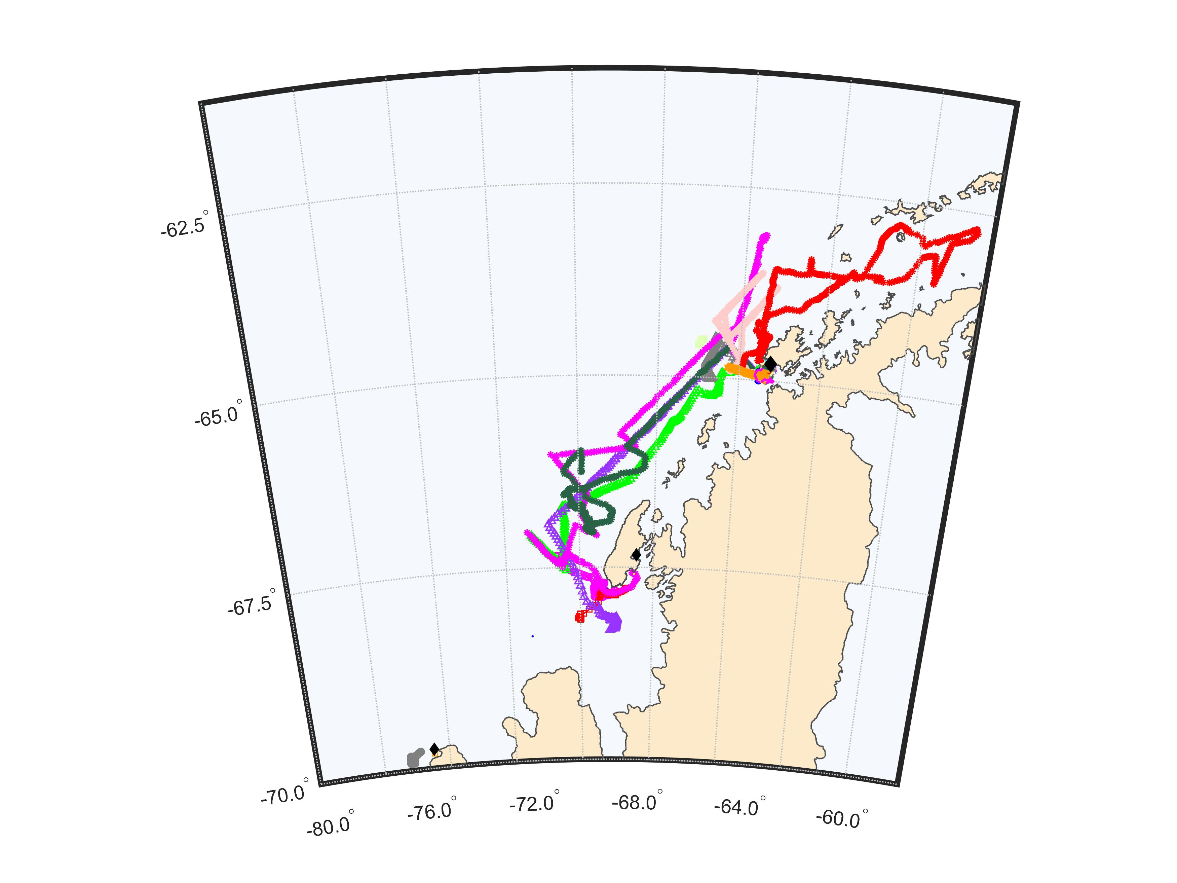
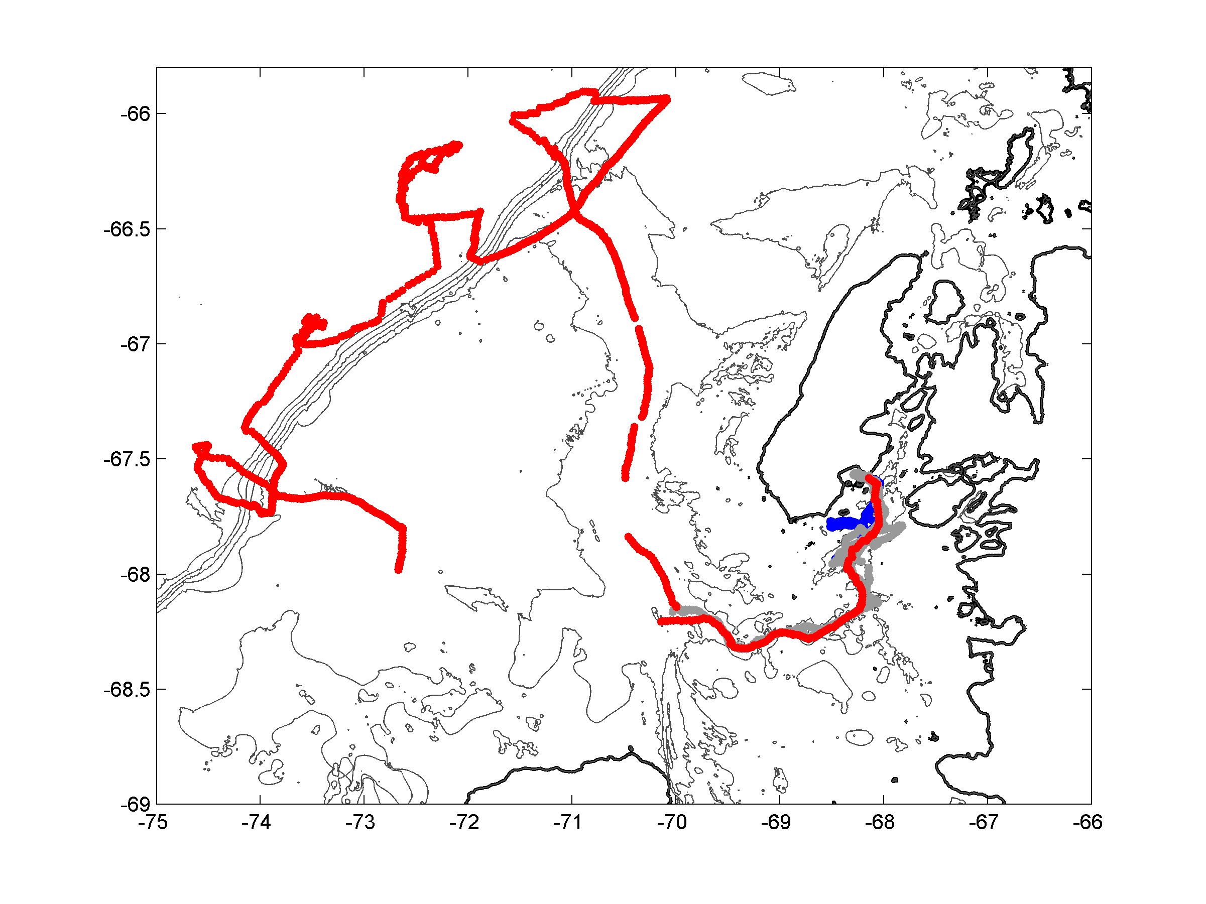

Slide 10
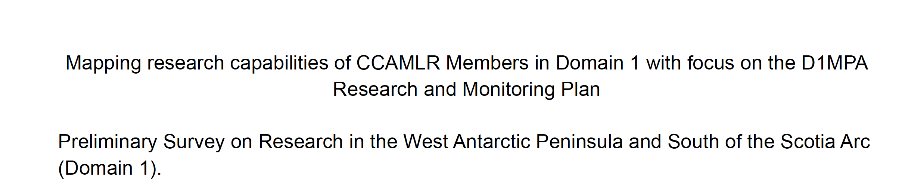

Slide 11
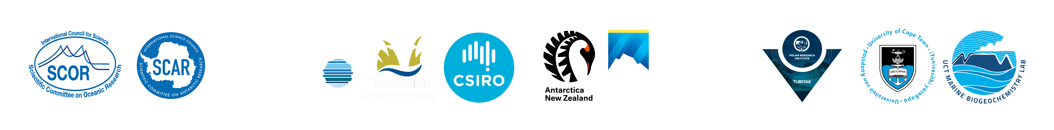
Acknowledgements
On a personal note, WASPA is well suited for moving forward looking forward to supporting expanding opportunities
This work is a contribution to the Southern Ocean Observing System (SOOS); an international initiative of SCAR and SCOR, funded by the Institute for Marine and Antarctic Studies, University of Tasmania; CSIRO; Tasmanian State Government; Swedish Polar Research Secretariat; Antarctica New Zealand; TUBITAK Marmara Research Center Polar Research Institute; and University of Cape Town Marine Biogeochemistry Lab.

