Slide 1
Observing Essential Ocean Features in the Eastern Caribbean for a Safe and Predicted Ocean
Joe Gradone, Travis Miles, Scott Glenn, Doug Wilson, Mike Smith
Ocean Sciences Meeting 2022

Slide 2
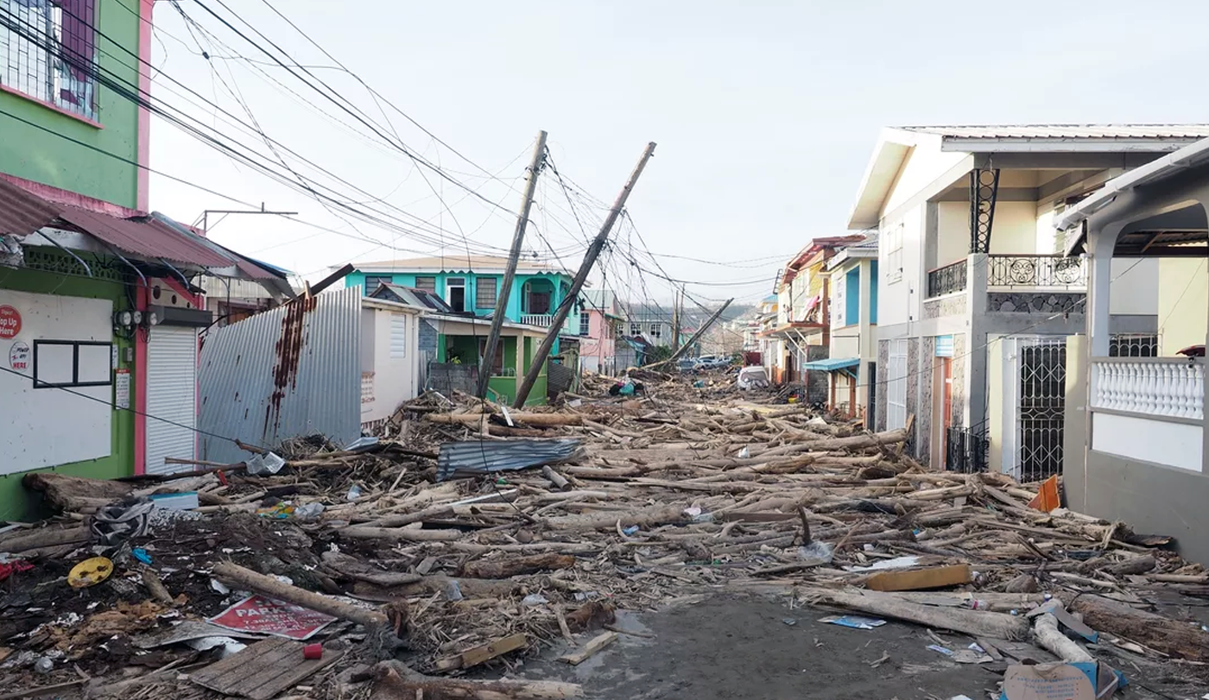
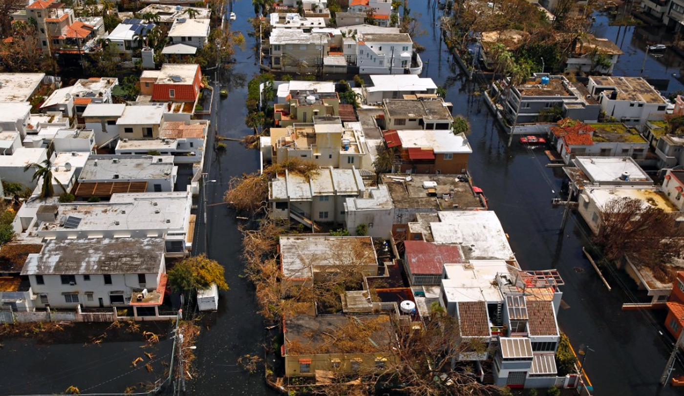
Caribbean is a Region of High Risk
$$RISK = HAZARD × EXPOSURE × VULNERABILITY$$
(White, 1974)

Slide 3
$$RISK = HAZARD × EXPOSURE × VULNERABILITY$$
Climate Change
Rising sea levels
Coral bleaching
Biodiversity loss
Hurricanes
Earthquakes
Volcanoes
~70% of the Caribbean population lives on the coast
Environmentally exposed
Small Island Developing States (SIDS)
Undiversified economies
Tourism
Agriculture
Fisheries
Low availability of resources
High debt rates
Dependence on imports and global markets
(White, 1974)

Slide 4
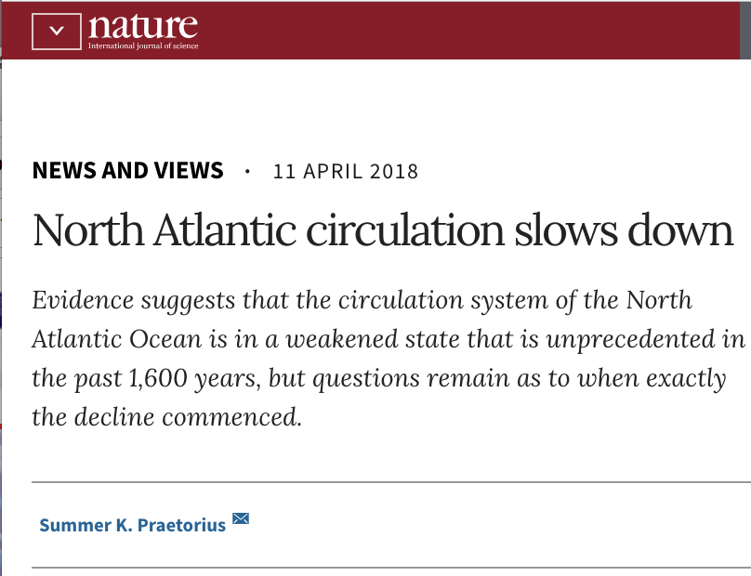
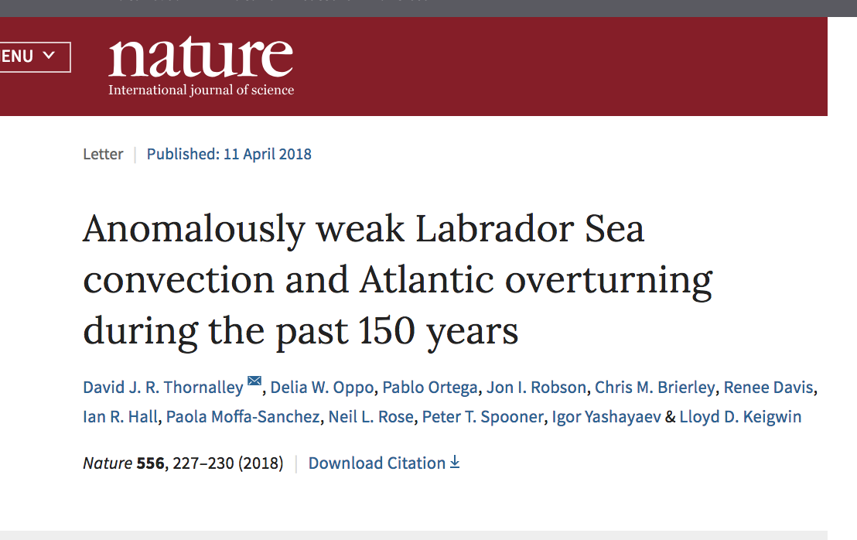
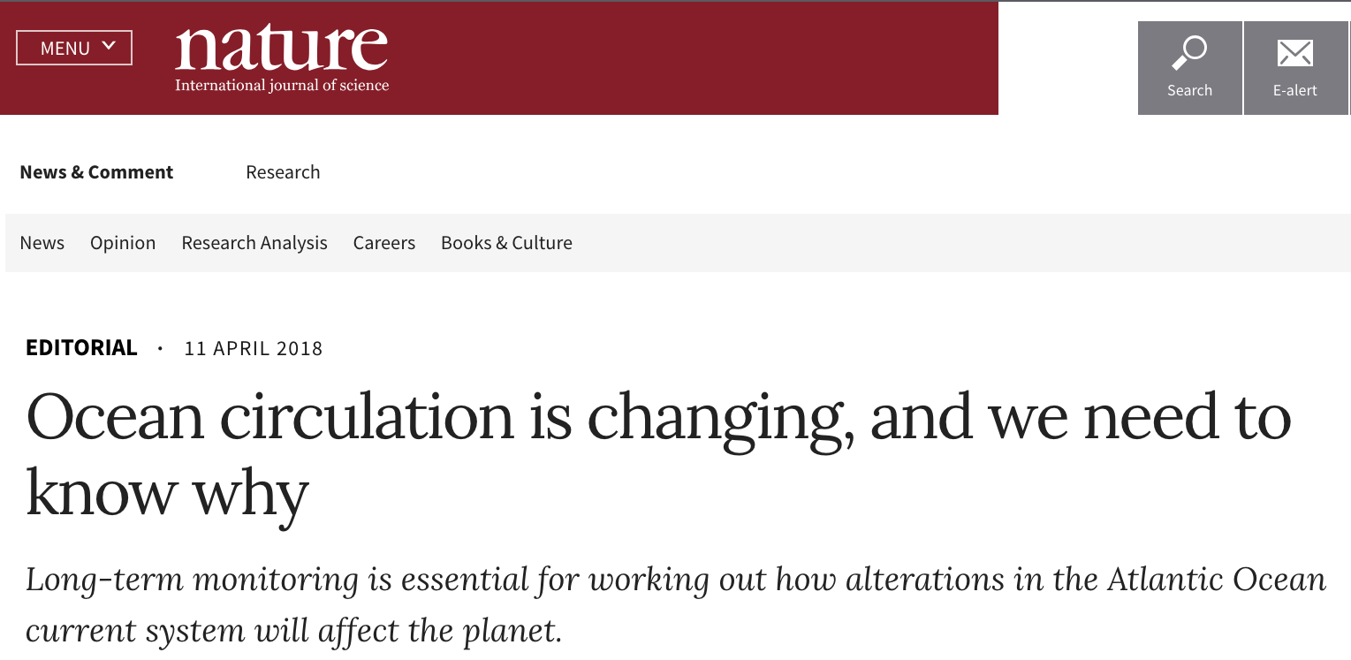
Contributing Factors to Environmental Exposure: Climate Scale Circulation/Transport
Cold Deep
Water Transported South
Published 11 April 2018:
Warm Surface
Water Transported North
Changes in AMOC impact the Planet!

Slide 5
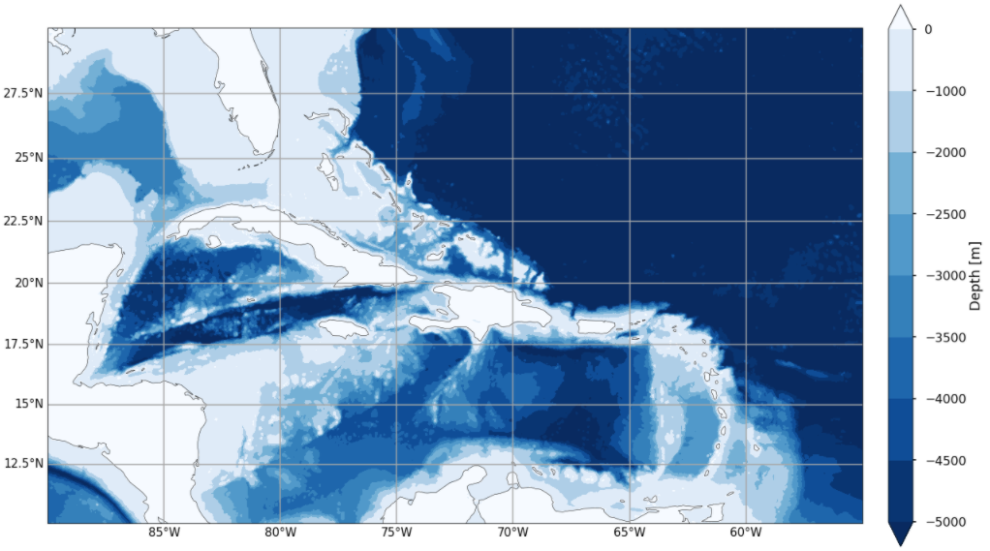
Contributing Factors to Environmental Exposure: Regional Scale Circulation/Transport

Slide 6
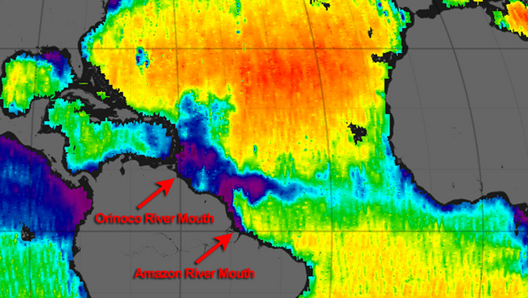
Freshwater Plumes in the Caribbean
Salty
Atlantic Ocean
Freshwater Plume
NASA Goddard

Slide 7
Unique Caribbean
Features:
Complex bathymetry
Heat transport
Freshwater plumes
Essential Ocean
Features:
Barrier layers
Caribbean warm pool
AKA: Ingredient for Hurricanes!

Slide 8
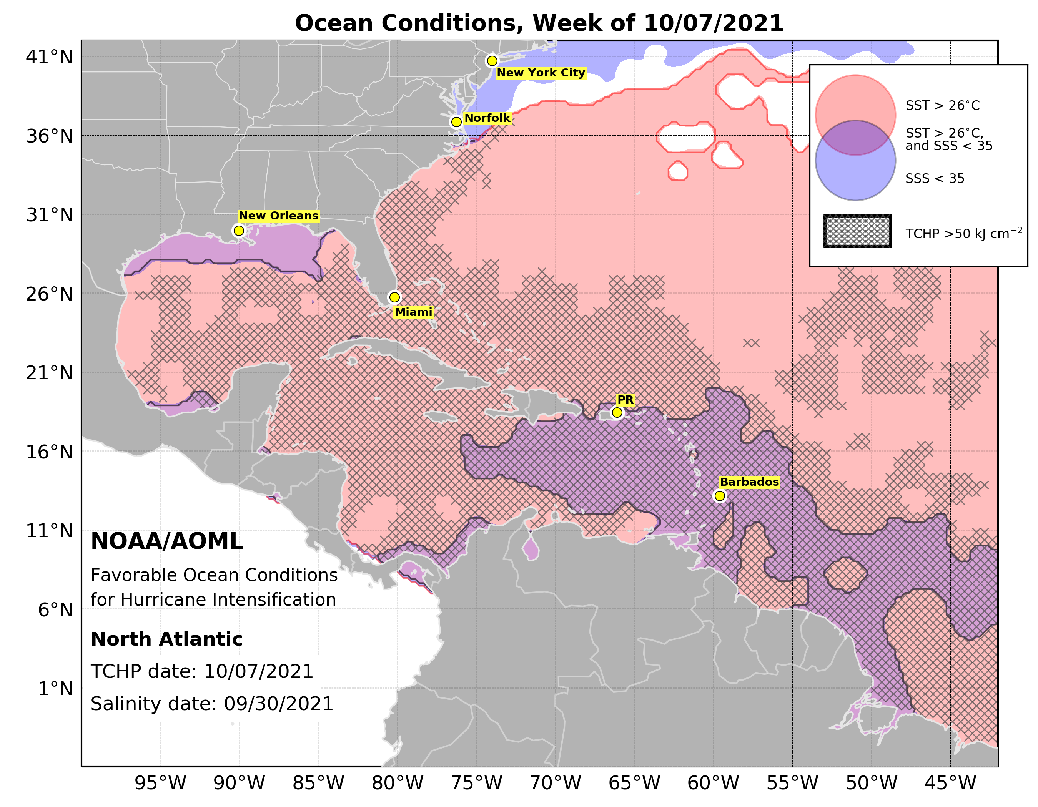
Essential Ocean Features as Ingredients for Hurricanes
Caribbean Warm Pool = fuel
Barrier layers prevent vertical mixing and SST cooling

Slide 9
$$RISK = HAZARD × EXPOSURE × VULNERABILITY$$
Climate Change
Rising sea levels
Coral bleaching
Biodiversity loss
Hurricanes
Earthquakes
Volcanoes
~70% of the Caribbean population lives on the coast
Environmentally exposed
Caribbean Warm Pool
Freshwater Barrier Layers
Small Island Developing States (SIDS)
Undiversified economies
Tourism
Agriculture
Fisheries
Low availability of resources
High debt rates
Dependence on imports and global markets
(White, 1974)

Slide 10
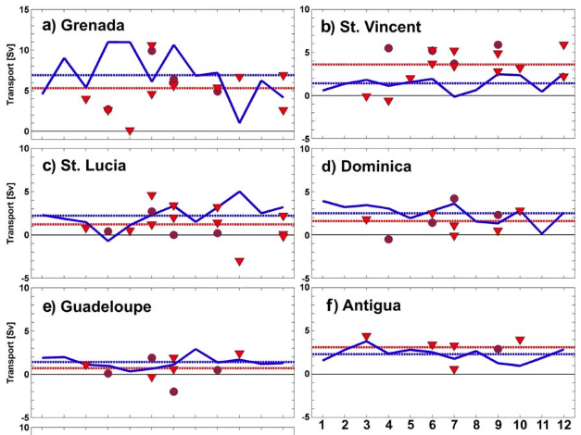
As if that wasn’t enough, the Caribbean is significantly under-sampled!
(Wilson and Johns, 1997, Johns et al. 2002)
Observations: 1991-1998
(Kirchner et al. 2008)
Observations: 2002 & 2005
No transport observations in over 15 years!

Slide 11
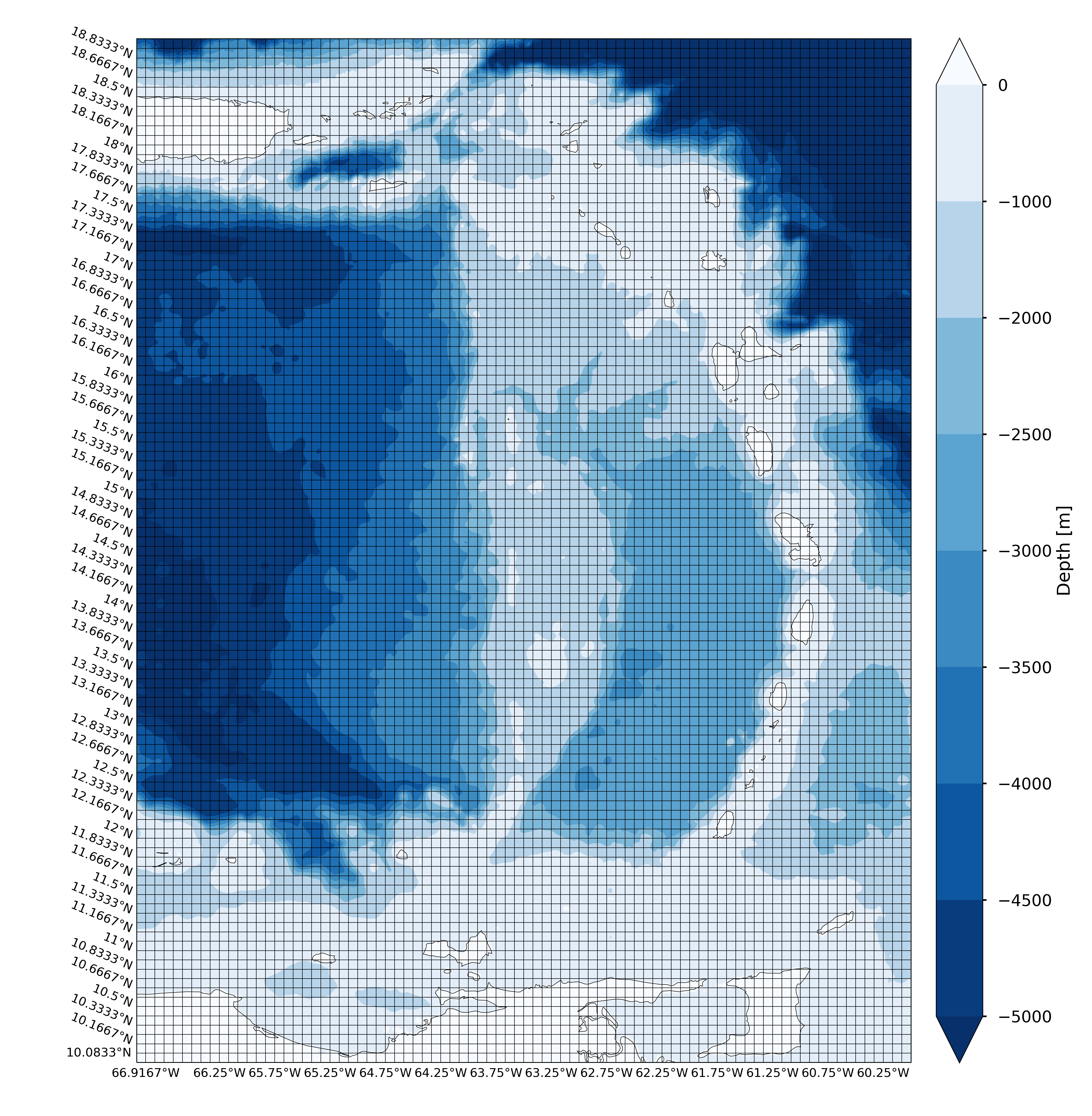
RTOFS $1/{12}$° Model Grid
Hard to model small scale features like transport through island passages
Most passages are only a few grid cells!
Hard for models to represent change

Slide 12
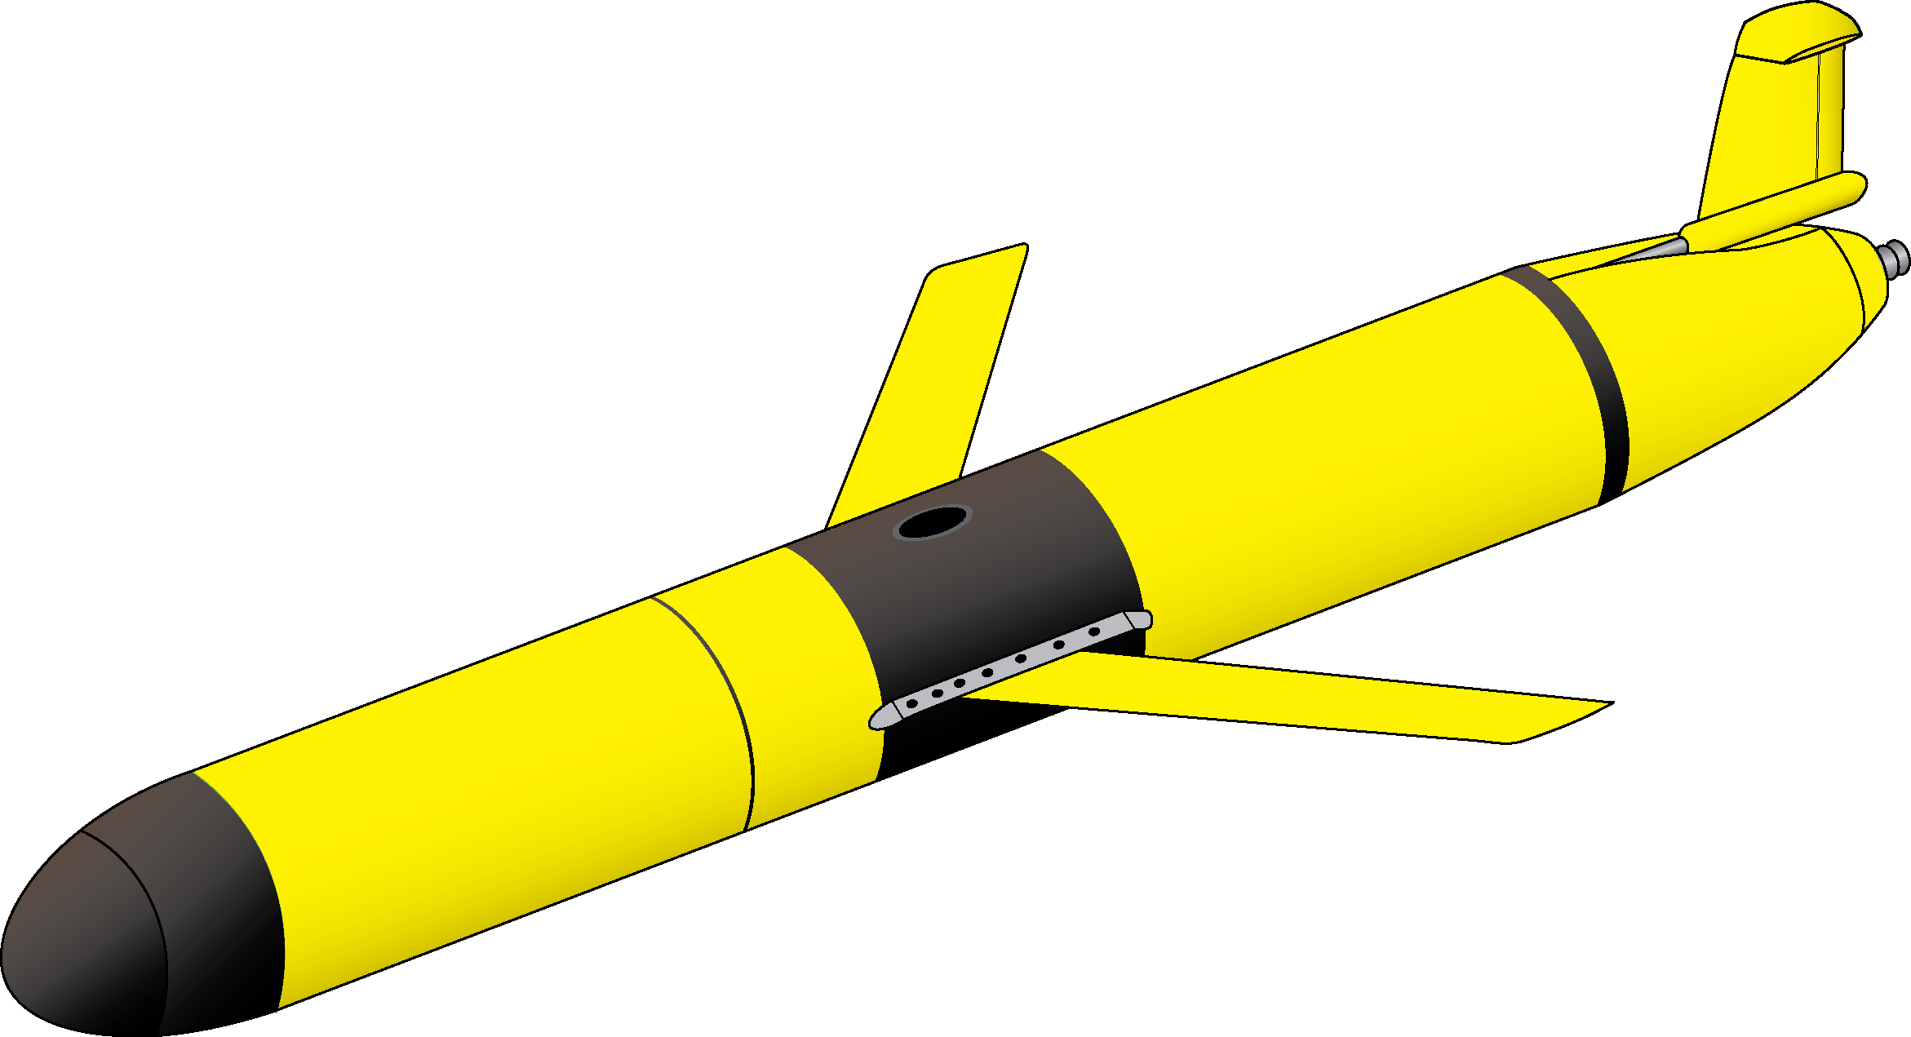
Summary
$$RISK = HAZARD × EXPOSURE × VULNERABILITY$$
If uncertainty in any component is reduced, then overall risk is reduced!
Gliders are a potential tool that can be used to fill this gap!
(White, 1974)

Slide 13
Increasing Salinity →
Essential Ocean Features/Processes in the Surface Ocean
Barrier
Layer
Warm
Pool
Temperature ✓
← Increasing Depth
Salinity ✓
Currents ?
Increasing Temperature →

Slide 14
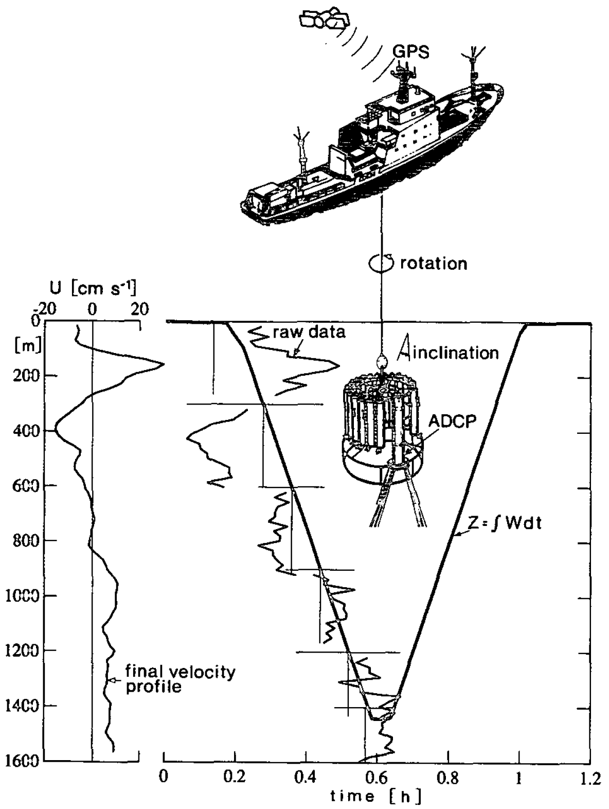
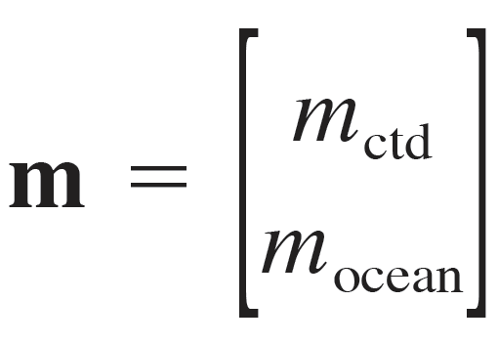
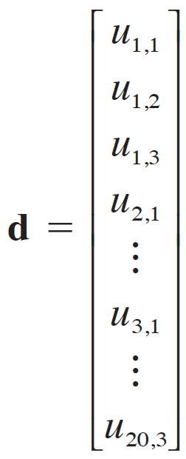
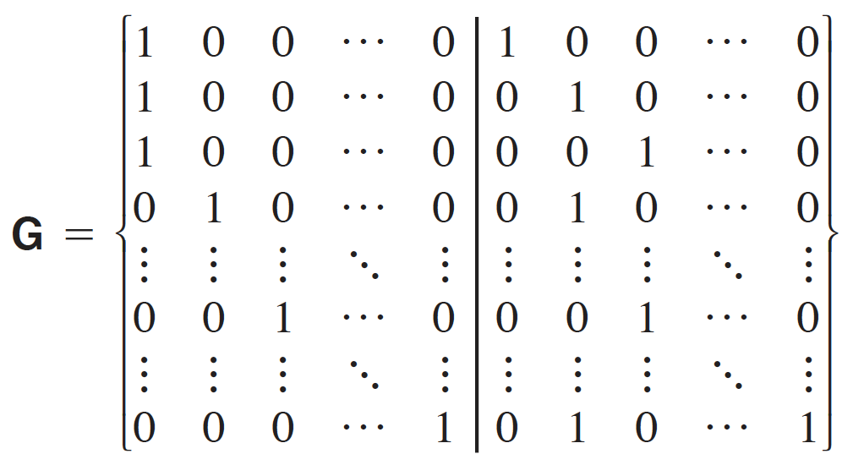
Visbeck et al. (2002)
Least Squares Linear Inversion
Solution:
Visbeck et al. (2002)

Slide 15
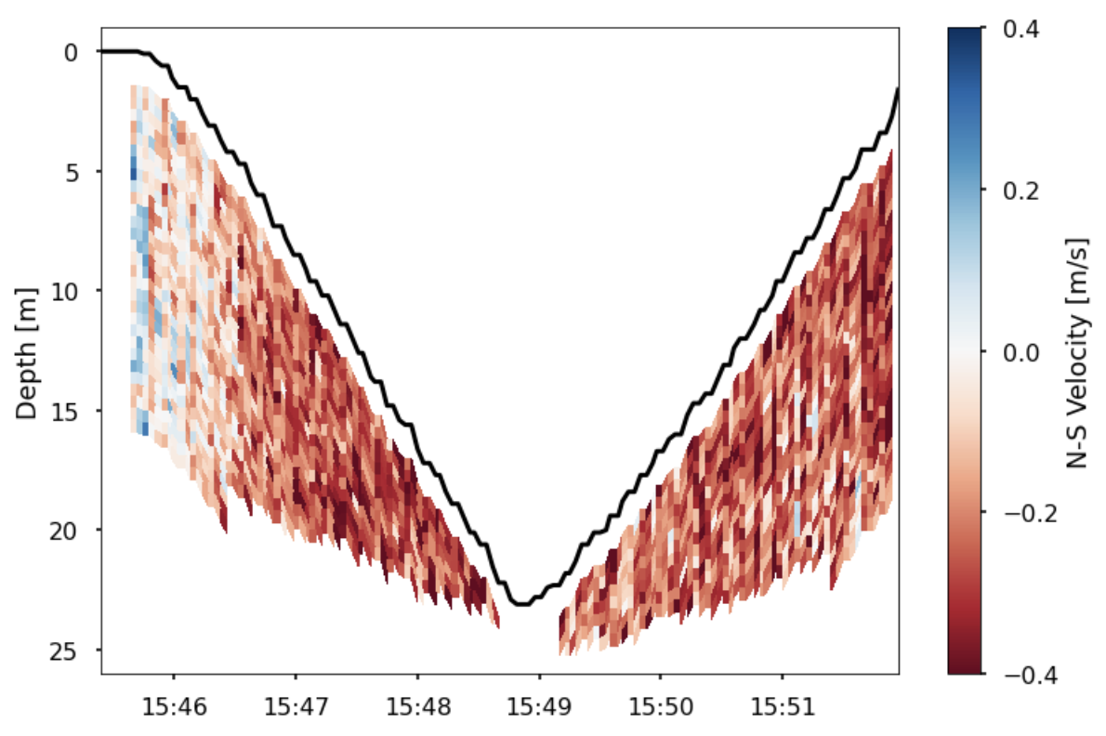
Raw Glider ADCP Data
~26°
Depth
Estimated Glider Horizontal Velocity

Slide 16
Two Methods for Adapting the Least Squares Inversion to Glider Applications
$$U_{glider}$$
$$U_{adcp}= U_{ocean}+ U_{ctd} + U_{noise}$$
$$U_{ctd}$$
Barotropic (Depth Average) Velocity: Constrain the solution using glider depth averaged velocity
Baroclinic (Depth Varying) Velocity: Calculate dU/dz and integrate over 1 m bins (shear is independent of glider motion)
Visbeck et al. (2002) Todd et al. (2011, 2017) Miles et al. (2015)

Slide 17
Raw ADCP Data
~26°
Depth
Estimated Glider Horizontal Velocity

Slide 18
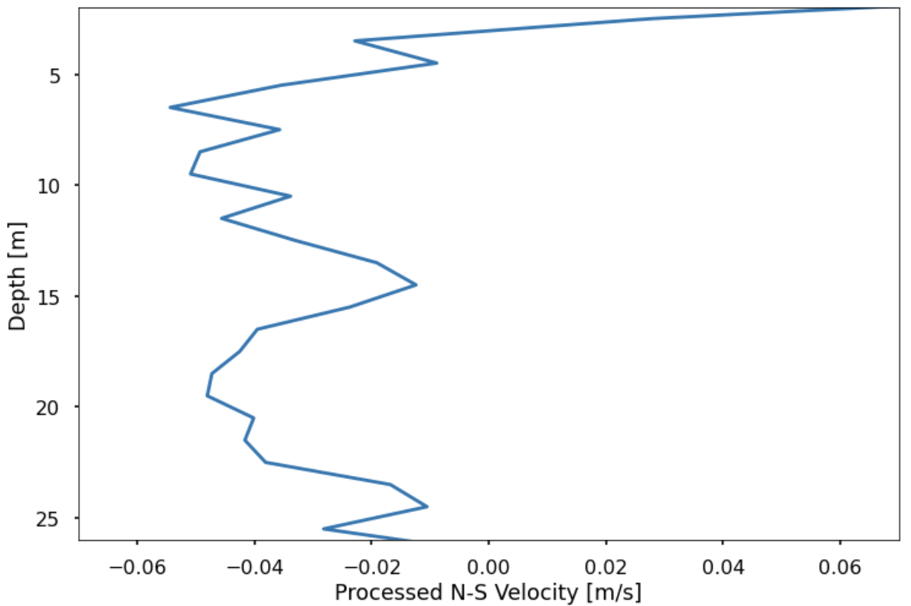
Processed ADCP Data
~26°
Depth
Estimated Glider Horizontal Velocity

Slide 19
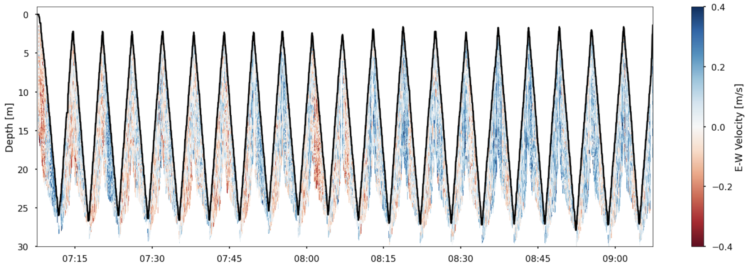
Large Data Files
~10,000X larger than telemetered glider data
Complex Post-Processing Algorithms
No Opportunity for Real-Time Data Transfer

Slide 20
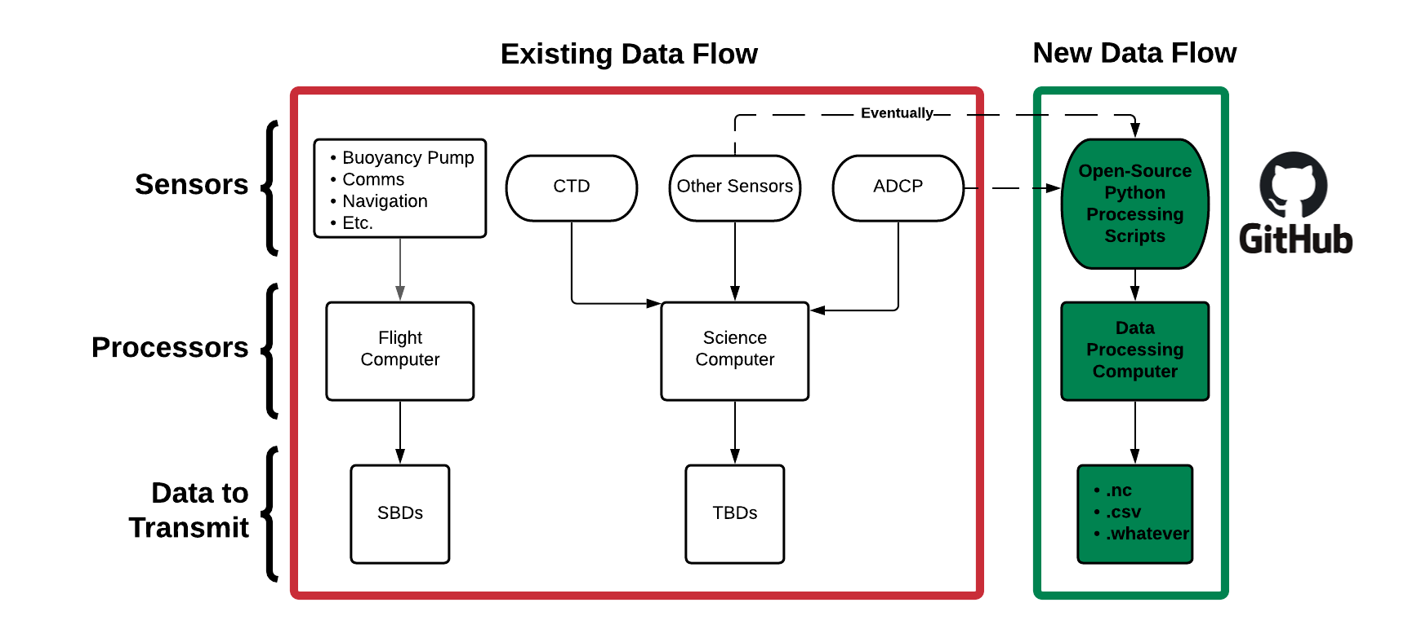
Slocum Glider On-Board Data Processor

Slide 21
Slocum Glider On-Board Data Processor: Next Steps
Code integrated → Prepping vehicle for bench testing
Winter 2022 deep water test (New RDI Pathfinder ADCP)
First field test of on-board processor (Spring 2022)
Improve processing code efficiency
https://github.com/JGradone/Glider_ADCP_Real_Time_Processing

Slide 22
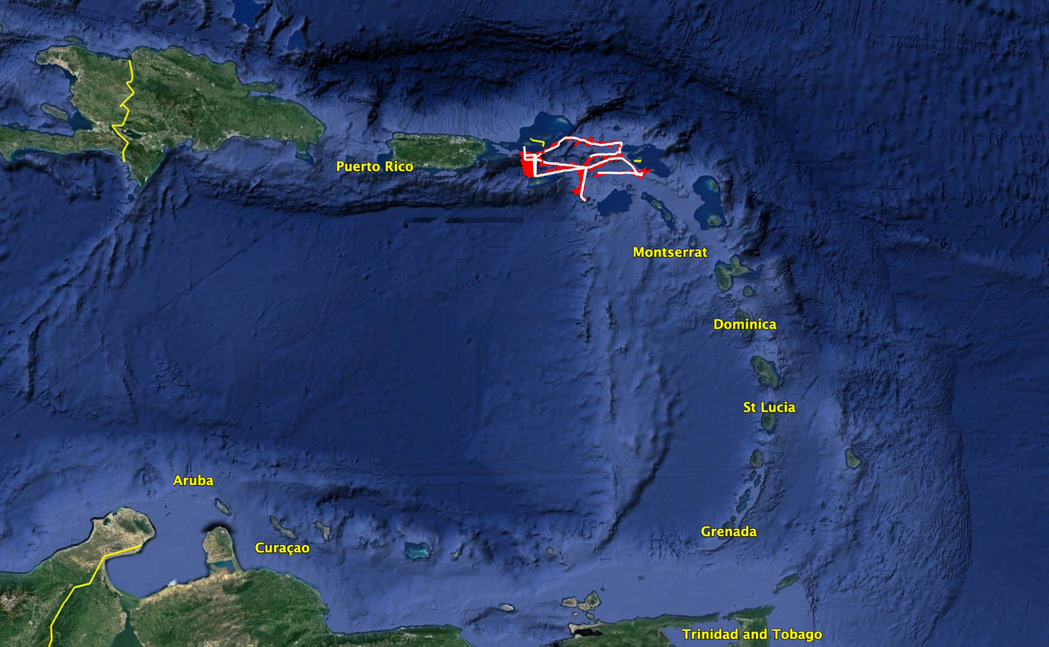
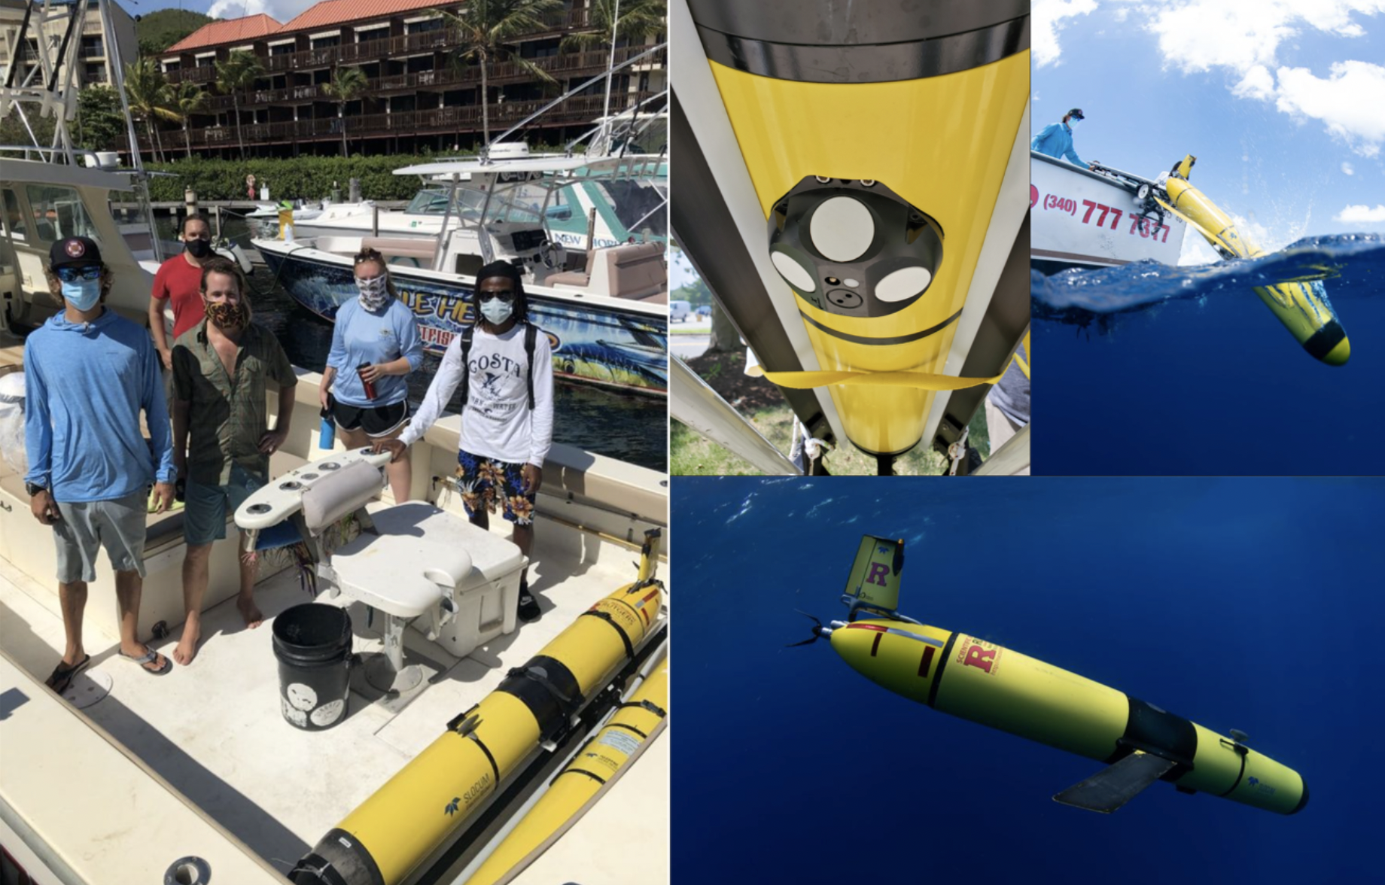
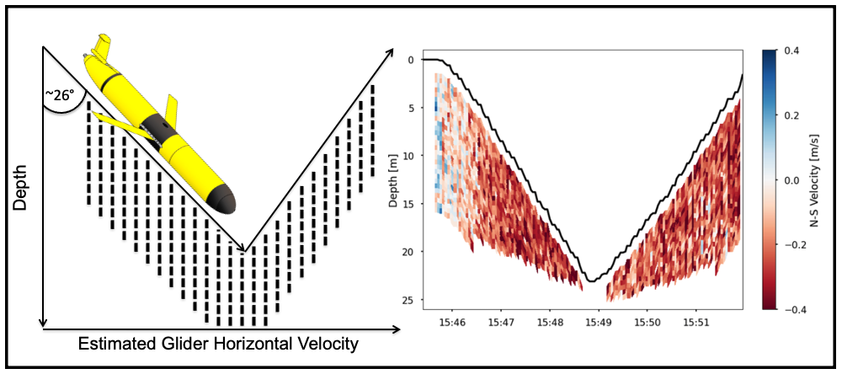
Transport Observation through Caribbean Passages
from a Slocum Glider ADCP
Glider ADCP Observations from both dives and climbs!

Slide 23
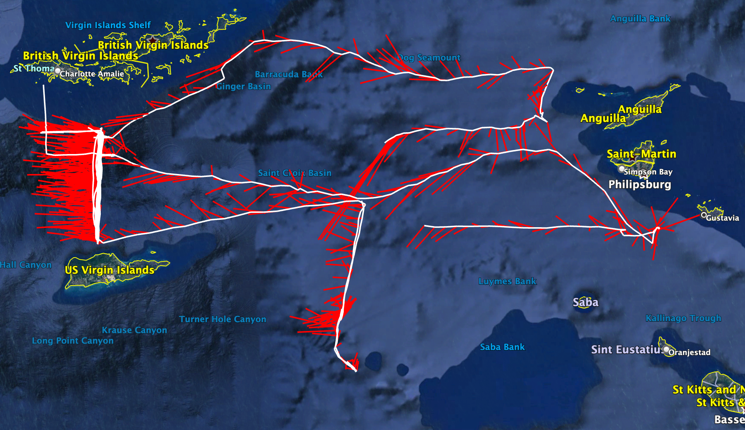
Transport Observation through Caribbean Passages
from a Slocum Glider ADCP

Slide 24
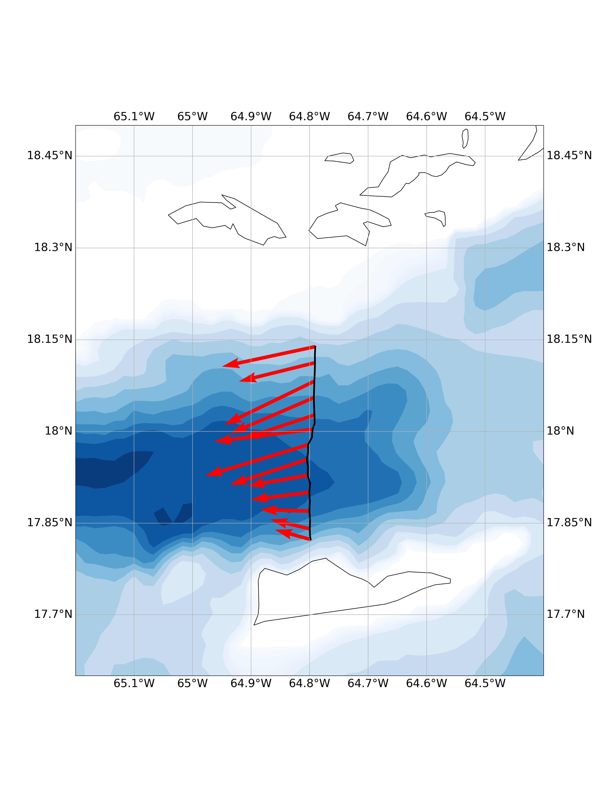
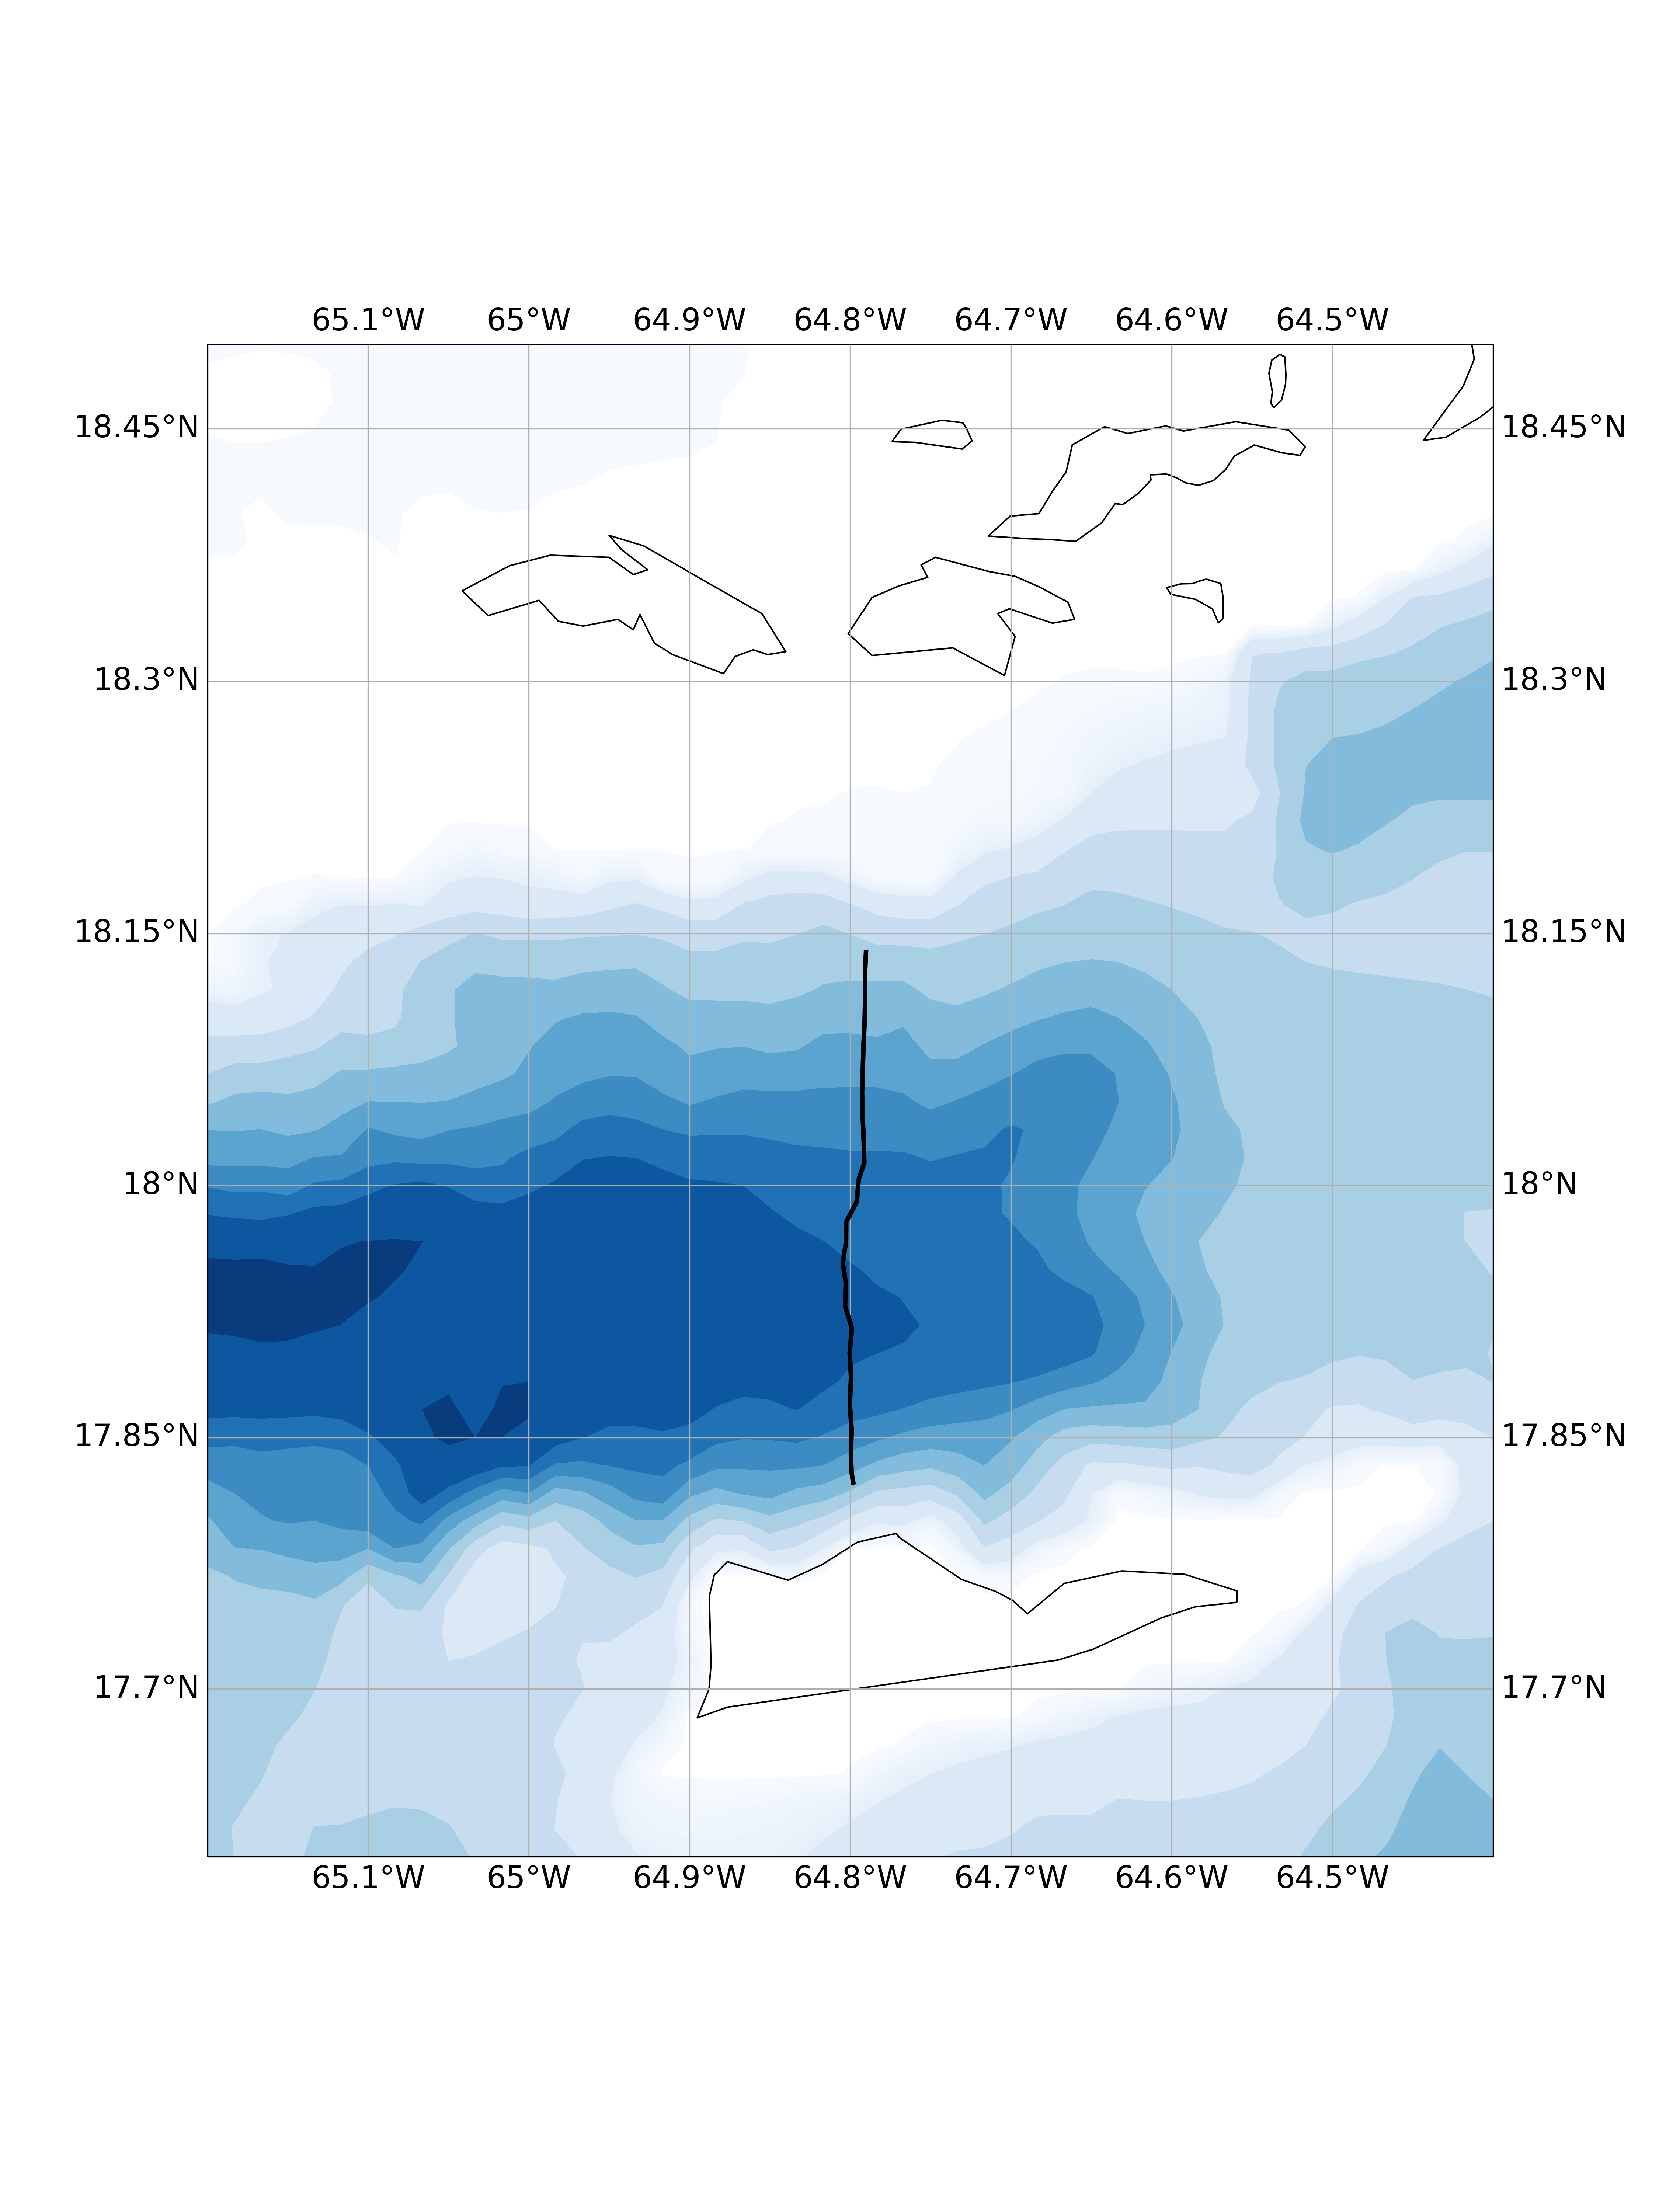
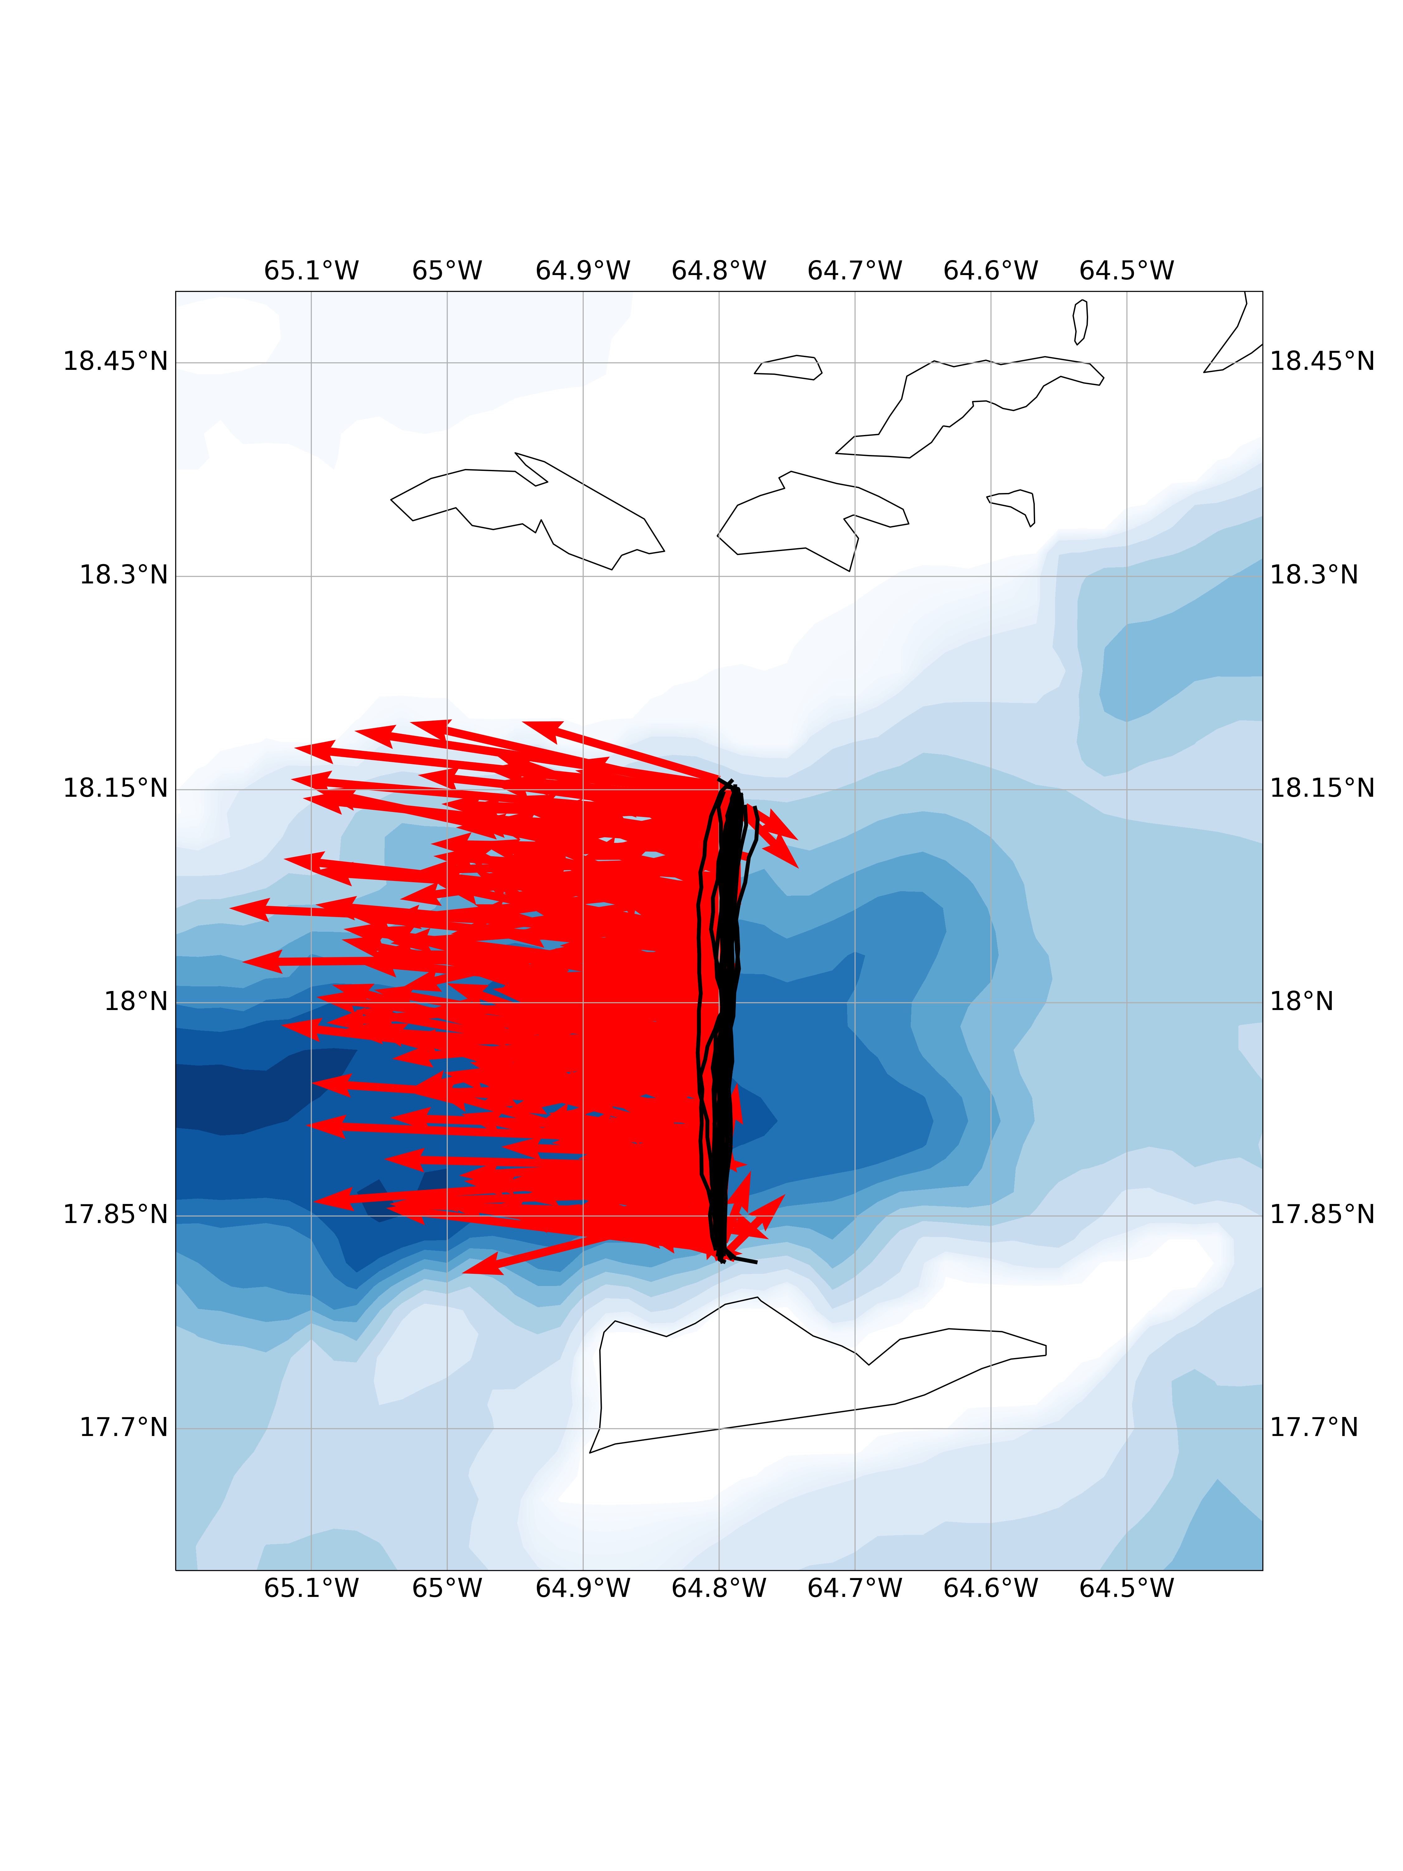
Transport Observation through Caribbean Passages
from a Slocum Glider ADCP
15 repeat transects of velocity observations!

Slide 25
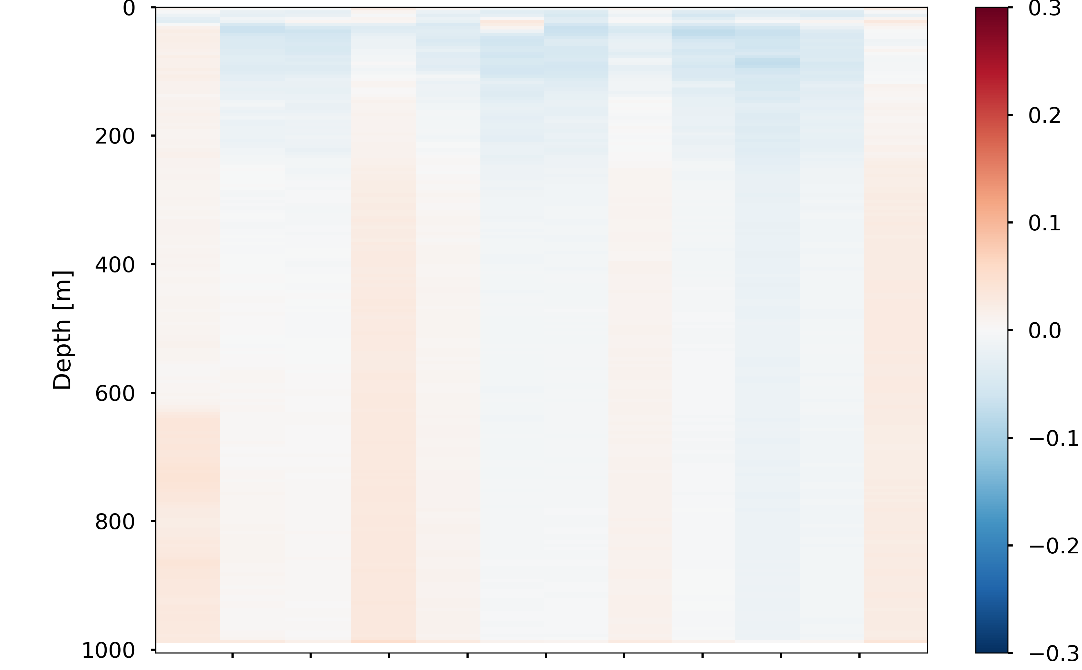
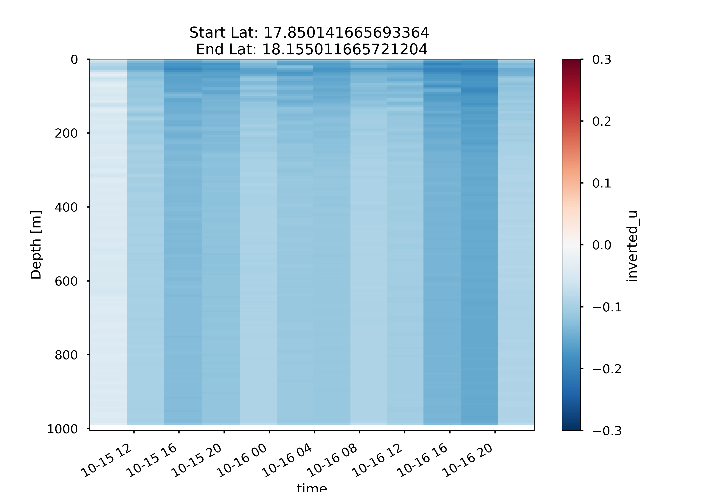
Southern Edge
Northern Edge
N-S Velocity [m/s]
E-W Velocity [m/s]

Slide 26
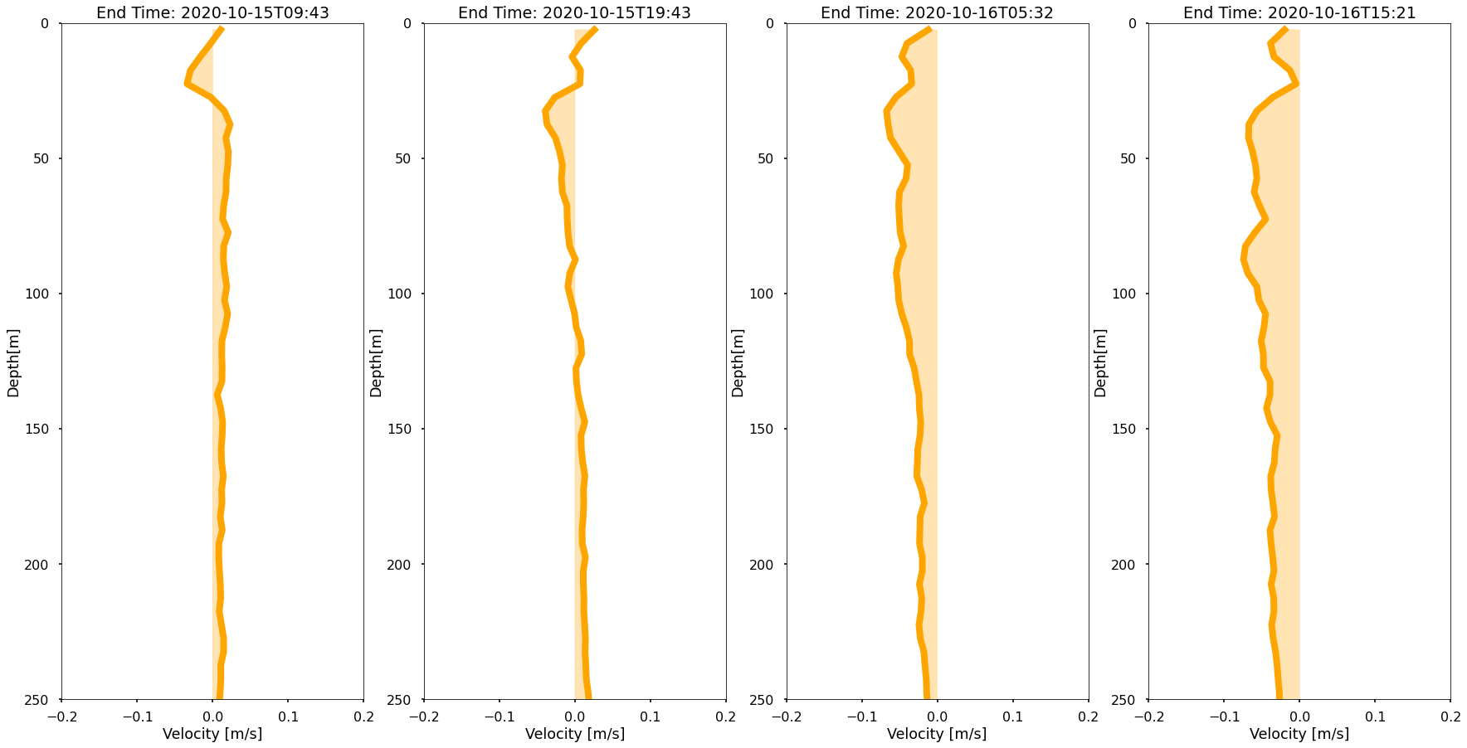
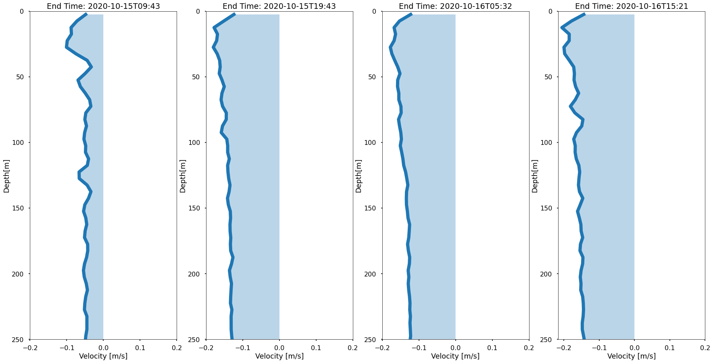
Southern Edge
Northern Edge
N-S Velocity [m/s]
E-W Velocity [m/s]

Slide 27
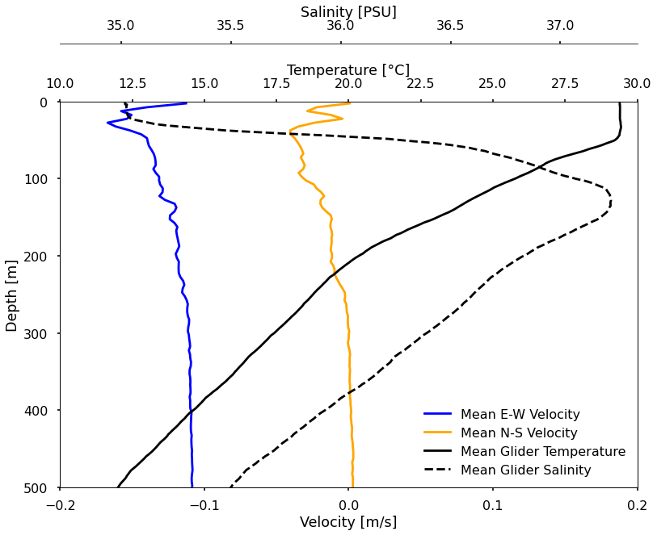
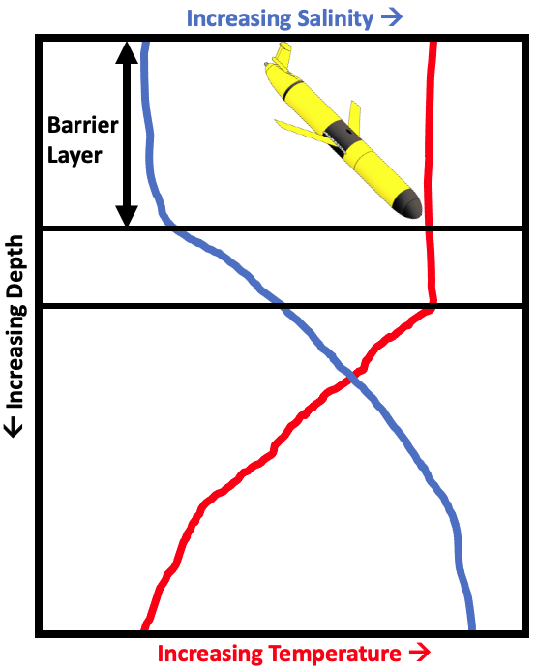
Transect Mean Profile

Slide 28
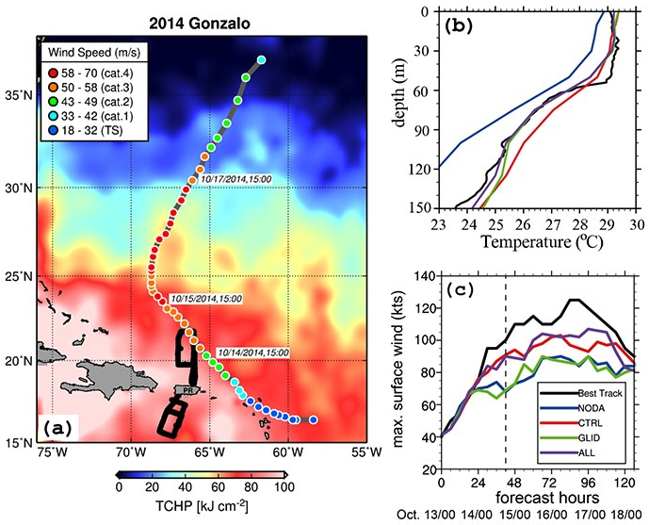
Real-Time Subsurface Current Assimilation in Hurricane Modeling and Forecasting
Assimilation of just glider temperature and salinity data reduced intensity forecasts errors as much as 50%
Initial modeled barrier layer was much weaker
(Dong et al. 2017)

Slide 29
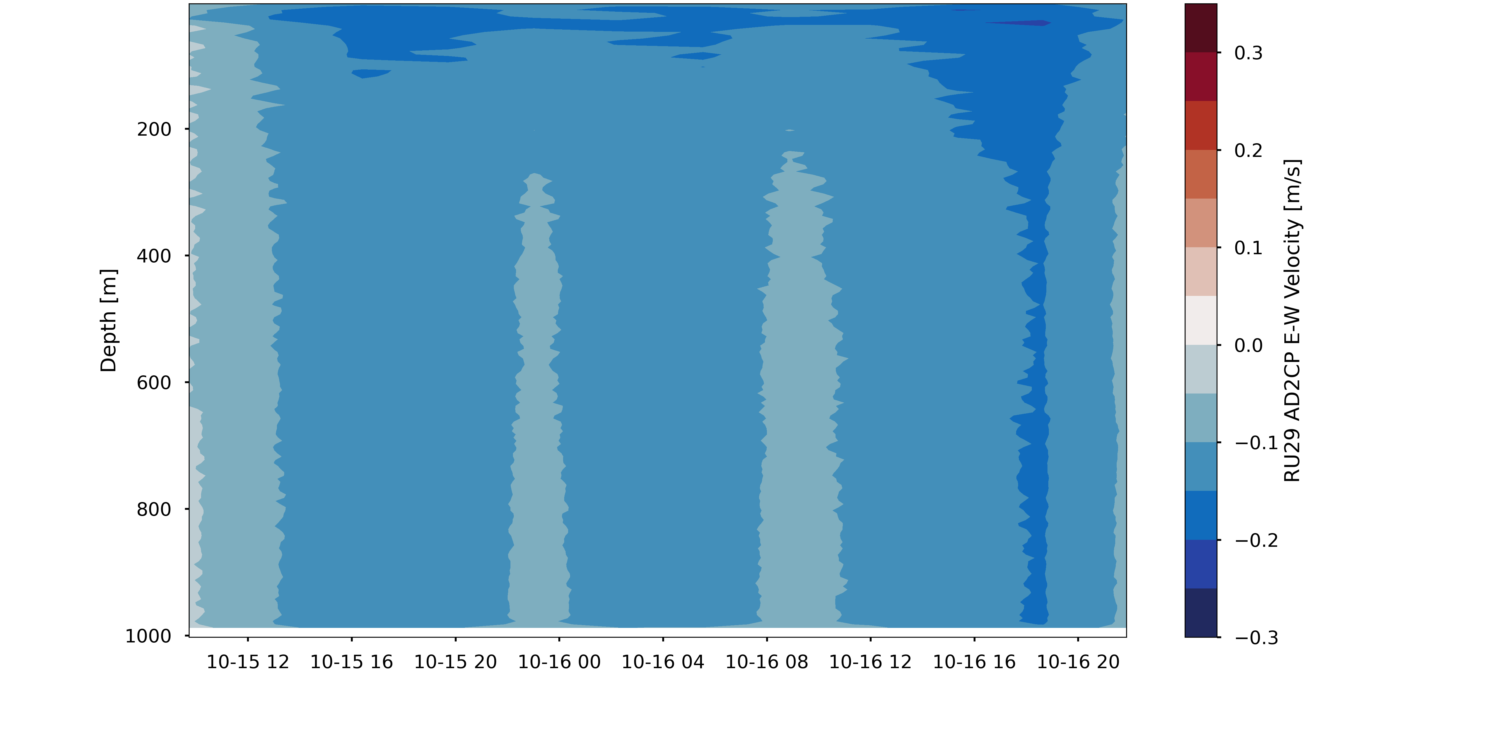
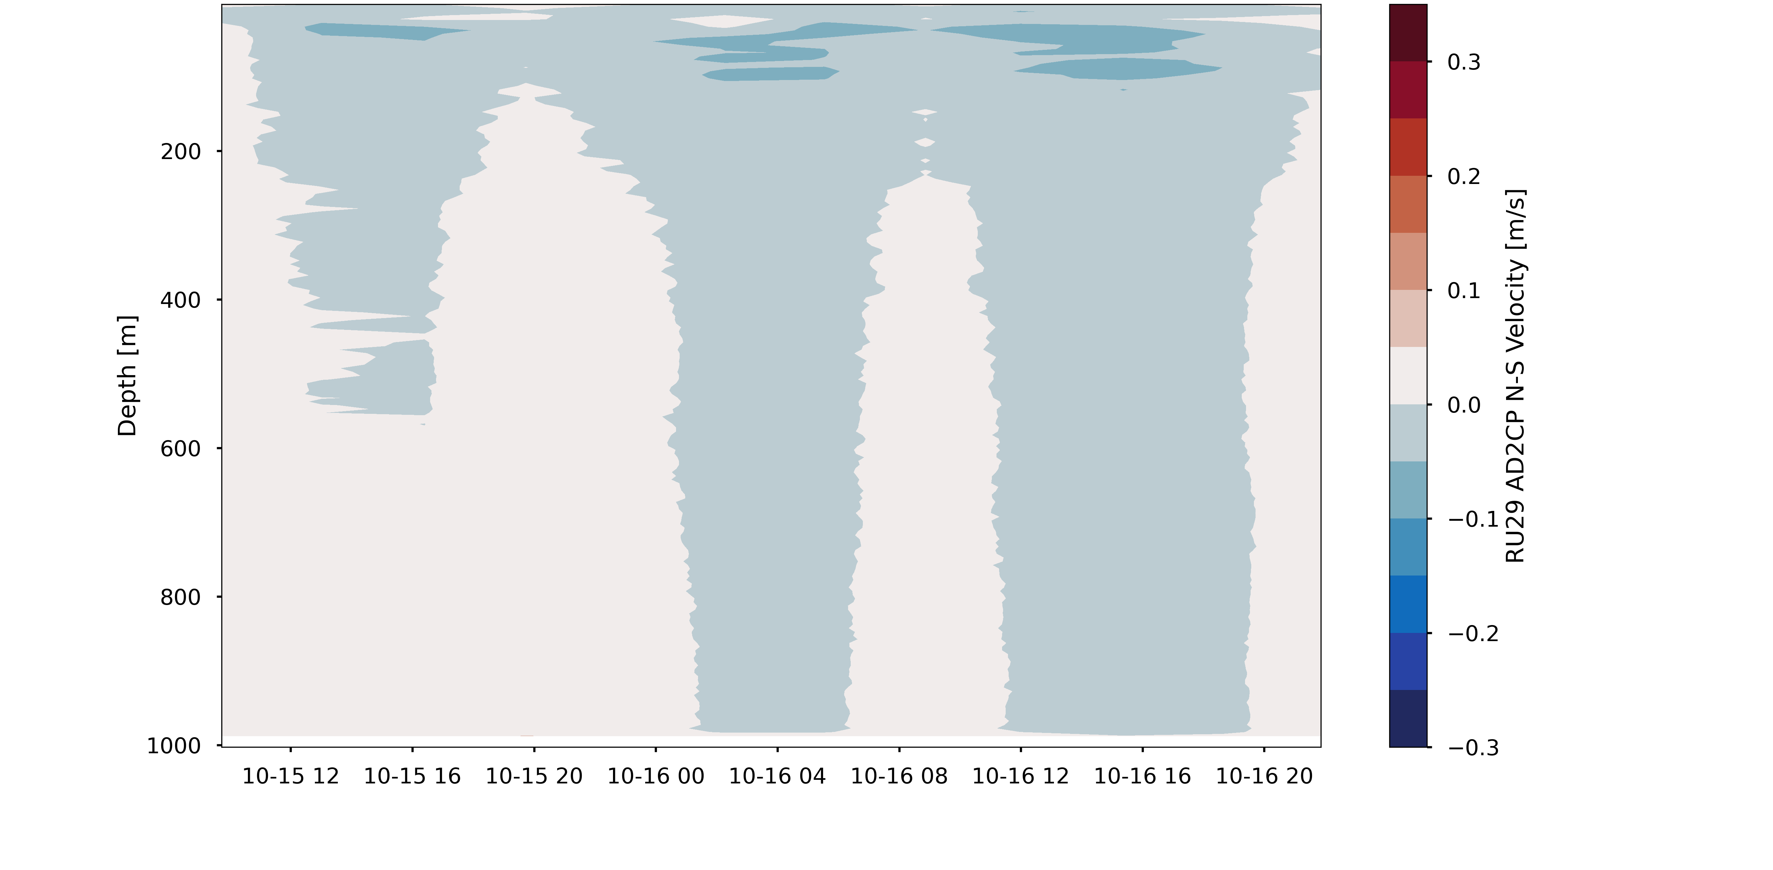
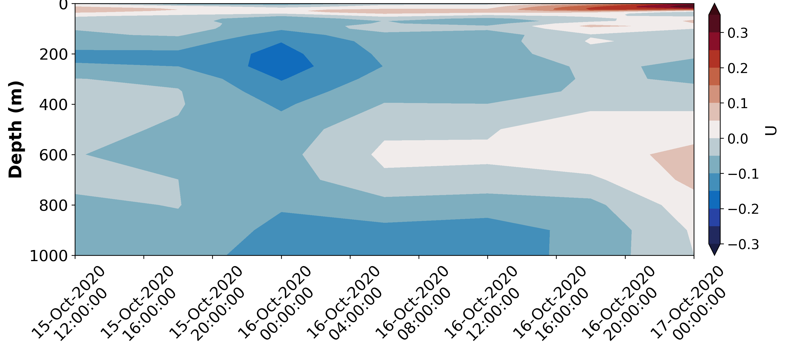
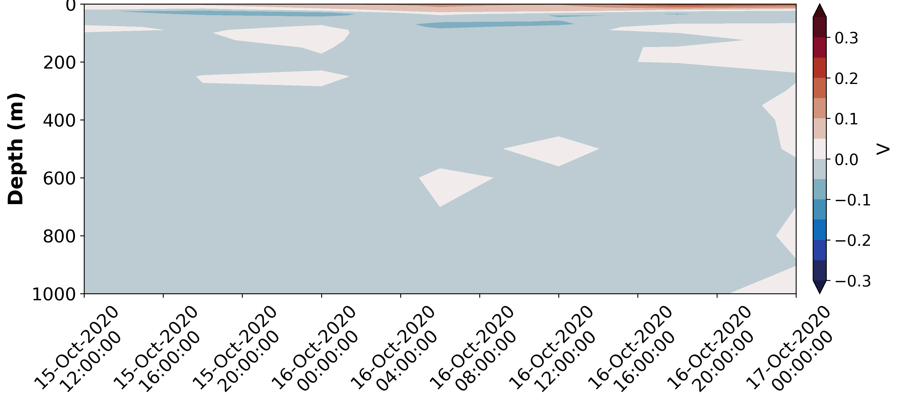
Glider ADCP E-W Velocity
Glider ADCP N-S Velocity
RTOFS E-W Velocity
RTOFS N-S Velocity

Slide 30
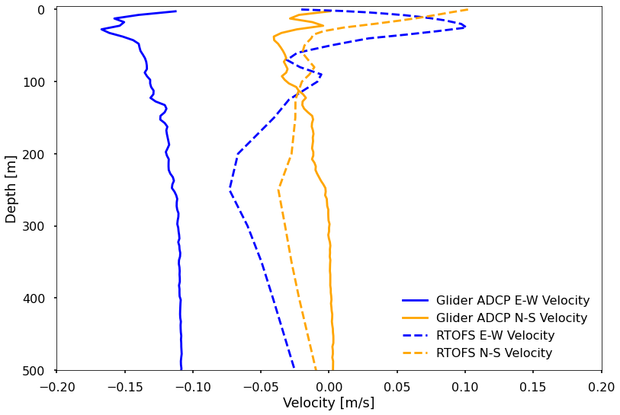
Transect Mean Profile
Into Caribbean
Out of Caribbean

Slide 31
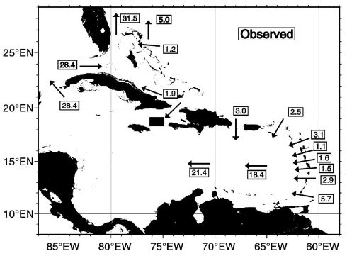
Future Work
Comparisons of glider ADCP transports with:
Additional models
AMSEAS ($1/{30}$° resolution)
Geostrophic vs wind-driven components
Historical observations
Wilson and Johns, 1997
Johns et al. 2002
Kirchner et al. 2008

Slide 32
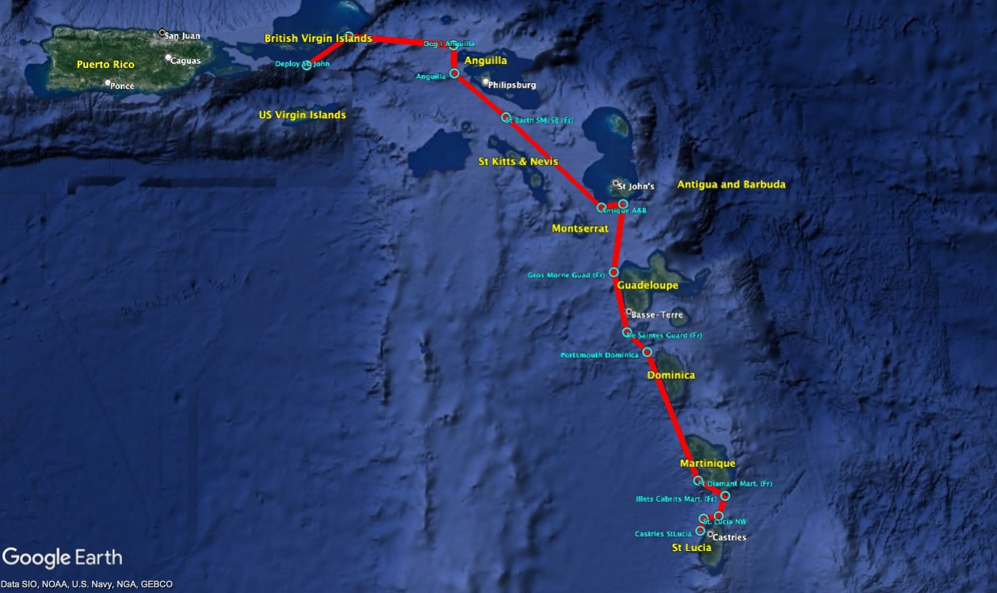
Future Work
Complete full Caribbean passage transect

Slide 33
Future Work
Application of real-time processed subsurface current data in model data assimilation
https://github.com/JGradone/Glider_ADCP_Real_Time_Processing

Slide 34
Thank you! Questions? Contact Info: jgradone@marine.rutgers.edu

