Slide 1
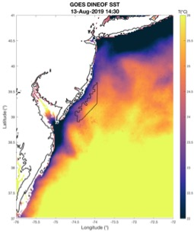
MID ATLANTIC BIGHT: COASTAL UPWELLING & THE OFFSHORE WIND ENVIRONMENT
Sarah Murphy
Dr. Travis Miles (Advisor)
Dr. Josh Kohut
Dr. Matt Oliver (external; University of Delaware)

Slide 2
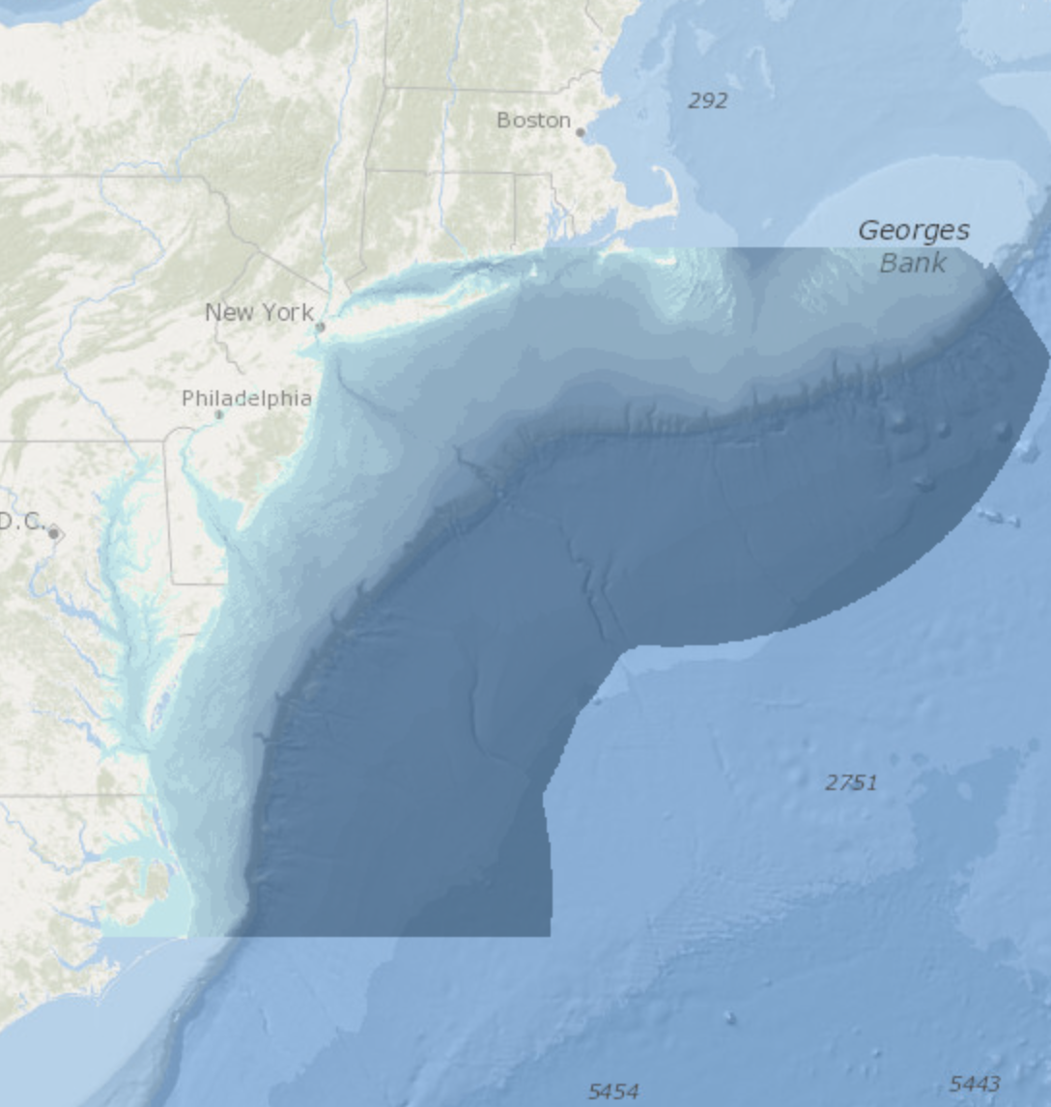
Mid Atlantic Bight
High population density
Ecologically diverse
Complex ocean dynamics

Slide 3
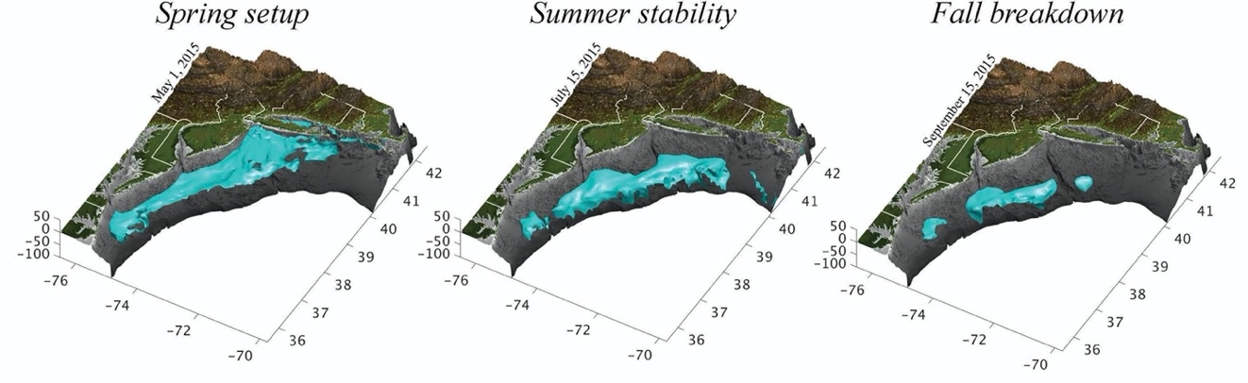
Cold pool
8-10 $°C$ cold water mass below seasonal thermocline
Forms from remnant winter water over the shelf
Central to structuring MAB ecosystem
Source for coastal upwelling
Cite from scemfis

Slide 4
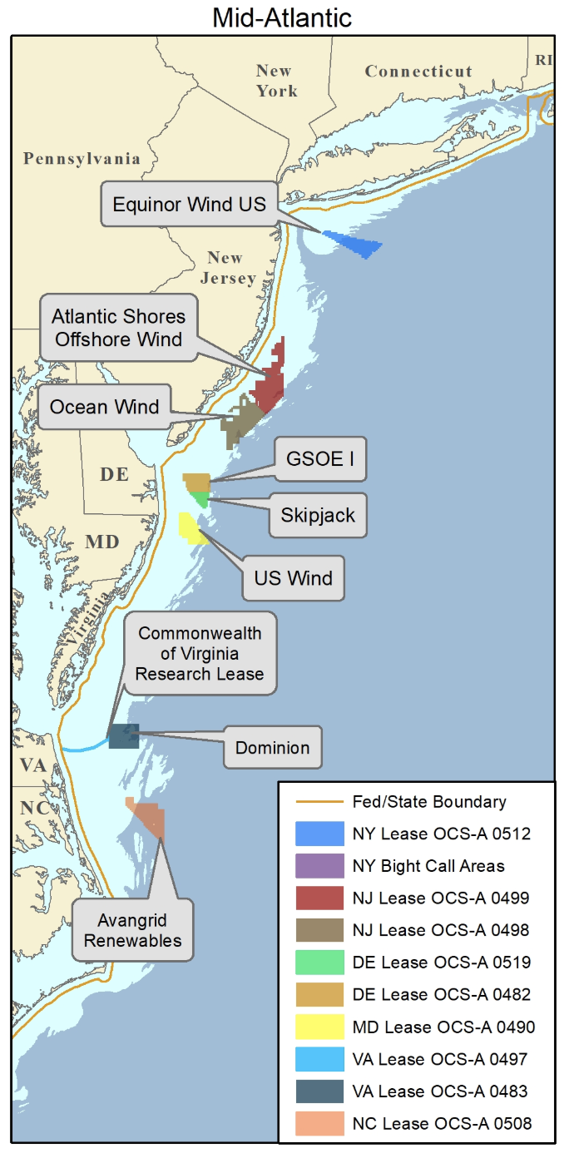
Offshore wind
NJ : 50% Renewable Energy by 2030
Offshore Wind 7500MW by 2035
1 leased area awarded
Challenges:
Complex political/regulatory climate
New offshore conditions
Variable source to supply energy market

Slide 5
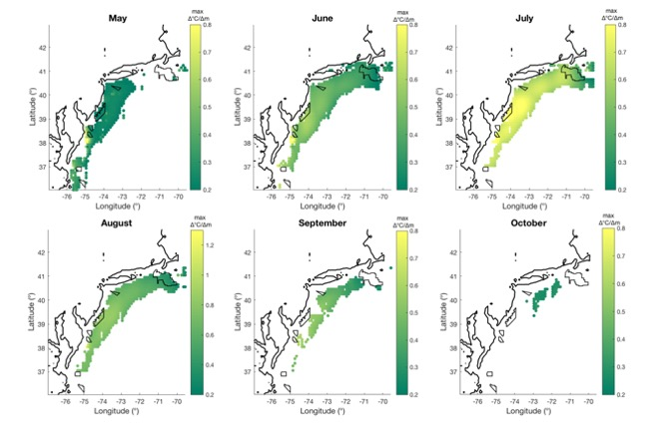
Cold pool & offshore wind

Slide 6
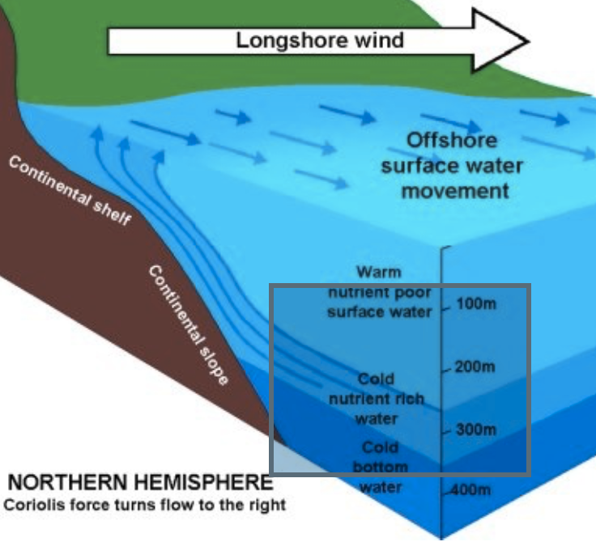
Coastal Upwelling:
Stratified ocean
Predominately southerly winds
Cold bottom water driven up along the coast

Slide 7
Importance of Coastal Upwelling
decrease coastal SST 2-8$°C$
decrease coastal SST 2-8°𝐂
Highly variable in size/duration
Can occur for up to half of the days of the summer
Fisheries:
Offshore Wind:
influence offshore sea breeze fronts
large coastal blooms, hypoxic bottom conditions
Glenn et al., 2004

Slide 8
Thesis Overview
Chapter 1:
Chapter 2:
Use of GOES-16 SST for the detection of coastal upwelling
RU-WRF sensitivity analysis to varying SST fields

Slide 9
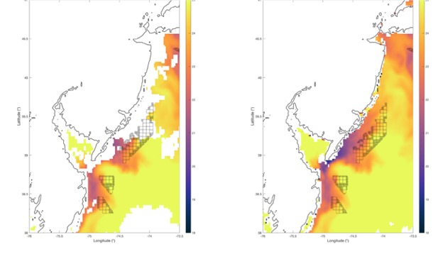
GOES-16
Quality Flag (QF)
Spike Filter (SF)
Available as of Nov. 2017
Resolution: Hourly, 2km
Challenge: provided Quality Flag removes upwelling

Slide 10
Chapter 1
Case study: Summer 2019
1. Prepare GOES data:
Cloud-correcting
Gap-filling
2. Analyze detection of upwelling

Slide 11
1. Methods: Spike Filter
Rate of SST change: >1°C/hour
Minimum SST threshold: 12 °C
Comparison to recent SST: >2 SDs moving 7 day per pixel average
Bias correction (up to +.3 °C)

Slide 12
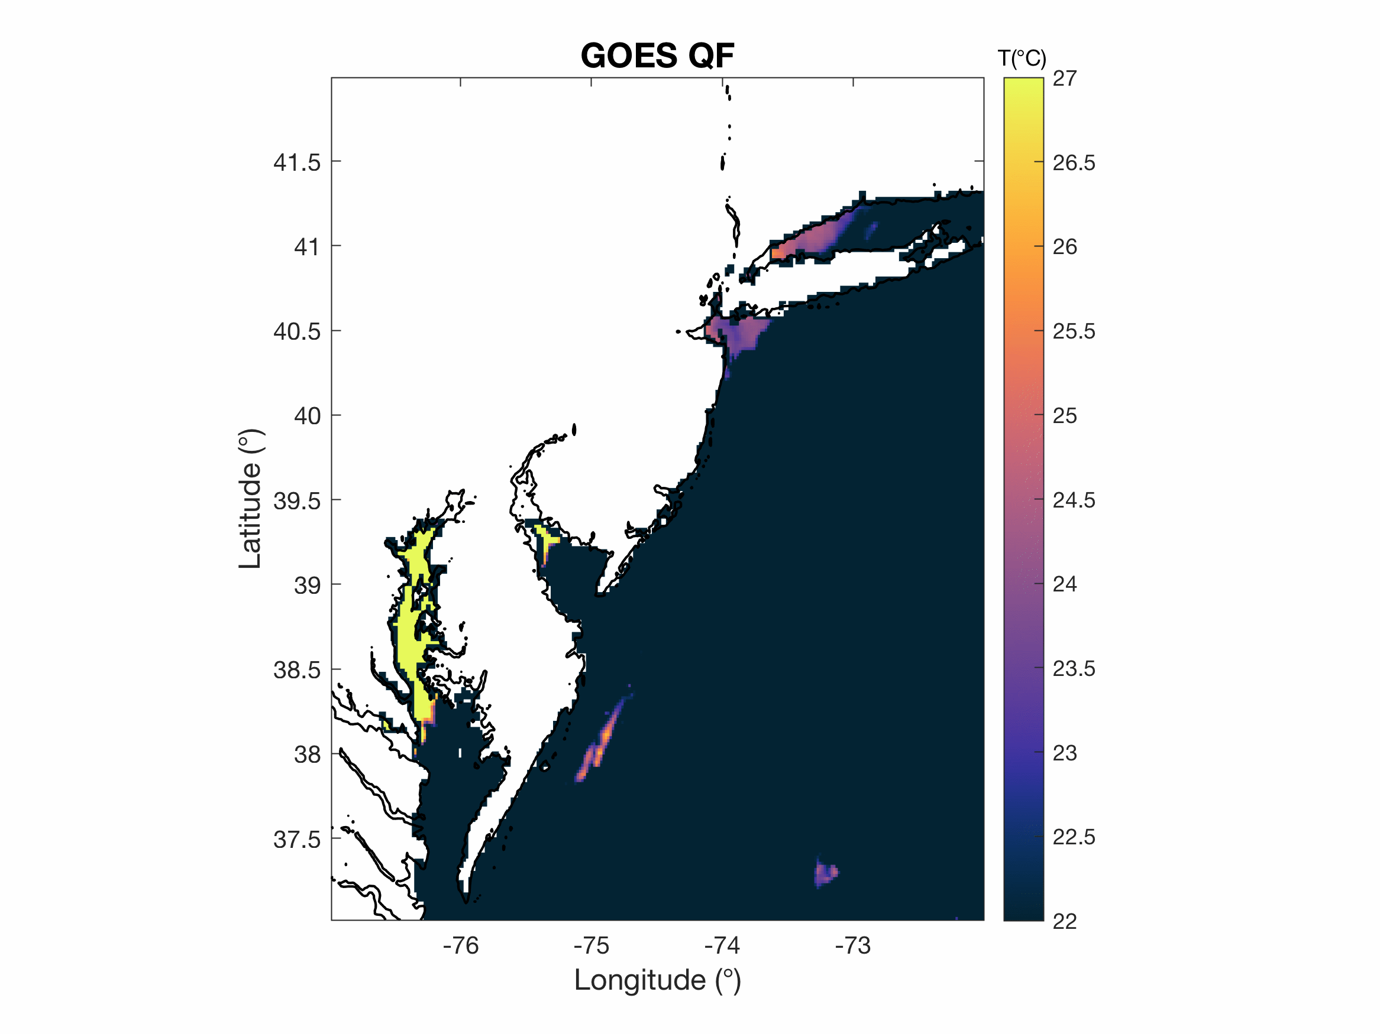
Applied Spike Filter
RAW GOES
GOES SF

Slide 14
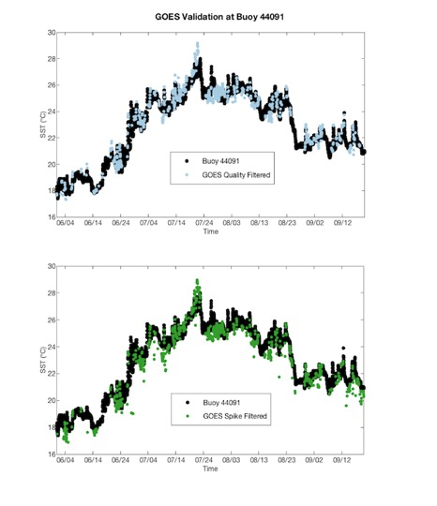
Buoy Validation
(Averaged across 3 buoys)
 | Quality Filter | Spike Filter
RMS: | .713 | .645
CRMS: | .652 | .626
MB: | .275 | -.055
Count: | 741 | 796
GOES Spike Filter:
Lower RMS, CRMS, MB
Improved count

Slide 15
2. Gap filling: DINEOF
DINEOF is an EOF-based method
Fill in missing data from geophysical fields, such as clouds in SST
Has been widely used and cited
Weighting in time and space
Calculates missing data from an optimal number of EOFs obtained by cross-validation
(Alvera-Azcárte et al., 2009).

Slide 16
Final product
1. Cloud corrected: Spike Filtered
2. Gap-Filled: DINEOF

Slide 17
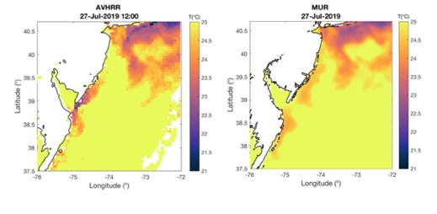
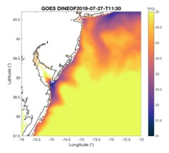
2. Comparison to other satellite products:
 | AVHRR | MUR | GOES-16
Satellite | Polar-Orbiting | observations from several instruments and climatology | Geostationary
Spatial Resolution | ~ 5 km | ~ 1 km | .~ 2 km
Temporal Resolution | Twice Daily | Daily | Hourly

Slide 18
Buoy Validation
(Averaged across 3 buoys)
 | GOES DINEOF | AVHRR | MUR
RMS: | 0.78 | 1.53 | 0.75
CRMS: | 0.75 | 1.45 | 0.67
MB: | -0.18 | -0.48 | 0.31
Count: | 2314 | 131 | 111
GOES DINEOF:
Low RMS error
High Count

Slide 20
 | GOES DINEOF | MUR
Total Upwelling Days | 33 | 15
Percent of summer upwelling occurred | 30% | 13.5%
Average upwelling SST | 22.5°C | 22.97°C
Minimum upwelling SST | 17.1 °C | 17.88°C
Maximum SST Diff (Off-Inshore) | 3.4 °C | 3.58°C
Average Duration | 6.5 days | 3 days
Max Duration | 17.66 days | 7 days
Average Area Upwelling | 3223 km² | 3091 km²
Max Extent Area | 5996 km² | 5799 km²
SST difference (offshore SST – inshore SST) at the 4 upwelling centers in the MAB for the summer time period. GOES DINEOF SST (solid lines) and GHRSST MUR SST(dashed lines) are shown. The upwelling threshold is defined as an SST difference in 2°C or greater.

Slide 21
The total area of upwelling SST pixels as detected by GOES DINEOF (blue) and MUR (orange) for the upwelling time period.

Slide 22
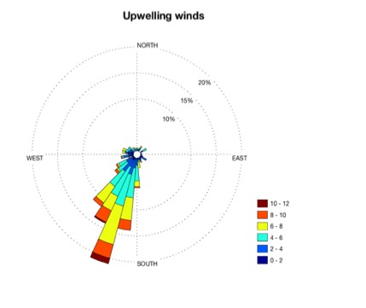
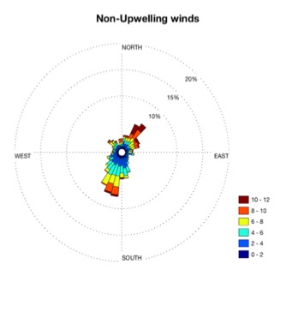
Figure 7. Winds speed and direction from buoy 44009 during GOES DINEOF detected upwelling (left) and non-upwelling (right) times for the summer-time period. The winds are shifted 18 hours earlier than the timing of the upwelling events to account for the local lag in Ekman transport.

Slide 23
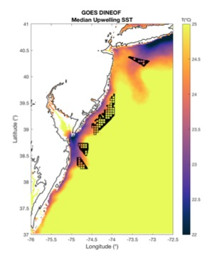
Fig. 8. The median upwelling SST averaged per pixel for the detected upwelling days for GOES DINEOF (33 days)

Slide 24
Key findings
Upwelling may be occurring more persistently, rather than a series of short episodic events
Less than half the number of total upwelling days observed using GOES DINEOF were observed in MUR SST
Clear detection of the timing and duration of upwelling events is important as it provides estimates for ecological and physical responses in the MAB.

Slide 25
Chapter 2: Sensitivity of RU-WRF winds to SSTs during Coastal Upwelling
SST important for atmospheric temperature conditions and circulation
SST used as the ocean surface boundary condition in atmospheric modeling and forecasting
Development of offshore wind energy, test the sensitivity of wind forecasting to SST fields
Coastal upwelling creates a higher thermal contrast between the warm land and cold ocean and has been shown to influence sea breeze fronts (Franchito et al. 1998; Seroka et al. 2018)

Slide 26
Offshore Wind
Offshore wind is a variable source of electricity
Balance the supply and demands of the system
Wind power forecasting is used by wind developers and grid system operators so that they can plan the amount of electricity that will be supplied to the grid

Slide 28
Chapter 2. varying SST in RU-WRF
Case study: 7/15/19-7/23/19
3 SSTs used: GFS, AVHRR, GOES
Forecasted wind speeds in offshore wind lease areas off of NJ
Determine the impact on wind power production

Slide 29
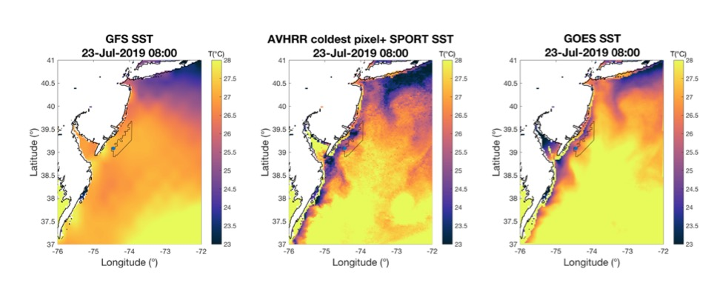
RU-WRF ocean surface boundary conditions

Slide 30
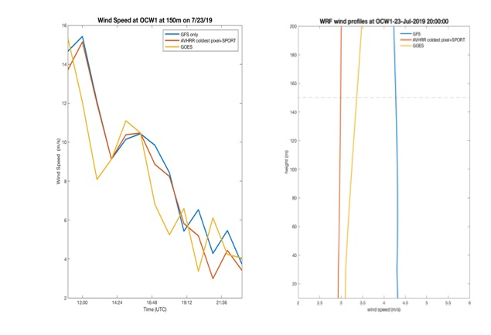
RU-WRF Winds at OCW1

Slide 31
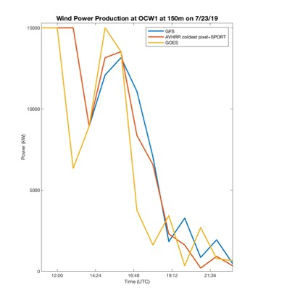
Wind Power Production
SST input | Total GWh | Capacity Factor
GFS | 1.3023 | 0.4201
AVHRR Coldest-pixel+ SPORT | 1.3786 | 0.437
GOES | 1.2691 | 0.409
The max. difference in energy production: 90,400 kWh
Equivalent to a difference in energy consumption by ~414 households

Slide 32
Future studies
Investigate over a longer time period- seasonal
Increase temporal resolution of GOES to hourly updating
Validation of SST and wind speeds could be completed with the newly available data from the Atlantic shores buoy for the following summer time period

Slide 33
Conclusions
Chapter 1. GOES SST is valuable for the detection of coastal upwelling in the MAB
Chapter 2. Varying ocean surface boundary conditions in RU-WRF affects forecasted wind speeds during an upwelling event in the NJ WEA
GOES SST be valuable for improving our understanding of other regional oceanographic and atmospheric processes

Slide 34
Acknowledgements
Advisor:
Travis Miles
Committee:
Josh Kohut, Matt Oliver
Contributors:
Laura Nazzaro, Joe Brodie, Jaden Dicopoulos
James Simkins, Matt Shatley
C2R2 cohort, friends at Rutgers, family for support

