Slide 1







A reflection on the changing landscape of observational programs
Oscar Schofield Representing Many

Slide 2

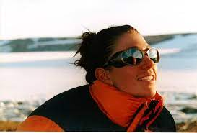



My first involvement Salt Lake City
Louise Neuman

Slide 3
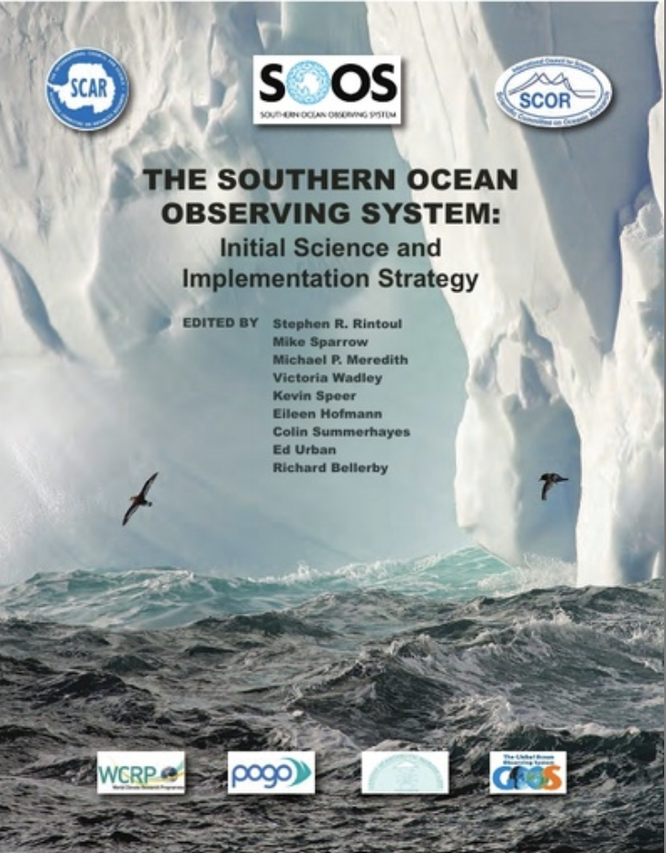

Slide 4
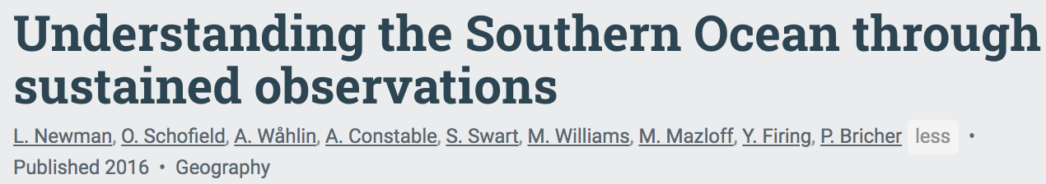
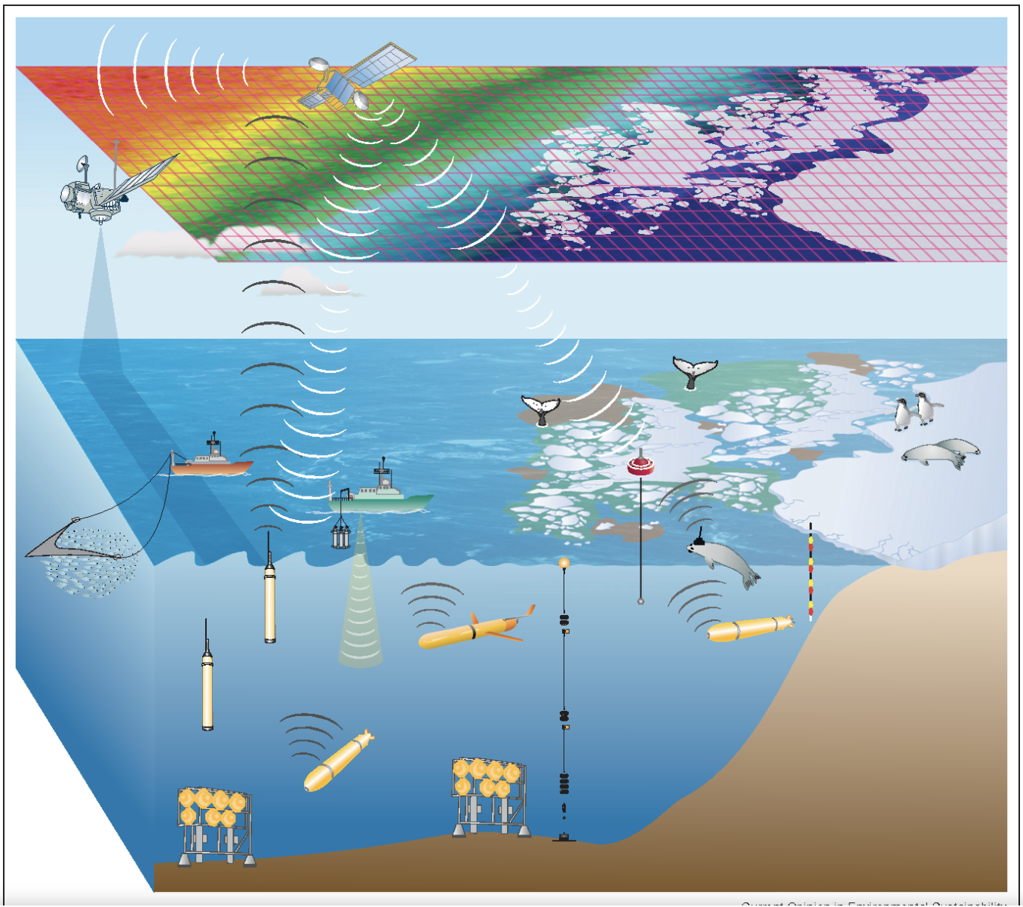
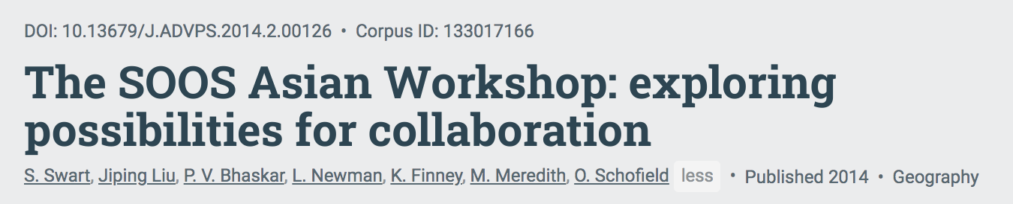
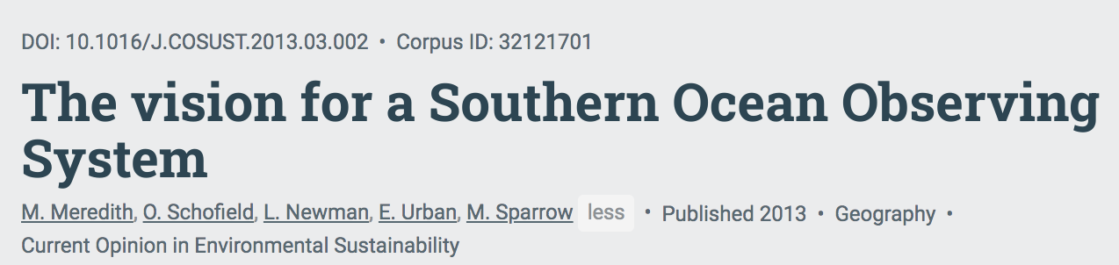
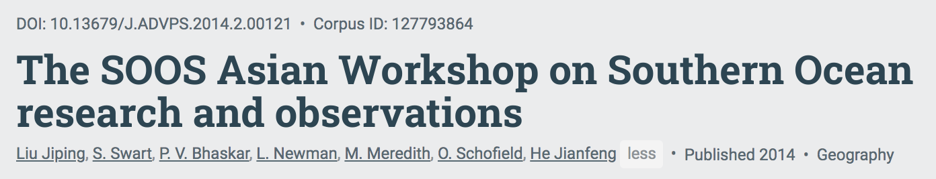
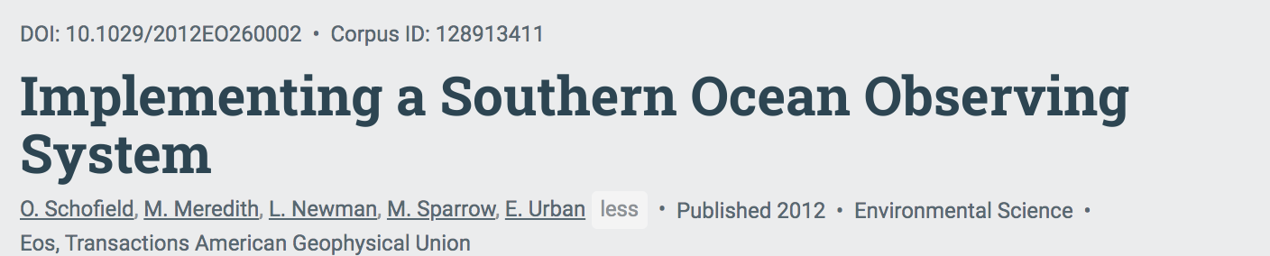
Spread the Gospel!

Slide 5
Sampling Can Be Rough

Slide 6
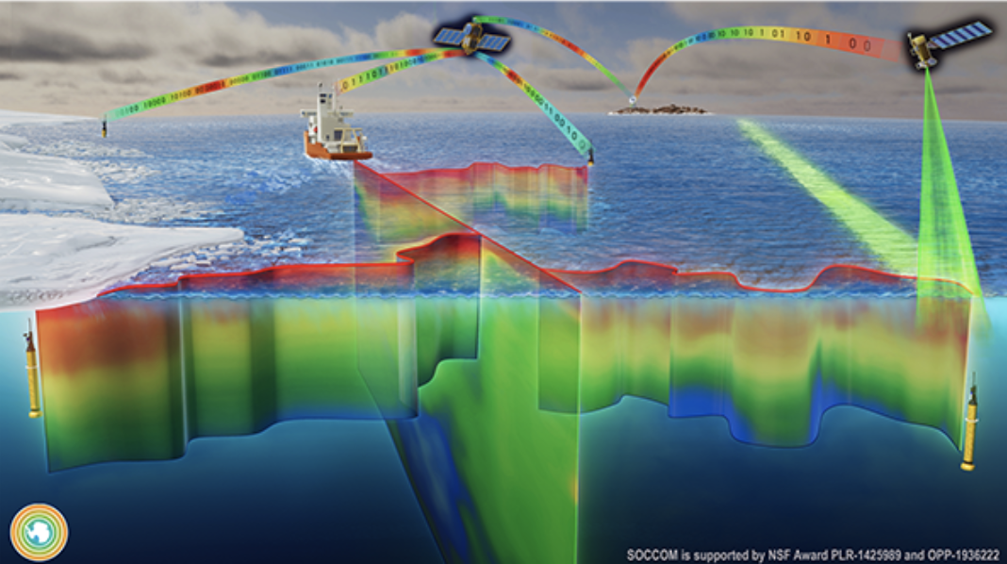
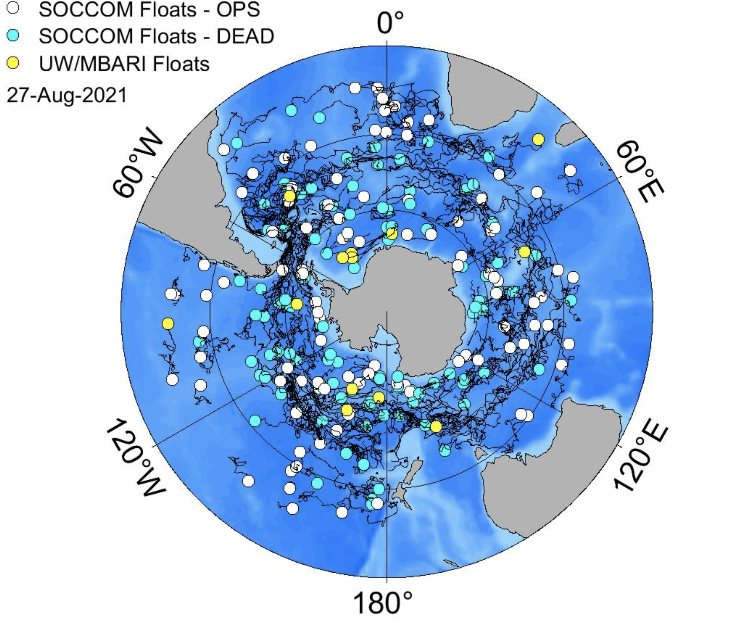

The Technology Explosion!!!!
Open Ocean

Slide 7
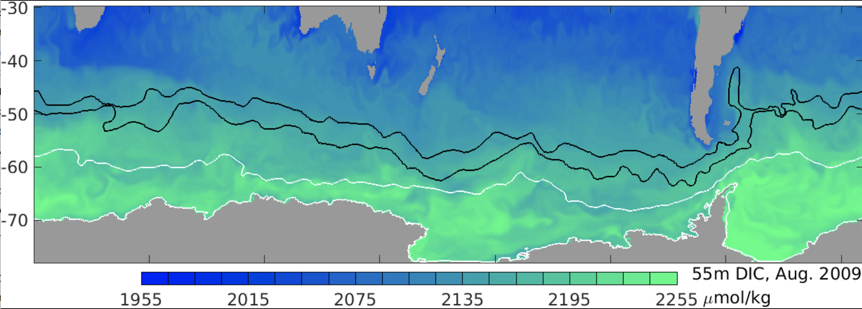
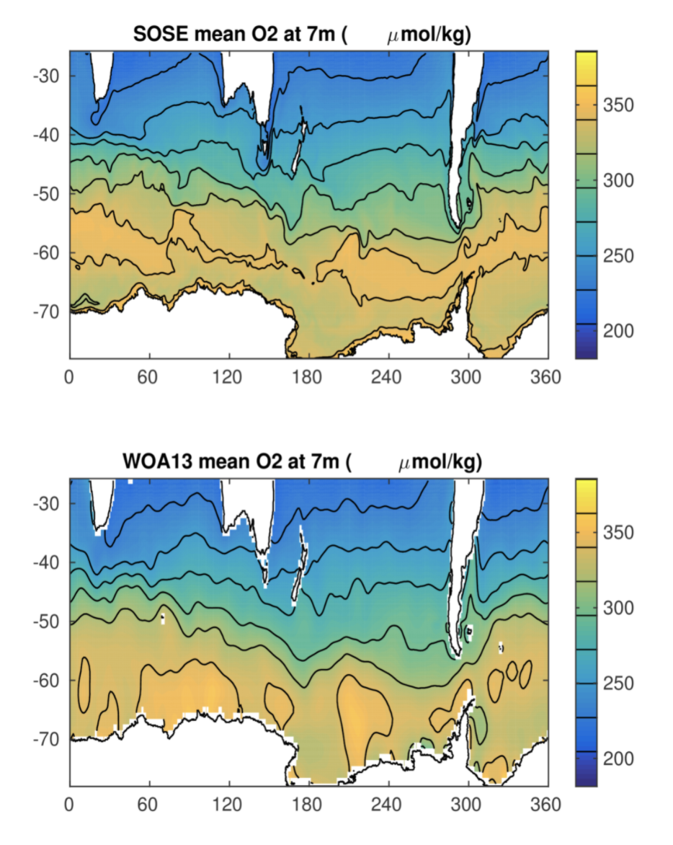
Biogeochemical SOSE Solution Now Available
Mean simulation of Oxygen
World Ocean Atlas for Oxygen

Slide 8
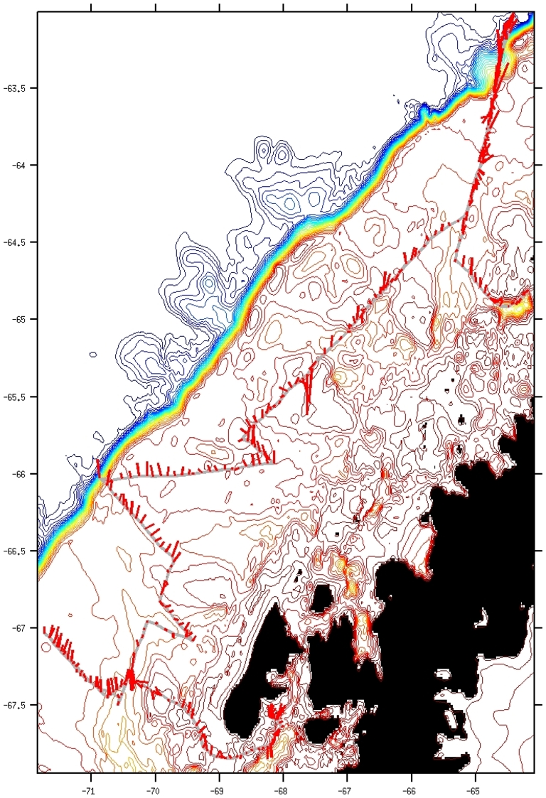
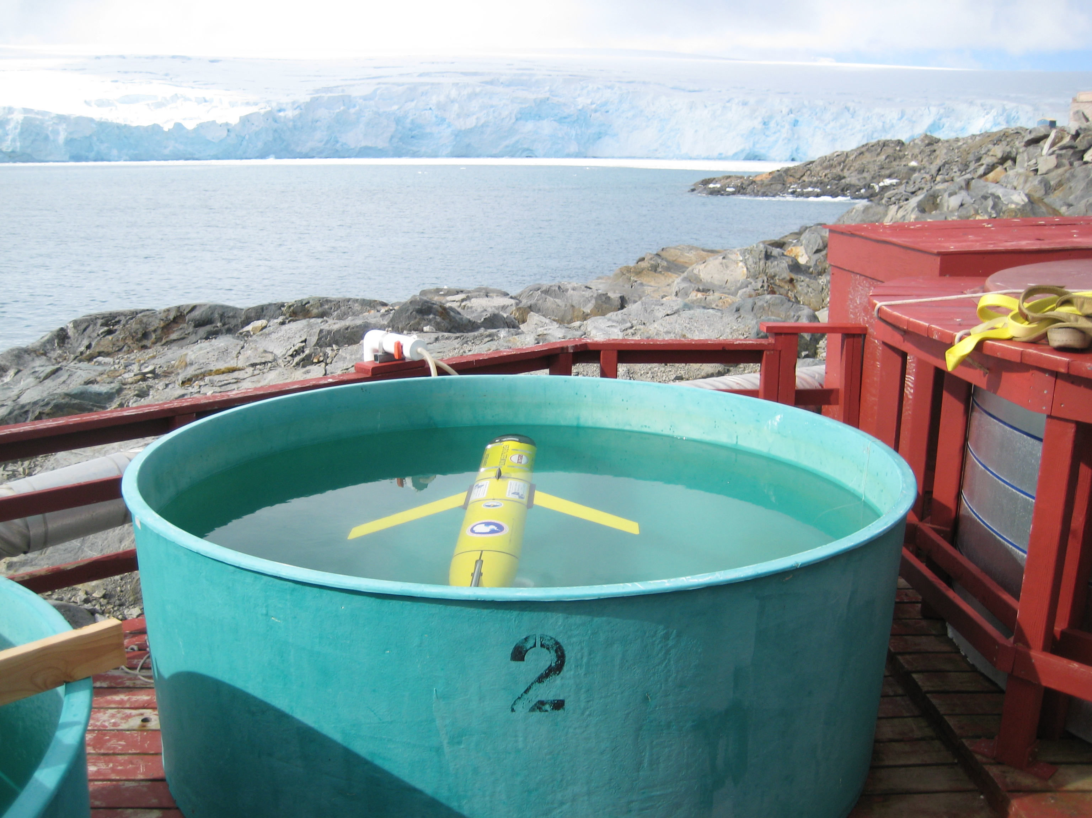
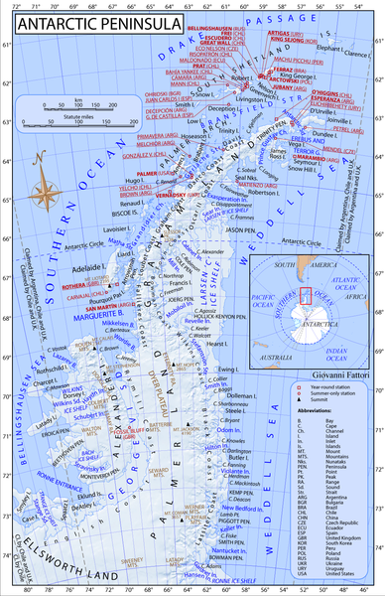
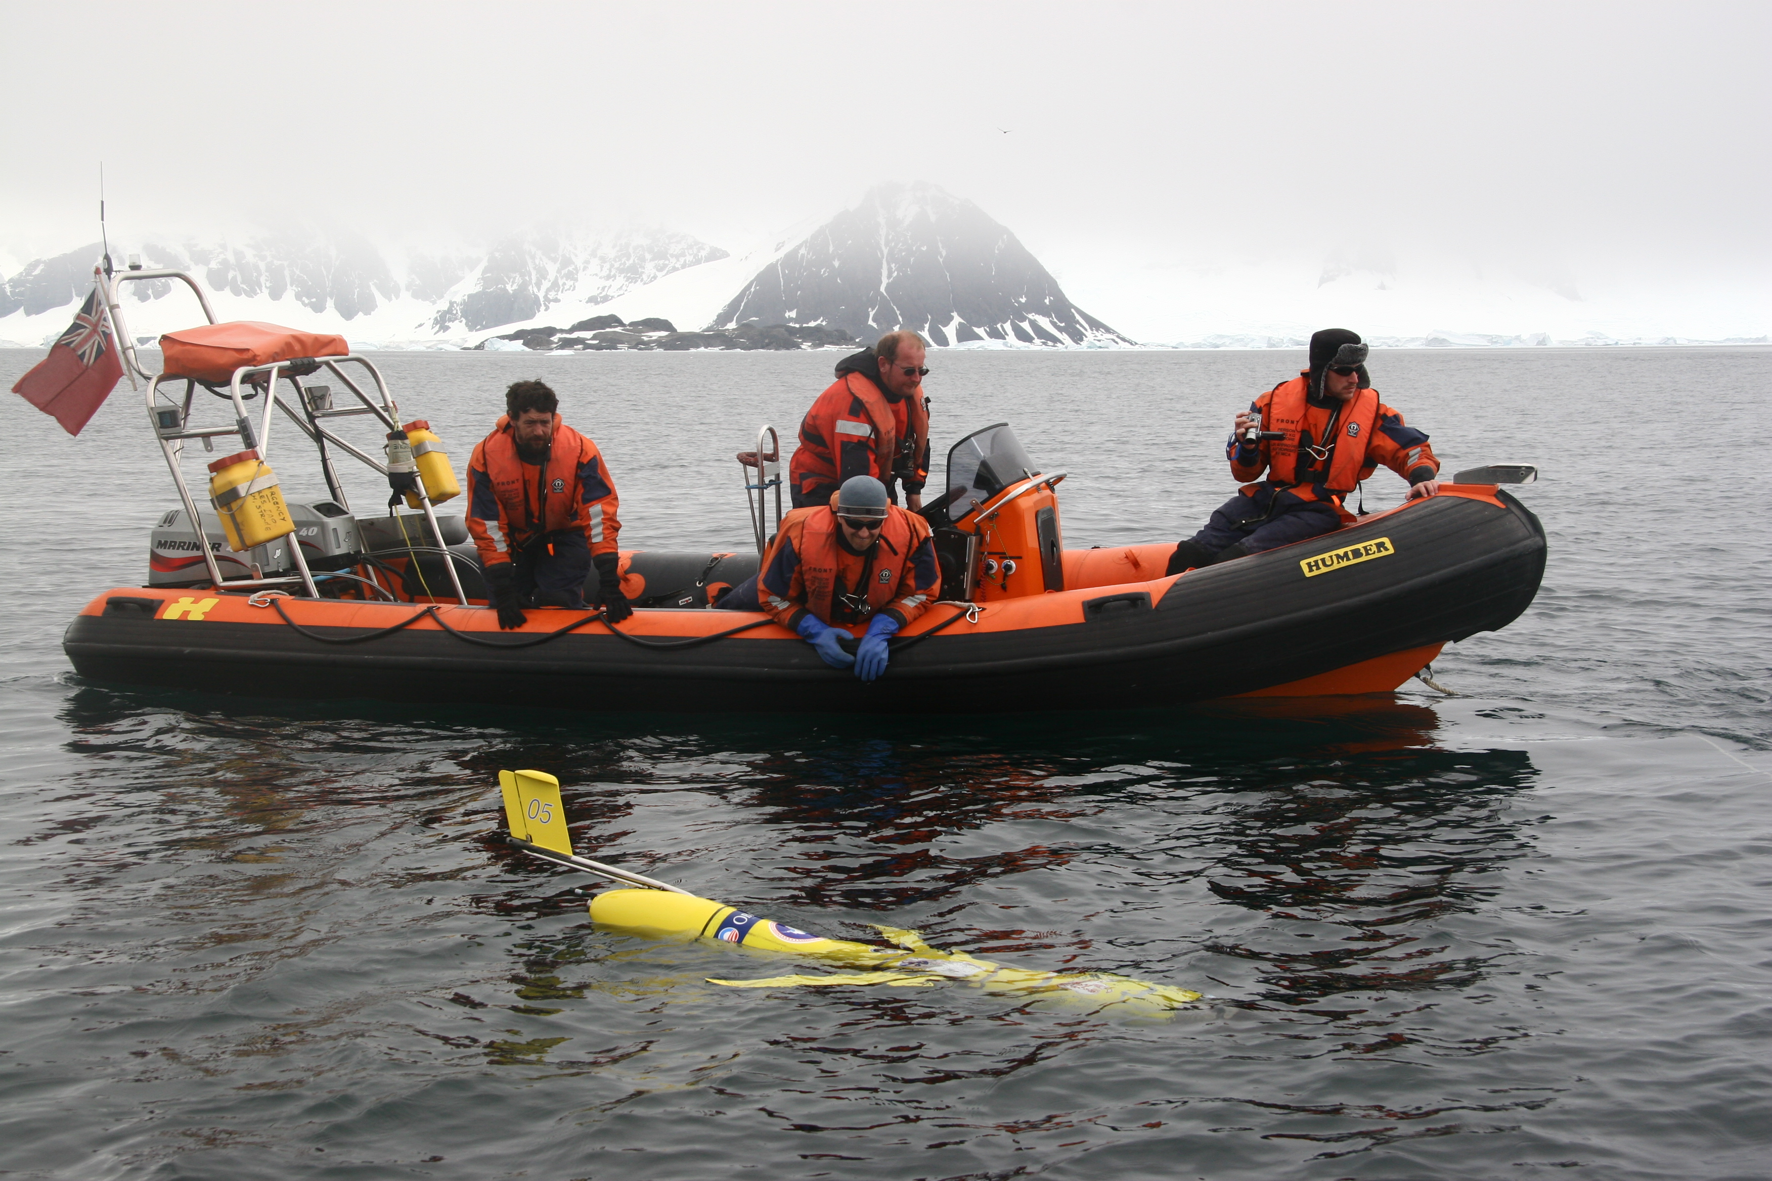
The Technology Explosion!!!!
Continental Margin And Coastal Waters
2009 Linking International Land
Antarctic Bases with Gliders

Slide 9
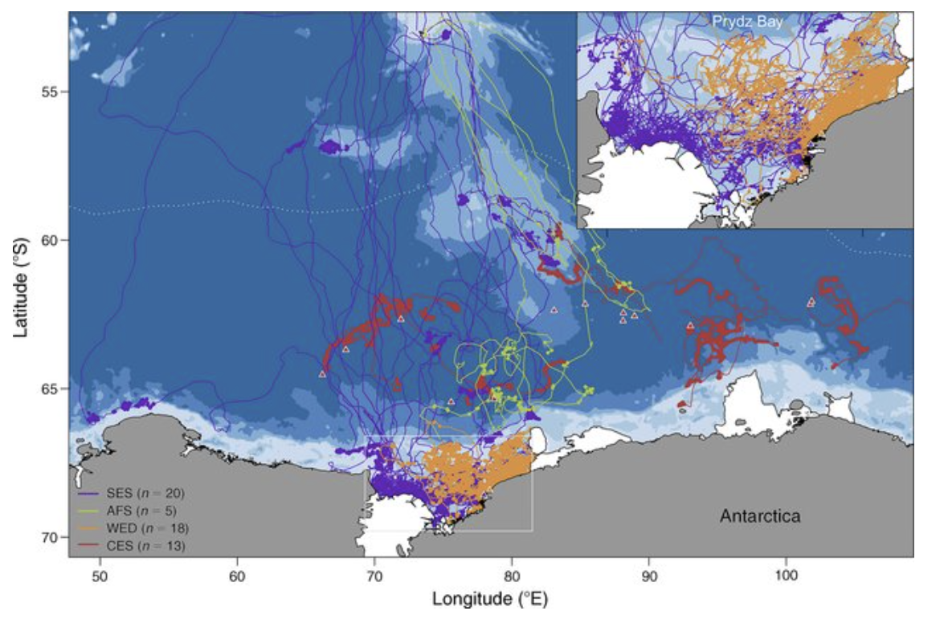
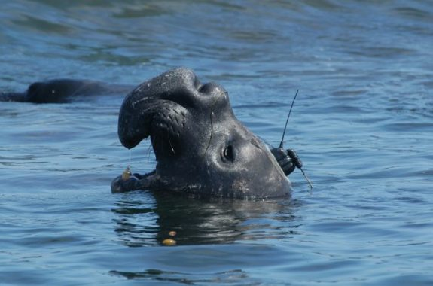
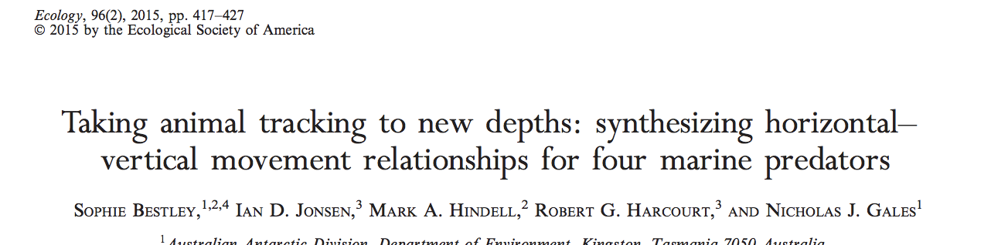
The Technology Explosion!!!!
Frontal Boundaries &
Biological Hotspots

Slide 10
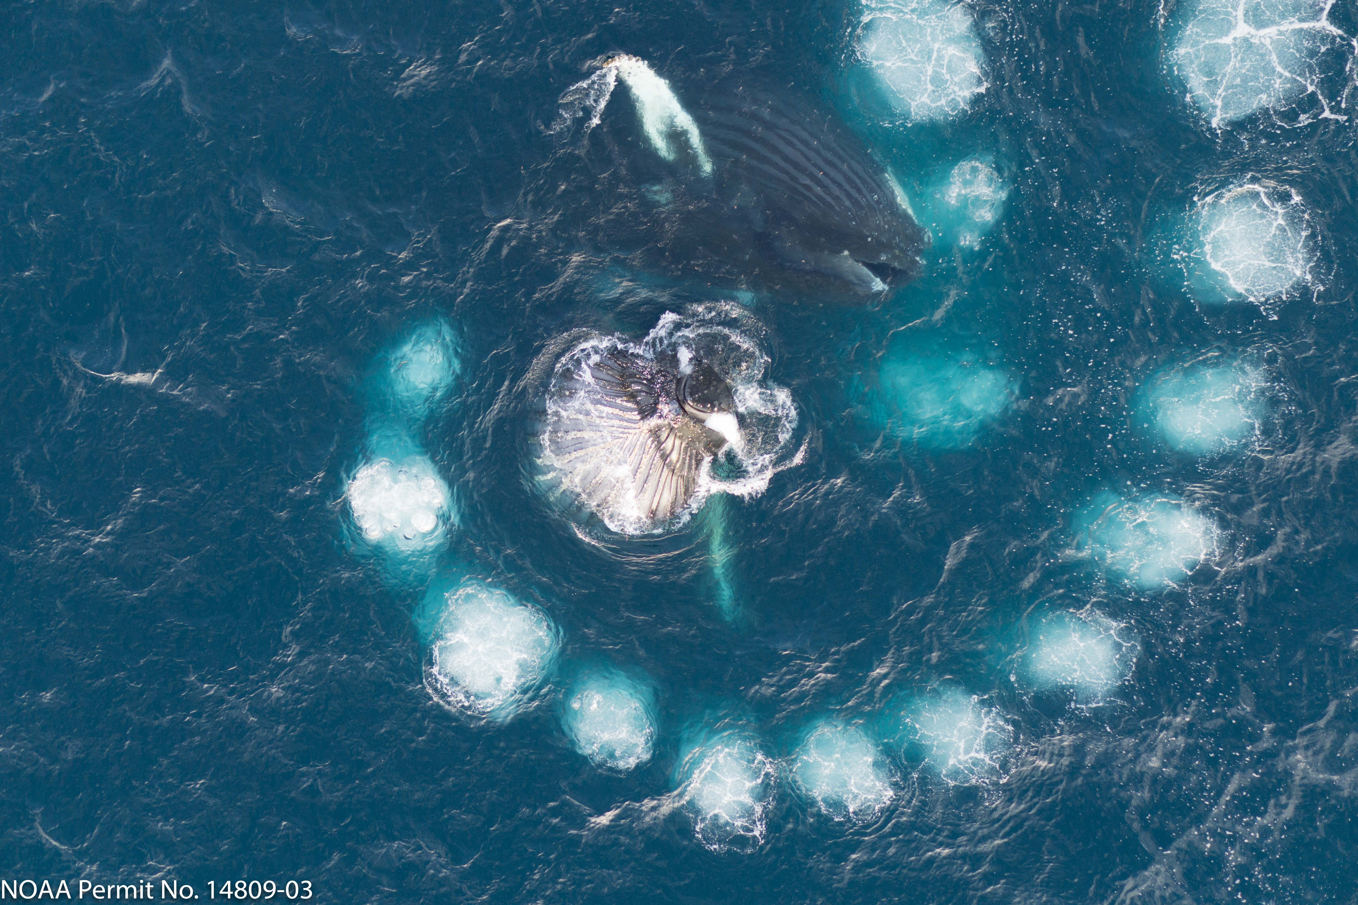
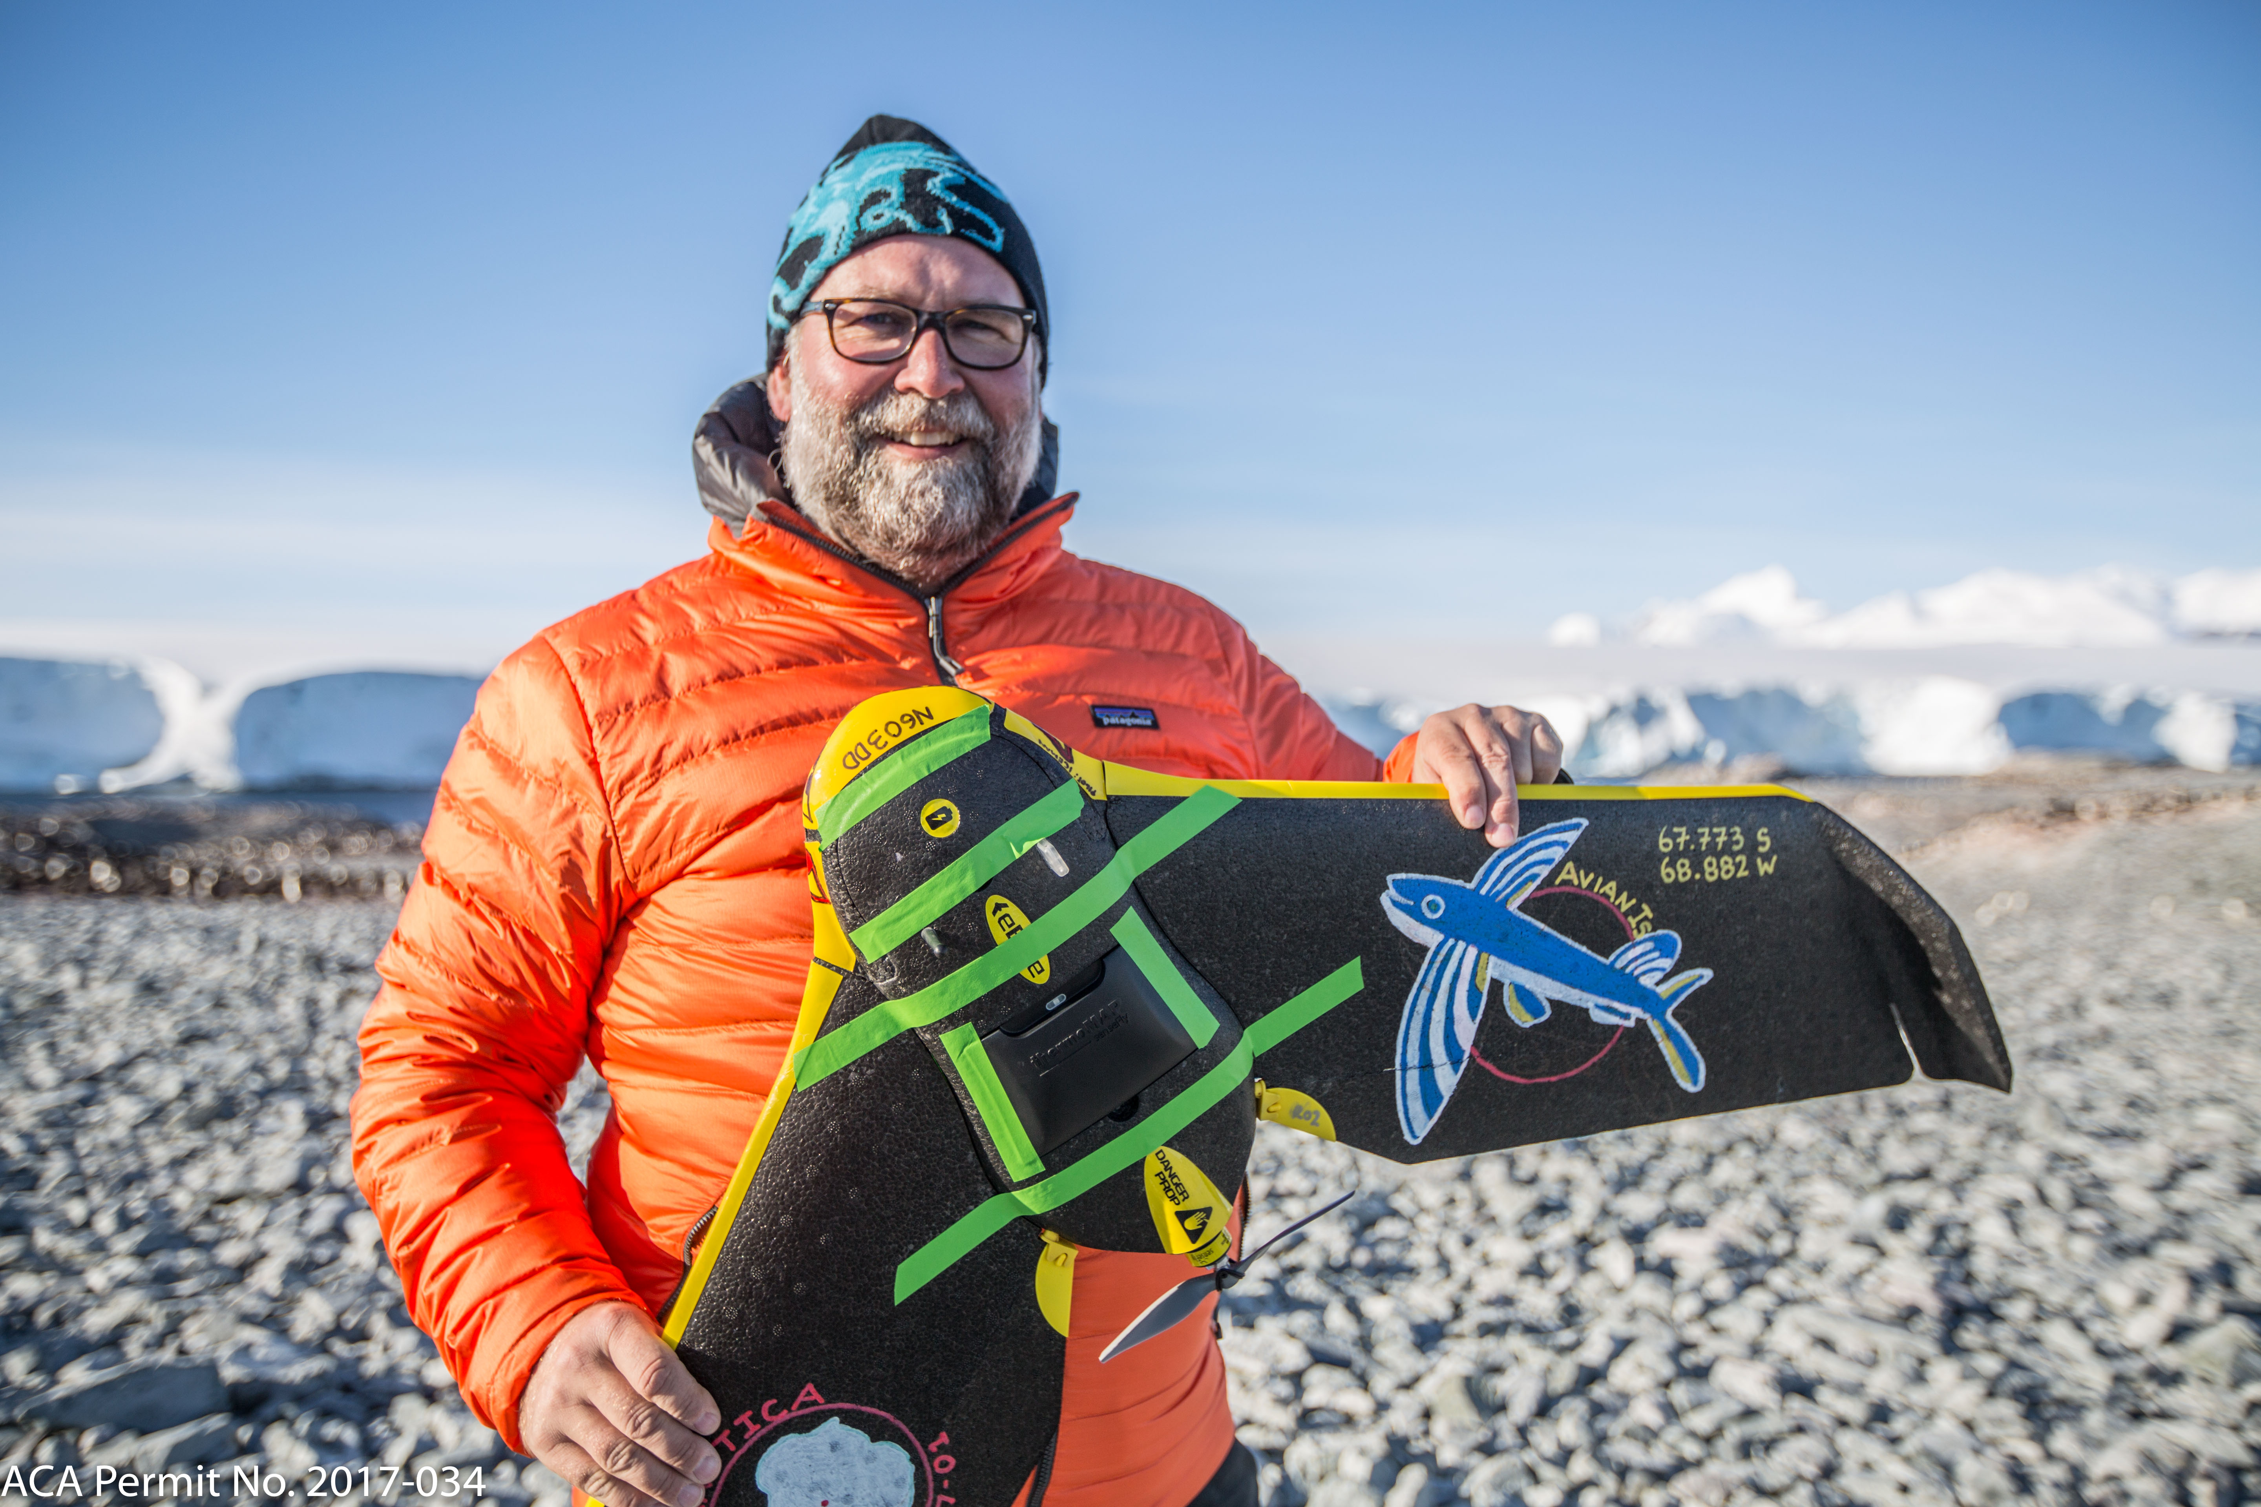
The Technology Explosion!!!!
Behavioral Ecology

Slide 11
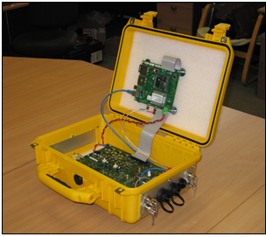
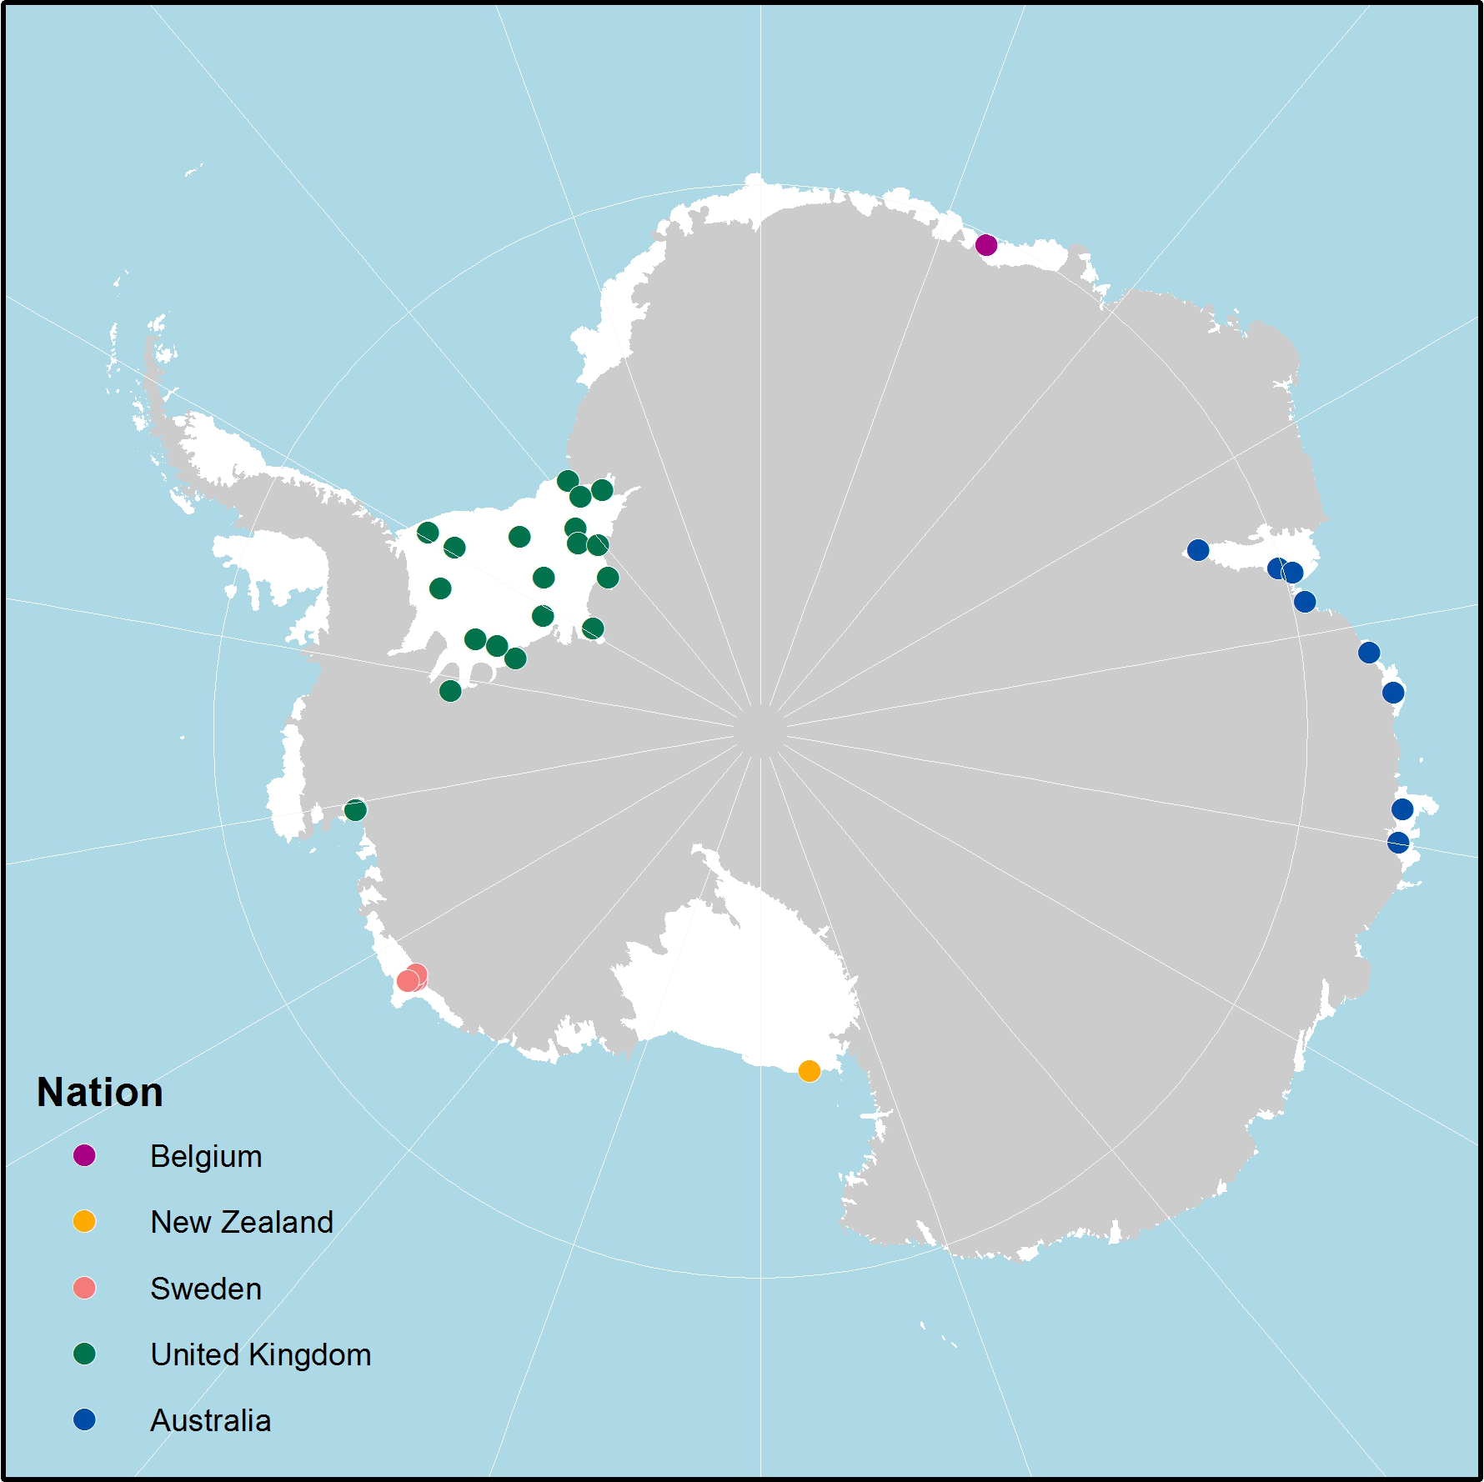
SOOS Endorsed, UK-led development of cheap, downward looking radar to measure ice-shelf thickness
The Technology Explosion!!!!
Ice

Slide 12






























10 Years of Sponsors
Core Sponsors
Other Sponsors
In-kind Sponsors

