Slide 1
Integration of UAS into Lifesaving Operations
Hugh Roarty and Jaden Dicopoulos
February 24, 2021

Slide 2
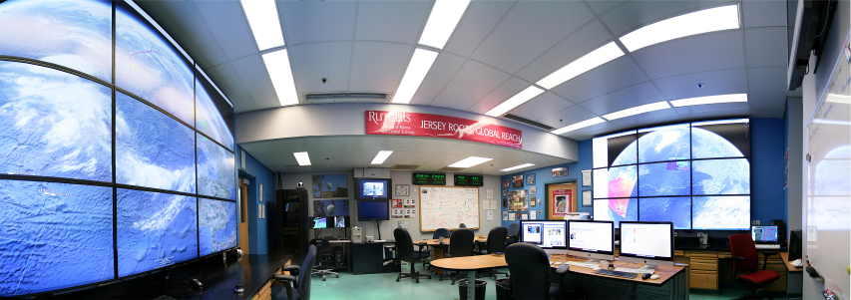
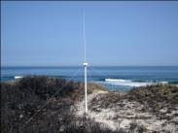
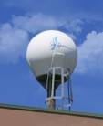
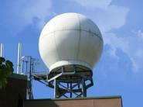
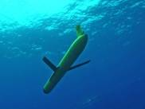
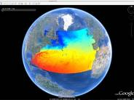
Rutgers University - Coastal Ocean Observation Lab 1992 - 2014
Center for Ocean Observing Leadership 2014 -
Vessels -
Satellite
Satellite
CODAR
Ships/ Vessels
Glider
REMUS
Data Vis.
Modeling
Security
Leadership
Education
CODAR Network
L-Band & X-Band Satellite Receivers
Glider Fleet
3-D Nowcasts
& Forecasts

Slide 3
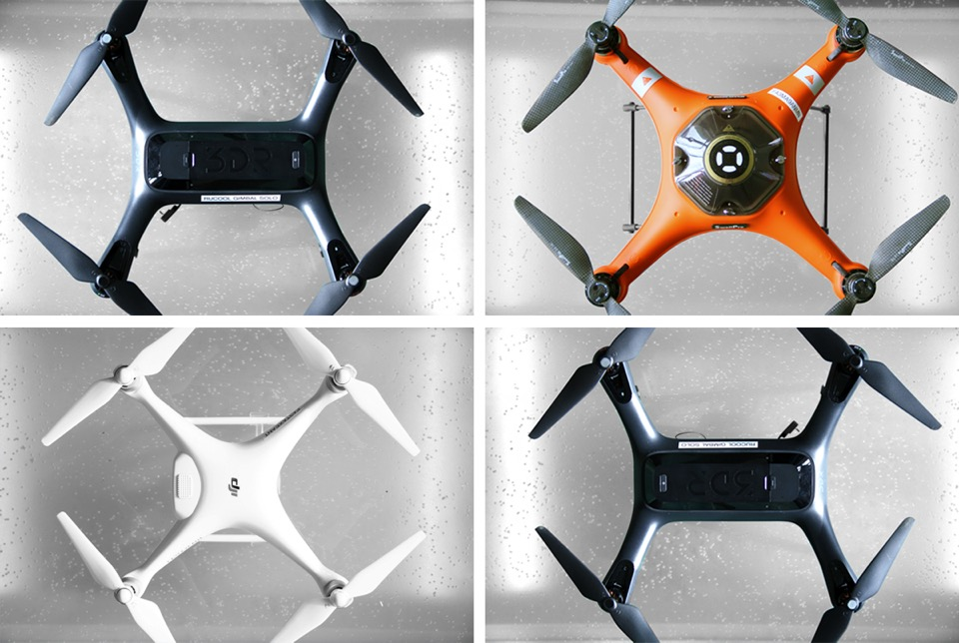

Slide 4
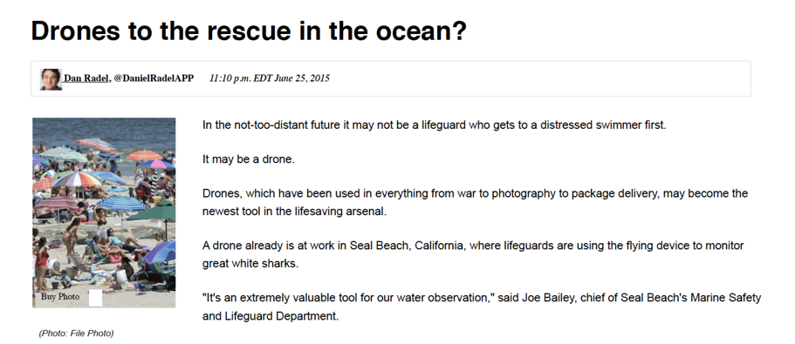
Long Branch - 2015

Slide 5
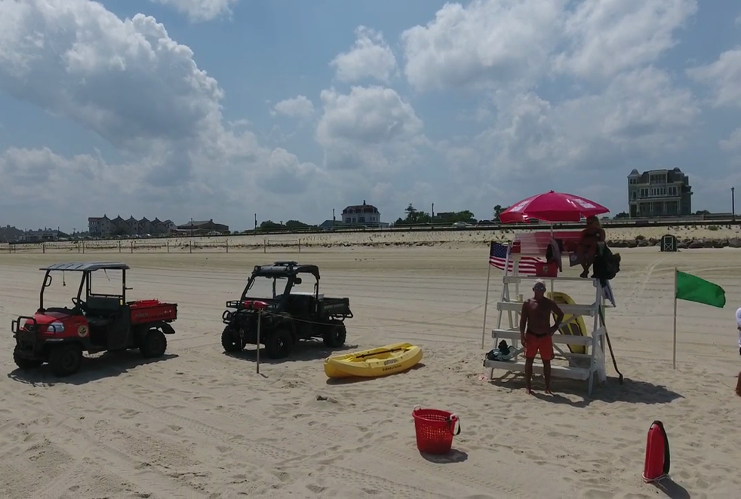
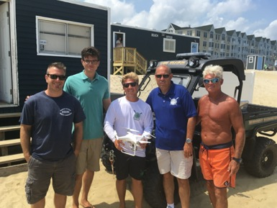
Long Branch - 2016
Notes:
Summer 2015 Ocean Rescue Report
582 Water Rescues (62 of these rescues occurred during our late shift hours, 5pm-7pm)
4,177 Preventions - Injuries, rescues and/or life-threatening situations prevented by lifeguards

Slide 6
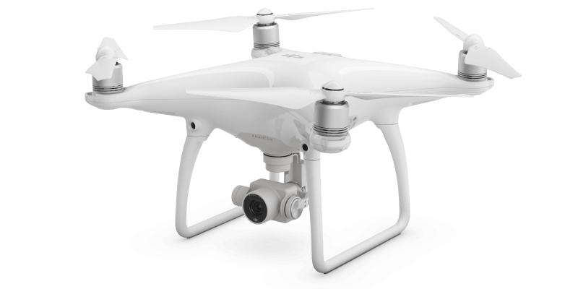
System Engineering Life Cycle Process
Step 1: Develop Concept of Operations
Rescue swimmers in need
Communicate to swimmers in need
Scout out an area for potential threats
Able to work Night or Day

Slide 7
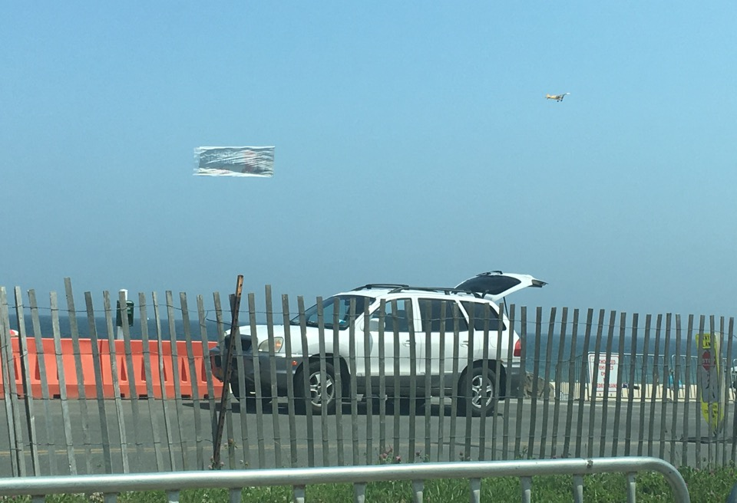
Restrictions
Notes:
Restrictions
Don't fly above 400 feet
Don't fly near people or stadiums
Don't fly within five miles of an airport
Don't let the drone out of your sight
Don't interfere with manned aircraft
Don't fly a drone that weighs more than 55 pounds

Slide 8
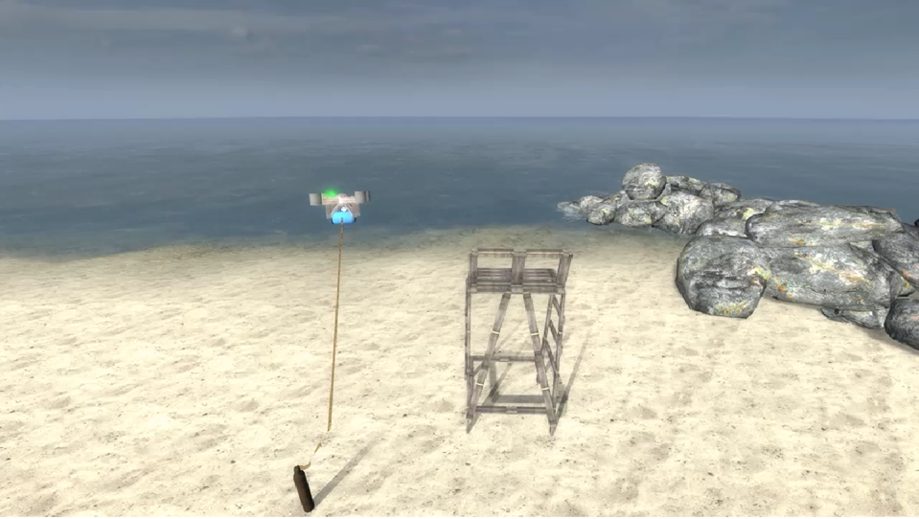
Simulation Software
Notes:
Modelling software package utilizing Garry’s Mod (GMod) is a sandbox game.

Slide 9
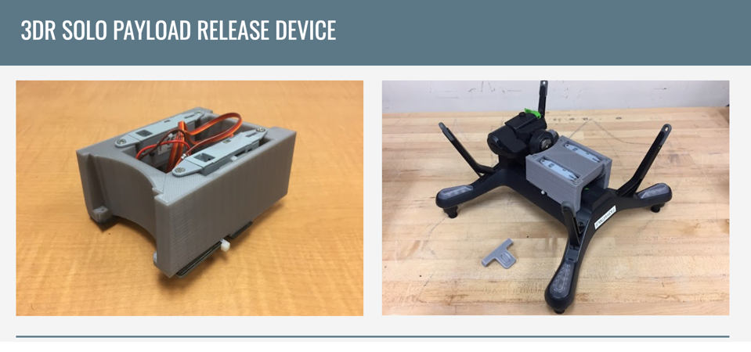
Release Mechanism Design
Weblink

Slide 10
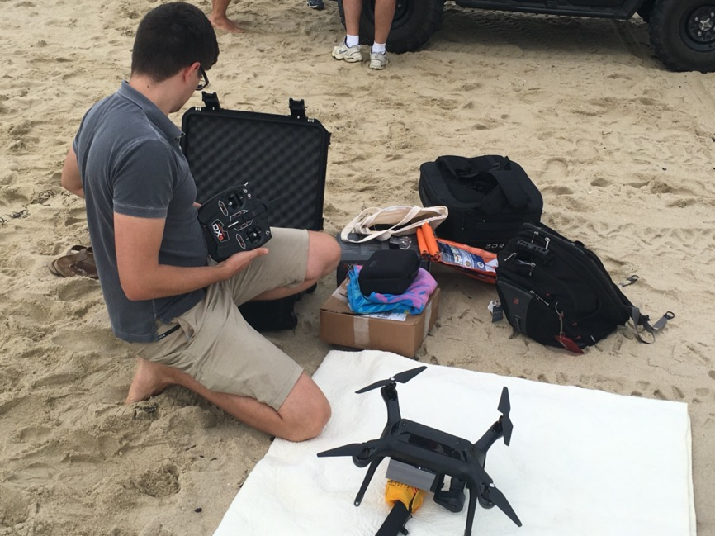
Long Branch - 2017

Slide 11
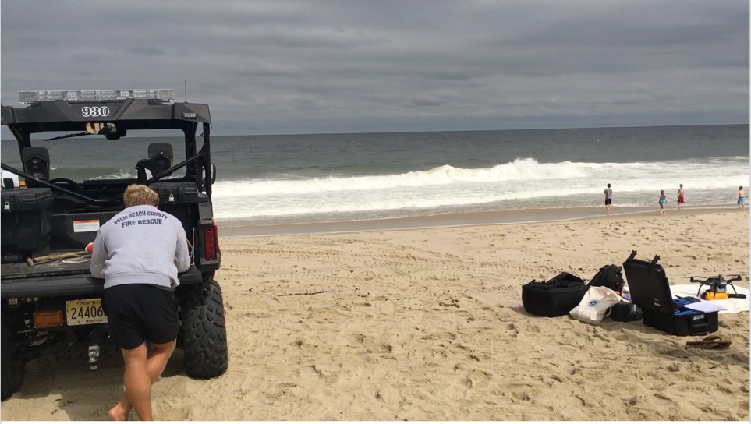
https://www.youtube.com/watch?v=Z1ild11zPFg&feature=youtu.be

Slide 12
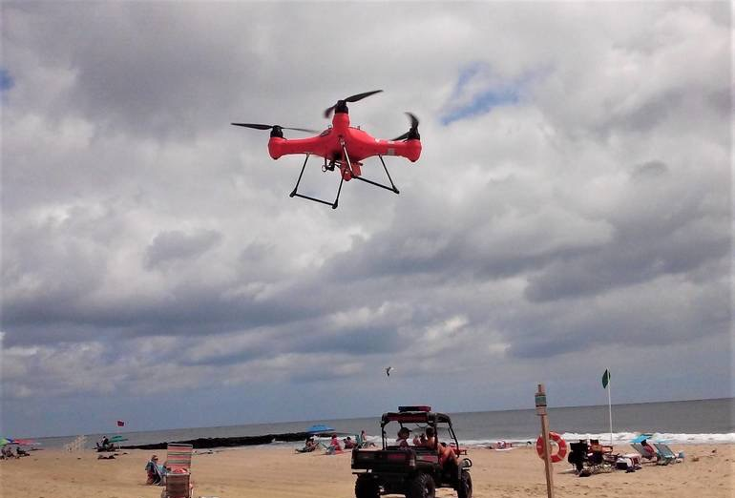
Belmar - 2018

Slide 13
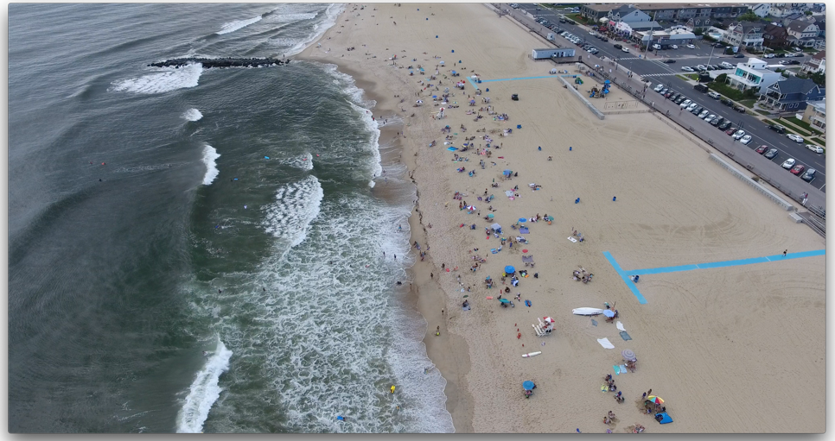
Aerial Video of Belmar Beach

Slide 14
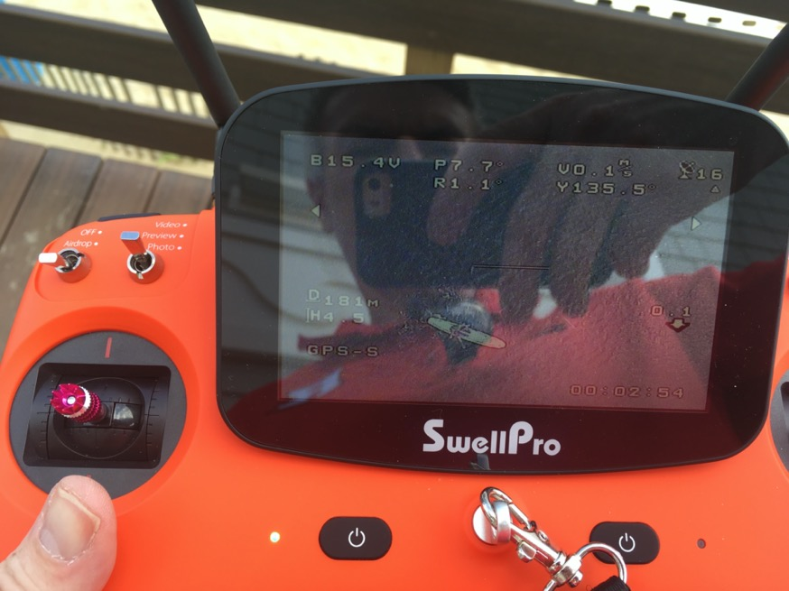

Slide 15
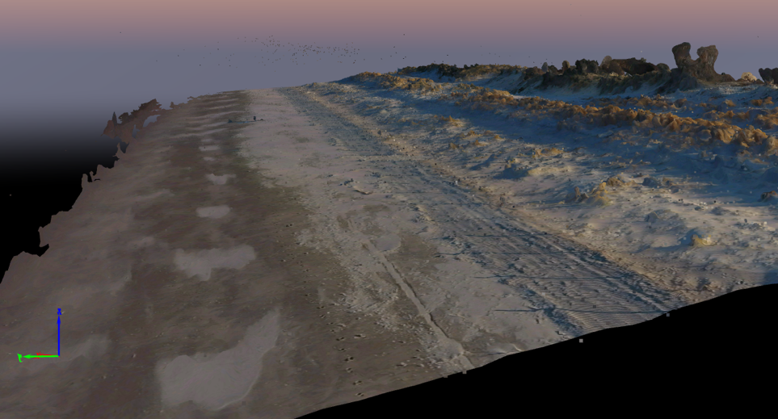
Port Monmouth, NJ Aerial Survey May 2018
dune
water
Pix4D Model

Slide 16
Integration of UAS into Lifesaving Operations
THANK YOU

