Slide 1
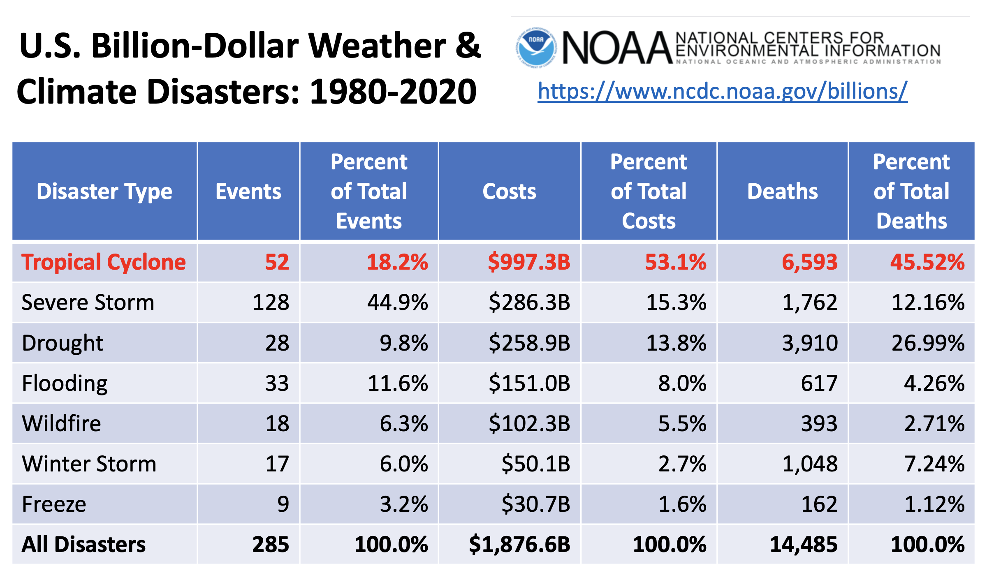
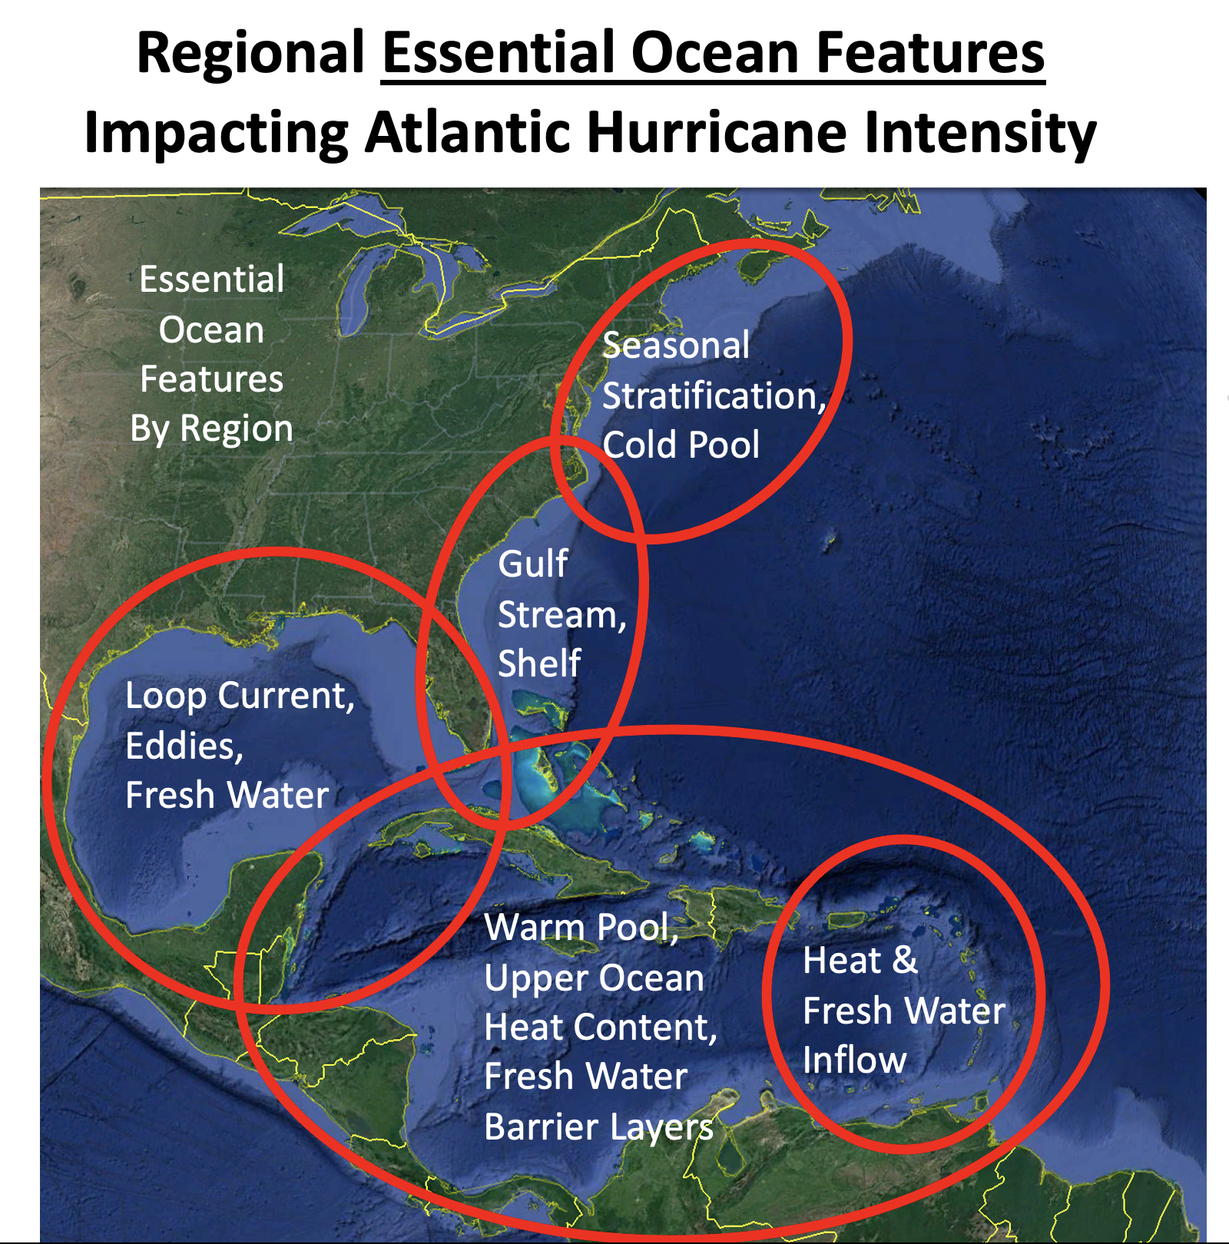

Slide 2
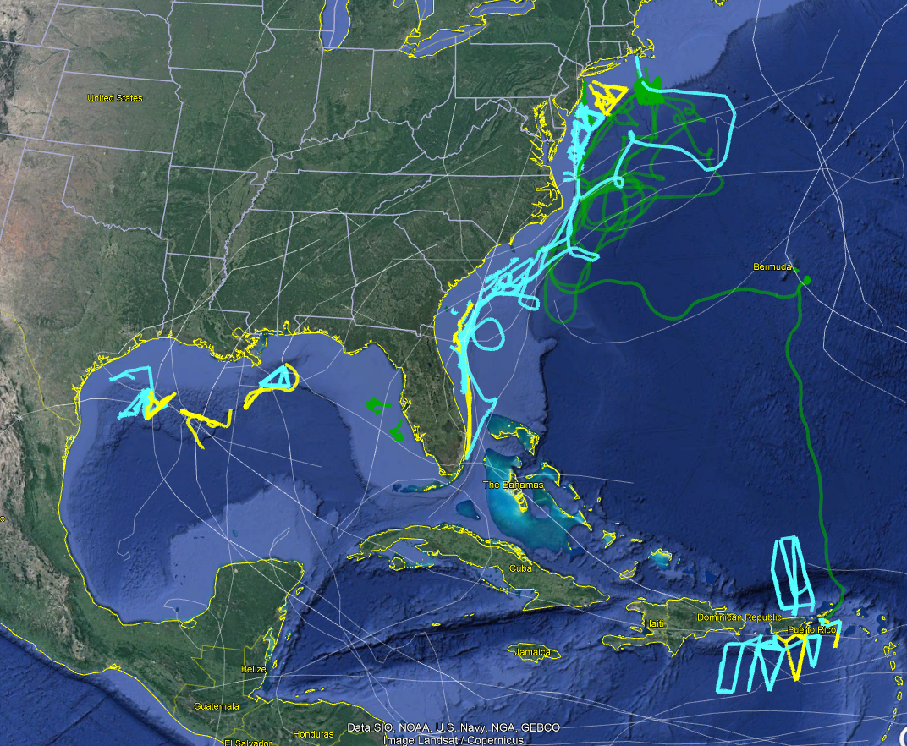
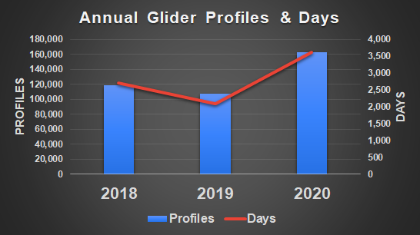
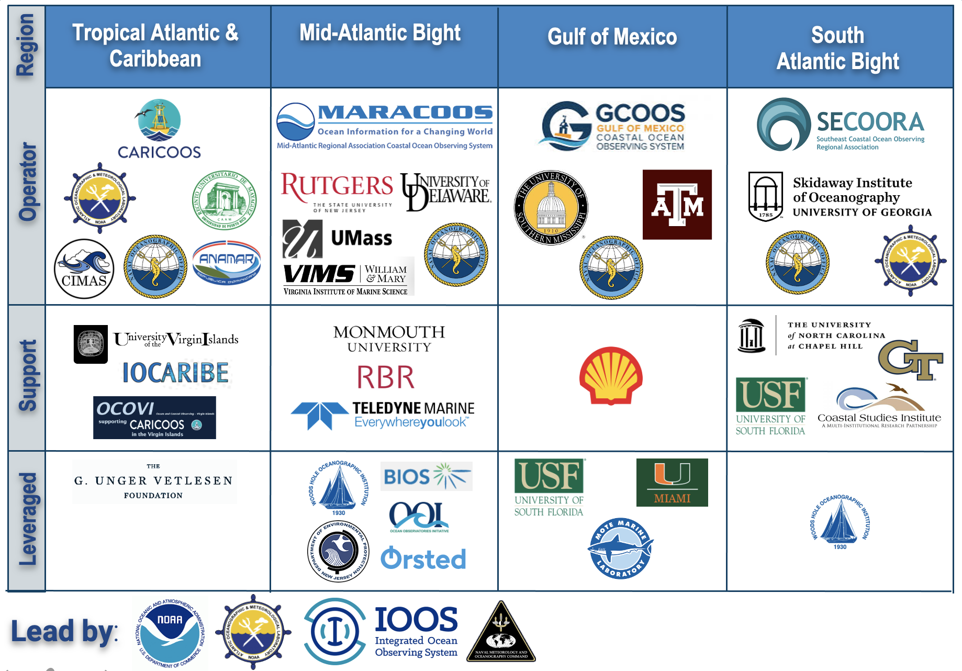
2020 Hurricane Glider Operations Summary
2020 Hurricane Season:
16 Institutions
78 Glider Missions
3,343 Glider Days
163,022 Data Profiles
(>50% increase over 2019)
Glider Data
in 15 Storms
NOAA/Partner
NAVY
Other Mission Glider*
Storm Track
Notes:
2020 Glider Days includes Hurricane Gliders and Other Mission Gliders
*Other Mission Glider (OMG): Partner gliders with missions not hurricane focused, but whose data is shared and used as part of the Hurricane Glider Effort
Annual Glider Profiles & Days: Chart data is for Jun 1 to Nov 15, 2020 for all Atlantic glider observations including Gulf of Mexico and Caribbean Sea.
Glider Days: The cumulative number of days that all gliders were at sea collecting observations. This is a similar metric as Days At Sea for ships.

Slide 3
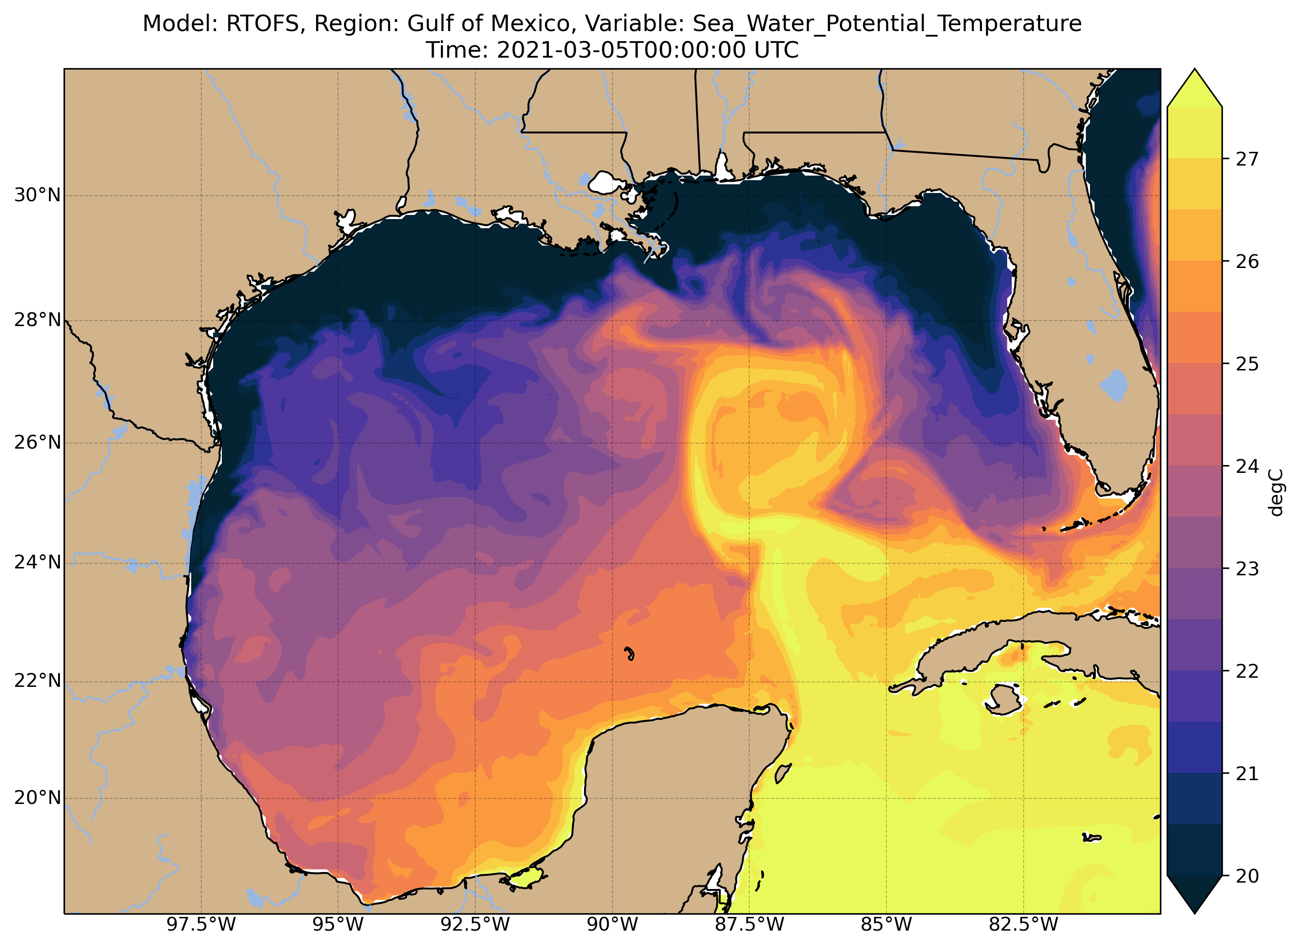
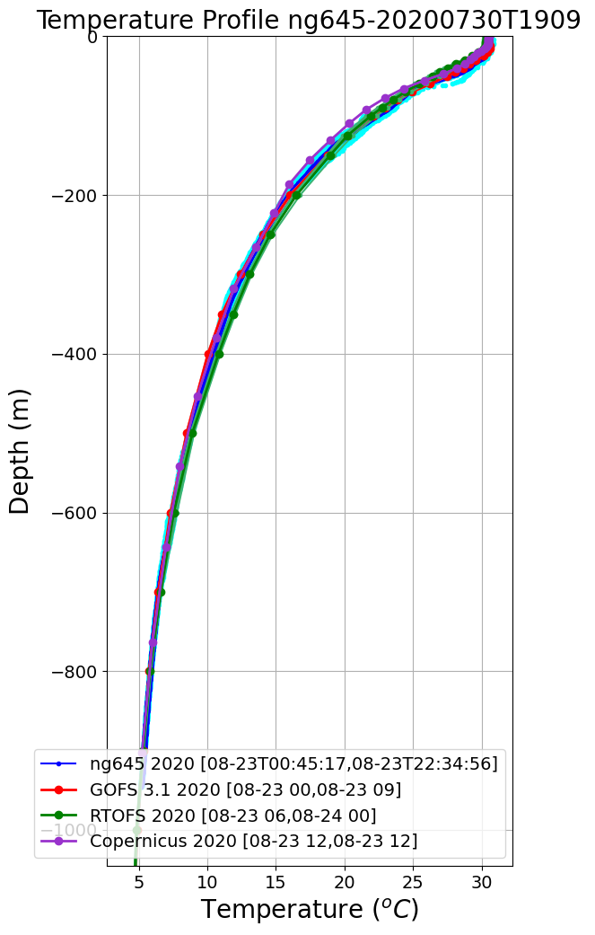
Ocean Side of Hurricane Forecasts start with Data Assimilation in the Global Model
Trans-Atlantic Glider Missions since 2009
Real Time Ocean Forecast System (RTOFS)
Compare Glider Data to RTOFS, GOFS, Copernicus
Glider

