Slide 1
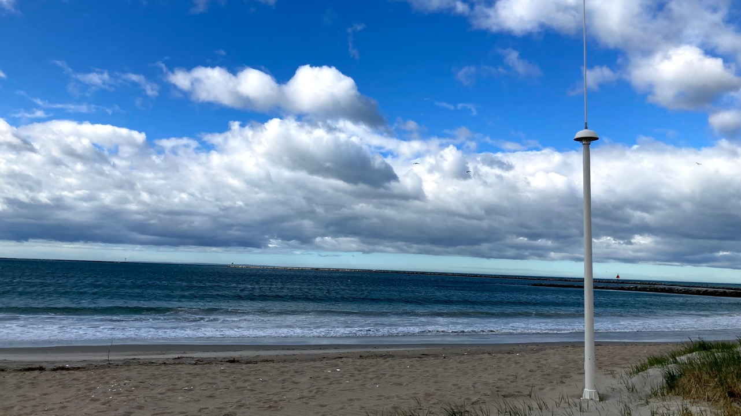




Development of a Multistatic
HF Radar Network
Hugh Roarty
Laura Nazzaro
Ethan Handel
Josh Kohut
Mike Smith
Scott Glenn
SICOMAR+ HF Radar Summer School
May 26, 2021

Slide 2


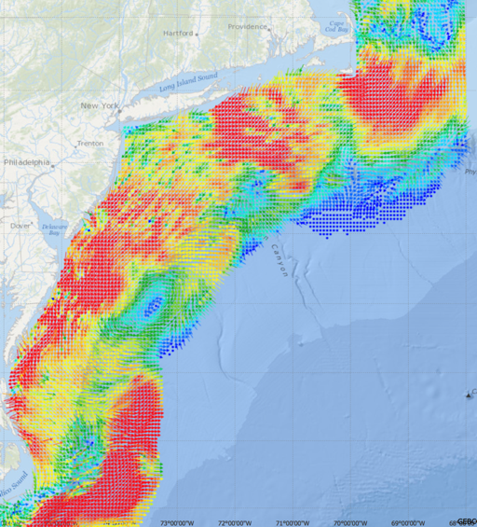
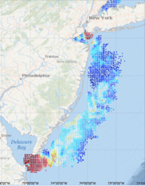
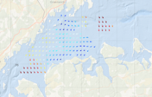


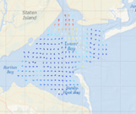

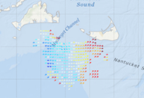
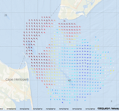

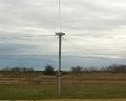


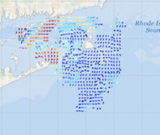
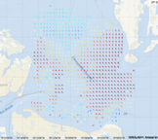
MARACOOS High Frequency Radar Network
Long Range Network
Western Long Island Sound
5 MHz - 17 Stations
13 MHz - 8 Stations
25 MHz - 16 Stations
TOTAL – 41 Stations
New Jersey 13 MHz
New York Harbor
Winter Storm Jonas
2016/01/23 20:00 UTC
Muskeget Channel
Delaware Bay
Block Island Sound
Key Applications
Search and Rescue
Coastal Hazards
Maritime Safety
Water Quality Forecasting
Chesapeake Bay
Notes:
Sends a radar signal out across the water
About as much energy as a 100w light bulb
3 types of networks with 3 resolutions
The mid range also measure wave height just offshore.

Slide 3
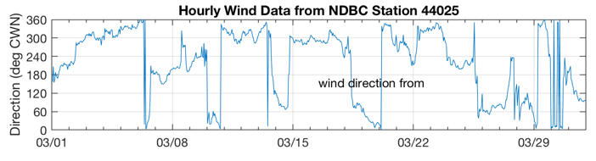
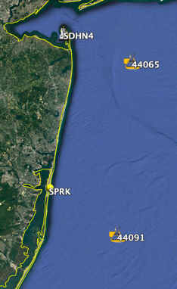
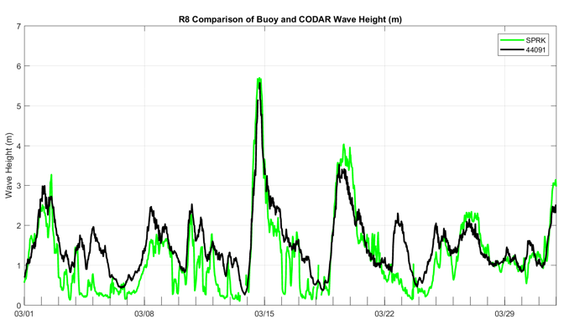
Wave Measurements from HF Radar Stations
10º
190º
March 2017

Slide 4
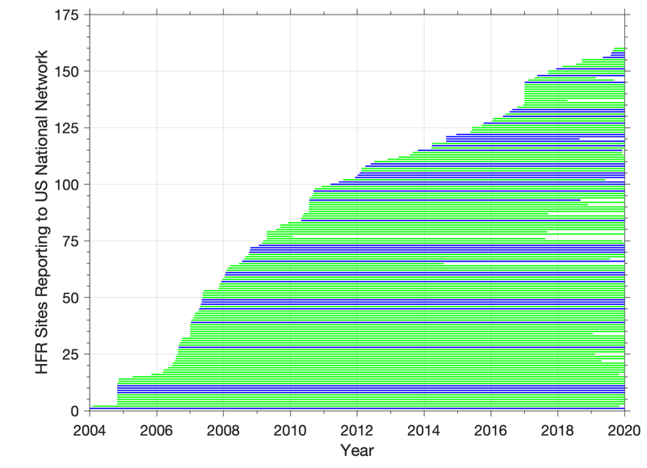
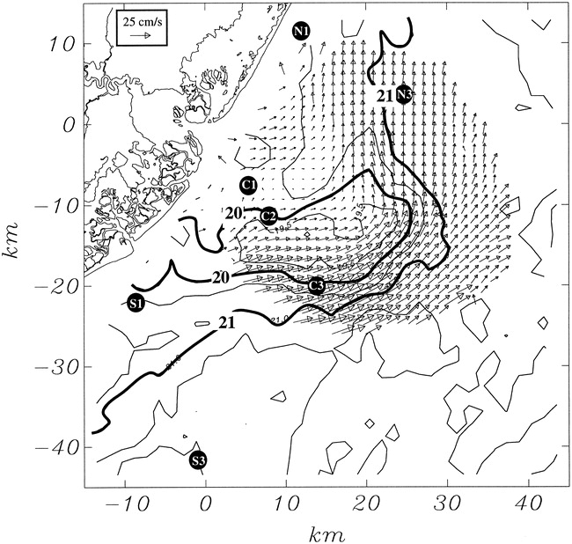
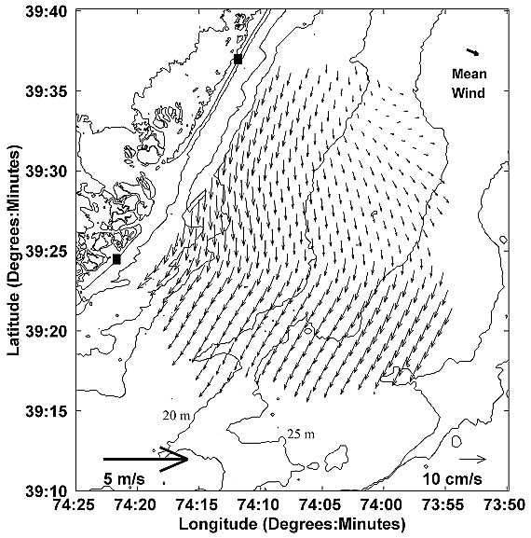
Growth of HF Radar in the US
Rutgers has been operating
HF Radars since 1996
MARACOOS Stations
IOOS Stations
Jun 14 - Aug 15, 1996
May 1999 - May 2000

Slide 5
Multistatic Introduction

Slide 6
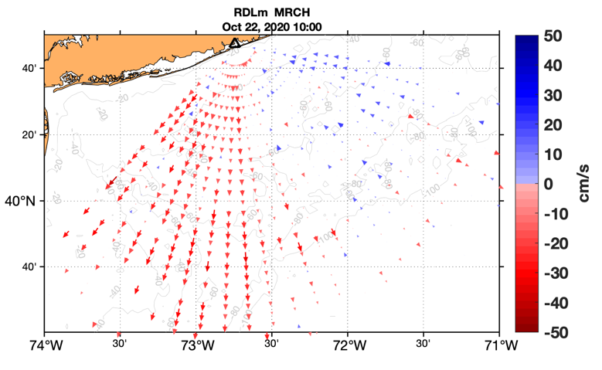
Terminology - Monostatic
Tx/Rx
Notes:
Constant time-delay paths form circles around HFR
Vectors normal to range circle

Slide 7
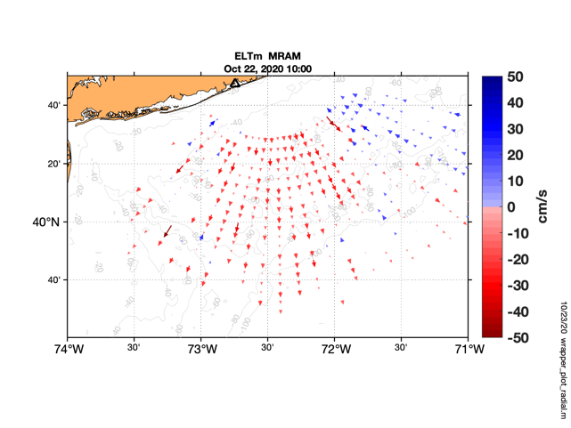
Terminology - Bistatic
Tx
Rx
Notes:
Constant time-delay paths form ellipses w/ foci @ Tx & Rx sites
Velocity component normal to ellipse

Slide 8
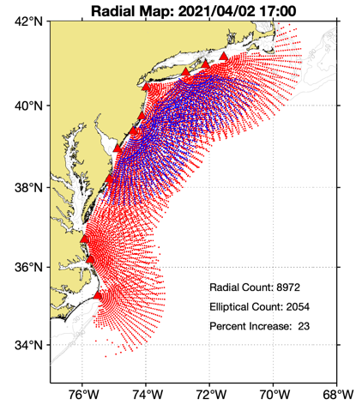
Terminology - Multistatic
Tx
Tx/Rx
Notes:
Operating the radars in monostatic and bistatic mode simultaneously

Slide 9
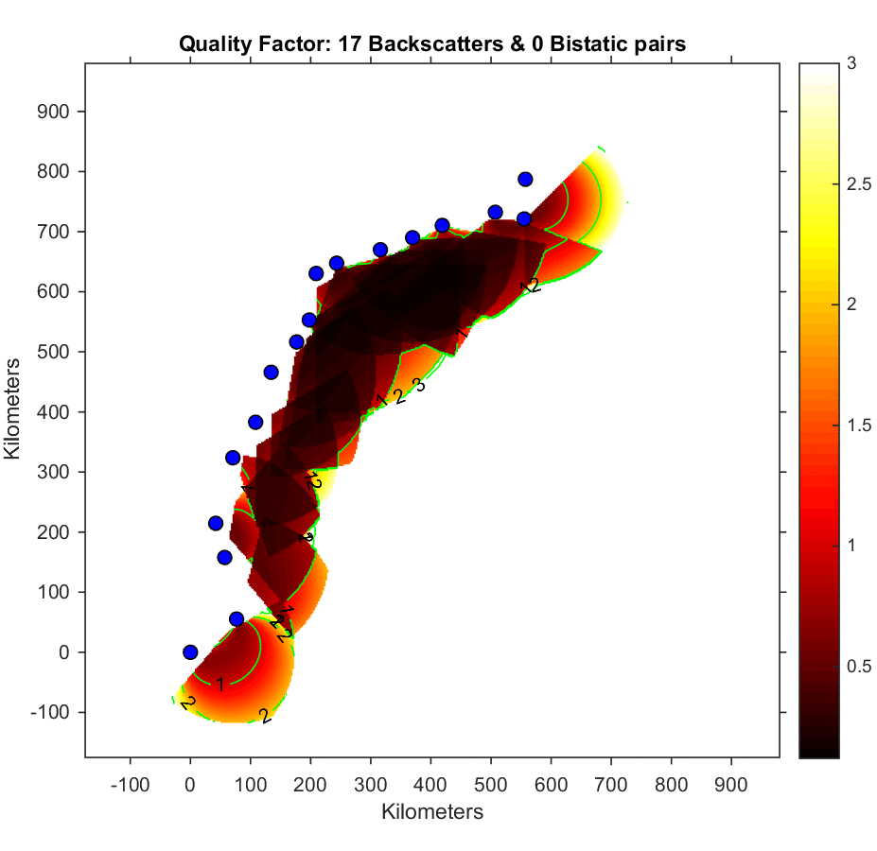
Multistatic Modelling
Signal Strength | Monostatic | Multistatic | Change | % Change
0.00 – 0.25 | 38,138 | 109,820 | 71,682 | 188%
0.25 – 0.50 | 46,444 | 28,725 | -17,719 | -38%
0.50 – 1.00 | 41,700 | 34,719 | -6,981 | -17%
1.00 – 2.00 | 40,444 | 33,669 | -6,775 | -17%
2.00 – 3.00 | 24,600 | 24,756 | 156 | 1%
Total | 191,326 | 231,689 | 40,363 | 21%

Slide 10
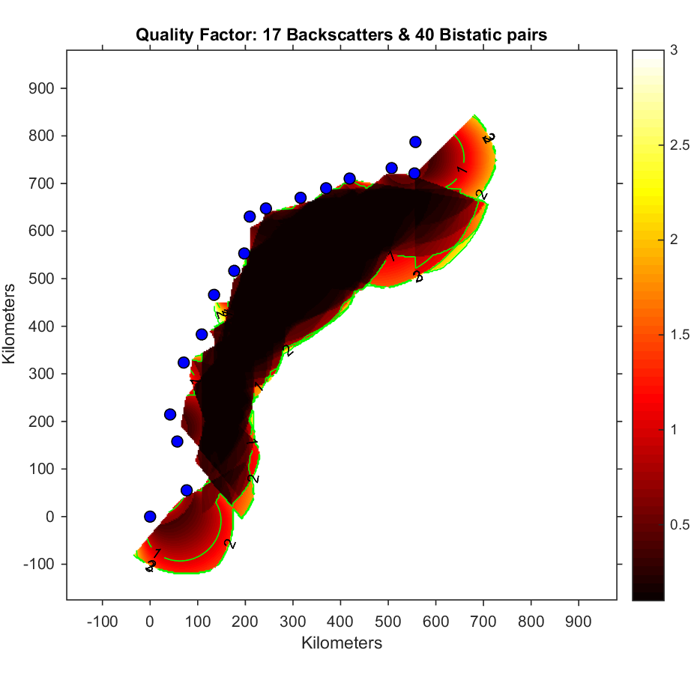
Multistatic Modelling
Signal Strength | Monostatic | Multistatic | Change | % Change
0.00 – 0.25 | 38,138 | 109,820 | 71,682 | 188%
0.25 – 0.50 | 46,444 | 28,725 | -17,719 | -38%
0.50 – 1.00 | 41,700 | 34,719 | -6,981 | -17%
1.00 – 2.00 | 40,444 | 33,669 | -6,775 | -17%
2.00 – 3.00 | 24,600 | 24,756 | 156 | 1%
Total | 191,326 | 231,689 | 40,363 | 21%

Slide 11
Multistatic Operations

Slide 12
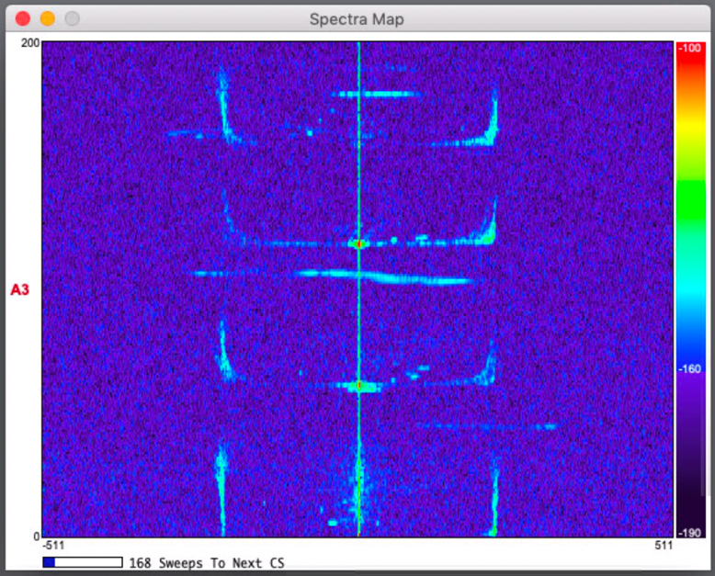
Radar
Spectra
Bistatic 03
Bistatic 02
Bistatic 01
Monostatic

Slide 13
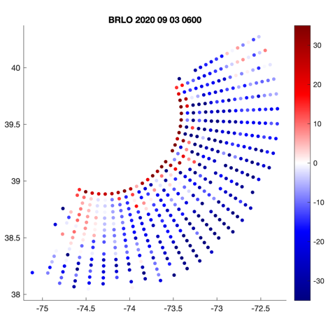
BRLO QC – Sep 3, 2020 06:00

Slide 14
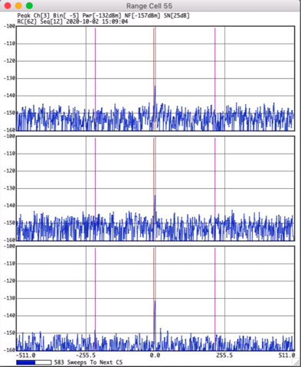
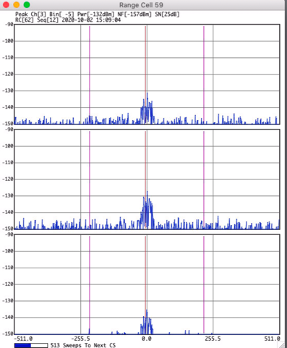
Previous BRLO Settings
DC Peak - Range Cell 55
First RC To Process - Range Cell 59

Slide 15
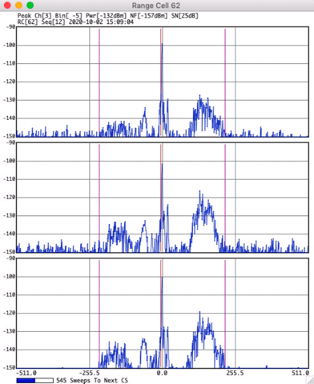
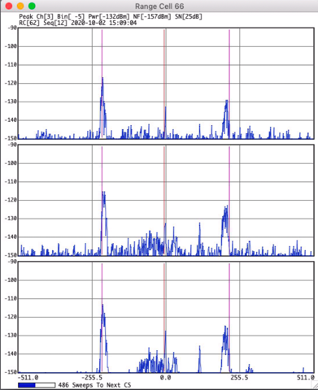
New BRLO Settings
Made changes on 2020-09-25 18:42 UTC
DC Peak - Range Cell 62
First RC To Process - Range Cell 66
DC Peak

Slide 16
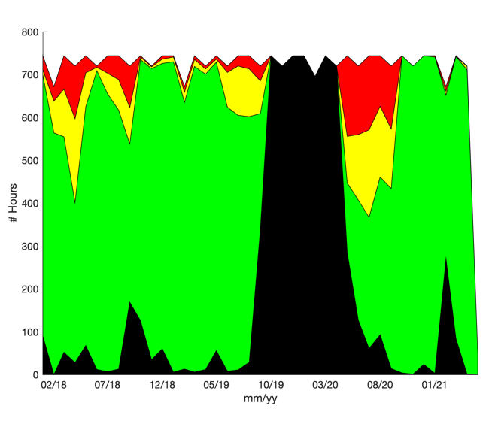
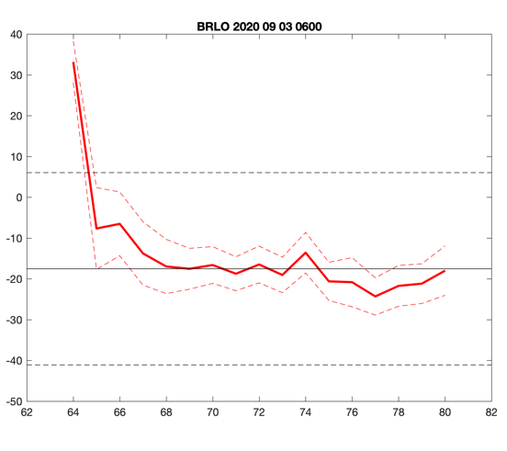
Quality Control Test
Legend
Monthly Flag Rate:
February 2018 to April 2021
No data Suspect
Pass Fail
1
Mean velocity within a range cell
2
95% confidence interval
3
Median of all range cell means
4
Median +/- 2 SD
4
3
1
2

Slide 17
Multistatic Verification

Slide 18
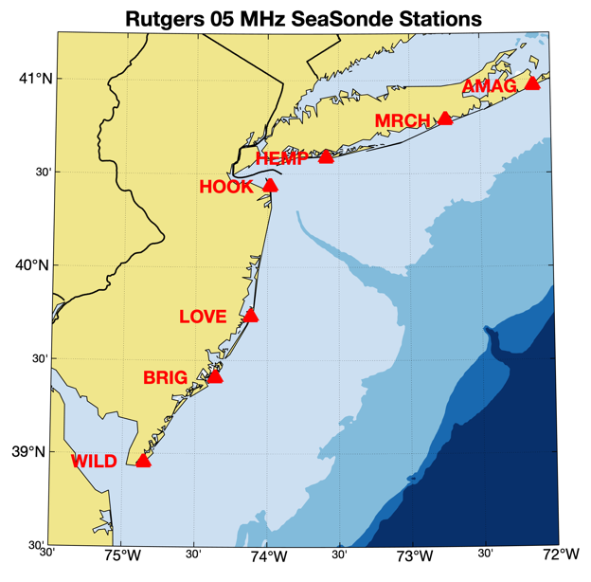
Receive Station
Transmit Station
MRCH
AMAG
MRAM
MRCH
HEMP
MRHE

Slide 19
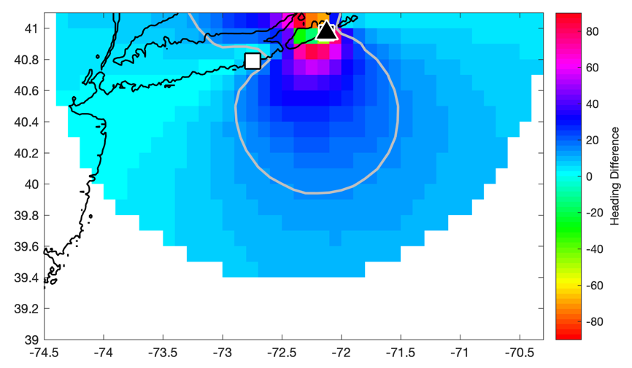
Comparison Ellipticals with Radials
MRAM vs. AMAG

Slide 20
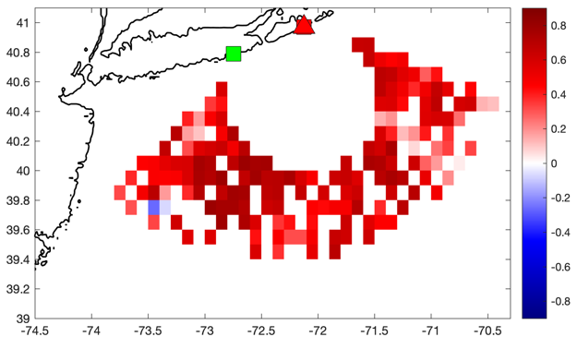
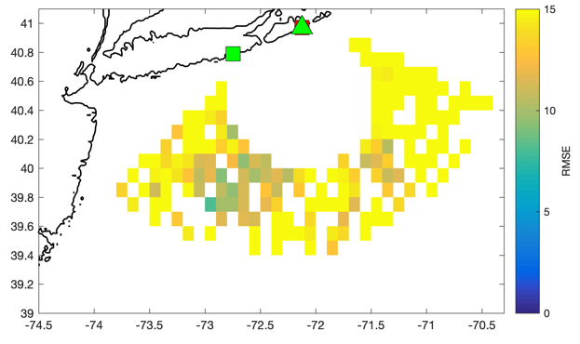
Comparison with Radials
MRAM vs. AMAG
Correlation Coefficient
Root Mean Square Error
MRCH
AMAG
MRCH
AMAG
August 2018

Slide 21
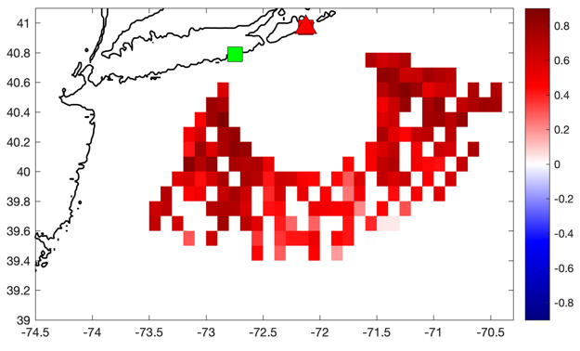
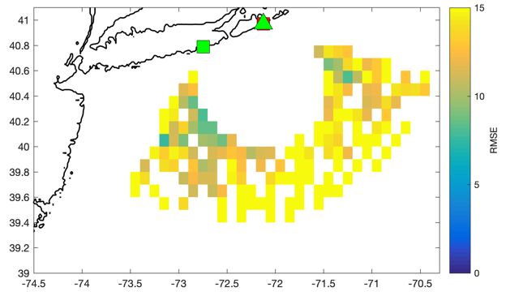
Comparison with Radials
MRAM vs. AMAG
Correlation Coefficient
Root Mean Square Error
MRCH
AMAG
MRCH
AMAG
January 2021

Slide 22
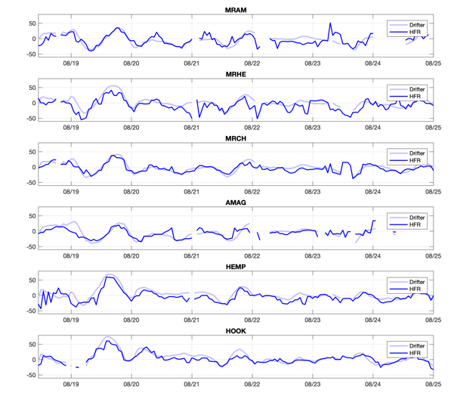
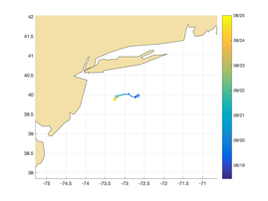
Comparison with Drifters
sldmb65141730
August 2018
Ellipticals
MRAM: N=131, r=.675, RMSE=13.4
MRHE: N=149, r=.654, RMSE=16.3
Radials
MRCH: N=150, r=.845, RMSE=8.8
AMAG: N=121, r=.723, RMSE=12.2
HEMP: N=150, r=.781, RMSE=14.8
HOOK: N=147, r=.875, RMSE=10.4

Slide 23
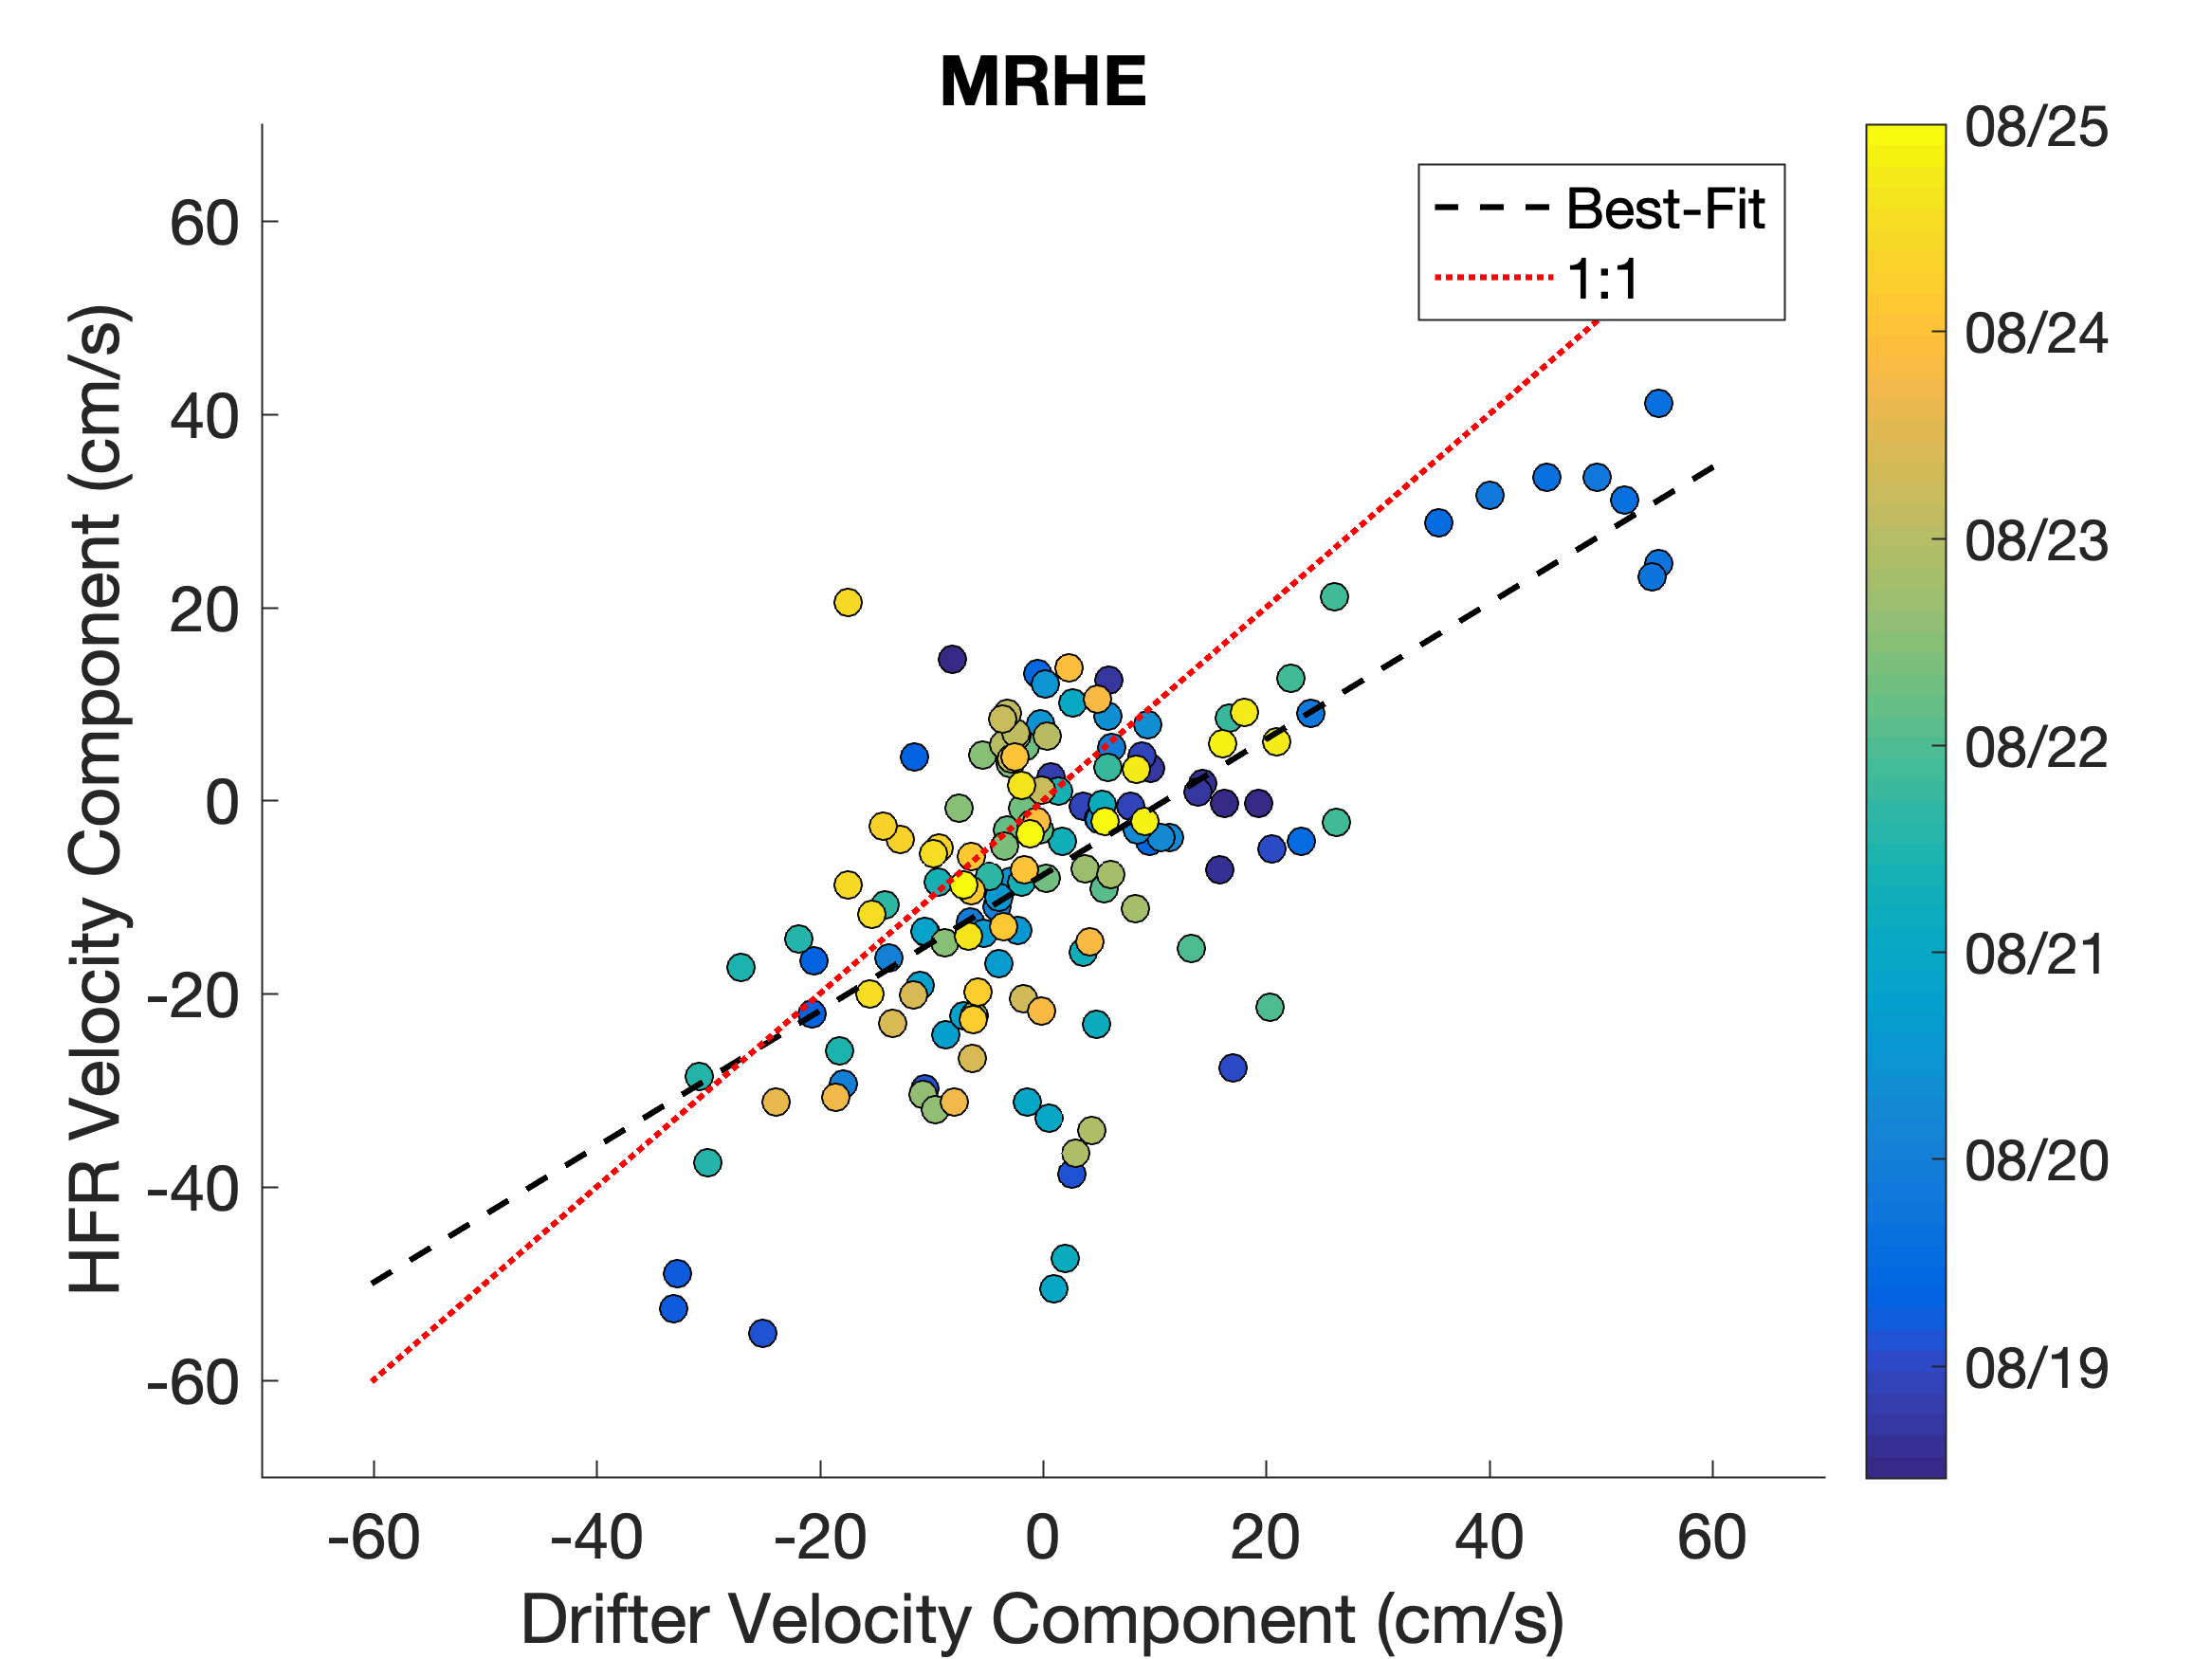
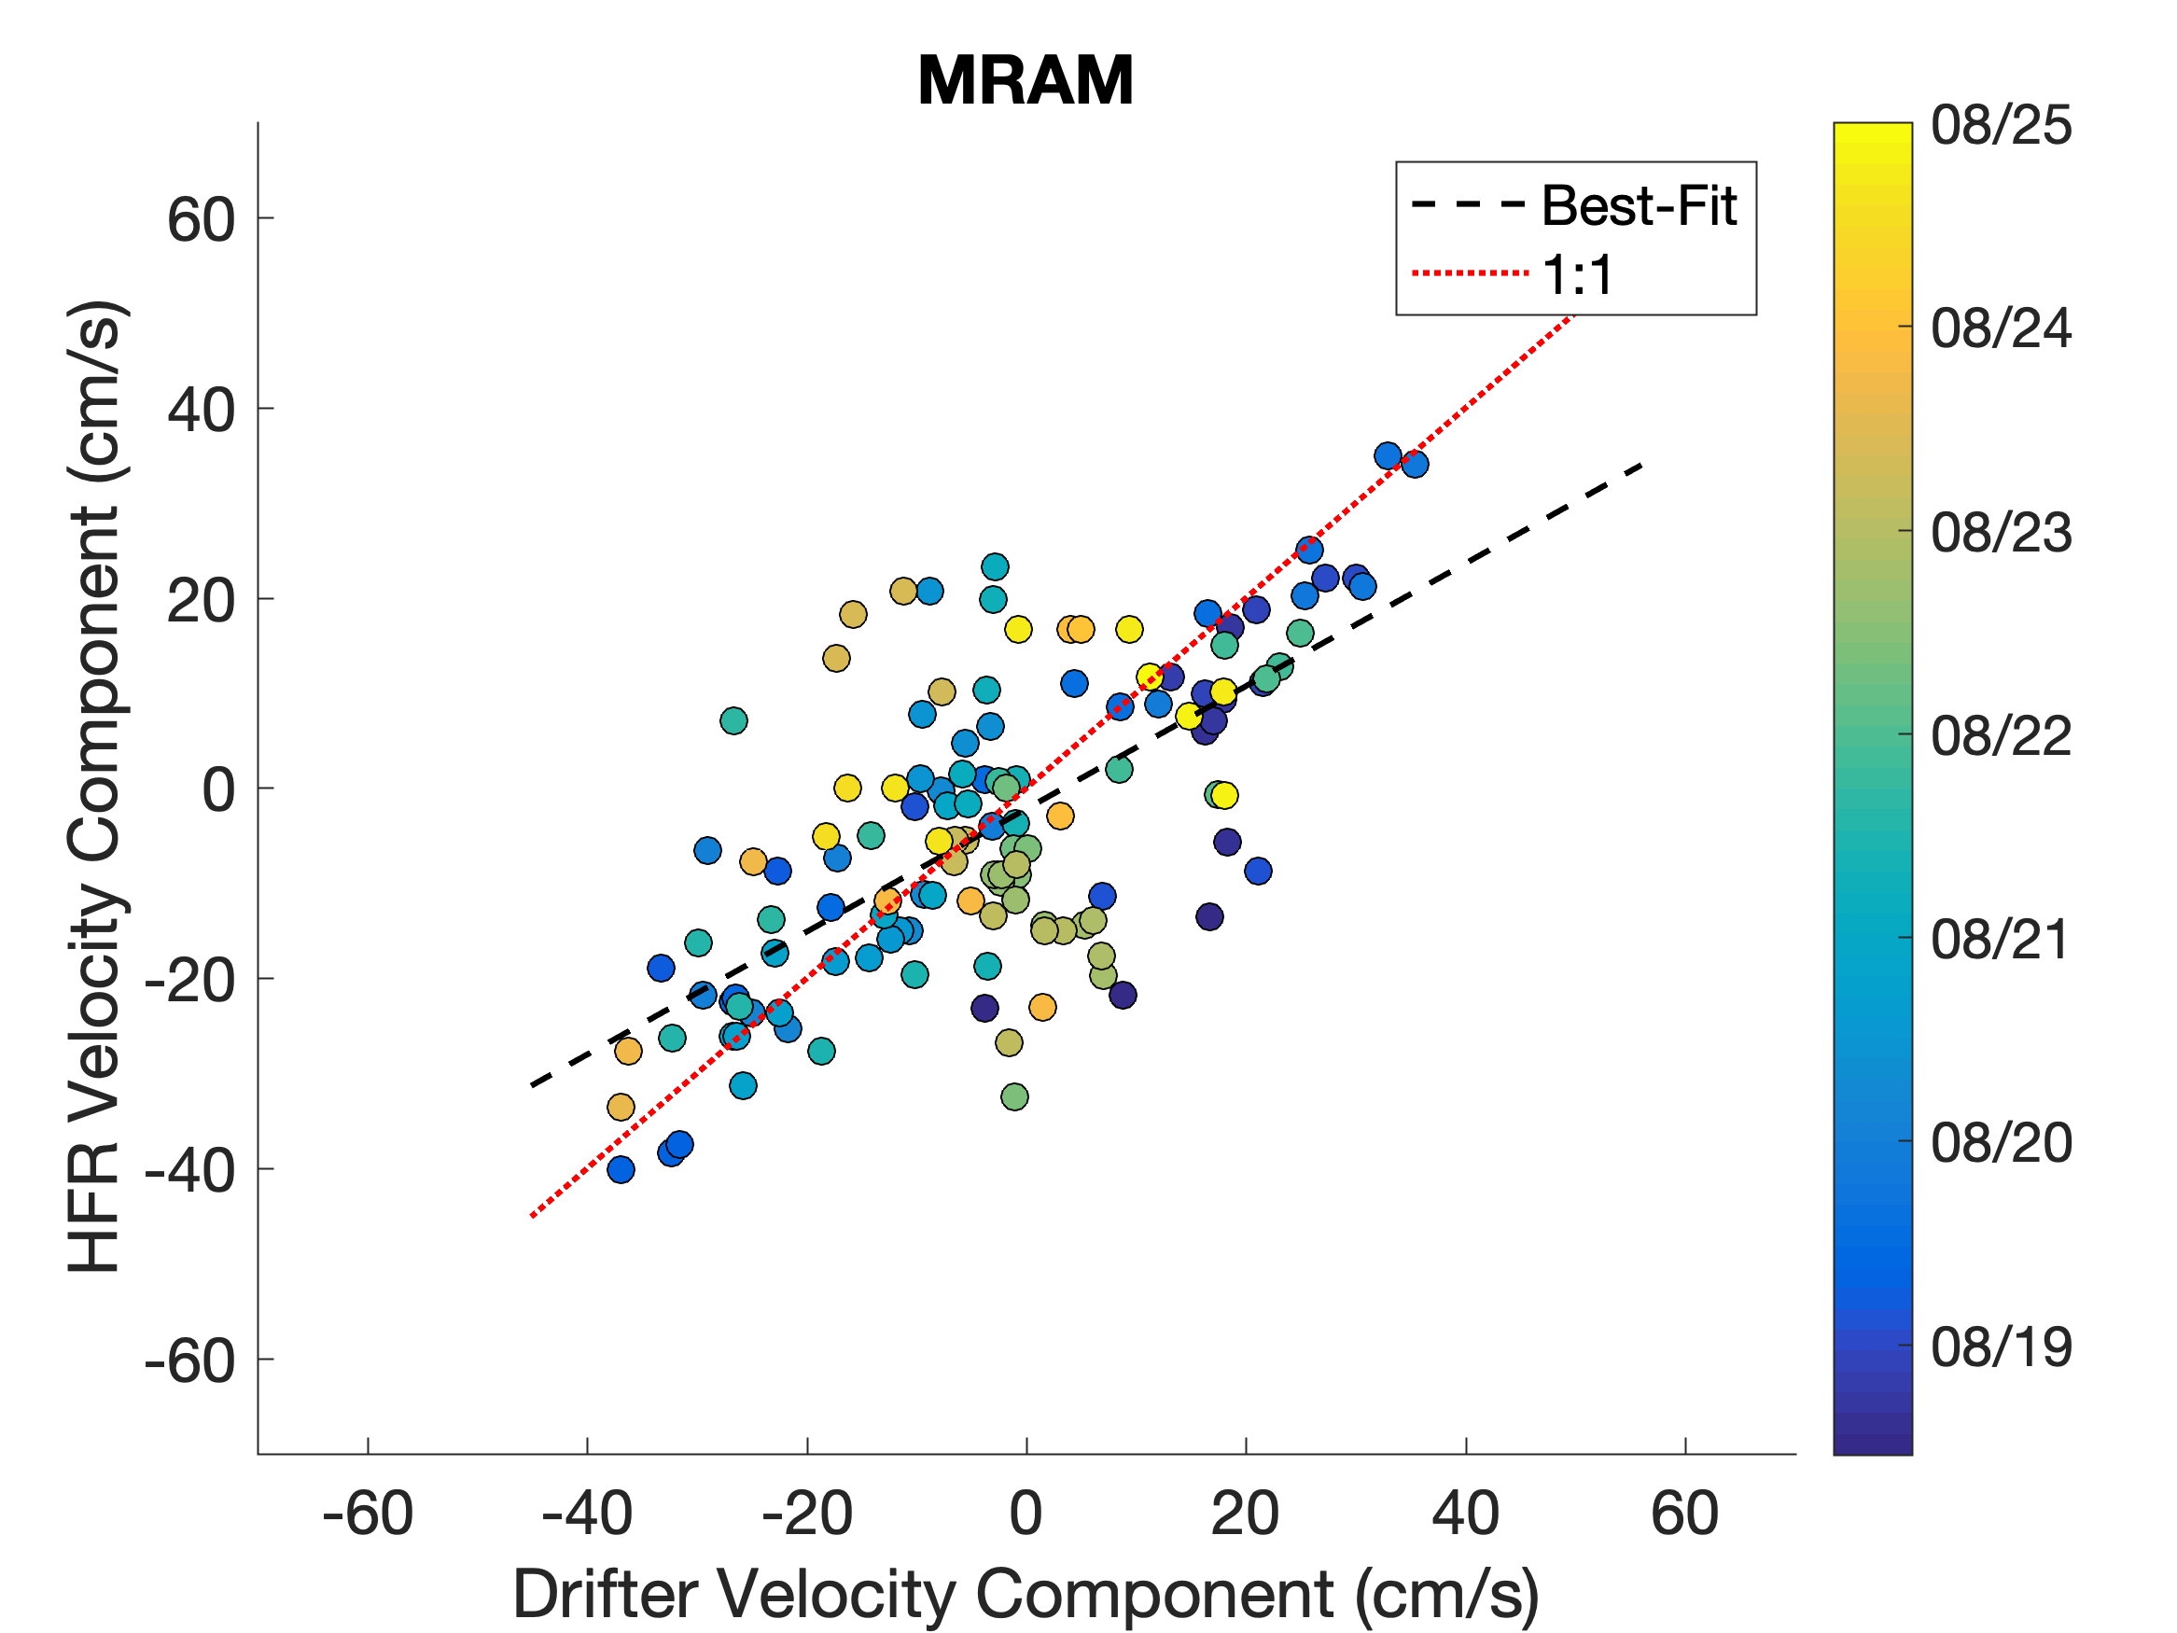
Comparison with Drifters - Ellipticals
MRHE
MRAM

Slide 24
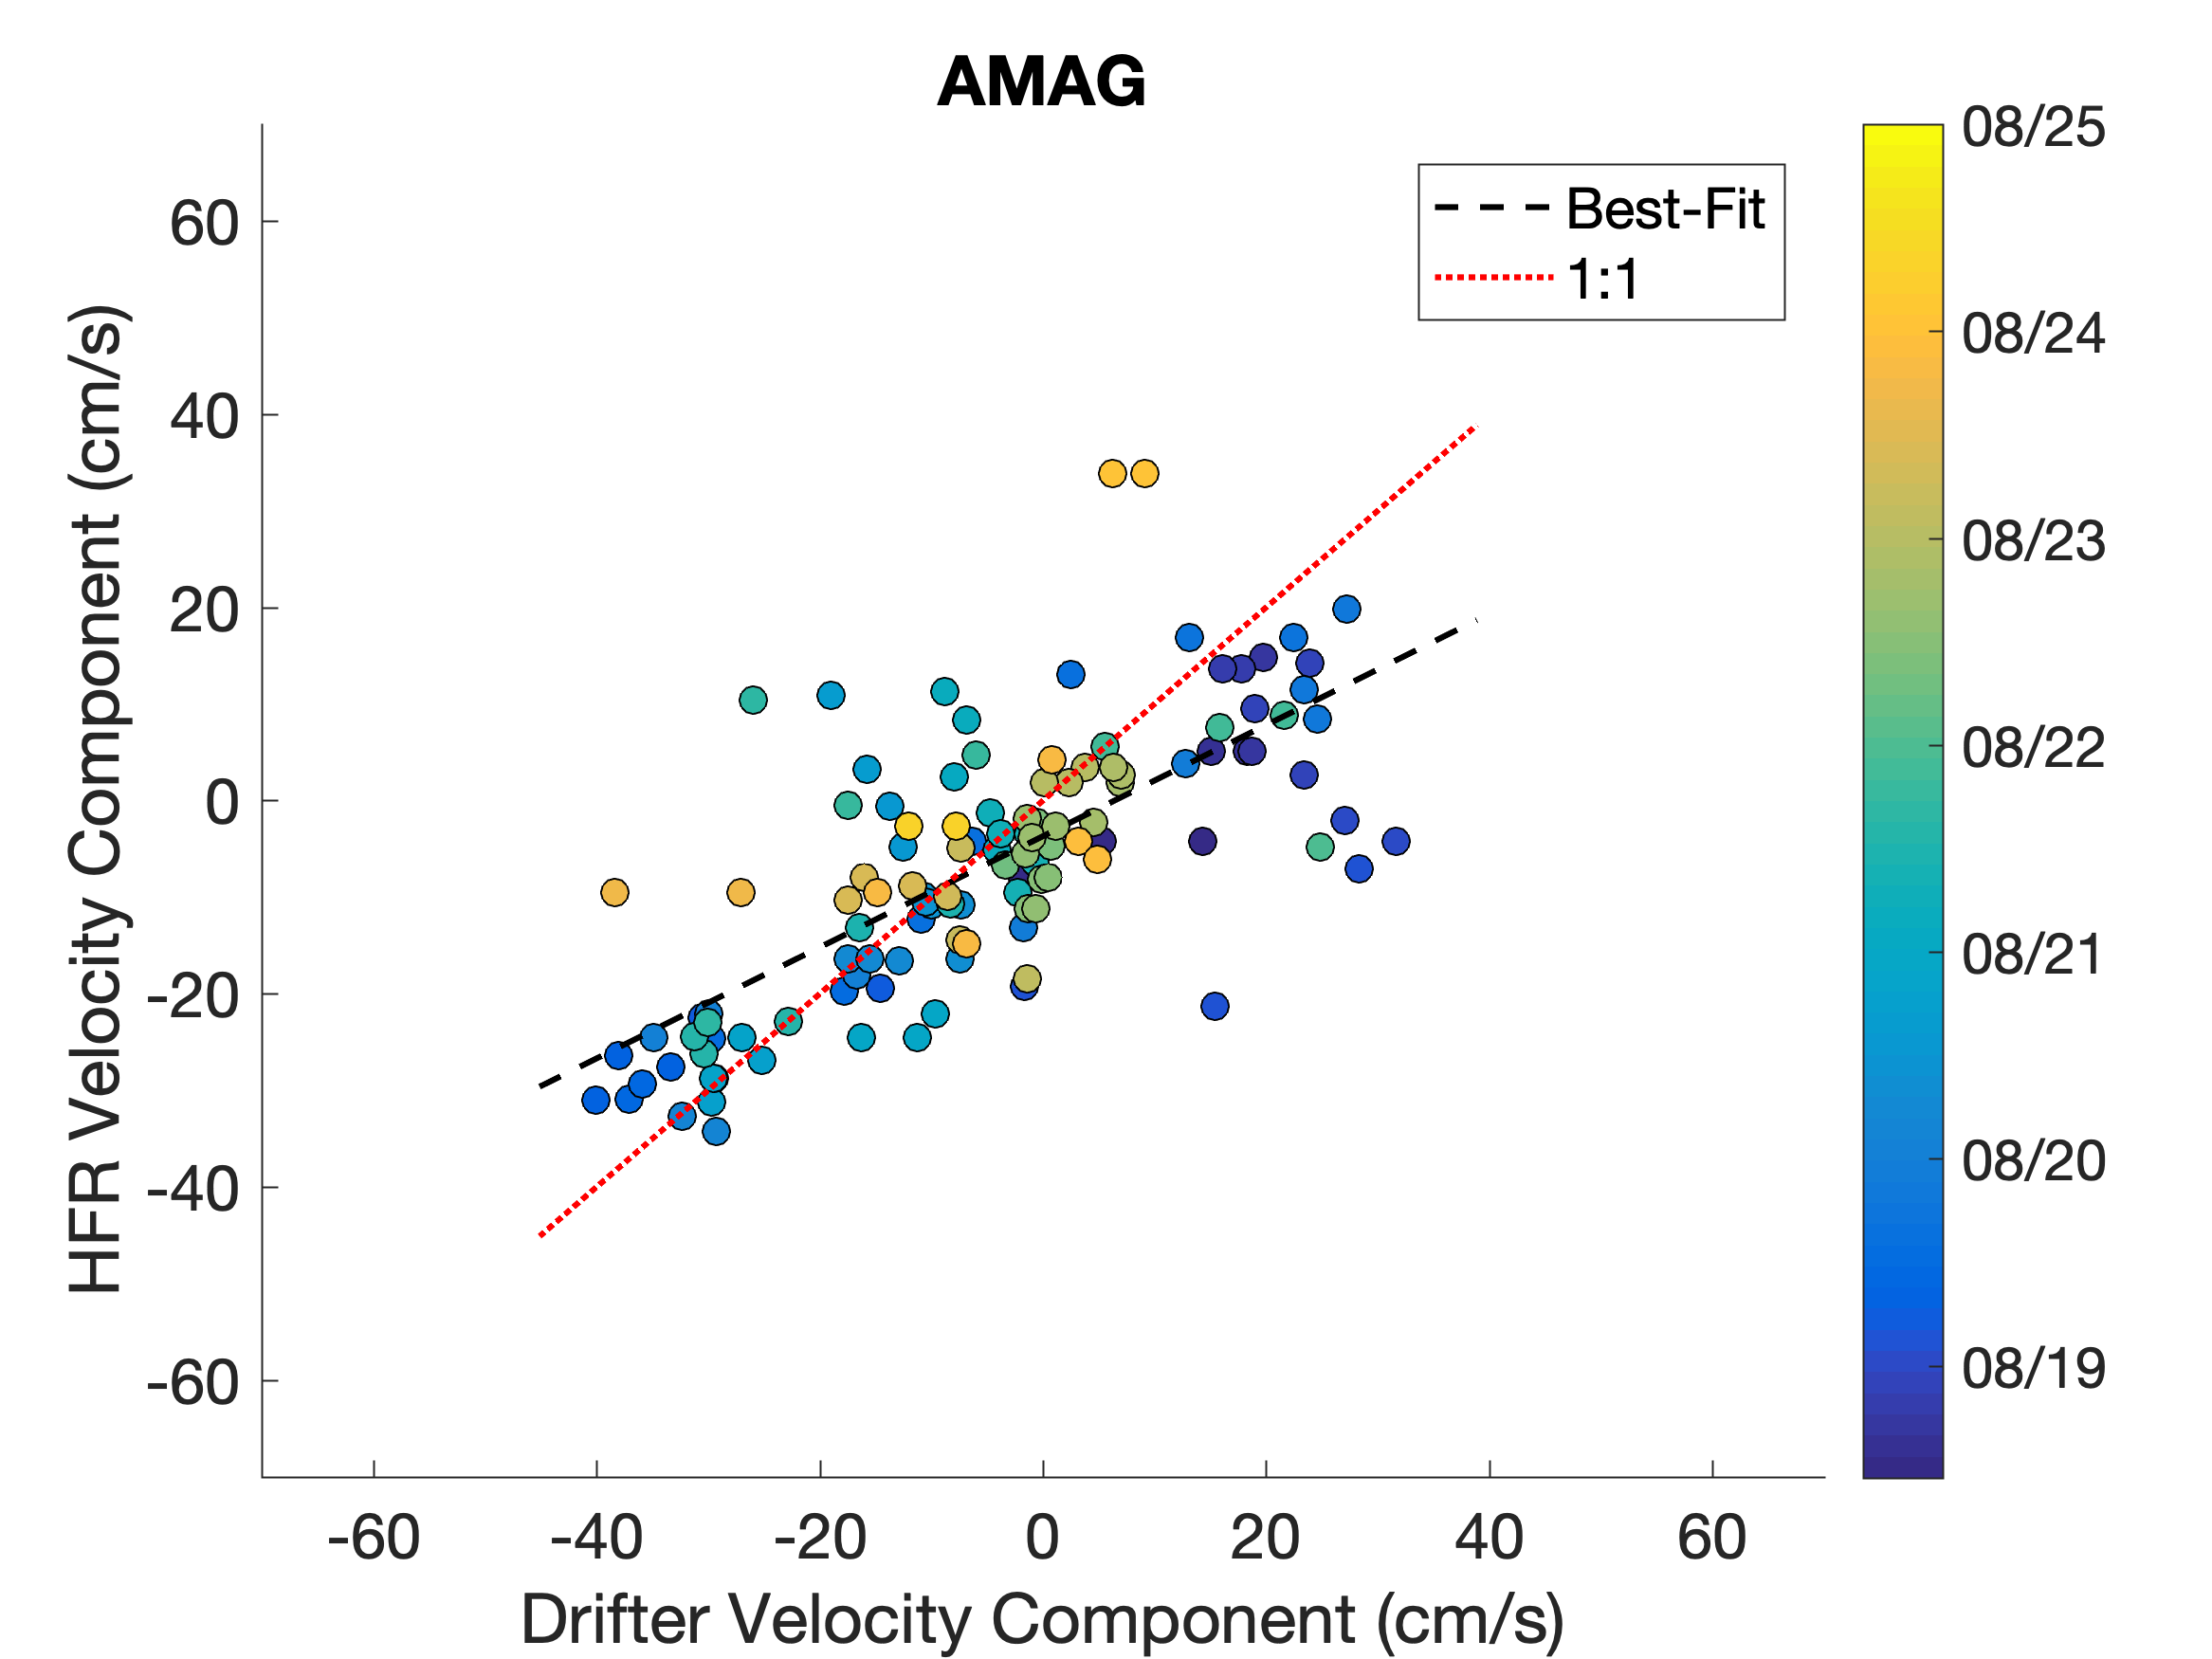
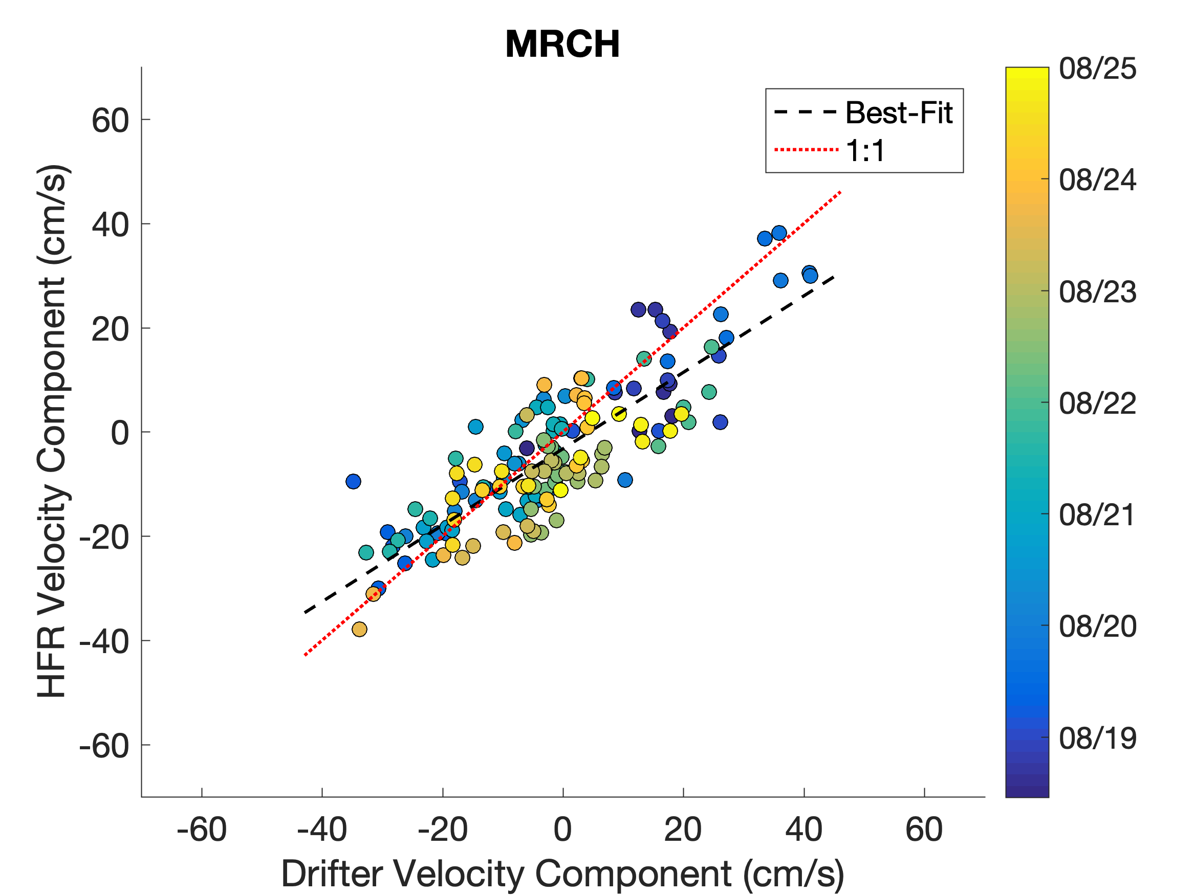
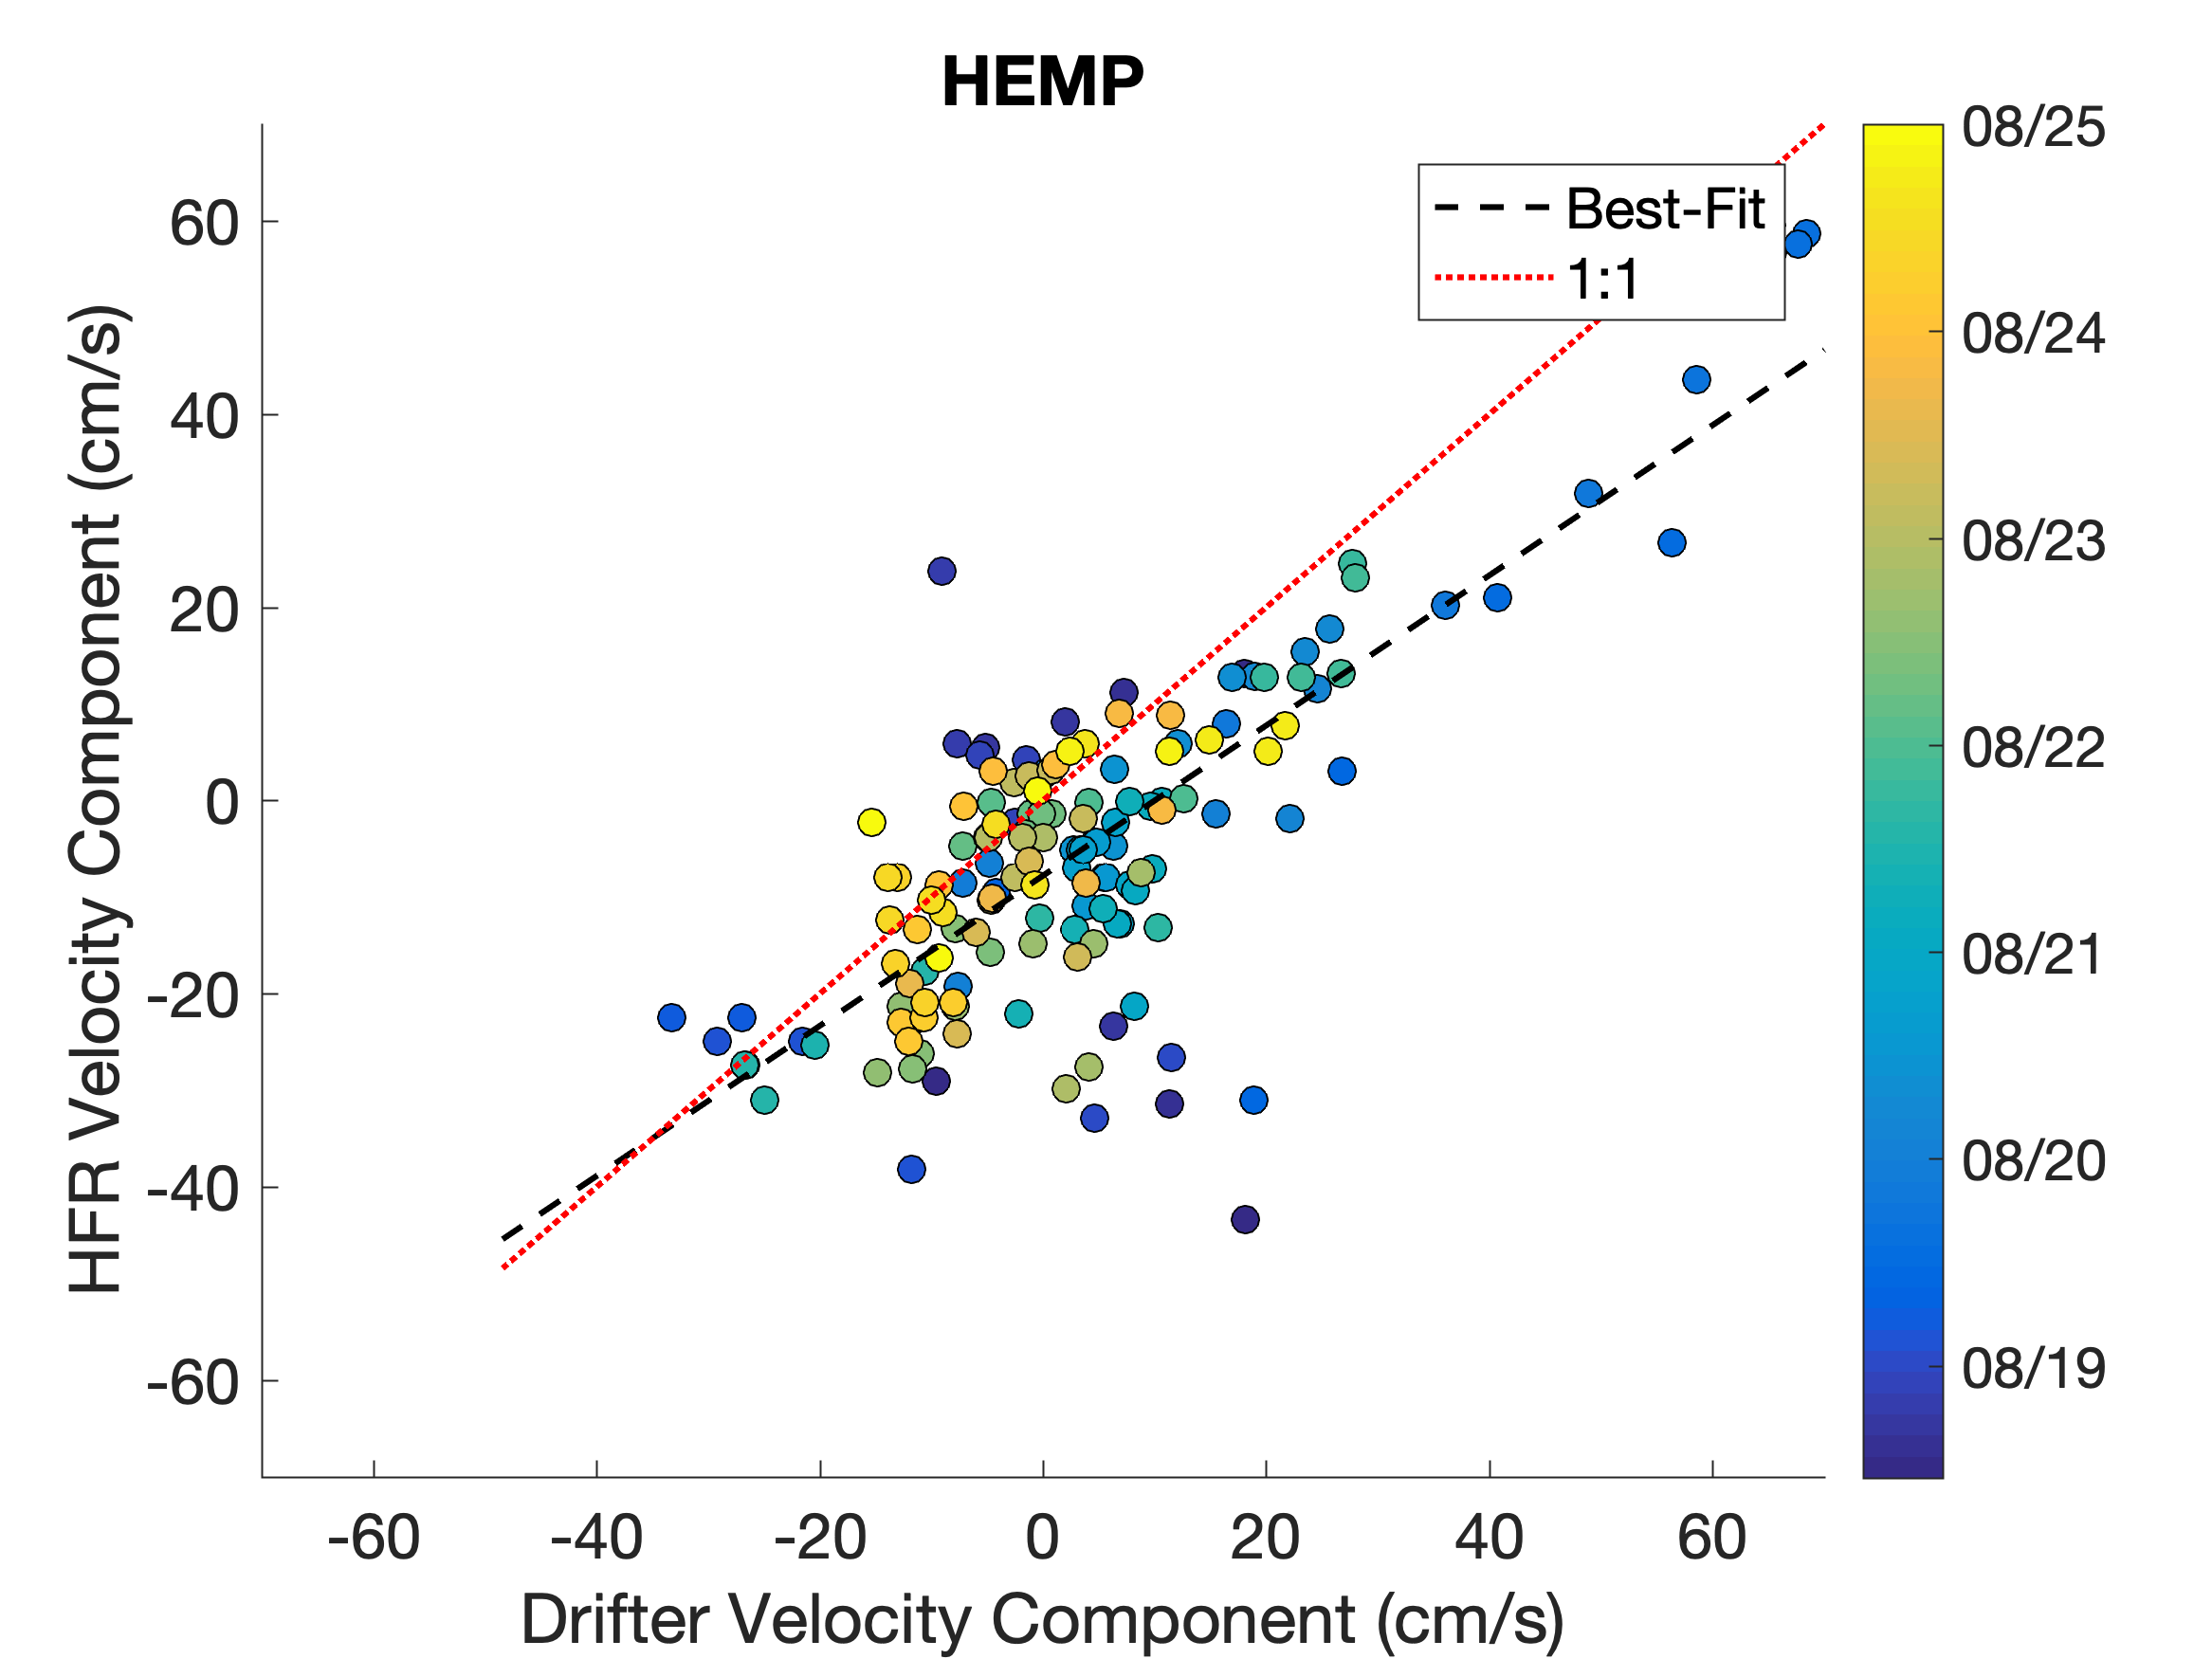
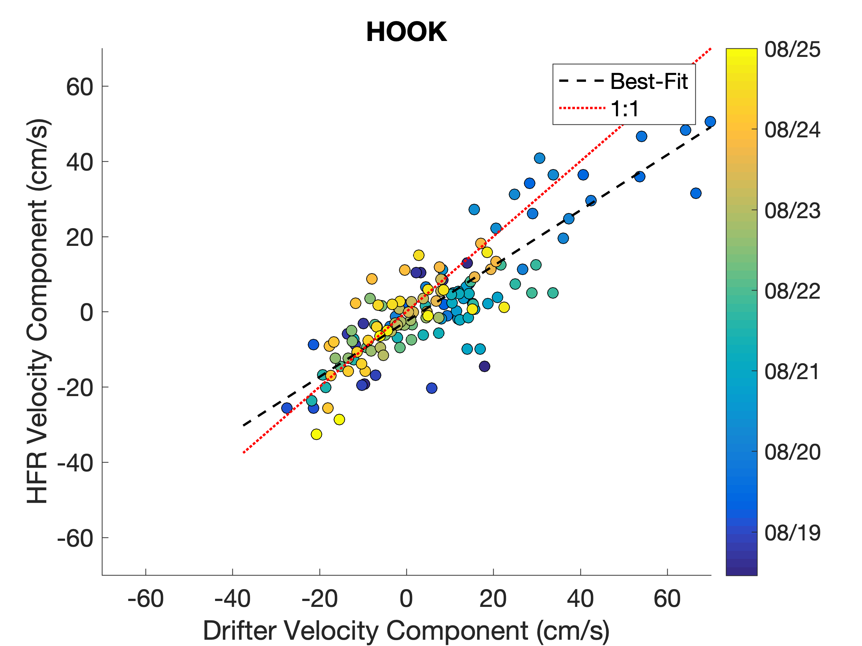
Comparison with Drifters - Radials
AMAG
MRCH
HEMP
HOOK

Slide 25
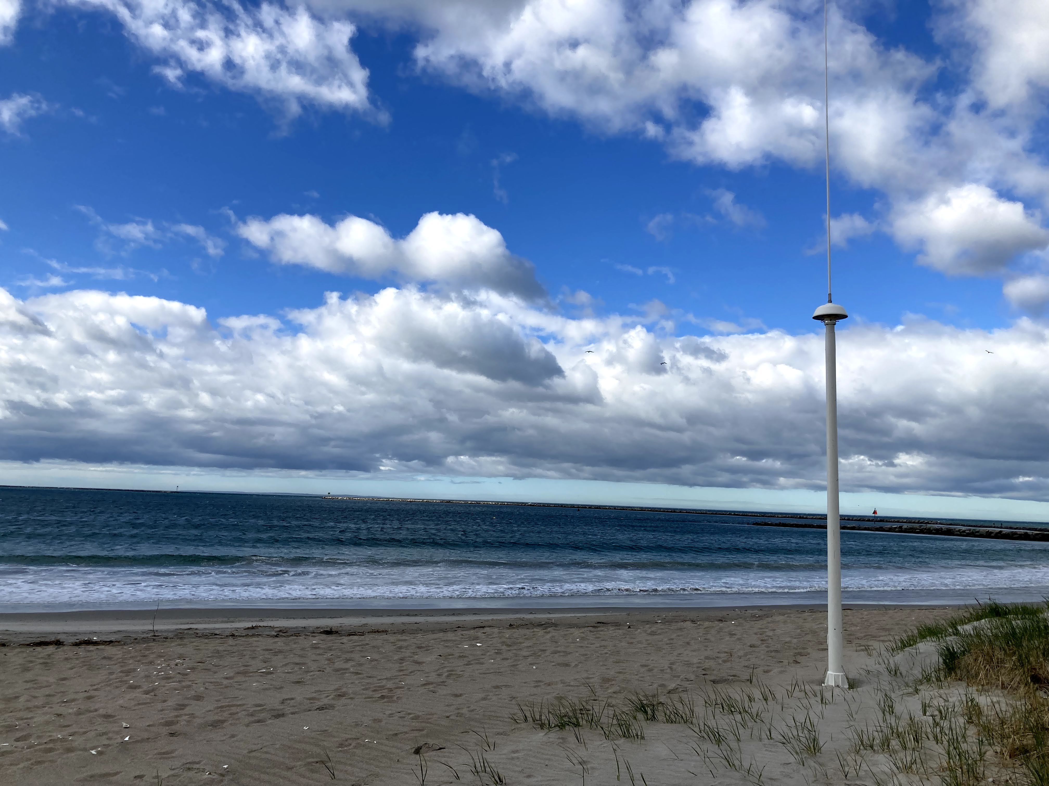
Conclusions
Rutgers HF Radar Network entering its 25th year
MARACOOS HFR Network entering its 14th year
Multistatics have potential to expand coverage and reduce uncertainty
Elliptical comparisons with drifters on par with radials

Slide 26
Development of a Multistatic
HF Radar Network
THANK YOU
SICOMAR+ HF Radar Summer School
May 26, 2021

