Slide 1
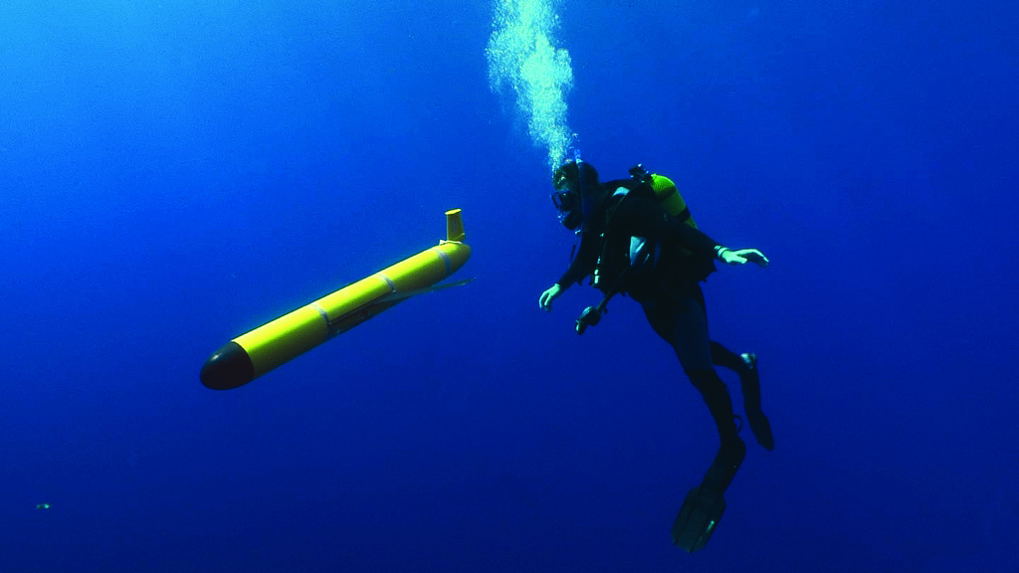
Empirical corrections to thermal lag on ocean gliders
Travis Miles
Rutgers University
Department of Marine and Coastal Sciences
RBR2020 Cohort
RBR Technical Workshop
Ocean Sciences 2020 – San Diego

Slide 2
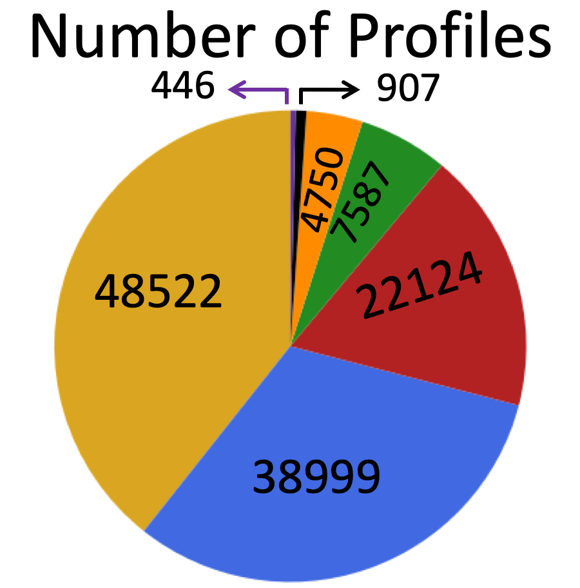
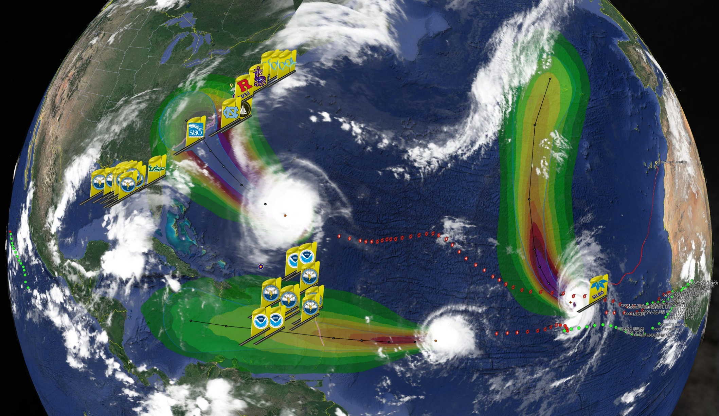
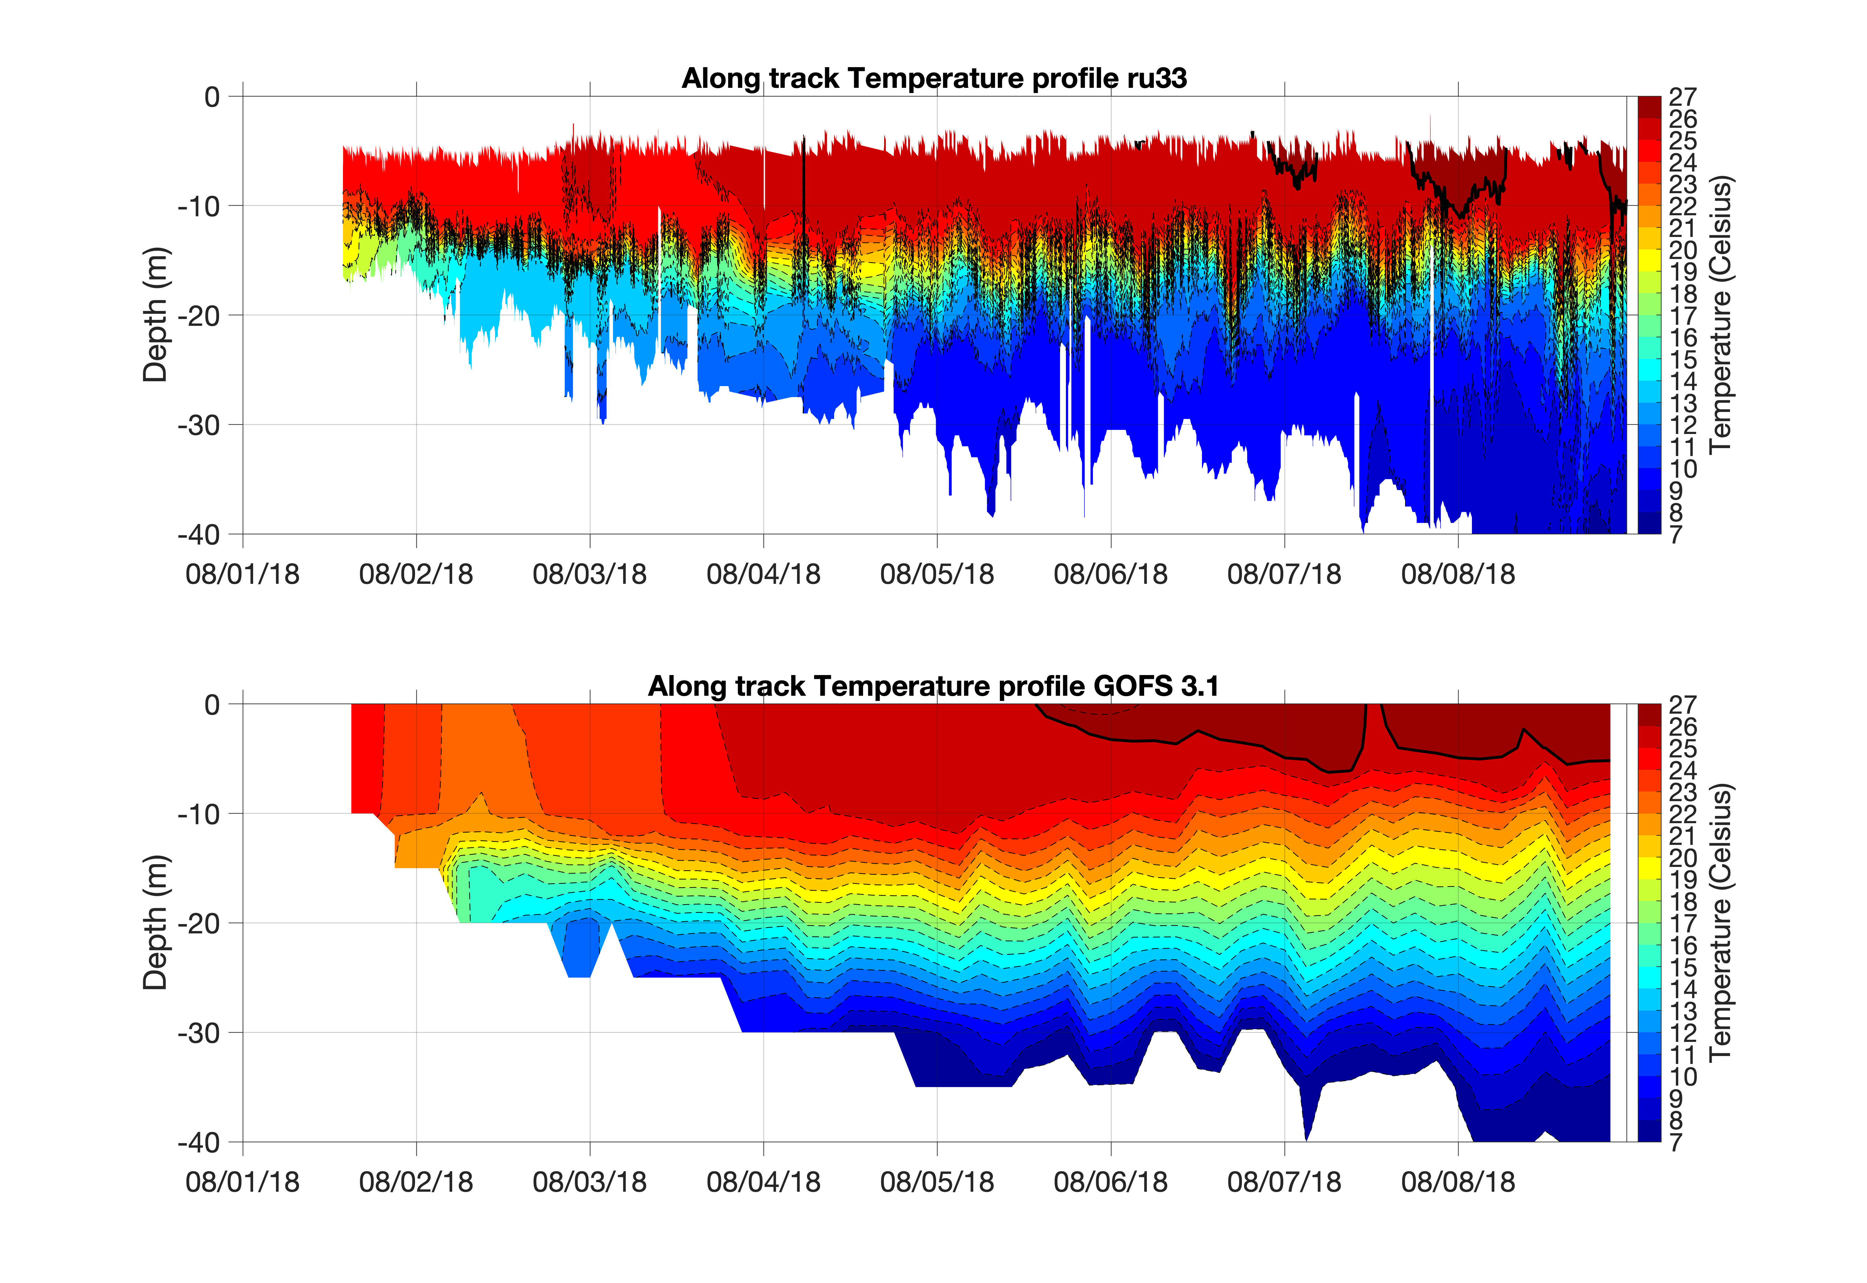
2018 Community Gliders deployed in 3 Picket Lines
25% Hurricane Gliders
75% Shared Community Gliders
123,335 Total Glider Profiles

Slide 3
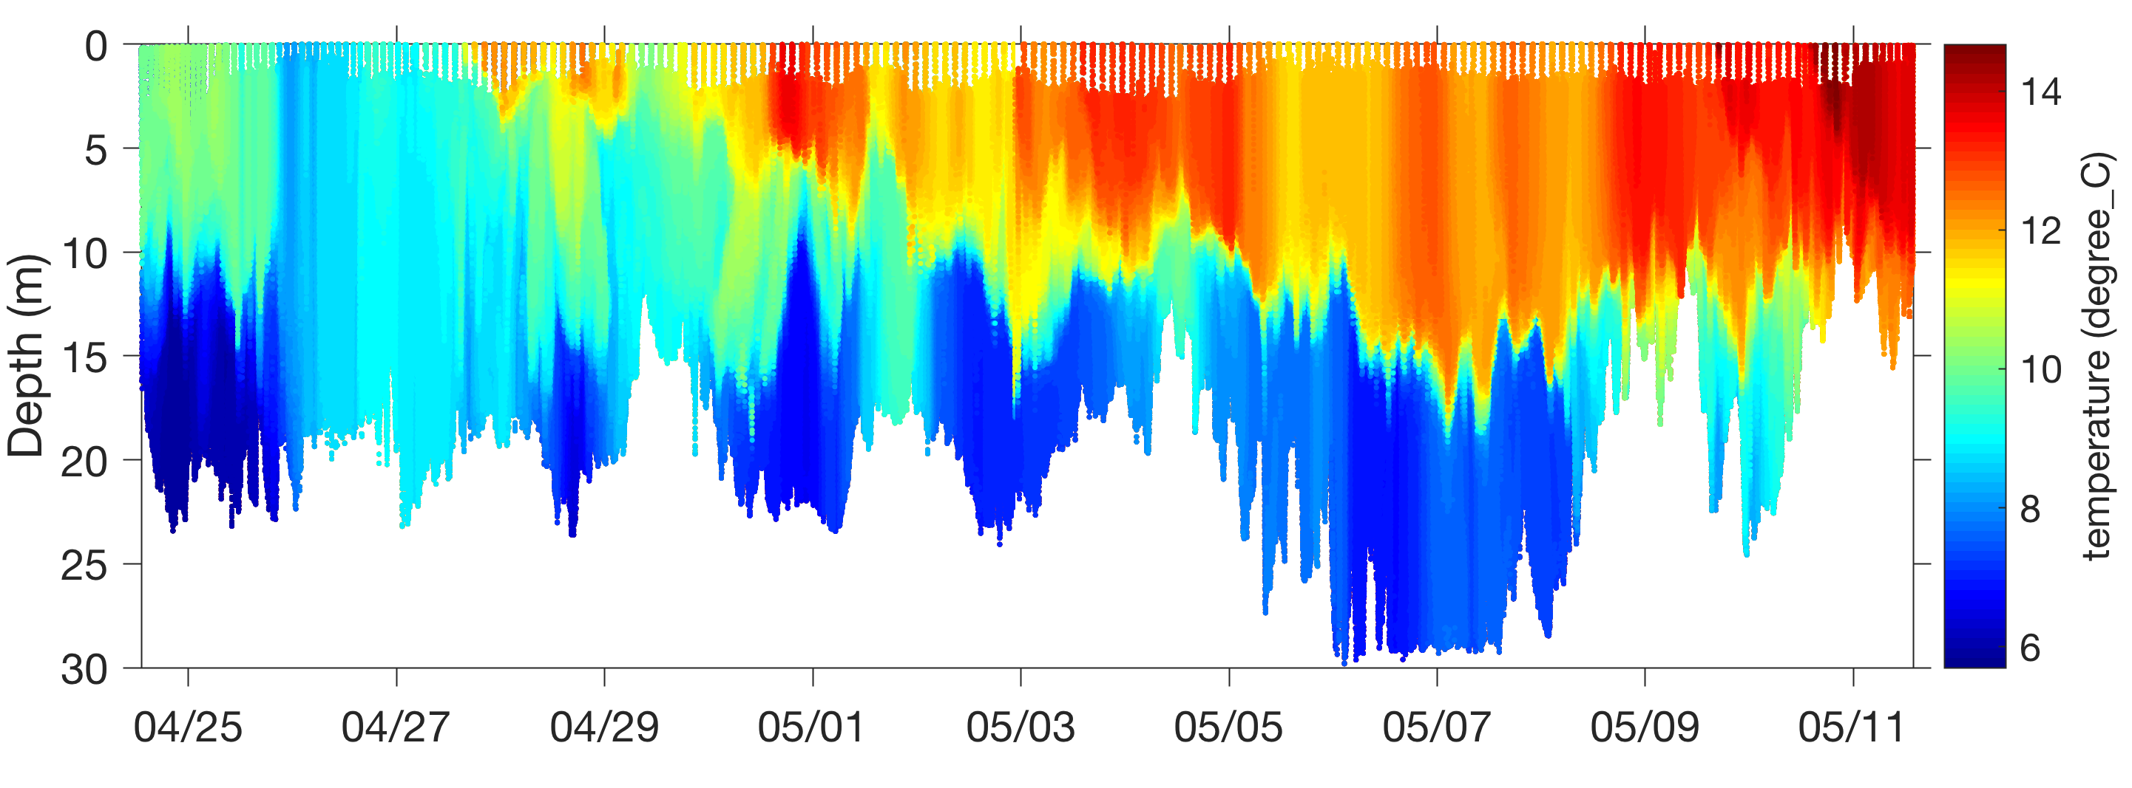
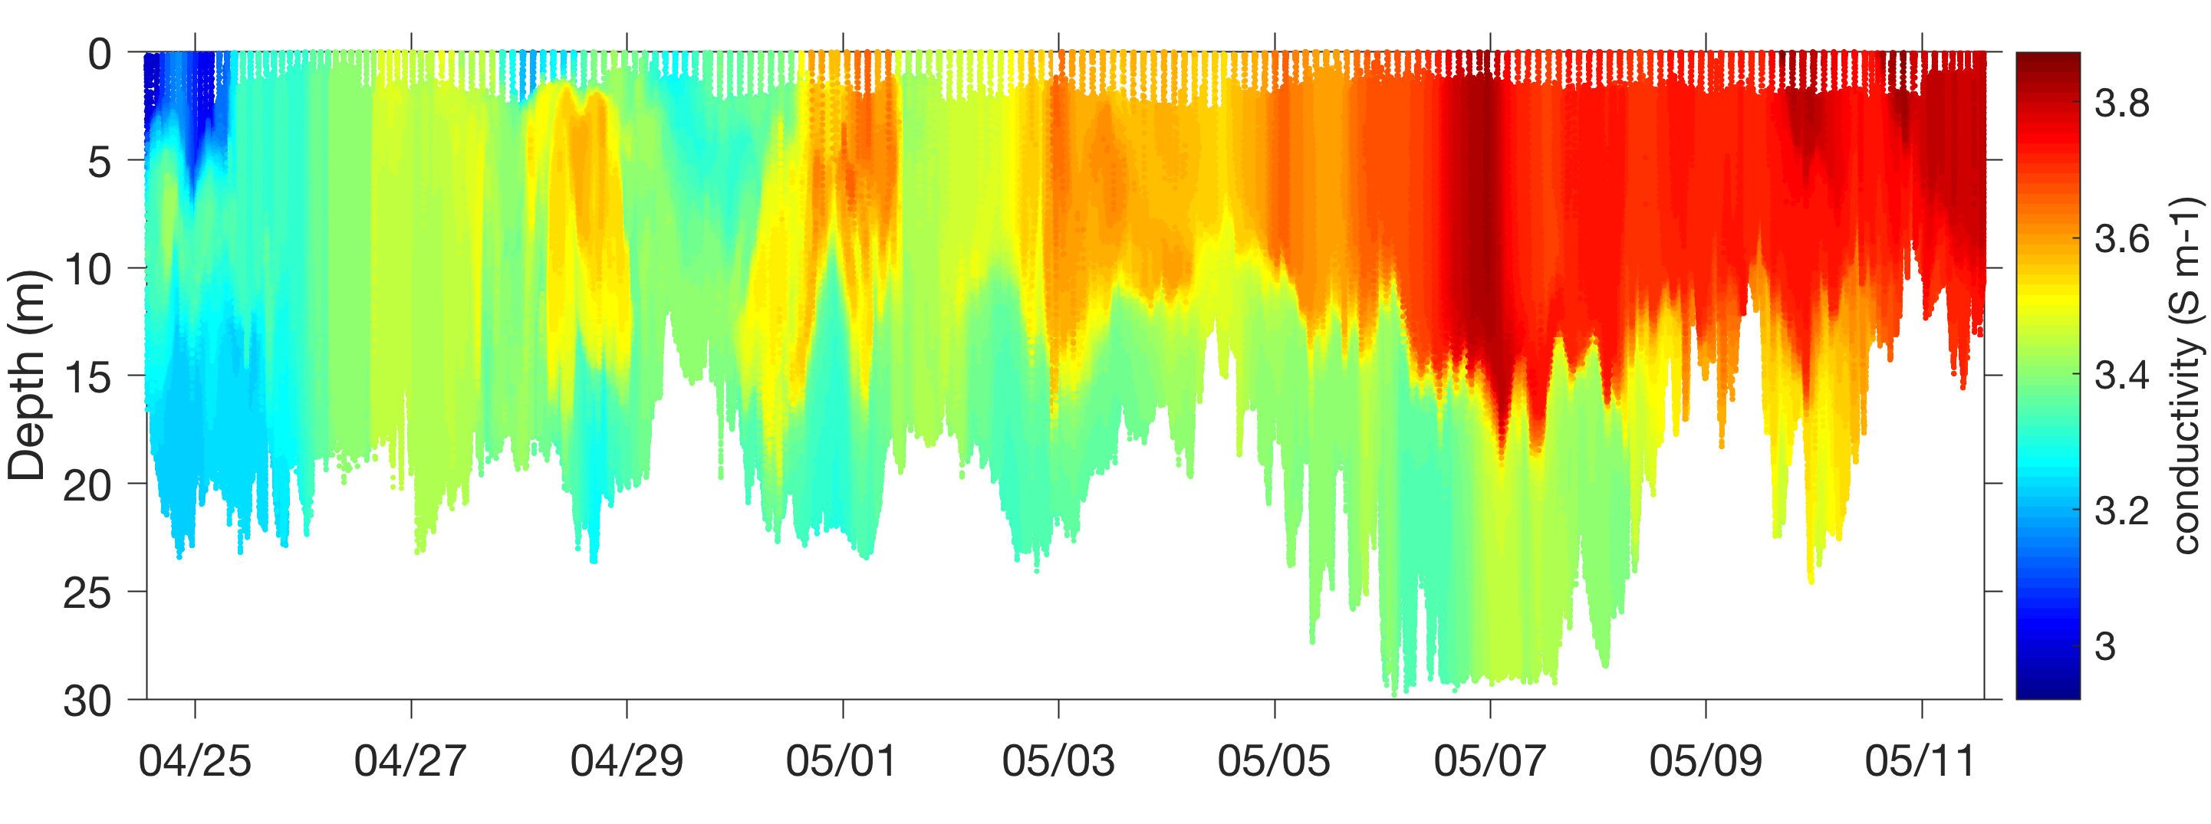
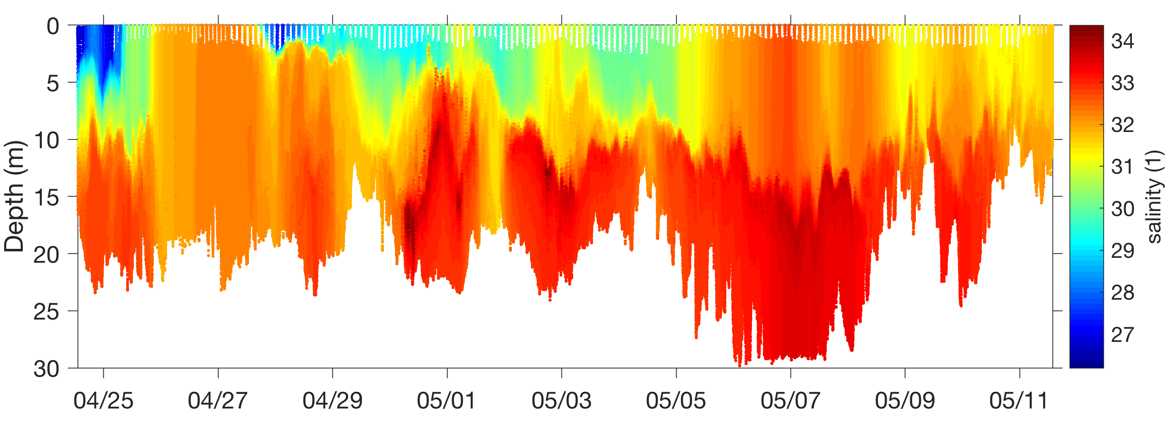
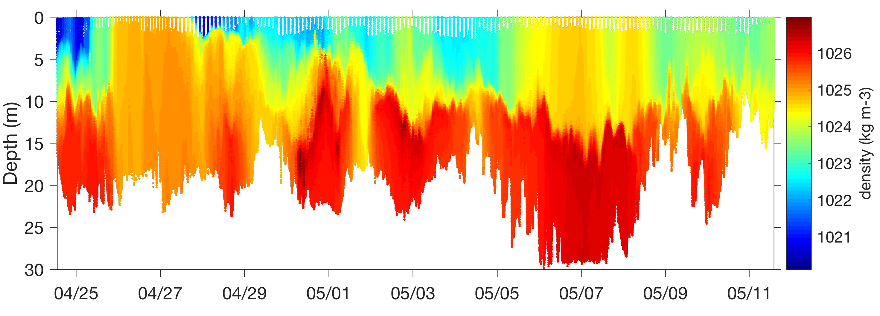
Temperature
Conductivity
C
Salinity
Density

Slide 4
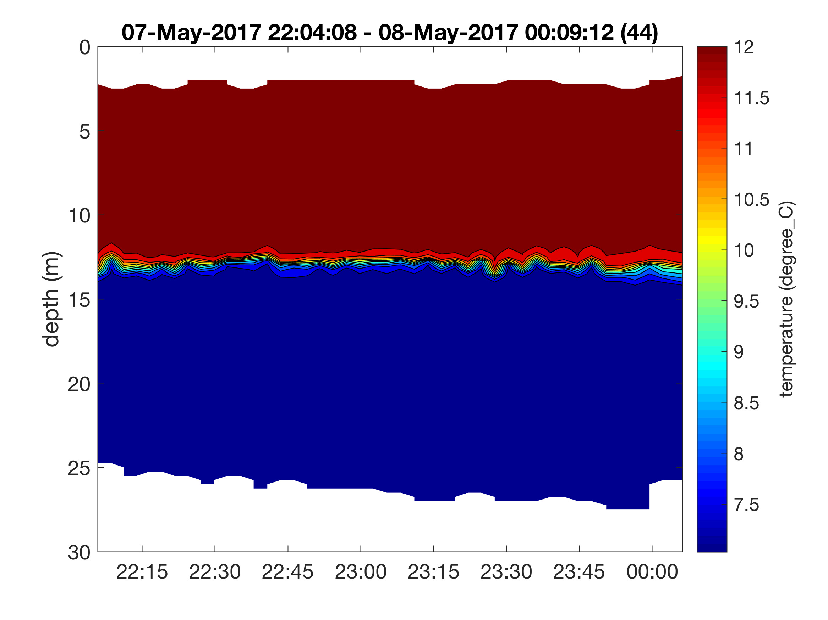
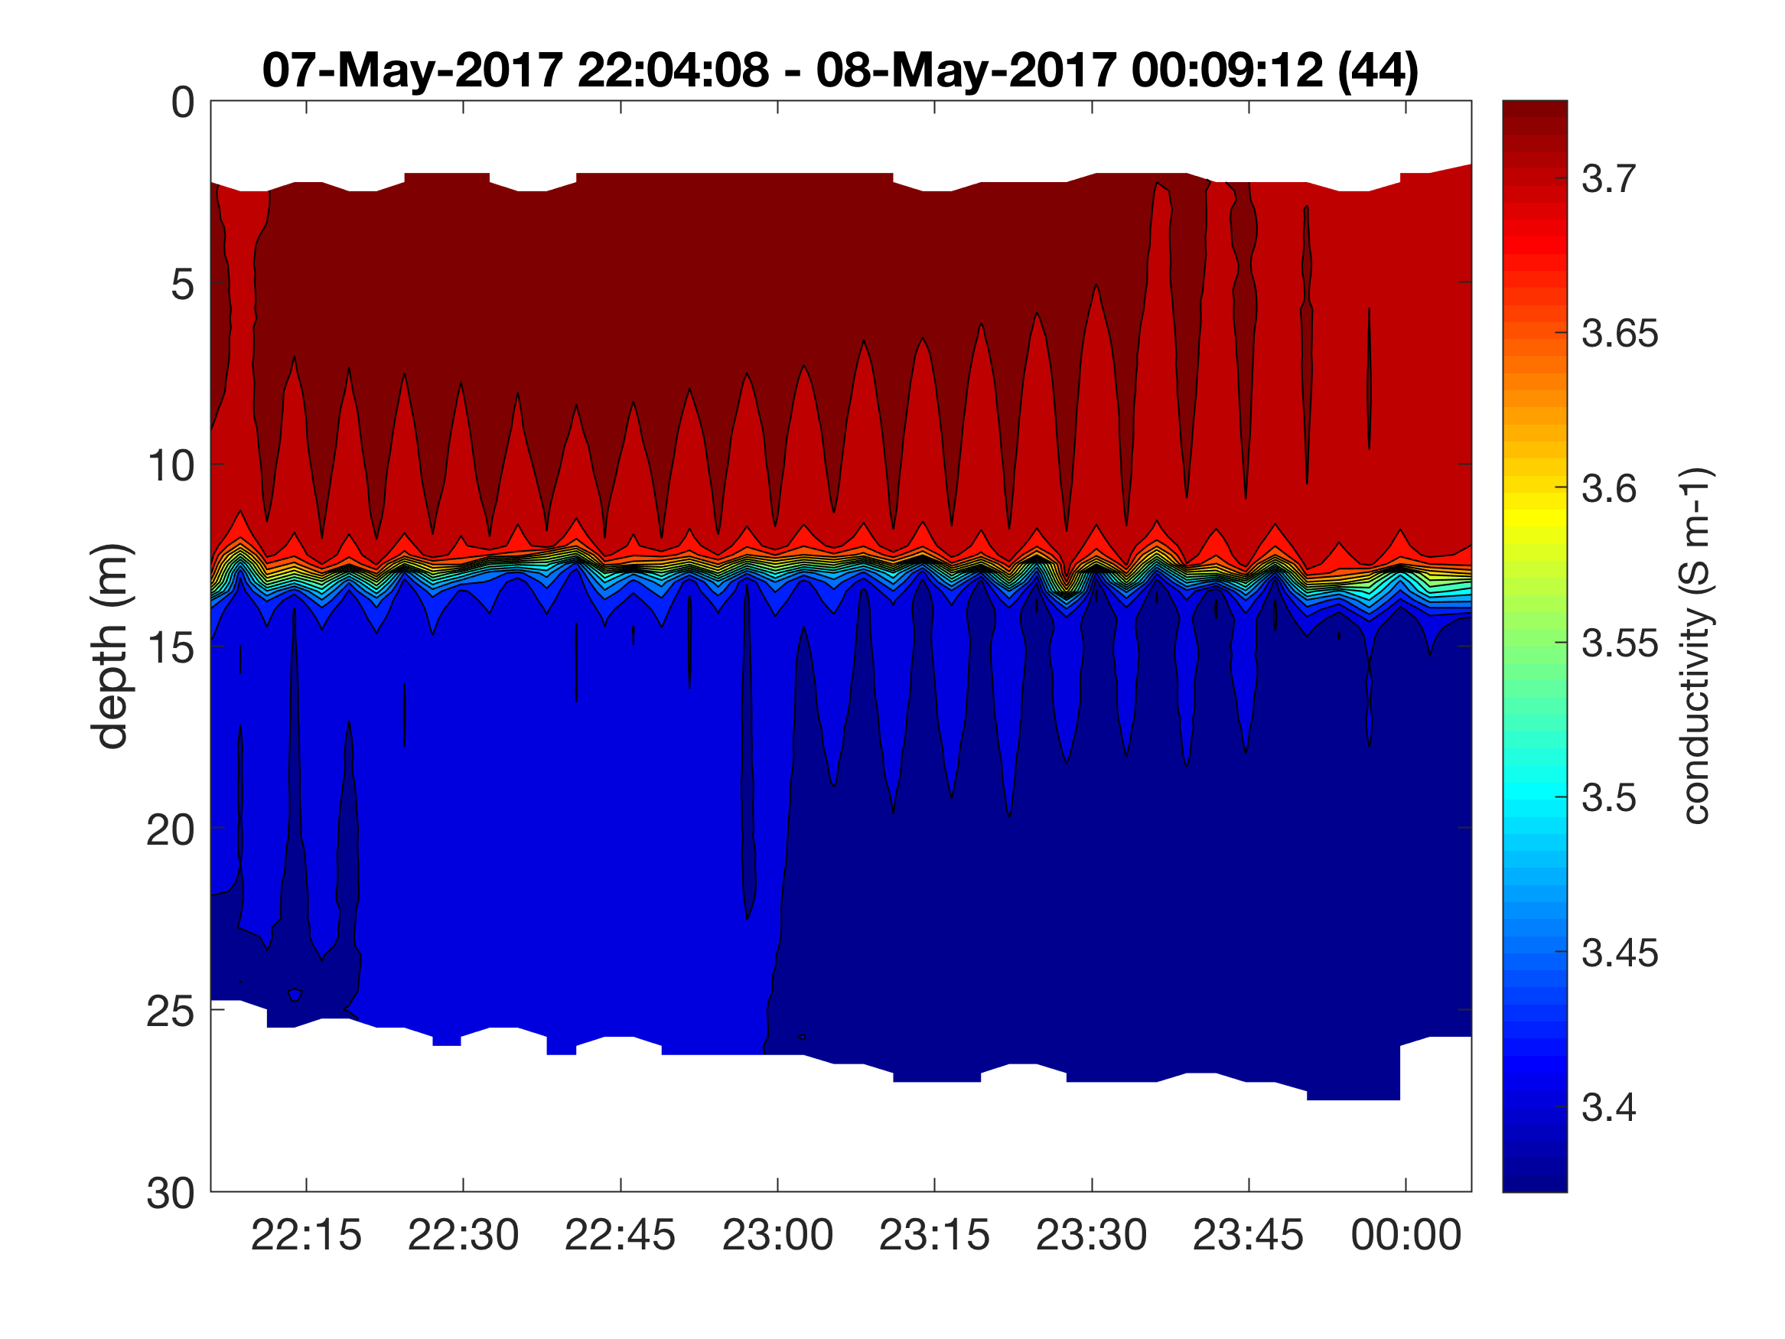
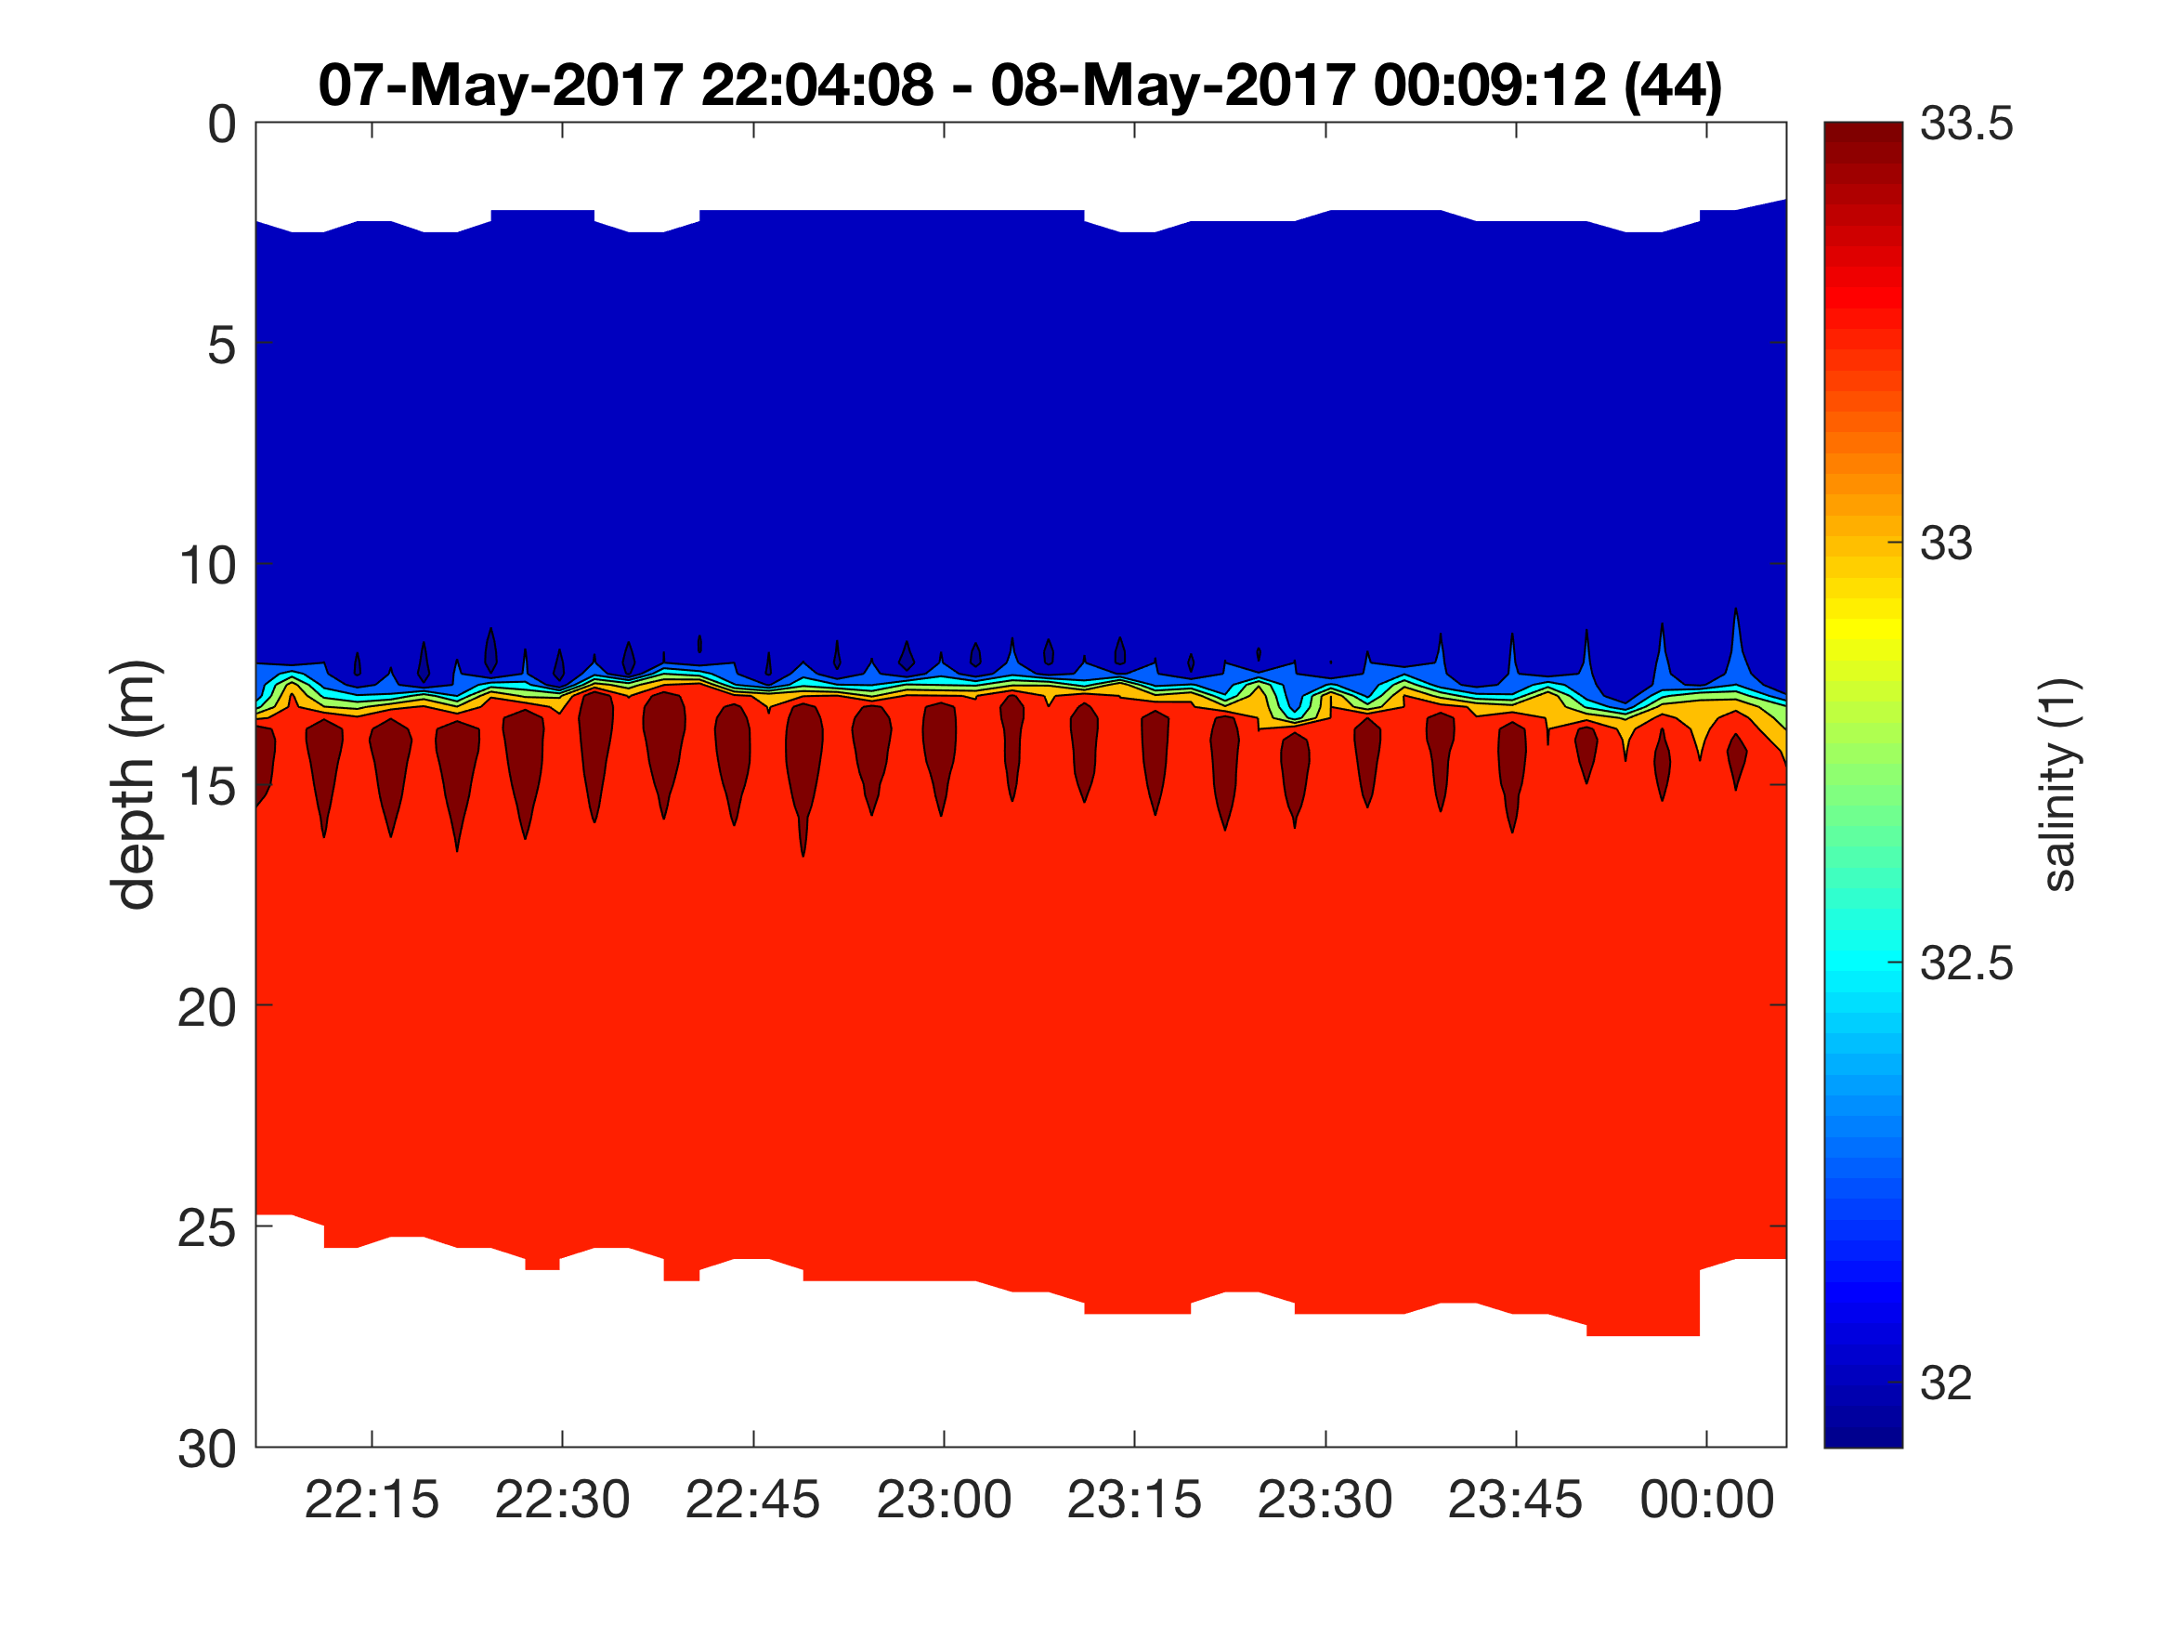
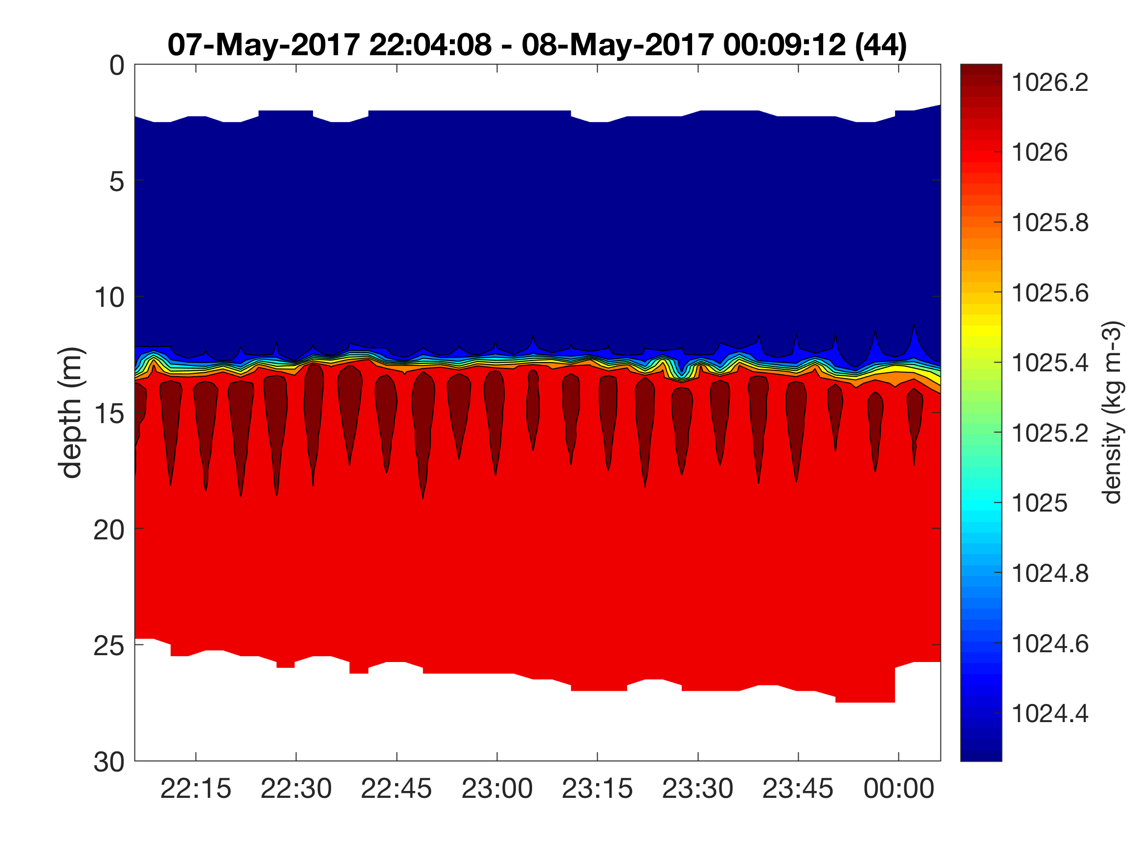
Temperature
Temperature
Conductivity
Conductivity
Salinity
C
Salinity
Density
Density

Slide 5
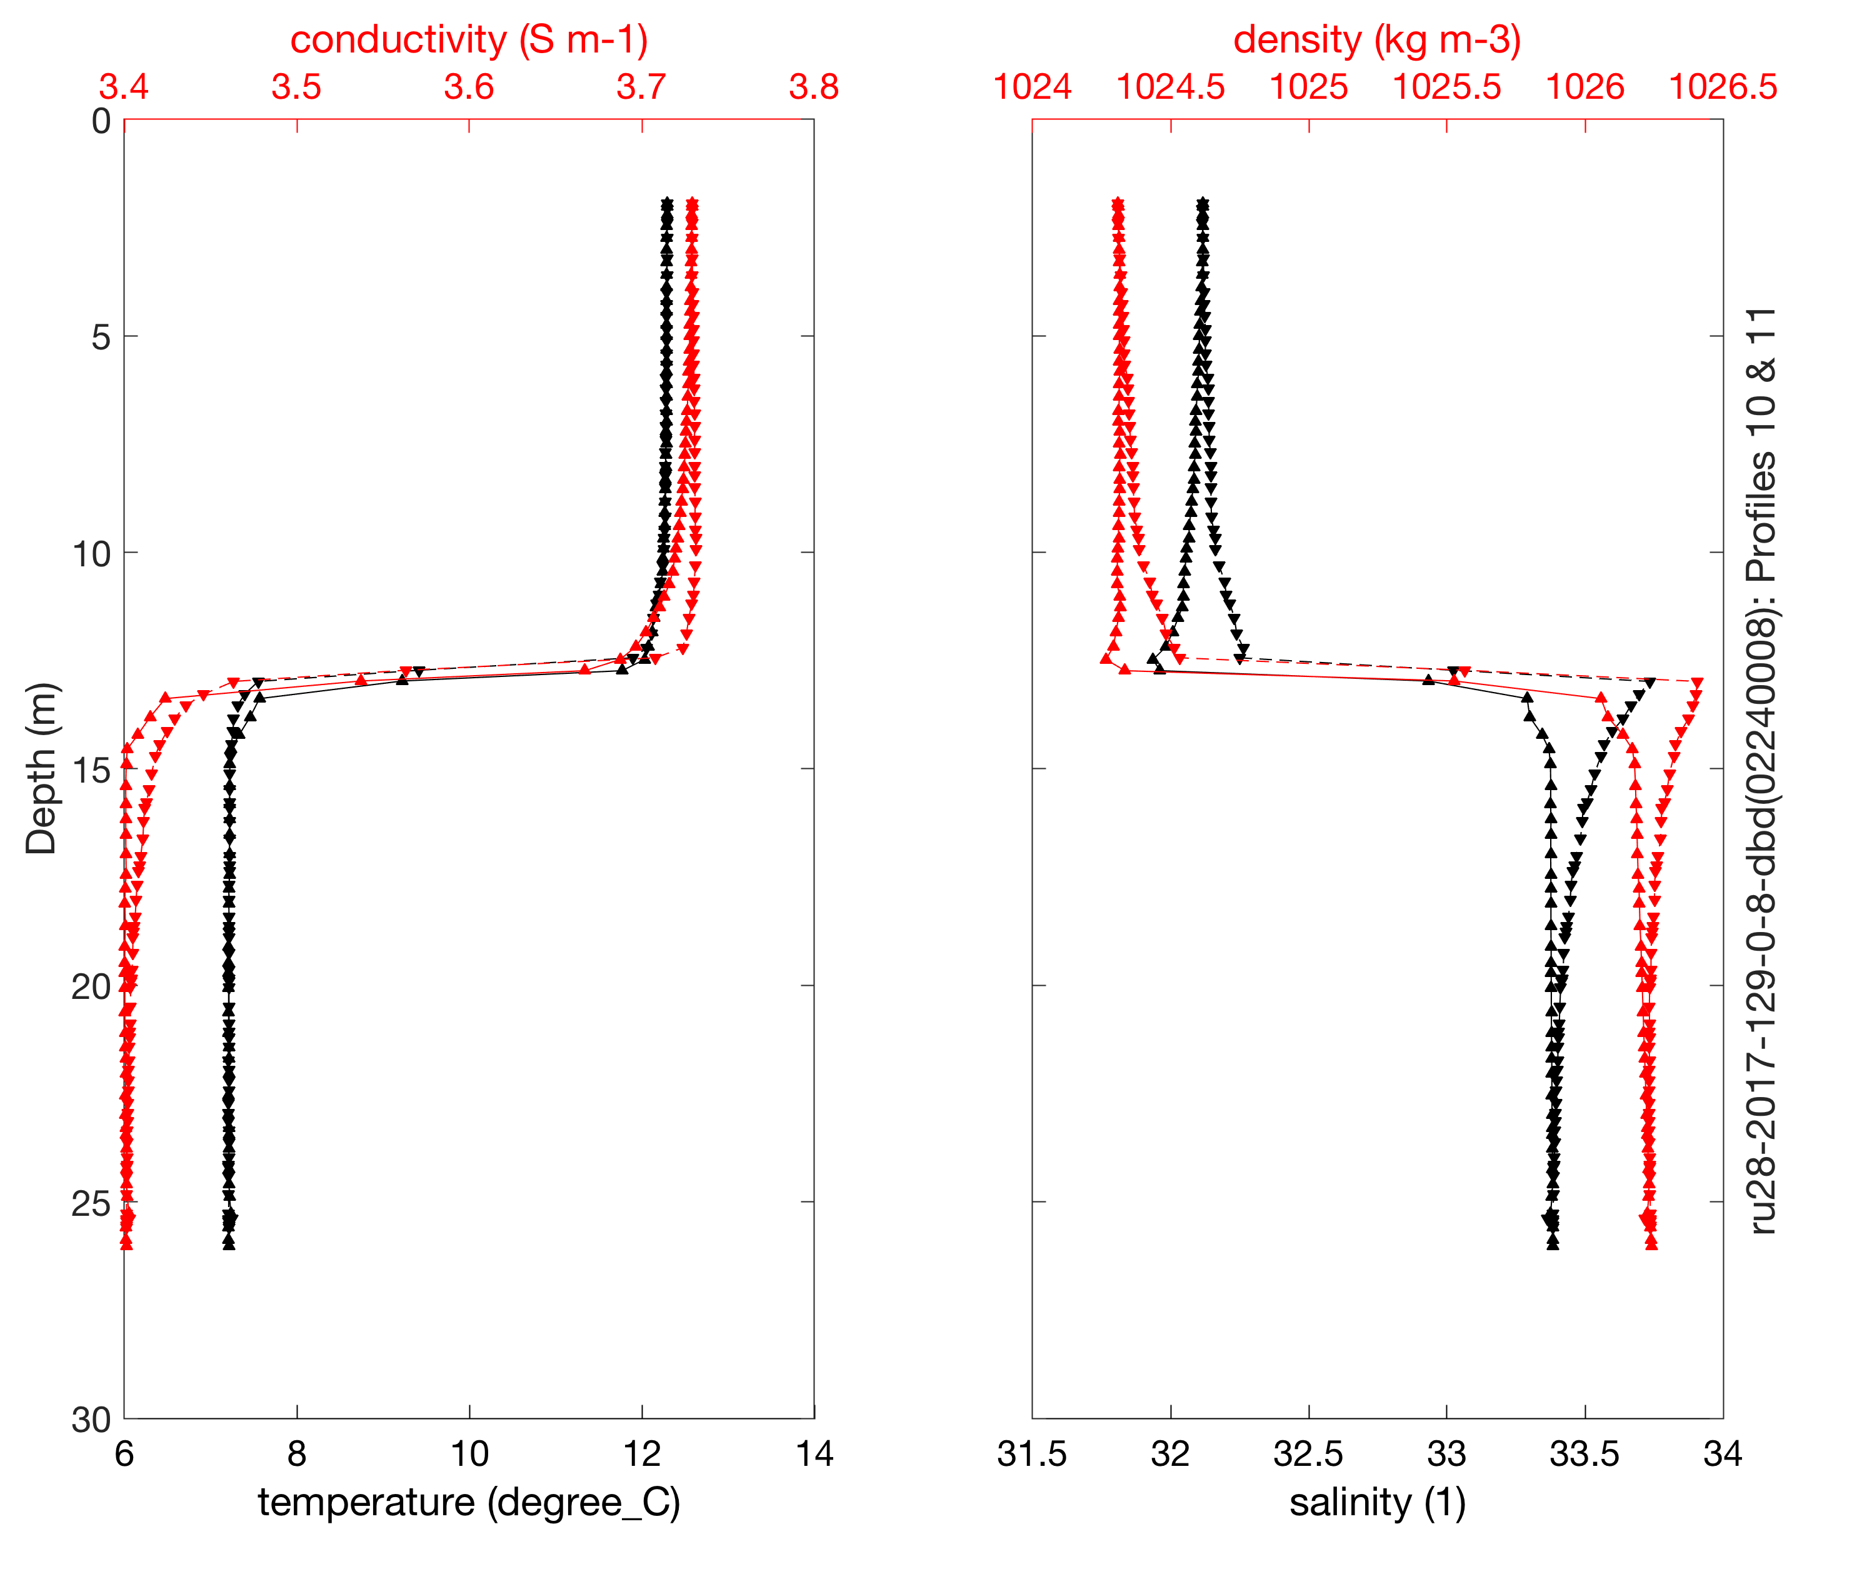
Temperature
Temperature
Conductivity
Conductivity
Salinity
C
Salinity
Density
Density

Slide 6
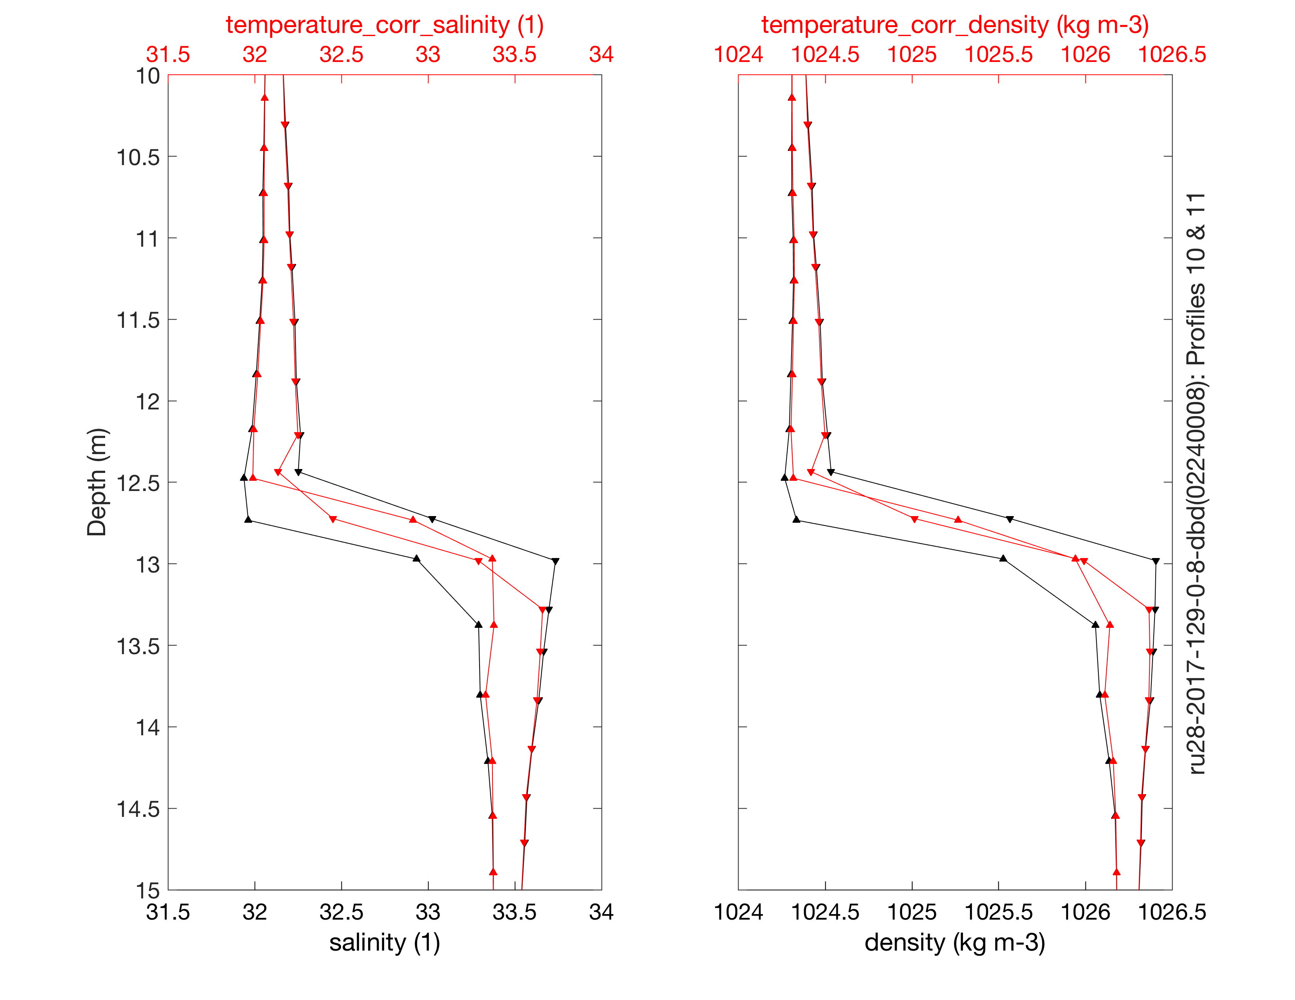
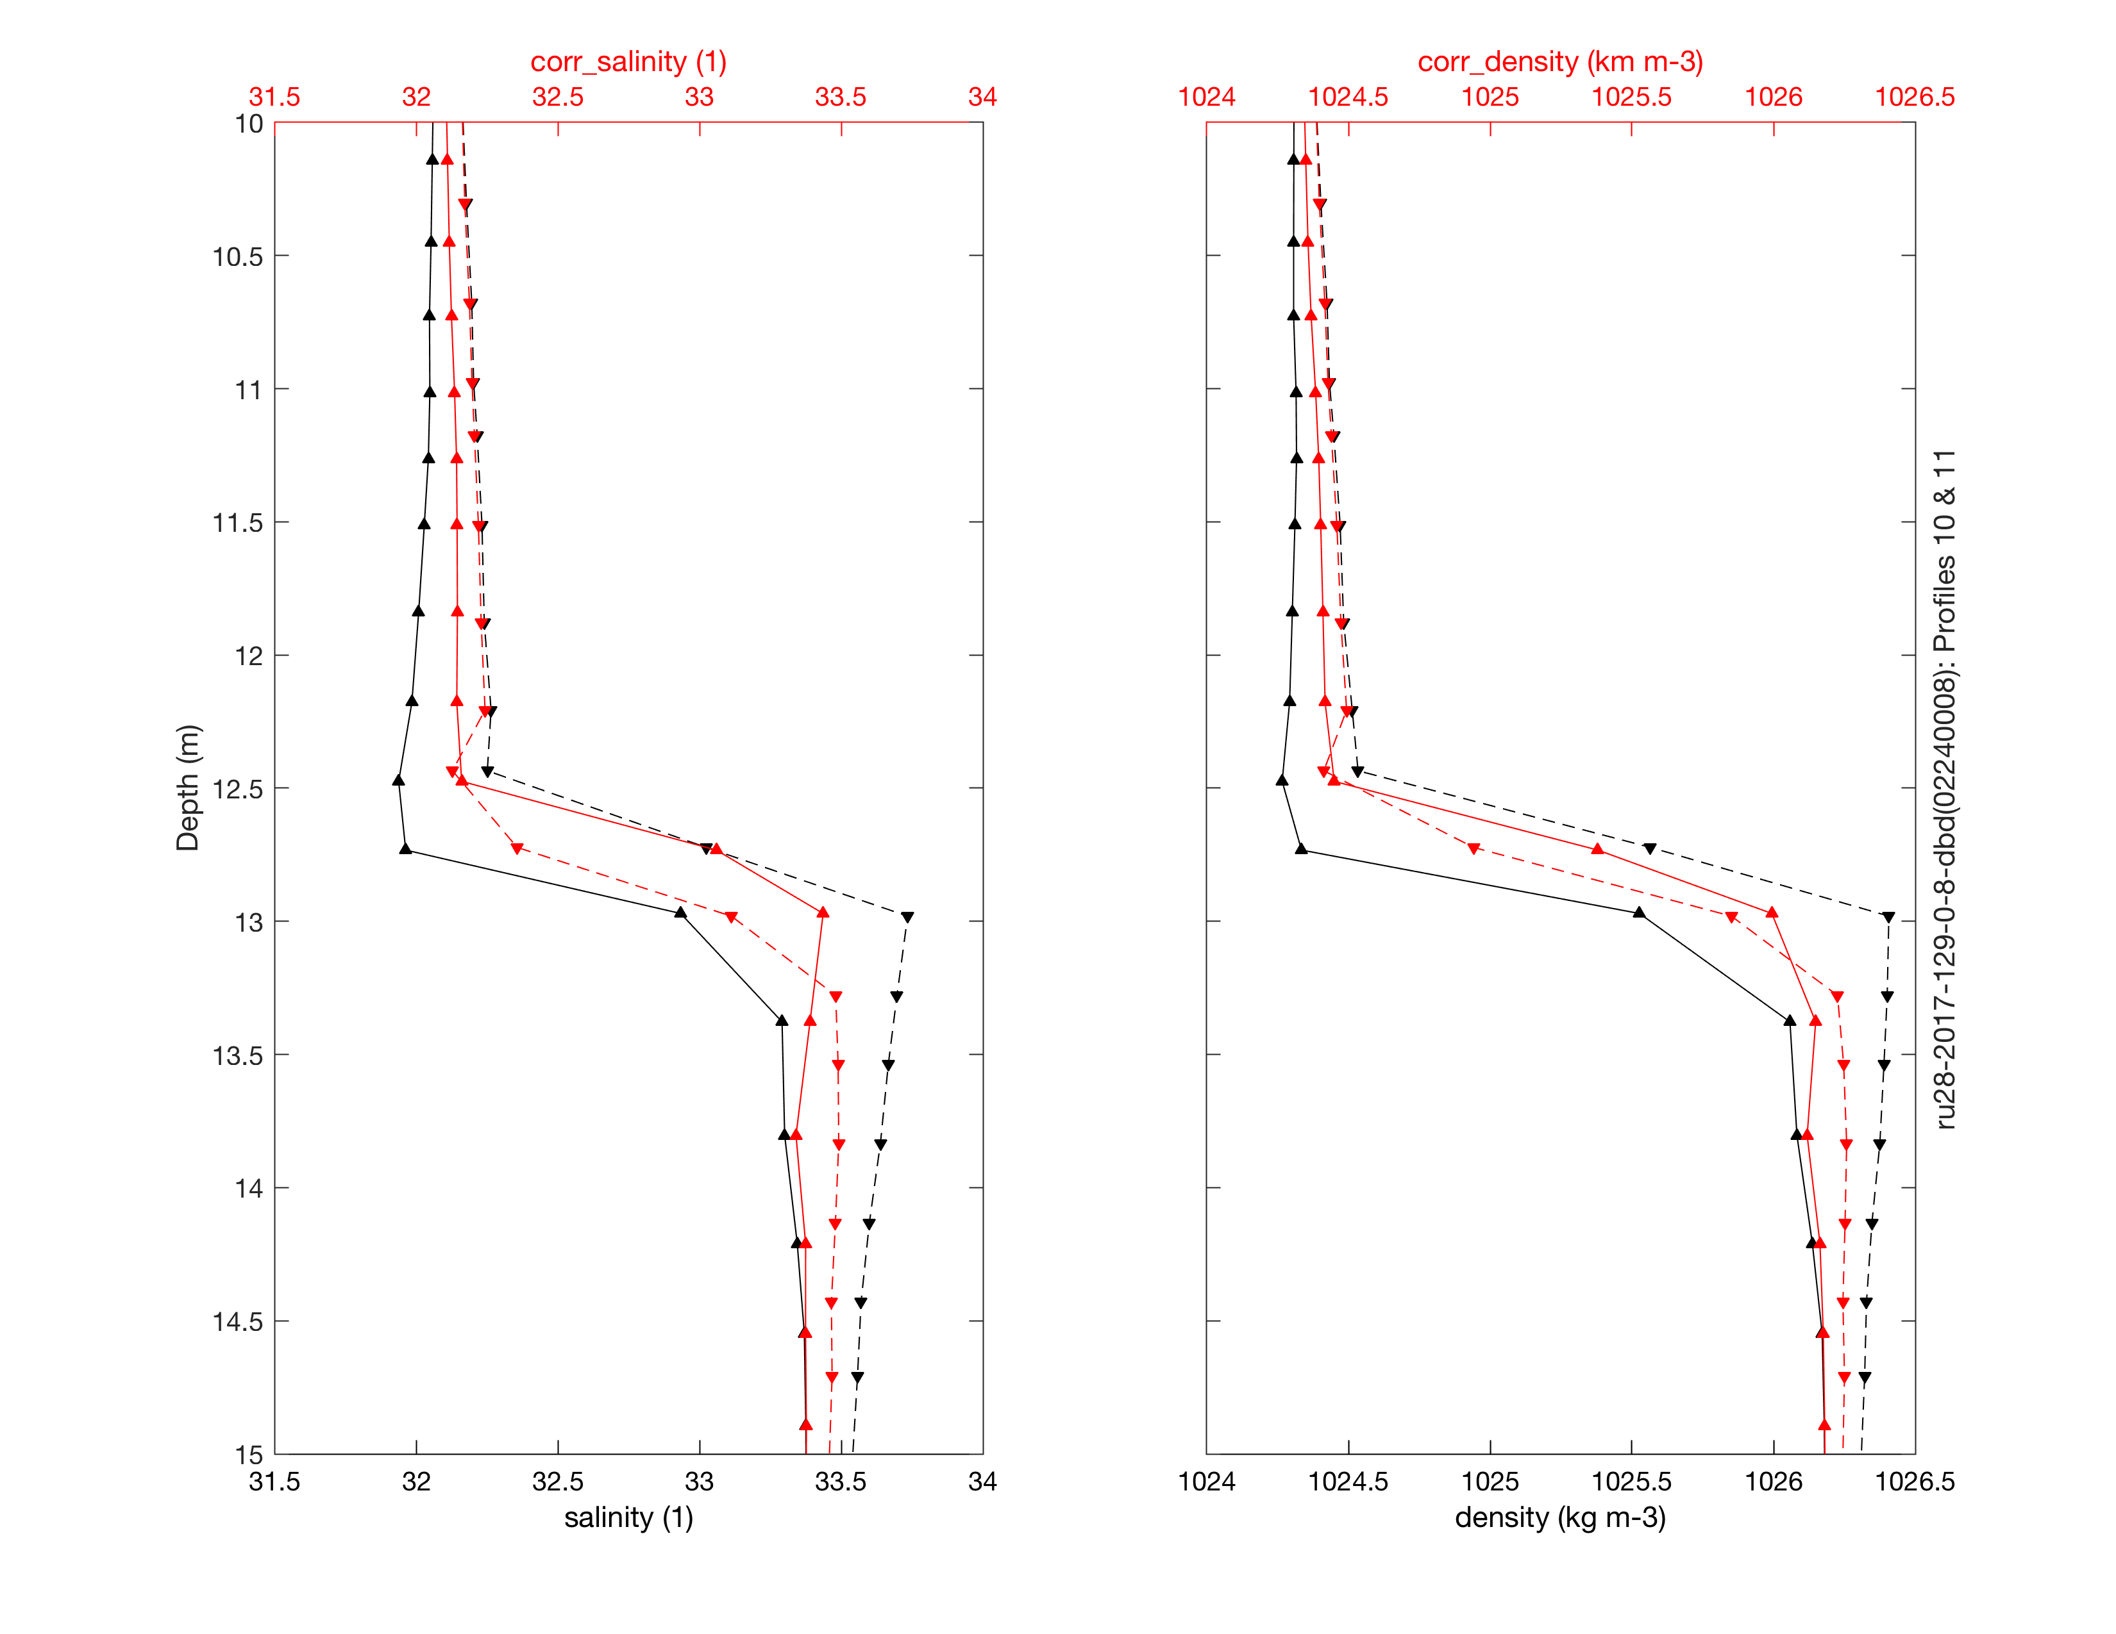
Recursive filter (developed by Sea-Bird Scientific) to remove conductivity cell thermal mass (ctm) effects:
Fofonoff (1974): Thermistor Response Correction:
T_{O} = T + 𝝉_{T} * dT/dt
ctm[S/m] = -1.0 * b * ctm_{n-1} + a * dc/dT * dT
a = 2 * ⍺ / (sample interval * 1/𝝉 + 2)
b = 1 – (2 * a/⍺)
dc/dT = 0.1 * (1 + 0.006 * [temperature – 20])
dT = t_{n} – t_{n-1}
Corrected Conductivity = Measured Conductivity + ctm
T_{O} is the true temperature,
T is the measured temperature,
𝝉_{T} is the thermistor time constant,
dT/dt is the change in temperature over change in measurement time
⍺ and 𝝉 were determined empirically by iterating through a range of values

Slide 7
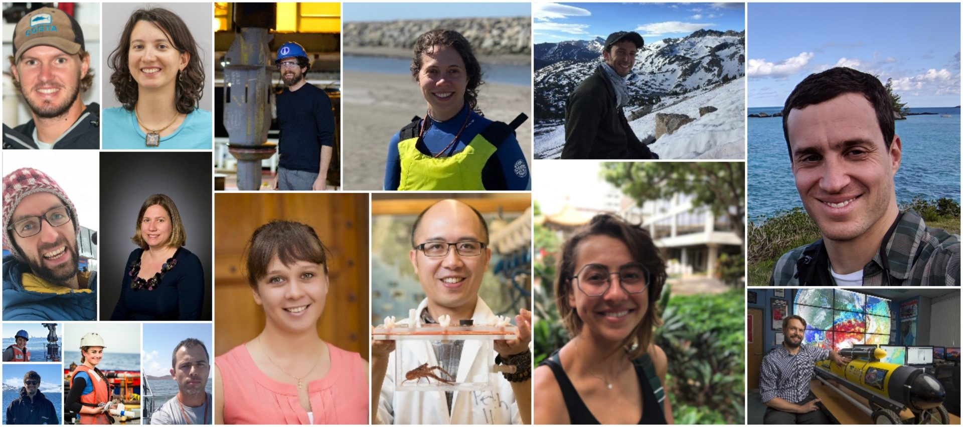
RBR2020 Cohort Project:
The existing correction methods require realtime delivery of many consecutive profiles to determine correction constants.
Plan to collaboratively work with RBR to explore the algorithm and parameter space for thermal mass corrections in their glider integrated inductive CTDs.
Deploy gliders with RBR CTDs through the highly stratified Mid Atlantic summer thermocline.
Evaluate the impact of using the novel internal thermistors within the conductivity cell to improve thermal mass corrections.
Explore realtime onboard processing on glider platforms
Thank You!

