Slide 1
Critical ocean processes in Tropical cyclone-ocean interactions
Sam Coakley
Advisor: Travis Miles, Ph.D.

Slide 2
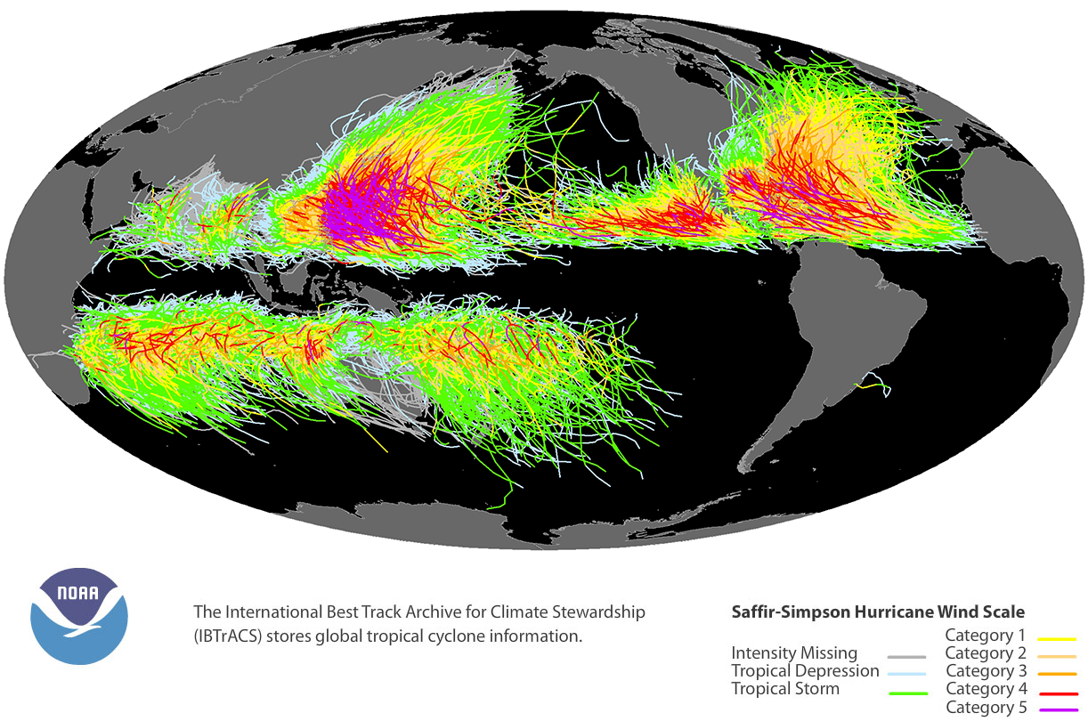
Notes:
Look at impact regions of these storms
We can see the WP and US are heavily impacted
Lets zoom in on the US

Slide 3
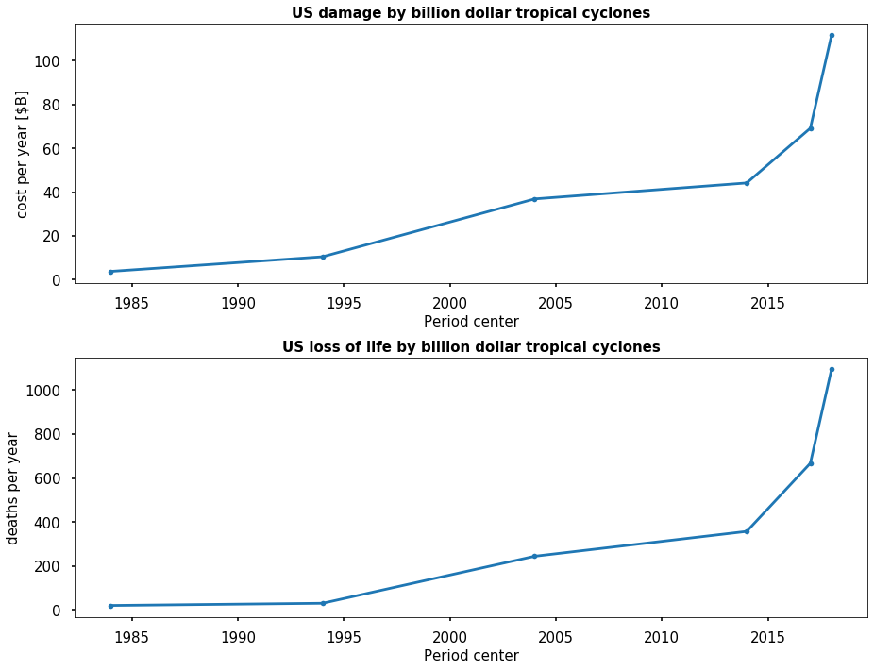
Tropical cyclone impact on US
Total cost 1980-2019: $954.4B
Total deaths 1980-2019: 6,507
https://www.ncdc.noaa.gov/billions/summary-stats
Notes:
Billion $ storms in last 3 years
Wind, storm surge, flooding causes huge loss of life and damage
How can we mitigate these losses
It is critical that we understand these storms

Slide 4
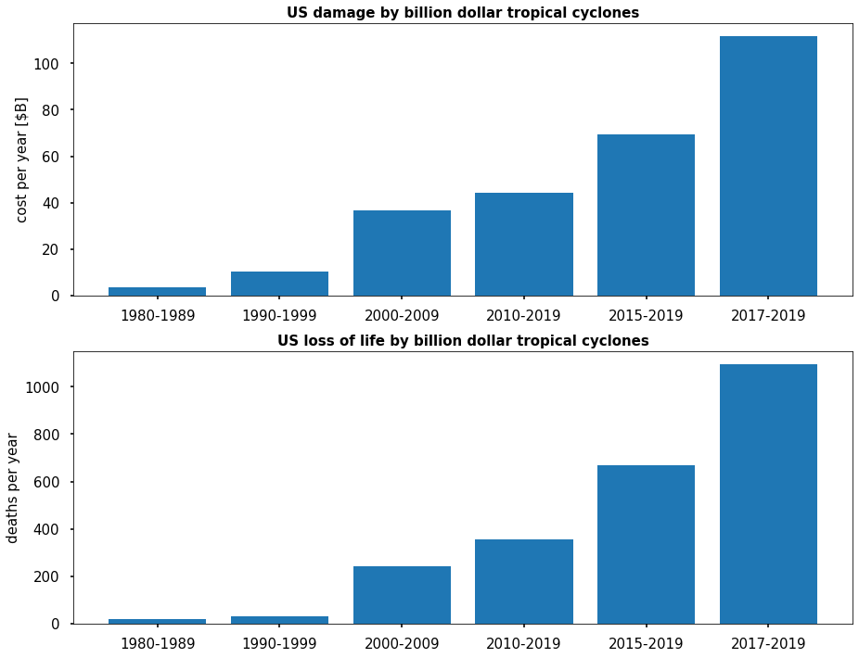
Tropical cyclone impact on US
Total cost 1980-2019: $954.4B
Total deaths 1980-2019: 6,507
https://www.ncdc.noaa.gov/billions/summary-stats
Notes:
Billion $ storms in last 3 years
Wind, storm surge, flooding causes huge loss of life and damage
How can we mitigate these losses
It is critical that we understand these storms

Slide 5
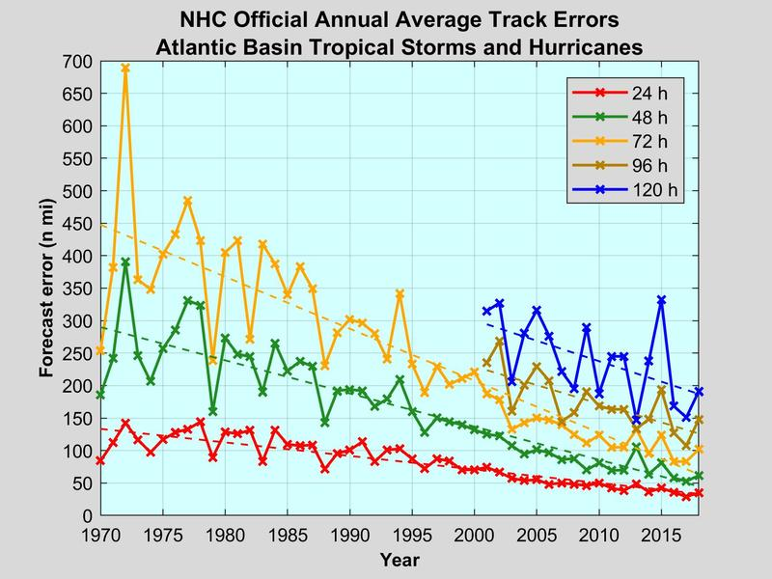
Forecasting track
National Hurricane Center Forecast Verification Report: 2019 Hurricane Season
Notes:
Importance of accurate/reliable forecasting!
Track forecasting → driven by large scale atmospheric forcing
Intensity forecasting → driven by smaller scales (mesoscale) // ~10kts is a whole category on the S-S scale
Intensity + precip + storm surge drives damages
The ocean plays a key role in intensity, especially in the coastal ocean as the storm approaches landfall

Slide 6
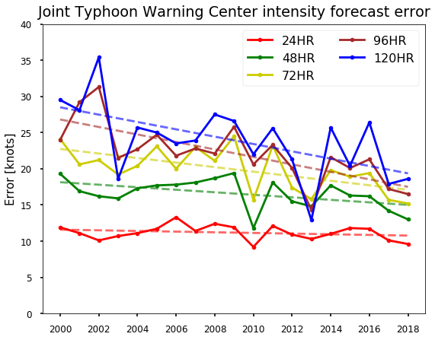
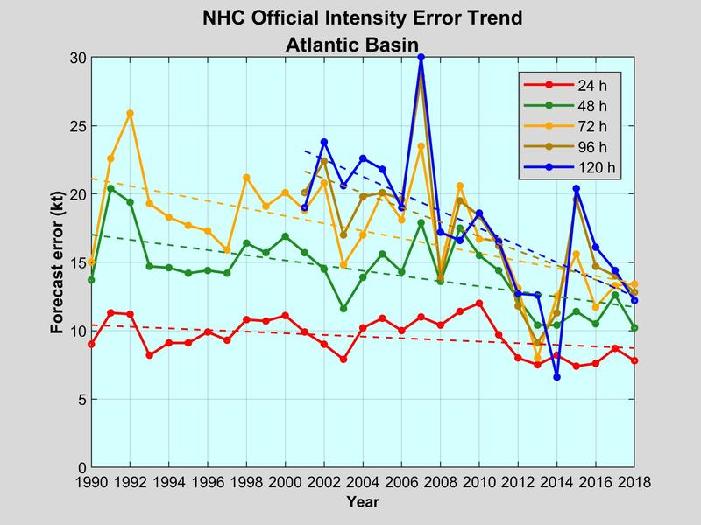
Forecasting intensity
National Hurricane Center Forecast Verification Report: 2019 Hurricane Season
Joint Typhoon Warning Center Annual Tropical Cyclone Report 2018
Notes:
Intensity error plot → Same story in West Pacific as in US
JTWC (run by US Navy/Airforce) and provide the information publicly for foreign governments

Slide 7
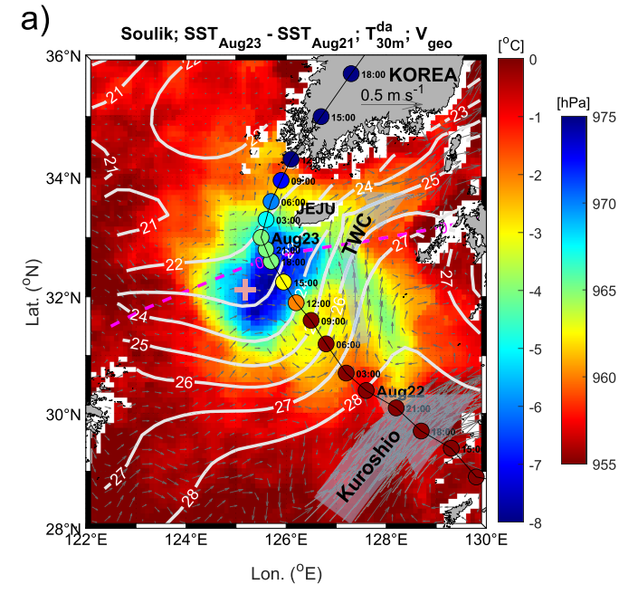
Typhoon Soulik 2018
Atmospheric perspective (Park et al, 2019)
  Intensity was overpredicted
  Decay of storm began after entering coastal ocean
  Slowly translating storm over cold surface ocean
Modified from Figure 1 (Park et al, 2019)
Notes:
Describe Figure 1 Park
Their data collection was on the left side of the track but they also used methods to extrapolate wind speed around the radius of the minimum SLP
Caveats: The atmospheric research station is on a sea mound and is only ~40m while the surrounding NE China Sea is ~100m deep
Typhoon Soulik began to decay when it moved into the NE China Sea
It was over a branch of the warm, Kuroshio current but it moved over the stratified coastal sea
The NE China Sea in this area is similar to the MAB in that there is a seasonally formed stratification that traps the coldest waters at the bottom O(10s-100m)

Slide 8
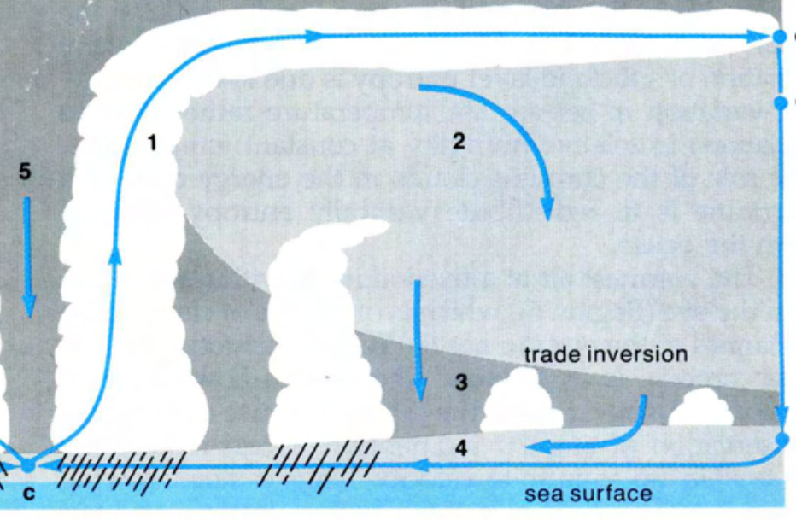



Tropical cyclones and air-sea interaction
Wind stress equation
$$τ=ρ_{air} ∗C_{D} ∗U_{wind}^{2}$$
Sensible heat flux equation
$$SHF=ρ_{air} ∗ c_{p,air}∗C_{k} ∗U_{wind}∗(SST−T_{air})$$
Low
pressure
High pressure
Latent heat flux equation
$$LHF=ρ_{air} ∗l_{vap}∗C_{k} ∗U_{wind}∗(q_{sat}−q)$$
Warm sea surface
$$τ$$
SHF
LHF
Modified from Figure 6 (Emmanuel, 1988)
Notes:
**Lots of laser pointer gesturing to guide through the slide**
Radial cross section of a TC
Key energy budget terms
Friction
Sensible (temperature gradient)
Latent (evaporation)

Slide 9
Tropical cyclones and air-sea interaction
Wind stress equation
$$τ=ρ_{air} ∗C_{D} ∗U_{wind}^{2}$$
Sensible heat flux equation
$$SHF=ρ_{air} ∗ c_{p,air}∗C_{k} ∗U_{wind}∗(SST−T_{air})$$
High pressure
Low
pressure
High pressure
Latent heat flux equation
$$LHF=ρ_{air} ∗l_{vap}∗C_{k} ∗U_{wind}∗(q_{sat}−q)$$
Cool sea surface
$$τ$$
SHF
LHF
Modified from Figure 6 (Emmanuel, 1988)
Notes:
**Lots of laser pointer gesturing to guide through the slide**
Looking at a radial view of a TC
Wind from high pressure → low pressure
TC always loses energy from friction at surface: wind stress into ocean
TC gains energy from: LHF and SHF when its intensifying
SST is the most important piece if SST warms/cools heat fluxes can go so far as to change direction
- Vertical mixing, upwelling, advection can lead to SST change

Slide 10
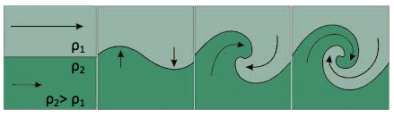

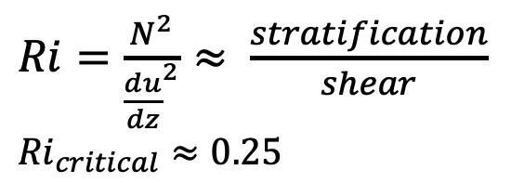
Shear instabilities
$Ri=\frac{N^{2}}{{\frac{du}{dz}}^{2}}≈ \frac{stratification}{shear}$ ${Ri}_{critical}≈0.25$
Notes:
SST cooling is caused by upwelling, advection, or vertical mixing
I am focusing on vertical mixing for my work
Zoom in on key processes on the left
Shear mixing occurs where Ri < 1/4 ---- t/o surface layer because N=0 and wind stress drives shear in mean flow
At pycnocline, shear needs to overcome stratification
My work is focused here

Slide 11
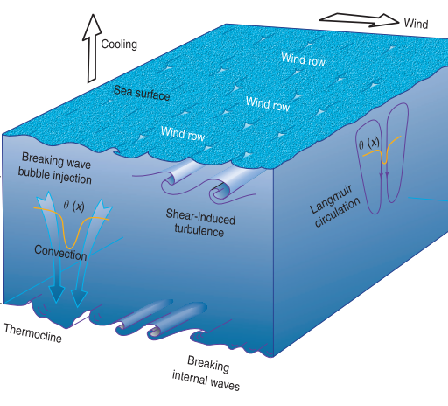
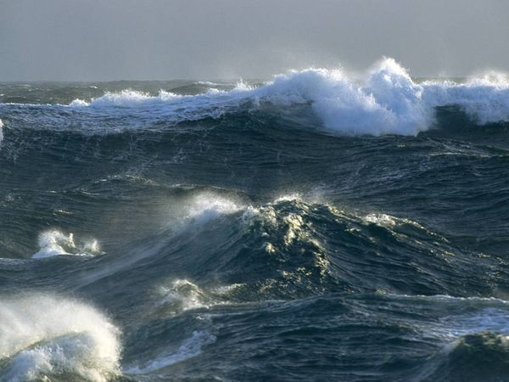
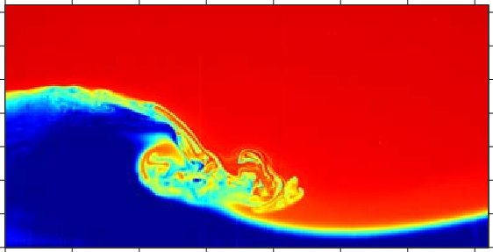
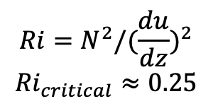
Upper ocean mixing
Shear instabilities [b]
[a]
$${Ri=N}^{2}/{(\frac{du}{dz})}^{2}$$
$${Ri}_{critical}≈0.25$$
Surface wave breaking [c]
Internal wave breaking [d]
[a] Modified from Figure 2 (Moum and Smyth, 2001)
[b] Modified from Figure 5 (Philippi et al. 2015)
[c] Source
[d] Figure 14 (Troy and Koseff, 2005)
Notes:
SST cooling is caused by upwelling, advection, or vertical mixing
I am focusing on vertical mixing for my work
Focus on the ‘homogenous’ surface layer
Figure on the right shows general surface layer mixing processes
Zoom in on key processes on the left
Shear mixing occurs where Ri < 1/4 ---- t/o surface layer because N=0 and wind stress drives shear in mean flow
At pycnocline, shear needs to overcome stratification
My work is focused here
Other exciting sources of mixing in TC forcing are surface and internal wave breaking

Slide 12
Lessons from the previous storms
Super typhoon Neparatak (2016): 1D shear case
  Strong winds drove surface layer current leading to shear with static lower layer
  Saw 4°C cooling of SST caused by mixing and change in direction of heat flux but there was no change in storm intensity
  (Yang et al. 2019)
Hurricane Irene (2011): Across shore shear case
  7°C cooling observed by glider
  Baroclinic shear induced by winds → rapid vertical mixing → cooling of SST → heat flux into the ocean → weakening of storm (Glenn et al., 2016; Seroka et al., 2017)
  Wind forcing drives shear instability → Kelvin-Helmholtz billows grow and break → widening of the mixed layer and cooling of sea surface (Watkins and Whitt, In prep)
Notes:
Looking at past cases to see what mixing processes were critical
Neparatak
Classic case of deeper water column response to storm forcing
Wind drove shear which caused instabilities and mixing at the thermocline
Dominantly a 1D response to storm forcing

Slide 13
Lessons from the previous storms
Super typhoon Neparatak (2016): 1D shear case
  Strong winds drove surface layer current leading to shear with static lower layer
  Saw 4°C cooling of SST caused by mixing and change in direction of heat flux but there was no change in storm intensity
  (Yang et al. 2019)
Hurricane Irene (2011):
  Baroclinic shear induced by winds → rapid vertical mixing → cooling of SST → heat flux into the ocean → weakening of storm (Glenn et al., 2016; Seroka et al., 2017)
  Wind forcing drives shear instability → Kelvin-Helmholtz billows grow and break → widening of the mixed layer and cooling of sea surface (Watkins and Whitt, In prep)
  7°C cooling observed by glider
Notes:
Irene
- The near shore response is a more 2D case
Forecasts of Hurricane Irene did not account for such a dramatic change in SST, leading to an over prediction of the storm’s strength

Slide 14
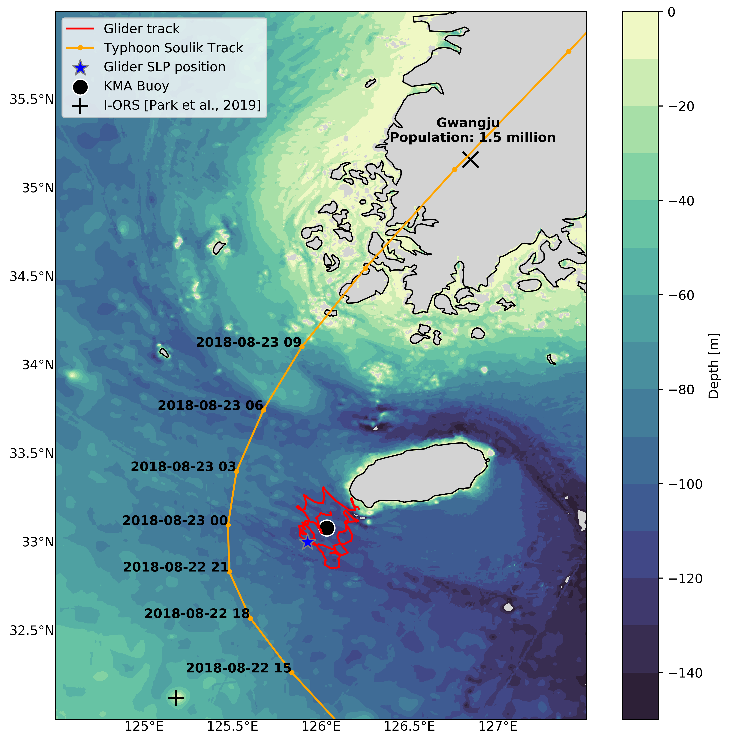
Typhoon Soulik 2018
Notes:
What we know: Heat fluxes contributed to deintensification
What we don’t know: What process drove SST cooling?
Deployment story:
2018 → Travis went to South korea to visit KIOST (Korea Institute of Ocean Science and Tech) to demonstrate value of the gliders
Test deployment of glider off of Jeju Island was coming to a close when they noticed typhoon soulik’s predicted track was near the glider track
Opportunistic science!
The closest approach of the storm was 51 km to the buoy and 40 km to the glider.
The glider and buoy were within 15 km of each other for the duration of the storm forcing period.

Slide 15
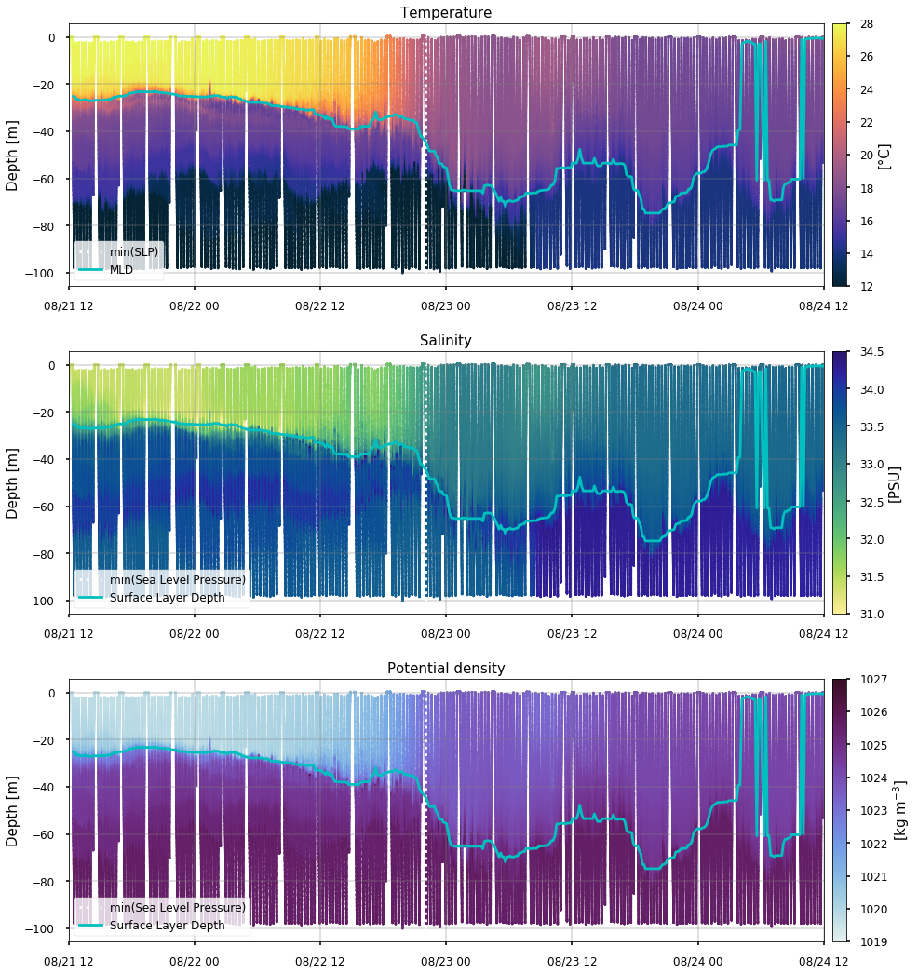
Typhoon Soulik 2018
All state variables measured showed similar responses
11°C of SST cooling
Cooling of surface layer begins ~16 hours before min(SLP)
Deepening of surface layer by ~30m
Notes:
Similar responses are seen in each of the state variables but the discussion will focus on temperature because of the impact of SST on the feedback to the storm
Surface layer begins to cool and ML begins to deepen approaching min(SLP)
These changes are concurrent with the peak in wind stress recorded at the nearby buoy
SST dec. by ~11°C over ~24 hours with ~9°C cooling before min(slp)
MLD deepen by ~30m
Most evident in backscatter plots, there is a periodic signal (period near both the inertial frequency and the K1 tide ~12hrs) that was not present prior to the storm
Currently investigating what this could be, likely an internal wave
Increase in backscatter indicates that there is significant bottom stress driving resuspension of sediments

Slide 16
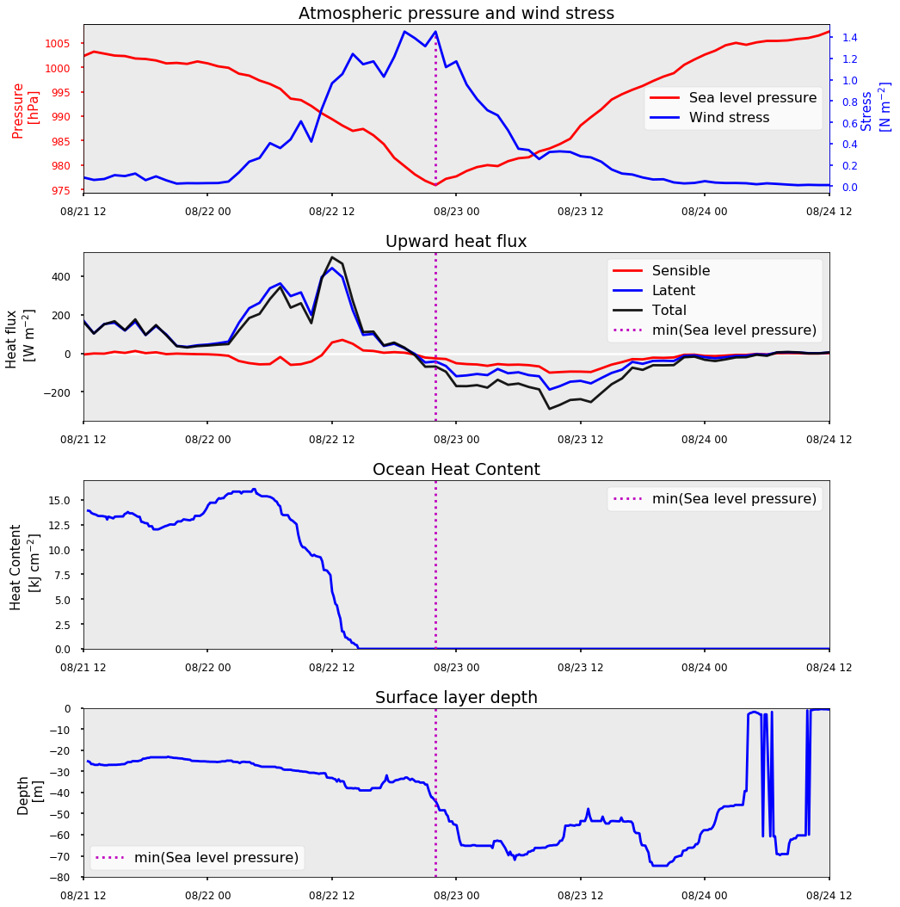
Typhoon Soulik 2018
Wind stress peaks with min(SLP)
Shortly before min(SLP), total heat flux changes direction
Ocean heat content goes to 0 before storm arrival
Most rapid deepening of the surface layer occurs during min(SLP)
Notes:
Pressure for timing of forcing
Heat flux is the fuel source
OHC is amount of energy the ocean has to give a storm
As wind stress rises, OHC decreases
Peak wind stress coincides with rapid deepening

Slide 17
Typhoon Soulik 2018
Wind stress peaks with min(SLP)
Shortly before min(SLP), total heat flux changes direction
Ocean heat content goes to 0 before storm arrival
Most rapid deepening of the surface layer occurs during min(SLP)
Notes:
Pressure for timing of forcing
Heat flux is the fuel source
OHC is amount of energy the ocean has to give a storm
As wind stress rises, OHC decreases
Peak wind stress coincides with rapid deepening

Slide 18
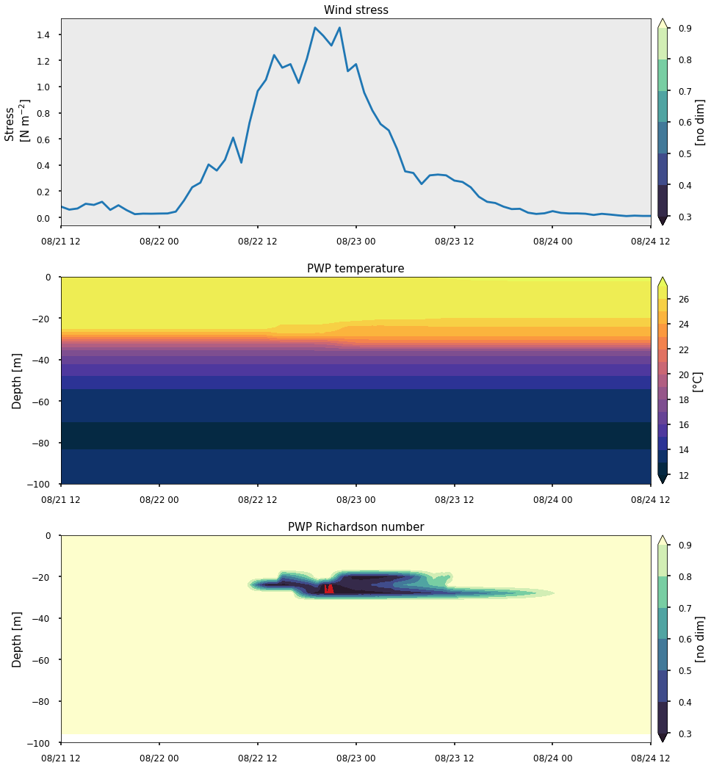
PWP Simulation
What is PWP?
  1D mixing model
  Forced by heat and momentum flux
  Heat flux drives convection
  Momentum flux drives shear
Initialized PWP with a smoothed density profile
Wind stress was the dominant driver of SST cooling
Saw no cooling of SST
$${Ri=N}^{2}/{(\frac{du}{dz})}^{2}$$
$${Ri}_{critical}≈0.25$$
Notes:
*include discussion of stratification between us and Yang*
What is PWP?
- 1D ocean mixing model
Only considers 1D heat and momentum fluxes (LW, SW, LHF, SHF // wind stress and shear) respectively
Adjusts density of given initial profile in response to heat fluxes
Adjusts velocity of initially static profile in response to momentum flux (ie wind stress)
Uses Richardson # to determine if adjacent points are unstable and, if they are unstable, it homogenizes the two ‘parcels’
Initialized PWP with a smoother density profile
PWP forced with buoy winds and heat fluxes (excluding LW and SW rad) produced ~1°C of cooling compared to the 11°C observed
- After running a few simulations, we saw that the wind stress was the dominant driver of PWP’s response in this case
The magnitude of the shear produced in our PWP runs is an order of magnitude greater than that seen in the case of Neparatak
We have a shallower sharper thermocline and a shallower water column (ours ~100m theirs ~5000m)
Need to compare reduced shear calculations from our runs to theirs' to properly include impacts of stratification
Want to try the same tests with COD 1D mixing ROMS model to see if PWP might just be missing processes or maybe it sucks
So PWP definitely does not capture the response so the process driving the mixing must be multidimensional or not driven by surface fluxes of momentum and heat

Slide 19
Next steps
PWP in other storms
  Typhoon Soulik: 0% of SST cooling
  Super typhoon Neparatak: 100% of SST cooling (Yang et al., 2019)
  Hurricane Irene: ~32% of SST cooling (Glenn et al., 2016)
Large Eddy Simulation: Irene vs Soulik
  LES will better resolve shear instabilities
  Similar preconditioning of ocean and wind stress forcing
  Key difference: Irene’s rapid wind rotation
Notes:
LES is expected to be better than PWP because it
Resolves more scales
Has more realistic representations of mixing?
Will provide us with turbulent fluxes that can help us to identify and quantify the mixing

Slide 20
Conclusions
Air-sea interactions in the coastal ocean are critical to our understanding of tropical cyclones
SST changes driven by vertical mixing processes can cause a change in the intensity of a tropical cyclone
1 dimensional processes are not enough in this case
What processes are driving the SST cooling?
Notes:
Where and when does this mixing occur? → leads us to the process controlling the response

Slide 21
References
Emanuel, K. A. (1988). Toward a General Theory of Hurricanes. American Scientist.
Glenn, S. M., Miles, T. N., Seroka, G. N., Xu, Y., Forney, R. K., Yu, F., … Kohut, J. (2016). Stratified coastal ocean interactions with tropical cyclones. Nature Communications, 7(May 2015). https://doi.org/10.1038/ncomms10887
Lim, H. S., Miles, T. N., Glenn, S., Kim, D., Kim, M., Shim, J. S., … Hwang, K. N. (2020). Rapid Ocean Destratification by Typhoon Soulik over the Highly Stratified Waters of West Jeju Island, Korea. Journal of Coastal Research, 95(sp1), 1480–1484. https://doi.org/10.2112/SI95-285.1
Miles, T., Seroka, G., & Glenn, S. (2017). Coastal ocean circulation during Hurricane Sandy. Journal of Geophysical Research: Oceans, 122(9), 7095–7114. https://doi.org/10.1002/2017JC013031
Moum, J. N., & Smyth, W. D. (2001). Upper Ocean Mixing Processes. Encyclopedia of Ocean Sciences, 3093–3100. https://doi.org/10.1006/rwos.2001.0156
NOAA National Centers for Environmental Information (NCEI) U.S. Billion-Dollar Weather and Climate Disasters (2020). https://www.ncdc.noaa.gov/billions/, DOI: 10.25921/stkw-7w73
Park, J., Yeo, D., Lee, K., Lee, H., Lee, S., Noh, S., … Nam, S. (2019). Rapid Decay of Slowly Moving Typhoon Soulik (2018) due to Interactions With the Strongly Stratified Northern East China Sea. Geophysical Research Letters, 46(24), 14595–14603. https://doi.org/10.1029/2019GL086274
Philippi, Paulo & Mattila, Keijo & Hegele, Luiz & Siebert, Diogo. (2015). KINETIC PROJECTION AND STABILITY IN LATTICE- BOLTZMANN SCHEMES. 10.20906/CPS/CILAMCE2015-0398.
Seroka, G., Miles, T., Xu, Y., Kohut, J., Schofield, O., & Glenn, S. (2017). Rapid shelf-wide cooling response of a stratified coastal ocean to hurricanes. Journal of Geophysical Research: Oceans, 122(6), 4845–4867. https://doi.org/10.1002/2017JC012756
Troy, C. & Koseff, Jeffrey. (2005). The generation and quantitative visualization of breaking internal waves. Experiments in Fluids. 38. 549-562. 10.1007/s00348-004-0909-9.
Watkins, C., & Whitt, D. B. (2020). Large-aspect-ratio structures in simulated ocean surface boundary layer turbulence under a hurricane.
Yang, Y. J., Chang, M. H., Hsieh, C. Y., Chang, H. I., Jan, S., & Wei, C. L. (2019). The role of enhanced velocity shears in rapid ocean cooling during Super Typhoon Nepartak 2016. Nature Communications, 10(1), 1–11. https://doi.org/10.1038/s41467-019-09574-3

Slide 22



Thank you
Are there any questions?

Slide 23
Large Eddy Simulation (LES)
Justification
  Similarity in stratification strength and wind stress between Soulik and Irene
  Difference in forcing and initial MLD
    Rapid rotation of winds in Irene shutdown Ekman rolls but Soulik’s winds changed direction very steadily as the storm slowly translated across the region
Expectation
  The combined effects of sustained Ekman rolls and Kelvin-Helmholtz billows will drive intense mixing in Soulik

Slide 24
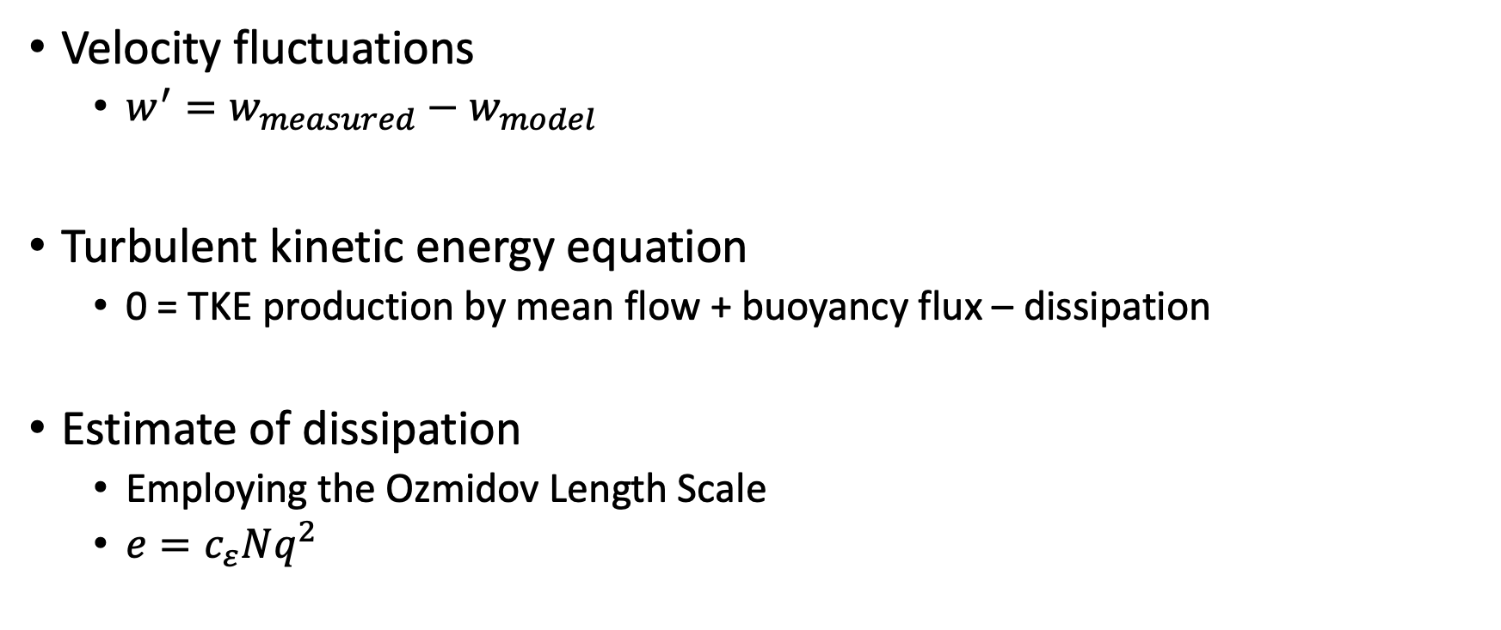
Dissipation from a glider
Velocity fluctuations
  $w^{′}=w_{measured}−w_{model}$
Turbulent kinetic energy equation
  0 = TKE production by mean flow + buoyancy flux – dissipation
Estimate of dissipation
  Employing the Ozmidov Length Scale
  $e=c_{ε}Nq^{2}$
Notes:
The TKE equation is a balance between production of turbulence by shear in the mean flow, buoyancy flux associated with turbulent fluctuations, and dissipation of TKE to heat by the smallest eddies
So measuring the dissipation of TKE gives us information about where these smallest eddies are that are doing a lot of mixing
Using the large eddy method, we can describe dissipation as a function of buoyancy frequency and the square of some velocity fluctuation
Vertical velocity fluctuations are easier to measure because the mean vertical velocity is small
Measuring the velocity fluctuations s still a challenge
We employ a glider flight model to predict the flight behavior of the glider
We then subtract the modeled signal from the measured signal
However, we have run into some difficulty here as you can see in the figure here.
The glider’s measured pressure signal is dominated by the dominant wave period during the storm
The glider feels the waves passing overhead as changes in pressure which is interpreted as rapid vertical movement
Waves are not predicted by the model and thus these waves velocities make it through the modeling step and appear as turbulent velocity fluctuations
This may be a nail in the coffin for this method but I would still like to investigate turbulence in these extreme conditions so in the future I would like to continue this work by mounting an ADCP or microstructure sampler on a glider and praying we get hit by a storm

