Slide 1
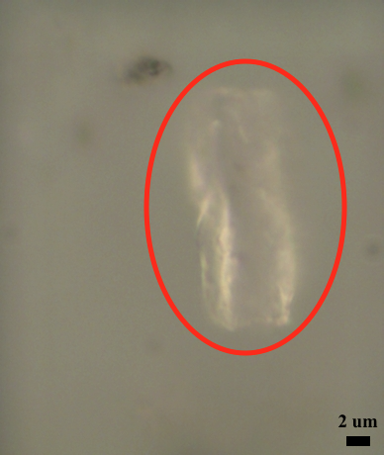
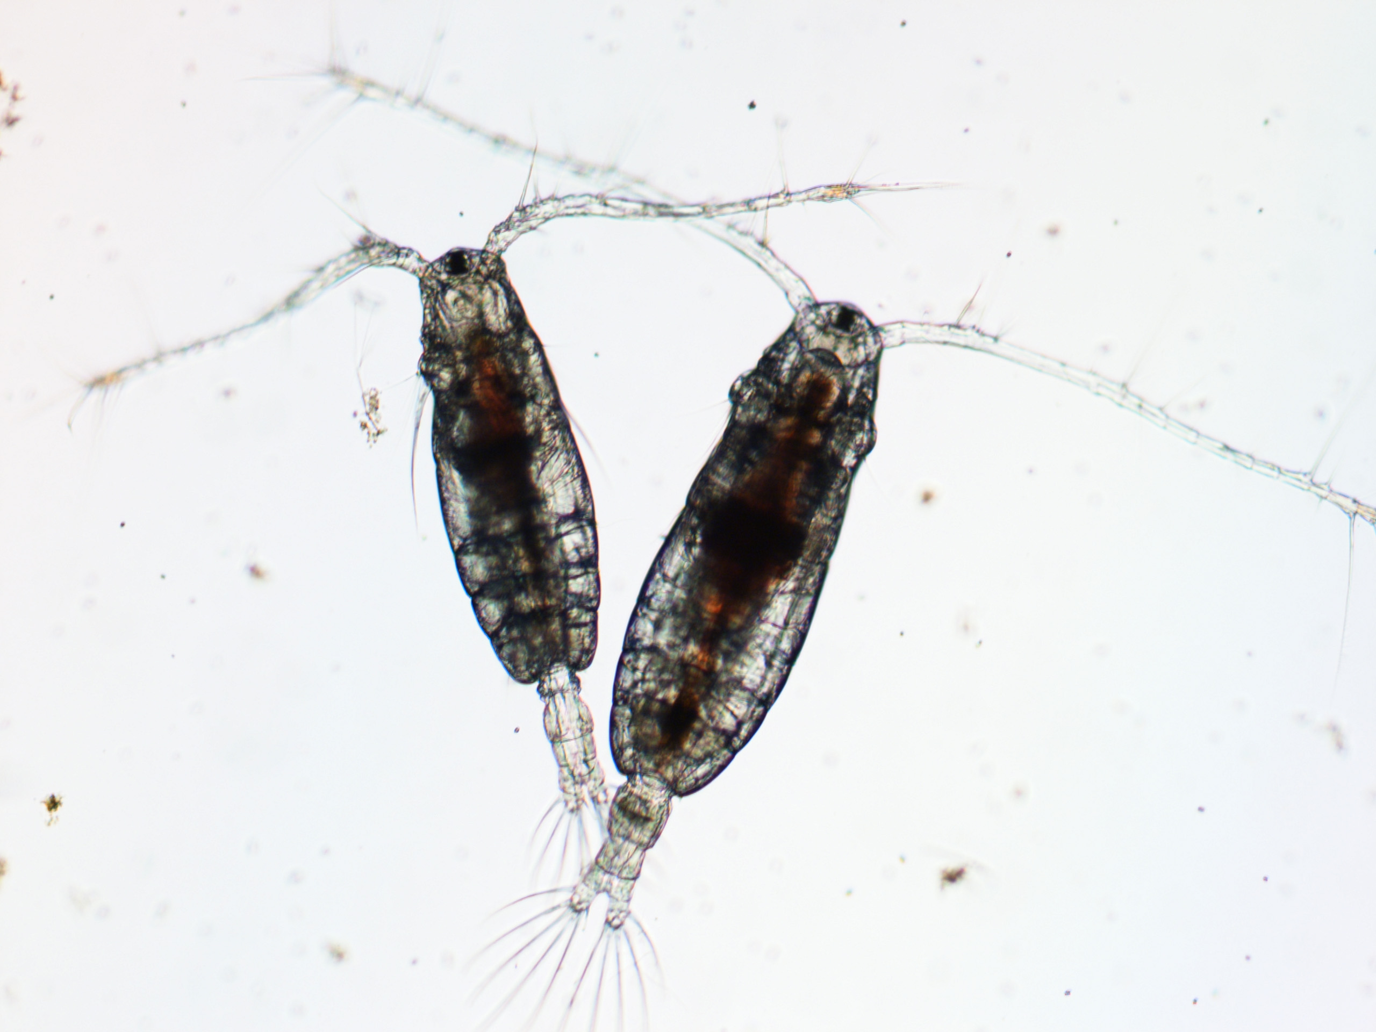
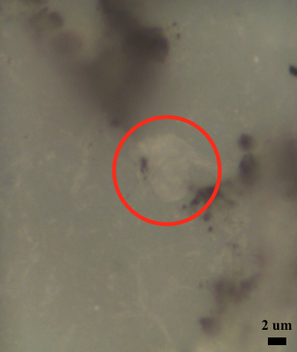
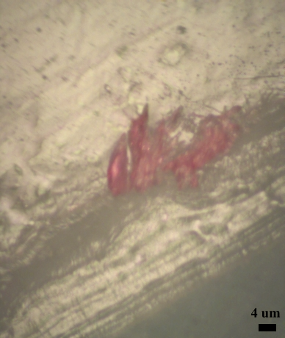
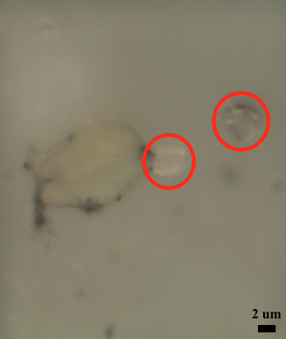
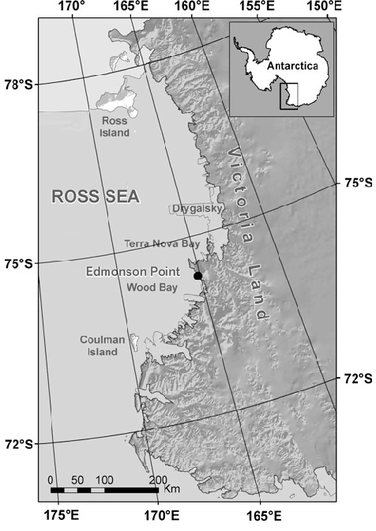
The examination of microplastic consumption by zooplankton collected in an urban estuary and a pristine Antarctic coastal system: Approaches, challenges, and outcomes
Kasey Walsh¹, Karli Sipps², Georgia Arbuckle-Keil², Robert Chant¹, Nicole Fahrenfeld³, Grace Saba¹
¹Marine and Coastal Sciences, Rutgers University-New Brunswick; ²Chemistry, Rutgers University-Camden, ³Civil and Environmental Engineering, Rutgers University-New Brunswick
Background
Preliminary Results
Trials for Different Digestion Procedures
Microplastics (MPs; <5mm) are found throughout marine environments worldwide including the Ross Sea, Antarctica^{1,2}.
They are considered emerging contaminants in the marine environment with the potential to enter the food chain. Smaller diameter MPs are of concern given the bioavailability to zooplankton that play a key role in potential transport of MPs up to higher trophic levels.
This project aims to determine the consumption of MPs by zooplankton in the Raritan Bay, New Jersey (copepods) and in the Terra Nova Bay, western Ross Sea (crystal krill, Euphausia crystallorophias).
Raritan Bay
To examine MPs consumed by zooplankton, a digestion procedure must be conducted to remove biological material and isolate MPs. We tested an enzymatic digestion using Proteinase-K¹ and a chemical digestion using nitric acid³.
After digestion, samples were filtered through anodized aluminum (Anodisc) filters and analyzed through a 50X or 100X microscope objective using both a Horiba Jobin Yvon XploRA Raman microscope and a Bruker Hyperion FTIR microscope equipped with a focal plane array (FPA) detector.
MPs were detected in every zooplankton sample analyzed so far, averaging 5 MPs per 100 copepods collected in July 2018.
Species | Number Zooplankton in Sub-Sample | Digestion Method | Total MPs Detected | Types of MPs Detected
Acartia tonsa | 50 | Enzymatic | 1 | PE
Acartia tonsa | 100 | Enzymatic | 3 | PP, PE
Acartia tonsa | 100 | Chemical | 7 | PP, PS, PE, polyamide
Acartia tonsa | 100 | Chemical | 6 | PE, PS
Acartia tonsa | 100 | Chemical | 5 | PE, PP
Proteinase-K
Field Collection
Many MPs detected (circled in red) were colorless and less than 100 µm in size.
The most abundant MP was polyethylene (PE), followed by polypropylene (PP), polystyrene (PS), and polyamide
Digestion was incomplete, leaving exoskeleton fragments, and MPs were difficult to identify.
Zooplankton samples of primarily Acartia tonsa copepods were recently collected using net tows inside and outside of frontal systems during both a low-flow and high-flow event in a highly urbanized estuary (Raritan Bay, NJ/NY, 2018-2019).
Nitric Acid (HNO₃)
HNO₃ completely digested zooplankton exoskeleton. This allowed for Raman confirmation of MPs in copepods and crystal krill.
Visually identified MPs were examined further using Raman and/or FTIR spectroscopic analyses to characterize the chemical compositions of the particles.
Crystal krill were collected using net tows during an austral summer 2018 cruise in the Terra Nova Bay, western Ross Sea, Antarctica ( ).
Ross Sea, Antarctica
Future Work
Quantify the amount of MPs consumed by Raritan Bay copepods and Antarctic crystal krill. Determine the role of frontal systems as an entry point for MPs into the food chain Compare nearshore, estuarine, and coastal MP particle distribution and abundance and MP ingestion by zooplankton during low and high flow conditions .
All samples were preserved in 4% buffered formaldehyde.
References
The Raman spectrum, at a 785nm excitation wavelength, confirmed the presence of PE on the Anodisc filter.
Funding Support
Cole, M. et al. 2011. Mar Poll Bull, 62: 2588-2597.
Cincinelli, A. et al. 2017. Chemosphere, 175: 391-400.
3. Desforges, J-P. W. et al. 2015. Arch Environ Contam Toxicol, 69: 320-330.
The FTIR spectra show that crystal krill exoskeleton (blue) and an organic substance (red) were present on the Anodisc filter.
These efforts were funded by the New Jersey Sea Grant Consortium (NA18OAR4170087 ) and NSF Office of Polar Programs (NSF OPP1743035).

