Slide 1
The Physiology of a Changing Antarctic Ecosystem: Examining the Roles of Light in Phytoplankton Biology in the WAP
Presented to the RUCOOL Group
by Quintin Diou-Cass
Designed Some Light Manipulation Experiments
Went on the LTER Summer Cruise (LMG20-01)
Stayed At Palmer Station for 2.5 Months
Began Some Analysis of Historic Data
Fall 2019
Now
Learned Some Oceanography
Ran some In-Situ Light Manipulations
Ran some In-Situ Light Manipulations
Studied and Completed Initial Prelims

Slide 2
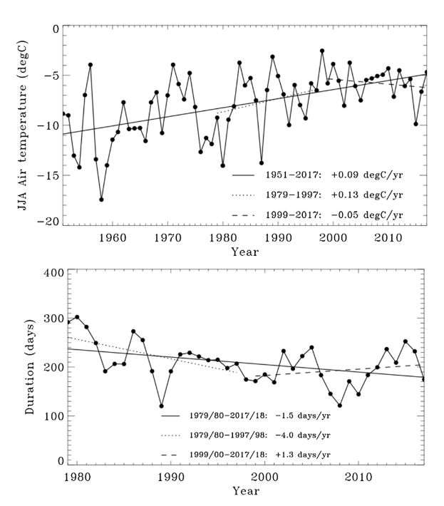
Sea Ice Dynamics and Air Temperature
The WAP: A Rapidly Changing Ecosystem
Polar marine ecosystems are centered around the seasonal dynamics of sea ice
Dynamics are a Product of:
Climate Modes
(SAM/ENSO)
Climate Change
(Increased Air Temp)
+
Congruent long-term trends in warming and sea ice loss
The WAP is a bottom-up controlled ecosystem dictated by sea ice dynamics…

Slide 3
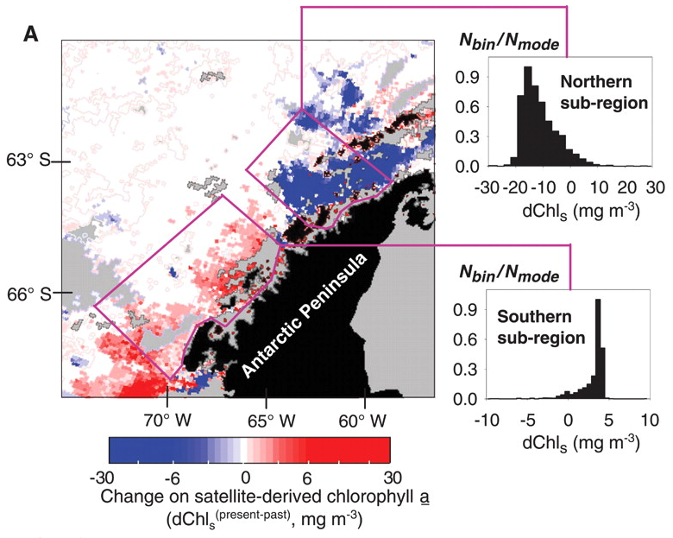
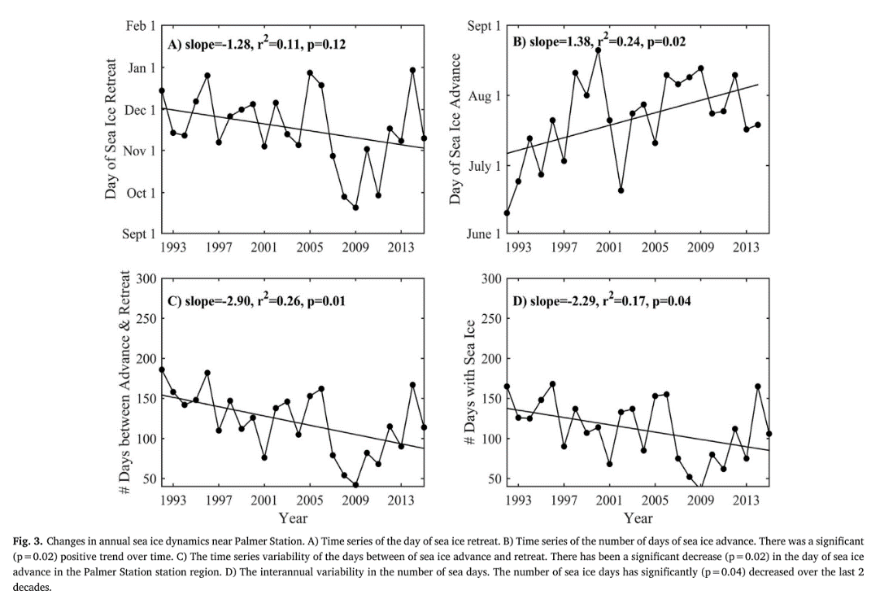
MLD and Chlorophyll-a
The WAP: A Rapidly Changing Ecosystem
= Palmer Station
2009 Analysis
-
+
Corresponding decreases in Sea Ice and MLD congruent with increasing chlorophyll biomass
WAP Grid Mean
400km shift to the South
2018 Analysis
Southward rolling trends in regional chlorophyll biomass
-
+
But these are not the only changes…

Slide 4
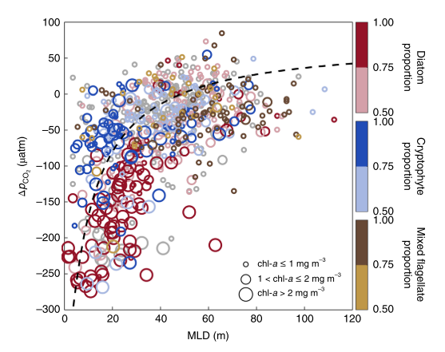
Community Composition and Air-Sea ${CO}_{2}$ Exchange
The WAP: A Rapidly Changing Ecosystem
-
+
+
-
= Palmer Station
Inshore-Offshore shifts in phytoplankton community size
Increasing chlorophyll biomass drives increased ${CO}_{2}$ drawdown that is group-specific
WAP Grid Mean

Slide 5
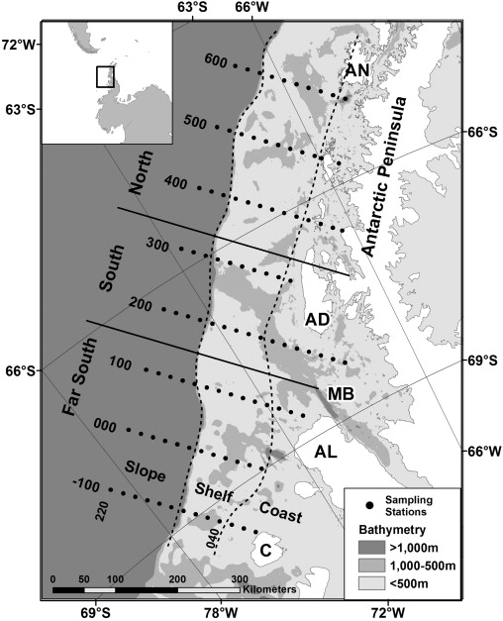
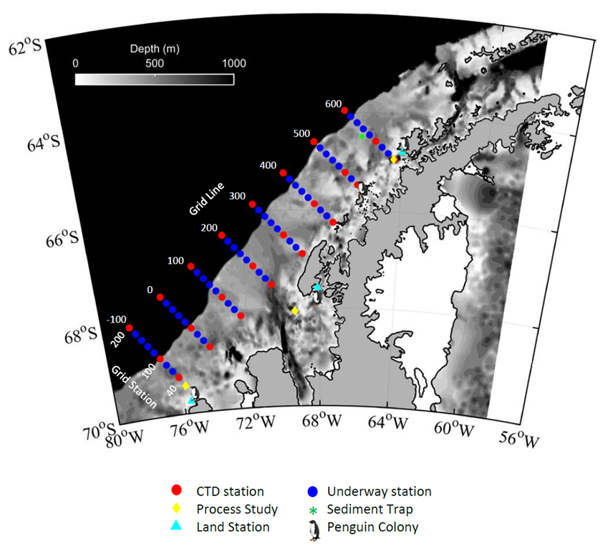
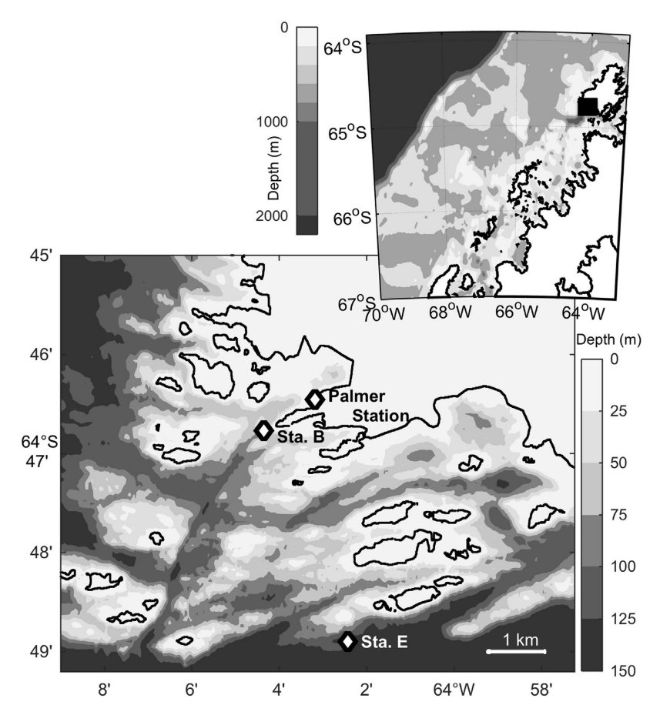
Palmer LTER: An Extensive Temporal and Spatial Study System
Palmer Station
LTER Length: 1992-Present

Slide 6
Shifts in Light Availability
The WAP: Exploring the Role of Light
Shifts in WAP Climate
How Exactly Does Light Influence Phytoplankton Physiology and Physiological Processes (Like Photoacclimation) in the WAP?
Community Composition and Function (Omics)
=> Provide Community Context and Physiological Specifics
Shifts in MLD
Photosynthetic Storage (Lipids)
=> Show End Results of Physiology
Focus Areas:
In-Situ POC:Chl Relationships (Time Series)
=> Identify Spatiotemporal Trends to Analyze with Physiological Context
Phytoplankton Physiology and Physiological Processes
Influences
Influences
General Shifts in Phytoplankton Dynamics
Shifts in Overall Biogeochemistry and Ecology

Slide 7
Focus Area: Community Dynamics
Method: Meta-Omics + Fluorometry
Community Composition and Function:
Why These Aspects?
Questions
Composition
Function
What is the high-resolution in-situ composition of the phytoplankton community across the WAP?
What are the functional responses of phytoplankton communities to saturating light? Do they show any regional trends?
Community Context
Physiological Rates
What are the rates at which WAP phytoplankton photoacclimate?
How does community composition shift under enhanced light availability?
Physiological and Biogeochemical Potential
Photosynthetic Biology
How does phytoplankton energy usage differ regionally and across a distinct light regime?

Slide 8
Focus Area: Photosynthetic Storage
Method: Lipidomics + Fluorometry
Photosynthetic Energy Storage:
Why Energy Storage?
Questions
Abundance of Storage Lipids
Do phytoplankton in the WAP store excess light energy?
Do different phytoplankton communities in the north/south exhibit different extents of energy storage?
How does energy storage change under variable light conditions for dominant WAP phytoplankton?
Storage Extent
Storage Rates
Trophic Potential
To what degree are changes in physiology being expressed in
lipid biology?
Relationships with Physiology and Light
Under differing levels of photoacclimation, at what rate do phytoplankton store energy from saturating light?
Degree of Excess Light Energy Storage

Slide 9
Focus Area: POC:Chl Ratio
Method: Time Series Historic Data Analysis
In-Situ POC:Chl Relationships:
Why POC:Chl?
Questions
POC:Chl Ratio
What is the relationship between depth-integrated POC and Chl in the surface WAP?
Do calculated POC values from beam transmission agree with measured POC values?
C:Chl
ΔPOC:Chl
Do POC:Chl values agree with calculated $C_{phyto}$:Chl values?
Overall Biogeochemical State
How does POC:Chl vary with space and time? What are the major modes that drive this variability?
Productivity Algorithms
Do trends in POC:Chl correlate with expected or calculated changes in phytoplankton physiology?
Trophodynamic Status
Community Physiology

Slide 10
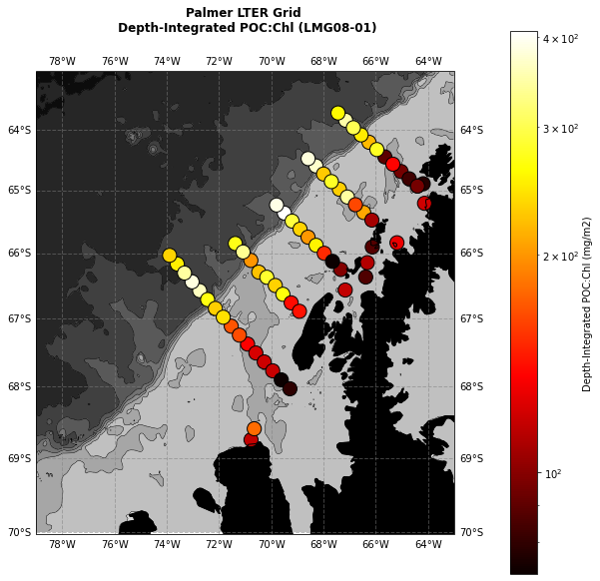
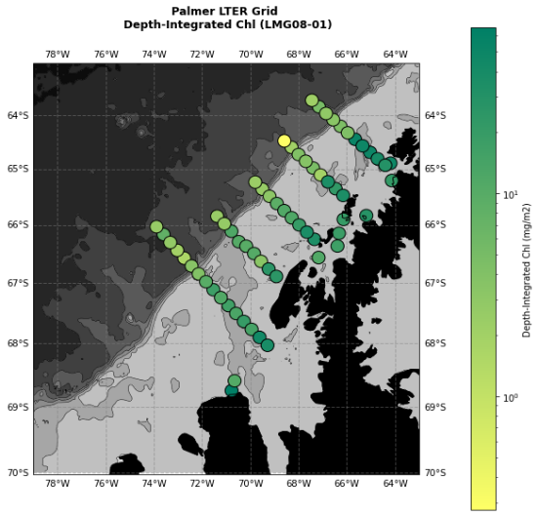
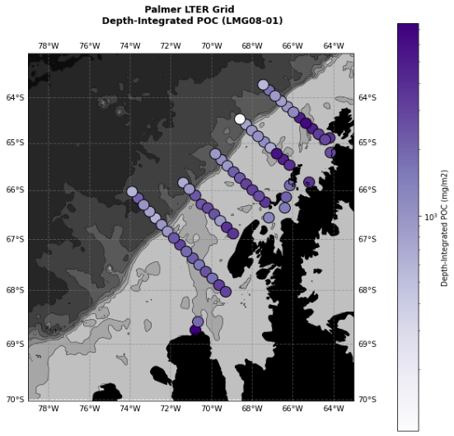
Current Progress: POC:Chl Ratio and Historic Data
METHOD: Analysis of Historic Data from the LTER Time Series
POC:Chl
Onshore-Offshore Trend Seems to be Present
Chl
POC

Slide 11
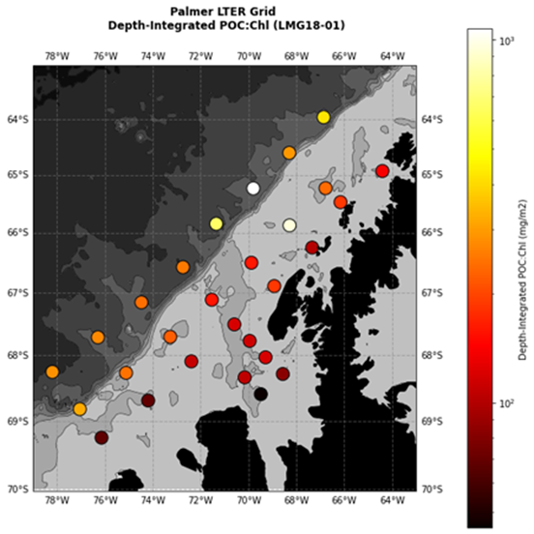
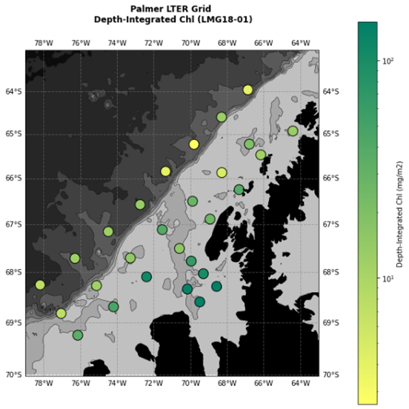
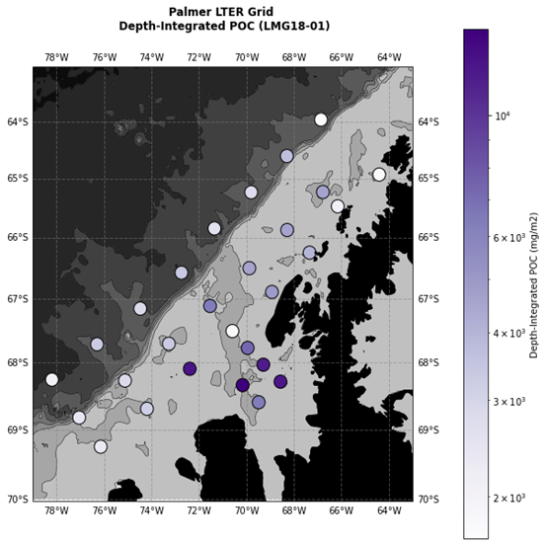
Current Progress: POC:Chl Ratio and Historic Data
Trend Seems to Hold in Modern Times
+
Maybe North-South Trend?
POC:Chl
Chl
POC

Slide 12
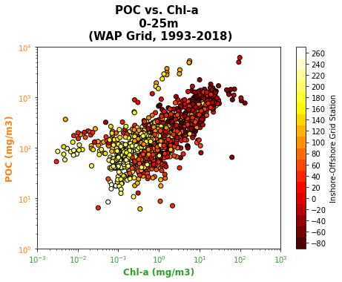
Current Progress: POC:Chl Ratio and Historic Data
Trend May Hold Throughout Time Series
Does this trend hold through time? Is it statistically significant?
Is this trend a result of photoacclimation processes? Or is it more indicative of shifts in biomass?
Are changes in POC congruent with changes in Chl? May indicate presence of photoacclimation if not…
Do calculated phytoplankton C:Chl ratios show a similar trend?

Slide 13
Next Steps: POC:Chl Ratio and Historic Data
Temporal Trends and Inter-Regional Comparisons
Empirical Orthogonal Function Analysis
C:Chl Calculations from Beam Transmission
Now
New Years
Looking at POC, Chl, and Trophodynamics
Regional and Temporal Statistics
POC:Chl as a good Substitute for C:Chl?

Slide 14
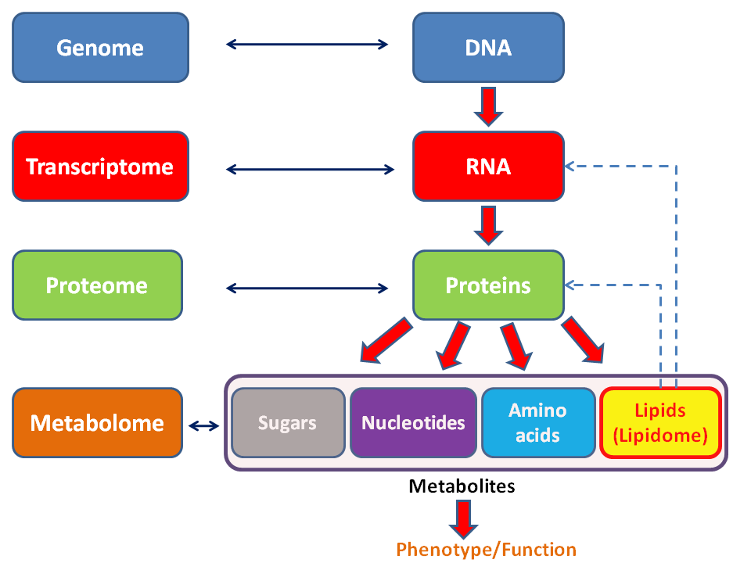
Future Steps: Meta-Omics and Lipidomics
Environmental or Laboratory Biomass Sample
METHOD: Using Omics to Gain Insight on Community Dynamics via Laboratory/In Situ Experiments and Field Measurements
Who’s There? What Can They Do?
(Taxonomic Identification and Phytochemical Potential)
What Are They Actively Doing?
(Gene Transcription and Regulation)
Lipids
What Are the Biological End Results?
(Lipid Abundance and Characterization)

Slide 15
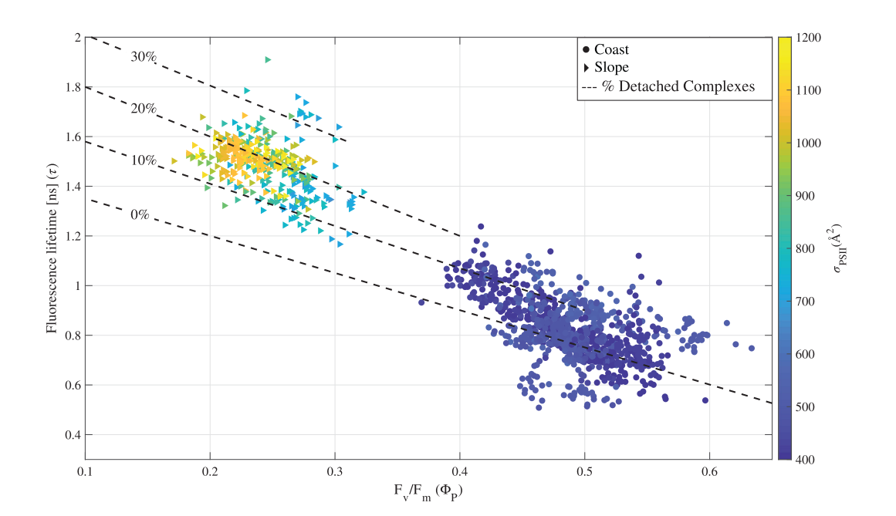
Future Steps: Fluorescence
METHOD: Using Two-pronged Fluorometry to Gain Insight on Photosynthetic Physiological State Across Space and Light Levels
New Technology!
Fluorescence Lifetime (PicoLiF)
+
Light Energy
Fv/Fm (FIRe Fluorometer)
Fluorescence
Emission
Thermal Dissipation
Iron Limited
Photochemistry
Light Limited
Utilize Simultaneously with Lipid Quantification and Functional Processes
Provide Biological Context to Inform Analyses

Slide 16
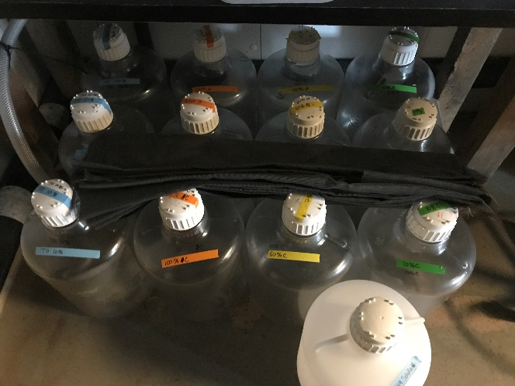
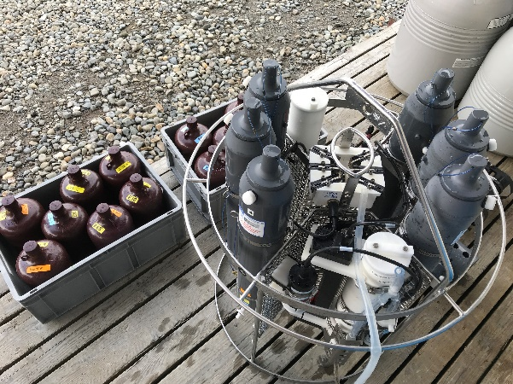
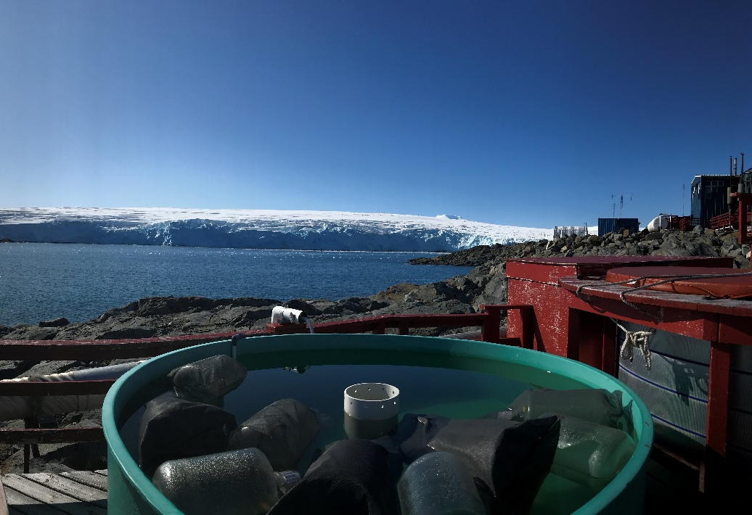
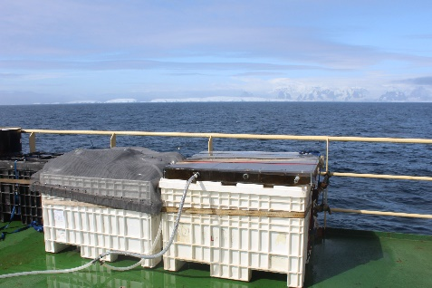
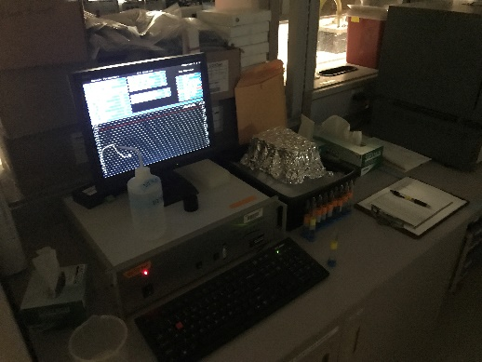
Future Steps: Community Dynamics and Meta-Omics

Slide 17
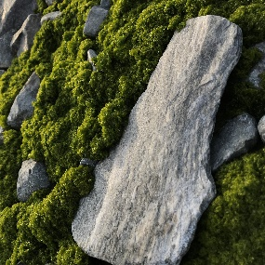
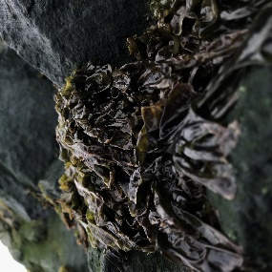
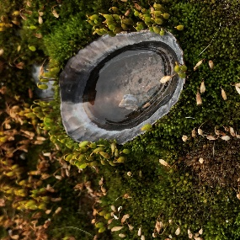
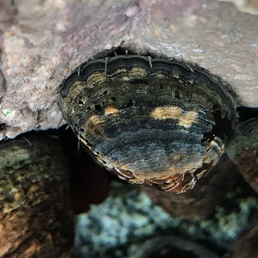
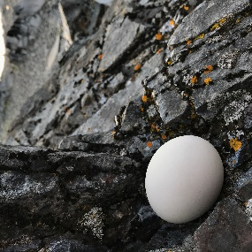
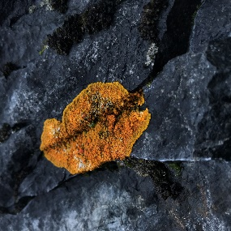
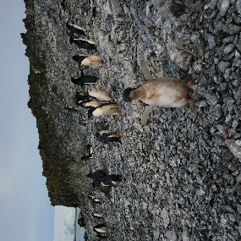
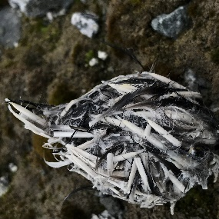
Timeline for the Future
How Exactly Does Light Influence Phytoplankton Physiology and Physiological Processes (Specifically Photoacclimation) in the WAP?
Analyze Historic Data Further
Flush Out Themes and Ideas for Thesis Chapters
Run Laboratory Experiments and Manipulations
Spring 2022
Now
Study Omic Methods and Theory
Write Up Findings From Historic Data
Return to Antarctica to Conduct Field Work
Begin Acquiring and Analyzing Omic Data

Slide 18
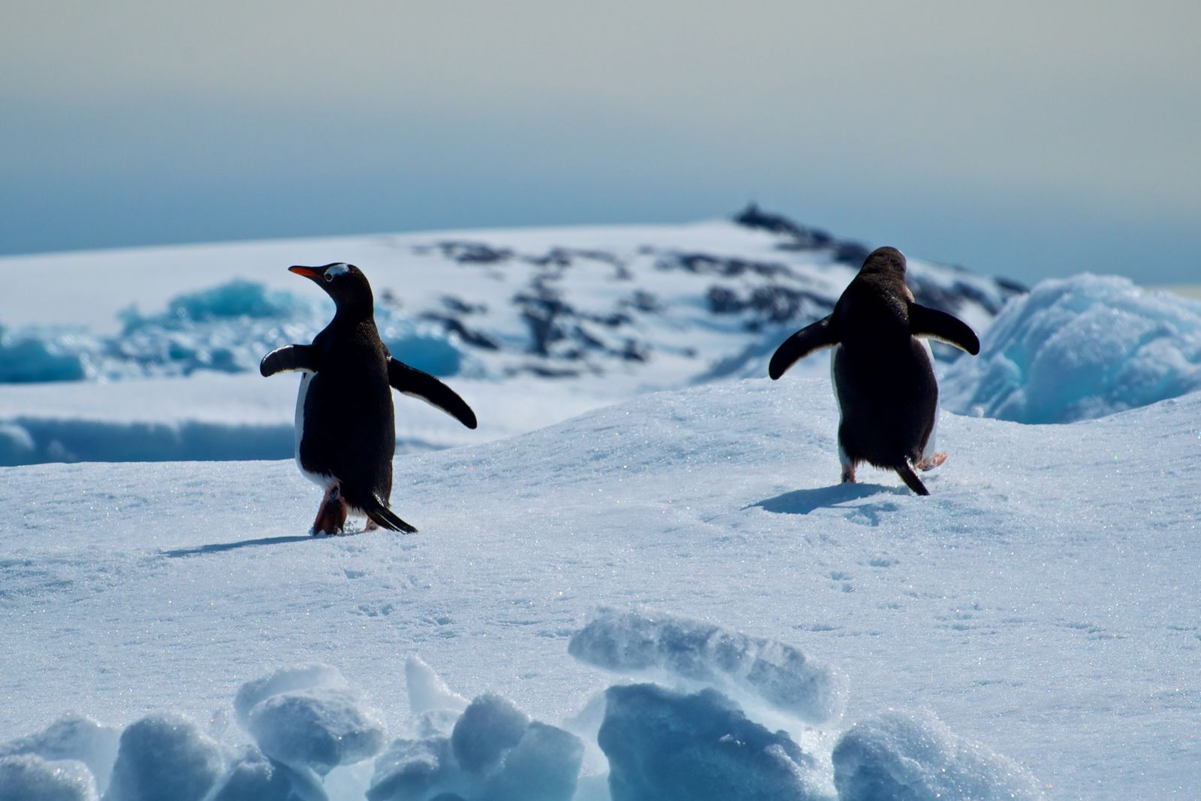
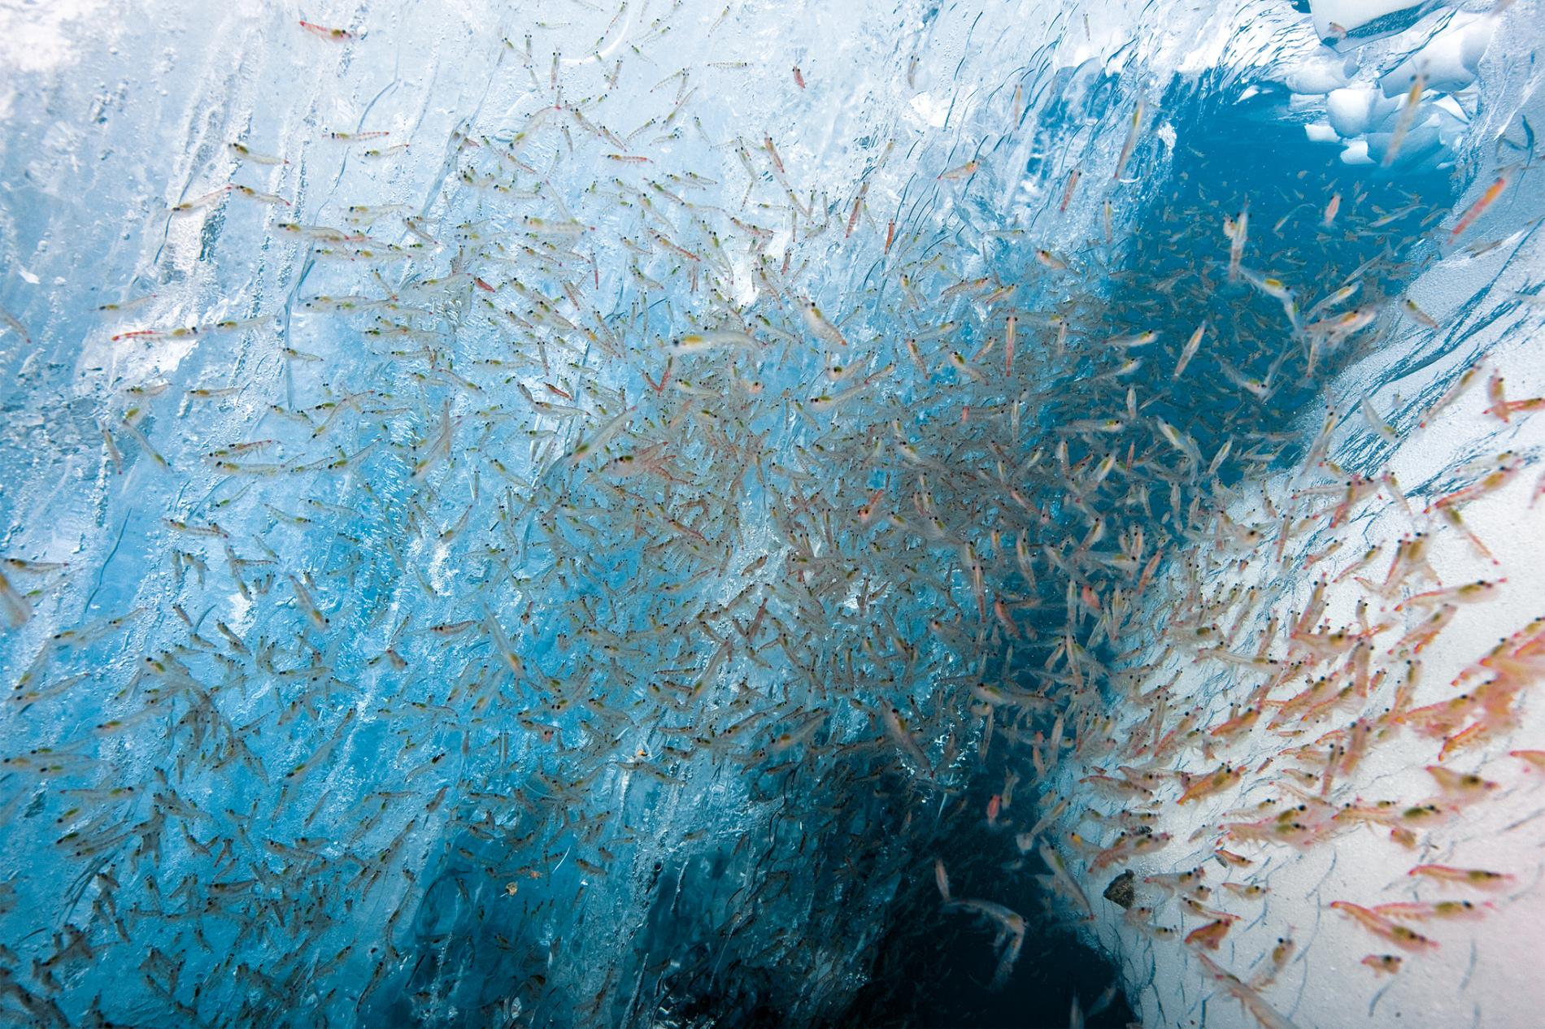
References
Brown, M. S., Munro, D. R., Feehan, C. J., Sweeney, C., Ducklow, H. W., & Schofield, O. M. (2019). Enhanced oceanic CO 2 uptake along the rapidly changing West Antarctic Peninsula. Nature Climate Change, 9(9), 678-683.
Henley, S. F., Schofield, O. M., Hendry, K. R., Schloss, I. R., Steinberg, D. K., Moffat, C., ... & Rozema, P. D. (2019). Variability and change in the west Antarctic Peninsula marine system: Research priorities and opportunities. Progress in Oceanography, 173, 208-237.
Montes-Hugo, M., Doney, S. C., Ducklow, H. W., Fraser, W., Martinson, D., Stammerjohn, S. E., & Schofield, O. (2009). Recent changes in phytoplankton communities associated with rapid regional climate change along the western Antarctic Peninsula. Science, 323(5920), 1470-1473.
Rogers, A. D., Frinault, B. A. V., Barnes, D. K. A., Bindoff, N. L., Downie, R., Ducklow, H. W., ... & Linse, K. (2019). Antarctic futures: an assessment of climate-driven changes in ecosystem structure, function, and service provisioning in the Southern Ocean. Annual review of marine science, 12.
Schallenberg, C., Harley, J. W., Jansen, P., Davies, D. M., & Trull, T. W. (2019). Multi-year observations of fluorescence and backscatter at the Southern Ocean Time Series (SOTS) shed light on two distinct seasonal bio-optical regimes. Frontiers in Marine Science, 6, 595.
Schofield, O., Saba, G., Coleman, K., Carvalho, F., Couto, N., Ducklow, H., ... & Montes-Hugo, M. (2017). Decadal variability in coastal phytoplankton community composition in a changing West Antarctic Peninsula. Deep Sea Research Part I: Oceanographic Research Papers, 124, 42-54.
Sherman, J., Gorbunov, M. Y., Schofield, O., & Falkowski, P. G. (2020). Photosynthetic energy conversion efficiency in the West Antarctic Peninsula. Limnology and Oceanography.
Stammerjohn, S., & Maksym, T. (2017). Gaining (and losing) Antarctic sea ice: variability, trends and mechanisms. Sea Ice,, 261-289.
Steinberg, D. K., Ruck, K. E., Gleiber, M. R., Garzio, L. M., Cope, J. S., Bernard, K. S., ... & Ross, R. M. (2015). Long-term (1993–2013) changes in macrozooplankton off the Western Antarctic Peninsula. Deep Sea Research Part I: Oceanographic Research Papers, 101, 54-70.
Thomalla, S. J., Ogunkoya, A. G., Vichi, M., & Swart, S. (2017). Using optical sensors on gliders to estimate phytoplankton carbon concentrations and chlorophyll-to-carbon ratios in the Southern Ocean. Frontiers in Marine Science, 4, 34.

Slide 19
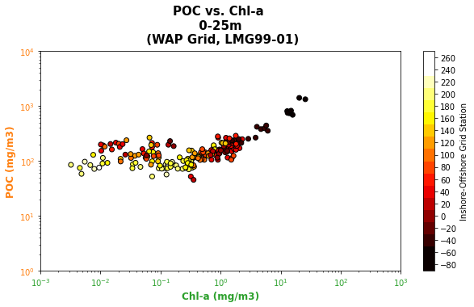
Supplementary
Scatter plots with PAL9192, PAL1011, and PD94-01 removed (unusually low POC values?)
LMG99-01
Scatter plots with PAL9192, PAL1011, and PD94-01 NOT removed (unusually low POC values?)
PAL9192
PAL9192
PD94-01
PAL1011
PAL1011

Slide 20
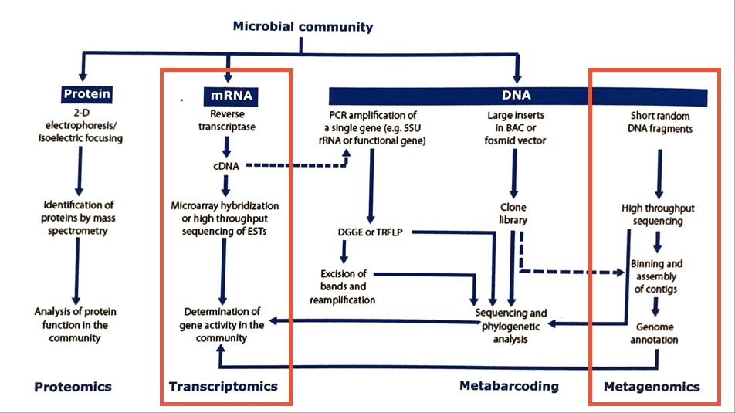
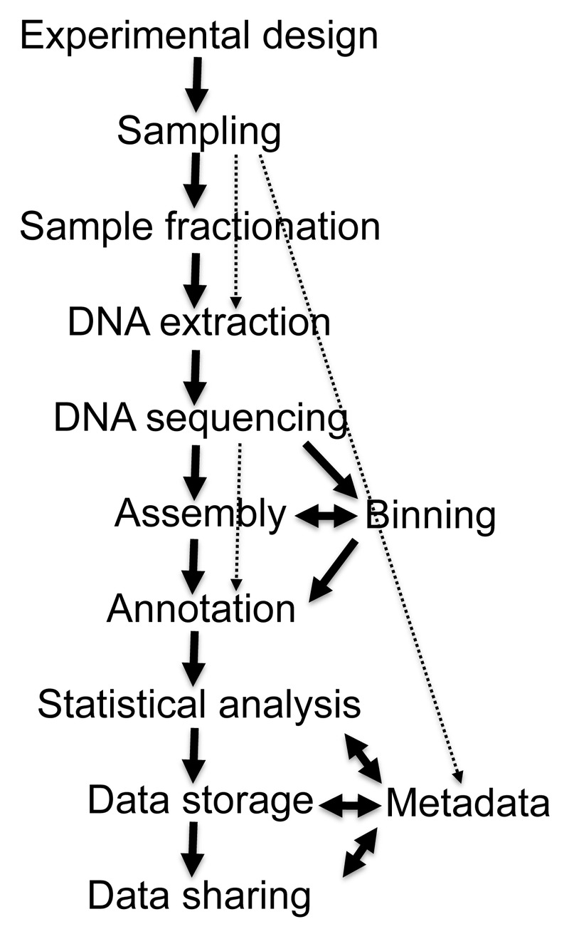
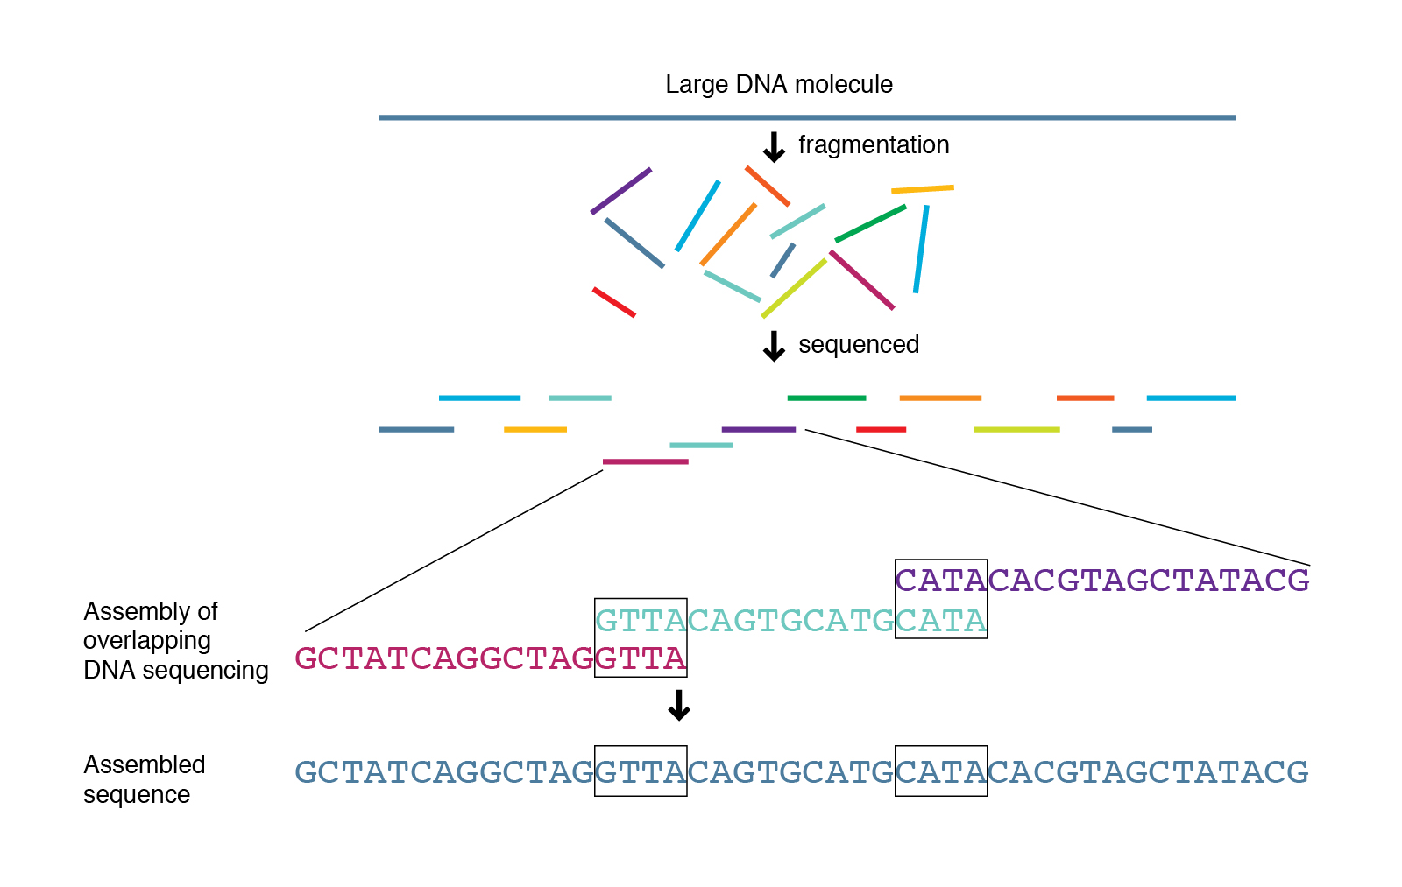
Supplementary
Shotgun Sequencing

Slide 21
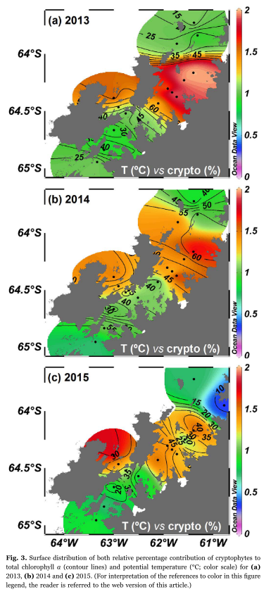
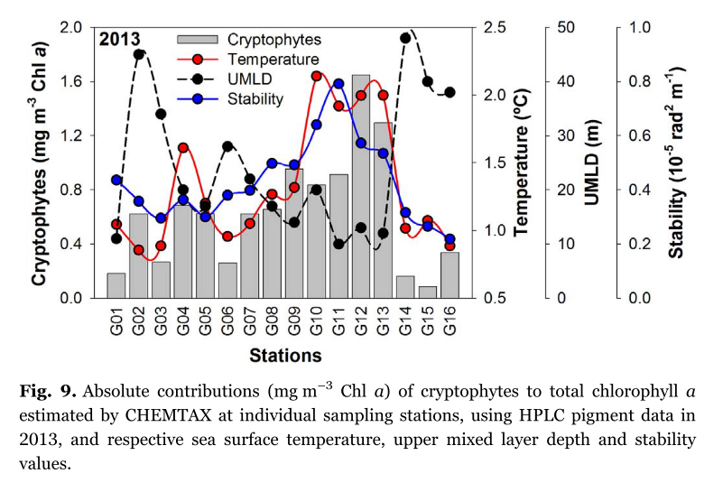
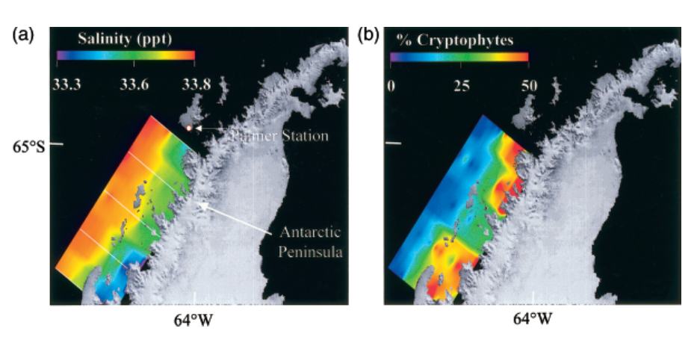
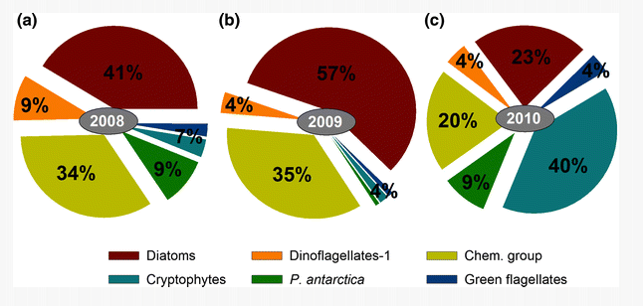
Supplementary
Henley et al. 2019
${CO}^{2}$Outgassing
Mendes et al. (2018)
${CO}^{2}$ Uptake
Mendes et al. (2013)
Deep MLD
Shallow MLD

Slide 22
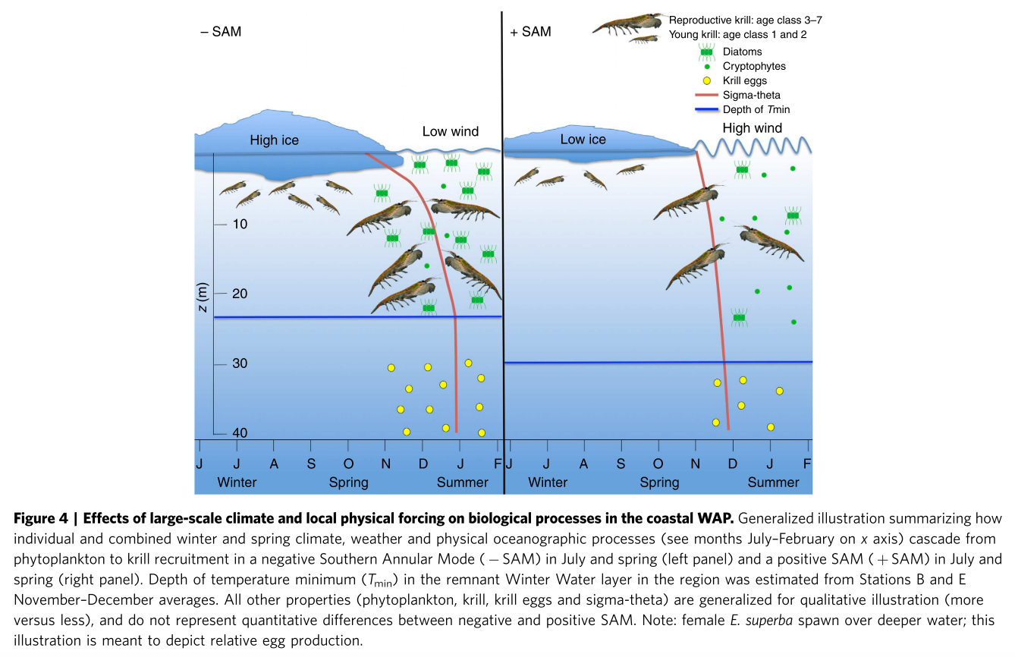
Supplementary
NEGATIVE SAM
Cold Winds Across The WAP
▼
Increased Sea Ice Extent
▼
Decreased Wind Mixing
▼
Shallow Mixed Layer Depth
▼
Increased Light
▼
Increased Phytoplankton
▼
Increased Krill Recruitment
▼
Not-Dead Penguin Babies
POSITIVE SAM
Warm Winds Across The WAP
▼
Decreased Sea Ice Extent
▼
Increased Wind Mixing
▼
Deep Mixed Layer Depth
▼
Decreased Light
▼
Decreased Phytoplankton
▼
Decreased Krill Recruitment
▼
Dead Penguin Babies
-
+
SAM Is A Key Influencer Of WAP Trophic System

