Slide 1

Air-Sea coupling with the ESMF/NUOPC Layer:
WRF and ROMS
Travis Miles,
Hernan Arango, and John Wilkin
Department of Marine and Coastal Sciences
Rutgers University, New Brunswick NJ
U.S. IOOS 2019 COMT Annual Meeting
Silver Spring, MD
October 22-24th, 2019

Slide 2

Hurricane Irene
2011

Slide 3

Pre-Irene Storm Warnings
Over 2 million people ordered to “flee the storm’s path”.
President Obama: Shaping up to be a “historic hurricane” and urged residents to “be prepared for the worst”. “Don’t wait. Don’t delay.”
New Jersey Governor Christie: Ordered evacuation of 1 million people - “This is going to be an enormous storm, and for New Jersey, something we haven’t seen in over 60 years”. “Get the hell off the beach”.
New York Mayor Bloomberg: “Staying behind is dangerous, staying behind is foolish, and its against the law”. “The time to leave is right now”. The bridges, streets and subways were nearly empty ahead of a nearly unprecedented mass transit shutdown.

Slide 4
AP PHOTO/MEL EVANS
Notes:
Can I improve this picture?

Slide 5
Official NHC intensity forecasts for Irene every 6 h from 1200 UTC 23 August to 0600 UTC 28 August.

Slide 6
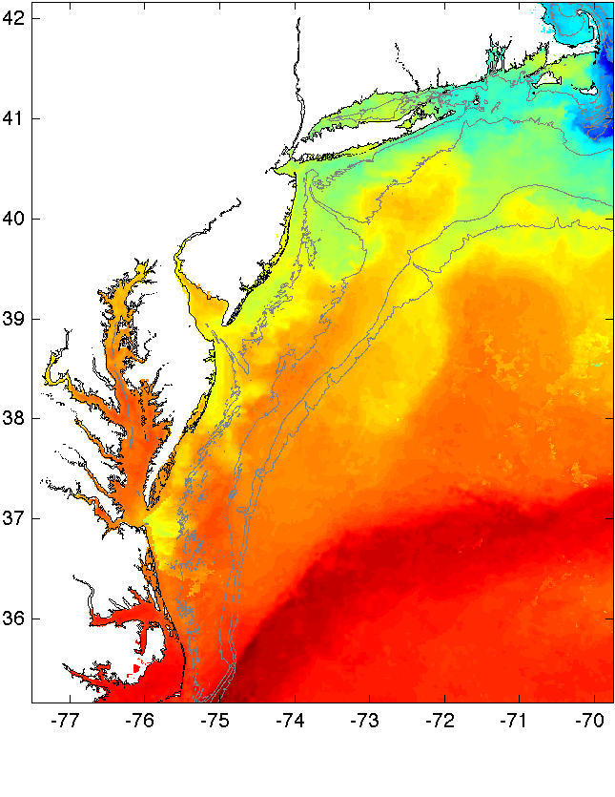
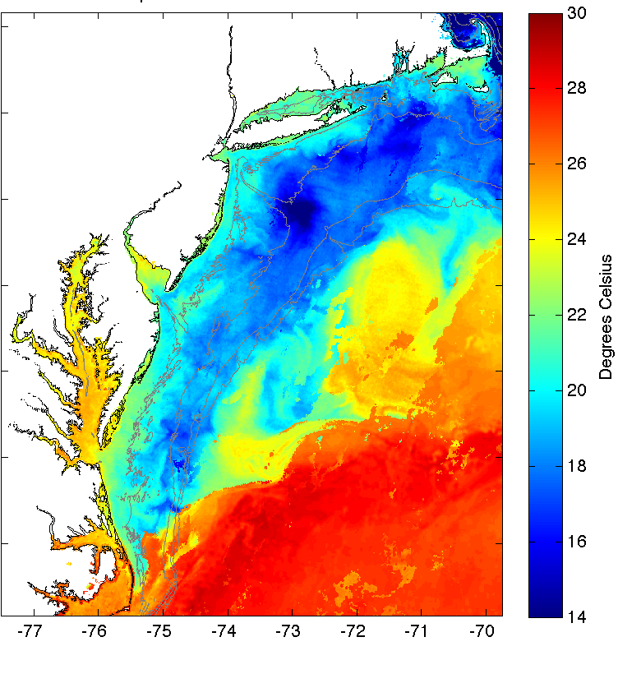
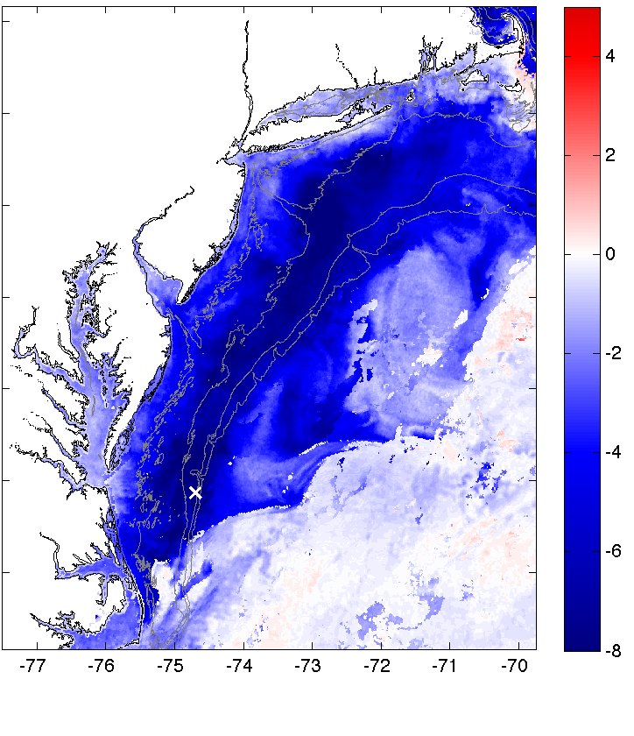
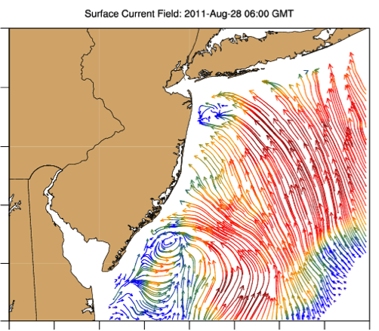
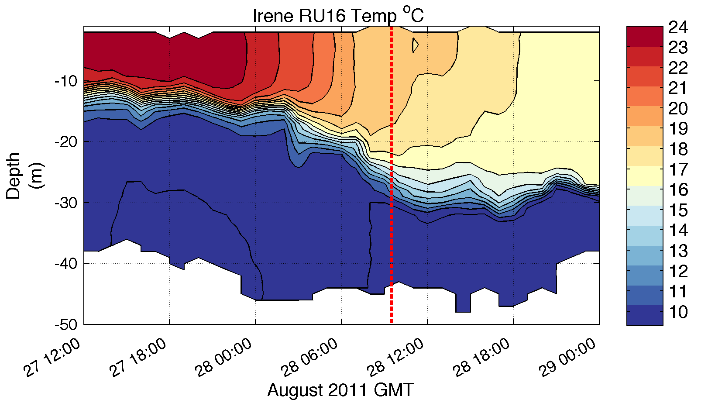
Pre-Irene
Post-Irene
Difference
11C max Cooling
Satellite
SST
Glider Temperature
HF Radar
Currents
Eye Passage
Glenn et al., Nature Communications (2016)

Slide 7
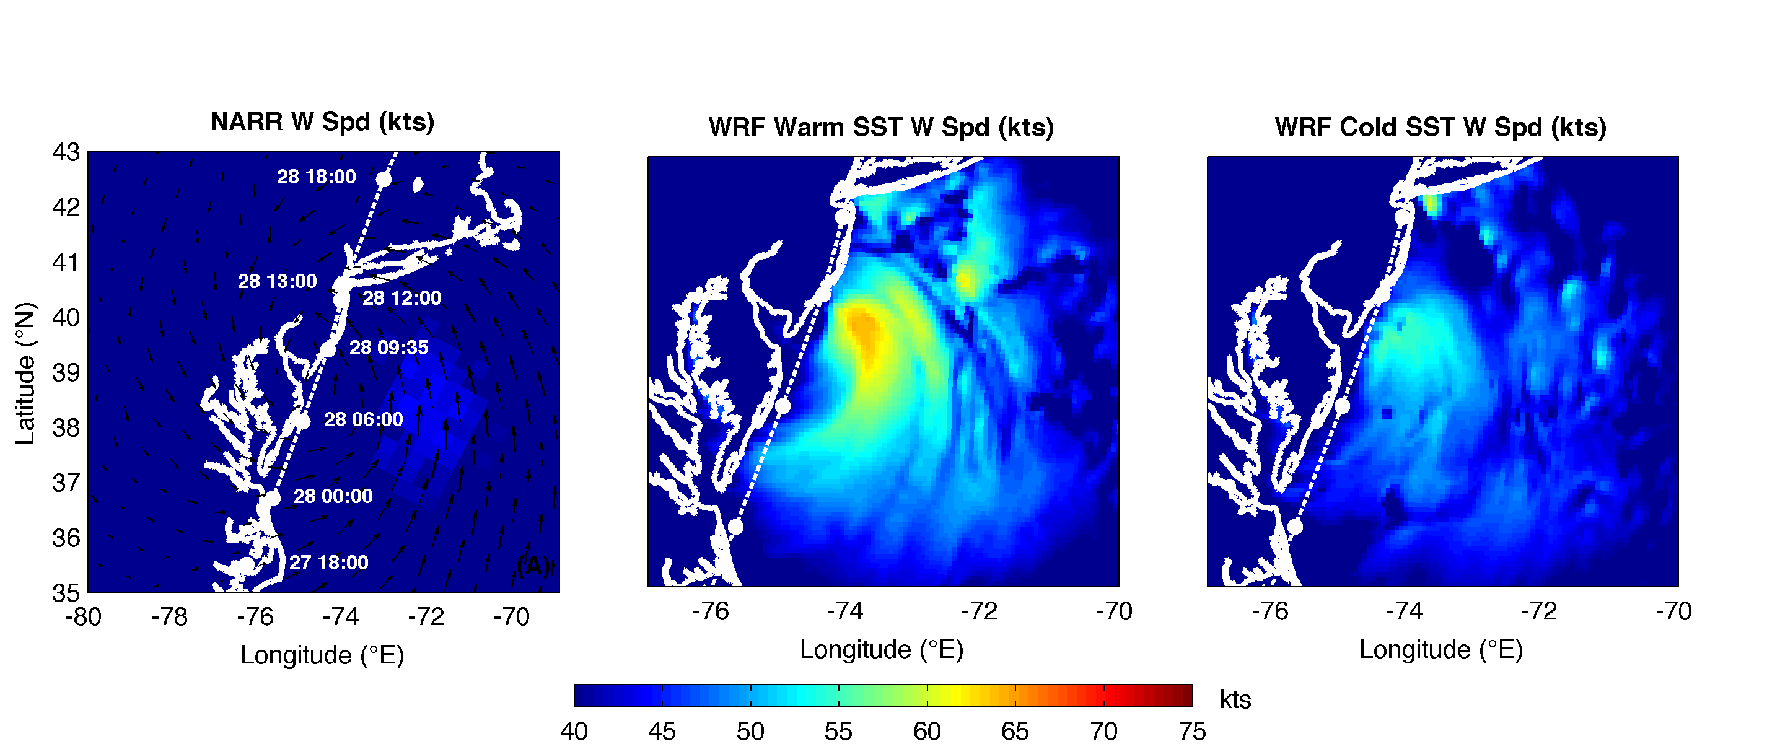
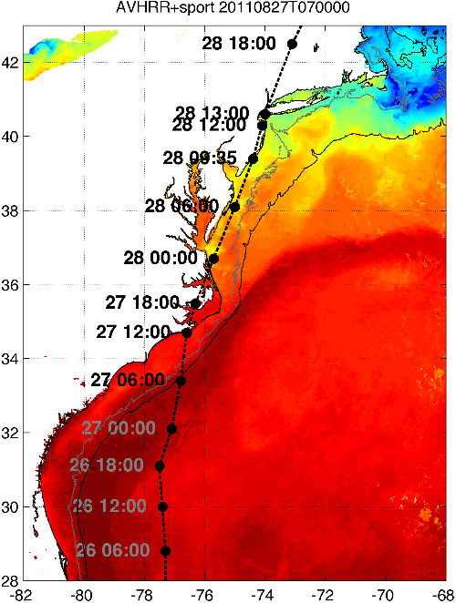
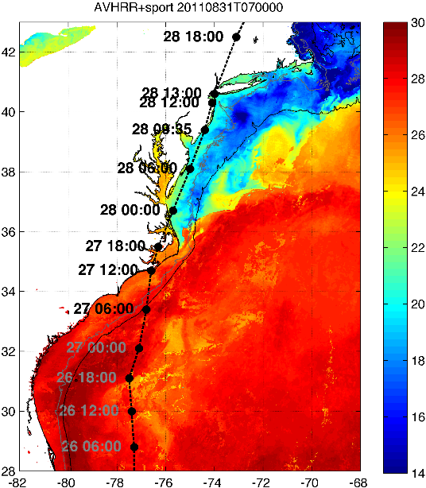
Atmospheric Forecast Sensitivity Study
Cat 1 Hurricane
Warm Ocean
Boundary Condition
Tropical Storm
Cold Ocean
Boundary Condition
IMPACT?
>10 knots reduction in peak wind speed
Seroka et al. Monthly Weather Review (2016)

Slide 8
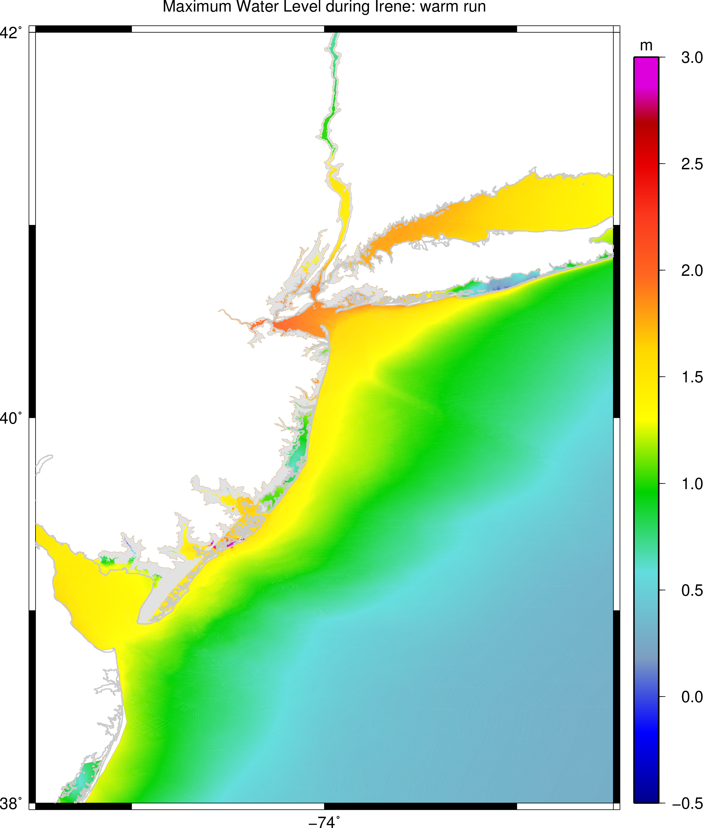
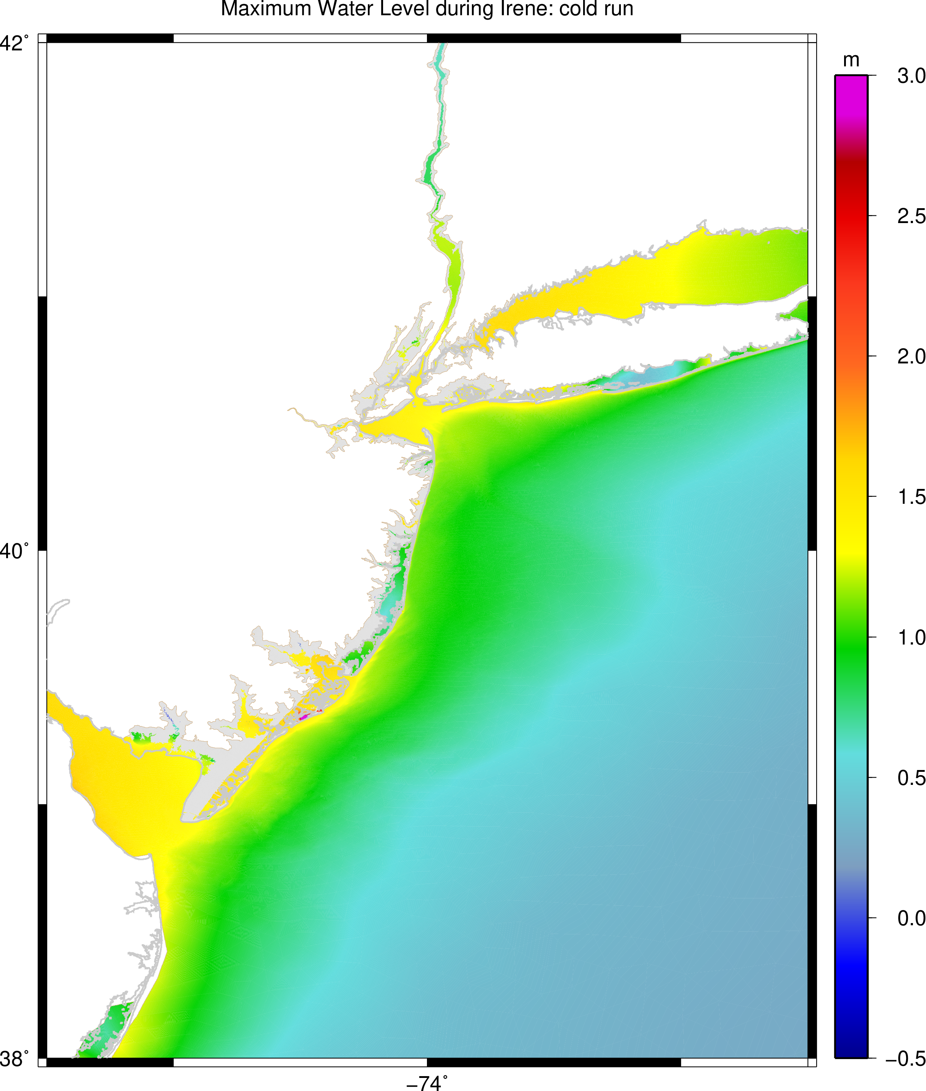
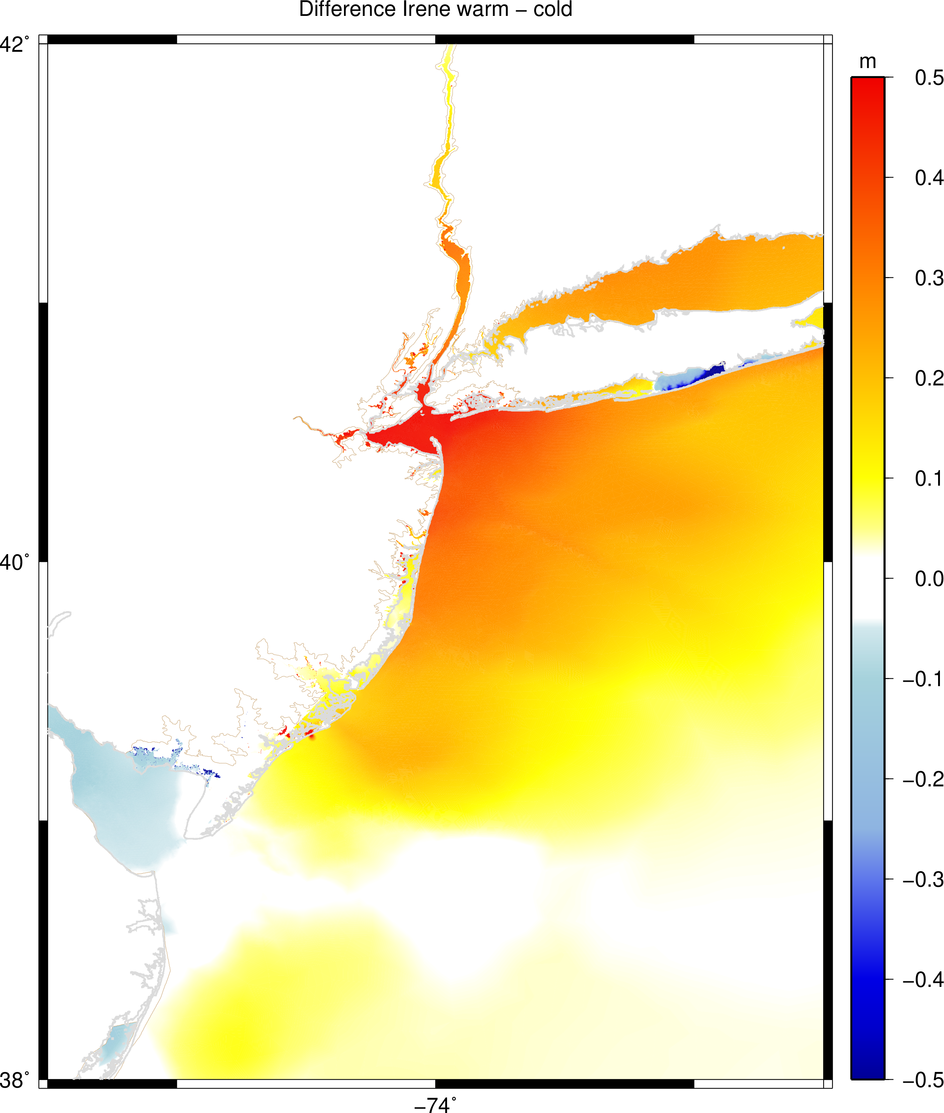
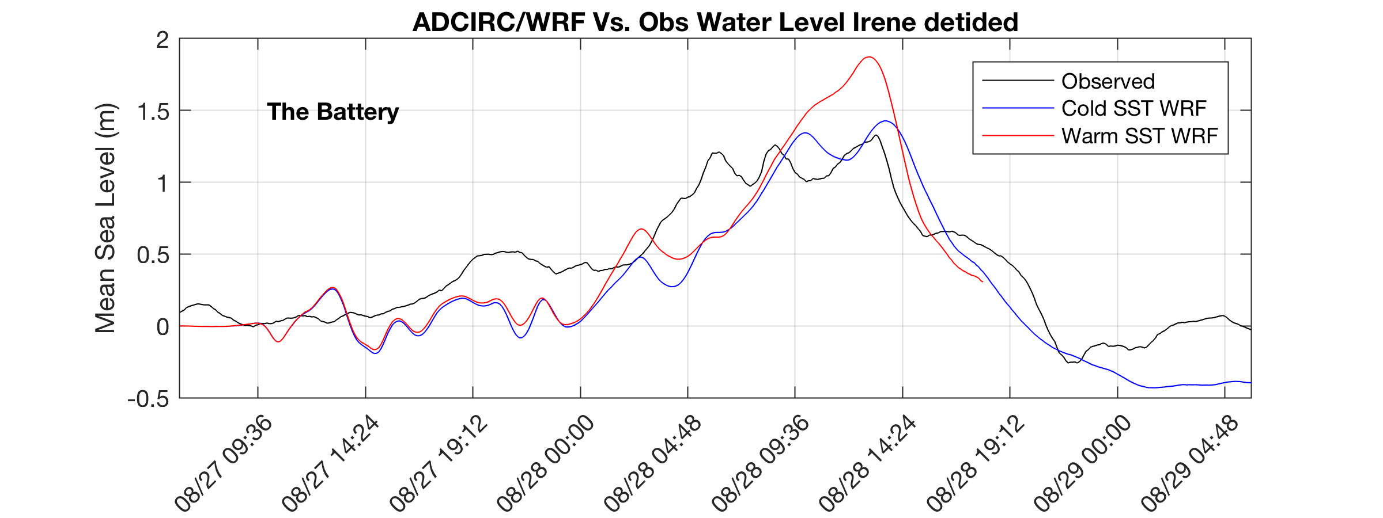
ADCIRC Storm Surge Model driven by RUWRF winds
ADCIRC - FEMA Region II Mesh
Maximum water level:
Warm Run
Maximum water level:
Cold Run
Water Level Difference (m)
Warm - Cold
1.9 m
1.4 m
From PhD candidate Alexandra Ramos

Slide 9
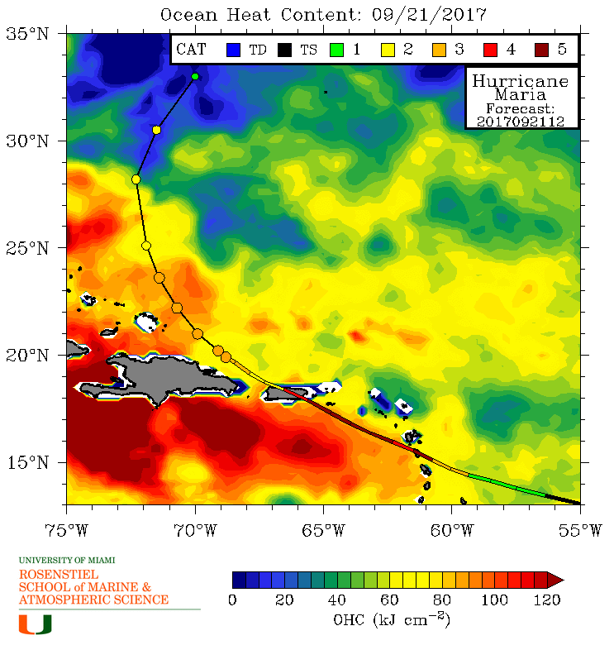
Hurricane Intensity is modulated by upper ocean heat content
Rapid intensification of Hurricane Maria over warm ocean water

Slide 10
Hurricane Supplemental
ESMF/NUOPC Coupling ROMS-WRF
Project Overview:
Develop Air-Sea coupling with the ESMF coupler and NUOPC layer for the Regional Ocean Modeling System (ROMS) and the Weather Research and Forecasting (WRF) model. Allow coupled ROMS applications to join the NOAA Unified Forecasting System.
Utilize existing MARACOOS domain applications to test and evaluate the coupling system. Specifically Hurricane Irene, which was strongly coupled to the atmosphere.
Establish a path for future work: Coupling ROMS to other NOAA operational modeling systems, test nested coupled modeling, and develop coupled data assimilation.
Notes:
Develop ROMS-WRF coupling with ESMF/NUOPC libraries
capabilities between WRF and ROMS with the ESMF/NUOPC libraries to join other operational NOAA modeling systems.
Initially develop a coupled model domain for the MARACOOS region
Coupling philosophy without WRF intervention
Loosely coupled DA, Background trajectory is a coupled run

Slide 11

Earth System Modeling Framework (ESMF)
High performance and flexible software infrastructure for building and coupling weather, climate, and other Earth Science applications.
Basic idea: Applications should be broken up into coherent pieces, or components, with standard calling interfaces.
Components can be physical domains, earth system models, couplers, parameterizations, nested grids, etc.
Community development of coupling tools: v8 released 10/18/19
git clone https://git.code.sf.net/p/esmf/esmf esmf-esmf
https://www.earthsystemcog.org/projects/esmf/

Slide 12

National Unified Operational Prediction Capability
NUOPC is a consortium of Navy, NOAA, and Air Force modelers and their research partners, with the aim to advance weather prediction capabilities.
The NUOPC Layer is a simplified infrastructure on top of the ESMF library that provides conventions and templates to facilitate the easy coupling between Earth System Models (ESMs).
Allows for coupling with limited or no editing of ESM component source code.
https://www.earthsystemcog.org/projects/nuopc/
Notes:
Develop a coupling interface with the ESMF Library Version 7.0 or higher. Using the National Unified Operational Prediction Capability (NUOPC) Layer.

Slide 13
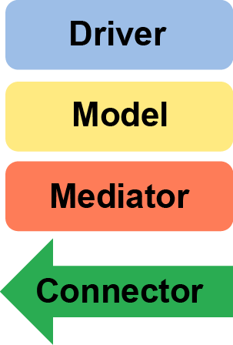
ESMF/NUOPC Coupling
The NUOPC layer consist of four generic components:
Controls Models, Mediators, and Connectors. Coordinates initialization and time-stepping.
Earth System Models: Atmosphere, Ocean, Sea Ice, Waves, etc.
Custom coupling code between models: Flux calculations, scaling, averaging, etc.
Connects pair of components: Model to/from Model, Model to/from Mediator. Computes transformations and re-gridding.

Slide 14
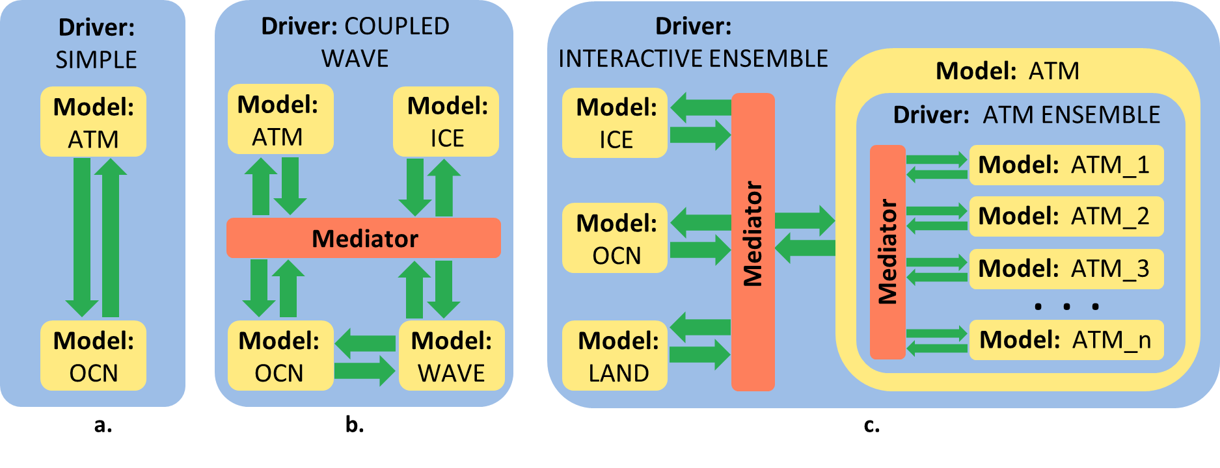
ESMF/NUOPC Coupling

Slide 15
ESMF/NUOPC Coupling
Component Mode: The NUOPC ROMS cap module (esmf_roms.F) is provided which can be adapted and incorporated into other NUOPC-based coupling systems.
A NUOPC Model cap is a Fortran module layer that sits on top of the ESM component, making calls into it (initialize, run, and finalize phases).

Slide 16
ESMF/NUOPC Coupling
Component Mode: The NUOPC ROMS cap module (esmf_roms.F) is provided which can be adapted and incorporated into other NUOPC-based coupling systems.
A NUOPC Model cap is a Fortran module layer that sits on top of the ESM component, making calls into it (initialize, run, and finalize phases).
Driver Mode: ROMS provides all the interfaces needed to couple to other ESM components including:
  Main Driver (esmf_driver.h)
  NUOPC-based generic ESM component services (esmf_esm.F)
  Utility module (mod_esmf_esm.F) defining structures and variables for ESM coupling. It includes several support routines.
  Model gridded components or NUOPC model cap files (esmf_atm.F, esmf_data.F, esmf_ice.F, esmf_roms.F, and esmf_wav.F)
  Connectors between components for re-gridding source and destination fields (esmf_coupler.h)
  Coupling input script (coupling_esmf.in) and import/export fields metadata management (coupling_esmf.dat)

Slide 17
ROMS ESMF Coupling Infrastructure
master.F
esmf_driver.h
esmf_esm.F mod_esmf_esm.F
esmf_roms.F
esmf_ice.F
esmf_atm.F
esmf_wav.F
esmf_data.F

Slide 18
ROMS ESMF Coupling Infrastructure
Sea Ice ESM
Atmospheric ESMs
COAMPS: Coupled Ocean-Atmosphere Mesoscale Prediction System (Hodur, 1997; Chen et al., 2014). It can be used for both free and restricted NRL versions.
RegCM: Regional Climate Model (Elguindi et al., 2014), Version 4.5 (RegCM4) and up. Maintained by the International Centre for Theoretical Physics (ICTP), Trieste, Italy. It was build upon the NCAR-PSU Mesoscale Model version 4 (MM4; Dickinson et al., 1989; Giorgi, 1989).
WRF: Weather Research and Forecasting model (Skamarock et al., 2005). Maintained by a consortium of US agencies and institutions (NCAR, NCEP, FSL, AFWA, NRL, FAA, and University of Oklahoma).
CICE: Los Alamos sea ice model (Hunkle et al., 2015).
Wave ESMs in Development
SWAN: Simulating Waves Nearshore (Booij et al., 1999).
WAM: Wave Modelling (WAMDI Group, 1998).
WW3: WaveWatch III (Tolman, 2009). Developed at MMAB/NCEP.

Slide 19
ROMS Coupling Framework Summary
The ROMS coupling framework via the ESMF/NUOPC library can be executed sequentially or concurrently:
  In sequential mode, all the coupled model components are executed on all of the specified Persistent Execution Threads (PETs).
  In concurrent mode, each coupled model component is executed on non-overlapping sets of PETs.

Slide 20
ROMS Coupling Framework Summary
The ROMS coupling framework via the ESMF/NUOPC library can be executed sequentially or concurrently:
  In sequential mode, all the coupled model components are executed on all of the specified Persistent Execution Threads (PETs).
  In concurrent mode, each coupled model component is executed on non-overlapping sets of PETs.
The coupling type can be explicit, implicit, or semi-implicit:
  Explicit coupling: exchange fields at the next time-step (n+1) are defined using known values from the time-step (n) before it. Requires less computational effort and are accurate for small coupling time windows.
  implicit coupling: exchange fields defined using values for the next time-step (n+1) in both the source and destination models. Stable and allow longer coupling time-steps but can be more expensive.
  Semi-implicit: exchange in one direction is explicit (ocean-to-atmosphere) and in the reverse direction is implicit (atmosphere-to-ocean). Usually used for the atmosphere-ocean coupling.

Slide 21
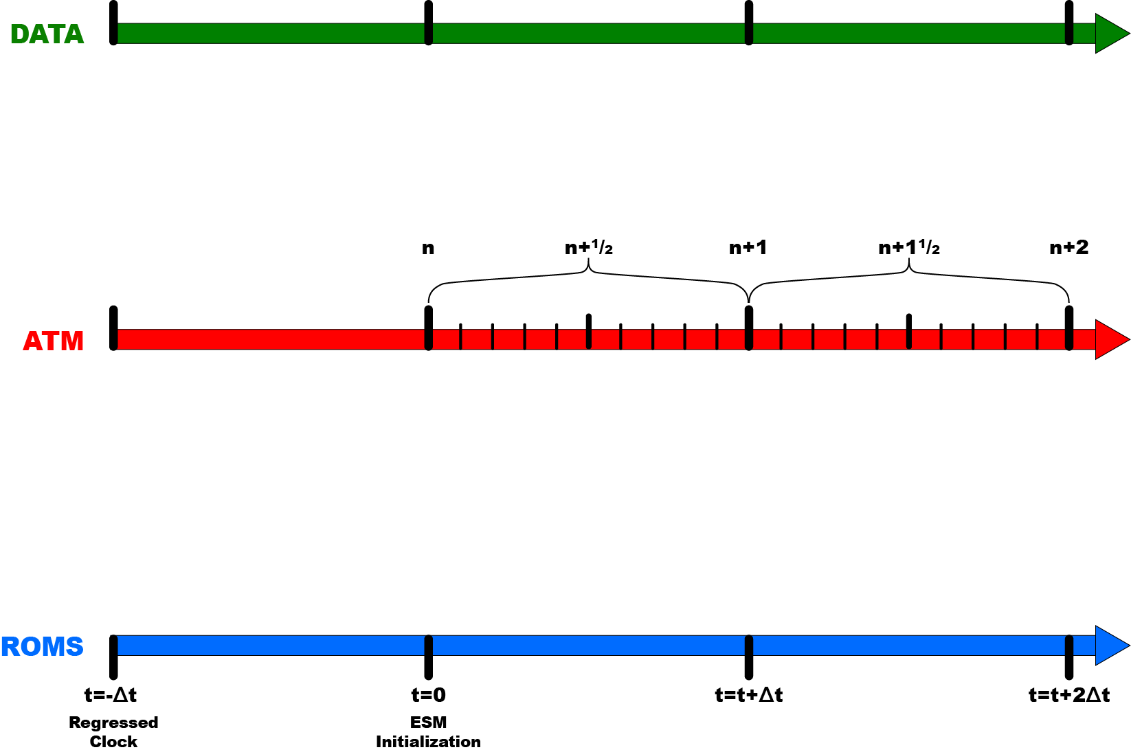
Coupling Run Sequence: DATA-ATM-ROMS
Semi-Implicit: ATM-Average

Slide 22
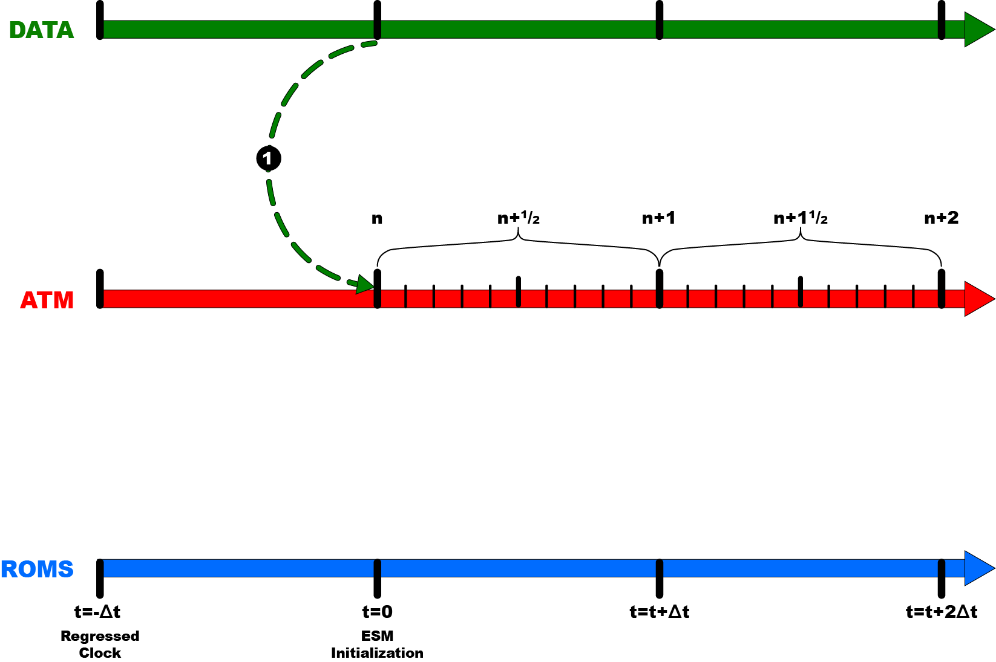
Coupling Run Sequence: DATA-ATM-ROMS
Semi-Implicit: ATM-Average
DATA exports SST to ATM
at locations not covered by
ROMS

Slide 23
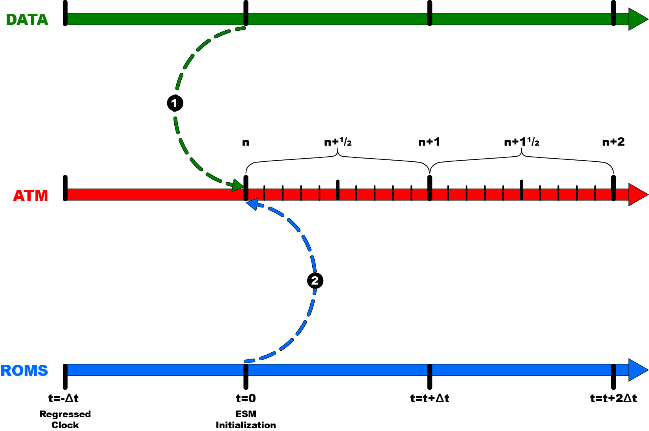
Coupling Run Sequence: DATA-ATM-ROMS
Semi-Implicit: ATM-Average
ROMS exports SST to ATM

Slide 24
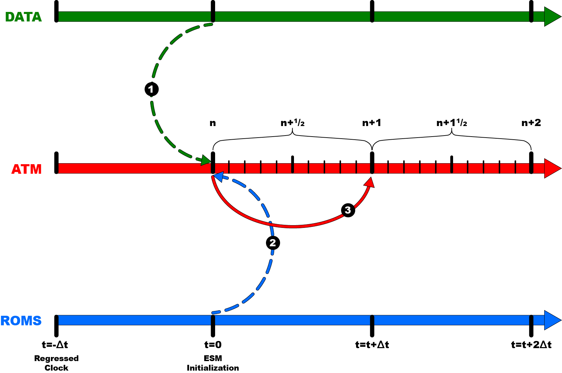
Coupling Run Sequence: DATA-ATM-ROMS
Semi-Implicit: ATM-Average
ATM timesteps for a coupling interval

Slide 25
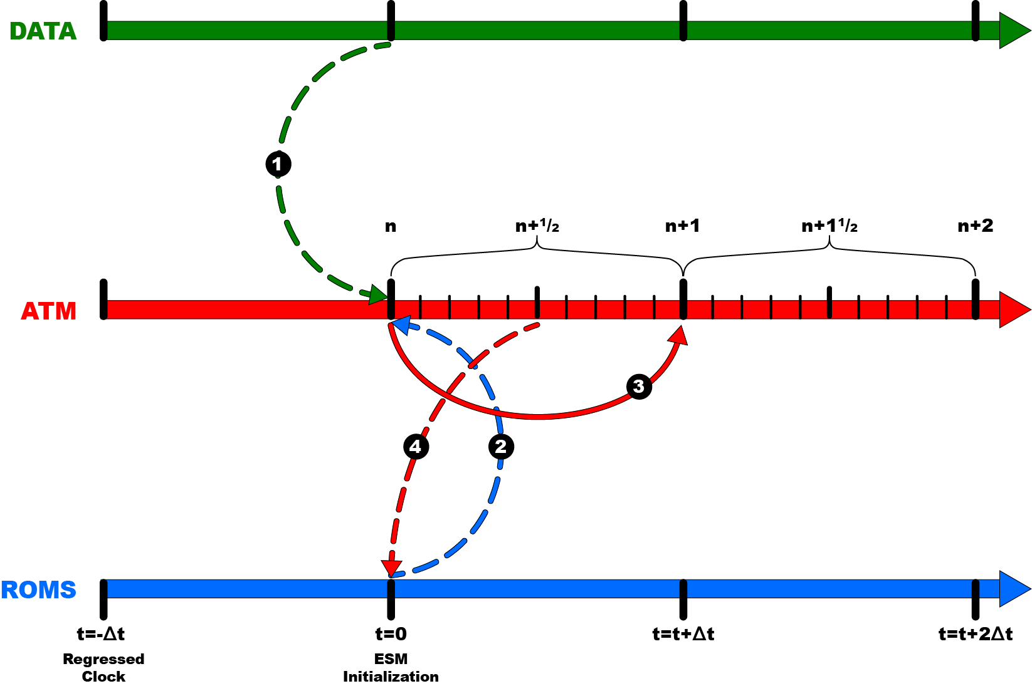
Coupling Run Sequence: DATA-ATM-ROMS
Semi-Implicit: ATM-Average
ATM exports time averaged
fields to ROMS

Slide 26
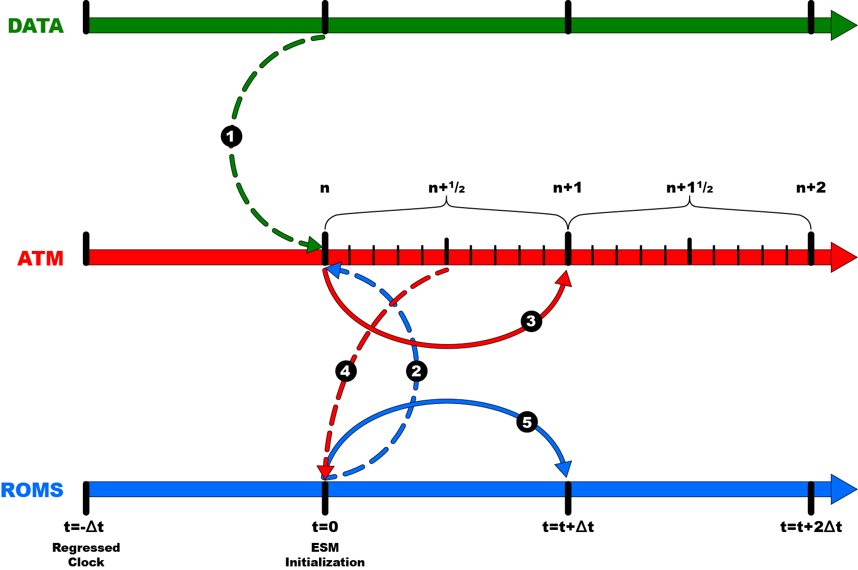
Coupling Run Sequence: DATA-ATM-ROMS
Semi-Implicit: ATM-Average
ROMS timesteps for a coupling interval

Slide 27
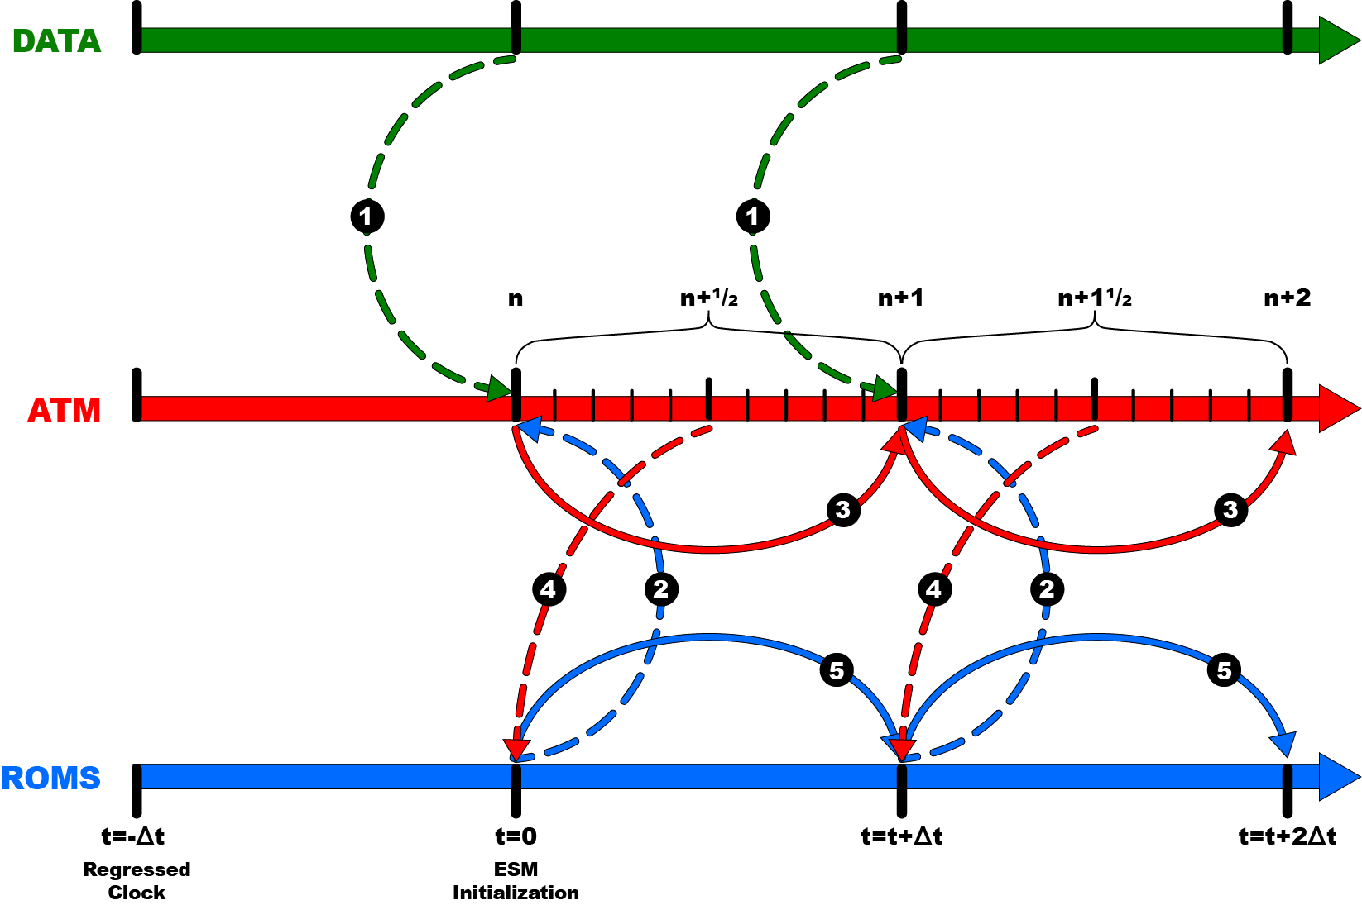
Coupling Run Sequence: DATA-ATM-ROMS
Semi-Implicit: ATM-Average

Slide 28
ROMS Coupling Framework Summary
The ROMS coupling framework via the ESMF/NUOPC library can be executed sequentially or concurrently:
  In sequential mode, all the coupled model components are executed on all of the specified Persistent Execution Threads (PETs).
  In concurrent mode, each coupled model component is executed on non-overlapping sets of PETs.
The coupling type can be explicit, implicit, or semi-implicit:
  Explicit coupling: exchange fields at the next time-step (n+1) are defined using known values from the time-step (n) before it. Requires less computational effort and are accurate for small coupling time windows.
  implicit coupling: exchange fields defined using values for the next time-step (n+1) in both the source and destination models. Stable and allow longer coupling time-steps but can be more expensive.
  Semi-implicit: exchange in one direction is explicit (ocean-to-atmosphere) and in the reverse direction is implicit (atmosphere-to-ocean). Usually used for the atmosphere-ocean coupling.
Regridding: ESMF includes built-in REGRID interpolation between source and destination fields: Bilinear, Nearest Neighbor, two-step extrapolation, support for user defined grid weighting.

Slide 29
ROMS Coupling Framework Summary
The ROMS coupling framework via the ESMF/NUOPC library can be executed sequentially or concurrently:
  In sequential mode, all the coupled model components are executed on all of the specified Persistent Execution Threads (PETs).
  In concurrent mode, each coupled model component is executed on non-overlapping sets of PETs.
The coupling type can be explicit, implicit, or semi-implicit:
  Explicit coupling: exchange fields at the next time-step (n+1) are defined using known values from the time-step (n) before it. Requires less computational effort and are accurate for small coupling time windows.
  implicit coupling: exchange fields defined using values for the next time-step (n+1) in both the source and destination models. Stable and allow longer coupling time-steps but can be more expensive.
  Semi-implicit: exchange in one direction is explicit (ocean-to-atmosphere) and in the reverse direction is implicit (atmosphere-to-ocean). Usually used for the atmosphere-ocean coupling.
Regridding: ESMF includes built-in REGRID interpolation between source and destination fields: Bilinear, Nearest Neighbor, two-step extrapolation, support for user defined grid weighting.
Nesting: Each nested grid is considered a separate component. NUOPC Connector recognizes different grids and transfers data to a connected component including nest-to-nest, if both components have refined grids. Or it can regrid between a finer grid in one component and a coarser grid in another.

Slide 30
ROMS Coupling Framework Summary
The ROMS coupling framework via the ESMF/NUOPC library can be executed sequentially or concurrently:
  In sequential mode, all the coupled model components are executed on all of the specified Persistent Execution Threads (PETs).
  In concurrent mode, each coupled model component is executed on non-overlapping sets of PETs.
The coupling type can be explicit, implicit, or semi-implicit:
  Explicit coupling: exchange fields at the next time-step (n+1) are defined using known values from the time-step (n) before it. Requires less computational effort and are accurate for small coupling time windows.
  implicit coupling: exchange fields defined using values for the next time-step (n+1) in both the source and destination models. Stable and allow longer coupling time-steps but can be more expensive.
  Semi-implicit: exchange in one direction is explicit (ocean-to-atmosphere) and in the reverse direction is implicit (atmosphere-to-ocean). Usually used for the atmosphere-ocean coupling.
Regridding: ESMF includes built-in REGRID interpolation between source and destination fields
Nesting: Each nested grid is considered a separate component. NUOPC Connector recognizes different grids and transfers data to a connected component including nest-to-nest, if both components have refined grids. Or it can regrid between a finer grid in one component and a coarser grid in another.
Similar approach in future data assimilation efforts: Split - 4Dvar

Slide 31
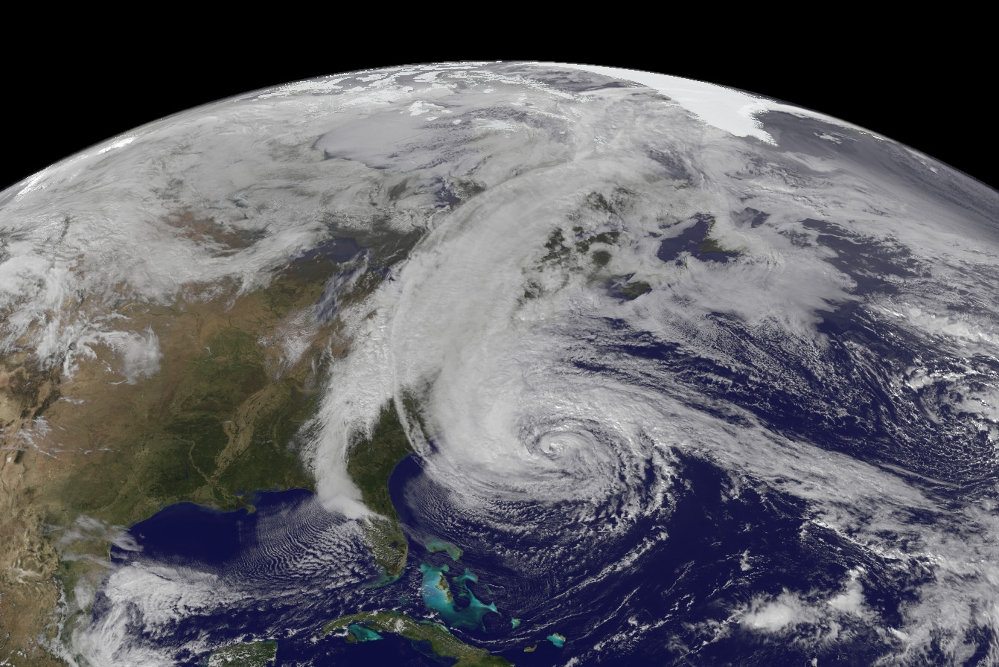
Hurricane Sandy
October 29, 2012
NOAA/NHC Damage:
>$68 Billion.

Slide 32
DATA-WRF-ROMS Coupled Application: Hurricane Sandy
From Coupled Ocean Atmosphere Wave Sediment Transport (COAWST)
Coarse grids
Coupling Simulation E03: Using ROMS bulk fluxes parameterization
  Time stepping: WRF 180, ROMS 30
    Sequential and semi-implicit coupling, No Nesting,
    Coupling interval: 180 s (every 6 ROMS timesteps), WRF exports instantaneous fields
    WRF imports SST from DATA and ROMS components
    DATA component reads SST from HyCOM 1/12 dataset, 4500x3298
    ROMS activates BULK_FLUXES, EMINUSP, LONGWAVE_OUT
    ROMS imports dLWrad, SWrad, Pair, Tair, Qair, rain, Uwind, and Vwind
Coupling Simulation E02: Using WRF surface fluxes parameterization
    Same as E03 but ROMS deactivates BULK_FLUXES, EMINUSP, LONGWAVE_OUT
    ROMS imports SWrad, Pair, shflux, swflux, sustr, svstr

Slide 33
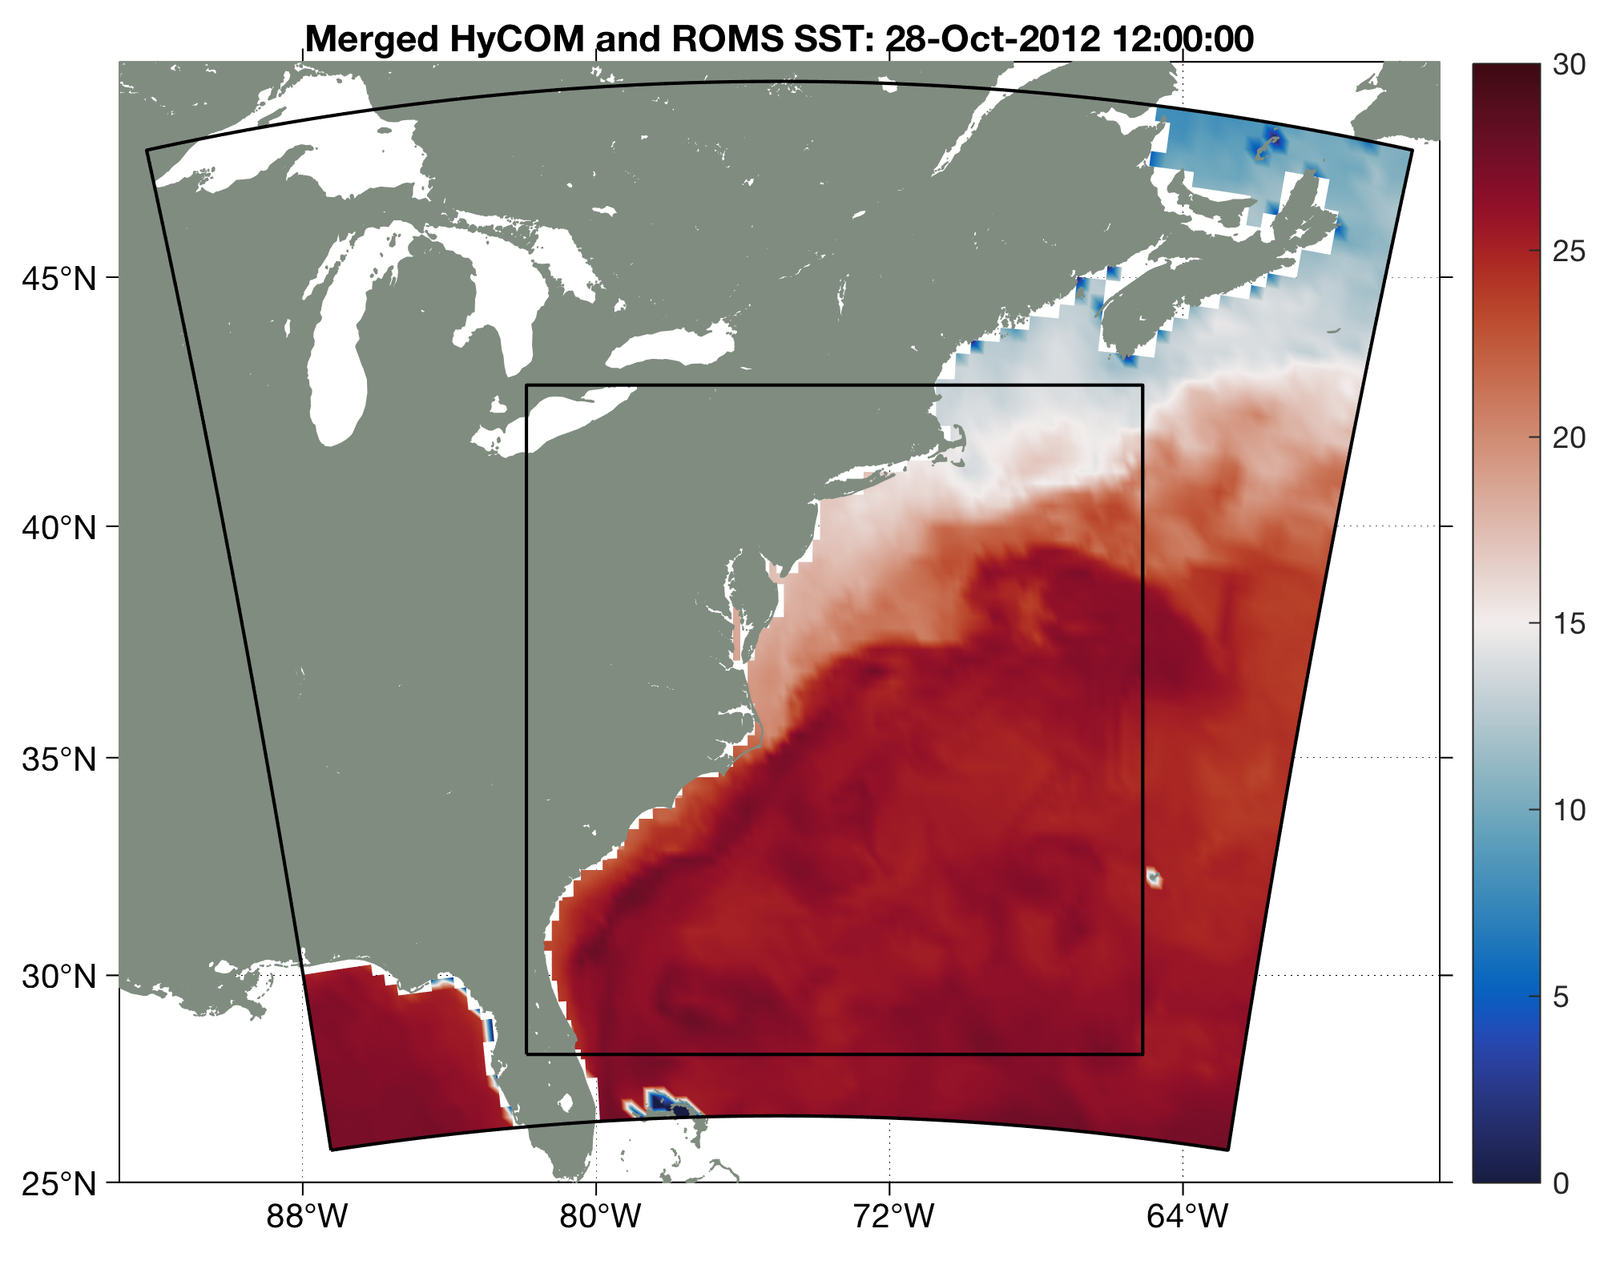
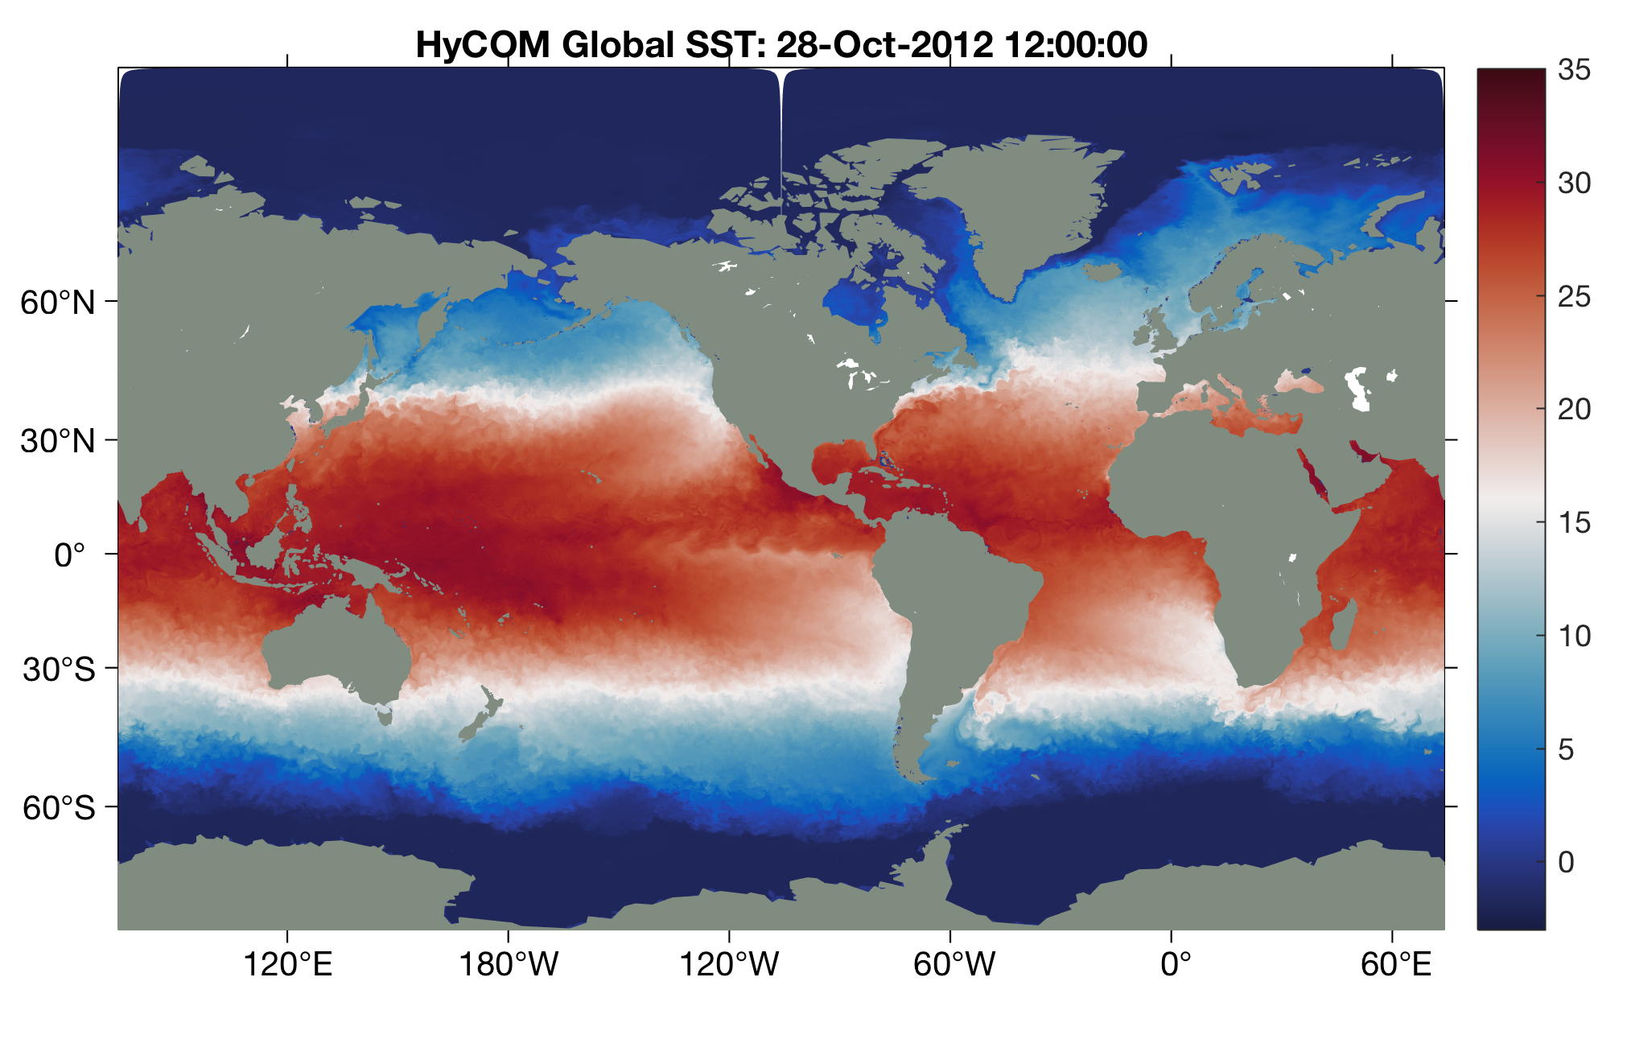
DATA-WRF-ROMS Coupled Application: Hurricane Sandy
From Coupled Ocean Atmosphere Wave Sediment Transport (COAWST)
Coarse grids
Merged Sea Surface Temperature (ºC): WRF Import

Slide 34
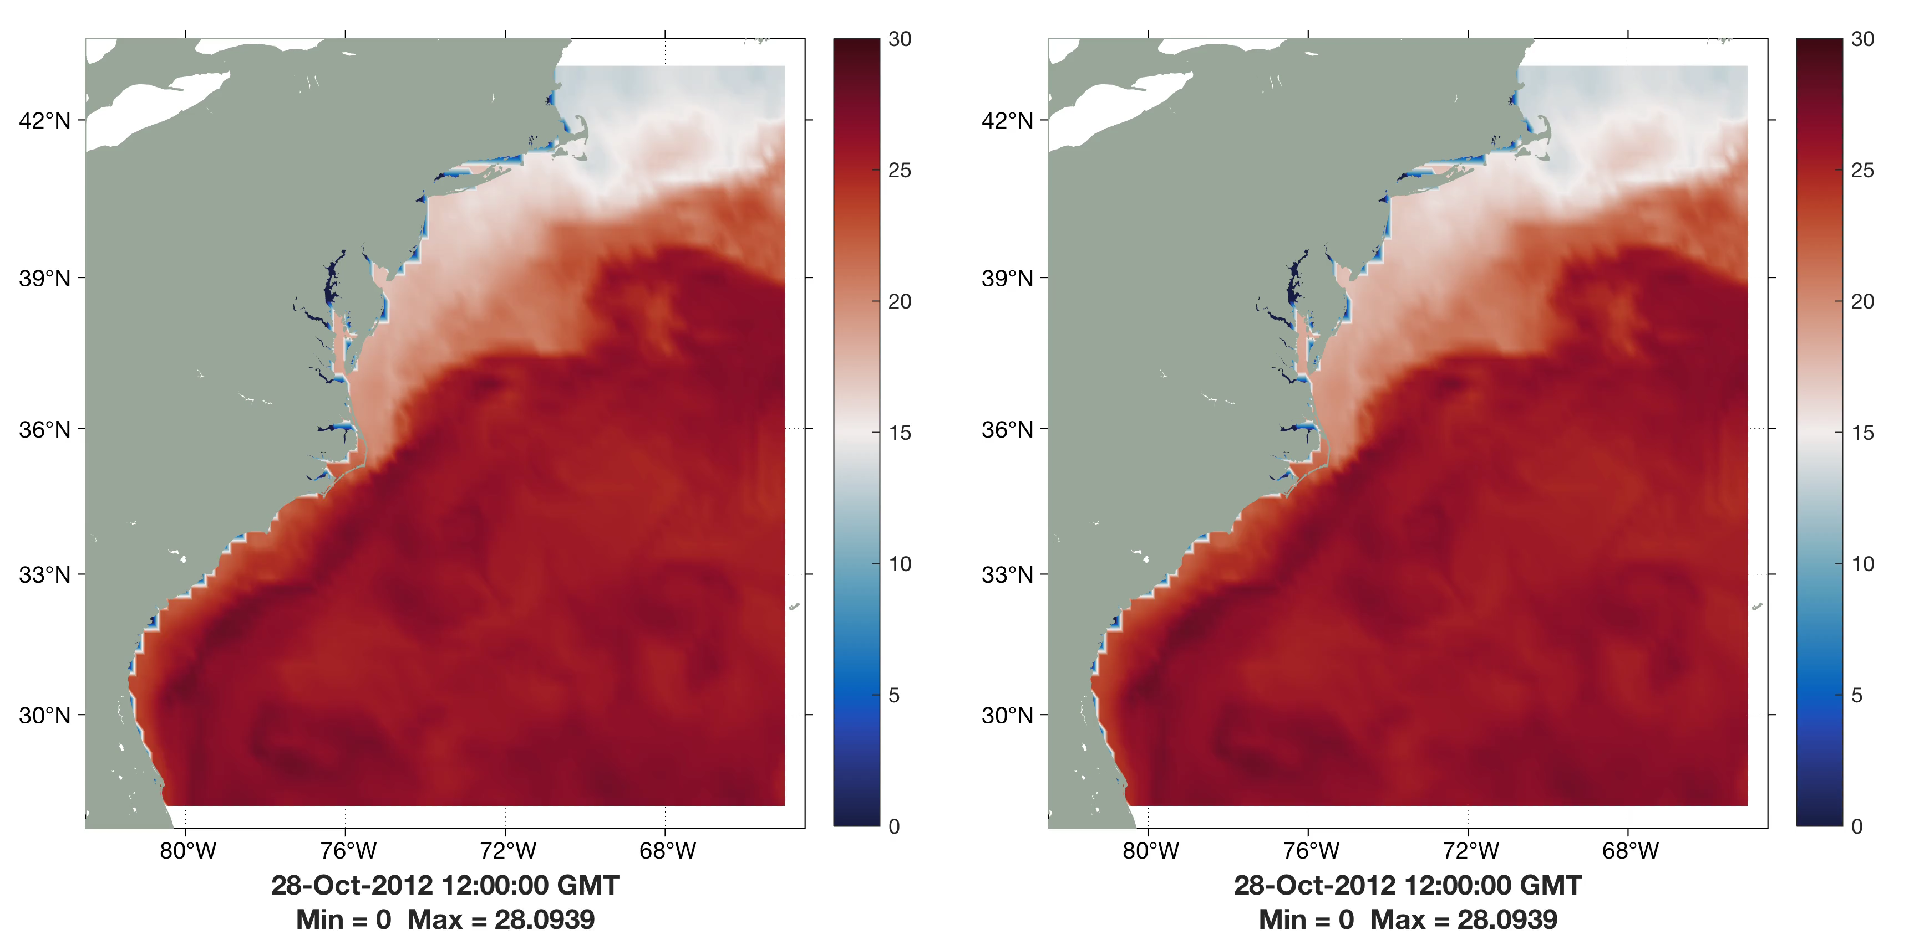
Surface Temperature Comparison (ºC)
DATA-WRF-ROMS
No Nesting
ESMF Coupling: 180 s
BULK_FLUXES
ESMF Coupling: 180 s
ATM SBL

Slide 35
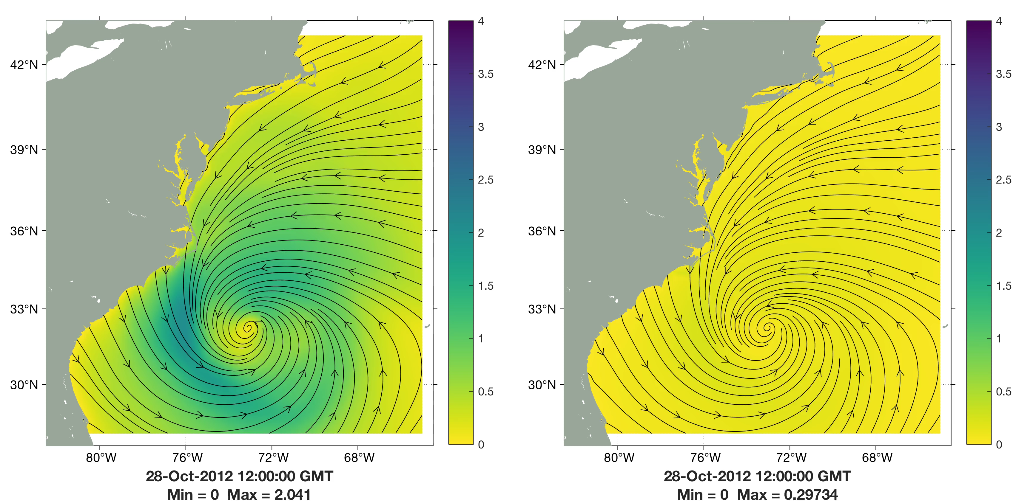
Surface Wind Stress Comparison (N/m²)
DATA-WRF-ROMS
No Nesting
ESMF Coupling: 180 s
BULK_FLUXES
ESMF Coupling: 180 s
ATM SBL

Slide 36
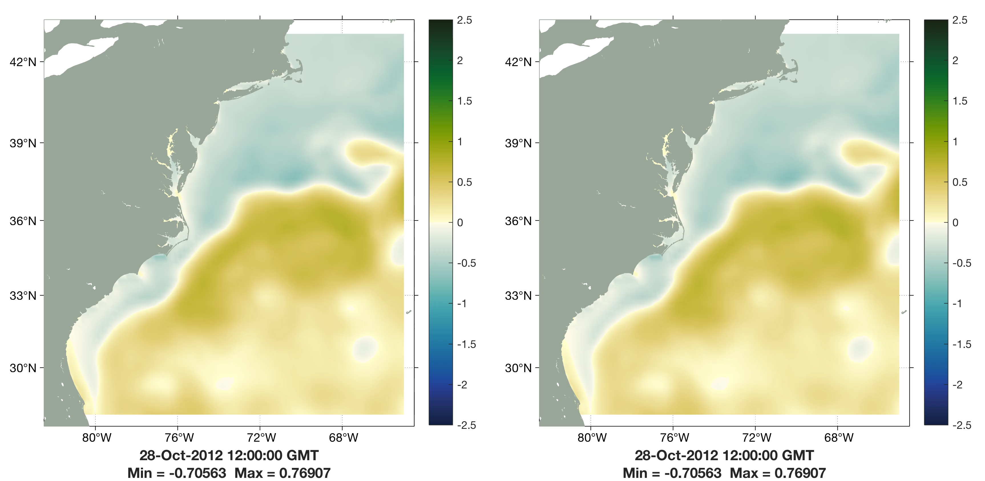
Free-Surface Comparison (m)
DATA-WRF-ROMS
No Nesting
ESMF Coupling: 180 s
BULK_FLUXES
ESMF Coupling: 180 s
ATM SBL

Slide 37
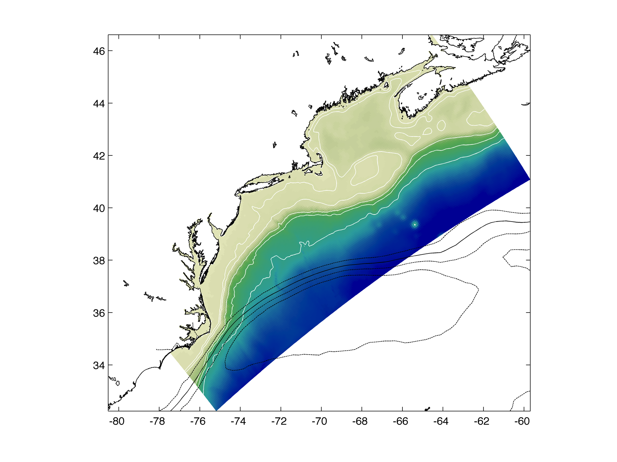
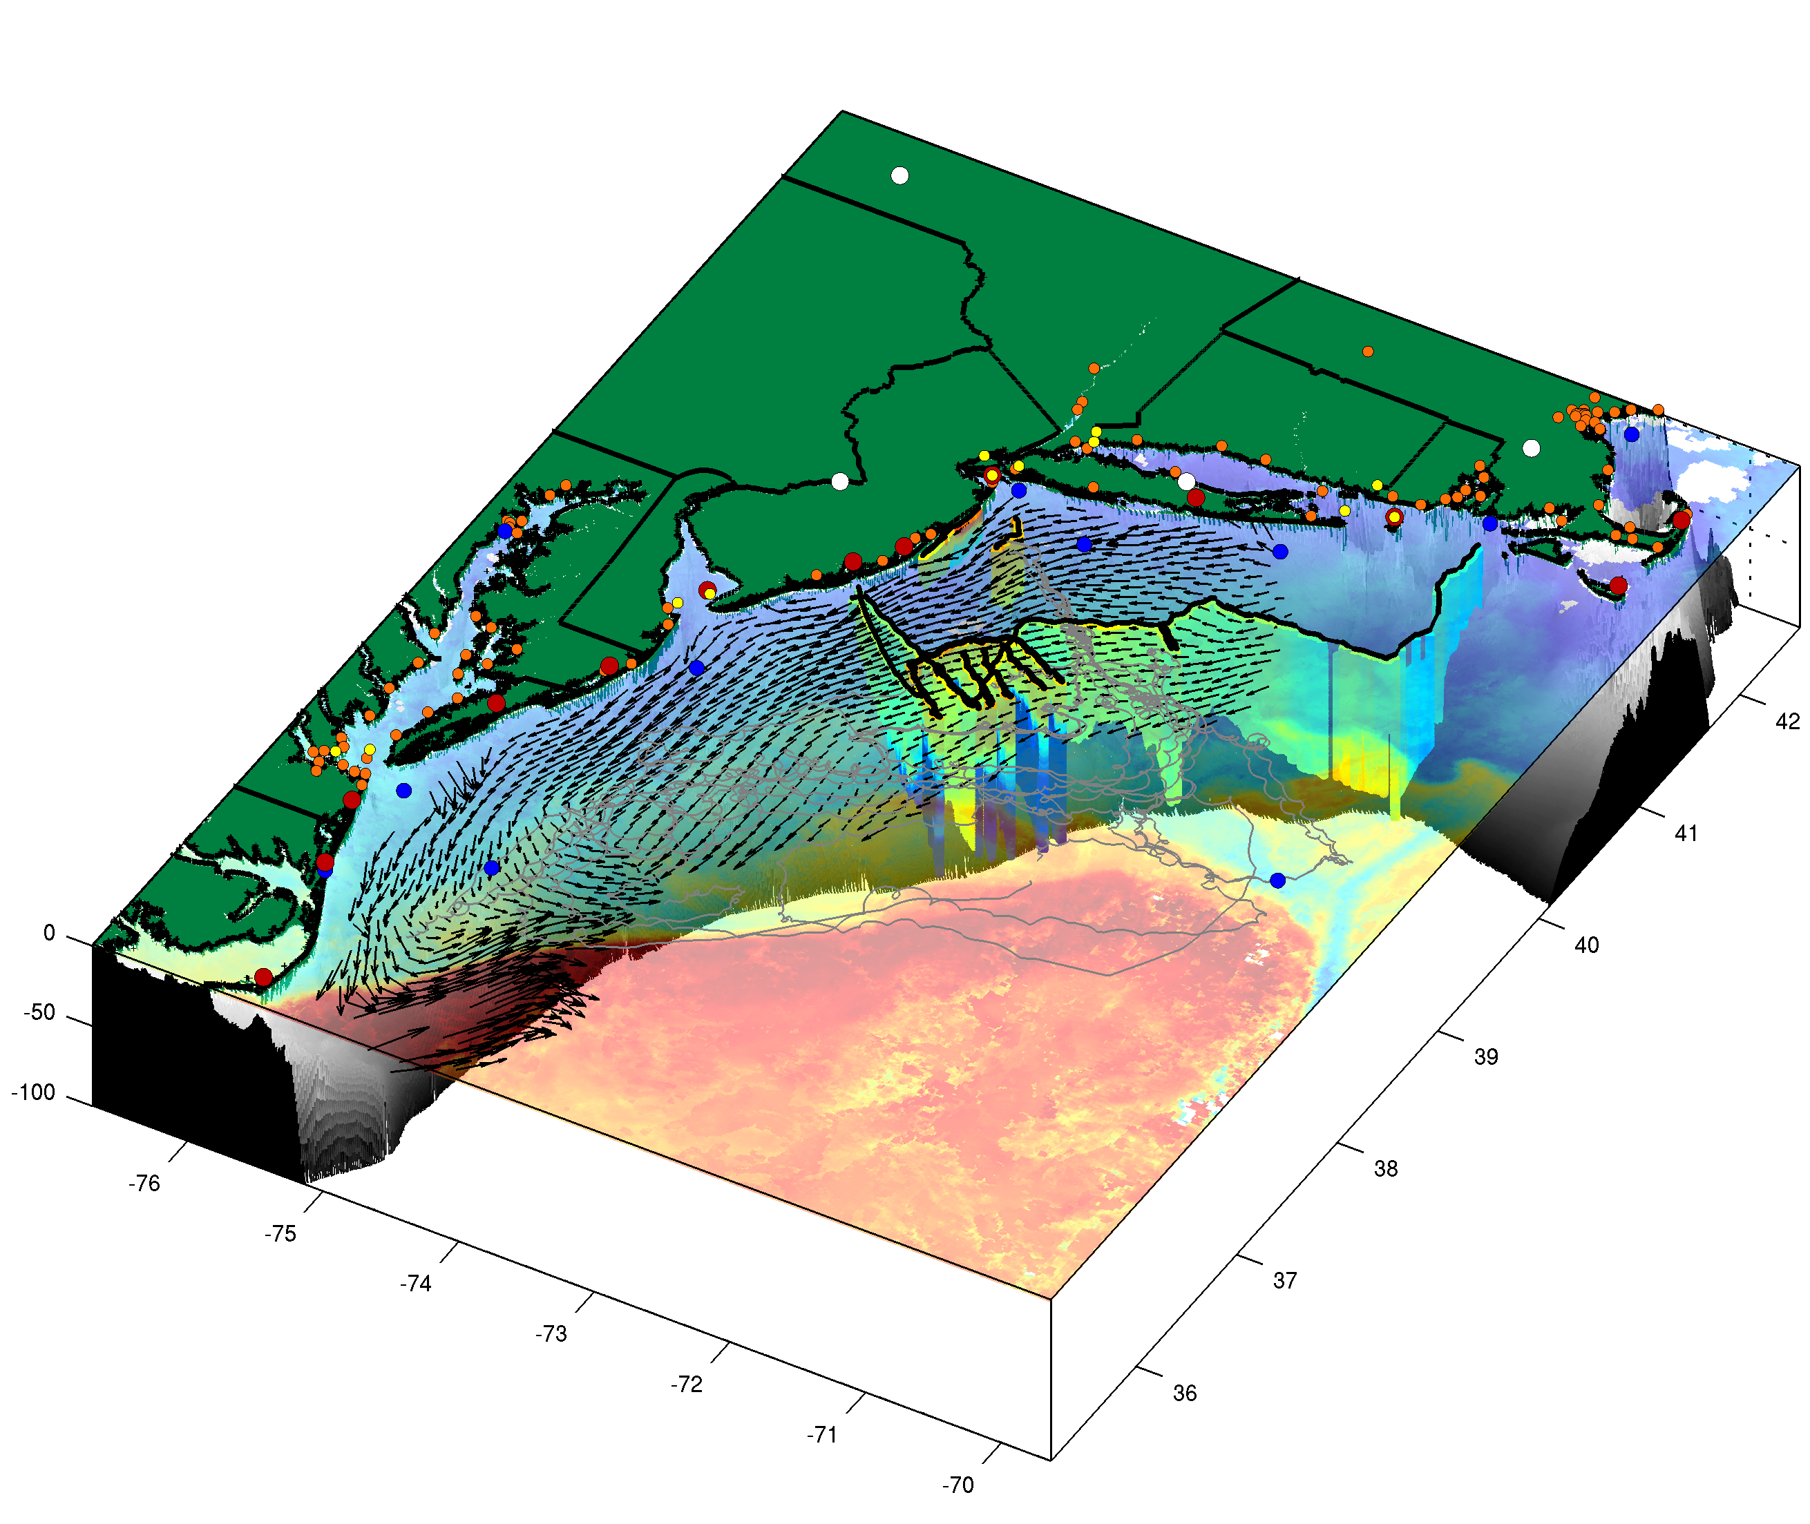
MARACOOS ROMS: Real-time forecast for Mid-Atlantic Bight and Gulf of Maine
Mean Sea Level (m) from ROMS climatological 4D Variational (4D-Var) data
assimilation
Scotian Shelf
GOM Coastal
Current
Cape Cod
Georges
Bank
Mid
Atlantic
Bight
Shelf-break front
Slope Sea Gyre
Gulf Stream
Cape
Hatteras
ROMS ocean physics …
+ MARACOOS data
+ 4D-Var data assimilation
= ‘best’ estimate of ocean state
Notes:
The MARACOOS ROMS ocean forecast assimilation system assimilates ALL available data from satellites and in situ platforms to produce the ‘best’ possible analysis consistent with ocean physics (ROMS) and data (MARACOOS).

Slide 38
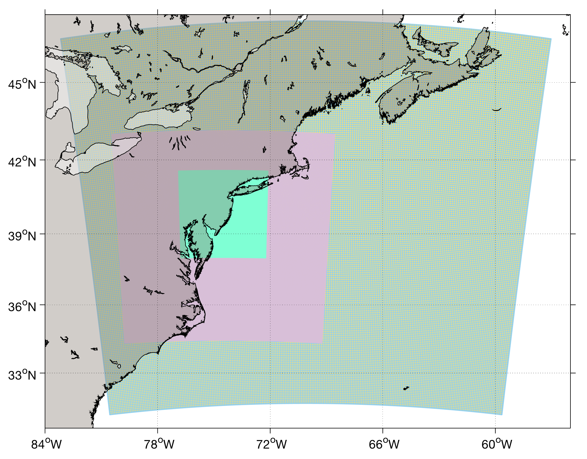

RU-WRF: Real-time forecast for Mid-Atlantic Bight and Gulf of Maine
Recently updated to WRF v4.0
Run daily 2011 – Present
Triple nested: 9km-3km-1km
  9km: 0, 6, 12, 18Z cycles
  3km: 0, 12Z cycles
  1km: 0Z cycle (Research Mode)
Hourly forecast:
  9km: out 5 days
  3km: out 2 days
  1km: out 1 days
Lateral Boundary Conditions:
  9km: 0.25 degree Global Forecast System
  3km: RU-WRF 9km
  1km: RU-WRF 3km
Vertical Levels:
  40 levels more tightly packed near the surface.
Evaluated against coastal observations

Slide 39
Summary
Developed the NUOPC CAP file for ROMS and a coupled application for ROMS-WRF using the ESMF Library. Planned inclusion of coupling tools in the regular ROMS trunk www.myroms.org
Tested coupled modeling infrastructure with the COAWST Hurricane Sandy application
Developing an application for Hurricane Irene, which had strong ocean coupling using the established MARACOOS DOPPIO domain and a modified grid from the real-time RU-WRF forecasting system
Evaluation of simulations vs. MARACOOS ocean datasets (gliders, HF Radar, Satellite) and regional atmospheric datasets (NDBC buoys, Coastal MET stations, etc.)
Expansion of domain to include Hurricane Michael from 2018 (Extensive set of datasets collected during Michaels rapid intensification with gliders provided by the Navy).

Slide 40

Team
Hernan Arango
John Wilkin
Julia Levin
Joseph Brodie
Dave Robertson
Mike Crowley
Sam Coakley
Thank You!

Slide 41
Hurricane Irene
2011

Slide 42
Pre-Irene
Post-Irene
Difference
11C max Cooling
Satellite
SST
Glider Temperature
HF Radar
Currents
Eye Passage
Glenn et al., Nature Communications(2016)

Slide 43
Atmospheric Forecast Sensitivity Study
Cat 1 Hurricane
Warm Ocean
Boundary Condition
Tropical Storm
Cold Ocean
Boundary Condition
IMPACT?
>10 knots reduction in peak wind speed
Seroka et al. Monthly Weather Review (2016)

Slide 45
Pre-Irene Storm Warnings
Over 2 million people ordered to “flee the storm’s path”.
President Obama: Shaping up to be a “historic hurricane” and urged residents to “be prepared for the worst”. “Don’t wait. Don’t delay.”
New Jersey Governor Christie: Ordered evacuation of 1 million people - “This is going to be an enormous storm, and for New Jersey, something we haven’t seen in over 60 years”. “Get the hell off the beach”.
New York Mayor Bloomberg: “Staying behind is dangerous, staying behind is foolish, and its against the law”. “The time to leave is right now”. The bridges, streets and subways were nearly empty ahead of a nearly unprecedented mass transit shutdown.

Slide 46
AP PHOTO/MEL EVANS
Notes:
Can I improve this picture?

Slide 47
Official NHC intensity forecasts for Irene every 6 h from 1200 UTC 23 August to 0600 UTC 28 August.

Slide 48
Pre-Irene
Post-Irene
Difference
11C max Cooling
Satellite
SST
Glider Temperature
HF Radar
Currents
Eye Passage
Essential Ocean Processes:
Ahead of eye center – Vertical Shear > Mixing > Cooling > Reduced Intensity > Reduced Surge

Slide 49
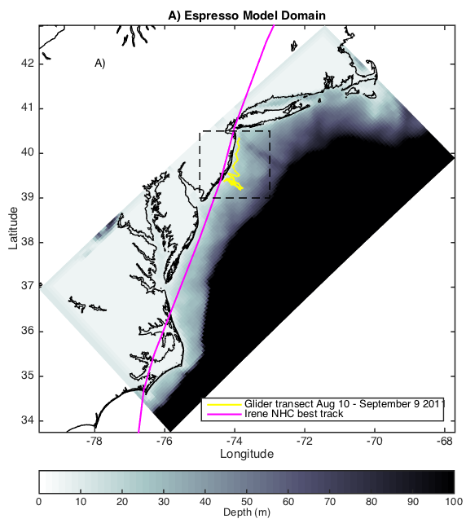
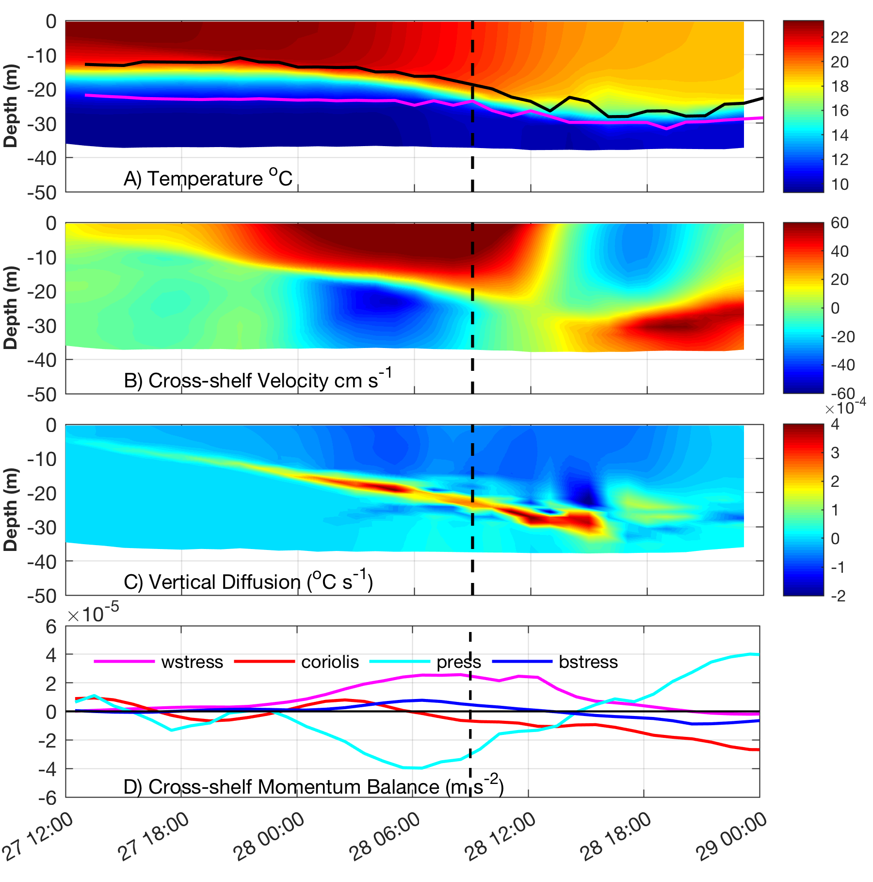
Ahead-of-Eye-Center Cooling in Irene: Ocean Modeling
Rutgers ROMS on the ESPreSSO domain
http://www.myroms.org/espresso/
36 Levels, ~5 km resolution, output hourly
HYCOM-NCODA Boundary Conditions
NCEP North American Mesoscale (NAM) 12km 3 hourly Wind forcing
Time
Glenn et al. Nature Communications (2016)
Notes:
Put citations

Slide 50
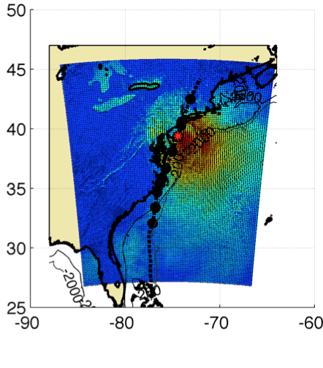
Atmospheric Forecast Sensitivity Study
Warm Ocean
Boundary Condition
Weather Research and Forecasting (WRF) model, Advanced Research core (ARW) version 3.4.1
Horizontal Resolution: 6 km
Vertical Resolution: 35 levels
Lateral Boundary Condition: Global Forecast System (GFS)
Bottom Boundary Condition: AVHRR fixed Sea Surface Temperature
Cold Ocean
Boundary Condition
Seroka et al. Monthly Weather Review (2016)

Slide 51
Atmospheric Forecast Sensitivity Study
Cat 1 Hurricane
Warm Ocean
Boundary Condition
Tropical Storm
Cold Ocean
Boundary Condition
IMPACT?
>10 knots reduction in peak wind speed
Seroka et al. Monthly Weather Review (2016)

Slide 52
ROMS Algorithms in Development
ROMS Nesting:
  Nonaligned Refinement
  Hybrid heterogeneous nesting
  Nested 4D-Var
ROMS Coupling (ESMF/NUOPC):
  NUOPC layer now supports native nesting within ESM components (ESMF, v7.1.0r)
  Atmosphere coupling (COAMPS, WRF)
  Sea ice coupling (CICE)
  Wave coupling (WAM, WW3)
  Estuary coupling
  Hybrid coupling
Split 4D-Var: Coupling, Nesting, and 4D-Var

Slide 53
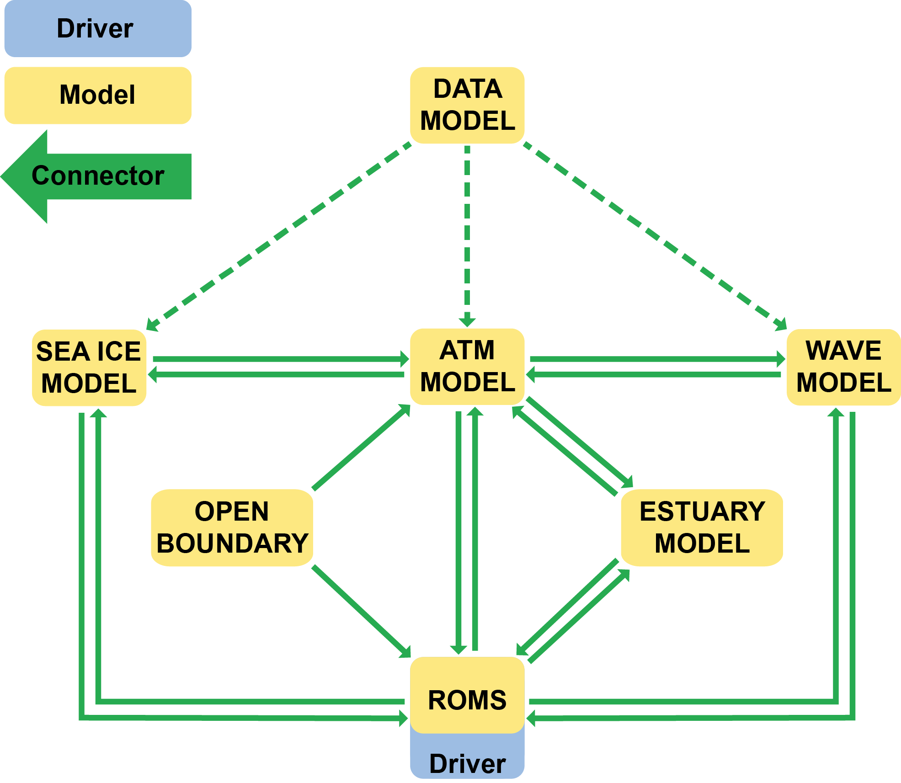
ROMS Coupling Framework: Driver Mode

Slide 54
ROMS Coupling: Driver Mode
master.F:
#if defined MODEL_COUPLING
# if defined MCT_LIB
# include "mct_driver.h"
# elif defined ESMF_LIB
# include "esmf_driver.h"
# else
PROGRAM master
END PROGRAM
# endif
#else
# include "ocean.h"
#endif
coupler.F:
#if defined MODEL_COUPLING
# if defined MCT_LIB
# include "mct_coupler.h"
# elif defined ESMF_LIB
# include "esmf_coupler.h"
# endif
#else
MODULE coupler_mod
END MODULE coupler_mod
#endif
ROMS is coupled to other external software and drivers not written by us (like RegESM; Turuncoglu and Sannino, 2016)

Slide 55
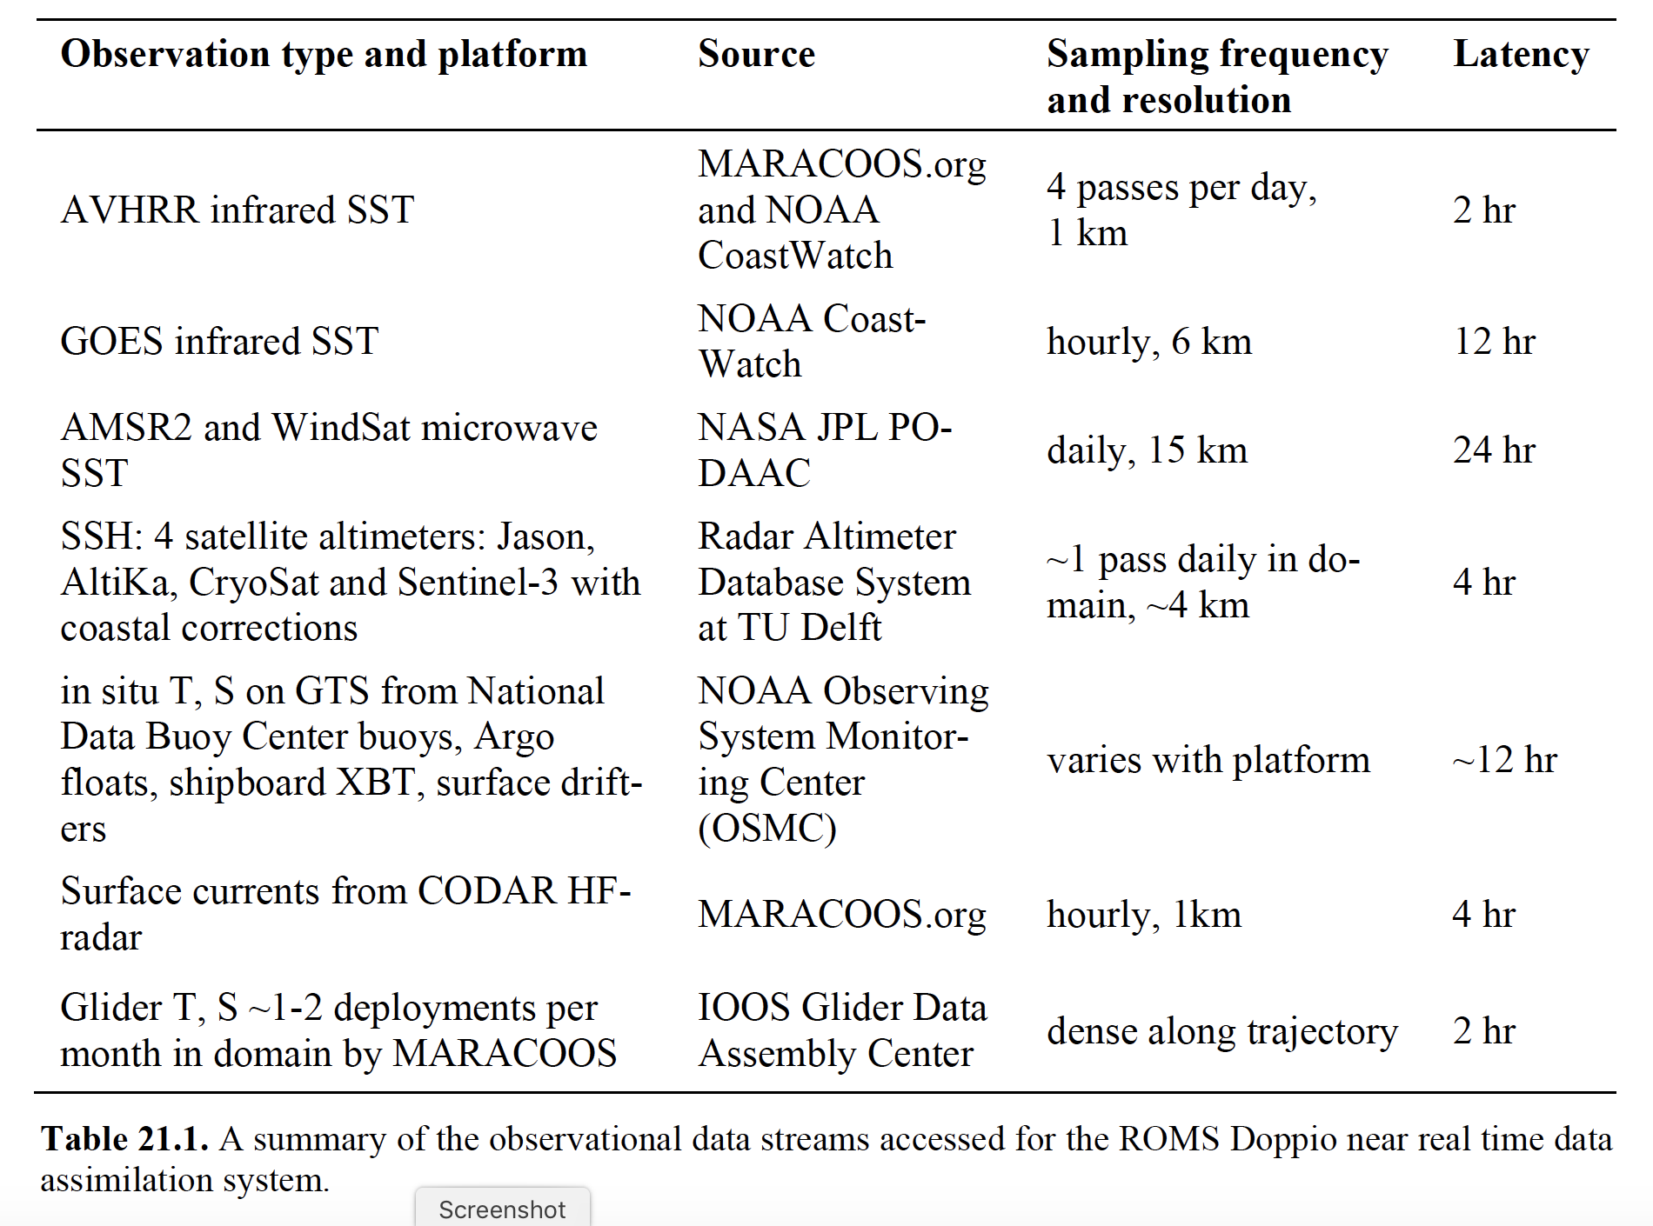
MARACOOS ROMS: Data streams routinely assimilated into the 4D-Var ‘best’ analysis of Mid-Atlantic Bight and Gulf of Maine ocean conditions
Notes:
MARACOOS ROMS input data are comprehensive. 4D-Var uses data at its precise observation time and place, for example retaining all diurnal cycle information implicit in the time of passage of low earth orbit (LEO) satellites or the multiple sampling times of geostationary satellites, or the capture of high frequency variability of sea level variability by altimeter satellites.

Slide 56
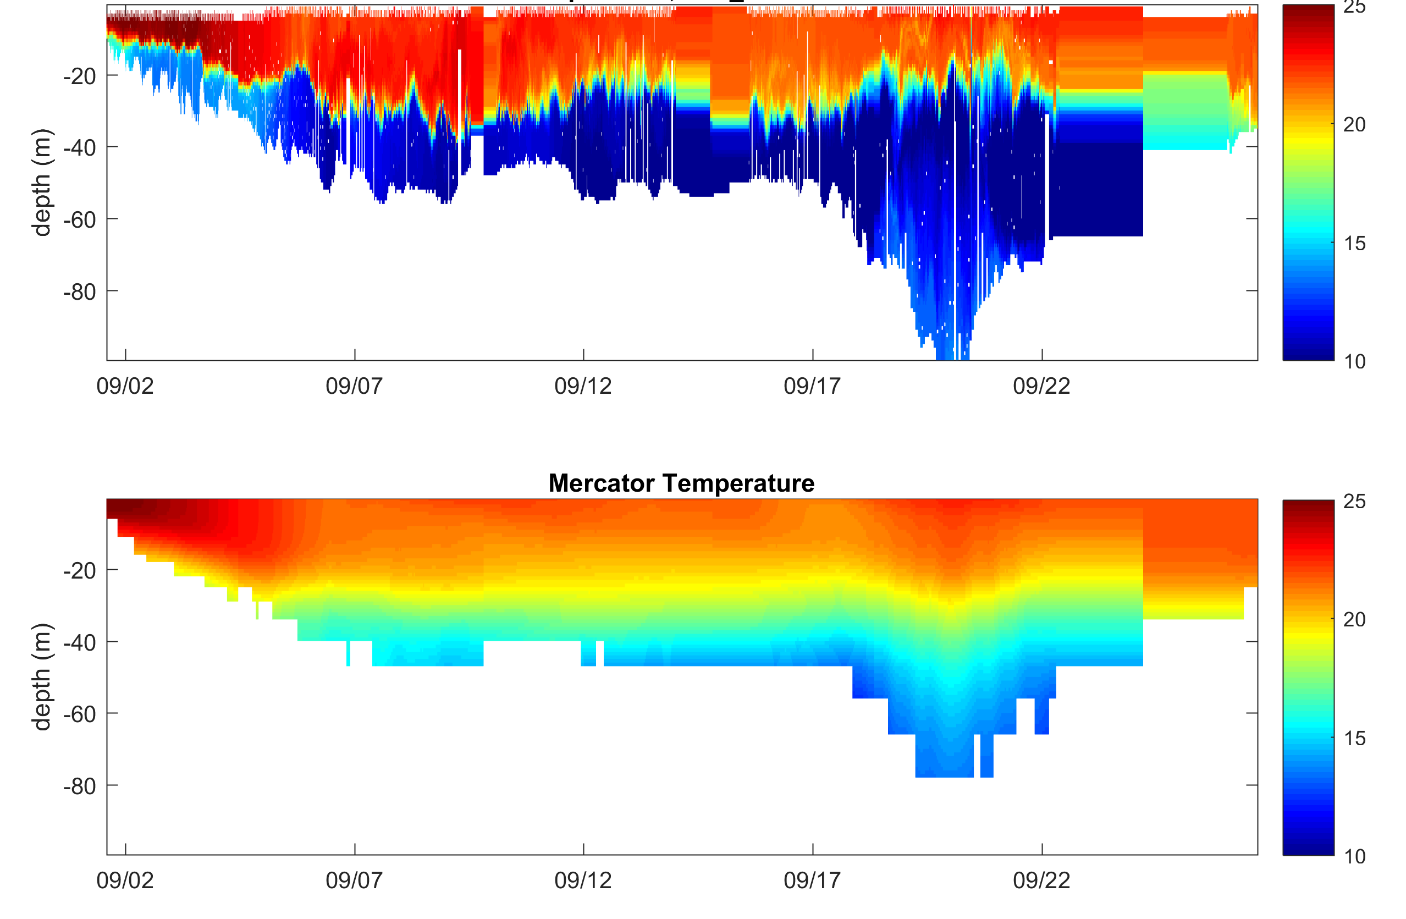
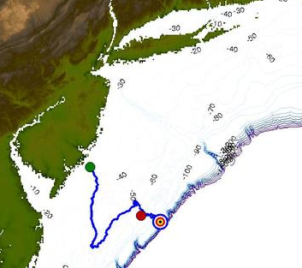
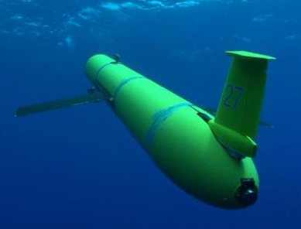
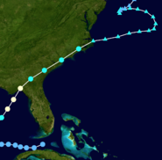
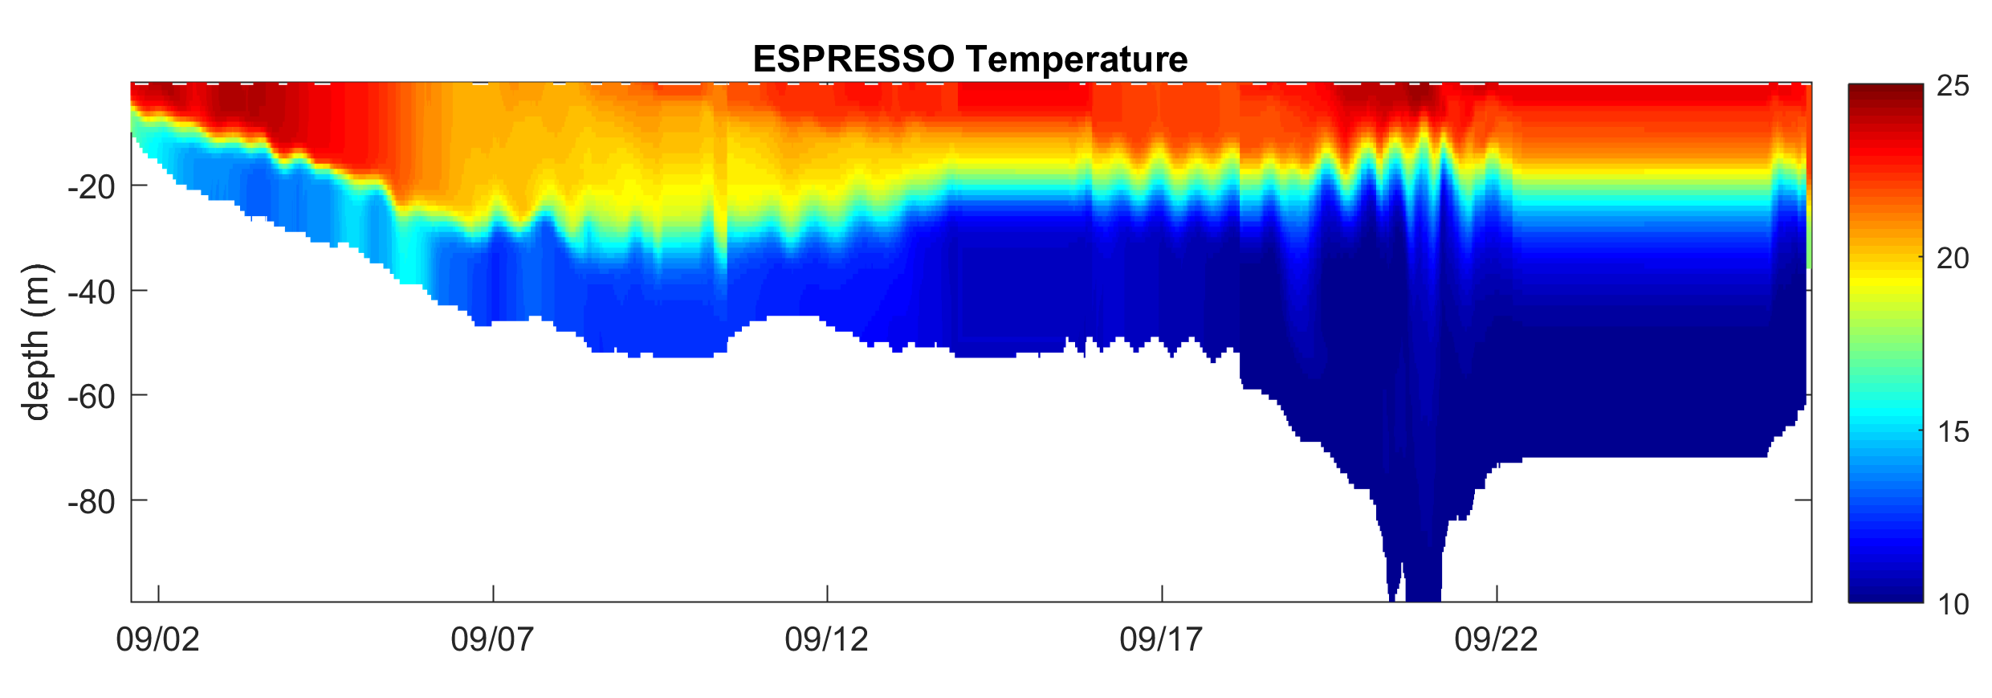
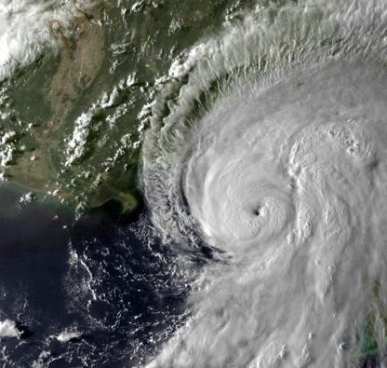
MARACOOS ROMS: Data assimilation adds skill to global class analysis systems by greater attention to ocean physics, finer resolution,
and a more comprehensive input data stream.
Glider observations and model predictions during hurricane Hermine, August 2016
Rutgers RU30 glider observations
deploy
recover
Regional ROMS improves on global model (MERCATOR) in coastal waters – vital to local ecosystem forecasting
CMEMS MERCATOR model
Hurricane
Hermine
track
MARACOOS ROMS model

Slide 57
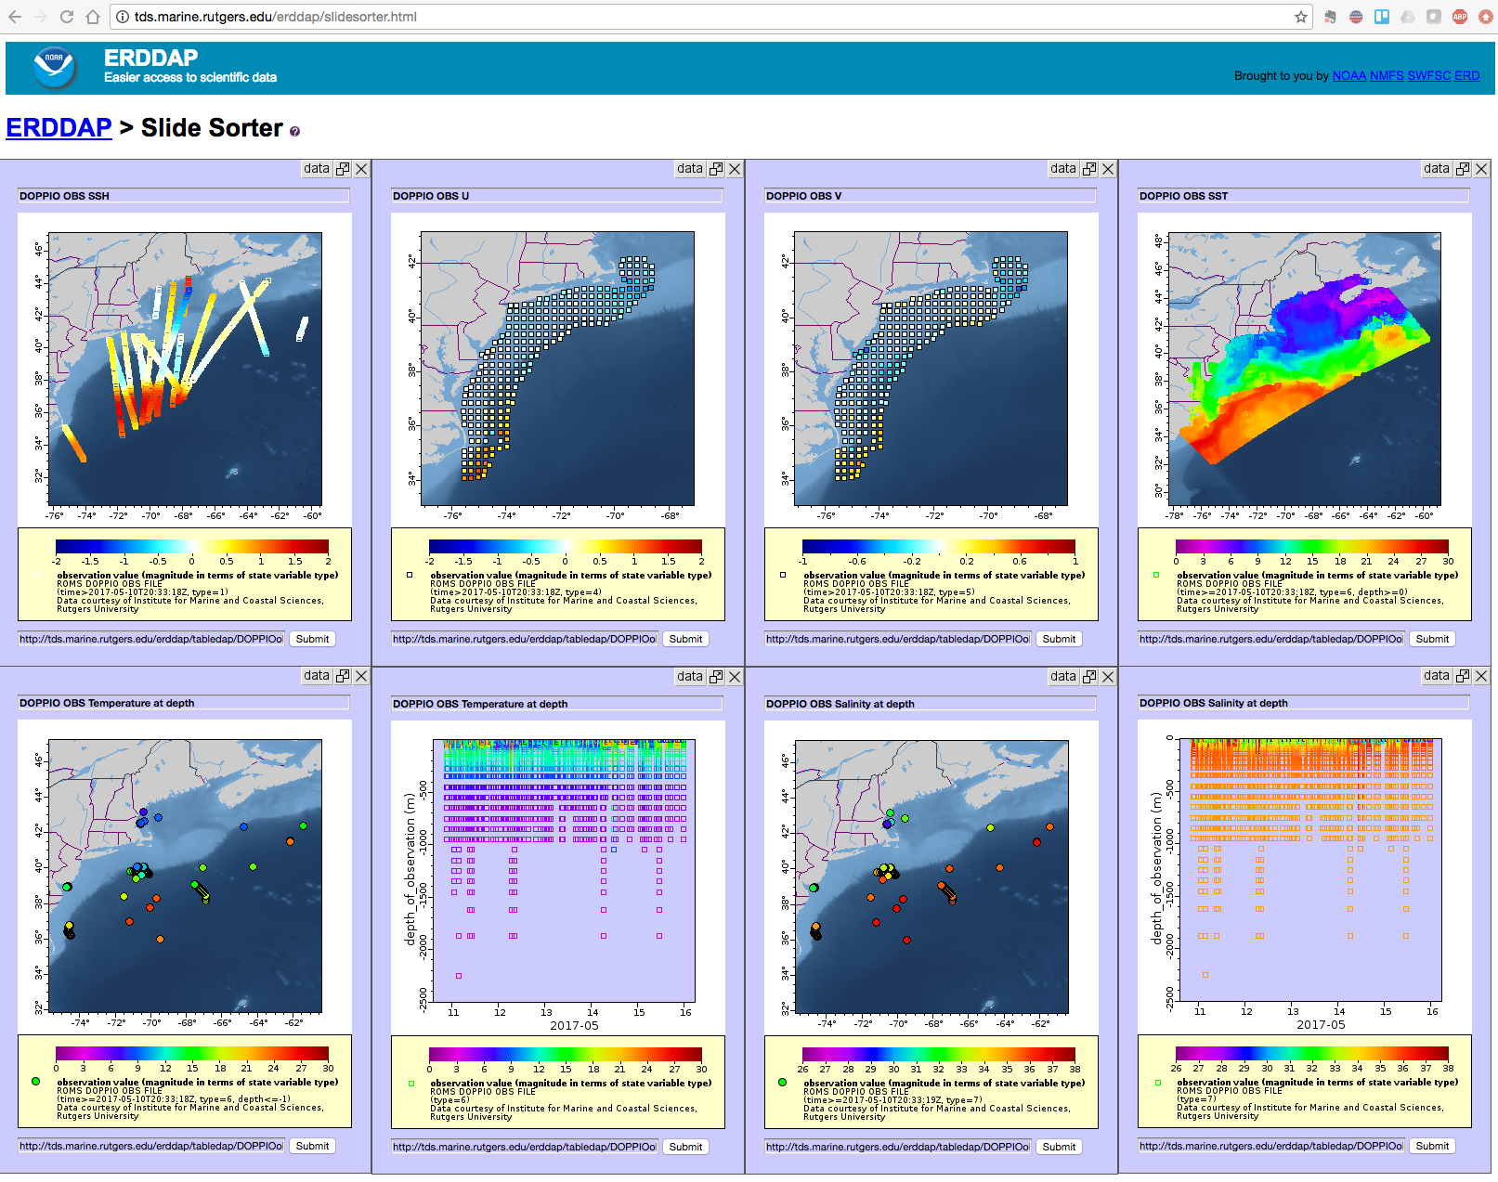
MARACOOS ROMS: ERDDAP control panel allows a browse view of all observations entering the Doppio data assimilation for any given analysis cycle
This example shows a typical 7-day data set: Altimeter SSH, CODAR velocity, all satellite SST, and sub-surface temperature and salinity. The data button launches direct access to numerical data values.

Slide 58
Earth System Modeling Framework (ESMF)
High performance and flexible software infrastructure for building and coupling weather, climate, and other Earth Science applications.
Basic idea: Applications should be broken up into coherent pieces, or components, with standard calling interfaces.
Components can be physical domains, earth system models, couplers, etc.
git clone https://git.code.sf.net/p/esmf/esmf esmf-esmf v8.0.0 released 10/18/19
https://www.earthsystemcog.org/projects/esmf/

Slide 59
ROMS Coupling: Sea Ice Model NUOPC Cap Files
esmf_ice.F:
# if defined ICE_COUPLING
# if defined CICE_COUPLING
# include "esmf_ice_cice.h"
# else
# include "esmf_ice_void.h"
# endif
# else
MODULE esmf_ice_mod
END MODULE esmf_ice_mod
# endif
#else
MODULE esmf_ice_mod
END MODULE esmf_ice_mod
#endif
CICE: Los Alamos sea ice model (Hunkle et al., 2015).

Slide 60
ROMS Coupling: Wave Model NUOPC Cap Files
esmf_wave.F:
# if defined WAV_COUPLING
# if defined SWAN_COUPLING
# include "esmf_wav_swan.h"
# elif defined WAM_COUPLING
# include "esmf_wav_wam.h”
# elif defined WW3_COUPLING
# include "esmf_ww3_wam.h”
# else
# include "esmf_wav_void.h"
# endif
# else
MODULE esmf_wav_mod
END MODULE esmf_wav_mod
# endif
#else
MODULE esmf_wav_mod
END MODULE esmf_wav_mod
#endif
SWAN: Simulating Waves Nearshore (Booij et al., 1999).
WAM: Wave Modelling (WAMDI Group, 1998).
WW3: WaveWatch III (Tolman, 2009). Developed at MMAB/NCEP.

Slide 61
ROMS Coupling: Atmosphere Model NUOPC Cap Files
esmf_atm.F:
# if defined ATM_COUPLING
# if defined COAMPS_COUPLING
# include "esmf_atm_coamps.h"
# elif defined REGCM_COUPLING
# include "esmf_atm_regcm.h"
# elif defined WRF_COUPLING
# include "esmf_atm_wrf.h"
# else
# include "esmf_atm_void.h"
# endif
# else
MODULE esmf_atm_mod
END MODULE esmf_atm_mod
# endif
#else
MODULE esmf_atm_mod
END MODULE esmf_atm_mod
#endif
COAMPS: Coupled Ocean-Atmosphere Mesoscale Prediction System (Hodur, 1997; Chen et al., 2014). It can be used for both free and restricted NRL versions.
RegCM: Regional Climate Model (Elguindi et al., 2014), Version 4.5 (RegCM4) and up. Maintained by the International Centre for Theoretical Physics (ICTP), Trieste, Italy. It was build upon the NCAR-PSU Mesoscale Model version 4 (MM4; Dickinson et al., 1989; Giorgi, 1989).
WRF: Weather Research and Forecasting model (Skamarock et al., 2005). Maintained by a consortium of US agencies and institutions (NCAR, NCEP, FSL, AFWA, NRL, FAA, and University of Oklahoma).

Slide 62
Ahead-of-Eye-Center Cooling in Irene: Ocean Modeling
Rutgers ROMS on the ESPreSSO domain
http://www.myroms.org/espresso/
36 Levels, ~5 km resolution, output hourly
HYCOM-NCODA Boundary Conditions
NCEP North American Mesoscale (NAM) 12km 3 hourly Wind forcing
Time
Glenn et al. Nature Communications (2016)
Notes:
Put citations

Slide 63
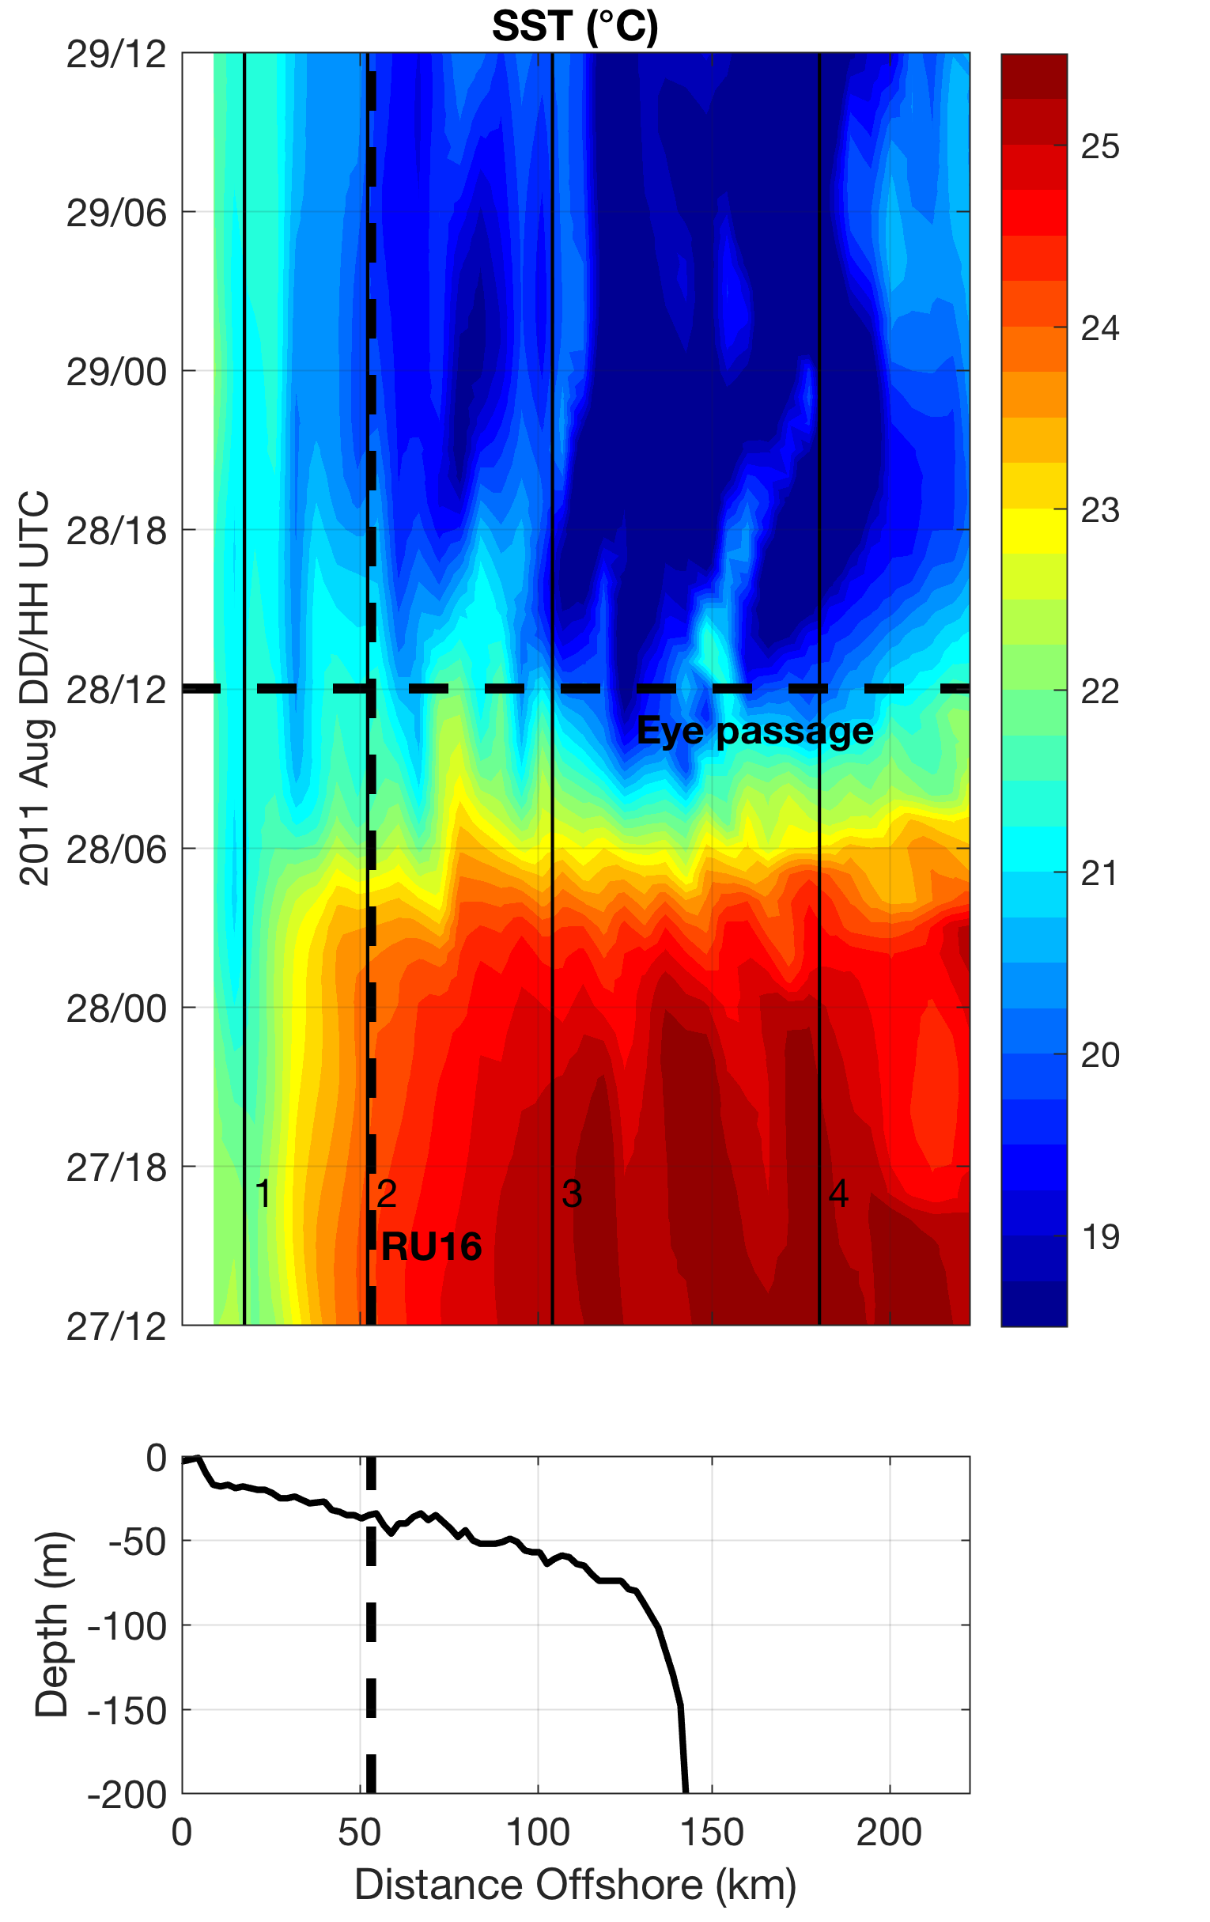
Ahead-of-Eye-Center Cooling in Irene: Ocean Modeling
AOEC SST cooling
Rutgers ROMS on the ESPreSSO domain
http://www.myroms.org/espresso/
36 Levels, ~5 km resolution, output hourly
HYCOM-NCODA Boundary Conditions
NCEP North American Mesoscale (NAM) 12km 3 hourly Wind forcing
Seroka et al. J. of Geophys. Res. Oceans (2017)
Notes:
10

Slide 64
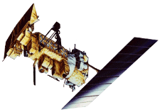


Atmospheric Forecast Sensitivity Study
Warm Ocean
Boundary Condition
Cat 1 Hurricane
Tropical Storm
Cold Ocean
Boundary Condition
IMPACT?
>10 knots reduction in peak wind speed

Slide 65
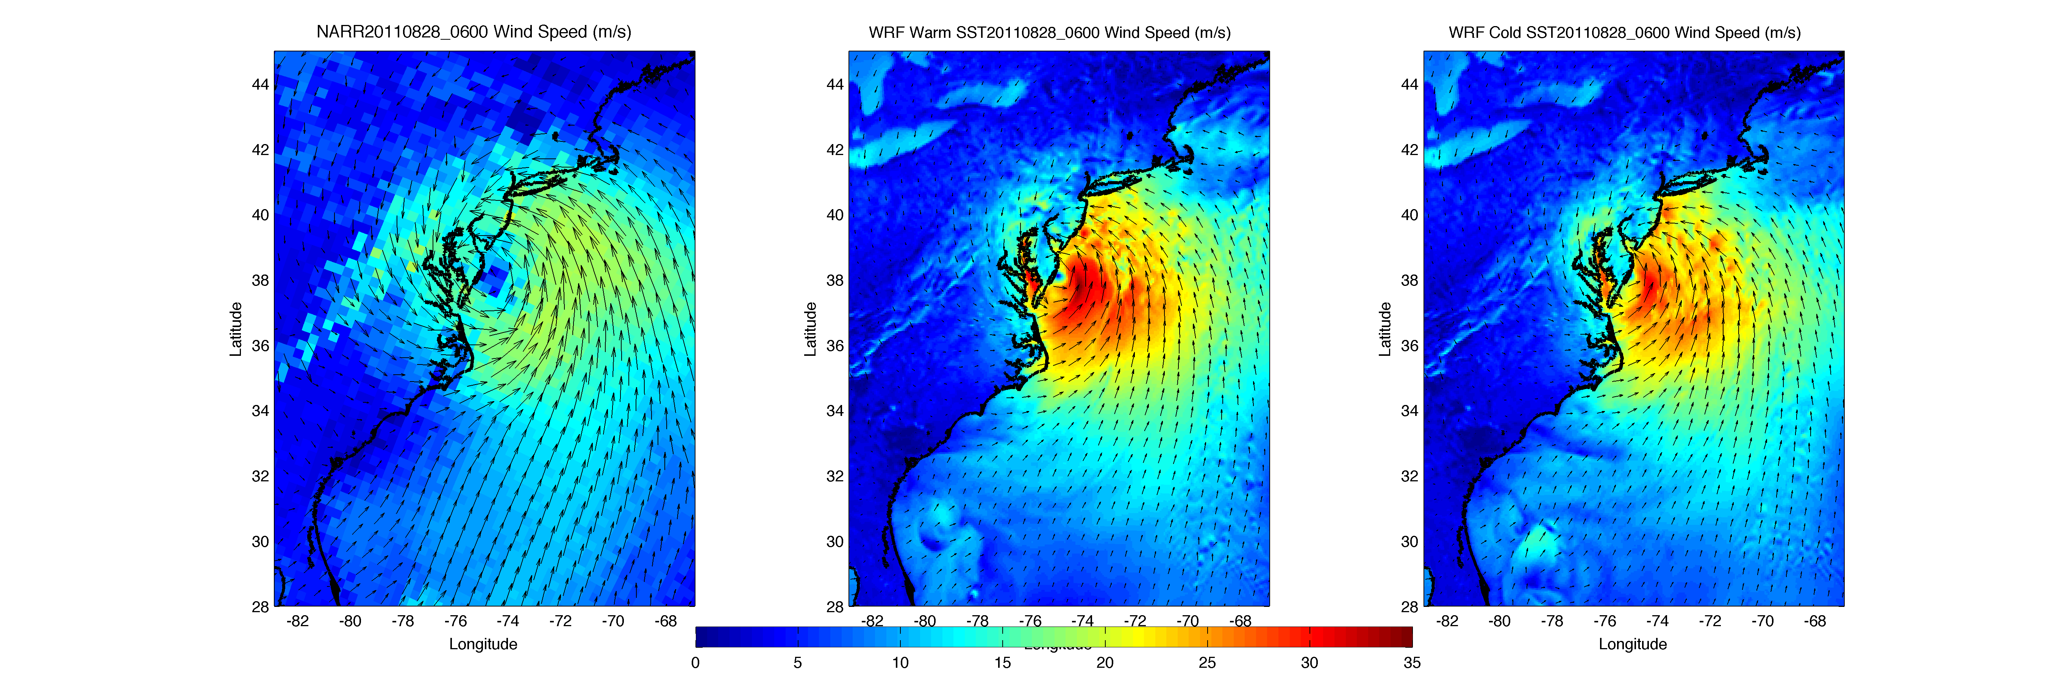
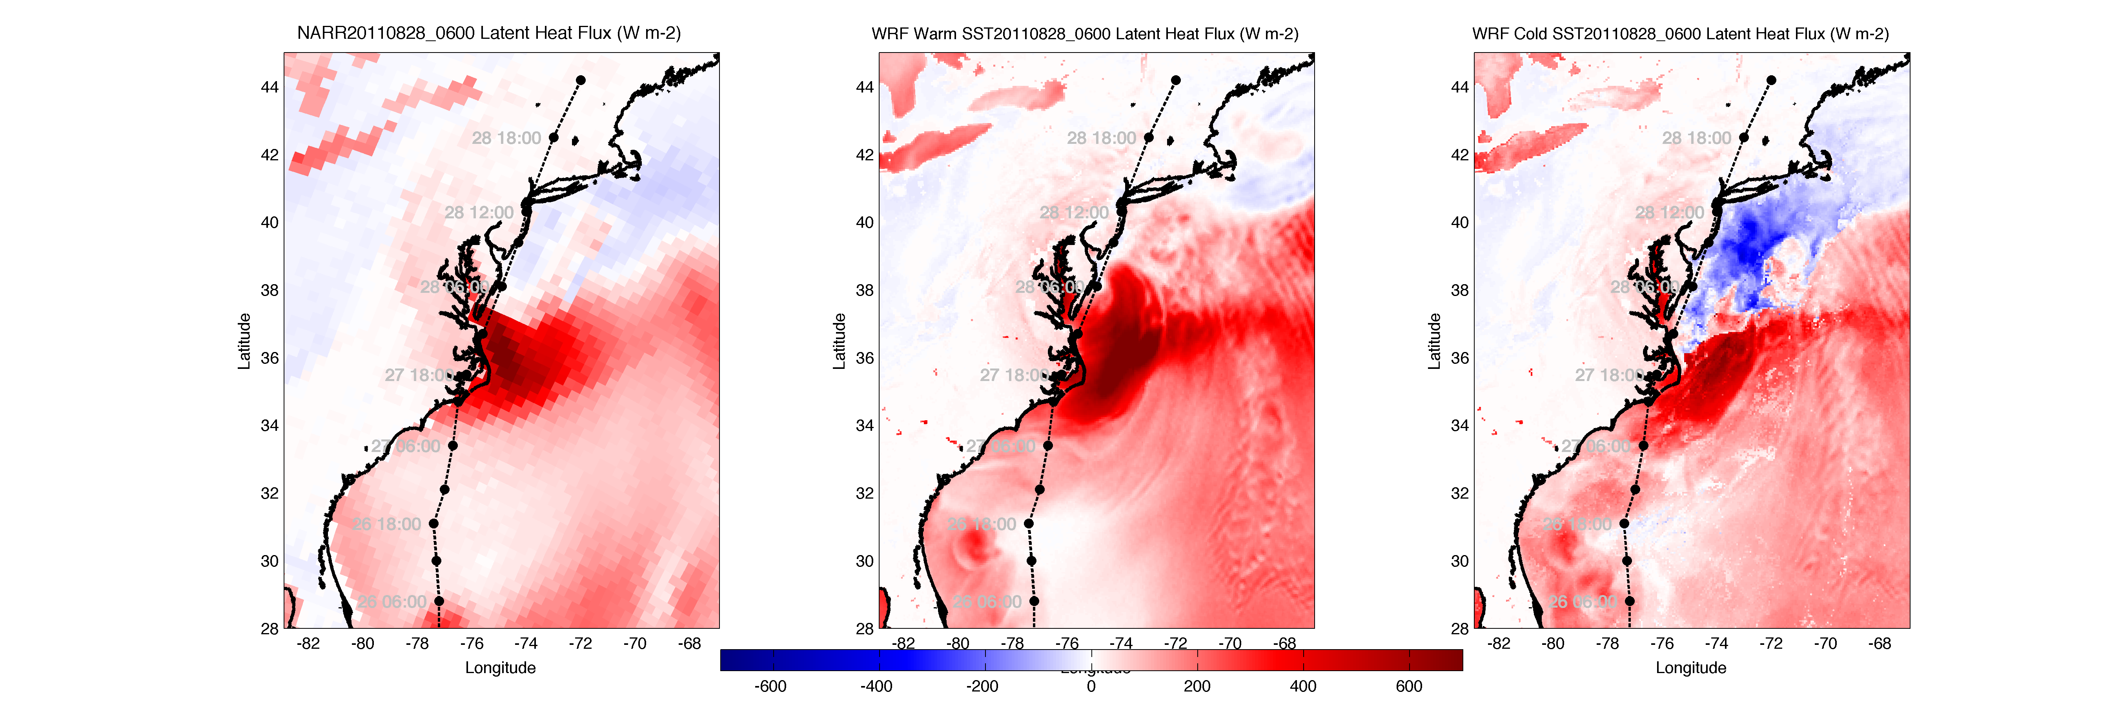
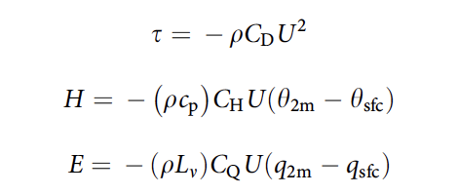
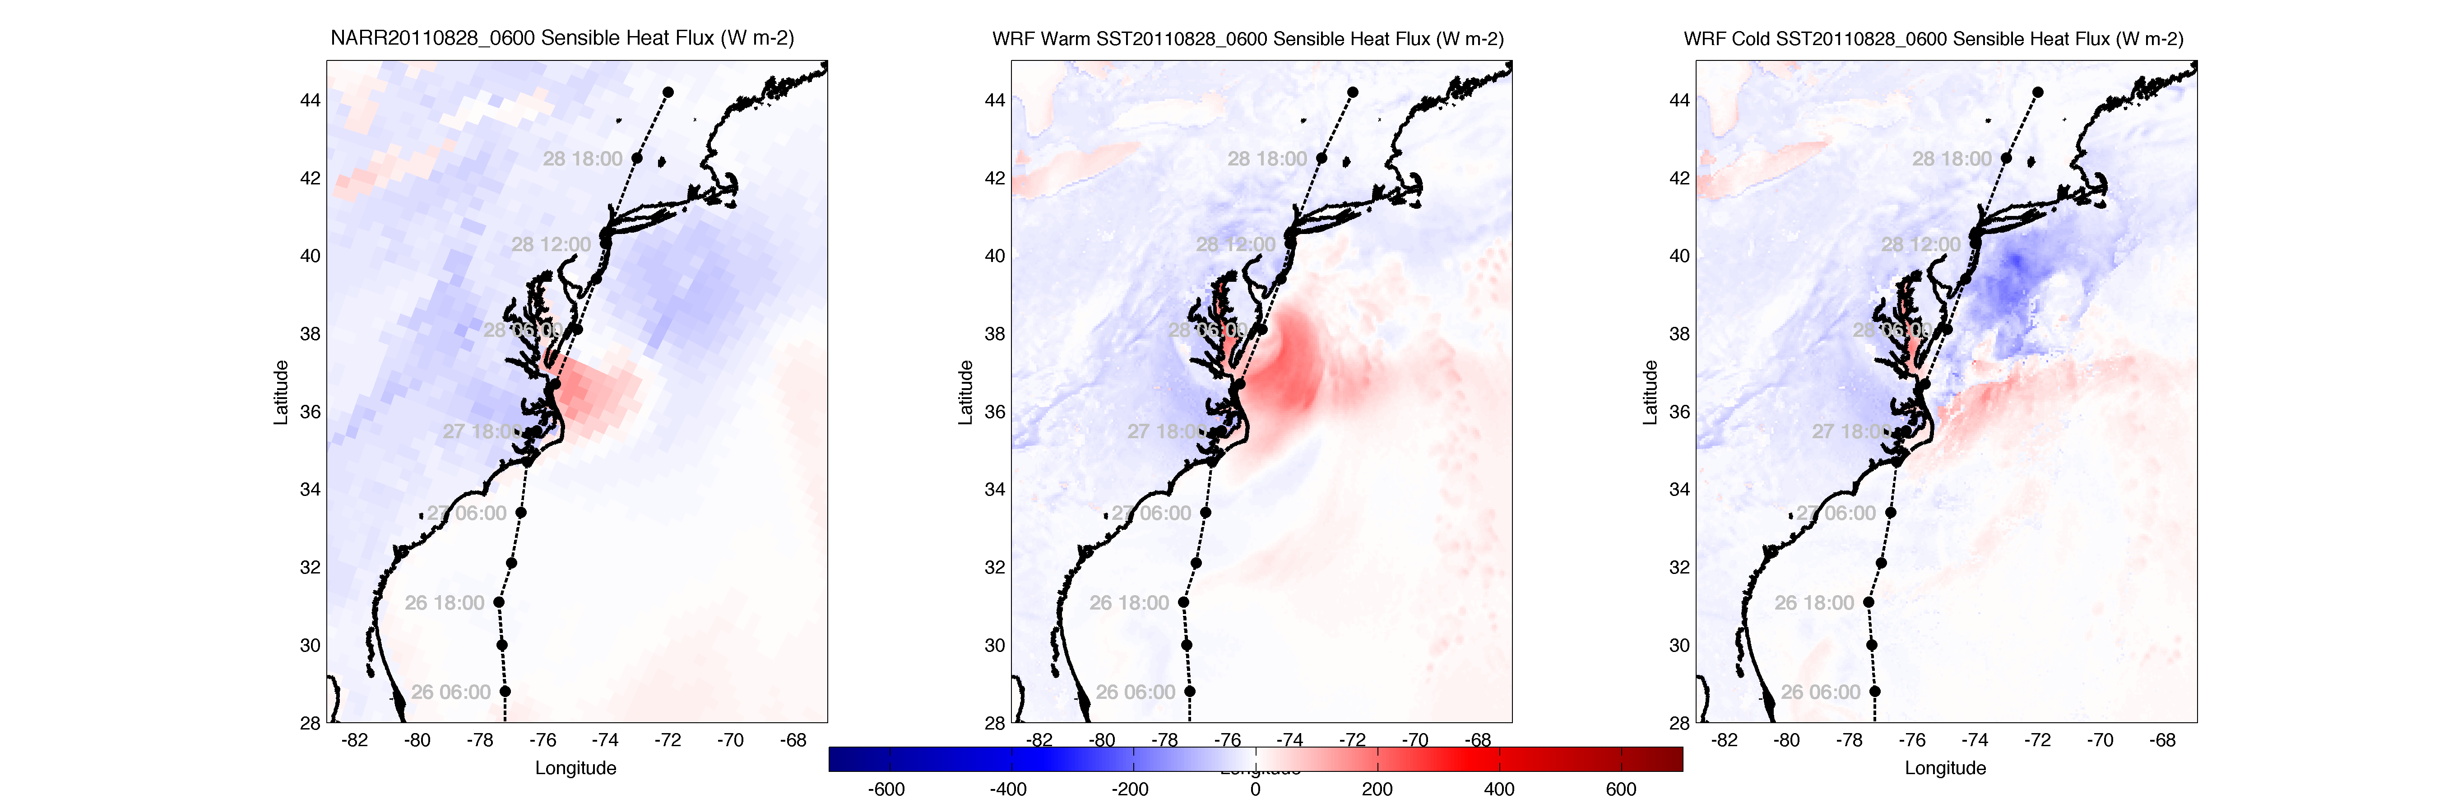
NARR
WARM SST
COLD SST
WRF Heat Flux Comparison to
North American Regional Reanalysis
Wind
Latent heat flux
Sensible heat flux

Slide 66

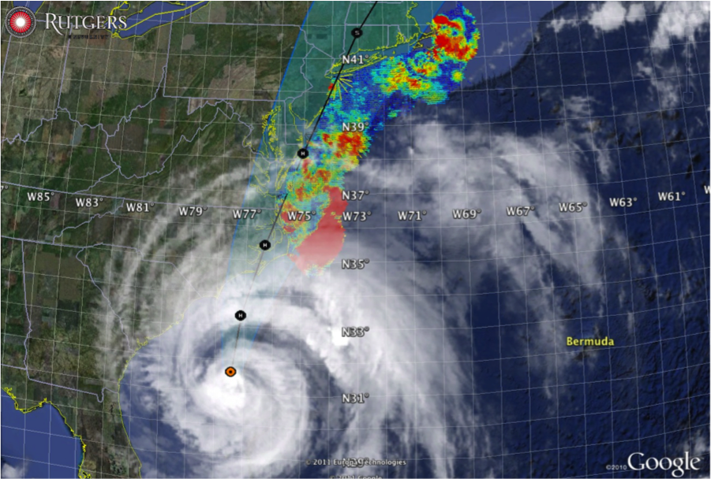
Hurricane Sandy
October 29, 2012
NOAA/NHC Damage:
>$68 Billion.
Hurricane Irene
August 28, 2011
NOAA/NHC Damage:
>$16 Billion.

Slide 67
ESMF/NUOPC Coupling
esmf_roms.F:
MODULE esmf_roms_mod
ROMS_SetServices:
ROMS_SetInitializeP1:
ROMS_SetInitializeP2:
ROMS_DataInit:
ROMS_SetClock:
ROMS_SetRunClock;
ROMS_CheckImport:
ROMS_SetGridArrays:
ROMS_SetStates:
ROMS_ModelAdvance:
ROMS_SetFinalize:
ROMS_Import:
ROMS_Export:
Sets shared-object entry points using NUPOC generic methods for initialize, run, and finalize kernel routines (PUBLIC routine)
Phase 1 initialization: advertise import and export fields long- and short-names
Phase 2 initialization: Initializes solution, sets application grid arrays, and registers fields into import state and export state
Exports fields during initialization or restart
Sets calendar, start and stop times, and coupling interval
Sets ROMS run clock manually
Checks if import field is at the correct time
Sets staggered, horizontal grid arrays, grid area, and land/sea masks
Realize fields into import and export states by allocating and initializing pointers
Advances kernel for a coupling interval and calls import and export routines
Finalizes execution
Imports fields from other connected components
Exports fields to other connected components
END MODULE esmf_roms_mod

Slide 68


Coupling Run Sequence: DATA-ATM-ROMS
Semi-Implicit, ATM average
Semi-Implicit, ATM instantaneous
Explicit

Slide 69

Surface Current Comparison (m/s)
DATA-WRF-ROMS
No Nesting
ESMF Coupling: 180 s
BULK_FLUXES
ESMF Coupling: 180 s
ATM SBL

Slide 70

Surface Salinity Comparison
DATA-WRF-ROMS
No Nesting
ESMF Coupling: 180 s
BULK_FLUXES
ESMF Coupling: 180 s
ATM SBL

Slide 71

Hurricane Supplemental
ESMF/NUOPC Coupling ROMS-WRF
Motivation:
Improve Hurricane Intensity Forecasting, Analysis, and Research
Some of the current challenges:
Uncertain ocean initial states
Rapidly evolving stratified coastal oceans
Freshwater barrier layers
Air-sea flux parameterizations
20%-30% improvement since 1985
Notes:
Develop ROMS-WRF coupling with ESMF/NUOPC libraries
capabilities between WRF and ROMS with the ESMF/NUOPC libraries to join other operational NOAA modeling systems.
Initially develop a coupled model domain for the MARACOOS region
Coupling philosophy without WRF intervention
Loosely coupled DA, Background trajectory is a coupled run

Slide 72

Hurricane Supplemental
ESMF/NUOPC Coupling ROMS-WRF
Motivation:
Improve Hurricane Intensity Forecasting, Analysis, and Research
Develop tools to better resolve impacts, extreme precipitation, and storm surge.
Hurricanes have caused $934.6 B in damages since 1980, and killed over 13,000 people in the US alone
Notes:
Develop ROMS-WRF coupling with ESMF/NUOPC libraries
capabilities between WRF and ROMS with the ESMF/NUOPC libraries to join other operational NOAA modeling systems.
Initially develop a coupled model domain for the MARACOOS region
Coupling philosophy without WRF intervention
Loosely coupled DA, Background trajectory is a coupled run

Slide 73

Average Track Errors:
Atlantic Basin
Average Intensity Errors:
Atlantic Basin
Limitations on Hurricane Intensity Improvement
Computing resources and model resolution (Rotunno et al., 2009)
Poor understanding of the atmospheric boundary layer (Nolan et al., 2009; Andreas et al., 2015)
Difficulty in modeling the upper ocean response to storm forcing (Yablonsky and Ginis, 2009).
Cangialosi and Franklin 2017

Slide 74

RUWRF Rainfall Forecast
Rainfall Difference
Warm-Cold
Rainfall w/ Warm SST
Rainfall w/ Cold SST
At Atlantic City:
WRF Warm SST Total Rainfall = 130.4 mm
WRF Cold SST Total Rainfall = 96.6 mm
Atlantic City Observed Rainfall = 92.5 mm
Maximum Difference = 133 mm
Average difference = 2 mm
Total Volume Difference = 8.6 km³
Lake Pontchartrain = 6.0 km³

