Slide 1
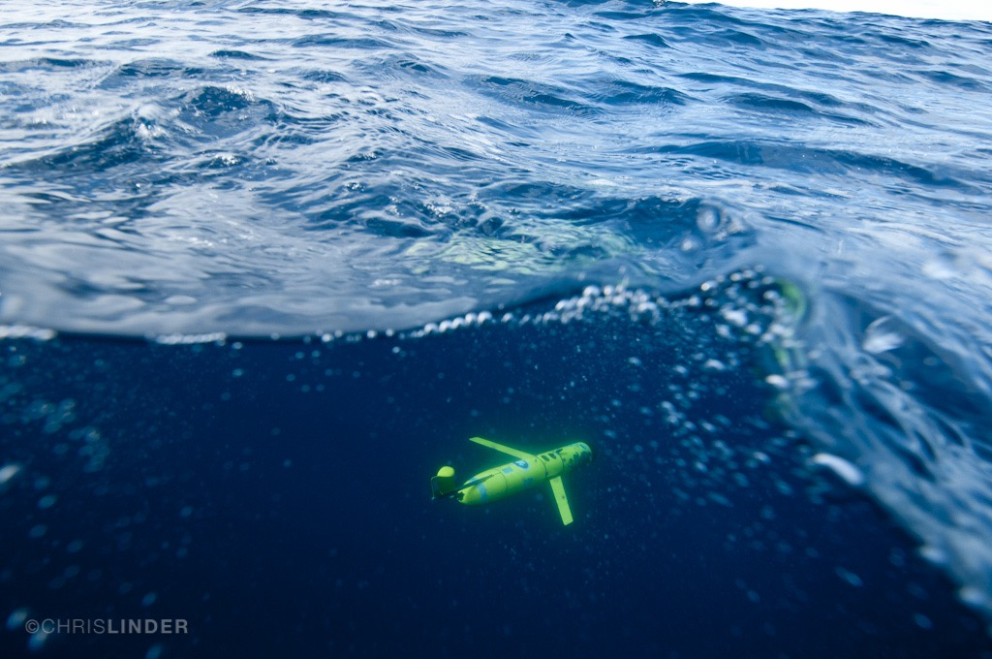
Using Autonomous Underwater Gliders to Map, Chemical,
and Biological Processes in the Ocean
Oscar Schofield on behalf of many

Slide 2
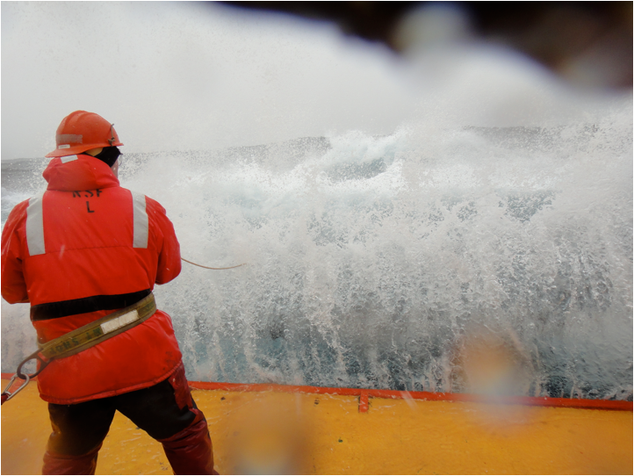
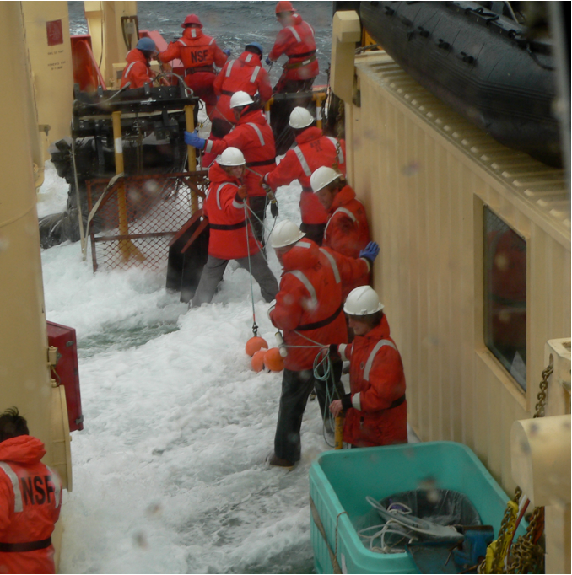
The challenge is to collecting sustained spatial physical, chemical, and biological data in a rough sea

Slide 3

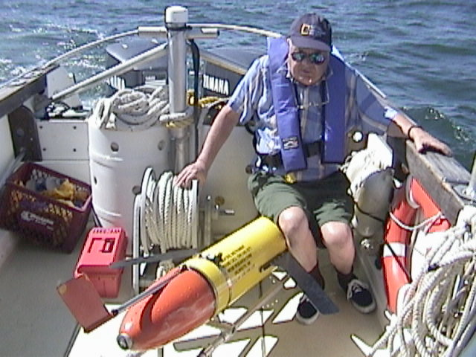
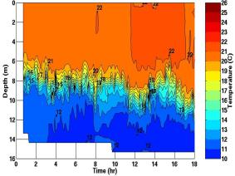
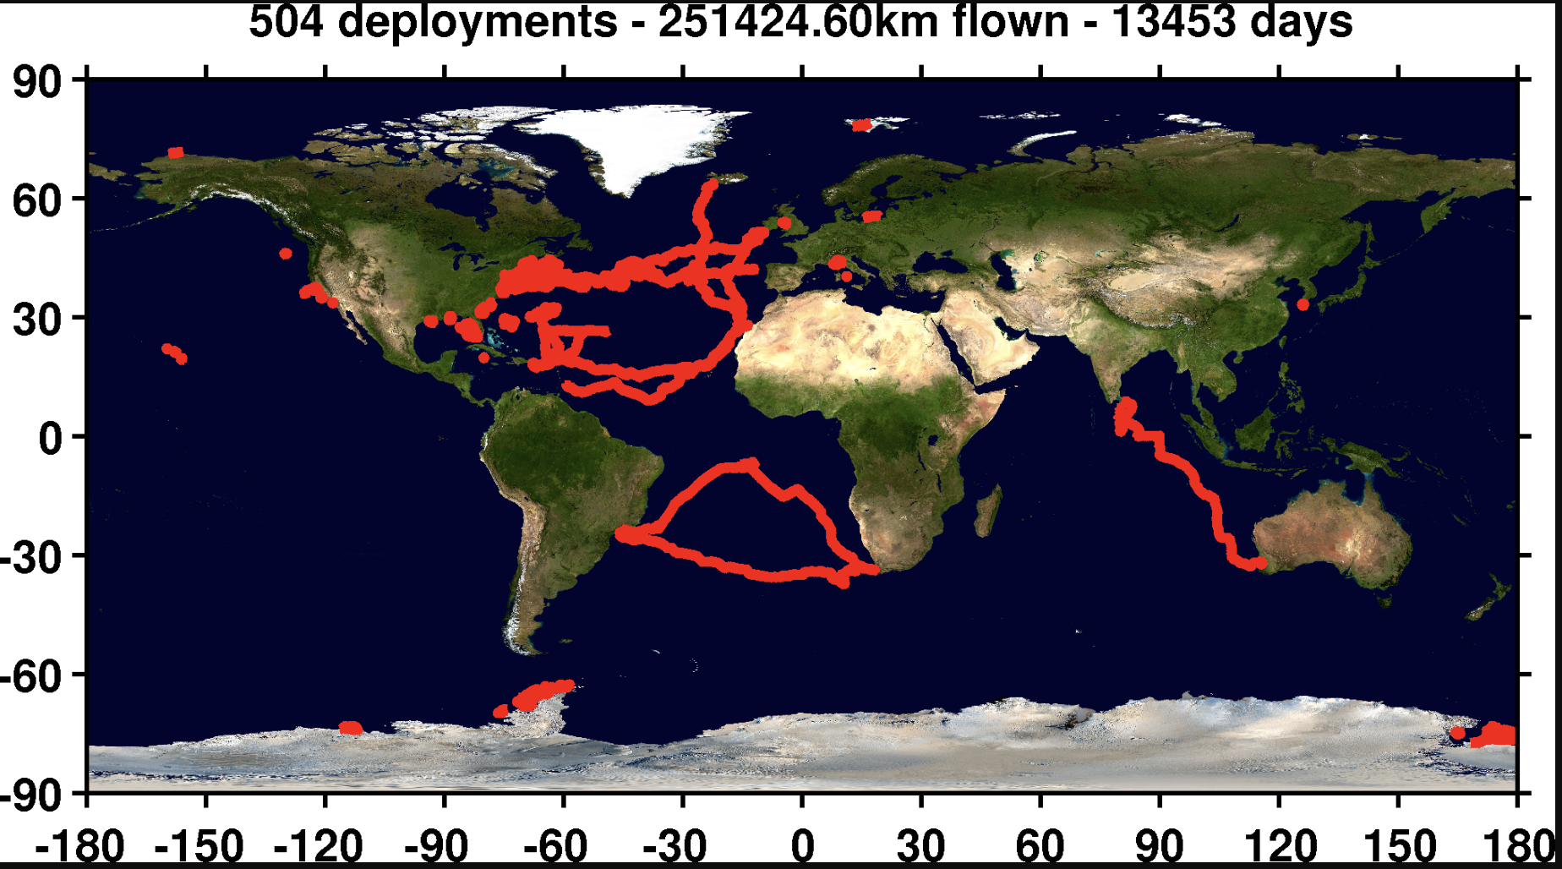
Glider history and our timeline of their evolution
Doug with first at sea test
Glider history
1989 (Stommel’s
Sloccum Mission)
1999 (Test Flight)
2003 (First cross
shelf mission)
Time
2006 (First
Antarctic mission)
2009 (First
Basin Crossing)
2011-2012
(Hurricane missions)
2013-2014 (South
Atlantic gyre w/
Challenger)

Slide 4
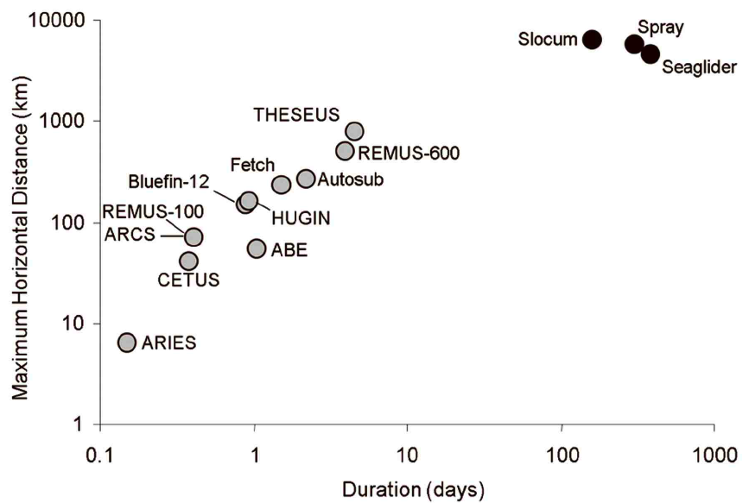
Glider’s are “steerable” underwater vehicle with real-time communications that can cover great distances over long periods
-Long duration
-Grand space scales
Moline et al. 2009

Slide 5


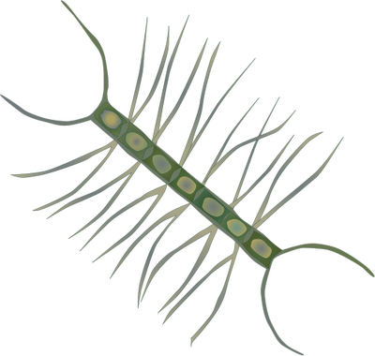
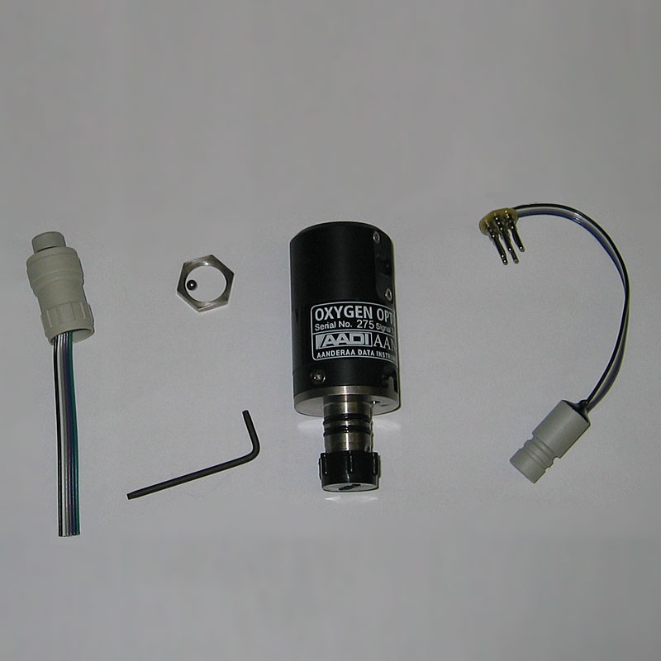
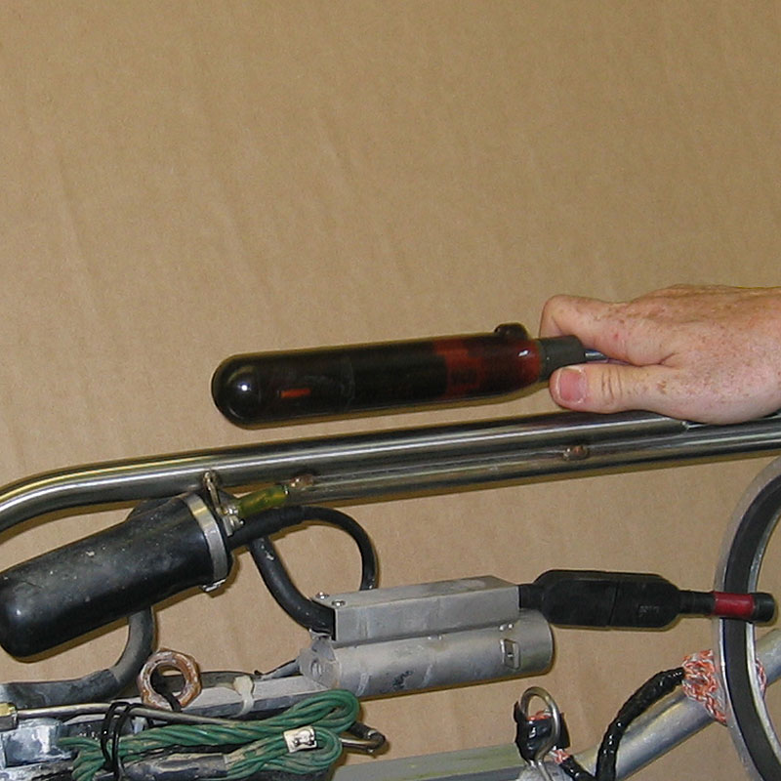
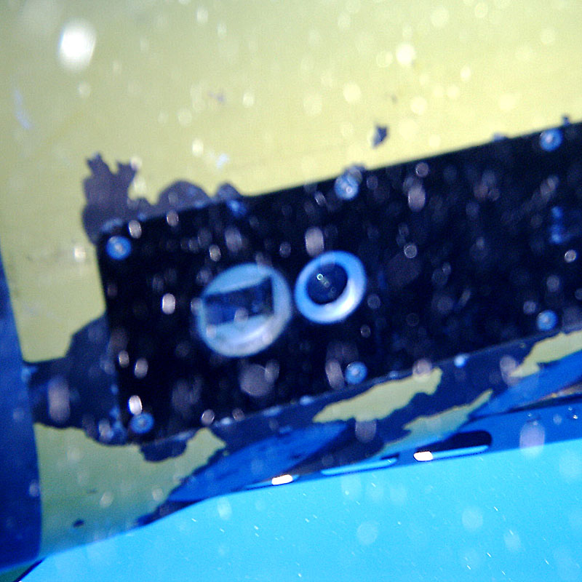
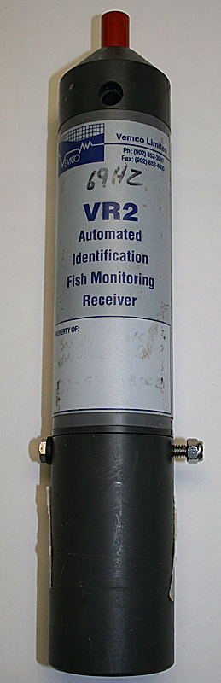
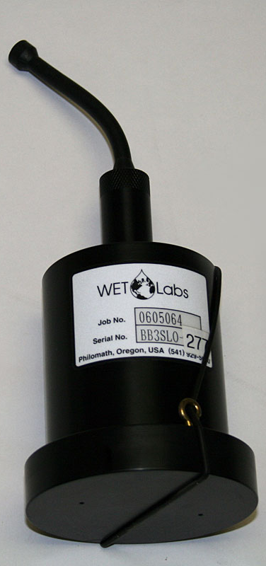
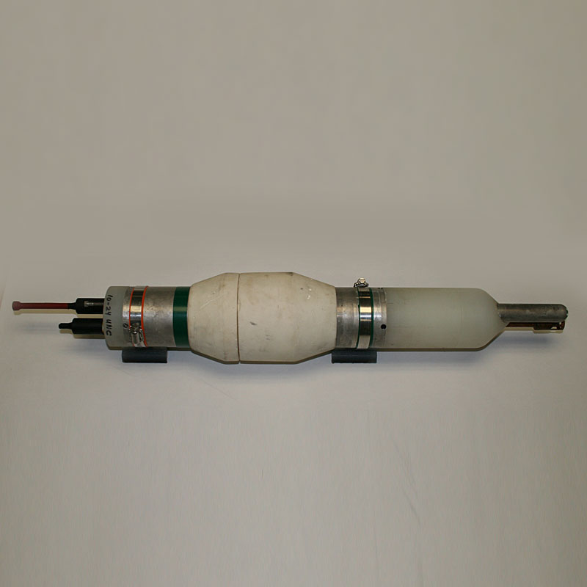
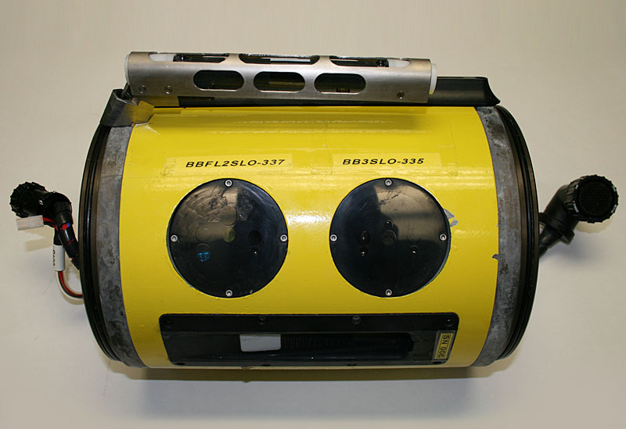
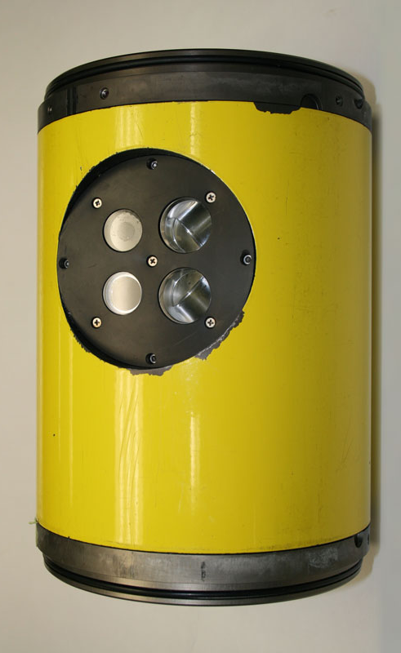
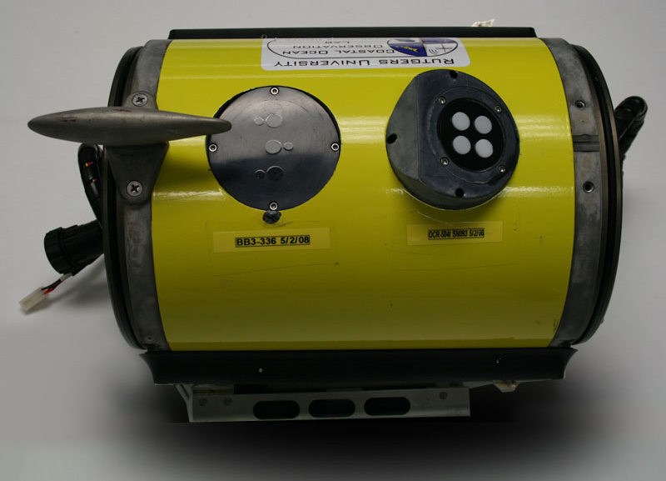
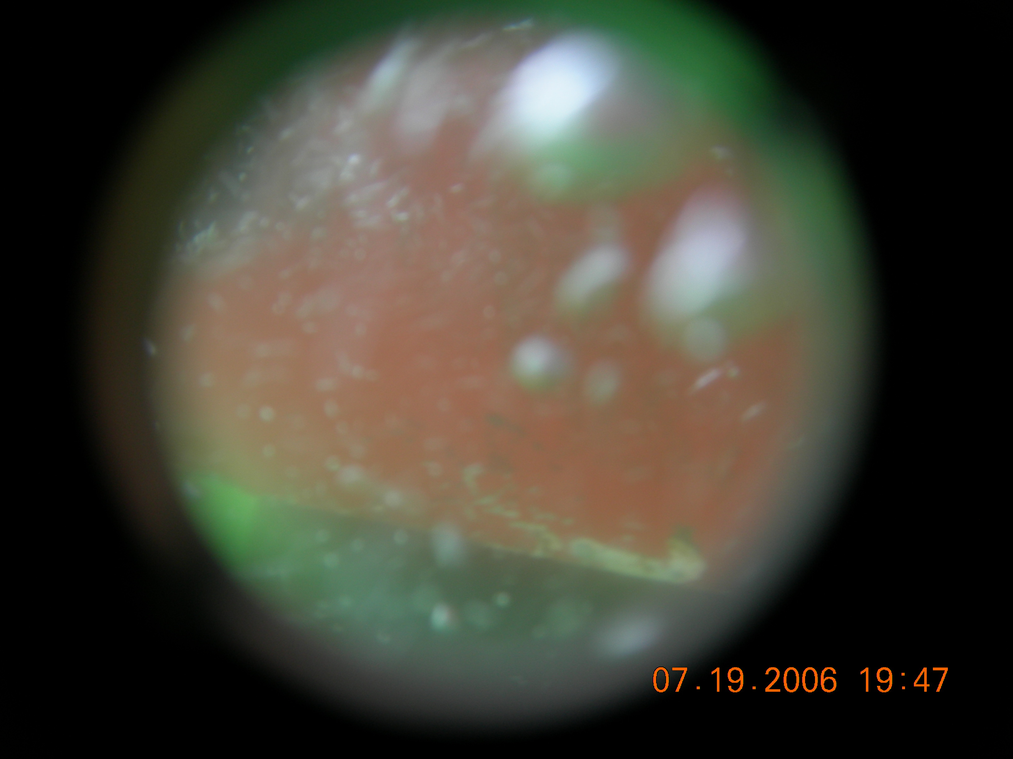
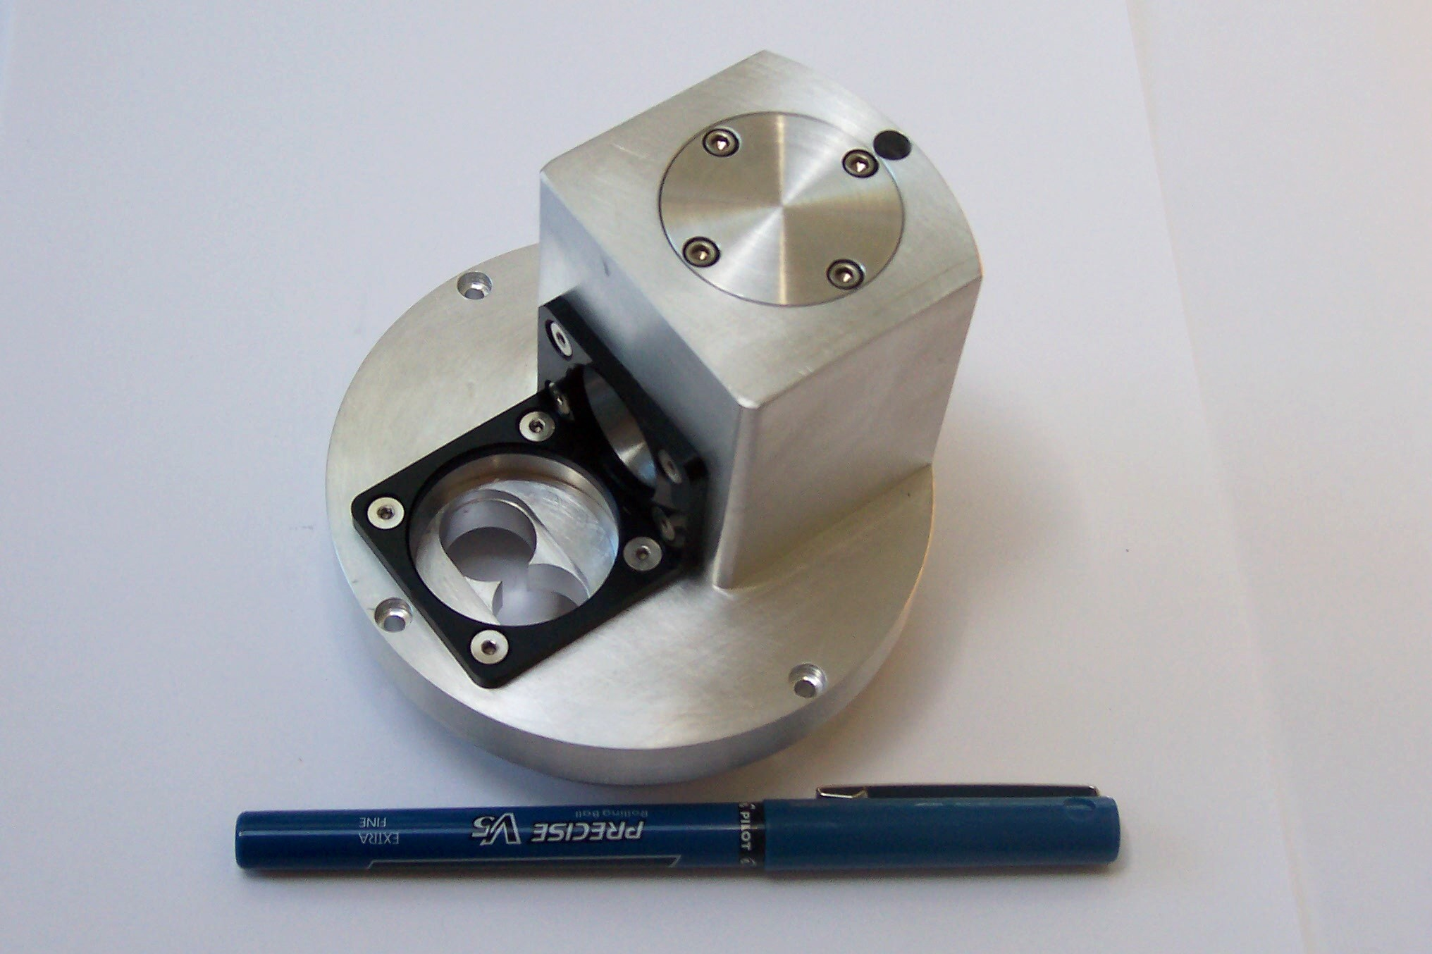
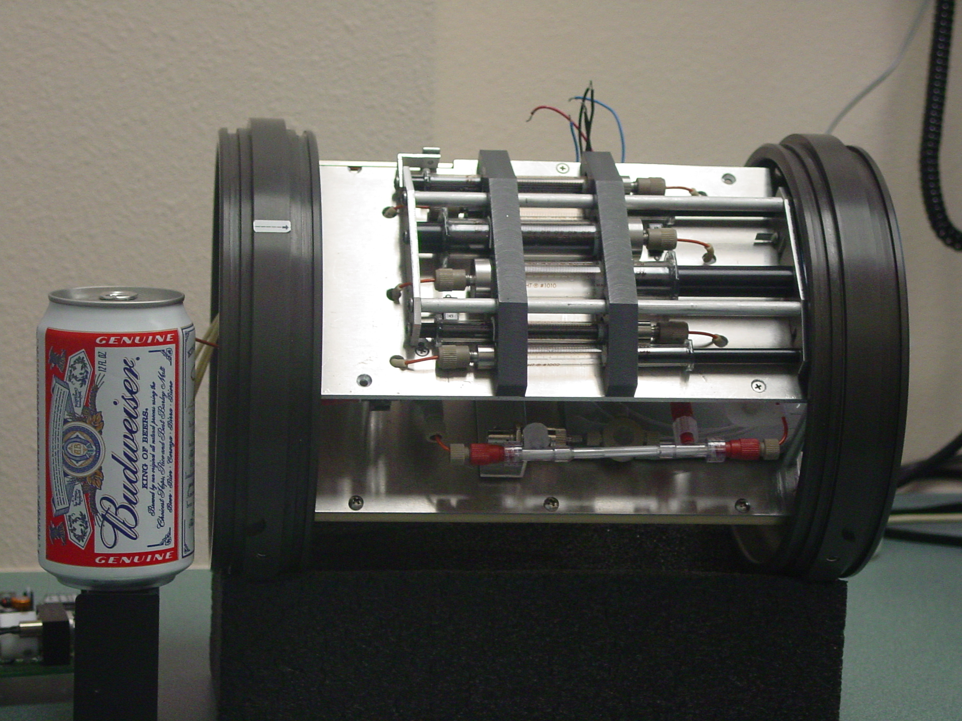

What can science data can be collected by gliders?
IN SITU
OPTICS
TRANSPORT
TRACE GASES
Inherent optics
Absorption (λ)
Scattering (λ)
Volume scattering
Attenuation (λ)
Refractive Index
Apparent Optics
(λ) Light intensity
up & down
ADCP
Estimated geostrophic
currents
Optical Oxygen
Optical CO2
Mass Spectrometers
Phytoplankton
WATER
COLUMN
PHYSICS
Concentration
Spectral Backscatter
Hyperspectral Absorption
Chlorophyll fluorescence
Imagery (visual, holography)
Diversity
Spectral Backscatter (proxy for composition/size)
Imagery (visual, holography)
“Omics”
Rates
Kinetic fluorescence
Photoacoustics
Stimulated oxygen kinetics
Macro/ Micro
nutrients & chem
Temperature
Salinity
Turbulence
CHEMISTRY
Optical nutrients
Optical CO2
Optical pH
Mass Spectrometers
e⁻
Proteins
Lipids
Carbos
Chl a
Zooplankton
TEP, DOM
Concentration
Acoustic backscatter
Imagery (visual, holography)
Diversity
Multi frequency Acoustics Imagery (visual, holography)
“Omics”
Organic Matter Flux
Concentration
Spectral Backscatter spikes
Particle settling rate
Imagery (visual, holography)
Diversity
Imagery (visual, holography)
“Omics”
Mass Spectrometers
Rates
Spatial calibrated fall rates
via imagery
Higher Trophic Levels
Concentration
Acoustic backscatter
Imagery (visual, holography)
Passive acoustics
Acoustic tags + Receiver
Diversity
Multi frequency Acoustics Imagery (visual, holography)
“Omics”
Passive acoustics
Acoustic tags + Receiver
Marine snow & Export Flux
Schofield et al. MTS 2015

Slide 6
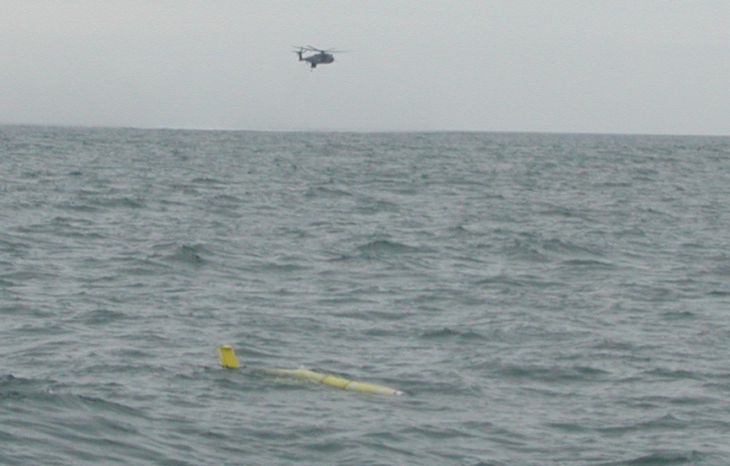

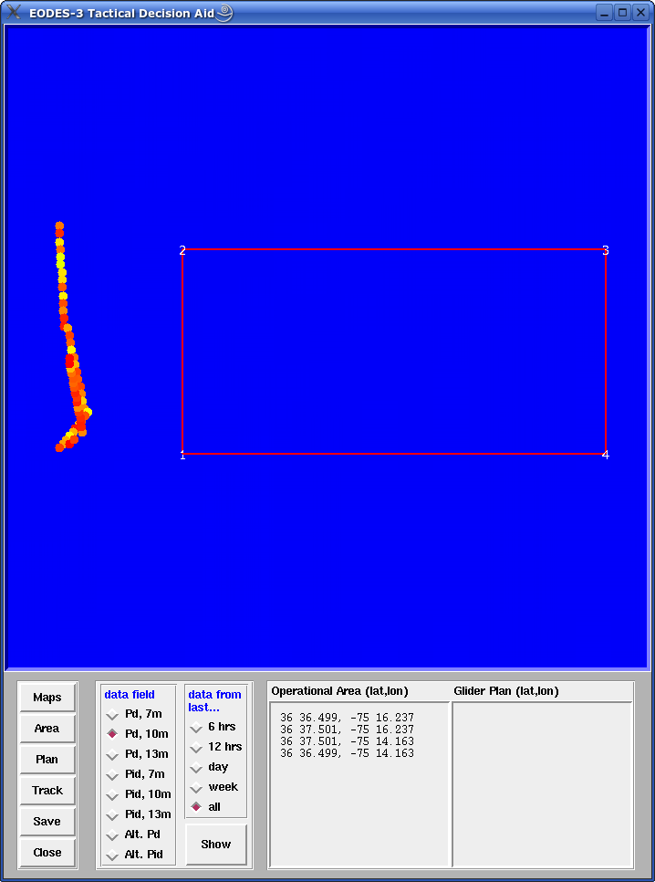
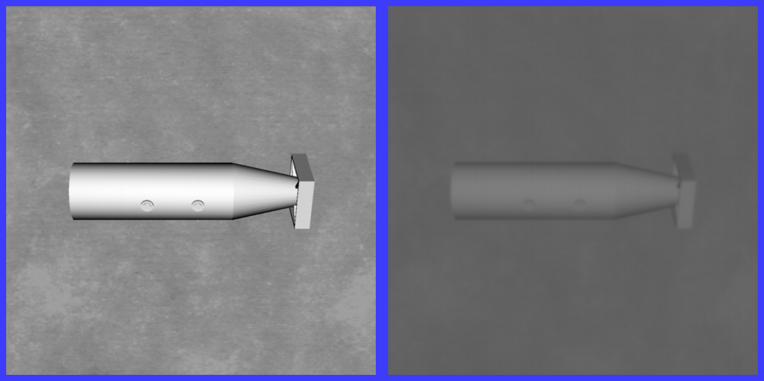
From the optics, one can calculate water column turbidity. What is the depth of the euphotic zone?
An example for a very applied problem: What can you see?
Helicopter or diver….
Towed MCM detection system
Clear water
Real water
MIREM April 2005
probability of detection
at an altitude of 10m
off bottom
Clear water
Real water
Red = poor detection

Slide 7
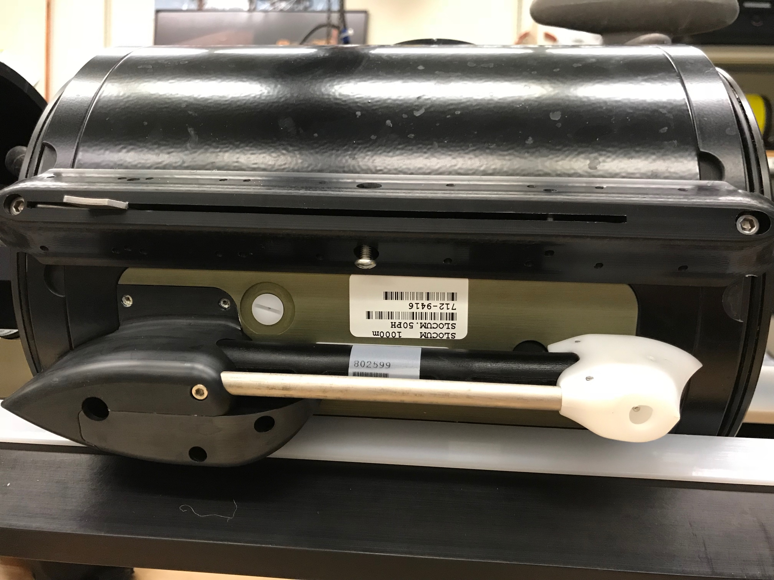

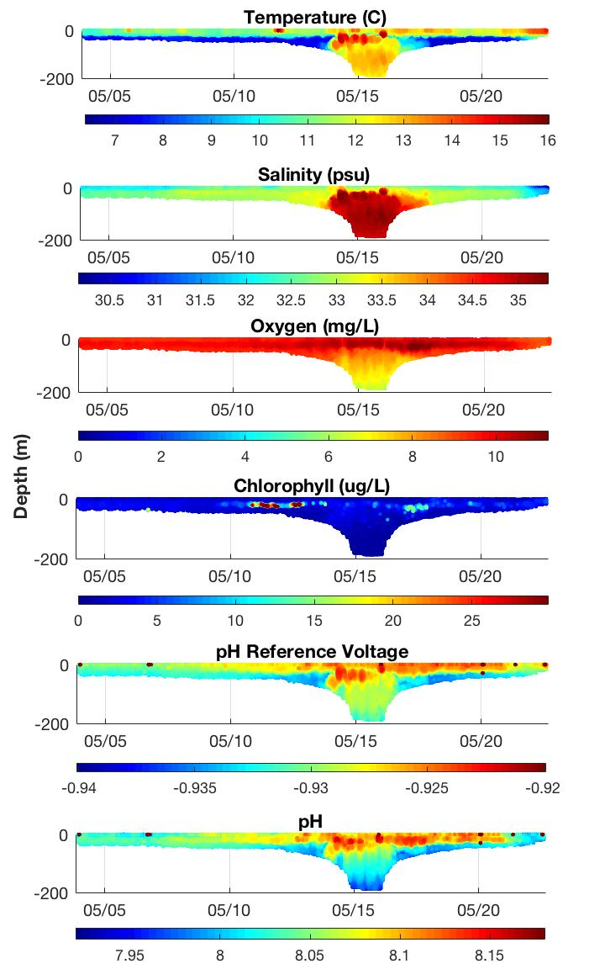

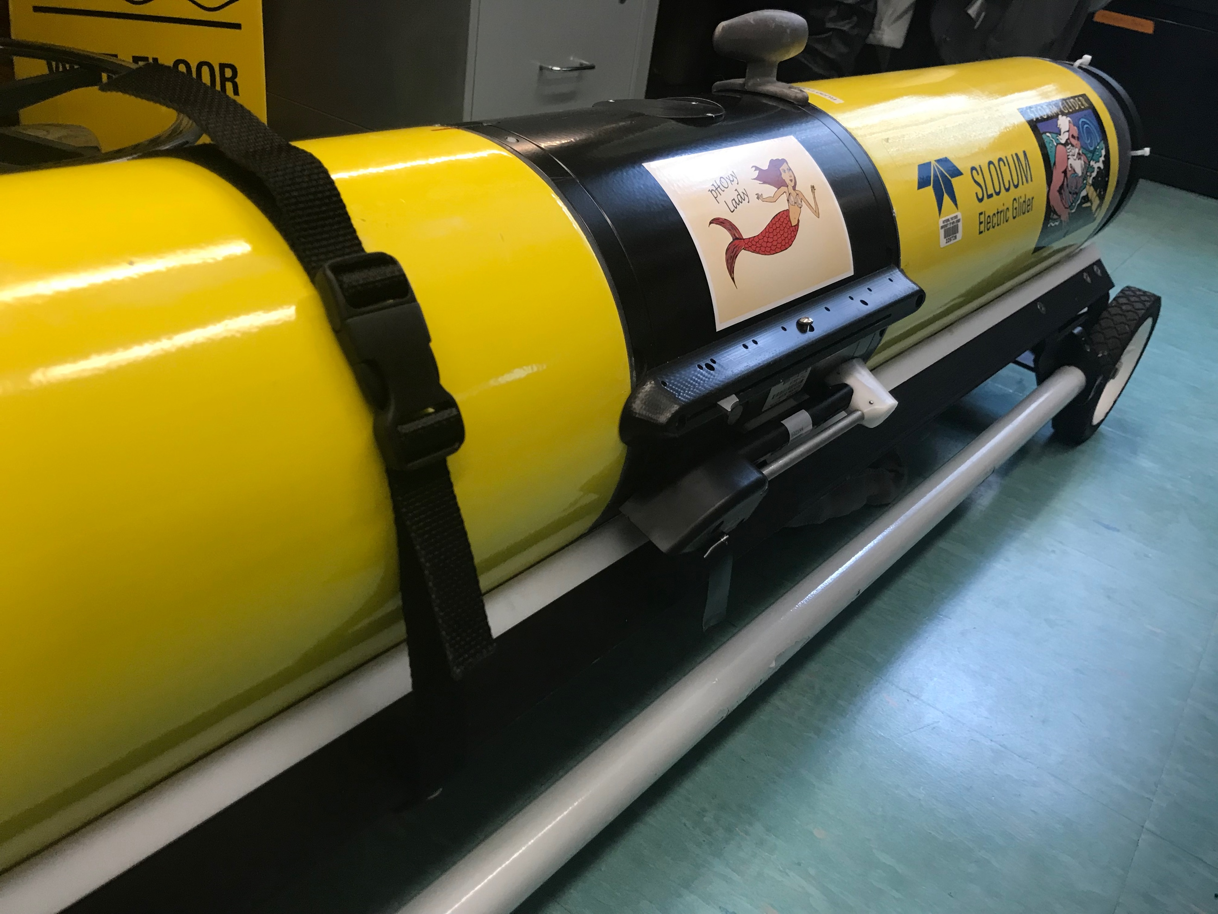
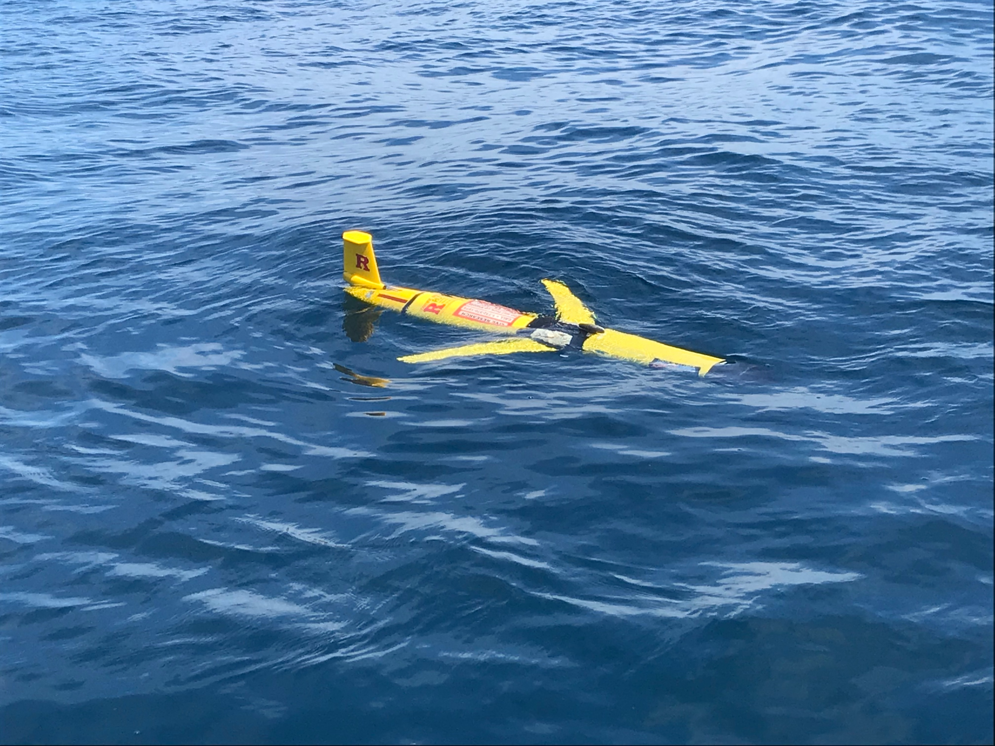
Ocean Chemistry (pH)
Development & Testing of New Glider Sensors
pH for Ocean Acidification Monitoring
May 2018 – NJ cross-shelf
May 2018 Deployment
NSF OTIC Program (OCE #1634520)
Thanks to Grace Saba

Slide 8
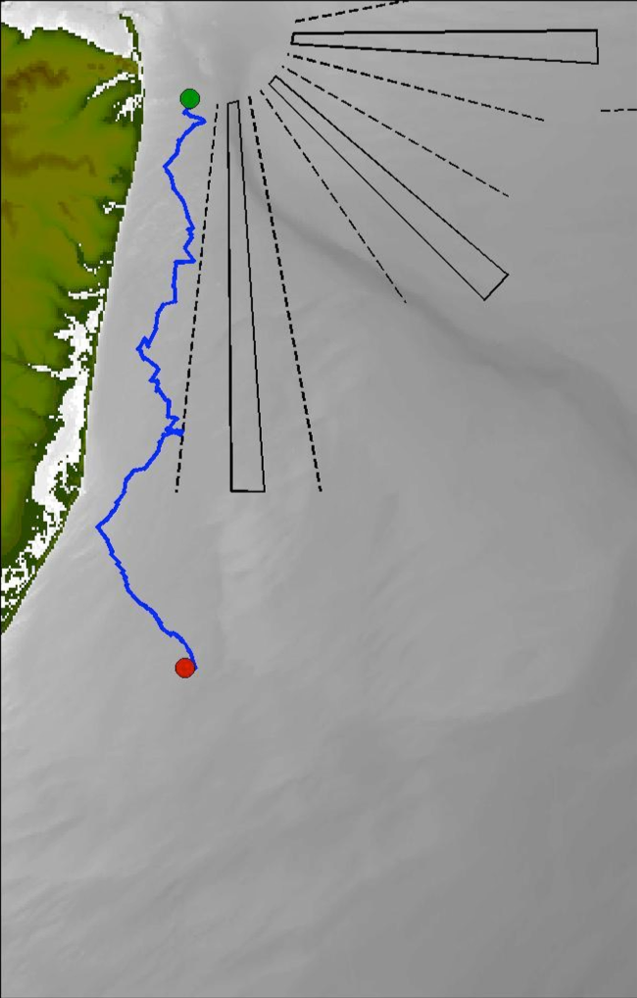


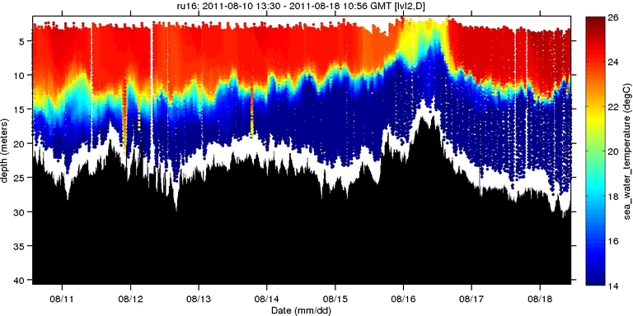
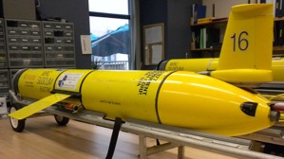
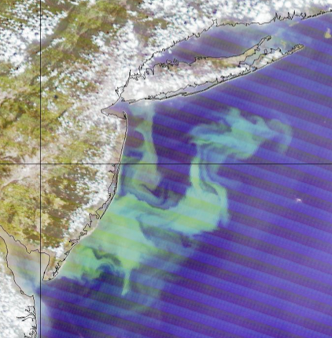
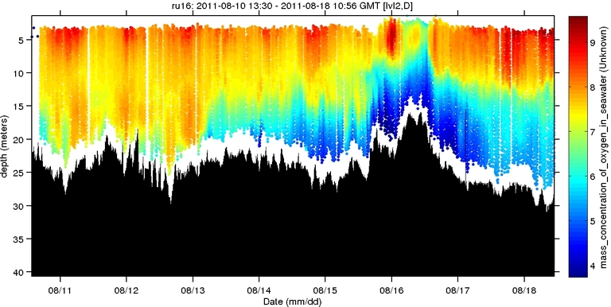
Ocean Chemistry (O₂)
Autonomous Platforms:
Dissolved Oxygen
Shallow Water (5-30m)
Temperature (°C)
Thanks to
Josh Kohut
Dissolved Oxygen (mg/L)

Slide 9
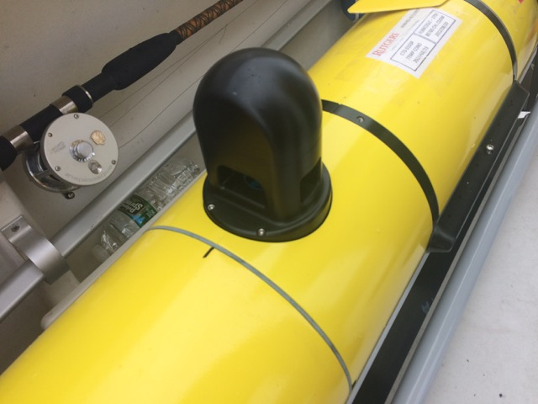


Laser systems allow for estimates particle size distribution and particle number
Thanks to Travis Miles
Suspended Sediment
Thanks to Travis Miles

Slide 10
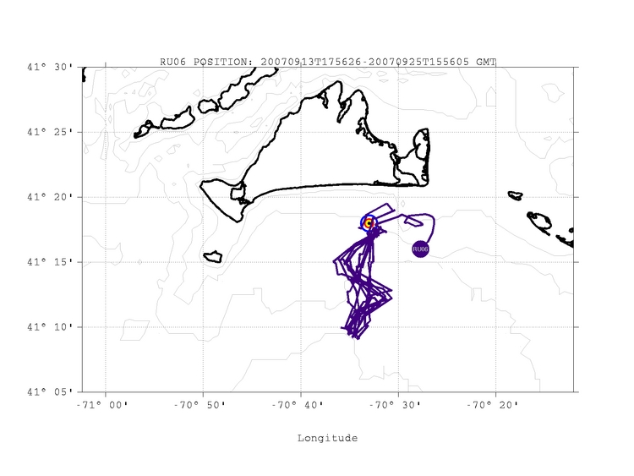
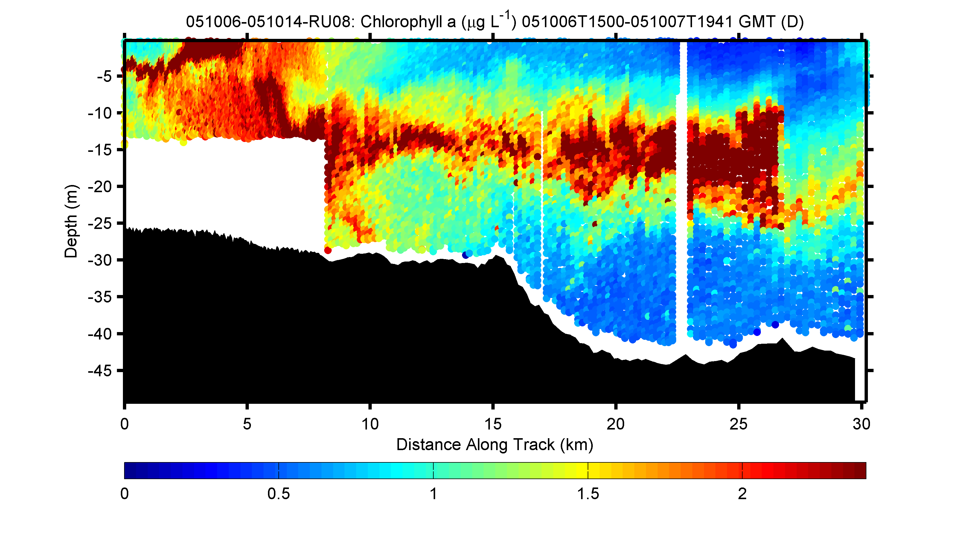
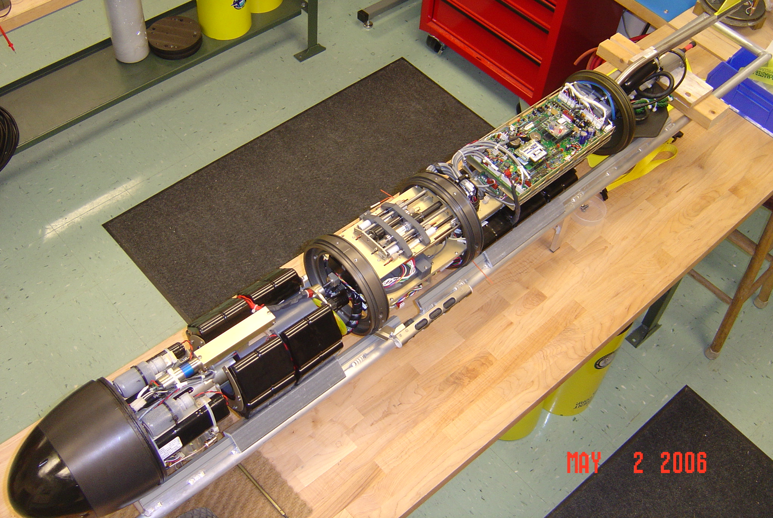
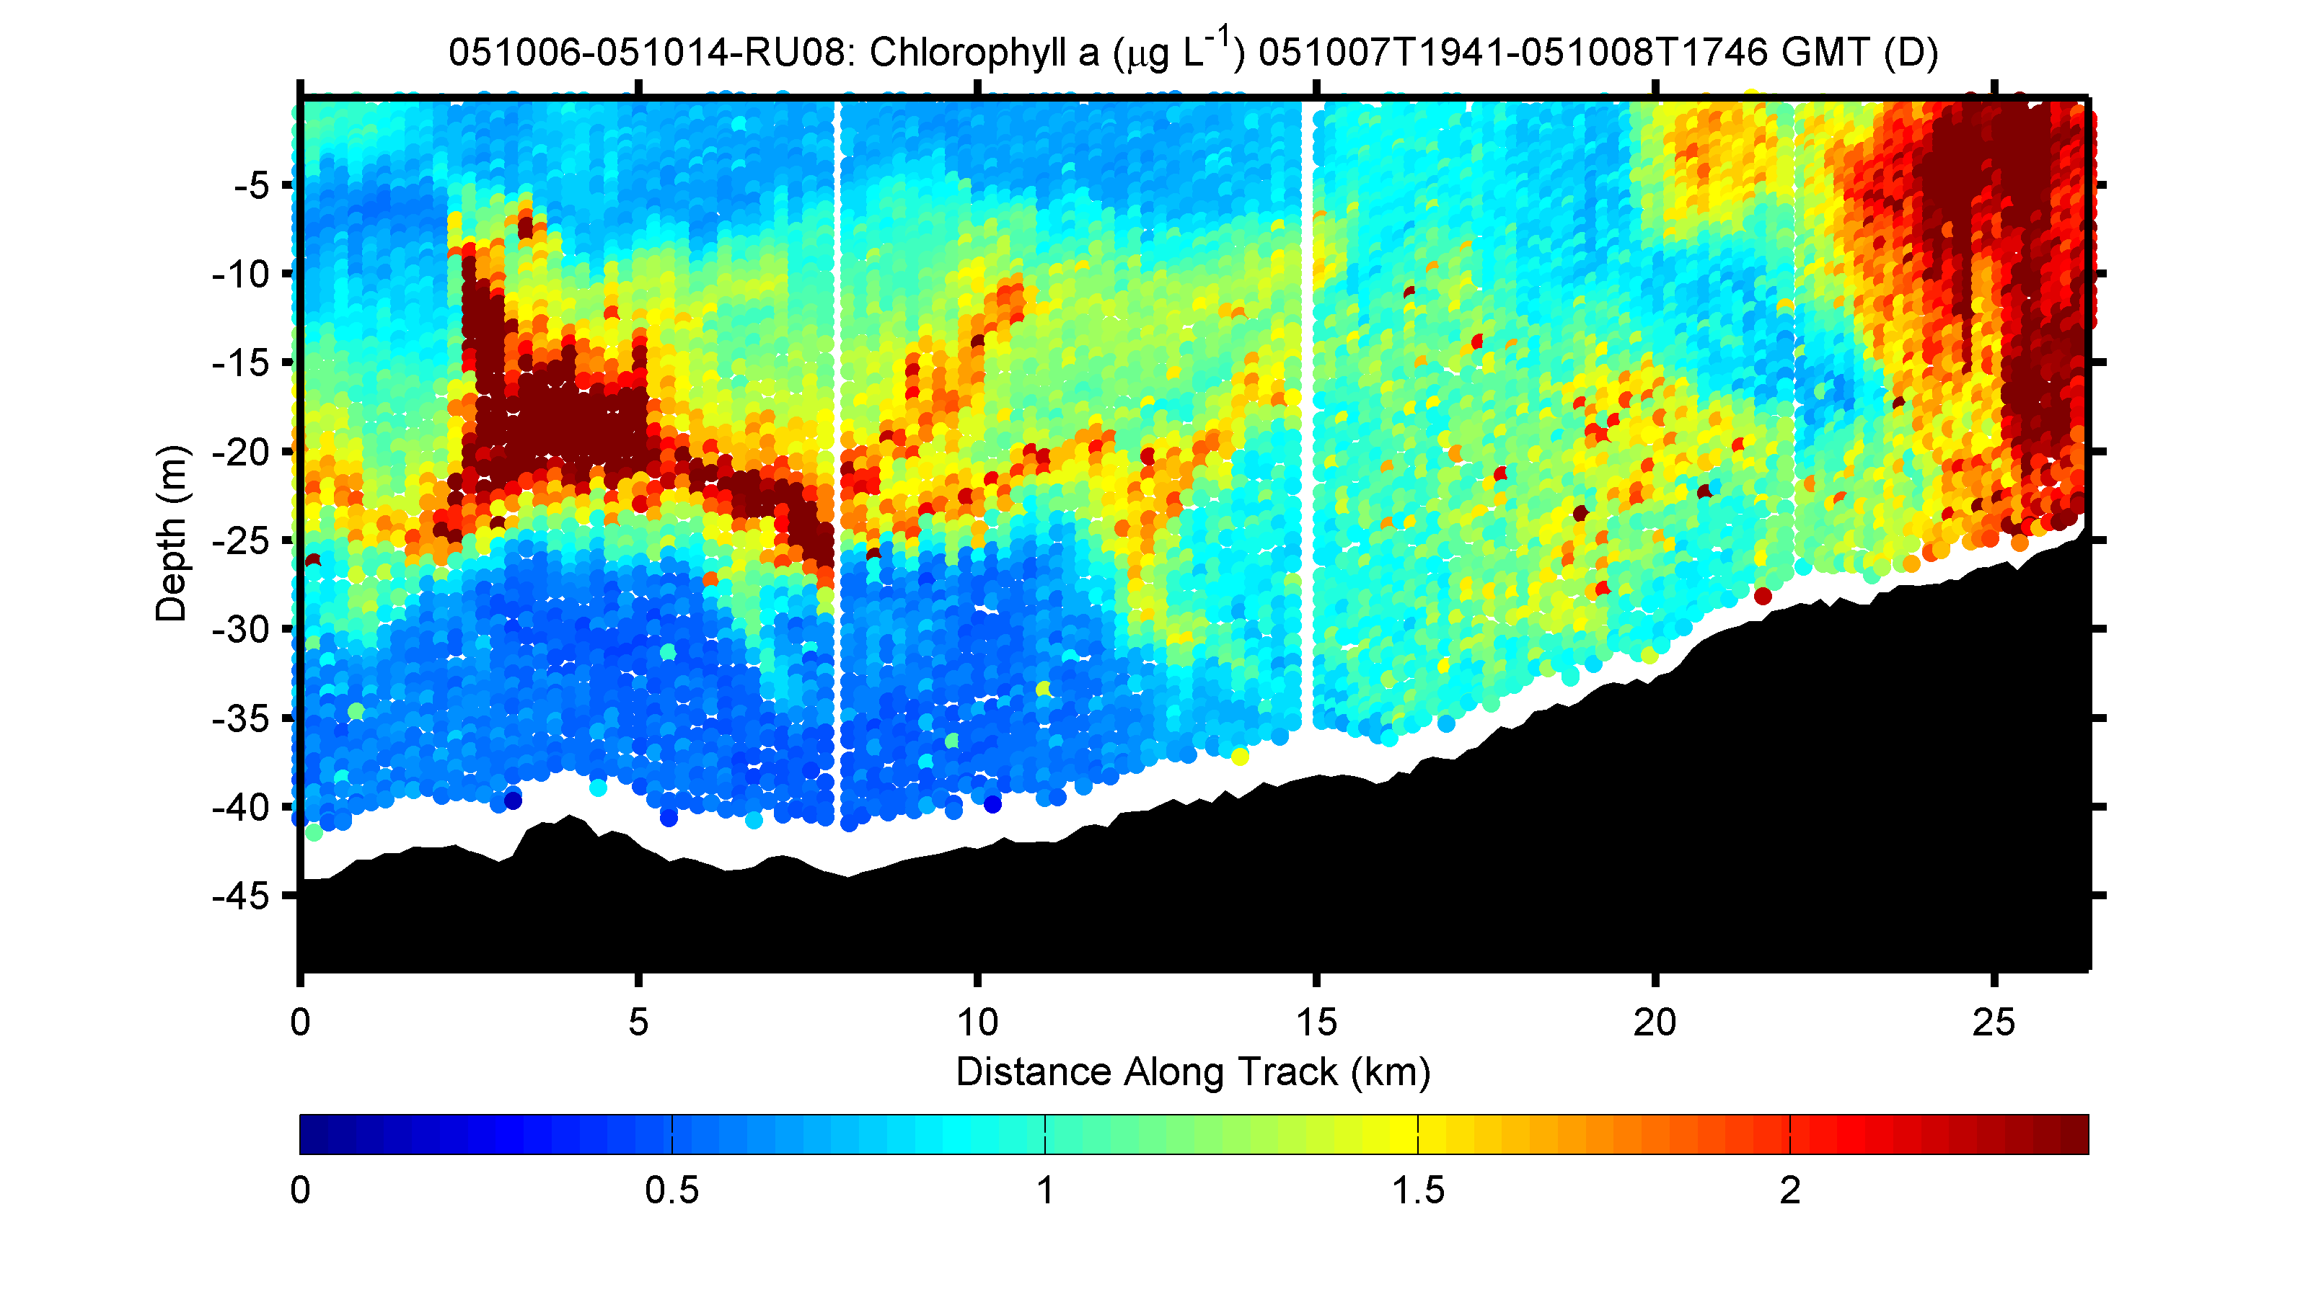
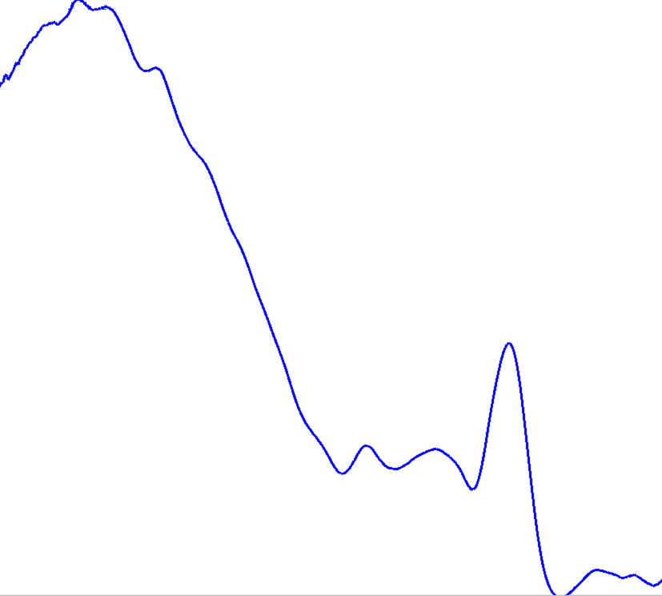
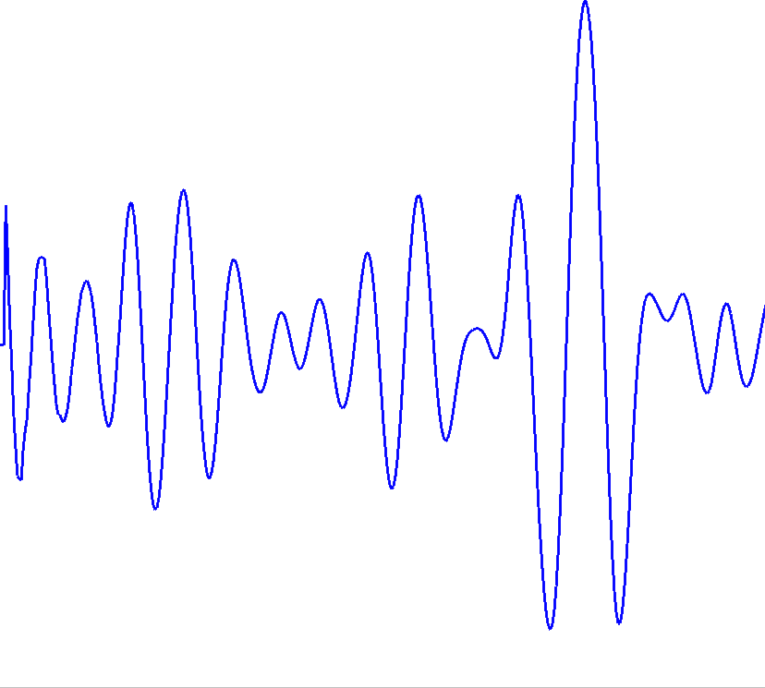
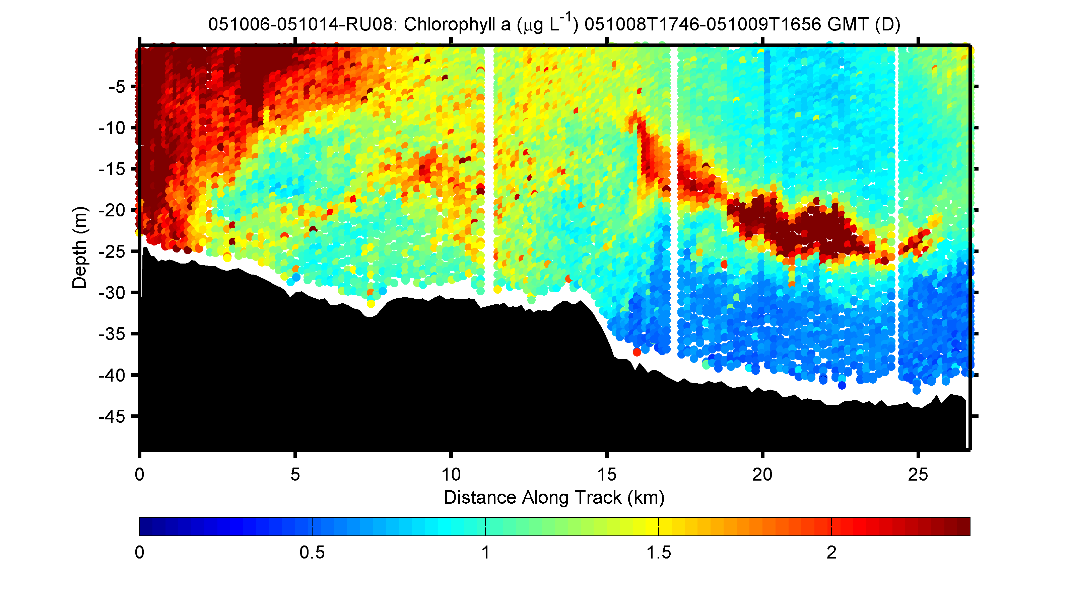
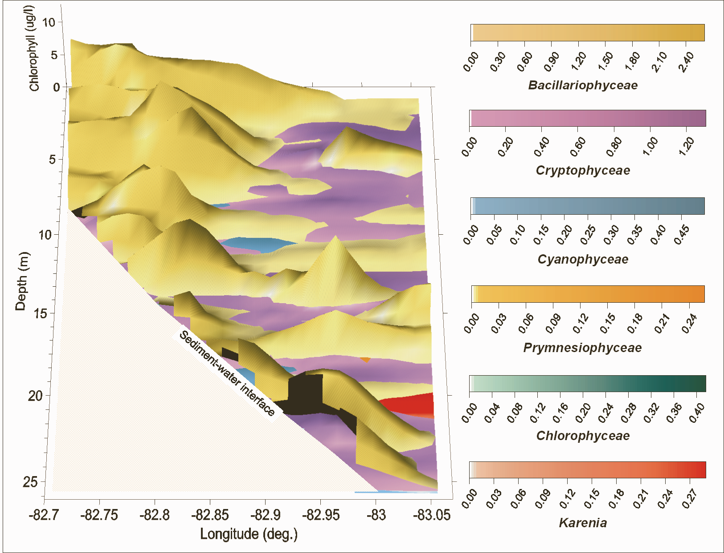
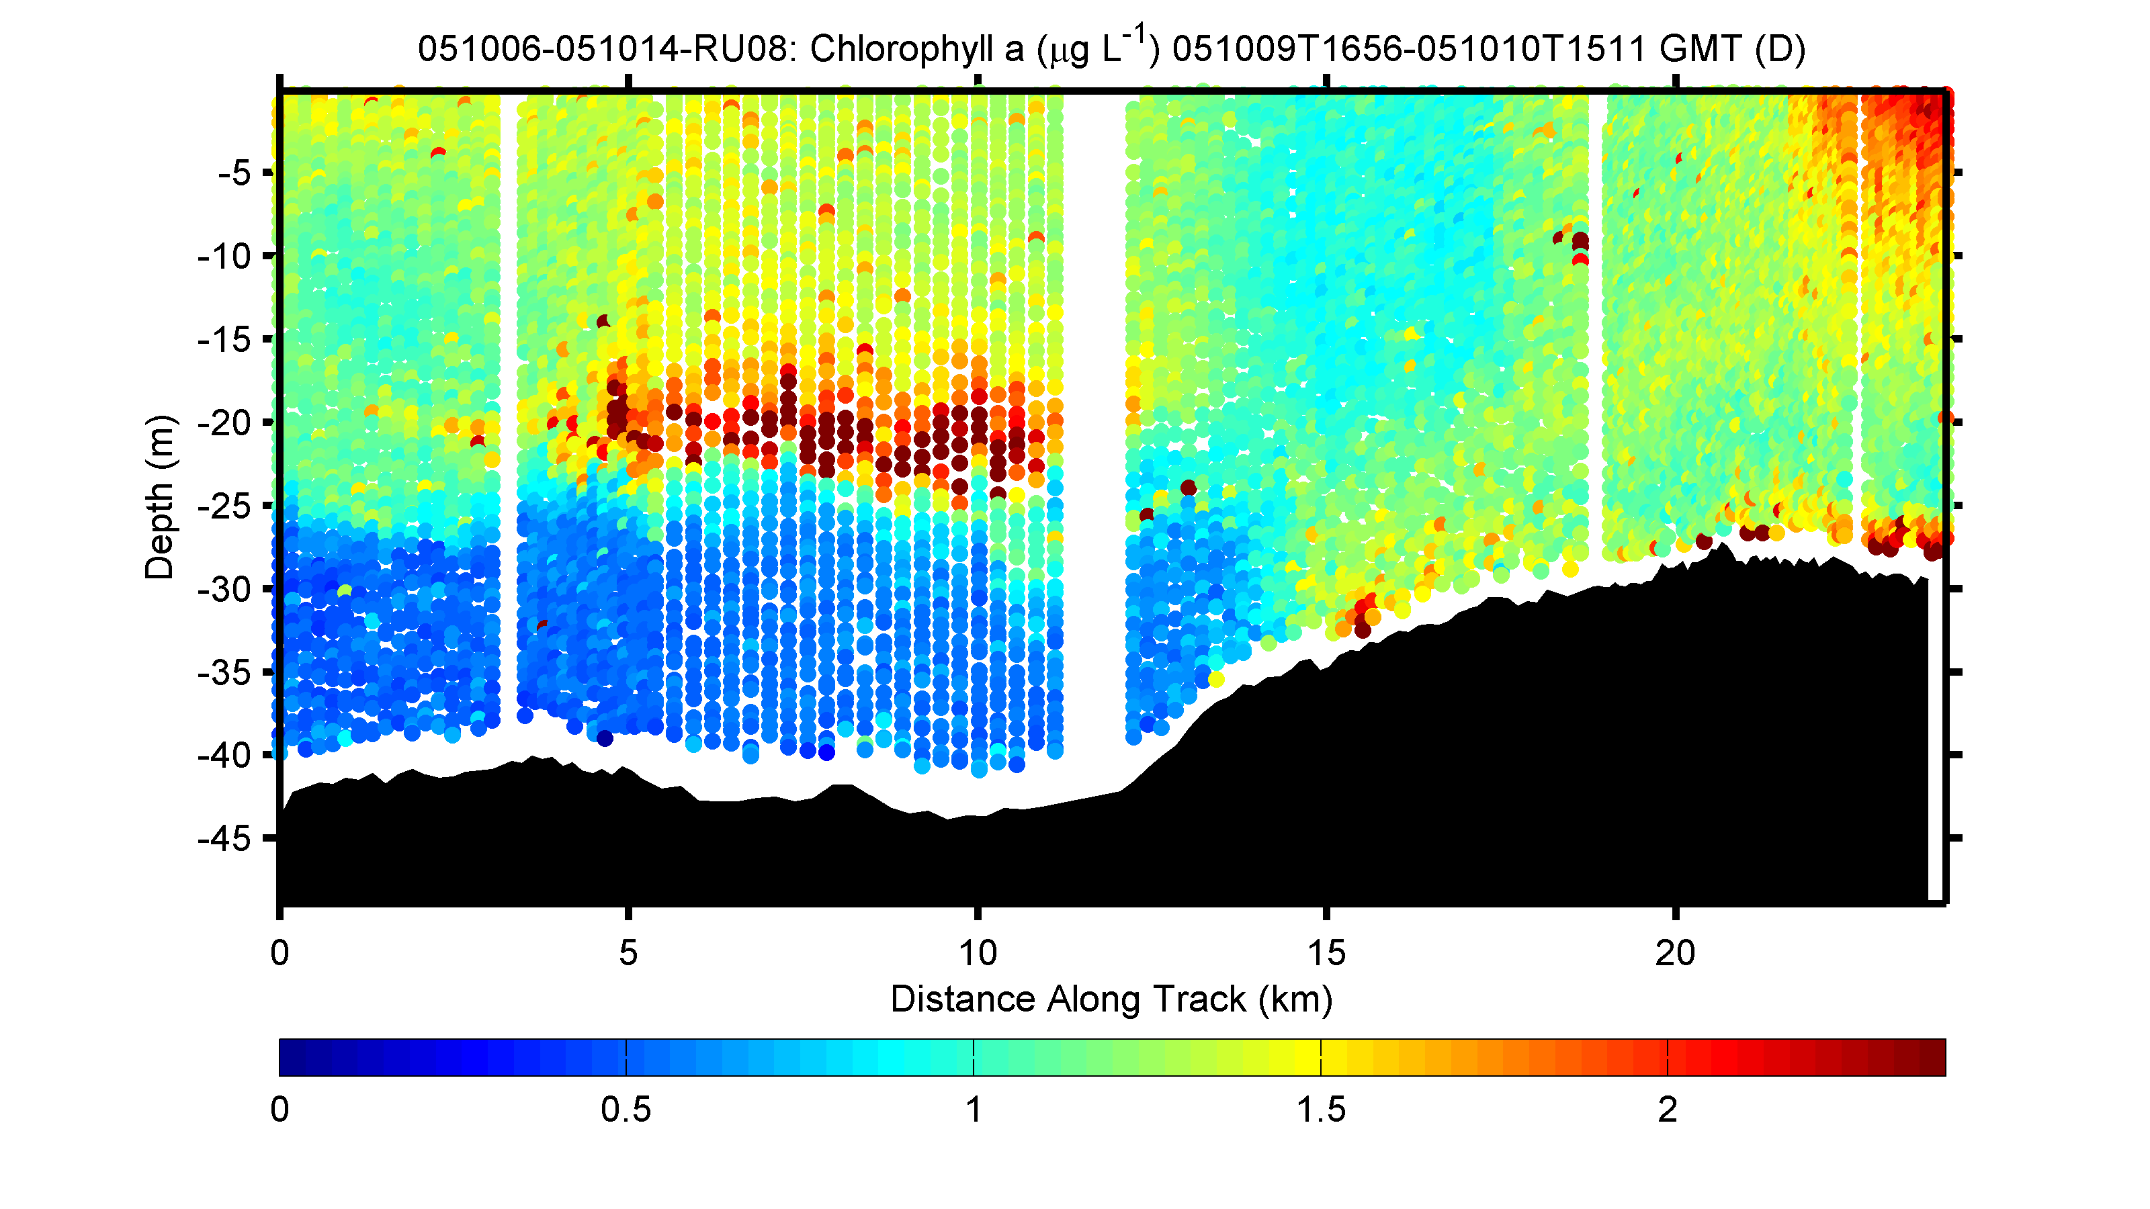
Gliders can provide high resolution biomass and taxa estimates
Phytoplankton biomass
Phytoplankton communities
Phytoplankton response
to the passage of large coastal
storm

Slide 11
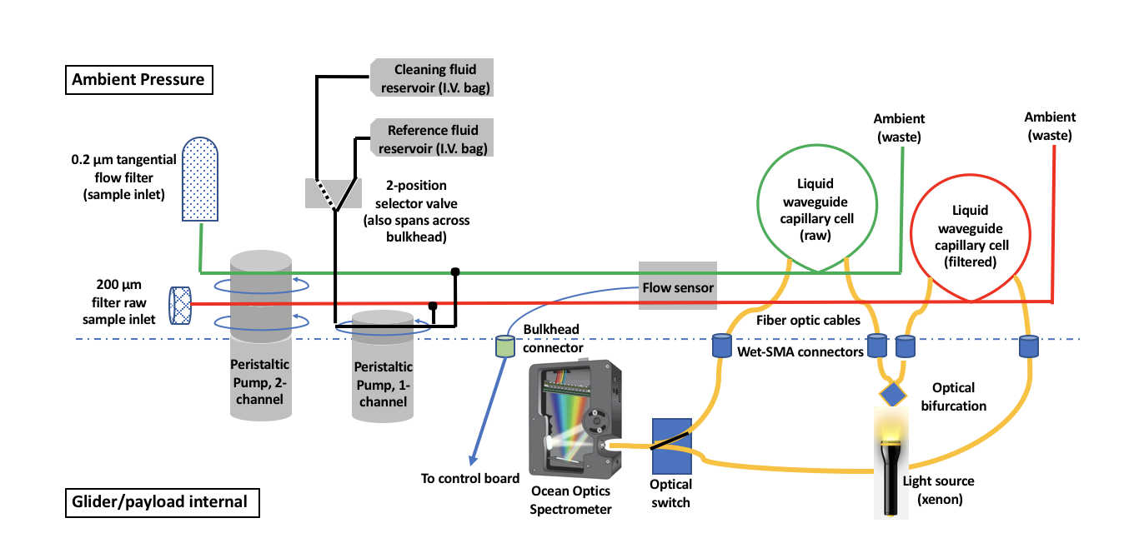
Full spectral measurements of absorption
Improve in-water bio-optical measurements for
constituents in the water
Glider based hyperspectral absorption
-provides 2nm resolution
-does not need concentration
to provide robust measurements
-both particulate and dissolved phases
-coupled with backscatter can provide proxy for reflectance

Slide 12
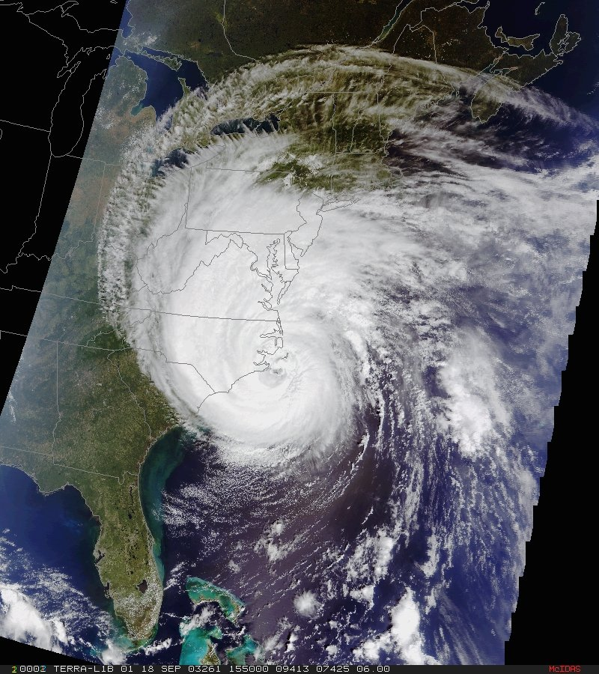
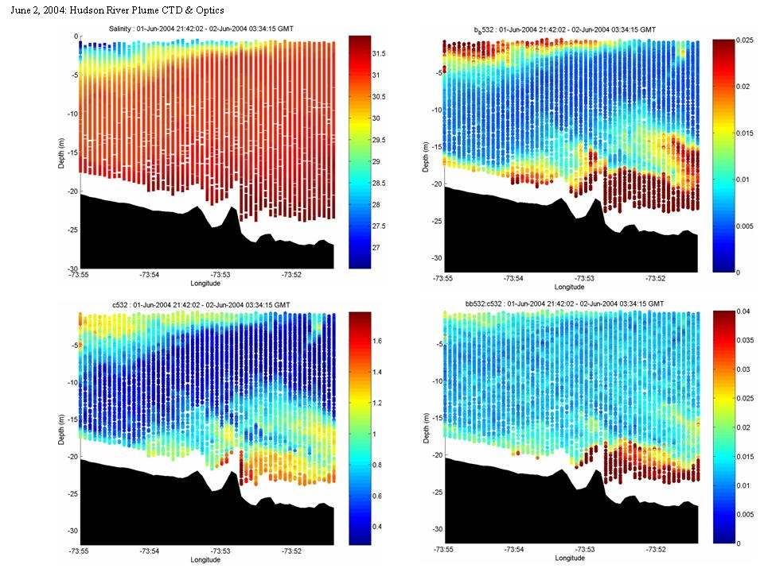
Glider’s provide insight into the nature of phytoplankton composition
c_{b650}
C_{b650}/b_{b650}
Empirical algorithms
%Mineral (in situ)
salinity
b_{b650}

Slide 13
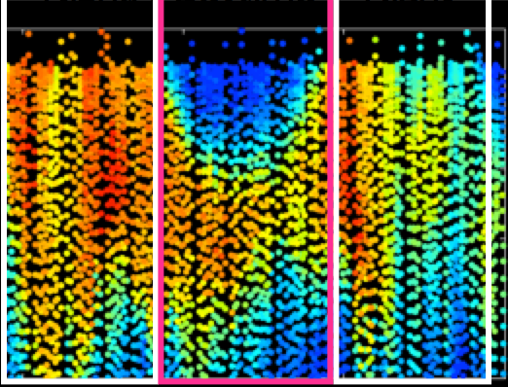
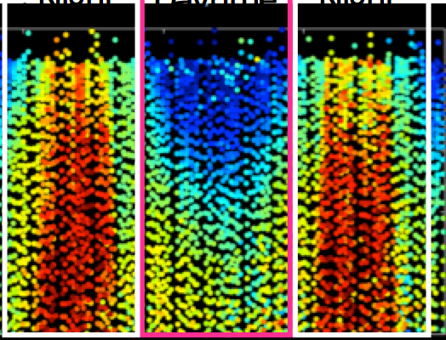
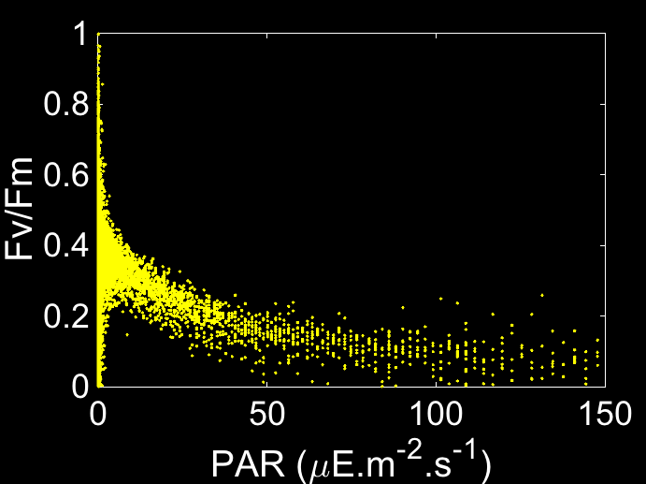
The ability to look at phytoplankton physiology and rate processes
PROXY FOR BIOMASS
HEALTH
Night
Daytime
Night
Night
Daytime
Night
0
0
25
25
50
50
02/20
02/21
02/20
02/21
Time (month/day)
Time (month/day)
0
4000
8000
0
0.3
0.6
Biomass Proxy (Fm)
Quantum Yield of Photosynthesis (Fv/Fm)

Slide 14
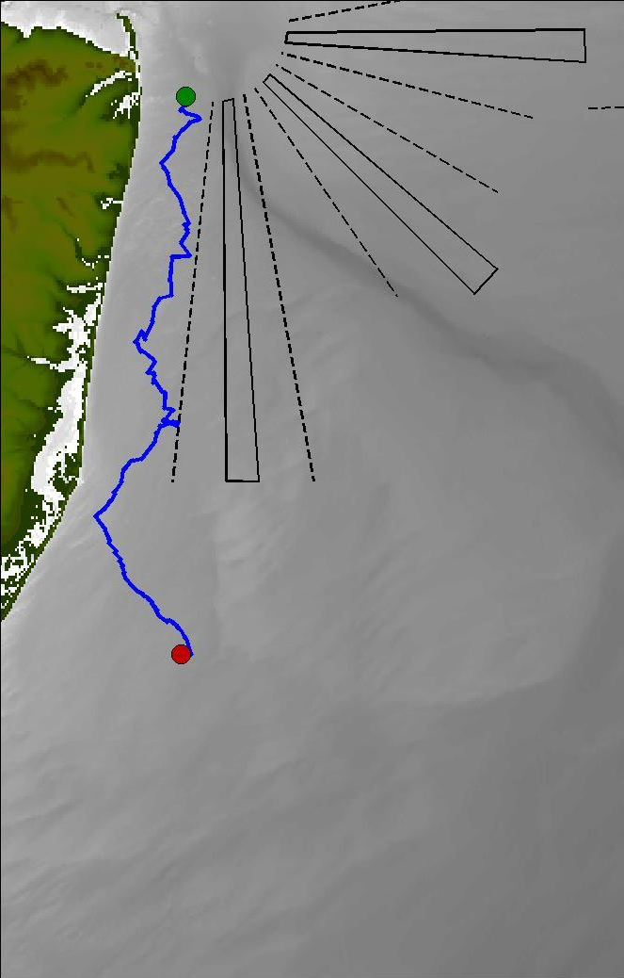


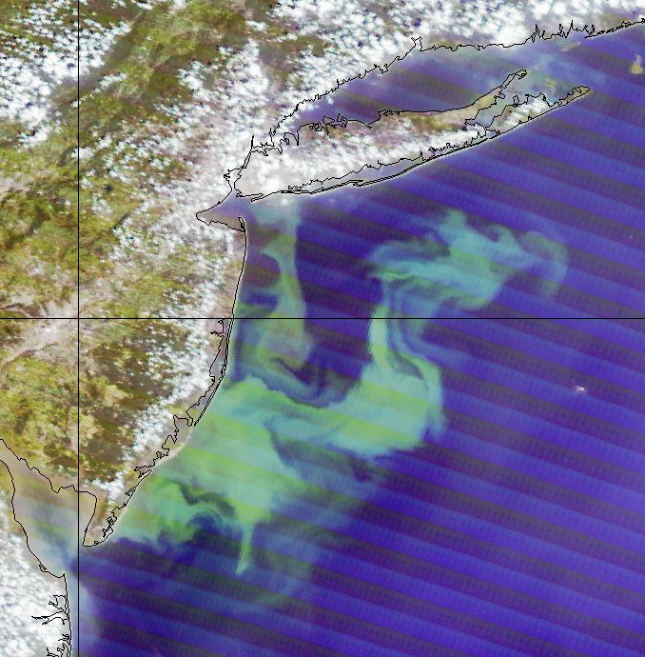

Ability to link phytoplankton to watercolumn biogeochemistry
State of New Jersey is now using gliders to map summer water quality. Is low bottom water oxygen due to outflows from the New York city or is a naturally driven by natural dynamics.
State sponsored state wide surveys providing 3-4 missions each summer, and provides close to 10,000 profiles/summer as opposed to ~150 profiles/summer by ship/
New York
city outflow
Upwelling driven
phytoplankton bloom

Slide 15




Multifrequency acoustics and mapping of zooplankton and fish
Development & Testing of New Glider Sensors
Acoustic Zooplankton Fish Profiler Echosounder
Thanks to Grace Saba
NSF Polar Programs
(OPP #1743035)
Ability to examine the interactions between multiple trophic levels (phytoplankton, zooplankton and fish) and their relationships to the physical hydrographic driving forces

Slide 16

Gliders being able to track animals based on passive acoustics
Receiver Integrated Glider
Enables coupling of data sets
  Telemetry data
  Temperature
  Salinity
  Productivity
Moves us beyond fixed arrays
Thanks to Mathew Oliver

Slide 17



Gliders being able to track animals based on passive acoustics
Drs. Baumgartner (WHOI) and Fratantoni (SeaTrec) from to develop autonomous gliders, equipped with a reliable acoustic detection algorithm to allow near real time detection of North Atlantic right, fin, sei and humpback whales.
Dr. Baumgartner
Dr. Fratantoni

Slide 18

Animal dynamics via active optics
wind speed (m s⁻¹)
Ophelia
Sensor damage

Slide 19




Dynamic analysis of penguin foraging in the vertical
Penguin
Foraging
locations
Kahl et al., 2010

Slide 20



Coming soon (2-4 years) micro- and small zooplankton imaging
Holographic images from Monterey
by an AUV
Design strategies are underway
Thanks to James Bellingham (WHOI)

Slide 21






40
31
22
13
4
http://rucool.marine.rutgers.edu

