Slide 1
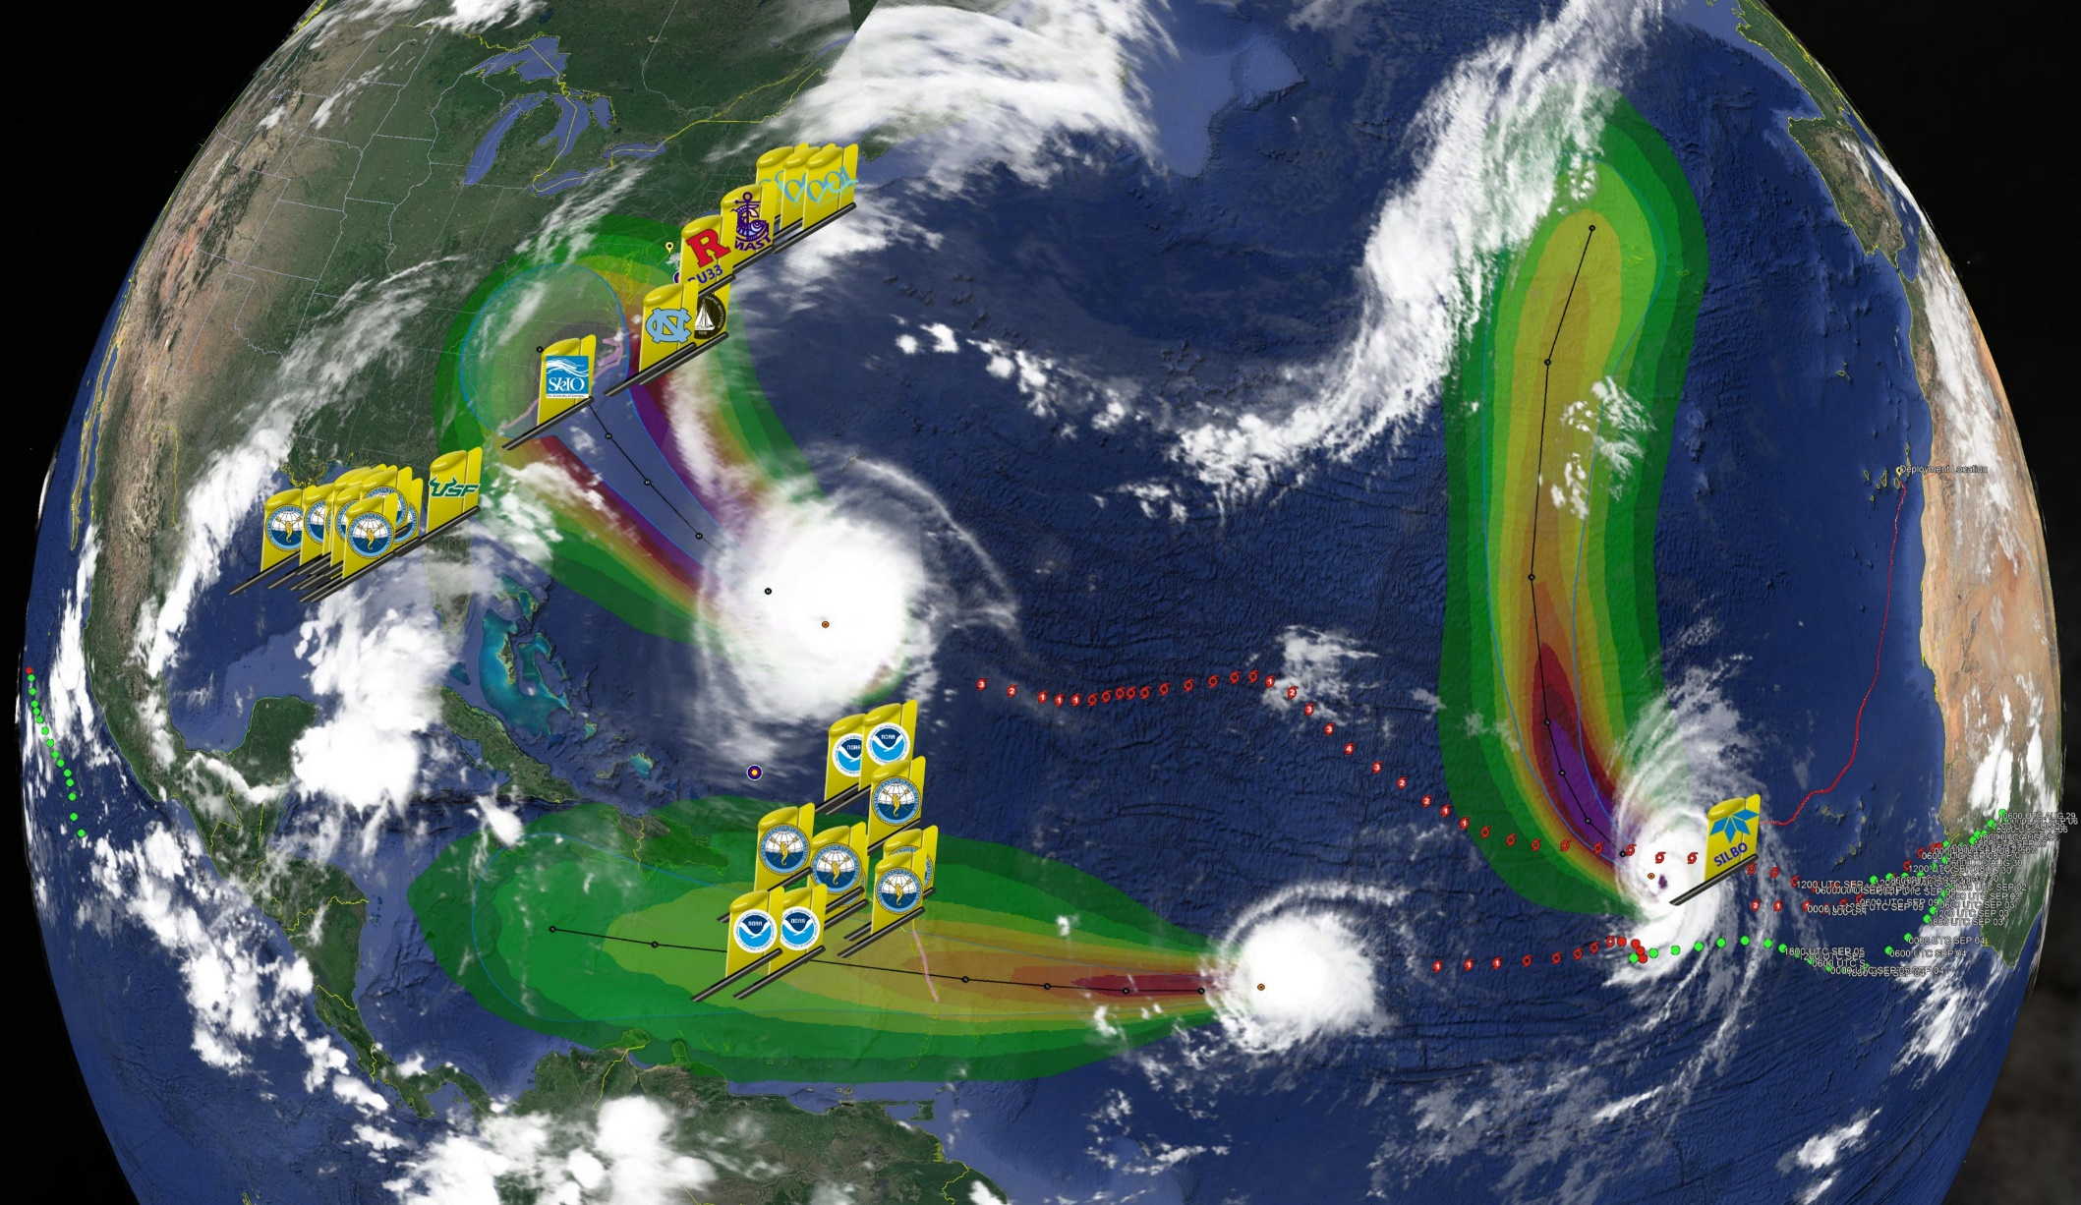
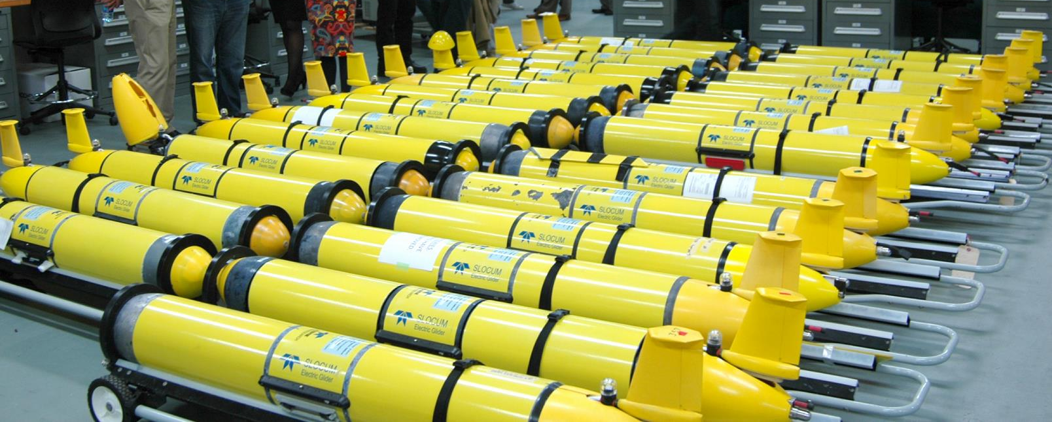
Initial impacts of the Hurricane Sentinel glider fleet deployed during the 2018 hurricane season
Florence
Helene
Isaac
Travis N Miles¹, Catherine Edwards², Stephan Howden³, Ruth Perry⁴, Maria Aristizabal¹, Benjamin LaCour⁵, Rebecca Baltes⁶, Jerry Townsend⁷, Jonathan Illich⁷, Scott Bruner⁷, Nathan Allen⁷, John Kerfoot¹, Dawn C Petraitis⁸, Kevin M Martin⁹, Doug Wilson¹⁰, Roy A Watlington¹¹, Paul Jobsis¹², Patrick J Hogan¹³, Hyun-Sook Kim¹⁴, Carl Gouldman¹⁵, Julio M Morell¹⁶, Barbara A Kirkpatrick¹⁷, Debra Lee Hernandez¹⁸, Gerhard Kuska¹⁹, Gustavo Goni²⁰ and Scott M Glenn¹
Notes:
My name is Travis Miles, I’m an assistant professor at Rutgers University. You can see that I have many collaborators on this project. A few organizations I’d like to highlight include many individuals and different organizatiins within the Navy, NOAA, the Integrated Ocean Observing System, NSF, Private companies including Teledyne Webb and Shell, and many academic partners from U. Puerto Rico, UVI, Skidaway IO, U. S. Miss, and many others.

Slide 2
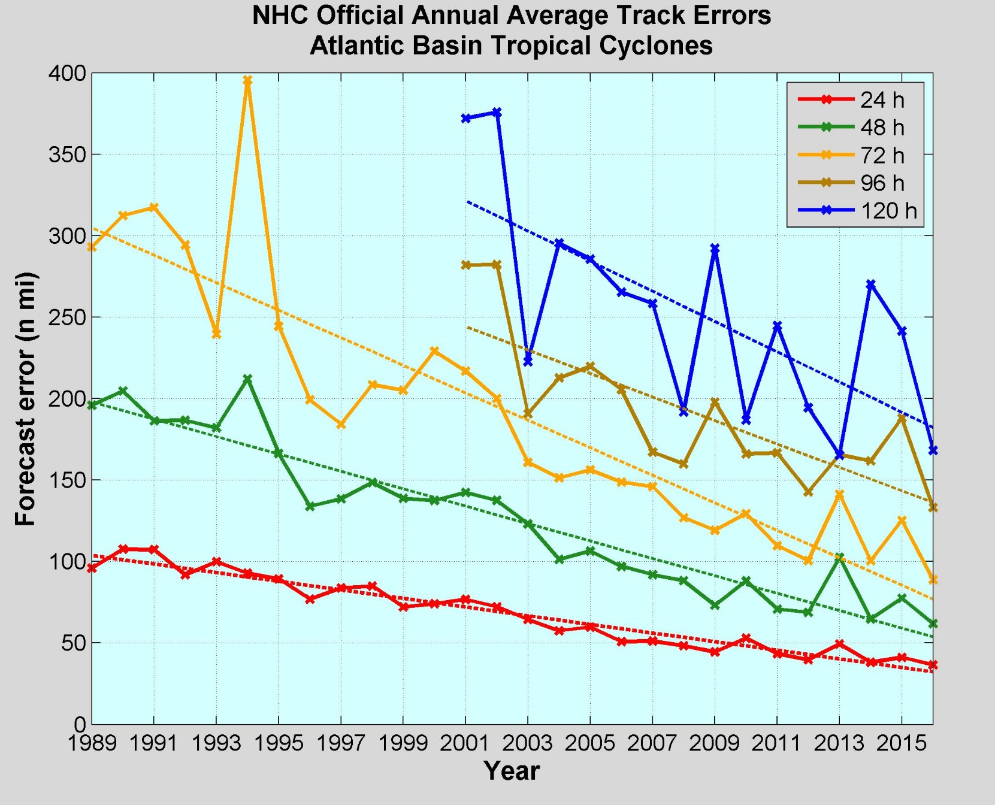
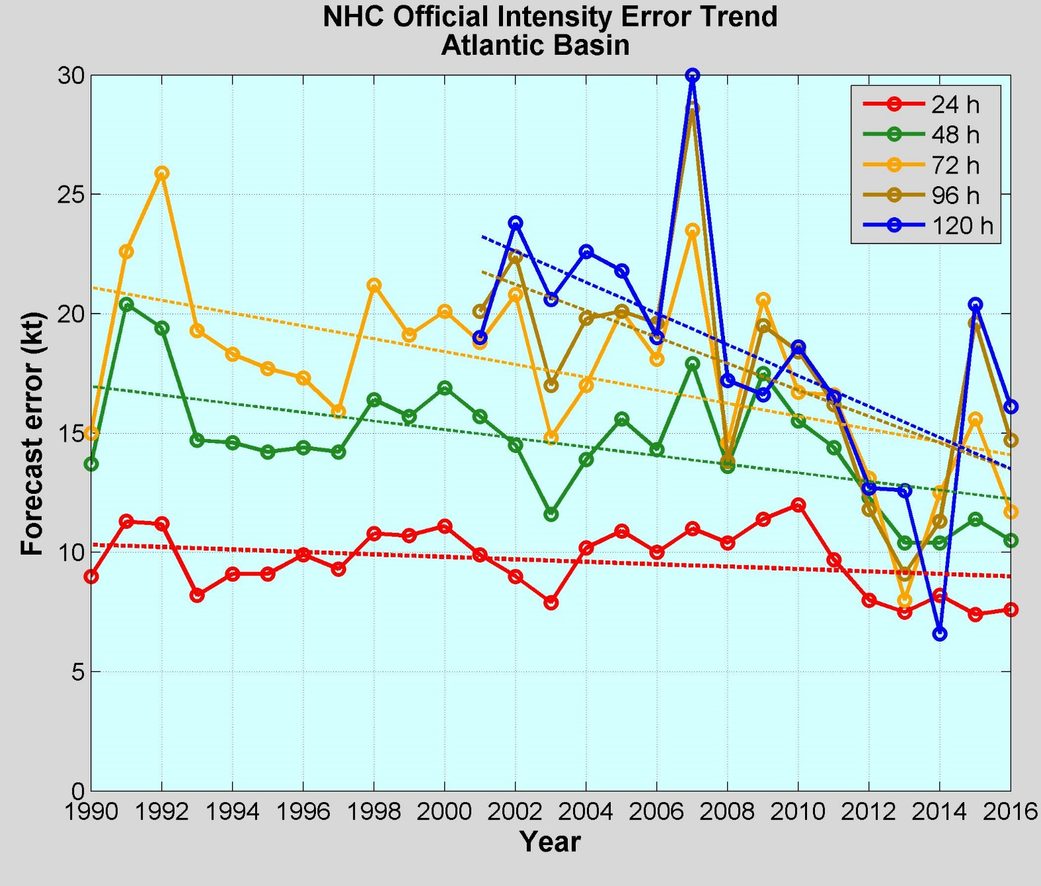
NOAA Annual Operational Suite Review
Average Track Errors:
Atlantic Basin
Average Intensity Errors:
Atlantic Basin
Factor of 2-4 improvement
20%-30% improvement
Limitations on Hurricane Intensity Improvement
Computing resources and model resolution (Rotunno et al., 2009)
Poor understanding of the atmospheric boundary layer (Nolan et al., 2009; Andreas et al., 2015)
Difficulty in modeling the upper ocean response to storm forcing (Yablonsky and Ginis, 2009).
Cangialosi and Franklin 2017

Slide 3
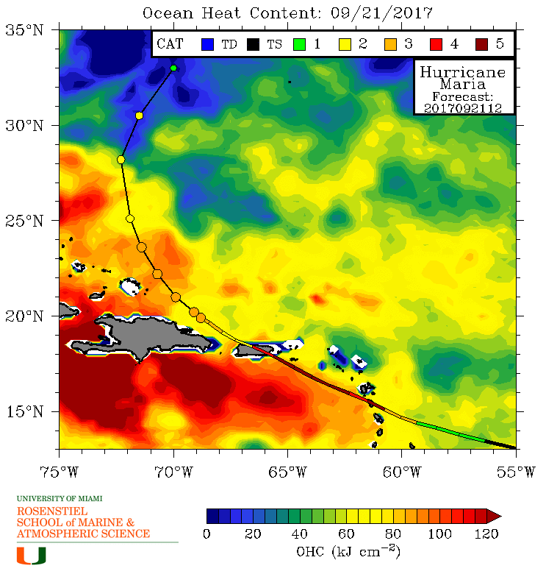
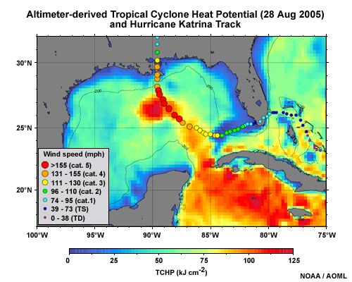
Rapid intensification of Hurricanes Katrina & Maria
Ocean’s impact on Intensity Forecasts:
A) through the upper ocean heat content (model initial condition),
B) the transfer of heat across the air-sea interface (model response and feedback).

Slide 4



Operational Coupled Atmosphere and Ocean Forecasting Models
Atmosphere
HMON (Hurricanes in a Multi-scale Ocean-coupled Non-hydrostatic model)
HWRF (Hurricane Weather Research and Forecasting)
Ocean
NOAA RTOFS (Real Time Ocean Forecast System)
HYCOM model based on and initialized by the Navy Global Ocean Forecast System (GOFS 3.1)
NAVY
GOFS 3.1 (Global Ocean Forecasting System)
Navy Coupled Ocean Data Assimilation
Data Assimilation once per day
Satellite SST Maps
Satellite Altimetry – through ISOP
CTD profiles – numerous sources and rules
NCODA 3DVar
Initialization fields (from the Naval Oceanographic Office,
Currently being transitioned to NOAA.

Slide 5
Operational Coupled Atmosphere and Ocean Forecasting Models
Atmosphere
HMON (Hurricanes in a Multi-scale Ocean-coupled Non-hydrostatic model)
HWRF (Hurricane Weather Research and Forecasting)
Ocean
NOAA RTOFS (Real Time Ocean Forecast System)
HYCOM model based on and initialized by the Navy Global Ocean Forecast System (GOFS 3.1)
NAVY
GOFS 3.1 (Global Ocean Forecasting System)
Navy Coupled Ocean Data Assimilation
Data Assimilation once per day
Satellite SST Maps
Satellite Altimetry – through ISOP
CTD profiles – numerous sources and rules
NCODA 3DVar
Initialization fields (from the Naval Oceanographic Office,
Currently being transitioned to NOAA.

Slide 6
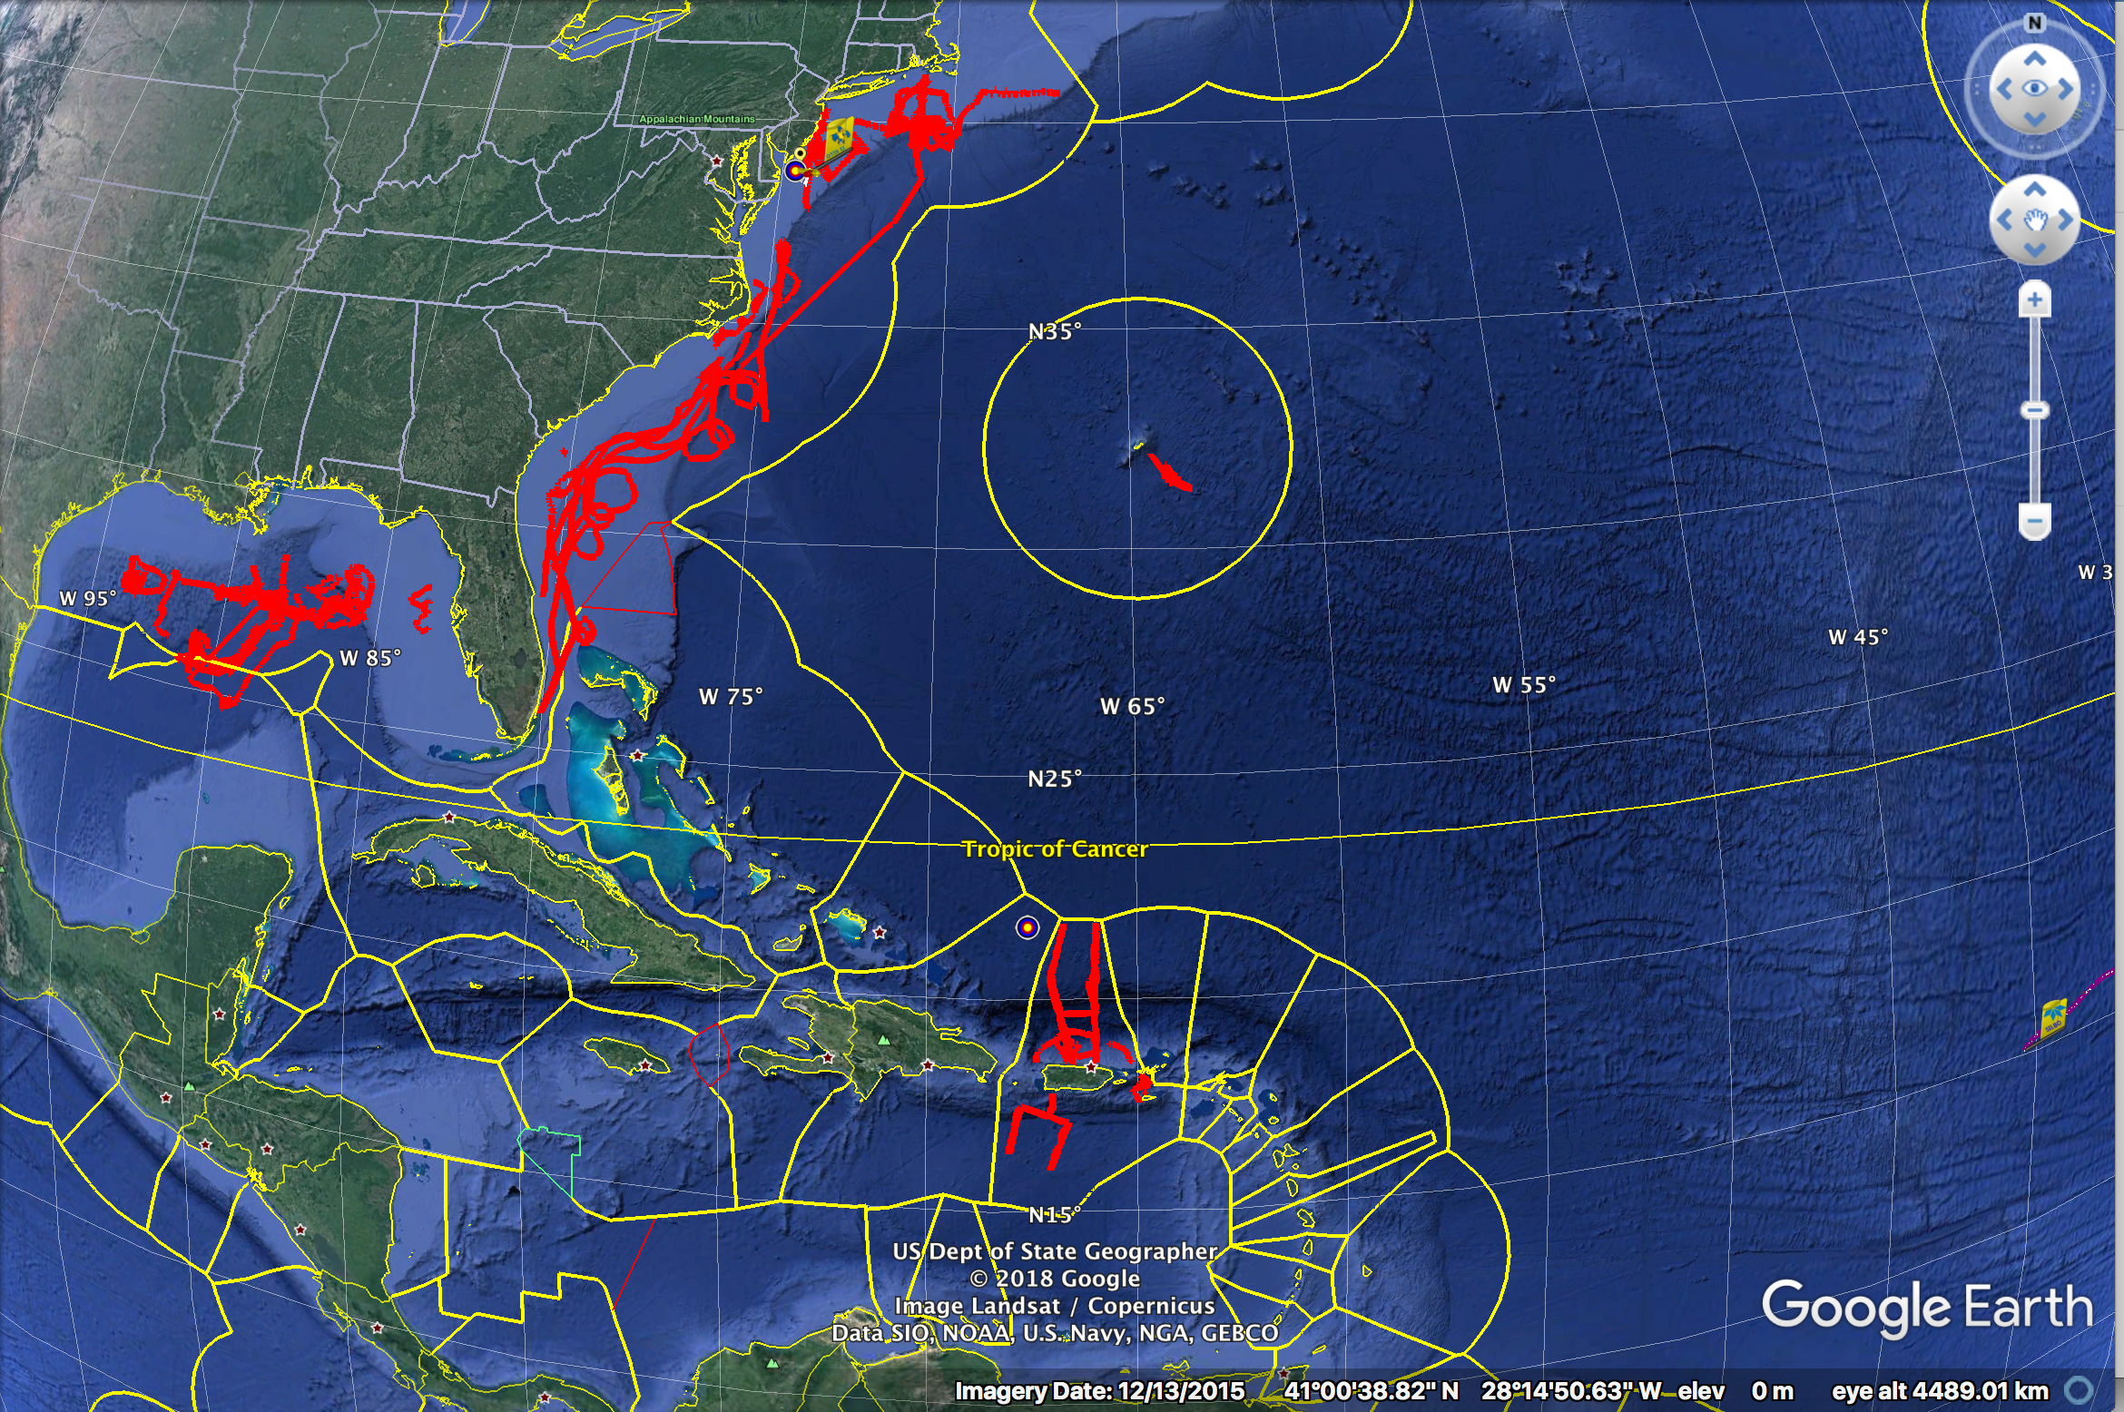
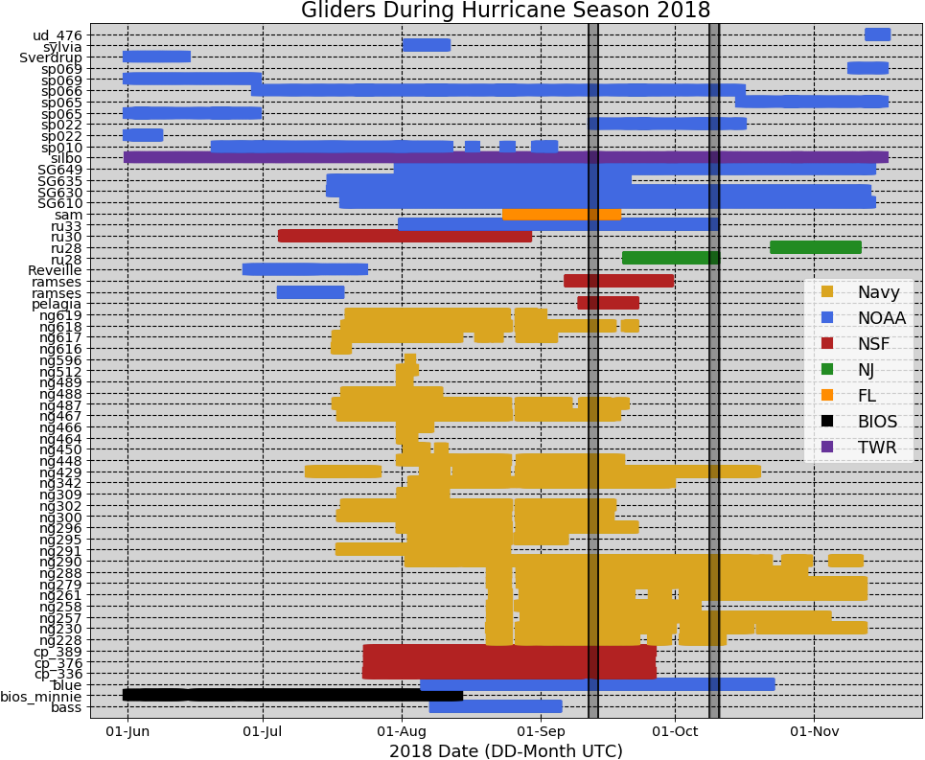
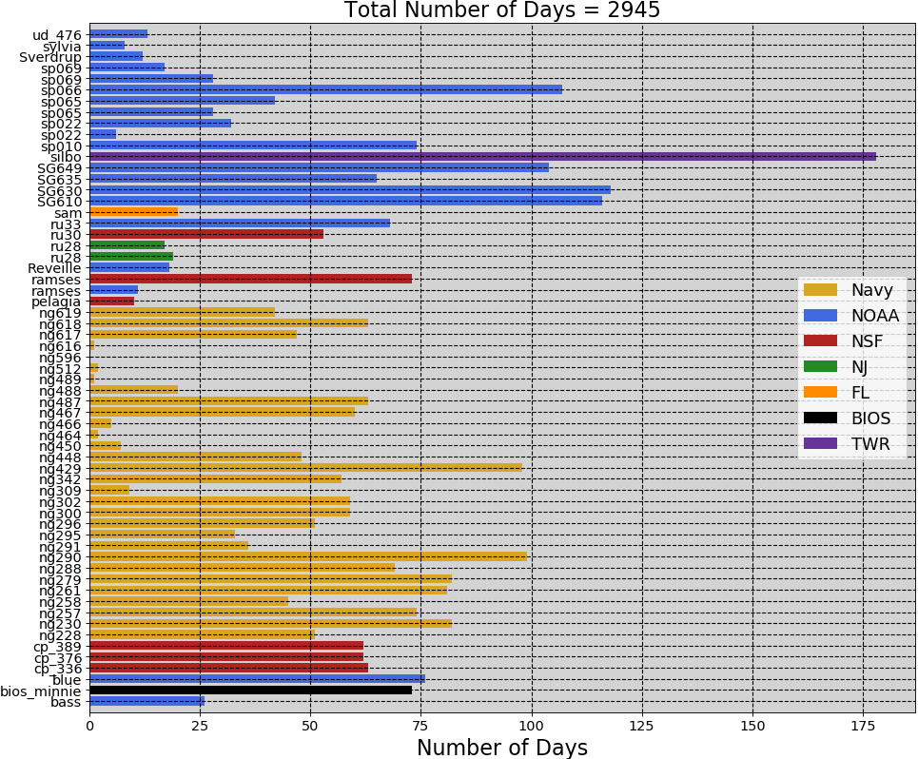
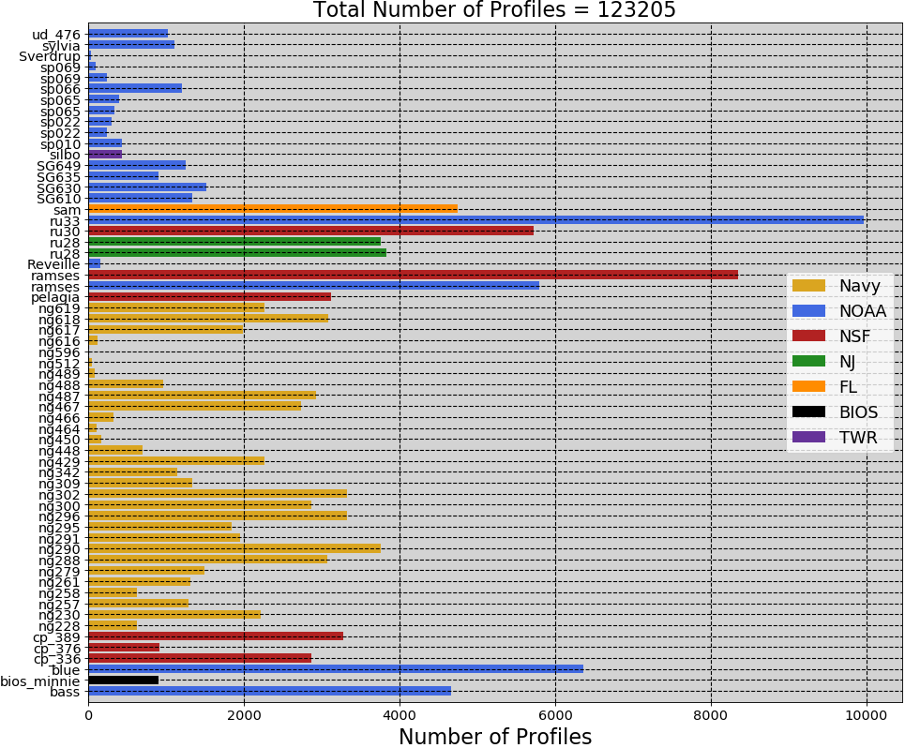
2018 Hurricane Season – 61 Gliders in IOOS Glider DAC
Florence
Michael
2945
Glider
Days
123,205
Glider
Profiles

Slide 7
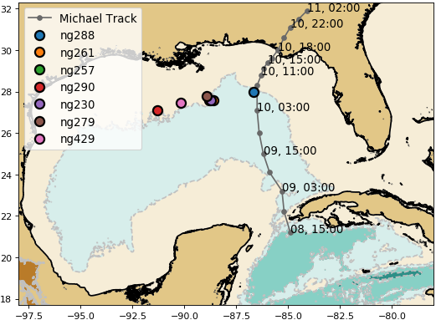
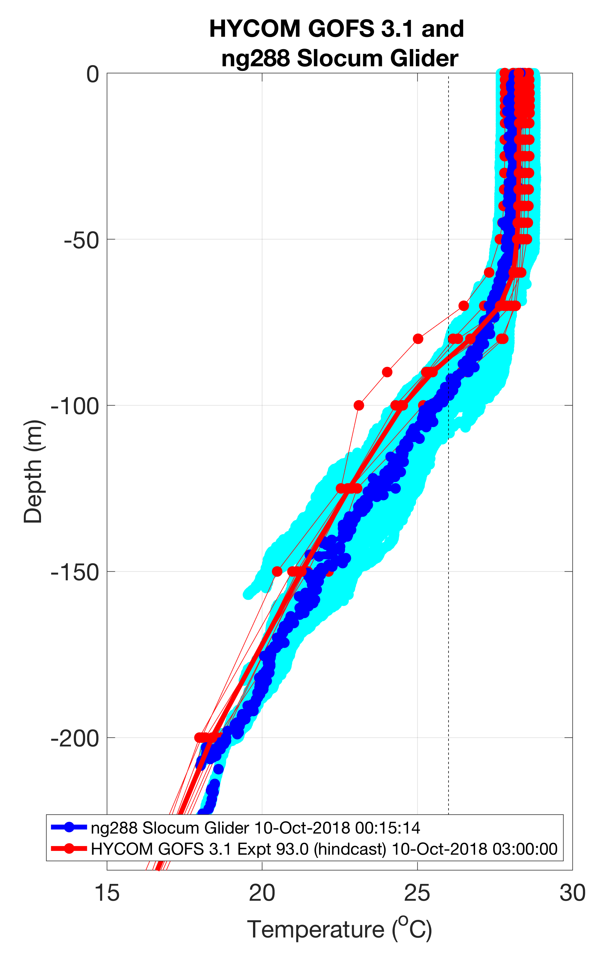
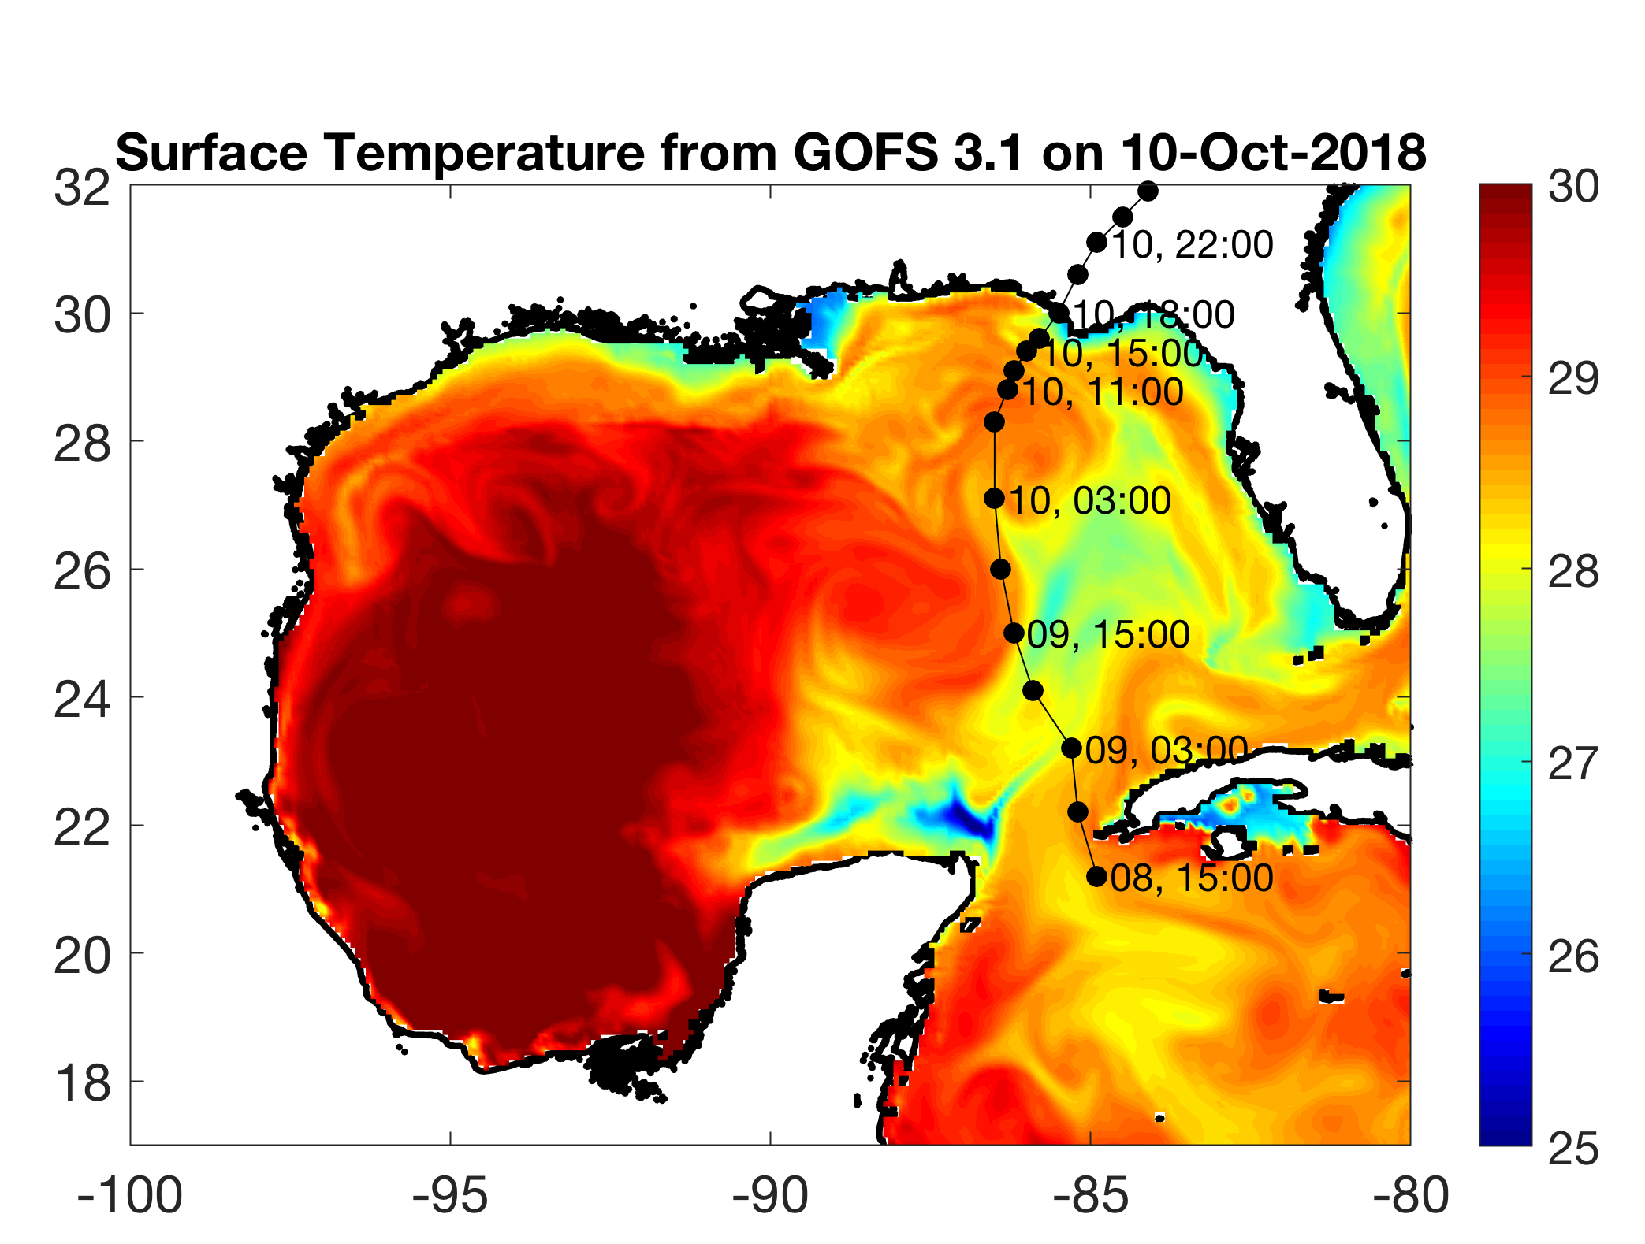
Hurricane Michael – NG288
Model
Glider

Slide 8
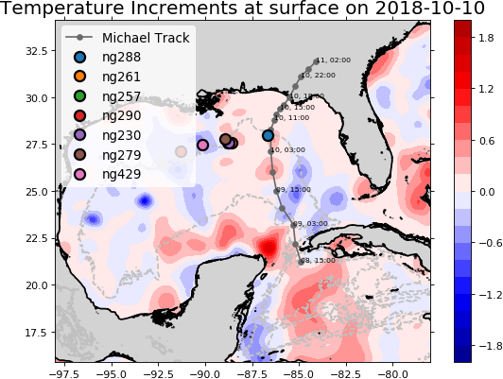
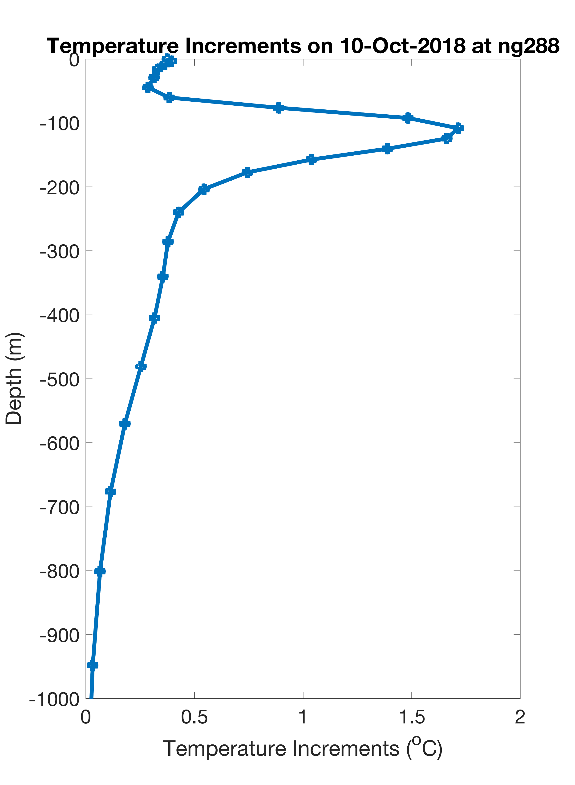
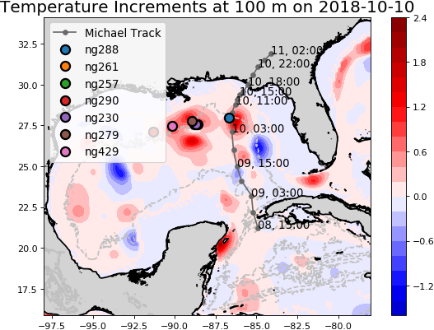
Hurricane Michael – NG288 - NCODA Temperature Increments
From NCODA

Slide 9
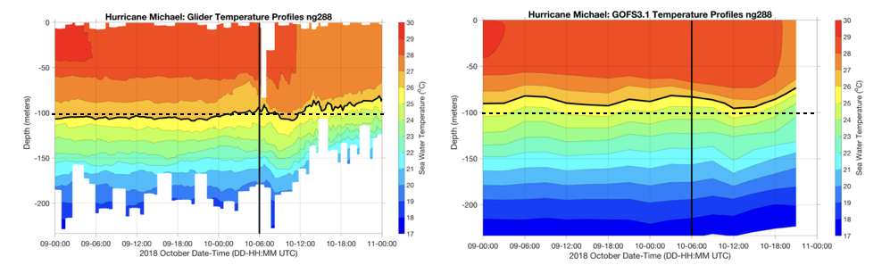
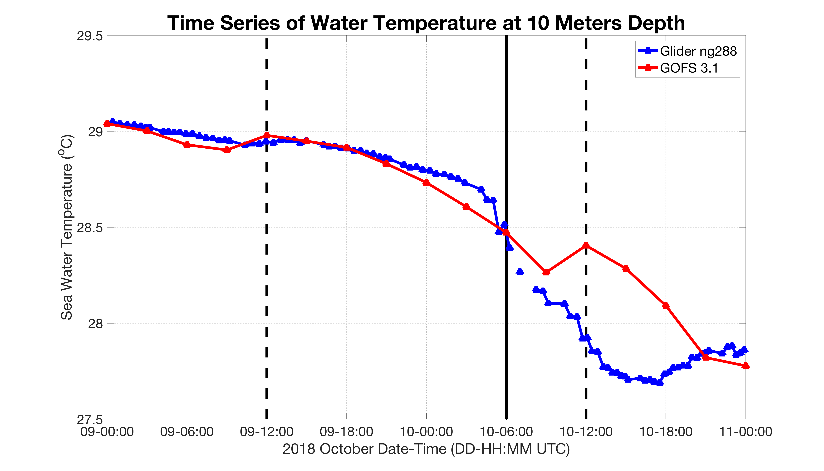
Hurricane Michael – NG288 vs GOFS 3.1
Impact of Data Assimilation on
Near Surface Water Temperature at 10 m
Model
Glider
Michael
Assimilation Times
Model Surface Temperature stays warm for too long during a rapid change

Slide 10
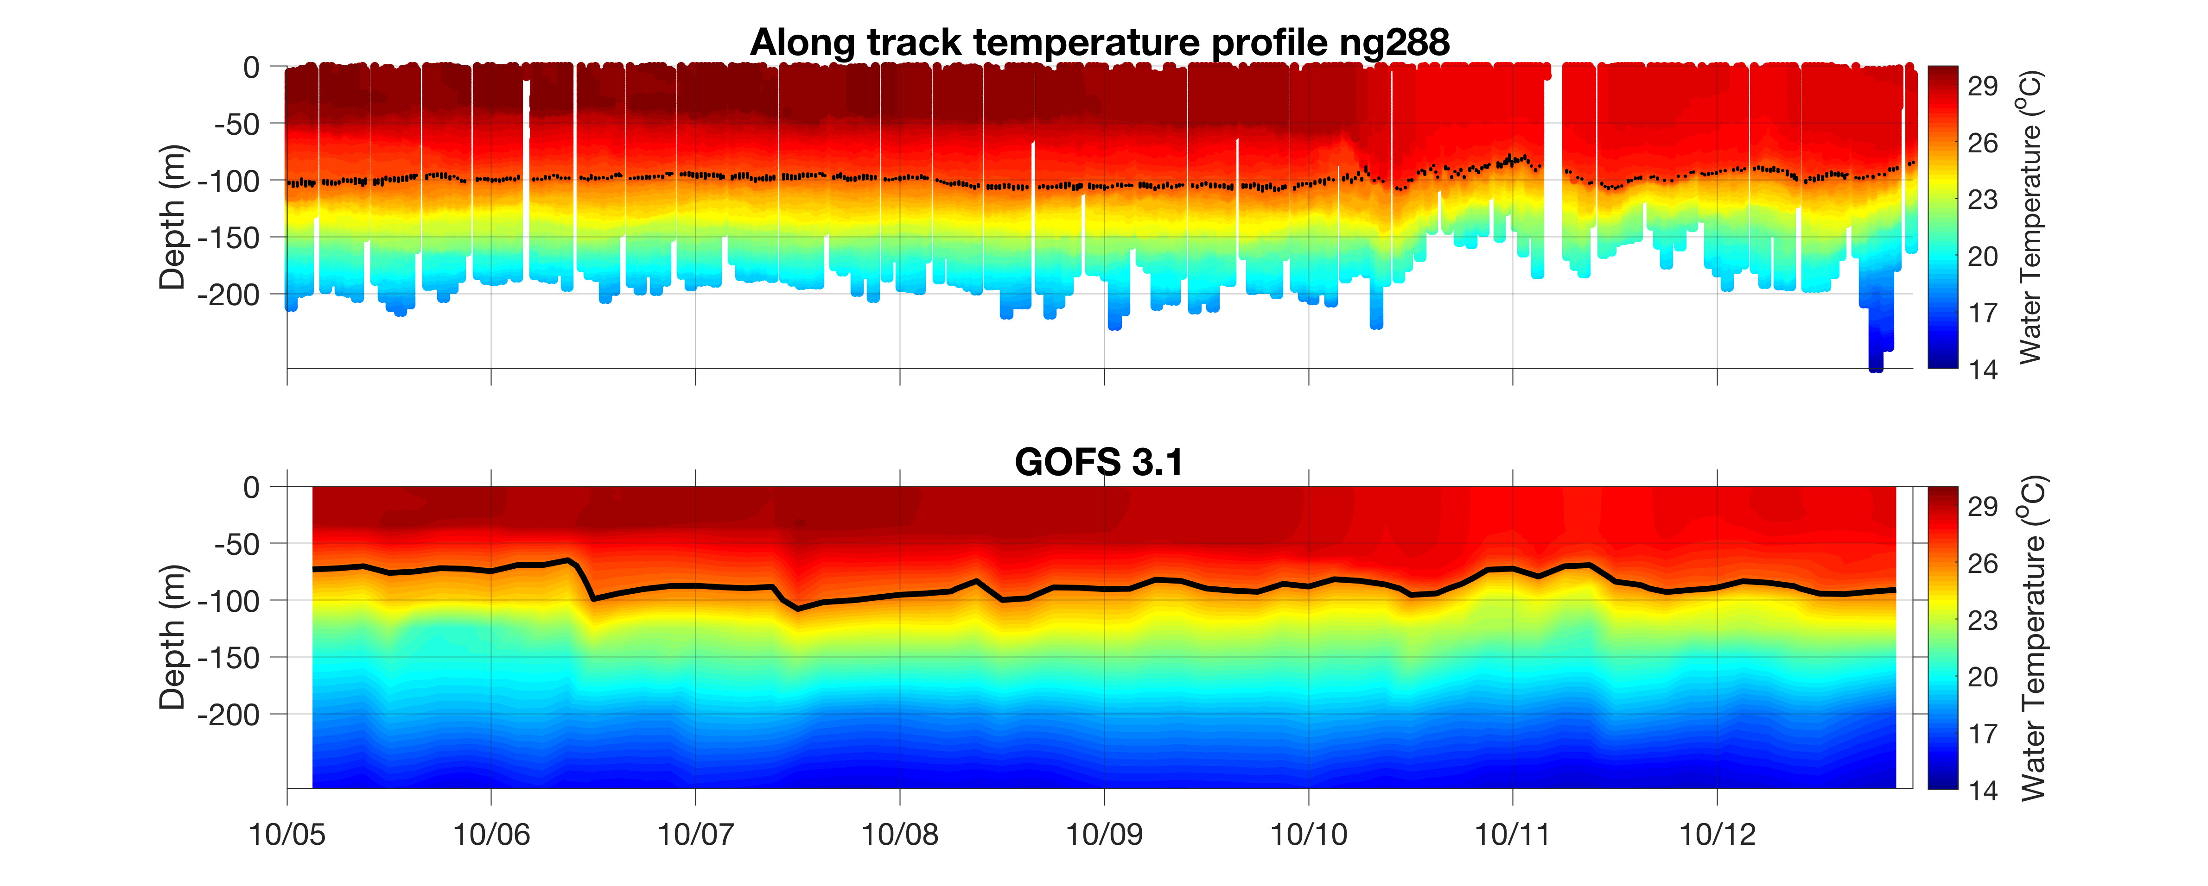

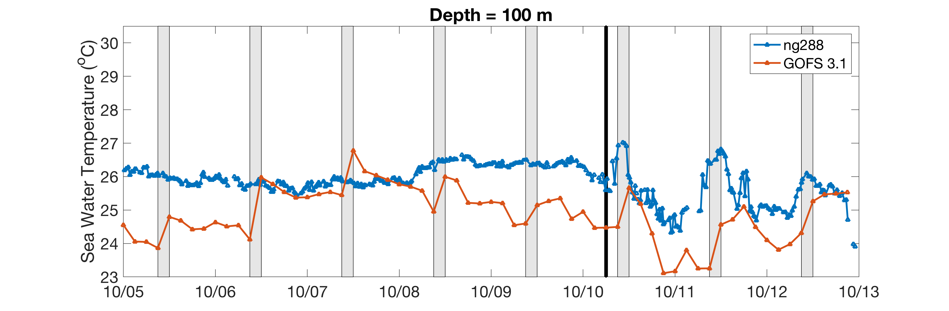
Hurricane Michael – NG288 - Assimilation Windows
Glider
26C
Michael
Model
26C
Assimilation windows
in Gray
Temp
at
100 m
Glider
Model

Slide 11
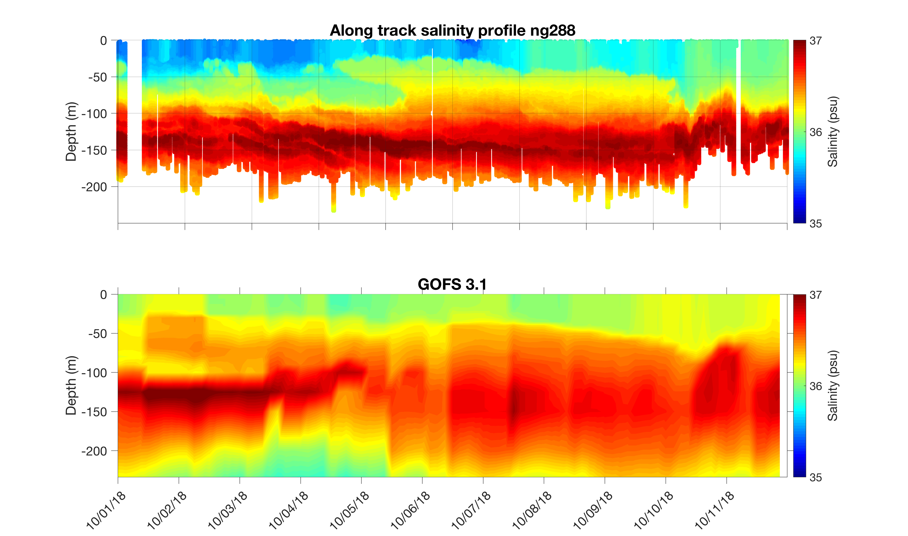
Hurricane Michael – NG288 - Salinity
Glider
Model
Detailed study of why model salinity is high at surface and low at depth is still underway

Slide 12
Next Steps – Now through Start of 2019 Hurricane Season
Questions:
What is the impact of the gliders on the NCODA/GOFS/RTOFS ocean forecast? The hurricane track and intensity forecast? The hurricane impact forecast?
Can we propose changes to improve NCODA for Operational Forecasting?
Where do we want to deploy gliders in the 2019 Hurricane Season?
Partnership Approach:
Deploy/Recover Gliders – 2018 Hurricane Season - Completed
Model/Data Comparisons – Fall - Ongoing
Collaborative Deep Dive into Critical Components – Winter
Joint Recommendations for 2019 Hurricane Season - Spring
In-person Tiger Team events with
  NOAA/Navy (Silver Spring, Stennis) - 29 Nov
  Navy Scientists (NRL Stennis, NRL Monterey) - Ongoing
  NOAA Operational Center (NCEP – College Park) – Winter
  Research Centers (AOML, GFDL, VIMS, UMiami) - Winter
  HFIP/OMITT/NHC (Miami) – Spring
  Joint Hurricane Glider Planning Meeting (TBD) - Spring
  EGO Global Glider Meeting (Rutgers) - May

Slide 13
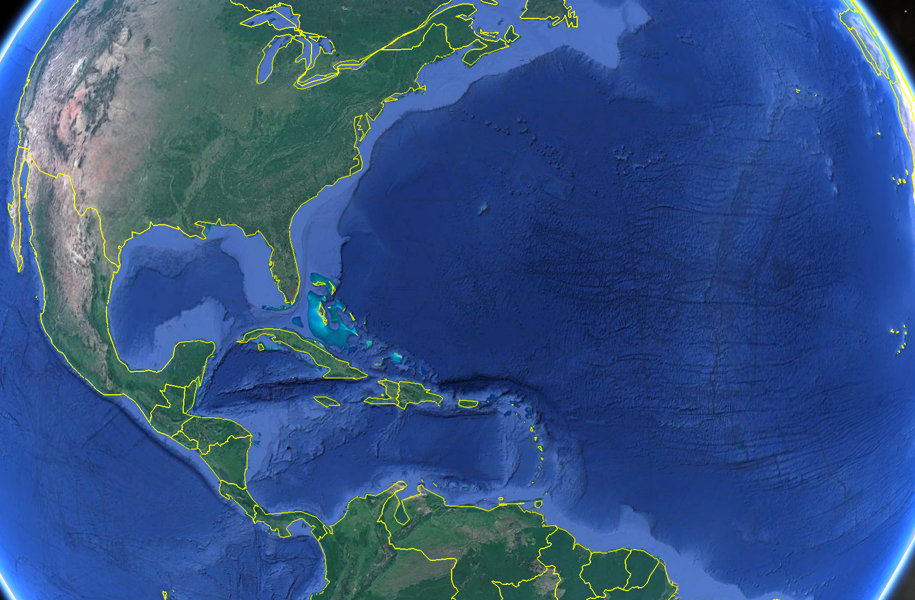
















Thank You!
Asia-
Pacific
Travis N Miles¹, Catherine Richardson Edwards², Stephan Dixon Howden³, Ruth Perry⁴, Maria Fernanda Aristizabal¹, Benjamin LaCour⁵, Rebecca Baltes⁶, Jerry Townsend⁷, Jonathan Illich⁷, Scott Bruner⁷, Nathan Allen⁷, John Kerfoot¹, Dawn C Petraitis⁸, Kevin M Martin⁹, William Douglas Wilson¹⁰, Roy A Watlington¹¹, Paul Jobsis¹², Patrick J Hogan¹³, Hyun-Sook Kim¹⁴, Carl Gouldman¹⁵, Julio M Morell¹⁶, Barbara A Kirkpatrick¹⁷, Debra Lee Hernandez¹⁸, Gerhard Kuska¹⁹, Gustavo Jorge Goni²⁰ and Scott M Glenn¹
Indian
Ocean

Slide 14
Hurricane Sentinel Gliders deployed in 3 Picket Lines
Florence
Helene
Isaac
>30 Hurricane Sentinel Gliders from the Navy, NOAA, NSF, Academic & Industry Partners
reporting ocean conditions through the U.S. IOOS Glider Data Assembly Center (DAC)
ahead of Hurricanes Florence, Isaac and Helene on September 11, 2018.

Slide 15




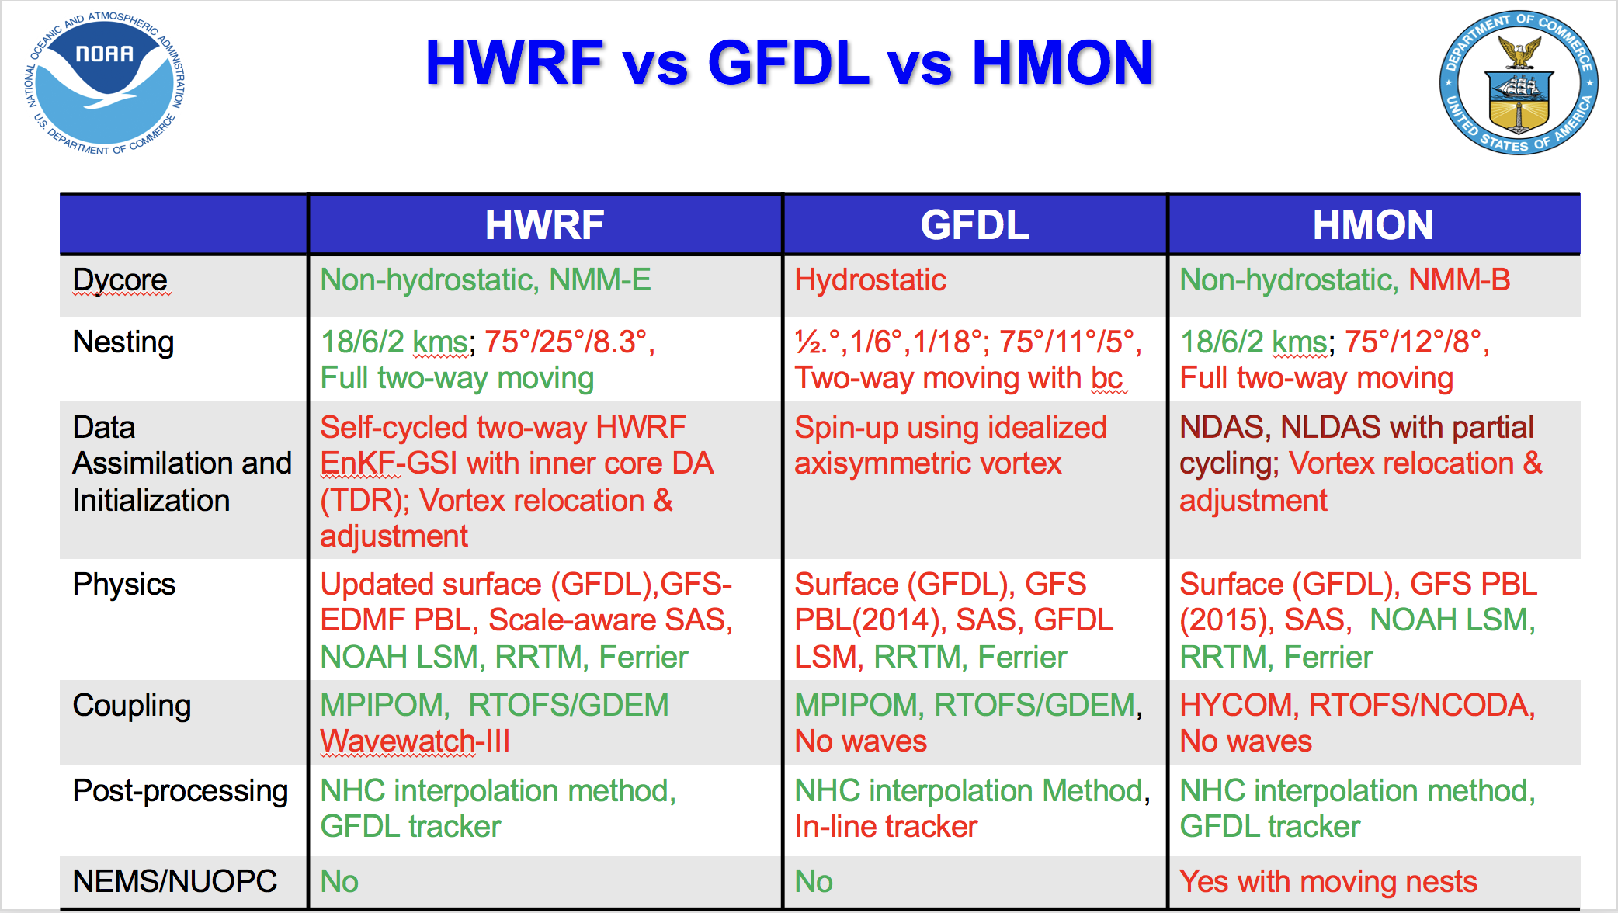

Slide 16
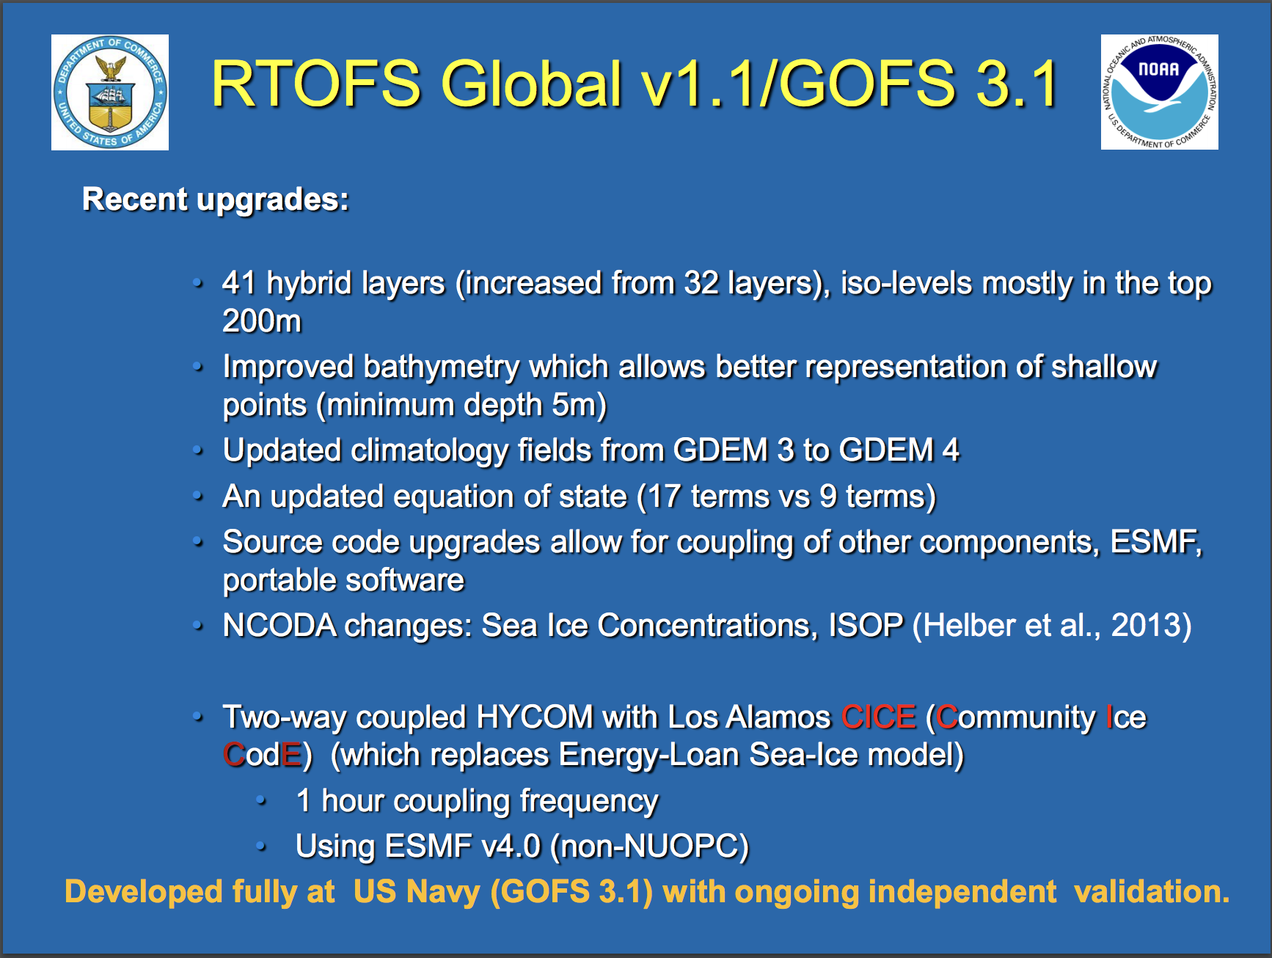
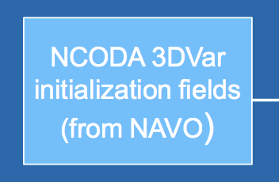
Navy Coupled Ocean Data Assimilation
Data Assimilation once per day
Satellite SST Maps
Satellite Altimetry – through ISOP
CTD profiles – numerous sources and rules

Slide 17
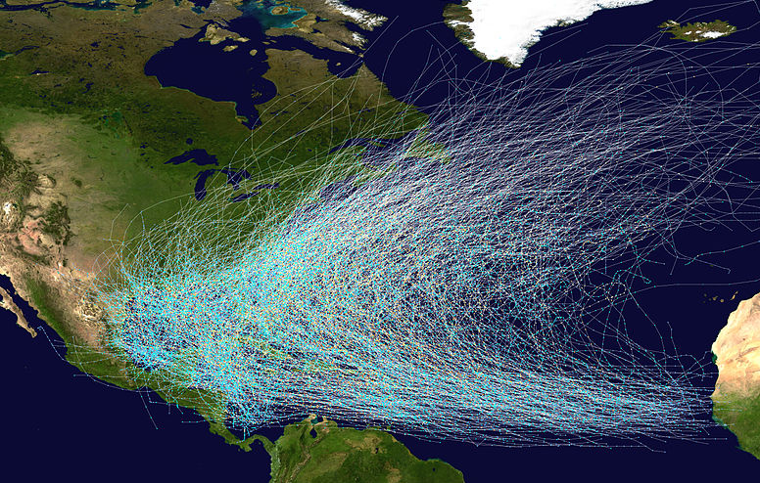
NOAA Historical Hurricane Tracks: 1851 - previous season
North Atlantic Testbed for the Hurricane Sentinel Glider Lines

Slide 18
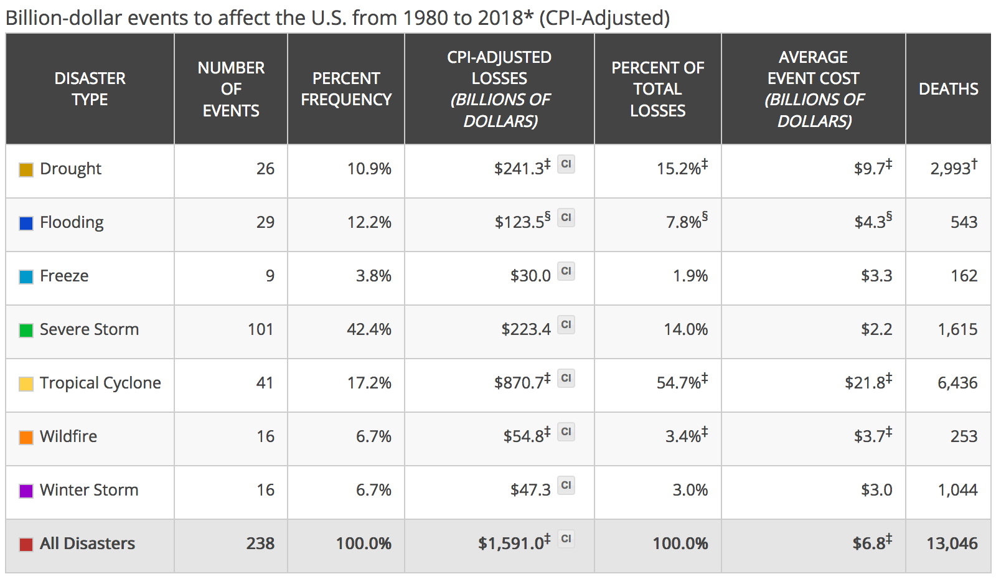
Why Study Tropical Cyclones?
Hurricanes cause damage and deaths similar to all other natural disasters combined!
Source: NOAA National Centers for Environmental Information (NCEI) U.S. Billion-Dollar
Weather and Climate Disasters (2018). https://www.ncdc.noaa.gov/billions/

Slide 19
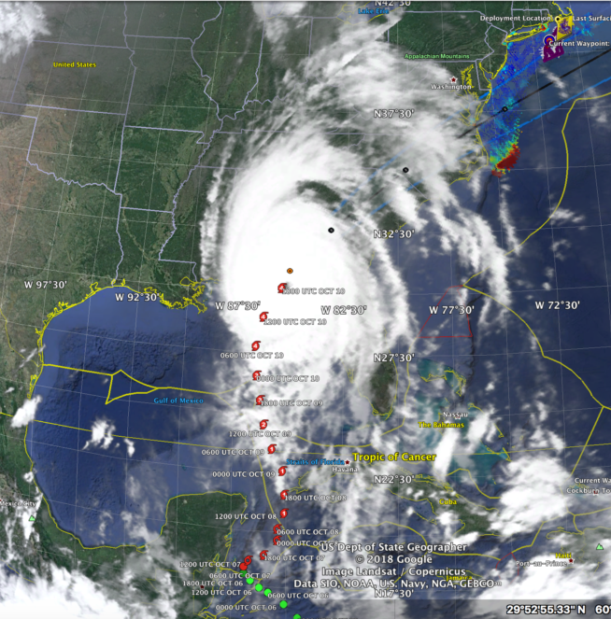
2018 Hurricane Season – Hurricane Michael in the Gulf

