Slide 1



Suspended particle characteristics from a glider integrated LISST sensor
Travis Miles¹, Wayne Slade², Josh Kohut¹, and Donglai Gong³
¹Rutgers University, ²Sequoia Scientific, Inc., ³Virginia Institute of Marine Sciences
MTS Oceans
Charleston, SC
October 23, 2018
Notes:
Water column optical properties
Important for understanding sedimentation and erosion around structures [Fredsøe and Deigaard, 1992].
Development of continental Margin morphology [Nittrouer and Wright, 1994]
Sediment resuspension can have a significant impact on benthic habitat and overlying primary productivity [Pilskaln et al., 1998; Fanning et al., 1982], resuspension and replenishment of nutrients.
Understanding fate of sediments can aid with understanding and predicting the fate of pollutants introduced at the coast [Biscaye et al., 1988]

Slide 2
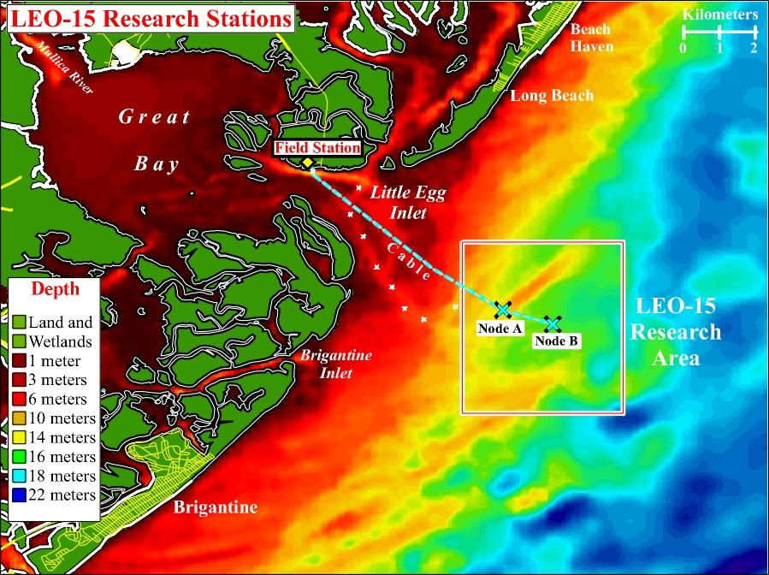
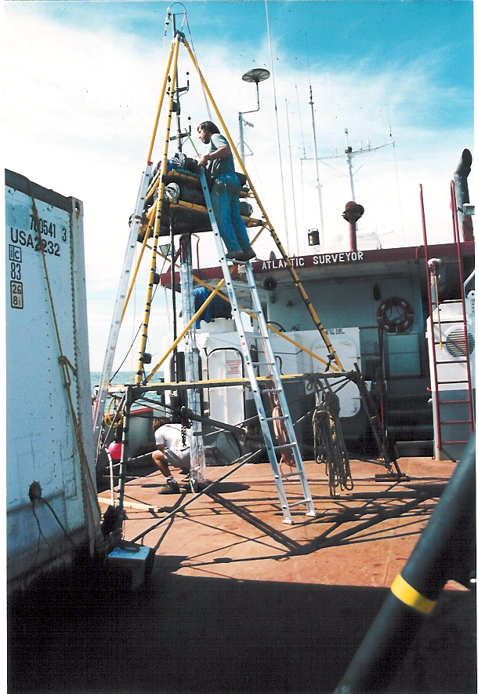
Sediment Transport Studies at LEO Site –early 1990’s
Benthic Acoustic Stress Sensor (BASS) Tripod
Notes:
BASS sensor, ADCPS, Optical instruments, LISSTs
Very good at resolving wave bottom boundary layer
Provides high temporal resolution at a single location
Instrumental in developing one-dimenisional bottom boundary layer models coupled to Regional Ocean Modeling System
New technologies needed for regional model validation

Slide 3
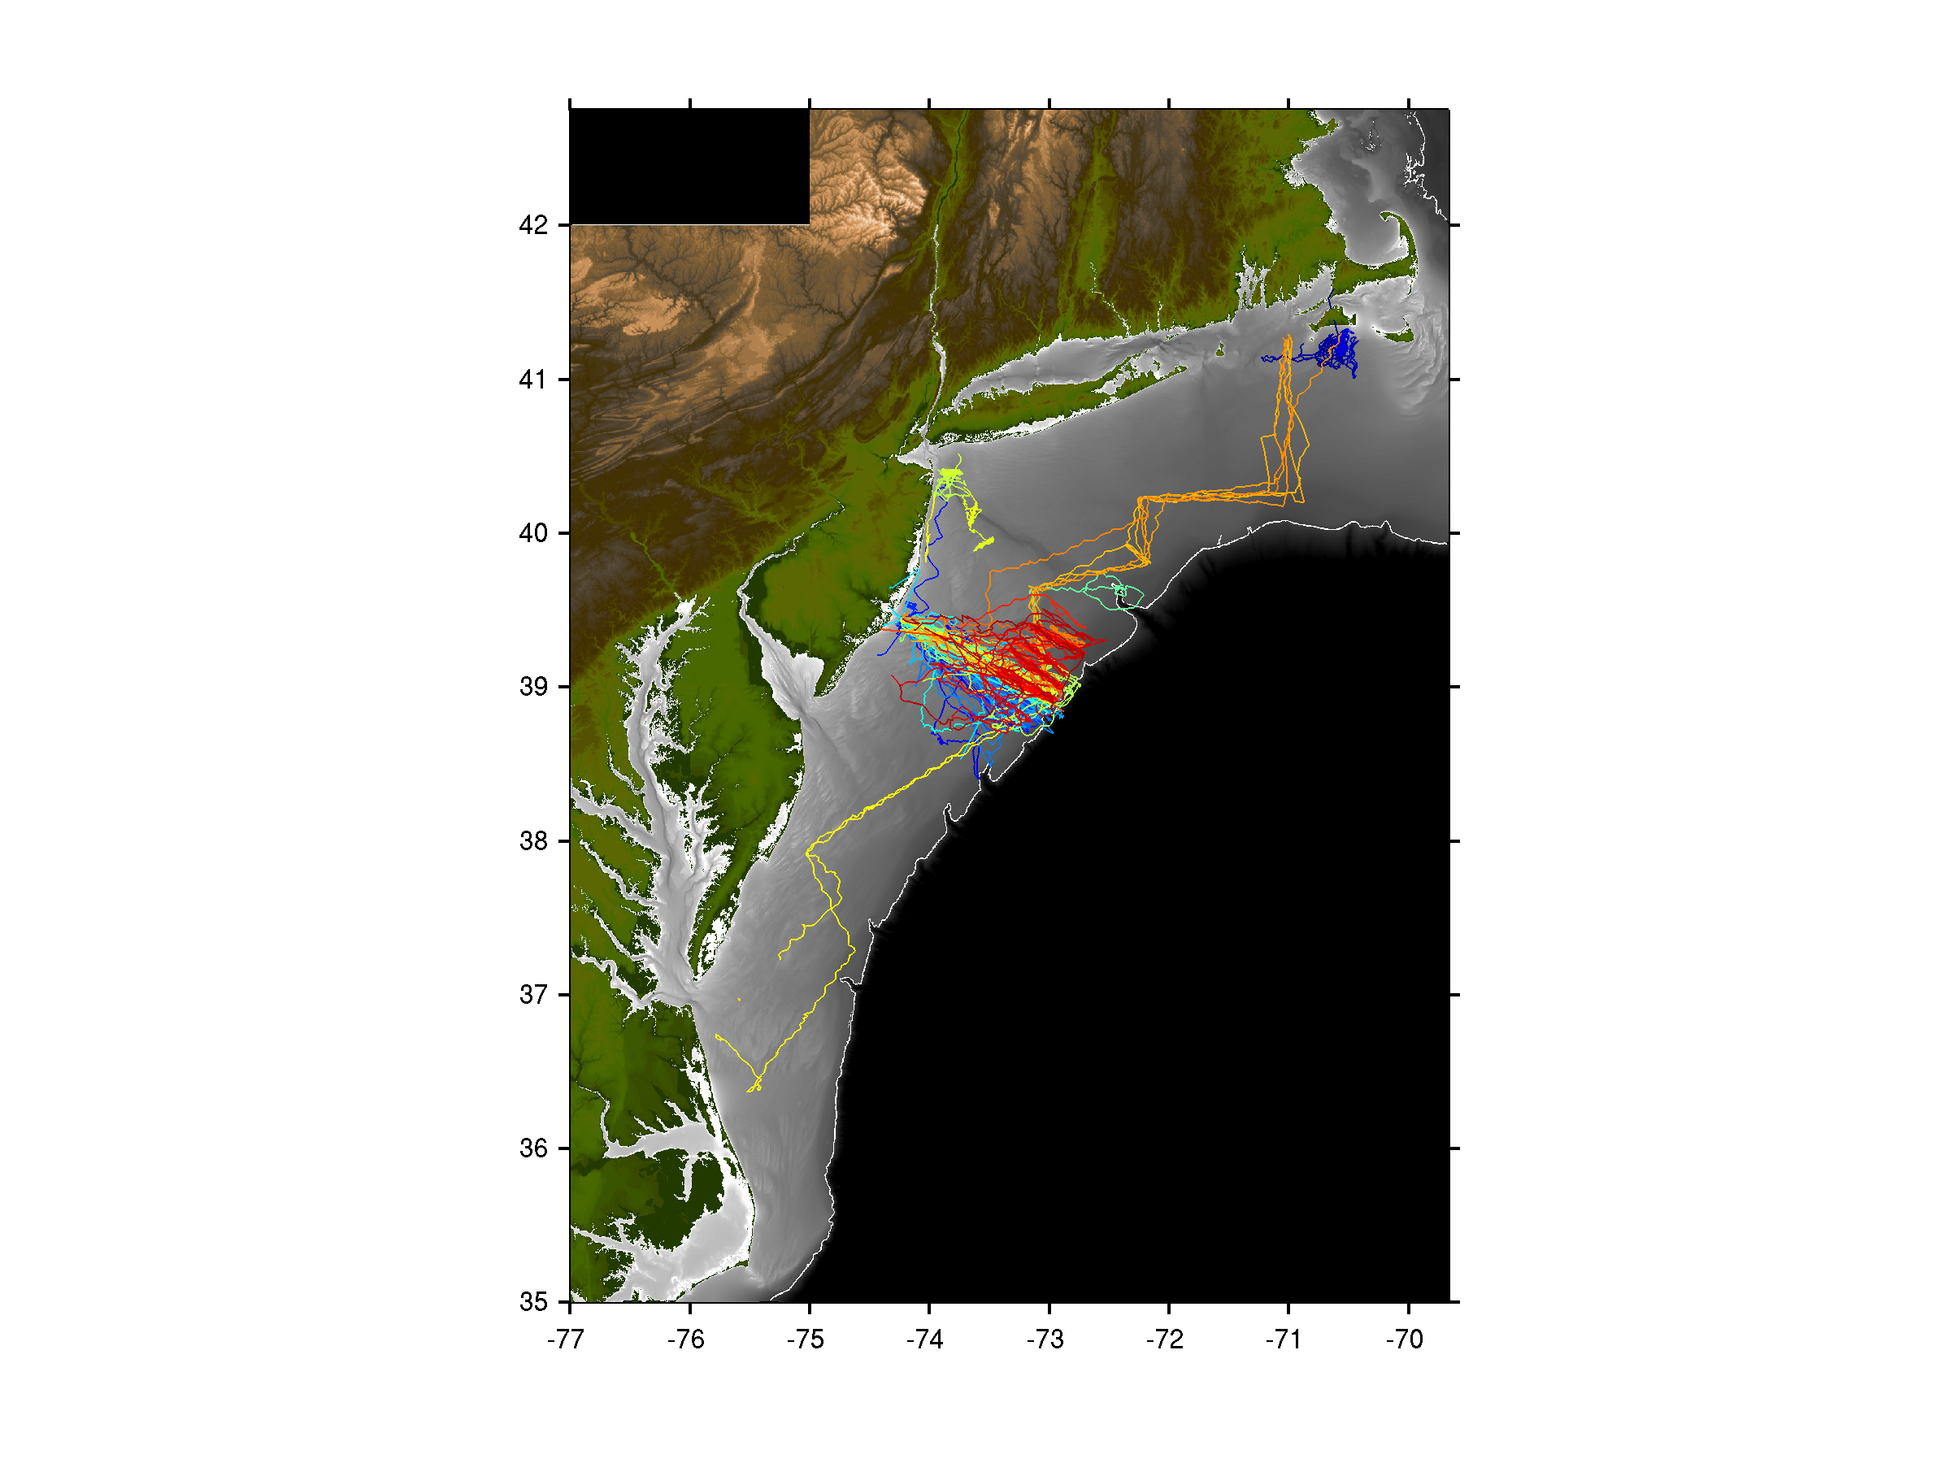

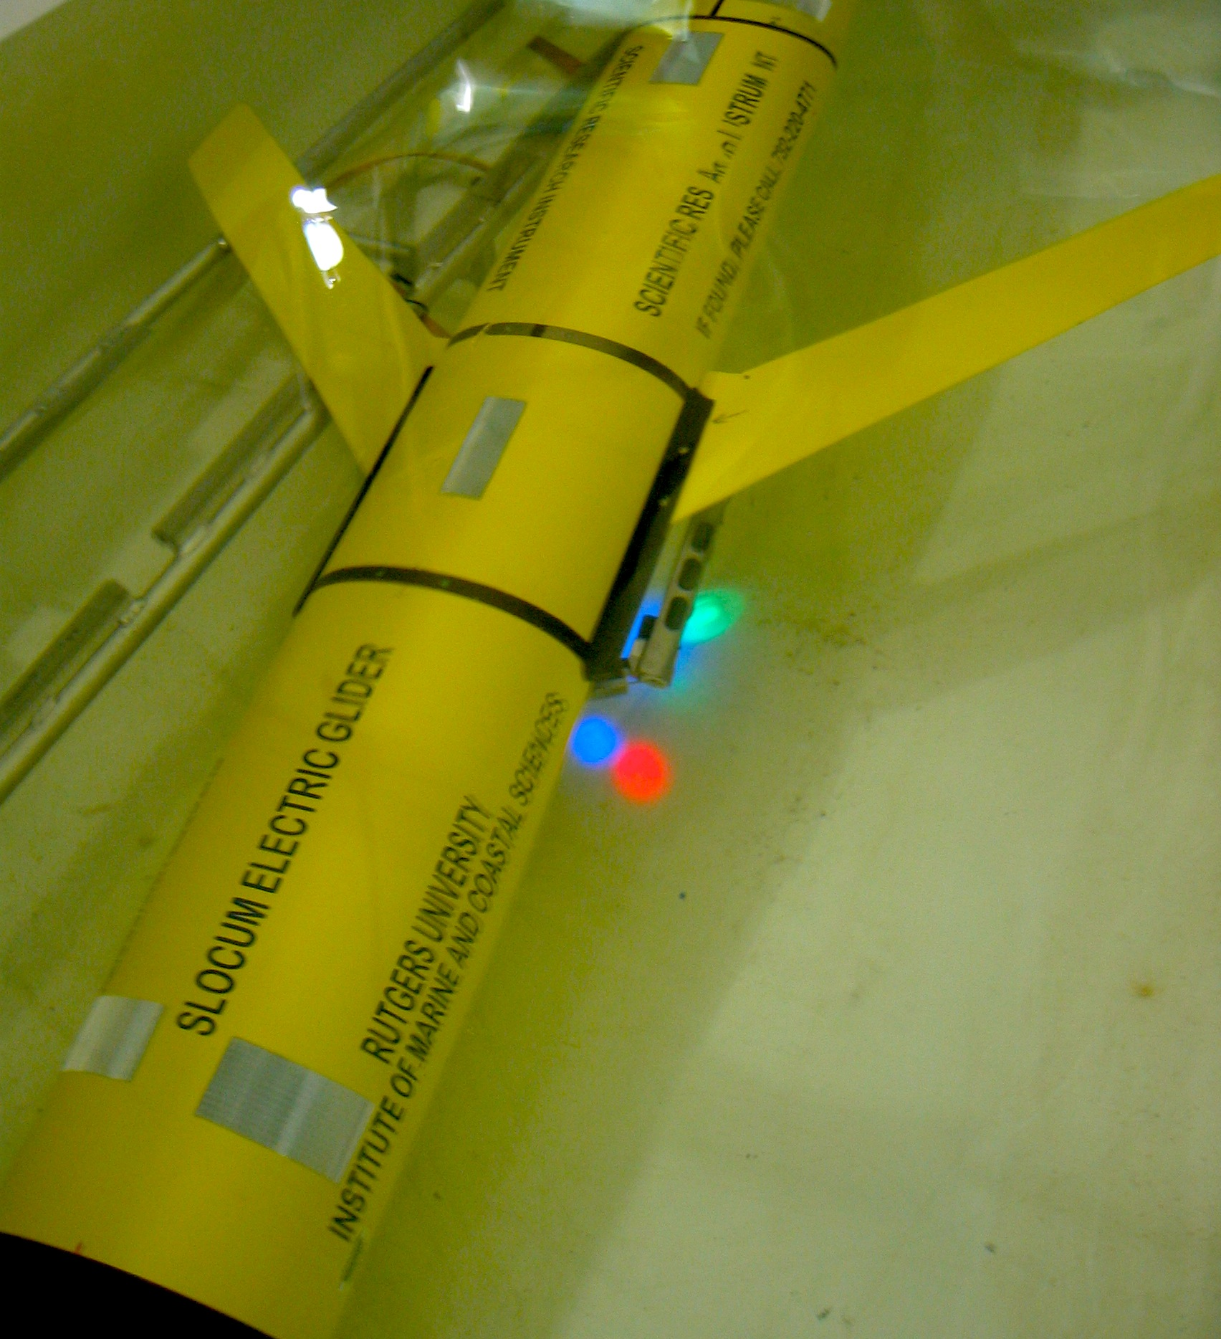
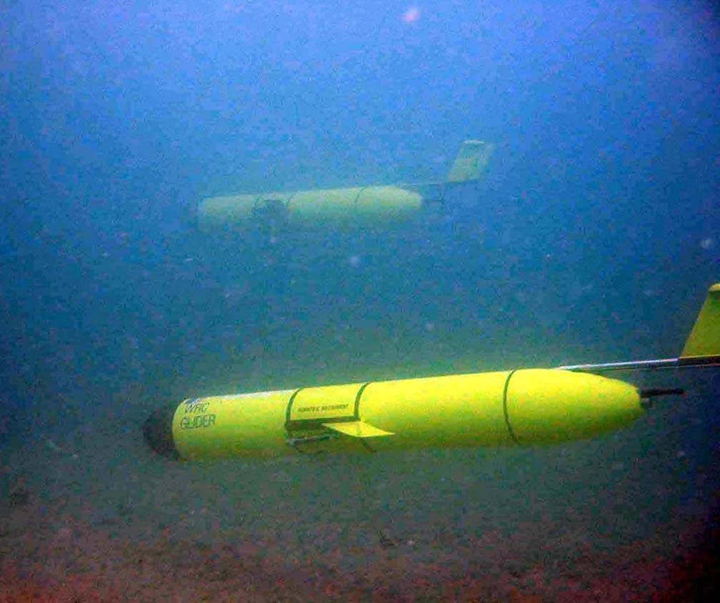
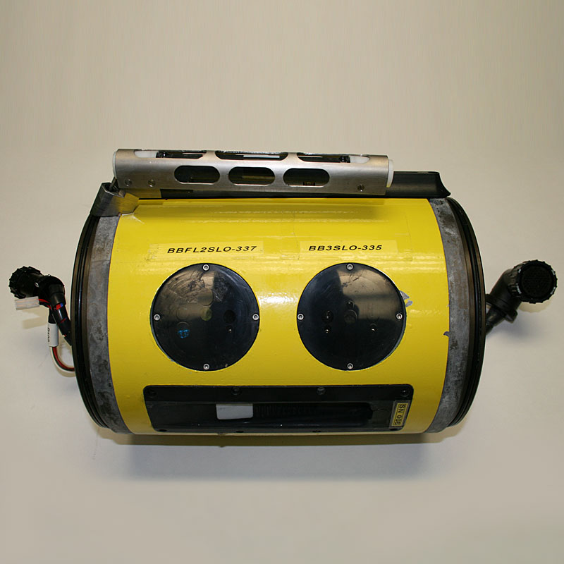
Glider Observations of Sediment Resuspension in a Middle Atlantic Bight Fall Transition Storm (Glenn et al., 2008)
Temperature
Optical
Sensors
Notes:
Regional Perspectives

Slide 4
Notes:
Two storms were sampled and presented in this study during unstratified and stratified conditions
Here you see Temperature and optical backscatter during a fall transition storm on the left
The water column is vertically well mixed and you can see full water column sediment resuspension from the bed to the surface at nearly 40 meters depth
A deployment on a similar line in Summer of 2004 shows the highly stratified continental shelf, and sediment resuspended, but limited by the stable thermocline (likely not visible from satellite etc.)

Slide 5
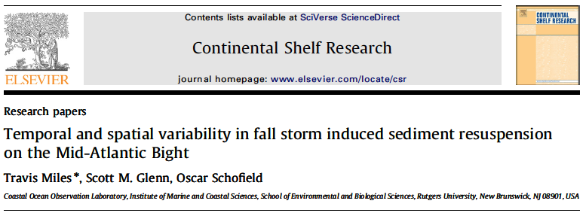
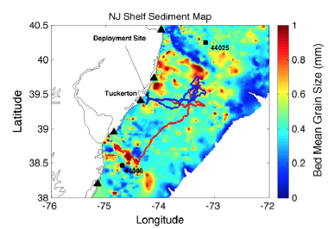
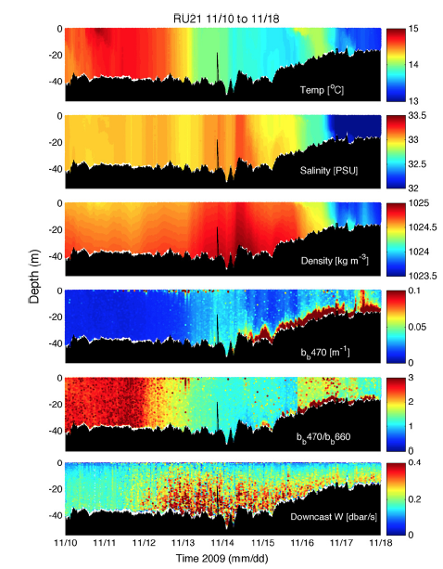
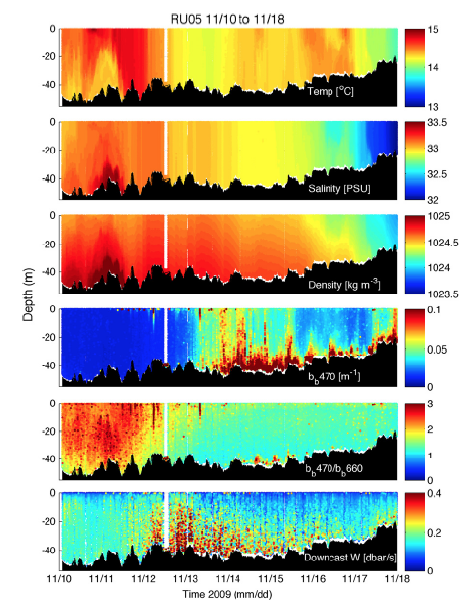
Notes:
Multiple gliders to investigate spatial variability in sediment transport

Slide 6


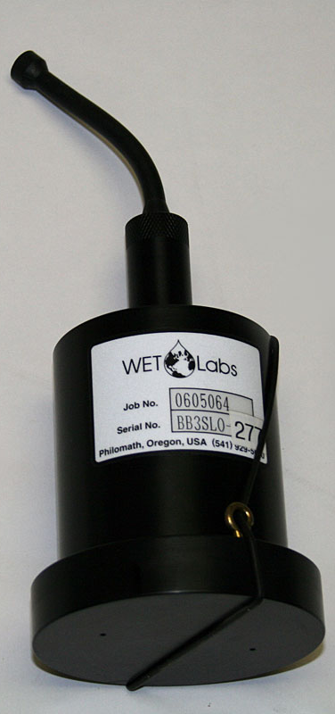

Storm Glider Development
Storm Glider (v1)
Un-pumped Seabird Conductivity Temperature Depth (CTD), Aandera Optode (Oxygen), Wetlabs ECOpuck (CDOM, Chlorophyll, Backscatter) – Small Particles

Slide 7
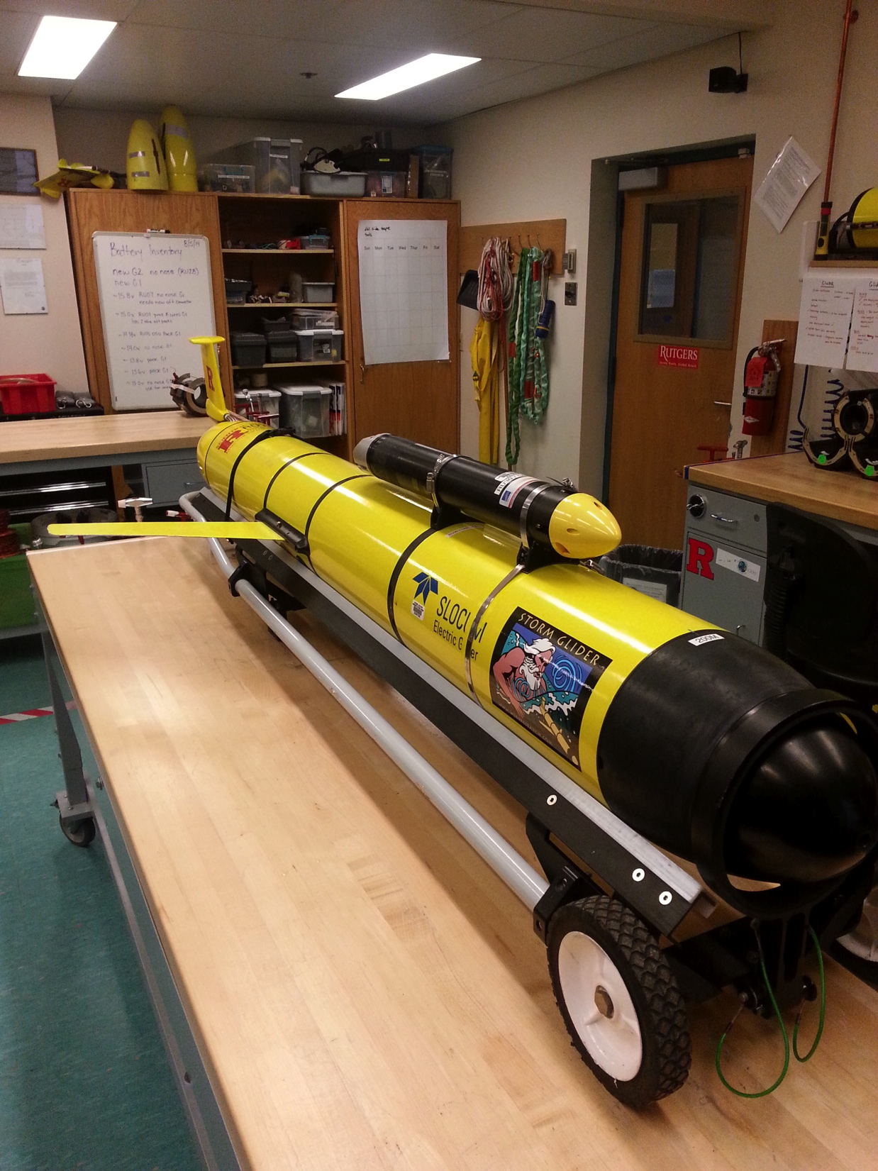
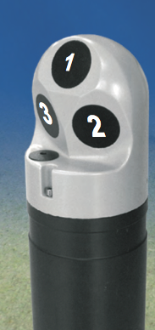
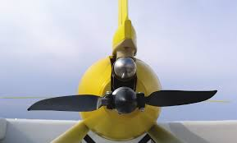
Storm Glider Development
Storm Glider (v1)
Un-pumped Seabird Conductivity Temperature Depth (CTD), Aandera Optode (Oxygen), Wetlabs ECOpuck (CDOM, Chlorophyll, Backscatter) – Small Particles
Storm Glider (v2)
Pumped CTD, accelerometer test for waves, extended battery bay , Externally mounted Nortek Aquadopp Current Profiler – Large Particles

Slide 8
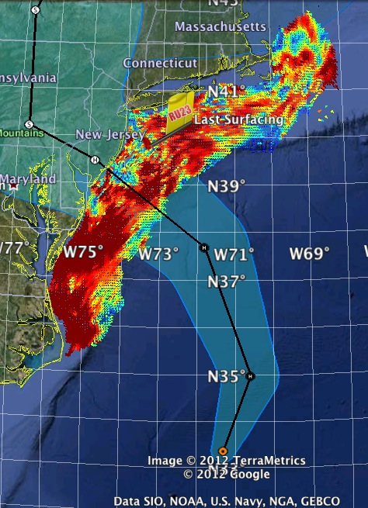
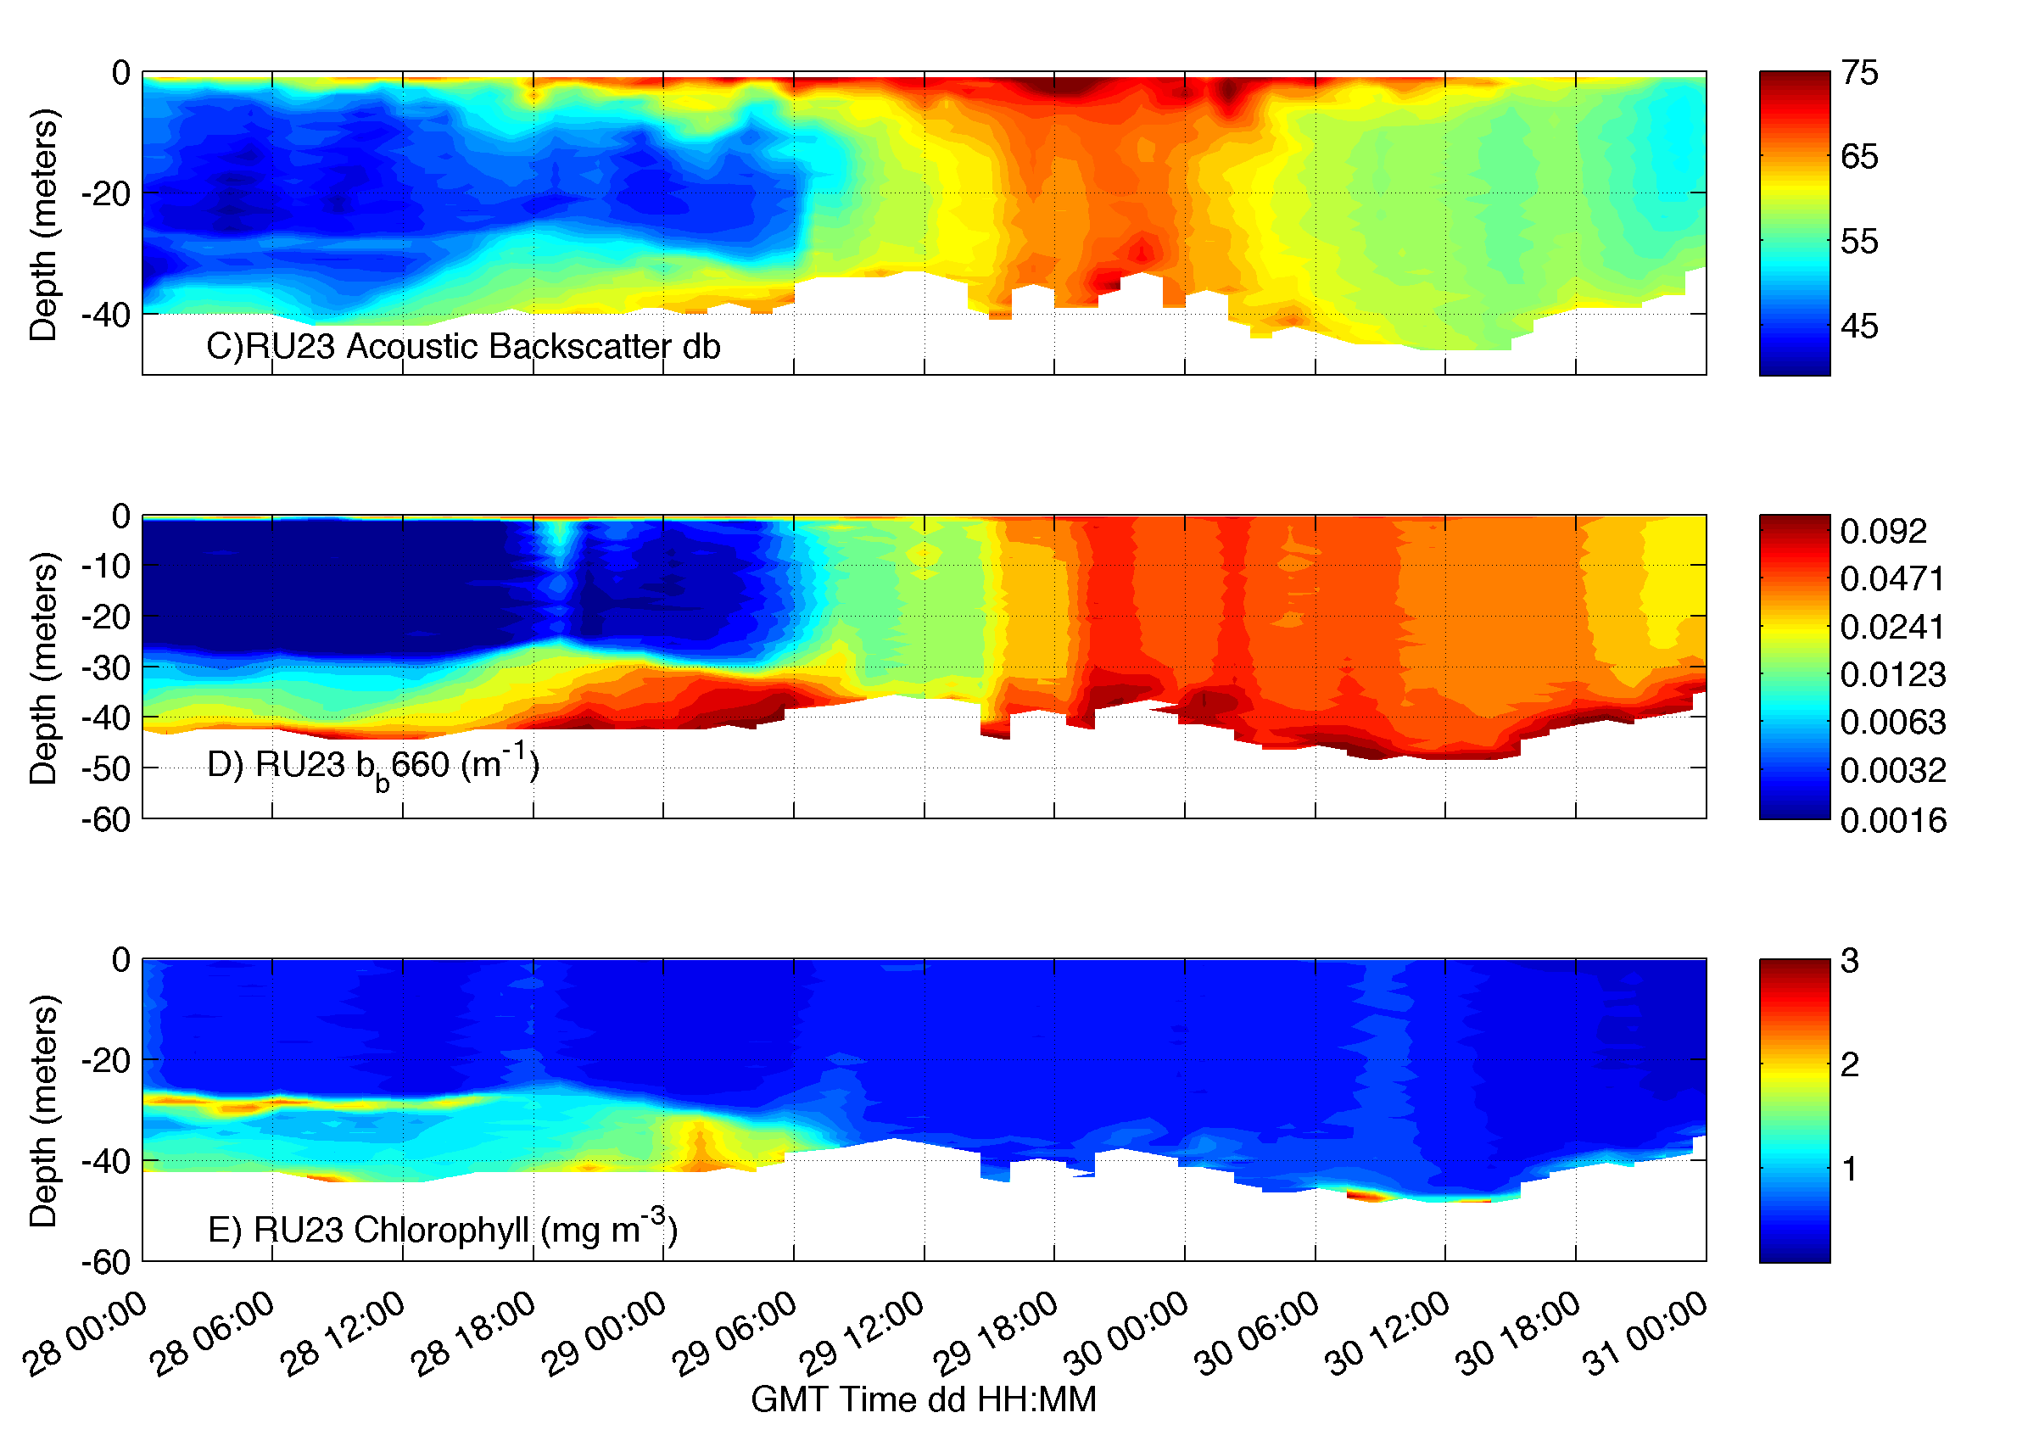

Slide 9
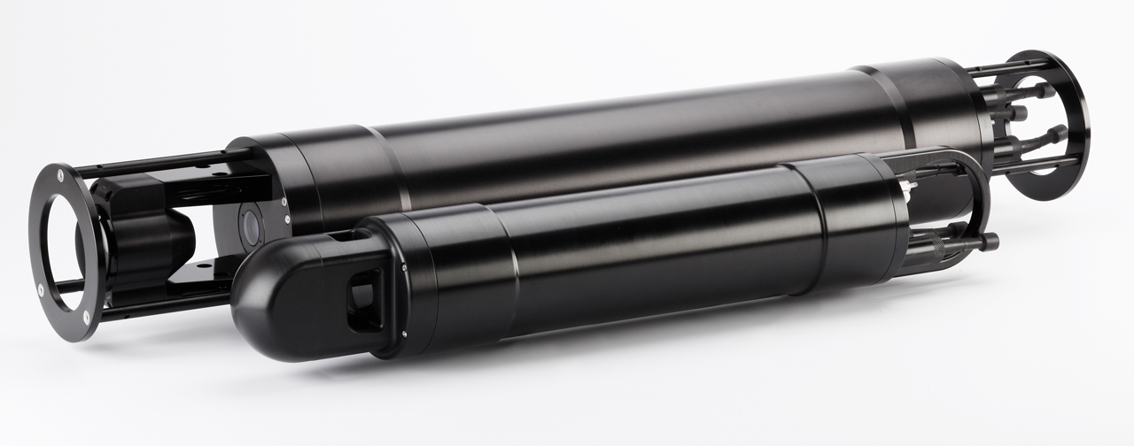
Laser In-Situ Scattering and Transmissometry (LISST) sensor
Agrawal, Y. C., and H. C. Pottsmith (2000), Instruments for particle size and settling velocity observations in sediment transport, Mar. Geol., 168(1–4), 89–114, doi:10.1016/s0025-3227(00)00044-x.

Slide 10
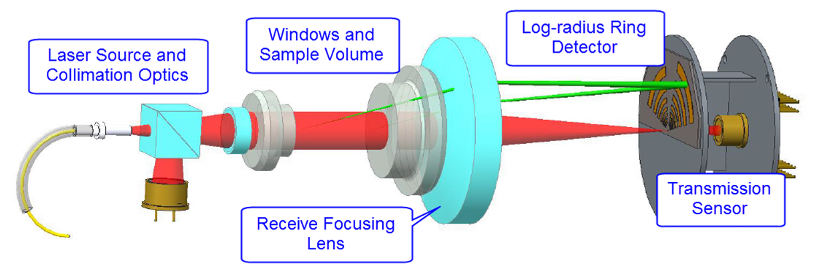
How laser diffraction works
Volume illuminated by laser light, which is scattered by particles in sample volume
Large particles scatter most of their light at small angles and small particles scatter at larger angles
Sum of scattering by all particles is measured as function of angle using specialized detector array
Scattering by particles of different sizes can be modeled using Mie Theory --> Inversion technique can be used to determine amount of each size needed to produce the measured scattering vs. angle
Inversion result is the equivalent spherical size distribution by volume

Slide 11
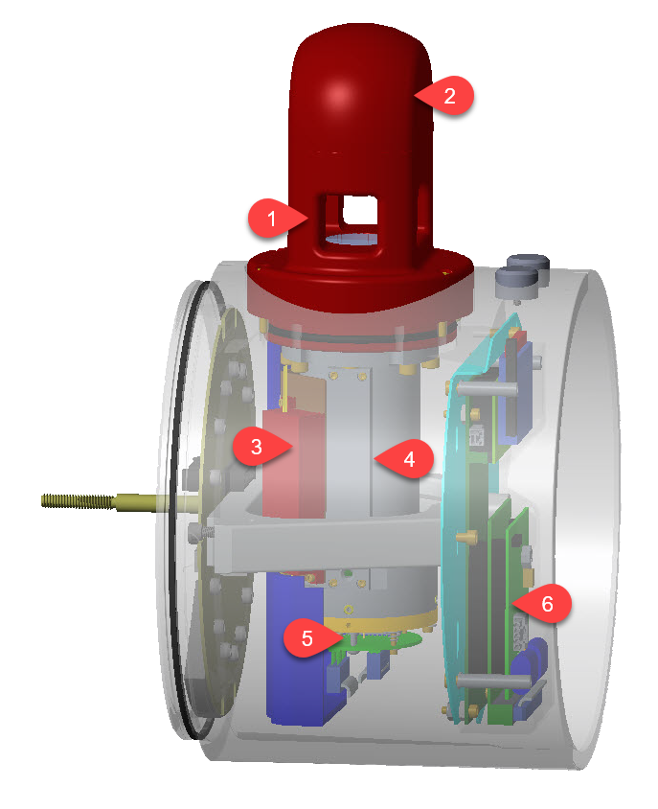
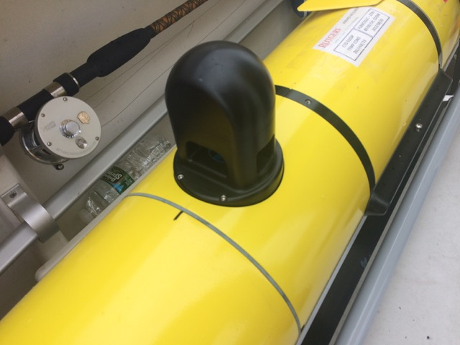
LISST particle sizer glider integration and test deployment
Scattering volume
Beam collimation optics and reference detector
Fiber coupled diode laser module
Scattered light received through lens tube
Ring detectors and transmission sensor
Electronics section
Notes:
The sample volume (1) is a 2.5 cm pathlength scattering volume flanked with fused quartz windows for durability. The beam collimation optics and reference detector are also contained in the optical head (2), connected to a fiber coupled diode laser module (3). Scattered light is received through the lens tube (4) that also contains an extended detector array. The primary ring detectors and transmission sensor (5) are mounted on a XY stage that is used to adjust the instrument alignment, which can then be locked into place. An electronics section (6) digitizes the analog signals from the scattering detectors, controls the sampling process, logs the full scattering dataset, and calculates beam attenuation particle size metrics (i.e., mean size and total concentration)

Slide 12
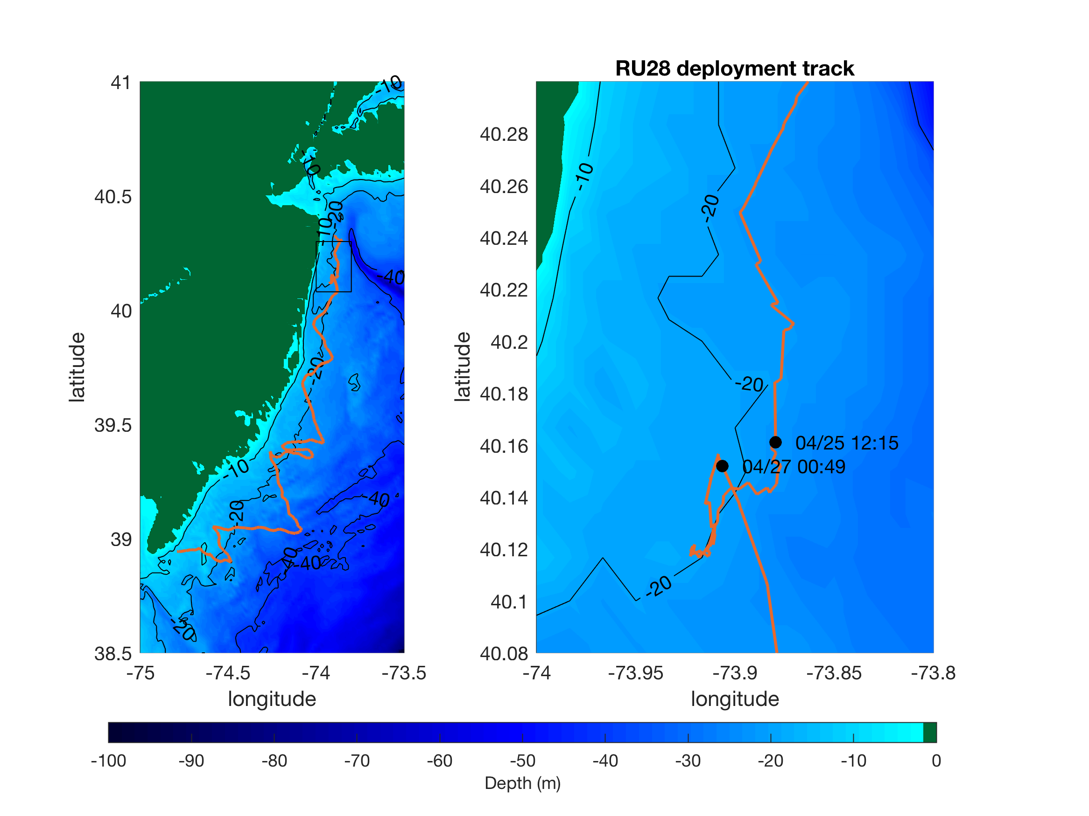
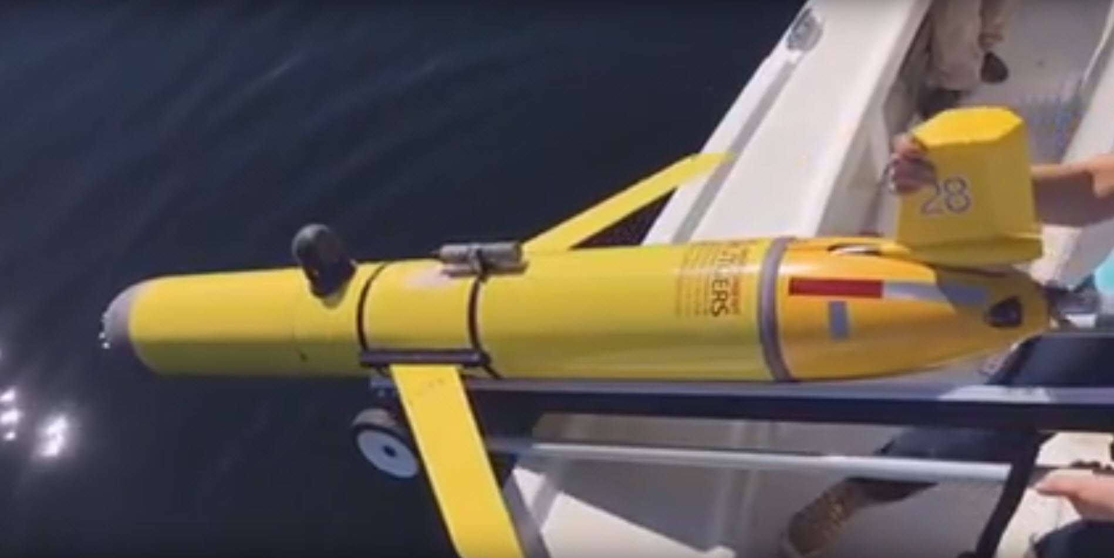

LISST – Glider test deployment April 2017
Deployed for a 1 month mission along the New Jersey Coast in April of 2017.
NJ Department of Environmental Protection mission mapping low oxygen
Large supporter of new sensor testing and storm research.

Slide 13
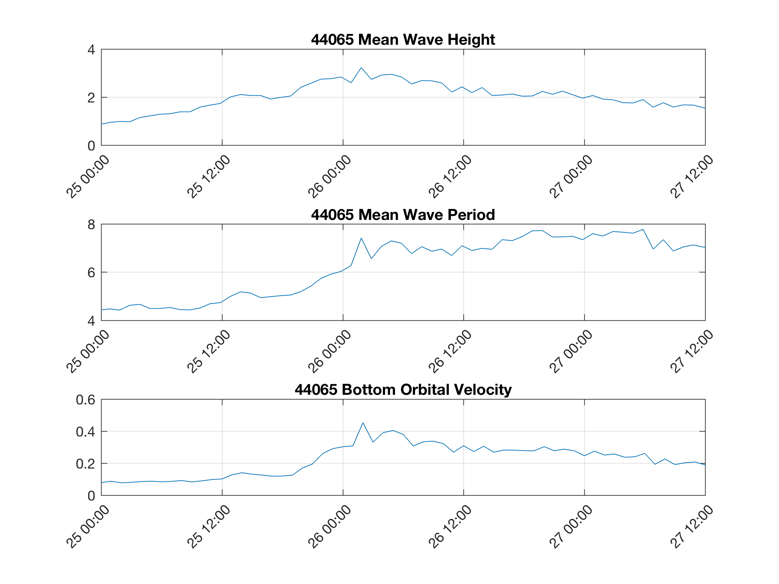
LISST – Glider test deployment April 2017

Slide 14
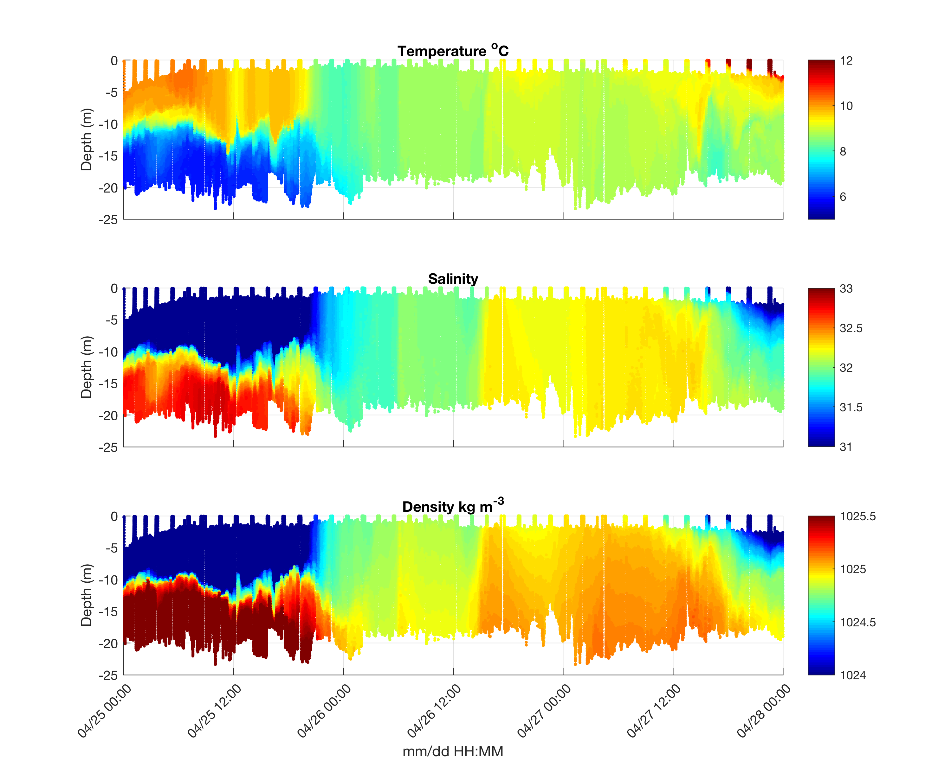
LISST – Glider test deployment April 2017

Slide 15
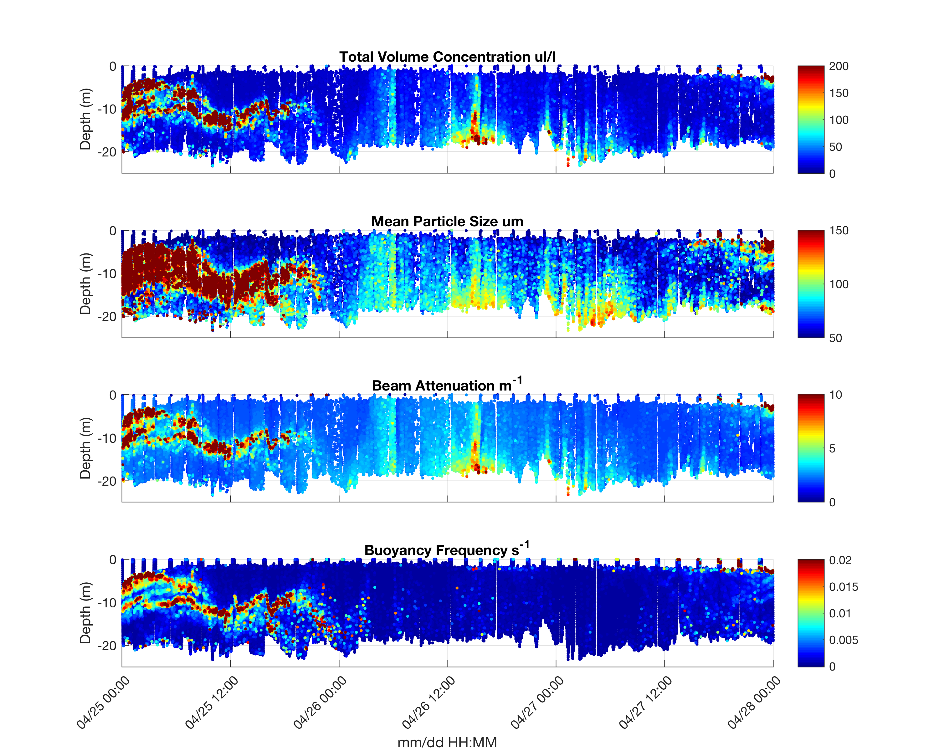
LISST – Glider test deployment April 2017
Real time data delivered in regular glider data stream:
Estimated using the weighted sum of net scattered light
Notes:
The quick estimates are based on weighted sum of the net scattered light. One set of weight factors yields the total volume concentration; the other yields the area concentration of particles. The volume/area ratio provides mean diameter, also known as the Sauter Mean Diameter (SMD)

Slide 16
LISST – Glider test deployment April 2017
Schlieren is visible in images when the buoyancy frequency exceeds ~0.12 s-1.
Buoyancy frequencies above 0.025 s⁻¹ may increases beam attenuation due to scattering from density gradients.
Measured as particles in larger size bins, >100 um
Mikkelson et al., 2008
Tao et al., 2017
Real time data delivered in regular glider data stream:
Estimated using the weighted sum of net scattered light
Notes:
﻿Light scattering caused by density differences can also cause multiple scattering, which produces an apparent decrease in particle size derived from the LISST.

Slide 17
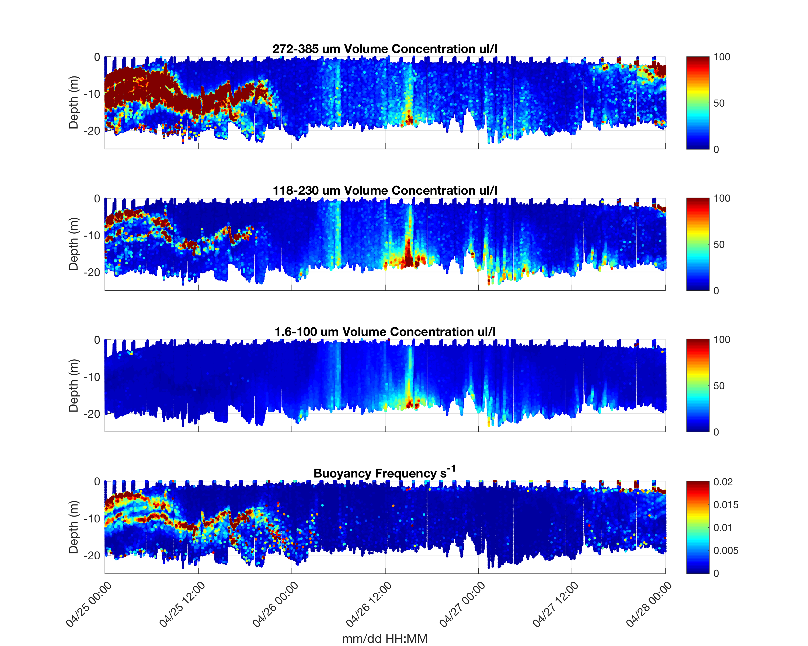
LISST – Glider test deployment April 2017
Schlieren is visible in images when the buoyancy frequency exceeds ~0.12 s-1.
Buoyancy frequencies above 0.025 s⁻¹ may increases beam attenuation due to scattering from density gradients.
Measured as particles in larger size bins, >100 um
Mikkelson et al., 2008
Tao et al., 2017
Post processed data using standard Sequoia processing codes to estimate the Particle Size Distribution (PSD)
Notes:
Light scattering caused by density differences can also cause multiple scattering, which produces an apparent decrease in particle size derived from the LISST.

Slide 18
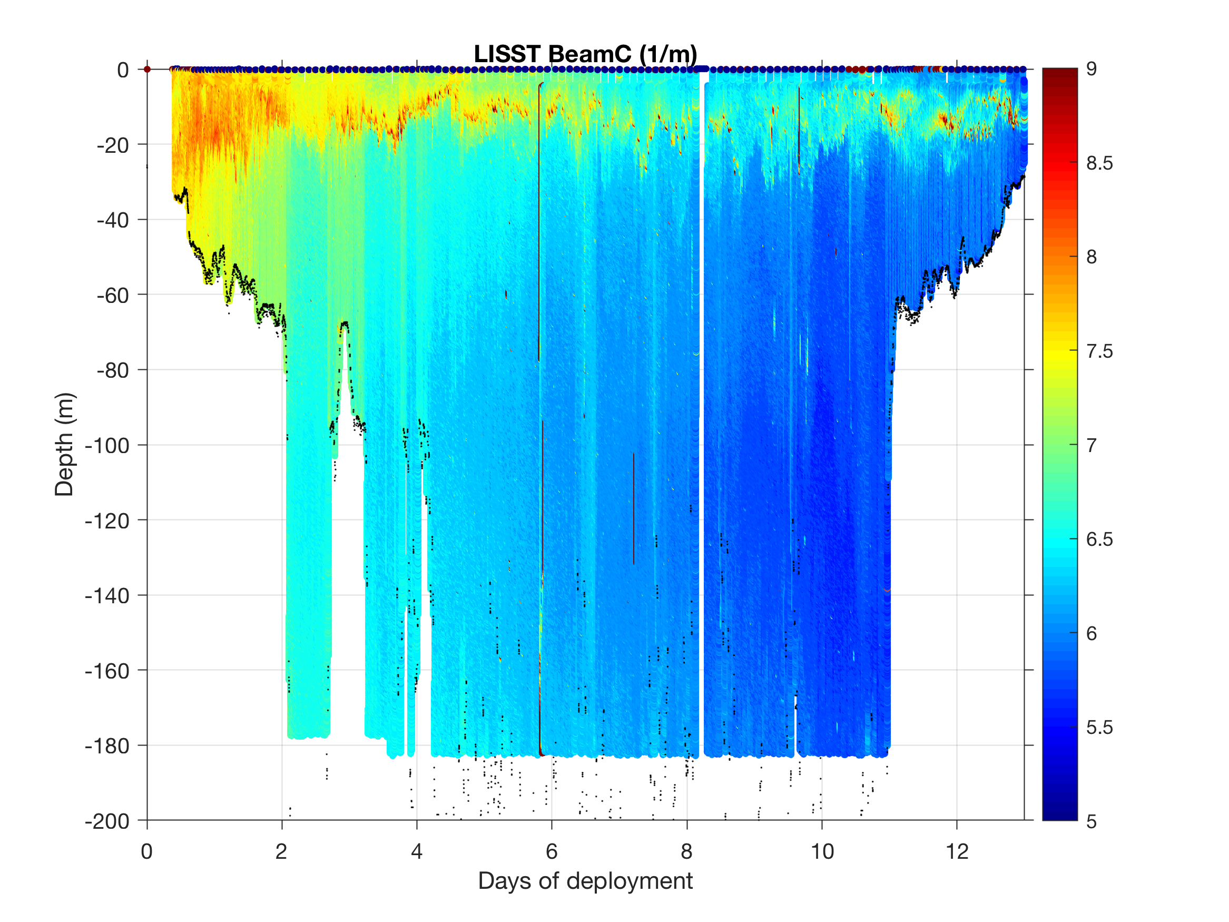
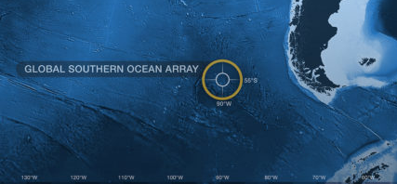


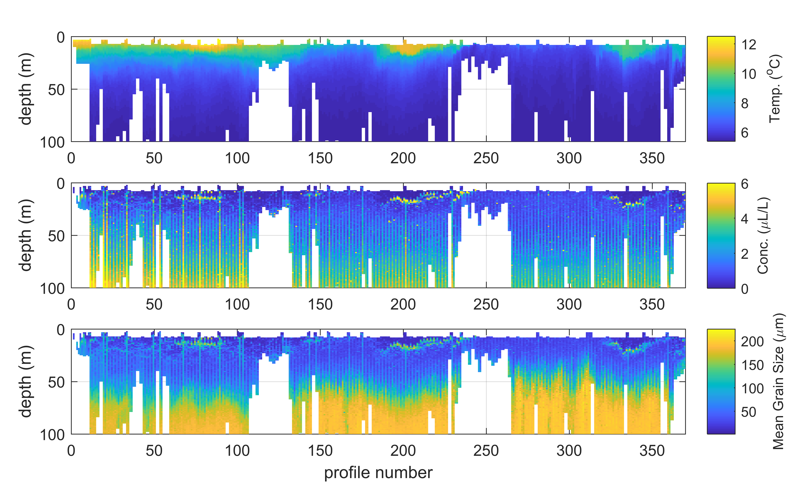

Current and future field tests
Wilmington Canyon
Lake Tahoe

Slide 19
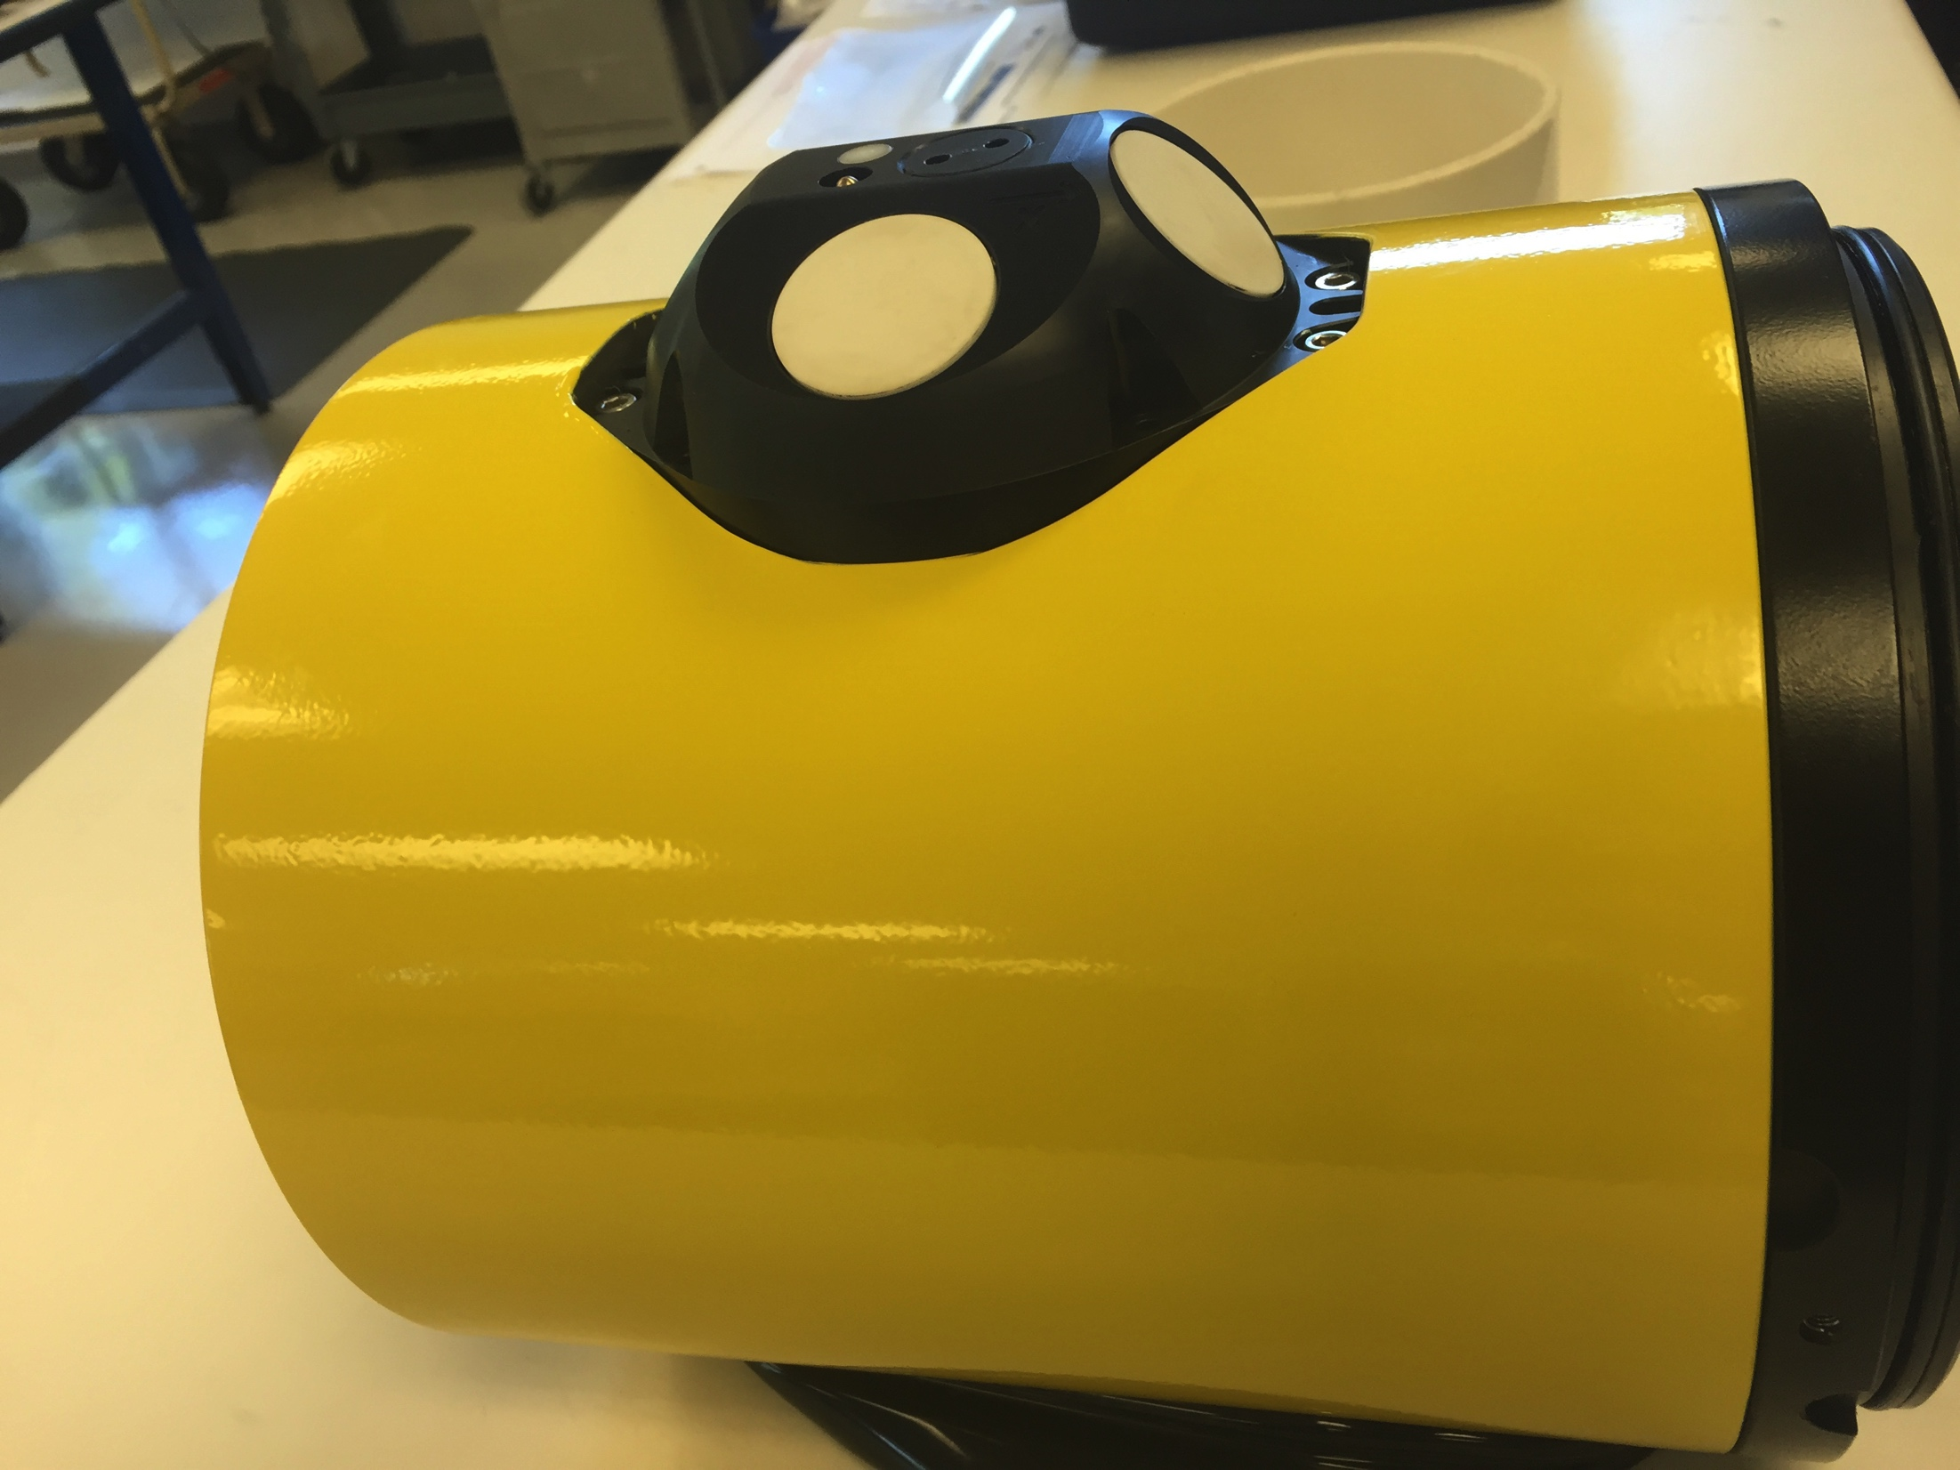
Storm Glider Development
Storm Glider (v1)
Un-pumped Seabird Conductivity Temperature Depth (CTD), Aandera Optode (Oxygen), Wetlabs ECOpuck (CDOM, Chlorophyll, Backscatter) – Small Particles
Storm Glider (v2)
Pumped CTD, accelerometer test for waves, extended battery bay , Externally mounted Nortek Aquadopp Current Profiler – Large Particles
Storm Glider (v3)
Integrated current profilers, expanded capacity buoyancy pumps, thruster G2, integrated LISST-200X particle sizer (sediment, oil droplet, phytoplankton, etc.). – Measures particle size and concentration using laser diffraction

Slide 20
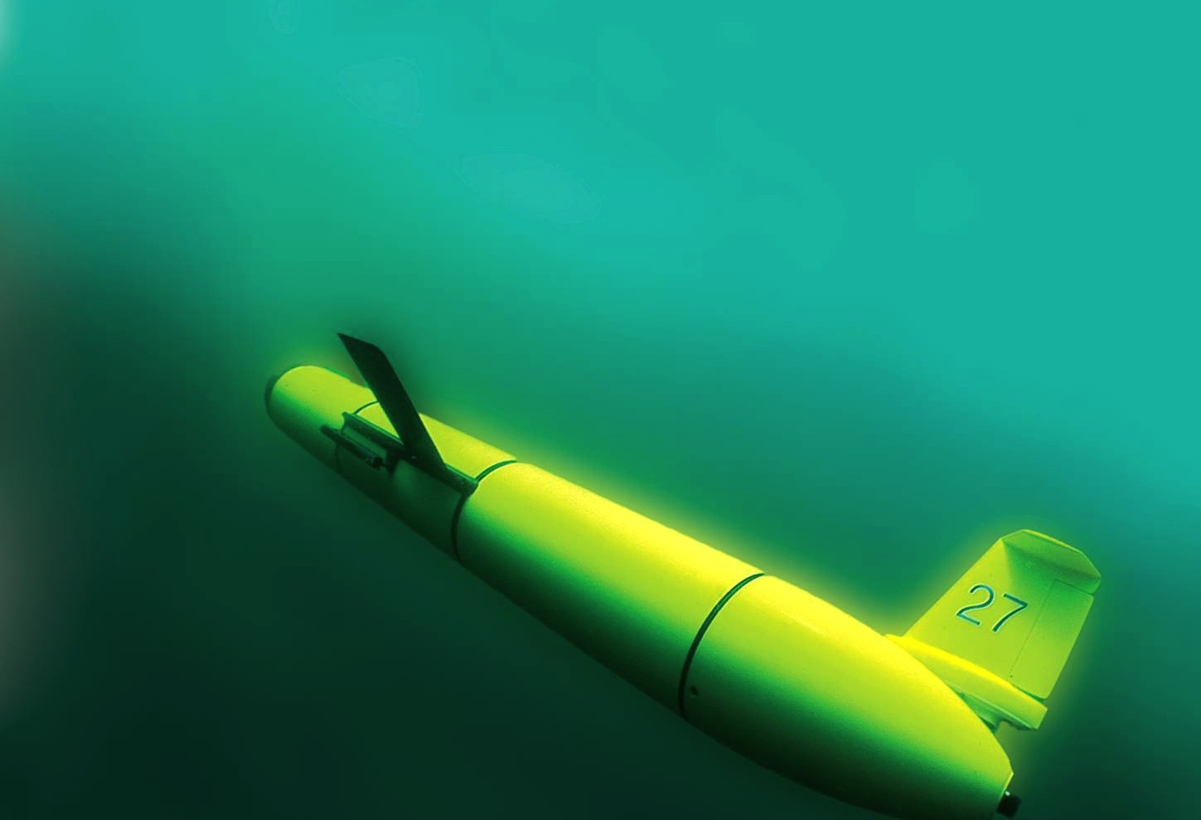
Thank You!
Questions?
ONR Award # N000141612553

Slide 22
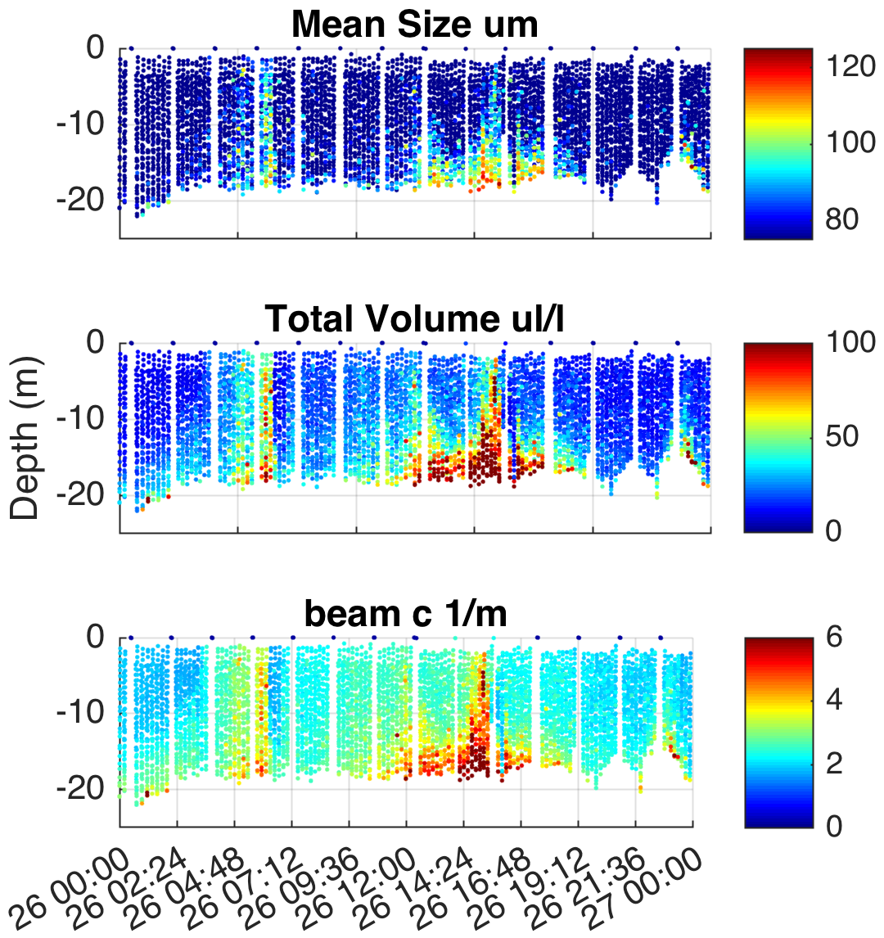

Project Title: Slocum Glider Integrated Laser In-Situ Scattering and Transmissometry Sensors for Suspended Particle Characterization Beneath Tropical Cyclones
Project Lead: Travis Miles (Rutgers University)
Project Funding: ($500,000) Office of Naval Research: DURIP.
ONR Award # N000141612553

Slide 23
Notes:
COAWST – Developed by USGS for sediment transport (Cross-disciplinary leveraged research support)

Slide 24
Regional models
Primary validation is post storm surveys and limited point measurements.
Need for new technologies for regional in situ validation

Slide 25
LISST – Glider test deployment April 2017
Machine Vision Floc Camera
Tao, J., P. S. Hill, E. S. Boss, and T. G. Milligan (2017), Evaluation of optical proxies for suspended particulate mass in stratified waters, J. Atmos. Ocean. Technol., 34(10), 2203–2212, doi:10.1175/JTECH-D-17-0042.1.

Slide 26
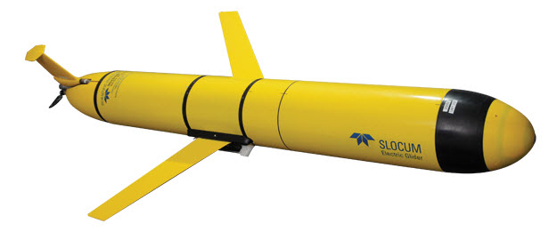

Slide 27
Storm Glider Development
Rapid Response Glider (v1)
Un-pumped Seabird Conductivity Temperature Depth (CTD), Wetlabs ECOpuck (CDOM, Chlorophyll, Backscatter), Aandera Optode (Oxygen).
Rapid Response Glider (v2)
Pumped CTD, Externally mounted Nortek Aquadopp Current Profiler, integrated accelerometer, extended battery bay, Thruster G1.
Optical Backscatter: Wet Labs Eco-puck BB3 (470, 532, 660 nm) – Smaller particles
Acoustic Backscatter/Currents: Nortek Aquadopp Current Profiler (2 MHz head, 1 meter bins, internally logging, 30 days) – medium sands

