Slide 1
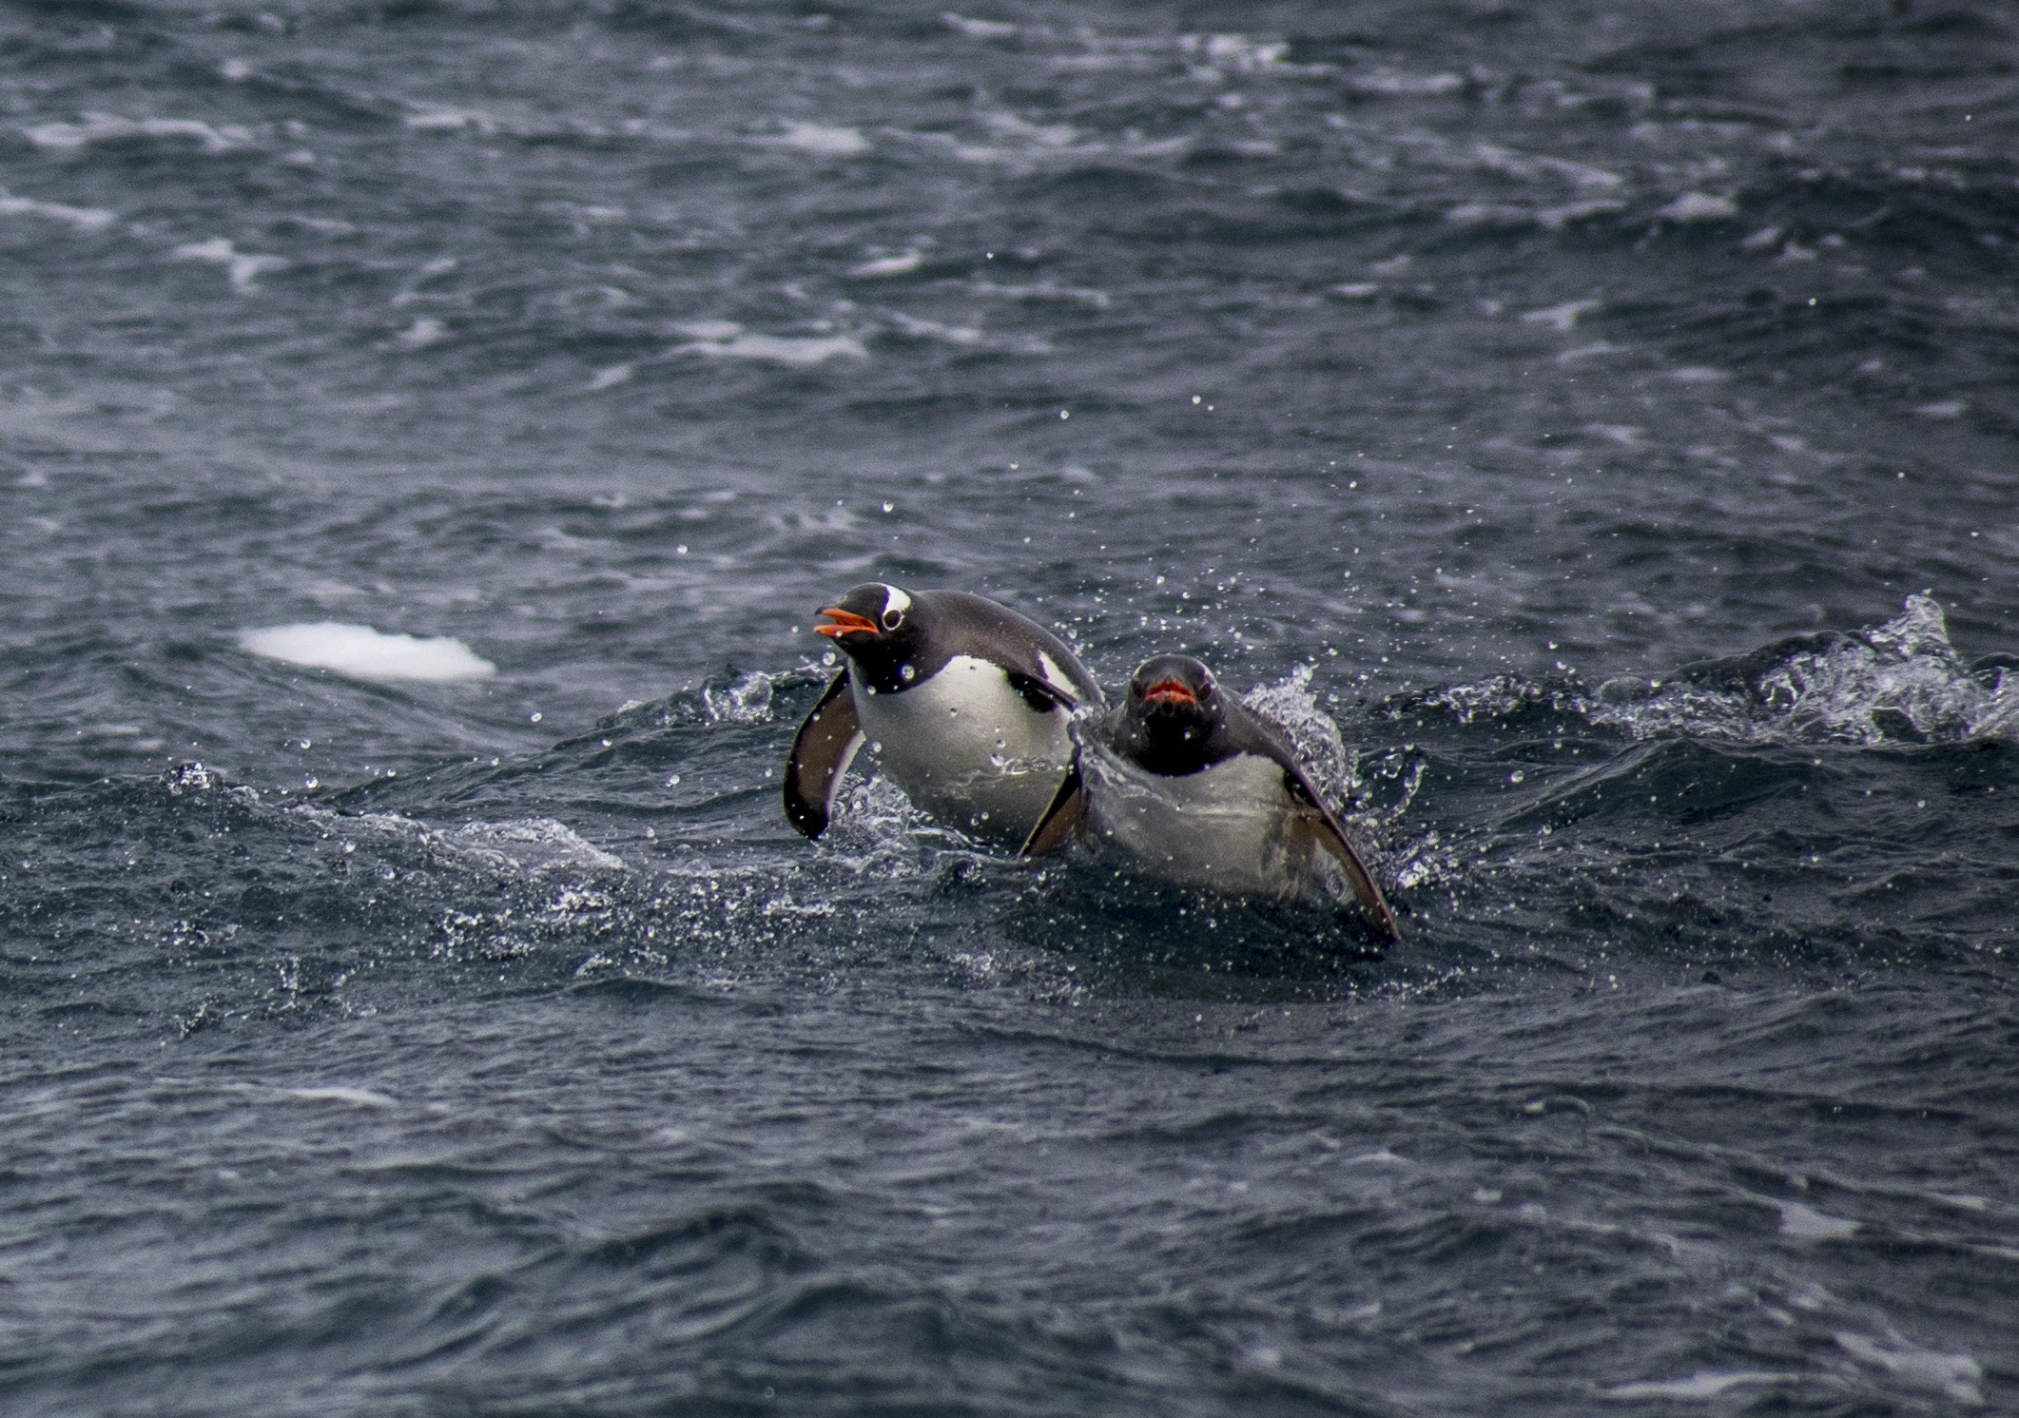


Changing sea ice dynamics on West Antarctic Peninsula underlying ecosystem alterations
Conclusions:
Climate cycles are affecting sea ice in the WAP.
Changes in sea ice affecting physics driving changes in lower trophic levels
Relatively linear food-web modulated however by life history processes

Slide 2
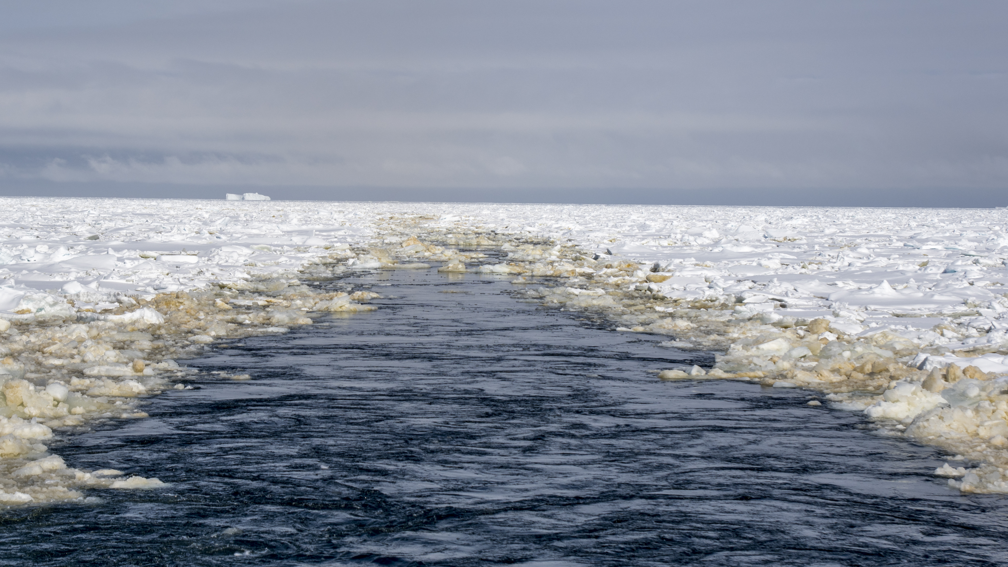
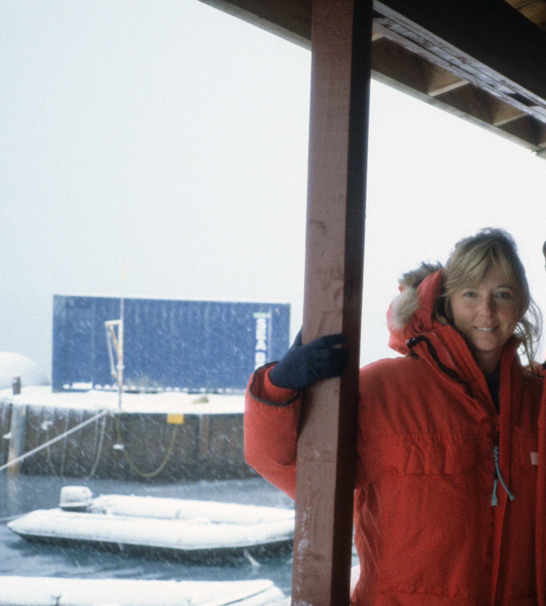
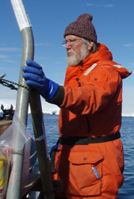


Great programs reflect the people involved
Current LTER team: Hugh Ducklow (Columbia University, bacteria), Debbie Steinberg (VIMs, zooplankton), Scott Doney (UVA), Sharon Stammerjohn (U Col, Climate), Doug Martinson (Columbia, physical oceanography), Ari Fiedlaender (UC Santa Cruz, Whales), Doug Novacek & David Johnston (Duke, Whales), James Conners (UCSD, data), Janice McDonnell (Rutgers, EO) and Bill Fraser (Polar Assoc., sea birds)
RU COOL lab: Scott Glenn, Josh Kohut, Grace Saba, Travis Miles, Nicole Waite, David Aragon, Chip Handelmann
Current and former post-docs & grad students: Alex Kahl, Nicole Couto, Filipa Carvalho, Michael Brown, Schulyer Nardelli, Martin Montes-Hugo
Special toast to founding team of the Palmer LTER at UCSB
Barbara Prezelin
Langdon Quetin
Robin Ross
Ray Smith

Slide 3
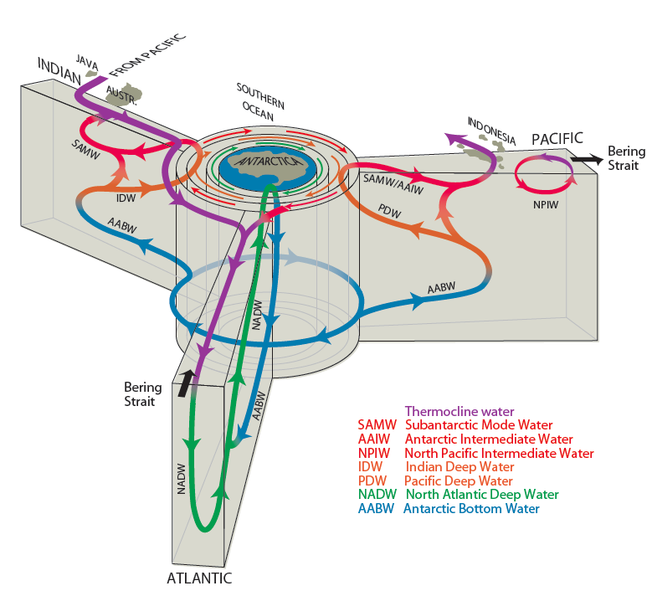
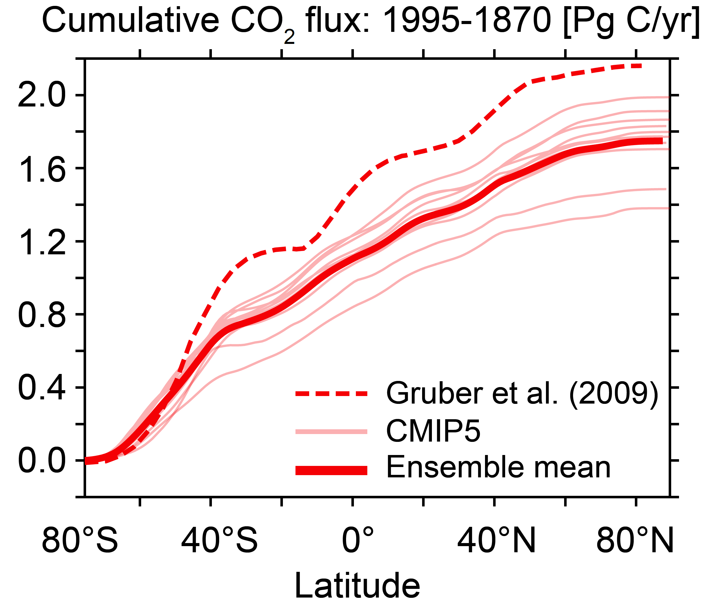
Southern Ocean is central to the Earth’s metabolism
51%
Major region of deep ocean water mass formation. Associated with the upwelling of the basin deep water masses
Southern Ocean arguably takes up
~50% of global anthropogenic
carbon

Slide 4
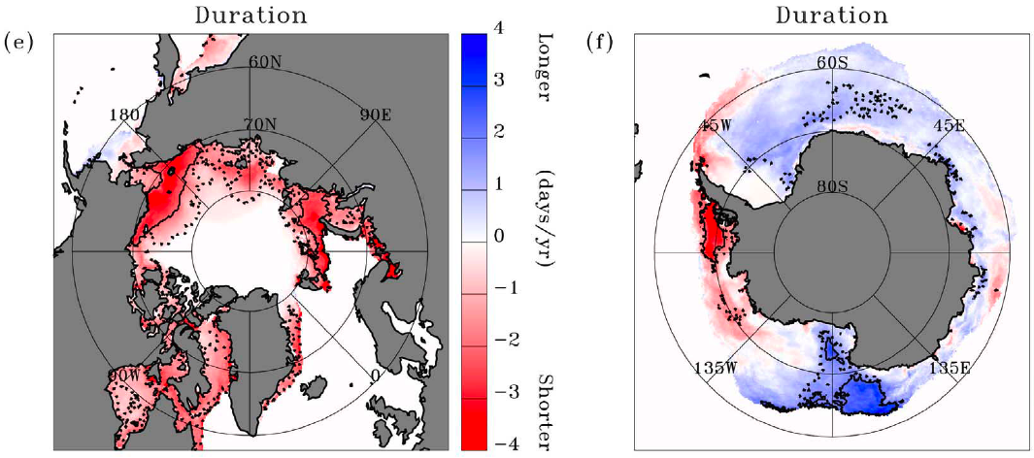
Overall LTER question: How do seasonality, interannual variability, and long term trends in sea ice extent and duration influence the structure and dynamics of marine ecosystems and biogeochemical cycling?
-WAP system showing rapid change,
90 days/yr decline in sea ice, one of fastest winter warming locations on Earth, 87% glaciers in retreat, however significant variability
-System heavily influenced by the El Nino/La Nina and the Southern Annular Mode
-Climate modulates position of circumpolar current position relative to Peninsula, which determines how much heat is on the shelf
~1 month longer
3.3 months shorter
1979 – 2010
2.6 months longer
~1 month shorter
Stammerjohn et al (2012), GRL

Slide 5
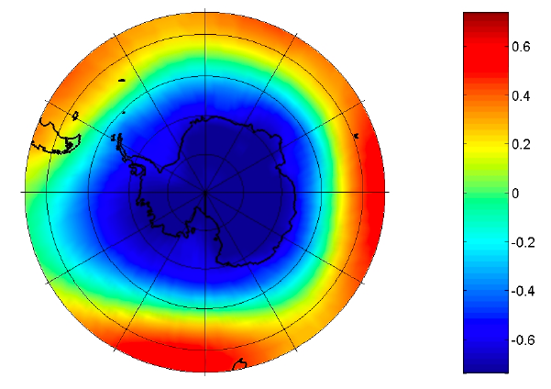
There is significant melting and warming along the WAP. Why?
Atmospheric temperatures
Sea Ice Duration
Faraday/Vernadsky Winter (JJA) Air Temperature Trends
Yearly variability decreases with shift to more maritime climate
SLP vs SAM
Southern Annular Mode (SAM), dominant mode of atmospheric variability
Amundsen Sea Low (ASL) deepens during +SAM, as well as during La Nina
ASL
Trend toward +SAM since 1990s (during summer/autumn)
+SAM & La Nina: enhanced warm northerly winds & less sea ice
Meredith et al., 2010

Slide 6
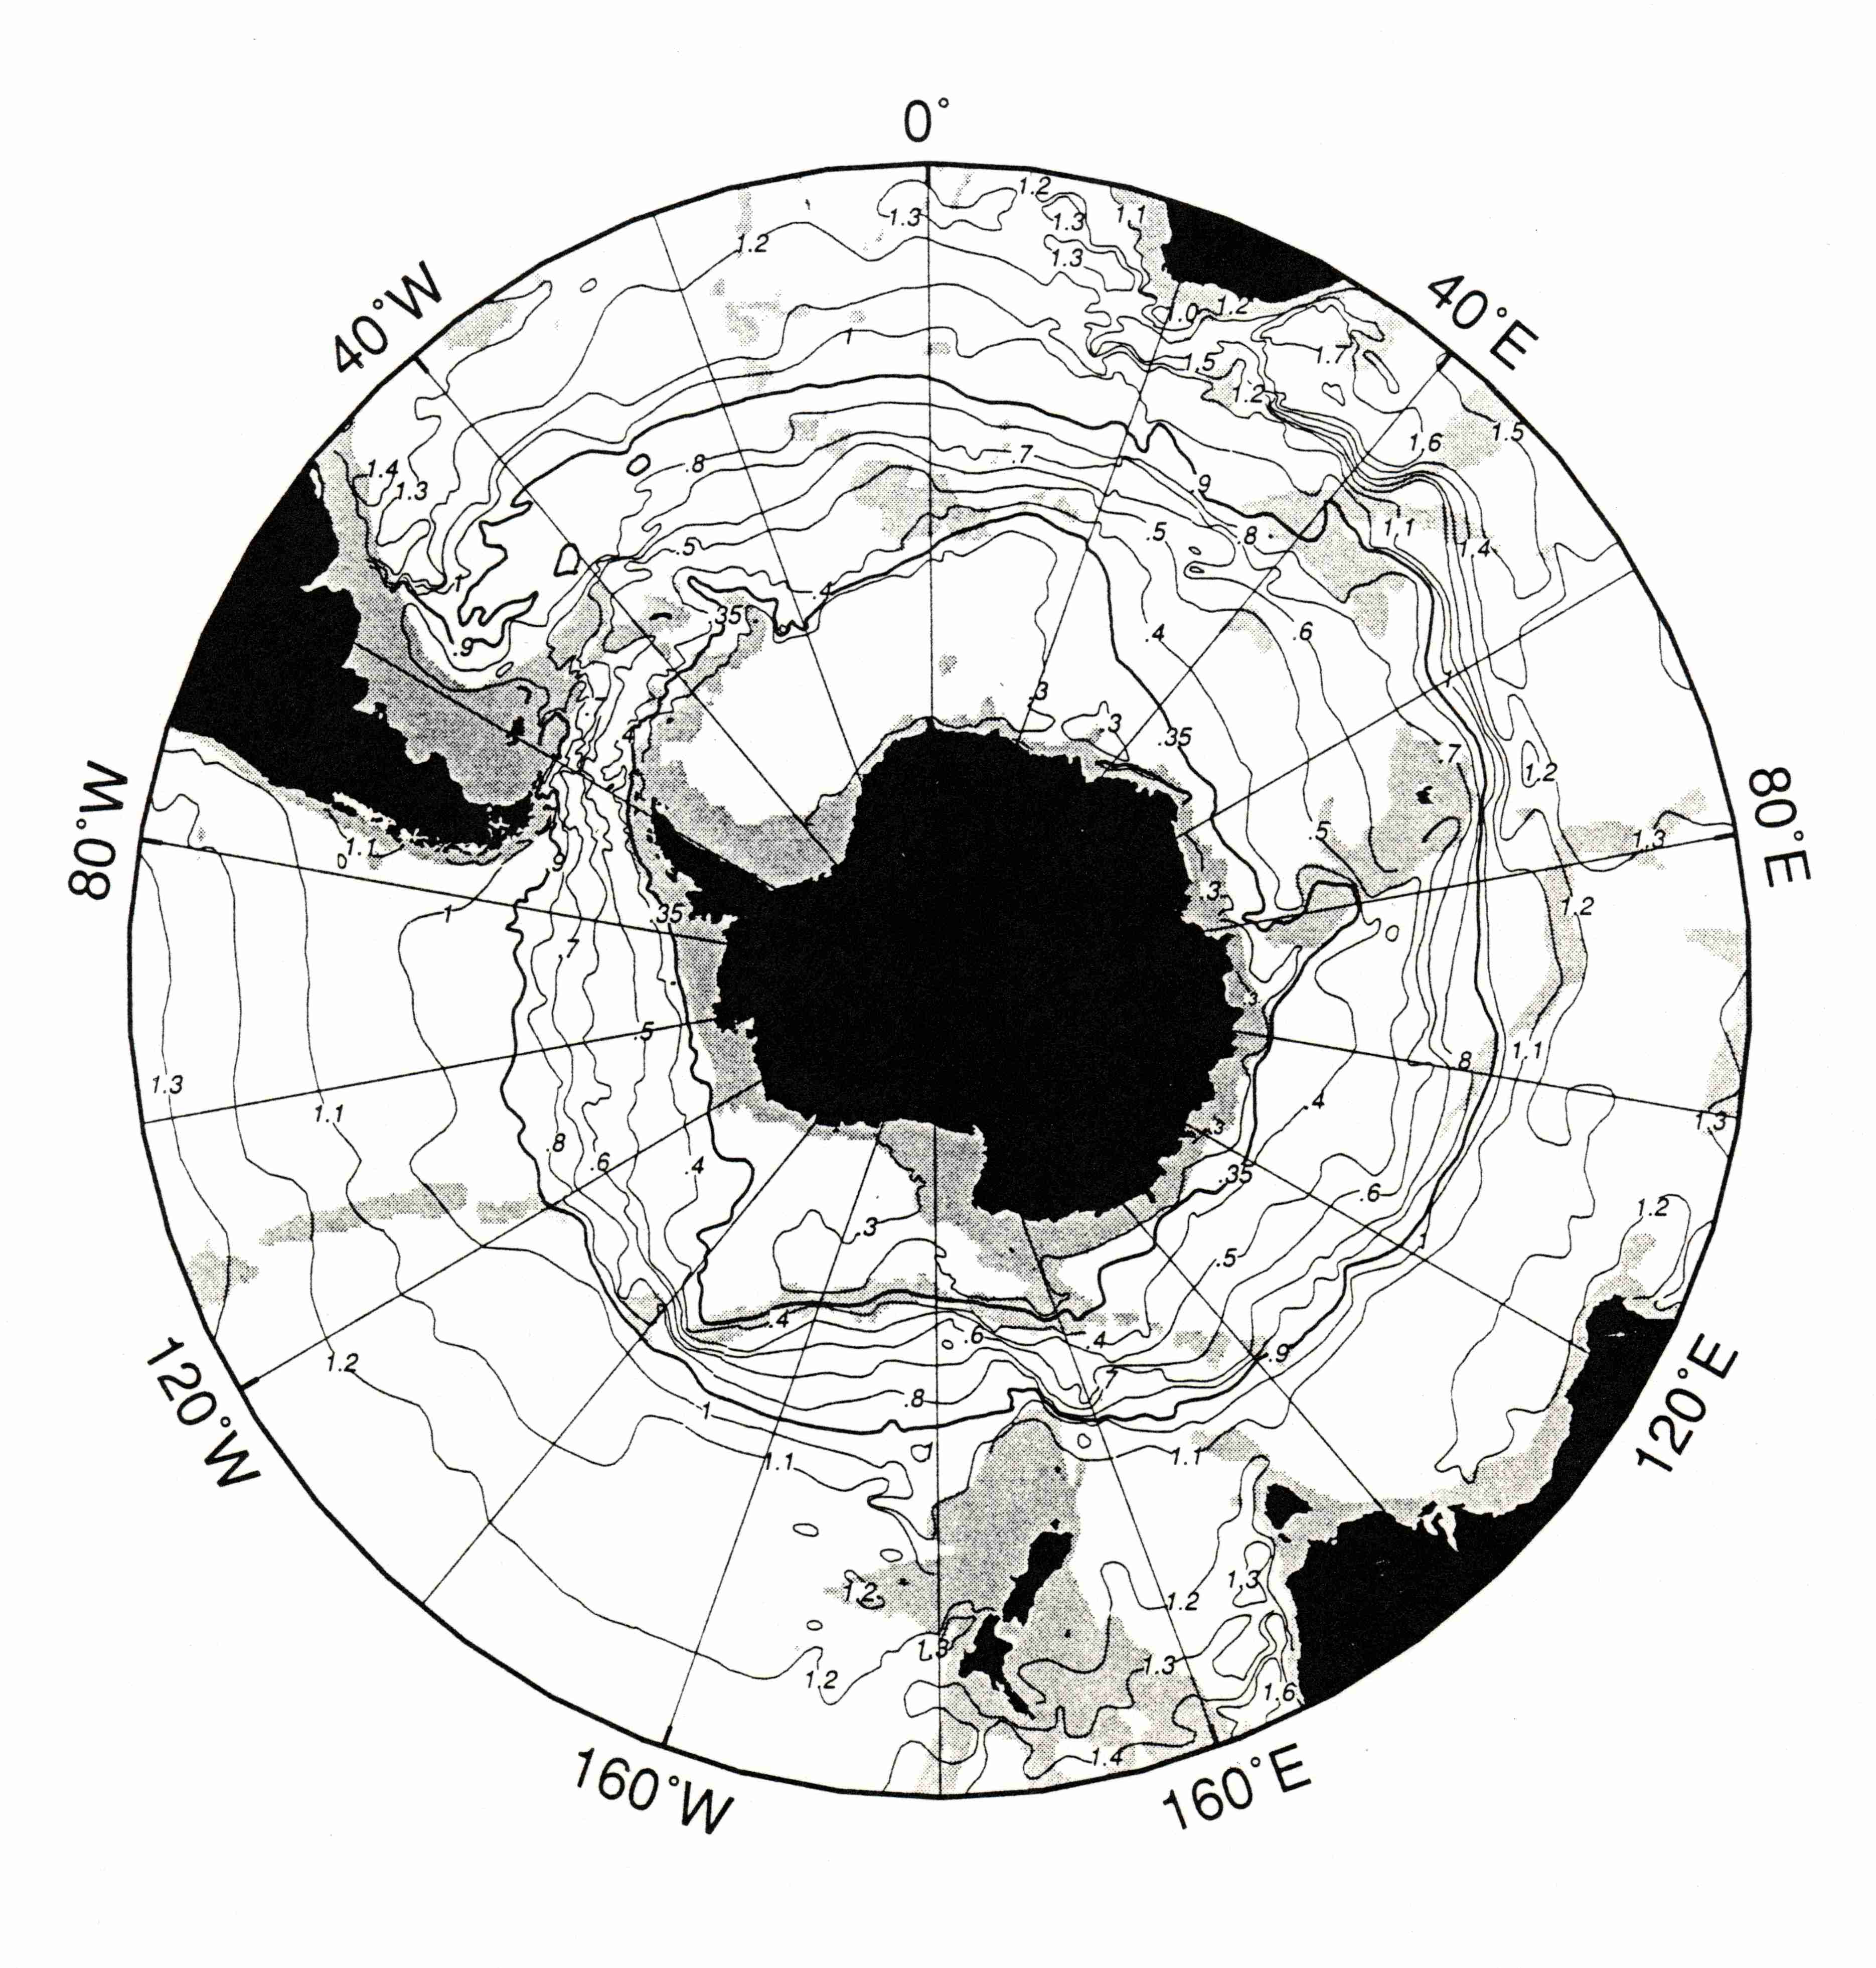
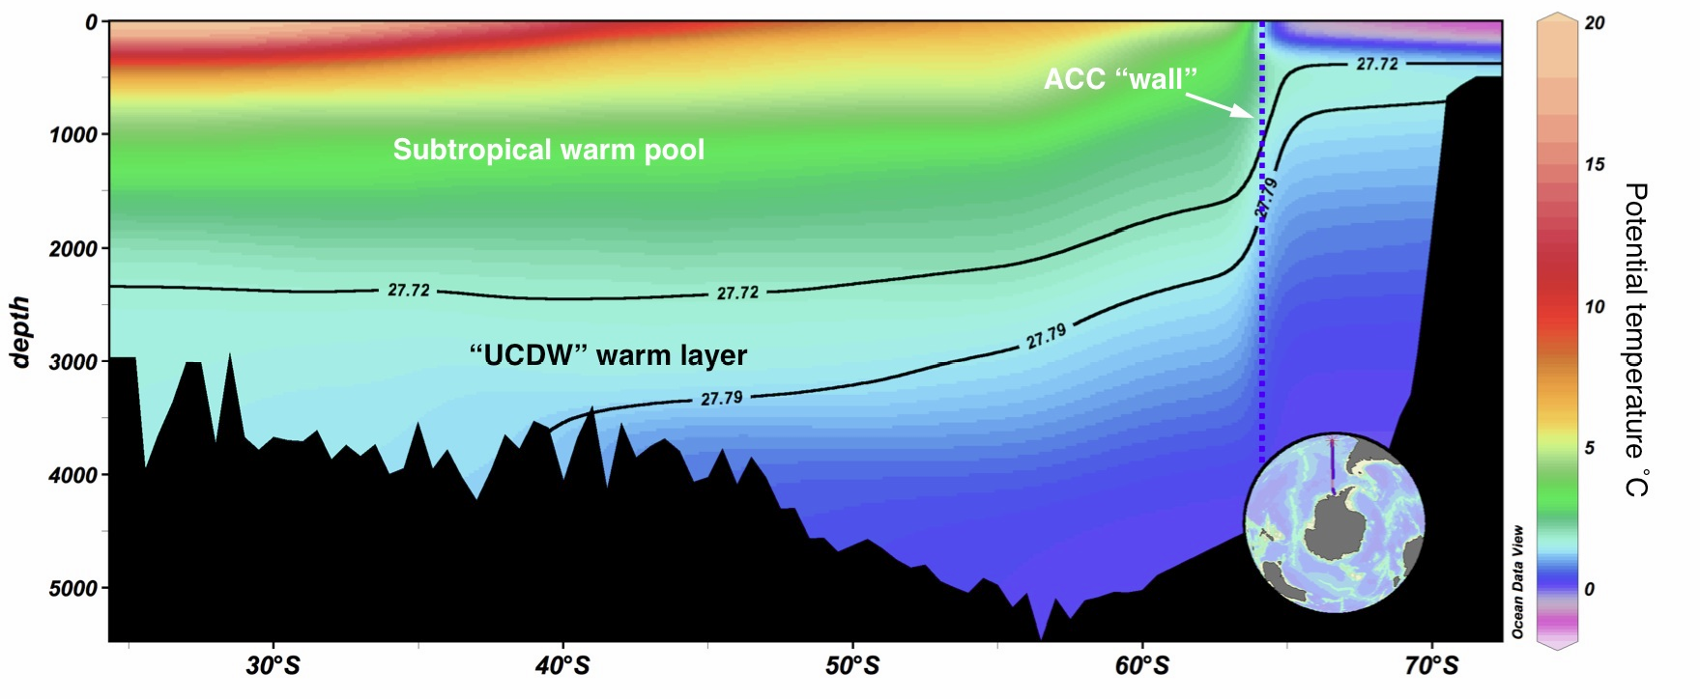
…the warm Upper Circumpolar Deep Water (UCDW)
~80% of warming - Sharon Stammerjohn, U. Colorado
Antarctic Peninsula to the Amundsen Sea: one of the few regions in Antarctica where the Antarctic Circumpolar Current (ACC) directly impinges on the shelf break. Upper Circumpolar Deep Water (UCDW) is Antarctica’s warmest water.
Gray shading, < 300m
Doug Martinson, LDEO

Slide 7
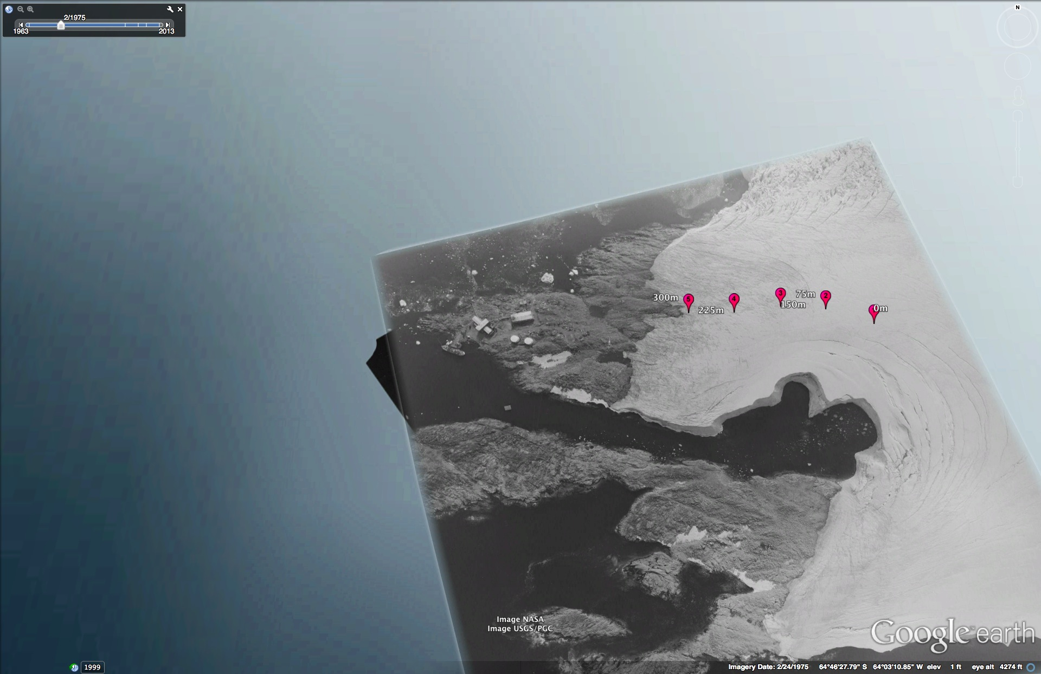
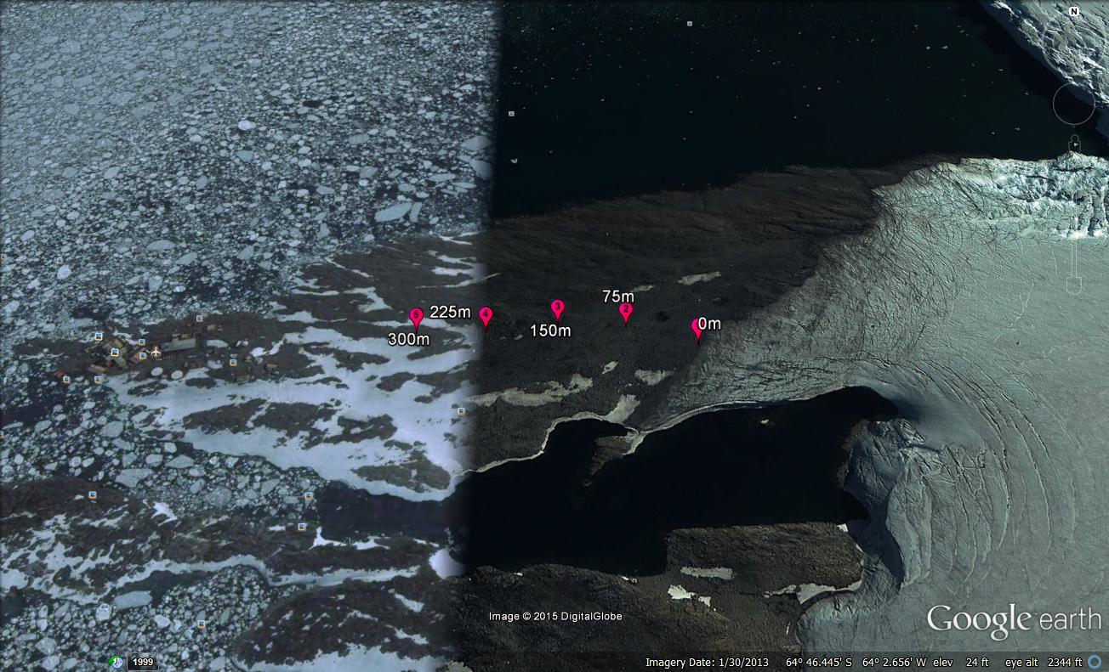
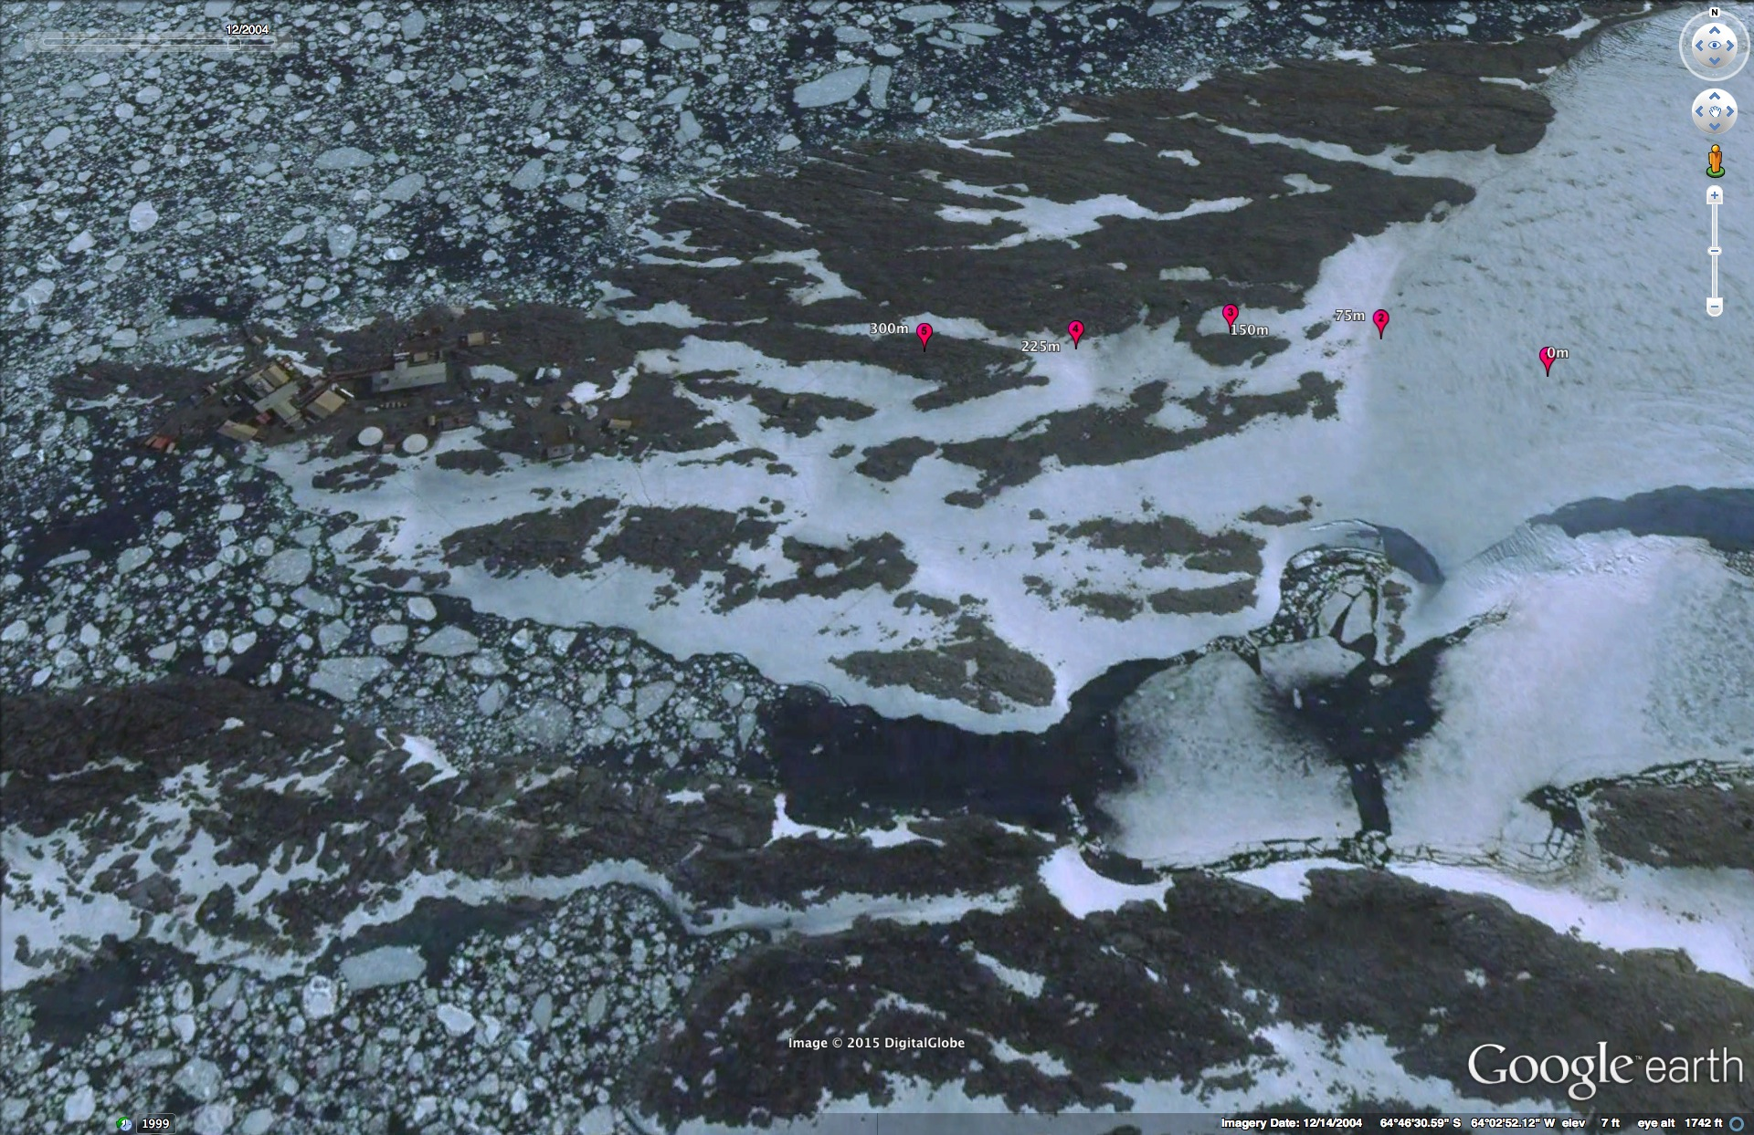
150 m
Year 1974
Palmer
Station
150 m
Year 2004
Year 2013
150 m

Slide 8
Sea ice shows significant interannual variability, with similar dynamics seen over the full WAP
South
North

Slide 9
Hoe might variability in sea ice drive the variability in the WAP food web?
Saba et al. 2014
Heavy ice years result in protection from wind mixing in early spring and the resulting with a deeper mixed layer, low productivity, combined with increased upper water column stratification

Slide 10
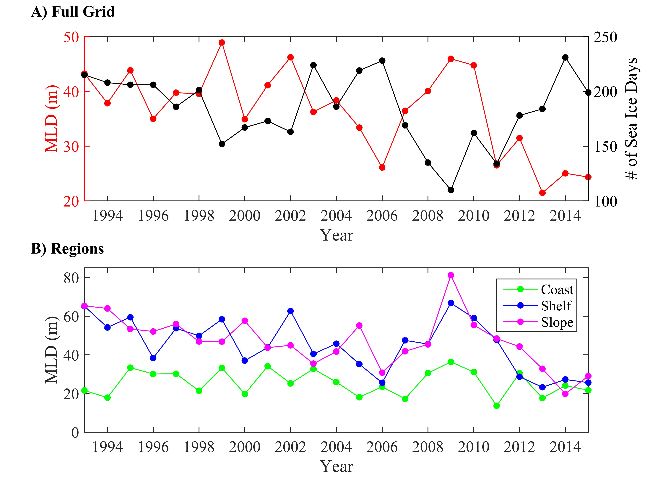
We do see a relationship between the number of sea ice days and seasonal stability of the upper ocean
Schofield et al. 2018

Slide 11
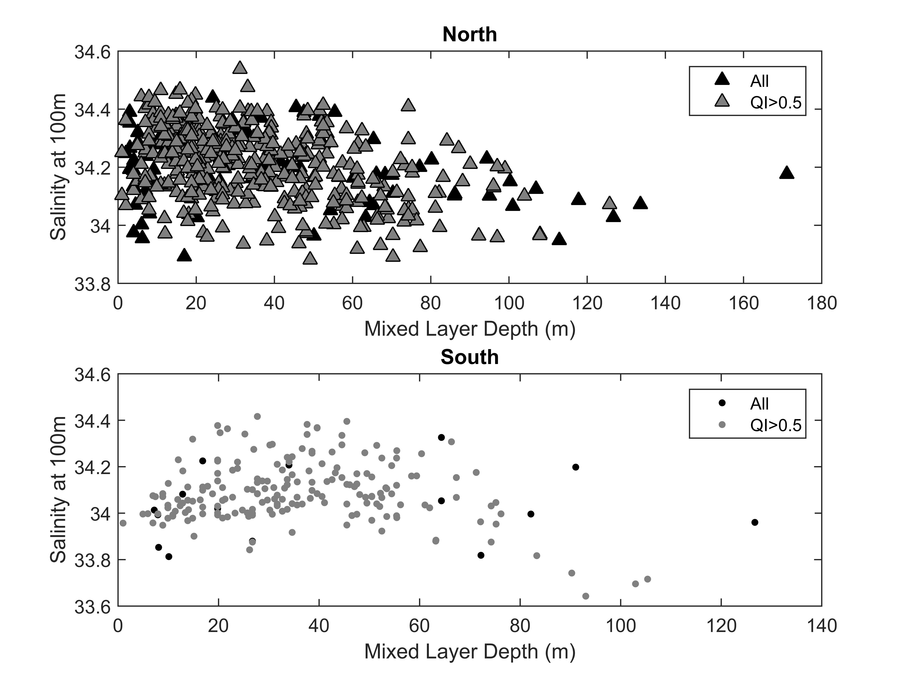
We do see a relationship between the number of sea ice days and seasonal stability of the upper ocean
Amount o f sea ice does affect the seasonal MLD upper ocean density
The upper MLD becomes fresher
Effect is largely confined to upper ocean (<100m)
Schofield et al.
2018

Slide 12
Impact on Phytoplankton?
Over decadal scales (30 years), trended changes observed in MLD in South but not in the North.
Associated with MLD increased phytoplankton in south, not on north. Significant interannaul variability superimposed over these means changes.
Montes-Hugo et al.
2009

Slide 13
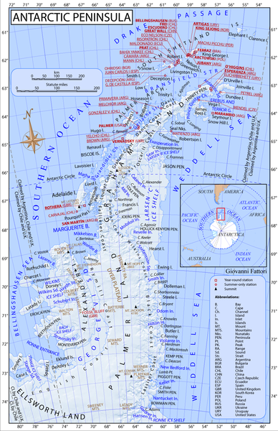
Impact on Phytoplankton?
Time Series from Land Stations across the Peninsula
(daily measurements across the Peninsula)
Kim et al. 2018
Comparison of decadal times series of chlorophyll a across the
Argentinean Base
Both north stations show increased chlorophyll since ice recovery, not in south.
US Base
UK Base

Slide 14
Rest of Food Web? Tightly Coupled Food Web & Penguin Diet Changes
High chl anomaly years result in high krill recruitment
immediately affecting penguin diet
Krill Size Distributions in Penguin Diet Samples
Saba et al (2014)

Slide 15
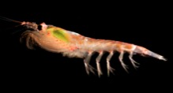
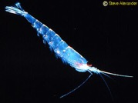
Cyclical behavior in zooplankton also observed along WAP shelf in north
With a general decrease in south.
E. superba
E. Crystallorophias
(ice-obligate)
p < 0.001
r² = 0.45
Steinberg et al. (2015)
updated

Slide 16
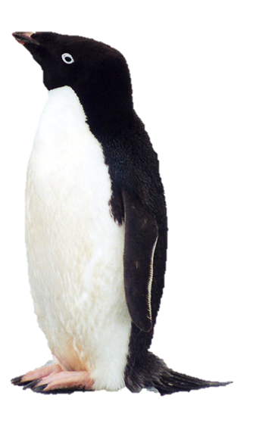
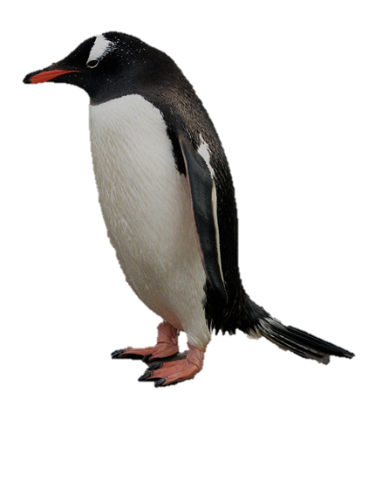
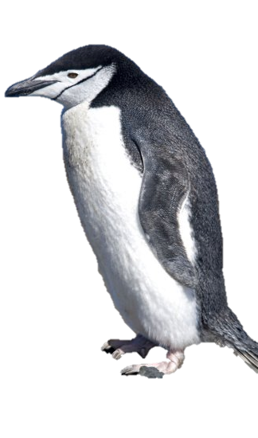
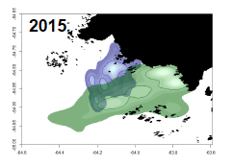
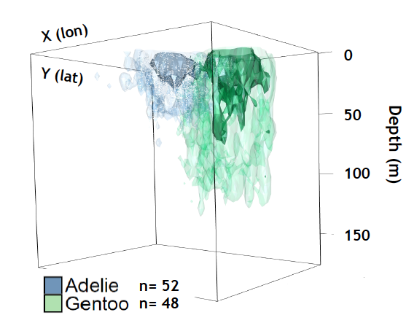
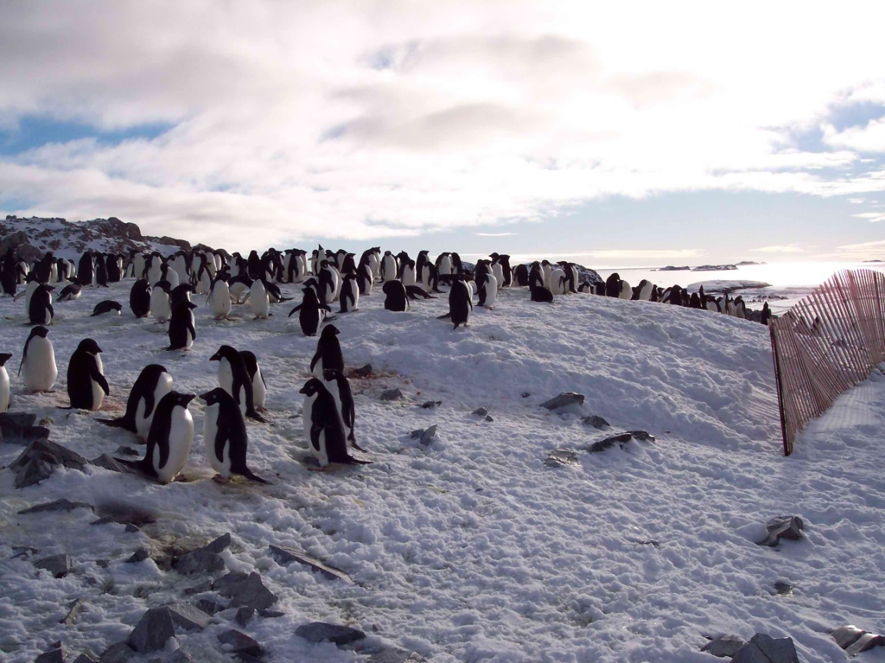
Like krill a non-uniform response in high trophic levels such as penguins
Updated Fraser et al. 1991
Different foraging strategies
(horizontal and vertical space)
Non-ocean impacts: Snow effects on chick/egg survivorship
Cimino et al. 2015
Fraser et al. 2010

Slide 17
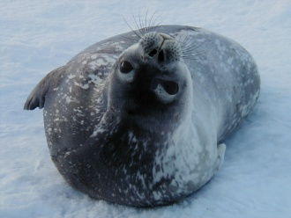
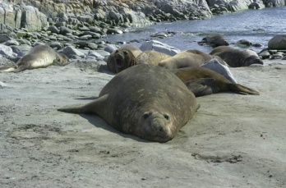
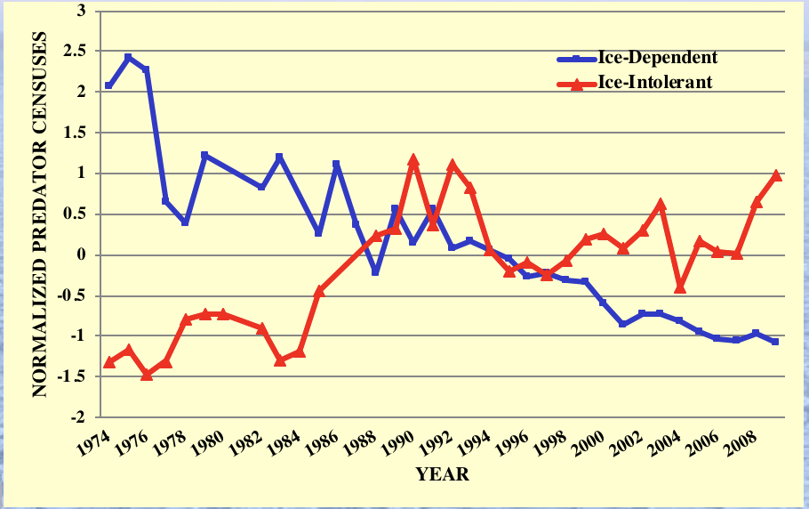
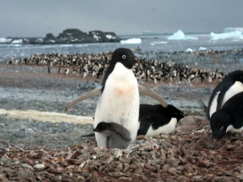
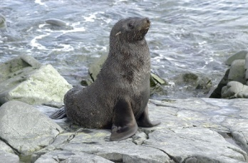
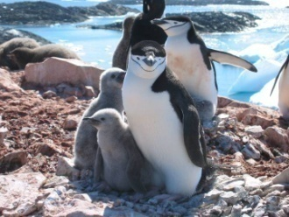
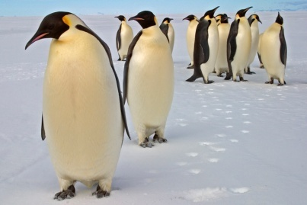
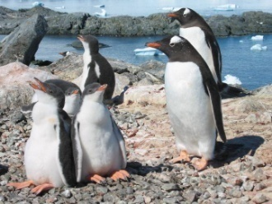
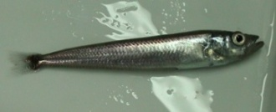
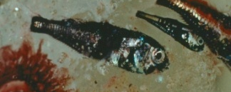
Population trends of ice-dependent versus ice-intolerant species, Anvers Island, 1974-2010.
Ice-dependent
Ice-intolerant
FUNCTIONALLY EXTINCT

Slide 18
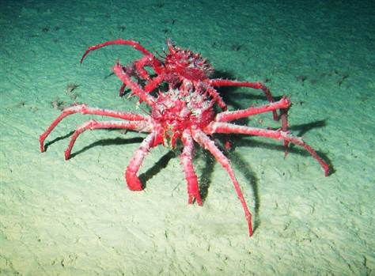
Collapsing Ice shelves?
Invasive species?
Greening continent?

Slide 19


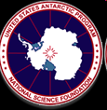

Conclusions and Looking Forward
Climate cycles are modulating the presence/absence of sea ice.
Sea ice in winter and spring modulates the MLD on shelf and slope and this affects the phytoplankton
There is a direct connection to krill (one year lag) which translates to the diets of apex predators
This relative linear process is modulated however by life processes

