Slide 1
Pathways and retention times to a biologically productive canyon on the West Antarctic Peninsula
Nicole Couto^{1,2}, Josh Kohut¹, Oscar Schofield¹, Michael Dinniman³, Jennifer Graham³
¹Rutgers University, New Brunswick, NJ
²Scripps Institution of Oceanography, La Jolla, CA
³Old Dominion University, Norfolk, VA

Slide 2
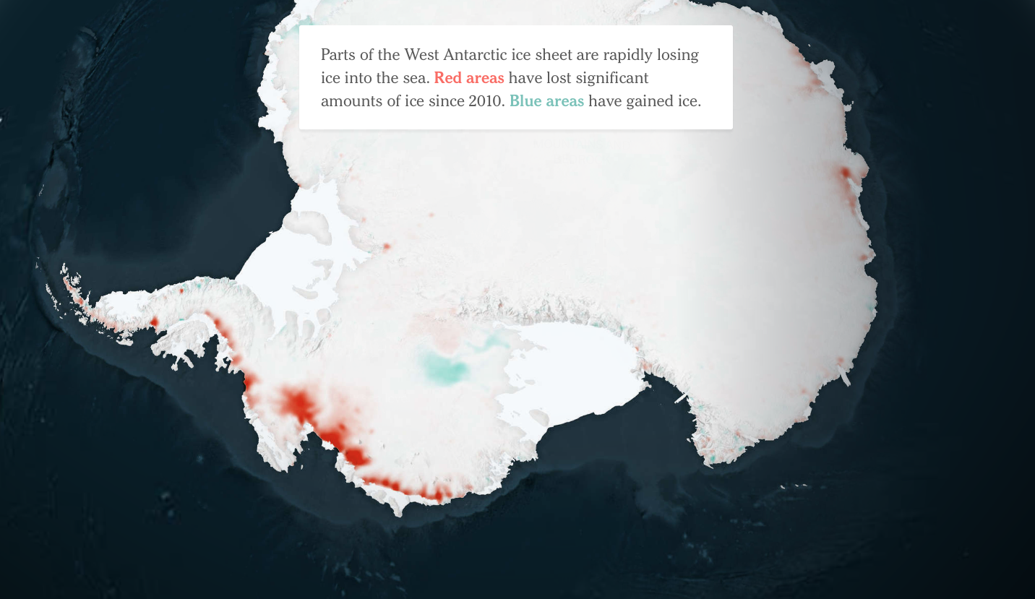
The New York Times: Antarctic Dispatches
Notes:
One of fastest warming regions of the planet. During winter, THE fastest warming region. “Average annual temperatures have risen nearly 5 degrees F since 1950 and winters have warmed 9 degrees. Sea ice now forms 4 months a year instead of 7.”
Glaciers retreating. Sea ice retreating. Ice-dependent ecosystem – krill, Adelie, minke whales. This is why we care about this region.

Slide 3
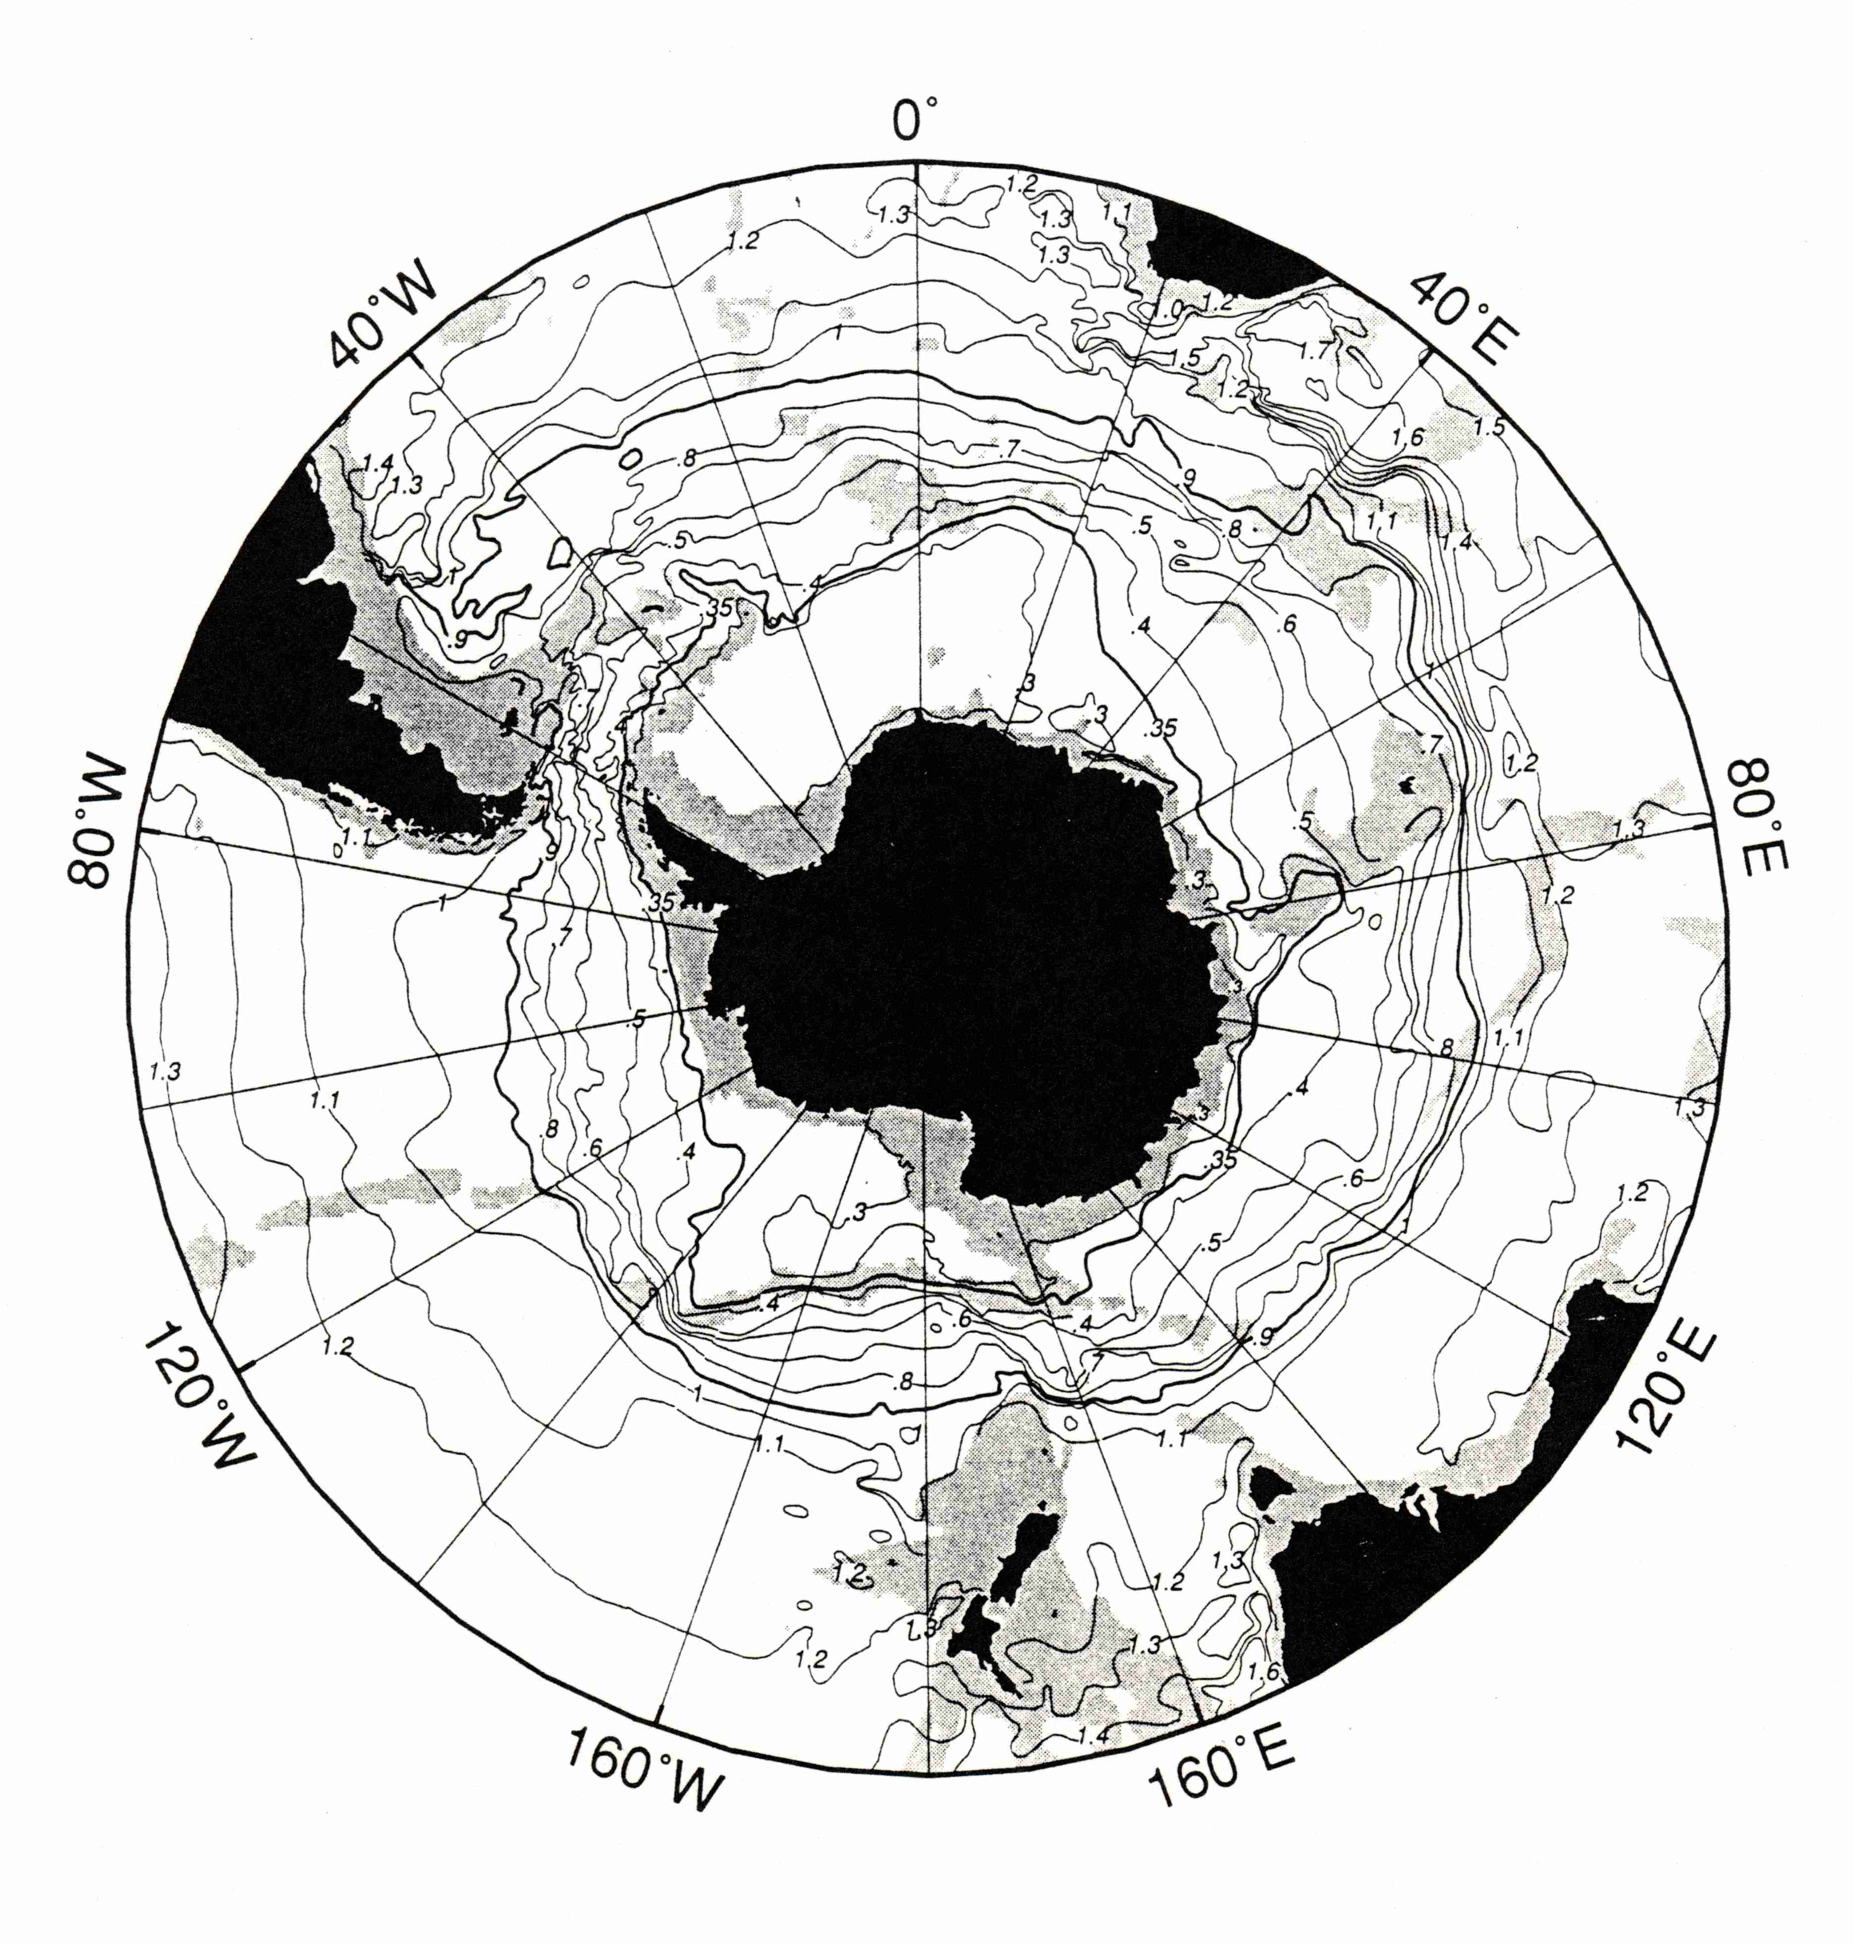
Where is the heat coming from?
ACC
UCDW
Continental
shelf
Notes:
Mar- tinson et al. (2008; hereafter MSISV08) using LTER data through 2004, show that on the WAP continental shelf, the heat content of the sub-surface water column (a 3 water mass mixture dominated by UCDW) has increased. Webb (2011) documents a 50-year warming of UCDW in the ACC as it flows past western Antarctica.

Slide 4
Where is the heat coming from?
ACC
Warming of the ocean’s deep water masses
Intensification and poleward shifting of the circumpolar winds
Notes:
Mar- tinson et al. (2008; hereafter MSISV08) using LTER data through 2004, show that on the WAP continental shelf, the heat content of the sub-surface water column (a 3 water mass mixture dominated by UCDW) has increased. Webb (2011) documents a 50-year warming of UCDW in the ACC as it flows past western Antarctica.

Slide 5
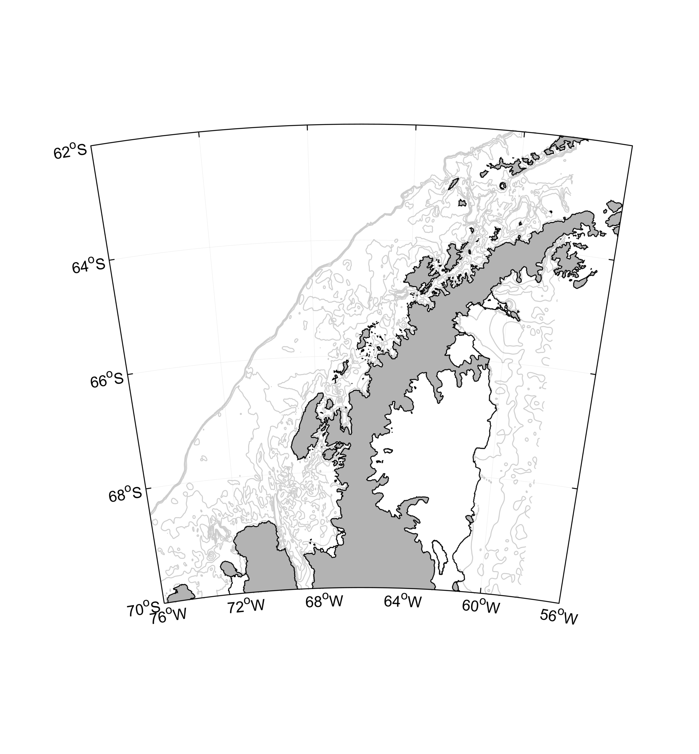
Palmer Deep
Antarctic Circumpolar Current
Palmer Deep is a “biological hotspot”
Productivity has been linked to upwelling of warm water
Ducklow 2007, Schofield 2013

Slide 6
What are the primary pathways to Palmer Deep?
What is the retention time of Palmer Deep?

Slide 7
Circulation on the WAP
Antarctic Circumpolar Current
Weddell
Sea
Hoffman 1996, Savidge and Amft 2009
Notes:
Talk about southward coastal current

Slide 8
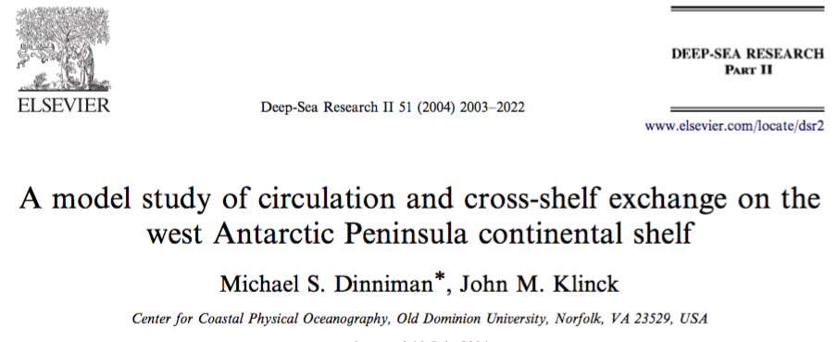
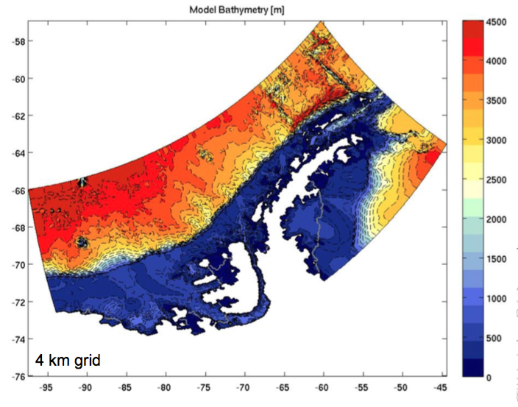

Slide 9
ROMS: Regional Ocean Modeling System
Grids produced at 4 km resolution using Bedmap2
High resolution and accurate bathymetry required to reproduce cross-shelf transfer.
Terrain following coordinates
24 levels, with resolution increased at both surface and bottom
Sea ice mechanics and thermodynamics.
Ice shelf cavity thermodynamics
Open boundaries and atmospheric forcing
No tides
Notes:
The model does not include tides so the output represents processes forced by mechanisms occurring at longer than daily time scales.

Slide 10
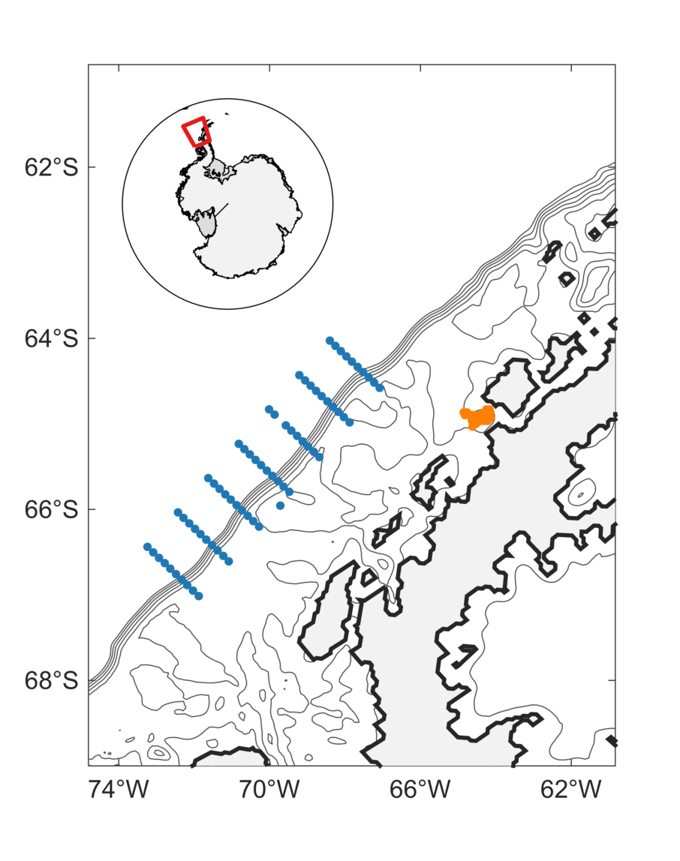
 | Shelf break | Canyon
Total # drifters | 26,460 | 12,096
# release points | 70 | 32
Depth of release (m) | 100, 200, 250, 300, 350, 400, 450, 500, 600 | 100, 200, 300, 400, 500, 600, 800, 1000, 1200
Release dates | 1 January to 27 January at 2 day intervals | 1 January to 27 January at 2 day intervals
Release years | 2007, 2008, 2009 | 2007, 2008, 2009
Palmer Deep
Marguerite Trough

Slide 11
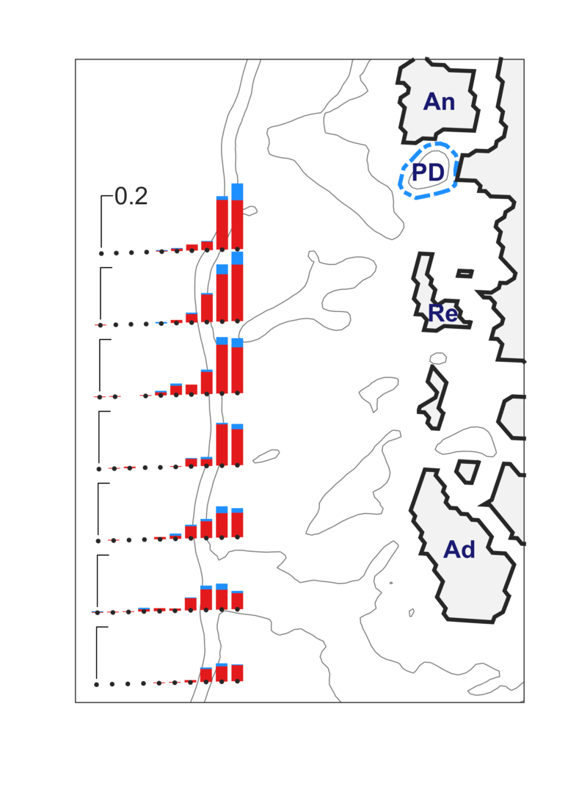
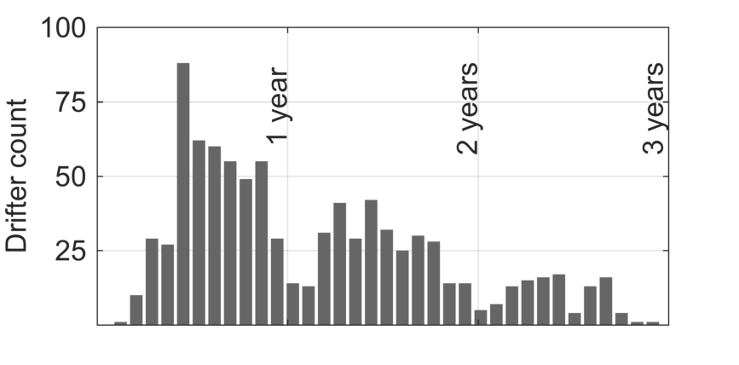
Drifters that reached Palmer Deep
% Drifters that reached Palmer Deep
% Drifters that began as UCDW and reached Palmer Deep
Jan
Jul
Jan
Jul
Jan
Jul
The majority of drifters that reached Palmer Deep were already on the shelf or shelf slope when they were released.
Most of the drifters that reached Palmer Deep were initiated within the UCDW water mass.
More drifters entered the canyon during Fall/Winter than during Spring/Summer

Slide 12
Seasonality differences in the APCC
APCC is stronger in the north during winter and stronger in the south during summer
Inputs of freshwater at the surface intensify this buoyancy-driven flow
?
Antarctic Peninsula Counter Current
?
Notes:
A possible explanation for the difference in seasonality between the APCC near Anvers and the APCC near Adelaide Island is the different effect that northerly winds have on the sea ice environment in each area. Northerly winds tend to push sea ice away from the northern part of the WAP toward the south where ice accumulates and melts [Stammerjohn et al., 2008b; Meredith et al., 2017]. Surface layer salinity decreases from north to south [Meredith et al., 2017] with the highest freshwater content in the WAP surface waters found in Marguerite Bay [Stammerjohn et al., 2008a]. The opening of the surface ocean in the north exposes it to wind forcing, leading to a more wind-driven flow and weakening the net effect of the APCC in the north. In the south, the increased volume of freshwater at the surface strengthens the buoyant plume that supports the APCC.
80Southward currents at Station E at the end of the deployment are consistent with northerly wind forcing.

Slide 13
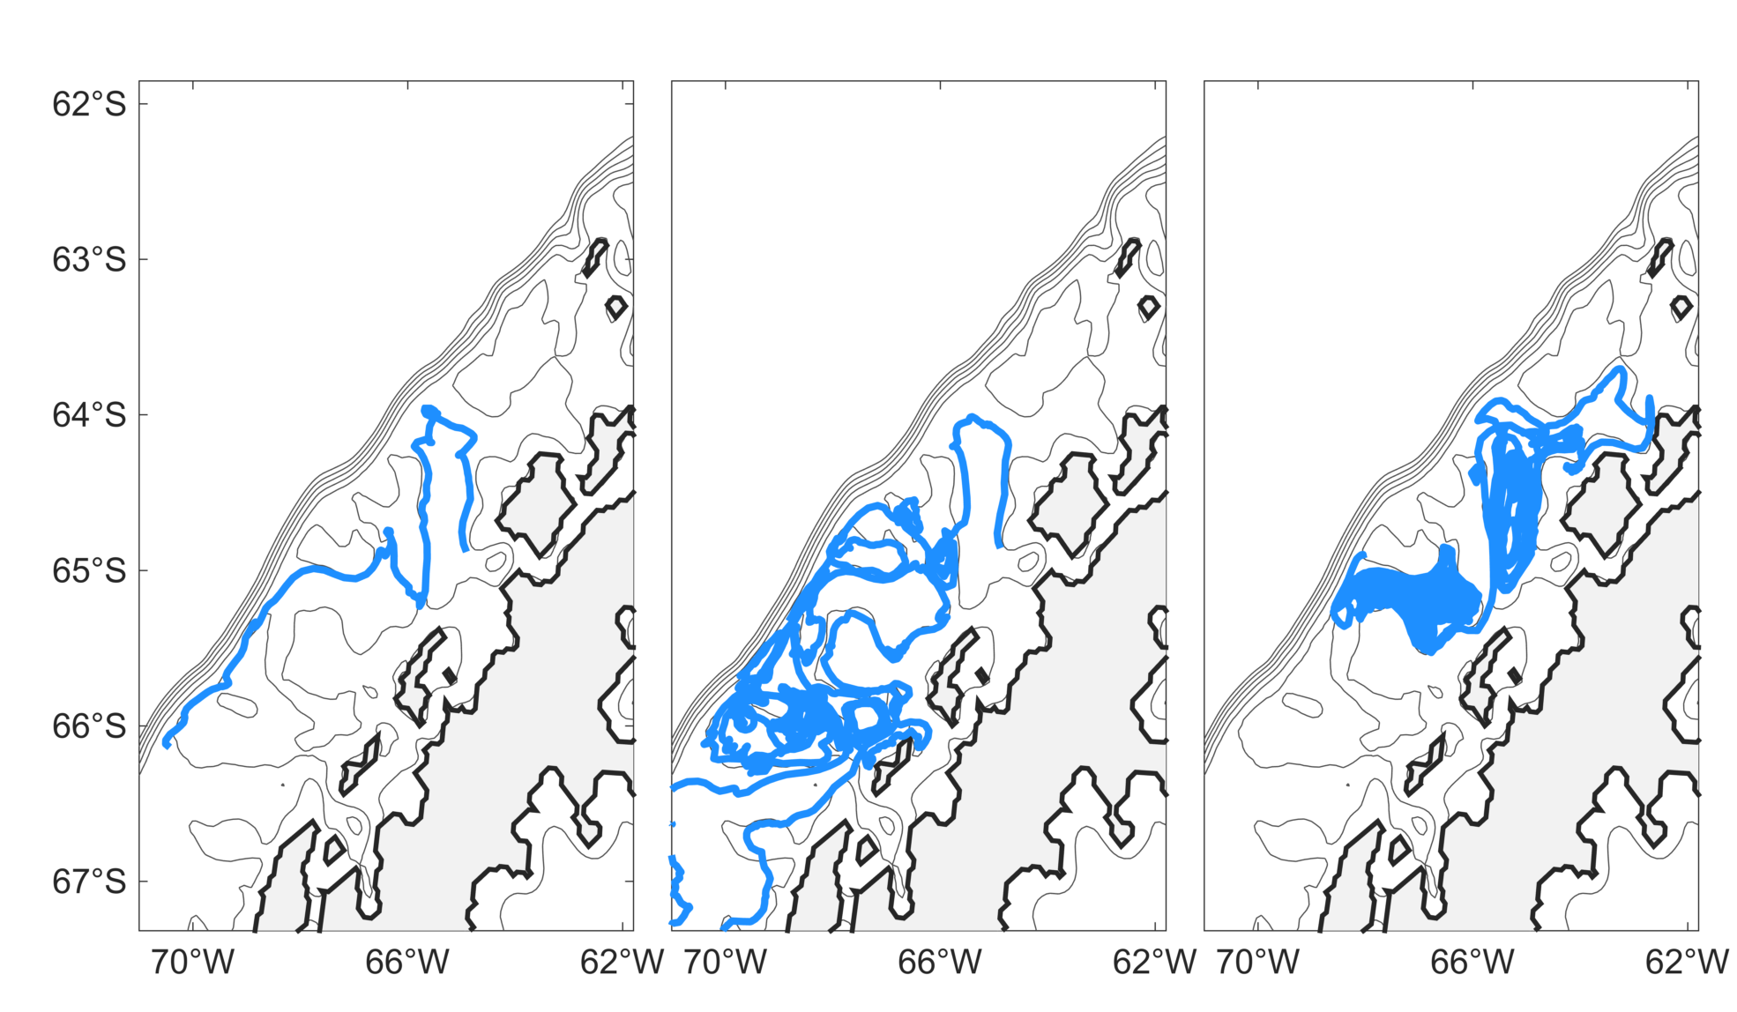
Pathways to Palmer Deep

Slide 14
Circulation on the WAP
Most are already on the shelf break and get pulled in at one of the troughs
Often retained in cyclonic gyres within the troughs
Time spent circling troughs did not affect water properties upon entry to Palmer Deep
Antarctic Circumpolar Current
Weddell
Sea

Slide 15
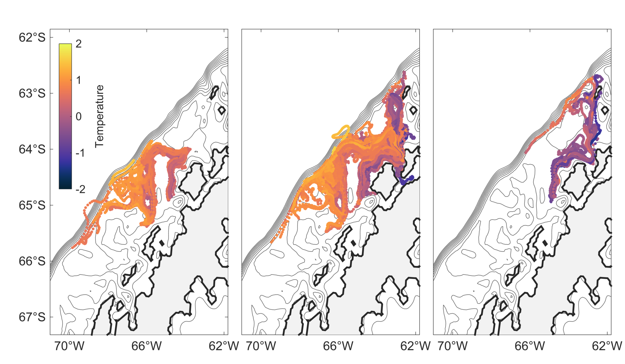
Modification of UCDW

Slide 16
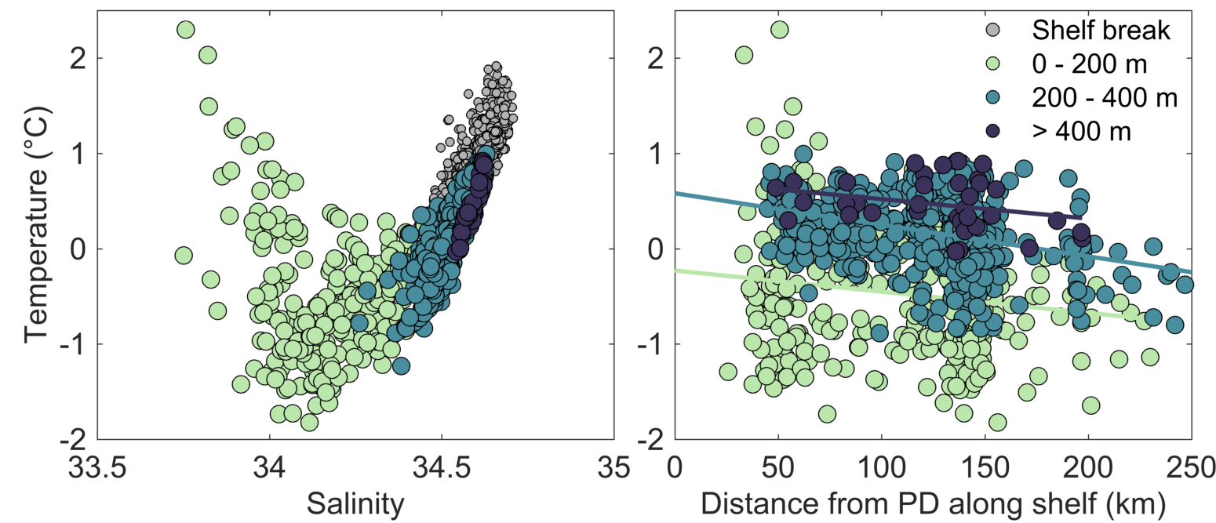
Modification of UCDW
Notes:
Water properties were affected by the depth at which drifters entered the canyon and the distance they had traveled northeastward on the peninsula

Slide 17
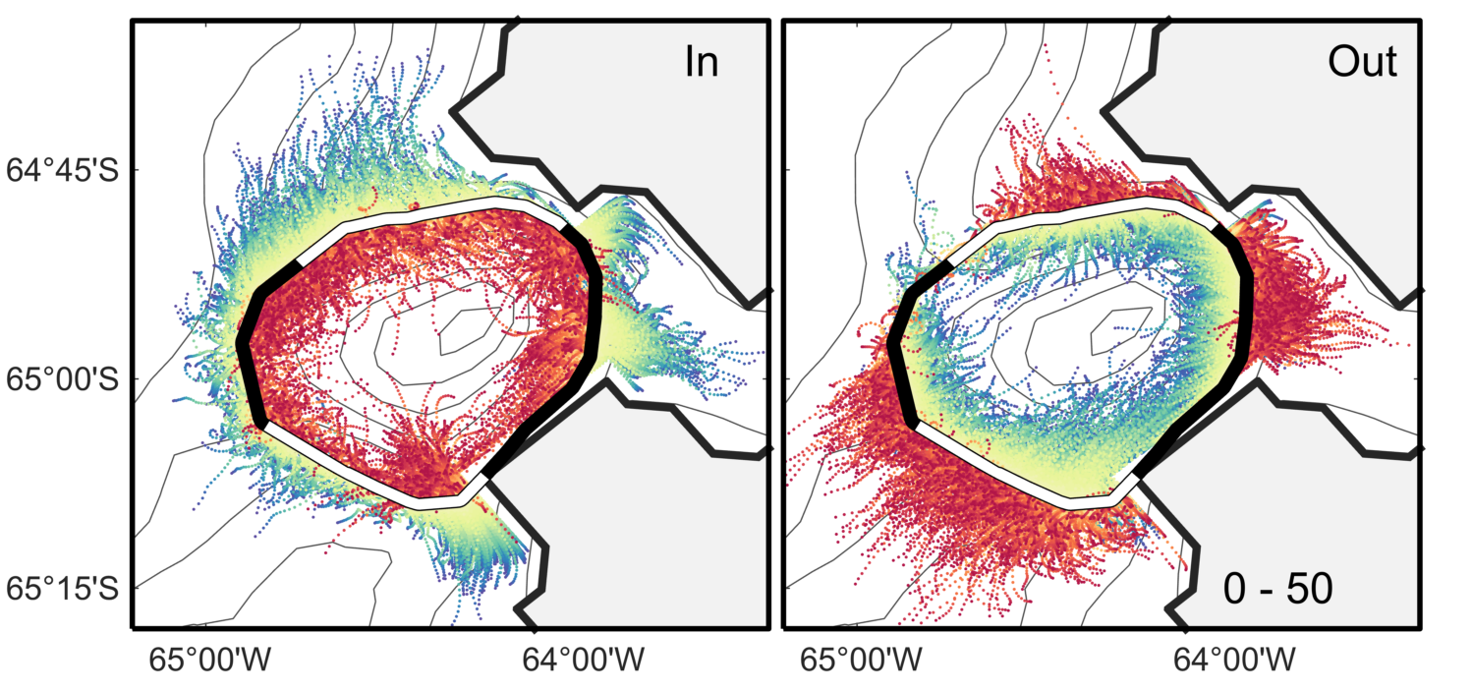
Drifters entering and exiting the canyon (surface)

Slide 18
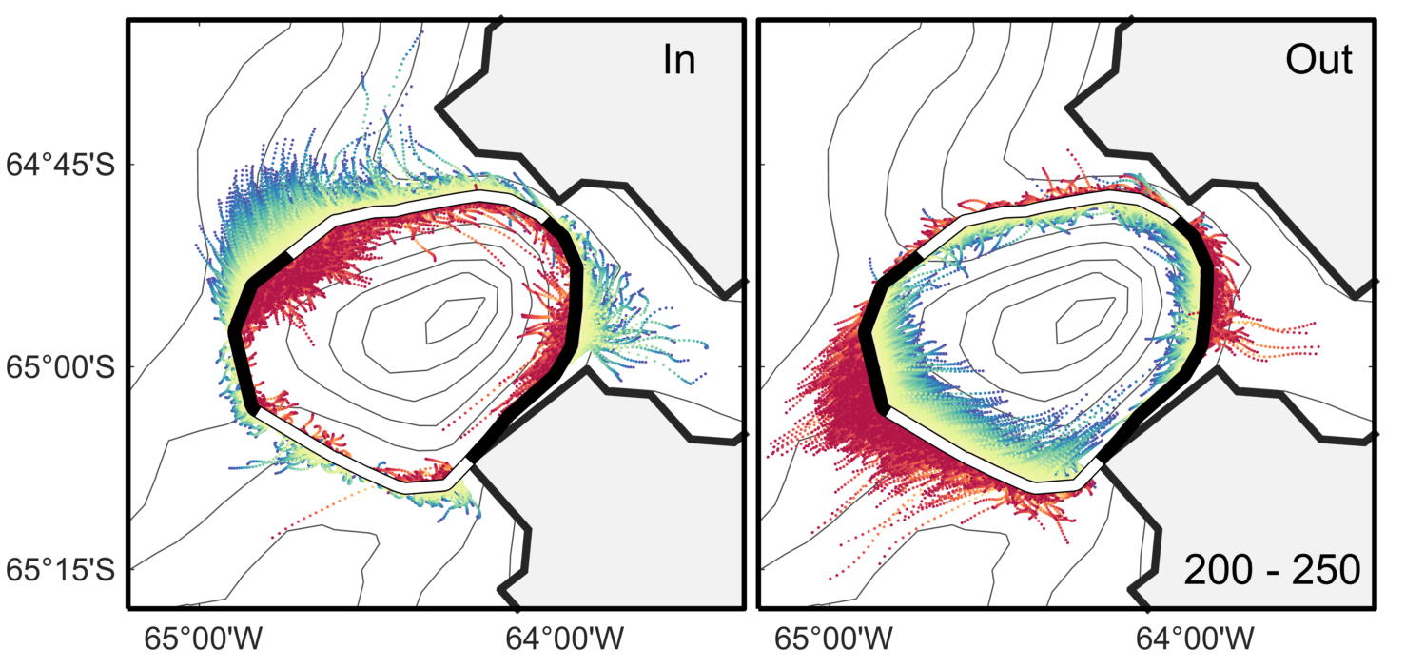
Drifters entering and exiting the canyon (mid-depth)

Slide 19
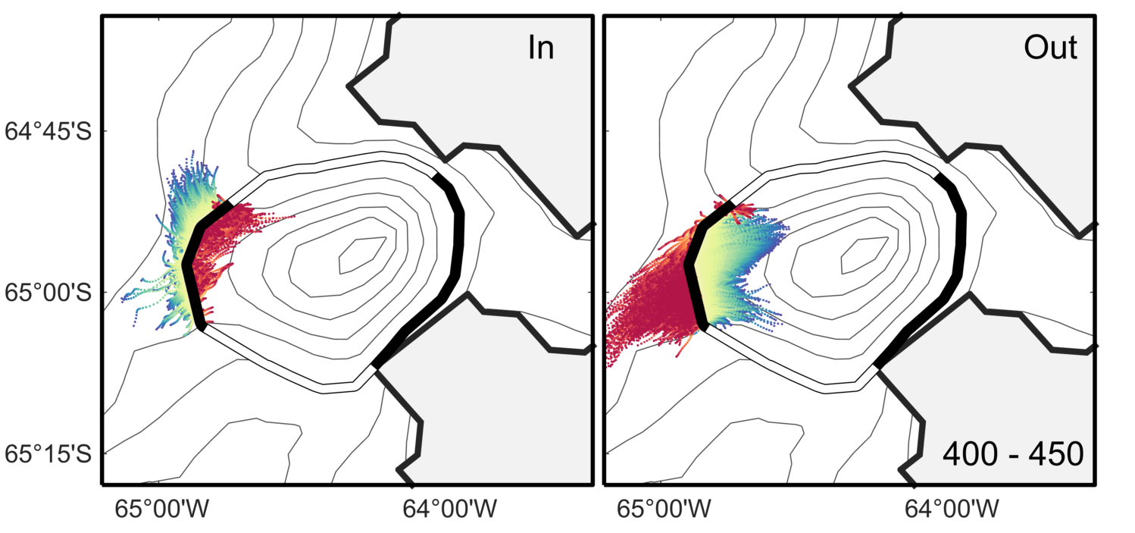
Drifters entering and exiting the canyon (deep)

Slide 20
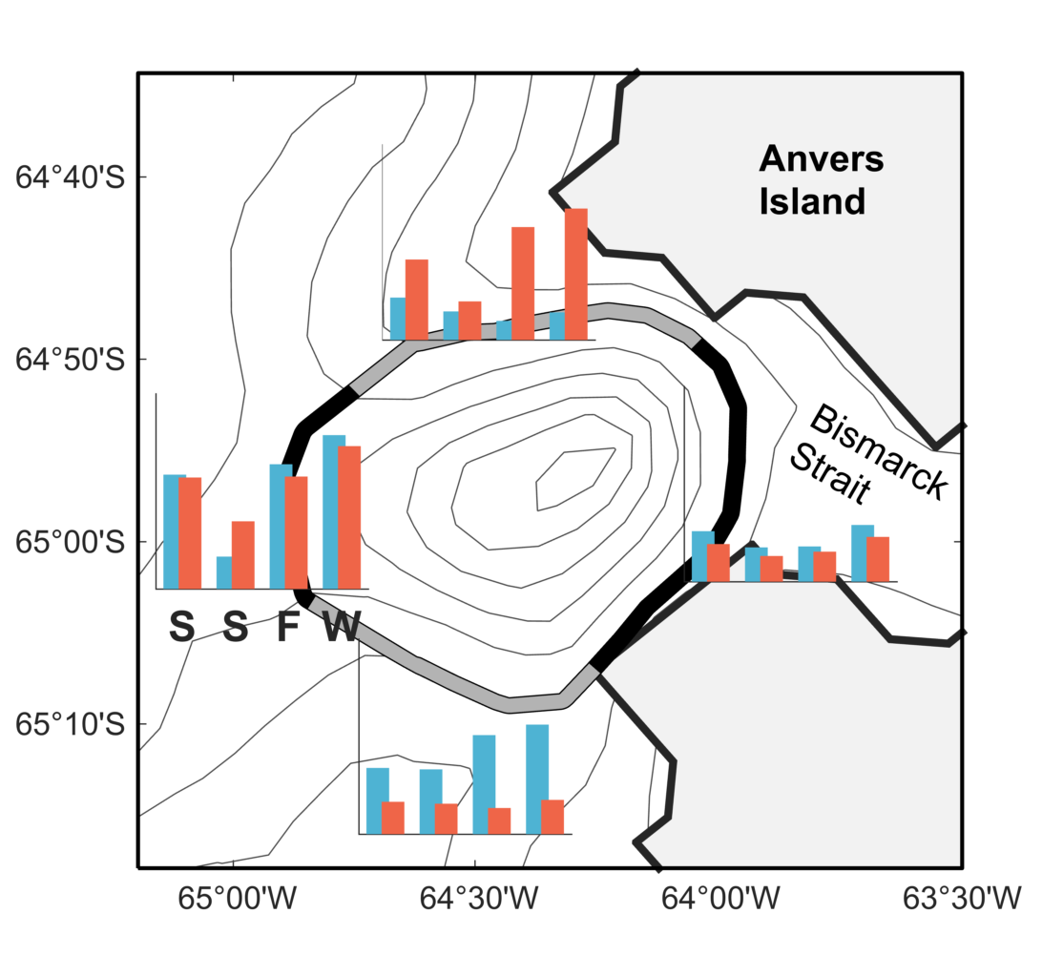
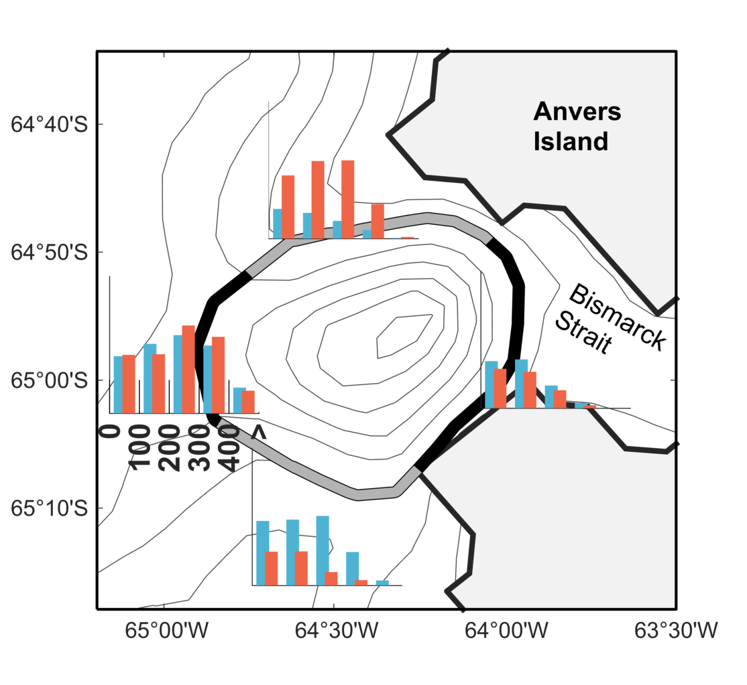
Drifters entering and exiting the canyon (from shelf)
Binned by season
Binned by depth
Enter
Enter
Exit
Exit
Notes:
Mouth of the canon is important entry/exit gate, especially at depth. North is entry. South is exit. More entry in the north during fall/winter.
Why are fewer coming during summer?

Slide 21
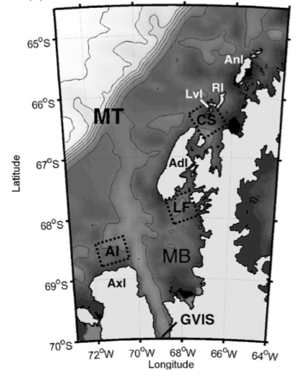
Calculating retention time – Method 1
Retention times at three biological hotspots farther south along the WAP were 18-35 days.
This time period is sufficient to accumulate phytoplankton biomass and promote zooplankton population growth.
Piñones 2011, Genin 2004

Slide 22
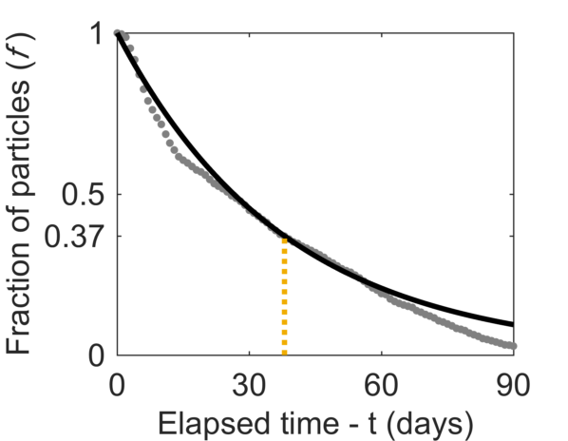
Calculating retention time – Method 1
T
Determine the time it takes for the fraction of drifters remaining to be reduced to 0.3679 (e-folding time scale) of the original number.
T
Piñones 2011

Slide 23
Calculating retention time – Method 2
Follow each drifter from when it enters the canyon to when it exits

Slide 24
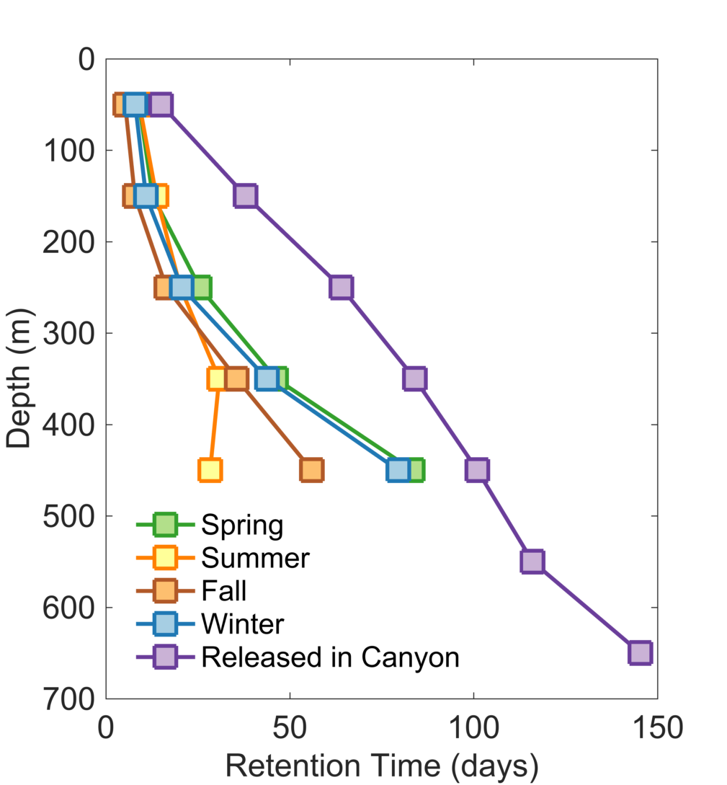
Palmer Deep retention time

Slide 25
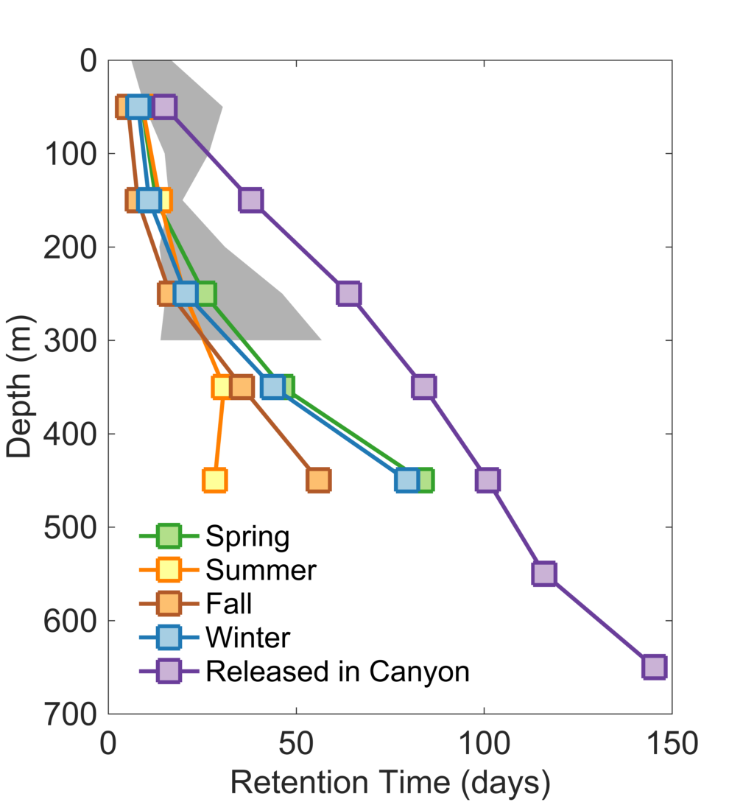
Palmer Deep retention time
Range of summer retention times

Slide 26
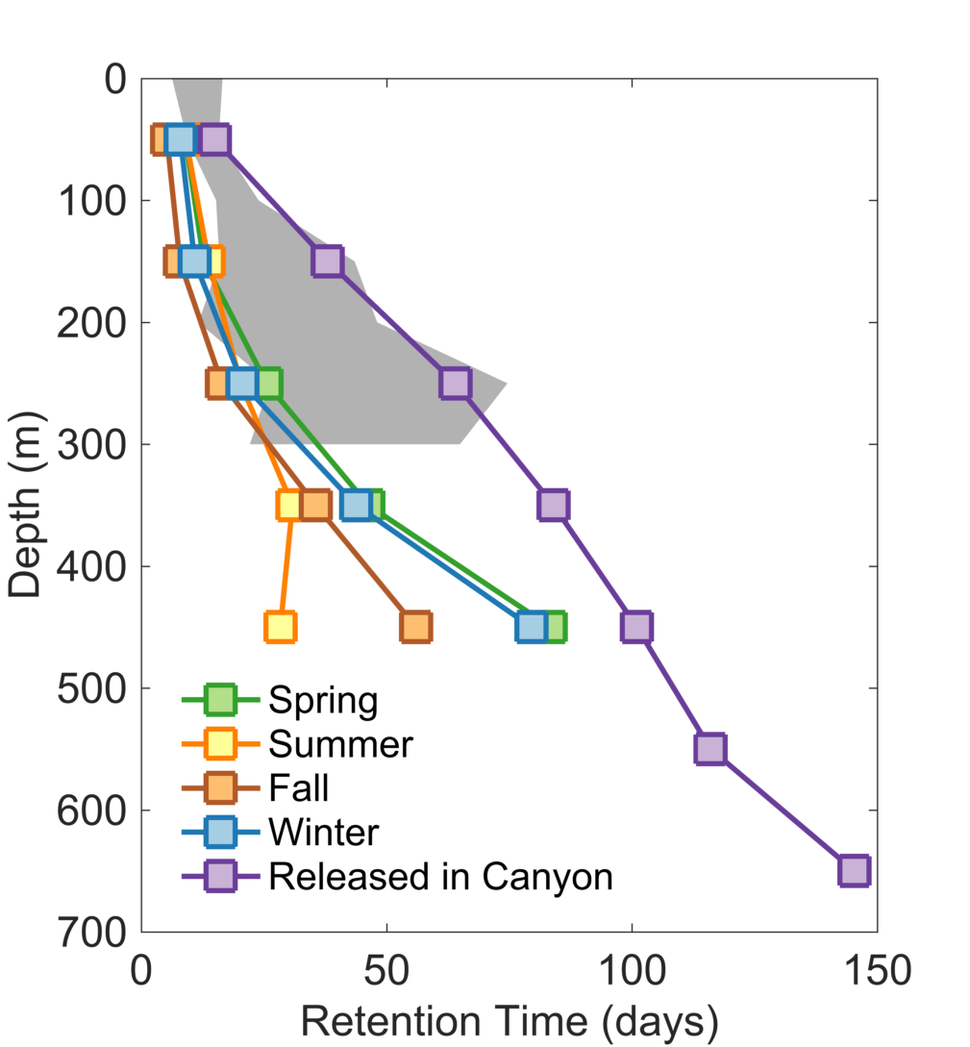
Palmer Deep retention time
Range of winter retention times

Slide 27
Conclusions
UCDW that reaches the Palmer Deep crosses the shelf break south of Marguerite Trough.
Several shelf-incising troughs support cyclonic gyres that can trap particles.
Interaction with Bransfield Strait waters significantly decreases the temperature of water entering Palmer Deep.
Retention time of Palmer Deep is similar to other biological hotspots in the region

