Slide 1
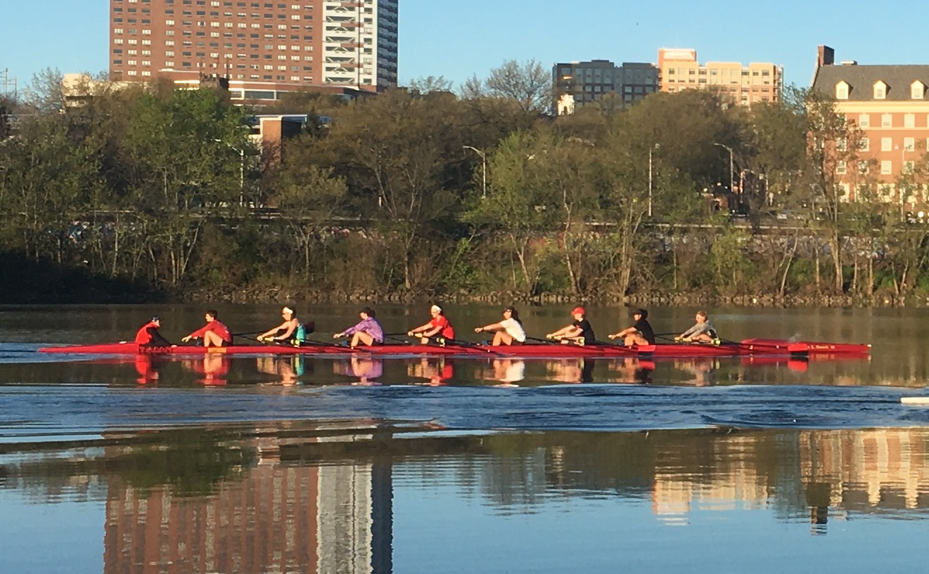
Rutgers Raritan River Initiatives
Sustainable Raritan River Initiative (SRRI)
Rutgers Raritan River Consortium (R3C)
Johnson Family Chair in Water Resources & Watershed Ecology
Notes:
Rutgers initiatives involved in Raritan-related efforts include
the Sustainable Raritan River Initiative
Rutgers Raritan River Consortium, and
the Johnson Family Chair in Water Resources and Watershed Ecology
Together these three initiatives engage and train the Raritan stewards of tomorrow, facilitate multidisciplinary research and expand the university's engagement with external partners.
They also better integrate Rutgers' science and research into regional planning and decision making, while establishing partnerships to help build a more sustainable Raritan River, basin, and bay.
Going to talk about the first two of these today
First, a little bit about the area we work in.

Slide 2
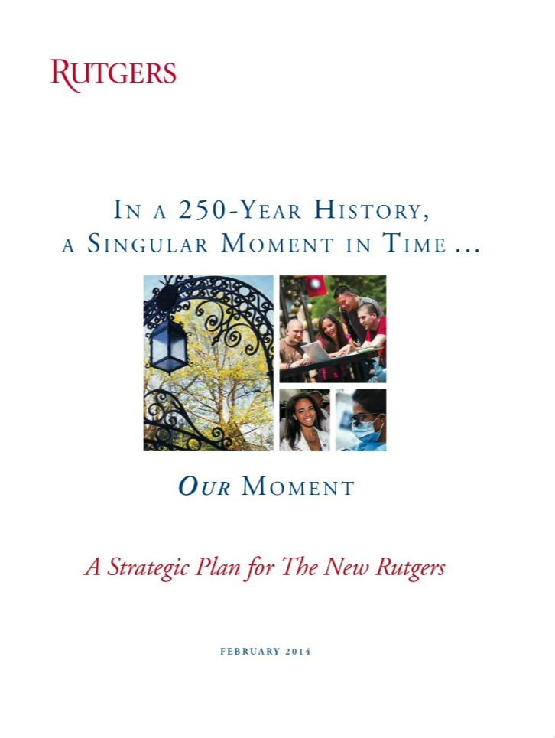
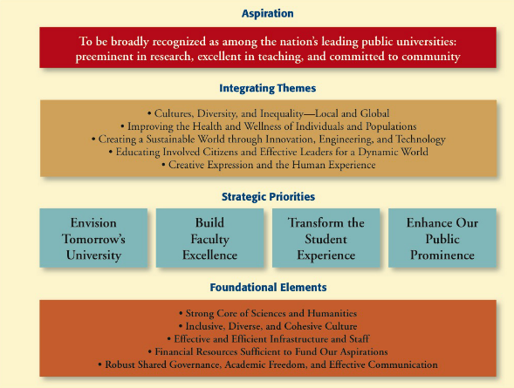
Rutgers Raritan River Consortium
Rutgers self study suggests paths to improve and we believe that the Raritan will be an important part of the solution
The strategic priorities for the University will all be met in some form by transforming the Raritan to focal point for the University
Notes:
In 2014, Rutgers University a new Strategic Plan, a five-year roadmap for excellence written for Rutgers, by Rutgers. This plan sets a clear aspiration (read from slide). We believe that the Raritan will be an important part of achieving this vision. In fact, if you look at the four strategic priorities, they can all be met in some form by transforming the Raritan into a focal point for the University.

Slide 3
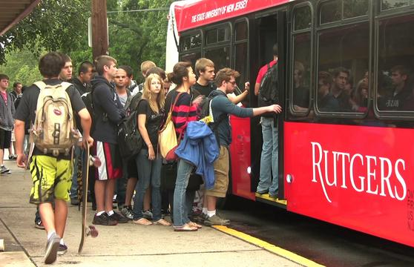

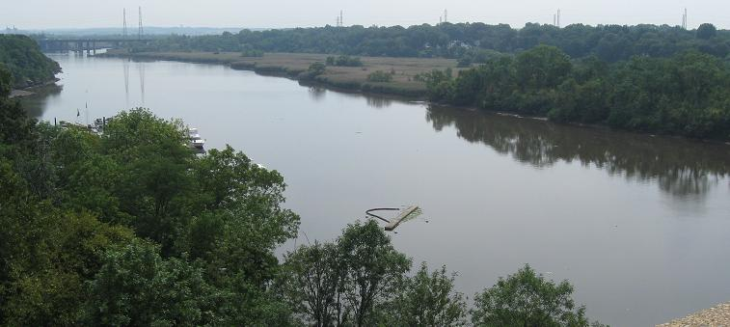
Strategic Priority: Transform the Student Experience
Rutgers Raritan River Consortium
Student’s current view of the river
Notes:
The plan cites a renewed focus on the student experience. Right now, most Rutgers Students perceive the river as a barrier that makes it hard to get between campuses One way to enhance the student experience is to create a stronger connection to the Raritan. In doing so, it provides them with a better sense of their local environment and how it fits into the larger world. It also allows students to see first hand and apply the concepts that are addressed in their courses. These hands-on experiences have also been shownto increase student research skills and feelings of self-efficacy, and retention.

Slide 4
The Raritan is a unique laboratory available to Rutgers
Raritan represents a unique watershed with almost a century of urbanization
(Richard J. Walsh, Save the Raritan, Queen of Rivers, 1928)
Images courtesy of Dr. John Reinfelder

Slide 5
Rutgers Raritan River Consortium - Mission
to utilize Rutgers’ proximity to the Raritan to inform university-based education, research and scholarship, and
to apply our efforts, in collaboration with Raritan partners, to advance improvements in regional planning, policy and decision-making that positively affect the ecology and economy of the Raritan region
Notes:
Recognize the critical value of the Raritan and its environs to the social, economic and ecological integrity of the region that Rutgers calls home.
Mission is to…..utilize Rutgers’ proximity to the Raritan to inform university-based education research and scholarship, and
To apply our efforts, in collaboration with Raritan Partners, to advance improvements in regional planning, policy and decision-making that positively affect the ecology and economy of the Raritan region
By facilitating collaboration among Rutgers faculty, staff and students and engaging the greater Raritan community of businesses, municipalities, NGOs and other Raritan stakeholders, we will bring the university’s resources to bear to address concerns for the Raritan.

Slide 6
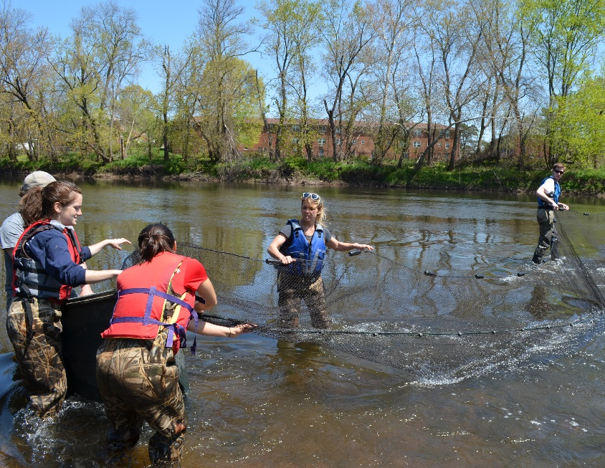
Rutgers Raritan River Consortium
Edward J. Bloustein School of Planning and Public Policy
School of Environmental & Biological Sciences
School of Arts and Sciences
School of Engineering
Mason Gross School of the Arts
Recreation
Facilities & Capital Planning
… and growing
Notes:
The R3C is comprised of multiple schools, programs and departments of Rutgers
joined together to develop and leverage resources and capabilities to advance university-based educational programming and research as well as improvements in planning, policy and decision-making for a more sustainable Raritan.
We are organized as a “virtual” network throughout the university and are
guided by a small steering committee of faculty and staff from different departments and schools on the New Brunswick-Piscataway campus.
The steering committee is also guided by external stakeholders – many of the people I work with on the SRRI that I just spoke about -- that help the R3C address issues of sustainability for the Raritan while advancing the goals of the university’s Strategic Plan.

Slide 7
Building Faculty Excellence
The Raritan is a unique laboratory available to Rutgers
It represents a unique integrator of environmental forcing between terrestrial, aquatic (fresh and marine), and human influences. This provides a unique environment for many interdisciplinary problems, How has is the river changed? Have conditions improved? How will it change in the future? How can we use the river to spawn many interdisciplinary projects?
Dissolved oxygen in the Raritan River estuary June 1949
(x 1.36 = mg/L)
(Ketchum et al., 1952)
O₂ (mg/L)
(Chant, pers. comm.)

Slide 8
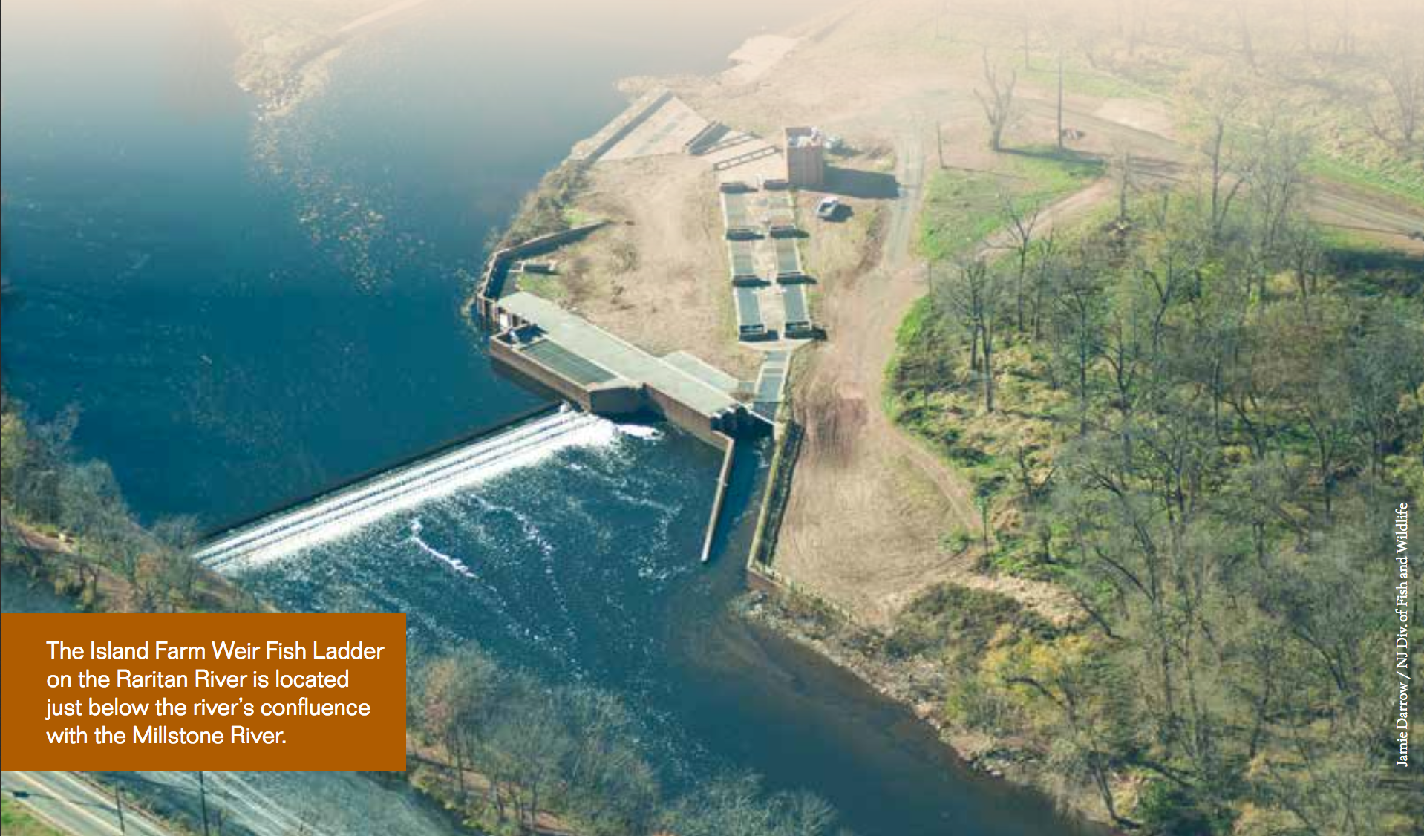

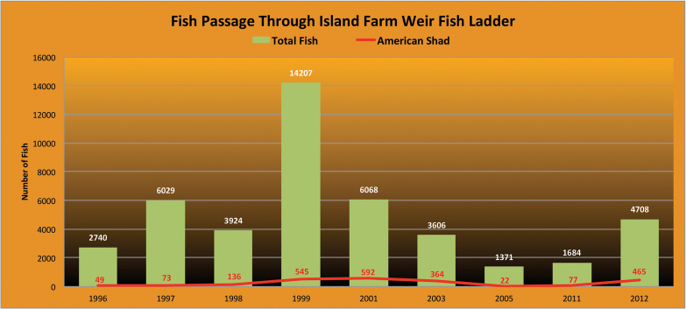
The Raritan is a unique laboratory available to Rutgers
How are current policy and regulations impacting the the watershed and river? Can we provide quantitative metrics and models that will enable development of assessment and management efficacy tools? How will the river to spawn many interdisciplinary projects?

Slide 9
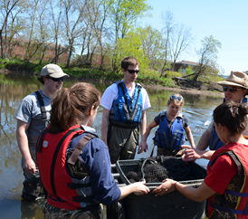
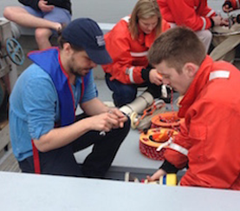
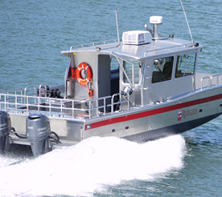
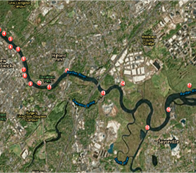
Rutgers Raritan River Consortium - Focus
Key areas of focus
  Student Engagement
  Raritan Research
  Access to the River
  Access to Data
Notes:
Inspired by Rutgers New Brunswick Strategic Plan, and the Chancellors’ vision for Rutgers to become a better steward of the Raritan, the R3C is focused on enhancing the student experience, promoting and facilitating research on Raritan issues, facilitating access to the Raritan, and helping to provide open access to data about the Raritan and its resources.
Student Engagement - Rutgers students often perceive the Raritan River as a barrier that makes it hard to get between campuses. The R3C enhances the student experience by creating a stronger connection to the Raritan. We are transforming the Raritan Basin into an academic solution, an interactive field laboratory linking science, engineering, and humanities programs through interdisciplinary classes, projects and activities. Ultimately, these experiences give students a better sense of their local environment and how it fits into the larger world.
Raritan Research - The Raritan Basin is a unique laboratory, ripe with opportunities for interdisciplinary and trans-disciplinary research. The basin, the largest contained within New Jersey, is home to 1.5 million people and to Rutgers University. The headwaters in the Highlands are largely unpolluted and contain major drinking water reservoirs, while industrial development in the lower basin has left a legacy of Superfund sites and brownfields within a few miles of the river. The R3C connects faculty, staff, students, and Raritan stakeholders to facilitate collaboration on research that will inform planning, policy and decision-making to protect and preserve the Raritan’s valuable assets.
Access to the Raritan - The R3C connects students to the local environment and facilitates the study of the evolving status of the Raritan River through access to the River. Rutgers’ 20 passenger landing craft, the R/V Rutgers, can navigate the lower Raritan River and estuary. Operated by the Department of Marine and Coastal Sciences, the R/V Rutgers provides the opportunity to experience the Raritan ecosystem firsthand and to participate in authentic research and data collection. Moreover, the R3C is partnering with Rutgers Recreation to explore opportunities to combine recreation with scientific research.
Access to Data - In addition to facilitating collection of data, the R3C also explores ways for this data to be shared more broadly through online resources. While onboard the R/V Rutgers, students, researchers and other stakeholders routinely collect data on temperature, salinity, pH, dissolved oxygen, backscatter, and fluorescence within the water column. This cruise data is complemented by a real time water quality monitoring station deployed off the Rutgers boathouse. This information, along with other related data, has been integrated and made available through an open access data portal.

