Slide 1
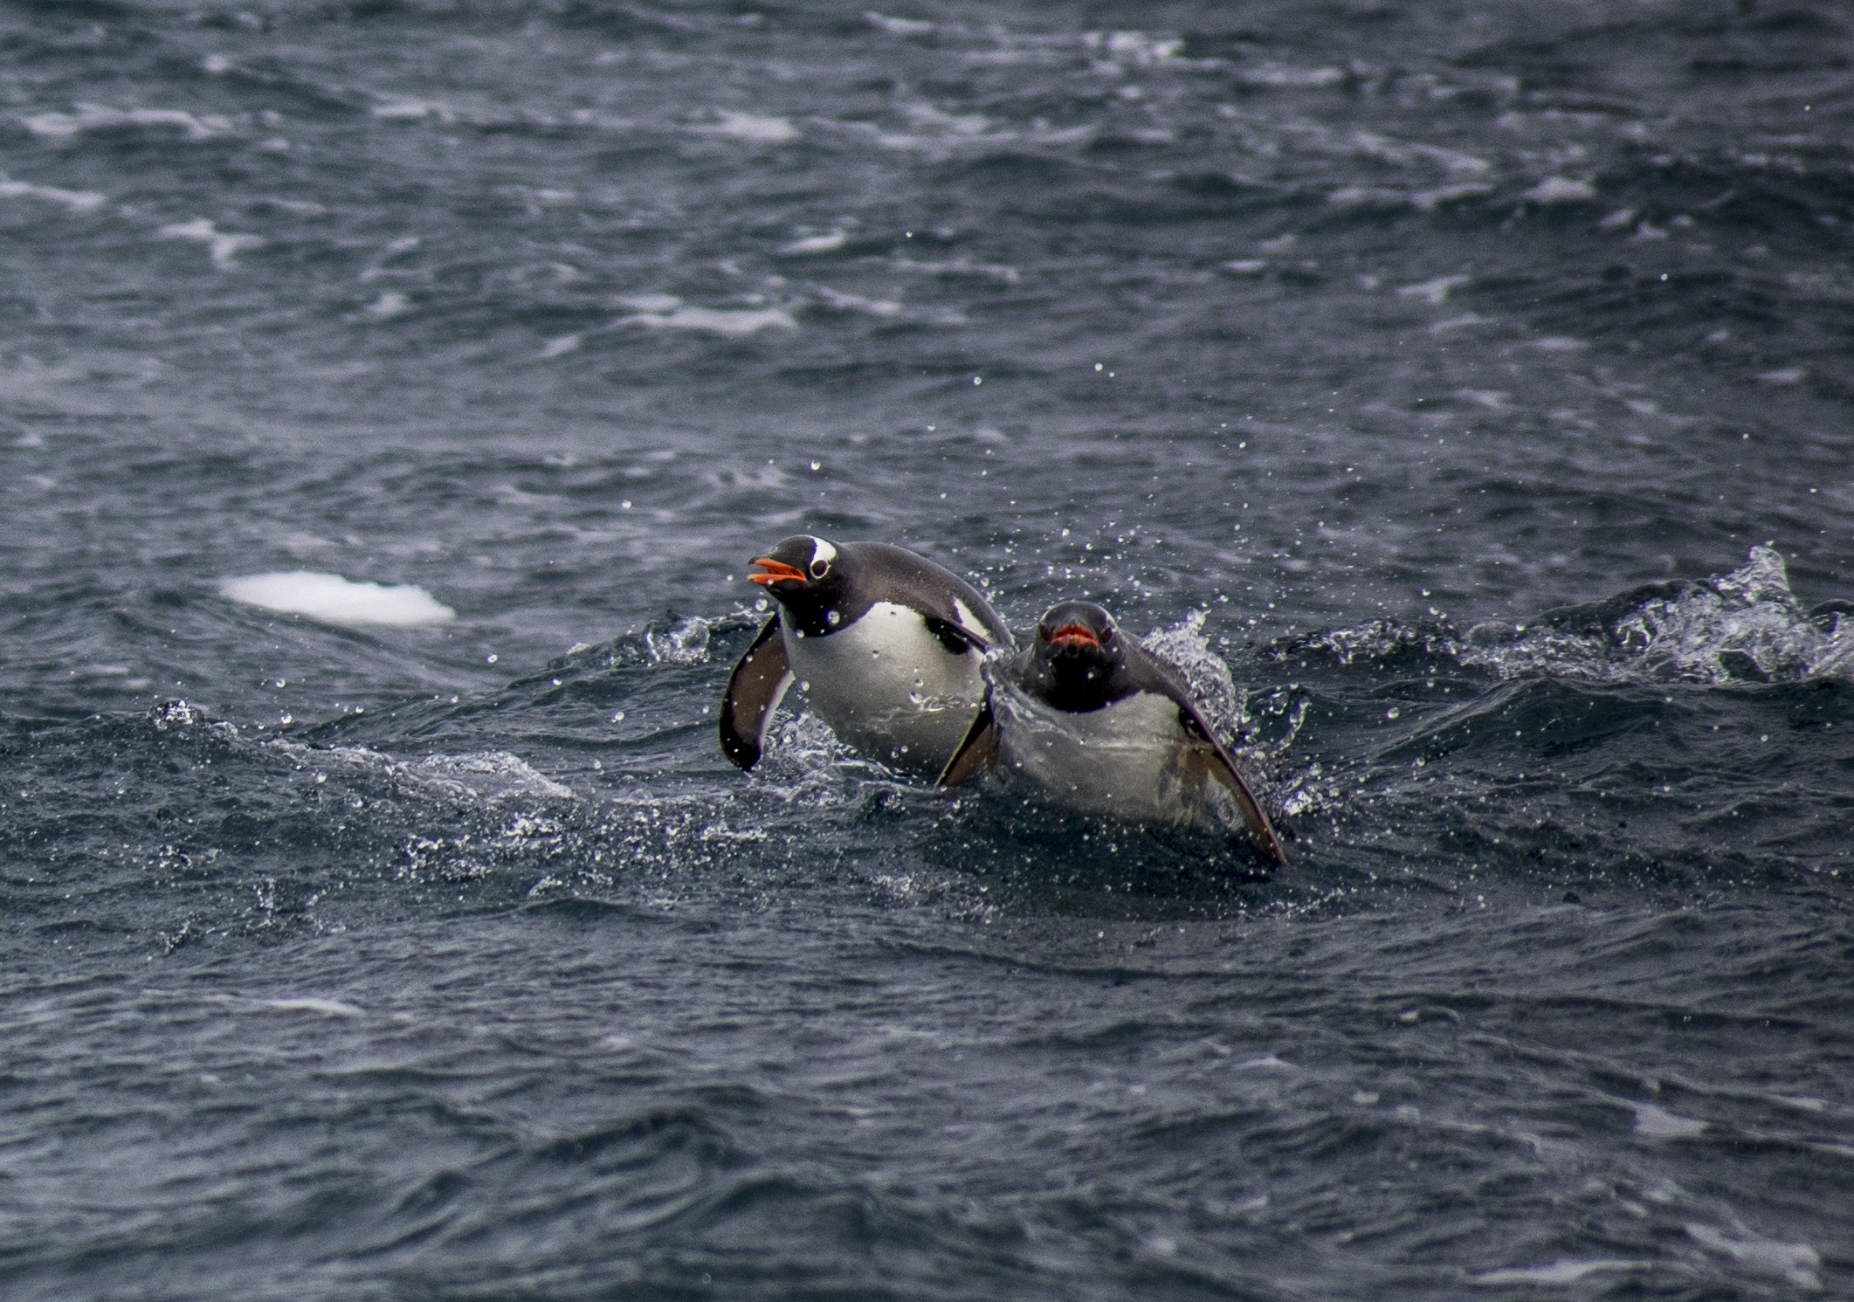


Palmer LTER: A dynamic changing system
Some themes that may have commonalities with other marine sites

Slide 2
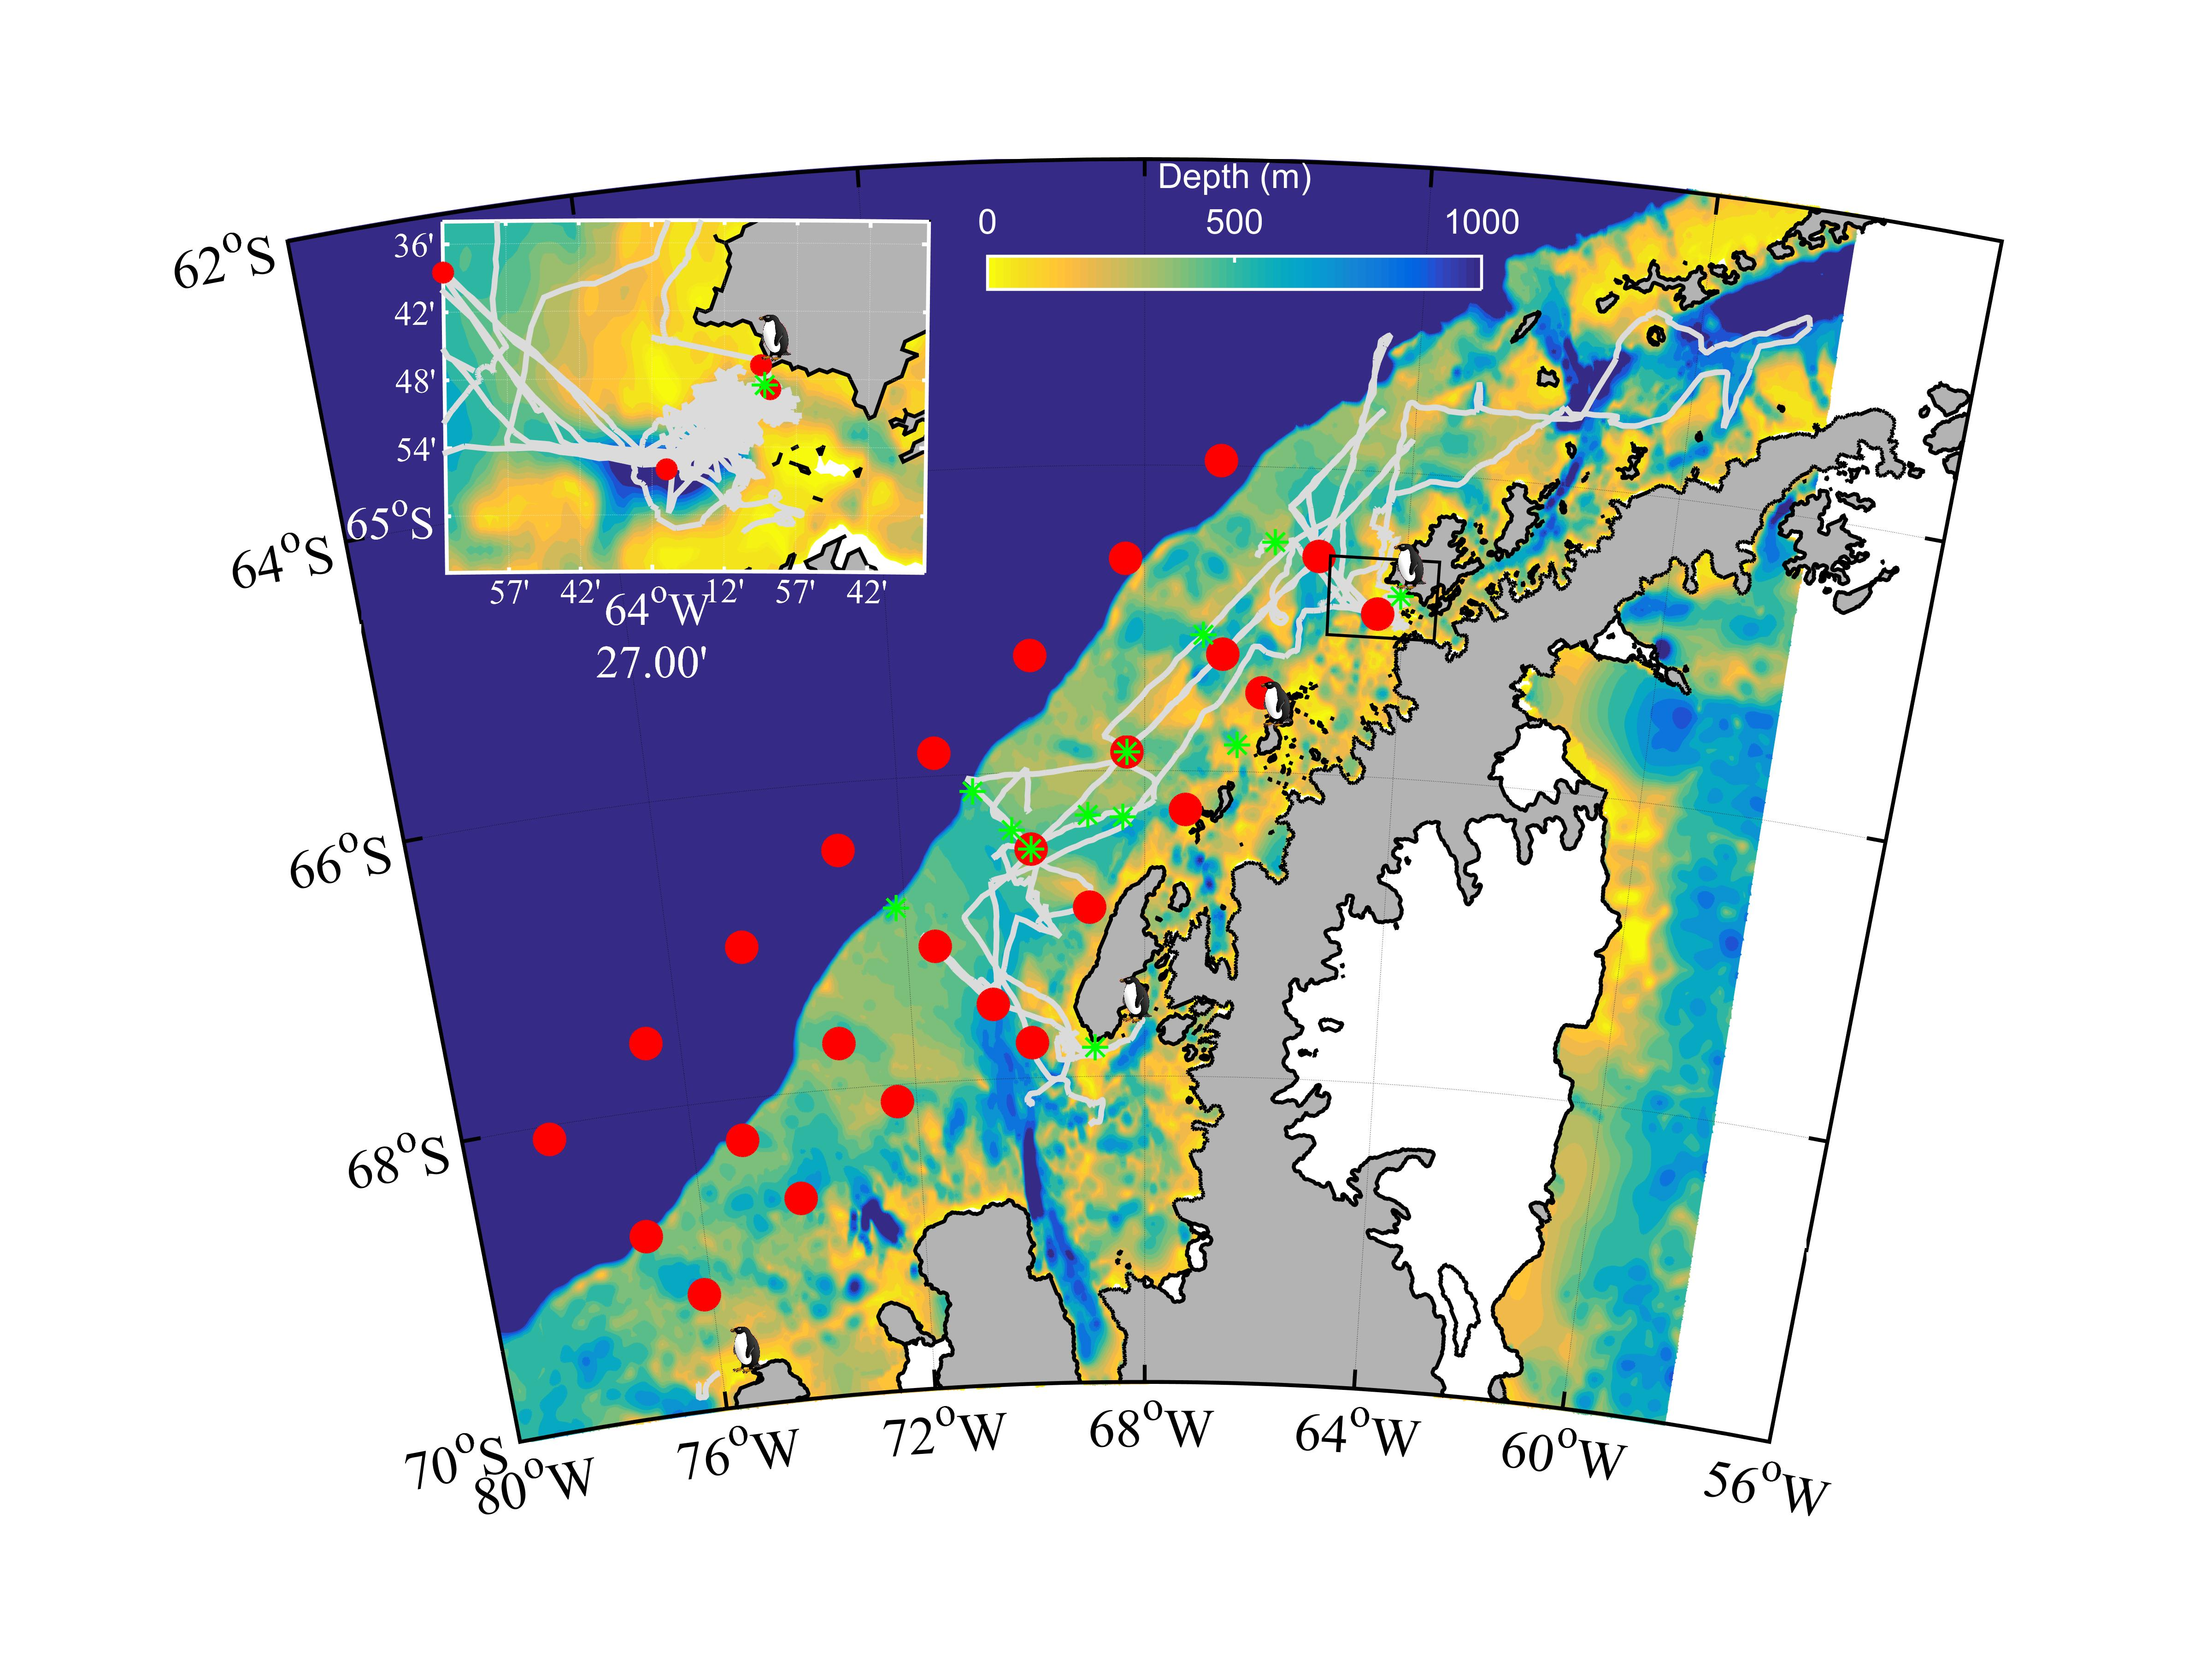
Theme: A climate gradient across the site
Warmer wet
subpolar
system
Cooler moist
polar
system

Slide 3
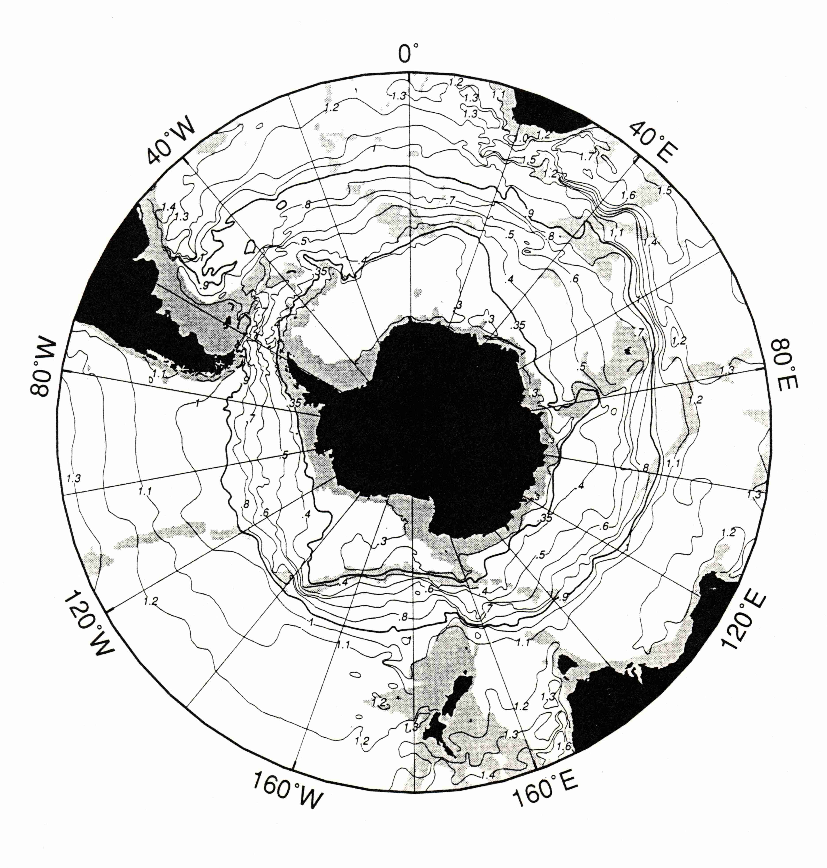
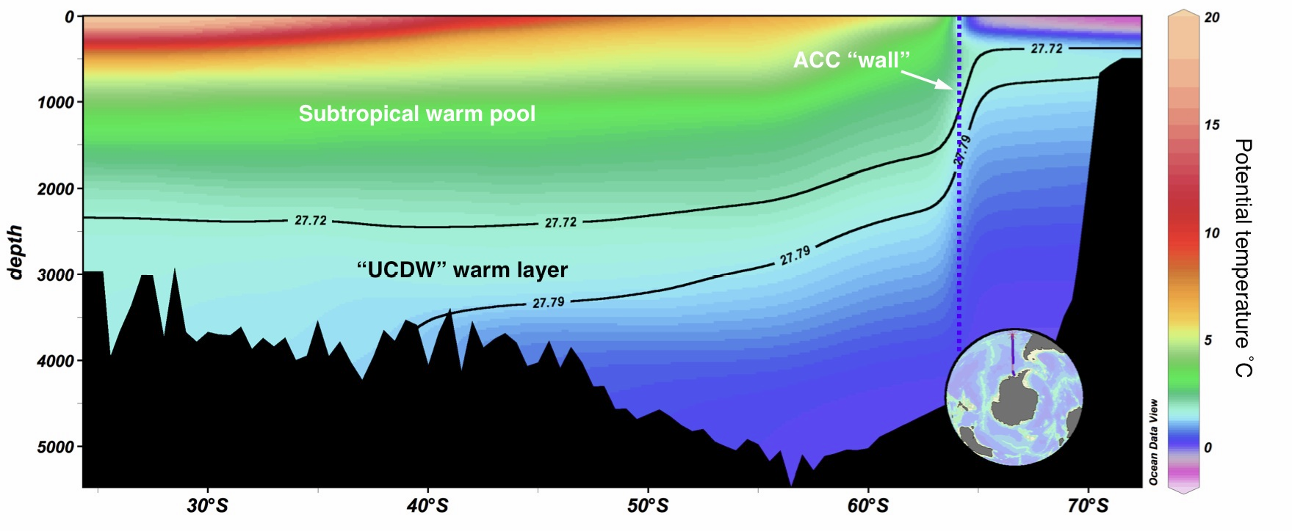
Themes: Ocean is the heat engine driving change at our site
Antarctic Peninsula to the Amundsen Sea: one of the few regions in Antarctica where the Antarctic Circumpolar Current (ACC) directly impinges on the shelf break. Upper Circumpolar Deep Water (UCDW) is Antarctica’s warmest water.
Gray shading, < 300m
Doug Martinson, LDEO

Slide 4
Theme: Bottom topography is critical to circulation

Slide 5
Theme: System is showing change

Slide 6
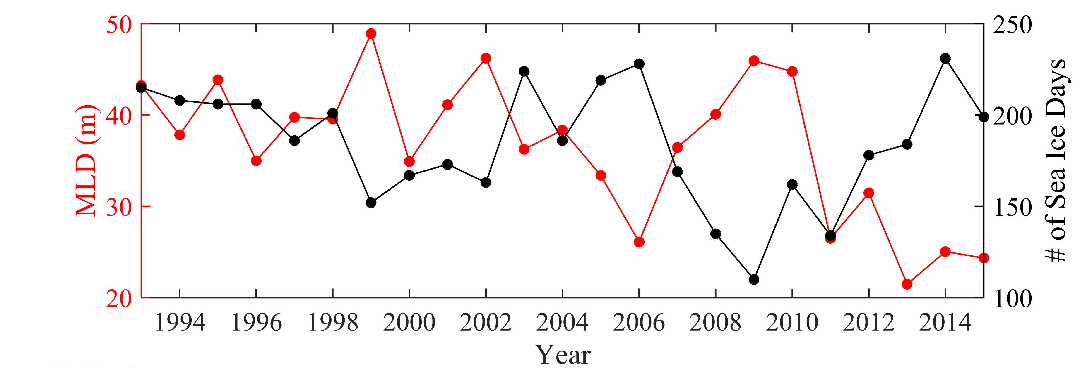
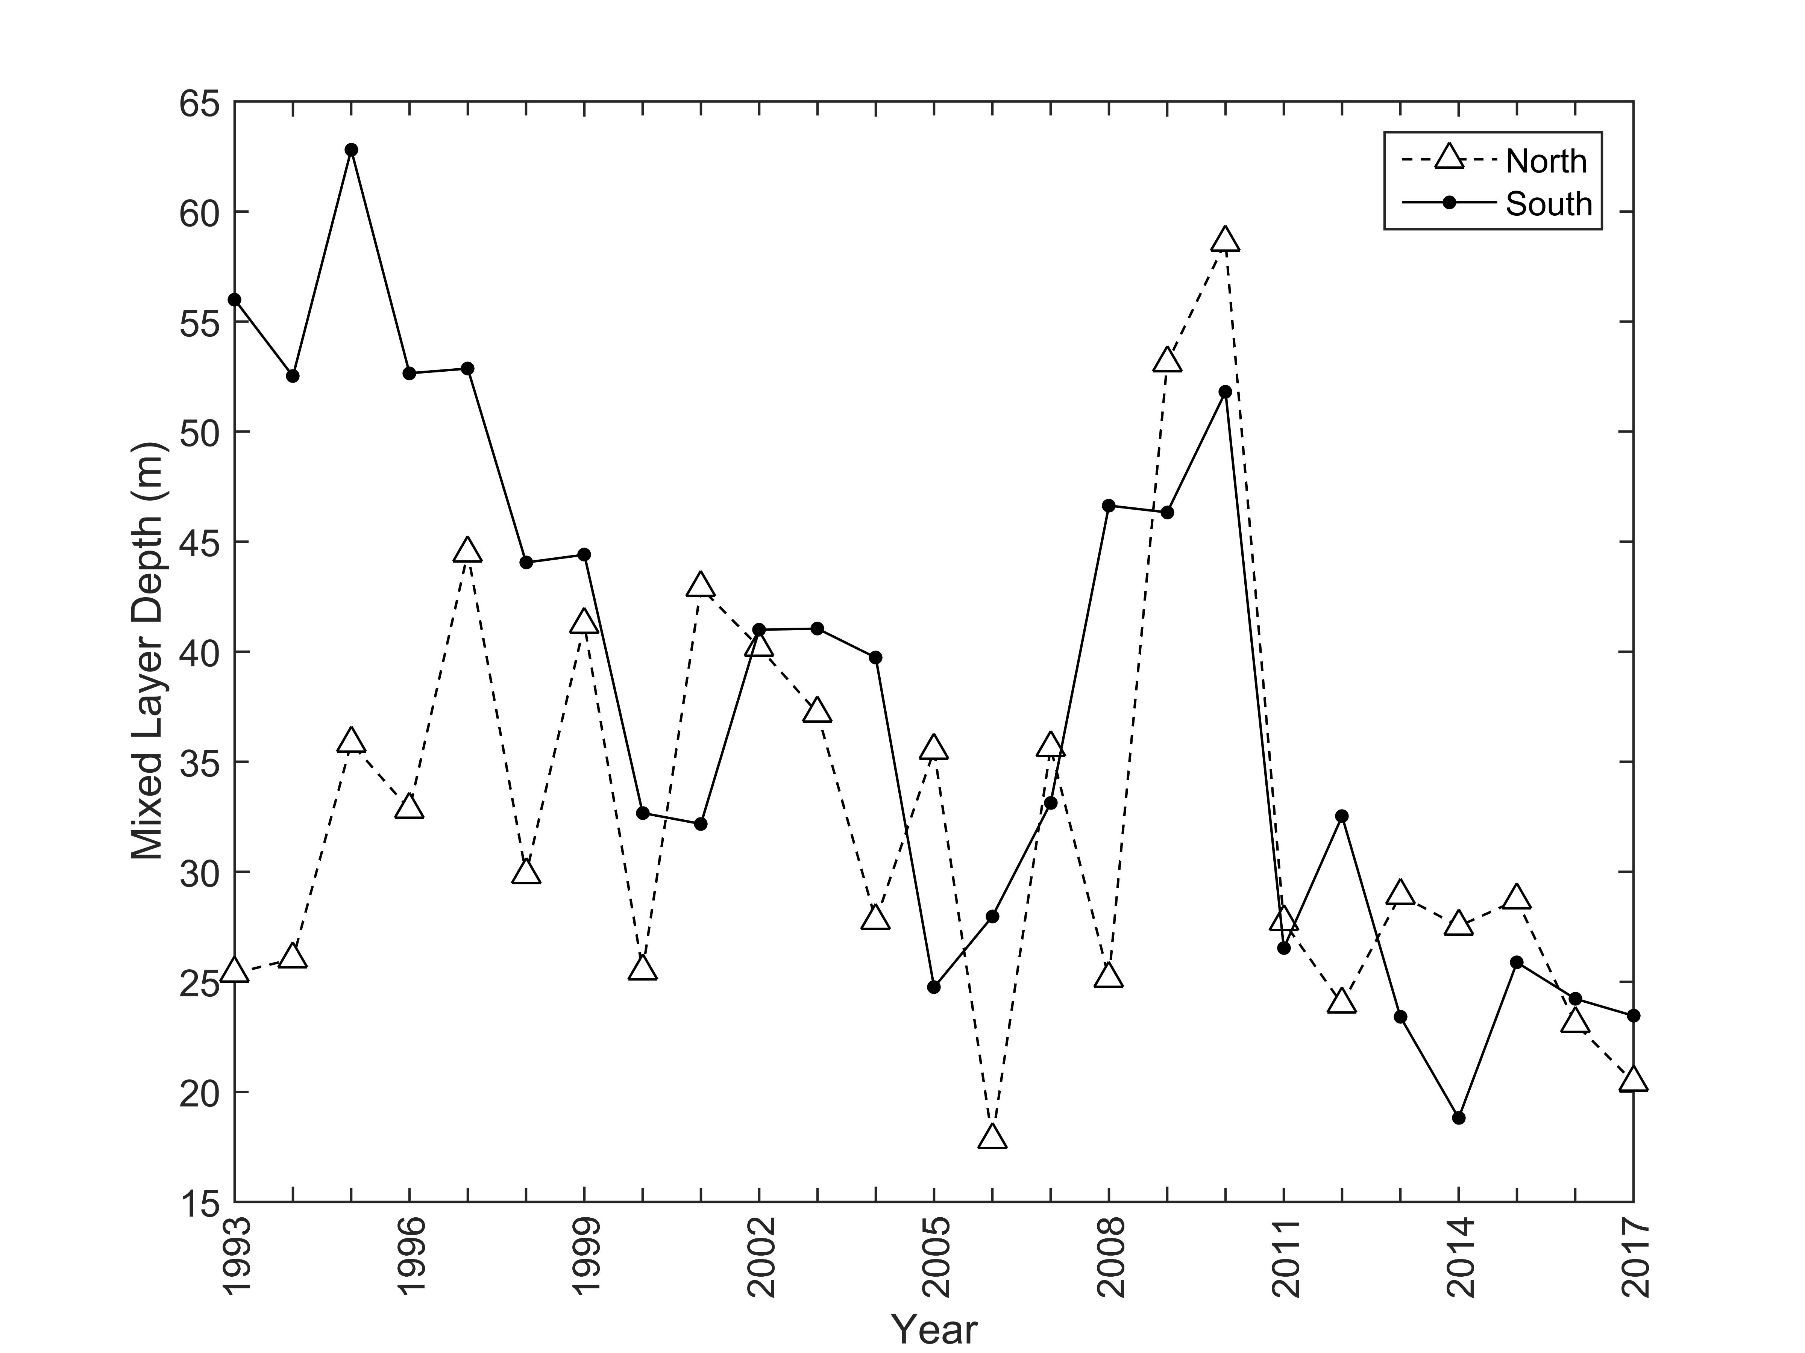
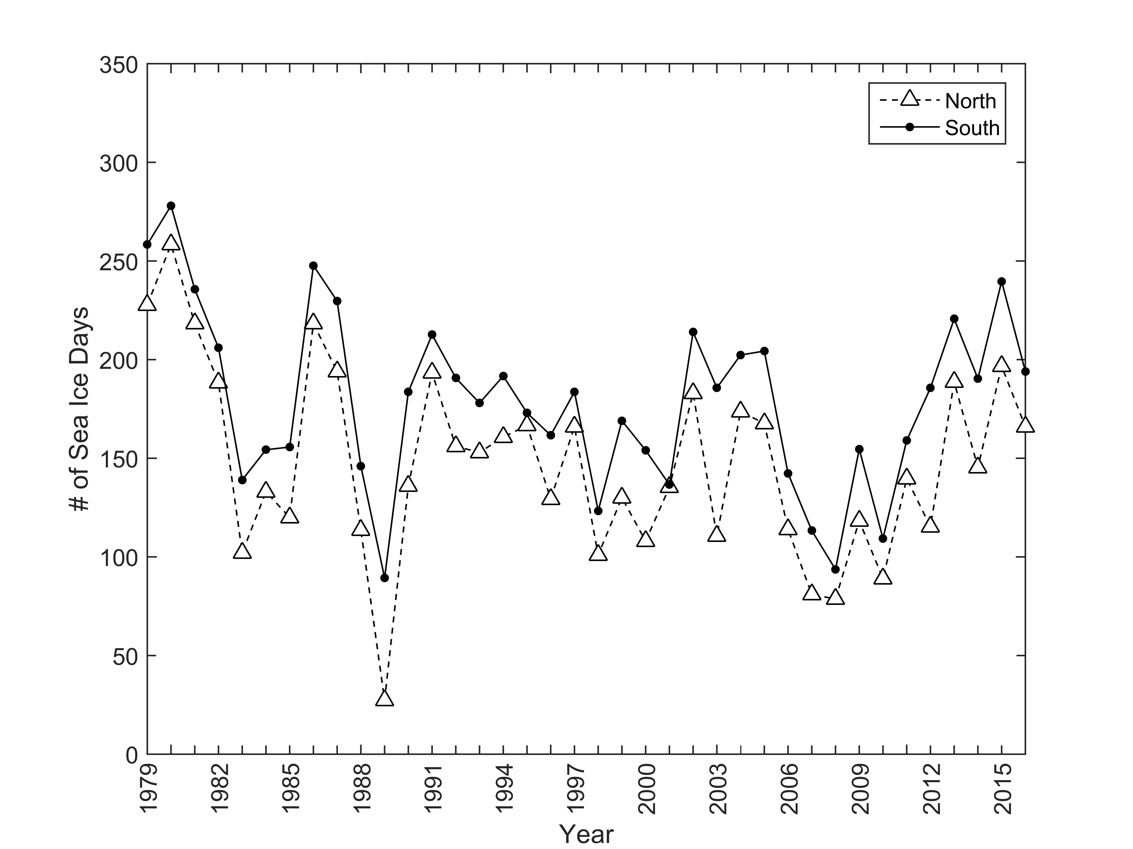
Theme: Changes altering the physical environment
Lowest sea ice

Slide 7
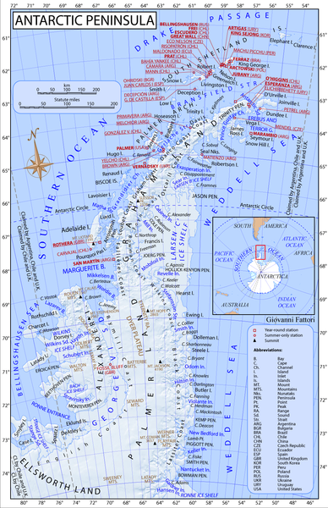
Theme: Regional change in primary production
Over decadal scales (30 years), trended changes observed in MLD in South but not in the North.
Associated with MLD increased phytoplankton in south, not on north.
Comparison of decadal times series of chlorophyll a across the
Argentinean Base
US Base
UK Base

Slide 8
Theme: Shifting biomass associated with shifting communities
9%
5%
5%
Big Chlorophyll Year
16%
65%
160
% Diatoms
80
% Prasinophytes
Anomaly of
chlorophyll a (mg m⁻²)
% Haptophytes
0
% Flagellates
9%
4%
% Cryptophytes
-80
8%
Low Chlorophyll Year
27%
52%

Slide 9
Theme: Primary productivity Ripples Through Food Web

Slide 10
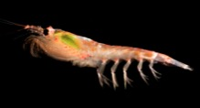
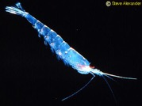
Theme: Climate cyles (El Nino, SAM)
E. Crystallorophias
(ice-obligate)
p < 0.001
r² = 0.45
Steinberg et al. (2015)
updated

Slide 11
