Slide 1
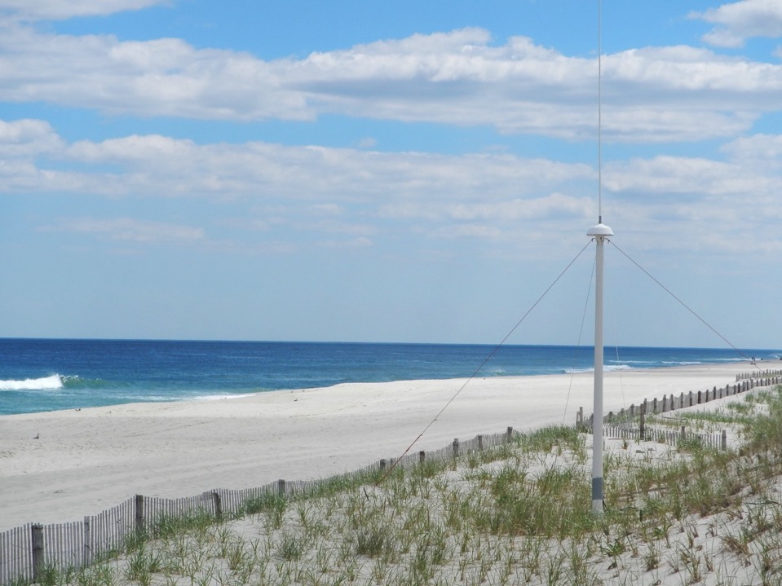








A Decade of Surface Current Measurements Over the Mid Atlantic Continental Shelf
Hugh Roarty Josh Kohut Scott Glenn Mike Smith Laura Nazzaro
Ethan Handel
Travis Miles
Joe Brodie
Larry Atkinson
Teresa Updyke
Donglai Gong
Wendell Brown
Harvey Seim
Mike Muglia
Oceanology International 2018
London, UK

Slide 2




















RI
U..
Middle Atlantic
Regional Association
Coastal
Ocean Observing System
10 States - 78 Million People
1000 km Cape to Cape
CT
Cape
Cod
MA
NY
PA
NJ
MARACOOS:
An Integrated, Sustained & Certified Real-time Observation and Forecast System
DE
MD
VA
NC
Cape
Hatteras
Notes:
2

Slide 3
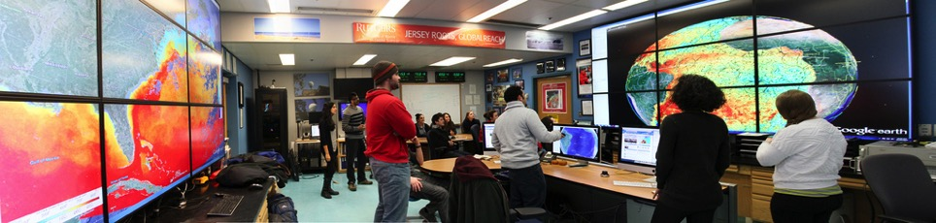

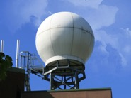
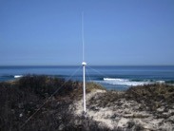

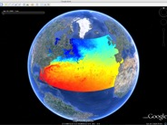















Rutgers University - Coastal Ocean Observation Lab
Observatory Operations, Data Fusion & Training Center
L-Band & X-Band Satellite Receivers
CODAR Network
Glider Fleet
3-D Nowcasts
& Forecasts
Notes:
3

Slide 4






MARACOOS Integration Matrix
Integration Matrix: Capabilities Support Multiple Themes
Regional Priority Themes | Regional Observation & Modeling Capabilities
 | Weather Mesonet | HF Radar Network | Statistical STPS | Satellite Imagery | Glider Surveys | Dynamical Ocean Forecasts
Theme 1. Maritime Commerce & Safety | Operational Input to USCG SAROPS | Operational input to USCG SAROPS | Operational input to USCG SAROPS | SST for survivability planning | Assimilation dataset for forecast models | Surface currents for SAROPS
Theme 2. Fisheries | Weather forecast ensemble validation | Circulation and divergence maps for habitat |  | SST & Color for habitat | Subsurface T & S for habitat | 3-D fields of T, S, circulation for habitat
Theme 3. Public Health & Water Quality | Winds for transport, river plumes, & upwelling | Surface currents for floatables, bacteria, spill response | Surface currents for floatables, bacteria, spill response | Ocean color for river plumes | Nearshore dissolved oxygen surveys | Surface currents for floatables, bacteria, spill response
Theme 4. Coastal Flooding | Weather forecast ensemble validation | Assimilation dataset for forecast models |  | SSTs assimilation into forecast models | Assimilation dataset for forecast models | Nested forecast ensembles
Theme 5. Offshore Energy | Historical analysis & wind model validation | Historical current analysis & wind model validation |  | Historical analysis surface fronts & plumes for siting | Historical analysis of subsurface fronts & plumes | Coupled ocean-atmosphere models for resource estimates

Slide 5
MARACOOS Integration Matrix
Integration Matrix: Capabilities Support Multiple Themes
Regional Priority Themes | Regional Observation & Modeling Capabilities
 | Weather Mesonet | HF Radar Network | Statistical STPS | Satellite Imagery | Glider Surveys | Dynamical Ocean Forecasts
Theme 1. Maritime Commerce & Safety | Operational Input to USCG SAROPS | Operational input to USCG SAROPS | Operational input to USCG SAROPS | SST for survivability planning | Assimilation dataset for forecast models | Surface currents for SAROPS
Theme 2. Fisheries | Weather forecast ensemble validation | Circulation and divergence maps for habitat |  | SST & Color for habitat | Subsurface T & S for habitat | 3-D fields of T, S, circulation for habitat
Theme 3. Public Health & Water Quality | Winds for transport, river plumes, & upwelling | Surface currents for floatables, bacteria, spill response | Surface currents for floatables, bacteria, spill response | Ocean color for river plumes | Nearshore dissolved oxygen surveys | Surface currents for floatables, bacteria, spill response
Theme 4. Coastal Flooding | Weather forecast ensemble validation | Assimilation dataset for forecast models |  | SSTs assimilation into forecast models | Assimilation dataset for forecast models | Nested forecast ensembles
Theme 5. Offshore Energy | Historical analysis & wind model validation | Historical current analysis & wind model validation |  | Historical analysis surface fronts & plumes for siting | Historical analysis of subsurface fronts & plumes | Coupled ocean-atmosphere models for resource estimates
+ Long-term Scientific Archive

Slide 6
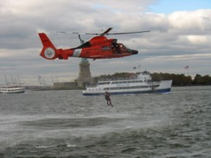
Search And Rescue Cases
in MARACOOS Region
U.S. Coast Guard Search And Rescue Data, FY2014
 | Bays, Rivers, Near Shore (< 3 NM) | Offshore (> 3 NM to 200 NM) | Total
Cases | 2,433 | 247 | 2,688
Lives Saved | 500 | 96 | 596
Lives Assisted | 3,332 | 319 | 3,651
Lives Lost | 160 | 14 | 174

Slide 7
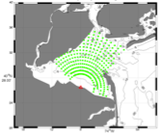
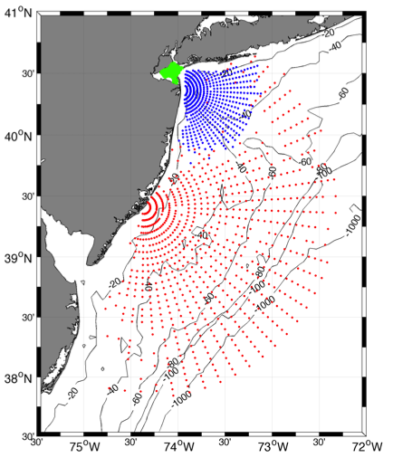
Surface Current Mapping Capability
25 MHz
Radar λ: 12 m Ocean λ: 6 m
Range: >30 km Resolution: 1 km
13 MHz
Radar λ: 23 m Ocean λ: 12 m
Range: >80 km Resolution: 3 km
05 MHz
Radar λ: 60m Ocean λ: 30 m
Range: >180 km Resolution: 6 km

Slide 8
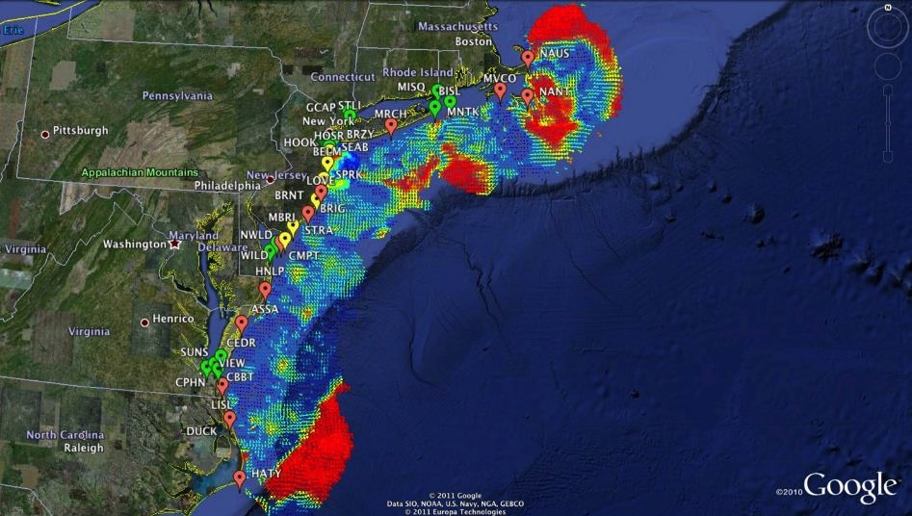

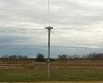
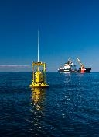
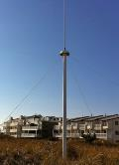

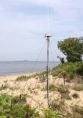





Mid-Atlantic Bight HF Radar Network
1000 km
Cape to Cape
Mid-Atlantic HF Radar Network
17 Long-Range CODARs
8 Medium-Range CODARs
16 Short-Range CODARs
41 Total CODARs in Region
+5 CODARs Roaming
46 Total CODARs
Triple Nested, Multi-static, Multi-use
Industry Partner: CODAR Ocean Sensors

Slide 9
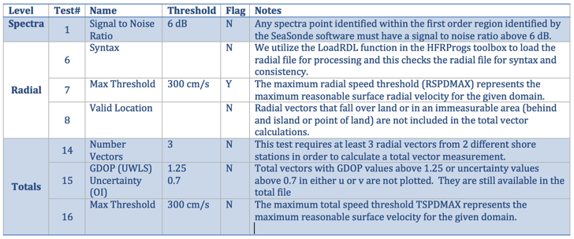

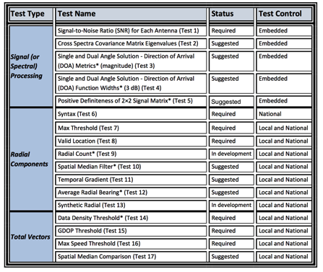
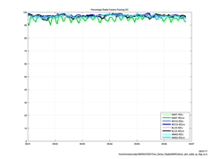
HFR Data Quality Assurance/Quality Control (QA/QC)
Regional Information Coordination Entity -
RICE
From
QARTOD
Manual for
HF Radar
Plotting QC flags in real time

Slide 10
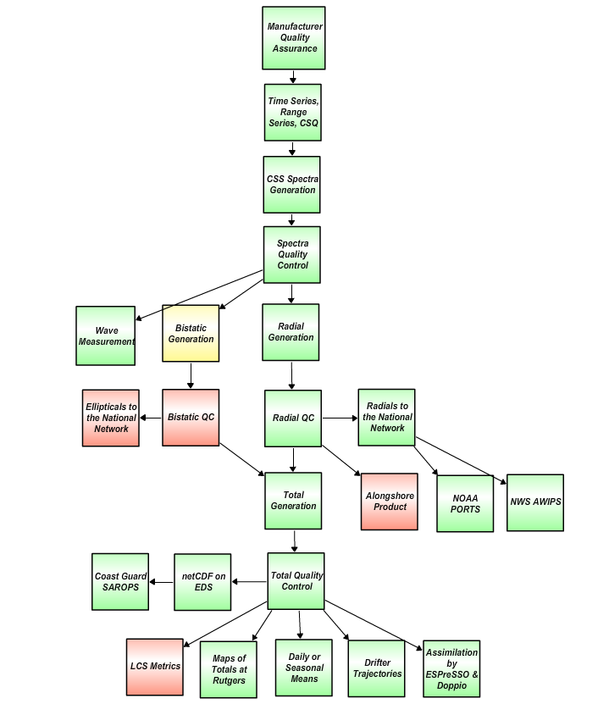
HF Radar Data Real Time Flow Chart
Nov. 2017
For IOOS HFR DAC
Quality Assurance
Manufacturer recommended Antenna Patterns not older than 1 year
Weekly 11-point remote site inspections
Physical site inspection every 6 months
Level 0
QARTOD
R Test 1: SNR Ratio, Filter < 7dB
S Test 2: Cross Spectra Covariance Matrix Eigenvalue
S Test 3: Direction of Arrival Magnitude
S Test 4: Direction of Arrival Signal Width
S Test 5: Positive Definiteness 2x2 Signal Matrix
Requires SeaSonde Radial Metric Processing
Level 1
R Test 6: Syntax, Filter
R Test 7: Max Threshold, Filter > 150 cm/s (13/25 MHz) 300 cm/s (5 MHz)
R Test 8: Radial Valid Location, Filter
D Test 9: Radial Count, Filter < 300
S Test 10: Spatial Median Test
S Test 11: Temporal Gradient
S Test 12: Average Radial Bearing
S Test 13: Synthetic Radial
Level 2
R Test 14: Data Density Threshold, Filter, At least 3 vectors from 2 separate stations
R Test 15: GDOP, OI Uncertainty, Flag > 0.6 in U or V Velocity
R Test 16: Max. Speed Threshold , Filter > 150 cm/s (13/25 MHz) 300 cm/s (5 MHz)
S Test 17: Spatial Median Test
R Required
SR Strongly Recommended
S Suggested
D Development
Level 3
Green – Operational
Yellow – Development
Red - Planned
Level 4
Data levels defined by NASA Earth Science Reference Handbook ( 2006, p.31)

Slide 11
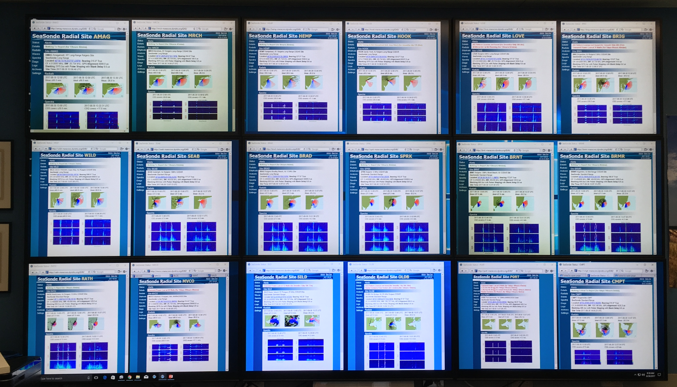
Radial Web Server
Human in the Loop QA/QC
Rutgers COOLroom CODAR Wall

Slide 12
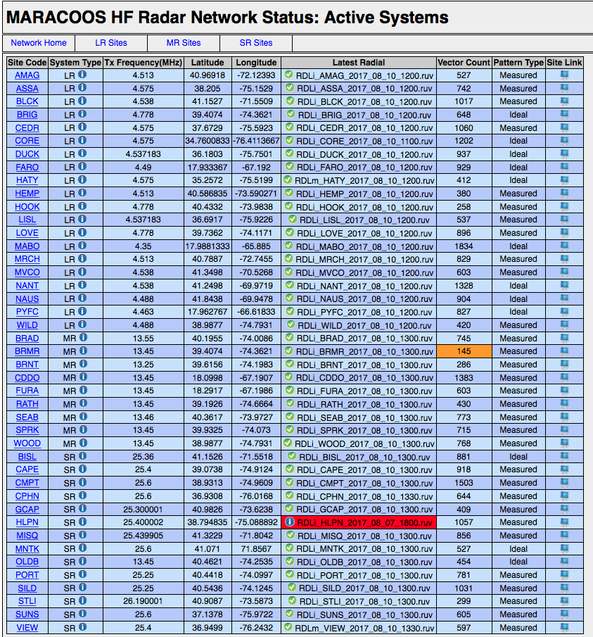
Radial Diagnostic
Displays Most Recent Radial File
If radial count drops below 200
If radial file older than 12 hours
Displays Preferred Radial Type for Total Processing

Slide 13
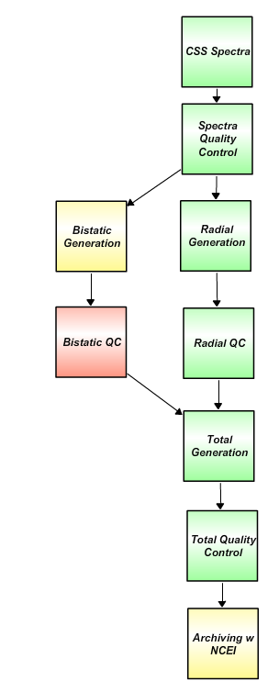
HF Radar Data Delayed Mode Flow Chart
Nov. 2017
For NCEI Archive
Level 0
Plot hardware diagnostic data to identify questionable time periods.
Plot radial diagnostic data to identify questionable time periods.
Determine what stations need to be reprocessed for specific time periods
Generate reprocessing time line with appropriate file type (ideal or measured) and antenna patterns.
Generate archived best radial data set.
Create totals from best radial data set.
Level 1
Level 2
Level 3
Green – Operational
Yellow – Development
Red - Planned
Level 4
Data levels defined by NASA Earth Science Reference Handbook ( 2006, p.31)

Slide 14
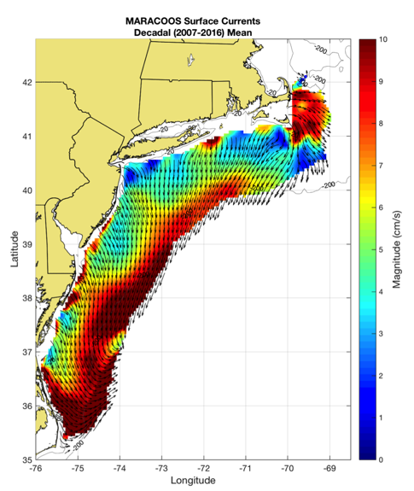
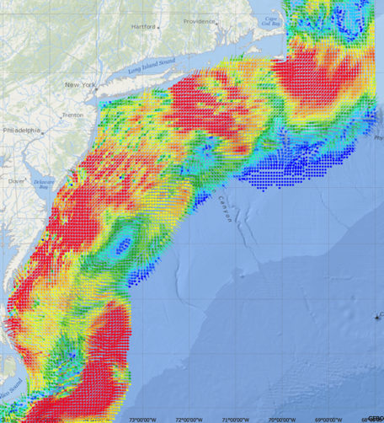
Generate Surface Current Maps Every Hour for a Decade
5 MHz- 17 Stations
13 MHz- 7 Stations
25 MHz- 16 Stations
Outside- 6 Stations
TOTAL – 46 Stations
Winter Storm Jonas
2016/01/23 20:00 UTC
Hourly Maps for
Search And Rescue
Decadal Mean Currents
for Scientific Analysis

Slide 15
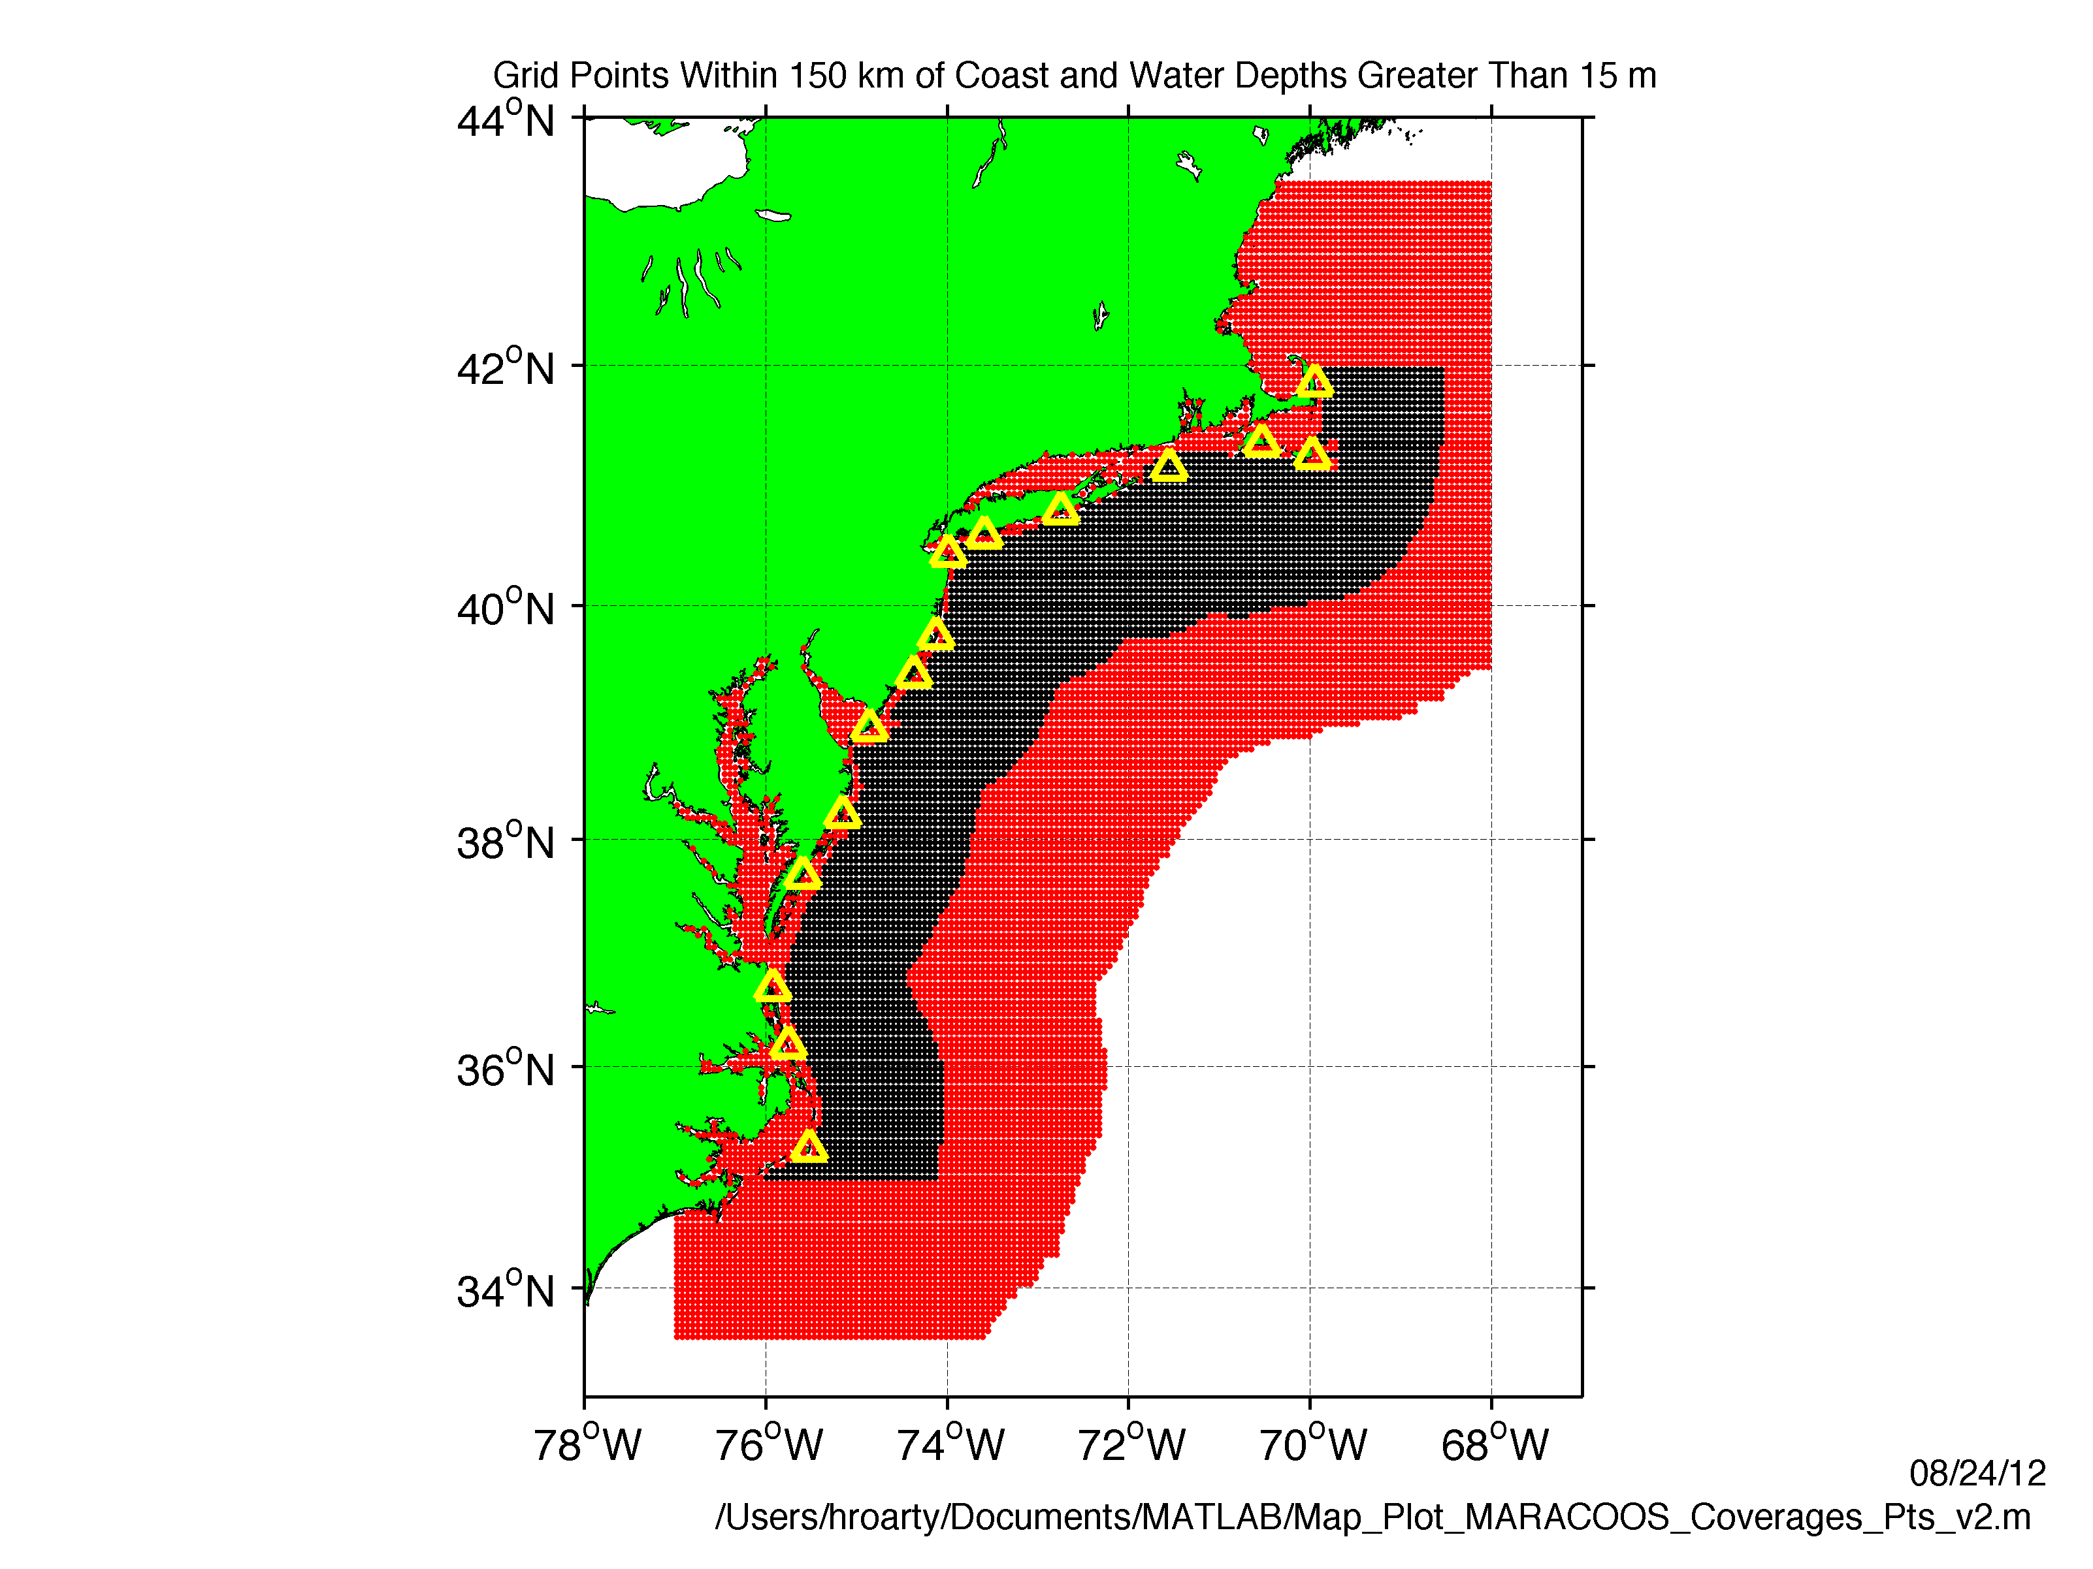
Grid Points for USCG 80-80 Metric
U.S. Coast Guard
HF Radar Metrics
Data quality: Produce better results than existing products (Proven in the USCG tests)
2) Data availability:
Total Current Vectors:
80% Spatial Coverage
80% of the Time
USCG SAR Grid
National HFR Grid

Slide 16
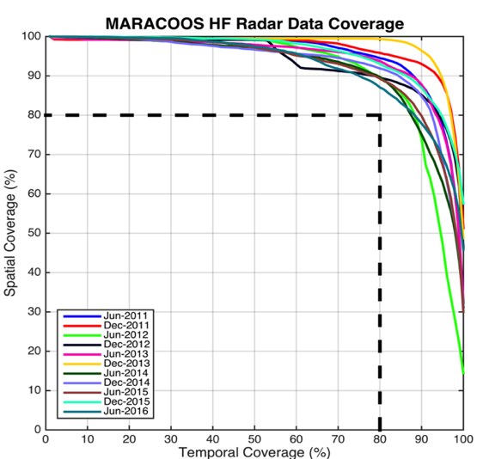
Search And Rescue Data Availability Metrics
MARACOOS 17-Site Long Range Network:
Consistently exceeds U.S. Coast Guard 80-80 Metric
80 % spatial coverage 80% of the time
Achieved through site resiliency and active spares approach.
Accomplished with 2.5 Field Technicians
Every
6 Months since 2011

Slide 17
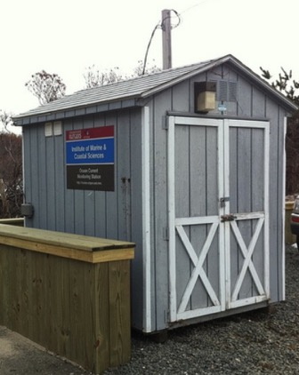
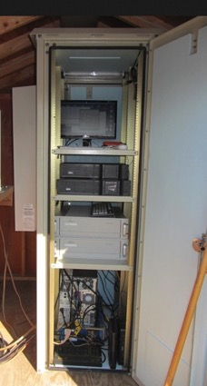
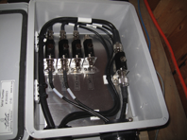
Resilient CODAR Shore Site: Phase 1
Shed, Enclosure, Tx/Rx, Comms, Power, GPS, AIS
monitor
computer & external hard drive
A.C. unit
UPS system
transmitter
receiver
Two lines of Communication
Shed
Enclosure
Lightning Protection

Slide 18
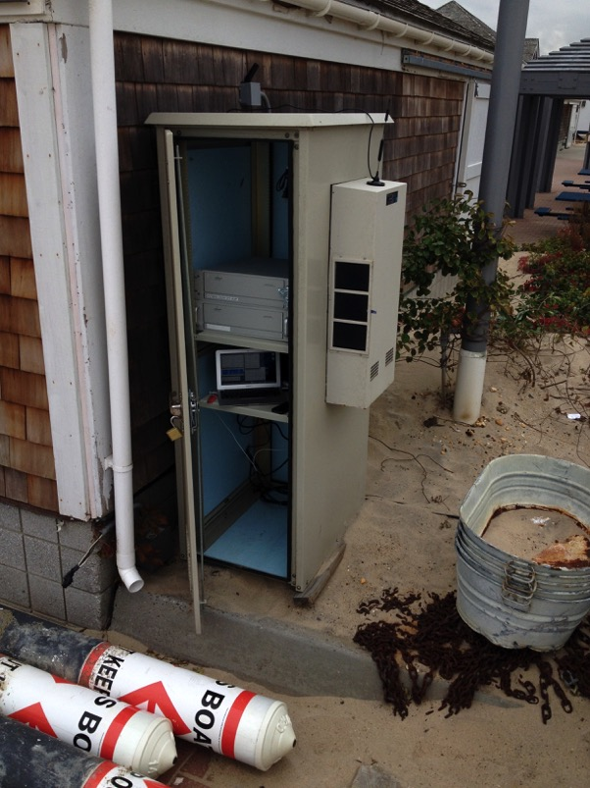
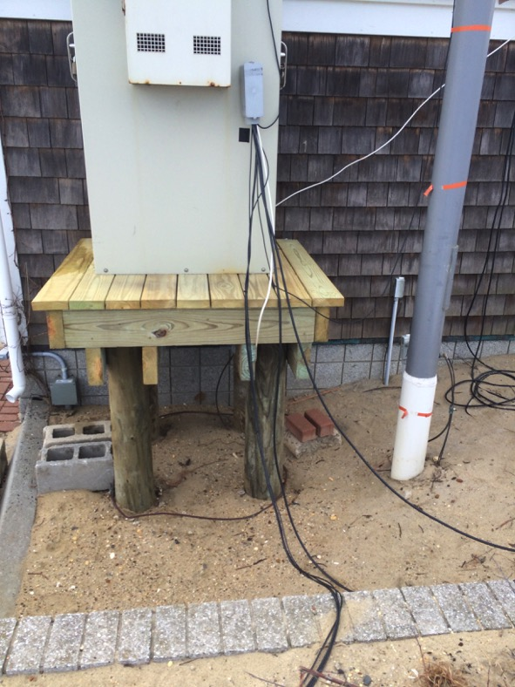
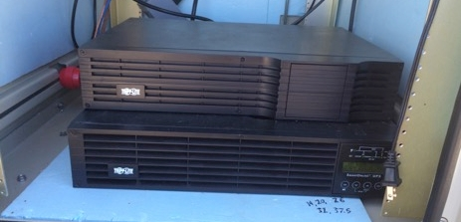
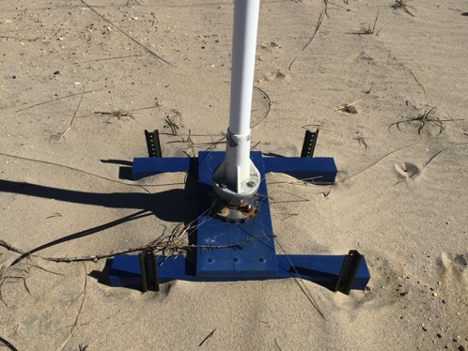
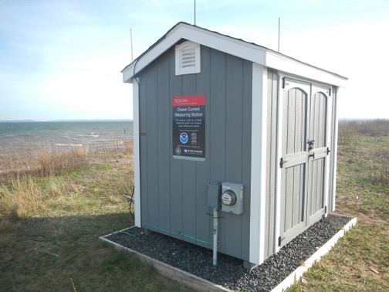
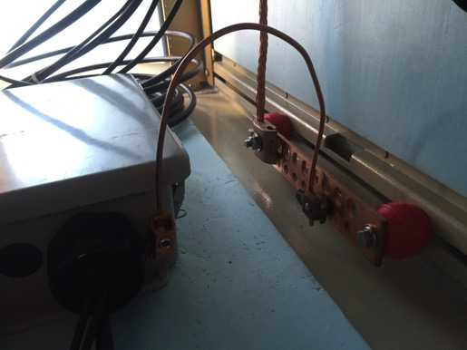
Resilient CODAR Shore Site: Phase 2
Raised Platforms
Shed Lightning Protection
Uninterruptible Power Supplies
Antenna Bases 6’ Deep
Radar Lightning Protection
BEFORE
AFTER

Slide 19
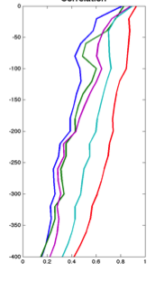
Rutgers ROMS 4DVAR uses all available data
from a modern coastal ocean observing system
  more and diverse data is better (T, S, u, sea level)
  bias correction to OBC and MDT is essential
Useful subsurface skill for real-time applications:
  4 days for temperature and salinity;
  1-2 days for velocity
Future directions: variational methods for
observing system design; coupling; ecosystems
correlation
Forward model
Forward model
after bias removal
Data assimilation
analysis/hindcast
depth
2-day forecast
4-day forecast
Bottom temperature
Data used [… real-time SOURCE]
*THREDDS Data Server
72-hour forecast NAM 0Z cycle at 2 am EST [NCEP NOMADS]
RU regional CODAR hourly [RU TDS*]
RU glider T,S [RU TDS]
USGS daily average flow available 11:00 EST [USGS waterdata]
AVHRR IR passes 6-8 per day [MARACOOS TDS]
REMSS MW-IR blended SST daily average [NASA PO-DAAC]
HYCOM NCODA 7-day forecast updated daily [NRL]
Jason-2, CryoSat, AltiKa along-track altimeter OGDR [RADS.nl]
SOOP XBT/CTD, Argo floats, on GTS [NOAA OSMC ERDDAP]

Slide 20
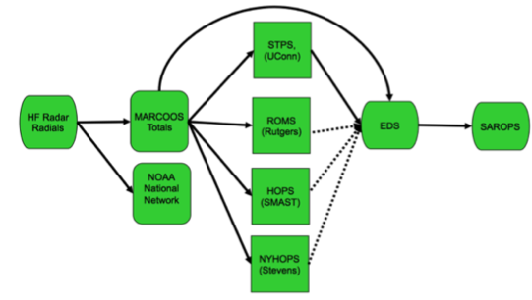
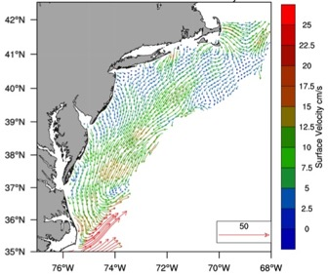

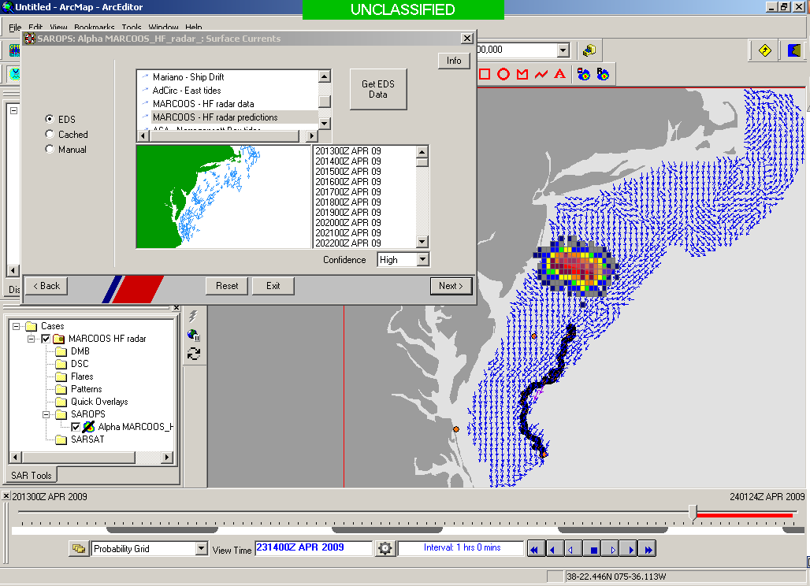
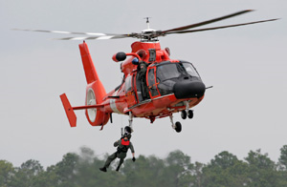

Transition Objective –
Operational Use of HF Radar Surface Currents for Search And Rescue
Surface Currents
Data Acquisition
Data Product Generation & Management
Search And Rescue Optimal Planning System (SAROPS)

Slide 21

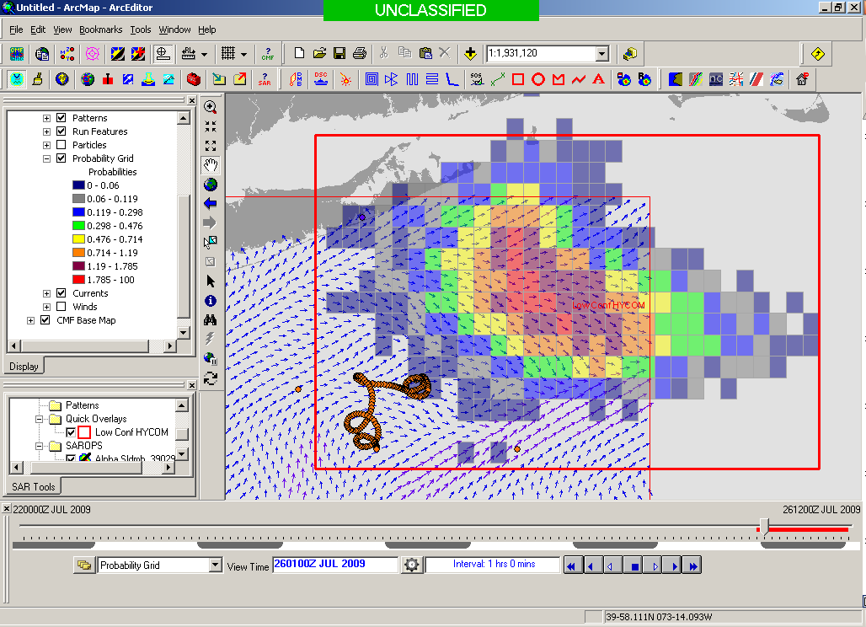
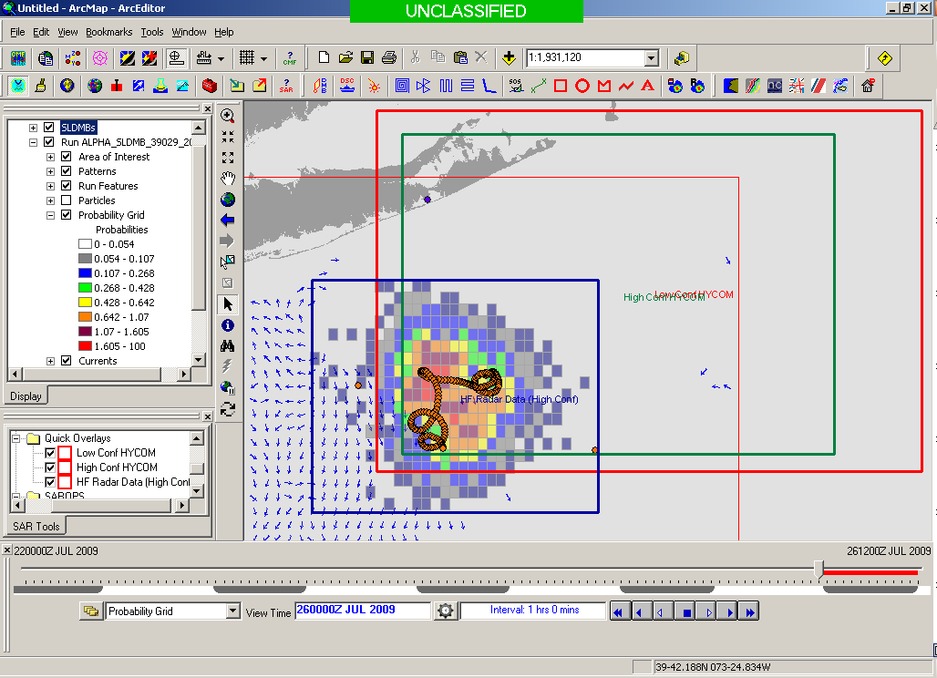
USCG Evaluation Process -
5000 Virtual Drifters & 1 Real Drifter:
Compare Search Areas after X Hours
154 km
100 km
232 km
123 km
HYCOM @ 96 Hours
Search Area = 36,000 km²
CODAR @ 96 Hours
Search Area = 12,000 km²
Notes:
HYCOM (Low Conf) 48 hours

Slide 22

May 4, 2009: After a year of USCG testing, NOAA announces on
U.S. Department of Commerce Website that
MARACOOS CODAR is Operational in USCG SAROPS
2009-2010 Activity:
Bring all
sustained regional-scale HFR networks up to operational status in USCG SAROPS
3 West Coast Regions for
California & Oregon are ready.

Slide 23
2011-2014 2016-2017
USCG SAROPS Ocean Current Product Requests
Global HYCOM Products – Always there “100-100” metric
HF Radar Data & Statistical Predictions – #8
Assimilative Regional Espresso ROMS - not on the list
Global HYCOM Products – Still Always there “100-100” metric
HF Radar Data & Statistical Predictions – up to #6
Assimilative Regional Espresso ROMS - up to #4

Slide 24
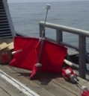
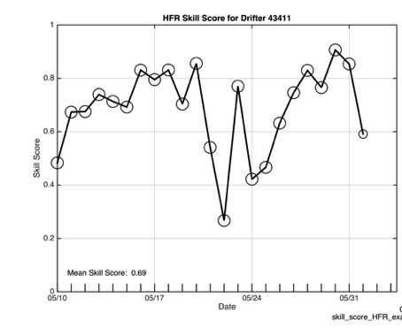
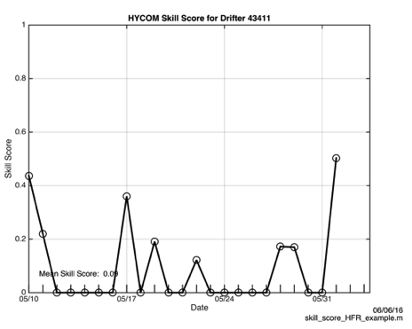
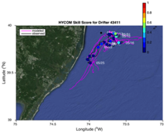
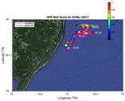
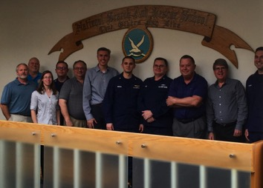
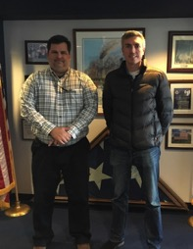


2016 Surface Current Drifter Skill Score
Navy HYCOM Region 1
No HFR Assimilation
HFR Data
Active Education & Outreach to USCG Users of the HFR Data & Data Assimilative Products
National Search and Rescue School
Yorktown, VA
January 19, 2017
Coast Guard Sector NY
Staten Island, NY
March 21, 2017

Slide 25
Coast Guard Wind & Current Data Requests
Requests June 1 to December 1, 2017

Slide 26

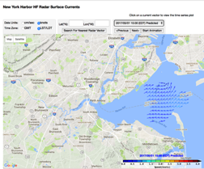

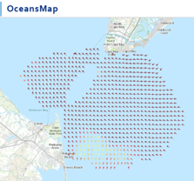
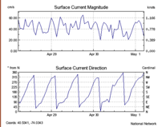


Nested High Resolution HF Radars in NOAA PORTS
5 MHz- 17 Stations
13 MHz- 7 Stations
25 MHz- 16 Stations
Outside- 6 Stations
TOTAL – 46 Stations
Winter Storm Jonas
2016/01/23 20:00 UTC

Slide 27



Medium Range HF Radar Network – Nearshore Waves
New Jersey 13 MHz
HFR wave observations combined with co-located Surfcams
Gap fills a sparse buoy network in regions of high variability & interest

Slide 28







Significant Wave Height (m) Versus Time
Landward Winds For First Half+ of March 14, 2017
SEAB
44065
SPRK
44091
BRNT
Winds become seaward at the times listed below, shown in time series plots with vertical lines. The first transition occurs at WOOD and progresses northward:
SEAB (19:00)
SPRK (18:00)
44065 (17:00 / 18:00)
BRNT (17:00)
WOOD (14:00)
WOOD

Slide 29





Significant Wave Height (m) Versus Time
Seaward Winds: March 22-23, 2017
Buoy 44091 , SPRK: RC10 RC5 RC3
landward
seaward
RC10
Significant wave height data are displayed for RC10, RC5, and RC3 and for buoy 44091.
Seaward winds are reflected in a seaward increase in wave height extending through SPRK range cells and the buoy.
RC5
RC3
SPRK
44091

Slide 30


12 Stations
17

Slide 31


Data Coverage
Each hexagon represents a season
(24 maps/day) * (90 days/season) = 2160 maps/season

Slide 32

Decadal Mean
Detided using t_tide
30 hour low pass filter applied
50% temporal coverage per year required
Major Features:
Shelf Slope Front
4 River Outflows
Notes:
Like previous studies flow is alongshelf and towards the south
As observed by Steve Lentz The flow speed increases with water depth reaching a maximum at the shelf break
You can also observe this low velocity zone near the bight apex that was first observed by Donglai Gong in his 2010 paper of the surface currents on the NJ shelf

Slide 33
Inter-Annual Variability
Variability between years averaged over the decade
Tides not included

Slide 34
Intra-Annual Variability
Variability within a year averaged over the decade
Tides not included

Slide 35
Intra-Annual Forcing
Winds and River Discharge

Slide 36





Slide 37



Slide 38
Seasonal Means

Slide 39

Winter
December, January and February

Slide 40

Spring
March, April and May

Slide 41

Summer
June, July and August

Slide 42

Autumn
September, October and November

Slide 43


Shelf Slope Front
Increase in alongshore speed
From north to south
Furthest offshore extent in winter and spring

Slide 44


Alongshore and Cross-shore currents along the 50 m isobath
LIS
HSV
Del Bay
Ches Bay
Alongshore current increases
From North to South
Spring – least increase
Fall – most increase
Cross-shore current has local peaks
Associated with River inflows

Slide 45

Intra-Annual Variability
Figure 5: Average 10 year intra-annual Variability: winter, spring, summer, Autumn
Notes:
Seasonal varibaility of the temperature, break up the
Inter is same varibaility is in the alongshelf
Add river discharge for season in the winter wind plot

Slide 46

Inter-Annual Variability
Figure 6: 10 year interannual variability: Winter, Spring, Summer, Autumn
Notes:
Seasonal varibaility of the temperature, break up the
Inter is same varibaility is in the alongshelf
Add river discharge for season in the winter wind plot

Slide 47
Individual Autumns

Slide 48
Mean Buoy Winds
Fall 2009 Outlier

Slide 49

River Discharge Fall Means – 2011 Outlier

Slide 50

Autumn 2009

Slide 51
Synoptic Wind Types – Delaware State Climatologist

Slide 52


Windy Fall of 2009
Alongshore Currents
Cool Surface Layer
Nearshore Mixed
Notes:
Fall 2009 the wind was out of the NE (normally it is out of the NW). This drove the flow downshelf.

Slide 53

Autumn 2011

Slide 54




Lee
Hurricane Irene Aug 25 2011
Irene
9/27
TC Lee Sept 5 2011
September 27 2011

Slide 55


Rainy Fall of 2009
Cross-shore Currents
Warm Surface Layer
Two layers across entire shelf
River Influence
Notes:
Fall 2011 had the highest river discharge, this was seen as the plumes in the fall 2011 map

Slide 56

Biological Response – 20 years of Satellite Chl

Slide 57

A Decade of Surface Current Measurements Over the Mid Atlantic Continental Shelf
Mean surface flow is cross shelf nearshore rotating to alongshelf with a maximum near the shelf break
Wind and river inputs play a role in the spatial, seasonal, annual variability
Inter-annual variability relatively small
Mean and intra-annual variability is highest in fall & winter
Fall variability impacts Hurricane Forecasting

