Slide 1
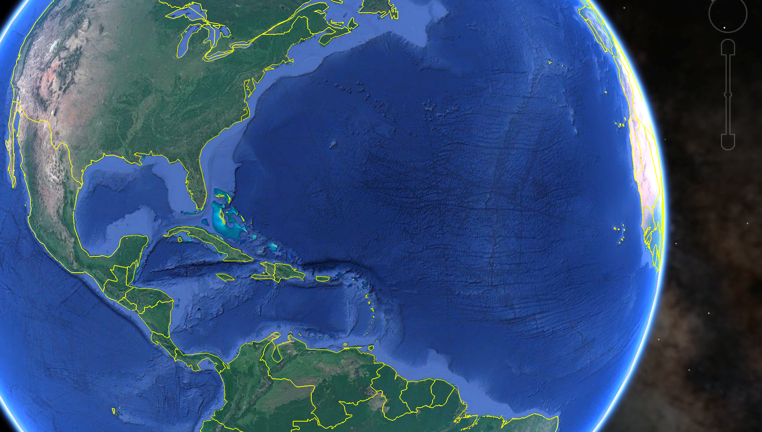





Expanding
International Partnerships
for Integrated Ocean Observing
supporting Sustainable Development
along the Caribbean Corridor
Scott Glenn, Josh Kohut, Travis Miles (RU)
Anthony Knap, Steve DiMarco (TAMU)
Elva Escobar Briones, David Salas (UNAM)
Cliff Merz, Bob Weisberg (USF)
Stephan Howden (USM)
Nick Shay (UM)
MarCuba 2018
La Habana, Cuba
“The LOOP Consortium”

Slide 2
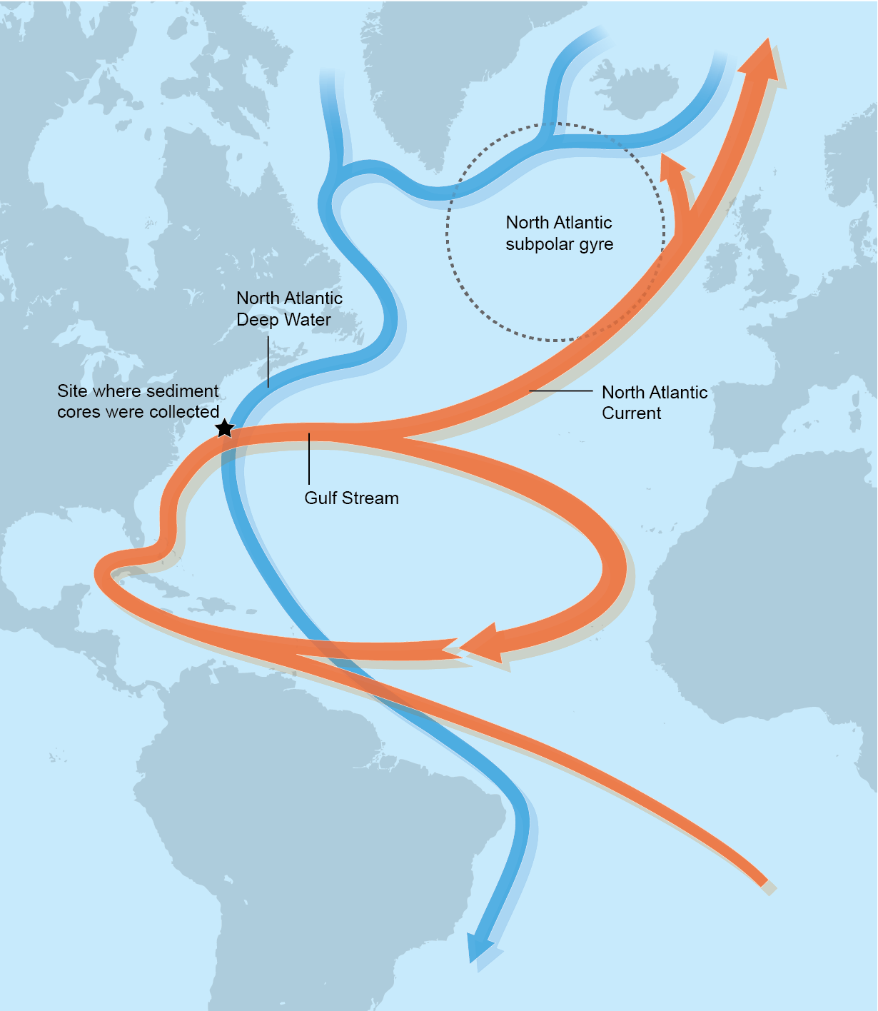
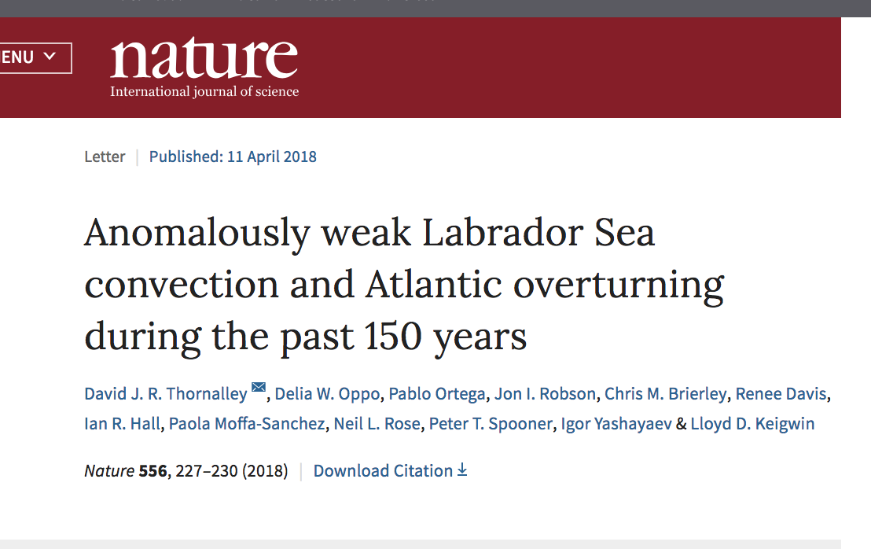
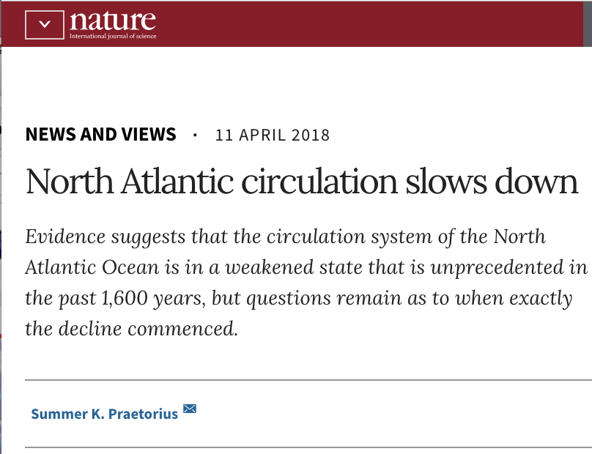
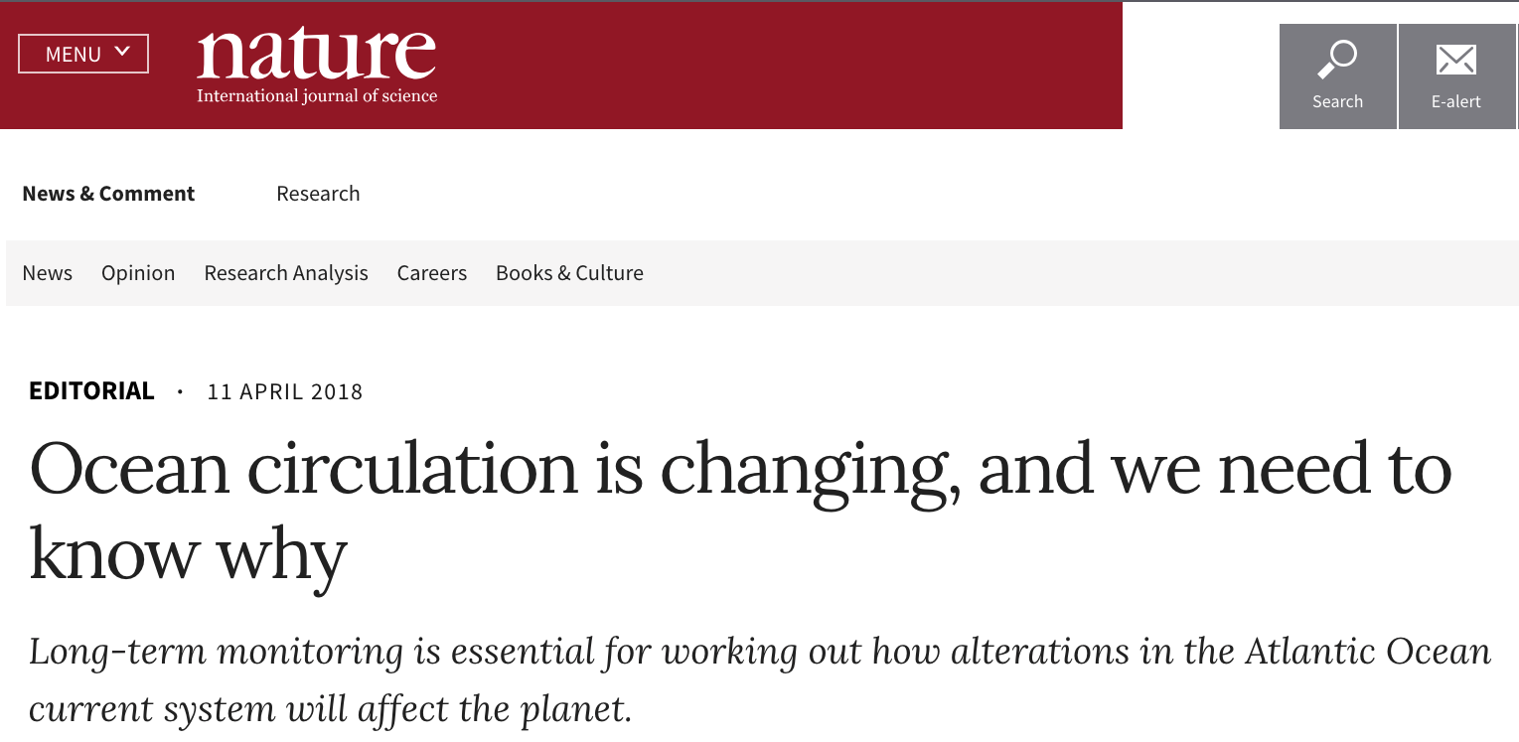
Atlantic Meridional Overturning Circulation (AMOC)
Published 11 April 2018:
Cold Deep
Water Transported South
Loop
Current
Warm Surface
Water Transported North

Slide 3
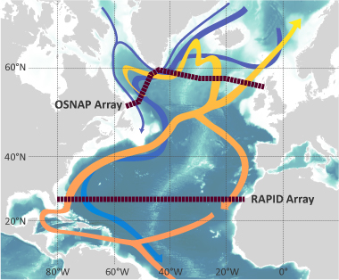
Atlantic Meridional Overturning Circulation (AMOC)
How do we currently monitor heat transport?
The RAPID Array
Moorings & Ships – Expensive & Limited

Slide 4
NOAA Historical Hurricane Tracks: 1851 - previous season

Slide 5
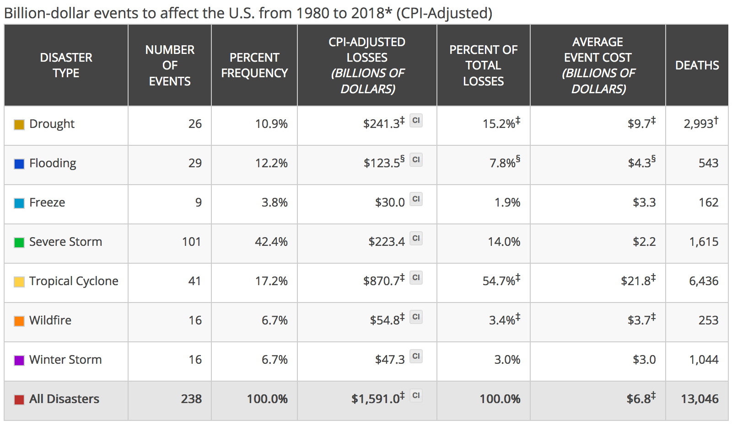
NOAA Historical Hurricane Tracks: 1851 - previous season
Hurricanes cause more damage and deaths than all other natural disasters combined.
Source: NOAA National Centers for Environmental Information (NCEI) U.S. Billion-Dollar
Weather and Climate Disasters (2018). https://www.ncdc.noaa.gov/billions/

Slide 6
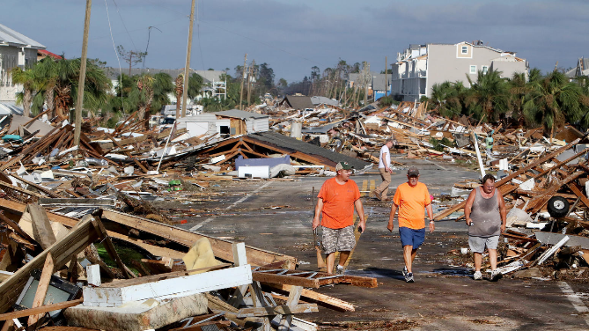
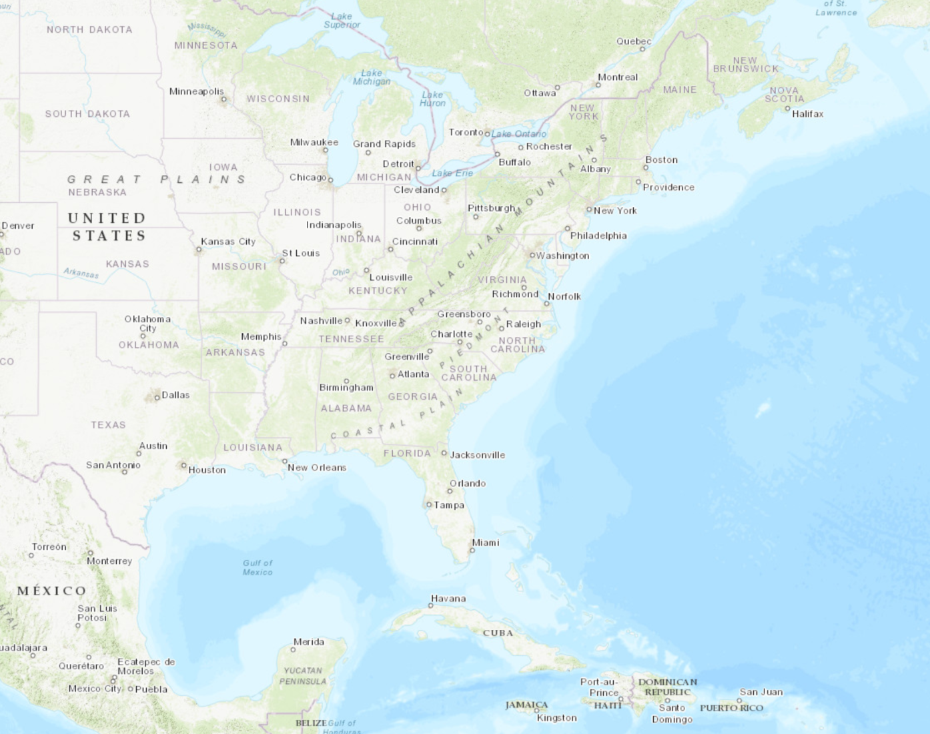
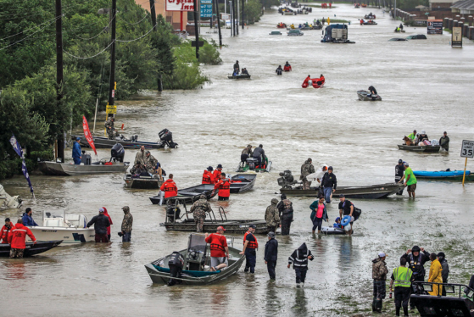
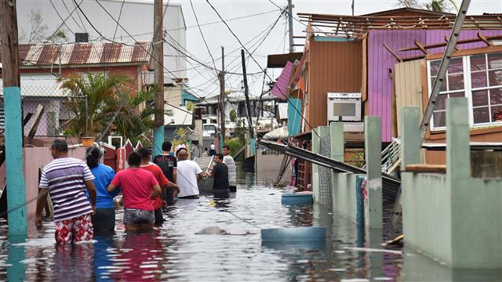
Tropical Cyclone Damage in the U.S. since 2011
Michael
>$400 Billion in Damage
3532 Deceased
Sandy
2012
$72b
Irene
2011
$15
Harvey
Florence 2018
TBD
Lee
2011
$3
Matthew
2016
$11
Harvey
2017
$128b
Michael 2018
TBD
Isaac
2018
$3
Maria
Irma
2017
$51
Maria
2017
$92b
Source: NOAA National Centers for Environmental Information (NCEI) U.S. Billion-Dollar
Weather and Climate Disasters (2018). https://www.ncdc.noaa.gov/billions/

Slide 7
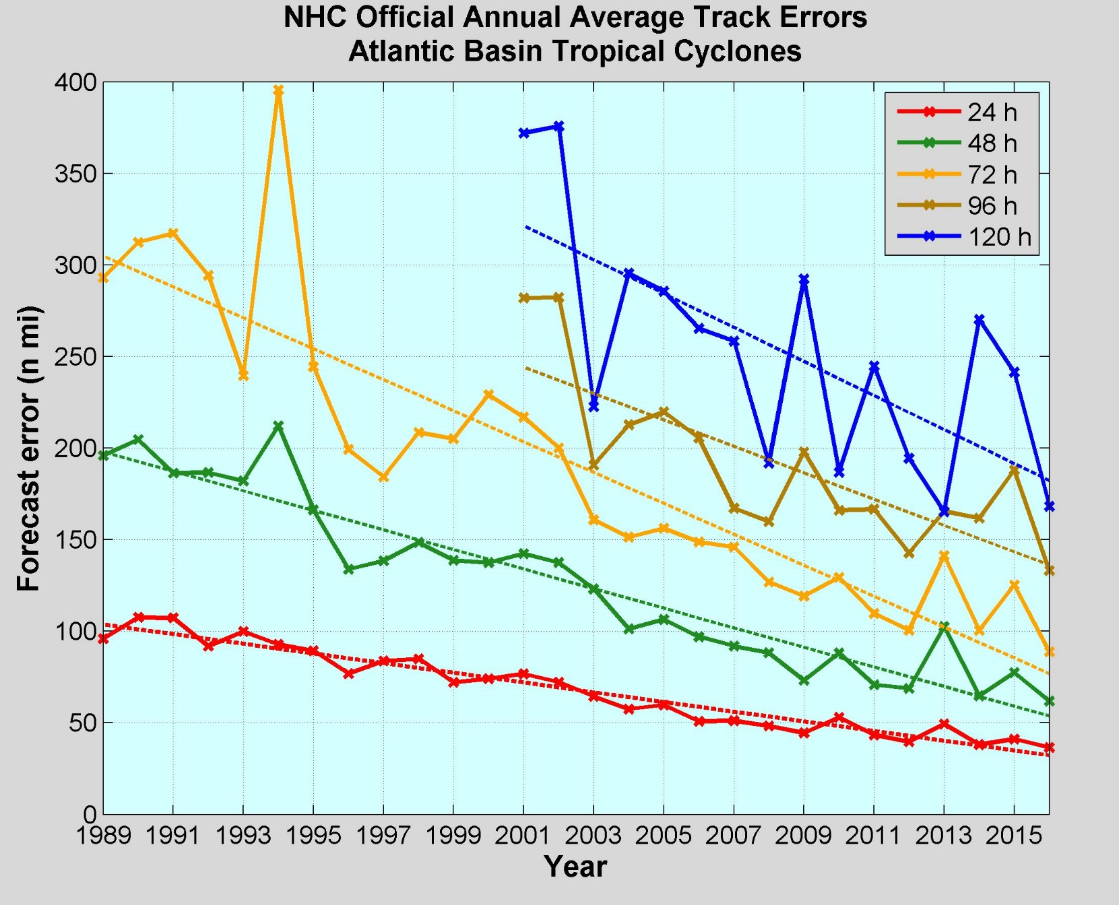
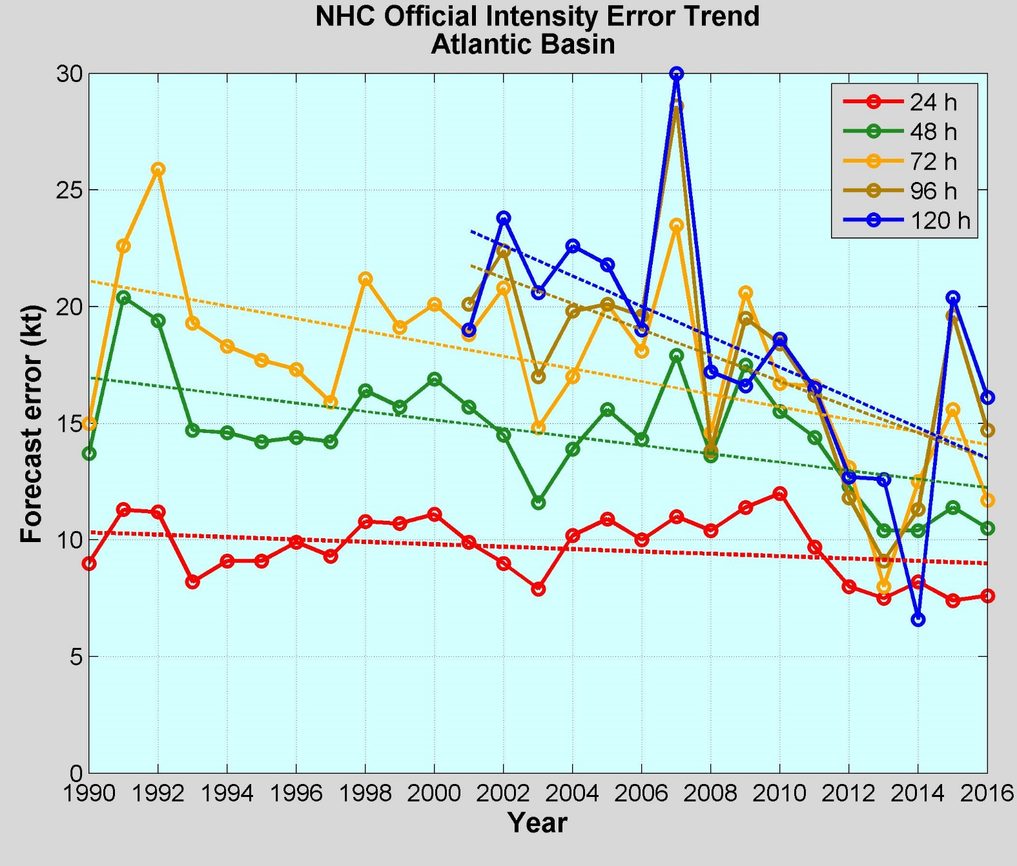
Average Track Errors:
Atlantic Basin
Average Intensity Errors:
Atlantic Basin
Limitations on Hurricane Intensity Forecast Improvement:
Computing resources and model resolution (Rotunno et al., 2009)
Poor understanding of the atmospheric boundary layer (Nolan et al., 2009; Andreas et al., 2015)
Difficulty in modeling the upper ocean response to storm forcing (Yablonsky and Ginis, 2009).
Cangialosi and Franklin 2017

Slide 8
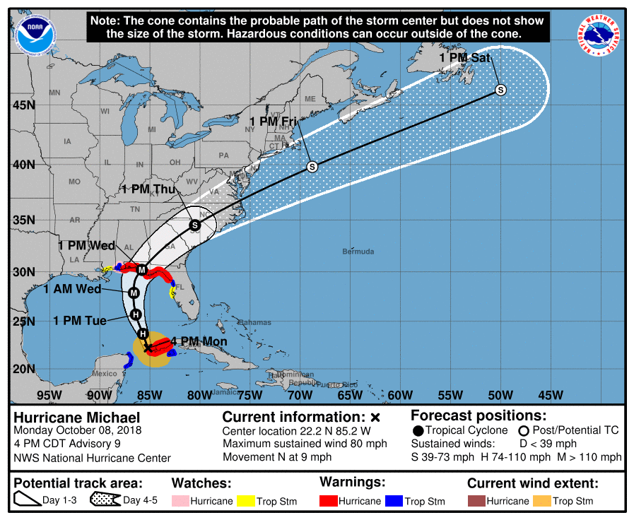
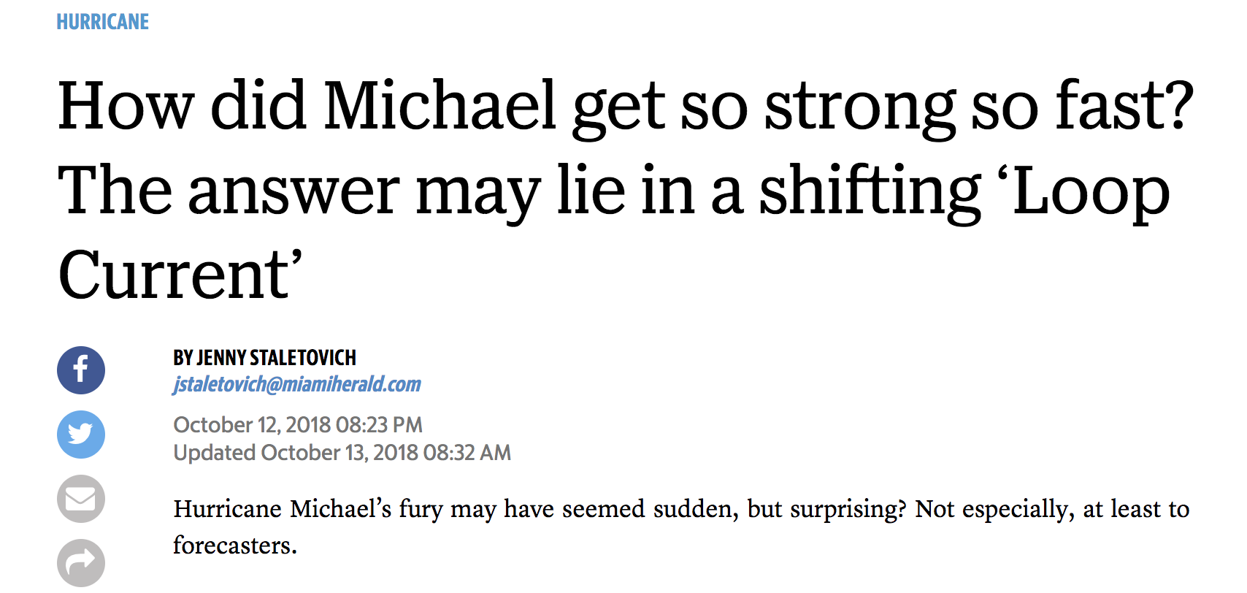

Hurricane Michael – Rapid Intensification before US Landfall
3 cycles of rapid intensification:
>35 mph increase in less than 24 hours
“Where do we focus attention?
Increasingly, with Michael as the latest example, the answer is ocean.”

Slide 9
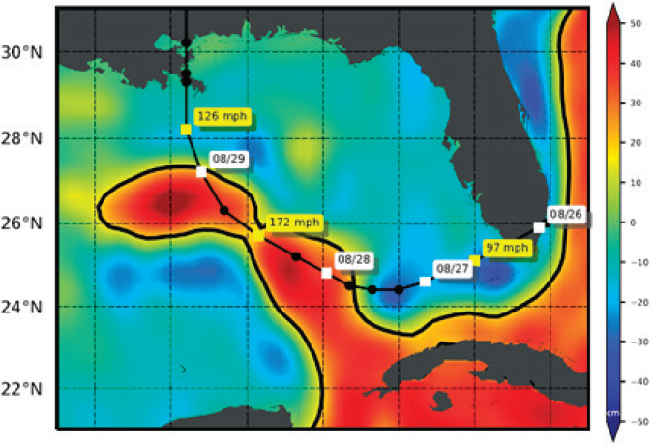
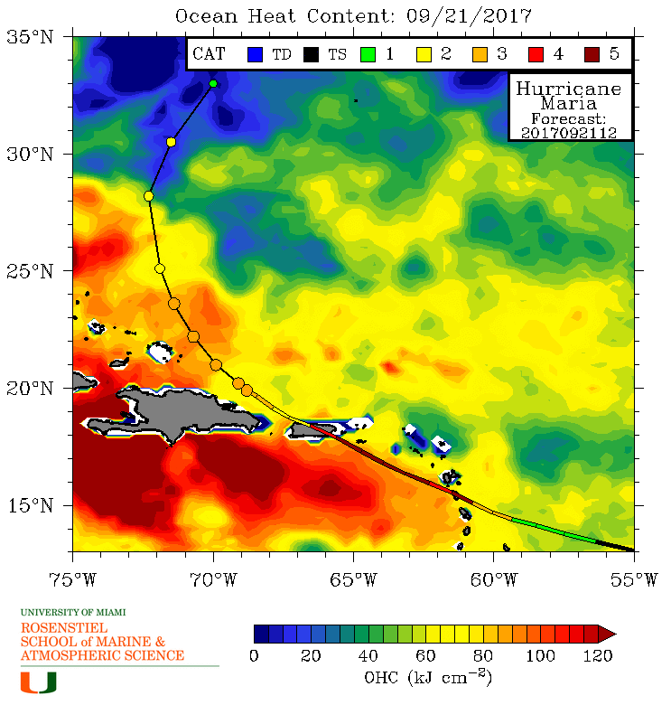
Hurricane Intensity modulated by upper Ocean Heat Content
Hurricane Katrina 2005
Hurricane Maria 2017
Rapid intensification observed where ocean has deep warm layers

Slide 10
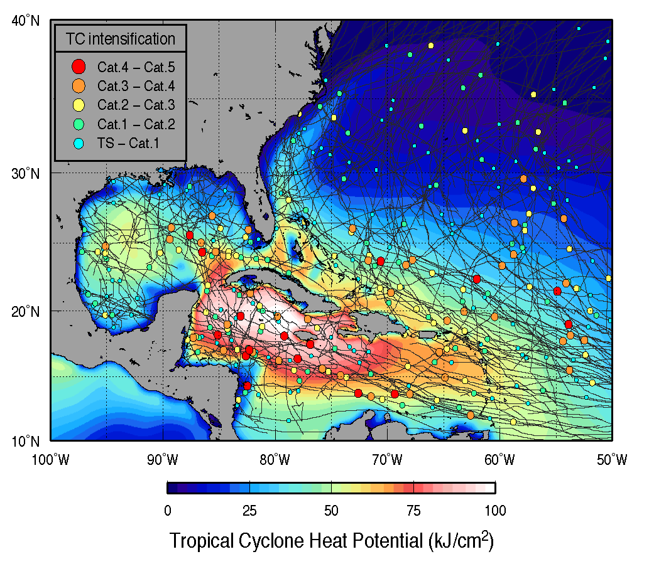

Locations of Hurricane Rapid Intensification
In 2017, 39 cases of rapid intensification observed, only 6 forecast

Slide 11

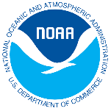




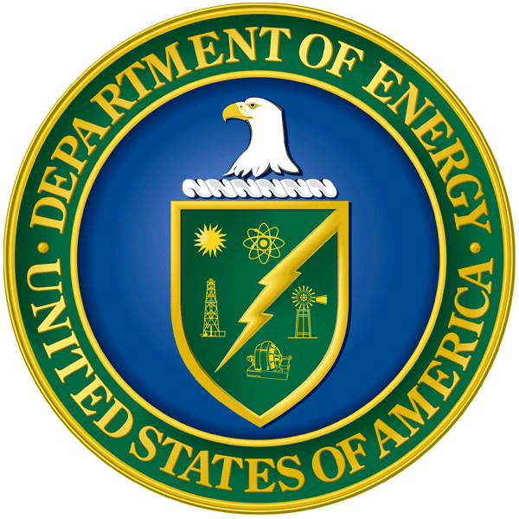
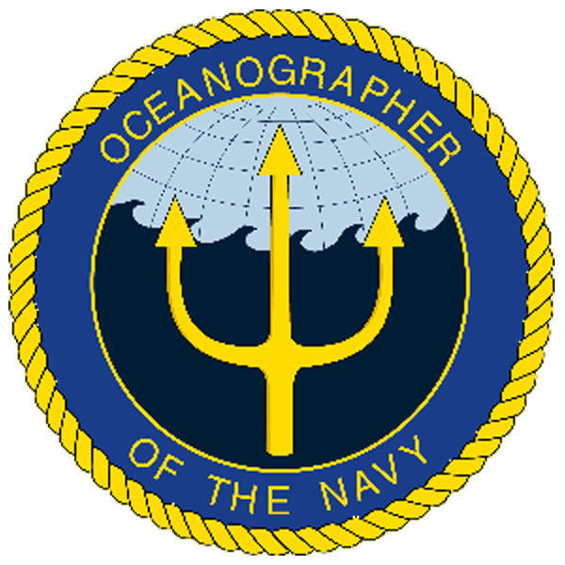
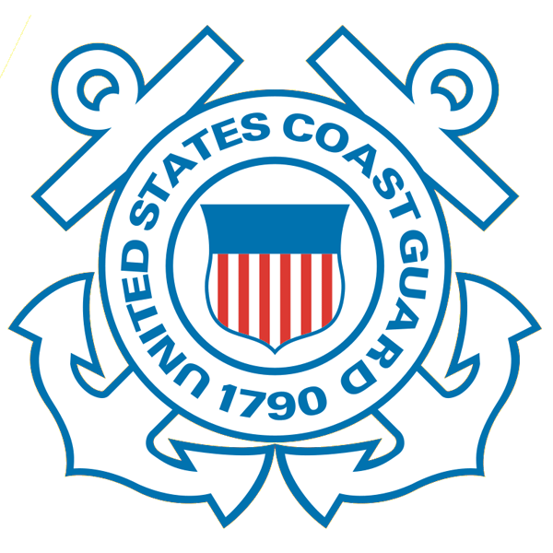




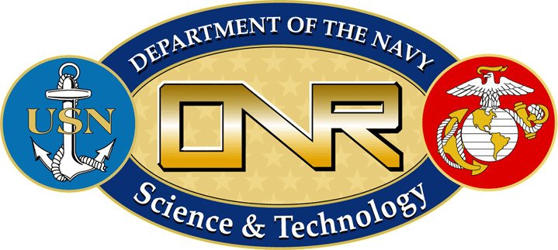




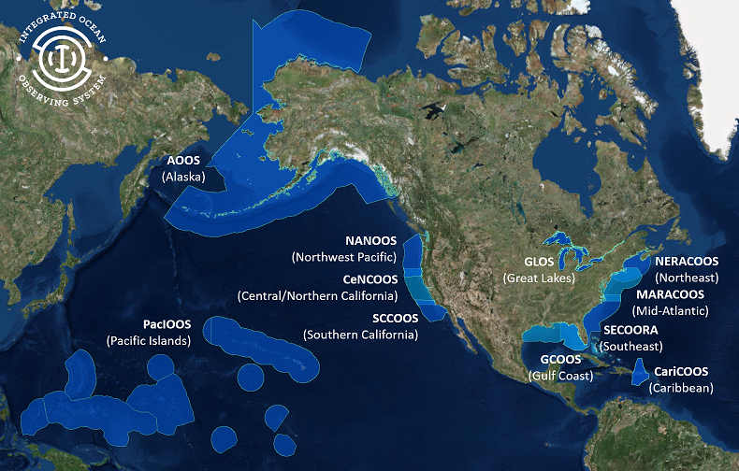
Integrated Ocean Observing System (IOOS)
Partnership effort that leverages dispersed national investments to deliver ocean, coastal and Great Lakes data relevant to decision-makers.
  Global Component
  US contribution to Global Ocean Observing System (GOOS)
  1 of 15 Regional Alliances of GOOS
  National Component
  17 Federal agencies
Regional Component
  11 Regional Associations
    Stakeholder driven
    Academia, state/local/tribal government, private industry
Notes:
NOAA is the Lead Federal Agency
US IOOS program office is within NOAA, but intended to be a multi agency network and federal to non-federal so we use the term U.S. IOOS.
Additional Background:
US IOOS is a national endeavor and spans from global to coastal, with federal and non-federal partners. The majority of non-federal partners are represented by 11 Regional Associations (RAs) that represent the US EEZ and Great Lakes.

Slide 12

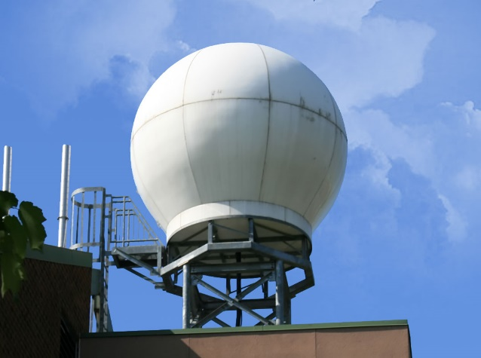
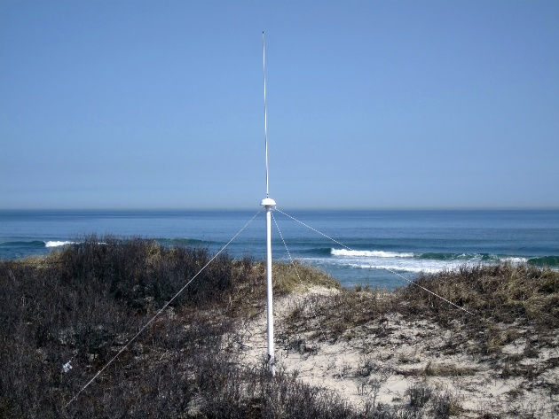
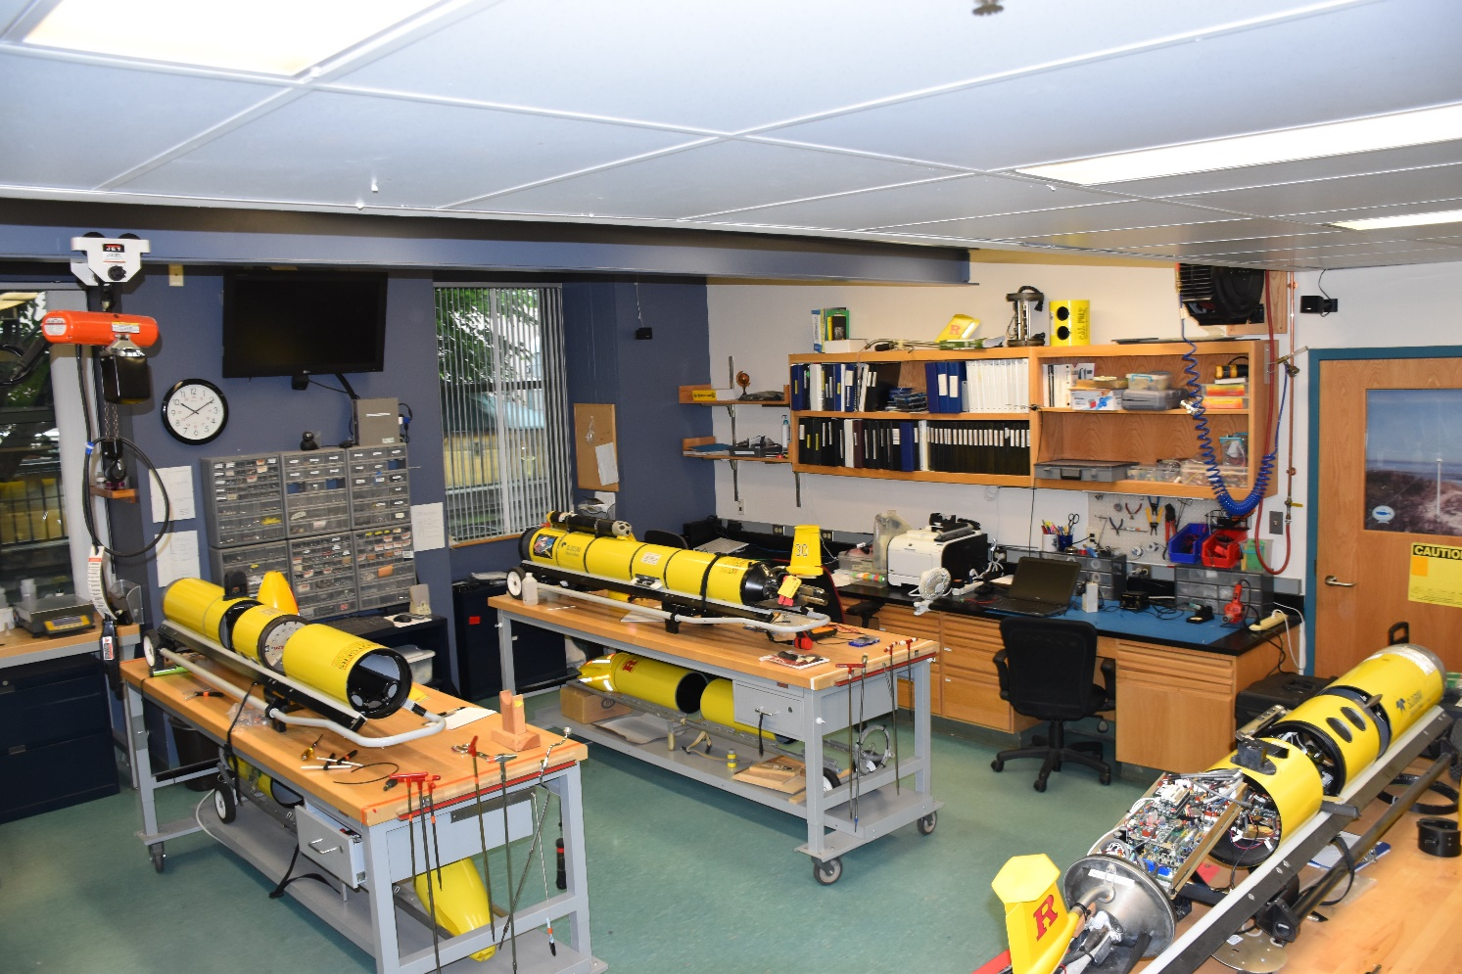
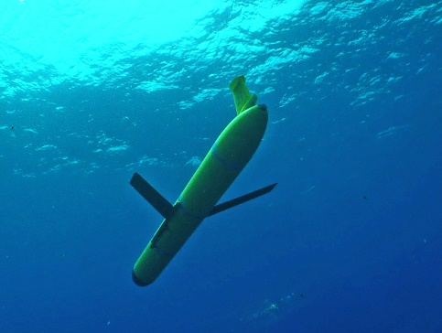
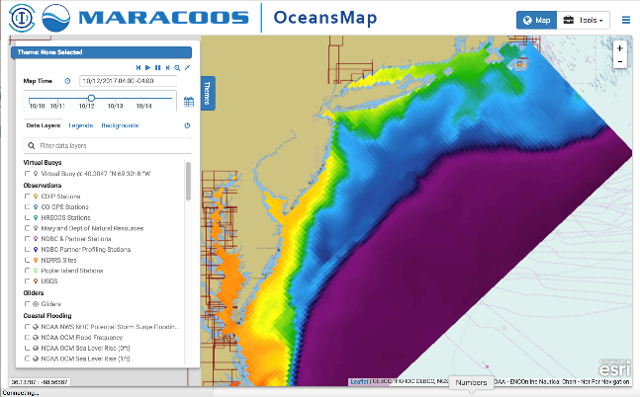

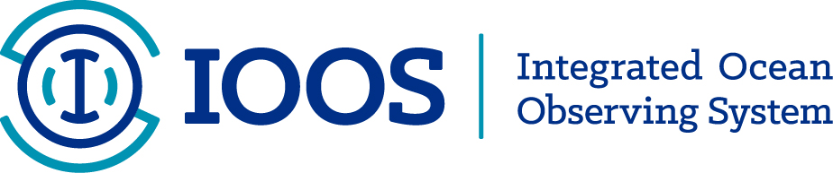

MARACOOS Operations Center:
Rutgers University Center for Ocean Observing Leadership
Satellite Receivers
46 Site CODAR Network
>480 Glider
Deployments
Met-Ocean
Modeling
Glider Lab
Notes:
12
All of this gets combined into our overall operations, research, and educational initiatives in the “COOL Room,” shown here (with a class in the background)
Thanks to many partners

Slide 13
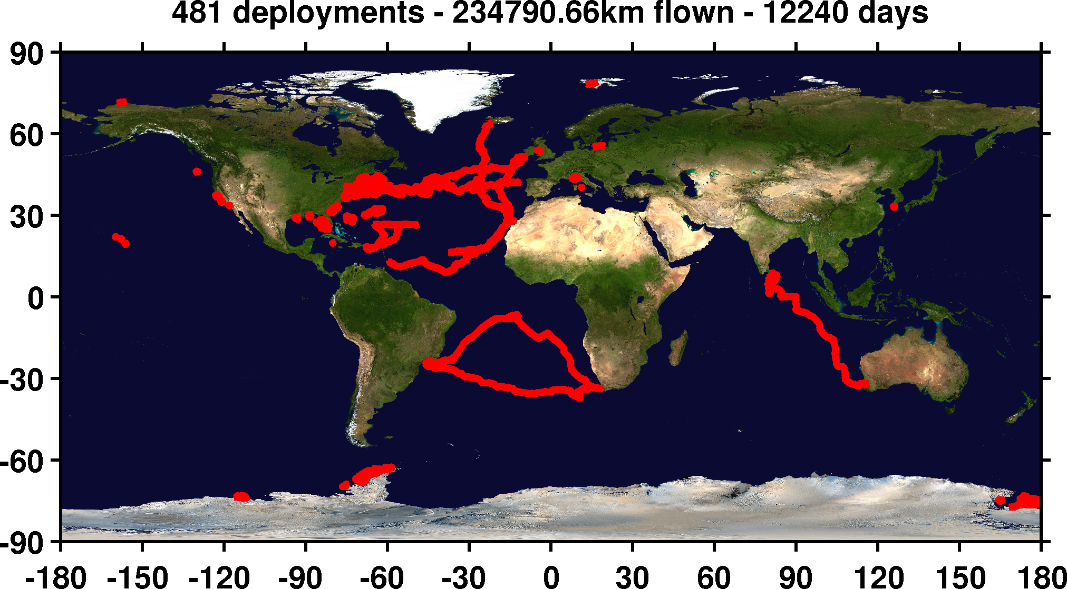
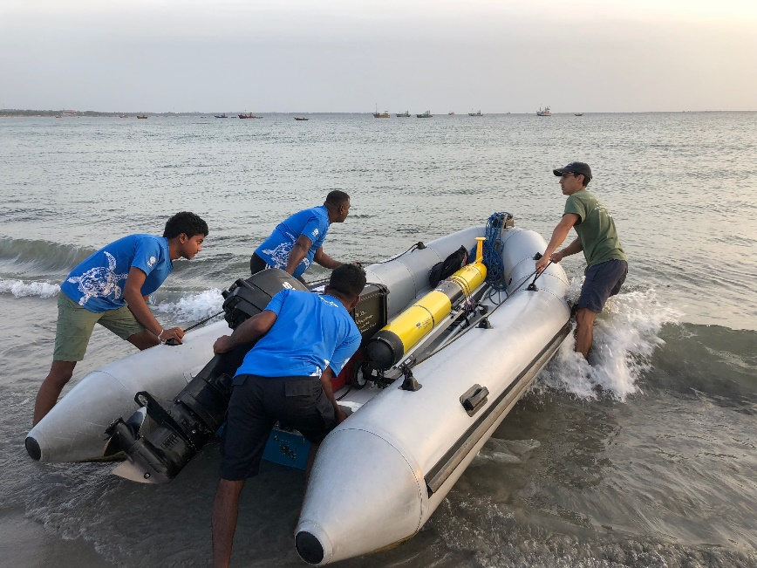
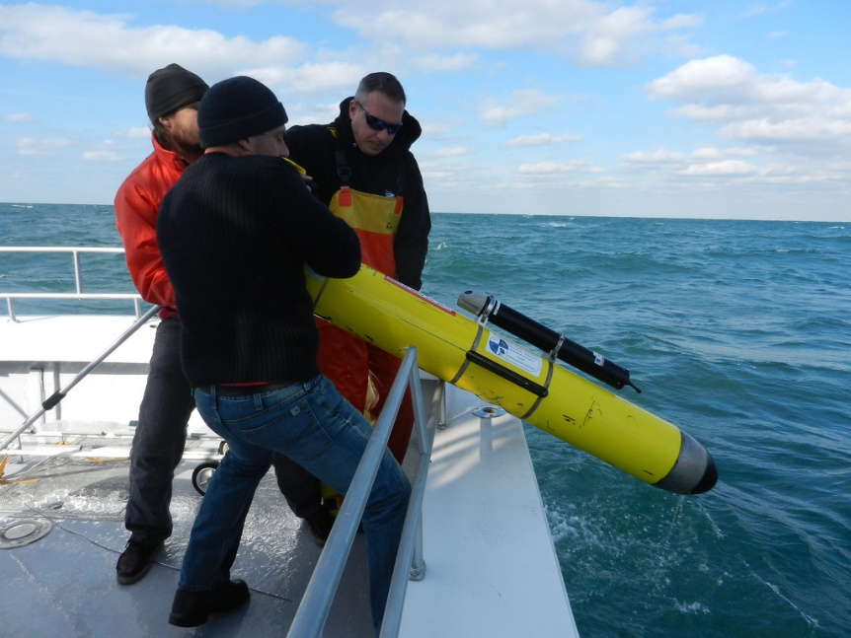
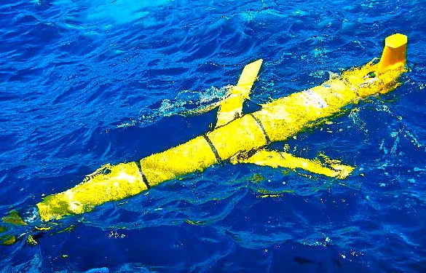
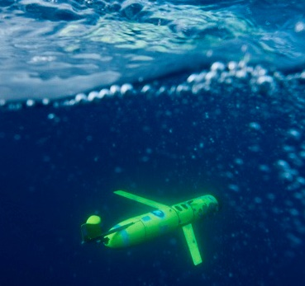

Slide 14
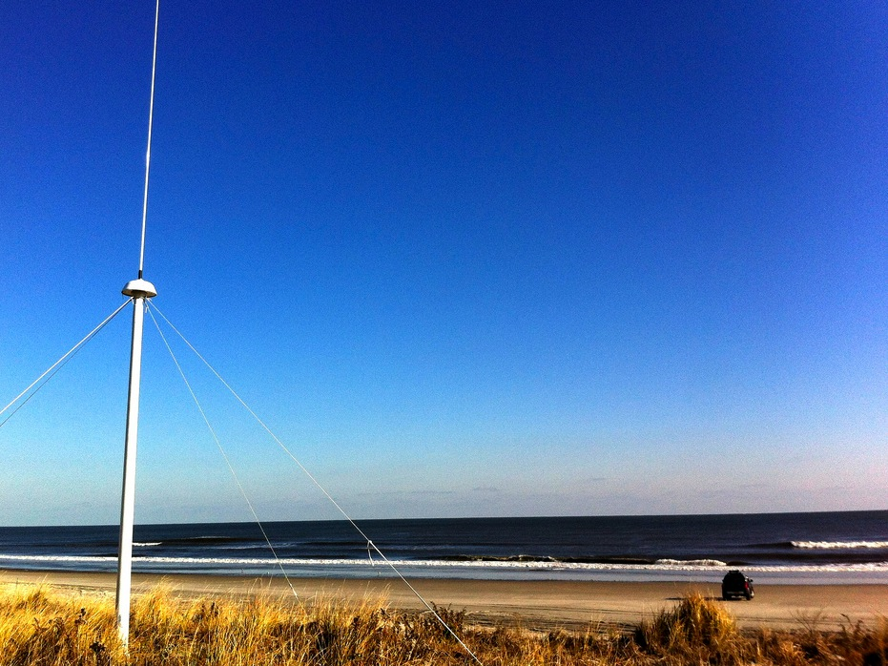
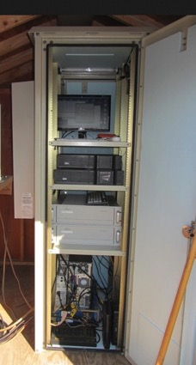
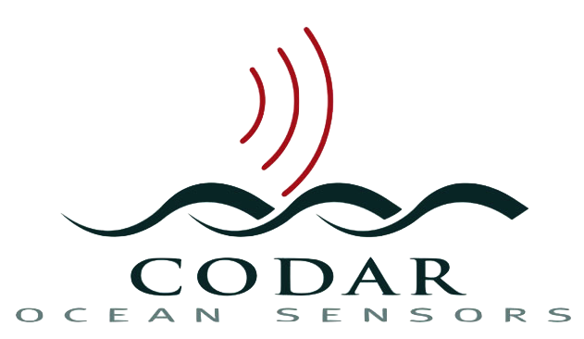
13 MHz Transmit and Receive Antenna
Weathertight SeaSonde Enclosure
Doppler shift gives ocean currents
monitor
computer & external hard drive
A.C. unit
UPS system
transmitter
receiver
lightning protection
two lines of Communication
4 m
SeaSonde
HF Radar

Slide 15
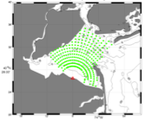
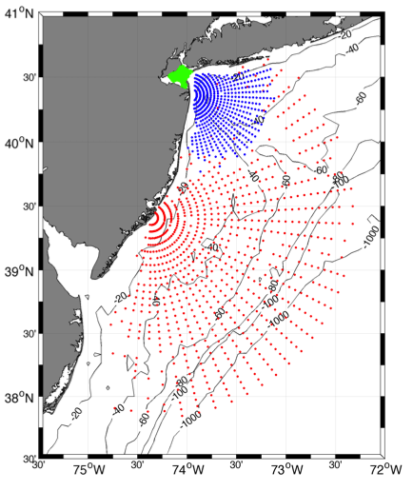



Individual HF Radar Sites
Generate Radial Vector Surface Current Maps
25 MHz
Radar λ: 12 m Ocean λ: 6 m
Range: >30 km Resolution: 1 km
13 MHz
Radar λ: 23 m Ocean λ: 12 m
Range: >80 km Resolution: 3 km
05 MHz
Radar λ: 60m Ocean λ: 30 m
Range: >180 km Resolution: 6 km

Slide 16
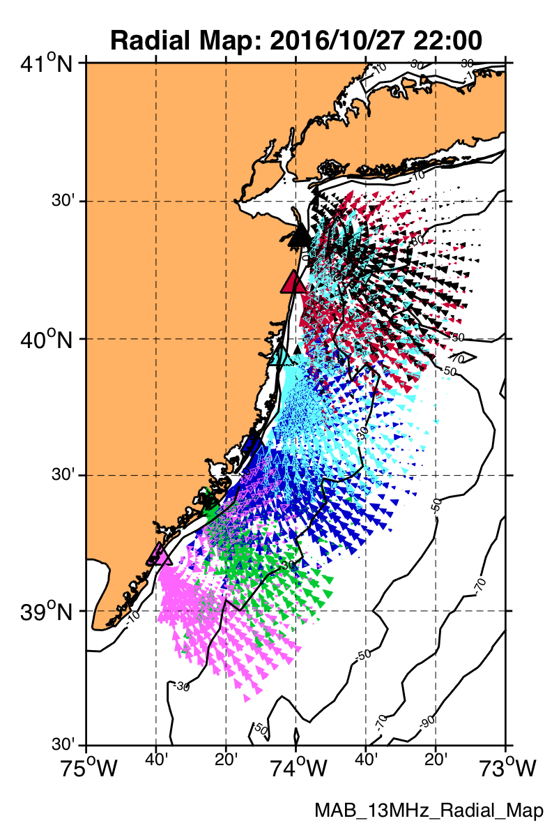
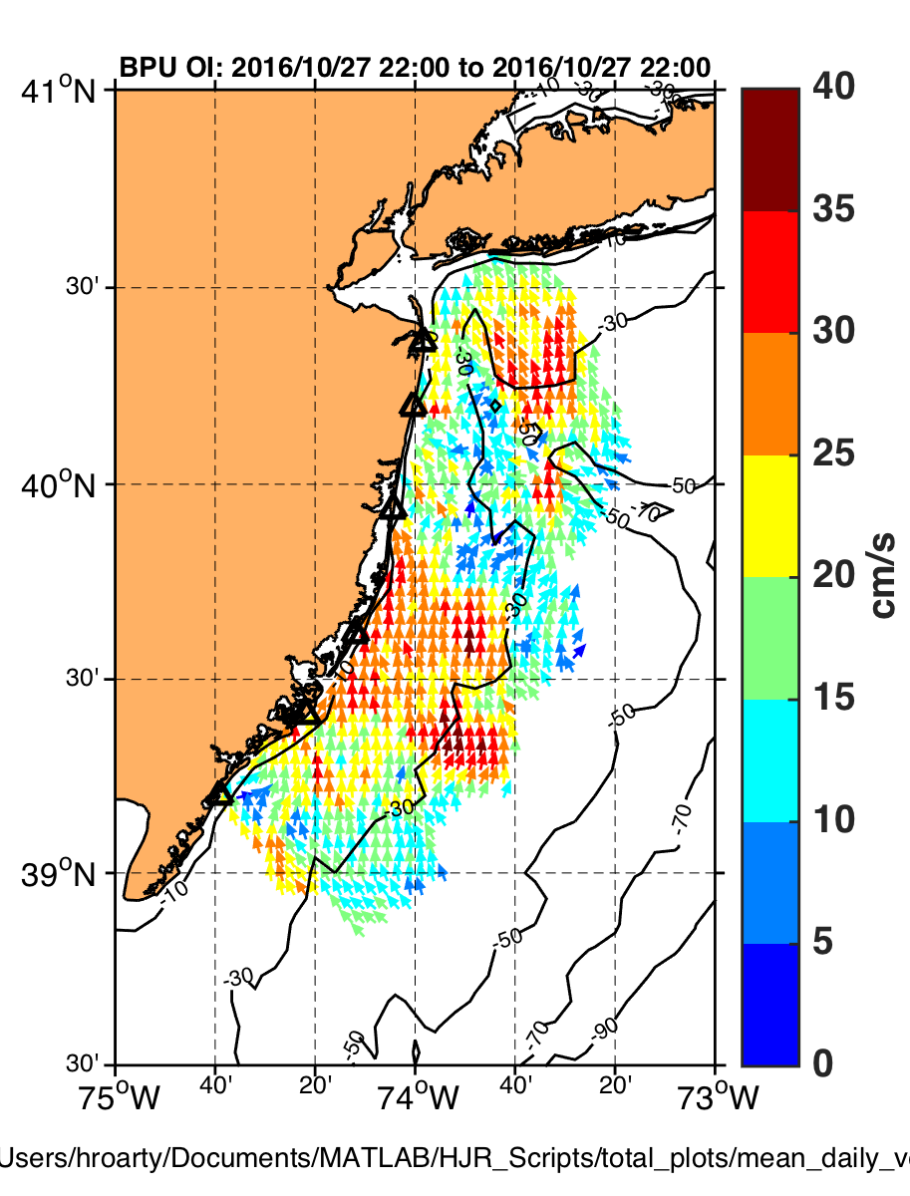
Radial Current
Vectors from Multiple Sites
Combined into Total Vectors
by UWLS or OI

Slide 17
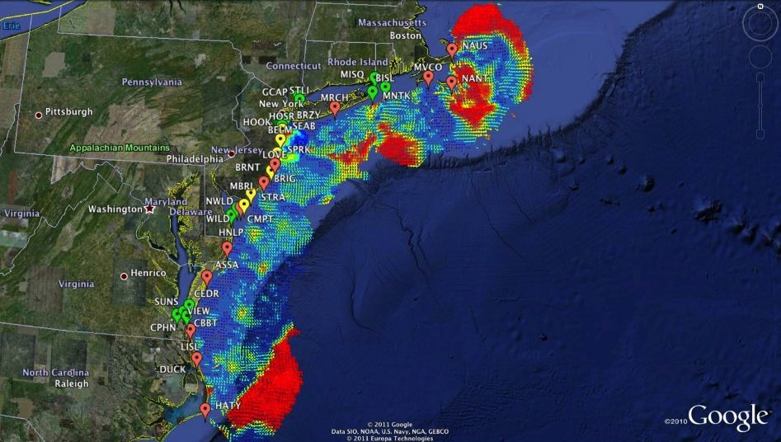

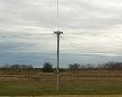
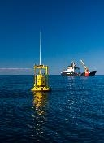
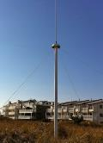

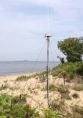






Mid-Atlantic Bight HF Radar Network
Generates Total Vector Surface Current Maps
1000 km
Cape to Cape
Mid-Atlantic HF Radar Network
17 Long-Range CODARs
8 Medium-Range CODARs
16 Short-Range CODARs
41 Total CODARs in Region
+5 CODARs Roaming
46 Total CODARs
Triple Nested, Multi-static, Multi-use
Industry Partner: CODAR Ocean Sensors

Slide 18
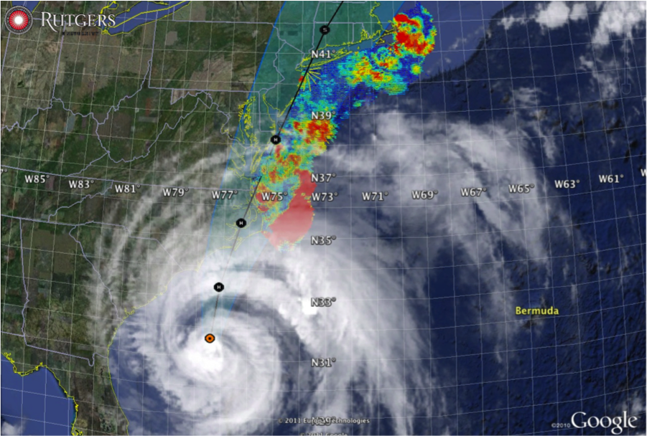

Hurricane Irene
August 28, 2011
NOAA/NHC Damage:
>$15 Billion, #14.
Track Accurate;
Intensity Over-predicted.
Avila & Cangialosi, 2012, Tropical Cyclone Report
Hurricane Sandy
October 29, 2012
NOAA/NHC Damage:
>$72 Billion, #4.
Track Accurate;
Surge Under-predicted.
Georgas et al., 2014, J. of Extr. Even.
Colle et al., 2015, J. Mar. Sci. & Engr.

Slide 19
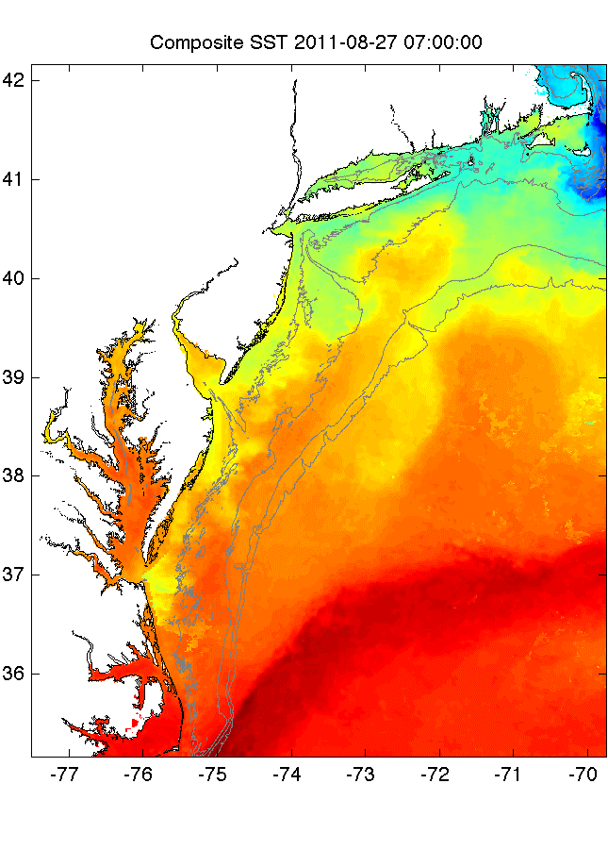
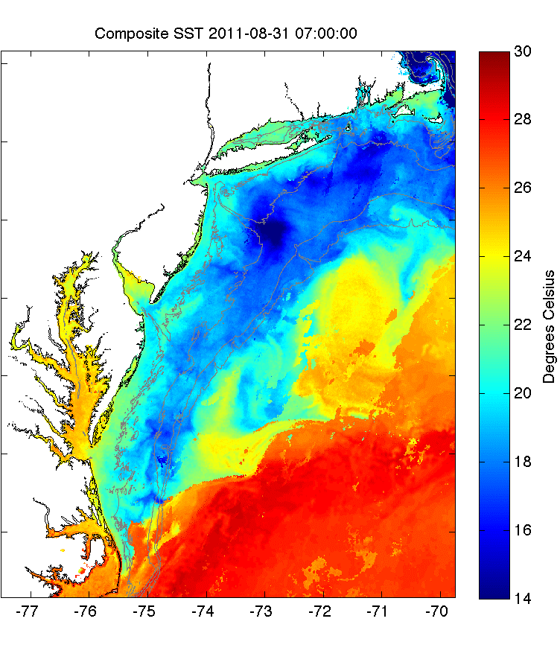



Pre-Irene
Post-Irene
Difference
11C max Cooling
WHAT?
Satellite
SST
WHEN? Glider Temperature
WHY?
HF Radar
Currents
Eye Passage
Essential Ocean Processes:
Ahead of eye center – Vertical Shear > Mixing > Cooling

Slide 20



New Scientific Understanding:
Two types of coastal ocean response
to Mid Atlantic hurricanes discovered
The essential ocean features are
  Seasonally warmed surface water
  Persistent Cold Pool bottom water.
The essential ocean processes are
  (a) ahead-of-eye mixing/cooling
  (b) ahead-of-eye advection.
The essential ocean impacts on the atmosphere are
  (a) ocean mixing/cooling reduces storm intensity - Irene
  (b) offshore advection acts to increase intensity - Sandy
+ Monthly Weather Review (2016)
+ JGR-Oceans (2017)
+ JGR-Oceans (2017)

Slide 21




Since
1946
Hurricane Sentinels – Starting 2018

Slide 22

Hurricane Sentinel Gliders deployed in 3 Picket Lines
Florence
Helene
Isaac
>30 Hurricane Sentinel Gliders from the Navy, NOAA, NSF, Academic & Industry Partners
reporting ocean conditions through the U.S. IOOS Glider Data Assembly Center (DAC)
ahead of Hurricanes Florence, Isaac and Helene on September 11, 2018.

Slide 23


WMO/IOC JCOMM Global HF Radar Network
MARACOOS
> IOOS > GOOS
I
IOCARIBE
> GOOS
http://global-hfradar.org/

Slide 24
NASEM Loop Current Recommendations:
#3) Install HFRs on the oil platforms in the northern Gulf of Mexico
#10) Install HFRs for the Loop Current Outflow
#11) Install HFRs for the Loop Current Inflow
#3
#10
#11

Slide 25

CODAR SeaSondes in the Gulf of Mexico: Existing

Slide 26

CODAR SeaSondes in the Gulf of Mexico: Existing+Proposed
La Habana
Cabo San Antonio

Slide 27




Many Ocean Observing Education & Training Opportunities

Slide 28

Summary
Caribbean Corridor is a key component of the global climate system – AMOC heat transport, hurricane intensity
Gliders and HF Radar are recently added observing system elements in the Global Ocean Observing System (GOOS)
We can expand partnerships now – education programs > HF Radar operations > improved hurricane forecasts
CODAR SeaSonde
Mona Island, Puerto Rico
Rutgers & UPRM Partnership

