Slide 1
Pathways Toward Successful Underwater Glider Deployments
Mike Crowley, David Aragon, Scott Glenn, John Kerfoot, Gerhard Kuska, Josh Kohut, Laura Nazzaro
February 2018
Ocean Sciences
Portland

Slide 2
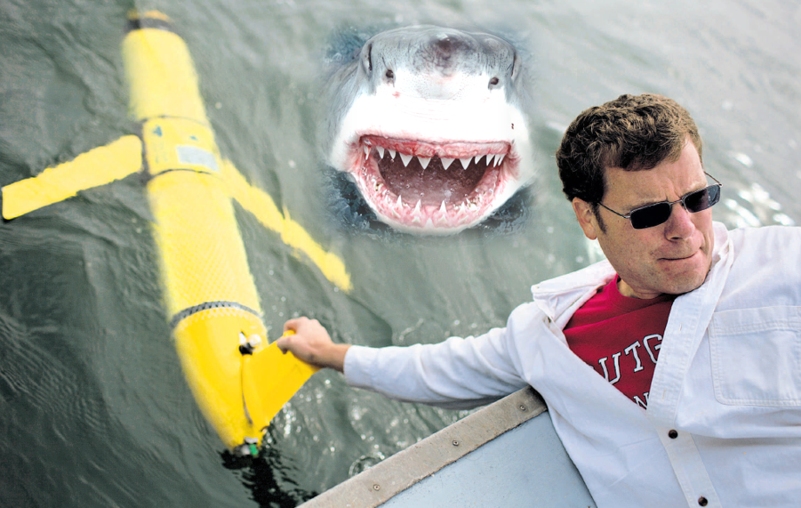
Just to clarify something before we get started…
Ocean Sciences 2018
crowley@Rutgers.edu
Notes:
Dedicated person, follow process, learns from others, does homework = success

Slide 3
The next 12 minutes
Overview of MARACOOS
IOOS Certification and QARTOD
Rutgers/MARACOOS Glider Experience
Glider Success Statistics
US Underwater Glider Workshop
Take Home Message:
A dedicated person that follows a process, learns from others’ experiences, and does their homework, is everything!
Ocean Sciences 2018
crowley@Rutgers.edu
Notes:
Dedicated person, follow process, learns from others, does homework = success

Slide 4
IOOS MARACOOS
Ocean Sciences 2018
crowley@Rutgers.edu

Slide 5
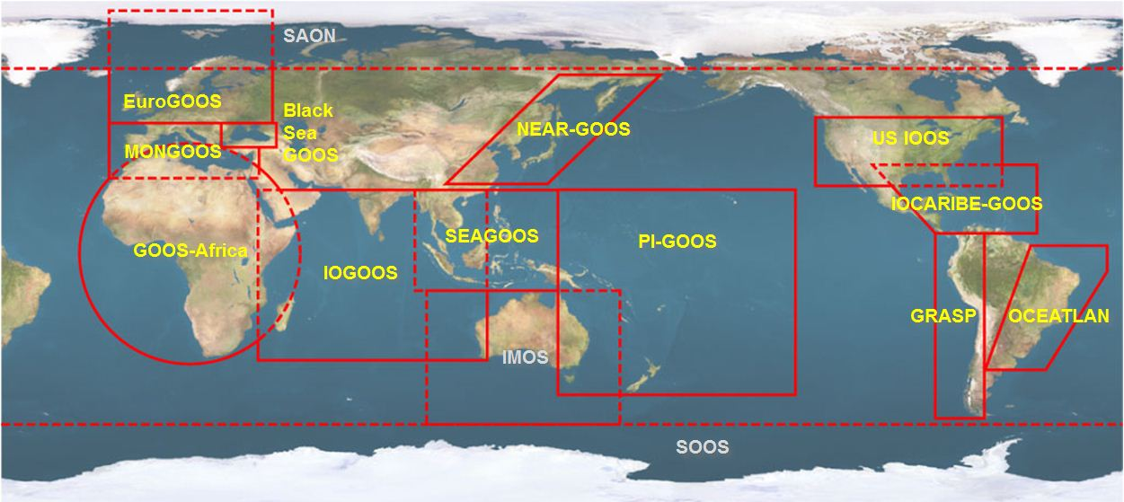
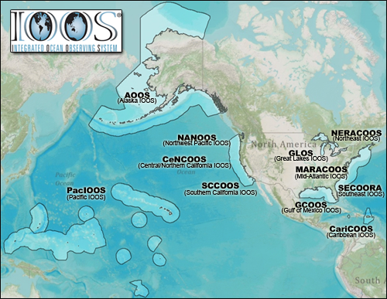
NOAA-led U.S. Integrated Ocean Observing System (IOOS)
Global Component
National Component
Regional Component
15 Regional Alliances in GOOS
Vessels -
Satellite
Satellite
CODAR
Ships/ Vessels
Glider
REMUS
Data Vis.
Modeling
Security
Leadership
Education
11 Regional Associations
17 U.S. Federal Agencies
Ocean Sciences 2018
crowley@Rutgers.edu

Slide 6
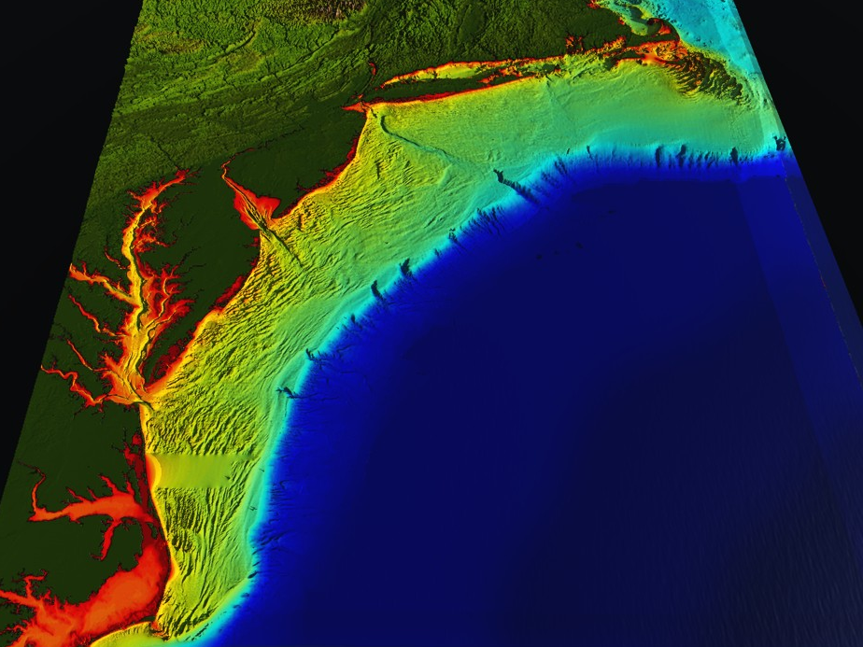
NOAA-led U.S. Integrated Ocean Observing System (IOOS)
RI
U..
Middle Atlantic
Regional Association
Coastal
Ocean Observing System
10 States - 76 Million People
1000 km Cape to Cape
CT
Cape
Cod
MA
NY
PA
NJ
DE
MD
MARACOOS:
An Integrated, Sustained & Certified Real-time Observation System
VA
501(c)3 association
25 universities
21 state/federal government agencies
18 private sector partners
12 non-governmental entities
NC
Cape
Hatteras
Ocean Sciences 2018
crowley@Rutgers.edu

Slide 7
MARACOOS Certification
MARACOOS’ ability to achieve and consistently maintain federal data quality standards led to its certification as a Regional Information Coordination Entity (RICE) in December 2016.
What does that all mean?
Assures users that MARACOOS data meet or exceed federal standards for quality (names names!)
Ensures that the data collected and distributed by the RICE are managed according to the best practices, as identified by NOAA.
MARACOOS.org/certification
Ocean Sciences 2018
crowley@Rutgers.edu

Slide 8
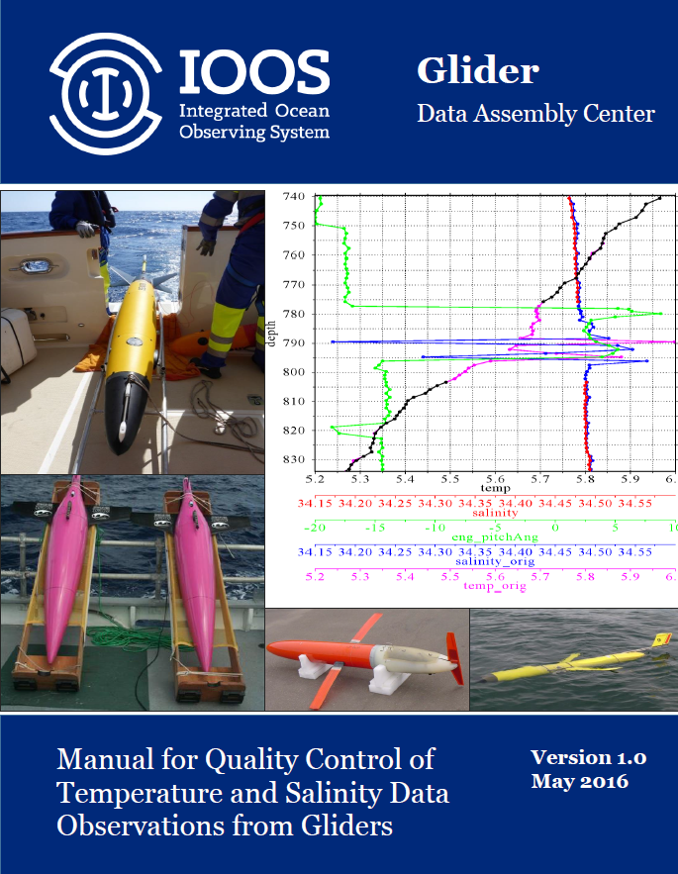
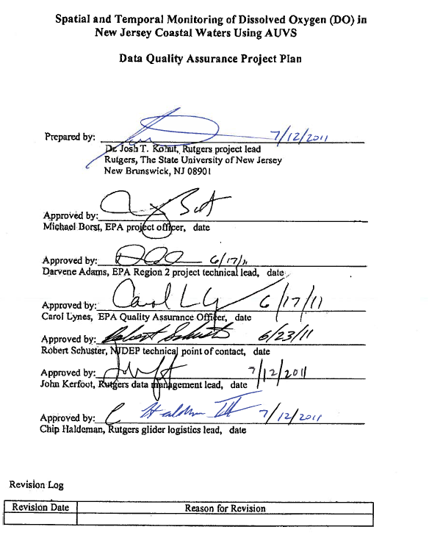
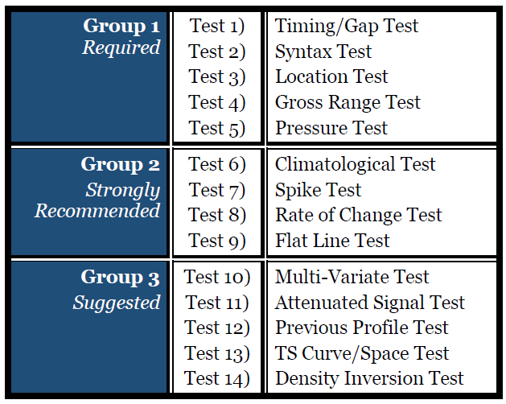
Glider Data QA/QC
QARTOD (thanks Mark B)
EPA Quality Assurance Project Plan:
Glider Mission Planning
SeaBird CTD
Aanderra Optode 3835
Documents for pre- and
post- deployment glider, CTD and DO QA
Ocean Sciences 2018
crowley@Rutgers.edu
Notes:
IOOS has used QARTOD for gliders as a minimum requirement for data quality. A list of data quality tests for all Glider data is shown at the right. MARACOOS has implemented the first 9 (required and strongly Recommended). This was not a big leap for MARACOOS as a glider QC document had been implemented in 2011 for the NJDEP, called a QAPP. This was QA AND QC. In addition to CTD, there were tests for DO as well.

Slide 9
Rutgers Glider Experience
Ocean Sciences 2018
crowley@Rutgers.edu

Slide 10
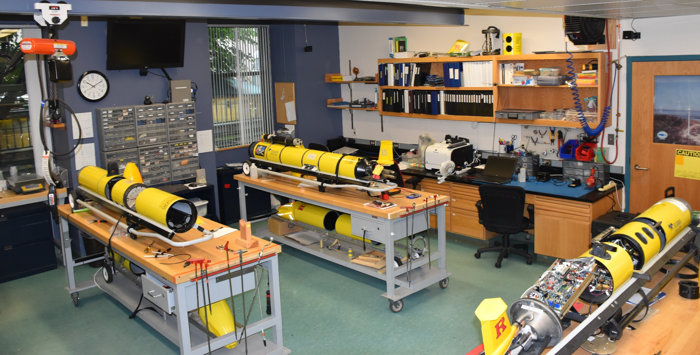
Rutgers Slocum Gliders
MARACOOS leverages Teledyne Webb Slocum Gliders
Ocean Sciences 2018
crowley@Rutgers.edu

Slide 11
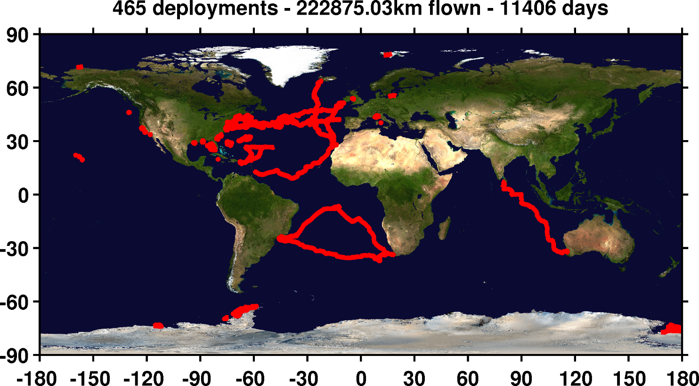
Rutgers/Partner Glider Experience
Mid-Atlantic: ~1/2
Ocean Sciences 2018
crowley@Rutgers.edu

Slide 12
Glider Success Statistics
Ocean Sciences 2018
crowley@Rutgers.edu

Slide 13
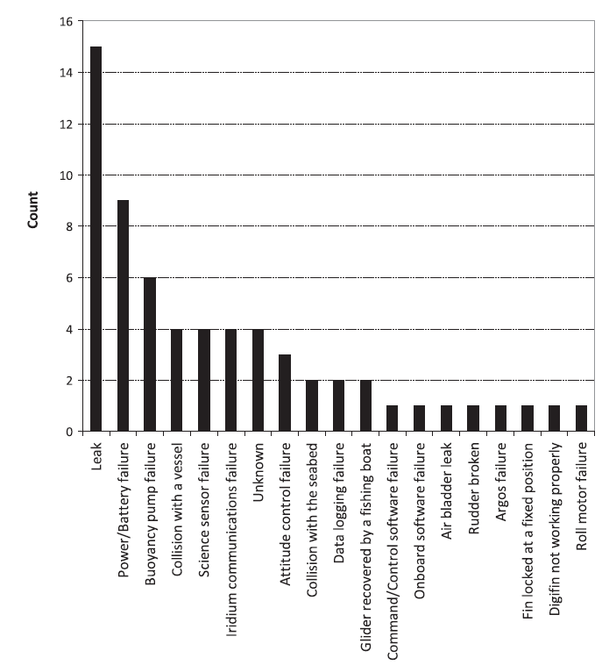
Some success statistics
General success rates with gliders has varied considerably
Statistical estimate basis varies (what is considered failure)
Some examples
Europe** (Brito 2014) 50% success deep gliders, 59% shallow (Slocum, Sea, Spray)
OOI approximately 56% success (Slocum)
** Brito, M., Smeed, D., Griffiths, G., 2014: Underwater Glider Reliability and Implications for Survey Design. Journal of Atmosphereic and Oceanic Technology, 31, 2858-2870., DOI: 10.1175/JTECH-D-13-00138.1.
Ocean Sciences 2018
crowley@Rutgers.edu

Slide 14
Success Stats: Scripps Spray & Rutgers Slocum Gliders
Successful missions either completed the planned deployment or completed science mission
Does not include missions that failed within 48 hours (IM).
 | Scripps Spray
# of Missions | 297
# Missions Ending with critical problems | 49
Success Rate | 84%
# Gliders Lost | 9
Rutgers Slocum
274
44
84%
9.5
Note: Gliders listed here are only gliders prepared, deployed and piloted by Rutgers and Scripps
** Rudnick, D. L., R. E. Davis, and J. T. Sherman, 2016: Spray underwater glider operations. Journal of Atmospheric and Oceanic Technology, 33, 1113-1122, doi: 10.1175/JTECH-D-15-0252.1.
Ocean Sciences 2018
crowley@Rutgers.edu
Notes:
A very high set of success rates for two different types of gliders as compared to other groups…. Why??

Slide 15
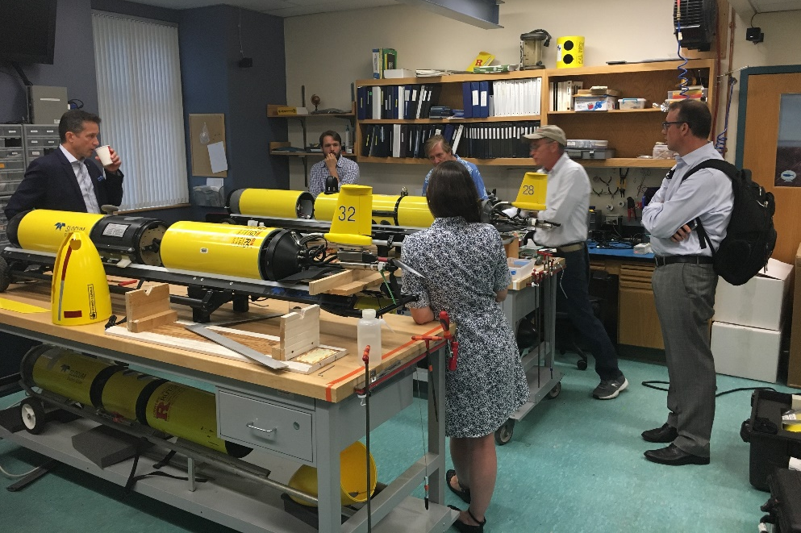
Statistics: Comparing apples to apples
Europe** (Brito 2014) 50% success deep gliders, 59% shallow (Slocum, Sea, Spray)
OOI approximately 56% success (Slocum)
Rudnick 84% (79%) success (Spray)
Rutgers 84% (79%) success (Slocum)
Why the success gap?
Ocean Sciences 2018
crowley@Rutgers.edu

Slide 16
US Underwater Glider Workshop: Glider Reliability Working Group
Ocean Sciences 2018
crowley@Rutgers.edu

Slide 17
January 18-19, 2017 at the INFINITY Science Center, LA
Ocean Sciences 2018
crowley@Rutgers.edu

Slide 18
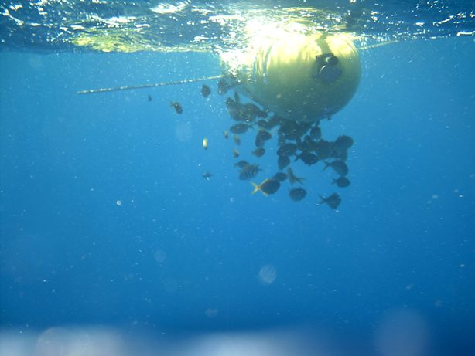
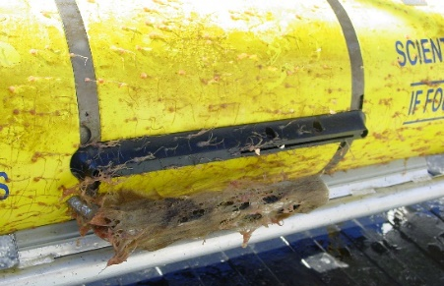
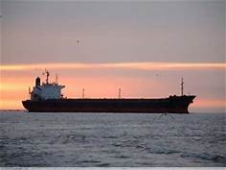
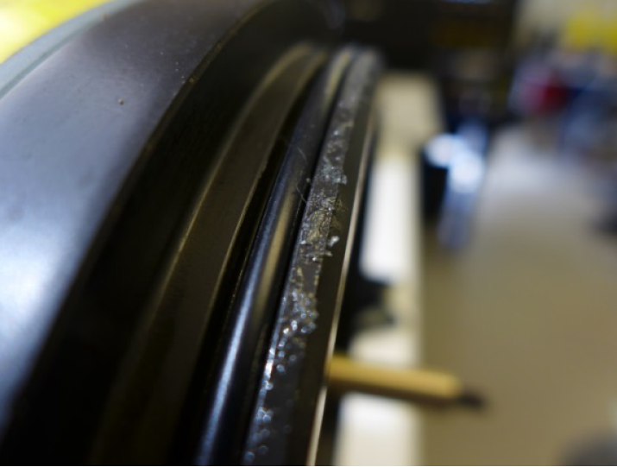
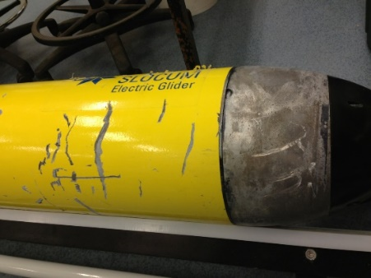
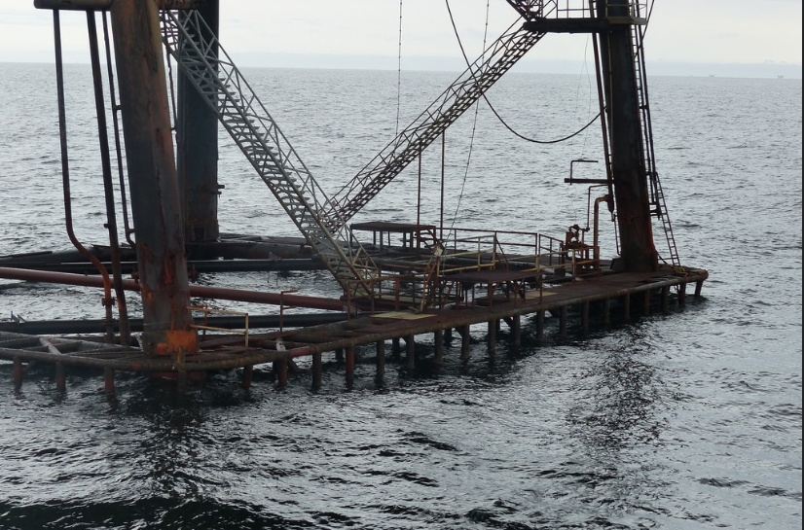
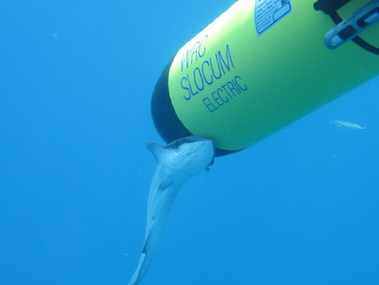
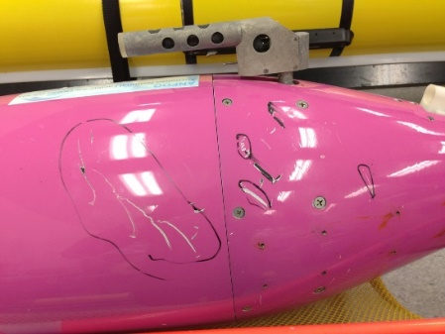
Breakout Session on Reliability
Purpose of breakout is to determine how to implement strategies towards minimizing operational reliability risks
Ocean Sciences 2018
crowley@Rutgers.edu
Notes:
I MC’d the session on reliability.
Note the last two slides here are issues that Rutgers had with two of our lost gliders. Kuwaiti tanker and oil platform.

Slide 19
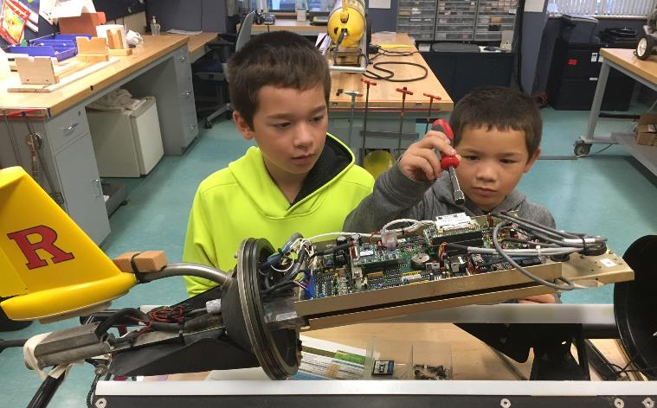
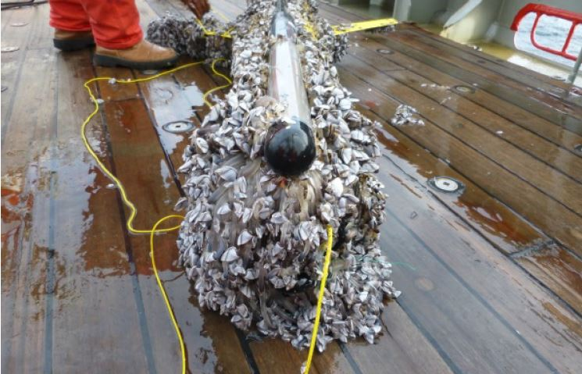
First we identified causes of failure: Examples
Inexperienced people/lack of available prep time/rush
Time between deployments
Deployment team separate from prep team, not focused solely on glider work
Biofouling or biological impact (shark, remora)
Leaks
Sensor failure (eg. ctd pump, or a pressure leak)
Buoyancy (fresh water lens)
Length of deployment (up to a year difficult, biology happens)
90 day cutoff (battery)
Damage in shipping
Environment challenges (currents)
Ocean Sciences 2018
crowley@Rutgers.edu

Slide 20
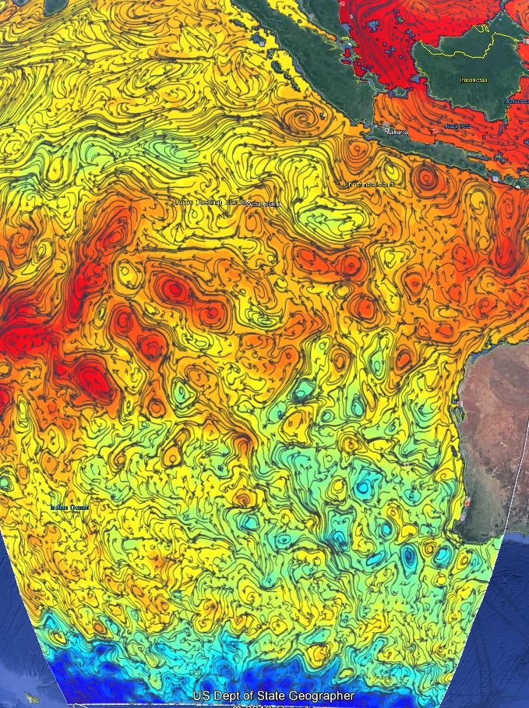
Ingredients for Success: The big 2
Some (not all) keys for success:
A single person or small team prepares, deploys and pilots (communication)
75-100% time focused on gliders (Scripps & Rutgers)
Regional expertise: do your homework!!
Fishermen
Shallow bathymetry
Currents
Fresh water (river outflows, ice melt)
Wrecks
Sea ice
Shipping lanes
Models
HF-RADAR
Satellite
Leverage ocean model guidance for remote locations (RTOFS)
Ocean Sciences 2018
crowley@Rutgers.edu

Slide 21
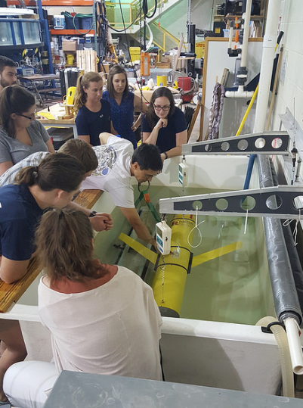
Challenges to future success
What are some of the challenges in achieving these opportunities?
$$
Dedicated personnel
Training
Testing
Technology refresh
Configuration management
You name it
Centralized feedback organization does not exist (user groups)…..
Ocean Sciences 2018
crowley@Rutgers.edu

Slide 22
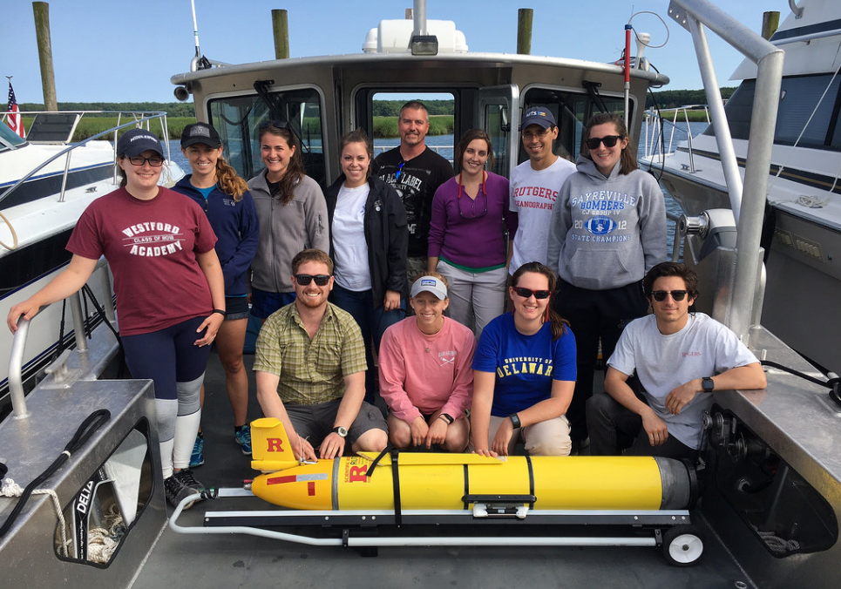
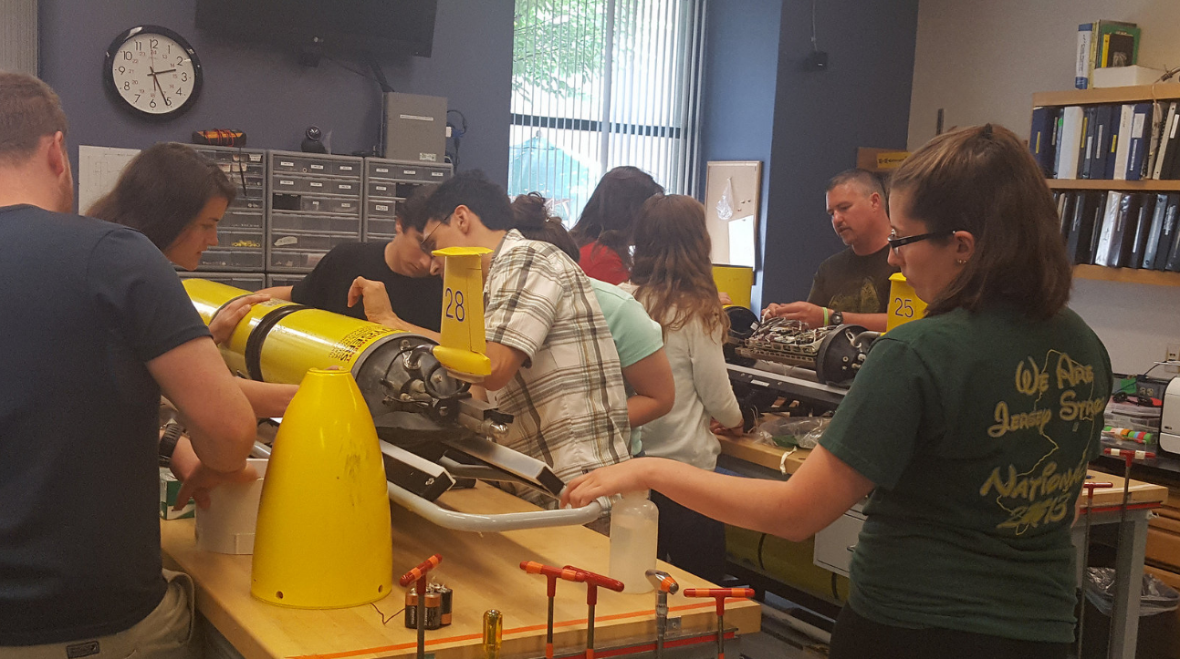
Glider reliability breakout: 1-3 year goals
Create a user working group
Resource pools (local expertise)
Training courses
Environmental testing process early, especially new sensors (vendors)
Formalize preparation procedures (users & providers)
Improved piloting software
Detailed feedback to glider producers to improve process
Root cause analysis (RCA)
Detailed record keeping by users
PROCESS, COMMUNICATIONS & SHARING
Ocean Sciences 2018
crowley@Rutgers.edu

Slide 23
RU Trending toward support of other groups
Ocean Sciences 2018
crowley@Rutgers.edu
Notes:
Over the last 15 years, Rutgers has transitioned from only performing deployments within the team, to supporting multiple glider teams in multiple ways including piloting, glider prep and data mirroring.

Slide 24
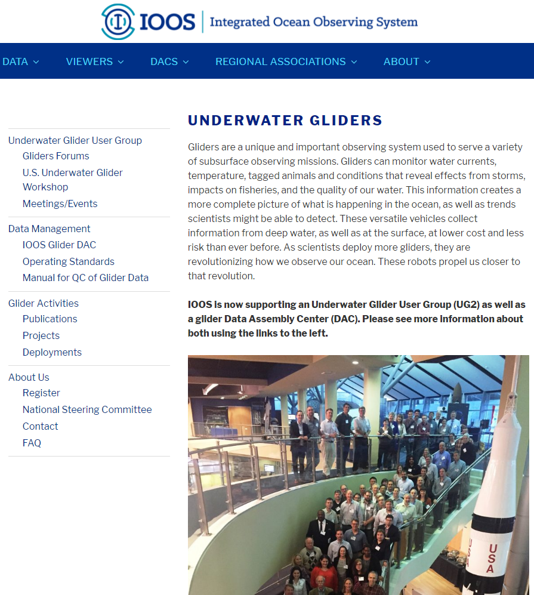
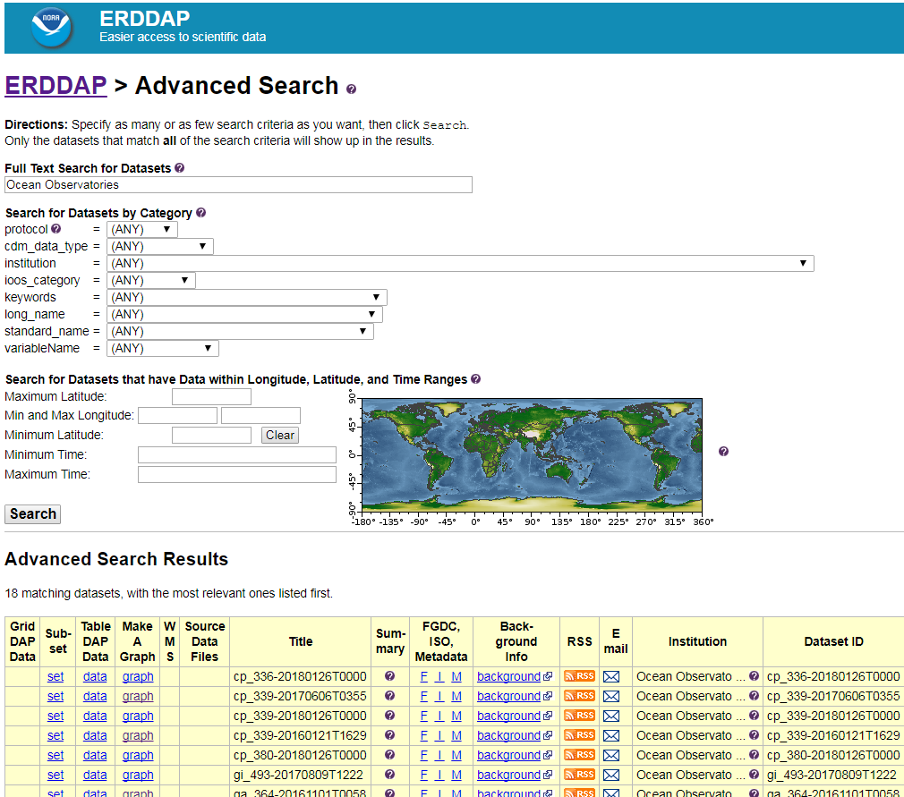
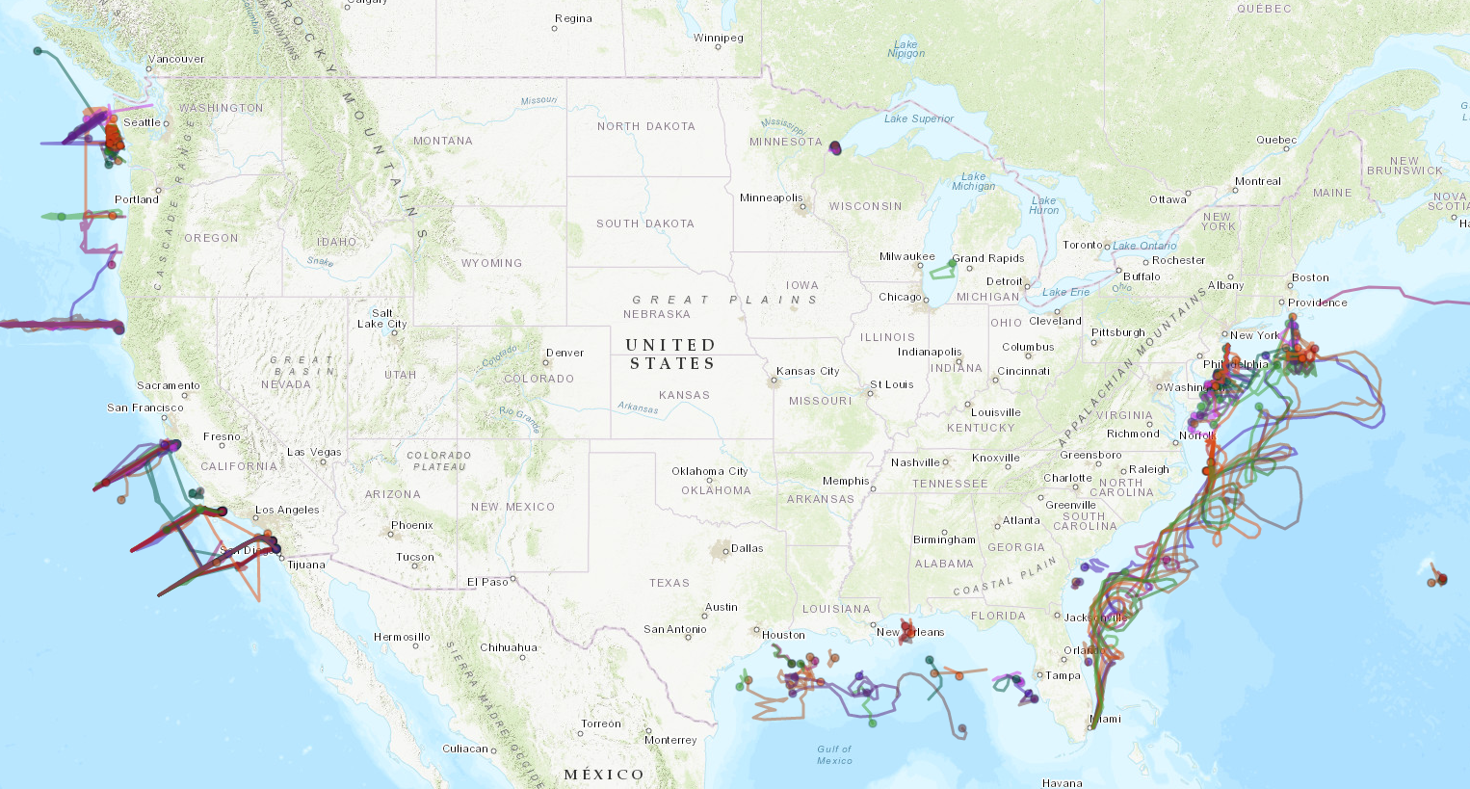
Success Path Step 1: User Group
Gliders.IOOS.us
It’s a start
Ocean Sciences 2018
crowley@Rutgers.edu

Slide 25
Glider reliability breatkout: Long Term Goals
4-10 year goals to minimize risk: The clock is our enemy, but time is our friend
Current technology needs to become more commercial
Improved power/batteries
Biofouling improvements (including remora)
Chlorine generation
Snails on a tether
Improved sensor calibrations
Minimized sensor drift
sensor/software redundancy where available
Configuration management – shared database of what sensors are used, how calibrated, etc
Cross agency collaboration
Ocean Sciences 2018
crowley@Rutgers.edu

Slide 26
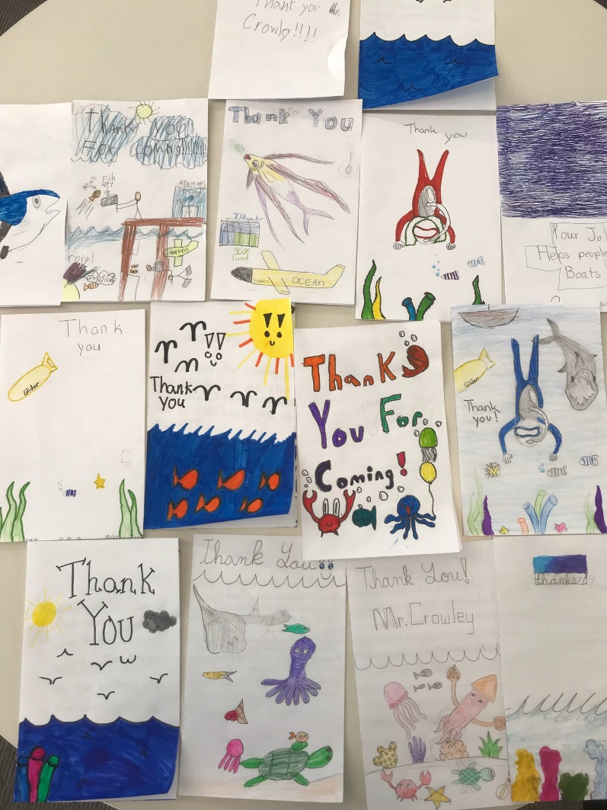
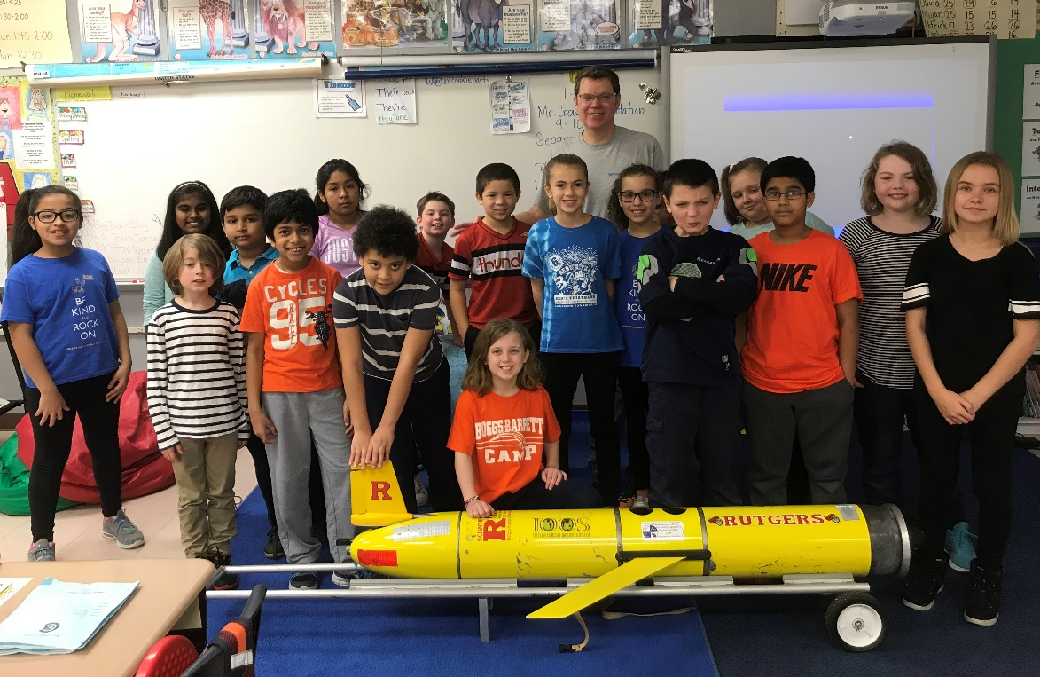
Because in 4-10 years….
… they can be more successful due to work we put in now.
Ocean Sciences 2018
crowley@Rutgers.edu
Notes:
If we can achieve these 4-10 year goals, these will be the glider technicians and pilots of tomorrow.

Slide 27
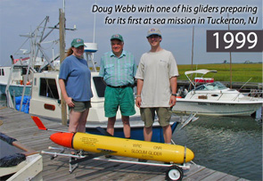
The Success Path
Preparation, preparation, preparation: Do your homework
Don’t be shy: Leverage other groups’ expertise (both success and failure)
Communication is a two way street (preaching to the choir)
The more we share the knowledge, the more successful we will be TOGETHER!! – Glider.IOOS.us is just getting started.
A dedicated person that follows a process, learns from others’ experiencs, and does their homework, is everything!
“Work hard, have fun, change the world”
– Doug Webb
Ocean Sciences 2018
crowley@Rutgers.edu

