Slide 1
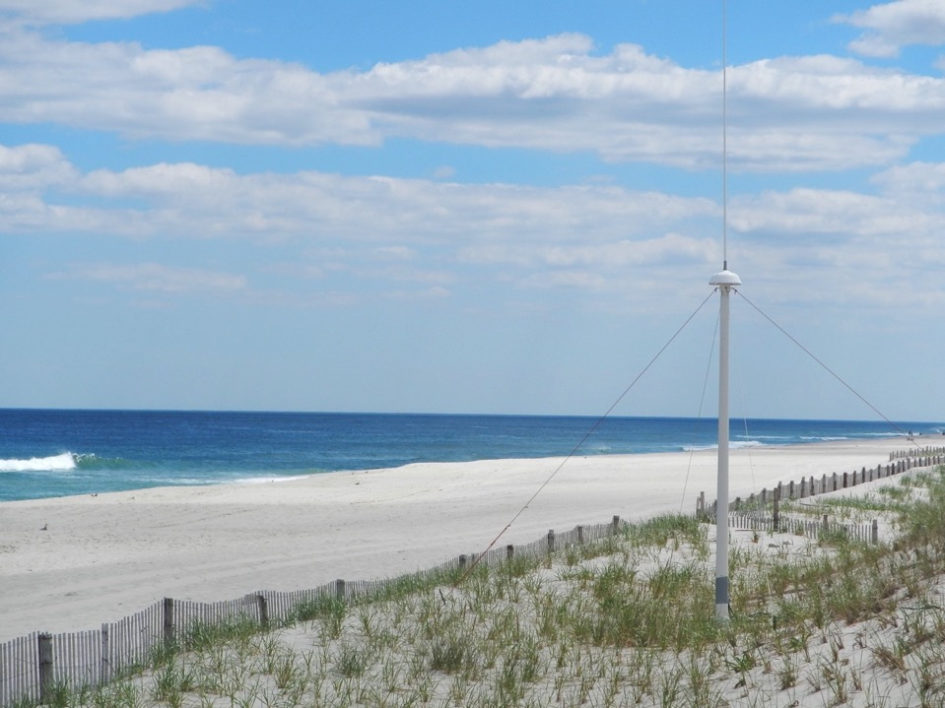








A Decade of Surface Current Measurements Over the Mid Atlantic Continental Shelf
Hugh Roarty Josh Kohut Scott Glenn Mike Smith Laura Nazzaro
Larry Atkinson
Teresa Updyke
Donglai Gong
Wendell Brown
Harvey Seim
Mike Muglia
AGU Ocean Sciences 2018
Portland, Oregon

Slide 2
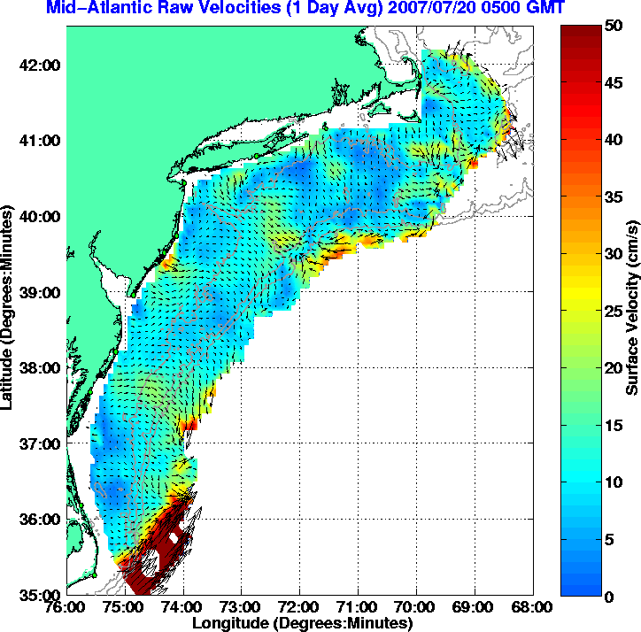
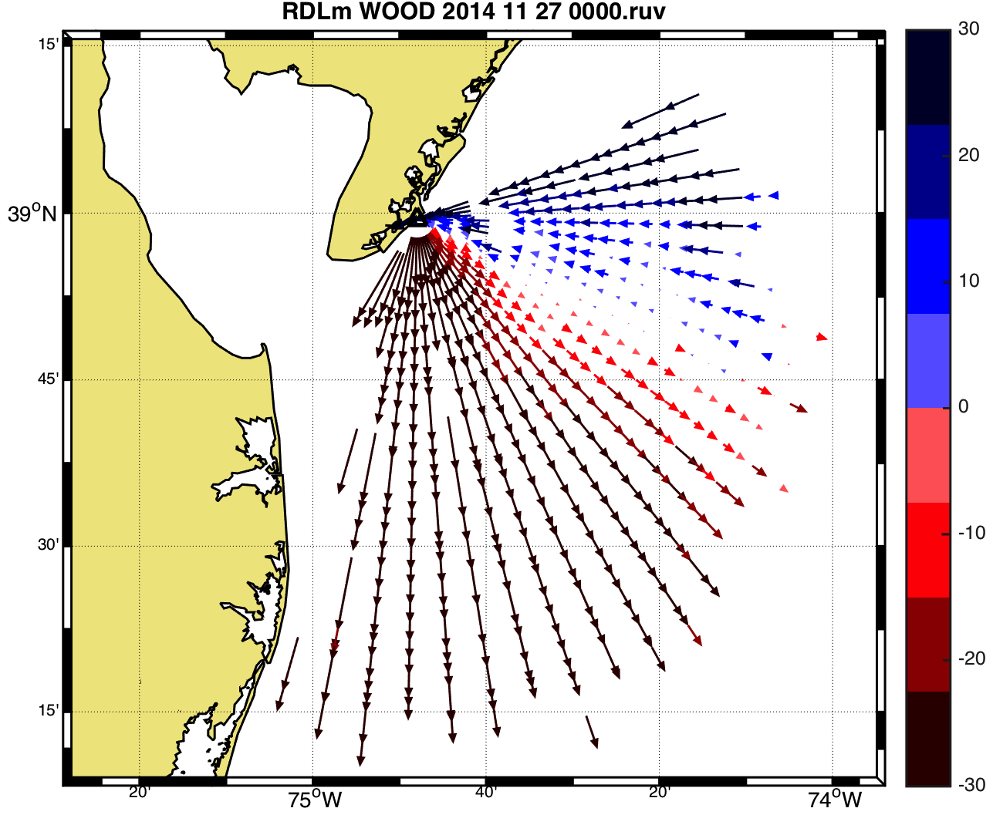
12 Stations
17

Slide 3
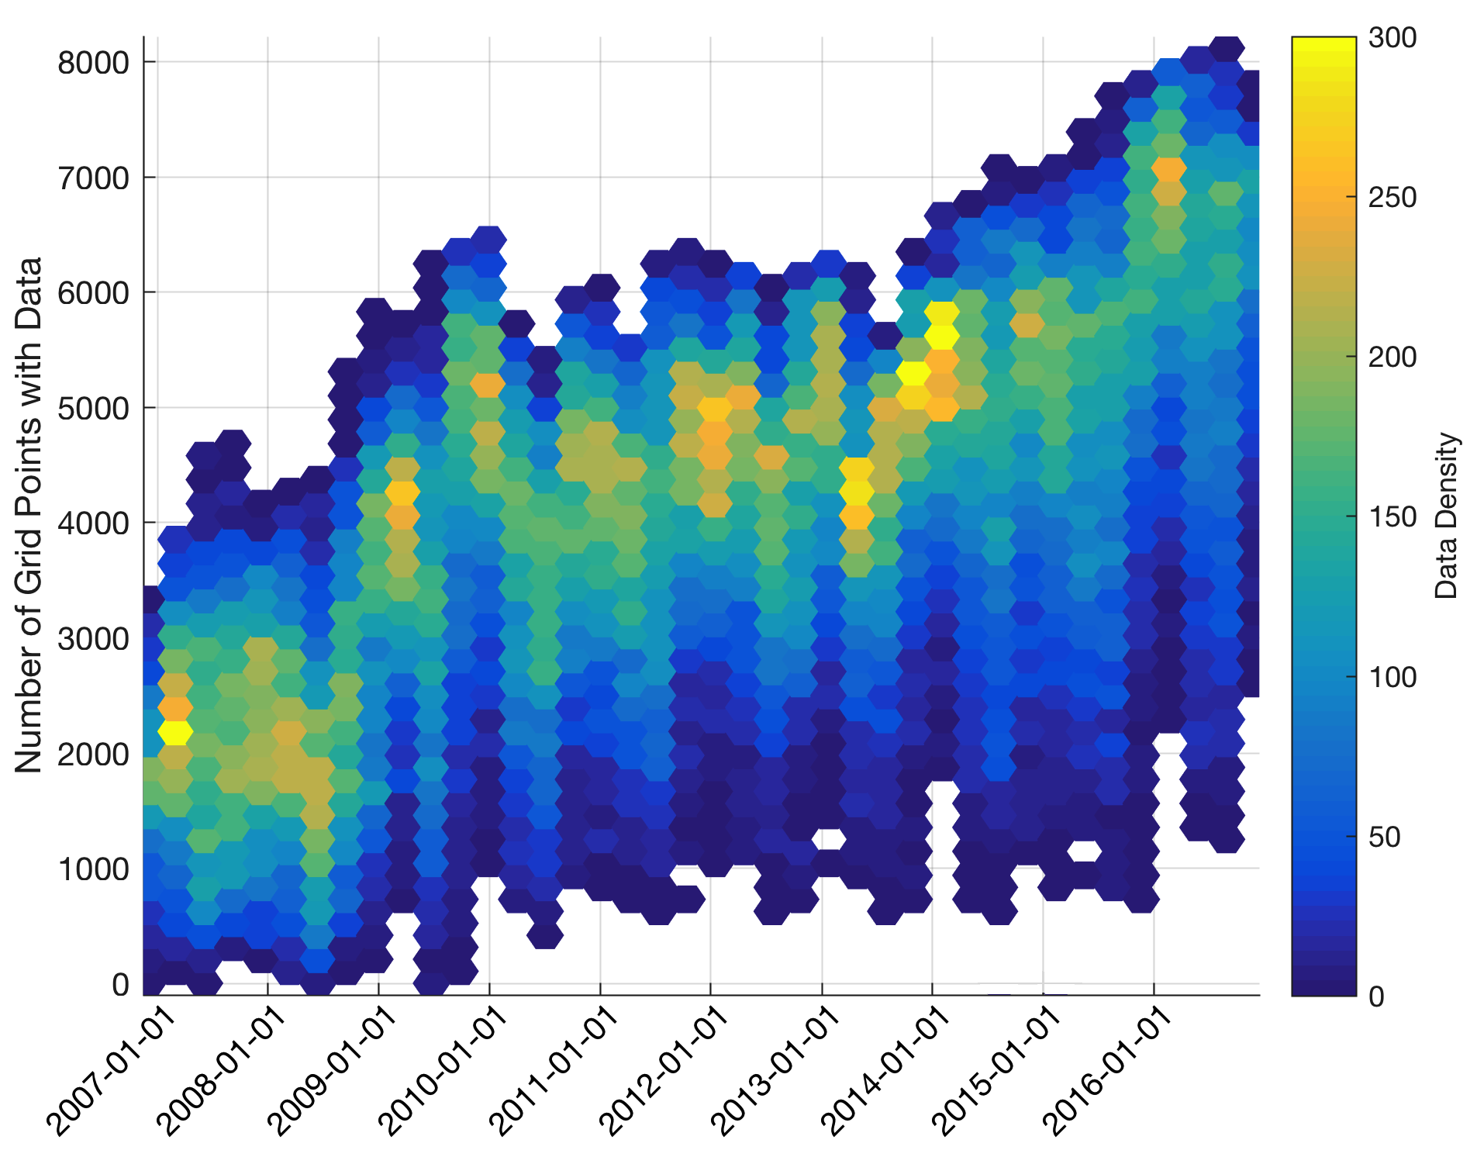
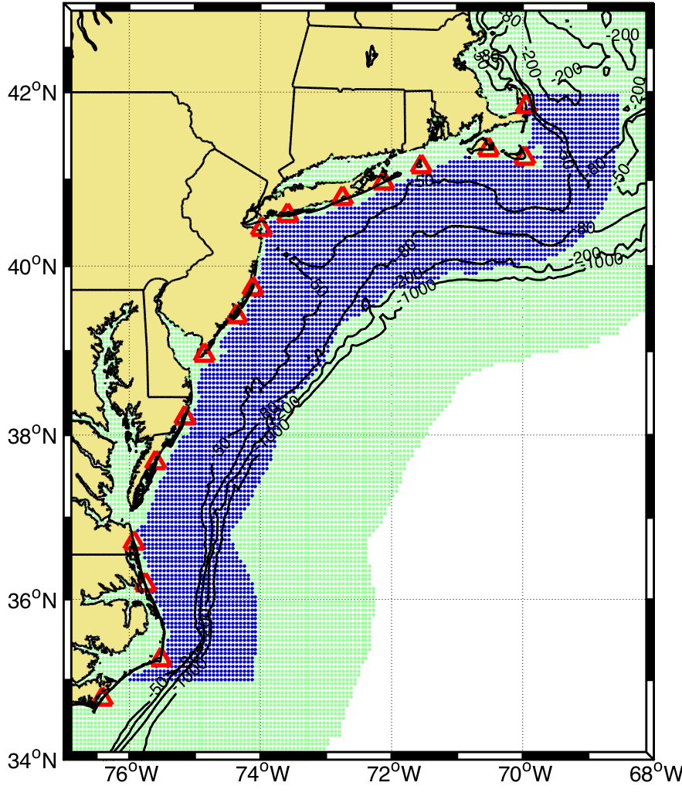
Data Coverage
Each hexagon represents a season

Slide 4
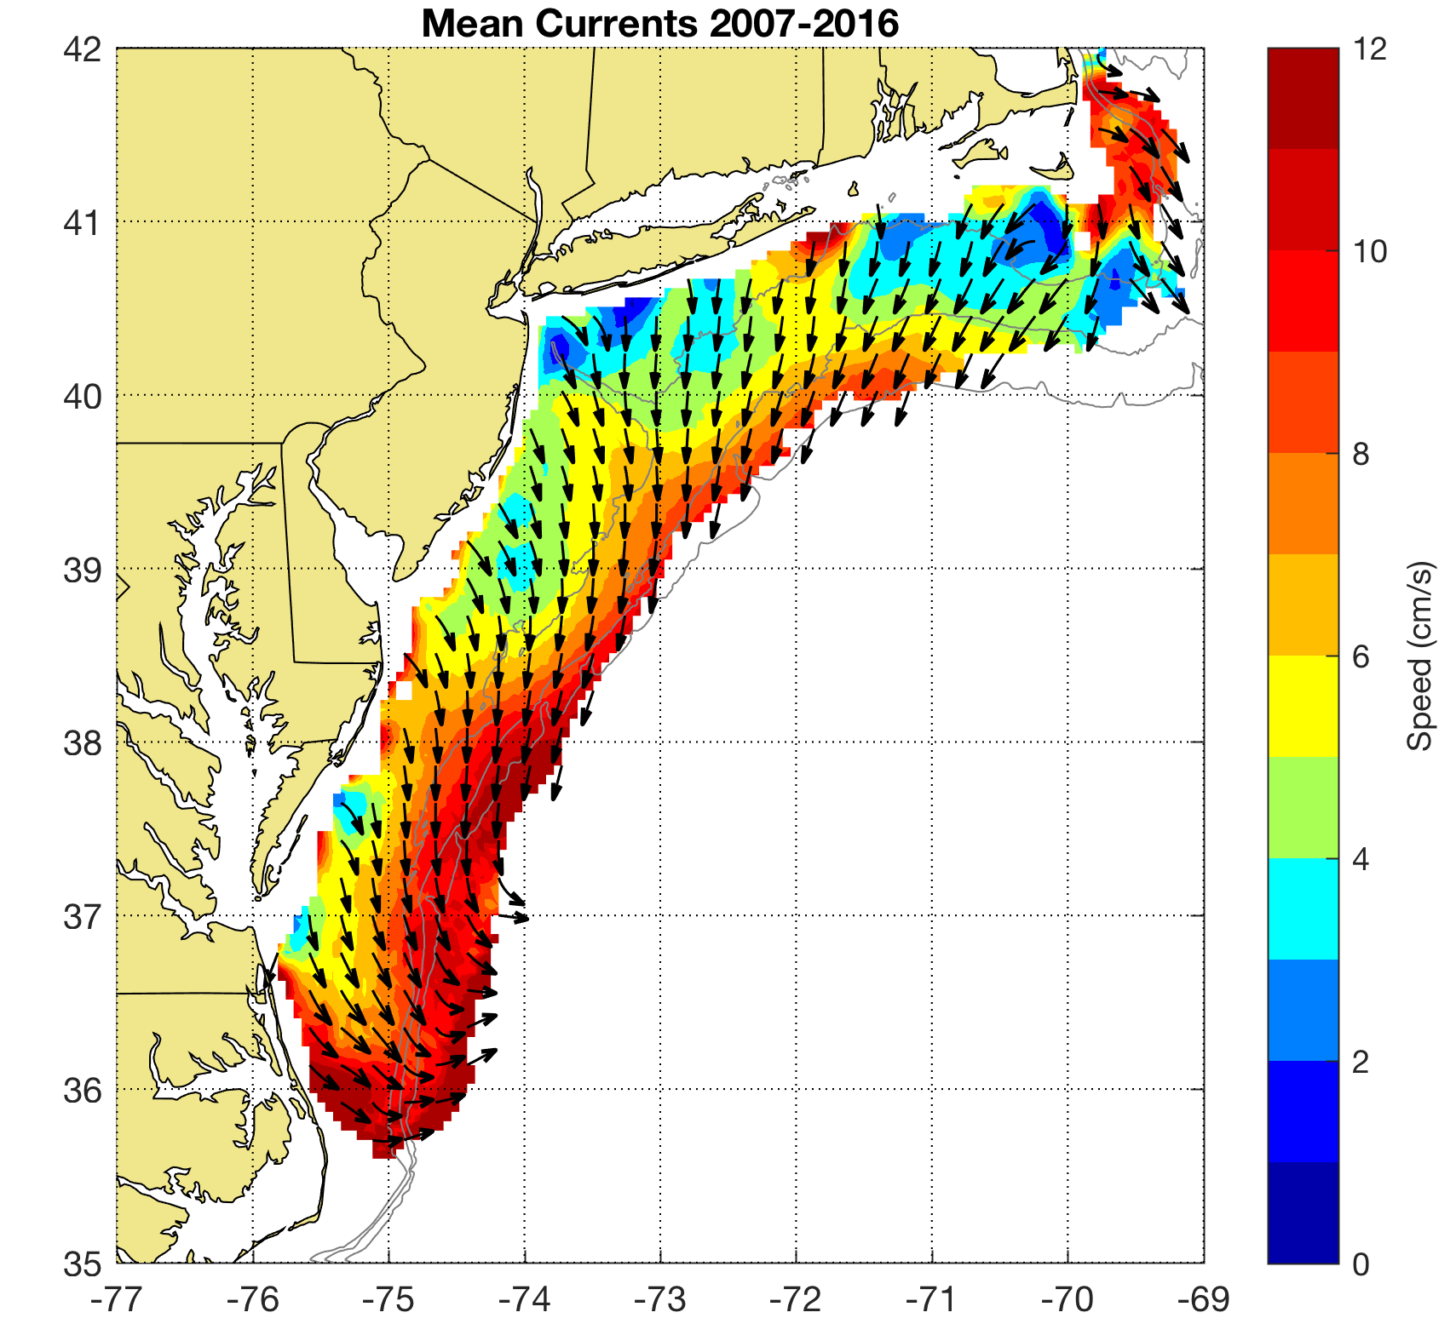
Decadal Mean
Detided using t_tide
30 hour low pass filter applied
50% temporal coverage per year required
Major Features:
Shelf Slope Front
4 River Outflows
Notes:
Like previous studies flow is alongshelf and towards the south
As observed by Steve Lentz The flow speed increases with water depth reaching a maximum at the shelf break
You can also observe this low velocity zone near the bight apex that was first observed by Donglai Gong in his 2010 paper of the surface currents on the NJ shelf

Slide 5
Inter-Annual Variability
Variability between years averaged over the decade
Tides not included

Slide 6
Intra-Annual Variability
Variability within a year averaged over the decade
Tides not included

Slide 7
Intra-Annual Forcing
Winds and River Discharge

Slide 8
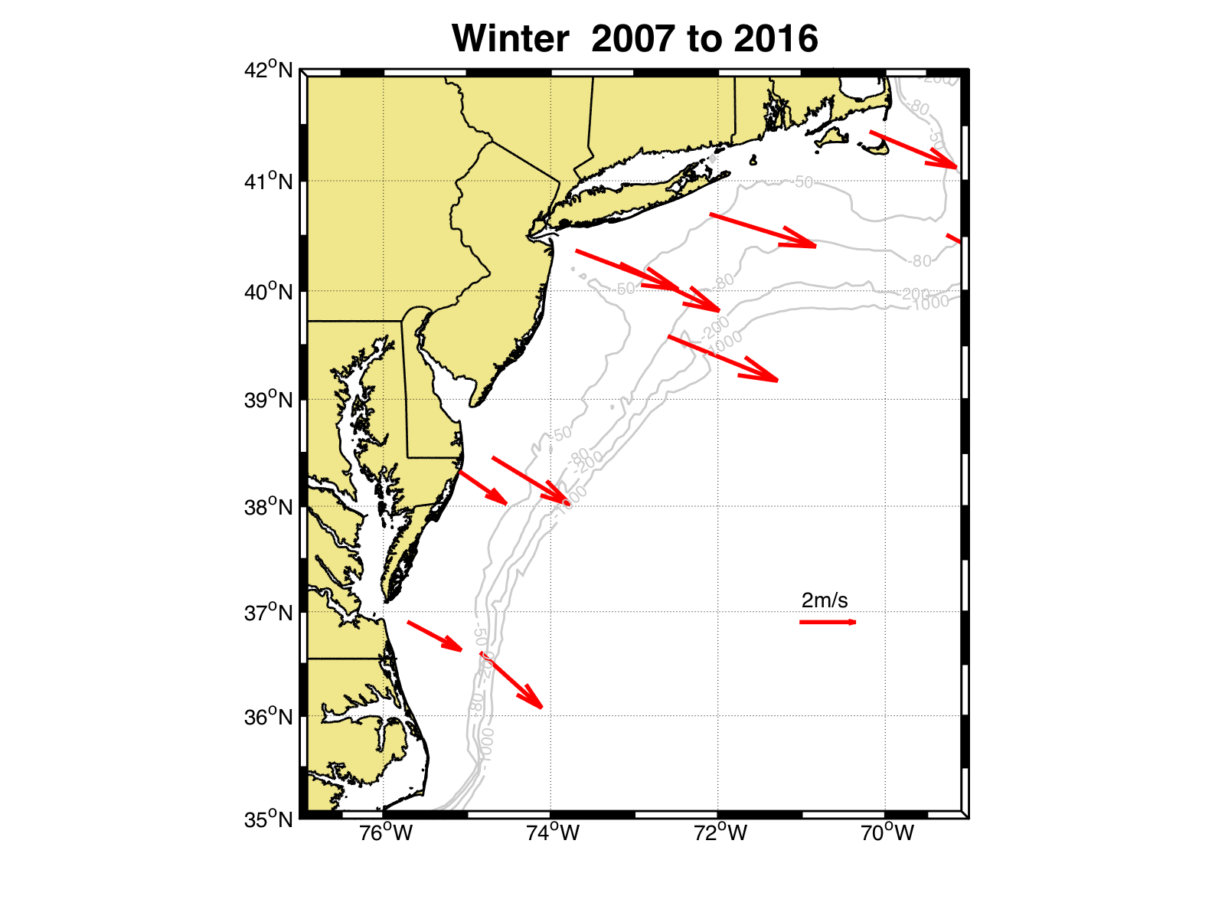
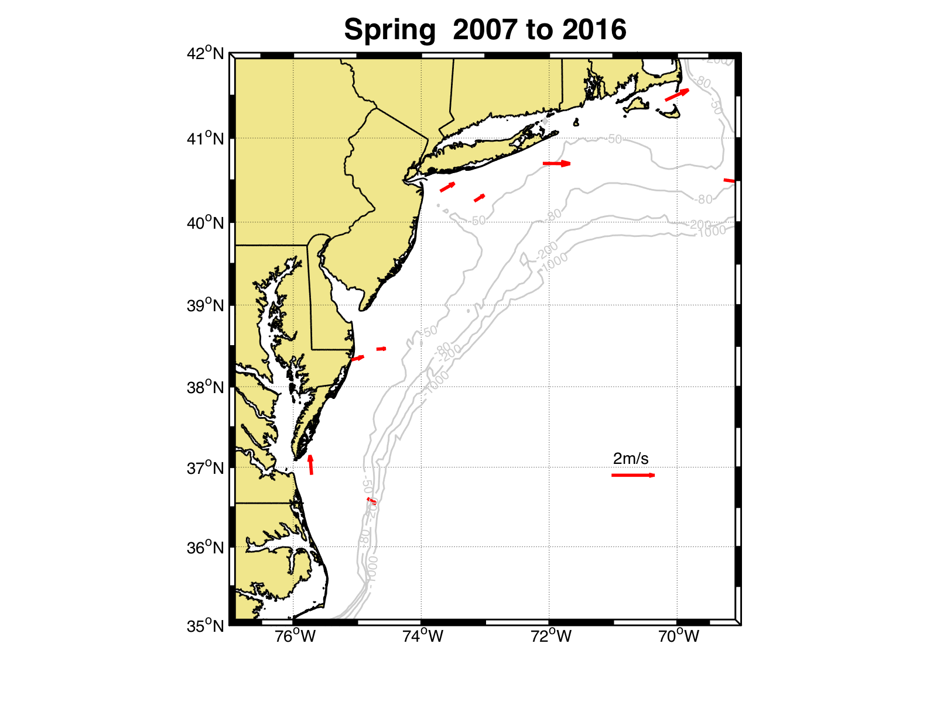

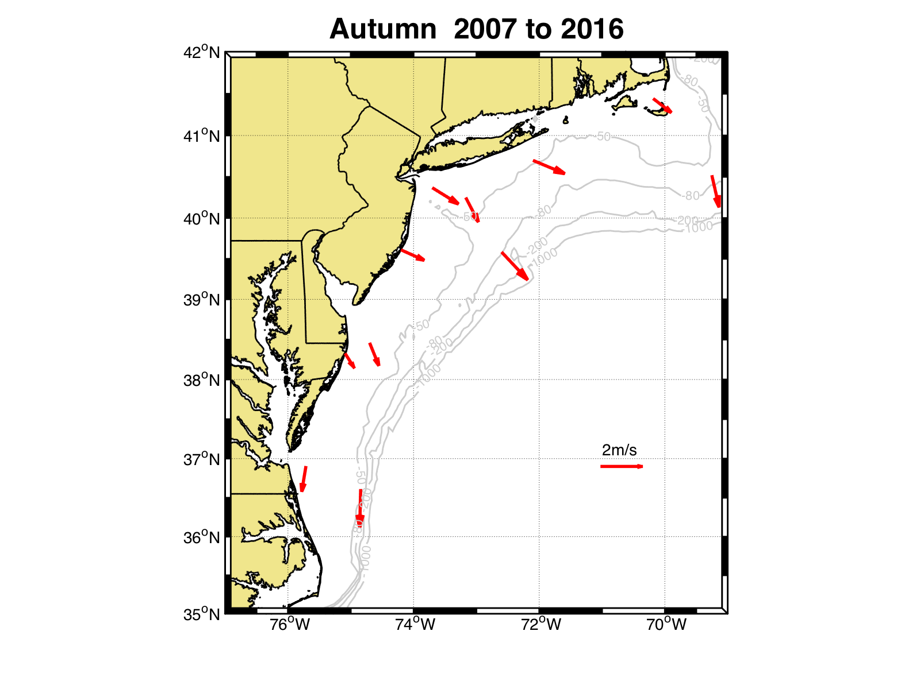

Slide 9
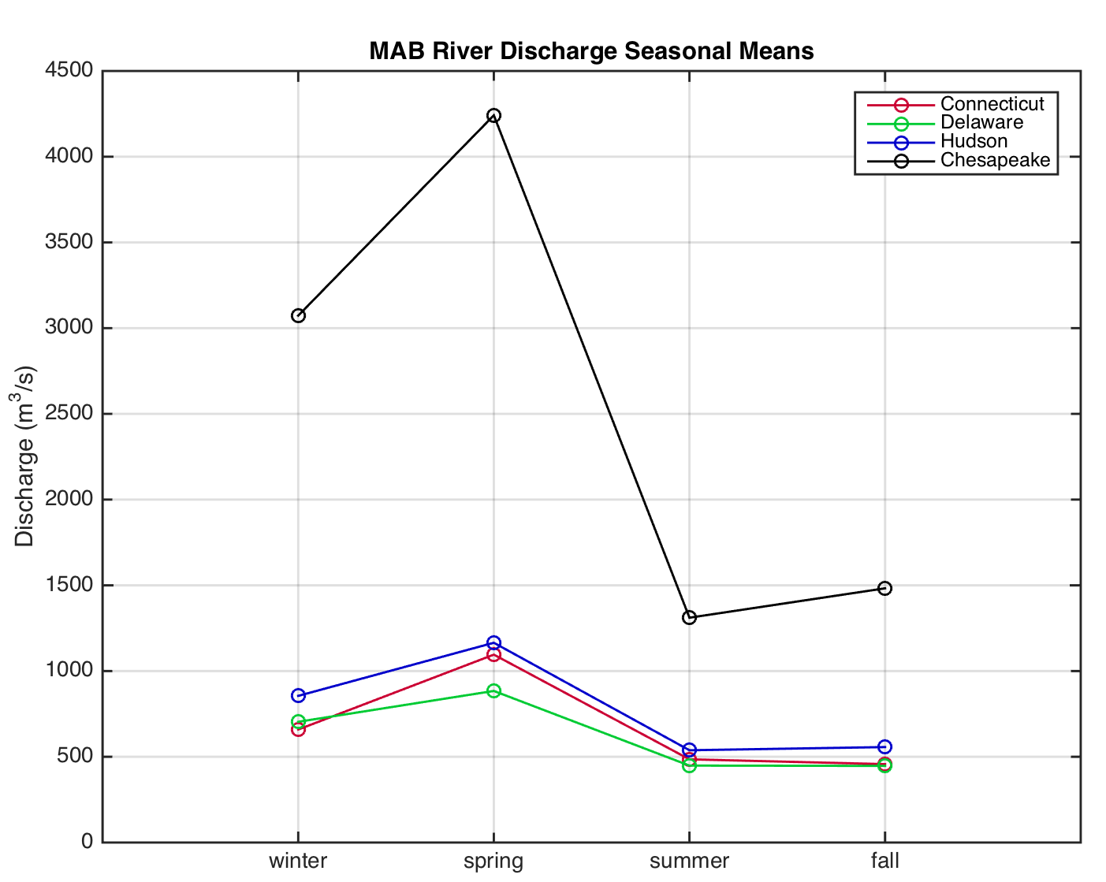
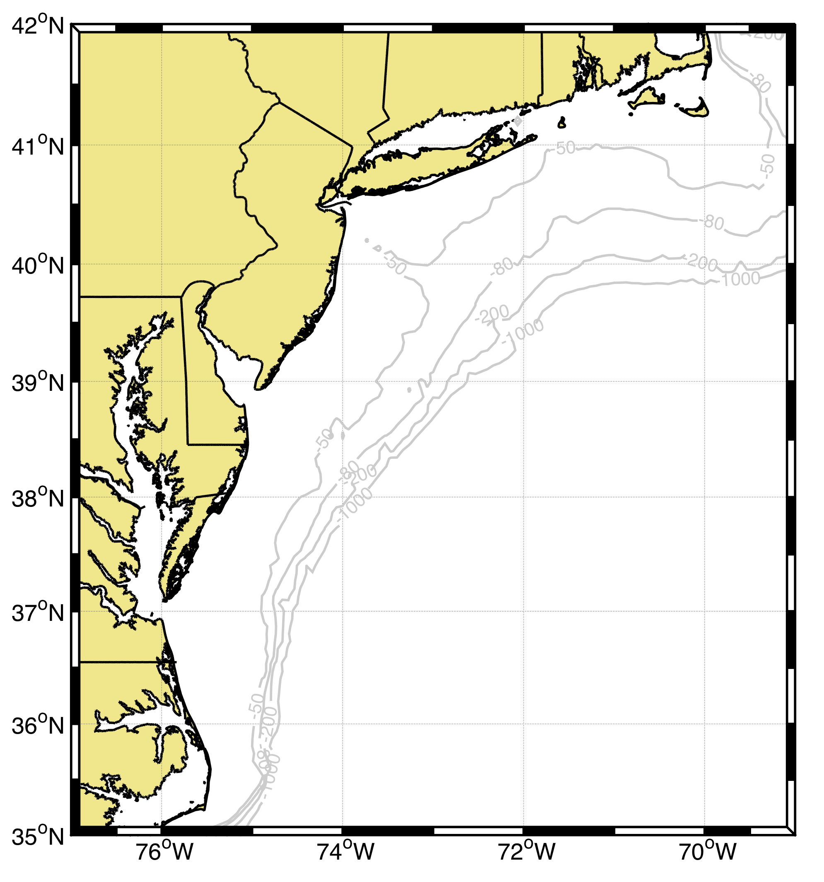

Slide 10
Seasonal Means

Slide 11
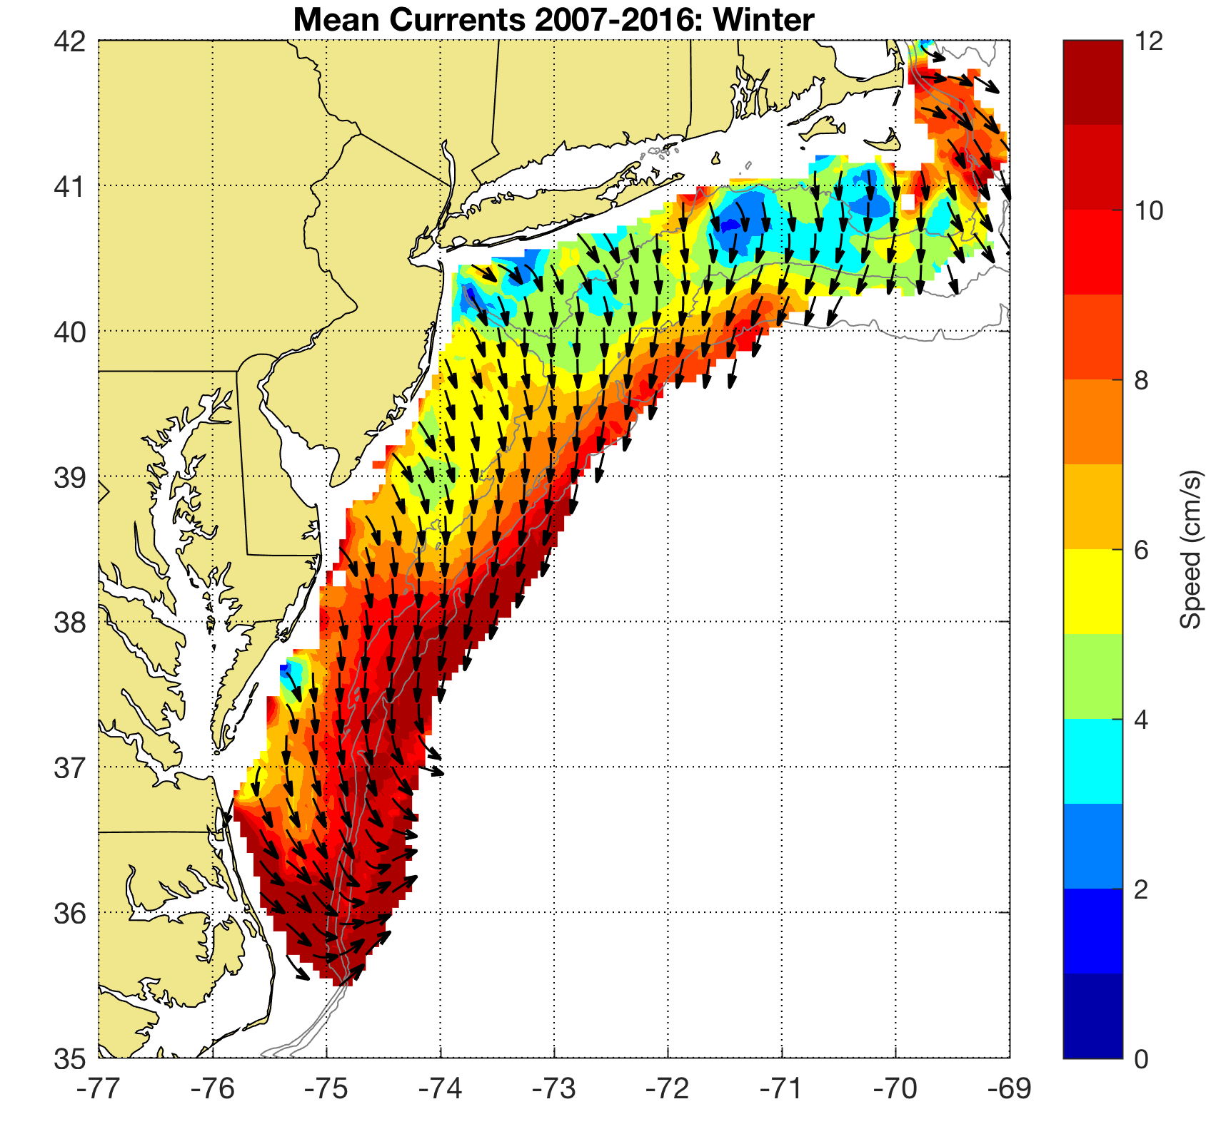
Winter
December, January and February

Slide 12
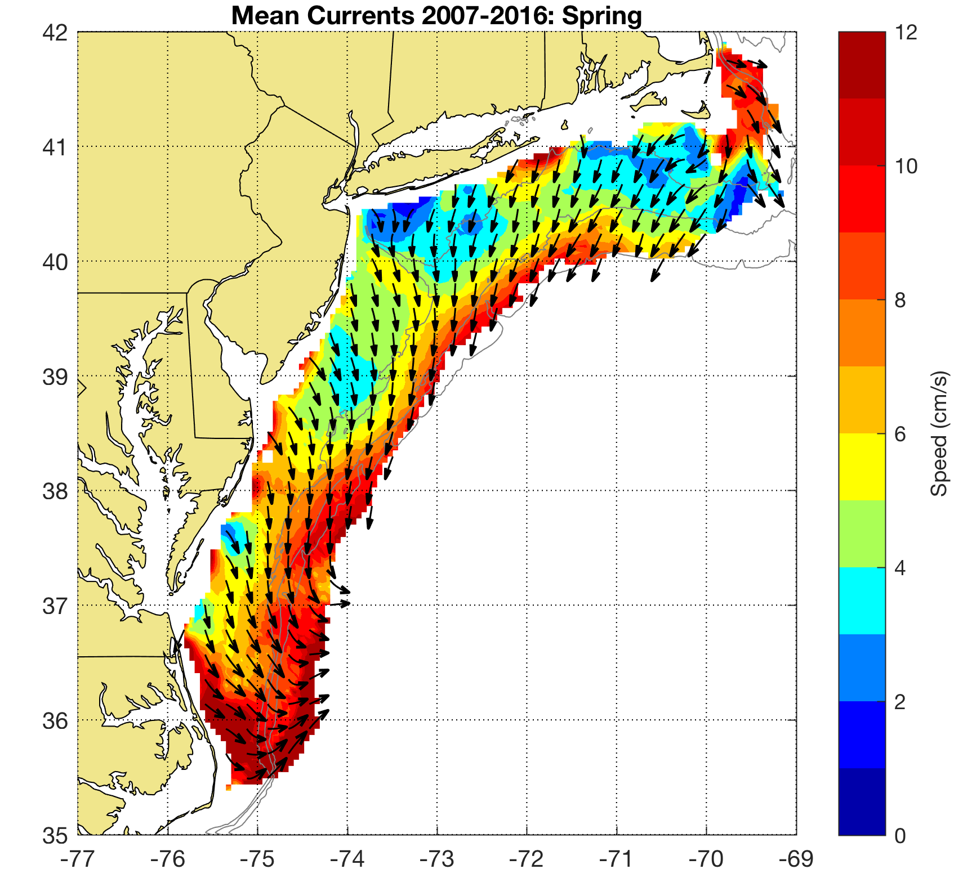
Spring
March, April and May

Slide 13
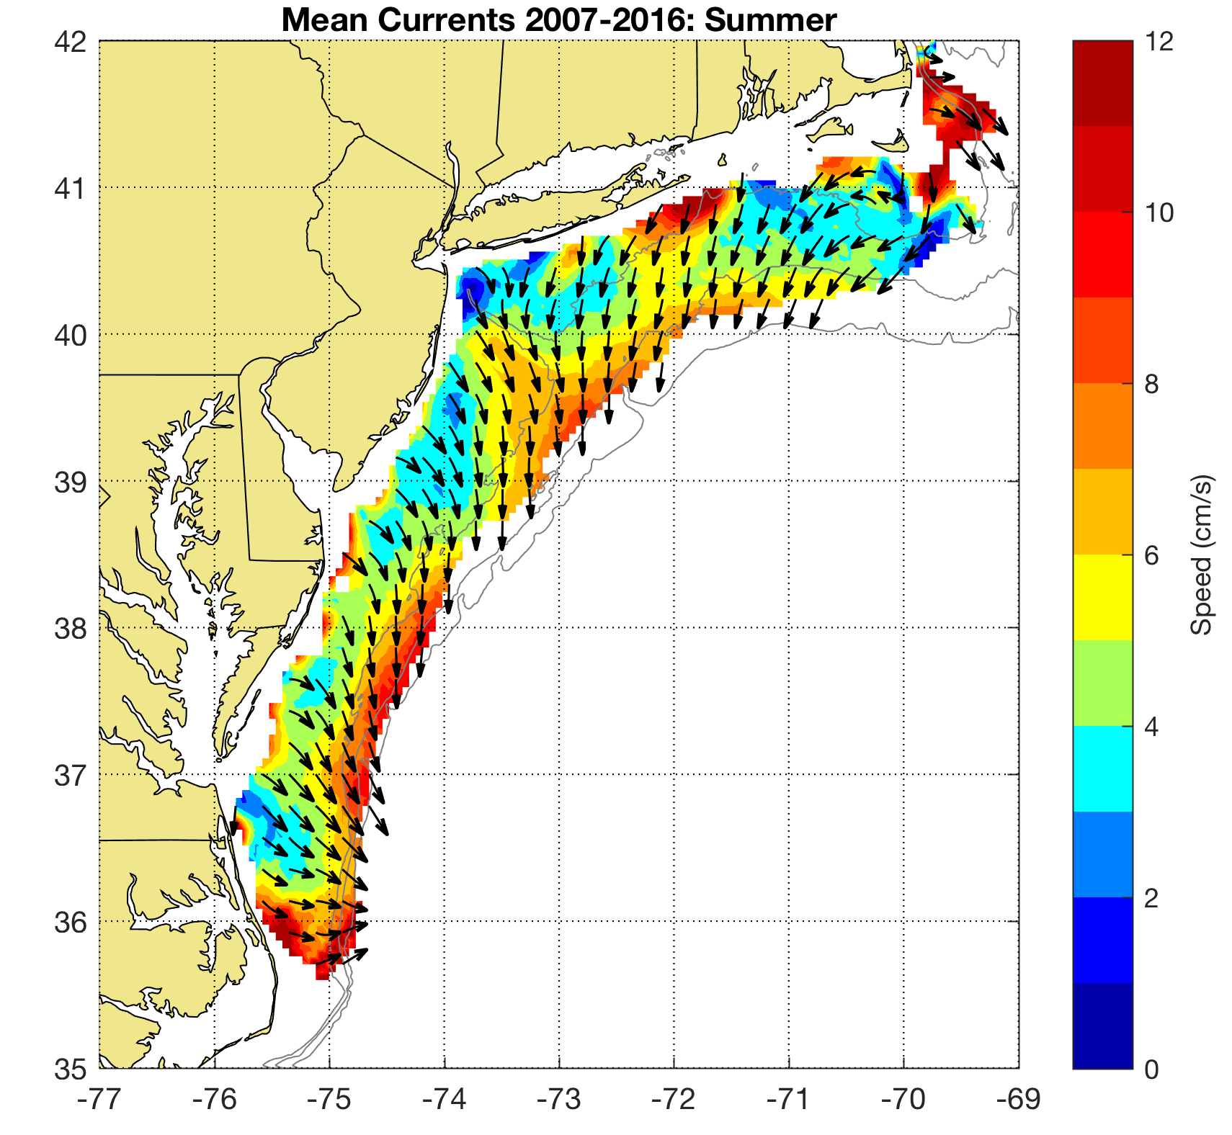
Summer
June, July and August

Slide 14
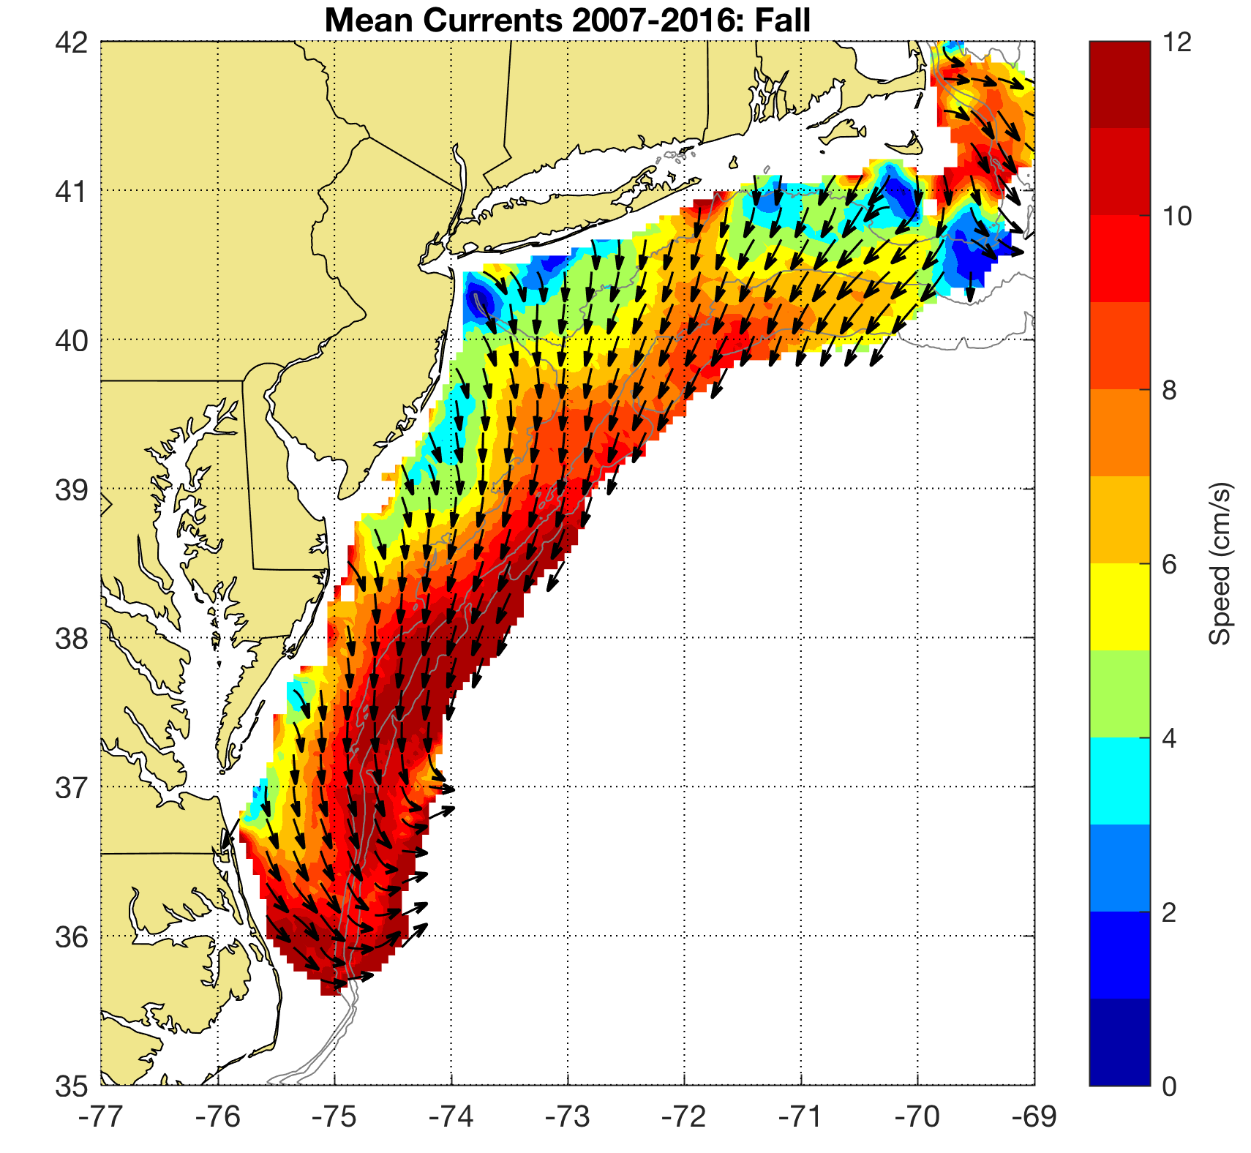
Autumn
September, October and November

Slide 15
Individual Autumns

Slide 16
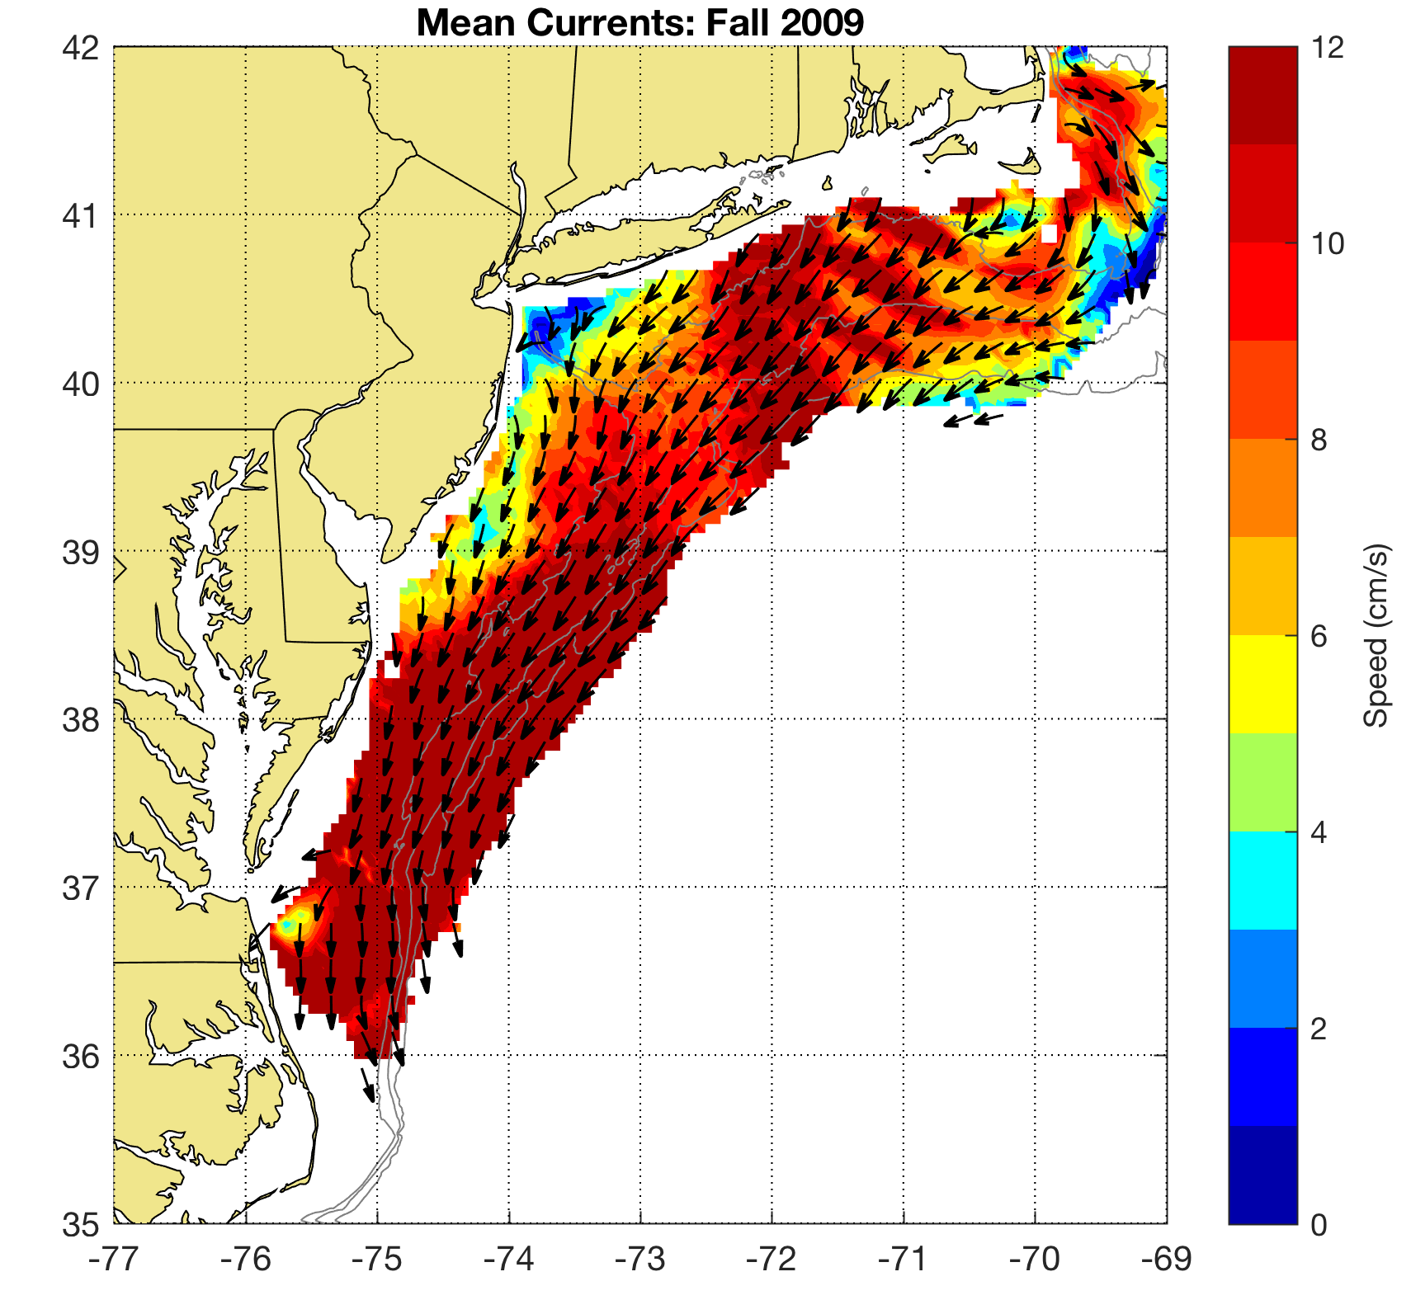
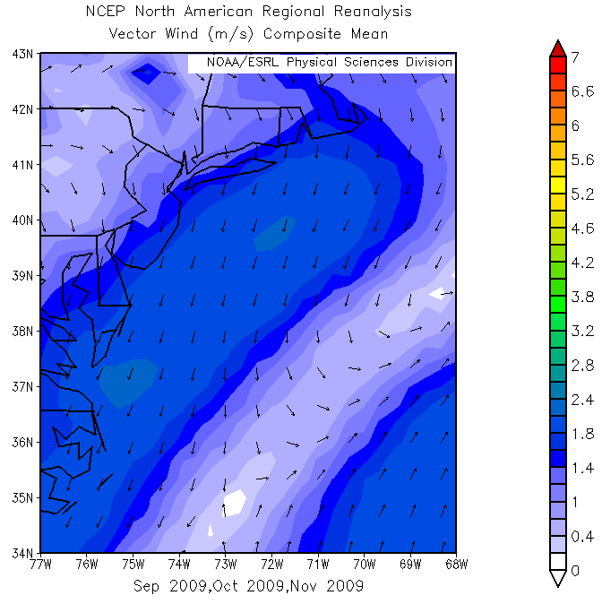
Autumn 2009

Slide 17
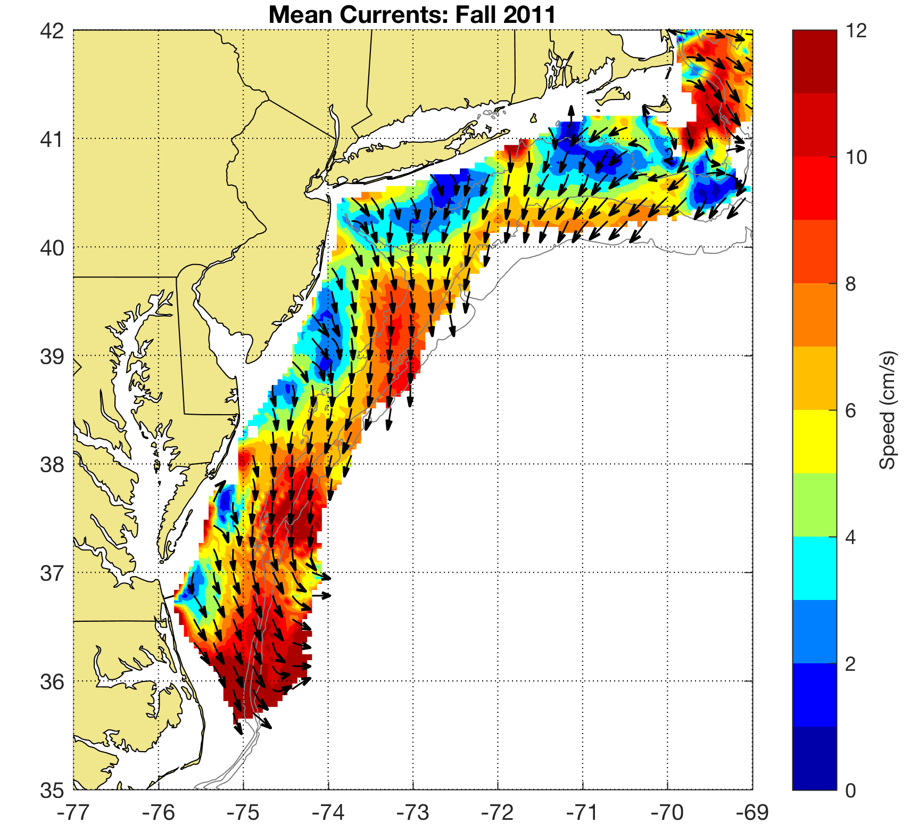
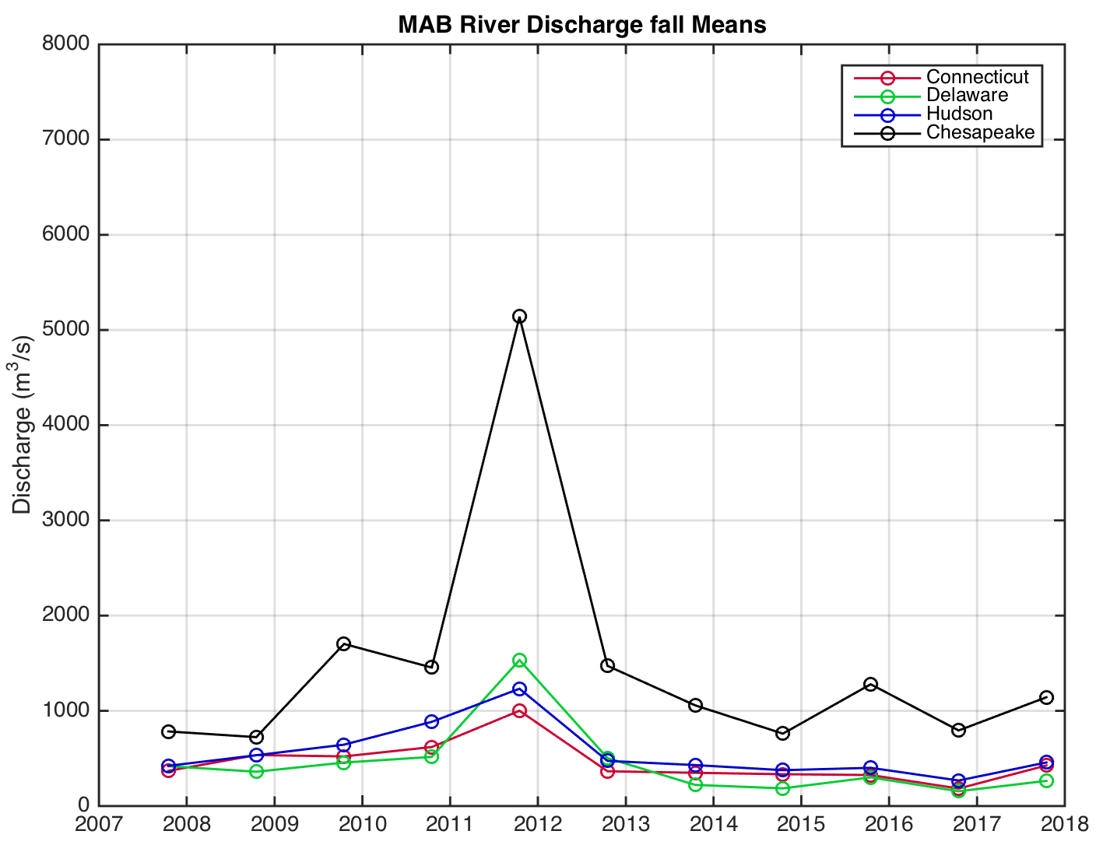
Autumn 2011

Slide 18
2009 and 2011 are Anomalous Years
2011: unusual high prevalence of western Pennsylvania high pressure
2009: unusual high prevalence of New England high pressure
What is driving these anomalies? How does it influence the storms in these years?

Slide 19
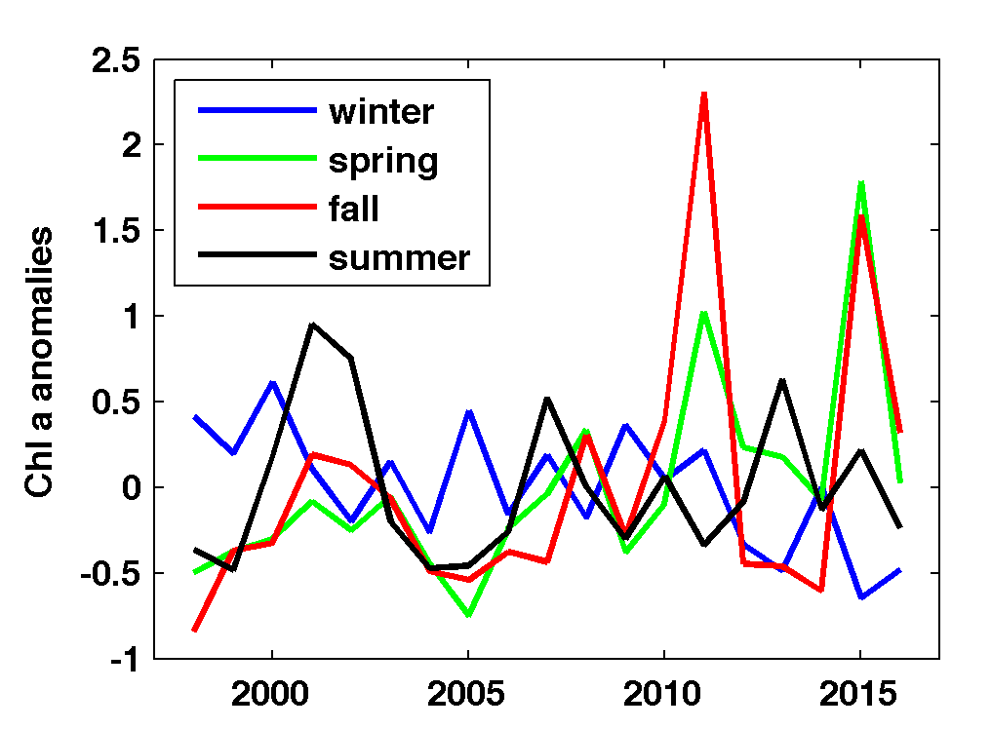
Biological Response

Slide 20
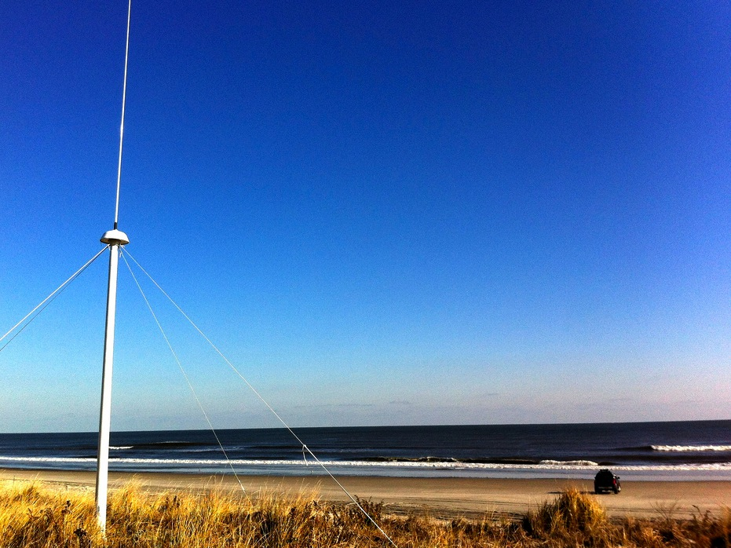
A Decade of Surface Current Measurements Over the Mid Atlantic Continental Shelf
Mean surface flow is cross shelf nearshore rotating to alongshelf with a maximum near the shelf break
Mean and intra-annual variability is highest in autumn and winter
Wind and river inputs play a role in the seasonal variability

