Slide 1

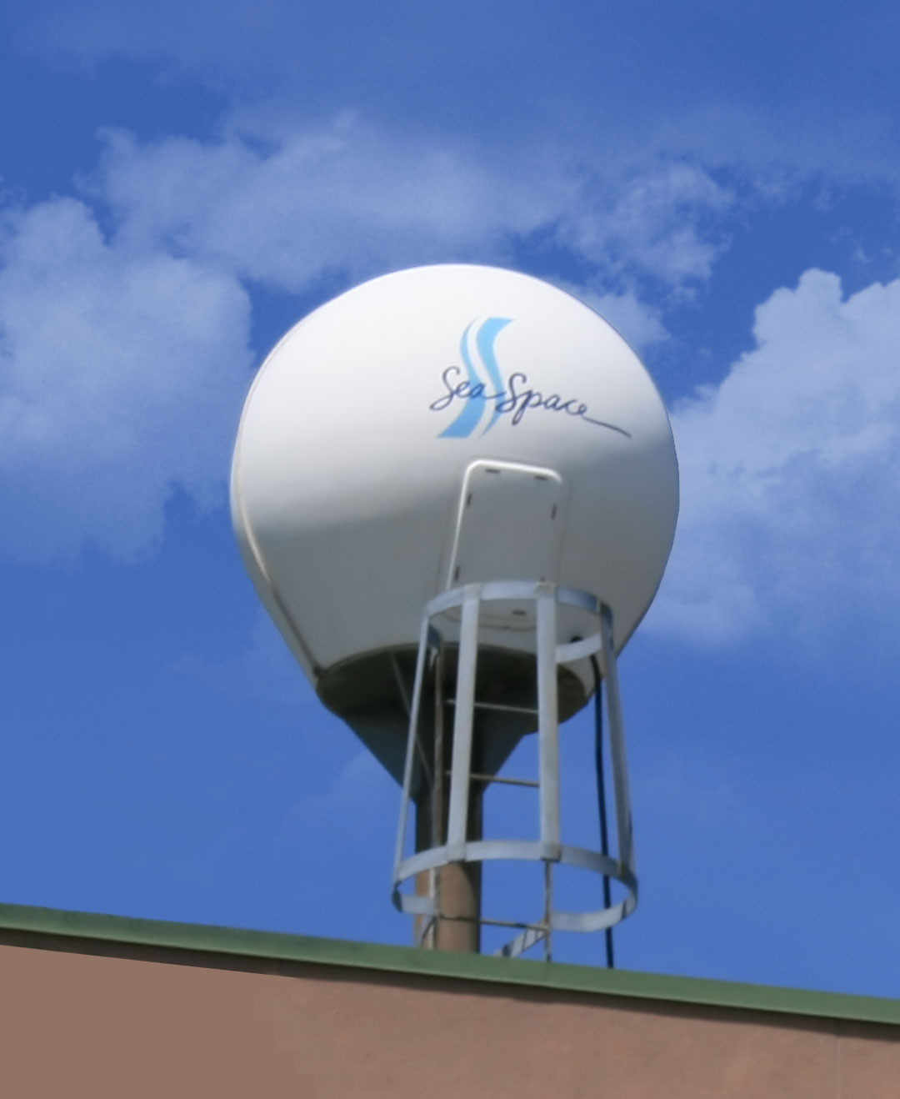
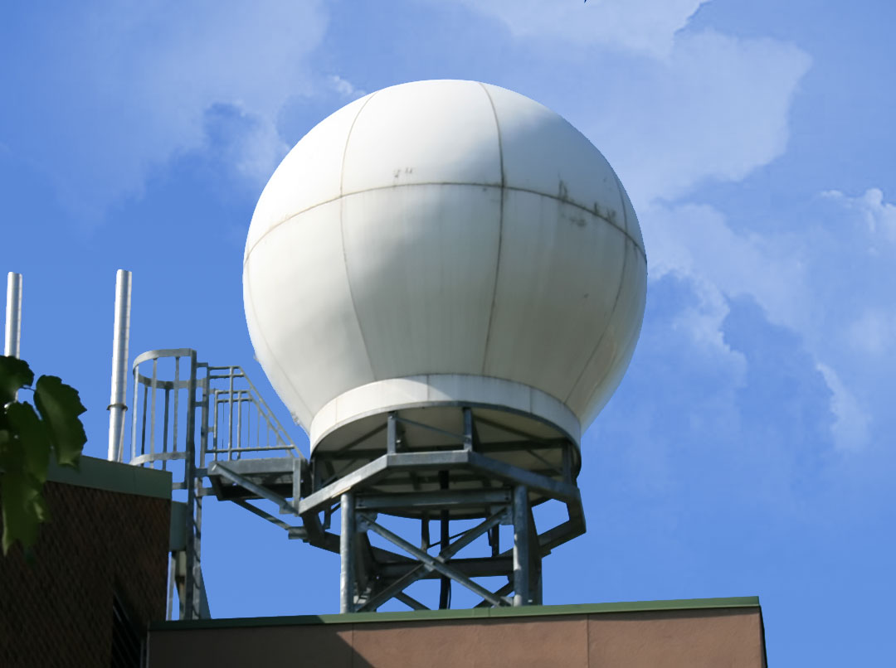
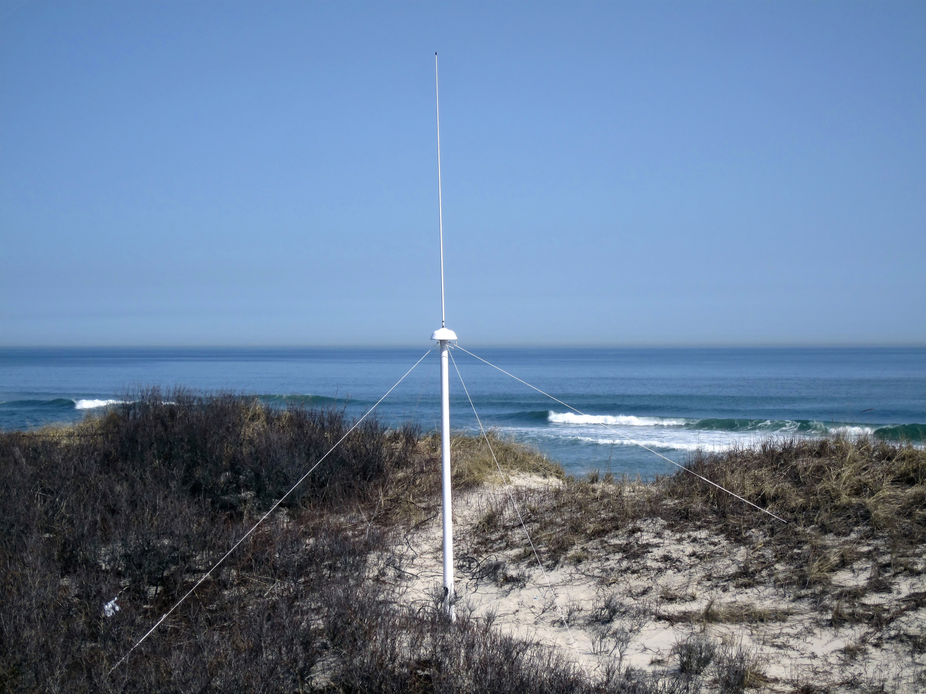
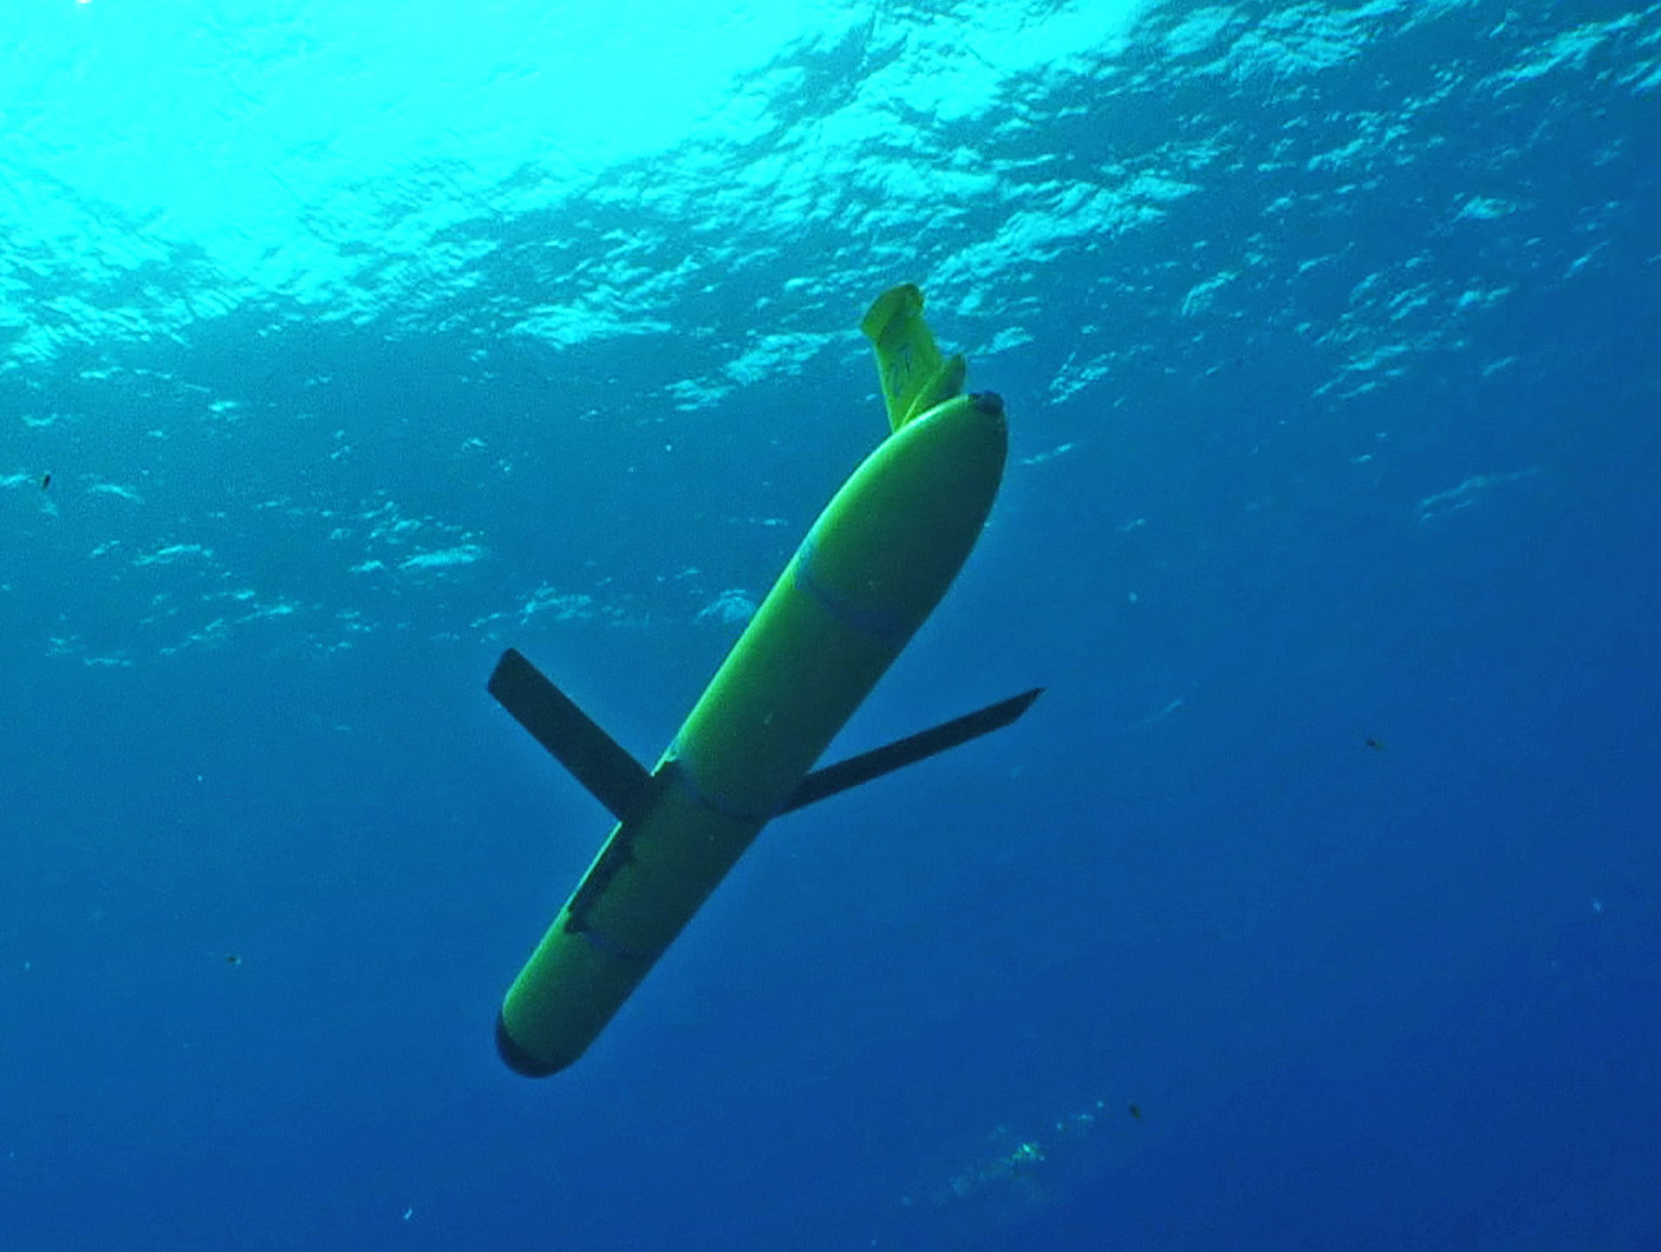
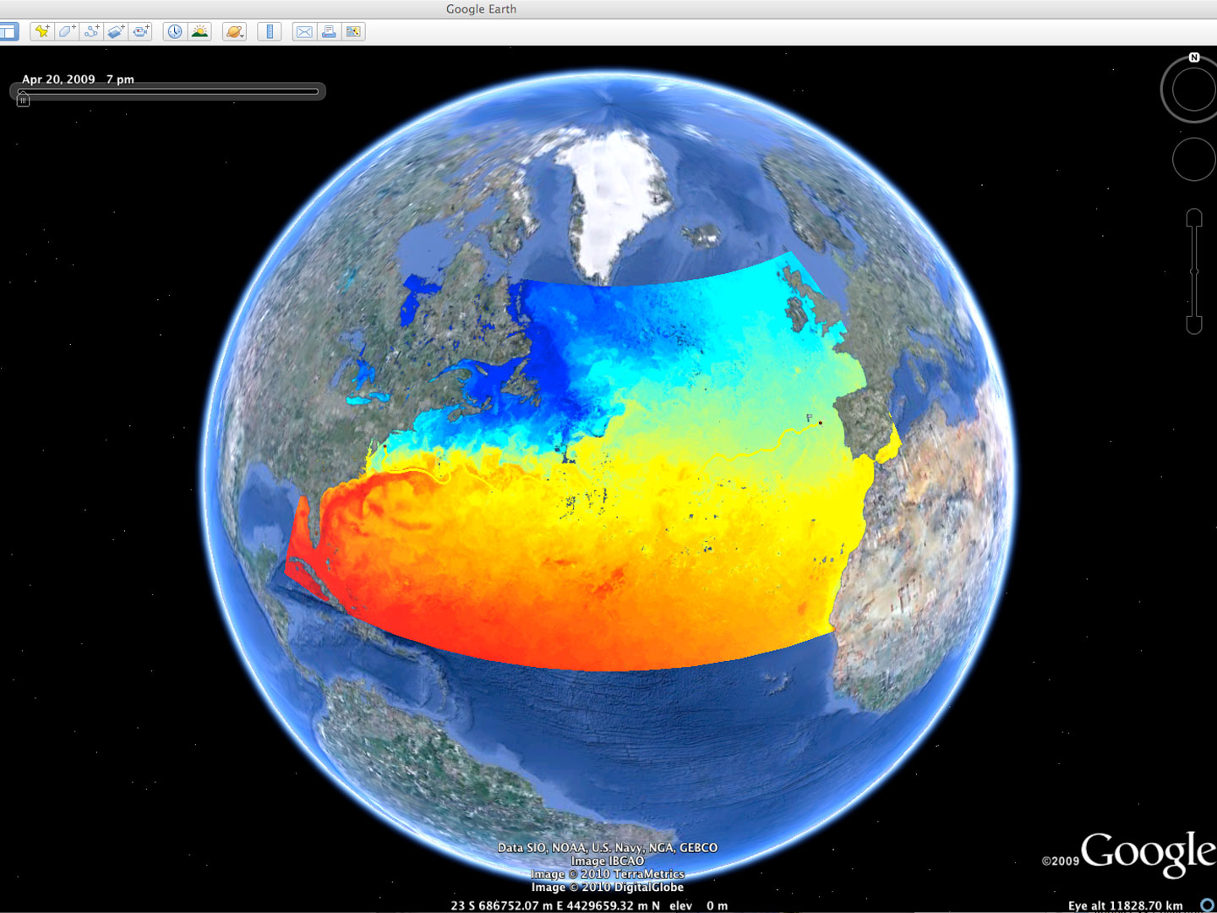














Rutgers University - Coastal Ocean Observation Lab
Observatory Operations, Data Fusion & Training Center
L-Band & X-Band Satellite Receivers
CODAR Network
Glider Fleet
3-D Nowcasts
& Forecasts
Notes:
1

Slide 2






MARACOOS Integration Matrix
Integration Matrix: Capabilities Support Multiple Themes
Regional Priority Themes | Regional Observation & Modeling Capabilities
 | Weather Mesonet | HF Radar Network | Statistical STPS | Satellite Imagery | Glider Surveys | Dynamical Ocean Forecasts
Theme 1. Maritime Commerce & Safety | Operational Input to USCG SAROPS | Operational input to USCG SAROPS | Operational input to USCG SAROPS | SST for survivability planning | Assimilation dataset for forecast models | Surface currents for SAROPS
Theme 2. Fisheries | Weather forecast ensemble validation | Circulation and divergence maps for habitat |  | SST & Color for habitat | Subsurface T & S for habitat | 3-D fields of T, S, circulation for habitat
Theme 3. Public Health & Water Quality | Winds for transport, river plumes, & upwelling | Surface currents for floatables, bacteria, spill response | Surface currents for floatables, bacteria, spill response | Ocean color for river plumes | Nearshore dissolved oxygen surveys | Surface currents for floatables, bacteria, spill response
Theme 4. Coastal Flooding | Weather forecast ensemble validation | Assimilation dataset for forecast models |  | SSTs assimilation into forecast models | Assimilation dataset for forecast models | Nested forecast ensembles
Theme 5. Offshore Energy | Historical analysis & wind model validation | Historical current analysis & wind model validation |  | Historical analysis surface fronts & plumes for siting | Historical analysis of subsurface fronts & plumes | Coupled ocean-atmosphere models for resource estimates

Slide 3

Search And Rescue Cases
in MARACOOS Region
U.S. Coast Guard Search And Rescue Data, FY2014
 | Bays, Rivers, Near Shore (< 3 NM) | Offshore (> 3 NM to 200 NM) | Total
Cases | 2,433 | 247 | 2,688
Lives Saved | 500 | 96 | 596
Lives Assisted | 3,332 | 319 | 3,651
Lives Lost | 160 | 14 | 174

Slide 4
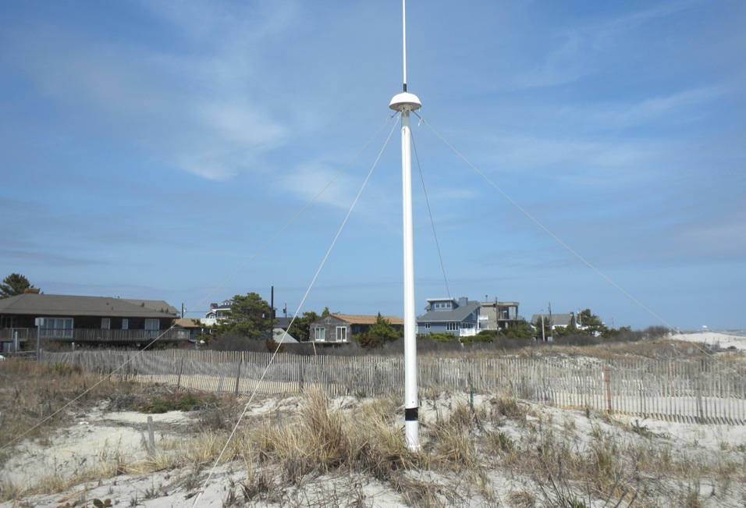
CODAR Omnidirectional
Direction Finding (DF)
13 MHz Combined
Transmit and Receive Antenna
4 meters

Slide 5
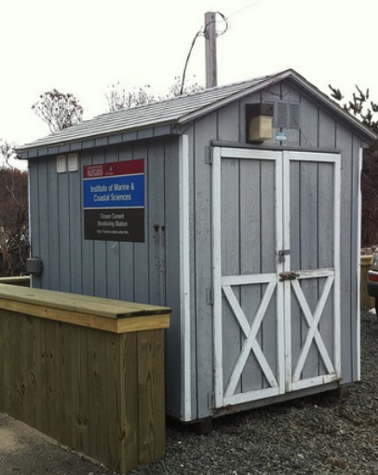
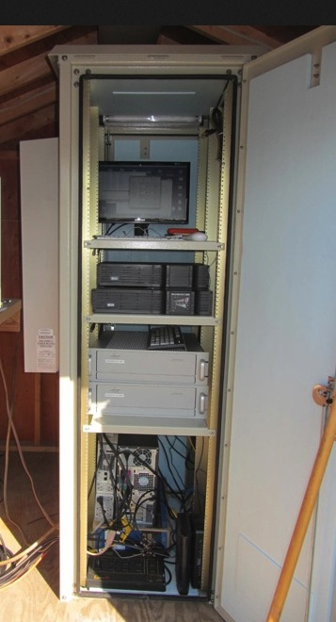
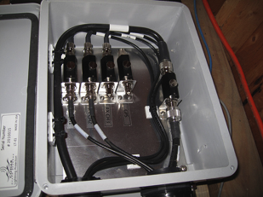
Resilient CODAR Shore Site:
Shed, Enclosure, Tx/Rx, Comms, Power, GPS, AIS
monitor
computer & external hard drive
A.C. unit
UPS system
transmitter
receiver
Two lines of Communication
Shed
Enclosure
Lightning Protection

Slide 6
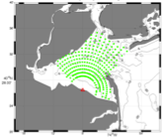
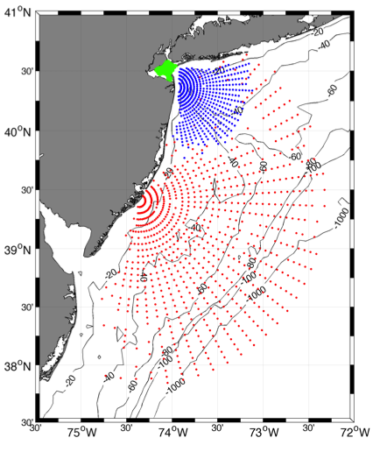
Surface Current Mapping Capability
25 MHz
Radar λ: 12 m Ocean λ: 6 m
Range: >30 km Resolution: 1 km
13 MHz
Radar λ: 23 m Ocean λ: 12 m
Range: >80 km Resolution: 3 km
05 MHz
Radar λ: 60m Ocean λ: 30 m
Range: >180 km Resolution: 6 km

Slide 7
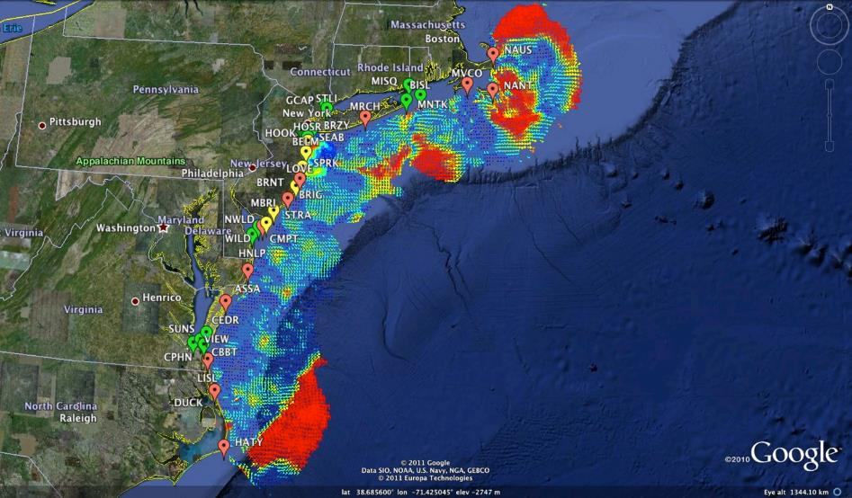

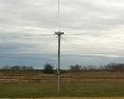
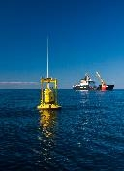
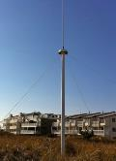

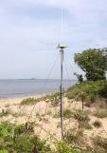

Mid-Atlantic Bight HF Radar Network
1000 km
Cape to Cape
Mid-Atlantic HF Radar Network
17 Long-Range CODARs
8 Medium-Range CODARs
16 Short-Range CODARs
41 Total CODARs in Region
+5 CODARs Roaming
46 Total CODARs
Triple Nested, Multi-static, Multi-use
Industry Partner: CODAR Ocean Sensors

Slide 8
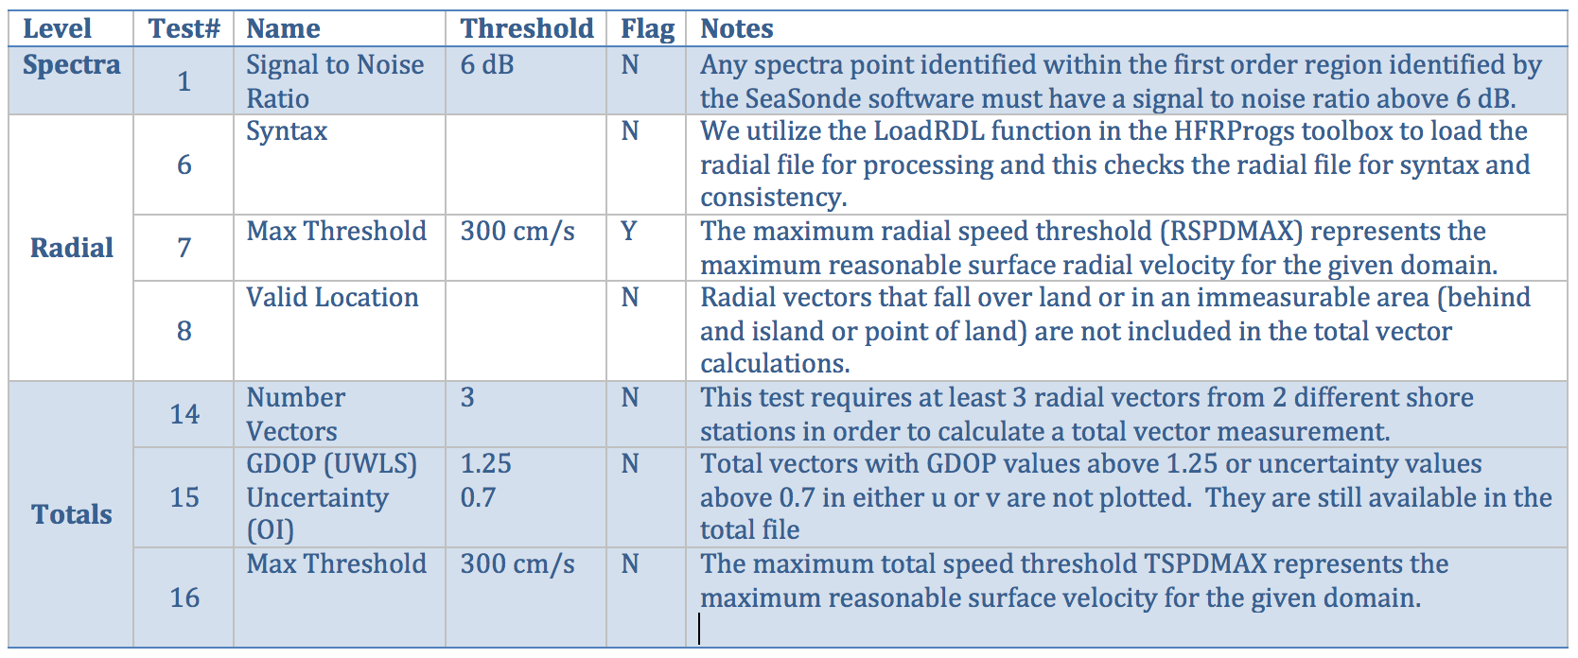
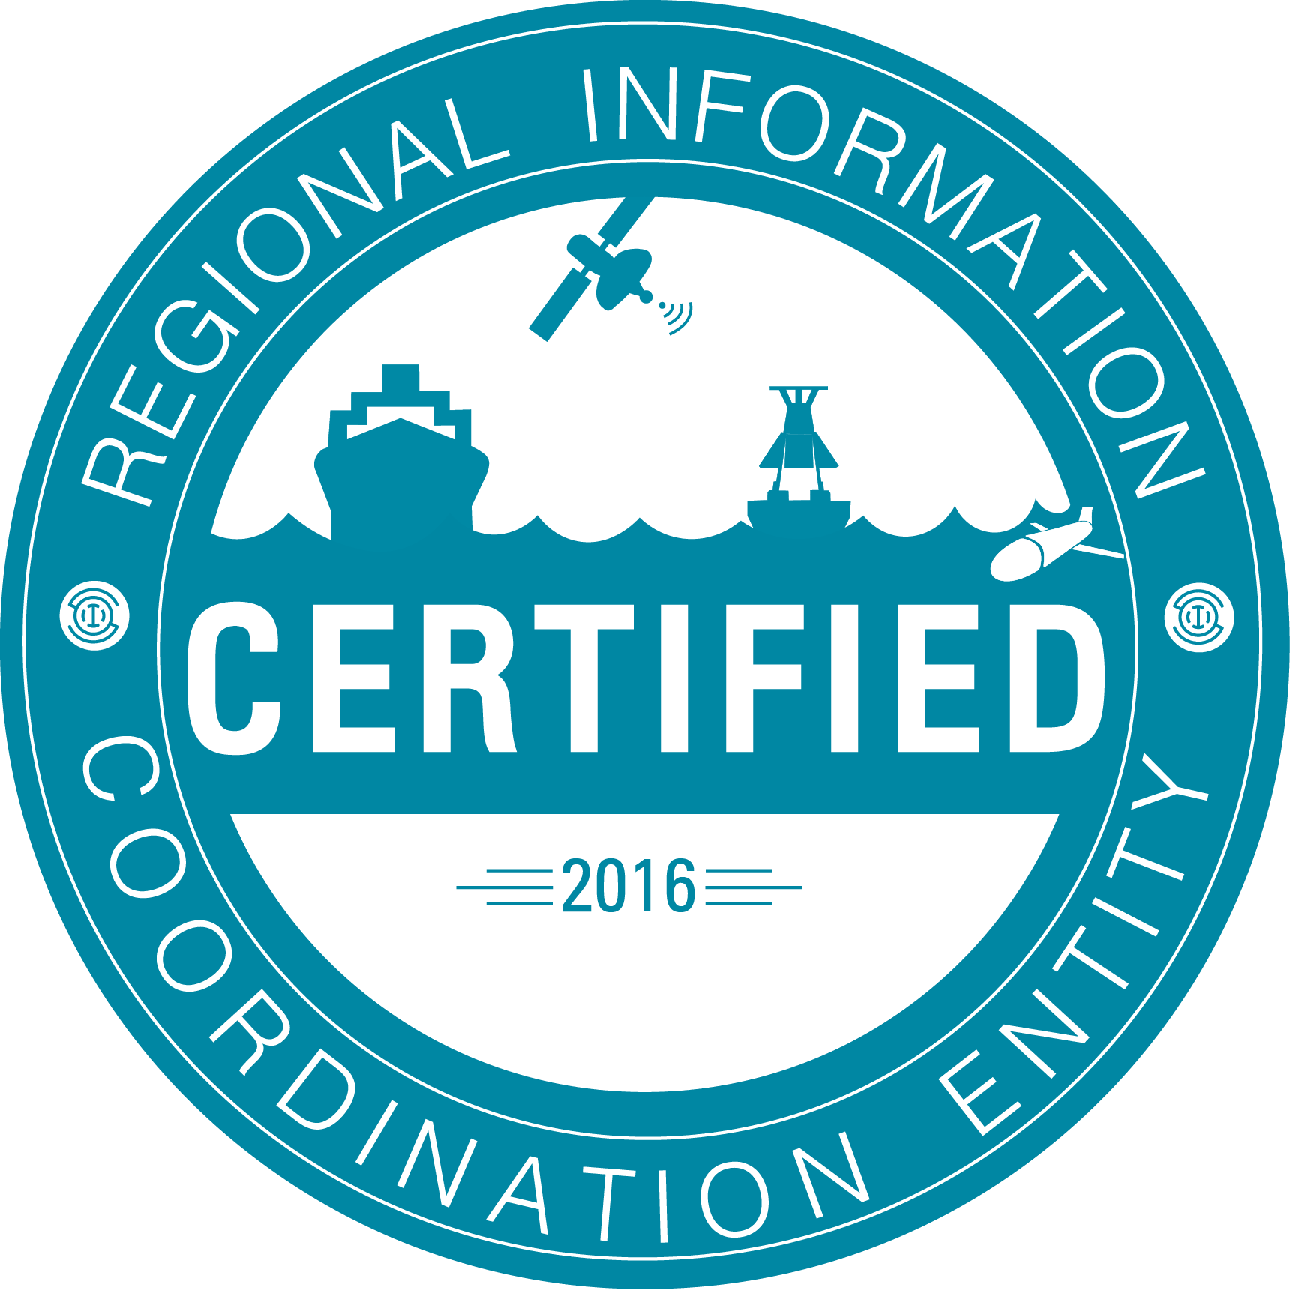
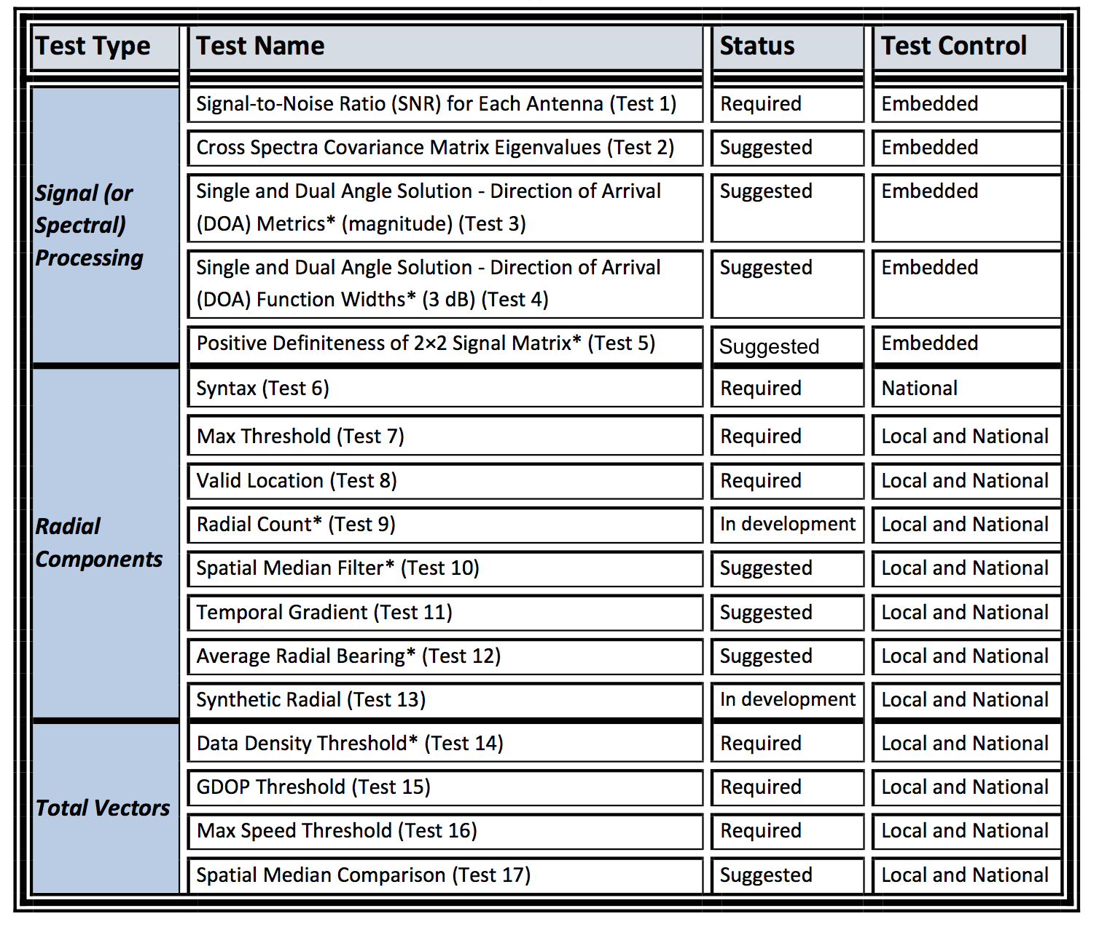
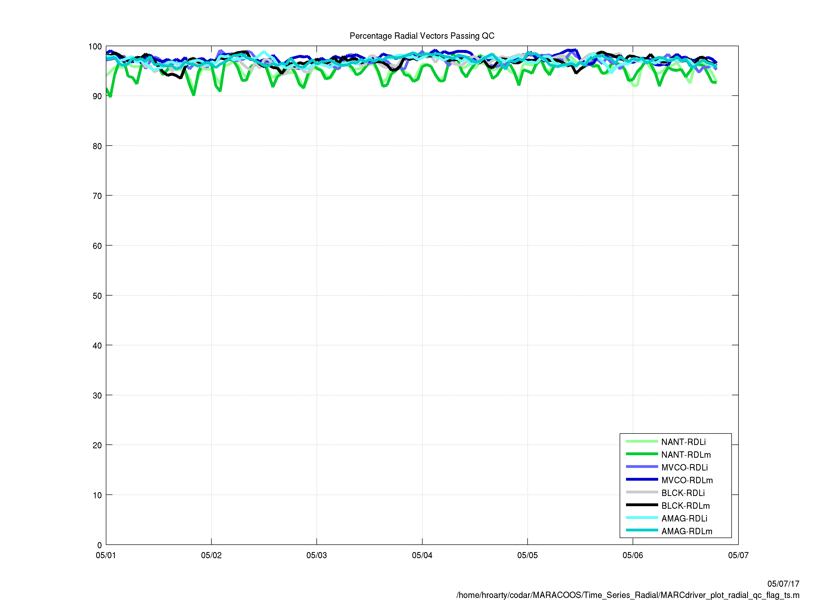
HFR Data Quality Assurance/Quality Control (QA/QC)
Regional Information Coordination Entity -
RICE
From
QARTOD
Manual for
HF Radar
Plotting QC flags in real time

Slide 9
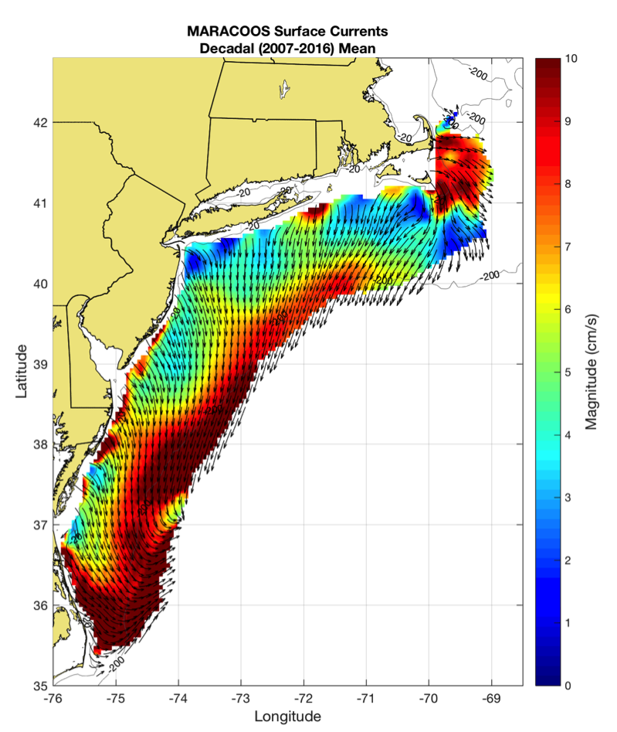
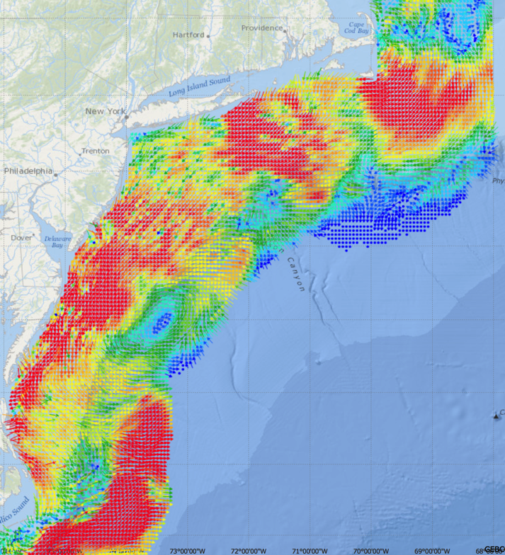
Generate Surface Current Maps Every Hour for a Decade
5 MHz- 17 Stations
13 MHz- 7 Stations
25 MHz- 16 Stations
Outside- 6 Stations
TOTAL – 46 Stations
Winter Storm Jonas
2016/01/23 20:00 UTC
Hourly Maps for
Search And Rescue
Decadal Mean Currents
for Spatial Planning

Slide 10
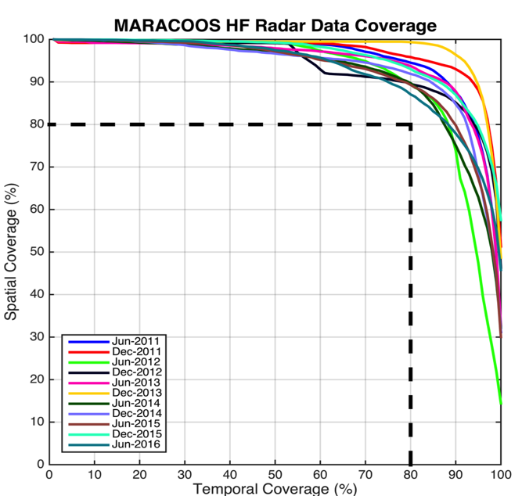
Search And Rescue Data Availability Metrics
MARACOOS 17-Site Long Range Network:
Consistently exceeds U.S. Coast Guard 80-80 Metric
80 % spatial coverage 80% of the time
Achieved through site resiliency and active spares approach.
Accomplished with 2.5 Field Technicians
Every
6 Months since 2011

Slide 11
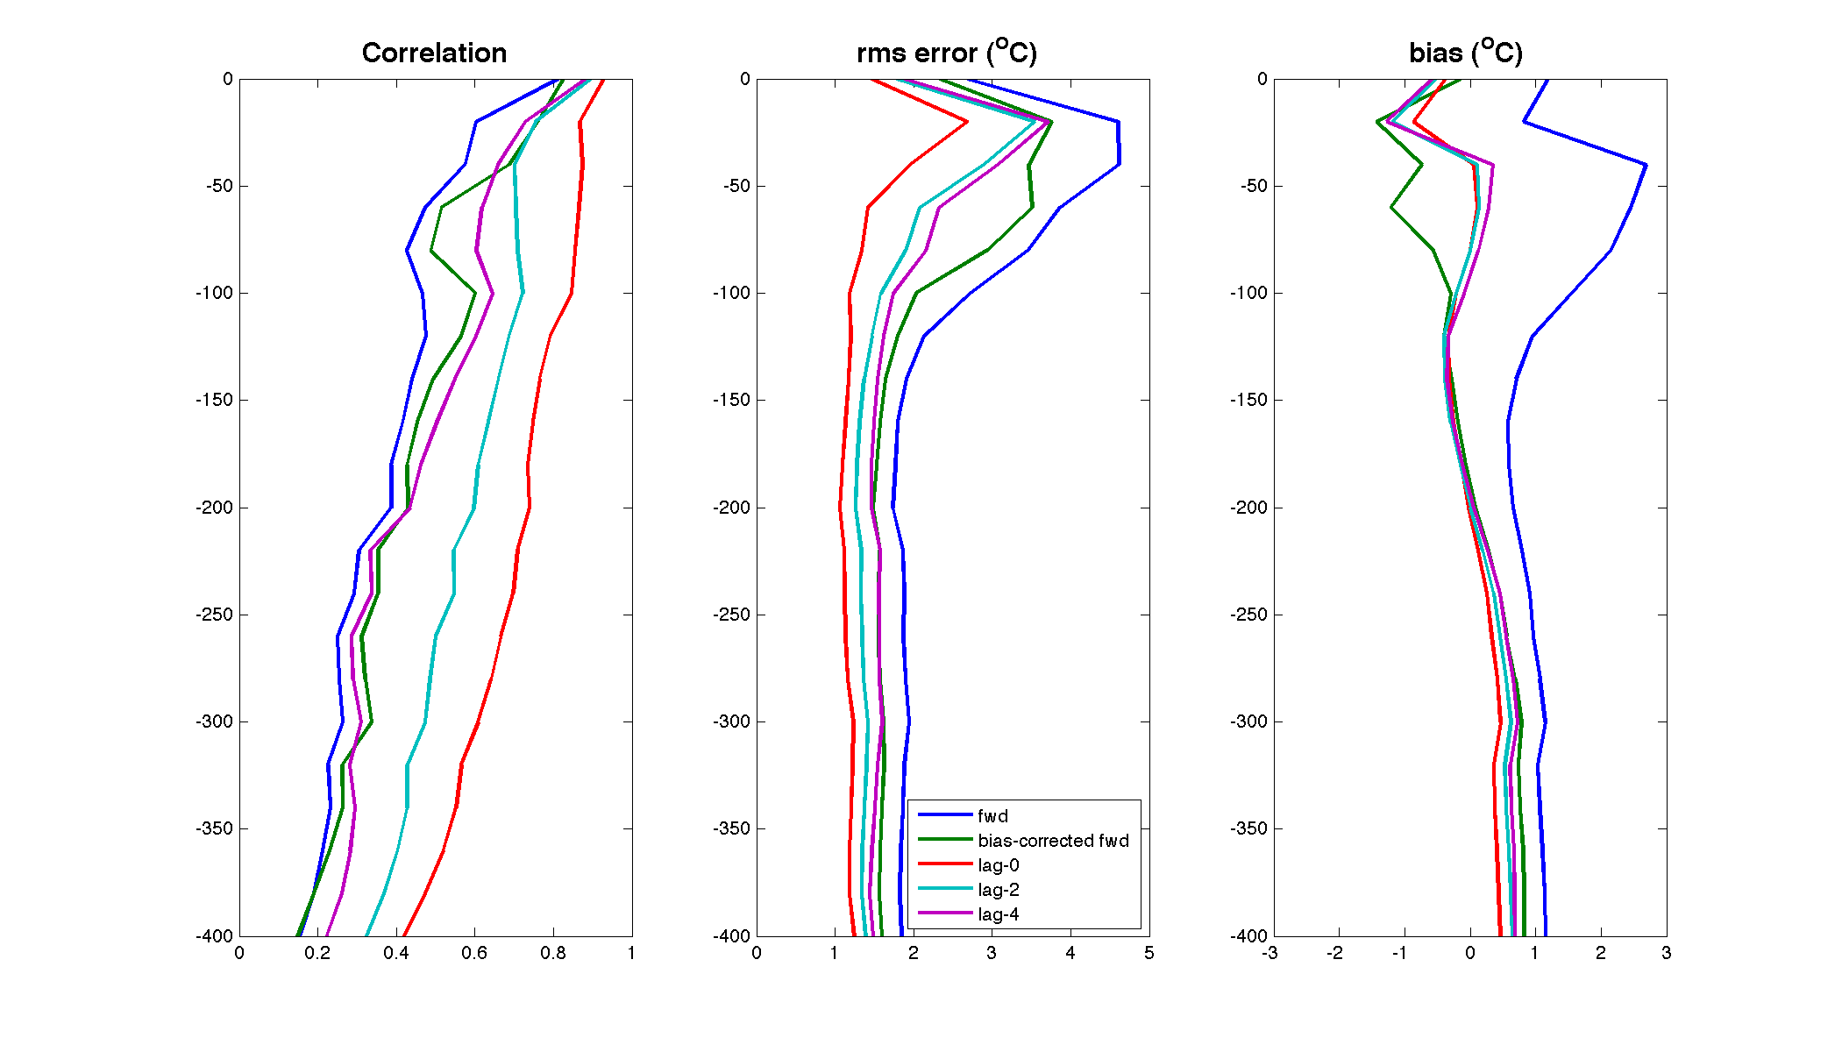
Rutgers ROMS 4DVAR uses all available data
from a modern coastal ocean observing system
  more and diverse data is better (T, S, u, sea level)
  bias correction to OBC and MDT is essential
Useful subsurface skill for real-time applications:
  4 days for temperature and salinity;
  1-2 days for velocity
Future directions: variational methods for
observing system design; coupling; ecosystems
correlation
Forward model
Forward model
after bias removal
Data assimilation
analysis/hindcast
depth
2-day forecast
4-day forecast
Bottom temperature
Data used [… real-time SOURCE]
*THREDDS Data Server
72-hour forecast NAM 0Z cycle at 2 am EST [NCEP NOMADS]
RU regional CODAR hourly [RU TDS*]
RU glider T,S [RU TDS]
USGS daily average flow available 11:00 EST [USGS waterdata]
AVHRR IR passes 6-8 per day [MARACOOS TDS]
REMSS MW-IR blended SST daily average [NASA PO-DAAC]
HYCOM NCODA 7-day forecast updated daily [NRL]
Jason-2, CryoSat, AltiKa along-track altimeter OGDR [RADS.nl]
SOOP XBT/CTD, Argo floats, on GTS [NOAA OSMC ERDDAP]

Slide 12
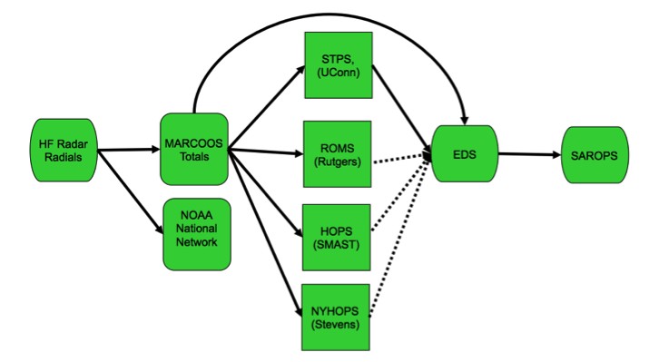
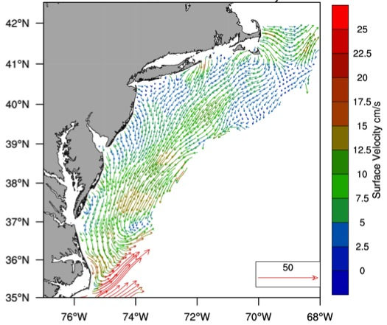

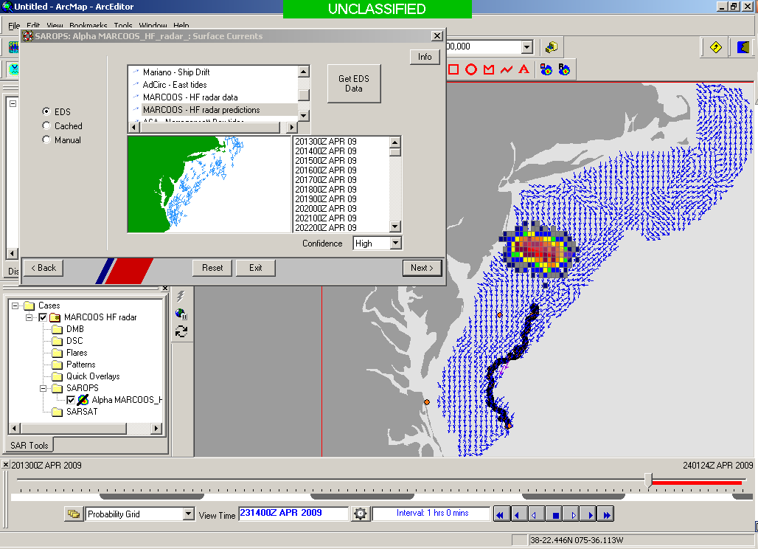
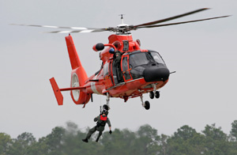

Transition Objective –
Operational Use of HF Radar Surface Currents for Search And Rescue
Surface Currents
Data Acquisition
Data Product Generation & Management
Search And Rescue Optimal Planning System (SAROPS)

Slide 13
2011-2014 2016-2017
USCG SAROPS Ocean Current Product Requests
Global HYCOM Products – Always there “100-100” metric
HF Radar Data & Statistical Predictions – #8
Assimilative Regional Espresso ROMS - not on the list
Global HYCOM Products – Still Always there “100-100” metric
HF Radar Data & Statistical Predictions – up to #6
Assimilative Regional Espresso ROMS - up to #4

Slide 14
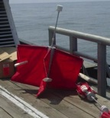
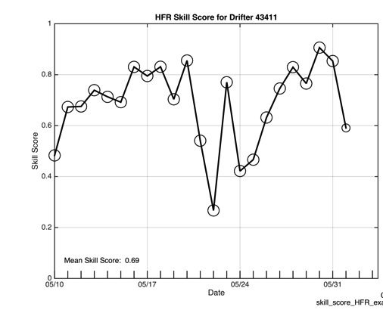
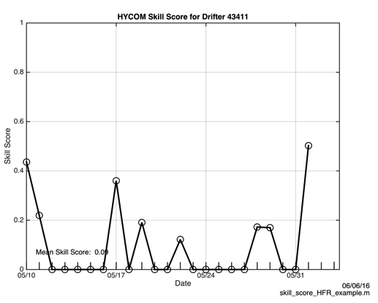
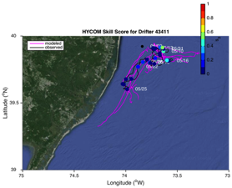
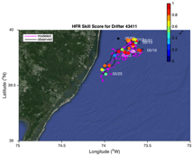
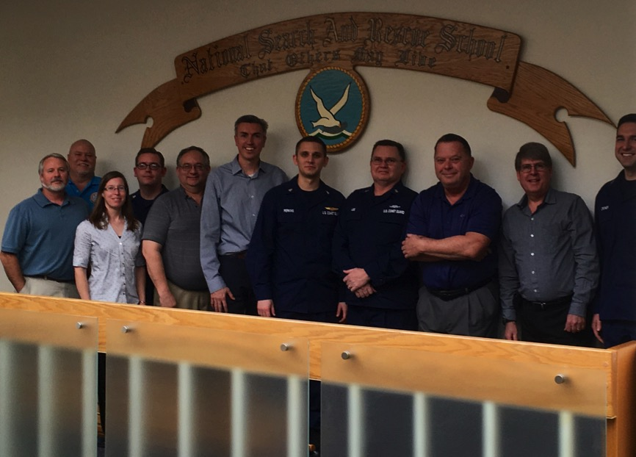
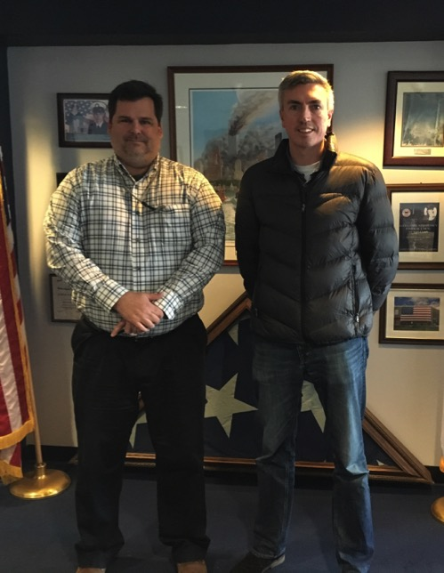


2016 Surface Current Drifter Skill Score
Navy HYCOM Region 1
No HFR Assimilation
HFR Data
Active Education & Outreach to USCG Users of the HFR Data & Data Assimilative Products
National Search and Rescue School
Yorktown, VA
January 19, 2017
Coast Guard Sector NY
Staten Island, NY
March 21, 2017

Slide 15
Coast Guard Wind & Current Data Requests
Requests June 1 to December 1, 2017

Slide 16

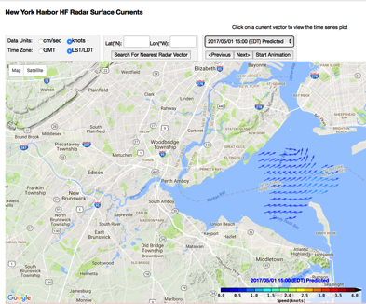
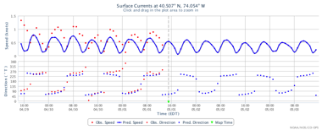
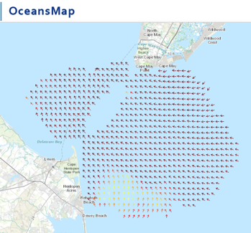
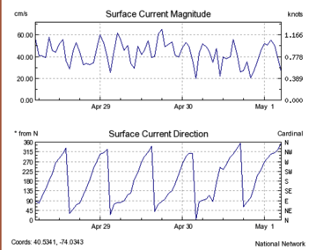
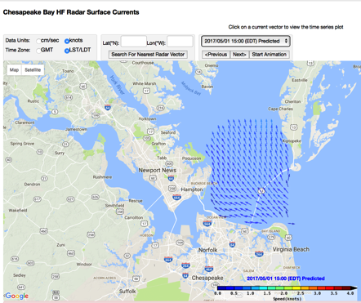
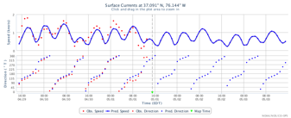
Nested High Resolution HF Radars in NOAA PORTS
5 MHz- 17 Stations
13 MHz- 7 Stations
25 MHz- 16 Stations
Outside- 6 Stations
TOTAL – 46 Stations
Winter Storm Jonas
2016/01/23 20:00 UTC

Slide 17
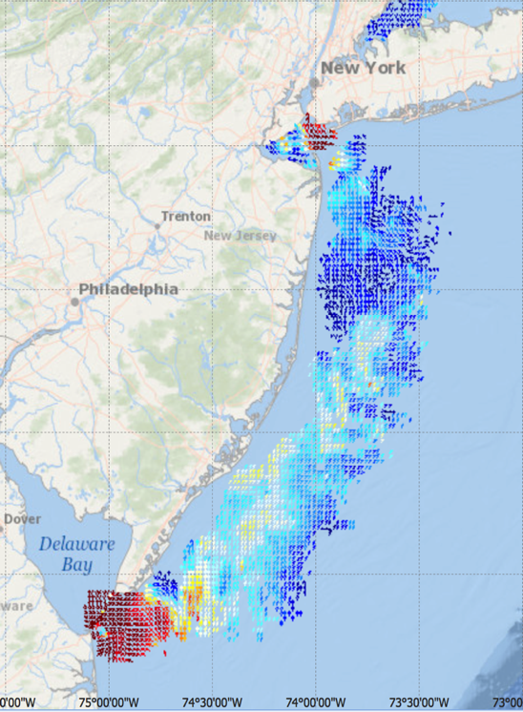
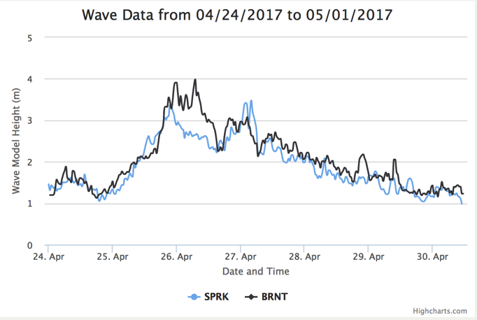
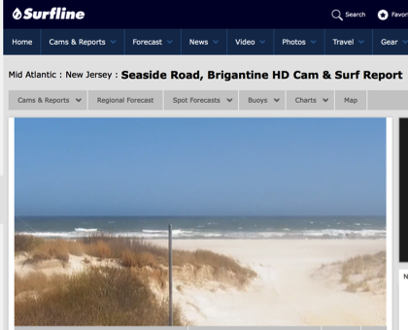
Medium Range HF Radar Network – Nearshore Waves
New Jersey 13 MHz
HFR wave observations combined with co-located Surfcams
Gap fills a sparse buoy network in regions of high variability & interest

Slide 18
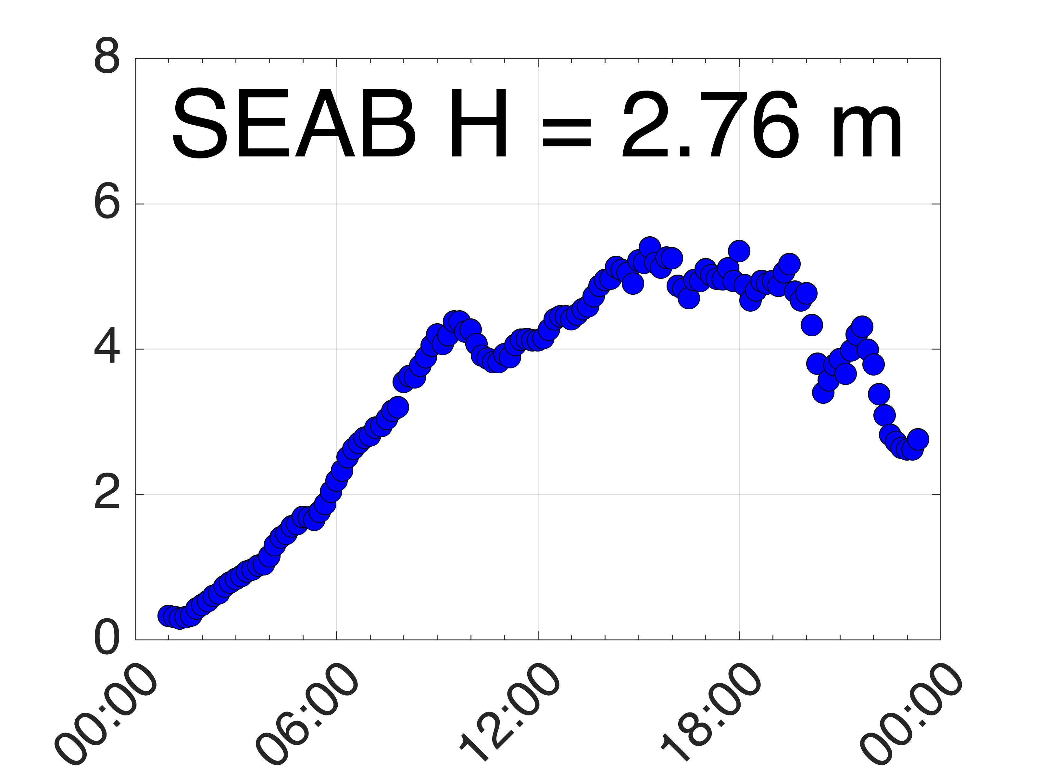
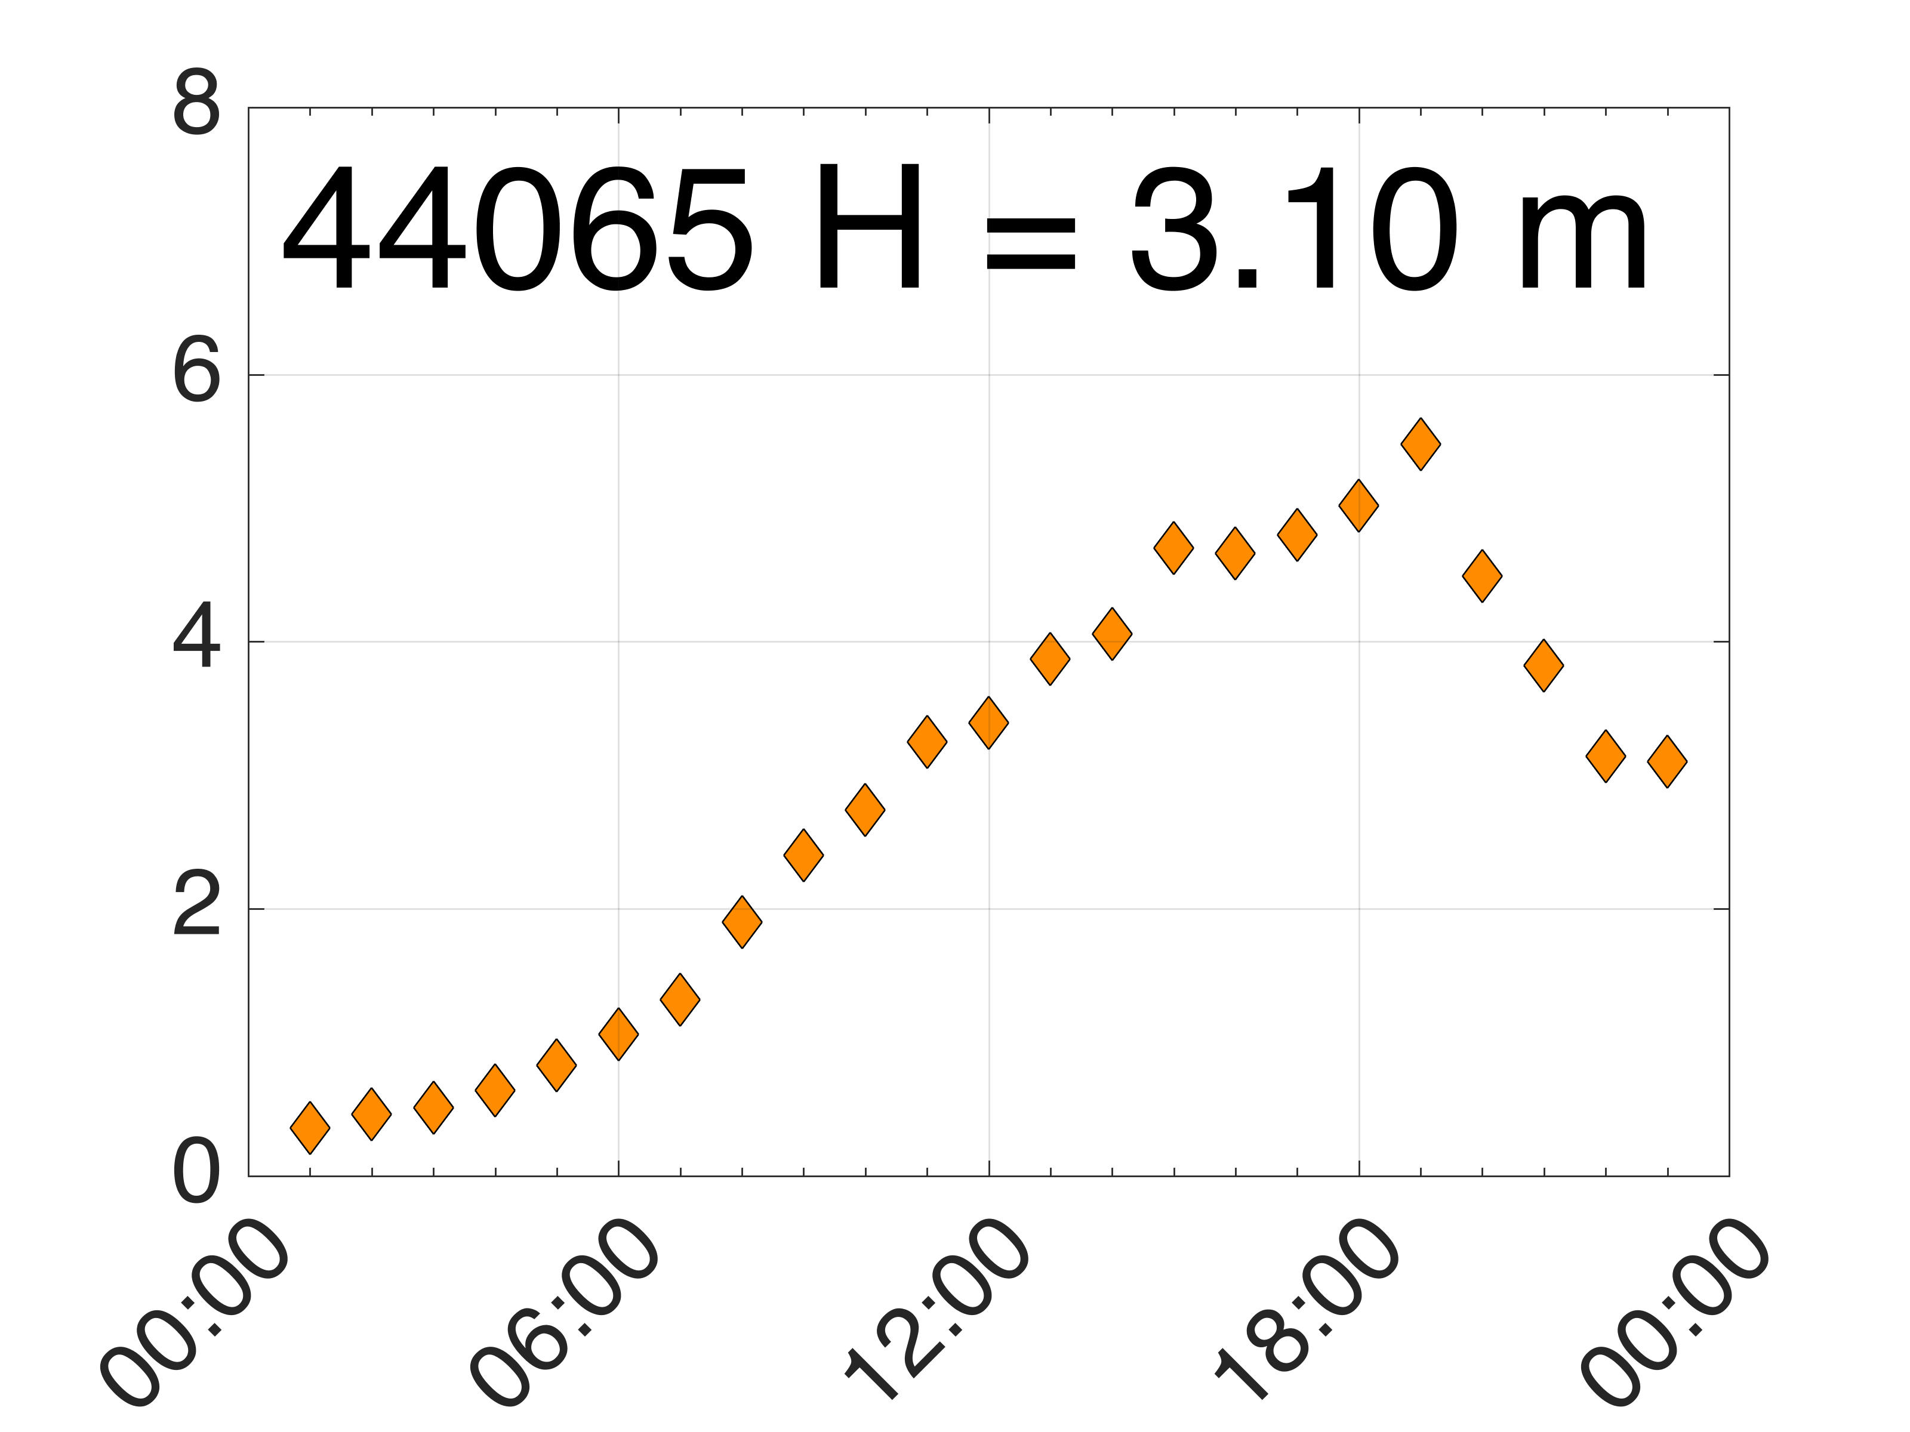
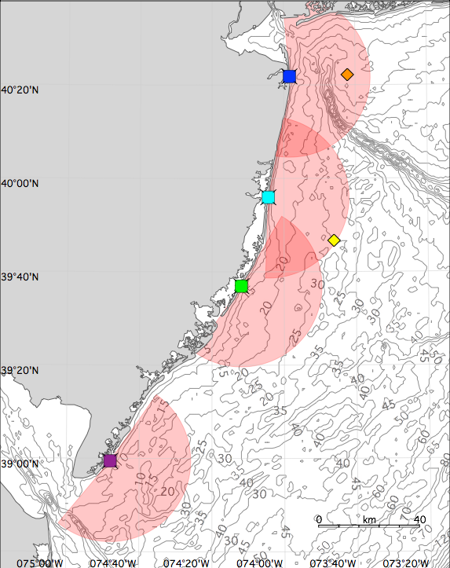
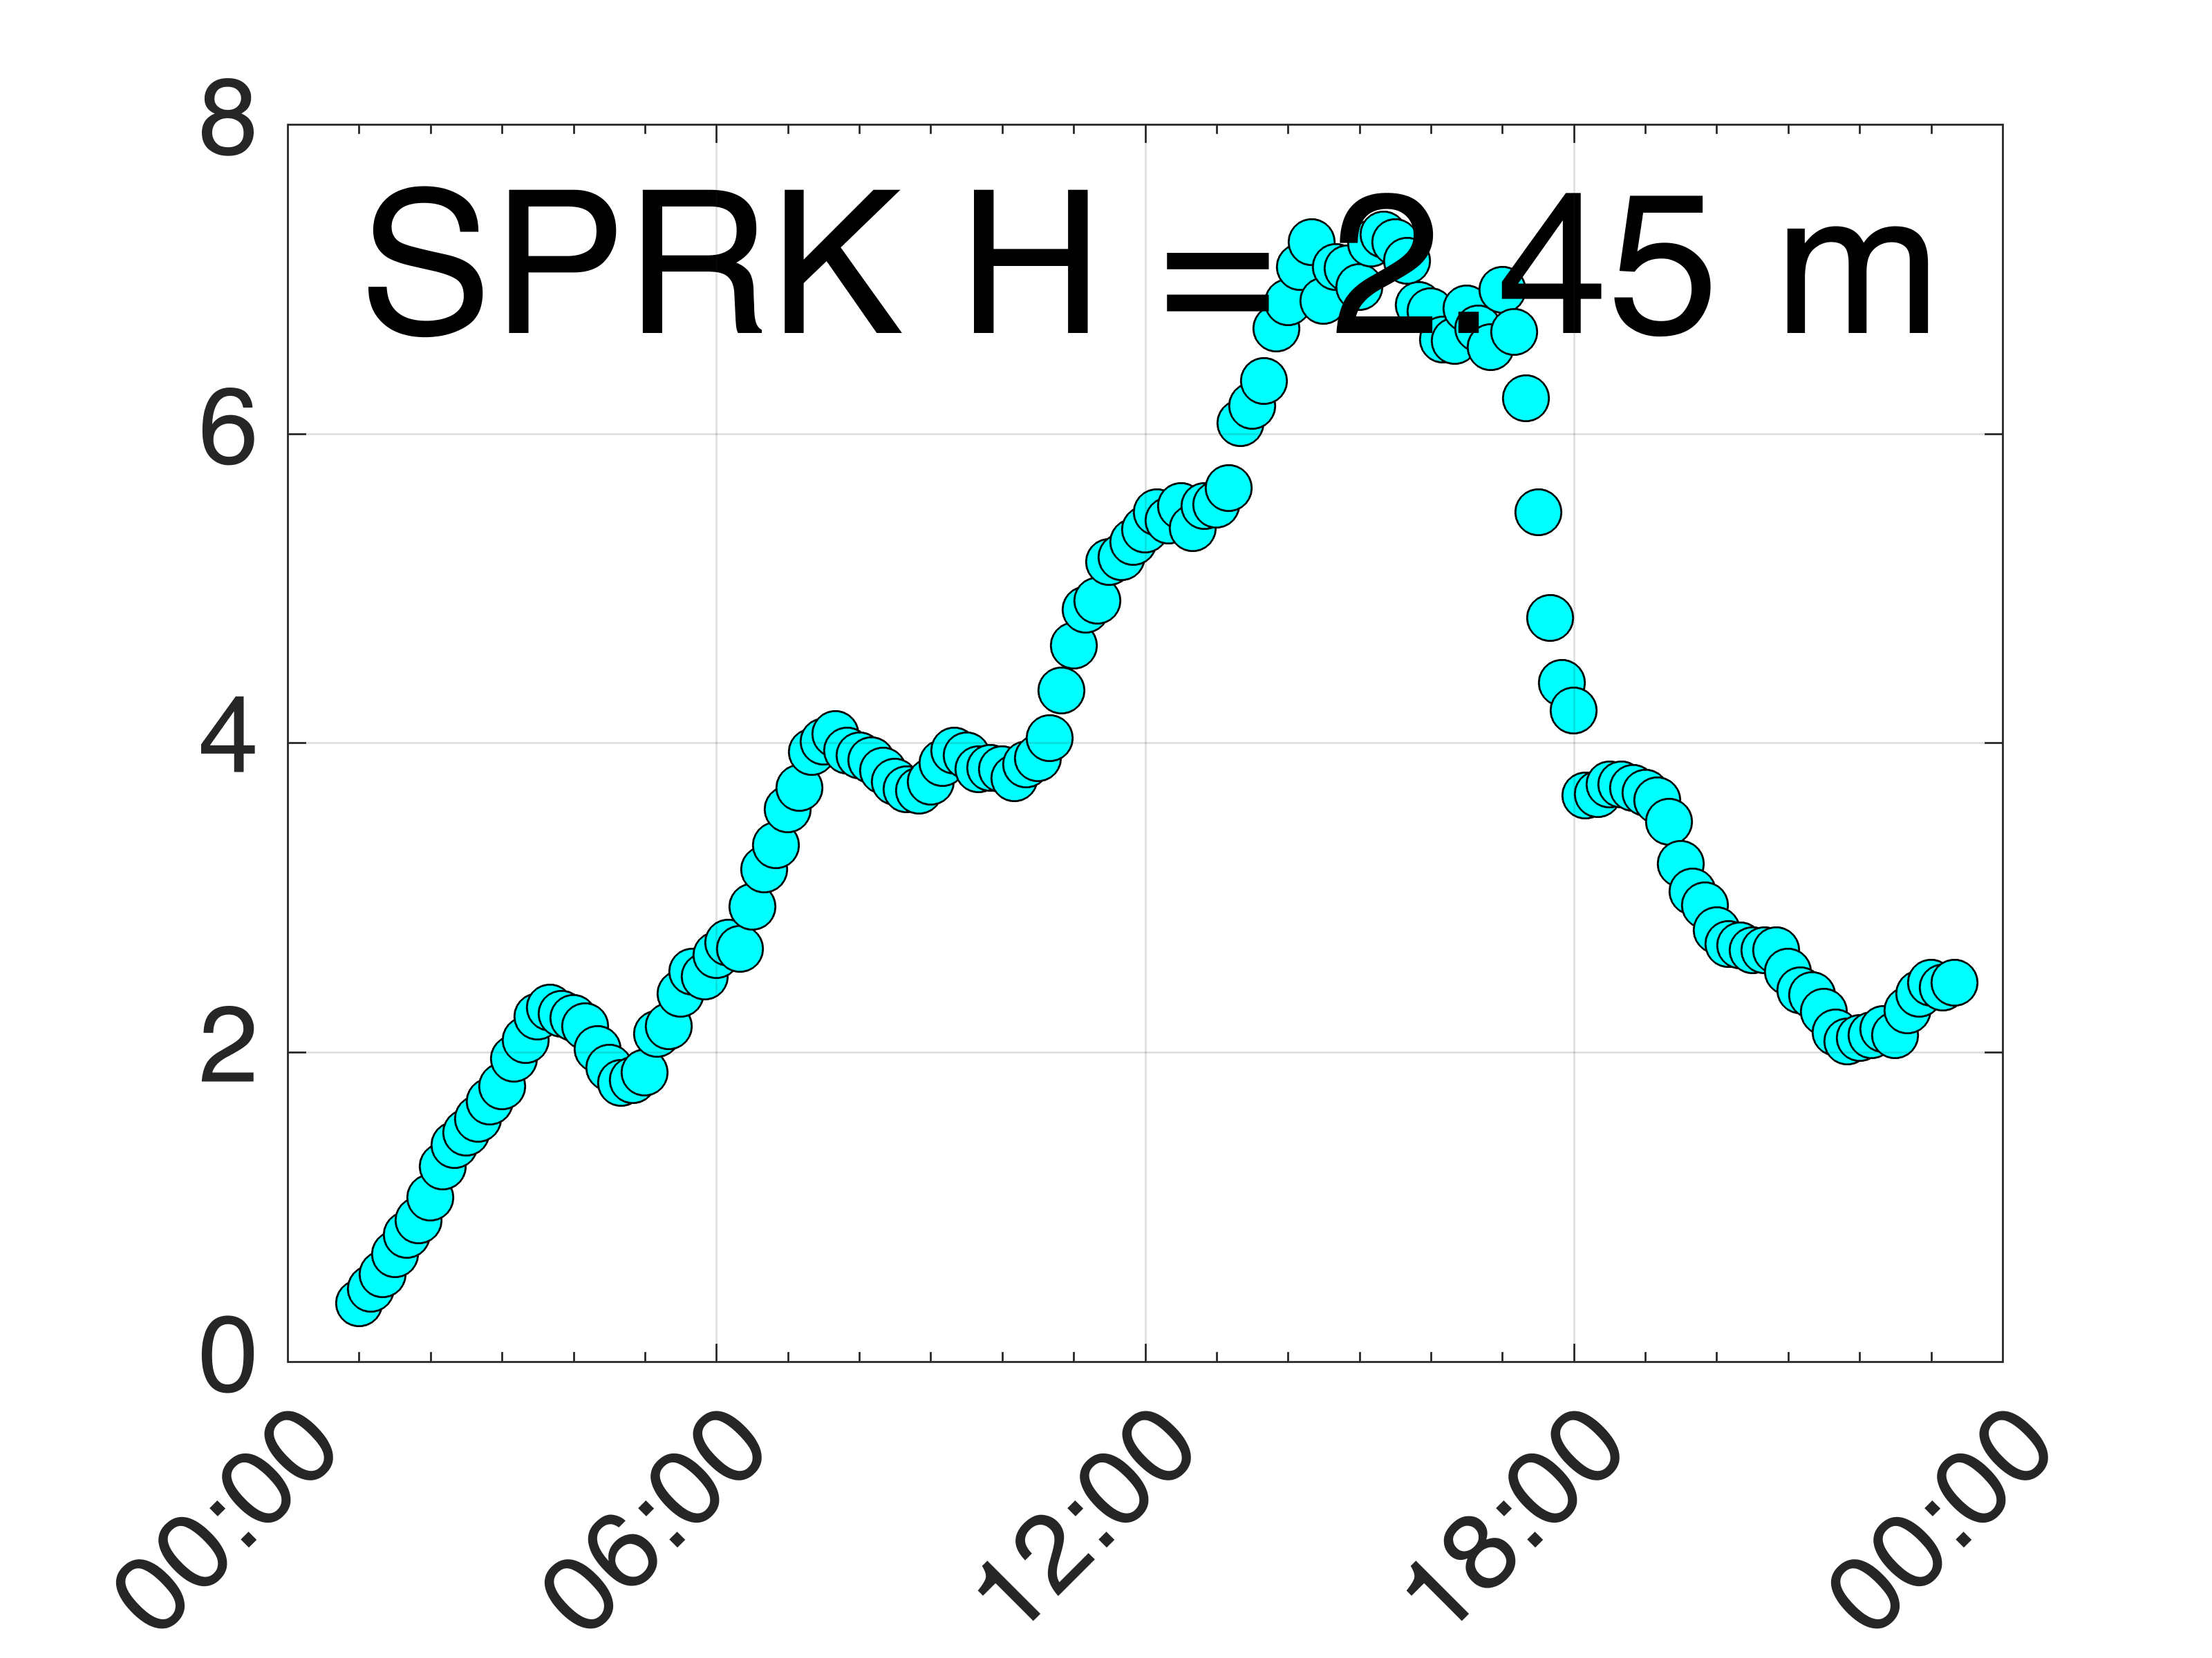
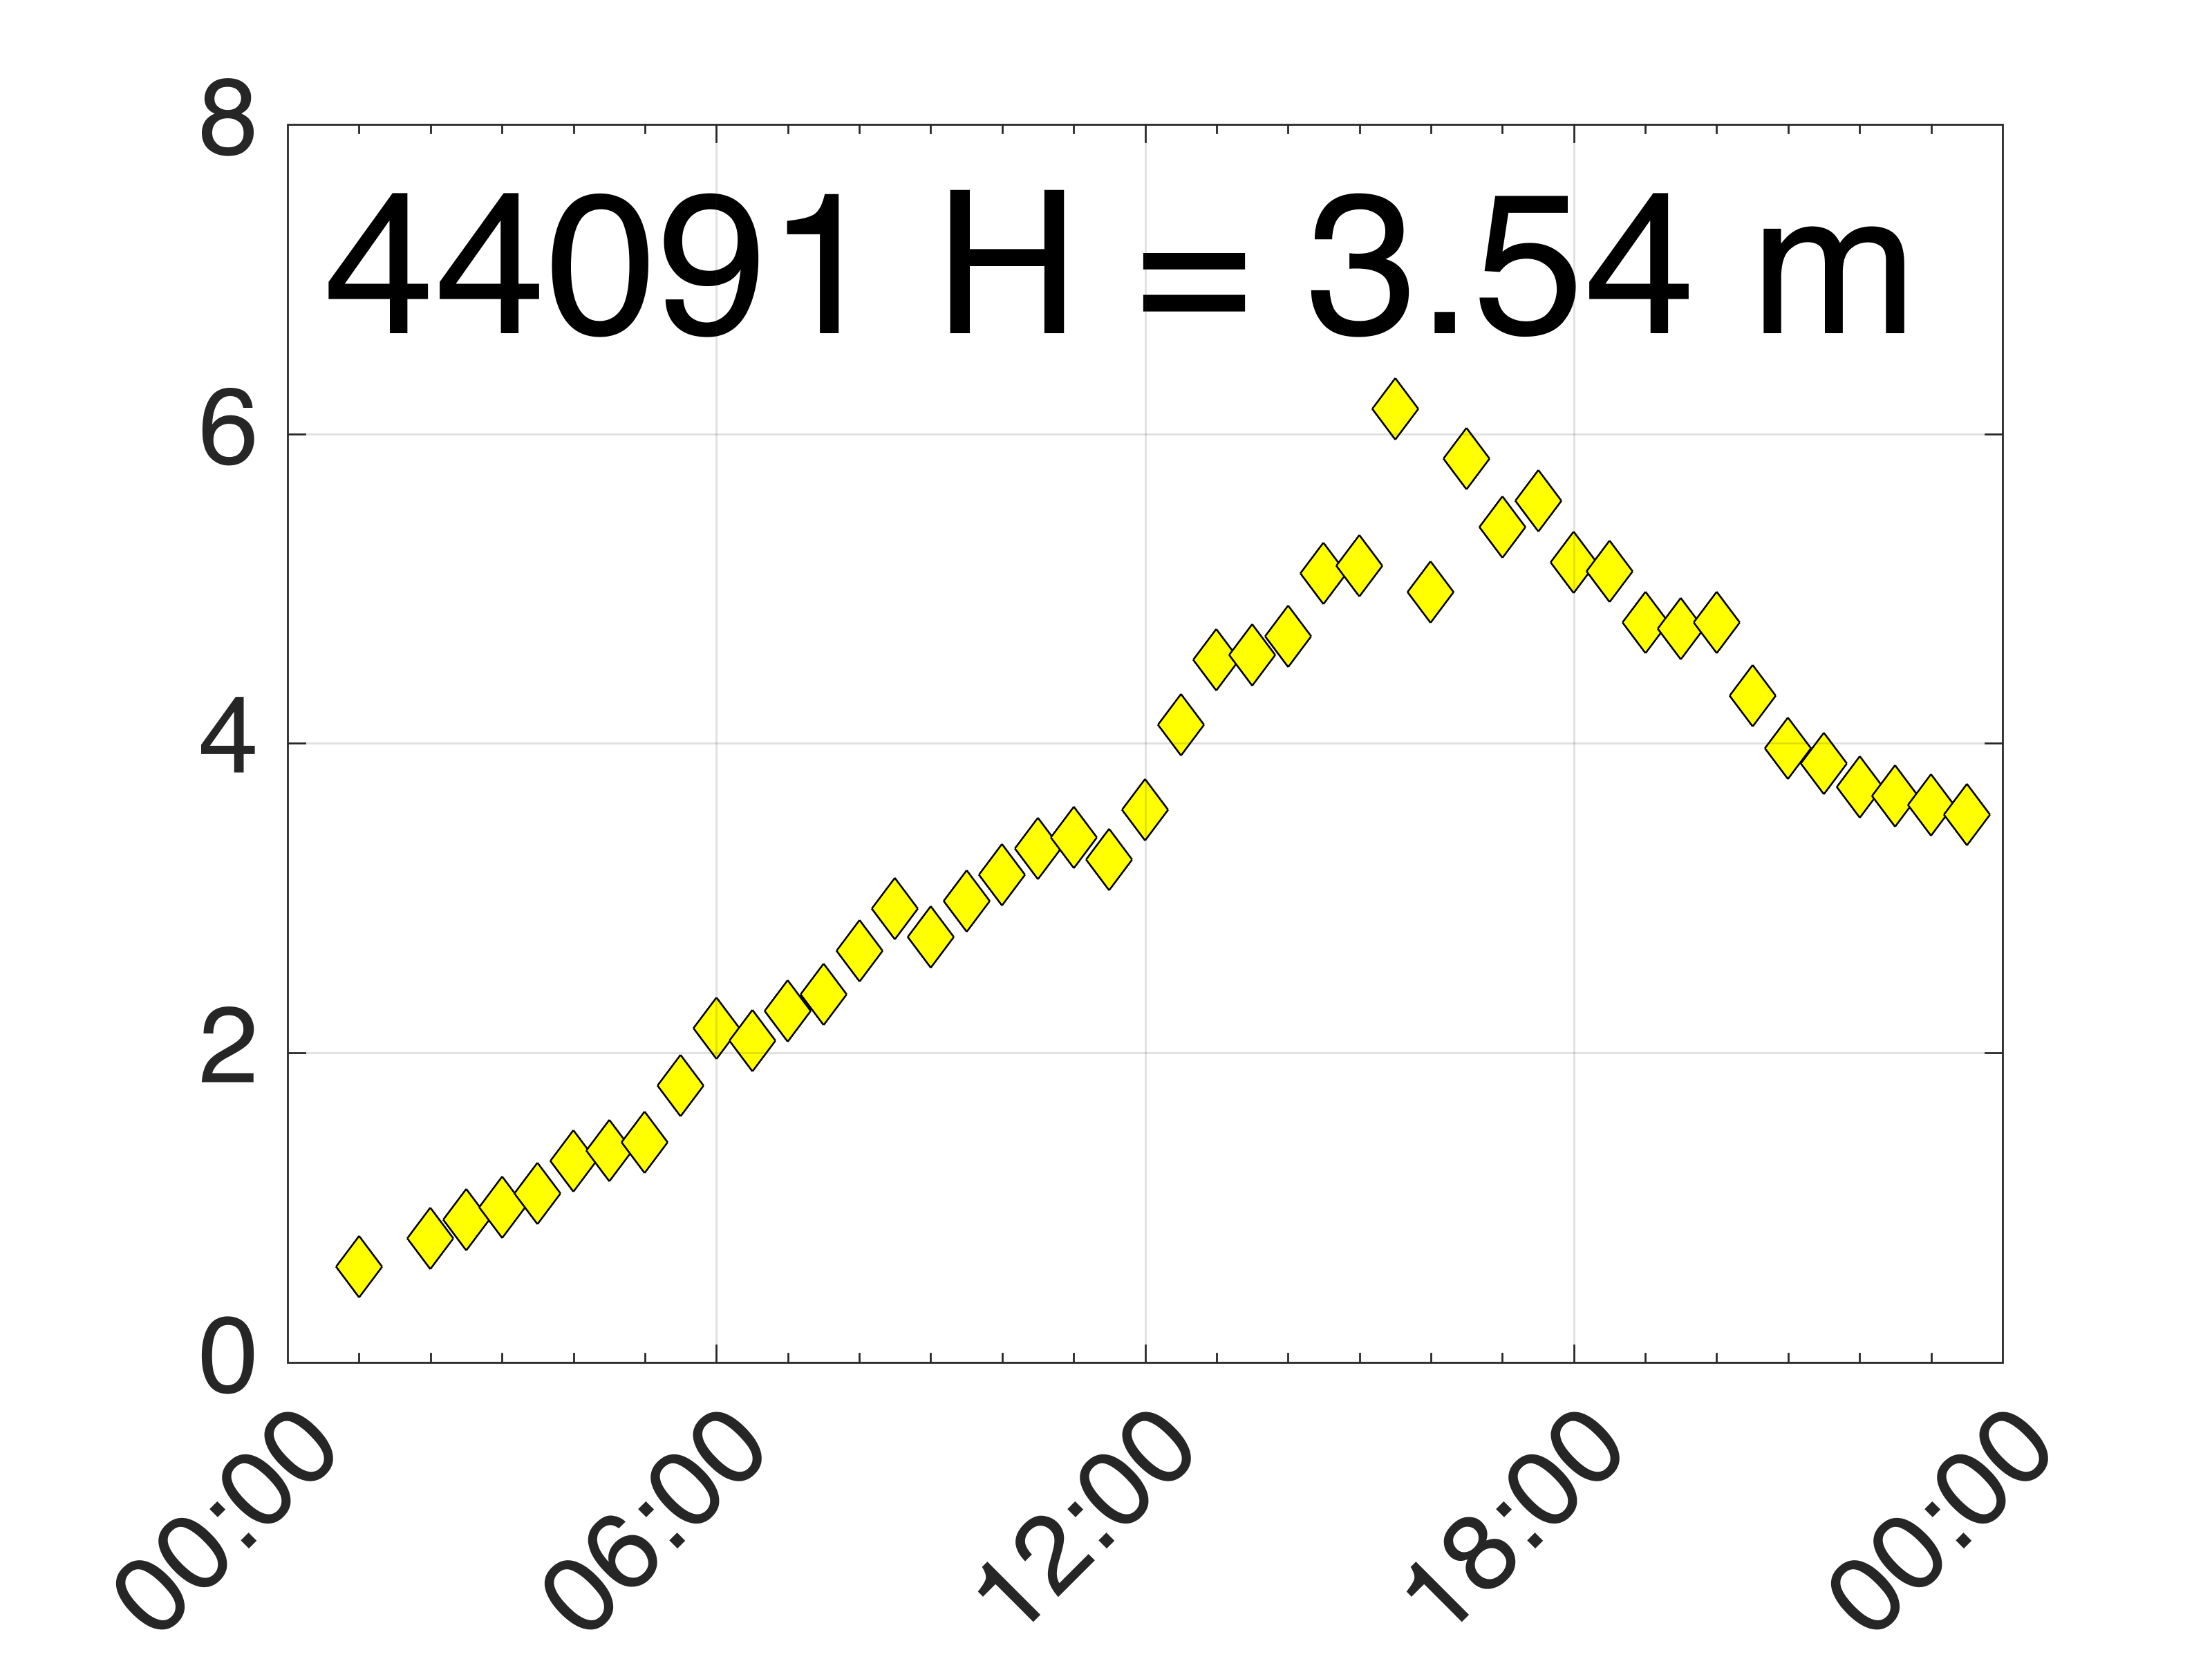
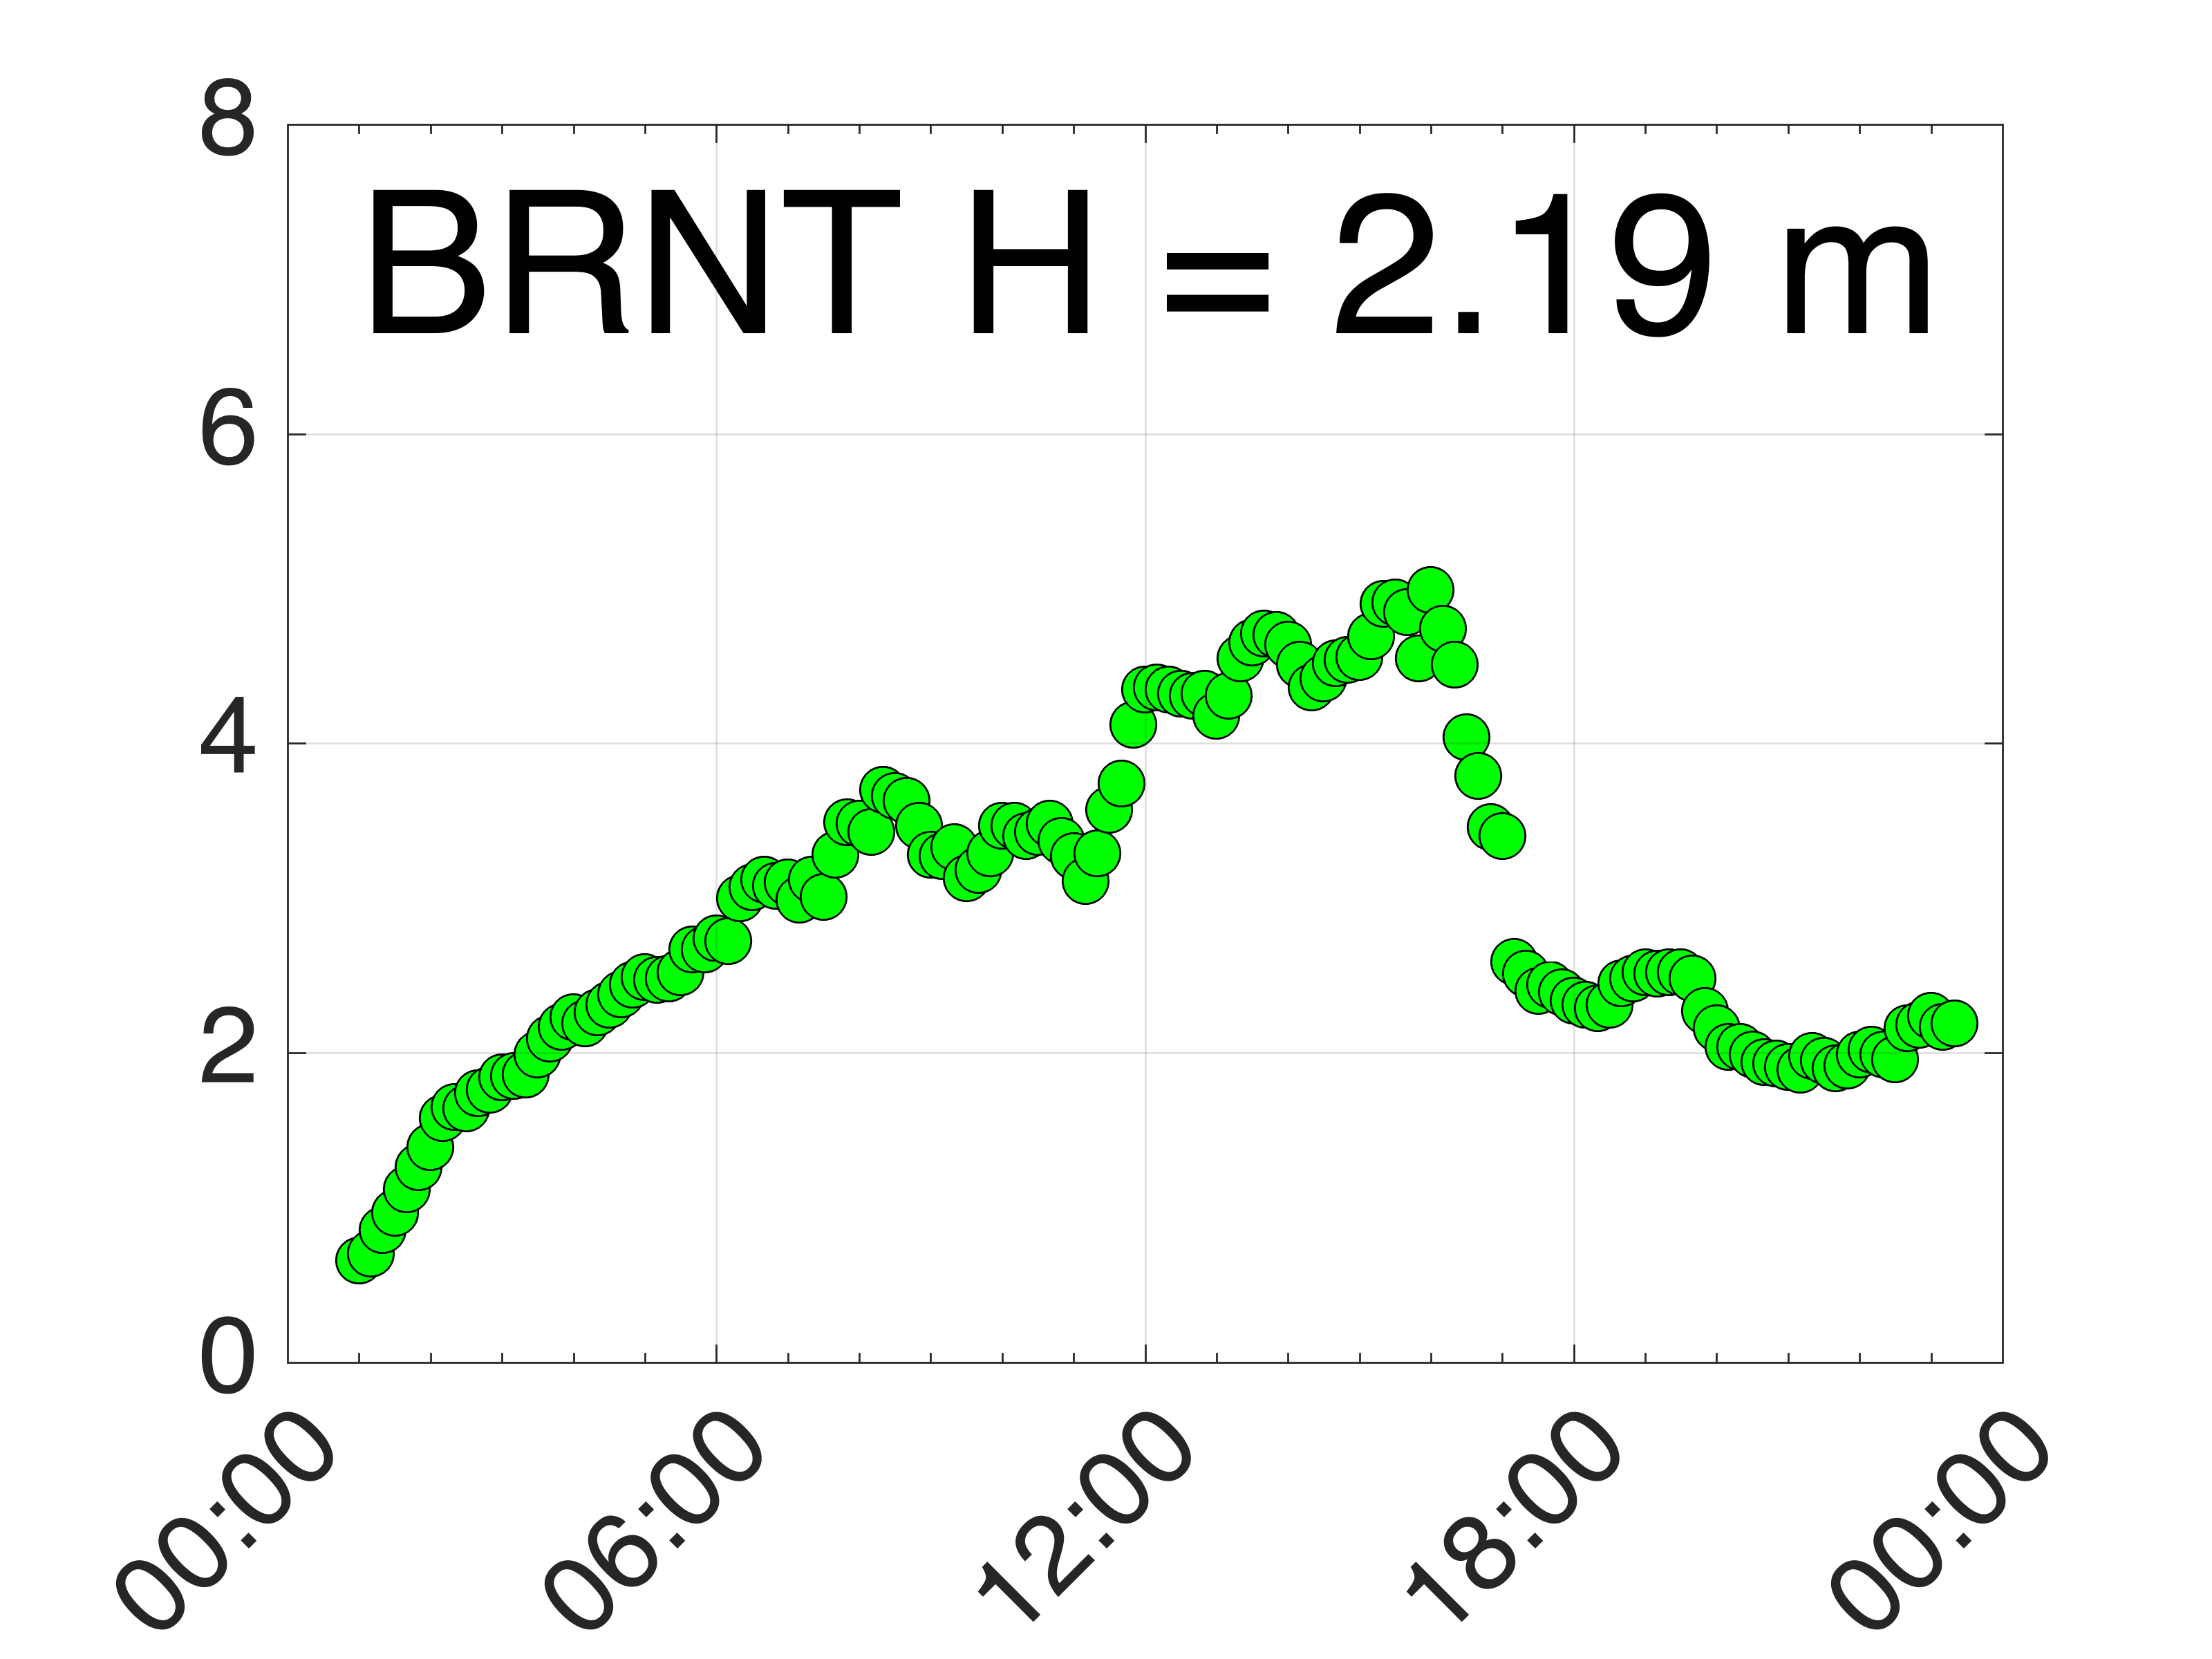

Significant Wave Height (m) Versus Time
Landward Winds For First Half+ of March 14, 2017
SEAB
44065
SPRK
44091
BRNT
Winds become seaward at the times listed below, shown in time series plots with vertical lines. The first transition occurs at WOOD and progresses northward:
SEAB (19:00)
SPRK (18:00)
44065 (17:00 / 18:00)
BRNT (17:00)
WOOD (14:00)
WOOD

Slide 19





Significant Wave Height (m) Versus Time
Seaward Winds: March 22-23, 2017
Buoy 44091 , SPRK: RC10 RC5 RC3
landward
seaward
RC10
Significant wave height data are displayed for RC10, RC5, and RC3 and for buoy 44091.
Seaward winds are reflected in a seaward increase in wave height extending through SPRK range cells and the buoy.
RC5
RC3
SPRK
44091

Slide 20



Medium Range HF Radar Network – Tsunami Detection
June 13, 2013 Meteo-tsunami
New Jersey 13 MHz

Slide 21

Summary:
Integrated, Sustained and Certified Regional Ocean Observing Systems are operating in the U.S.
Transformational Observing Technologies (HF Radar & Gliders) Key to Success
Integrated approach demonstrates every day that knowledge of the ocean improves weather forecasts
Global Glider & HF Radar networks are forming – participation is welcomed
Indian Ocean Glider/Model Validation Mission ongoing – collaborators are welcomed
Workforce Training is ongoing – students are welcomed – BMKG Academy, Rutgers Masters Operational Oceanography

