Slide 1
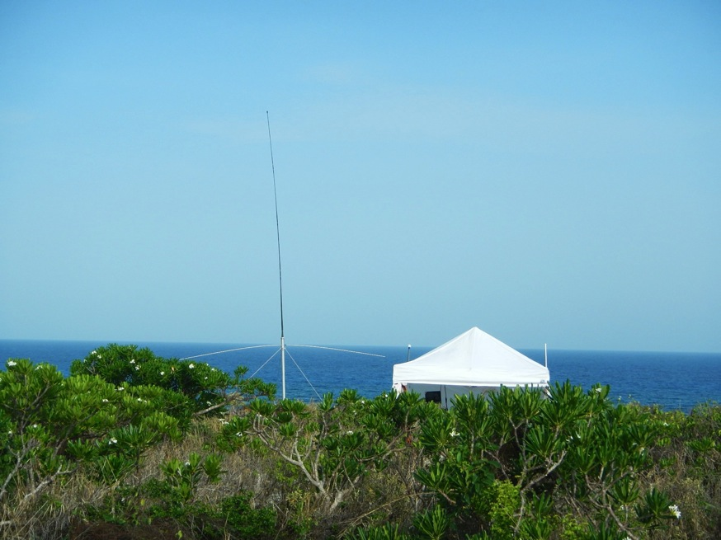
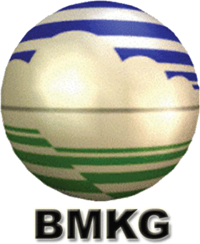

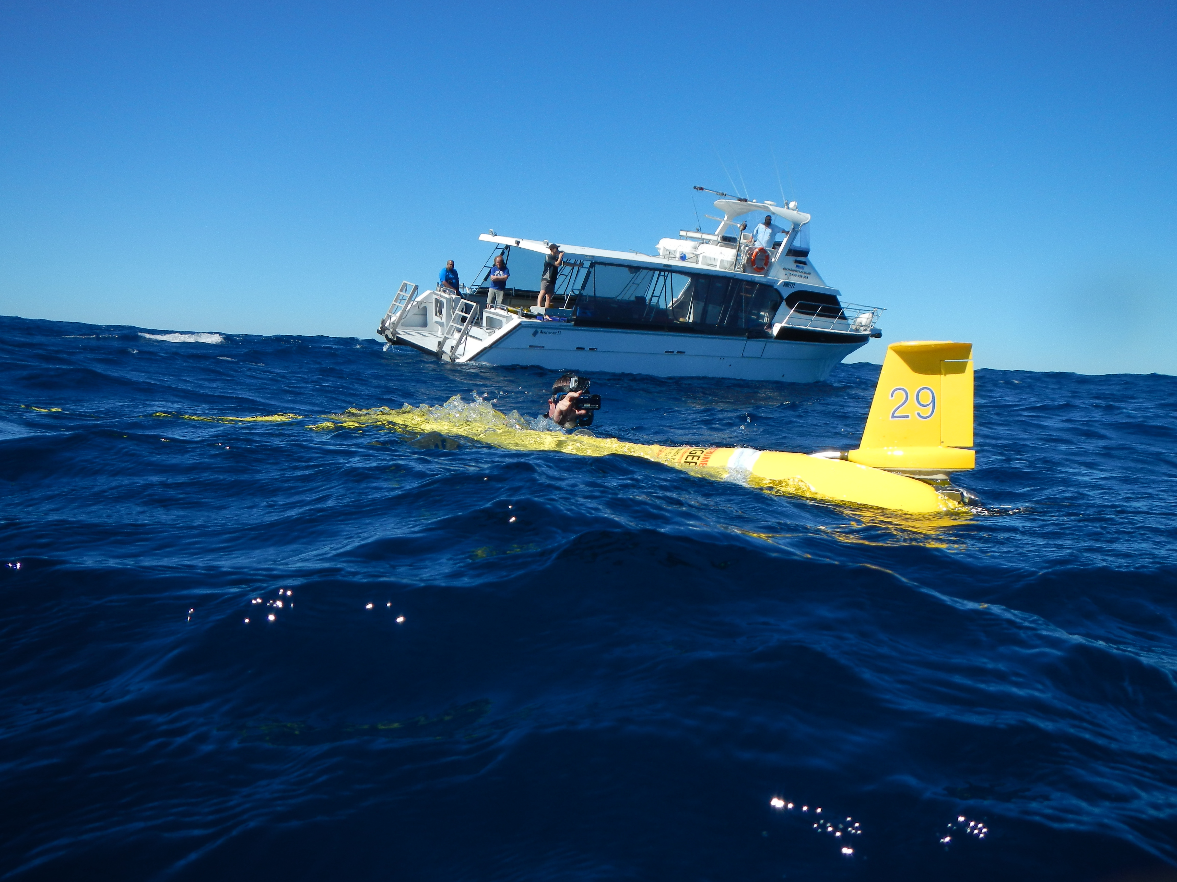



Globalizing HF Radar Networks & Underwater Glider Fleets to Improve
Ocean-Atmospheric Forecasts
12th Annual Indonesia – U.S.
Ocean and Climate Observations, Analysis and Applications Partnership Workshop
”The Role of Ocean Observations for Improving Subseaonal to Seasonal Forecasts in Indonesia”
Scott Glenn, Josh Kohut & Hugh Roarty
Rutgers University
New Brunswick, New Jersey, USA
CODAR HF Radar on
Mona Island, Puerto Rico
Slocum Glider deployment off Perth, Australia

Slide 2
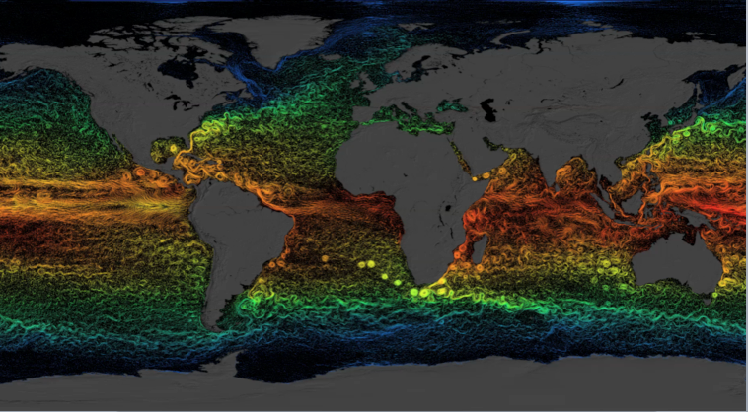
The Ocean is Physically Complex & Biologically Diverse
Global circulation maps dominated by the Mesoscale

Slide 3
The Ocean is Physically Complex & Biologically Diverse
61 Large Marine Ecosystems Dominated by Coastal Regions

Slide 4
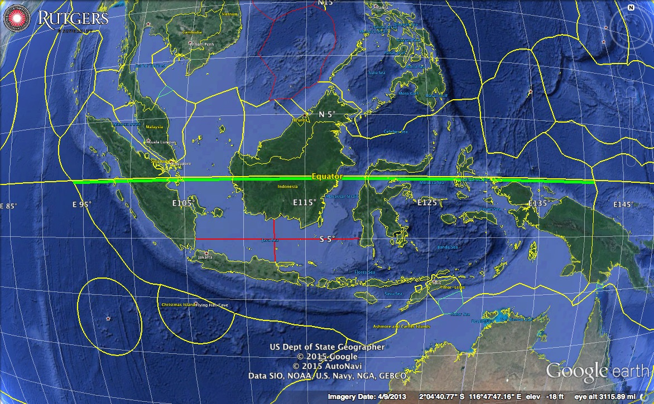
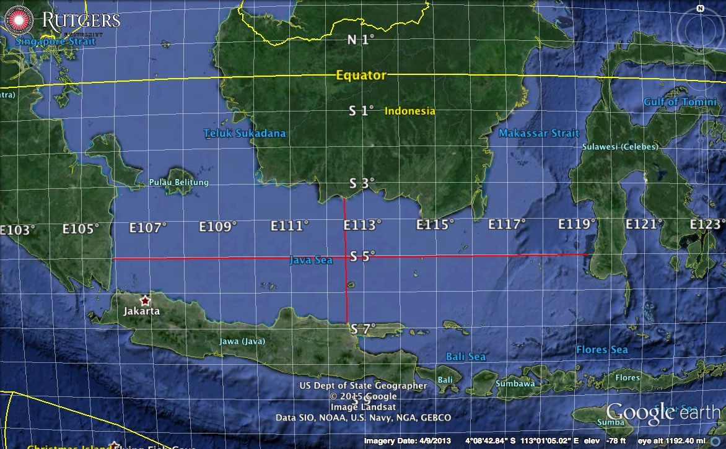
Requires new at-sea sampling & on-shore cyber technologies
Enhance multi-disciplinary spatial observations at regional scales
Organized as a global system
Locally implemented
Every coastal country could be enabled to
  Monitor their own waters
  Share their data as appropriate
  Respond to actionable forecasts and information
  Build a sustainable and resilient blue economy
5,250 km
Indonesia & Java Sea
1,500 km
375 km

Slide 5
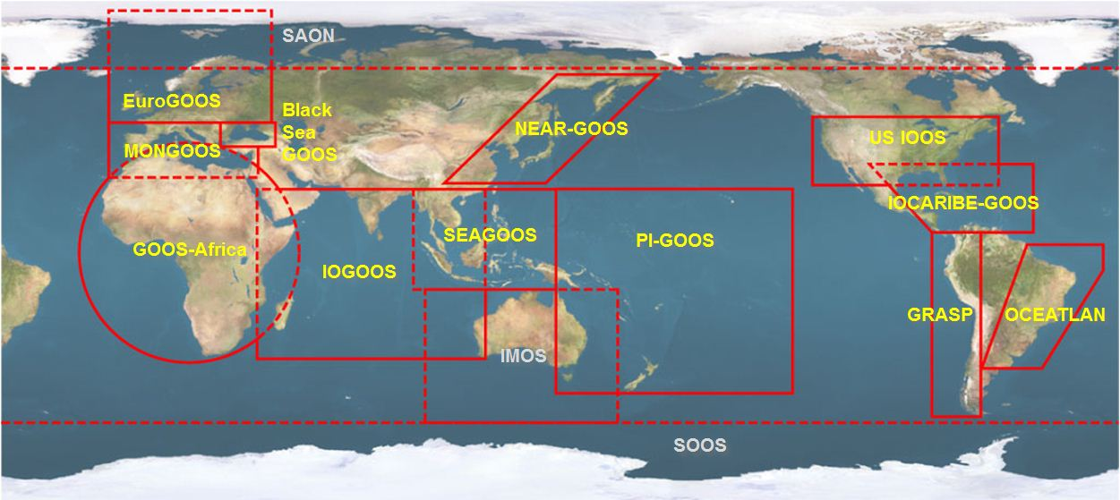





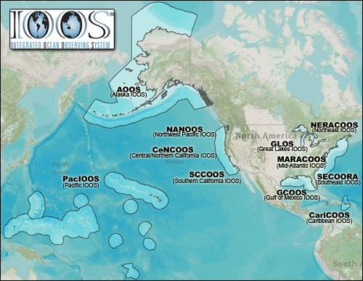


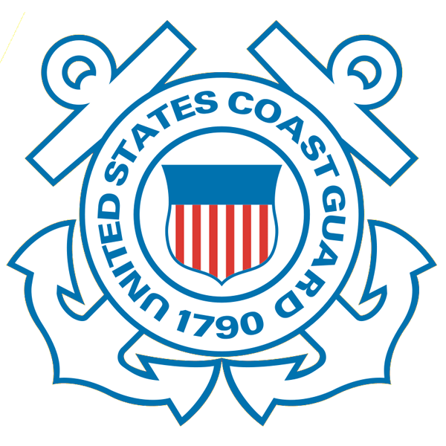










NOAA-led U.S. Integrated Ocean Observing System (IOOS)
Global Component
National Component
Regional Component
15 Regional Alliances in GOOS
Vessels -
Satellite
Satellite
CODAR
Ships/ Vessels
Glider
REMUS
Data Vis.
Modeling
Security
Leadership
Education
11 Regional Associations
17 U.S. Federal Agencies

Slide 6

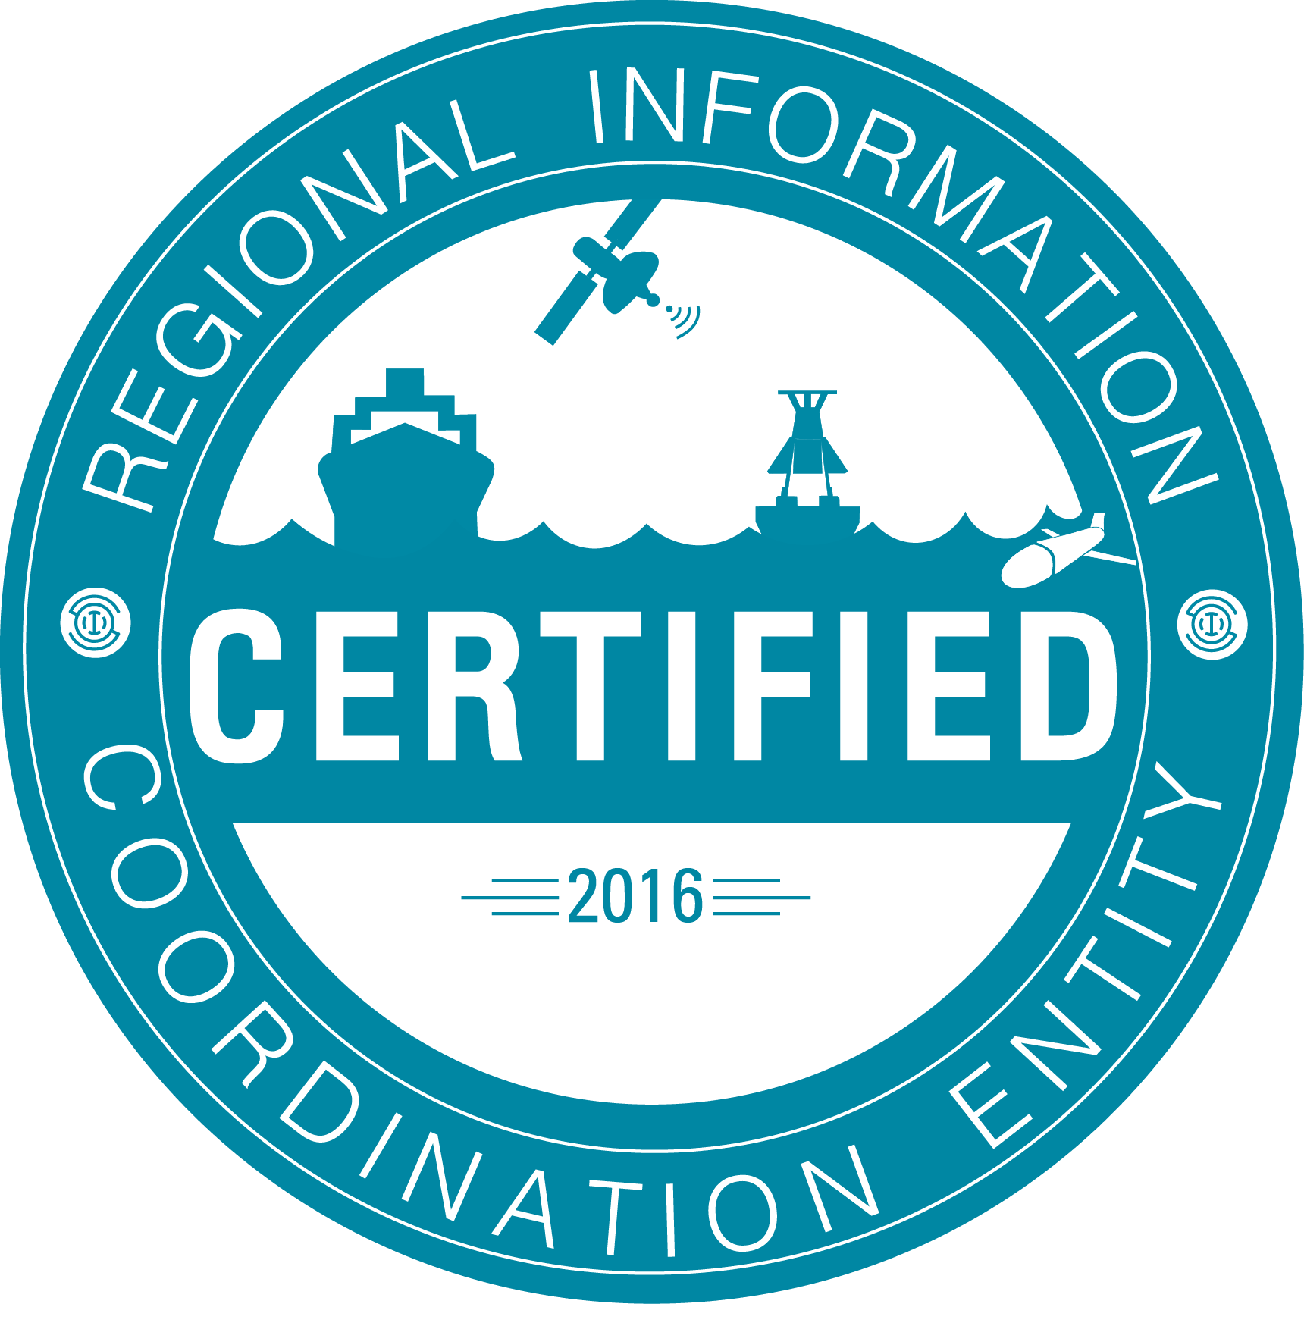












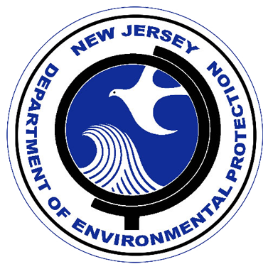


RI
U..
Middle Atlantic
Regional Association
Coastal
Ocean Observing System
10 States - 78 Million People
1000 km Cape to Cape
CT
Cape
Cod
MA
NY
PA
NJ
MARACOOS:
An Integrated, Sustained & Certified Real-time Observation and Forecast System
DE
MD
VA
NC
Cape
Hatteras
Notes:
6

Slide 7
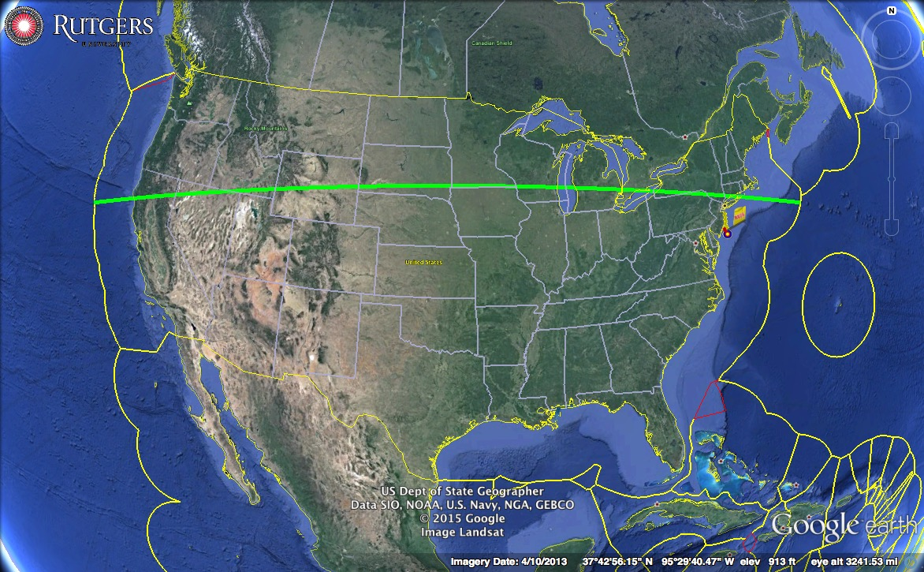
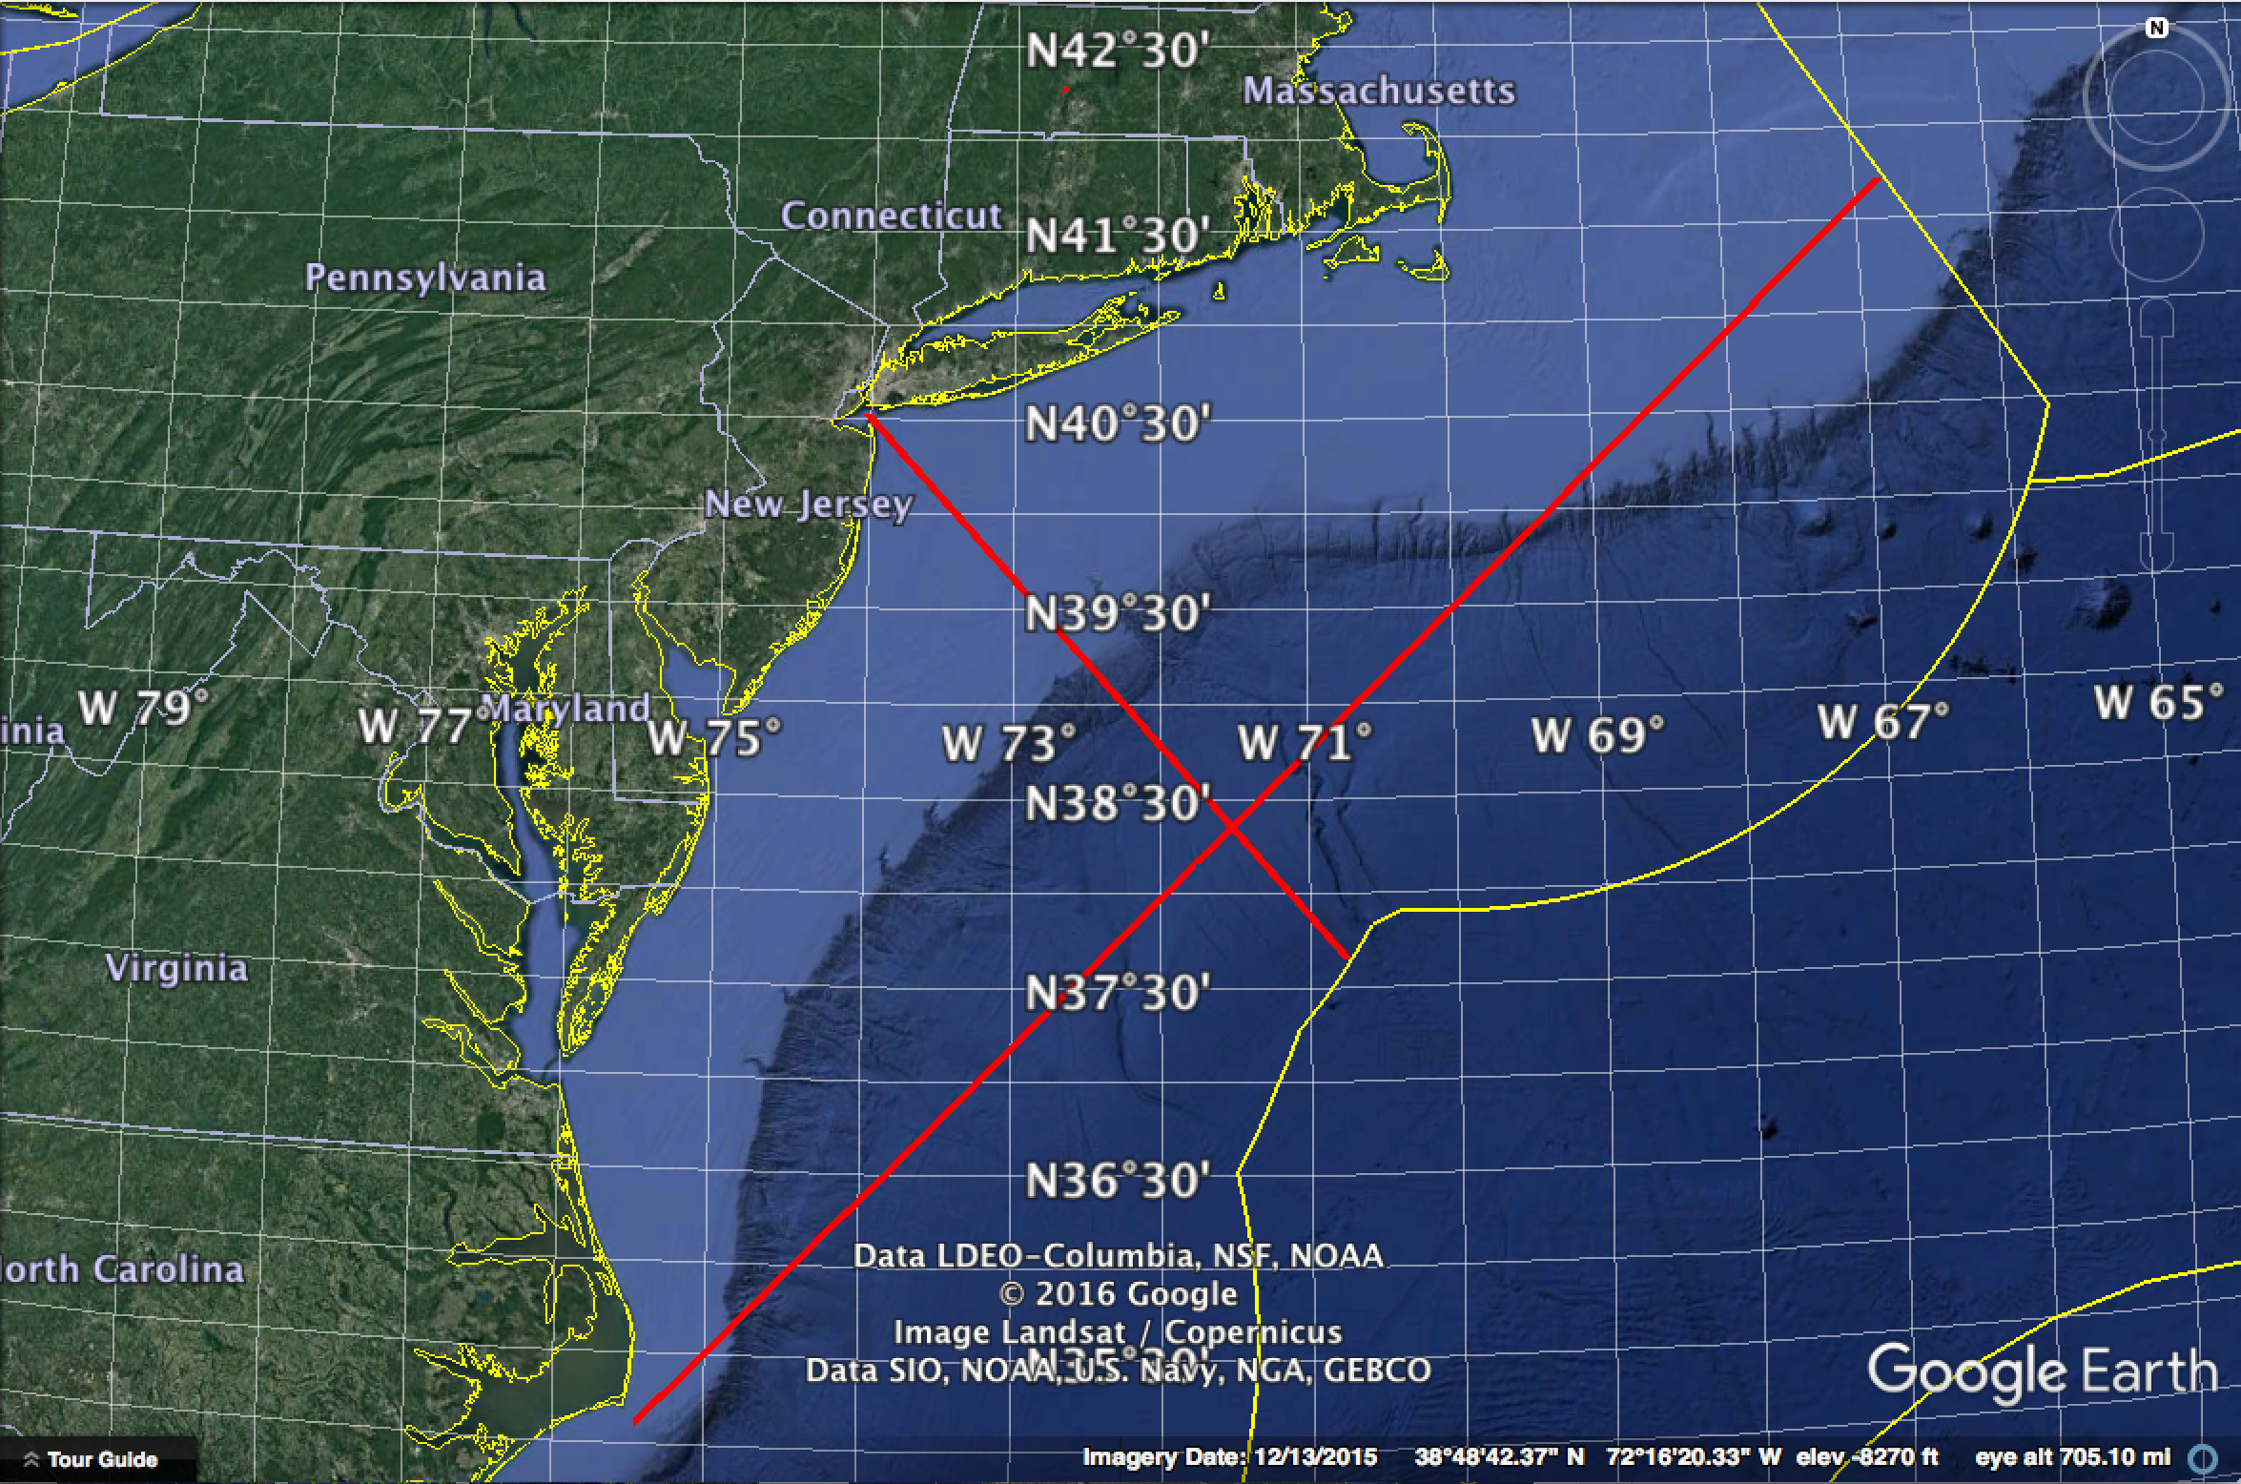
National & Regional Spatial Scales
5,250 km
5,250 km
Indonesia & Java Sea
United States & Mid Atlantic Bight
425 km
1,050 km
1,500 km
375 km

Slide 8
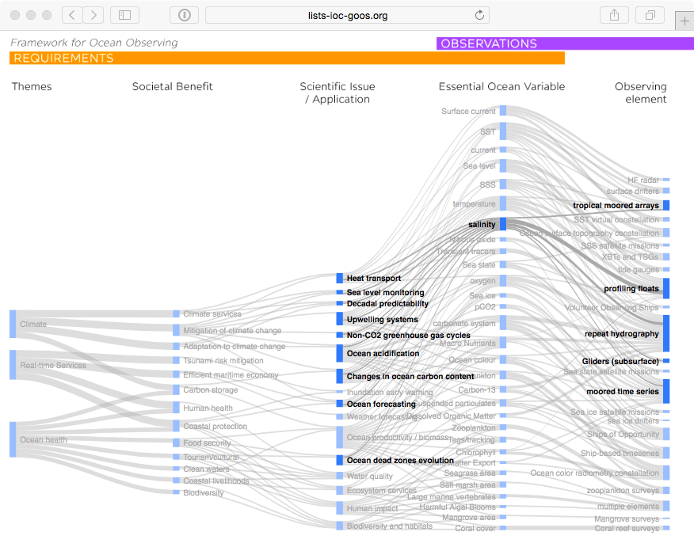

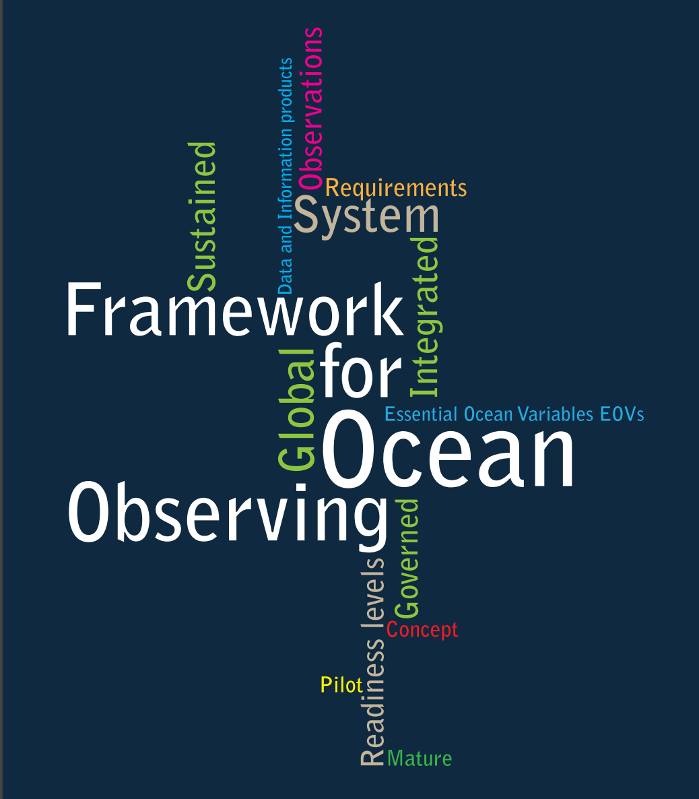

GOOS Strategic Mapping
Notes:
This activity will allow us to improve a Strategic Mapping of GOOS, which is shown here linking the three major societal drivers of GOOS: climate, services, and ocean health; with the societal benefits informed by sustained ocean data; the scientific issue, application, or product needed; the Essential Ocean Variable we need to capture; and the type of observing element contributing to the measure of these variables.
We can track how any particular observing platform measures a number of variables, feeding products and applications that deliver societal benefit.
A major message from this complicated diagram is that there are many interconnections. Many observations have multiple lifetimes – multiple uses. With growing sensor capability we are increasingly building an integrated observing system. And there is a tremendous needs for the coordination activities that make this system as efficient and effective as possible.
Behind each of the nodes in this mapping that we continue to build is a specification sheet with additional information on the global groups and standards and best practices information.
Each GOOS Regional Alliance or national effort will have its own variant of this mapping, based on local priorities and capacities.

Slide 9
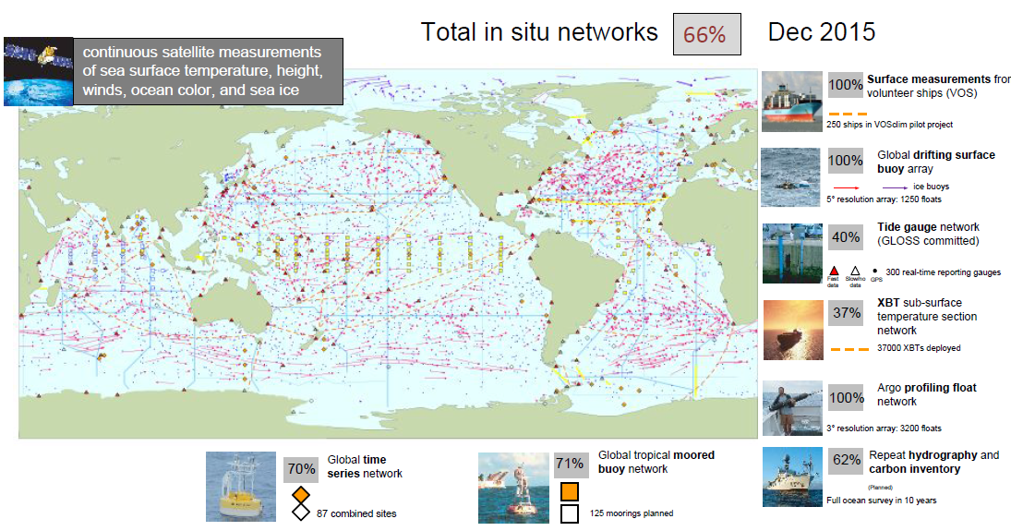


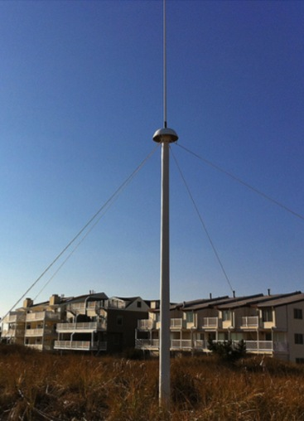
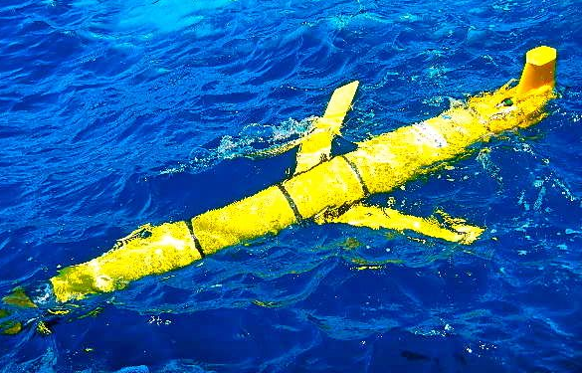
Global Ocean Observing System
Needs to be updated…
Now being added:
HF Radar & Gliders

Slide 10
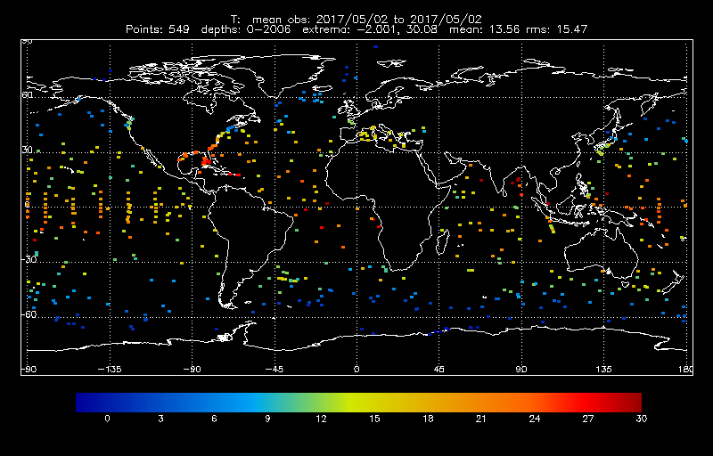
Sub-surface T coverage (over 24 hrs)

Slide 11

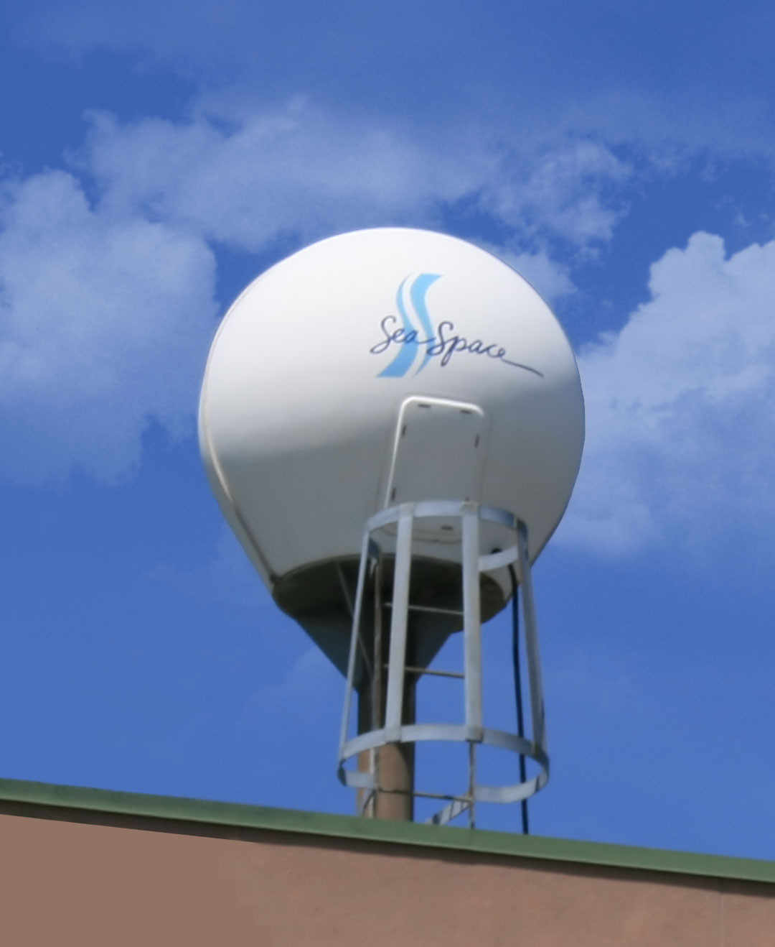
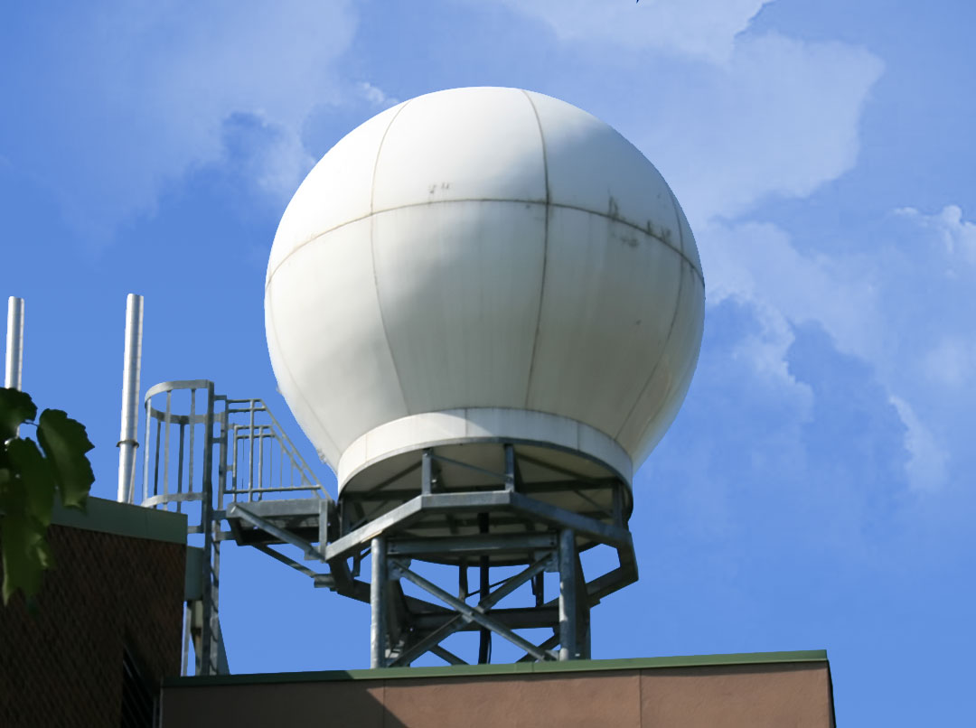
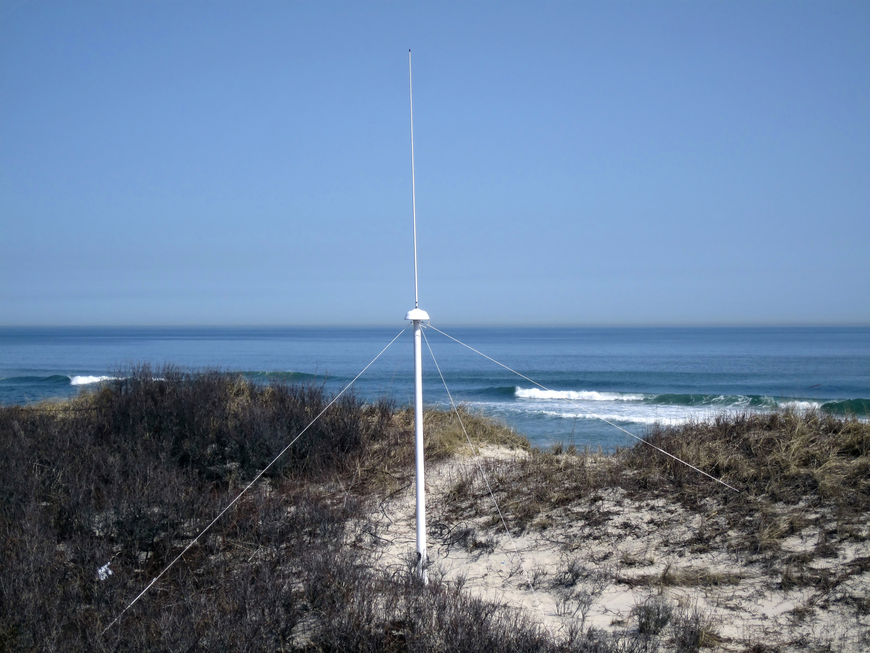
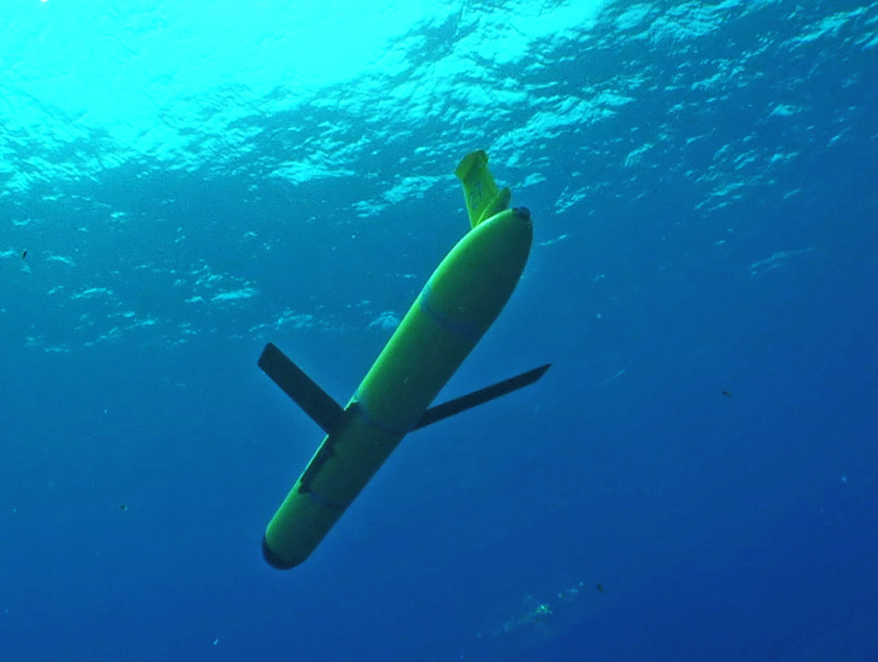
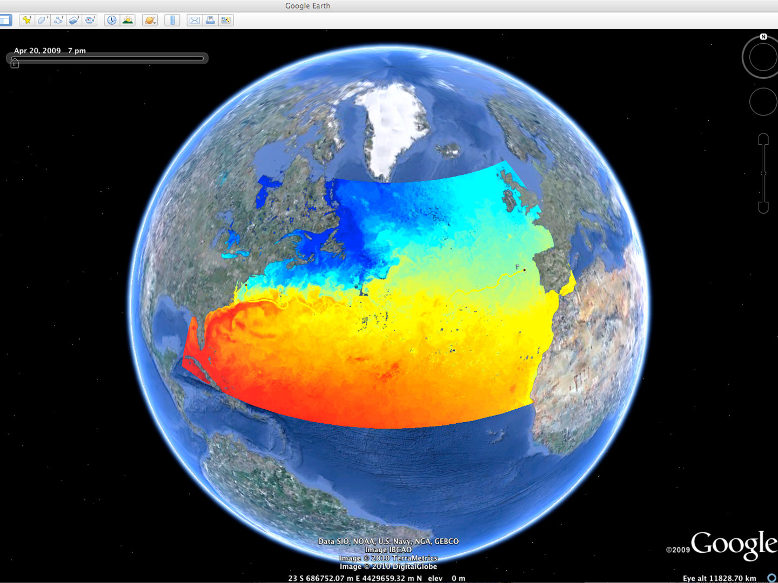


Rutgers University - Coastal Ocean Observation Lab
Observatory Operations, Data Fusion & Training Center
L-Band & X-Band Satellite Receivers
CODAR Network
Glider Fleet
Ocean & Atmos. Forecasts
Notes:
11

Slide 12






MARACOOS Integration Matrix
Integration Matrix: Capabilities Support Multiple Themes
Regional Priority Themes | Regional Observation & Modeling Capabilities
 | Weather Mesonet | HF Radar Network | Statistical STPS | Satellite Imagery | Glider Surveys | Dynamical Ocean Forecasts
Theme 1. Maritime Commerce & Safety | Operational Input to USCG SAROPS | Operational input to USCG SAROPS | Operational input to USCG SAROPS | SST for survivability planning | Assimilation dataset for forecast models | Surface currents for SAROPS
Theme 2. Fisheries | Weather forecast ensemble validation | Circulation and divergence maps for habitat |  | SST & Color for habitat | Subsurface T & S for habitat | 3-D fields of T, S, circulation for habitat
Theme 3. Public Health & Water Quality | Winds for transport, river plumes, & upwelling | Surface currents for floatables, bacteria, spill response | Surface currents for floatables, bacteria, spill response | Ocean color for river plumes | Nearshore dissolved oxygen surveys | Surface currents for floatables, bacteria, spill response
Theme 4. Coastal Flooding | Weather forecast ensemble validation | Assimilation dataset for forecast models |  | SSTs assimilation into forecast models | Assimilation dataset for forecast models | Nested forecast ensembles
Theme 5. Offshore Energy | Historical analysis & wind model validation | Historical current analysis & wind model validation |  | Historical analysis surface fronts & plumes for siting | Historical analysis of subsurface fronts & plumes | Coupled ocean-atmosphere models for resource estimates

Slide 13
MARACOOS Integration Matrix
Integration Matrix: Capabilities Support Multiple Themes
Regional Priority Themes | Regional Observation & Modeling Capabilities
 | Weather Mesonet | HF Radar Network | Statistical STPS | Satellite Imagery | Glider Surveys | Dynamical Ocean Forecasts
Theme 1. Maritime Commerce & Safety | Operational Input to USCG SAROPS | Operational input to USCG SAROPS | Operational input to USCG SAROPS | SST for survivability planning | Assimilation dataset for forecast models | Surface currents for SAROPS
Theme 2. Fisheries | Weather forecast ensemble validation | Circulation and divergence maps for habitat |  | SST & Color for habitat | Subsurface T & S for habitat | 3-D fields of T, S, circulation for habitat
Theme 3. Public Health & Water Quality | Winds for transport, river plumes, & upwelling | Surface currents for floatables, bacteria, spill response | Surface currents for floatables, bacteria, spill response | Ocean color for river plumes | Nearshore dissolved oxygen surveys | Surface currents for floatables, bacteria, spill response
Theme 4. Coastal Flooding | Weather forecast ensemble validation | Assimilation dataset for forecast models |  | SSTs assimilation into forecast models | Assimilation dataset for forecast models | Nested forecast ensembles
Theme 5. Offshore Energy | Historical analysis & wind model validation | Historical current analysis & wind model validation |  | Historical analysis surface fronts & plumes for siting | Historical analysis of subsurface fronts & plumes | Coupled ocean-atmosphere models for resource estimates

Slide 14
MARACOOS Integration Matrix
Integration Matrix: Capabilities Support Multiple Themes
Regional Priority Themes | Regional Observation & Modeling Capabilities
 | Weather Mesonet | HF Radar Network | Statistical STPS | Satellite Imagery | Glider Surveys | Dynamical Ocean Forecasts
Theme 1. Maritime Commerce & Safety | Operational Input to USCG SAROPS | Operational input to USCG SAROPS | Operational input to USCG SAROPS | SST for survivability planning | Assimilation dataset for forecast models | Surface currents for SAROPS
Theme 2. Fisheries | Weather forecast ensemble validation | Circulation and divergence maps for habitat |  | SST & Color for habitat | Subsurface T & S for habitat | 3-D fields of T, S, circulation for habitat
Theme 3. Public Health & Water Quality | Winds for transport, river plumes, & upwelling | Surface currents for floatables, bacteria, spill response | Surface currents for floatables, bacteria, spill response | Ocean color for river plumes | Nearshore dissolved oxygen surveys | Surface currents for floatables, bacteria, spill response
Theme 4. Coastal Flooding | Weather forecast ensemble validation | Assimilation dataset for forecast models |  | SSTs assimilation into forecast models | Assimilation dataset for forecast models | Nested forecast ensembles
Theme 5. Offshore Energy | Historical analysis & wind model validation | Historical current analysis & wind model validation |  | Historical analysis surface fronts & plumes for siting | Historical analysis of subsurface fronts & plumes | Coupled ocean-atmosphere models for resource estimates

Slide 15
MARACOOS Integration Matrix
Integration Matrix: Capabilities Support Multiple Themes
Regional Priority Themes | Regional Observation & Modeling Capabilities
 | Weather Mesonet | HF Radar Network | Statistical STPS | Satellite Imagery | Glider Surveys | Dynamical Ocean Forecasts
Theme 1. Maritime Commerce & Safety | Operational Input to USCG SAROPS | Operational input to USCG SAROPS | Operational input to USCG SAROPS | SST for survivability planning | Assimilation dataset for forecast models | Surface currents for SAROPS
Theme 2. Fisheries | Weather forecast ensemble validation | Circulation and divergence maps for habitat |  | SST & Color for habitat | Subsurface T & S for habitat | 3-D fields of T, S, circulation for habitat
Theme 3. Public Health & Water Quality | Winds for transport, river plumes, & upwelling | Surface currents for floatables, bacteria, spill response | Surface currents for floatables, bacteria, spill response | Ocean color for river plumes | Nearshore dissolved oxygen surveys | Surface currents for floatables, bacteria, spill response
Theme 4. Coastal Flooding | Weather forecast ensemble validation | Assimilation dataset for forecast models |  | SSTs assimilation into forecast models | Assimilation dataset for forecast models | Nested forecast ensembles
Theme 5. Offshore Energy | Historical analysis & wind model validation | Historical current analysis & wind model validation |  | Historical analysis surface fronts & plumes for siting | Historical analysis of subsurface fronts & plumes | Coupled ocean-atmosphere models for resource estimates

Slide 16
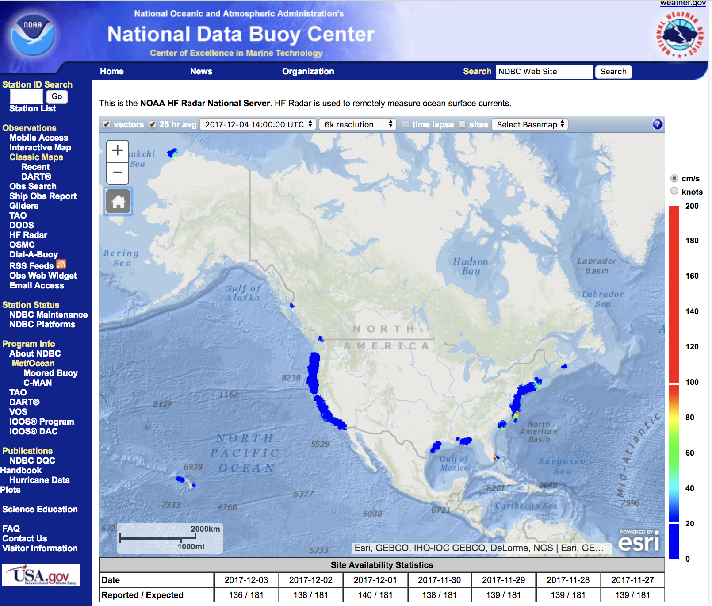
U.S. National
HF Radar Network
Accessed through the U.S. National Weather Service (NWS)
website
140
HF Radars reporting from 11 Regional Associations

Slide 17
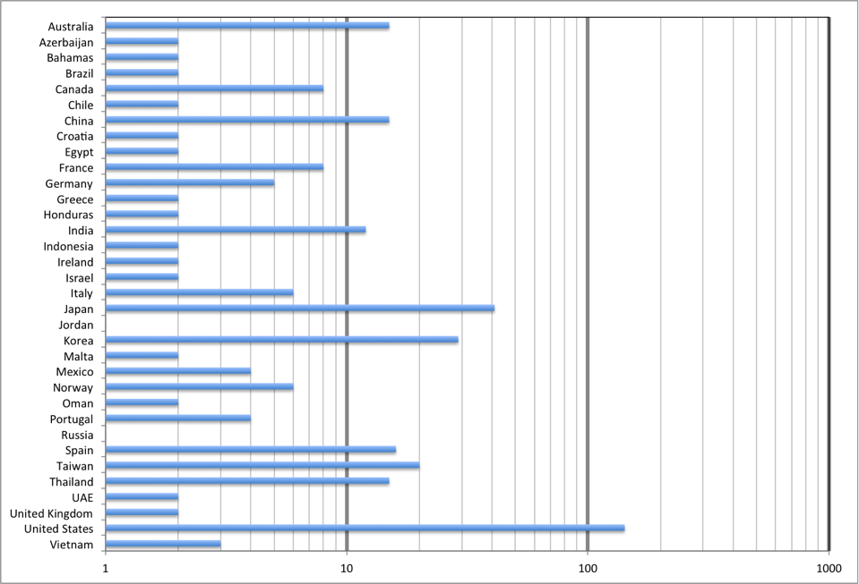
Global
HF Radar
Inventory

Slide 18
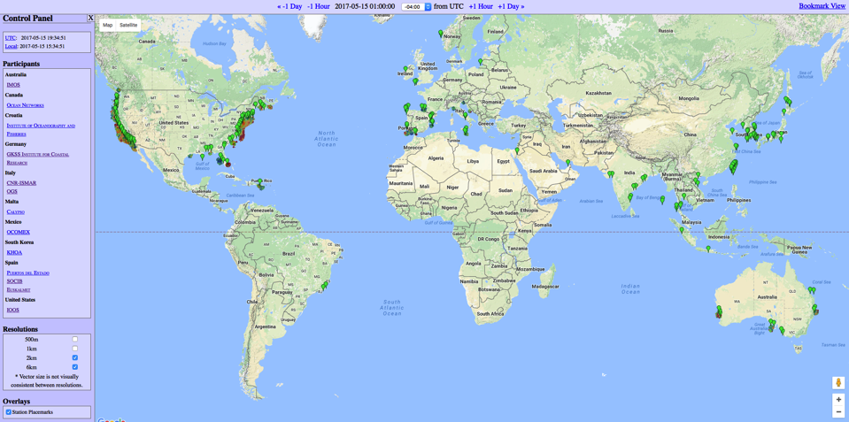
Global HF Radar Network Update
400 stations operating in
31 countries with
7 countries sharing surface current data
Formed March 13, 2012 in London, UK
http://global-hfradar.org/

Slide 19
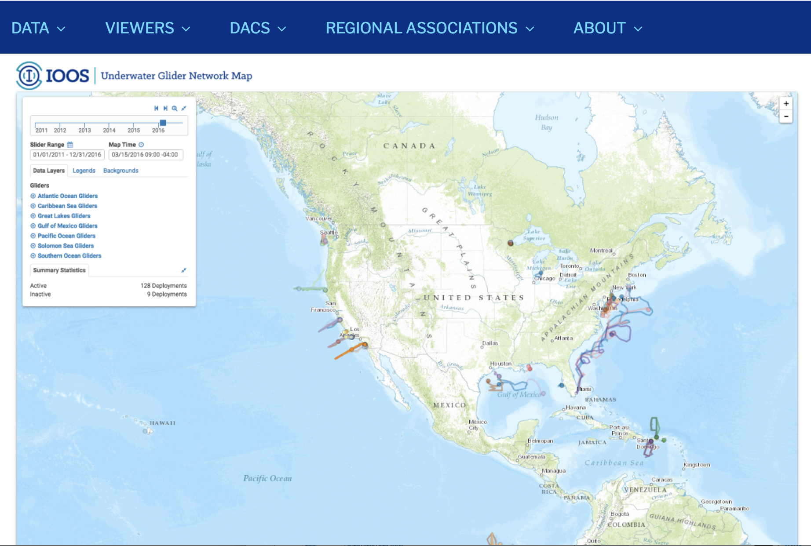
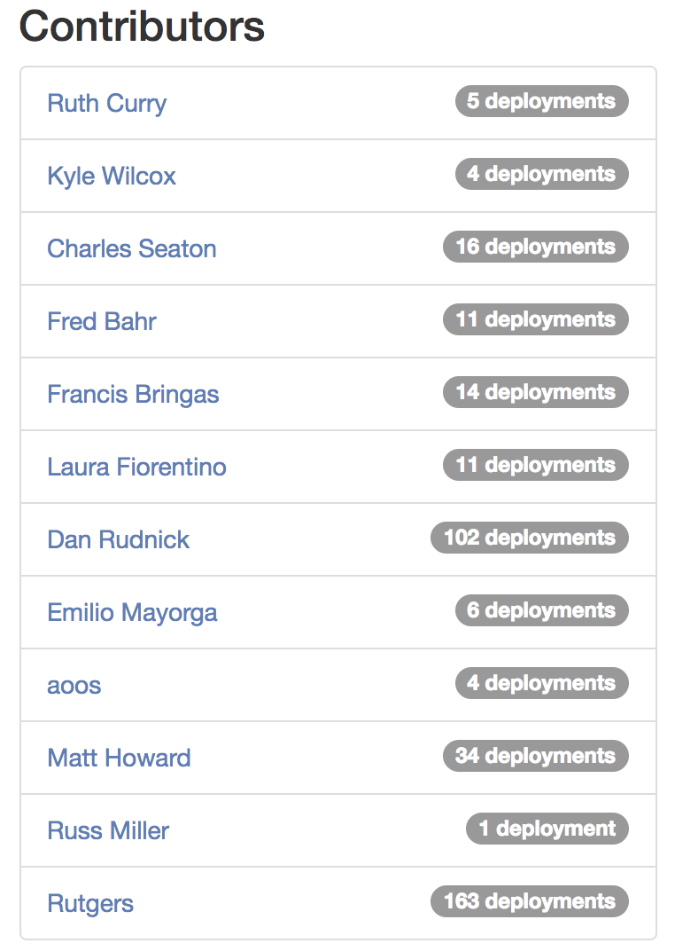
US National Glider DAC

Slide 21
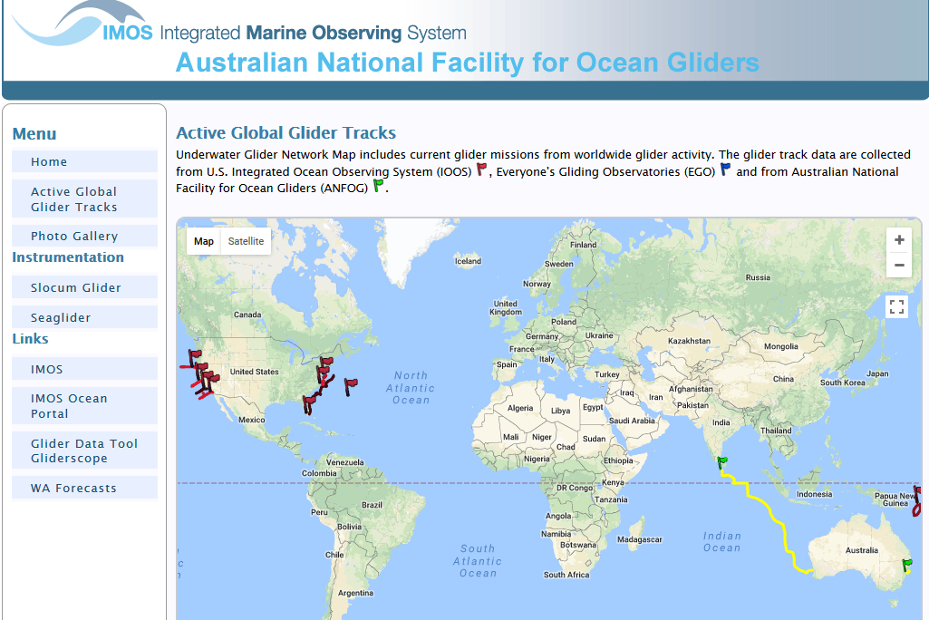
Global OceanGliders Network Update
8 countries operating in
3 major networks
4 task teams
Formed September 27, 2016 in Southampton, UK

Slide 22
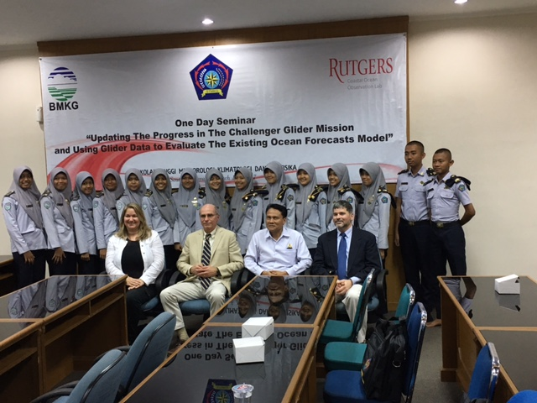
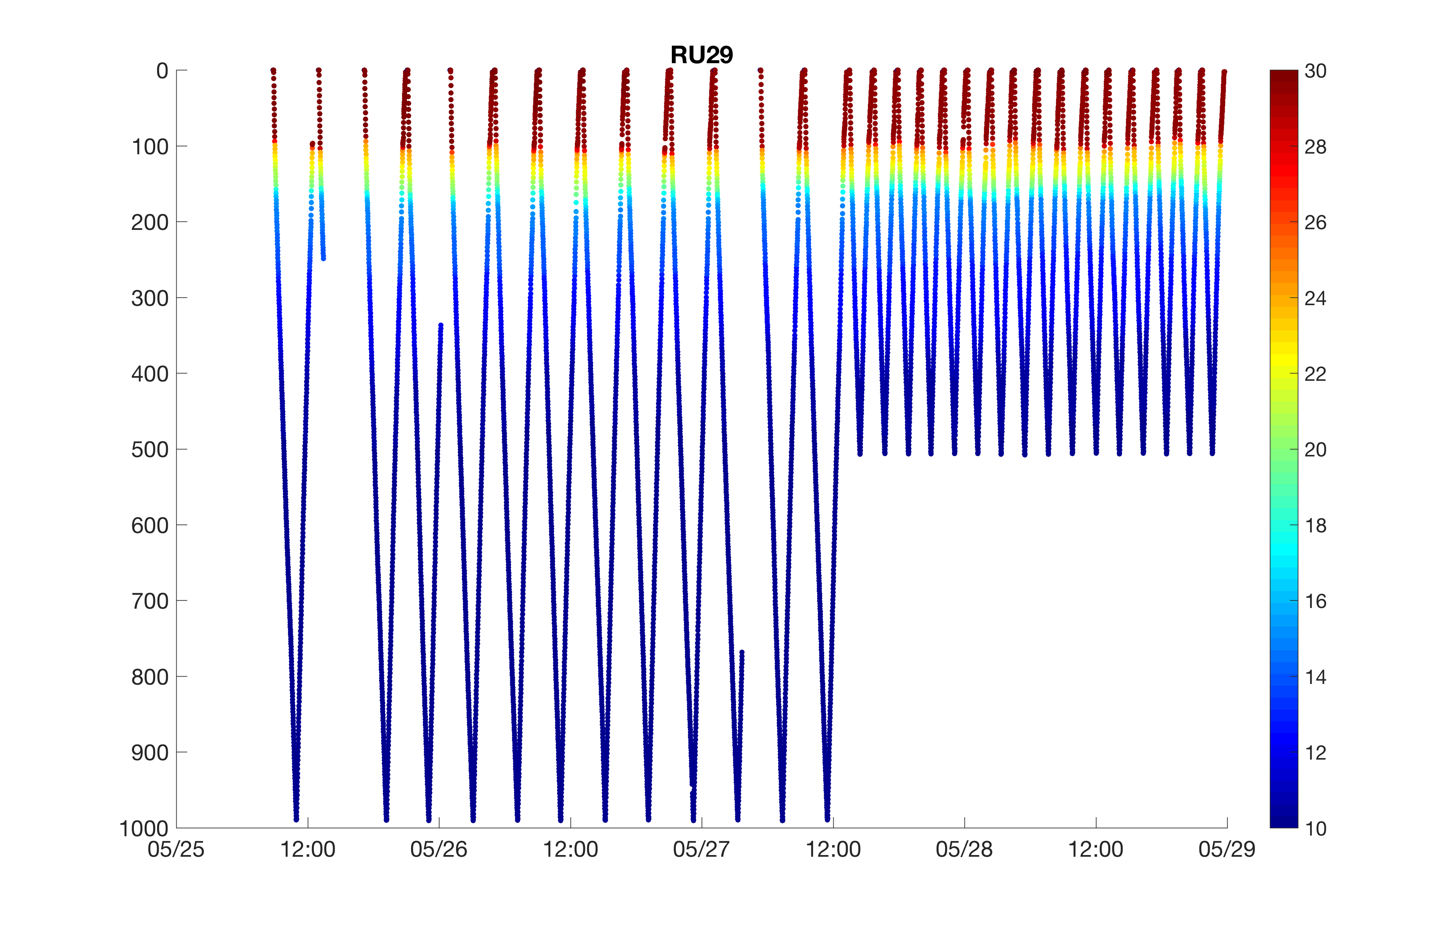
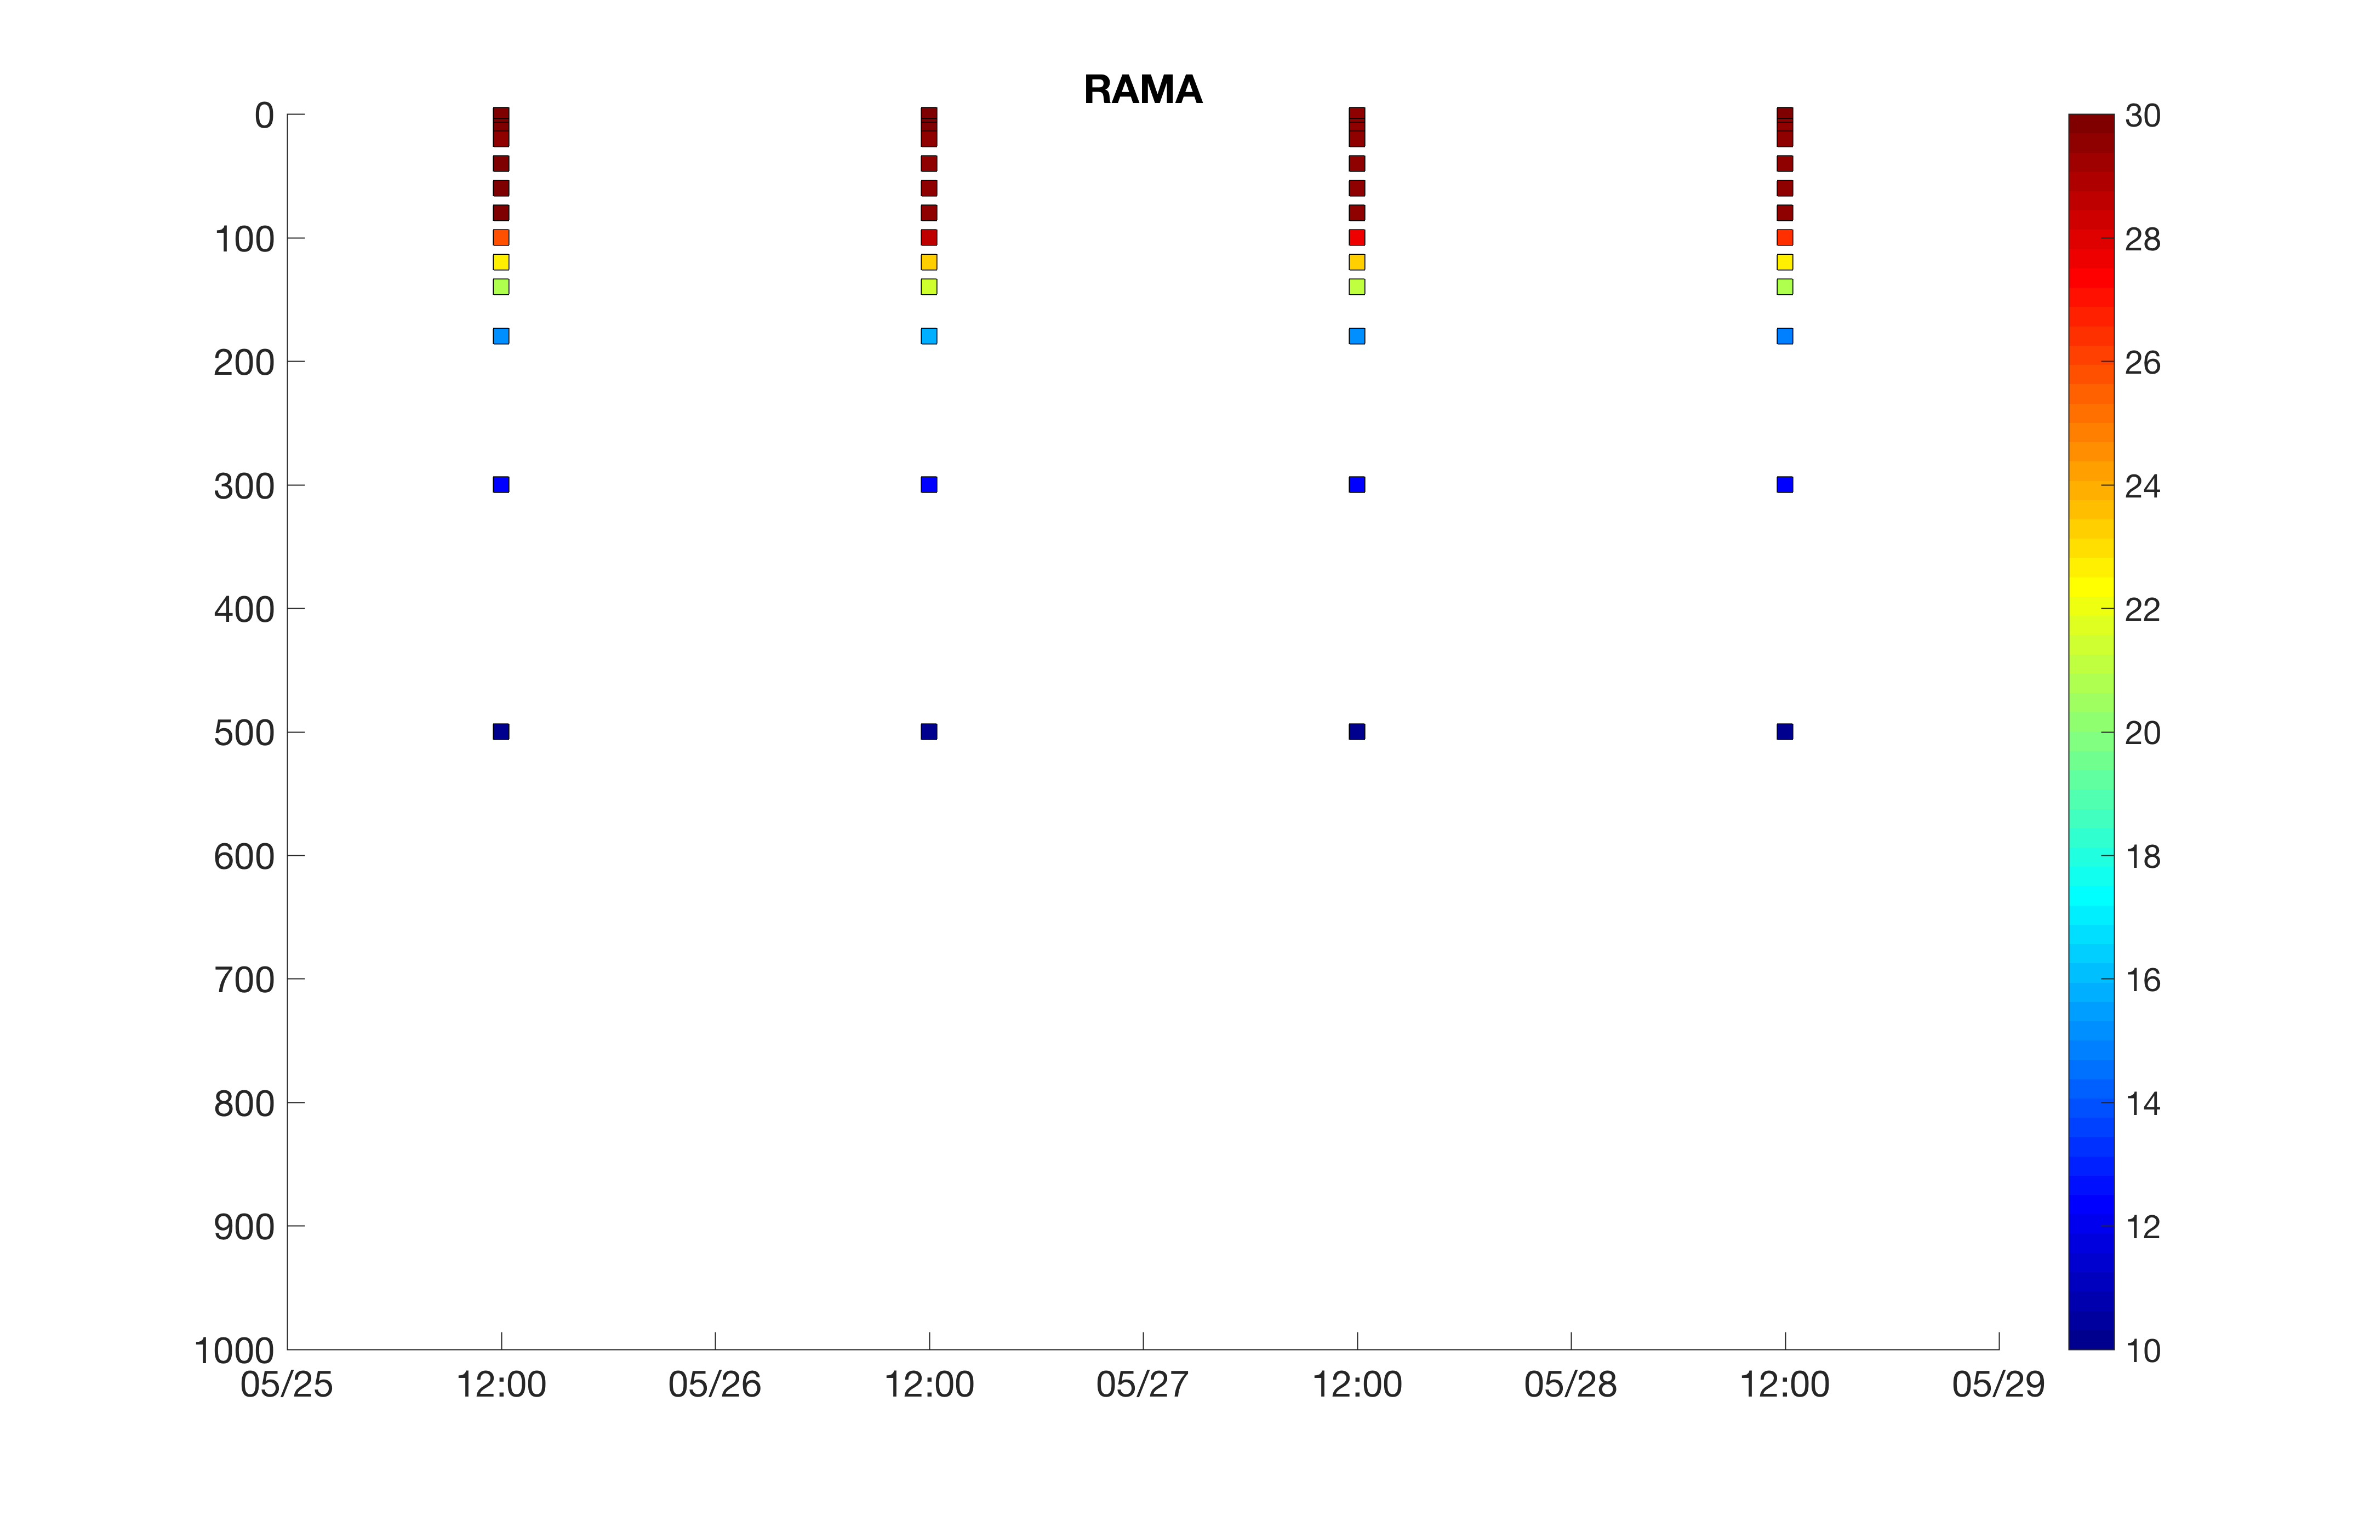
Challenger Glider Mission
Indian Ocean Leg 1: 7,570 km, 330 Days
Perth, Australia to Colombo, Sri Lanka
with BMKG Academy students
Glider
RU29
4-day Station Keeping at ..,
RAMA
Mooring

